Slide 1
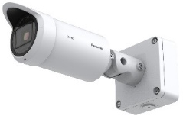
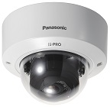
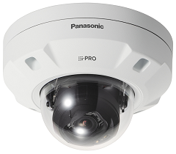
4K/6MP/5MP Fixed Network Camera with AI engine Material for SE
Model: WV-S15700-V2LN, WV-S15600-V2LN, WV-S15500-V3LN
WV-S22700-V2L, WV-S22600-V2L, WV-S22500-V3L
WV-S25700-V2LN, WV-S25600-V2LN, WV-S25500-V3LN, etc.
Ver.1.00
Mar. 2022

Slide 2

Contents
Product Summary
Key Features
Specification Comparison
Other Hardware Specifications
Other Software Specifications
AI Application
Appearance
Standard Accessories
Optional Accessories
System Support Schedule
About icons
This icon is for brand new functions
Indoor
This icon is for indoor cameras
Outdoor
This icon is for outdoor cameras

Slide 3
1. Product Summary

Slide 4






1-1. Targets for the New S series camera
Camera type
Multi-Sensor
Panoramic
PTZ
4K/6MP/5MP FIX
FHD FIX
High end
Industry model
Q Series
P Series
X Series
Target
P Series
X Series
S Series
Middle
Middle Low
M Series
Q Series
U Series
Indoor
Outdoor

Slide 5







1-2. Model Transition
Integrate X & S series and promote S series as a model equipped with standard AI
 | LENS | FY18 | FY19 | FY20 | FY21 | FY22
 | Vari lens
 | Vari lens
 | Fix lens
4K
Vari
New
5M
4K
5M
4K
5M
6M
4K
Vari
5M
6mm
Fix
3.2mm
Indoor
Outdoor

Slide 6
1-3. Product Concept
New
Key features
i-PRO S series with AI engine
4K/6MP/5MP high resolution model
Line-up
AI camera line-up meets various needs
- With the release of a total 34 models including varifocal, fixed focus lenses (3.2mm and 6mm), black body, smoke dome, heavy salt damage resistant model, etc., enables to meet requirement in various on-site scenes.
Analytics
AI Analytics
- Equipped with an AI engine inside the camera for AI processing on the edge side. Up to 3 AI apps can be operated at the same time.
Vandal resistant Indoor Dome
Outdoor Bullet
Vandal resistant Outdoor Dome
Visibility
High image quality / High compression
- The intelligent auto (iA) function adjusts the image quality optimally depending on the environment.
- i-PRO Smart coding provides high quality video at a low bit rate.
- The dynamic range is 132 dB, which is higher than competitors.
LINE UP: 34 models
 | Indoor Dome | Outdoor Bullet | Outdoor Dome
4K | 3 models | 3 models | 4 models
6MP | 2 models | 2 models | 3 models
5MP | 5 models | 6 models | 6 models
Simplicity
Easy Kitting
- The Easy Kitting package allows you to configure IP settings without taking the camera out of the carton box.
Security
High security
- Equipped FIPS 140-2 level3 certified hardware.
- Pre-installed digital certificates issued by Global Sign.
Indoor
Outdoor

Slide 7
2. Key Features

Slide 8
2-1. Camera Lineup
Indoor Dome
Release in Apr. 2022
Release in Jun. 2022
Release in Jul. 2022
Model No | Resolution | Lens | Differences between each model |  |  |  |  | Destination
 |  |  | Basic | Clear Sight coating | Smoke dome | Black | Salt damage resistance | USA | WW global
WV-S22700-V2L | 4K | Vari | Yes |  |  |  |  | Yes | Yes
WV-S22700-V2L1 | 4K | Vari |  |  |  | Yes |  | Yes | Yes
WV-S22700-V2LG | 4K | Vari |  |  | Yes |  |  | Yes | Yes
WV-S22600-V2L | 6MP | Vari | Yes |  |  |  |  | Yes | Yes
WV-S22600-V2LG | 6MP | Vari |  |  | Yes |  |  | Yes | Yes
WV-S22500-V3L | 5MP | Vari | Yes |  |  |  |  | Yes | Yes
WV-S22500-V3L1 | 5MP | Vari |  |  |  | Yes |  | Yes | Yes
WV-S22500-V3LG | 5MP | Vari |  |  | Yes |  |  | Yes | Yes
WV-S22500-F3L | 5MP | Fixed | Yes |  |  |  |  | Yes | Yes
WV-S22500-F6L | 5MP | Fixed | Yes |  |  |  |  | Yes | Yes
Indoor

Slide 9
2-1. Camera Lineup
Outdoor Bullet
Release in Apr. 2022
Release in Jun. 2022
Release in Jul. 2022
Model No | Resolution | Lens | Differences between each model |  |  |  |  | Destination
 |  |  | Basic | Clear Sight coating | Smoke dome | Black | Salt damage resistance | USA | WW global
WV-S15700-V2L | 4K | Vari | Yes |  |  |  |  |  | Yes
WV-S15700-V2LN | 4K | Vari |  | Yes |  |  |  | Yes | Yes
WV-S15700-V2LK | 4K | Vari |  | Yes |  |  | Yes | Yes | Yes
WV-S15600-V2L | 6MP | Vari | Yes |  |  |  |  |  | Yes
WV-S15600-V2LN | 6MP | Vari |  | Yes |  |  |  | Yes | Yes
WV-S15500-V3L | 5MP | Vari | Yes |  |  |  |  |  | Yes
WV-S15500-V3LN | 5MP | Vari |  | Yes |  |  |  | Yes | Yes
WV-S15500-V3LN1 | 5MP | Vari |  | Yes |  | Yes |  | Yes | Yes
WV-S15500-V3LK | 5MP | Vari |  | Yes |  |  | Yes | Yes | Yes
WV-S15500-F3L | 5MP | Fixed | Yes |  |  |  |  | Yes | Yes
WV-S15500-F6L | 5MP | Fixed | Yes |  |  |  |  | Yes | Yes
Outdoor

Slide 10
2-1. Camera Lineup
Outdoor Dome
Release in Apr. 2022
Release in Jun. 2022
Release in Jul. 2022
Model No | Resolution | Lens | Differences between each model |  |  |  |  | Destination
 |  |  | Basic | Clear Sight coating | Smoke dome | Black | Salt damage resistance | USA | WW global
WV-S25700-V2L | 4K | Vari | Yes |  |  |  |  |  | Yes
WV-S25700-V2LG | 4K | Vari |  |  | Yes |  |  | Yes | Yes
WV-S25700-V2LN | 4K | Vari |  | Yes |  |  |  | Yes | Yes
WV-S25700-V2LN1 | 4K | Vari |  | Yes |  | Yes |  | Yes | Yes
WV-S25600-V2L | 6MP | Vari | Yes |  |  |  |  |  | Yes
WV-S25600-V2LG | 6MP | Vari |  |  | Yes |  |  | Yes | Yes
WV-S25600-V2LN | 6MP | Vari |  | Yes |  |  |  | Yes | Yes
WV-S25500-V3L | 5MP | Vari | Yes |  |  |  |  |  | Yes
WV-S25500-V3LG | 5MP | Vari |  |  | Yes |  |  | Yes | Yes
WV-S25500-V3LN | 5MP | Vari |  | Yes |  |  |  | Yes | Yes
WV-S25500-V3LN1 | 5MP | Vari |  | Yes |  | Yes |  | Yes | Yes
WV-S25500-F3L | 5MP | Fixed | Yes |  |  |  |  | Yes | Yes
WV-S25500-F6L | 5MP | Fixed | Yes |  |  |  |  | Yes | Yes
Outdoor

Slide 11
[Ref.] Naming convention for new camera model number
1 | ２ | ３ | ４ | ５ | ６ | ７ | ８ | 9 | 10 | 11 | 12 | 13 | 14 | 15 | 16 | 17
W | V | - | S | 1 | 5 | 7 | 0 | 0 |  | - | V | 2 | L | N
 |  |  | Series | Form | Environment | Resolution | Serial1 | Serial2 | Version A/B/C |  | Lens1 | Lens2 | Feature1 | Feature2 | Feature3 | Color
 |  |  | X : Hi-end S : Middle- range U : Middle- low B : Remote monitoring V : Entry | 9 : - 8 : Multi- sensor 7 : Mini 6 : PTZ (Dome) 5 : VCC,PT 4 :360 deg. 3 : Compact Dome 2 : Dome 1 : Box | 9 : - 8 : - 7 : - 6 : Outdoor Vandal 5 : Outdoor Vandal 4 : Outdoor Normal 3 : - 2 : Indoor Vandal 1 : Indoor Normal 0 : - | 9 : - 8 : 6K - 7 : 4K - 6 : 6MP 5 : 5MP 4 : 4MP 3 : FHD - 2 : 1 : HD- | 00~09 : 10~19 : 20~29 : 30~39 : 40~49 : ・・・ 90~99 : Serial# can divide according to structure. (10xN) |  | A B C |  | F : Fixed lens T : Long focal V : Vari lens Z : Zoom lens U : No lens | See *1 | L : LED W : Wireless TH : Thermal RZ : PTRZ D : Analog/NW output F : Optical I/F G : Smoke dome M : M12 N : Clear Sight S : Salt resistance K : NS model |  |  | None : White 1 : Black 2 : Silver 3 : Gray 4 : Brown (When there is no Feature) -1 : Black -2 : Silver -3 : Gray -4 : Brown
*1 Details of Lens2
Fixed lens
Y : Reserve
1 : 1~1.9mm
2 : 2~2.9mm
3 : 3~3.9mm
4 : 4~4.9mm
5 : 5~5.9mm
6 : 6~6.9mm
7 : 7~7.9mm
8 : 8~8.9mm
9 : 9~9.9mm
A : 10mm - (TBD)
B~X, Z:Reserve
Vari lens / Long focal
Y : No Lens
1 : 1 ~ x1.9
2 : 2 ~ x2.9
3 : 3 ~ x3.9
4 : 4 ~ x4.9
5~9 : Reserve
A : 10x - (TBD)
B~X, Z : Reserve
PTZ Zoom lens
Y : ~ x9.9
1 : 10 ~ x19.9
2 : 20~ x29.9
3 : 30~ x39.9
4 : 40~ x49.9
5 : 50~ x59.9
6~9 : Reserve
A~X, Z : Reserve
Indoor
Outdoor

Slide 12
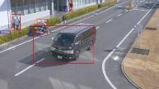

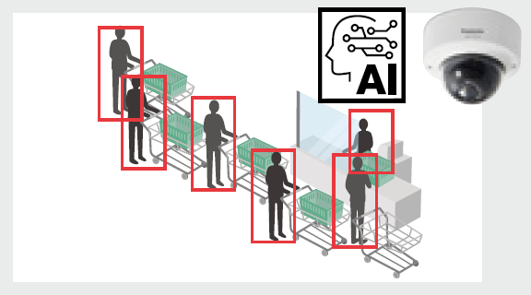

2-2. AI Analytics
Supports various apps such as AI Face Detection, AI People Detection, AI Vehicle Detection and etc.
AI apps | Detail
AI Face Detection
Detect face and cut out face image for best-shot
Extraction of facial features
AI People Detection
Extraction of various identifying elements for people
: 11 items 46 attributes
Age / Gender / Hair type / Tops type / etc.
AI Vehicle Detection
Extraction of various identifying elements for vehicles
: 2 items 17 attributes
Type / Color
AI-VMD
AI Privacy Guard
AI Non Mask Detection
AI Occupancy Detection
AI Sound Classification
Others
Indoor
Outdoor

Slide 13
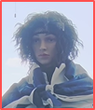
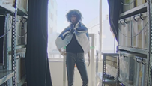

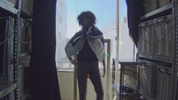
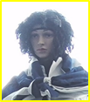
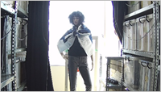
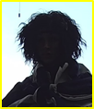
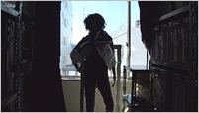
2-3-1. Intelligent Auto
Automatically optimize the image depending on the environment
The visibility of backlit human has been remarkably improved by human detection (upper body) even in the situation where face detection is difficult.
Face Priority Level: High | Face Priority Level: Low
SD ON
SD ON
SD OFF
SD OFF
Indoor
Outdoor

Slide 14
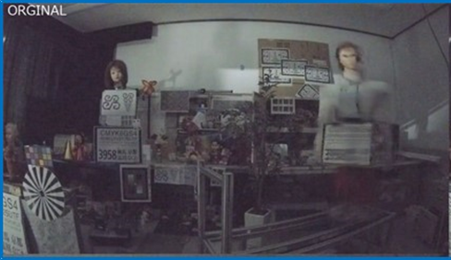
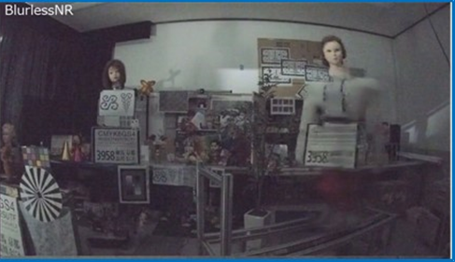
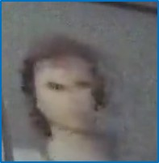
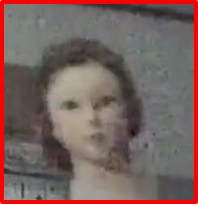
2-3-2. Blur less NR (Noise Reduction)
Suppress blurring when “People” move
X Series model
New S Series model
move
move
It detects people and controls blur suppression with priority over noise reduction.
blurred Image
Less blur Image
Indoor
Outdoor

Slide 15
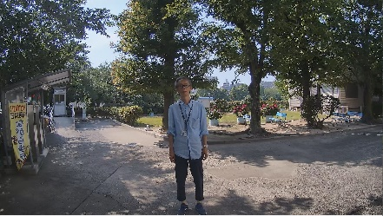
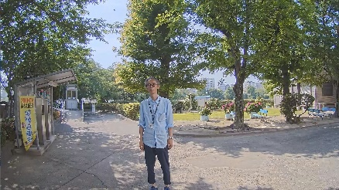


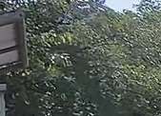
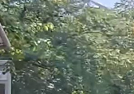
2-3-3. AI Smart Object Coding - Smart VIQS
Automatically control the compression rate depending on the environment
The object detection accuracy has been improved, and the non-detection area can be further compressed. (Approx. 50 % reduction compared to conventional models)
Conventional model (WV-S2570L etc.)
New S Series model
Detects motion and automatically adjusts the image quality of moving objects to high and others to low.
Detects objects (face, human and vehicle) and adjusts the image quality of those objects to high and others to low.
Person on the image does not move
Image quality is adjusted to low
Camera detect “face” and “human”
Adjusts the image quality of the face area to high
Swaying tree is recognized as a moving object
Increase data amount
Swaying tree is NOT recognized as an object
Suppress data amount
Measured bit rate: 6733kbps
Measured bit rate: 3855kbps
Indoor
Outdoor

Slide 16
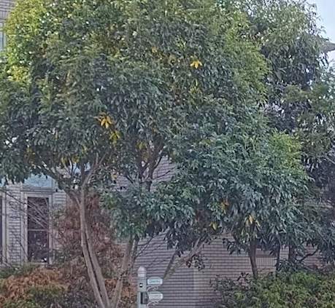
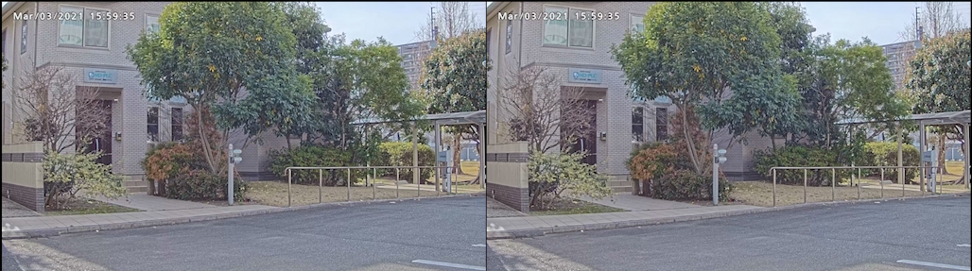
2-3-4. AI Smart Object Coding - Smart P-picture control
Automatically control the data volume of P-picture depending on the environment
With using AI-based object detection, the P-picture (forward predictive picture) data volume in areas, where no objects are detected, can be reduced
Hence, the movement of human and vehicle (important object) is displayed smoothly by reducing the data volume such as the shaking of trees (not important area).
the shaking of trees is not smooth
Smart P-picture control : OFF
Smart P-picture control : ON
Measured bit rate : 3179 kbps
Measured bit rate : 2219 kbps
Indoor
Outdoor

Slide 17
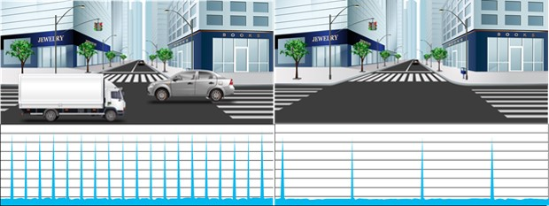
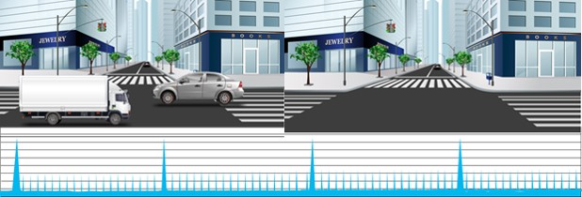
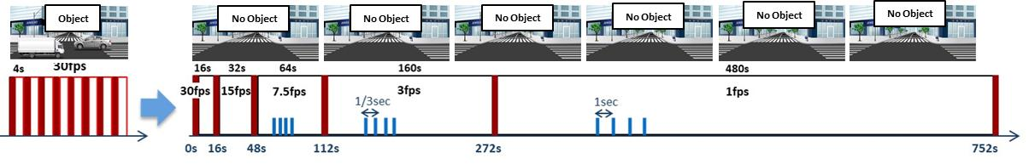
2-3-5. AI Smart Object Coding - GOP control
Control GOP using object detection instead of motion detection
Low / Mid
GOP control
Low (Variable GOP 1s-8s) | I-picture interval variable between 1sec-8sec by detected object (People and vehicles). *VBR only
Mid (Variable GOP 4s-16s) | I-picture interval variable between 4sec-16sec by detected object. *VBR only
Advanced (Fixed GOP 60s w/1s key-frame) | I-picture interval fixed at 60s, key-frame inserted at 1sec intervals regardless of detected object. *Selectable in all transfer modes
Frame rate control (Variable GOP 4s-16s w/frame rate control) | If there is no detected object, reduce the frame rate to 1 fps. I-picture interval variable between 4sec-16sec by detected object. *VBR only
Object
No Object
Advanced
Object
No Object
Frame rate control
Indoor
Outdoor

Slide 18
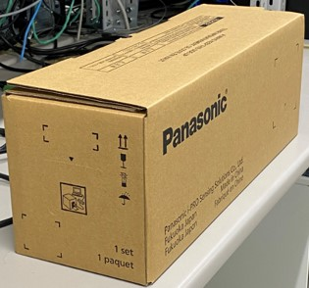
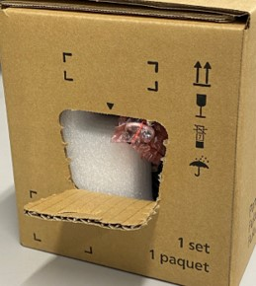
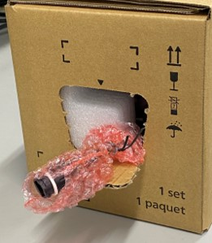
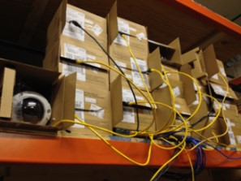
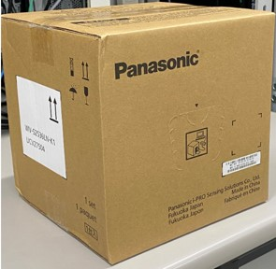
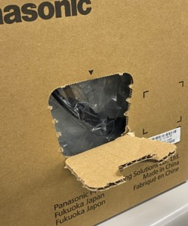
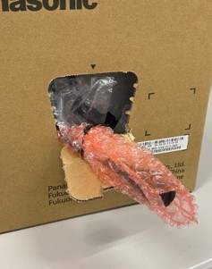
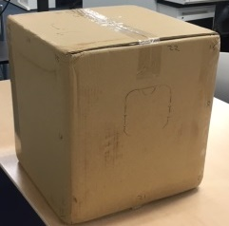
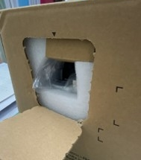
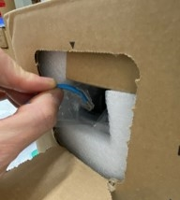
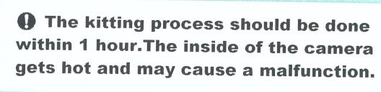
2-4. Easy kitting
“Easy Kitting Package” reduces the installation time
Kitting work without removing from the carton box
Kitting time reduced by 3 minutes
EASY ACCESS !
Outdoor Bullet
Kitting Window
Outdoor Dome
EASY ACCESS !
Indoor Dome
EASY ACCESS !
*Indoor DOME only
Kitting Window
Indoor
Outdoor

Slide 19




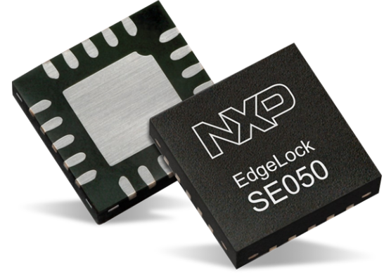
2-5. High Security
Industry leading FIPS 140-2 Level 3 encryption
Achieve a secure connection even in an Internet environment with a certificate and TPM ​chip.
What is a TPM chip?
Until now, store the key to ROM
The encryption key is secured with onboard TPM (Trusted Platform Module) chip
FIPS 140-2 level 3 compliance means our cameras offer tamper resistant technology, identity-based authentication, strong encryption, and an extra layer of security that protects critical security parameters on the device. ​
Safely store the key required for encryption
TPM chip
Level criteria
Level 3 : Requires physical tamper-resistance and identity-based authentication for Hardware
Level 2 : Requires physical tamper-evidence and role-based authentication for Hardware
Level 1 : Requires production-grade equipment and externally tested algorithms be used
Indoor
Outdoor

Slide 20
3. Specification Comparison

Slide 21
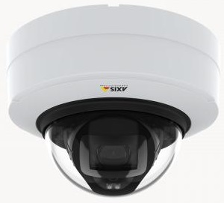
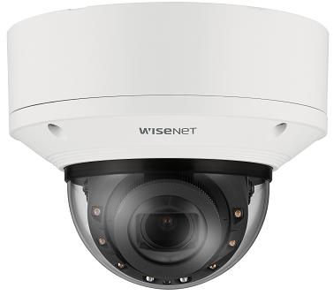
3-1. Comparison to other companies
Indoor Dome
*1 Super Resolution
*2 H.265/H.264 Stream transmission: Off
 |  | i-PRO |  |  | Axis |  | Hanwha
 |  | WV-S22700-V2L | WV-S22600-V2L | WV-S22500-V3L | P3248-LV | P3247-LV | XND-9083RV | XND-8083RV | XND-8093RV
Video Codec |  | H.265/H.264/JPEG |  |  | H.265/H.264/JPEG |  | H.265/H.264/JPEG
Image Sensor |  | 1/1.8” 8.4MP |  | 1/2.8” 5.1MP | 1/1.8” | 1/2.7” | 1/1.8”
Max. Resolution |  | 3840 x 2160 | 3328 x 1872 | 3072 x 1728 [16:9] *1 3072 x 2304 [4:3] *1 | 3840 x 2160 | 2592 x 1944 | 3840 x 2160 | 3328 x 1872
Max. Frame rate | H.265/H.264 | 30fps |  |  | 30fps |  | 30fps
 | JPEG | 5fps (30fps *2) |  |  | 30fps |  | 15fps
Lens | Optical zoom | X2.0 |  | x3.1 | x2.0 | x2.6 | x2.1 |  | x2.7
 | F number | 1.5 |  | 1.3 | 1.5 | 1.3 | 1.3 - 2.15 |  | 1.7 - 1.73
 | Focal length | 4.3 - 8.6 mm |  | 2.9 - 9.0 mm | 4.3 - 8.6 mm | 3.0 - 8.0 mm | 4.4 - 9.3 mm |  | 10.9 - 29 mm
Horizontal angle of view |  | W: 101 deg. / T: 52 deg. |  | W: 105 deg. / T: 33 deg. | W: 100 deg. / T: 53 deg. | W: 104 deg. / T: 40 deg. | W: 112.1 deg. / T: 47.5 deg. |  | W: 42 deg. / T: 15 deg.
Dynamic range |  | 132dB |  |  | 120dB |  | 120dB
Minimum Illumination (color) |  | 0.04 lx [30IRE] 0.06 lx [50IRE] |  | 0.05 lx [30IRE] 0.07 lx [50IRE] | 0.14 lx [50IRE] | 0.13 lx [50IRE] | 0.04 lx [30IRE] |  | 0.06 lx [30IRE]
Smart Coding |  | Smart VIQS / GOP control |  |  | Zipstream |  | WiseStreamⅢ
AI processor |  | Yes |  |  | No |  | Yes
Video Analytics |  | Object detection (Person/Face/Vehicle), AI-VMD (Intruder/Loitering/Direction/Cross line), Non mask Detection, Occupancy Detection, AI Privacy Guard , AI Sound Classification |  |  | AXIS Object Analytics, AXIS Video Motion Detection, AXIS Motion Guard, AXIS Fence Guard, AXIS Loitering Guard, active tampering alarm, Audio detection, AXIS Live Privacy Shield |  | Object detection (Person/Face/Vehicle/License plate), Virtual line/Area, Enter/Exit, Loitering, direction, Appear/Disappear, intrusion, Defocus detection, Motion detection, Tampering, Fog detection, Audio detection, Sound classification, Shock detection, People counting, Queue management, Heatmap
Audio |  | In(mic in / line in), Out |  |  | In(mic in / line in), Out |  | In(mic in / line in / built-in MIC), Out
IR-LED |  | 50 m [30IRE] 35 m [50IRE] |  | 40 m [30IRE] 30 m [50IRE] | 40 m |  | 50 m |  | 70 m
Clear Sight coating |  | No |  |  | No |  | No
Operating Temperature |  | -10 to +50 deg.C |  |  | 0 to +50 deg.C |  | -25 to +50 deg.C
4K
6M
5M
4K
5M
4K
6M
6M
Tele lens
Indoor

Slide 22
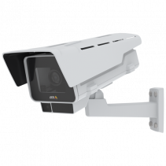
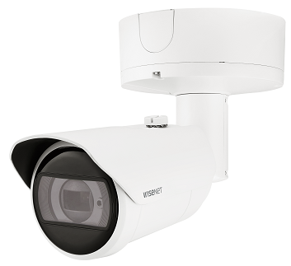
3-1. Comparison to other companies
Outdoor Bullet
*1 Super Resolution
*2 H.265/H.264 Stream transmission: Off
*3 Capture mode HDTV 720p, WDR: Off
 |  | i-PRO |  |  | Axis |  | Hanwha
 |  | WV-S15700-V2LN | WV-S15600-V2LN | WV-S15500-V3LN | P1378-LV | P1377-LV | XNO-9083R | XNO-8083R
Video Codec |  | H.265/H.264/JPEG |  |  | H.265/H.264/JPEG |  | H.265/H.264/JPEG
Image Sensor |  | 1/1.8” 8.4MP |  | 1/2.8” 5.1MP | 1/1.8” | 1/2.7” | 1/1.8”
Max. Resolution |  | 3840 x 2160 | 3328 x 1872 | 3072 x 1728 [16:9] *1 3072 x 2304 [4:3] *1 | 3840 x 2160 | 2592 x 1944 | 3840 x 2160 | 3328 x 1872
Max. Frame rate | H.265/H.264 | 30fps |  |  | 30fps | 30fps (180fps *3) | 30fps
 | JPEG | 5fps (30fps *2) |  |  | 30fps | 30fps (180fps *3) | 15fps
Lens | Optical zoom | x2.0 |  | x3.1 | x2.5 | x2.8 | x2.1
 | F number | 1.5 |  | 1.3 | 1.5 | 1.2 | 1.3 - 2.15
 | Focal length | 4.3 - 8.6 mm |  | 2.9 - 9.0 mm | 3.9 - 10.0 mm | 2.8 - 8.0 mm | 4.4 - 9.3 mm
Horizontal angle of view |  | W: 104 deg. / T: 53 deg. |  | W: 106 deg. / T: 34 deg. | W: 115 deg. / T: 45 deg. | W: 90 deg. / T: 38 deg. | W: 112.1 deg. / T: 47.5 deg.
Dynamic range |  | 132dB |  |  | 120dB |  | 120dB
Minimum Illumination (color) |  | 0.04 lx [30IRE] 0.06 lx [50IRE] |  | 0.05 lx [30IRE] 0.07 lx [50IRE] | 0.15 lx [50IRE] | 0.13 lx [50IRE] | 0.04 lx [30IRE]
Smart Coding |  | Smart VIQS / GOP control |  |  | Zipstream |  | WiseStreamⅢ
AI processor |  | Yes |  |  | No |  | Yes
Video Analytics |  | Object detection (Person/Face/Vehicle), AI-VMD (Intruder/Loitering/Direction/Cross line), Non mask Detection, Occupancy Detection, AI Privacy Guard , AI Sound Classification |  |  | AXIS Object Analytics, AXIS Video Motion Detection, AXIS Motion Guard, AXIS Fence Guard, AXIS Loitering Guard, active tampering alarm, Audio detection, AXIS Live Privacy Shield |  | Object detection (Person/Face/Vehicle/License plate), Virtual line/Area, Enter/Exit, Loitering, direction, Appear/Disappear, intrusion, Defocus detection, Motion detection, Tampering, Fog detection, Audio detection, Sound classification, Shock detection, People counting, Queue management, Heatmap
Audio |  | In(mic in / line in), Out |  |  | In(mic in / line in), Out |  | In(mic in / line in), Out
IR-LED |  | 70 m [30IRE] 50 m [50IRE] |  | 55 m [30IRE] 40 m [50IRE] | 50 m |  | 50 m
Clear Sight coating |  | Yes |  |  | No |  | No
Operating Temperature |  | -40 to +60 deg.C |  |  | -40 to +60 deg.C |  | -50 to +60 deg.C
4K
6M
5M
4K
5M
4K
6M
Outdoor

Slide 23
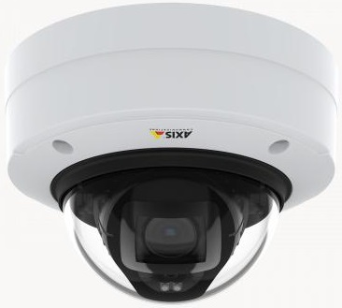
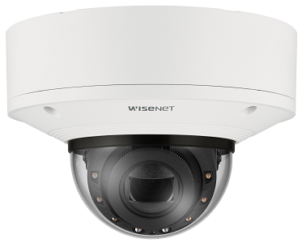
3-1. Comparison to other companies
Outdoor Dome
*1 Super Resolution
*2 H.265/H.264 Stream transmission: Off
 |  | i-PRO |  |  | Axis |  | Hanwha
 |  | WV-S25700-V2LN | WV-S25600-V2LN | WV-S25500-V3LN | P3248-LVE | P3247-LVE | XNV-9083R | XNV-8083R | XNV-8093R
Video Codec |  | H.265/H.264/JPEG |  |  | H.265/H.264/JPEG |  | H.265/H.264/JPEG
Image Sensor |  | 1/1.8” 8.4MP |  | 1/2.8” 5.1MP | 1/1.8” | 1/2.7” | 1/1.8”
Max. Resolution |  | 3840 x 2160 | 3328 x 1872 | 3072 x 1728 [16:9] *1 3072 x 2304 [4:3] *1 | 3840 x 2160 | 2592 x 1944 | 3840 x 2160 | 3328 x 1872
Max. Frame rate | H.265/H.264 | 30fps |  |  | 30fps |  | 30fps
 | JPEG | 5fps (30fps *2) |  |  | 30fps |  | 15fps
Lens | Optical zoom | x2.0 |  | x3.1 | x2.0 | x2.6 | x2.1 |  | x2.7
 | F number | 1.5 |  | 1.3 | 1.5 | 1.3 | 1.3 - 2.15 |  | 1.7 - 1.73
 | Focal length | 4.3 - 8.6 mm |  | 2.9 - 9.0 mm | 4.3 - 8.6 mm | 3.0 - 8.0 mm | 4.4 - 9.3 mm |  | 10.9 - 29 mm
Horizontal angle of view |  | W: 101 deg. / T: 52 deg. |  | W: 103 deg. / T: 33 deg. | W: 100 deg. / T: 53 deg. | W: 104 deg. / T: 40 deg. | W: 112.1 deg. / T: 47.5 deg. |  | W: 42 deg. / T: 15 deg.
Dynamic range |  | 132dB |  |  | 120dB |  | 120dB
Minimum Illumination (color) |  | 0.04 lx [30IRE] 0.06 lx [50IRE] |  | 0.05 lx [30IRE] 0.07 lx [50IRE] | 0.14 lx [50IRE] | 0.13 lx [50IRE] | 0.04 lx [30IRE] |  | 0.06 lx [30IRE]
Smart Coding |  | Smart VIQS / GOP control |  |  | Zipstream |  | WiseStreamⅢ
AI processor |  | Yes |  |  | No |  | Yes
Video Analytics |  | Object detection (Person/Face/Vehicle), AI-VMD (Intruder/Loitering/Direction/Cross line), Non mask Detection, Occupancy Detection, AI Privacy Guard , AI Sound Classification |  |  | AXIS Object Analytics, AXIS Video Motion Detection, AXIS Motion Guard, AXIS Fence Guard, AXIS Loitering Guard, active tampering alarm, Audio detection, AXIS Live Privacy Shield |  | Object detection (Person/Face/Vehicle/License plate), Virtual line/Area, Enter/Exit, Loitering, direction, Appear/Disappear, intrusion, Defocus detection, Motion detection, Tampering, Fog detection, Audio detection, Sound classification, Shock detection, People counting, Queue management, Heatmap
Audio |  | In(mic in / line in), Out |  |  | In(mic in / line in), Out |  | In(mic in / line in), Out
IR-LED |  | 70 m [30IRE] 50 m [50IRE] |  | 55 m [30IRE] 40 m [50IRE] | 40 m |  | 50 m |  | 70 m
Clear Sight coating |  | Yes |  |  | No |  | No
Operating Temperature |  | -40 to +60 deg.C |  |  | -40 to +50 deg.C |  | -50 to +55 deg.C
4K
6M
5M
4K
5M
4K
6M
6M
Tele lens
Outdoor

Slide 24
3-2. Comparison to conventional models
 | New S series camera (4K/6MP/5MP) | Conventional S series camera (4K/5MP) | X series camera (4K/5MP)
Image capture mode | 16:9(30fps/25fps) 4:3(30fps / 25fps) *5M model only | 16:9(30fps/25fps) 4:3(30fps / 25fps) *5M model only | 16:9(30fps/25fps)
Compression method | H.265 (or H.264) (1)-(4), JPEG(1)(2) | H.265 (or H.264) (1)-(4), JPEG(1)(2) | H.265 (or H.264) (1)-(4), JPEG(1)(2)
Minimum Illumination (color) | 0.04 lx [30IRE] 0.06 lx [50IRE] *4K/6MP model 0.05 lx [30IRE] 0.07 lx [50IRE] *5MP model | 0.09 lx [50IRE] *4K model 0.07 lx [50IRE] *5MP model | 0.09 lx [50IRE] *4K model 0.07 lx [50IRE] *5MP model
Camera title on screen (OSD) | Character no. : Max. 40 Line no. : Max. 2 Display size : 50% / 75% / 100% / 150% / 200% Display style : Transparent / Opaque | Character no. : Max. 20 Line no. : Max. 1 Display size : 100% / 150% / 200% Display style : Transparent | Character no. : Max. 40 Line no. : Max. 2 Display size : 50% / 75% / 100% / 150% / 200% Display style : Transparent / Opaque
Overlay image | Yes | No | No
Smart Coding | Smart VIQS / Smart P-picture control / GOP control | Auto VIQS / GOP Control | Auto VIQS / Smart Facial Coding / GOP Control
SD recording | Number of recording streams : 1 Recording format : H.265 / H.264 / JPEG Transmission priority : Constant bit rate / VBR / Frame rate | Number of recording streams : 1 Recording format : H.265 / H.264 / JPEG Transmission priority : Frame rate | Number of recording streams : 1 Recording format : H.265 / H.264 / JPEG Transmission priority : Frame rate
i-VMD / AI-VMD | AI-VMD | i-VMD (type7) | AI-VMD
Audio alarm | Yes (Audio Detection / AI Sound classification) | No | Yes (Audio Detection / AI Sound classification)
Max. number of apps | 3 | 1 | 3
Max. capacity for apps | 250MB | 150MB | 250MB
ONVIF | Profile S / G / T / M | Profile S / G / T | Profile S / G / T / M
FTP / SFTP | SFTP | No | FTP
Indoor
Outdoor

Slide 25

[Ref.] Spec comparison with smoke dome model - Indoor Dome
4K / 6MP model
 | Base model |  | Smoke Dome model
 |  | WV-S22700-V2L WV-S22600-V2L |  | WV-S22700-V2LG WV-S22600-V2LG
Dome Cover | Clear Dome |  | Smoke Dome
Minimum Illumination (color) | 0.04 lx [30IRE] / 0.06 lx [50IRE] |  | 0.12 lx [30IRE] / 0.17 lx [50IRE]
IR-LED | 50 m [30IRE] / 35 m [50IRE] |  | 35 m [30IRE] / 25 m [50IRE]
5MP model
 | Base model |  | Smoke Dome model
 |  | WV-S22500-V2L |  | WV-S22500-V2LG
Dome Cover | Clear Dome |  | Smoke Dome
Minimum Illumination (color) | 0.05 lx [30IRE] / 0.07 lx [50IRE] |  | 0.15 lx [30IRE] / 0.20 lx [50IRE]
IR-LED | 40 m [30IRE] / 30 m [50IRE] |  | 25 m [30IRE] / 20 m [50IRE]
Indoor

Slide 26

[Ref.] Spec comparison with smoke dome model - Outdoor Dome
4K / 6MP model
 | Base model |  | Smoke Dome model
 |  | WV-S25700-V2L WV-S25600-V2L |  | WV-S25700-V2LG WV-S25600-V2LG
Dome Cover | Clear Dome |  | Smoke Dome
Minimum Illumination (color) | 0.04 lx [30IRE] / 0.06 lx [50IRE] |  | 0.12 lx [30IRE] / 0.17 lx [50IRE]
IR-LED | 70 m [30IRE] / 50 m [50IRE] |  | 45 m [30IRE] / 35 m [50IRE]
5MP model
 | Base model |  | Smoke Dome model
 |  | WV-S25500-V2L |  | WV-S25500-V2LG
Dome Cover | Clear Dome |  | Smoke Dome
Minimum Illumination (color) | 0.05 lx [30IRE] / 0.07 lx [50IRE] |  | 0.15 lx [30IRE] / 0.20 lx [50IRE]
IR-LED | 55 m [30IRE] / 40 m [50IRE] |  | 35 m [30IRE] / 25 m [50IRE]
Outdoor

Slide 27
4. Other Hardware Specifications

Slide 28
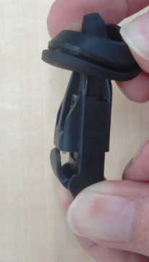
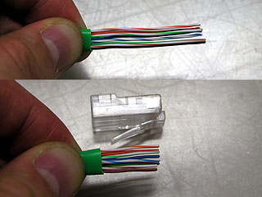
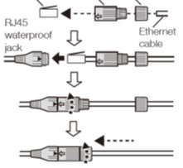
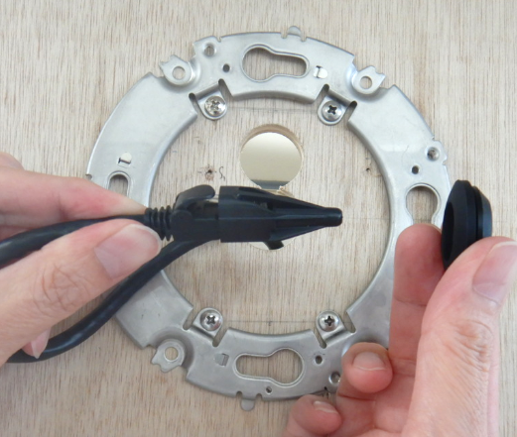

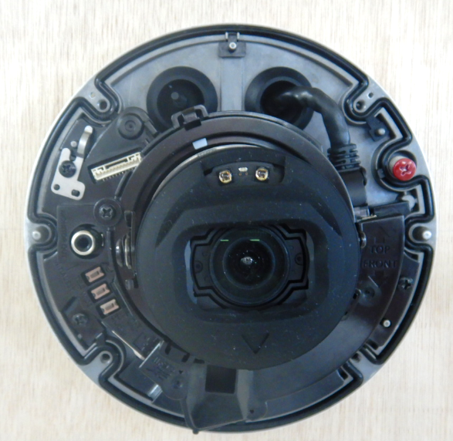
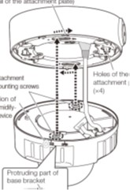
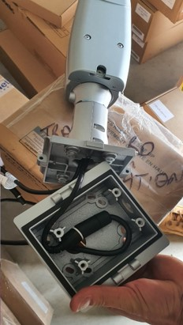

4-1. Grommet support
Reduce installation time by threading the RJ45 connector directly into the grommet.
X Series model (Pigtail)
New S Series model (Grommet)
After passing the cable through the waterproof connector, it is necessary to caulk RJ45 connector.
Waterproof treatment is required even if not using a multi-cable.
RJ45 connector can thread the grommet
Water resistant treatment is not required when multi-cable is not used.
Need for space to house waterproof connectors
No need for space to house waterproof connectors
Grommet service life (design target) is 7 years
Outdoor

Slide 29


[Ref.] Note for using multi-cable
When using the audio and I/O terminal, use a multi-cable with grommet (WV-QCA501A).
Waterproofing is required to the multi-cable.
WV-QJB501-W is required to store the waterproof multi-cable.
Optional Accessories
WV-QCA501A
Optional Accessories
WV-QJB501-W
Outdoor

Slide 30






4-2. Lateral conduit support
New S series camera has adopted a new side cover mechanism so that lateral conduits can be connected as shown in the right picture.
Indoor Dome
Insert the conduit (3/4 inches)
Remove the side cover
Outdoor Dome
For outdoor dome models, use the included attachment.
There is no fixing mechanism for piping such as screws.
Please fix with a saddle like the one on the left picture.
Indoor
Outdoor

Slide 31


4-3. Sunshade rotation mechanism
U Series model
New S Series model
During image rotation 90 deg., the sunshade also rotates.
・ It is exposed to direct sunlight.
・ Water droplets such as rain tends to stick to the lens cover surface.
・ i-PRO logo also rotates.
Uses a sunshade (i-PRO logo) rotation mechanism.
* Please check the video posted on the following site for the installation image.
http://10.75.24.156/en/index.php/File:Corridor_setup_procedure.wmv
Outdoor

Slide 32


4-4. Installation method - Indoor Dome
X Series model
New S Series model
Mounting with attachment plate
7 screws (=4+1+2)
Installation time : 196 sec
Fixing screws directly to ceilings
4 screws (=2+2)
Installation time : 144 sec
Indoor

Slide 33



4-4. Installation method - Outdoor Dome (Lateral conduit)
X Series model
New S Series model
Mounting with attachment plate & mount box
13 screws (=4+4+1+4)
Mounting with attachment plate
9 screws (=4+1+4)
Outdoor

Slide 34




4-5. Dehumidification method - Outdoor Bullet
X Series model
New S Series model
Heater
+ Dehumidification Device (ROSAL)
Heater + Dehumidification membrane
+ Moisture absorption gel
ROSAL electrolyzes water and actively discharges humidity outside.
Controlling of heater maintains constant humidity inside and outside.
Furthermore, absorption gel (humidity capacitor) prevents condensation.
ROSAL
Performance is equivalent to ROSAL
Dehumidification membrane *1
Fan
Moisture absorption gel *1
Heater
Heater
*1 Service life (design target) is 7 years
Outdoor

Slide 35


4-5. Dehumidification method - Outdoor Dome
X Series model
New S Series model
Heater
+ Dehumidification Device (ROSAL)
Heater + Dehumidification membrane
+ Moisture absorption gel
ROSAL electrolyzes water and actively discharges humidity outside.
Controlling of heater maintains constant humidity inside and outside.
Furthermore, absorption gel (humidity capacitor) prevents condensation.
Heater
Performance is equivalent to ROSAL
Heater
Fan
Dehumidification membrane *1
Moisture absorption gel *1
ROSAL
*1 Service life (design target) is 7 years
Outdoor

Slide 36


4-6. External button - Indoor / Outdoor Dome
X Series model
New S Series model
TELE button
[TELE] / [WIDE]
Auto focus (AF) button
WIDE button
AF （Auto Focus） starts in 3 seconds after releasing TELE or WIDE button.
[AF] / [TELE] / [WIDE]
Indoor
Outdoor

Slide 37
5. Other Software Specifications

Slide 38

5-1. DORI
*1
Indoor Dome
DORI (Detect, Observe, Recognize, Identify) is a standard system (EN-62676-4) for defining the ability of a camera to distinguish persons or objects within a covered area. This value does not indicate the performance of the camera.
The maximum distance at which a camera/lens combination can meet these criteria is shown below:
4K model
Resolution : 3840 x 2160 |  | Tele : 52 deg. |  | Wide : 101 deg.
 |  | Unit : m | Unit : feet | Unit : m | Unit : feet
Detect | 25ppm / 8ppf | 157.5 | 516.6 | 63.3 | 207.7
Observe | 62.5ppm / 19ppf | 63.0 | 206.6 | 25.3 | 83.1
Recognize | 125ppm / 38ppf | 31.5 | 103.3 | 12.7 | 41.5
Identify | 250ppm / 76ppf | 15.7 | 51.7 | 6.3 | 20.8
6MP model
Resolution : 3328 x 1872 |  | Tele : 52 deg. |  | Wide : 101 deg.
 |  | Unit : m | Unit : feet | Unit : m | Unit : feet
Detect | 25ppm / 8ppf | 136.5 | 447.7 | 54.9 | 180.0
Observe | 62.5ppm / 19ppf | 54.6 | 179.1 | 21.9 | 72.0
Recognize | 125ppm / 38ppf | 27.3 | 89.5 | 11.0 | 36.0
Identify | 250ppm / 76ppf | 13.6 | 44.8 | 5.5 | 18.0
5MP model
Resolution : 3072 x 1728 |  | Tele : 33 deg. |  | Wide : 105 deg.
 |  | Unit : m | Unit : feet | Unit : m | Unit : feet
Detect | 25ppm / 8ppf | 207.4 | 680.5 | 47.1 | 154.7
Observe | 62.5ppm / 19ppf | 83.0 | 272.2 | 18.9 | 61.9
Recognize | 125ppm / 38ppf | 41.5 | 136.1 | 9.4 | 30.9
Identify | 250ppm / 76ppf | 20.7 | 68.1 | 4.7 | 15.5
*2
*1 Calculated with the camera installed horizontally
*2 Super resolution imaging
Indoor

Slide 39
5-1. DORI
*1
Outdoor Bullet
DORI (Detect, Observe, Recognize, Identify) is a standard system (EN-62676-4) for defining the ability of a camera to distinguish persons or objects within a covered area. This value does not indicate the performance of the camera.
The maximum distance at which a camera/lens combination can meet these criteria is shown below:
4K model
Resolution : 3840 x 2160 |  | Tele : 53 deg. |  | Wide : 104 deg.
 |  | Unit : m | Unit : feet | Unit : m | Unit : feet
Detect | 25ppm / 8ppf | 154.0 | 505.4 | 60.0 | 196.9
Observe | 62.5ppm / 19ppf | 61.6 | 202.1 | 24.0 | 78.7
Recognize | 125ppm / 38ppf | 30.8 | 101.1 | 12.0 | 39.4
Identify | 250ppm / 76ppf | 15.4 | 50.5 | 6.0 | 19.7
6MP model
Resolution : 3328 x 1872 |  | Tele : 53 deg. |  | Wide : 104 deg.
 |  | Unit : m | Unit : feet | Unit : m | Unit : feet
Detect | 25ppm / 8ppf | 133.5 | 438.0 | 52.0 | 170.6
Observe | 62.5ppm / 19ppf | 53.4 | 175.2 | 20.8 | 68.2
Recognize | 125ppm / 38ppf | 26.7 | 87.6 | 10.4 | 34.1
Identify | 250ppm / 76ppf | 13.3 | 43.8 | 5.2 | 17.1
5MP model
Resolution : 3072 x 1728 |  | Tele : 34 deg. |  | Wide : 106 deg.
 |  | Unit : m | Unit : feet | Unit : m | Unit : feet
Detect | 25ppm / 8ppf | 201.0 | 659.3 | 46.3 | 151.9
Observe | 62.5ppm / 19ppf | 80.4 | 263.7 | 18.5 | 60.8
Recognize | 125ppm / 38ppf | 40.2 | 131.9 | 9.3 | 30.4
Identify | 250ppm / 76ppf | 20.1 | 65.9 | 4.6 | 15.2
*2
*1 Calculated with the camera installed horizontally
*2 Super resolution imaging
Outdoor

Slide 40
5-1. DORI
*1
Outdoor Dome
DORI (Detect, Observe, Recognize, Identify) is a standard system (EN-62676-4) for defining the ability of a camera to distinguish persons or objects within a covered area. This value does not indicate the performance of the camera.
The maximum distance at which a camera/lens combination can meet these criteria is shown below:
4K model
Resolution : 3840 x 2160 |  | Tele : 52 deg. |  | Wide : 101 deg.
 |  | Unit : m | Unit : feet | Unit : m | Unit : feet
Detect | 25ppm / 8ppf | 157.5 | 516.6 | 63.3 | 207.7
Observe | 62.5ppm / 19ppf | 63.0 | 206.6 | 25.3 | 83.1
Recognize | 125ppm / 38ppf | 31.5 | 103.3 | 12.7 | 41.5
Identify | 250ppm / 76ppf | 15.7 | 51.7 | 6.3 | 20.8
6MP model
Resolution : 3328 x 1872 |  | Tele : 52 deg. |  | Wide : 101 deg.
 |  | Unit : m | Unit : feet | Unit : m | Unit : feet
Detect | 25ppm / 8ppf | 136.5 | 447.7 | 54.9 | 180.0
Observe | 62.5ppm / 19ppf | 54.6 | 179.1 | 21.9 | 72.0
Recognize | 125ppm / 38ppf | 27.3 | 89.5 | 11.0 | 36.0
Identify | 250ppm / 76ppf | 13.6 | 44.8 | 5.5 | 18.0
5MP model
Resolution : 3072 x 1728 |  | Tele : 33 deg. |  | Wide : 103 deg.
 |  | Unit : m | Unit : feet | Unit : m | Unit : feet
Detect | 25ppm / 8ppf | 207.4 | 680.5 | 48.9 | 160.3
Observe | 62.5ppm / 19ppf | 83.0 | 272.2 | 19.5 | 64.1
Recognize | 125ppm / 38ppf | 41.5 | 136.1 | 9.8 | 32.1
Identify | 250ppm / 76ppf | 20.7 | 68.1 | 4.9 | 16.0
*2
*1 Calculated with the camera installed horizontally
*2 Super resolution imaging
Outdoor

Slide 41
5-2. Supported resolution
4K model
*1
Mode |  | Stream(1) | Stream(2) | Stream(3) | Stream(4) | JPEG(1) | JPEG(2)
16:9(30fps) 16:9(25fps) |  | 3840x2160 2560x1440 | 3840x2160 2560x1440 1920x1080 1280x720 640x360 320x180 | 1280x720 640x360 320x180 | 1280x720 640x360 320x180 | 3840x2160 2560x1440 1920x1080 1280x720 640x360 320x180 | 640x360
 | (A) | Max 30(25) fps | Max 15(12.5) fps | Max 15(12.5) fps | Max 15(12.5) fps | Max 5(4.2) fps | Max 5(4.2) fps
 | (B) | Max 15(12.5) fps | Max 30(25) fps | Max 30(25) fps | Max 30(25) fps
*2
*2 *3
*2
*4
*4
*4
*4
*5
*6
*7
*7
*5
*6
*6
*6
*1 The resolution of JPEG(1) should be set to the same resolution as Stream(1), (2), (3), (4) or JPEG(2)
Ex: 320x180 cannot be selected for JPEG(1) if it is not selected for either Stream(1) to (4)
*2 When the resolution is selected as following, maximum framerate is 15fps(12.5fps) for all streams.
- 3840x2160, 2560x1440 of stream(2)
- 1280x720 of stream(4)
*3 2560x1440 of stream(2) can be selected in case of stream(1) is set to 2560x1440.
*4 “90 deg.” and “270 deg.” cannot be set for [Image rotation] when “320x180” is selected.
*5 The maximum frame rates of Stream(1) to Stream(4) are either the combination of (A) or (B).
*6 Under the following conditions, maximum framerate is 15fps(12.5fps).
- Extension software is running.
- “90 deg.” or “270 deg.” is selected for [Image rotation].
- Super Dynamic level is set to 30 or more.
*7 When "Off is selected for each stream transmission" and "none of the conditions of *6 are met", maximum framerate is 30fps(25fps).
Indoor
Outdoor

Slide 42
5-2. Supported resolution
6MP model
*1
Mode |  | Stream(1) | Stream(2) | Stream(3) | Stream(4) | JPEG(1) | JPEG(2)
16:9(30fps) 16:9(25fps) |  | 3328x1872 2560x1440 | 3328x1872 2560x1440 1920x1080 1280x720 640x360 320x180 | 1280x720 640x360 320x180 | 1280x720 640x360 320x180 | 3328x1872 2560x1440 1920x1080 1280x720 640x360 320x180 | 640x360
 | (A) | Max 30(25) fps | Max 15(12.5) fps | Max 15(12.5) fps | Max 15(12.5) fps | Max 5(4.2) fps | Max 5(4.2) fps
 | (B) | Max 15(12.5) fps | Max 30(25) fps | Max 30(25) fps | Max 30(25) fps
*2
*2 *3
*2
*4
*4
*4
*4
*5
*6
*7
*7
*5
*6
*6
*6
*1 The resolution of JPEG(1) should be set to the same resolution as Stream(1), (2), (3), (4) or JPEG(2)
Ex: 320x180 cannot be selected for JPEG(1) if it is not selected for either Stream(1) to (4)
*2 When the resolution is selected as following, maximum framerate is 15fps(12.5fps) for all streams.
- 3328x1872, 2560x1440 of stream(2)
- 1280x720 of stream(4)
*3 2560x1440 of stream(2) can be selected in case of stream(1) is set to 2560x1440.
*4 “90 deg.” and “270 deg.” cannot be set for [Image rotation] when “320x180” is selected.
*5 The maximum frame rates of Stream(1) to Stream(4) are either the combination of (A) or (B).
*6 Under the following conditions, maximum framerate is 15fps(12.5fps).
- Extension software is running.
- “90 deg.” or “270 deg.” is selected for [Image rotation].
- Super Dynamic level is set to 30 or more.
*7 When "Off is selected for each stream transmission" and "none of the conditions of *6 are met", maximum framerate is 30fps(25fps).
Indoor
Outdoor

Slide 43
5-2. Supported resolution
5MP model
*1
Mode | Stream(1) | Stream(2) | Stream(3) | Stream(4) | JPEG(1) | JPEG(2)
16:9(30fps) 16:9(25fps) | 3072x1728 2560x1440 | 3072x1728 2560x1440 1920x1080 1280x720 640x360 320x180 | 1280x720 640x360 320x180 | 1280x720 640x360 320x180 | 3072x1728 2560x1440 1920x1080 1280x720 640x360 320x180 | 640x360
 | Max 30(25) fps | Max 30(25) fps | Max 30(25) fps | Max 30(25) fps | Max 5(4.2) fps | Max 5(4.2) fps
4:3(30fps) 4:3(25fps) | 3072x2304 2560x1920 | 3072x2304 2560x1920 1280x960 800x600 640x480 400x300 320x240 | 640x480 320x240 | 640x480 320x240 | 3072x2304 2560x1920 1280x960 800x600 640x480 400x300 320x240 | 640x480
 | Max 30(25) fps | Max 30(25) fps | Max 30(25) fps | Max 30(25) fps | Max 5(4.2) fps | Max 5(4.2) fps
*2
*2 *3
*2
*4
*4
*4
*4
*5
*5
*5
*5
*6
*6
*4
*2
*4
*2 *3
*5
*5
*5
*5
*6
*6
*1 The resolution of JPEG(1) should be set to the same resolution as Stream(1), (2), (3), (4) or JPEG(2)
Ex: 320x180 cannot be selected for JPEG(1) if it is not selected for either Stream(1) to (4)
*2 When the resolution is selected as following, maximum framerate is 15fps(12.5fps) for all streams.
- 3072x1728(3072x2304), 2560x1440(2560x1920) of stream(2) - 1280x720 of stream(4)
*3 2560x1440(2560x1920) of stream(2) can be selected in case of stream(1) is set to 2560x1440(2560x1920).
*4 “90 deg.” and “270 deg.” cannot be set for [Image rotation] when “320x180” or “4:3” is selected.
*5 Up to 15fps(12.5fps) when Super Dynamic level is set to 30 or more.
*6 When "Off is selected for each stream transmission" and "none of the conditions of *5 are met", maximum framerate is 30fps(25fps).

Slide 44
5-3. Streaming Performance
Number of concurrent access : 14 user
Max. Bandwidth : 50 Mbps
14 user
Bandwidth
Total bandwidth
less than
50 Mbps
Indoor
Outdoor

Slide 45
6. AI Application

Slide 46
6-1. Overview
About “Pre-installed AI apps"
AI apps | Pre-install | KMS | License
AI-VMD | Yes | - | Free
AI Face Detection | No | Need | Free
AI People Detection | Yes *1 | - | Free
AI Vehicle Detection | No | - | Free
AI Privacy Guard | No | - | Free
AI Non Mask Detection | No | - | Free
AI Occupancy Detection | No | - | Free
AI Sound Classification | Standard feature
AI Processor Activation License
*1 For 4K/6MP models, you need to uninstall AI People Detection to get a frame rate of 30fps.
Indoor
Outdoor

Slide 47
6-1. Overview
Install up to 3 apps & Max. capacity will be 250MB
Max. 3 apps
AI-VMD
AI People Detection
AI Sound Classification
(Standard feature)
250MB
AI Processor
Activation License
AI application combination
As for the restrictions when installing multiple extension software applications on a camera, refer to the support information “Compatibility list for extension software <C0103>” at the link below.
https://i-pro.com/global/en/surveillance/training-support/support/technical-information
Indoor
Outdoor

Slide 48
6-1. Overview
Set up tools for AI apps
AI apps | iCT | Web browser
AI-VMD
AI Face Detection |  | ‐
AI People Detection |  | ‐
AI Vehicle Detection |  | ‐
AI Privacy Guard
AI Non Mask Detection | No settings is required | No settings is required
AI Occupancy Detection
Indoor
Outdoor

Slide 49







6-2. AI Sound Classification
Support identifying specific sound by AI
Gunshot
Daily noise
Gunshot
Vehicle horn
Identifying a specific sound
among other noises
Indoor
Outdoor

Slide 50

6-2. AI Sound Classification
Spec comparison
Function | New model | Conventional model
Audio Detection | Yes | Yes
AI Sound classification | Yes | No
SD card recording triggered by Audio Detection | No | Yes
Spec of AI Sound classification
Item | Content
Classification target / Examples | 1. Gunshot | 3. Vehicle Horn
 | 2. Yell | 4. Glass break
Classification condition | The level of target sound is 6dB larger than ambient sound. (sound classification can be used in indoor and outdoor environments) Target sound continues more than a second. (except for gunshot)
Indoor
Outdoor

Slide 51
6-2. AI Sound Classification
Detectable distance for AI Sound classification
Ambient noise level | Example of scene | Detectable distance (Guideline)
 |  | Yell / Glass break (90 - 110 dB) | Gunshot / Vehicle horn (110 - 130 dB)
70 dB | Noisy streets, main roads | 4 m (13 feet) | 15 m (49 feet)
60 dB | Ordinary conversation, quiet car | 8 m (26 feet) | 30 m (98 feet)
50 dB | Residential area, office in the daytime | 16 m (52 feet) | 50 m (164 feet) *1
40 dB | Residential area at night, library | 32 m (105 feet) | 50 m (164 feet) *1
*1 The detectable distance may change depending on the surrounding environment, such as when the building blocks it.
Microphone requirements for AI Sound classification
  Frequency characteristics: support 200 Hz to 8 KHz
  Omnidirectional microphone
Confirmed microphone (may not be available in your region)
  ECM-CS3 (SONY), AT9904 (audio-technica)
Indoor
Outdoor

Slide 52
6-2. AI Sound Classification
Restrictions
In the following cases, target sound may not be detected by AI sound identification.
Target sound is too short
Multiple types of target sounds occur at the same time (only one of them is detected)
It's raining (especially when rain drops hit the microphone directly)
Target sound is too quiet or too loud
Other sounds that are very similar to the target sound may be detected.
[Example]
Detects tire puncture as "gunshot"
If the sound of glass breaking and the impact sound is strong, it is detected as "gunshot".
Detects bird calls as “yell"
Detects an emergency vehicle siren as a “yell"
Detects the sound of tableware breaking as "glass break“
Indoor
Outdoor

Slide 53

6-2. AI Sound Classification
Setting screen
Select On/Off.
Select detection sensitivity for the volume from Low/Middle/High.
Select sound for the target of alarm.
"Other" is detected by volume.
Select when there is no sound to be classified in the setting items.
It is not recommended to select "Other" in duplicate with other analytics target (such as a “Gunshot”).
When a gunshot actually occurs, “Gunshot" and “Other" are detected
and two alarms are notified.
In particular, when linking an alarm with the NX recorder, it is possible
that the “Gunshot" detection cannot be received because
the NX recorder has set a period during which notifications are not
continuously accepted (Alarm disarm duration [default : 2 seconds]).
In iCT V2.0 or later, you can adjust the judgment threshold of Gunshot/Yell/Vehicle horn/Glass break.
*In order to link the alarm with the NX recorder or ASM300, it is necessary to register the message ID of the alarm.
See next page.
Indoor
Outdoor

Slide 54
[Ref.] Extension software alarm setting - Recorder Setting
Extension software alarm setting
Extension software alarm
Go to [REC & event]-> [Advanced setup] tab -> [Extension software alarm], and click “Setup” to open the [Extension software alarm] setup screen.
Set an ID for AI Sound Classification alarm in an available line from No.5 to 8.
No.
No.1-4: reserved for AI-VMD
No.5-8: available
Name
Enter the name of alarm.
Ex. “AI Sound Classification (Gunshot)”
Message ID
Enter an ID (Gunshot:70 / Glass break:71 / Vehicle Horn:72 / Yell:73) for AI Sound Classification alarm.
Indoor
Outdoor

Slide 55


[Ref.] Extension software alarm setting - ASM300 Setting
Extension software alarm setting
Set an ID for AI Sound Classification alarm in an available line from No.5 to 8.
No.
No.1-4: reserved for AI-VMD
No.5-8: available
Intruder
Name
Enter the name of alarm.
Ex. “AI Sound Classification (Gunshot)”
Loitering
Direction
Cross Line
Message ID
Enter an ID (Gunshot:70 / Glass break:71 / Vehicle Horn:72 / Yell:73) for AI Sound Classification alarm.
User-defined 1
User-defined 2
User-defined 3
User-defined 4
Match the setting order of each message ID of No. 1 to No. 8 on the Extension software alarm setting screen of the recorder, and No. 1 to No. 8 of this setting screen.
Indoor
Outdoor

Slide 56




6-3. AI-VMD
Detection mode
Intruder detection
Direction detection
Issues an alarm when a moving object enters the configured area.
Issues an alarm when a moving object enters the configured area and moves to the specified direction.
Loitering detection
Cross line detection
Issues an alarm when a moving object enters and stays at the configured area for a specified period.
Issues an alarm when an object moving to the specified direction crosses the configured line.
Indoor
Outdoor

Slide 57
6-3. AI-VMD
Specification
Detection object | Human, Vehicle, Bicycle
Maximum number of simultaneous detection *1 | 40
Minimum detection size *2 | 24 pix
Maximum number of detection condition *3 | 2
Maximum number of detection area | 8 for each detection criteria, 16 in total
Maximum number of mask area | 8 for each detection criteria, 16 in total
Supported version (AI-VMD) | Ver.2.31 or later
*1 Depending on the size of moving object, the detecting situation and other conditions, it may not detect the objects up to the maximum number of detection.
*2 Minimum size is a theoretical value and does not guarantee the detection of objects of this size.
*3 The detection condition can be configured by setting the combination of "Detection area", "Detection object" and "Detection mode".
Indoor
Outdoor

Slide 58
6-3. AI-VMD
Restrictions
The accuracy of image analysis may be affected by the environmental causes listed below.
Although the performance has been remarkably improved by AI technology, the causes of false positives / false negatives listed below are not 100 percent eliminated.
The difference in brightness between the background and the moving object is small
Shooting when the brightness of the image is low such as nighttime
The object is too small or too large
Shooting under the changeable light conditions such as outdoors or near windows and so forth
External lights such as sunlight or car headlights come into the shooting area
Flickering fluorescent lamps
The dome of the camera is sweating or has dirt on it
The object is moving straight toward the camera
The object is moving too fast or too slow
Too many moving objects are in the shooting area
The camera is shaking
The weather is extremely bad
Reflected light from a puddle or glass comes into the shooting area
Flags or vinyl and so forth are fluttering in the wind
Insects or animals come into the shooting area
The object on posters may be alarmed
Indoor
Outdoor

Slide 59





6-4. AI Privacy Guard
Performs Blurring or Block processing to mask the face or person detected on the image in order to protect privacy.
Masking method : Blurring
Masking method : Block
Privacy Guard target : Face
AI Privacy Guard
Original
Privacy Guard target : Human
Privacy Guard target | Face/ Human
Masking method | Blurring / Block
AI Privacy Guard
Indoor
Outdoor

Slide 60
6-4. AI Privacy Guard
Specification
Privacy Guard target |  | Face / Human
Target stream |  | Stream(1) / (2) / (3) / (4) / Stream(2) & (4)
Masking method |  | Blurring / Block
Size *1 | 4K model | 64 - 2800 pixels
 | 6MP model | 55 - 2426 pixels
 | 5MP model | 42 - 1866 pixels *Super resolution imaging: 51 - 2240 pixels
Maximum number of persons |  | 99 persons
Range in the camera *2 |  | more than 2/3 of guard target
Direction *3 |  | Horizontal: within 90 degrees / Vertical: within 45 degrees
Rotation *4 |  | ±within ±90 degrees
Color / Monochrome |  | Support both (including IR-LED)
*1 When [Privacy Guard target] =“Face”: Facial width, When [Privacy Guard target] =“ Human”: Body width
*2 The upper body including face needs to be captured on the image when [Privacy Guard target] is set to “Human”
*3 The angle of camera optical axis and a target object
*4 When regarding the vertical line of an image as 0 degree
Indoor
Outdoor

Slide 61
6-4. AI Privacy Guard
Restrictions
Software specification related
- Target stream for AI Privacy Guard can be selected from Stream(1) to (4) or Stream(2)&Stream(4).
- “Stream(2) & Stream(4)” needs to be selected for [Target stream] when using AI Privacy Guard linked to NX recorder or WV-ASM300.
*When “Stream(2) & Stream(4)” is selected, "Stream (1)" and "Stream (2)" of the camera will have the same resolution.
Also, "Stream (3)" and "Stream (4)" will have the same resolution.
- JPEG(2) is NOT available when AI Privacy Guard is enabled. *JPEG(1) is available as an original image.
Performance related
- Blurring or Block may be applied on the area without “face” or “person”.
- Blurring or Block may be applied on dolls or posters.
- The size of the area where Blurring or Block performed may be larger than the actual size of a target object.
- Blurring or Block may NOT be performed in the following cases even if the conditions described above are met:
  The target object is out of focus.
  The target object is blurred.
  The target object is overexposed or underexposed.
  The target object is lying down or felled.
Indoor
Outdoor

Slide 62
6-5. Frame rate limitation
4K / 6MP model |  | AI Privacy Guard
 |  | Not installed | Installed
 |  |  | Function = ON | Function = OFF
AI-VMD | Not installed | Original image : Max. 30fps *2 | Original image : Max. 15fps AI Privacy Guard image : Max. 15fps *3 | Original image : Max. 30fps *2
 | Installed *1 | Original image : Max. 15fps | Original image : Max. 15fps AI Privacy Guard image : Max. 10fps *3 | Original image : Max. 15fps
5MP model |  | AI Privacy Guard
 |  | Not installed | Installed
 |  |  | Function = ON | Function = OFF
AI-VMD | Not installed | Original image : Max. 30fps | Original image : Max. 30fps AI Privacy Guard image : Max. 15fps | Original image : Max. 30fps
 | Installed *1 | Original image : Max. 30fps | Original image : Max. 30fps AI Privacy Guard image : Max. 10fps | Original image : Max. 30fps
*1: After pressing "Use AI-VMD" on the AI-VMD setup screen
*2: 15fps in maximum when “90°” or “270°” is selected for [Image rotation], or depending on the resolution and Super Dynamic level.
*3: 7.5fps in maximum when “90°” or “270°” is selected for [Image rotation].
Indoor
Outdoor

Slide 63

6-6. Easy installation with Grid display
Add grid display switching to the live image of the browser.
The grid display is effective when adjusting the angle of view of some extended software.
Number of pixels per grid
4K models | 6MP models | 5MP models
200 pixels | 173 pixels | 133 pixels
As for appropriate object size, refer to the support information “How to adjust viewing angle for extension software <C0320>” at the link below.
https://i-pro.com/global/en/surveillance/training-support/support/technical-information
Indoor
Outdoor

Slide 64


6-6. Easy installation with Grid display
When is the grid display used?
Installation process | System design | Camera installation | Camera settings
 | Design the position of cameras | Adjust angle of view | Set application
Who | System Integrator | Installer | System Integrator
Tool | SDT | Grid display (browser) | iCT
Benefit | By immediately reflecting the settings in the simulation results, the work spent on system design can be reduced. | Effective when adjusting the angle of view of some extension software. | System Integrator can centrally manage settings related to the camera and apps.
Indoor
Outdoor

Slide 65
7. Appearance

Slide 66

7. Appearance
Indoor Dome
Color
: i-PRO white / Black
Finish
: [Main body] Aluminum die cast
[Dome cover] Polycarbonate resin
Dimensions
: ø129.5 mm x 102.5 mm (H) {ø5-3/32 inches x 4-1/32 inches (H)}
: Dome radius 41.5 mm {1-5/8 inches}
Weight
: Approx. 800 g {1.77 lbs}
Indoor

Slide 67


7. Appearance
Outdoor Bullet
GND line
(locally procured)
Add M3×8 mm {5/16 inches}
with spring washer
Color
: i-PRO white / Black
Finish
: Aluminum die cast and resin
Dimensions
: Size : 133 mm (W) x 133 mm (H) x 383 mm (D)
{5-1/4 inches (W) x 5-1/4 inches (H) x 15-3/32 inches (D)}
Weight
: Approx. 2.4 kg {5.3 lbs}
Outdoor

Slide 68


7. Appearance
Outdoor Dome
GND line
(locally procured)
Add M3×6 mm
{1/4 inches}
Color
: i-PRO white / Black
Finish
: [Main body] Aluminum die cast
[Dome cover] Polycarbonate resin
Dimensions
: ø154 mm x 105 mm (H) {ø6-1/16 inches x 4-1/8 inches (H)}
: Dome radius 42 mm {1-21/32 inches}
Weight
: Approx. 1.1 kg {2.43 lbs}
Outdoor

Slide 69
8. Standard Accessories

Slide 70
8. Standard Accessories
Indoor Dome
No. | Standard accessories | Qt.
1 | Installation Guide | 1 pc.
2 | Installation procedure leaflet | 1 pc.
3 | Important Safety Instructions | 1 pc.
4 | Code label | 1 pc.
5 | EXT I/O terminal plug | 1 pc.
6 | Template A | 1 sheet
7 | Power cord plug | 1 pc.
8 | Bit (Hex wrench, screw size 6.35 mm {1/4 inches} T10) | 1 pc.
[Abolition Parts]
- CD-ROM
Indoor

Slide 71
8. Standard Accessories
Outdoor Bullet
No. | Standard accessories | Qt.
1 | Installation Guide | 1 pc.
2 | Installation procedure leaflet | 1 pc.
3 | Important Safety Instructions | 1 pc.
4 | Code label | 1 pc.
5 | Adapter box | 1 pc.
6 | Adapter box mounting pin | 1 pc.
7 | Mounting screw (M4 x 8mm {5/16 inches}) | 2 pcs.
8 | Grommet cover | 1 pc.
9 | Grommet | 2 pcs.
10 | RJ45 cap | 1 pc.
11 | Rain wash coating label <only WV-S15700-V2LN / WV-S15700-V2LK WV-S15600-V2LN / WV-S15500-V3LN / WV-S15500-V3LN1 WV-S15500-V3LK> | 1 pc.
[Abolition Parts]
- CD-ROM
Outdoor

Slide 72
8. Standard Accessories
Outdoor Dome
No. | Standard accessories | Qt.
1 | Installation Guide | 1 pc.
2 | Installation procedure leaflet | 1 pc.
3 | Important Safety Instructions | 1 pc.
4 | Code label | 1 pc.
5 | Attachment plate | 1 pc.
6 | Fixing screw for attachment plate (M4 x 8mm {5/16 inches}) | 5 pcs.
7 | Template | 1 sheet
8 | Attachment for the conduit | 1 pc.
9 | Cable for easy kitting | 1 pc.
10 | Bit (Hex wrench, screw size 6.35 mm {1/4 inches} T20) | 1 pc.
11 | Grommet | 2 pcs.
12 | RJ45 cap | 1 pc.
13 | Rain wash coating label <only WV-S25700-V2LN / WV-S25700-V2LN1 / WV-S25600-V2LN / WV-S25500-V3LN / WV-S25500-V3LN1> | 1 pc.
[Abolition Parts]
- CD-ROM
- Base bracket
--> Which was a Standard Accessories on the conventional model, is now
available as an Optional Accessories “WV-QJB501-W” on the new model.
Outdoor

Slide 73
9. Optional Accessories

Slide 74



















9. Optional Accessories
Indoor Dome
*1 Sold only in USA.
No. | Model No. | Image | Description
1 | WV-Q124 |  | Mount bracket (Fine silver)
2 | WV-Q186 |  | Mount bracket (Light gray)
3 | WV-QSR501-W |  | Mount bracket (i-PRO white)
4 | WV-QSR501F-W |  | Mount bracket (i-PRO white/ISO/Female screw)
5 | WV-QSR501M-W |  | Mount bracket (i-PRO white/ISO/Male screw)
6 | WV-QSR501F1-W |  | Mount bracket (i-PRO white/ANSI/Female screw) *1
7 | WV-QSR501M1-W |  | Mount bracket (i-PRO white/ANSI/Male screw) *1
8 | WV-QSR501-B |  | Mount bracket (Black)
9 | WV-Q105A |  | Ceiling Mount Bracket
10 | WV-Q174B |  | Ceiling mount bracket (White)
No. | Model No. | Image | Description
11 | WV-QEM100-W |  | Ceiling mount bracket (i-PRO white)
12 | WV-QEM100-B |  | Ceiling mount bracket (Black)
13 | WV-QCL100-W |  | Ceiling Mount Bracket (i-PRO white/ISO)
14 | WV-QCL101-W |  | Ceiling Mount Bracket (i-PRO white/ANSI) *1
15 | WV-QCL100-B |  | Ceiling Mount Bracket (Black/ISO)
16 | WV-QCL101-B |  | Ceiling Mount Bracket (Black/ANSI) *1
17 | WV-QWL500-G |  | Wall Mount Bracket (Light gray)
18 | WV-QWL500-W |  | Wall Mount Bracket (i-PRO white)
19 | WV-QWL500-B |  | Wall Mount Bracket (Black)
20 | WV-CR1S |  | Dome cover (Smoke type)
Indoor

Slide 75








9. Optional Accessories
Outdoor Bullet
No. | Model No. | Image | Description
1 | WV-Q188 |  | Pole mount bracket (Fine silver)
2 | WV-Q182 |  | Pole mount bracket (Light gray)
3 | WV-QPL500-W |  | Pole mount bracket (i-PRO white)
4 | WV-QPL500-B |  | Pole mount bracket (Black)
5 | WV-Q189 |  | Corner mount bracket (Fine silver)
6 | WV-Q183 |  | Corner mount bracket (Light gray)
7 | WV-QCN500-W |  | Corner mount bracket (i-PRO white)
8 | WV-QCA500A |  | RJ45 Ethernet cable
9 | WV-QCA501A |  | I/O cable
Outdoor

Slide 76











9. Optional Accessories
Outdoor Dome
*1 Refer to the Support Information page for the accessary combination required for installation.
*2 Sold only in USA.
No. | Model No. | Image | Description
1 | WV-Q121B |  | Ceiling mount bracket (Fine silver) *1
2 | WV-Q178 |  | Ceiling mount bracket (Light gray) *1
3 | WV-QCL501-W |  | Ceiling mount bracket (i-PRO white) *1
4 | WV-Q122A |  | Wall mount bracket (Fine silver) *1
5 | WV-Q185 |  | Wall mount bracket (Light gray) *1
6 | WV-QWL501-W |  | Wall mount bracket (i-PRO white) *1
7 | WV-QWL501-B |  | Wall mount bracket (Black) *1
8 | WV-Q123A |  | Pipe mount bracket (Fine silver/ISO) *1
9 | WV-QAT501-S |  | Pipe mount bracket (Fine silver/ANSI) *1 *2
10 | WV-Q179 |  | Pipe mount bracket (Light gray) *1
No. | Model No. | Image | Description
11 | WV-QAT500-W |  | Pipe mount bracket (i-PRO white) *1
12 | WV-Q124 |  | Mount bracket (Fine silver)
13 | WV-Q186 |  | Mount bracket (Light gray)
14 | WV-QSR501-W |  | Mount bracket (i-PRO white)
15 | WV-QSR501F-W |  | Mount bracket (i-PRO white/ISO/Female screw)
16 | WV-QSR501M-W |  | Mount bracket (i-PRO white/ISO/Male screw)
17 | WV-QSR501F1-W |  | Mount bracket (i-PRO white/ANSI/Female screw) *2
18 | WV-QSR501M1-W |  | Mount bracket (i-PRO white/ANSI/Male screw) *2
19 | WV-QSR501-B |  | Mount bracket (Black)
20 | WV-QJB500-S |  | Adaptor box (Fine silver) *1
Outdoor

Slide 77










9. Optional Accessories
Outdoor Dome
*1 Refer to the Support Information page for the accessary combination required for installation.
*2 it is “for indoor use only” when installing on the ceiling.
No. | Model No. | Image | Description
21 | WV-QJB500-G |  | Adaptor box (light gray) *1
22 | WV-QJB500-W |  | Adaptor box (i-PRO white) *1
23 | WV-Q188 |  | Pole mount bracket (Fine silver) *1
24 | WV-Q182 |  | Pole mount bracket (Light gray) *1
25 | WV-QPL500-W |  | Pole mount bracket (i-PRO white) *1
26 | WV-QPL500-B |  | Pole mount bracket (Black) *1
27 | WV-Q189 |  | Corner mount bracket (Fine silver) *1
28 | WV-Q183 |  | Corner mount bracket (Light gray) *1
29 | WV-QCN500-W |  | Corner mount bracket (i-PRO white) *1
30 | WV-Q193 |  | Base bracket (Light gray)
No. | Model No. | Image | Description
31 | WV-QJB501-W |  | Base bracket (i-PRO white)
32 | WV-QJB501-B |  | Base bracket (Black)
33 | WV-Q7118 |  | Sun shade (Light gray) *1
34 | WV-QSR500-W |  | Sun shade (i-PRO white) *1
35 | WV-Q169A |  | Ceiling Mount Bracket (Fine silver) *2
36 | WV-QEM500-W |  | Ceiling Mount Bracket (i-PRO white) *2
37 | WV-QWL500-G |  | Wall Mount Bracket (Light gray)
38 | WV-QWL500-W |  | Wall Mount Bracket (i-PRO white)
39 | WV-QWL500-B |  | Wall Mount Bracket (Black)
40 | WV-CW7CN |  | Dome cover (Clear type with ClearSight coating)
Outdoor

Slide 78


9. Optional Accessories
Outdoor Dome
No. | Model No. | Image | Description
41 | WV-CW7S |  | Dome cover (Smoke type)
42 | WV-CW7SN |  | Dome cover (Smoke type with ClearSight coating)
43 | WV-QCA500A |  | RJ45 Ethernet cable
44 | WV-QCA501A |  | I/O cable
Outdoor

Slide 79
10. System Support Schedule

Slide 80
10. System Support Schedule
 | Base model | Black body, Smoke dome, Heavy salt damage resistant model, etc. | 5MP fixed focus lens model
 | WV-S22700-V2L etc. | WV-S22700-V2L1 etc. | WV-S15500-F3L etc.
Product release | Apr. 2022 | Jun. 2022 | Jul. 2022
NVR | V5.00 / B. Apr. 2022 | V5.00 / B. Apr. 2022 | V5.10 / E. Jun. 2022 (T.B.D.)
ASM300 | V5.00 / B. Apr. 2022 | V5.00 / B. Apr. 2022 | V5.10 / E. Jun. 2022 (T.B.D.)
i-PRO Active Guard (Multi-AI server) | V1.3.1 / B. Apr. 2022 | V1.3.1 / B. Apr. 2022 | V1.4.0 / Jun. 2022
iMA (PSV) | V10.0 / B. Apr. 2022 | V11.0 / E. May. 2022 | V11.0 / E. May. 2022
iCT | V3.00 / B. Apr. 2022 | V3.10 / B. Jul. 2022 | V3.10 / B. Jul. 2022
SDT | V3.00 / B. Apr. 2022 | V3.00 / B. Apr. 2022 | V3.20 / E. Jun. 2022
VI | V7.9.2 / B. Apr. 2022 | V7.9.2 / B. Apr. 2022 | V7.9.2 / B. Apr. 2022 (T.B.D.)
Genetec | SC 5.10.4.0 / Apr. 2022 (T.B.D.) | SC 5.10.4.0 / Apr. 2022 (T.B.D.) | SC 5.10.4.0 / Apr. 2022 (T.B.D.)
Milestone | DP 12.1 / Apr. 2022 (T.B.D.) | DP 12.1 / Apr. 2022 (T.B.D.) | DP 12.1 / Apr. 2022 (T.B.D.)
Indoor
Outdoor

Slide 81
Appendix:
Image quality comparison (4K model)

Slide 82
Summary
i-PRO S25700-V2L
SD : ON, iA : ON, AGC : 11
H265, VBR, 30fps, MAX bitrate : 12288 kbps, image quality : 3
Smart coding : OFF
* Other setting parameters are default values.
AXIS P3248-LVE
SD : ON, AGC : 48dB
H265, VBR, 30fps, image quality : 3
Zipstream : OFF
* Other setting parameters are default values.
Hanwha XND-9082RV
SD : ON, AGC : high
H265, VBR, 30fps, MAX bitrate : 8192 kbps
WiseStream : OFF
* Other setting parameters are default values.
Scoring method: Scored by deducting and adding points beginning with 3 points.

Slide 83






Day time Outdoor
Illuminance : 10000 – 60000 lux
i-PRO S25700-V2L
AXIS P3248-LVE
Hanwha XND-9082RV
4.5 points
4.5 points
3.0 points
Evaluation item | Score
Face visibility | +1
Sensitivity, S/N | +0
Brightness | +0
Resolution | +0.5
Color reproduction | +0
Evaluation item | Score
Face visibility | +1
Sensitivity, S/N | +0
Brightness | +0
Resolution | +0.5
Color reproduction | +0
Evaluation item | Score
Face visibility | +0
Sensitivity, S/N | +0
Brightness | +0
Resolution | +0
Color reproduction | +0
Measured bit rate: 5434kbps
Measured bit rate: 7045kbps
Measured bit rate: 5036kbps

Slide 84









Day time Indoor
Illuminance : 150 – 250 lux
i-PRO S25700-V2L
AXIS P3248-LVE
Hanwha XND-9082RV
4.0 points
3.5 points
3.0 points
Evaluation item | Score
Face visibility | +1
Sensitivity, S/N | +0
Brightness | +0
Resolution | +0
Color reproduction | +0
Evaluation item | Score
Face visibility | +1
Sensitivity, S/N | +0
Brightness | +0
Resolution | +0
Color reproduction | -0.5
Evaluation item | Score
Face visibility | +0.5
Sensitivity, S/N | +0
Brightness | +0
Resolution | -0.5
Color reproduction | +0
Measured bit rate: 1458kbps
Measured bit rate: 2080kbps
Measured bit rate: 2155kbps

Slide 85









SD Day time
Illuminance: [Outside] 60000 lux / [Inside] 600 lux
i-PRO S25700-V2L
AXIS P3248-LVE
Hanwha XND-9082RV
4.5 points
4.5 points
3.0 points
Evaluation item | Score
Face visibility | +1
Sensitivity, S/N | +0
Brightness | +0
Resolution | +0.5
Color reproduction | +0
Evaluation item | Score
Face visibility | +1
Sensitivity, S/N | +0
Brightness | +0
Resolution | +0.5
Color reproduction | +0
Evaluation item | Score
Face visibility | +0.5
Sensitivity, S/N | +0
Brightness | +0
Resolution | -0.5
Color reproduction | +0
Measured bit rate: 5251kbps
Measured bit rate: 7726kbps
Measured bit rate: 4286kbps

Slide 86









Night time Outdoor
Illuminance : 1.0 lux
i-PRO S25700-V2L
AXIS P3248-LVE
Hanwha XND-9082RV
3.5 points
3.0 points
2.5 points
Evaluation item | Score
Face visibility | +0
Sensitivity, S/N | +0
Brightness | +0
Resolution | +0
Color reproduction | +0.5
Evaluation item | Score
Face visibility | +0
Sensitivity, S/N | -0.5
Brightness | +0
Resolution | +0.5
Color reproduction | +0
Evaluation item | Score
Face visibility | -0.5
Sensitivity, S/N | +0
Brightness | +0
Resolution | +0
Color reproduction | +0
Measured bit rate: 947kbps
Measured bit rate: 1157kbps
Measured bit rate: 2366kbps

Slide 87












Low light
Illuminance : 50 – 70 lux
i-PRO S25700-V2L
AXIS P3248-LVE
Hanwha XND-9082RV
move
move
move
4.5 points
stop
4.0 points
stop
3.5 points
stop
Evaluation item | Score
Face visibility | +1.0
Sensitivity, S/N | +0
Brightness | +0
Resolution | +0
Color reproduction | +0.5
Evaluation item | Score
Face visibility | +1.0
Sensitivity, S/N | +0
Brightness | +0
Resolution | +0
Color reproduction | +0
Evaluation item | Score
Face visibility | +0.5
Sensitivity, S/N | +0
Brightness | +0
Resolution | +0
Color reproduction | +0
Measured bit rate: 1671kbps
Measured bit rate: 2525kbps
Measured bit rate: 1914kbps

Slide 88









IR-LED
Illuminance : 1 lux less than
i-PRO S25700-V2L
AXIS P3248-LVE
Hanwha XND-9082RV
3.5 points
4.0 points
2.5 points
Evaluation item | Score
Face visibility | +0.5
Sensitivity, S/N | +0
Brightness | +0
Resolution | +0
Color reproduction | -
Evaluation item | Score
Face visibility | +1.0
Sensitivity, S/N | +0
Brightness | +0
Resolution | +0
Color reproduction | -
Evaluation item | Score
Face visibility | -0.5
Sensitivity, S/N | +0
Brightness | +0
Resolution | +0
Color reproduction | -
Measured bit rate: 808kbps
Measured bit rate: 1157kbps
Measured bit rate: 2366kbps

Slide 89
Appendix:
Image quality comparison (6MP model)

Slide 90
Summary
i-PRO S25600-V2L
SD : ON, iA : ON, AGC : 11
H265, VBR, 30fps, MAX bitrate : 12288 kbps, image quality : 3
Smart coding : OFF
* Other setting parameters are default values.
AXIS Q3527-LVE
SD : ON, AGC : 48dB
H265, VBR, 30fps, image quality : 3
Zipstream : OFF
* Other setting parameters are default values.
Hanwha XNO-8082R
SD : ON, AGC : high
H265, VBR, 30fps, MAX bitrate : 6144 kbps
WiseStream : OFF
* Other setting parameters are default values.
Scoring method: Scored by deducting and adding points beginning with 3 points.

Slide 91






Day time Outdoor
Illuminance : 10000 – 60000 lux
i-PRO S25600-V2L
AXIS Q3527-LVE
Hanwha XNO-8082R
4.5 points
4.0 points
3.0 points
Evaluation item | Score
Face visibility | +1
Sensitivity, S/N | +0
Brightness | +0
Resolution | +0.5
Color reproduction | +0
Evaluation item | Score
Face visibility | +1
Sensitivity, S/N | +0
Brightness | +0
Resolution | +0.5
Color reproduction | -0.5
Evaluation item | Score
Face visibility | +0
Sensitivity, S/N | +0
Brightness | +0
Resolution | +0
Color reproduction | +0
Measured bit rate: 5434kbps
Measured bit rate: 7270kbps
Measured bit rate: 3916kbps

Slide 92






Day time Indoor
Illuminance : 150 – 250 lux
i-PRO S25600-V2L
AXIS Q3527-LVE
Hanwha XNO-8082R
4.0 points
3.5 points
3.0 points
Evaluation item | Score
Face visibility | +1
Sensitivity, S/N | +0
Brightness | +0
Resolution | +0
Color reproduction | +0
Evaluation item | Score
Face visibility | +1
Sensitivity, S/N | +0
Brightness | +0
Resolution | +0
Color reproduction | -0.5
Evaluation item | Score
Face visibility | +0.5
Sensitivity, S/N | +0
Brightness | +0
Resolution | -0.5
Color reproduction | +0
Measured bit rate: 1458kbps
Measured bit rate: 2381kbps
Measured bit rate: 2155kbps

Slide 93






SD Day time
Illuminance: [Outside] 60000 lux / [Inside] 600 lux
i-PRO S25600-V2L
AXIS Q3527-LVE
Hanwha XNO-8082R
4.5 points
3.5 points
3.5 points
Evaluation item | Score
Face visibility | +1
Sensitivity, S/N | +0
Brightness | +0
Resolution | +0.5
Color reproduction | +0
Evaluation item | Score
Face visibility | +1
Sensitivity, S/N | +0
Brightness | +0
Resolution | +0
Color reproduction | -0.5
Evaluation item | Score
Face visibility | +0.5
Sensitivity, S/N | +0
Brightness | +0
Resolution | +0
Color reproduction | +0
Measured bit rate: 5251kbps
Measured bit rate: 8493kbps
Measured bit rate: 2914kbps

Slide 94






Night time Outdoor
Illuminance : 1.0 lux
i-PRO S25600-V2L
AXIS Q3527-LVE
Hanwha XNO-8082R
3.5 points
2.5 points
2.5 points
Evaluation item | Score
Face visibility | +0
Sensitivity, S/N | +0
Brightness | +0
Resolution | +0
Color reproduction | +0.5
Evaluation item | Score
Face visibility | -0.5
Sensitivity, S/N | -0.5
Brightness | +0
Resolution | +0.5
Color reproduction | +0
Evaluation item | Score
Face visibility | -0.5
Sensitivity, S/N | +0
Brightness | +0
Resolution | +0
Color reproduction | +0
Measured bit rate: 947kbps
Measured bit rate: 3497kbps
Measured bit rate: 1349kbps

Slide 95












Low light
Illuminance : 50 – 70 lux
i-PRO S25600-V2L
AXIS Q3527-LVE
Hanwha XNO-8082R
move
move
move
4.5 points
stop
3.5 points
stop
3.0 points
stop
Evaluation item | Score
Face visibility | +1.0
Sensitivity, S/N | +0
Brightness | +0
Resolution | +0
Color reproduction | +0.5
Evaluation item | Score
Face visibility | +0.5
Sensitivity, S/N | +0
Brightness | +0
Resolution | +0
Color reproduction | +0
Evaluation item | Score
Face visibility | +0
Sensitivity, S/N | +0
Brightness | +0
Resolution | +0
Color reproduction | +0
Measured bit rate: 1715kbps
Measured bit rate: 7324kbps
Measured bit rate: 1187kbps

Slide 96






IR-LED
Illuminance : 1 lux less than
i-PRO S25600-V2L
AXIS Q3527-LVE
Hanwha XNO-8082R
3.5 points
4.0 points
2.5 points
Evaluation item | Score
Face visibility | +0.5
Sensitivity, S/N | +0
Brightness | +0
Resolution | +0
Color reproduction | -
Evaluation item | Score
Face visibility | +1.0
Sensitivity, S/N | +0
Brightness | +0
Resolution | +0
Color reproduction | -
Evaluation item | Score
Face visibility | -0.5
Sensitivity, S/N | +0
Brightness | +0
Resolution | +0
Color reproduction | -
Measured bit rate: 808kbps
Measured bit rate: 3497kbps
Measured bit rate: 1349kbps

Slide 97
Appendix:
Image quality comparison (5MP model)

Slide 98
Summary
i-PRO S25500-V3L
SD : ON, iA : ON, AGC : 11
H265, VBR, 30fps, MAX bitrate : 12288 kbps, image quality : 3
Smart coding : OFF
* Other setting parameters are default values.
AXIS P3247-LVE
SD : ON, AGC : 48dB
H265, VBR, 30fps, image quality : 3
Zipstream : OFF
* Other setting parameters are default values.
Hanwha XNV-8081RE
SD : ON, AGC : high
H265, VBR, 30fps, MAX bitrate : 4608 kbps
WiseStream : OFF
* Other setting parameters are default values.
Scoring method: Scored by deducting and adding points beginning with 3 points.

Slide 99






Day time Outdoor
Illuminance : 10000 – 60000 lux
i-PRO S25500-V3L
AXIS P3247-LVE
Hanwha XNV-8081RE
4.0 points
4.5 points
3.5 points
Evaluation item | Score
Face visibility | +0.5
Sensitivity, S/N | +0
Brightness | +0
Resolution | +0.5
Color reproduction | +0
Evaluation item | Score
Face visibility | +1
Sensitivity, S/N | +0
Brightness | +0
Resolution | +0.5
Color reproduction | +0
Evaluation item | Score
Face visibility | +0.5
Sensitivity, S/N | +0
Brightness | +0
Resolution | +0
Color reproduction | +0
Measured bit rate: 2823kbps
Measured bit rate: 2488kbps
Measured bit rate: 4155kbps

Slide 100






Day time Indoor
Illuminance : 150 – 250 lux
i-PRO S25500-V3L
AXIS P3247-LVE
Hanwha XNV-8081RE
3.5 points
3.5 points
3.0 points
Evaluation item | Score
Face visibility | +0.5
Sensitivity, S/N | +0
Brightness | +0
Resolution | +0
Color reproduction | +0
Evaluation item | Score
Face visibility | +0.5
Sensitivity, S/N | +0
Brightness | +0
Resolution | +0
Color reproduction | +0
Evaluation item | Score
Face visibility | +0
Sensitivity, S/N | +0
Brightness | +0
Resolution | +0
Color reproduction | +0
Measured bit rate: 3114kbps
Measured bit rate: 1409kbps
Measured bit rate: 1117kbps

Slide 101









SD Day time
Illuminance: [Outside] 60000 lux / [Inside] 600 lux
i-PRO S25500-V3L
AXIS P3247-LVE
Hanwha XNV-8081RE
4.0 points
4.5 points
2.0 points
Evaluation item | Score
Face visibility | +0.5
Sensitivity, S/N | +0
Brightness | +0
Resolution | +0.5
Color reproduction | +0
Evaluation item | Score
Face visibility | +1.0
Sensitivity, S/N | +0
Brightness | +0
Resolution | +0.5
Color reproduction | +0
Evaluation item | Score
Face visibility | +0
Sensitivity, S/N | -0.5
Brightness | -0.5
Resolution | +0
Color reproduction | +0
Measured bit rate: 3114kbps
Measured bit rate: 3343kbps
Measured bit rate: 4311kbps

Slide 102









Night time Outdoor
Illuminance : 1.0 lux
i-PRO S25500-V3L
AXIS P3247-LVE
Hanwha XNV-8081RE
3.5 points
3.0 points
2.0 points
Evaluation item | Score
Face visibility | +0
Sensitivity, S/N | +0
Brightness | +0.5
Resolution | +0
Color reproduction | +0
Evaluation item | Score
Face visibility | +0
Sensitivity, S/N | +0
Brightness | +0
Resolution | +0
Color reproduction | +0
Evaluation item | Score
Face visibility | +0
Sensitivity, S/N | -0.5
Brightness | -0.5
Resolution | +0
Color reproduction | +0
Measured bit rate: 947kbps
Measured bit rate: 479kbps
Measured bit rate: 2875kbps

Slide 103






Low light
Illuminance : 50 – 70 lux
i-PRO S25500-V3L
AXIS P3247-LVE
Hanwha XNV-8081RE
3.5 points
3.0 points
3.0 points
Evaluation item | Score
Face visibility | +0.5
Sensitivity, S/N | +0
Brightness | +0
Resolution | +0
Color reproduction | +0
Evaluation item | Score
Face visibility | +0
Sensitivity, S/N | +0
Brightness | +0
Resolution | +0
Color reproduction | +0
Evaluation item | Score
Face visibility | +0.5
Sensitivity, S/N | +0
Brightness | -0.5
Resolution | +0
Color reproduction | +0
Measured bit rate: 758kbps
Measured bit rate: 1114kbps
Measured bit rate: 2162kbps

Slide 104






IR-LED
Illuminance : 1 lux less than
i-PRO S25500-V3L
AXIS P3247-LVE
Hanwha XNV-8081RE
3.5 points
4.0 points
2.0 points
Evaluation item | Score
Face visibility | +0.5
Sensitivity, S/N | +0
Brightness | +0
Resolution | +0
Color reproduction | -
Evaluation item | Score
Face visibility | +1.0
Sensitivity, S/N | +0
Brightness | +0
Resolution | +0
Color reproduction | -
Evaluation item | Score
Face visibility | -0.5
Sensitivity, S/N | +0
Brightness | -0.5
Resolution | +0
Color reproduction | -
Measured bit rate: 758kbps
Measured bit rate: 1114kbps
Measured bit rate: 2167kbps

Slide 105
Version History

Slide 106
Version History
No | Update contents | Page No. | Version | Update
1 | 1st Version | - | 1.00 | 14. Mar. 2022
2
3
4
5
6
7
8
9
10
11
12
13
14
15

