Slide 1
i-PRO Active Guard version up - V1.5.1 -
Document Ver.1.02
Sep. 2022

Slide 2
Overview
Target
Product
i-PRO Active Guard Server
i-PRO Active Guard for VMS
V1.5.1
Jul. 2022
i-PRO Active Guard for ASM300
V1.5.1
Jul. 2022
i-PRO Active Guard Plug-in
i-PRO Active Guard Plug-in for VI
V1.5.1
Sep. 2022
i-PRO Active Guard Plug-in for Genetec
V1.5.1
Jul. 2022
i-PRO Active Guard Plug-in for ASM300
V1.5.1
Jul. 2022

Slide 3
Overview
Contents | Server |  | Plug-in
 | VMS [V1.5.1] | ASM300 [V1.5.1] | VI *2 [V1.5.1] | Genetec [V1.5.1] | ASM300 [V1.5.1]
Install & Setup
1. Improve installer | Yes | Yes | - | - | -
2. Support multiple NICs (for Genetec) | Yes | - | - | - | -
Search & Event
3. Change “color” or “black & white” search condition *1 | Yes | Yes | Yes | Yes | Yes
Dashboard
4. Improve dashboard issue (by Table chart) | Yes | Yes | - | - | -
*1: V1.21 or later version of “AI People Detection” is required.
*2: Please refer to "Appendix" for other version up contents regarding “i-PRO Active Guard Plug-in for VI V1.5.1”.

Slide 4
Install & Setup

Slide 5
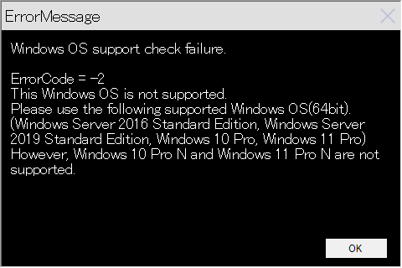
1. Improve installer
Target
Product
Server
i-PRO Active Guard for VMS
V1.5.1
i-PRO Active Guard for ASM300
V1.5.1
Improve installer to check if the OS version is supported.
If the OS is not supported, an error message will be displayed and the installation will be canceled.
Supported OS
Windows Server 2016 Standard Edition (64bit)
Windows Server 2019 Standard Edition (64bit)
Windows 10 Pro (64bit) version 2004, 21H1 or later
Windows 11 Pro (64bit)
* Windows 10 Pro N and Windows 11 Pro N are not supported.
* If you want to upgrade i-PRO Active Guard installed on Windows 10 Pro 20H2 to V1.5.1, please update Windows 10 Pro to 21H1 or later.

Slide 6
2. Support multiple NICs (for Genetec)
Target
Product
Server
i-PRO Active Guard for VMS
V1.5.1
Before
After
VI
VI
VI IP Server
NIC1 : Can be registered
or
NIC2 : Can be registered
VI IP Server
NIC1 : Can be registered
or
NIC2 : Can be registered
i-PRO Active Guard server
i-PRO Active Guard server
Genetec
Genetec
Register
Security Center
Register
Security Center
NIC1 : Can be registered
or
NIC2 : Can be registered
NIC1 : Can be registered
or
NIC2 : Cannot be registered
ASM300
ASM300
NVR
NVR
NIC1 : Can be registered
or
NIC2 : Can be registered
NIC1 : Can be registered
or
NIC2 : Can be registered

Slide 7
Search & Event

Slide 8
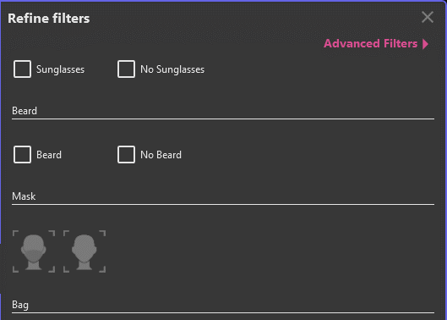
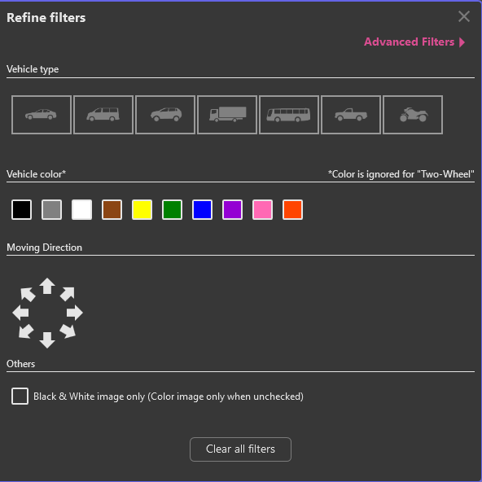
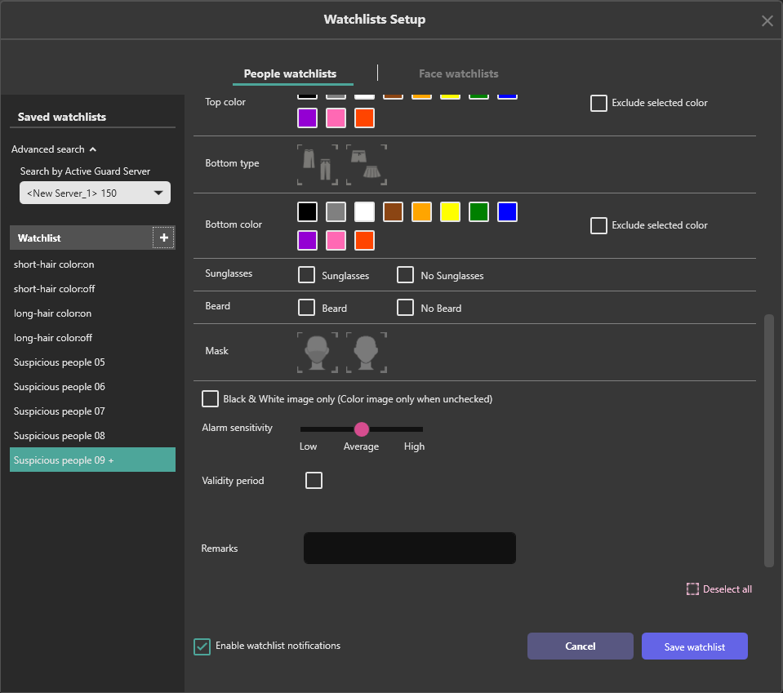
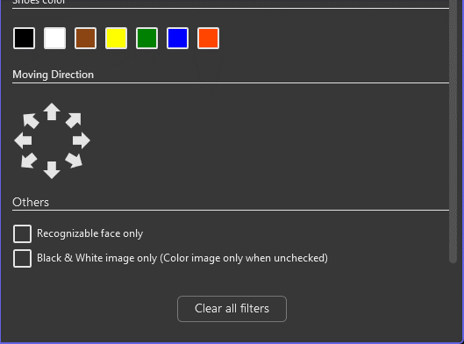
3. Change “color” or “black & white” search condition
Target
Product
Server
i-PRO Active Guard for VMS
V1.5.1
Plug-in
i-PRO Active Guard Plug-in for VI
V1.5.1
i-PRO Active Guard Plug-in for Genetec
i-PRO Active Guard for ASM300
i-PRO Active Guard Plug-in for ASM300
Change “color” or “black & white” search condition on the following screens.
*Replaced the option “Color image only” to “Black & White image only”
Color image will be appeared when the option is unchecked (default : unchecked)
Before
People search
Vehicle search
People watchlist setup
After

Slide 9
3. Change “color” or “black & white” search condition
Target
Product
Server
i-PRO Active Guard for VMS
V1.5.1
Plug-in
i-PRO Active Guard Plug-in for VI
V1.5.1
i-PRO Active Guard Plug-in for Genetec
i-PRO Active Guard for ASM300
i-PRO Active Guard Plug-in for ASM300
Before
Search condition | Search result
 | Color | Black & White
 | Yes | Yes
 | Yes | No
After
Search condition | Search result
 | Color | Black & White
 | Yes | No
 | No | Yes

Slide 10
Dashboard

Slide 11
4. Improve dashboard issue (by Table chart)
Target
Product
Server
i-PRO Active Guard for VMS
V1.5.1
i-PRO Active Guard for ASM300
V1.5.1
Improve the following phenomenon.
Phenomenon
The term of table chart is incorrect (1 day shifted).
Software
i-PRO Active Guard V1.2.0 - V1.5.0
AI-VMD / AI People Counting for 360-degree fisheye
Conditions
Display the “table chart” and select “week” or “month” as display duration.
In case of the time scale setting is “0:00-0:00 (24H)” and the time zone is UTC minus, the term of table chart will be incorrect. For example, Japan will have this issue since the time zone is UTC-9.
This issue will happen in table chart only. Other graph or pie chart doesn’t have this issue.

Slide 12
Appendix: Other version up contents
for i-PRO Active Guard Plug-in for VI

Slide 13
i-PRO Active Guard Plug-in for VI Improvements
 | #1 Initial display setting for “Information” (Map/Detected info/Camera info) | #2 Improved saving plugin settings for systems with multiple IP Servers | #3 Support presets in Event Monitor
Feature Description | This feature keeps the selection of information tab, when switching the thumbnail. | This feature saves settings of Plug-in setup to all InsightEnt databases which are connected to VIM+ at the same time. | This feature saves filtering settings as a preset for past event search. It can store up to 12 presets per a login user.
What issue does this solve for our users? | Today, a map is always displayed in information tab when switching a thumbnail.This feature keeps the selection that user selected one from information tab at previous. | Today, when user uses two or more IP Servers, shared db is required. This feature provides users the ability to configure a system without shared db. | This provides users the same function for past event search that Recording Search already has.
How does this benefit our users? | This benefits users for better paging selecting thumbnails. A map is not default anymore. | This benefits users for flexibility when considering system structure. | This benefits users to save time when users use past event search by creating presets for frequently used settings.
Video | https://youtu.be/I06Up8N43vk | - | https://youtu.be/fXua8mqaN6o

Slide 14
i-PRO Active Guard Plug-in for VI Improvements
 | #4 Improve camera order in list | #5 Change alarm status for multiple events at the same time | #6 Video export for selected multiple thumbnails at the same time
Feature Description | This feature sorts cameras in cameras list by name. | This feature changes multiple alarm status at the same time up to 50 events. | This feature exports videos against selected thumbnails at the same time. Thumbnails can be selected up to 10 at the same time. The video footage is 10 seconds. The video files will be created as same as the number of selected thumbnails.
What issue does this solve for our users? | This solves an issue that cameras are displayed randomly in list. | Currently user should change alarm status one by one. This allows users to change selected multiple alarm status at the same time. | This feature provides the ability to select multiple thumbnails and export for videos at the same time.
How does this benefit our users? | This benefits users to find cameras easily. Especially, multi-sensor cameras should benefit the most. | This benefits users to manage alarm events with status quickly. | This benefits users to export two or more files quickly. This will save time their daily work.
Video | https://youtu.be/eXgJ4XwATdE | https://youtu.be/mP1QDNpRQnQ | https://youtu.be/vAL6fp2FRLY

Slide 15
Version History

Slide 16
Version History
No | Update contents | Page No. | Version | Update
1 | 1st Version | - | 1.00 | 27. Jul. 2022
2 | Corrected supported OS. | P.4 | 1.01 | 04. Aug. 2022
3 | Added information “Other version up contents for i-PRO Active Guard Plug-in for VI”. | P.11 - 13 | 1.02 | 05. Sep. 2022
4
5
6
7
8
9
10

