Slide 1
NW camera Extension Software version up
[Jul. 2022]
Document Ver.1.01
Jul. 2022

Slide 2
Overview
Target Product
Version
Release
AI-VMD
V3.00
Jul. 2022
AI People Detection
V1.21
Jul. 2022
AI Occupancy Detection
V1.40
Jul. 2022
AI-VMD / AI People Counting for 360-degree fisheye
V1.30
Jul. 2022
Supported camera versions
Model | Version
X1551LN, X1571LN, X2251L, X2271L, X2551LN, X2571LN | V2.01 or later
S1136, S1536*, S2136*, S2236L, S2536* | V2.10 or later
S15500*, S15600*, S15700*, S22500*, S22600*, S22700*, S25500*, S25600*, S25700* | V2.10 or later
S4156, S4176, S4556*, S4576* | V2.10 or later
S65340*, S61301-Z2, S61302-Z4 | V1.00 or later
S71300-F3 | V1.10 or later
S8543*, S8544*, S8563L*, S8564L*, S8573L*, S8574L* | V2.10 or later

Slide 3
Overview
Note: "Done" means that it has already supported by previous version
Contents | AI-VMD | AI People Detection | AI Occupancy Detection | AI-VMD / AI People Counting for 360-degree fisheye
1. Support People / Vehicle Counting (by Cross Line Counting) | Yes | No | No | Done *1
2. Support count data transmission (HTTP) | Yes | No | Done | Done
3. Support count data transmission (MQTT) | Yes | No | Yes | Yes
4. Improve the detection accuracy of AI-VMD *2 | Yes | No | No | No
5. Add sensitivity / detection size / mask area settings | Done | Done *3 | Yes | Done *3
6. Add detection score display | Yes | No | Yes | Yes
7. Add a mode to notify the alarm only at the first detection | Yes | No | Yes | Yes
8. Add alarm image to Occupancy detection of “AI-VMD / AI People Counting for 360-degree fisheye” | No | No | No | Yes
9. Change initial value of attribute (bag color / shoes color) to ON | No | Yes | No | No
*1 Vehicle count is not supported.
*2 i-PRO mini / AI PTZ is not supported. It will be supported in the future.
*3 Detection size is not supported.

Slide 4
1. Support People / Vehicle Counting
(by Cross Line Counting)

Slide 5
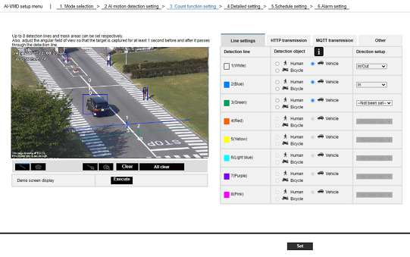
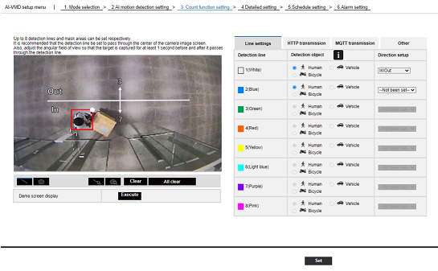
1-1. People / Vehicle Counting
Target
Product
AI-VMD (People / Vehicle Counting)
Version
V3.00
Add counting function (Cross Line Counting) to AI-VMD application.
The object to be counted depends on the angle mode.
<Normal angle mode>
<Perpendicular angle mode>
Count object
People
Vehicle
Bicycle
Count object
People

Slide 6
1-2. Comparison of each application
Target
Product
AI-VMD (People / Vehicle Counting)
Version
V3.00
Application |  | AI-VMD |  | AI Occupancy Detection | AI-VMD / AI People Counting for 360-degree fisheye
 |  | Normal angle mode | Perpendicular angle mode
Use case |  | A case of AI-VMD or Vehicle(Bicycle) Counting with normal monitoring angle of view | A case of People Counting with high accuracy *Monitoring angle of view is narrow | A case of Occupancy Detection or Area People Counting with normal monitoring angle of view | A case of highly accurate People Counting with a 360-degree monitoring angle of view
Tilt Angle |  | People/Bicycle : 0 - 45 deg. Vehicle : 0 - 90 deg. | 90 deg. | 0 - 45 deg. | 90 deg.
Function
 | AI-VMD | Yes (People/Vehicle/Bicycle) | Yes (People) | No | Yes (People/Vehicle)
 | Occupancy Detection | No | No | Yes (People) | Yes (People)
 | Cross Line Counting | Yes (People *1/Vehicle/Bicycle) | Yes (People) *1 | No | Yes (People)
 | Area Counting | No | No | Yes (People) | Yes (People)
 | Heat Map | No | No | No | Yes (People)
Count accuracy *2 |  | Cross Line Counting (Vehicle/Bicycle) : ± 10% | Cross Line Counting (People) : ± 5% | Area Counting : ± 10% | Cross Line Counting : ± 5% Area Counting : ± 10%
*1 Recommend “Perpendicular angle mode” for People Counting.
*2 Accuracy figures are reference values based on in-house evaluations. Accuracy is not guaranteed.

Slide 7
1-3. Supported camera with AI engine
Target
Product
AI-VMD (People / Vehicle Counting)
Version
V3.00
Camera type | Indoor | Outdoor
Box | S1136 | X1551LN / X1571LN S1536* S15500-F3L / S15500-F6L S15500-V3L* / S15600-V2L* / S15700-V2L*
Dome | X2251L / X2271L S2136* / S2236* S22500-F3L / S22500-F6L S22500-V3L* / S22600-V2L* / S22700-V2L* | X2551LN / X2571LN S2536* S25500-F3L / S25500-F6L S25500-V3L* / S25600-V2L* / S25700-V2L*
PTZ *1 | S61301-Z2 / S61302-Z4 | S65340*
Mini | S71300-F3
Multi-Sensor *2 |  | S8543* / S8544* / S8563L* / S8564L* / S8573L* / S8574L*
*1 Up to one “count line setting” pattern. Multiple “count line setting” cannot be set for each preset position.
*2 Not supported “Perpendicular angle mode”. Will be supported in the future.

Slide 8
1-4. System support status
Target
Product
AI-VMD (People / Vehicle Counting)
Version
V3.00
 |  | Set application | Collect data | Display data | Output data
Camera browser |  | Yes | No | No | No
iCT (V3.20) |  | Yes | Yes (Manual) | No | Yes (Excel)
i-PRO Active Guard (V1.5.0) |  | No | Yes (Auto) | Yes | Yes (CSV/PDF)
VMS | VI | No | No | No | No
 | Genetec | No | No | No | No
 | Milestone | No | No | No | No

Slide 9
1-5. Specification
Target
Product
AI-VMD (People / Vehicle Counting)
Version
V3.00
Item | Content
Number of simultaneous detection | Max. 40 in total (People / Vehicle / Bicycle)
Retention period | Max. 92 days in built-in memory
Counted object | People / Vehicle / Bicycle
Number of line | Max. 8 lines
Number of mask area | Max. 8 areas *1
Output method | - ONVIF *2 - CGI - Additional information in video stream - HTTP POST - MQTT
*1 Mask area is the same setting as AI-VMD.
*2 Data format is proprietary.

Slide 10
1-6. Count accuracy
Target
Product
AI-VMD (People / Vehicle Counting)
Version
V3.00
Reference value
Item | Normal angle mode |  | Perpendicular angle mode
 | People | Vehicle / Bicycle | People
Count accuracy *1 | Not recommend *2 | ± 10% | ± 5%
Maximum countable number of object per hour (approx.) |  | 1000 Vehicles / h *per lane | 5000 people / h
Countable object density per meter square (approx.) |  | N/A | 2 people / ㎡
*1 Accuracy figures are reference values based on in-house evaluations. Accuracy is not guaranteed.
*2 It can be used in scenes that cross the count line one by one.

Slide 11
1-7. Installation standard
Target
Product
AI-VMD (People / Vehicle Counting)
Version
V3.00
Item | Normal angle mode |  | Perpendicular angle mode
 | People | Vehicle / Bicycle | People
Environment | Indoor | Indoor / Outdoor | Indoor
Installation height | N/A | N/A | 2.5 m or more *1 (8.2 feet or more)
Minimum illuminance | 50lux | 5lux | 50lux
IR-LED | Not support | Not support | Not support
*1 Since the standard of installation height differs depending on the camera model and zoom magnification,
so be sure to check with SDT before actual installation.

Slide 12
1-7-1. Installation standard - People Counting
Target
Product
AI-VMD (People / Vehicle Counting)
Version
V3.00
Follow below conditions if high accuracy is required.
Angle of view
Angle mode : Perpendicular angle mode
Camera installation
Height from floor : 2.5 m or more (8.2 feet or more) *1
Distance from entrance (a) : 1.0 m (3.3 feet) or more
Camera angle should be adjusted so that it becomes entrance (door) is located at either top/bottom/left/right of the camera image.
Counting line
Distance from camera : Should be set directly below the camera
Camera
Counting line
(a)
Entrance (door)
<bottom>
indoor
outdoor
*1 Since the standard of installation height differs depending on the camera model and zoom magnification,
so be sure to check with SDT before actual installation.

Slide 13
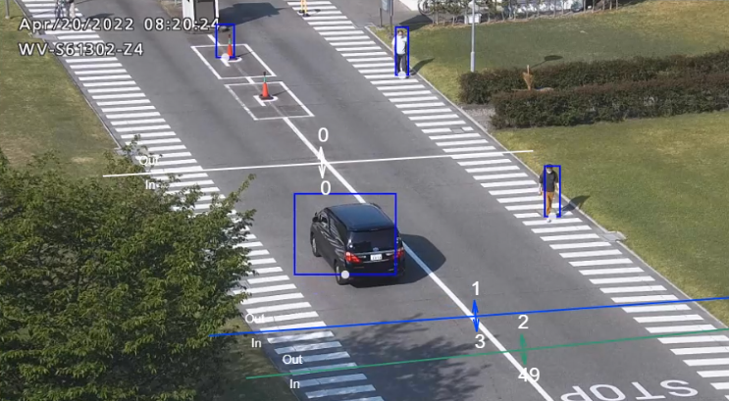
1-7-2. Installation standard - Vehicle Counting
Target
Product
AI-VMD (People / Vehicle Counting)
Version
V3.00
Follow below conditions if high accuracy is required.
Angle of view
Angle mode : Normal angle mode
Camera installation
Camera angle should be adjusted so that the direction of travel of the vehicle is the vertical direction of the camera image.
*If the vehicle moves horizontally with respect to the camera image, the vehicles will overlap in the case of multiple lanes and the accuracy will decrease.
Counting line
Setting position : Near the center of the camera image
Recommend
Not recommend

Slide 14
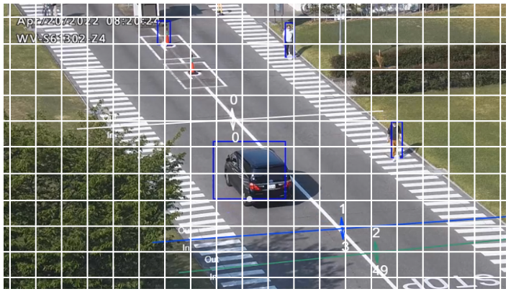
1-8. Appropriate object size
Target
Product
AI-VMD (People / Vehicle Counting)
Version
V3.00
Appropriate object size in grid display
[Unit: cell]
Angle mode | Object | 4K/6MP Model |  | 5MP model | 4MP model | 2MP model
 |  | Multi | Others |  |  | mini | Others
Normal angle | People | 0.5 | 0.5 | 1 | 0.5 | 1 | 1
 | Vehicle | 1 to 2 | 1 to 3 | 1 to 6 | 1 to 2 | 1 to 6 | 2 to 6
 | Bicycle | 1 to 2 | 1 to 2 | 1 to 2 | 1 to 2 | 1 to 2 | 2 to 4
Perpendicular angle | People | 1 | 1 | 1 to 3 | 1 | 1 to 3 | 2 to 3
Size Criteria
“People”: body width , “Vehicle/Bicycle”: short side
As for appropriate object size, refer to the support information “Appropriate object size for each AI analytics in Grid display <C0320>” at the link below.
https://i-pro.com/global/en/surveillance/training-support/support/technical-information

Slide 15
1-9-1. Restriction - People Counting
Target
Product
AI-VMD (People / Vehicle Counting)
Version
V3.00
The accuracy of image analysis may be affected by the environmental causes listed below.
The difference in brightness between the background and the moving object is small.
Shooting when the brightness of the image is low such as nighttime.
The object is out of focus.
The object is blurred.
The object is moving too fast or too slow.
The object is too small or too large.
Only part of the object is visible, hidden behind the privacy zone and other objects. (In the case of a person, 2/3 of the body from shoulder to head)
The height of the person is short. (When it is 120 cm or less)
The person is carrying a large baggage. (Pushing a cart, stroller or wheelchair)
The person is not walking independently. (Embraced toddler)
Too many moving objects are in the shooting area. (About 40 people or more)
Multiple objects intersect.
Shooting under the changeable light conditions such as outdoors or near windows and so forth.
External lights such as sunlight or car headlights come into the shooting area.
Strong outside light comes in, creating shadows on the object and others.
Flickering fluorescent lamps.
Insects or animals come into the shooting area.
The dome of the camera is sweating or has dirt on it.
The camera is shaking.
The camera is not facing downwards.

Slide 16
1-9-2. Restriction - Vehicle Counting
Target
Product
AI-VMD (People / Vehicle Counting)
Version
V3.00
The accuracy of image analysis may be affected by the environmental causes listed below.
The difference in brightness between the background and the moving object is small.
Shooting when the brightness of the image is low such as nighttime.
The object is out of focus.
The object is blurred.
The object is moving too fast or too slow.
The object is too small or too large.
Only part of the object is visible, hidden behind the privacy zone and other objects. (It is necessary to show at least 2/3 of the entire vehicle)
Too many moving objects are in the shooting area. (About 40 vehicle or more)
Multiple objects intersect.
External lights such as sunlight or car headlights come into the shooting area.
Strong outside light comes in, creating shadows on the object and others.
Flickering fluorescent lamps.
The weather is extremely bad.
Posters and signboard of vehicles come into the shooting area.
A vehicle is reflected in the windscreen.
If the vehicle has an trailer attached to it. (E.g., trailer, boat, etc.)
The dome of the camera is sweating or has dirt on it.
The camera is shaking.

Slide 17
Other version up contents
(Chapter. 2 - 9)

Slide 18
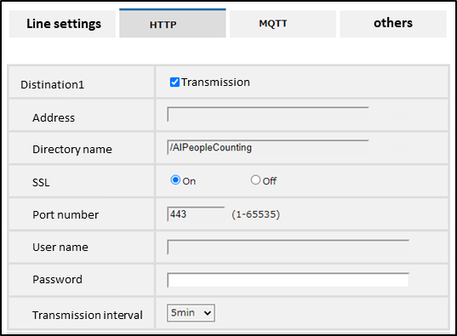
2. Support count data transmission (HTTP)
Target
Product
AI-VMD (People / Vehicle Counting)
Version
V3.00
AI-VMD Count function setting screen
Setting items | Settings
Destination | Set whether to enable send. Up to 4 destinations can be set.
Address | HTTP server IP address or host name
Directory name | Destination path name
SSL | Set whether to enable SSL [on / off]
Port number | HTTP server port number
User name | Username to access the HTTP server
Password | Password to access the HTTP server
Transmission interval | 1, 5, 10, 15, 30, 60（min.）
Note: For details of transmission content, refer to "External Interface Specifications" in the URL.
(https://i-pro.com/global/en/surveillance/training-supportsupport/technical-information).

Slide 19
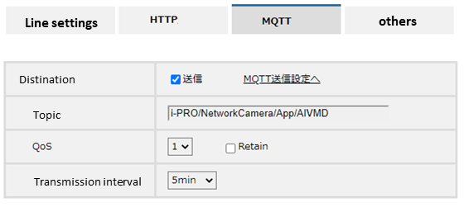
3. Support count data transmission (MQTT)
Target
Product
AI-VMD (People / Vehicle Counting)
Version
V3.00
AI Occupancy Detection
V1.40
AI-VMD / AI People Counting for 360-degree fisheye
V1.30
AI-VMD Count function setting screen (e.g.)
Setting items | Settings
Destination | ・Set whether to enable send. ・To MQTT settings : Displays the MQTT setting screen of camera setting. (*1)
Topic | Set the name of the MQTT topic to send.
QoS | ・Select a level from 0, 1, 2. ・Retain : Select to save the last notified message on the MQTT server.
Transmission interval | 1, 5, 10, 15, 30, 60（min.）
Transmission
To MQTT settings
*1 To send count data using MQTT, it is necessary to enable MQTT on the setting screen of camera settings.
Information such as the destination server address and port number is set on camera settings. Refer to the next page for camera settings.
Note: For details of transmission content, refer to "External Interface Specifications" in the URL.
(https://i-pro.com/global/en/surveillance/training-supportsupport/technical-information).

Slide 20
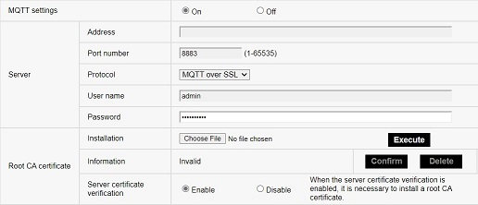
[Ref.] In case of MQTT setting on the camera side
To send count data using MQTT, the following settings are required on the camera side.
Camera setting screen
Setting items | Settings
MQTT settings | Set whether to enable MQTT [on / off].
Server | ・Address : MQTT server IP address or host name ・Port number : MQTT server port number ・Protocol : MQTT over SSL/MQTT over TCP ・User name : Username to access the MQTT server ・Password : Password to access the MQTT server
Root CA certificate | ・installation : Install the root CA certificate issued by the certificate authority. ・Information : The root CA certificate information is displayed. ・Server certificate verification : If "MQTT over SSL" is selected for [Protocol] and [Server Certificate Verification] is "Valid", the server certificate is verified using the root CA certificate registered at the time of SSL connection.

Slide 21
[Ref.] MQTT support status
Supported functions for camera
Supported functions for application
Alarm notification
Terminal 1 | Supported in Dec. 2021 *1
Terminal 2
Terminal 3
VMD
Audio detection
Command alarm
Alarm notification
AI-VMD | Will be supported in the future
AI Occupancy Detection
AI-VMD / AI People Counting for 360-degree fisheye
AI Non Mask Detection | Not supported
Count data transmission
AI-VMD | Supported in Jul. 2022
AI Occupancy Detection
AI-VMD / AI People Counting for 360-degree fisheye
*1 Supported for AI 360-degree in Jul. 2022.

Slide 22
4. Improve the detection accuracy of AI-VMD
Target
Product
AI-VMD
Version
V3.00
Reduced false positive alarm caused by animals
Improve detection accuracy by the following measures.
Add a false positive scene in the training data.
Enhance learning of AI model to exclude targets (animals, birds) that were falsely detected as human.
Before
After
Above the scapula
Above the scapula
Whole body
Whole body
Targets that are falsely detected as human are excluded from the detection targets.
False positive

Slide 23
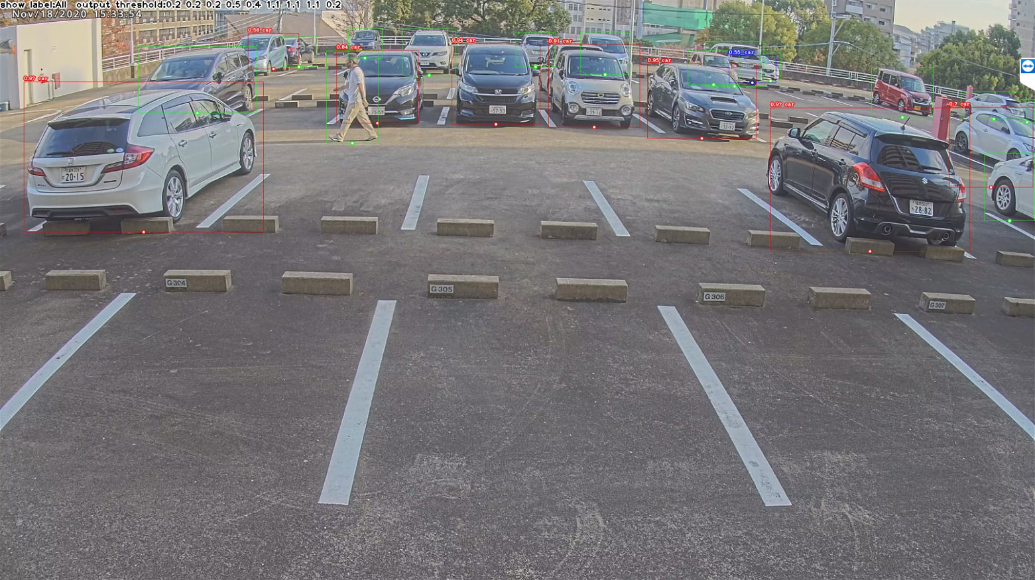
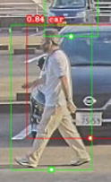
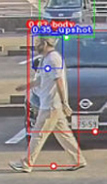
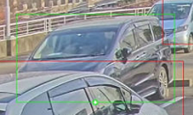
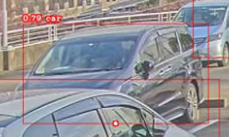
4. Improve the detection accuracy of AI-VMD
Target
Product
AI-VMD
Version
V3.00
Reduced false negative alarm in parking
Improve detection accuracy of vehicles and people walking near vehicles by making the training data more appropriate (deletion of inappropriate data / addition of crowded vehicle scenes).
Before
After
False negative
: People walking
near vehicles
True positive
False negative
: Vehicle in the back of the vehicle
True positive
*The image is different from the actual product.

Slide 24
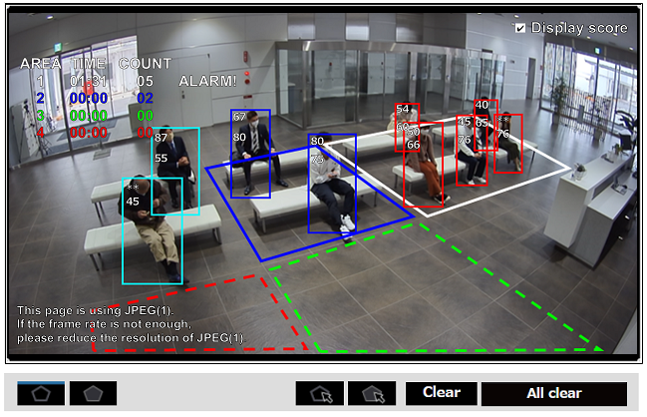
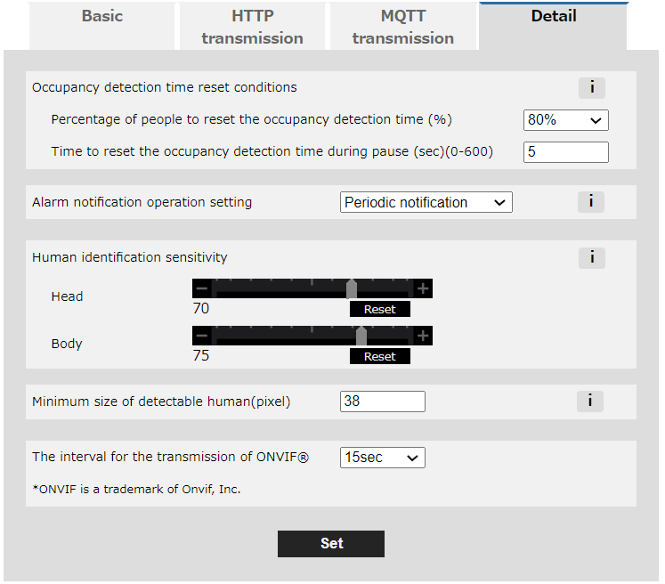
5. Add sensitivity / detection size / mask area settings
Target
Product
AI Occupancy Detection
Version
V1.40
Occupancy detection setting screen
Human identification sensitivity
Set the sensitivity (1 - 99) to judge as the head or body.
The higher the value, the less false negative alarm, but the more false positive alarm.
Please adjust while checking the detection score explained on the next page.
Mask area
Mask area
Minimum size of detectable human
Set the minimum size of the person you want to detect in pixels.
Mask area setting
Up to 8 locations can be set.

Slide 25
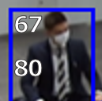
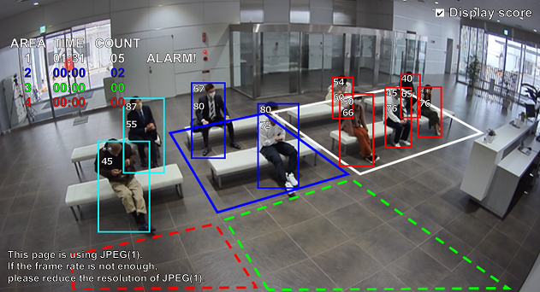
6. Add detection score display
Target
Product
AI-VMD (People / Vehicle Counting)
Version
V3.00
AI Occupancy Detection
V1.40
AI-VMD / AI People Counting for 360-degree fisheye
V1.30
Occupancy detection demo screen (e.g.)
Display score
By checking, the detection score will be displayed.
Detection score *1 *2
(1) Head / (2) Body
(1)
(2)
Demo screen support status
AI-VMD |  | AI Occupancy Detection | AI-VMD / AI People Counting for 360-degree fisheye
AI-VMD | Counting |  | AI-VMD | Counting
No | Yes | Yes | No | Yes
*1 Detects when the detection score (1-99) is higher than the detection threshold. Detection threshold ( = 100 - Identification sensitivity)
*2 For vehicle counting, the vehicle or bicycle detection score is displayed.

Slide 26
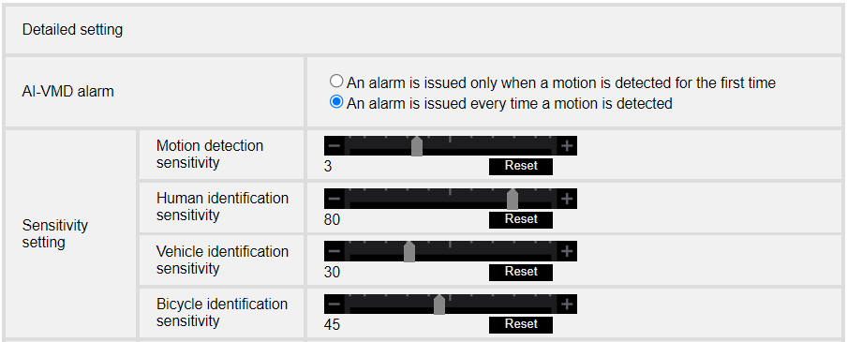
7. Add a mode to notify the alarm only at the first detection
Target
Product
AI-VMD
Version
V3.00
AI Occupancy Detection
V1.40
AI-VMD / AI People Counting for 360-degree fisheye
V1.30
AI-VMD Detailed setting screen (e.g.)
Add a setting item to allow the number of alarm notifications to be limited to the first one.

Slide 27
8. Add alarm image to Occupancy detection of “AI-VMD / AI People Counting for 360-degree fisheye”
Target
Product
AI-VMD / AI People Counting for 360-degree fisheye
Version
V1.30
Support Occupancy detection image display of "AI-VMD / AI People Counting for 360-degree fisheye“
on i-PRO Active Guard.
Before
After
*V1.5.0 or later version of “i-PRO Active Guard“ and “i-PRO Active Guard Plug-in for ASM300” is required.

Slide 28
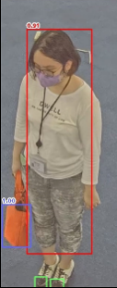
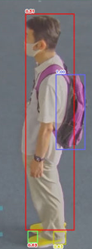
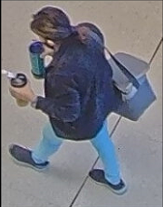
9. Change initial value of attribute (bag color / shoes color) to ON
Target
Product
AI People Detection
Version
V1.21
Bag and shoes attributes
Before
Initial value : Off
After
Initial value : On
*It is possible to change the initial value using iCT (V3.10 or later).
However, it cannot be changed for multiple cameras at once.
Enabling the bag and shoes attribute adds restrictions when installing multiple extension software on the camera, refer to the support information “Compatibility list for extension software <C0103>” at the link below.
https://i-pro.com/global/en/surveillance/training-support/support/technical-information

Slide 29
Version History

Slide 30
Version History
No | Update contents | Page No. | Version | Update
1 | 1st Version | - | 1.00 | 7. Jul. 2022
2 | Added that it is not possible to change the initial value for multiple cameras at once from iCT. | P.27 | 1.01 | 15. Jul. 2022
3
4
5
6
7
8
9
10

