Slide 1
i-PRO Active Guard version up - V1.5.0 -
[Jun. 2022]
Document Ver.1.00
Jun. 2022

Slide 2
Overview (1/3)
Target
Product
i-PRO Active Guard Server
i-PRO Active Guard for VMS
V1.5.0
Jun. 2022
i-PRO Active Guard for ASM300
V1.5.0
Jun. 2022
i-PRO Active Guard Plug-in
i-PRO Active Guard Plug-in for ASM300
V1.5.0
Jun. 2022
Contents | Server |  | Plug-in
 | VMS [V1.5.0] | ASM300 [V1.5.0] | VI [V1.4.0] | Genetec [V1.4.0] | ASM300 [V1.5.0]
Support Milestone system
1. Support Milestone system | Yes | - | - | - | -
Install & Setup
2. Improve installer | Yes | Yes | - | - | -
3. Enhance alarm notification settings | - | Yes | - | - | -

Slide 3
Overview (2/3)
Contents | Server |  | Plug-in
 | VMS [V1.5.0] | ASM300 [V1.5.0] | VI [V1.4.0] | Genetec [V1.4.0] | ASM300 [V1.5.0]
Search & Event (for ASM300)
4. Add function for batch copy registered face data | - | Yes | - | - | Yes
5. Support sort face search result by similarity | - | Yes | - | - | Yes
6. Support timeline display for registered face detection | - | - | - | - | Yes
7. Support to Occupancy detection alarm image display | - | Yes | - | - | Yes
8. Interlock with ASM300 display magnification setting | - | - | - | - | Yes
9. Improve search date and time setting GUI | - | - | Done | Done | Yes
10. Add message when face image that does not meet the recommended pixel is registered | - | - | Done | Done | Yes
11. Improve alarm status management function | Done | Yes | Done | - | Yes
Note: "Done" means that it has already supported by previous version

Slide 4
Overview (3/3)
Contents | Server |  | Plug-in
 | VMS [V1.5.0] | ASM300 [V1.5.0] | VI [V1.4.0] | Genetec [V1.4.0] | ASM300 [V1.5.0]
Dashboard
12. Support people / vehicle count (AI-VMD V3.00) | Yes | Yes | - | - | -
13. Support display for automatically backed up CSV file | Yes | Yes | - | - | -
14. Support to specify any number of days for “display duration” | Yes | Yes | - | - | -
15. Support enlarge view of heat map image | Yes | Yes | - | - | -
16. Add adjustment function for display character size | Yes | Yes | - | - | -
17. Add function for display the conditions set for each chart | Done | Yes | - | - | -
18. Add options for comparison data on Live mode | Done | Yes | - | - | -
19. Add option “Time transition” for Occupancy (Occupancy by time) | Done | Yes | - | - | -
Others
20. Support avoiding warning display when connecting via HTTPS | Done | Yes | - | - | -
21. Support for browser version 100 or later | Done | Yes | - | - | -
Note: "Done" means that it has already supported by previous version

Slide 5
Support Milestone system

Slide 6
1-1. System architecture
Target
Product
Server
i-PRO Active Guard for VMS
V1.5.0
Milestone system
B)
A)
Restriction
i-PRO Active Guard sever need to be installed to dedicated PC.
XProtect Management server and XProtect Event server need to be installed on the same PC.

Slide 7
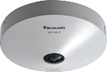
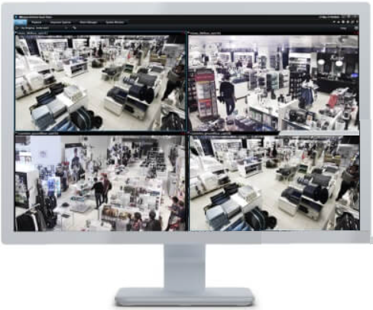
1-2. System lineup
Target
Product
Server
i-PRO Active Guard for VMS
V1.5.0
Camera + AI application
XProtect Server
i-PRO Active Guard server
XProtect
Smart client
i-PRO Active Guard Plug-in for XProtect
Extension software | Version
AI Face Detection | V1.10 or later *Required for age and gender statistics dashboard
AI People Detection | V1.00 or later
AI Vehicle Detection | V1.00 or later
AI-VMD | V2.00 or later
AI-VMD/AI People Counting for 360-degree fisheye | V1.20 or later
VMS | Version
XProtect Corporate / Expert / Professional+ / Express+ | 2022 R1 or later
XProtect Smart client
Software | Version
i-PRO Active Guard Server | V1.5.0 or later
i-PRO Active Guard Plug-in for XProtect *1 | V1.0.0 or later
*1: i-PRO Active Guard Plug-in can be downloaded on “Marketplace of Milestone” from June 1st.

Slide 8
1-3. Supported AI Application
Target
Product
Server
i-PRO Active Guard for VMS
V1.5.0
Application | VI | Genetec | Milestone | ASM300
AI Face Detection *1 | Yes | Yes | Yes | Yes
AI People Detection | Yes | Yes | Yes | Yes
AI Vehicle Detection | Yes | Yes | Yes | Yes
AI-VMD *2 | Yes | (by Security Desk) | (by XProtect) | Yes
AI Sound Classification | Yes | (by Security Desk) | No | Yes
AI Non Mask Detection | Yes (VCA) | No | No | (by ASM300)
AI Occupancy Detection | Yes (VCA) | (by Security Desk) | No | (by ASM300)
AI-VMD/AI People Counting for 360-degree fisheye *3 | Yes (VCA) | (by Security Desk) | (by XProtect) *4 | Yes
*1: V1.10 is required for age and gender statistics dashboard.
*2: V2.00 or later is supported.
*3: V1.20 or later is supported.
*4: Occupancy Detection is not supported.

Slide 9
1-4. How to count number of cameras
Target
Product
Server
i-PRO Active Guard for VMS
V1.5.0
Milestone : Count the number of cameras which application #1-4, #6 is installed
 | Application | Milestone
1 | AI Face Detection | ✓
2 | AI People Detection | ✓
3 | AI Vehicle Detection | ✓
4 | AI-VMD | ✓
5 | AI Sound Classification
6 | AI-VMD/AI People Counting for 360-degree fisheye | ✓
*Multi-sensor camera : Count by camera unit where the application is installed.
Example 1
If there is 2 cameras,
- cam1 is for AI People Detection and AI-VMD
- cam2 is for AI Sound Classification
number of camera will be 1
Example 2
If all camera units(4CH) of multi-sensor camera install AI-VMD
number of camera will be 4

Slide 10
1-5. Specification of i-PRO Active Guard server
Target
Product
Server
i-PRO Active Guard for VMS
V1.5.0
 |  | VI | Genetec | Milestone | ASM300
Scale | Number of camera (CH) | 1 to 100 CH when installed with VMS server (AI Face Detection is up to 20) |  | - | 1 to 4CH when installed with ASM300 (AI Face Detection is up to 4)
 |  | 1 to 300 CH when installed in dedicated server (AI Face Detection is up to 60)
 | Number of client | No limitation (depending on limitation of VMS) |  |  | No limitation (Up to 60 for TCP alarm linkage)
 | Number of Recording server | 12 VI IP servers | - (only main server should be registered) | - (Management server should be registered) | 12 Network disk recorders
 | Number of i-PRO Active Guard per a client | No limitation (depending on capability of whole system) |  | 1 | 100
Store | Retention period | Max. 31 days limitation for face, people or vehicle data Max. 92 days limitation for people counting data (After 92 days, it can be automatically saved as CSV)
 | Number of image data | No limitation (depending on HDD capacity) |  |  | 1 million when installed with ASM300 No limitation (depending on HDD capacity) when installed in dedicated server
Alarm | Watch list alarm | Up to 1,000 face Up to 12 people attributes

Slide 11
1-6. PC requirement
Target
Product
Server
i-PRO Active Guard for VMS
V1.5.0
PC requirement for i-PRO Active Guard server
i-PRO Active Guard server Installed in dedicated server | Up to 100 cameras | VI | • Intel® Core™ i7-9700 (4.9 GHz, 8 core 8 thread) or better • 32 GB of RAM or more • 64 bit operating system Microsoft® Windows 10 Pro version 2004 or later , Microsoft® Windows 11 Pro, Microsoft® Windows Server 2016/2019 Standard Edition • GbE network interface card
 |  | Genetec
 |  | Milestone
 |  | ASM300
 | Up to 300 cameras | VI | • Intel® Xeon® Silver 4208 2.1 GHz(8 core 16 thread) or better • 32 GB of RAM or more • 64 bit operating system Microsoft® Windows Server 2016/2019 Standard Edition • GbE network interface card
 |  | Genetec
 |  | Milestone
 |  | ASM300
Common software requirement
 | VI | Genetec | Milestone | ASM300
Database Engines | SQL server 2014/2016 Express/Standard Edition |  |  | SQL server 2016 Express/Standard Edition
Web browser | Microsoft Edge : Version 85 or later Chrome : Version 83 or later Firefox : Version 95 or later

Slide 12
1-6. PC requirement
Target
Product
Server
i-PRO Active Guard for VMS
V1.5.0
Client PC requirement for i-PRO Active Guard Plug-in
 | VI | Genetec | Milestone *1 | ASM300
Processor | 6th Generation or better Intel Core processor (3.1 GHz quad-core+) | Intel® CoreTM i7-9700 (4.9 GHz, 8 core 8 thread) or better | Hardware acceleration with Intel® Quick Sync requires an Intel® CPU from 4th generation up to 11th generation | Intel® Core™ i7-10700 (4.8 GHz, 8 core 16 thread) or better
Memory | 8 GB+ | 8 GB+ | - | 16 GB+
Video | 1GB | NVIDIA® GTX 1660 video card | Decoding with NVIDIA® graphics card is supported with GPU capability version 6.x (Pascal) or newer. | NVIDIA® Quadro P1000, NVIDIA® T1000
Network | 1 Gb/s+ | 1 Gb/s+ | - | 1 Gb/s+
Display Resolution | 1920 x 1080 | 1920 x 1080 | - | 1920 x 1080
OS | Windows 10 Pro (64 bit) Windows 11 Pro (64 bit) | Windows 10 Pro (64 bit) Windows 11 Pro (64 bit) | Windows 10 Pro Windows 11 Pro etc. | Windows 10 Pro version 20H2 or later (64bit) Windows 11 Pro (64 bit)
*1: For detail information , please refer milestone’ HP (https://www.milestonesys.com/systemrequirements/).

Slide 13
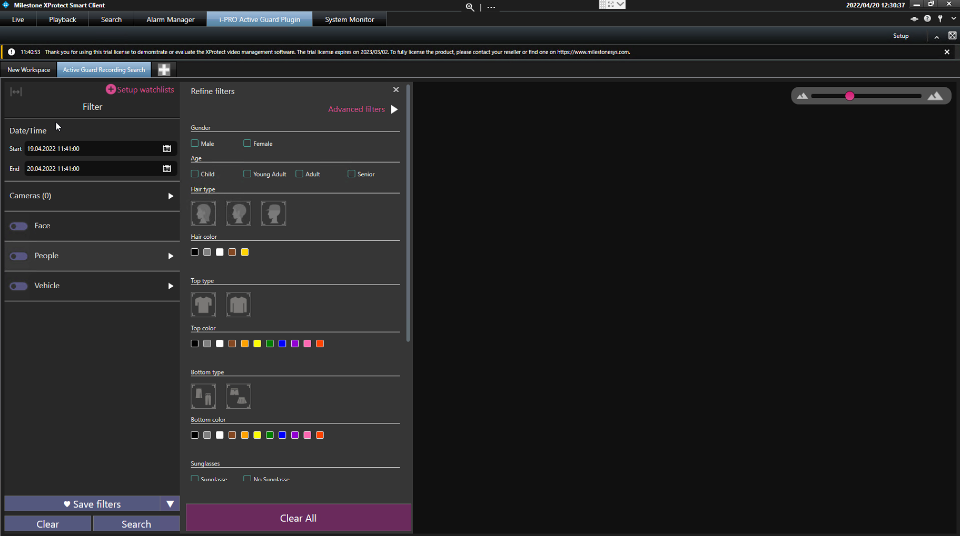
[Ref.] Sample screen
i-PRO Active Guard Plug-in for XProtect
Mostly equivalent to Genetec Plug-in V1.0. Major functional differences will be listed in the spec sheet.
The GUI design and usability details are slightly different from VI and Genetec.

Slide 14
Install & Setup

Slide 15
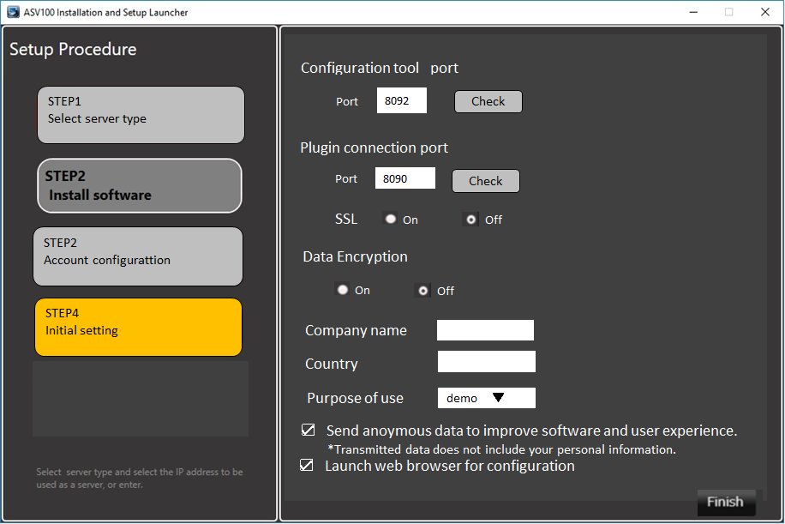
2. Improve installer
Target
Product
Server
i-PRO Active Guard for VMS
V1.5.0
i-PRO Active Guard for ASM300
V1.5.0
In order to grasp the usage record of i-PRO Active Guard,
add an item to enter user information in the installer.
Add input items for company name, country name, and purpose of use (Production Operation/Demo/PoC/Test/Others).
*You cannot press the "Finish" button unless you enter information in all items.
If you do not want to send the information (company name, country name, and purpose of use), please remove .

Slide 16
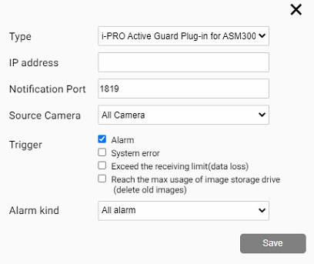
3. Enhance alarm notification settings
Target
Product
Server
i-PRO Active Guard for ASM300
V1.5.0
Add a setting item to Alarm Notification configuration.
Add to Type
IO Unit(ADAM-6256)
The output terminal of ADAM6256 can be controlled.
Custom HTTP
Arbitrary commands can be sent to devices controlled
by HTTP commands (ex. Rotary Beacon Light devices).
Mobile notification tool
Face matching alarms, People matching alarms, etc.
can be received on the i-PRO Mobile App.
*Mobile notification tool V1.30 or later is required.
Add menu “Source Camera”
“All camera” or each camera registered to server can be selected.

Slide 17
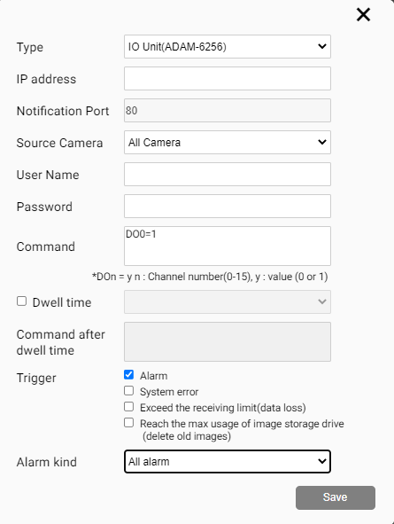
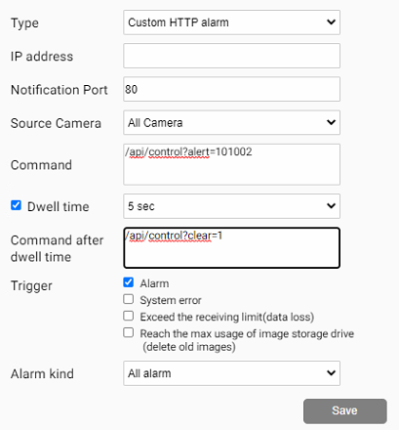
3. Enhance alarm notification settings
Target
Product
Server
i-PRO Active Guard for ASM300
V1.5.0
When “IO Unit（ADAM-6256）” is selected
When “Custom HTTP” is selected
Input according to the I/F of the device
300msec/600msec/5sec/10sec
/15sec/30sec/45sec/60sec
*For Custom HTTP alarm, only HTTP GET method is supported.
*Post method, HTTP authorization, HTTPS are not supported.

Slide 18
Search & Event (for ASM300)

Slide 19
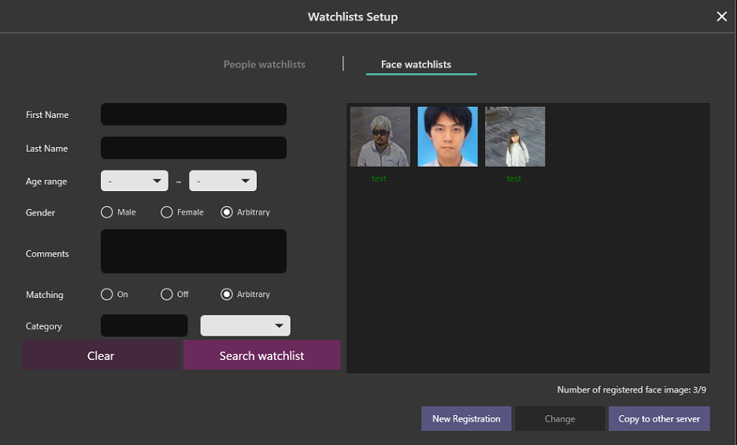
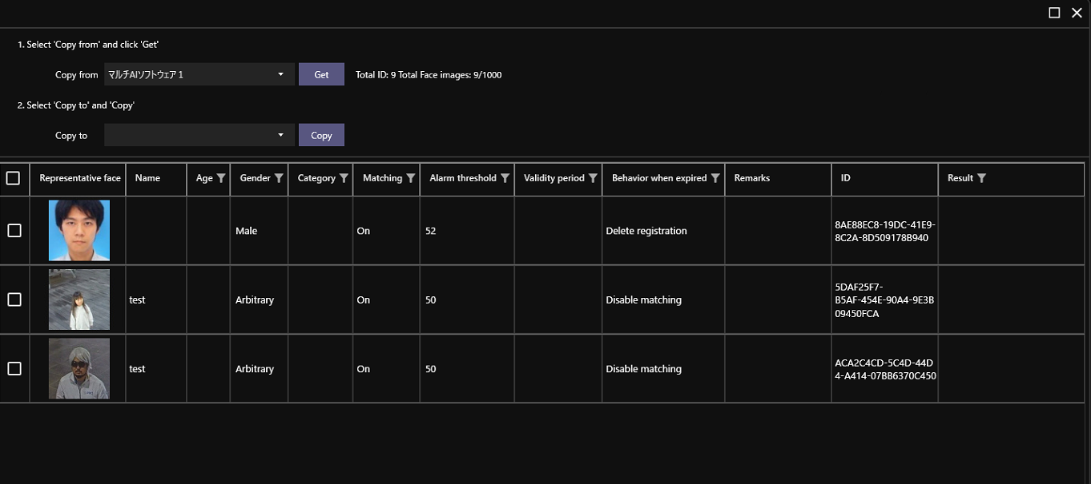
4. Add function for batch copy registered face data
Target
Product
Server
i-PRO Active Guard for ASM300
V1.5.0
Plug-in
i-PRO Active Guard
Plug-in for ASM300
V1.5.0
A function to batch copy the registered face matching list when adding or exchanging Active Guard server
2. Select server for “Copy from” and click “Get”
3. Select server for “Copy to” and click “Copy”
1. Click “Copy to other server”
In the following cases, copying will not be performed (displayed in "Results").
If the face information (ID) already exists in the copy destination, skip the process and copy the next face image
When the copy destination has reached the registration limit (1000 faces)
Communication error

Slide 20
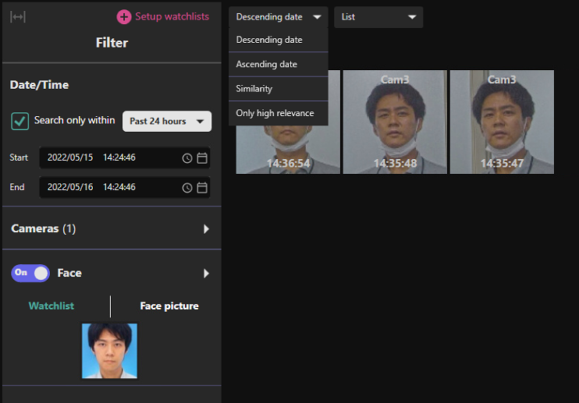
5. Support sort face search result by similarity
Target
Product
Server
i-PRO Active Guard for ASM300
V1.5.0
Plug-in
i-PRO Active Guard
Plug-in for ASM300
V1.5.0
After searching face, “similarity” can be selected as sort option.
The images are displayed in descending order of similarity to the specified face image.
*If you perform a face search without specifying a face image, you cannot select it.
*Cannot be used when searching for people or vehicle at the same time with the face.

Slide 21
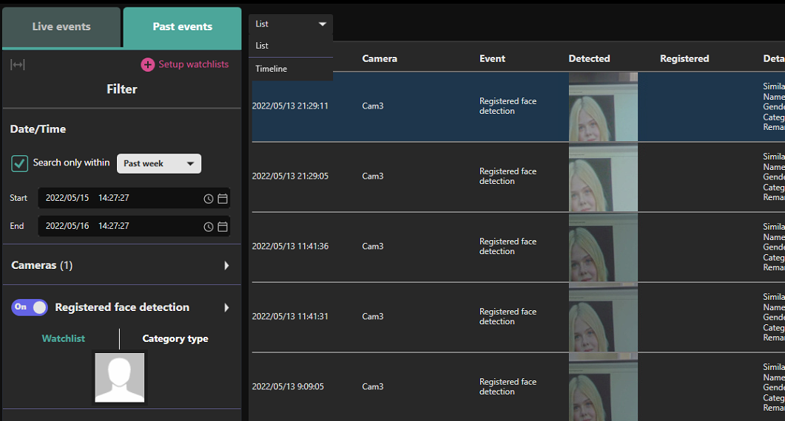
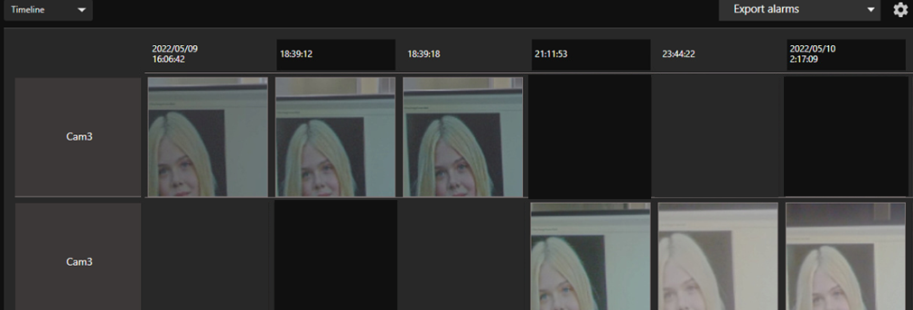
6. Support timeline display for registered face detection
Target
Product
Plug-in
i-PRO Active Guard Plug-in for ASM300
V1.5.0
Add timeline display mode to Past event tab.
Time
Camera
Available when only registered face detection filter is On.

Slide 22
7. Support to Occupancy detection alarm image display
Target
Product
Server
i-PRO Active Guard for ASM300
V1.5.0
Plug-in
i-PRO Active Guard
Plug-in for ASM300
V1.5.0
Support Occupancy detection image display of "AI-VMD / AI People Counting for 360-degree fisheye".
Before
After
*V1.30 or later version of "AI-VMD / AI People Counting for 360-degree fisheye" is required.

Slide 23
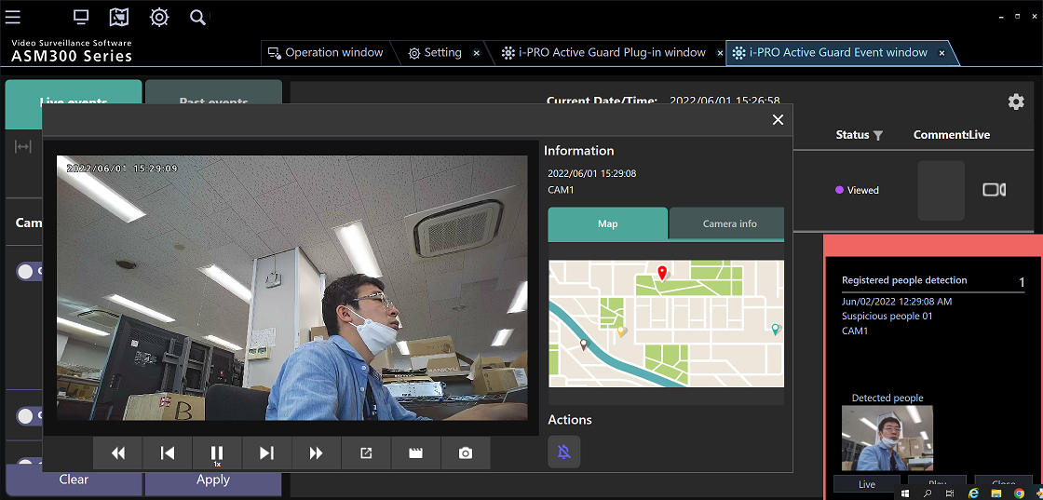
8. Interlock with ASM300 display magnification setting
Target
Product
Plug-in
i-PRO Active Guard Plug-in for ASM300
V1.5.0
Display magnification: 100%
Display magnification: 175%

Slide 24
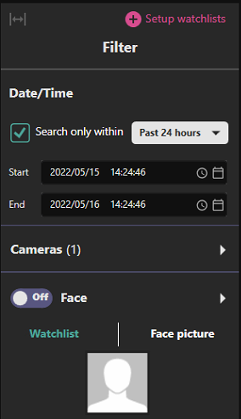
9. Improve search date and time setting GUI
Target
Product
Plug-in
i-PRO Active Guard Plug-in for ASM300
V1.5.0
Add default search preset such as Past 24 hours/Past week/Past month.
When these are selected, user can always get the latest results you intended without manual adjustment.
Before
Start time : 1 day before the time when opening tab
End time : the time when opening tab
After (Example: When “Past week" is selected)
Start time : 1 week before the time when opening tab
End time : the time when opening tab
*VI/Genetec system is supported by V1.4.0

Slide 25
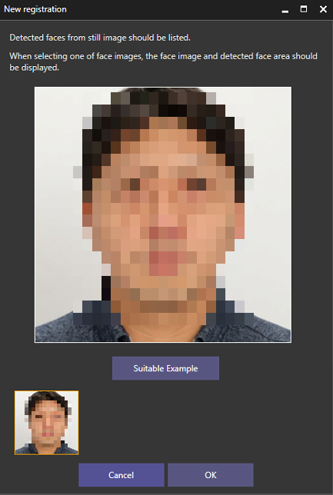
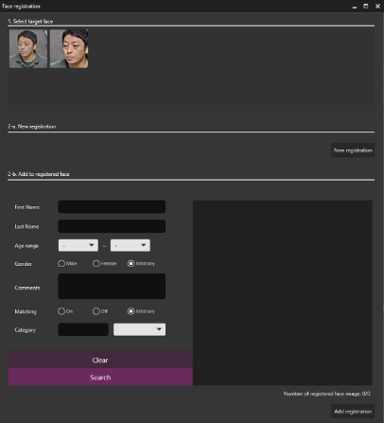
10. Add Message when face image that does not meet the recommended pixel is registered
Target
Product
Plug-in
i-PRO Active Guard Plug-in for ASM300
V1.5.0
Add text.
“Recommended width of face is more than 75 pixels.
Detected width is xxx pixels.
Please consider to register other face image”
xxx depends on selected face image.
*VI/Genetec system is supported by V1.4.0

Slide 26
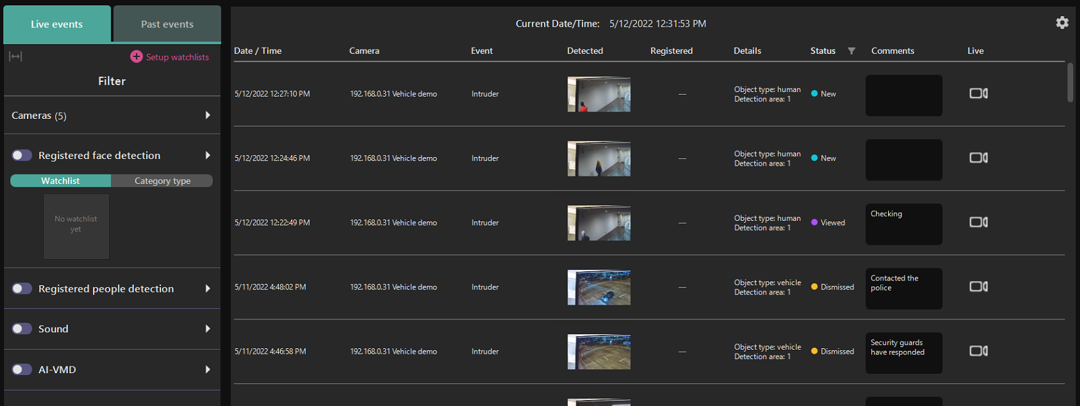
11. Improve alarm status management function
Target
Product
Server
i-PRO Active Guard for ASM300
V1.5.0
Plug-in
i-PRO Active Guard
Plug-in for ASM300
V1.5.0
User can confirm and manage events using "Alarm Status".
Status (New/Viewed/Dismissed) can be changed from right click menu.
Filter button on next to “Status” label. It can filter by New, Viewed and Dismissed.
Up to 64 characters can be added as comment.
*VI/Genetec system is supported by V1.4.0

Slide 27
Dashboard

Slide 28
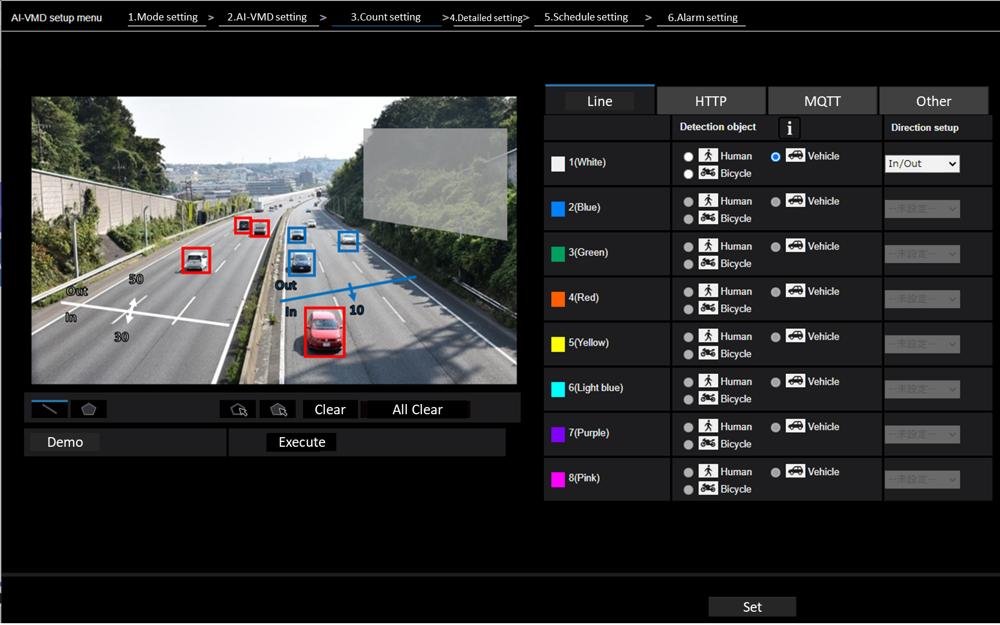
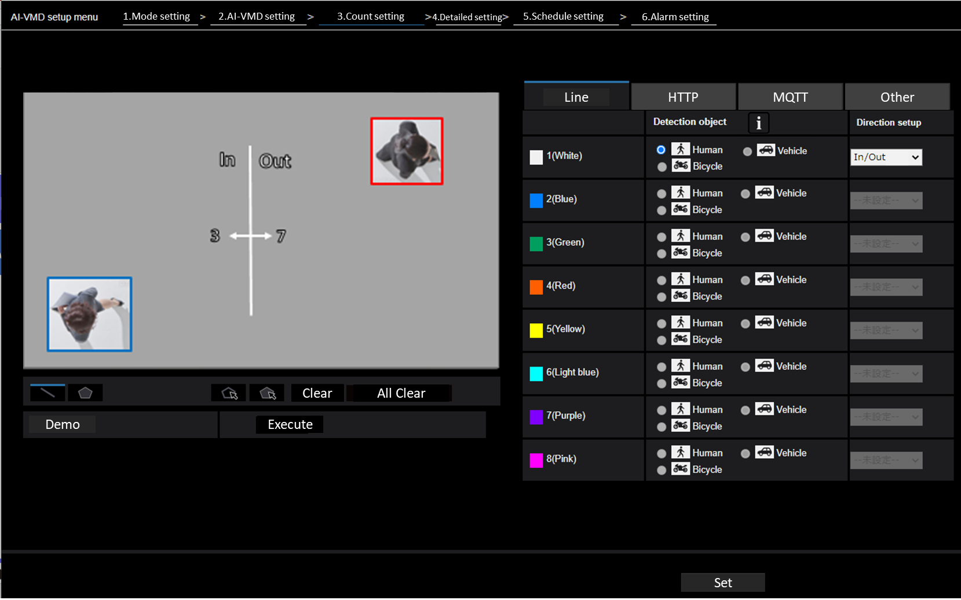
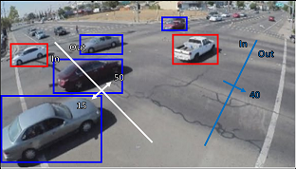
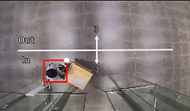
12. Support people / vehicle count (AI-VMD V3.00)
Target
Product
Server
i-PRO Active Guard for VMS
V1.5.0
i-PRO Active Guard for ASM300
V1.5.0
About people / vehicle count
Add counting function (Cross Line Counting) to AI-VMD V3.00.
The object to be counted differs depending on the angle of view of the camera.
<Normal angle of view mode>
<Directly below angle of view mode>
Count object
People
Vehicle
Bicycle
Count object
People

Slide 29
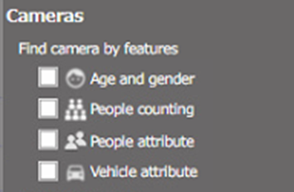
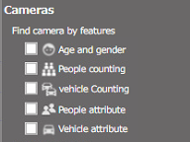
12. Support people / vehicle count (AI-VMD V3.00)
Target
Product
Server
i-PRO Active Guard for VMS
V1.5.0
i-PRO Active Guard for ASM300
V1.5.0
Functional comparison about counting
Changes in the camera selection menu
i-PRO Active Guard function |  |  | AI-VMD/ AI People Counting for 360-degree fisheye | AI-VMD (V3.00)
People counting | Statistics | Line cross | Yes | Yes
 |  | Area | Yes | No
 | Occupancy | Line cross | Yes | Yes
 |  | Area | Yes | No
 | Heat map |  | Yes | No
 | Image with line count |  | Yes | No
Vehicle counting | Statistics | Line cross | No | Yes
 | Occupancy | Line cross | No | Yes
Before
After

Slide 30
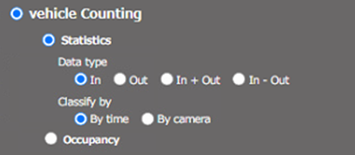
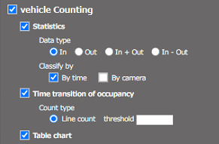
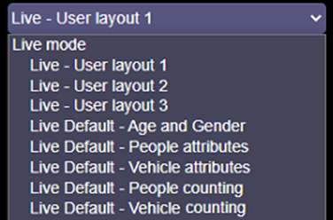
12. Support people / vehicle count (AI-VMD V3.00)
Target
Product
Server
i-PRO Active Guard for VMS
V1.5.0
i-PRO Active Guard for ASM300
V1.5.0
Selection menus for Vehicle counting
Selectable layout
Live mode
Search mode
“Live Default - People counting” and
“Live Default - Vehicle counting”
will be shown when AI-VMD is installed to cameras.
The same with People counting by crossline

Slide 31
12. Support people / vehicle count (AI-VMD V3.00)
Target
Product
Server
i-PRO Active Guard for VMS
V1.5.0
i-PRO Active Guard for ASM300
V1.5.0
How to count number of cameras with AI app
Before
After
 | Application | VI | Genetec | ASM300
1 | AI Face Detection | ✓ | ✓ | ✓
2 | AI People Detection | ✓ | ✓ | ✓
3 | AI Vehicle Detection | ✓ | ✓ | ✓
4 | AI-VMD | ✓ |  | ✓
5 | AI Sound Classification | ✓ |  | ✓
6 | AI-VMD/AI People Counting for 360-degree fisheye | ✓ | ✓ | ✓
VI | Genetec | ASM300
✓ | ✓ | ✓
✓ | ✓ | ✓
✓ | ✓ | ✓
✓ | ✓ | ✓
✓ |  | ✓
✓ | ✓ | ✓
Add to the count target because the dashboard supports AI-VMD V3.00 (People count / Vehicle count).

Slide 32
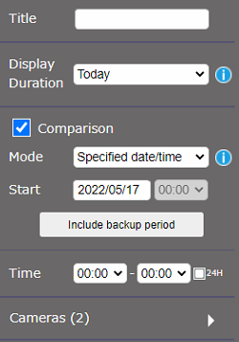
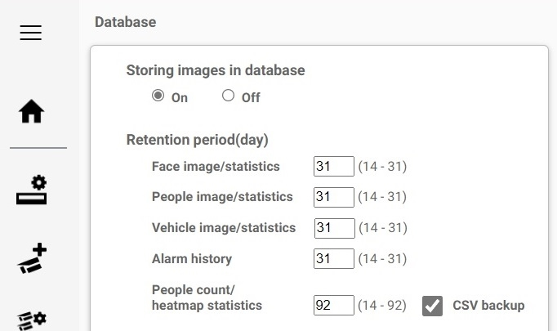
13. Support display for automatically backed up CSV file
Target
Product
Server
i-PRO Active Guard for VMS
V1.5.0
i-PRO Active Guard for ASM300
V1.5.0
Data older than the 92-day data retention period can be used for comparison.
*Backup configuration is required in advance on the "System configuration" screen.
Click when backed up data is needed.
Show the duration the backup file exist.
*It can be used only when "1 day" (search mode) is selected for “display duration“
*CSV files downloaded manually from the statistics display screen and CSV files downloaded with a camera or iCT are not applicable.
*You can compare CSV files with data in the database (up to 92 days). You cannot compare CSV files with each other.

Slide 33
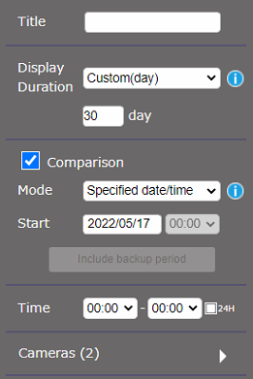
14. Support to specify any number of days for “display duration”
Target
Product
Server
i-PRO Active Guard for VMS
V1.5.0
i-PRO Active Guard for ASM300
V1.5.0
Selectable items for “display duration“
Before
Live mode : Last 1 hour, Today, Last 1 week, Last 1 month(5 weeks)
Search mode : 1 hour, Today, 1 week, 1 month(5 weeks)
After
Live mode : Last 1 hour, Today, Last 1 week, Last 1 month(5 weeks)
Custom(day) [1 to 31]
Search mode : 1 hour, Today, 1 week, 1 month(5 weeks)
Custom(day) [1 to 31]

Slide 34
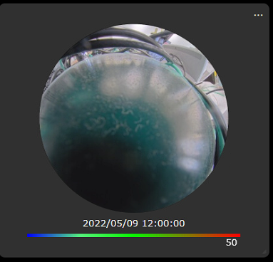
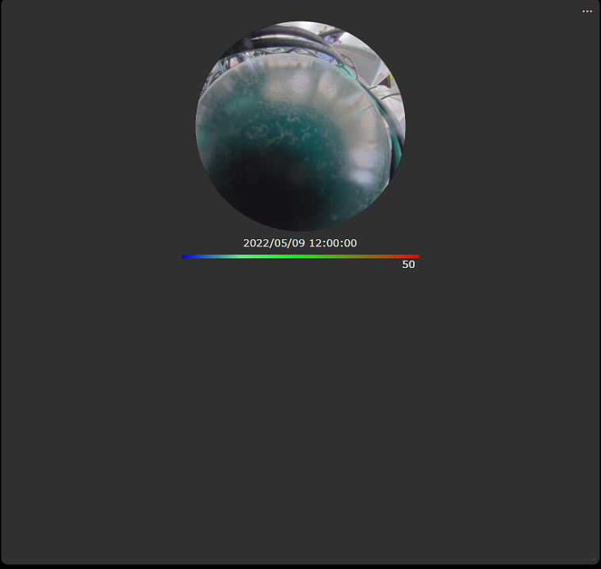
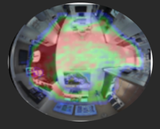
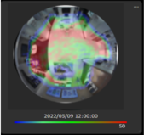
15. Support enlarge view of heat map image
Target
Product
Server
i-PRO Active Guard for VMS
V1.5.0
i-PRO Active Guard for ASM300
V1.5.0
The heat map image is also displayed larger along with the display size of the chart.
Before
After
Initial display size
When expanding the displayed area
Initial display size
When expanding the displayed area

Slide 35
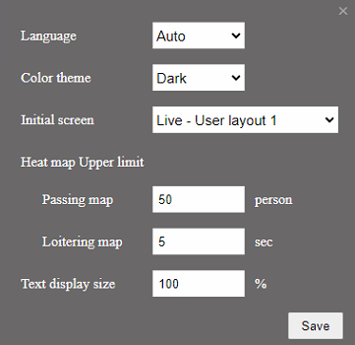
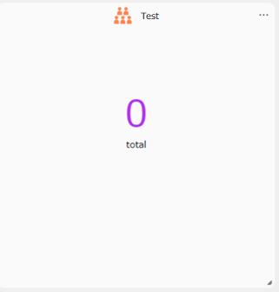
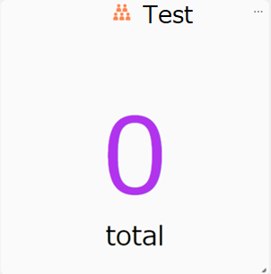
16. Add adjustment function for display character size
Target
Product
Server
i-PRO Active Guard for VMS
V1.5.0
i-PRO Active Guard for ASM300
V1.5.0
Before (font size is fixed)
100 to 300%
[default : 100%]
After (When 300% is used for the size)
*Target: Graph titles, legends, x-axis labels and others, numbers, and other characters and numbers in the chart display area.

Slide 36
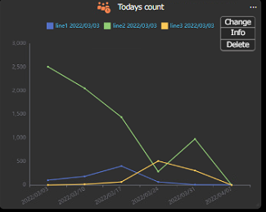
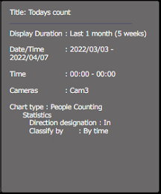
17. Add function for display the conditions set for each chart
Target
Product
Server
i-PRO Active Guard for ASM300
V1.5.0
Select the “Info" menu to display the chart setting conditions.
*VI/Genetec system is supported by V1.4.0

Slide 37
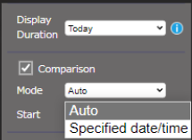
18. Add options for comparison data on Live mode
Target
Product
Server
i-PRO Active Guard for ASM300
V1.5.0
Add options “Mode” for comparison data on Live mode.
Before (only specified date/time)
For example, when “Today” is selected for “Display Duration”
and specified date/time is selected for “Comparison” (e.g. 7th, April, 0:00),
Data for Today will be always compared to 7th, April ｎo matter how much time passes.
After (specified date/time or Auto)
No matter how much time passes, users can always compare today's and yesterday's data
when “Auto” is selected.
*VI/Genetec system is supported by V1.4.0

Slide 38
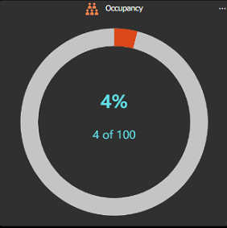
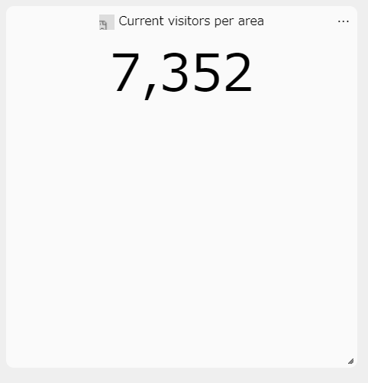
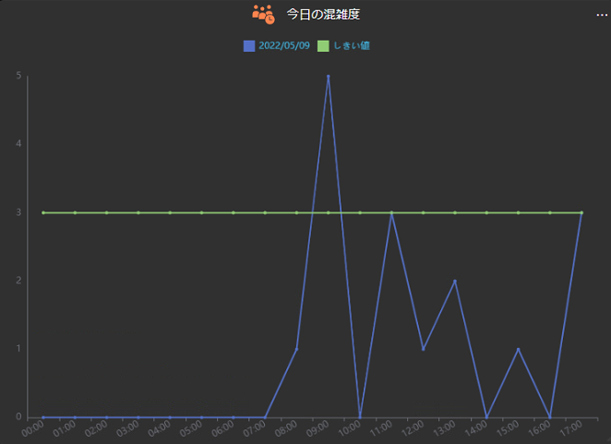
19. Add option “Time transition” for Occupancy
Target
Product
Server
i-PRO Active Guard for ASM300
V1.5.0
Before (only current occupancy)
After (Occupancy by time also can be shown)
*VI/Genetec system is supported by V1.4.0

Slide 39
Others

Slide 40
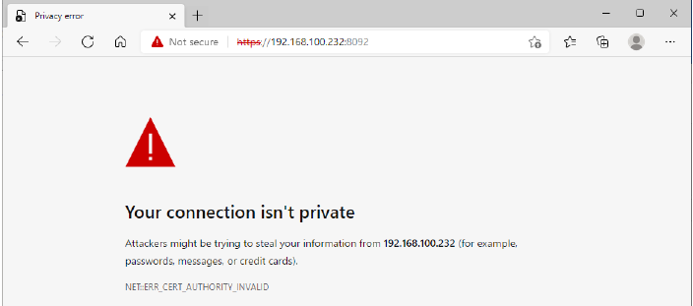
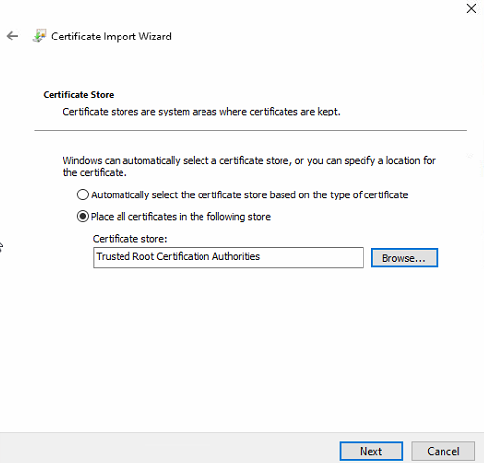
20. Support avoiding warning display when connecting via HTTPS
Target
Product
Server
i-PRO Active Guard for ASM300
V1.5.0
Currently, warning screen is displayed when accessing the server with a browser.
After install or upgrading to Active Guard server V1.4.0 and do following procedure for each client PC, security warning screen will not be shown.
*Following procedure will be shown on manual
It is possible to prevent the warning display by performing the following procedure for each client PC to be accessed.
1) Copy “C:\MultiAI\apache24\conf\server.crt” in i-PRO Active Guard server PC to client PC.
2) Double click the file and click “Install Certificate”.
3) Select “Local Machine” for Store Location
4) Select “Place all certificates in the following store and “Trusted Root Certification Authorities”.
Continue on to the next page
*VI/Genetec system is supported by V1.4.0

Slide 41
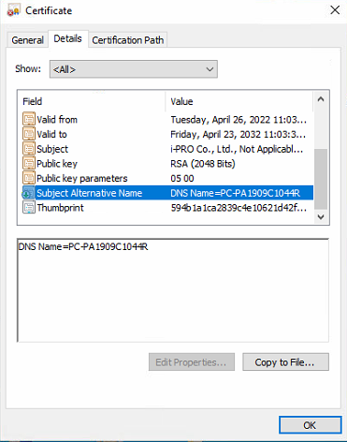
20. Support avoiding warning display when connecting via HTTPS
Target
Product
Server
i-PRO Active Guard for ASM300
V1.5.0
5) Confirm “Subject Alternative Name” from “Details”. DNS Name=xxxx is shown.
6) Open “C:\Windows\System32\drivers\etc\hosts” and add IP address of i-PRO Active Guard server and xxxx(DNS Name).
ex. 192.168.0.125 PC-PA1909C1044R
7) Access https://xxxx:8092 using web browser.
*VI/Genetec system is supported by V1.4.0

Slide 42
21. Support for browser version 100 or later
Target
Product
Server
i-PRO Active Guard for ASM300
V1.5.0
Support web browser
Before
Microsoft Edge : Version 85 - 99
Chrome : Version 83 - 99
Firefox : Version 95 - 99
After
Microsoft Edge : Version 85 or later
Chrome : Version 83 or later
Firefox : Version 95 or later
*VI/Genetec system is supported by V1.4.0

Slide 43
Version History

Slide 44
Version History
No | Update contents | Page No. | Version | Update
1 | 1st Version | - | 1.00 | 10. Jun. 2022
2
3
4
5
6
7
8
9
10

