Slide 1
Video Surveillance Software WV-ASM300 series Ver.5.1 version up contents - Jun 2022 -
Document Version : 1.00
Jun. 2022

Slide 2
Contents
No. | Items | pages
1 | New product / firmware support | 1
2 | Support electronic zoom for fixed camera by the mouse control | 2
3 | Suppress ASM300 installation when i-PRO Active Guard is installed on the same PC. | 3
Support New PTZ cameras
WV-S65340-Z4N, WV-S65340-Z2N, WV-S65340-Z4K, WV-S65340-Z2K
WV-U65302-Z2, WV-U65301-Z1, WV-U65300-ZY
WV-S61302-Z4, WV-S61301-Z2, WV-U61301-Z2, WV-U61301-Z1, WV-U61300-ZY
Support new firmware v5.10 of NX series Recorder
WJ-NX400/NX300/NX200/NX100
Software version: V5.10
Release date on the global site : Jun. 2022

Slide 3
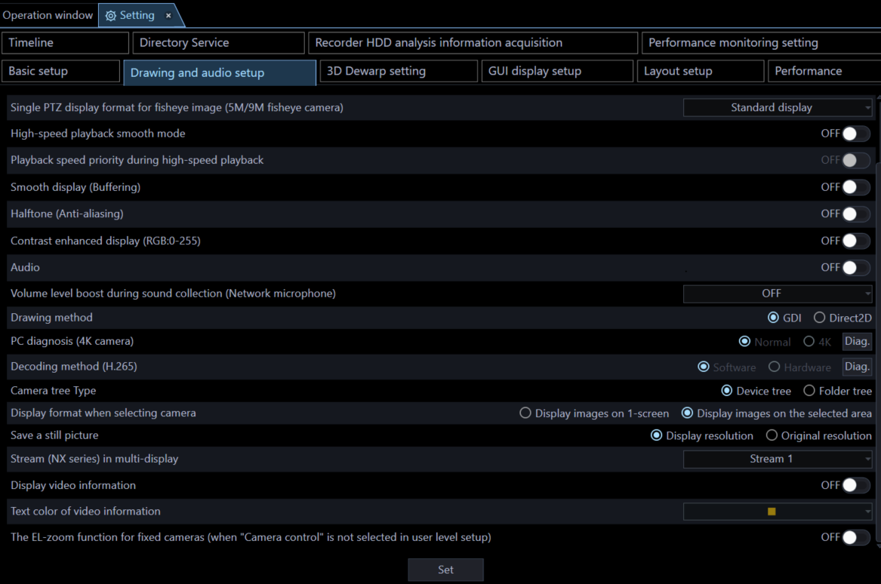
2. Support electronic zoom for fixed camera by the mouse
Target
Product
Video Surveillance Software
[ASM300]
Version
V5.10
In "System"-"Drawing and audio setup"
“The EL-zoom function for fixed cameras (when “Camera control” is not selected in user level setup”)
On: Both Drag zoom and Mouse wheel zoom are available
Off: Both are Not available (Default: Off)
* This function applies to all cameras such as the cameras directly registered to ASM300, cameras installed in recorder and cameras during playback.
Camera type |  |  | Drag zoom | Mouse wheel zoom
Fixed camera | Users who can control the camera |  |  (EL-zoom) |  (EL-zoom)
 | Users who can not control the camera | EL-zoom: Off | - | -
 |  | EL-zoom: On |  (EL-zoom) |  (EL-zoom)

Slide 4
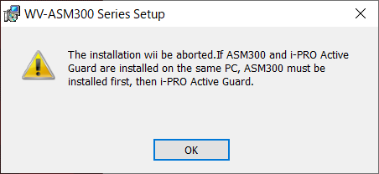
3. Suppress ASM300 installation when i-PRO Active Guard is installed on the same PC
Target
Product
Video Surveillance Software
[ASM300]
Version
V5.10
Install the software using the correct installation procedure when installing ASM300 and i-PRO Active Guard on the same PC.
Note: Correct installation procedure
① Install ASM300
② Install i-PRO Active Guard
③ Successful installation
* The number of registered cameras in i-PRO Active Guard is limited to four.
From this version, if you do not install in the above order, the ASM300 installation will be aborted.

Slide 5
Version History

Slide 6
Version History
No | Update contents | Page No. | Version | Update
1 | 1st Version | - | 1.00 | 20.Jun.2022
2
3
4
5
6
7
8
9
10
11
12
13
14
15

