Slide 1
Network Disk Recorder WJ-NX Series version up contents - Jun. 2022 -
Model : WJ-NX400, WJ-NX300, WJ-NX200 , WJ-NX100
Document Version : 1.00
Jun. 2022

Slide 2
Contents
No. | Items​ | NX400 | NX300 | NX200 | NX100
1 | Support New Cameras ( New PTZ Camera, New 5M Camera with AI engine) | Yes | Yes | Yes | Yes
2 | Function improvement (HDD hour meter warning ) | Yes | Yes | -- | --
Firmware Version : V5.10
Release date on the global site : 30 Jun. 2022

Slide 3
1. Support New Cameras
Target
Product
WJ-NX400, WJ-NX300, WJ-NX200, WJ-NX100
Version
V5.10
Contents
Support New PTZ Camera
Model : WV-S61301-Z2, WV-S61302-Z4, WV-S65340-Z2/Z2K , WV-S65340-Z4/Z4K,
WV-U61300-ZY, WV-U61301-Z1/Z2, WV-U65300-ZY, WV-U65301-Z1, WV-U65302-Z2
Limitations
If the recording frame rate is set to 60 ips/50 ips, the frame rate of the multi-screen display will drop to 10 ips/8.3 ips.
If the recording frame rate is set to 60 ips/50 ips, SD backup cannot be used.
When using AI privacy guard recording, the upper limit of the recording frame rate is 10ips. (S Series PTZ only)
When using AI privacy guard recording, the frame rate of the multi-screen display will drop to 10 ips.
(S Series PTZ only)
Support New 5M Camera with AI engine
Model : WV-S15500-F3/F6, WV-S22500-F3/F6, WV-S25500-F3/F6

Slide 4
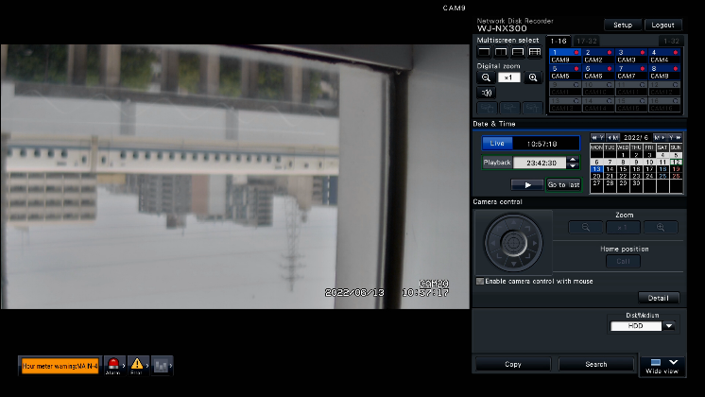
2. Function improvement
Target
Product
WJ-NX400, WJ-NX300
Version
V5.10
Contents
Detect HDD hour meter warning during RAID5 / RAID6 operation for all slots of HDDs
Notice :
HDD hour meter warning is used for error logs and TCP alarm notifications.

Slide 5
Version History

Slide 6
Version History
No | Update contents | Page No. | Version | Update
1 | 1st Version | All | 1.00 | 24.Jun.2022
2
3
4
5
6
7
8
9
10
11
12
13
14
15

