Slide 1
i-PRO Active Guard version up
[May. 2022]
Document Ver.1.00
May. 2022

Slide 2
Overview
Target
Product
i-PRO Active Guard Server
i-PRO Active Guard for VMS
V1.4.0
May.2022
i-PRO Active Guard Plug-in
i-PRO Active Guard Plug-in for VI
V1.4.0
May.2022
i-PRO Active Guard Plug-in for Genetec
V1.4.0
May.2022
Contents | Server | Plug-in
 |  | VI | Genetec
Search & Event
1. Support face search function | Yes | Yes | Yes
2. Add People attributes (bag color / shoes color) | Yes | Yes | Yes
3. Export search & alarm result | - | Yes | Yes
4. Improve search date and time setting GUI | - | Yes | Yes
5. Add message when face image that does not meet the recommended pixel is registered | - | Yes | Yes

Slide 3
Overview
Contents | Server | Plug-in
 |  | VI | Genetec
Search & Event (for VI)
6. Add alarm status management function | Yes | Yes | -
7. Display the detected frame of the selected target (i-PRO Active Guard Event) | - | Yes | -
8. Improve user permission settings | - | Yes | -
9. Show open street map on plug-in | - | Yes | -
Search & Event (for Genetec)
10. Add registration function for multiple i-PRO Active Guard servers | - | Done | Yes
11. Support digital zoom during playback | - | Done | Yes
12. Improve alarm linkage with Genetec server | Yes | - | -

Slide 4
Overview
Contents | Server | Plug-in
 |  | VI | Genetec
Dashboard
13. Display the conditions set for each chart | Yes | - | -
14. Add options for comparison data on Live mode | Yes | - | -
15. Add option “Time transition” for Occupancy (Occupancy by time) | Yes | - | -
Others
16. Support display of the number of occupancy detection alarms (configuration dashboard) | Yes | - | -
17. Support avoiding warning display when connecting via HTTPS | Yes | - | -
18. Support for browser version 100 or later | Yes | - | -

Slide 5
Search & Event

Slide 6
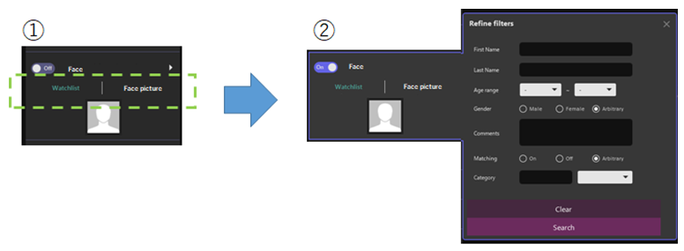
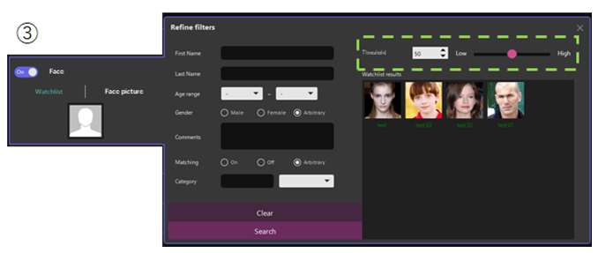
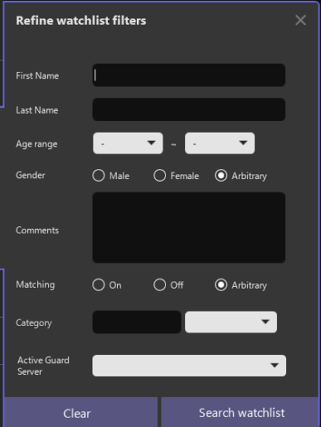
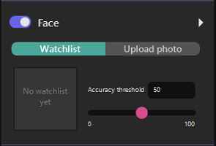


1. Support face search function
Target
Product
Server
i-PRO Active Guard for VMS
V1.4.0
Plug-in
Plug-in for VI
V1.4.0
Plug-in for Genetec
V1.4.0
Face similar search (from Watchlist)
Spinner and slider for threshold specification for thumbnail search
Select “Watchlist”
Set a filter in the detail menu and execute a search by pressing the “Search watchlist" button.
Further to the right, the window expands to show a list of results.

Slide 7
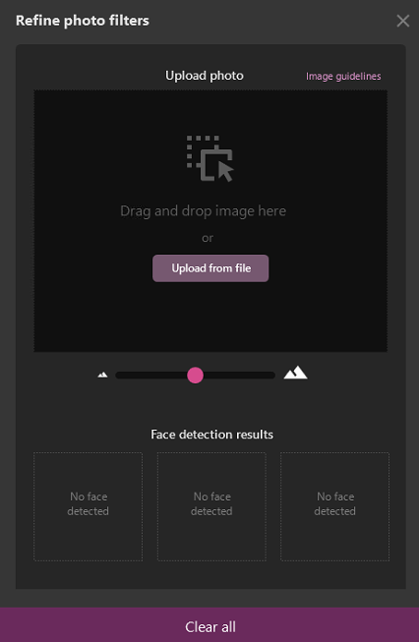
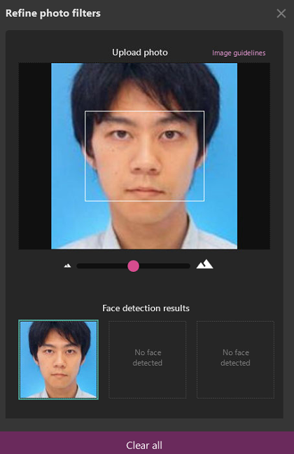
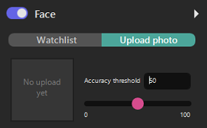
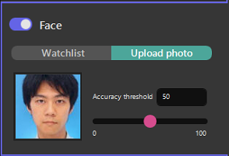
1. Support face search function
Target
Product
Server
i-PRO Active Guard for VMS
V1.4.0
Plug-in
Plug-in for VI
V1.4.0
Plug-in for Genetec
V1.4.0
Face similar search (from Upload photo)
①
②
③
Spinner and slider for threshold specification for thumbnail search
Select "Upload photo"
Click inside the image frame to pop up the Windows Explorer window.
The selected image file is inserted in the image selection frame, the detection of the face in the image starts, and the detected face is displayed on the lower side.
Select the image file that contains the face you want to search. (Bmp, jpg, jpeg, png)

Slide 8
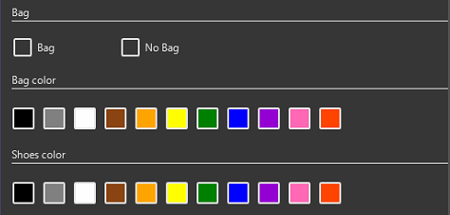
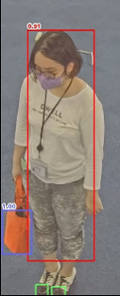
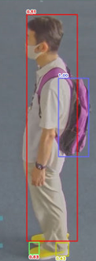
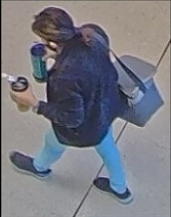



2. Add People attributes (bag color / shoes color)
Target
Product
Server
i-PRO Active Guard for VMS
V1.4.0
Plug-in
Plug-in for VI
V1.4.0
Plug-in for Genetec
V1.4.0
Add three people attribute information.
- Bag (Yes / No)
- Bag color (Black / Brown / White / Green / Red / Blue / Yellow / Orange / Purple / Pink)
- Shoes color (Black / Brown / White / Green / Red / Blue / Yellow)
<Accuracy>
*Verification results using an internal
evaluation data set (single pedestrian)
attribute | precision | recall
Bag | 93% | 91%
Bag color | 85% | 87%
Shoes color | 67% | 73%
Bag(with, w/o), Bag color and Shoes color are available for search.
*"AI People Detection" V1.20 or later is required.
*Not supported for watchlist registration and dashboard.

Slide 9
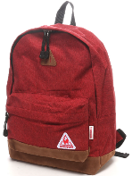
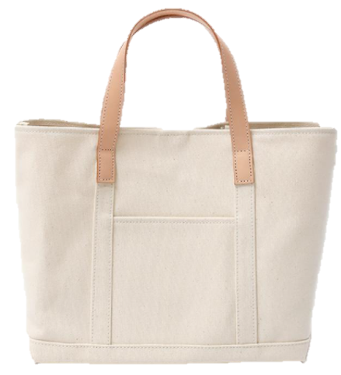


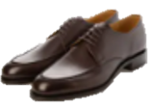


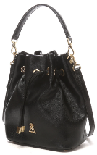
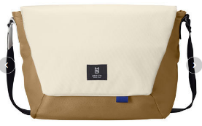
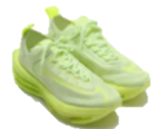
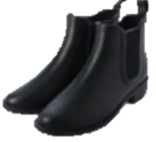
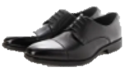
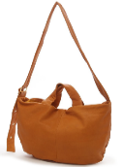






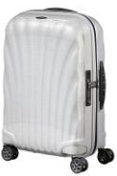

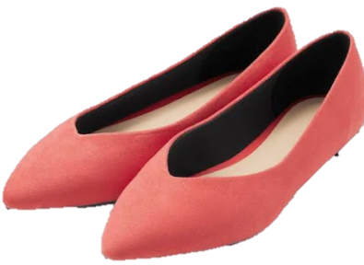
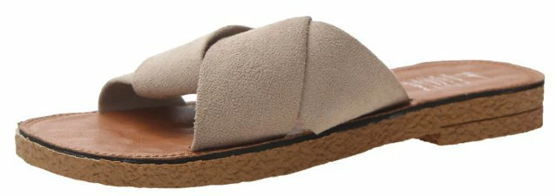
2. Add People attributes (bag color / shoes color)
Target
Product
Server
i-PRO Active Guard for VMS
V1.4.0
Plug-in
Plug-in for VI
V1.4.0
Plug-in for Genetec
V1.4.0
The types of analysis targets are as follows.
 | Bag | Shoes
Good accuracy
Medium accuracy
Backpacks
Tote bag
Shopping bag
Hand bag
Messenger bag
Bucket bag
Shoulder bag
Others (difficult to classify)
Sneakers
Leather shoes
Boots
Not supported (Difficult to detect and color analyze)
Suitcase
Plastic bag
Pumps
Sandals
*Classification of bag and shoes type are not supported.

Slide 10
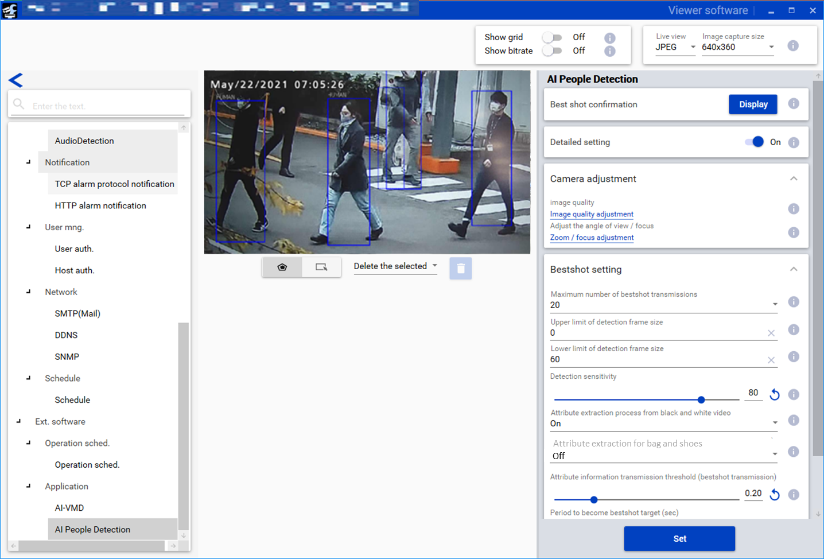
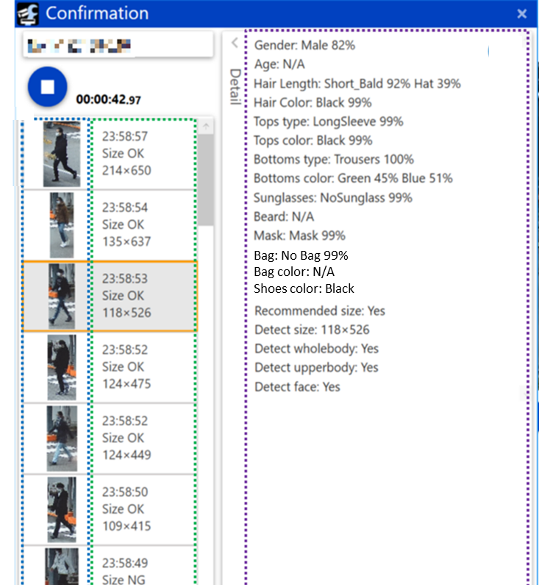
2. Add People attributes (bag color / shoes color)
Target
Product
Server
i-PRO Active Guard for VMS
V1.4.0
Plug-in
Plug-in for VI
V1.4.0
Plug-in for Genetec
V1.4.0
Bag and shoes attributes can be enabled from iCT (V3.10).
Bestshot confirmation
Enable from the Bestshot setting menu. (Default:Off)
Bag(with, w/o) / Bag color / Shoes color is displayed in the attribute information.
If the bag and shoes attribute is enabled, restrictions will be added when installing multiple extension software applications on a camera, refer to the support information “Compatibility list for extension software <C0103>” at the link below.
https://i-pro.com/global/en/surveillance/training-support/support/technical-information

Slide 11
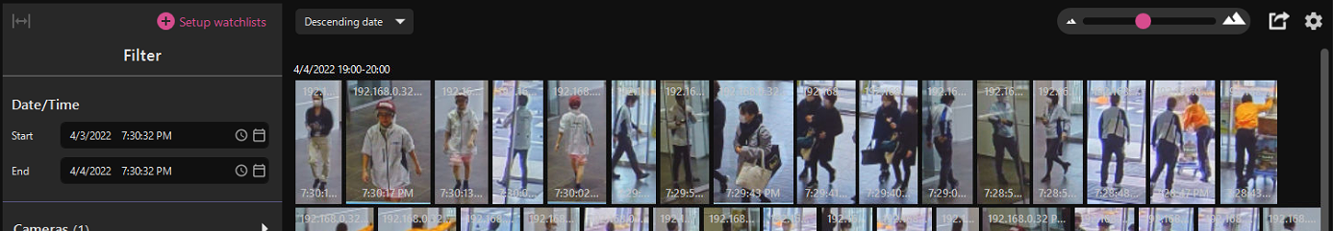


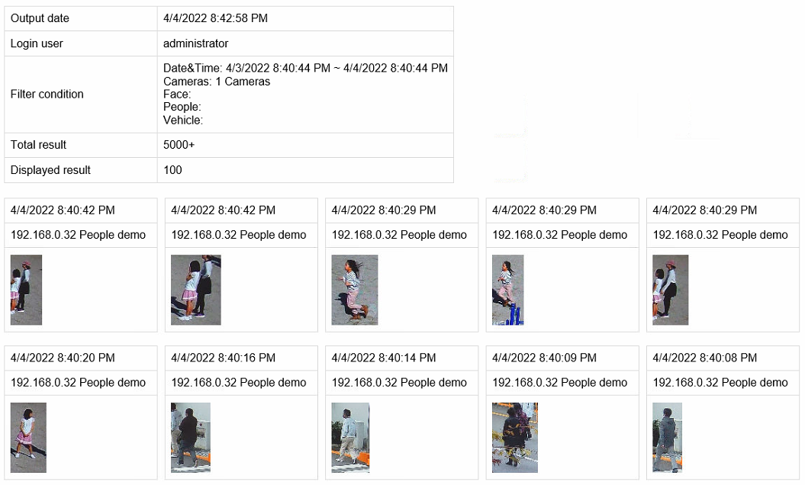

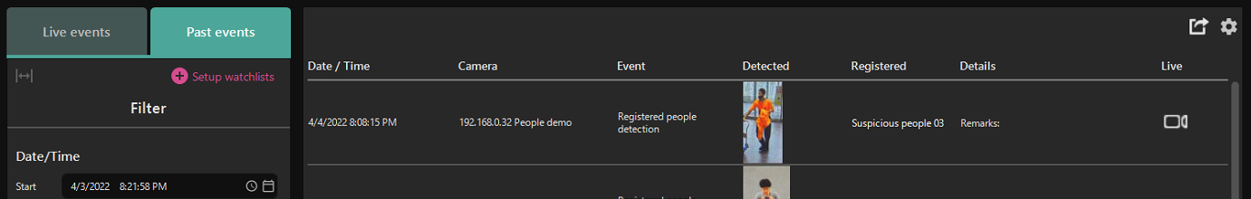
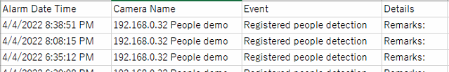
3. Export search & alarm result
Target
Product
Plug-in
i-PRO Active Guard Plug-in for VI
V1.4.0
i-PRO Active Guard Plug-in for Genetec
V1.4.0
Export Search Result (HTML)
HTML
Exported data
can be shown
on web browser.
VI
Genetec
: Will be supported V1.4.0
: Will be supported V1.4.0
Export Alarm Result (HTML / CSV)
CSV
VI
Genetec
: Will be supported V1.4.0
: Not support

Slide 12
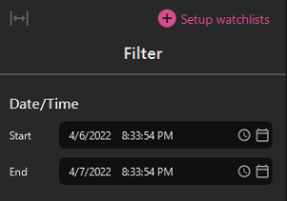
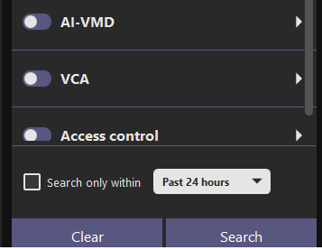
4. Improve search date and time setting GUI
Target
Product
Plug-in
i-PRO Active Guard Plug-in for VI
V1.4.0
i-PRO Active Guard Plug-in for Genetec
V1.4.0
Add default search preset such as Past 24 hours/Past week/Past month.
When these are selected, user can always get the latest results you intended without manual adjustment.
Before
Start time : 1 day before the time when opening tab
End time : the time when opening tab
After (Example: When “Past week" is selected)
Start time : 1 week before the time when opening tab
End time : the time when opening tab

Slide 13
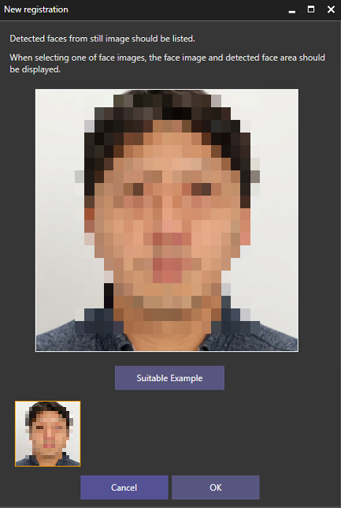
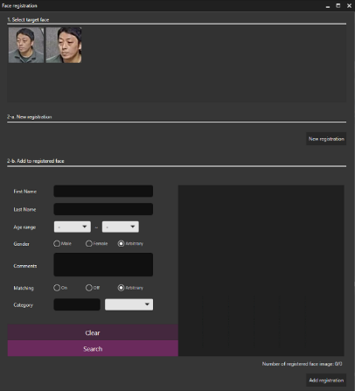
5. Add Message when face image that does not meet the recommended pixel is registered
Target
Product
Plug-in
i-PRO Active Guard Plug-in for VI
V1.4.0
i-PRO Active Guard Plug-in for Genetec
V1.4.0
Add text.
“Recommended width of face is more than 75 pixels.
Detected width is xxx pixels.
Please consider to register other face image”
xxx depends on selected face image.

Slide 14
Search & Event (for VI)

Slide 15
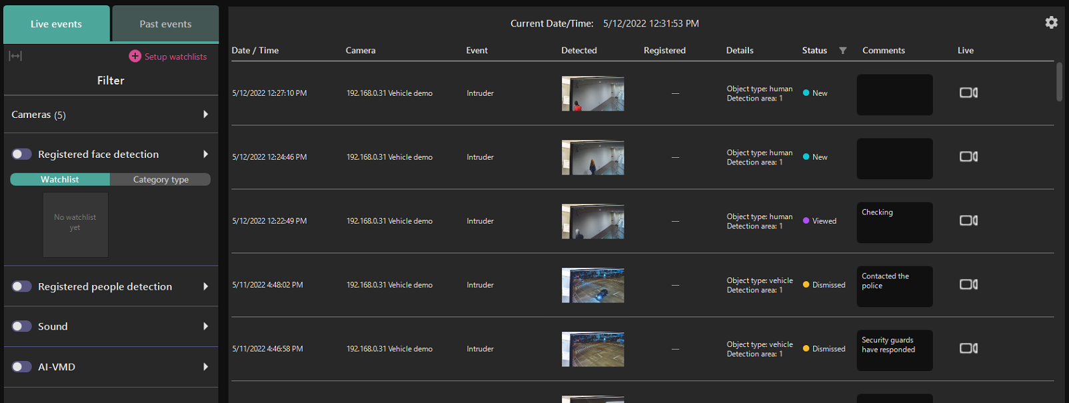
6. Add alarm status management function
Target
Product
Server
i-PRO Active Guard for VMS
V1.4.0
Plug-in
i-PRO Active Guard
Plug-in for VI
V1.4.0
User can confirm and manage events using "Alarm Status".
Status (New/Viewed/Dismissed) can be changed from right click menu.
Filter button on next to “Status” label. It can filter by New, Viewed and Dismissed.
Up to 64 characters can be added as comment.

Slide 16
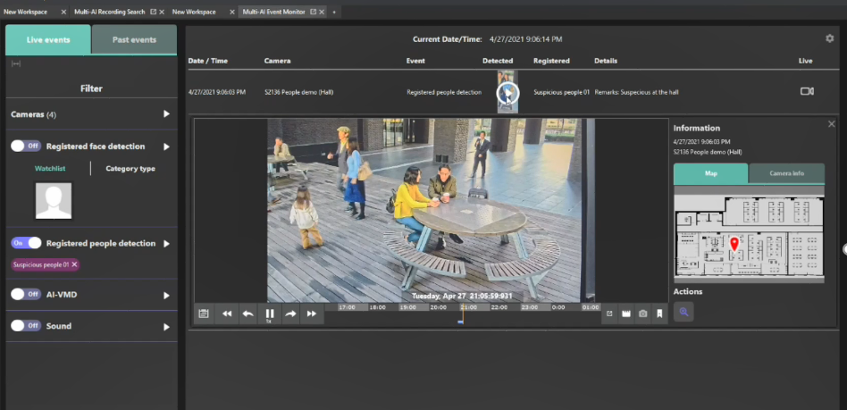
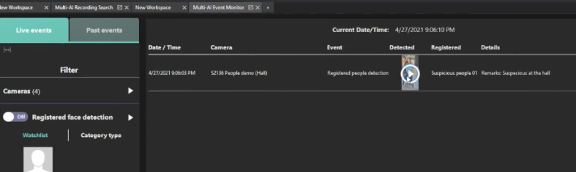
7. Display the detected frame of the selected target
Target
Product
Plug-in
i-PRO Active Guard Plug-in for VI
V1.4.0
The detection frame can be generated on the selected object to clarify the target.
- i-PRO Active Guard Search : Supported (V1.1.0 or later)
- i-PRO Active Guard Event : Will be supported V1.4.0
Displays a detected frame on the target object (the object on the thumbnail) when playing back a video by clicking a thumbnail in the thumbnail search result.
Select a target thumbnail

Slide 17
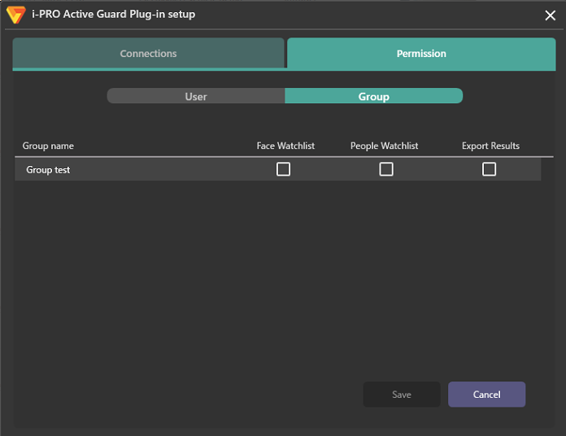
8. Improve user permission settings
Target
Product
Plug-in
i-PRO Active Guard Plug-in for VI
V1.4.0
Add “Group” for Permission configuration.
Groups registered to VI IP server are shown.
When using Active directory which is configured on
VI IP server, the group name is shown.
Add item “Export Result”.

Slide 18
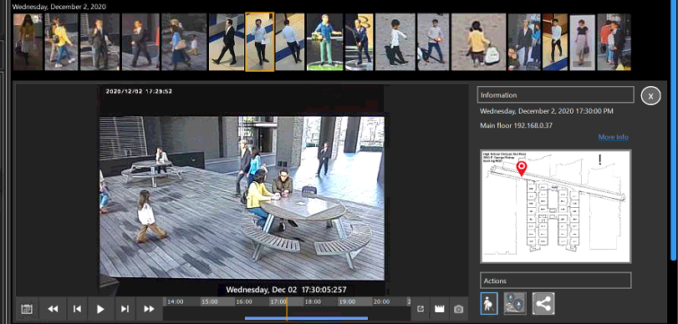
9. Show open street map on plug-in
Target
Product
Plug-in
i-PRO Active Guard Plug-in for VI
V1.4.0
When Open street map is registered to VI IP server, the map will be shown also in Plug-in window.
Show Open street map
when registered on VI IP server side.

Slide 19
Search & Event (for Genetec)

Slide 20
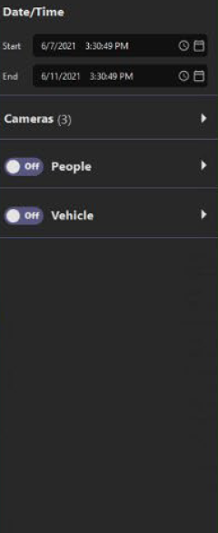
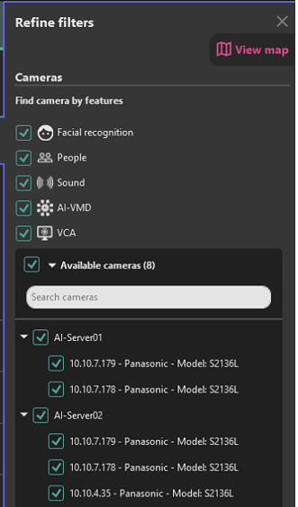
10. Add registration function for multiple i-PRO Active Guard servers
Target
Product
Plug-in
i-PRO Active Guard Plug-in for Genetec
V1.4.0
Multiple i-PRO Active Guard server can be registered as well as Video Insight.
Can be registered on Genetec config tool.
Can be selected for face, people or vehicle search.
Number of i-PRO Active Guard per a client : No limitation (depending on capability of whole system)
Search can be performed on multiple servers at the same time.
It is necessary to register "Watchlist" for each server. (Even when registering the same person, registration work is required for each server.)

Slide 21
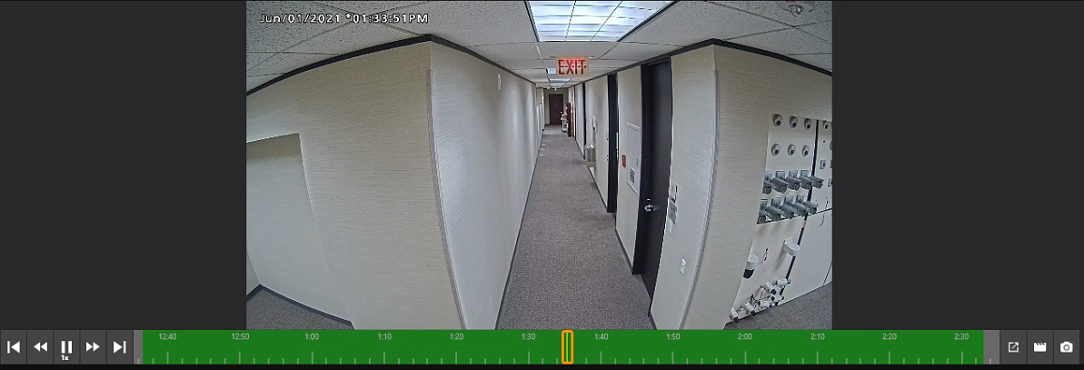
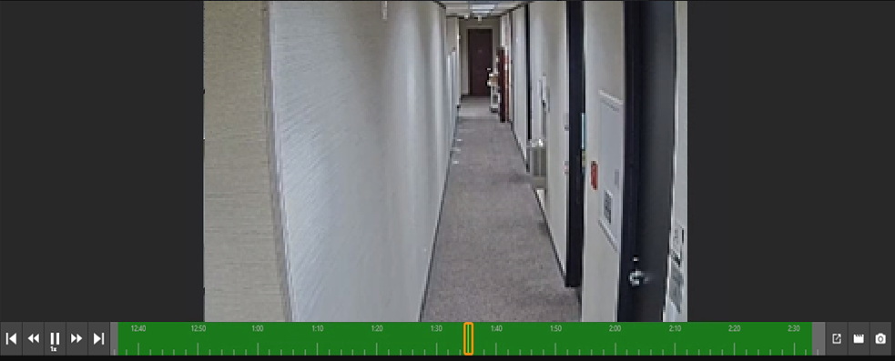
11. Support digital zoom during playback
Target
Product
Plug-in
i-PRO Active Guard Plug-in for Genetec
V1.4.0
Digital zoom by mouse operation becomes available on play back video screen.
If you operate the mouse wheel where you place the mouse cursor, the surrounding area will be digitally zoomed.

Slide 22
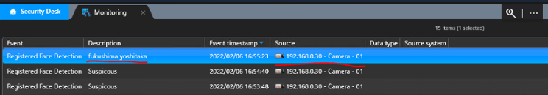
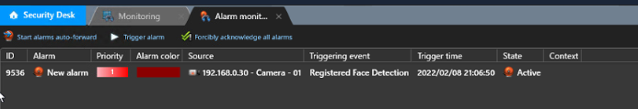
12. Improve alarm linkage with Genetec server
Target
Product
Server
i-PRO Active Guard for VMS
V1.4.0
When Registered face or people detection occurs on Genetec system,
Source camera, Name of watchlist will be shown.
Monitoring
Source camera and watchlist name can be shown on monitoring event.
Alarm monitoring
When Action is set for the event, source camera will be shown.

Slide 23
Dashboard

Slide 24
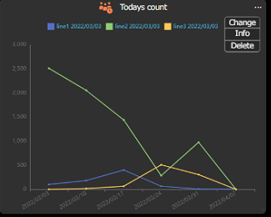
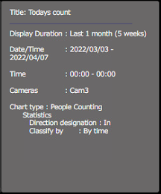
13. Display the conditions set for each chart
Target
Product
Server
i-PRO Active Guard for VMS
V1.4.0
Select the “Info" menu to display the chart setting conditions.

Slide 25

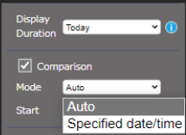
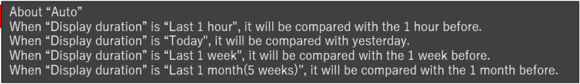
14. Add options for comparison data on Live mode
Target
Product
Server
i-PRO Active Guard for VMS
V1.4.0
Add options “Mode” for comparison data on Live mode.
Before (only specified date/time)
For example, when “Today” is selected for “Display Duration”
and specified date/time is selected for “Comparison” (e.g. 7th, April, 0:00),
Data for Today will be always compared to 7th, April ｎo matter how much time passes.
After (specified date/time or Auto)
No matter how much time passes, users can always compare today's and yesterday's data
when “Auto” is selected.

Slide 26
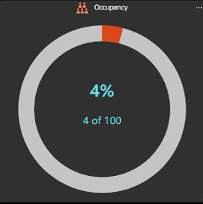



15. Add option “Time transition” for Occupancy
Target
Product
Server
i-PRO Active Guard for VMS
V1.4.0
Before (only current occupancy)
After (Occupancy by time also can be shown)

Slide 27
Others

Slide 28

16. Support display of the number of occupancy detection alarms
Target
Product
Server
i-PRO Active Guard for VMS
V1.4.0
Add “AI Occupancy Detection” to the diagnosis in the configuration dashboard.
Diagnosis
Record Summary (number of received data)
  - All Best shot images
  - Face Best shot images
  - People Best shot images
  - Vehicle Best shot images
  - All alarm
  - Registered face detection
  - Registered people detection
  - AI-VMD
  - Sound detection
  - AI Occupancy detection *1
*1: Only "AI-VMD / AI People Counting for 360-degree fisheye" is supported.

Slide 29


17. Support avoiding warning display when connecting via HTTPS
Target
Product
Server
i-PRO Active Guard for VMS
V1.4.0
Currently, warning screen is displayed when accessing the server with a browser.
After install or upgrading to Active Guard server V1.4.0 and do following procedure for each client PC, security warning screen will not be shown.
*Following procedure will be shown on manual
It is possible to prevent the warning display by performing the following procedure for each client PC to be accessed.
1) Copy “C:\MultiAI\apache24\conf\server.crt” in i-PRO Active Guard server PC to client PC.
2) Double click the file and click “Install Certificate”.
3) Select “Local Machine” for Store Location
4) Select “Place all certificates in the following store and “Trusted Root Certification Authorities”.
Continue on to the next page

Slide 30

17. Support avoiding warning display when connecting via HTTPS
Target
Product
Server
i-PRO Active Guard for VMS
V1.4.0
5) Confirm “Subject Alternative Name” from “Details”. DNS Name=xxxx is shown.
6) Open “C:\Windows\System32\drivers\etc\hosts” and add IP address of i-PRO Active Guard server and xxxx(DNS Name).
ex. 192.168.0.125 PC-PA1909C1044R
7) Access https://xxxx:8092 using web browser.

Slide 31
18. Support for browser version 100 or later
Target
Product
Server
i-PRO Active Guard for VMS
V1.4.0
Support web browser
Before
Microsoft Edge 85 - 99
Chrome 83 - 99
Firefox 95 - 99
After
Microsoft Edge 85 or later
Chrome 83 or later
Firefox 95 or later

Slide 32
Version History

Slide 33
Version History
No | Update contents | Page No. | Version | Update
1 | 1st Version | - | 1.00 | 20. May. 2022
2
3
4
5
6
7
8
9
10

