Slide 1
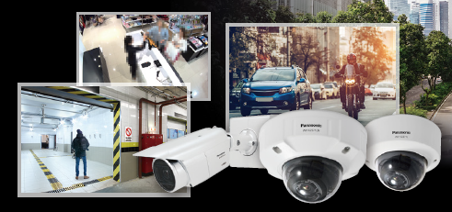
i-PRO Active Guard Material for SE
Dashboard part
Document Ver. 1.50
Sep. 2022

Slide 2
Welcome & Disclaimer
This document is based on the i-PRO Active Guard server Ver.1.5.1.
Please utilize this document together with other materials such as “Release note” “Specification Sheet” and “Product Presentation Material” if necessary.
These materials can be downloaded from the following website.
https://i-pro.com/global/en/surveillance/training-support/documentation-database-list
There is slide with “Internal use only” mark on the bottom right. It contains sensitive information, including competitor information. Therefore, please handle it with care.

Slide 3
Structure of i-PRO Active Guard SE materials
The SE material for the existing i-PRO Active Guard has been split into three parts.
This SE material is one of the three parts, the Dashboard part.
To understand the whole i-PRO Active Guard, you need to see the other two parts.
Operation guide
Setting guide
Search & Event
part
Dashboard
part
Install & Setup
part
<Surveillance>
Search suspect based by attribute info. and find the one by watch list
<Business intelligence tool>
A lot of data is aggregated into one database, then shown in Dashboard

Slide 4
Contents
Concept
Function
Specification
GUI
Appendix
:Default layout
:Sample video
:Other information

Slide 5
1. Concept

Slide 6
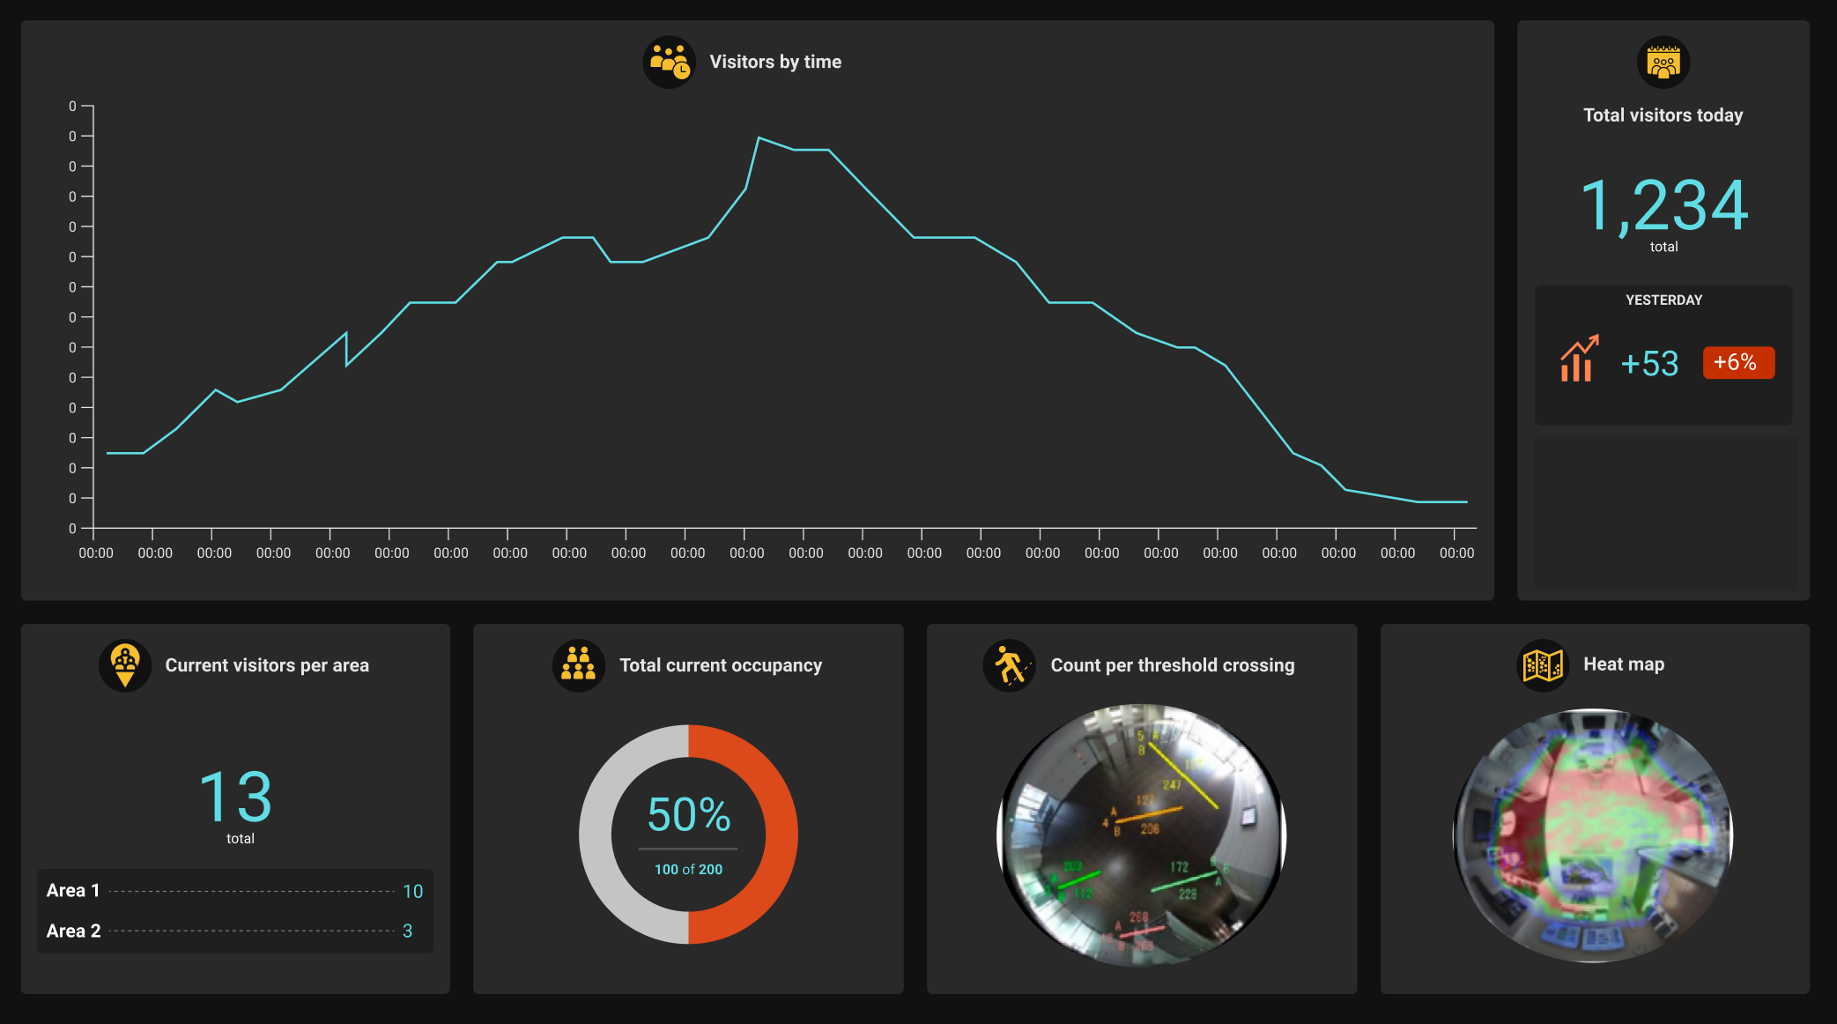
1-1. Concept
By combining AI app and i-PRO Active Guard, Analytics dashboard are enabled.
Analytics dashboard
Enable to visualize the number of people, the congestion status and attribute statistics with a dashboard that can be customized according to the customer's operation style, and use it for business intelligence purposes.
i-PRO Active Guard
AI Face Detection
AI People Detection
AI Vehicle Detection
AI-VMD
AI-VMD/AI People Counting for 360-degree fisheye

Slide 7
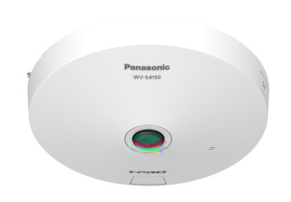
1-2. System overview
Example of Network configuration for analytics dashboard
People count data
i-PRO Active Guard server
Face/People/Vehicle Attributes
Alarm
Video Stream
Existing monitoring system
Web browser dashboard

Slide 8
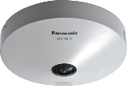
1-3. System lineup
Consist of AI camera app, Server that manages metadata, and a web browser to operate dashboard
Camera + AI application
i-PRO Active Guard server
Web browser dashboard
Extension software | Version
AI Face Detection | V1.10 or later
AI People Detection | V1.00 or later
AI Vehicle Detection | V1.00 or later
AI-VMD | V3.00 or later *1
AI-VMD/AI People Counting for 360-degree fisheye | V1.30 or later
Software | Version
i-PRO Active Guard Server | V1.3.0 or later
Web browser | Version
Microsoft Edge | 85 or later
Chrome | 83 or later
Firefox | 95 or later
*1: Required for people and vehicle count statistics dashboard.

Slide 9
2. Function

Slide 10
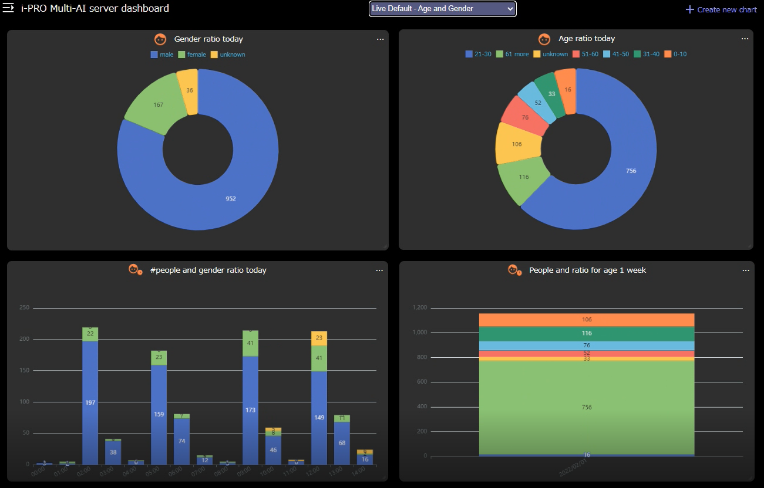
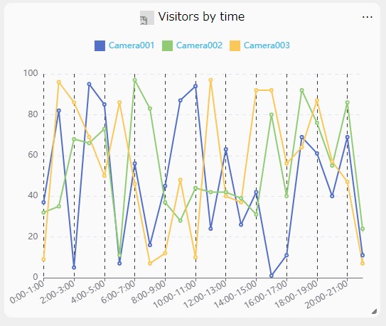
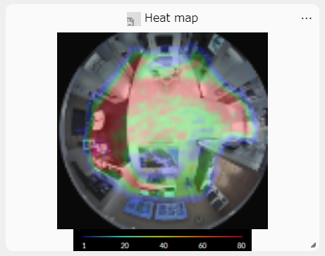
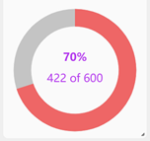
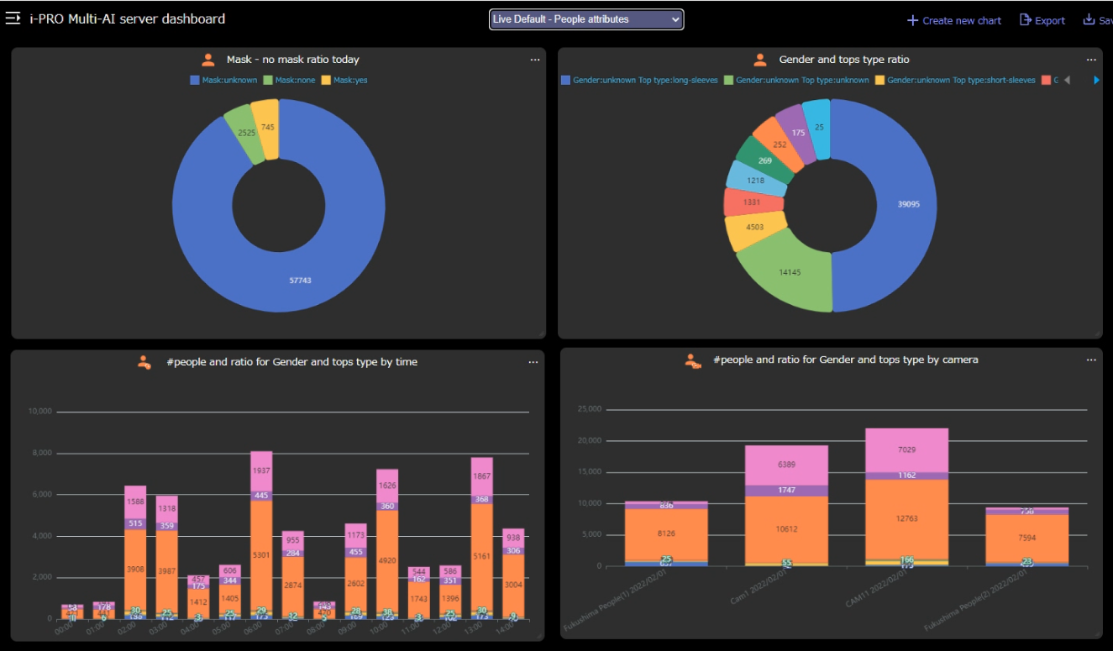
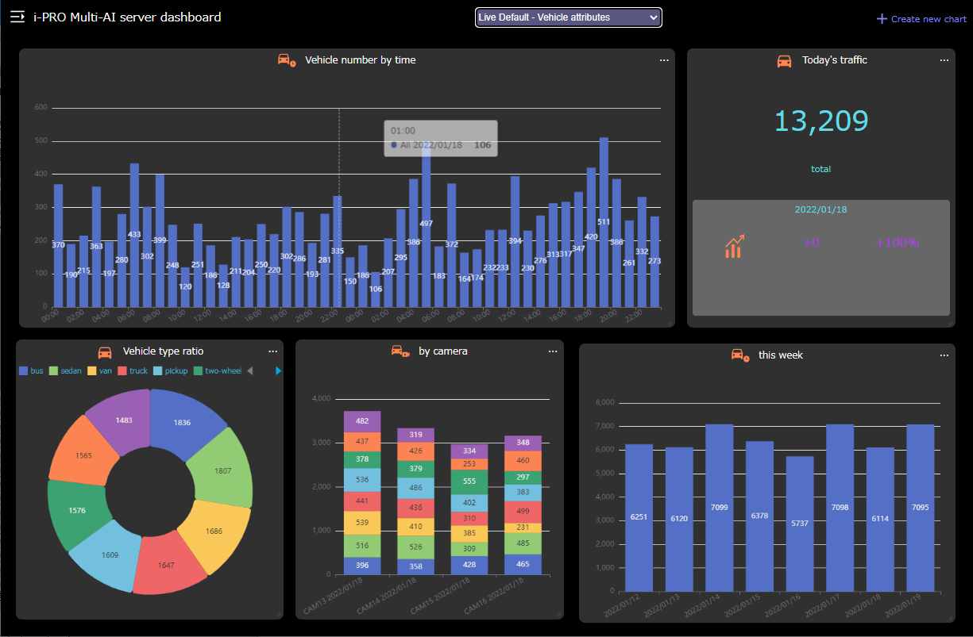
2-1. Overview
Enable to visualize number of people/vehicle, congestion status and attribute statistics with a dashboard
AI-VMD/AI People Counting for 360-degree fisheye
AI Face Detection
Age and Gender statistics
People counting
Occupancy
Heat map
AI People Detection
AI-VMD
People attribute
AI Vehicle Detection
Vehicle attribute
People/Vehicle counting
Occupancy

Slide 11
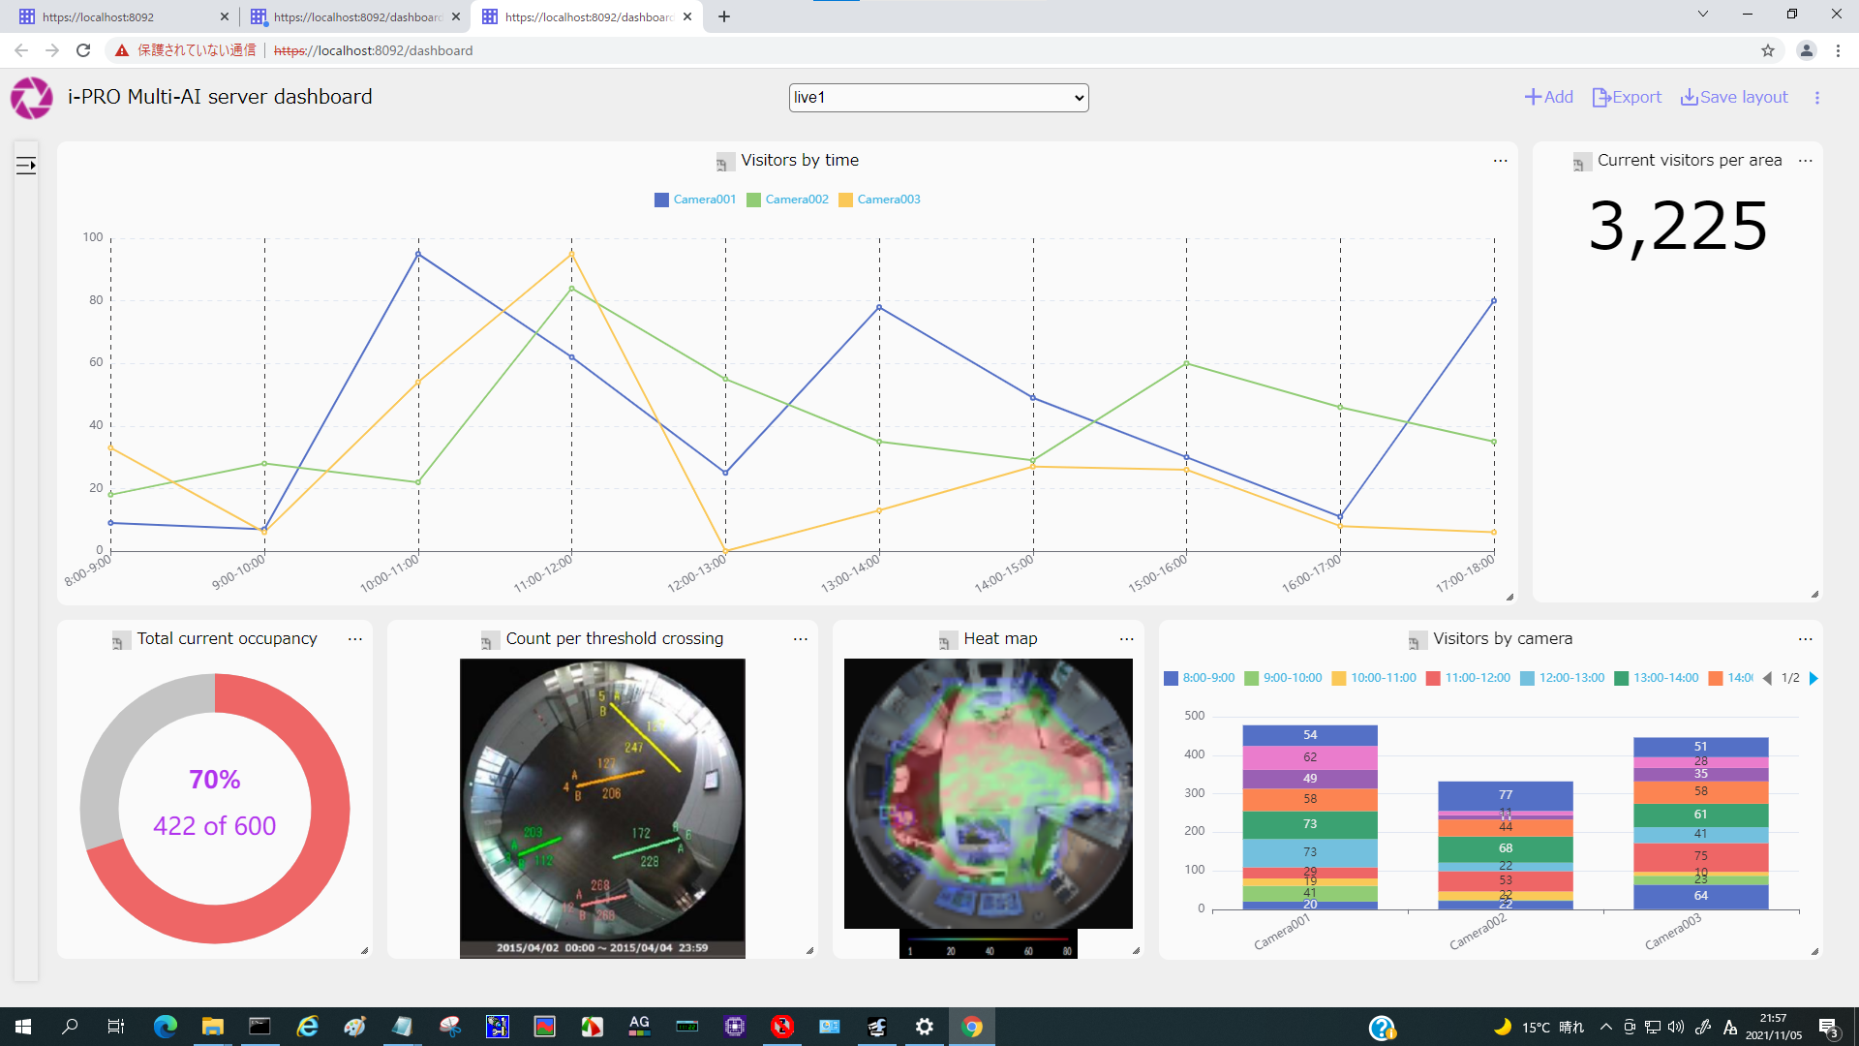
2-2. Live Mode
This mode allows you to grasp the current situation in real time. For example, it can be used for the following purposes.
Understand today’s number of visitors in real time.
Understand the degree of congestion in a specific area and check whether congestion exceeding the limit has occurred.
Understand the difference in people coming and going from a specific area in real time

Slide 12
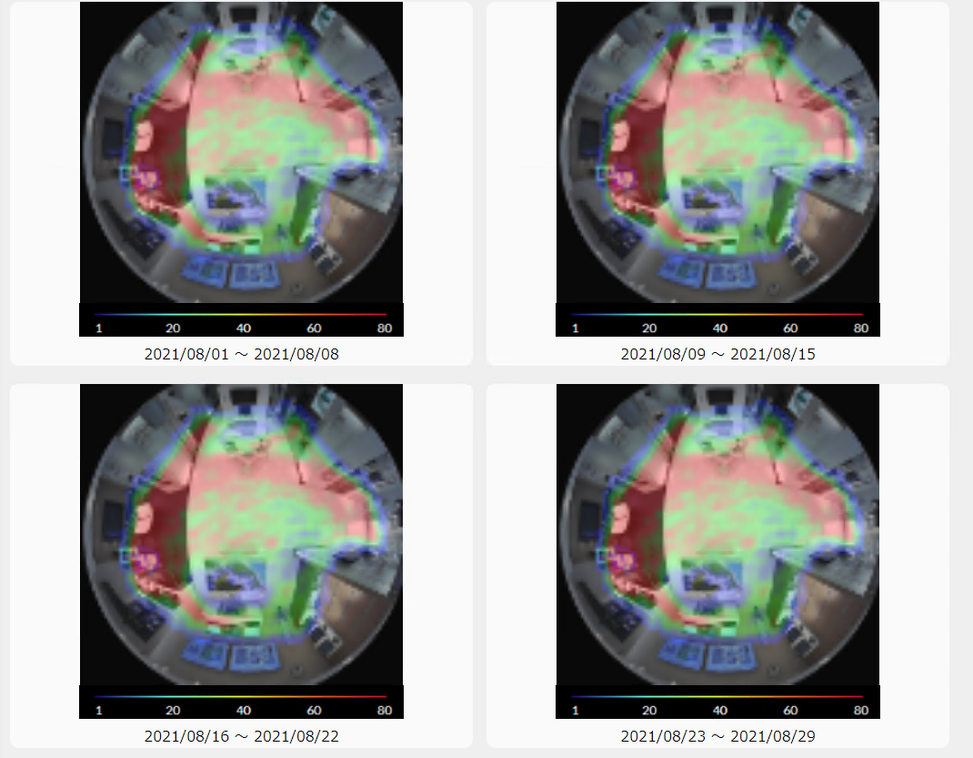
2-3. Search Mode
This mode allows you to display various charts for a specific period / camera in the past and perform multifaceted analysis. For example, it can be used for the following purposes.
Understanding changes in the number of visitors for each specific period (day / week / month).
Understanding changes in traffic volume over time using heat maps.
Understanding the difference from a specific period in the past.

Slide 13
2-4. Support application list
Application | Function | i-PRO Active Guard [V1.5.1]
AI Face Detection *1 | Age & Gender statistics | Yes
AI People Detection | People Attributes | Yes
AI Vehicle Detection | Vehicle Attributes | Yes
AI-VMD *2 | Cross Line Counting (for People) | Yes
 | Cross Line Counting (for Vehicle) | Yes
AI Occupancy Detection | Area Counting (for People) | No
AI-VMD / AI People Counting for 360-degree fisheye | Cross Line Counting (for People) | Yes
 | Area Counting (for People) | Yes
 | Heat Map (for People) | Yes
*1: it is necessary to upgrade AI Face Detection version (V1.10 or later).
*2: it is necessary to upgrade AI-VMD version (V3.00 or later).

Slide 14
2-5. Support function list
i-PRO Active Guard function |  |  | AI-VMD/ AI People Counting for 360-degree fisheye | AI-VMD (V3.00 or later)
People counting | Statistics | Line count | Yes | Yes
 |  | Area count | Yes | No
 | Occupancy | Line count | Yes | Yes
 |  | Area count | Yes | No
 | Heat map |  | Yes | No
 | Image with line count |  | Yes | No
Vehicle counting | Statistics | Line count | No | Yes
 | Occupancy | Line count | No | Yes

Slide 15
3. Specification

Slide 16
3-1. Specification
Dashboard | Supported browser | Microsoft Edge / Google Chrome / Firefox
 | Data interval for Past data display | People counting : 1 min / 1 hour / 1 day /1 week Heat map : 1 hour Age and gender, People attribute, Vehicle attribute : 1 min / 1 hour / 1 day / 1 week
 | Customize | Contents, location on browser, size for each chart. 24 users can be registered for dash board access (max. 4 user at the same time). Customized layout can be saved max [3 : Live] [3 : Search] for each user.
 | Data output | PDF, CSV, Image file for heat map

Slide 17
3-2. Attributes for dashboard
AI app | Type |  | Detail
AI Face Detection | Face | Gender | Male / Female
 |  | Age | Child(0-10) / Young adult(11-20) / Adult(21-30) / Adult(31-40) / Adult(41-50) / Adult(51-60) / Senior(61+)
AI People Detection | People | Gender | Male / Female
 |  | Age | Child(0-10) / Young adult(11-20) / Adult(21-60) / Senior(61+)
 |  | Hair type | long-hair/ short-hair / hat
 |  | Hair color | 5 (Black/Brown/White/Gray/Gold)
 |  | Sunglasses | Sunglass / No Sunglasses
 |  | Beard | Beard / No Beard
 |  | Top type | long-sleeves / short-sleeves
 |  | Top color | 11 (Black/Brown/White/Gray/Green/Red/Blue/Yellow/Orange/Purple/Pink)
 |  | Bottom type | short / long
 |  | Bottom color | 11 (Black/Brown/White/Gray/Green/Red/Blue/Yellow/Orange/Purple/Pink)
 |  | Mask | Mask / No Mask
AI Vehicle Detection | Vehicle | Type | 7 (Truck/Bus/SUV/Van/Sedan/Pick-up truck/Two wheels)
 |  | Color | 11 (black / brown / white / gray / orange / red / blue / yellow / green / purple / pink)

Slide 18
4. GUI

Slide 19
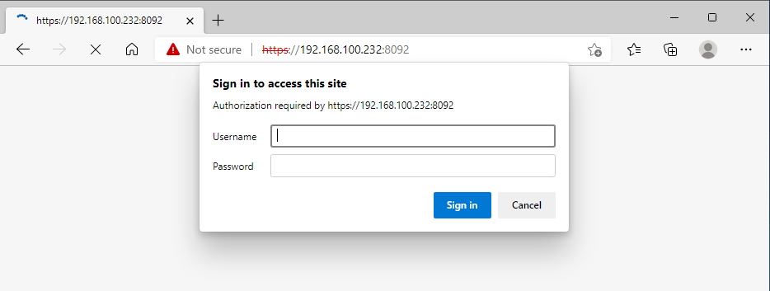
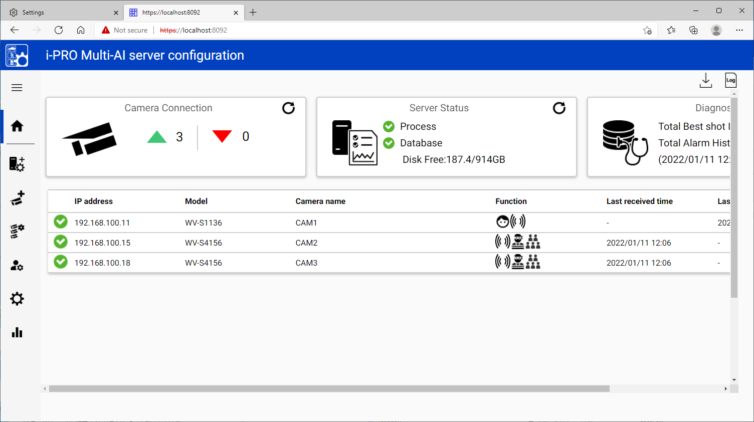
4-1. How to access
Enter your user information for authentication.
In case of access as an administrator:
To access as an administrator, enter the administrator user name and password set when installing i-PRO Active Guard server and press the “Sign in” button. After signing in as an administrator, click the dashboard icon to display the dashboard screen.
In case of access as a user:
When accessed by the user, the dashboard screen is
displayed directly.
In order to access as a user, it is necessary for the administrator to access the WEB configuration page and create a new user in advance. For details, refer to Setup Instructions. Up to 4 sessions can access the dashboard at the same time. When the number of sessions is exceeded, the following screen will be displayed. Please wait for other users to finish using dashboard and then try again.
There is no difference in the features available on the dashboard between administrators and users.

Slide 20
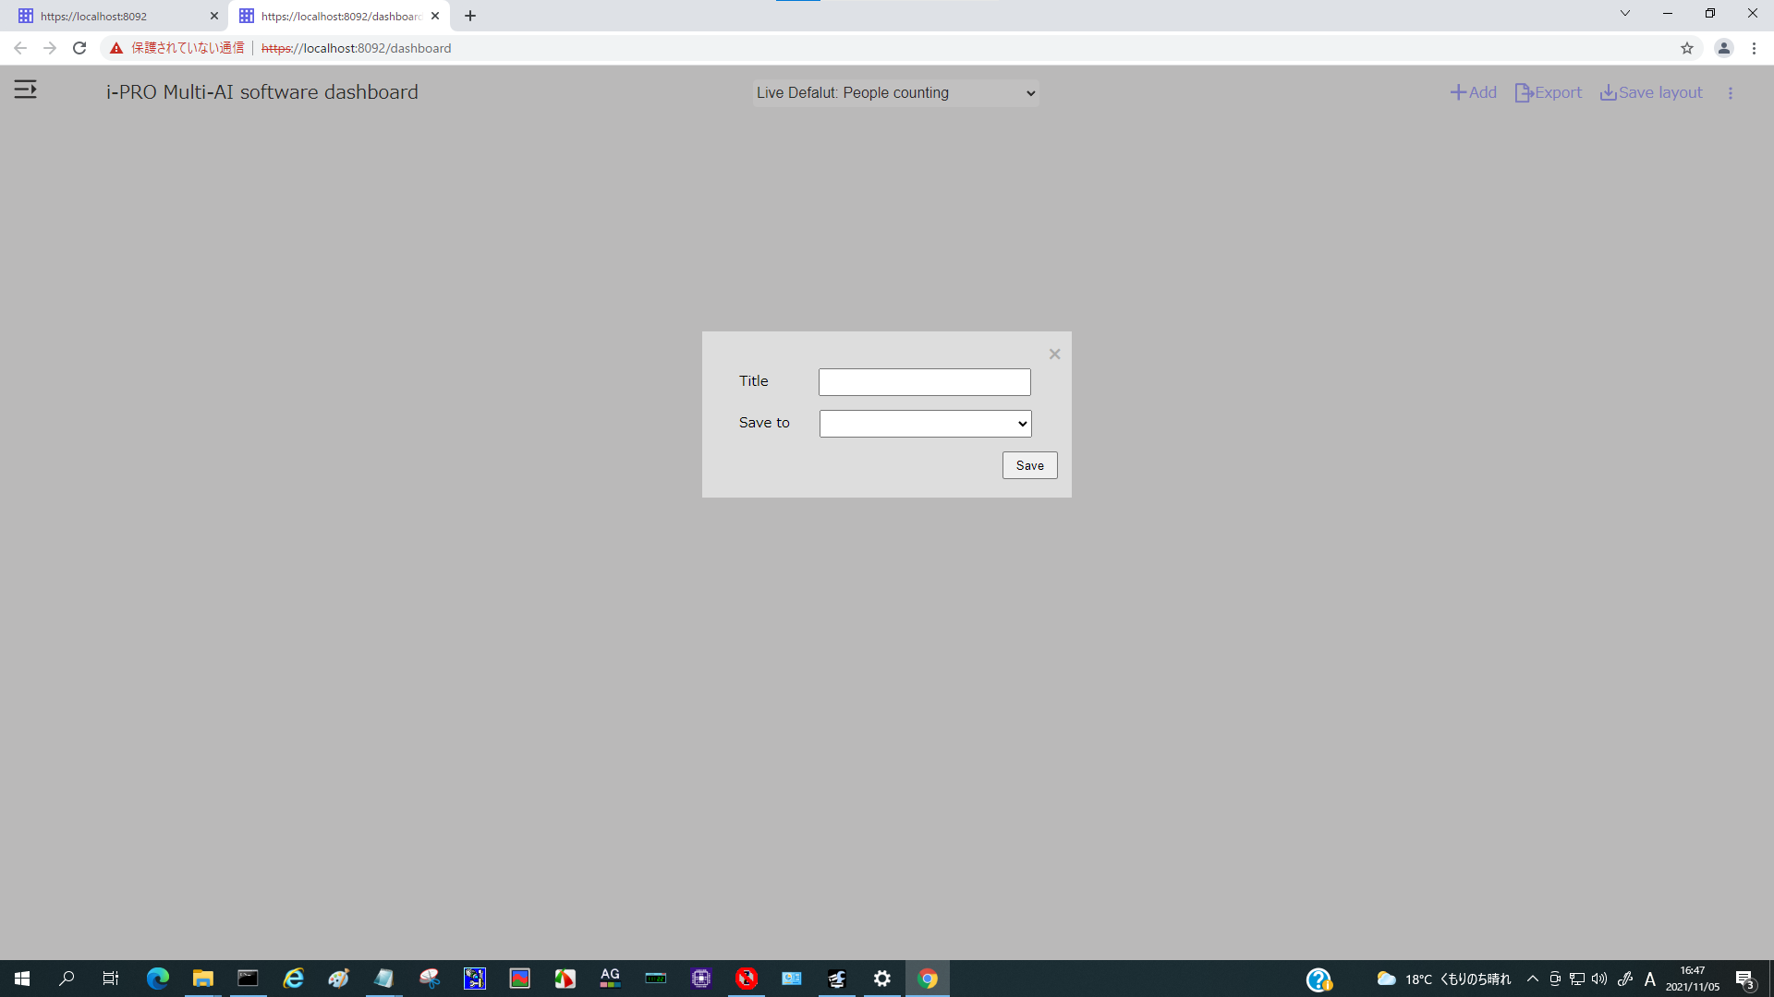
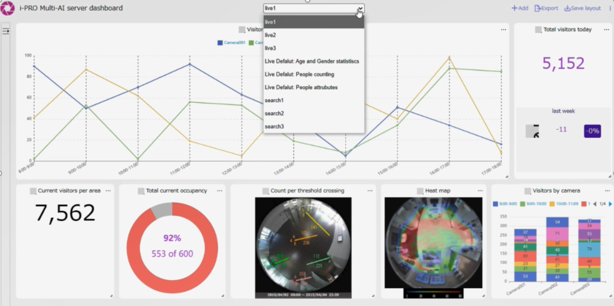
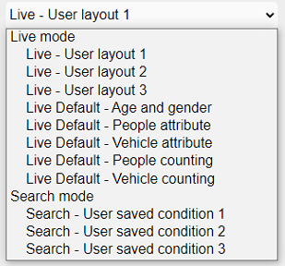
4-2. Layout
2 display modes
Live Mode Charts updated in real time.
Search Mode Charts for a specific period.
Create charts
& Edit layout
Sizes
Positions
Layout can be registered for each user.
Live 3 Custom layouts
Live Default layouts
Search 3 Custom layouts
255
total

Slide 21
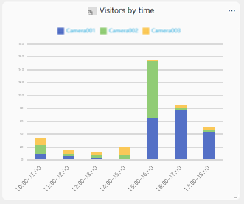
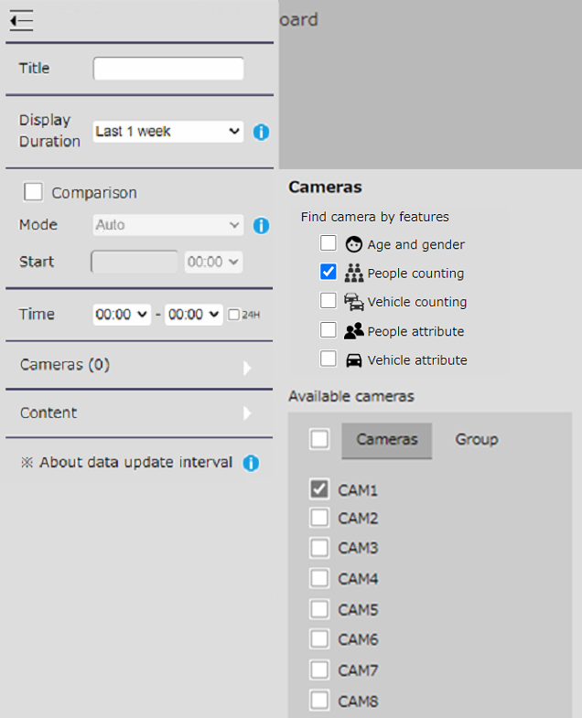
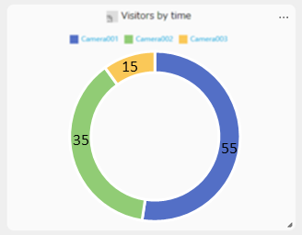
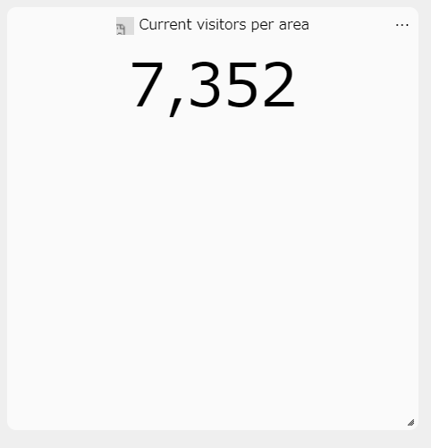
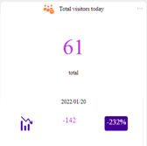
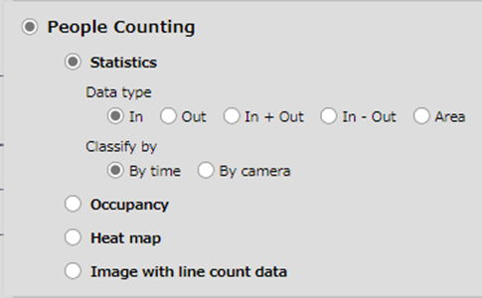
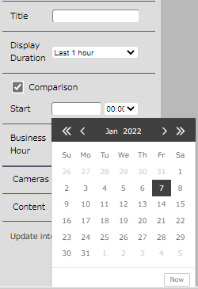
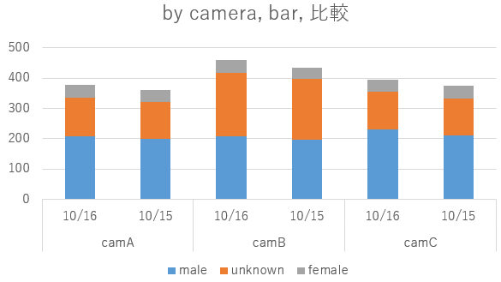
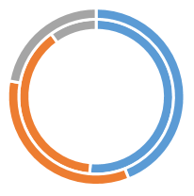
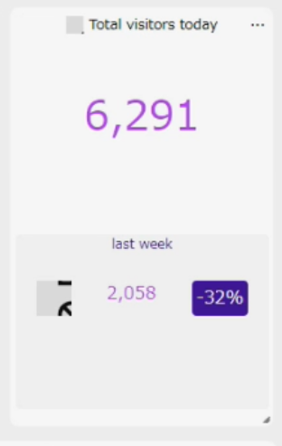
4-3-1. Live Mode: People Counting
Statistics
Select type
Input Title, Display Duration and Operating Time
*Select Duration from “Last 1hour / Today / Last 1week / Last 1 month”.
Select Camera / Group
*Up to 16 cameras / 16 groups
In the group, the values of the cameras to which they belong are aggregated.
Select parameters to create a chart
Check Comparison to display the data to be compared

Slide 22
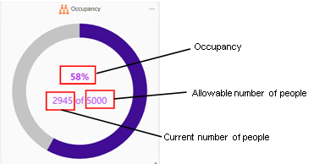
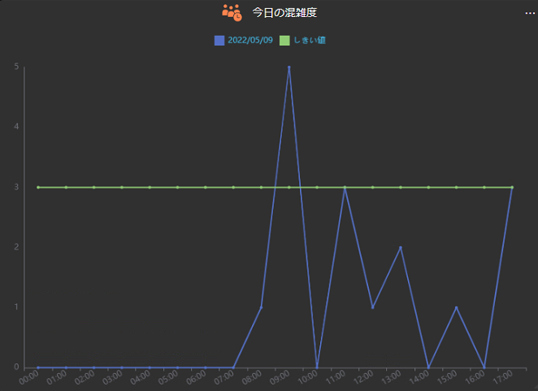
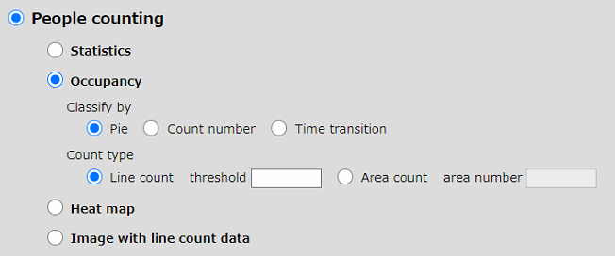
4-3-1. Live Mode: People Counting
Occupancy
Select type from Pie / Count number / Time transition
Input Title, Display Duration and Operating Time
*Select Duration from “Last 1hour / Today / Last 1week / Last 1 month”.
Select Camera / Group
*Up to 16 cameras / 16 groups
In the group, the values of the cameras to which they belong are aggregated.
Select parameters to create a chart
Line count : Total [in - out] of [threshold]
Threshold: Set the allowable number of people in the target area.
If this value is exceeded, the chart color will change to
a warning color.
Area count : from area count app
Area number: Enter the area number to be aggregated.
The allowable number of people uses the value set
in the camera.
* When [Count type] is [Area Count], only one camera can be selected.
Also, groups cannot be selected.
* When displaying the Occupancy, [Comparison] cannot be selected.

Slide 23
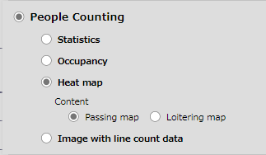
4-3-1. Live Mode: People Counting
Heat map
Input Title, Display Duration and Operating Time
*Select Duration from “Last 1hour”.
Select One Camera
Select parameters to create a chart
Passing map : Based on orbit of people
Loitering map : Based on time when people existed
It is a chart that displays the number of people passing and staying within a specific time as a color gradation on the background image of the AI fisheye camera. The superimposed data is always the sum of the past hour from the current time.
* When displaying the Heat map chart, only one camera can be selected.
Also, the group cannot be selected.
* When displaying the Heat map chart, [Display Duration] can only be selected
for [last 1 hour].
* When displaying the Heat map chart, [Comparison] cannot be selected.

Slide 24
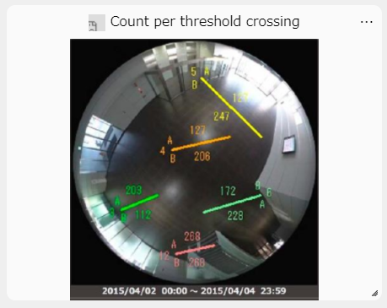
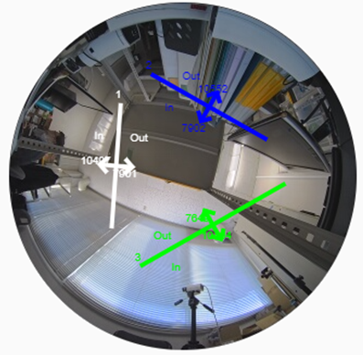
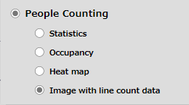
4-3-1. Live Mode: People Counting
Image with line count data
Input Title, Display Duration and Operating Time
*Select Duration from “Last 1hour / Today / Last 1week / Last 1 month”.
Select One Camera
Select parameters to create a chart
*Background is still image without people. Display the line and number of people passing by.
Only overlays are updated in real time.
Background image is updated regularly.
Up to 8 lines (app restrictions)
It is a chart that superimposes the set position of the line cross and the number of people passing by in a specific time on the background image of the AI fisheye camera.
* When displaying the image with line count data chart, only one camera can be selected. Also, the group cannot be selected.
* When displaying the image with line count data chart, [Comparison] cannot be selected.

Slide 25
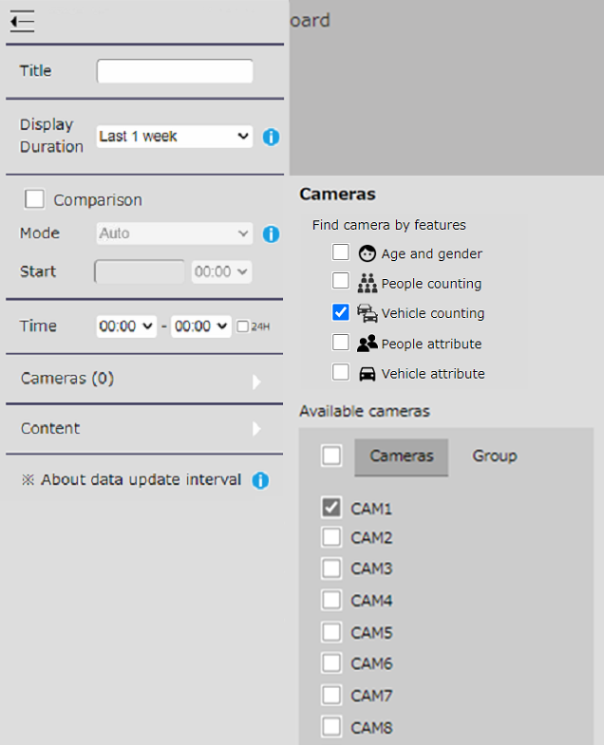
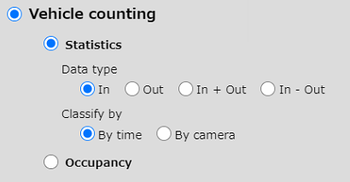
4-3-2. Live Mode: Vehicle Counting
Statistics
Select type
Input Title, Display Duration and Operating Time
*Select Duration from “Last 1hour / Today / Last 1week / Last 1 month”.
Select Camera / Group
*Up to 16 cameras / 16 groups
In the group, the values of the cameras to which they belong are aggregated.
Select parameters to create a chart
Check Comparison to display the data to be compared

Slide 26
4-3-2. Live Mode: Vehicle Counting
Occupancy
Select type from Pie / Count number / Time transition
Input Title, Display Duration and Operating Time
*Select Duration from “Last 1hour / Today / Last 1week / Last 1 month”.
Select Camera / Group
*Up to 16 cameras / 16 groups
In the group, the values of the cameras to which they belong are aggregated.
Select parameters to create a chart
Line count : Total [in - out] of [threshold]
Threshold: Set the allowable number of vehicle in the target area.
If this value is exceeded, the chart color will change to
a warning color.
* When displaying the Occupancy, [Comparison] cannot be selected.

Slide 27
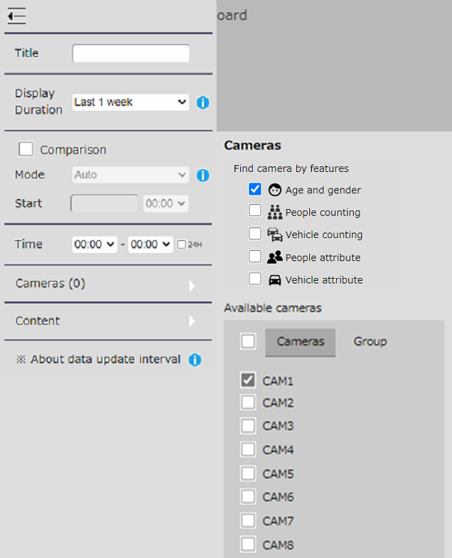
4-3-3. Live Mode: Age and Gender
Statistics
Select type
Input Title, Display Duration and Operating Time
*Select Duration from “Last 1hour / Today / Last 1week / Last 1 month”.
Select Camera / Group
*Up to 16 cameras / 16 groups
In the group, the values of the cameras to which they belong are aggregated.
Select parameters to create a chart
Check Comparison to display the data to be compared
Narrowing down by attributes
Shows the top 10 combinations of gender (male / female / unknown) and age (0-10, 11-20, 21-30, 31- 40, 41-50, 51-60, 61 +, unknown). Other combinations are displayed as "Other“.

Slide 28
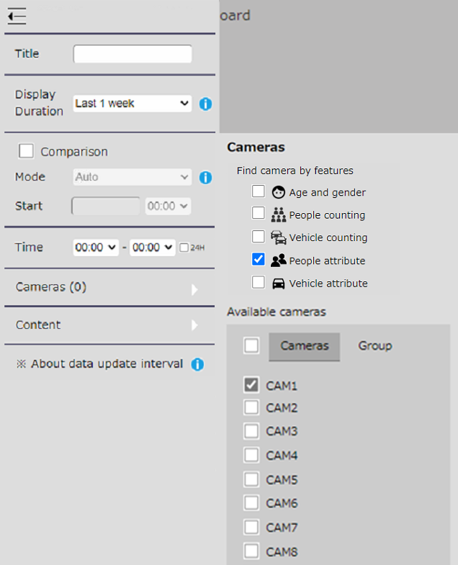
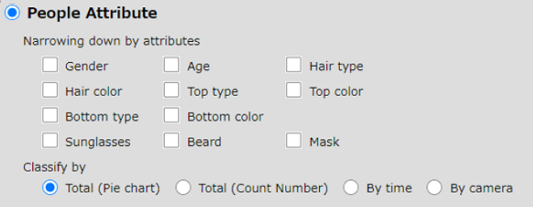
4-3-4. Live Mode: People attribute
Statistics
Select type
Input Title, Display Duration and Operating Time
*Select Duration from “Last 1hour / Today / Last 1week / Last 1 month”.
Select Camera / Group
*Up to 16 cameras / 16 groups
In the group, the values of the cameras to which they belong are aggregated.
Select parameters to create a chart
Check Comparison to display the data to be compared
Narrowing down by attributes
You can select up to 3 attributes to display. When multiple selections are made, the number and percentage of the top 10 combinations with the highest number of analyzed attributes are displayed. Other combinations are displayed as "Other". If all attributes are not selected, information on the number of all detected people will be displayed.

Slide 29
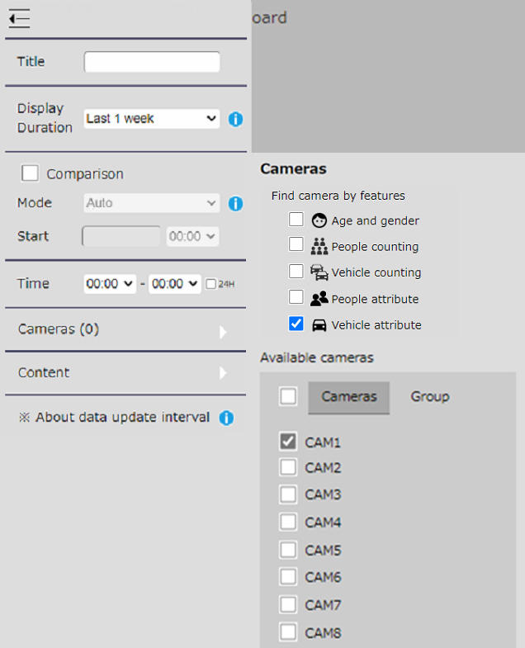
4-3-5. Live Mode: Vehicle attribute
Statistics
Select type
Input Title, Display Duration and Operating Time
*Select Duration from “Last 1hour / Today / Last 1week / Last 1 month”.
Select Camera / Group
*Up to 16 cameras / 16 groups
In the group, the values of the cameras to which they belong are aggregated.
Select parameters to create a chart
Check Comparison to display the data to be compared
Narrowing down by attributes
Shows the top 10 combinations of type and color. Other combinations are displayed as "Other“.

Slide 30
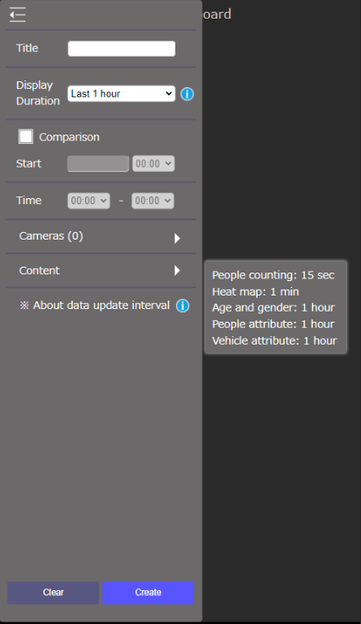
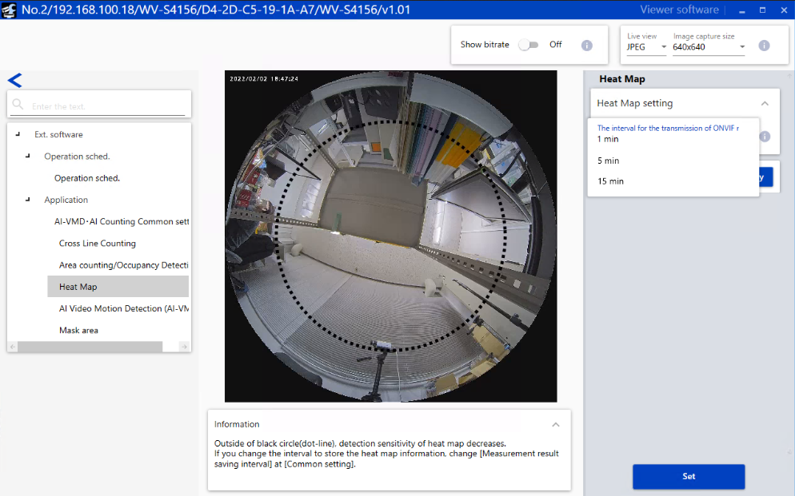
[Ref.] Live Mode: Update interval
Hover your mouse over the i symbol to see the description.
The update interval differs depending on the search target.
People count: 15 seconds, or 1 minute. (*)
Heatmap: 1 minute, 5 minutes, or 15 minutes. (*)
Age / Gender, Person Attribute, Vehicle Attribute: Fixed for 1 hour.
(*) Which setting is used depends on the setting value of "ONVIF Metadata transmission interval" on the camera body.

Slide 31
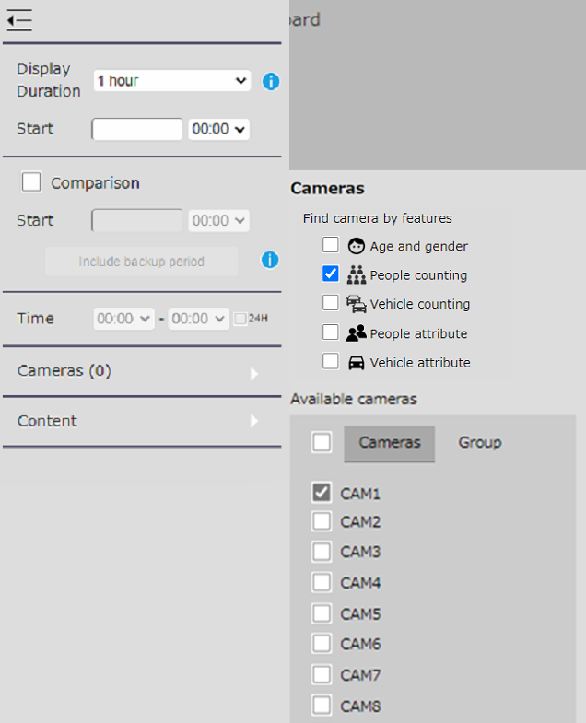
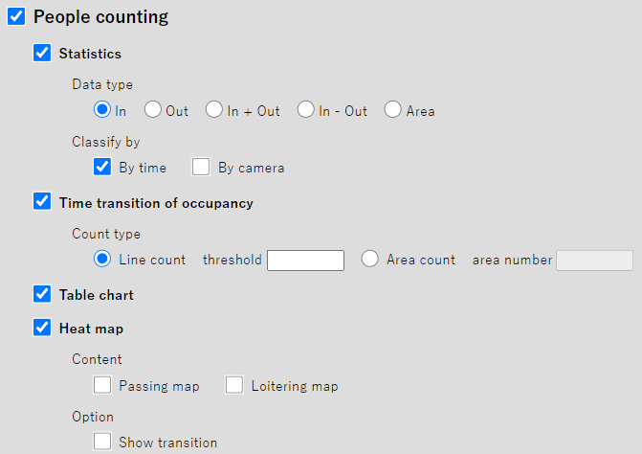
4-4-1. Search Mode: People Counting
Input Display Duration and Operating Time
*Select Duration from 1h / 1day / 1week / 1 month.
Statistics / Time transition of occupancy
The displayed contents are the same as in the Live Mode.
Select Camera / Group
*Up to 16 cameras / 16 groups
In the group, the values of the cameras to which they belong are aggregated.
Table chart
It is a chart that displays the number of people counting information as a table.
The values of each line are added up and displayed as the camera value.
Select parameters to create a chart
Heat map
The heat map for each hour within the set Time of the day will be displayed.
*If Duration is NOT 1 day, Transition cannot be displayed.
Image with line count data
The displayed contents are the same as in the Live Mode.

Slide 32
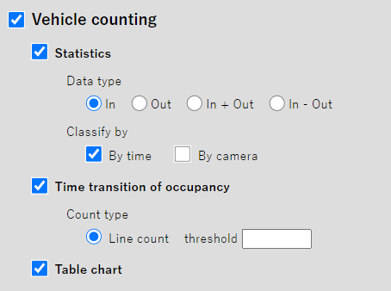
4-4-2. Search Mode: Vehicle Counting
Input Display Duration and Operating Time
*Select Duration from 1h / 1day / 1week / 1 month.
Statistics / Time transition of occupancy
The displayed contents are the same as in the Live Mode.
Select Camera / Group
*Up to 16 cameras / 16 groups
In the group, the values of the cameras to which they belong are aggregated.
Table chart
It is a chart that displays the number of people counting information as a table.
The values of each line are added up and displayed as the camera value.
Select parameters to create a chart

Slide 33
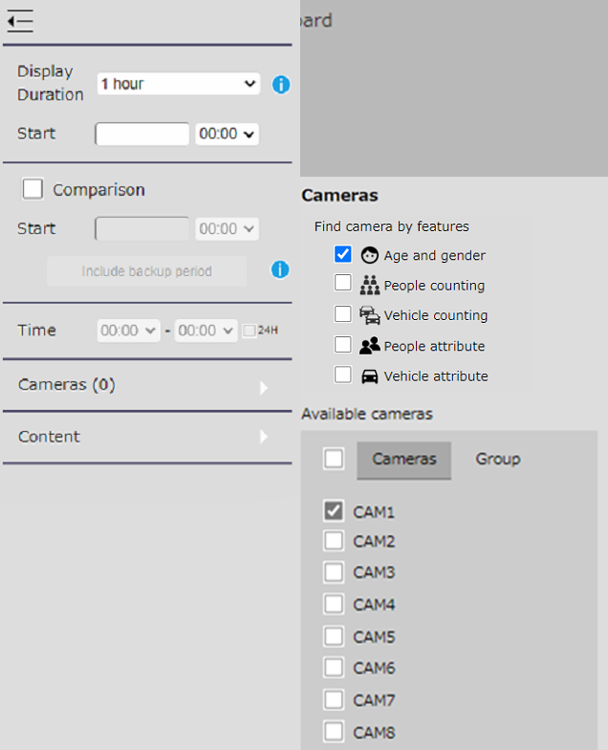
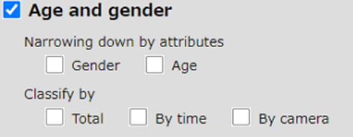
4-4-3. Search Mode: Age and Gender
Input Display Duration and Operating Time
*Select Duration from 1h / 1day / 1week / 1 month.
Statistics
The displayed contents are the same as in the Live Mode.
Select Camera / Group
*Up to 16 cameras / 16 groups
In the group, the values of the cameras to which they belong are aggregated.
Select parameters to create a chart

Slide 34
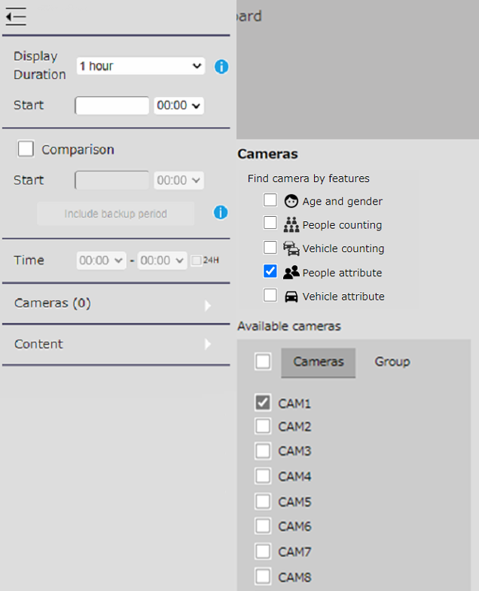
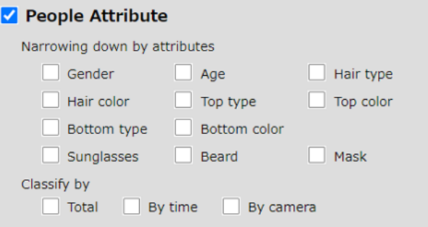
4-4-4. Search Mode: People attribute
Input Display Duration and Operating Time
*Select Duration from 1h / 1day / 1week / 1 month.
Statistics
The displayed contents are the same as in the Live Mode.
Select Camera / Group
*Up to 16 cameras / 16 groups
In the group, the values of the cameras to which they belong are aggregated.
Select parameters to create a chart

Slide 35
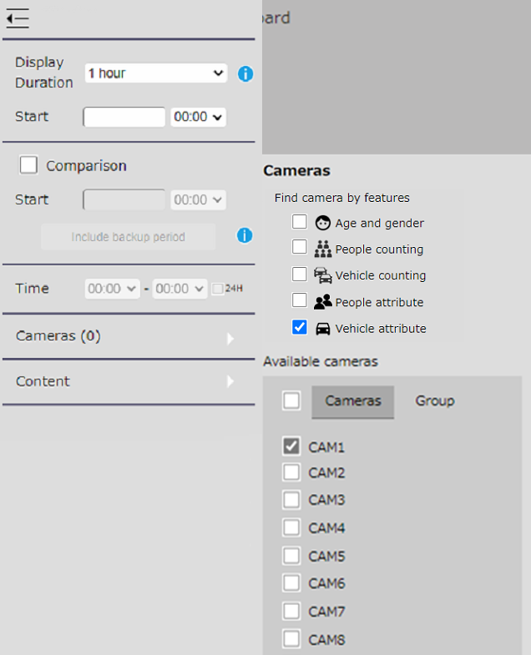
4-4-5. Search Mode: Vehicle attribute
Input Display Duration and Operating Time
*Select Duration from 1h / 1day / 1week / 1 month.
Statistics
The displayed contents are the same as in the Live Mode.
Select Camera / Group
*Up to 16 cameras / 16 groups
In the group, the values of the cameras to which they belong are aggregated.
Select parameters to create a chart

Slide 36
[Ref.] Display for automatically backed up count data
Data older than the 92-day data retention period can be used for comparison.
Dashboard screen
Required pre-settings
*Backup settings is required in advance on the "System configuration" screen.
Click when backed up data is needed.
Check "CSV backup“.
Show the duration the backup file exist.
*It can be used only when "1 day" (search mode) is selected for “display duration“.
*CSV files downloaded manually from the statistics display screen and CSV files downloaded with a camera or iCT are not applicable.
*You can compare CSV files with data in the database (up to 92 days). You cannot compare CSV files with each other.

Slide 37
4-5. Export
CSV Output Save the currently displayed chart data in CSV format.
The output target is the following chart. ・ Statistic graphs
・ Table chart
The output file name depends on the display duration.
PDF Output Output as PDF of each chart currently displayed on the screen.
Image Output Save as an image with heat maps and lines overlaid. Select when Heat map or Still image with count information overlay is displayed.

Slide 38
4-6. Option
Language : English / Japanese / Auto *Auto checking if it's Japanese or not.
Color theme : Light / Dark Select a screen color theme.
Initial screen Select the layout
for initial access to the dashboard.
Heat map upper limit Set the threshold value of the heat map that turns red.
Heat map upper limit

Slide 39
Appendix: Default layout

Slide 40
Default layout for People counting
No. | Title | Duration | Comparison | Type of chart | Classified by
1 | Today’s visitors by time | Today | - | Statistics - Data type: In - Line chart | By time
2 | Total visitors today | Today | Yesterday | Statistics - Data type: In - Count number | By time
3 | Current number of people | (The cumulative number of people from 8:00 AM to 8:00 PM) | - | Occupancy - Total (Count number) | -
4 | Total visitors by camera | Today | - | Statistics - Data type: In - Bar chart | By camera
5 | Count per threshold crossing | Today | - | Image with line count data | -
6 | Heat map | Last 1 hour | - | Heat map | Passing map

Slide 41
Default layout for Vehicle counting
No. | Title | Duration | Comparison | Type of chart | Classified by
1 | Today’s traffic by time | Today | - | Statistics - Data type: In - Line chart | By time
2 | Total traffic today | Today | - | Statistics - Data type: In - Count number | By time
3 | Current number of vehicle | (The cumulative number of vehicle from 8:00 AM to 8:00 PM) | - | Occupancy - Total (Count number) | -
4 | Total traffic by camera | Today | - | Statistics - Data type: In - Bar chart | By camera

Slide 42
Default layout for Age and Gender statistics
No. | Title | Duration | Comparison | Type of chart | Classified by
1 | Gender ratio today | Today | - | Gender | Total(Pie chart)
2 | Age ratio today | Today | - | Age | Total(Pie chart)
3 | People and ratio for gender today | Today | - | Gender | By time
4 | People and ratio for age 1 week | Last 1 week | - | Age | By time

Slide 43
Default layout for People attributes
No. | Title | Duration | Comparison | Type of chart | Classified by
1 | Mask - no mask ratio today | Today | - | Mask | Total(Pie chart)
2 | Gender and tops type ratio | Today | - | Gender, Tops | Total(Pie chart)
3 | People and ratio for Gender and tops type by time | Today | - | Gender, Tops | By time
4 | People and ratio for Gender and tops type by camera | Today | - | Gender, Tops | By camera

Slide 44
Default layout for Vehicle attributes
No. | Title | Duration | Comparison | Type of chart | Classified by
1 | Vehicle number by time | Today | - | Not selected (all) | By time
2 | Today's traffic | Today | Yesterday | Not selected (all) | Total(Counts)
3 | Vehicle type ratio | Today | - | Vehicle Type | Total(Pie chart)
4 | Number of Vehicles type by camera | Today | - | Vehicle Type | By camera
5 | Number of Vehicles this week | Last 1 week |  | Not selected (all) | By time

Slide 45
Appendix: Sample video

Slide 46
Overview
Analytics dashboard
Enable to visualize the number of people and the congestion status with a dashboard that can be customized according to the customer's operation style, and use it for business intelligence purposes.

Slide 47
Live Mode
Analytics dashboard
Enable to visualize the number of people and the congestion status with a dashboard that can be customized according to the customer's operation style, and use it for business intelligence purposes.

Slide 48
Search Mode
Analytics dashboard
Enable to visualize the number of people and the congestion status with a dashboard that can be customized according to the customer's operation style, and use it for business intelligence purposes.

Slide 49
Export & Save layout
Analytics dashboard
Enable to visualize the number of people and the congestion status with a dashboard that can be customized according to the customer's operation style, and use it for business intelligence purposes.

Slide 50
People attributes
Analytics dashboard
Enable to visualize the number of people and the congestion status with a dashboard that can be customized according to the customer's operation style, and use it for business intelligence purposes.

Slide 51
Appendix: Other information

Slide 52
Manual and FAQ
Manual
i-PRO AI application
Operation Instruction
- AI Face Detection
- AI People Detection
- AI Vehicle Detection
i-PRO Active Guard for Video Insight
i-PRO Active Guard for Genetec
i-PRO Active Guard for ASM300
Setup Instruction
Operation Instruction
Please utilize these manuals.
All setups can be completed with these manuals.
These manuals contain step-by-step instructions of how to install and setup.
FAQ
FAQ for AI analytics has been newly updated
Contents will be added continuously

Slide 53
Version History

Slide 54
Version History
No | Update contents | Page No. | Version | Update
1 | 1st Version | - | 1.30 | 26. Apr. 2022
2 | Removed browser restrictions. | P.7 | 1.50 | 6. Sep. 2022
3 | Removed page of “Lock the major version in the User-Agent string to 99”. | - | 1.50 | 6. Sep. 2022
4 | Added option “Time transition” for Occupancy. | P.21, 30 | 1.50 | 6. Sep. 2022
5 | Added “AI-VMD” information. | P.5, 7, 12 | 1.50 | 6. Sep. 2022
6 | Added “Display for automatically backed up count data”. | P.35 | 1.50 | 6. Sep. 2022
7 | Added “Support i-PRO Active Guard function list”. | P.13 | 1.50 | 6. Sep. 2022
8 | Added “Live Mode: Vehicle Counting”. | P.24, 25 | 1.50 | 6. Sep. 2022
9 | Added “Search Mode: Vehicle Counting”. | P.31 | 1.50 | 6. Sep. 2022
10 | Added “Default layout for Vehicle counting”. | P.40 | 1.50 | 6. Sep. 2022
11
12
13
14
15

