Slide 1
i-PRO Active Guard
Ver.1.31/1.32 version up contents
- April 2022 -
Ver.1.00
Apr. 2022

Slide 2
Contents
Target
Product
i-PRO Active Guard server
i-PRO Active Guard for VI / Genetec
V1.32
Apr.2022
i-PRO Active Guard for ASM300
V1.31
Apr.2022
i-PRO Active Guard Plug-in
i-PRO Active Guard Plug-in for VI
V1.30
Apr.2022
i-PRO Active Guard Plug-in for Genetec
V1.30
Apr.2022
i-PRO Active Guard Plug-in for ASM300
V1.30
Apr.2022
Note
Notes on ASM300 plug-in UPDATE (see p5). | Due to the name change to i-PRO Active Guard, the ASM300 plug-in must be uninstalled once before it can be updated.
Restrictions when installing “i-PRO Active Guard” and “ASM300” on the same PC | The software version should be the following combination. -"I-PRO Active Guard (v1.30)" and "i-PRO Active Guard plugin for ASM300 (v1.00)“ -"I-PRO Active Guard (v1.31)" and "i-PRO Active Guard plugin for ASM300 (v1.30)"

Slide 3
Contents
No | Items | Summary | i-PRO Active Guard | Plug-in
 |  |  |  | ASM300 | VI | Genetec
1 | Change software name | Change the name of the software to "i-PRO Active Guard" | ✓ | ✓ | ✓ | ✓
2 | New Product Support | Support Multi-Sensor Camera with AI engine, etc. (WV-S8543*, WV-S8544*, WV-S8563*, WV-S8564*, WV-S8573*, WV-S8574*) | ✓ | - | - | -
3 | Improve the accuracy of statistical calculation on dashboard | Improve the display of statistical information to more match the actual numerical value in the People Count | ✓ | - | - | -
4 | Supports launching the camera browser from the Home screen | Add the function to access the browser of the registered camera from the home screen of the WEB setting page. | ✓ | - | - | -
5 | Change the name of the company | Change the name of the company to "i-PRO Co., Ltd.“ (For VI/Genetec: "i-PRO Americas Co., Ltd.“) | ✓ | ✓ | ✓ | ✓
6 | Support Win 11 | Support Win 11 | ✓ | ✓ | ✓ | ✓
7 | Balance adjustment of people attribute threshold | Adjust the people attribute threshold value. This may change the result of the people attribute search, etc. | ✓ | - | - | -
8 | Fix the "Vehicle (SUV)" detection problem. | Solve the detection problem when the attribute name is "Vehicle (SUV)". | ✓ | - | - | -
9 | Improvement of camera registration screen (VI only) | Change to display only AI camera when acquiring / registering camera information from VI | ✓ | - | - | -
10 | Support for time format "HH.mm.ss" | Regardless of the OS language type, you can now search even if the time format is "HH.mm.ss". | - | ✓ | ✓ | ✓

Slide 4
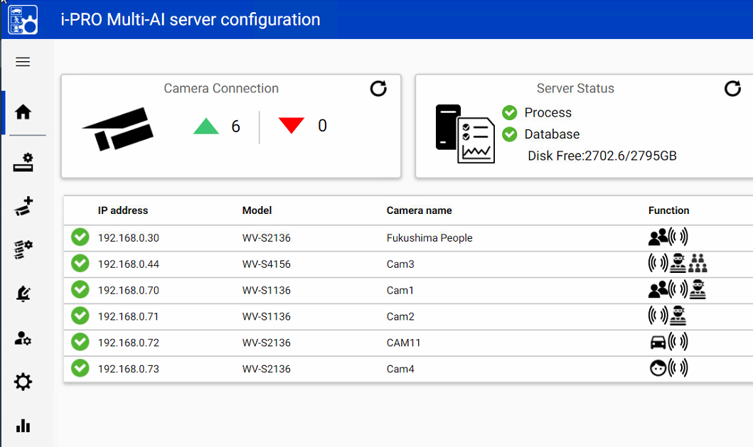
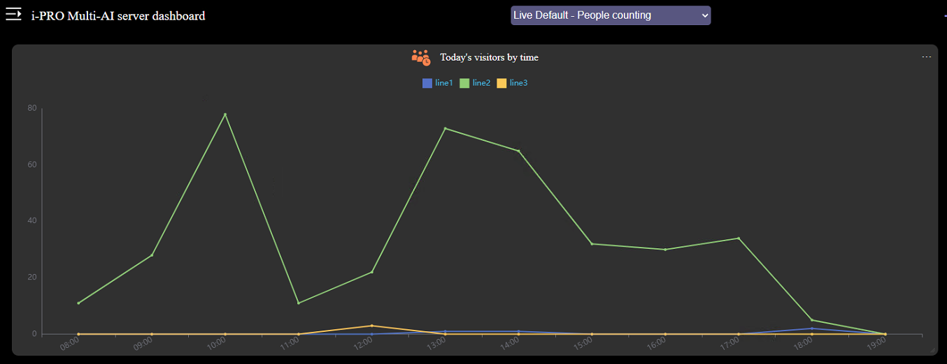
1. Change software name (1/3)
Target
Product
i-PRO Active Guard
Version
V1.31/1.32
 | Before | After
System name | i-PRO Multi-AI system | i-PRO Active Guard
Software name | i-PRO Multi-AI server | i-PRO Active Guard server
Title of the settings screen | i-PRO Multi-AI server configuration | i-PRO Active Guard configuration
Dashboard title. | i-PRO Multi-AI server dashboard | i-PRO Active Guard dashboard
i-PRO Active Guard
name change example
<Display example: i-PRO Active Guard configurtion>
<Display example: i-PRO Active Guard dashboard>
i-PRO Active Guard configuration
i-PRO Active Guard dashboard
The server has changed only web screen display. Also, there are no changes related to the installer (software name that can be seen from Windows settings, control panel, etc.).

Slide 5
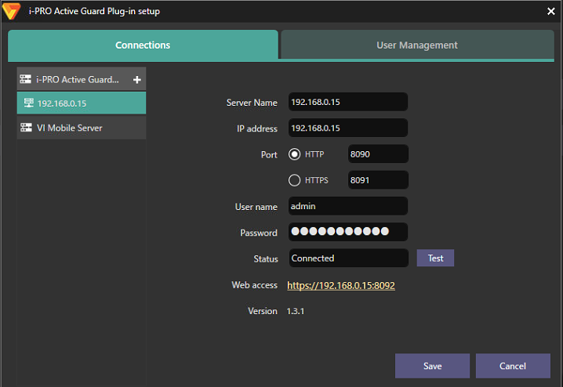
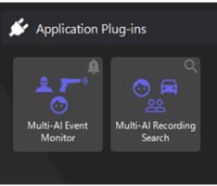
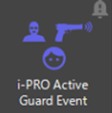
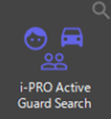
1. Change software name (2/3)
Target
Product
i-PRO Active Guard Plug-in for VI/Genetec/ASM
Version
V1.30
 | Before | After
Software name | i-PRO Multi-AI server Plug-in for Video Insight | i-PRO Active Guard Plug-in for Video Insight
 | i-PRO Multi-AI server Plug-in for Genetec | i-PRO Active Guard Plug-in for Genetec
 | i-PRO Multi-AI server Plug-in for WV-ASM300 | i-PRO Active Guard Plug-in for WV-ASM300
Title of the settings screen | i-PRO Multi-AI server Plug-in setup | i-PRO Active Guard Plug-in setup
Function Name | Multi-AI Recording Search (VI) | i-PRO Active Guard Search
 | Multi-AI Search (ASM300) | i-PRO Active Guard Event
 | Multi-AI Event monitor (VI,ASM300) | i-PRO Active Guard Event
i-PRO Active Guard Plug-in
name change example
< Display example: i-PRO Active Guard Plug-in setup>
< Display example: i-PRO Active Guard Search>
< Display example: i-PRO Active Guard Event>

Slide 6
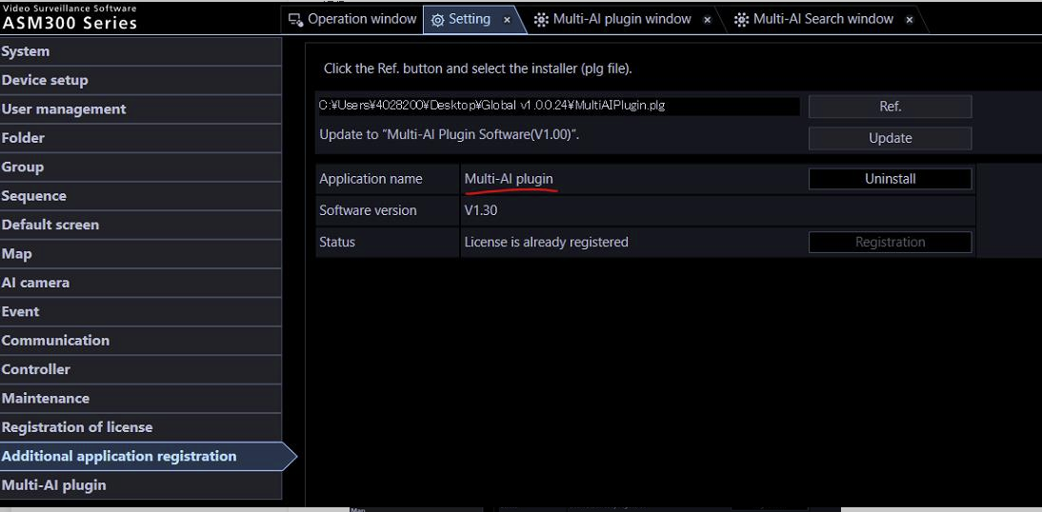
1. Change software name (3/3)
Notes on ASM300 plug-in UPDATE
Due to the name change to i-PRO Active Guard, the ASM300 plug-in software must be uninstalled first when updating the ASM300 plug-in software to this v1.30 or later version for the first time.
Normally, you would select the new version of the file and execute the Update button, but due to this software name change, an error occurs. (The reason is that the name of the plug-in no longer matches the name of the existing software.)
Therefore, before updating, uninstall once (execute Uninstall once on the screen above) and then install the new version.
After uninstalling and installing the new version, the release key and other information will be remained.

Slide 7
2. New Product Support
Target
Product
i-PRO Active Guard
Version
V1.31/1.32
Support AI Multi-sensor camera
WV-S8543*, WV-S8544*, WV-S8563*, WV-S8564*, WV-S8573*, WV-S8574*
Support i-PRO mini camera
WV-S71300-F3
Support AI Network camera (S series)
WV-S15500-V3*, WV-S15600-V2*, WV-S15700-V2*,
WV-S22500-V3*, WV-S22600-V2*, WV-S22700-V2*,
WV-S25500-V3*, WV-S25600-V2*, WV-S25700-V2*

Slide 8


3. Improved the accuracy of statistical calculation on dashboard
Target
Product
i-PRO Active Guard
Version
V1.31/1.32
Description: In the count of people, the statistical information is matched with the actual numerical value.
Before: All the best shots of the received person are counted.
Therefore, even if a plurality of best shots with the
same person ID are received, all of them are counted.
After: The best shot images with the same person ID are counted
as one.
ID: 001
ID: 001
ID: 001
ID: 001
ID: 001
ID: 001
ID: 002
ID: 002
ID: 002
ID: 002
The number of shots received is the same, but since they have the same best shot ID, they are counted as one shot.
Number of received: 5 Number of counted: 5
Number of received: 5 Number of counted: 2

Slide 9
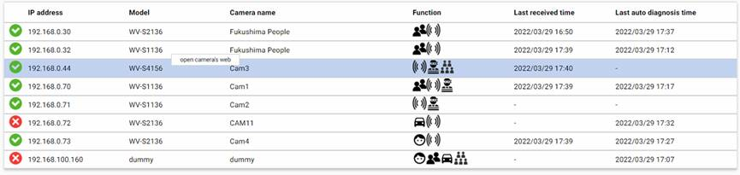
4. Supports launching the camera browser from the Home screen
Target
Product
i-PRO Active Guard
Version
V1.31/1.32
Add the function to access the browser of the registered camera from the home screen of the WEB setting page.
Select a camera and right-click to start the browser
open camera web

Slide 10
Version History

Slide 11
Version History
No | Update contents | Page No. | Version | Update
1 | 1st Version | - | 1.00 | 8.Apr.2022
2
3
4
5
6
7
8
9
10
11
12
13
14
15

