Slide 1
Network Disk Recorder WJ-NX Series version up contents - April 2022 -
Model : WJ-NX400, WJ-NX300, WJ-NX200 , WJ-NX100
File Version : 1.00
Apr. 2022

Slide 2
Contents
 | NX400 | NX300 | NX200 | NX100
Change the company name notation | Yes | Yes | Yes | Yes
New Product support ( Multi-Sensor Camera, New 4K/6M/5M camera, i-PRO mini camera ) | Yes | Yes | Yes | Yes
Bug fix (Not send cgi command for stream2 ) | Yes | Yes | Yes | Yes
Function improvement ( Remove the FTP ) | Yes | Yes | Yes | Yes
Firmware Version No. : V5.00
Release date on the global site : Apr. 2022

Slide 3
Change the notation of the company
Target
Product
WJ-NX400, WJ-NX300, WJ-NX200, WJ-NX100
Version
V5.00
Contents
All Panasonic notation that has been used will be change to i-PRO
Company name ​: Panasonic i-PRO Sensing Solutions Co., Ltd. → i-PRO Co., Ltd.​
Recorder startup screen logo : Panasonic → i-PRO
Web browser window title : Panasonic | Network Disk Recorder → Network Disk Recorder
MIB & sys Object ID : Panasonic(258) → PIPS(57501)
ActiveX / NX Viewer / HDD Viewer : PIPS → i-PRO
Name of alarm protocol : Panasonic alarm protocol → TCP alarm notification

Slide 4
New Product Support
Target
Product
WJ-NX400, WJ-NX300, WJ-NX200, WJ-NX100
Version
V5.00
Contents
Support Multi-Sensor Camera with AI engine
Model : WV-S8543 series, WV-S8544 series, WV-S8563 series, WV-S8564 series
WV-S8573 series, WV-S8574 series
Support New 4K/6M/5M Camera with AI engine
Model : WV-S15600 series, WV-S15700 series, WV-S22600 series, WV-S22700 series
WV-S25600 series, WV-S25700 series
WV-S15500 series, WV-S22500 series, WV-S25500 series
Support i-PRO mini Camera with AI engine
Model : WV-S71300

Slide 5
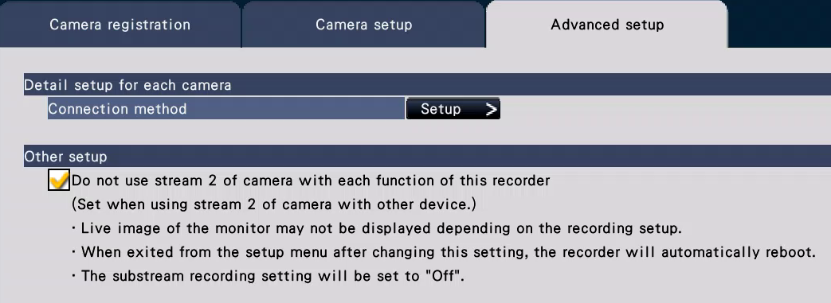
Bug fix
Target
Product
WJ-NX400, WJ-NX300, WJ-NX200, WJ-NX100
Version
V5.00
Contents
When "Do not use stream 2 of camera with each function of this recorder" is enabled, the recorder doesn't change compression method of stream 2 from Ver.5.00.

Slide 6
Function improvement
Target
Product
WJ-NX400, WJ-NX300, WJ-NX200, WJ-NX100
Version
V5.00
Contents
Remove the FTP
When the recorder version is updated to V5.00, ASM300 and iCT also need to be upgraded
for the below function.
- Time line display and n3r download on WV-ASM300
- File upload and download on iCT
Function | Before V4.00(ASM300) | V4.00(ASM300) or later
Display Timeline | No | Yes
Download n3r files | No | Yes
Function | V1.30(iCT) or before | V1.40(iCT) or later
Upload/Download Files | No | Yes

Slide 7
Version History

Slide 8
Version History
No | Update contents | Page No. | Version | Update
1 | 1st Version | All | 1.00 | 14.Apr.2022
2
3
4
5
6
7
8
9
10
11
12
13
14
15

