Slide 1
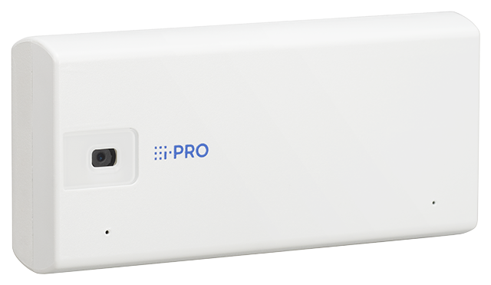
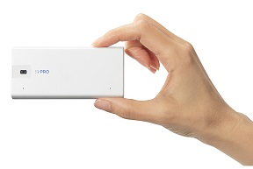
i-PRO mini Material for SE
Model: WV-S71300-F3
Ver.1.01
Aug. 2022

Slide 2

Contents
Product Summary
Key Features
Specification Comparison
Other Specifications
AI Application
Appearance
Standard Accessories
Optional Accessories
System Support Schedule
About icons
This icon is for brand new functions

Slide 3
1. Product Summary

Slide 4
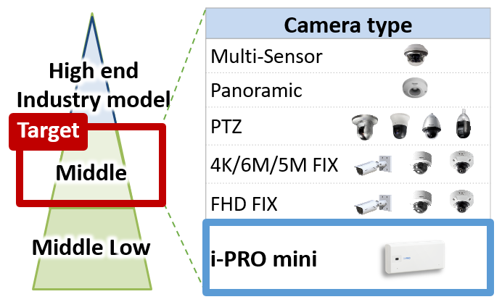

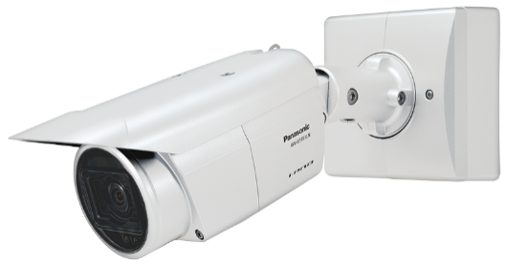

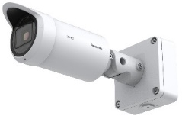
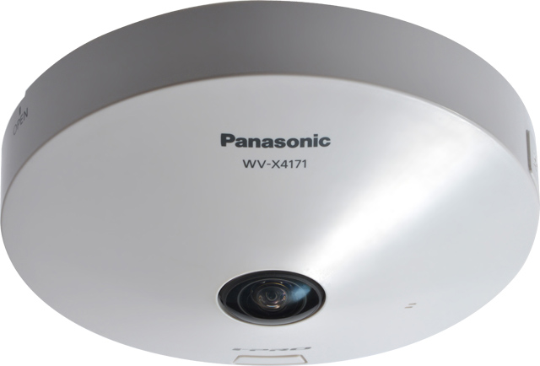
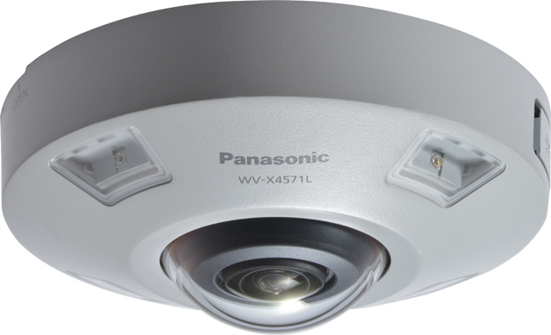
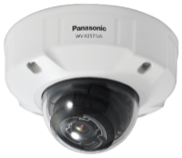
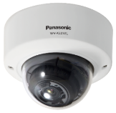
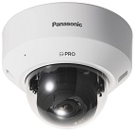
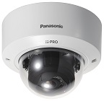



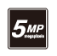


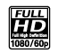
1-1. What is i-PRO mini?
A stylish compact AI network camera
that harmonize with the space
Develop new market
positioning
Reach out to previously unreachable customers
X Series [High end]
(6 model)
S Series [Middle]
(10 model)
Wide variety of lineup
Jul. 2020
Jun. 2021
FY21 / FY22
Expand lineup

Slide 5



1-2. Product Concept
A stylish compact Network Camera with AI engine that can harmonize with the space
Key features
Small size
Industry's short height and thin camera
- The industry‘s smallest (*1) camera that can harmonize with the space and does not stand out like typical security camera.
W:102 mm / H:48 mm / D:21 mm
Analytics
AI Analytics
- Equipped with an AI engine inside the camera for AI processing on the edge side. Up to 3 AI apps can be operated at the same time.
Simplicity
Easy installation
- Easily set up with a smartphone or tablet device via Wi-Fi connection. *Sold separately Wi-Fi USB adapter is required.
Easy maintenance
- Detect and notify of deviation in the camera angle of view.
LINE UP : 1 model
 | Indoor
FHD model | WV-S71300-F3
*1 According to our own research in Mar. 2022

Slide 6
[Ref.] Naming convention for new camera model number
1 | ２ | ３ | ４ | ５ | ６ | ７ | ８ | 9 | 10 | 11 | 12 | 13 | 14 | 15 | 16 | 17
W | V | - | S | 7 | 1 | 3 | 0 | 0 |  | - | F | 3
 |  |  | Series | Form | Environment | Resolution | Serial1 | Serial2 | Version A/B/C |  | Lens1 | Lens2 | Feature1 | Feature2 | Feature3 | Color
 |  |  | X : Hi-end S : Middle- range U : Middle- low B : Remote monitoring V : Entry | 9 : - 8 : Multi- sensor 7 : Mini 6 : PTZ (Dome) 5 : VCC,PT 4 :360 deg. 3 : Compact Dome 2 : Dome 1 : Box | 9 : - 8 : - 7 : - 6 : Outdoor Vandal 5 : Outdoor Vandal 4 : Outdoor Normal 3 : - 2 : Indoor Vandal 1 : Indoor Normal 0 : - | 9 : - 8 : 6K(24MP) - 7 : 4K(12MP) - 6 : 6MP 5 : 5MP 4 : 4MP 3 : FHD - 2 : 1 : HD- | 00~09 : 10~19 : 20~29 : 30~39 : 40~49 : ・・・ 90~99 : Serial# can divide according to structure. (10xN) |  | A B C |  | F : Fixed lens T : Long focal V : Vari lens Z : Zoom lens U : No lens | See *1 | L : LED W : Wireless TH : Thermal RZ : PTRZ D : Analog/NW output F : Optical I/F G : Smoke dome M : M12 N : Clear Sight S : Salt resistance K : NS model |  |  | None : White 1 : Black 2 : Silver 3 : Gray 4 : Brown (When there is no Feature) -1 : Black -2 : Silver -3 : Gray -4 : Brown
*1 Details of Lens2
Fixed lens
Y : Reserve
1 : 1~1.9mm
2 : 2~2.9mm
3 : 3~3.9mm
4 : 4~4.9mm
5 : 5~5.9mm
6 : 6~6.9mm
7 : 7~7.9mm
8 : 8~8.9mm
9 : 9~9.9mm
A : 10mm - (TBD)
B~X, Z:Reserve
Vari lens / Long focal
Y : No Lens
1 : 1 ~ x1.9
2 : 2 ~ x2.9
3 : 3 ~ x3.9
4 : 4 ~ x4.9
5~9 : Reserve
A : 10x - (TBD)
B~X, Z : Reserve
PTZ Zoom lens
Y : ~ x9.9
1 : 10 ~ x19.9
2 : 20~ x29.9
3 : 30~ x39.9
4 : 40~ x49.9
5 : 50~ x59.9
6~9 : Reserve
A~X, Z : Reserve

Slide 7
2. Key Features

Slide 8
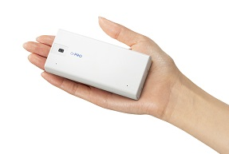
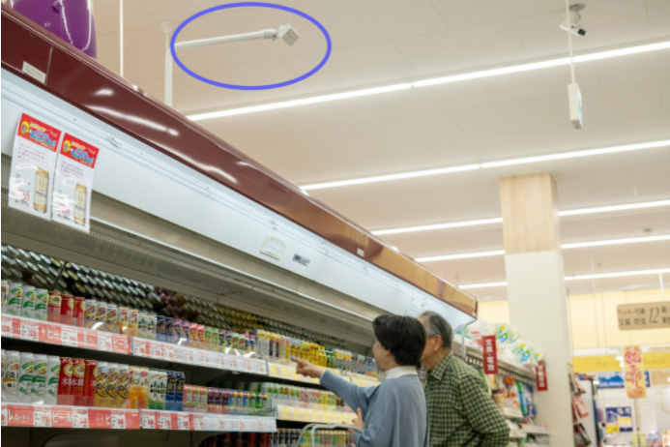
2-1. Industry's short height and thin camera
i-PRO mini is compact camera that can harmonize with the space and suitable for scenes where you don’t want the security camera to stand out.
Palm size
WV-S71300-F3
W:102 mm / H:48 mm / D:21 mm

Slide 9
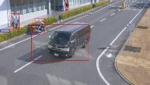

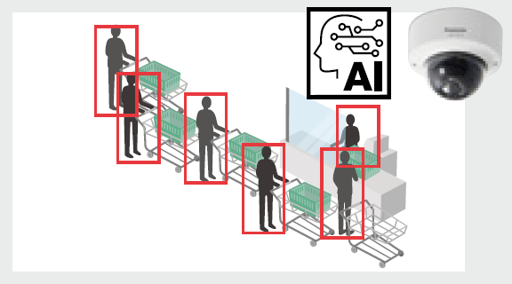

2-2. AI Analytics
Supports various apps such as AI Face Detection, AI People Detection, AI Vehicle Detection and etc.
AI apps | Detail
AI Face Detection
Detect face and cut out face image for best-shot
Extraction of facial features
AI People Detection
Extraction of various identifying elements for people
: 11 items 46 attributes
Age / Gender / Hair type / Tops type / etc.
AI Vehicle Detection
Extraction of various identifying elements for vehicles
: 2 items 17 attributes
Type / Color
AI-VMD
AI Privacy Guard
AI Non Mask Detection
AI Occupancy Detection
AI Sound Classification
Others

Slide 10
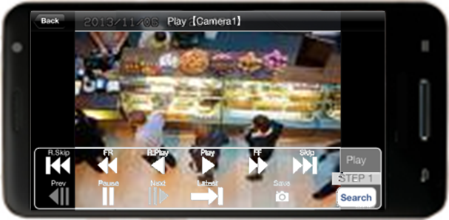
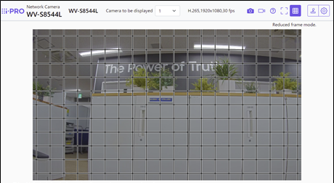
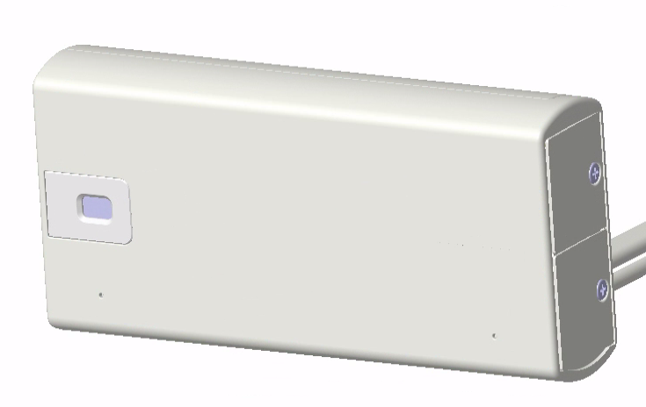

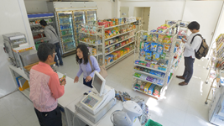
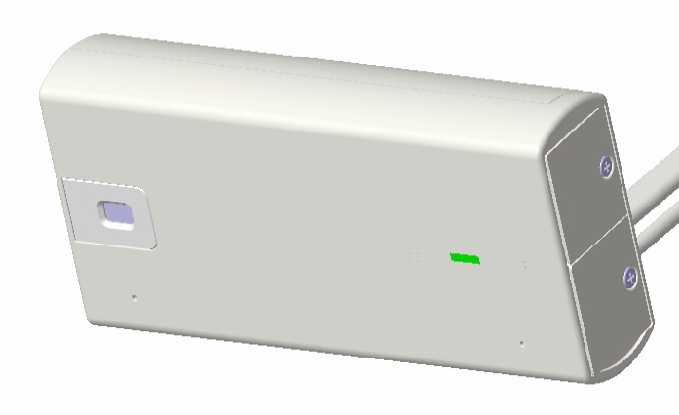


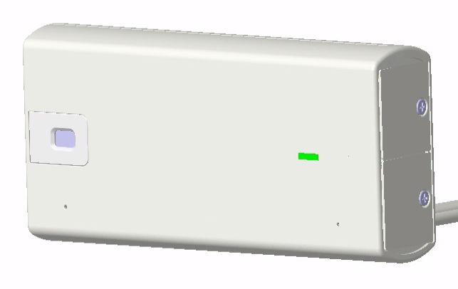
2-3. Easy installation and maintenance
Easy installation
Easy maintenance
The angle of view can be adjusted with your smartphone by connecting a Wi-Fi USB adapter.
Equipped with “Camera angle change detection”.
Easily recover the angle of view while checking the LED.
Step1
Step2
If the angle of view misaligned from the initial setting
LED notification of changes in angle of view
Adjust the angle of view by looking at the LED status
Connect the Wi-Fi USB adapter to the camera
Check the angle of view on smartphone
Correction completed
*Sold separately Wi-Fi USB adapter is required.

Slide 11
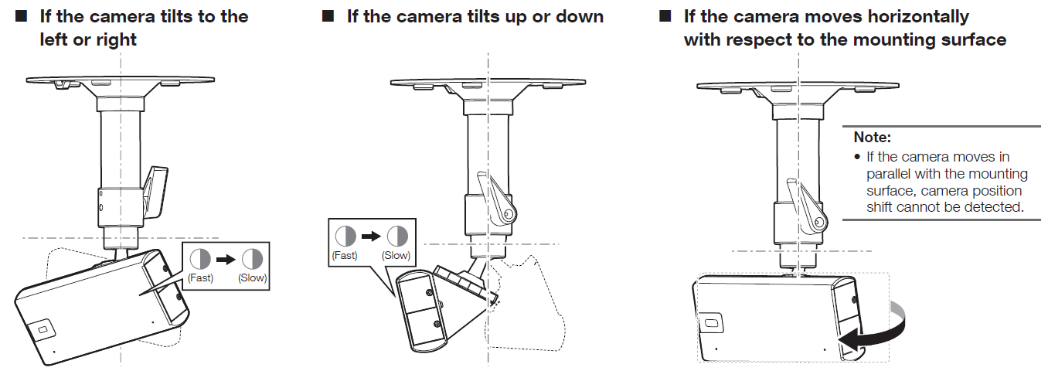

[Ref.] If the camera is misaligned after installation

Slide 12
3. Specification Comparison

Slide 13
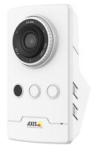
3-1. Comparison to other companies
 | i-PRO | Axis
 | Indoor | Indoor
 | WV-S71300-F3 | M1065-LW
Video Codec | H.265/H.264/JPEG | H.264/JPEG
Image Sensor | 1/2.8” 2MP | 1/3” 2MP
Max. Resolution | 1920 x 1080 [16:9] 2048 x 1536 [4:3] *Super Resolution | 1920 x 1080
Max. Frame rate | H.265/H.264: 30fps JPEG: 5fps (30fps *1) | H.264: 30fps JPEG: 30fps
Lens | F number: 2.0 Focal length: 3.2 mm | F number: 2.0 Focal length: 2.8 mm
Angular Field of view | H: 81.1 deg. / V: 51.4 deg. | H: 110 deg. / V: 61 deg.
Image rotation | Yes | Yes
WDR | No | Yes (*dB value unknown)
Sensitivity (color) | 0.3 lx (50 IRE) | 0.25 lx (50 IRE)
Smart Coding | AI Smart Object Coding | Zipstream
AI processor | Yes | No
Wireless interface | No | Yes
Audio | In (built-in mic) | In (built-in mic), Out
IR-LED | No | Yes (10m)
Power Source | 5VDC (USB Type-C), 48VDC (PoE) | 4.75 - 5.25 VDC (Micro USB Type-B)
Operating Temperature | -10 to +40 deg.C | 0 to +40 deg.C
Dimensions | 102 mm x 48 mm x 21 mm | 106 mm x 60 mm x 37 mm
*1 H.265/H.264 Stream transmission: Off

Slide 14
3-2. Comparison of New S series
 | i-PRO mini | New S series (WV-S2236L) Ver.1.40 or later
Image capture mode | 16:9 (30fps / 25fps) 4:3 (30fps / 25fps / 15fps / 12.5fps) | 16:9 (60fps / 50fps / 30fps / 25fps) 4:3 (30fps / 25fps / 15fps / 12.5fps)
Compression method | H.265[or H.264](1)(2) / JPEG(1)(2) | H.265[or H.264](1)(2) / JPEG(1)(2)
Image rotation | 0 / 90 / 180 / 270 deg. *90, 270 deg. : “320 x 180” is not supported *90, 270 deg. : “4:3” is not supported | 0 / 90 / 180 / 270 deg. *90, 270 deg. : “320 x 180” is not supported *90, 270 deg. : “60fps / 50fps” is not supported *90, 270 deg. : “4:3” is not supported
WDR | No | Yes (144 dB)
Sensitivity (color) | 0.3 lx (50 IRE) | 0.009 lx (50 IRE)
Smart Coding | Smart VIQS / Smart P-picture control / GOP control | Smart VIQS / Smart P-picture control / GOP control
SD recording | Number of recording streams : 1 Recording format : H.265 / H.264 / JPEG Transmission priority : Constant bit rate / VBR / Frame rate | Number of recording streams : 1 Recording format : H.265 / H.264 / JPEG Transmission priority : Constant bit rate / VBR / Frame rate * “60fps / 50fps” is not supported
Audio alarm | Yes (Audio Detection / AI Sound classification) | Yes (Audio Detection / AI Sound classification)
Maximum number of apps | 3 | 2
RAM capacity for extension software | 150MB | 150MB *When “RAM capacity expansion mode” is ON
ONVIF | Profile S / G / T / M | Profile S / G / T / M
SFTP Client function | Yes | Yes
SFTP Server function | No | No
Support browser | Google Chrome / Firefox / Microsoft Edge (Only Chromium ver. ) | Google Chrome / Firefox / Microsoft Edge (Only Chromium ver. )

Slide 15
4. Other Specifications

Slide 16
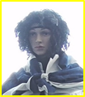
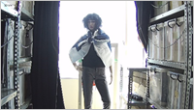
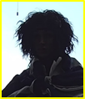
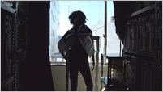
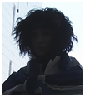
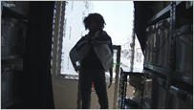
4-1. Intelligent Auto
Automatically optimize the image depending on the environment
The visibility of backlit human has been remarkably improved by human detection (upper body) even in the situation where face detection is difficult.
New model Face Priority Level: High | New model Face Priority Level: Low | Conventional model

Slide 17
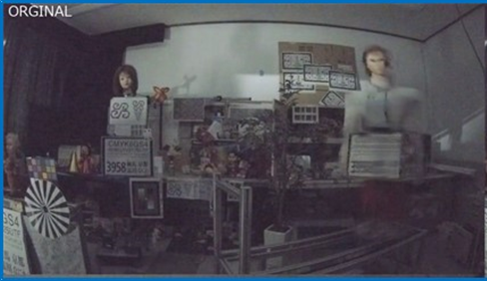
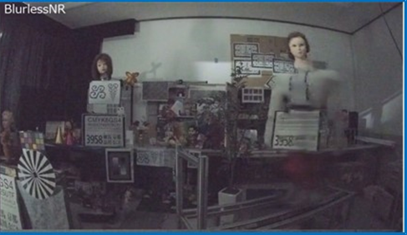
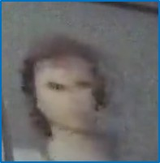
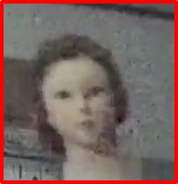
4-2. Blur less NR (noise reduction)
Suppress blurring when “People” move
Conventional model
New model
move
move
It detects people and controls blur suppression with priority over noise reduction.
blurred Image
Less blur Image

Slide 18
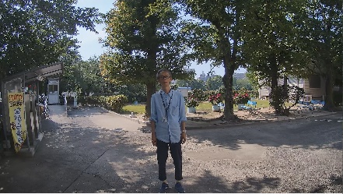
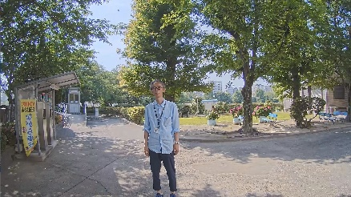


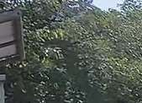
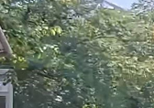
4-3. AI Smart Object Coding - Smart VIQS
Automatically control the compression rate depending on the environment
The object detection accuracy has been improved, and the non-detection area can be further compressed. (Approx. 50 % reduction compared to conventional models)
Conventional model
New model
Detects motion and automatically adjusts the image quality of moving objects to high and others to low.
Detects objects (face, human and vehicle) and adjusts the image quality of those objects to high and others to low.
Person on the image does not move
Image quality is adjusted to low
Camera detect “face” and “human”
Adjusts the image quality of the face area to high
Swaying tree is recognized as a moving object
Increase data amount
Swaying tree is NOT recognized as an object
Suppress data amount
Measured bit rate: 6733kbps
Measured bit rate: 3855kbps

Slide 19
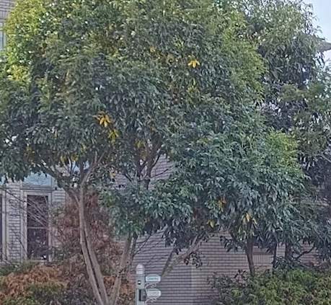
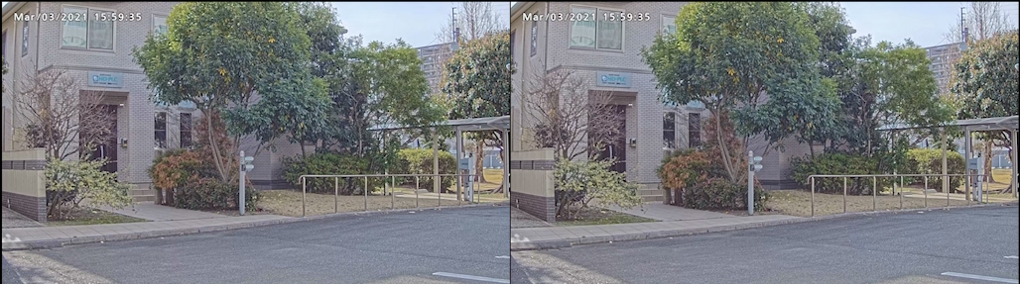
4-4. AI Smart Object Coding - Smart P-picture control
Automatically control the data volume of P-picture depending on the environment
With using AI-based object detection, the P-picture (forward predictive picture) data volume in areas, where no objects are detected, can be reduced
Hence, the movement of human and vehicle (important object) is displayed smoothly by reducing the data volume such as the shaking of trees (not important area).
the shaking of trees is not smooth
Smart P-picture control : OFF
Smart P-picture control : ON
Measured bit rate : 3179 kbps
Measured bit rate : 2219 kbps

Slide 20
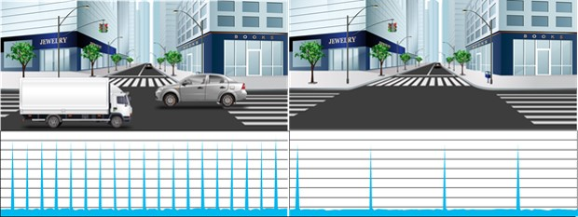
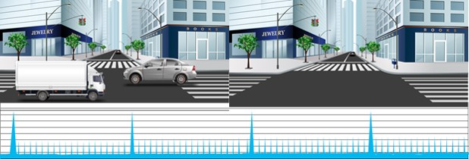
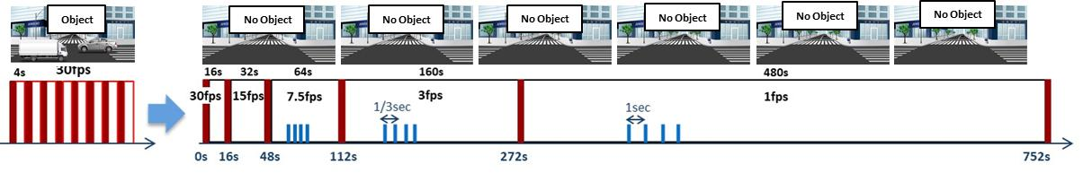
4-5. AI Smart Object Coding - GOP control
Control GOP using object detection instead of motion detection
Low / Mid
GOP control
Low (Variable GOP 1s-8s) | I-picture interval variable between 1sec-8sec by detected object (People and vehicles). *VBR only
Mid (Variable GOP 4s-16s) | I-picture interval variable between 4sec-16sec by detected object. *VBR only
Advanced (Fixed GOP 60s w/1s key-frame) | I-picture interval fixed at 60s, key-frame inserted at 1sec intervals regardless of detected object. *Selectable in all transfer modes
Frame rate control (Variable GOP 4s-16s w/frame rate control) | If there is no detected object, reduce the frame rate to 1 fps. I-picture interval variable between 4sec-16sec by detected object. *VBR only
Object
No Object
Advanced
Object
No Object
Frame rate control

Slide 21
4-6. DORI
*1
DORI (Detect, Observe, Recognize, Identify) is a standard system (EN-62676-4) for defining the ability of a camera to distinguish persons or objects within a covered area. This value does not indicate the performance of the camera.
The maximum distance at which a camera/lens combination can meet these criteria is shown below:
WV-S71300-F3
Resolution : 1920 x 1080 |  | 81.1 deg.
 |  | Unit : m | Unit : feet
Detect | 25ppm / 8ppf | 44.9 | 147.2
Observe | 62.5ppm / 19ppf | 18.0 | 58.9
Recognize | 125ppm / 38ppf | 9.0 | 29.4
Identify | 250ppm / 76ppf | 4.5 | 14.7
*1 Calculated with the camera installed horizontally

Slide 22
4-7. Supported resolution
16:9
*Underline is default value
Image capture mode | Stream(1) | Stream(2) | Stream(3) | Stream(4) | JPEG(1) | JPEG(2)
16:9(30fps) 16:9(25fps) | 1920x1080 1280x720 640x360 320x180 *1 | 1920x1080 1280x720 640x360 320x180 *1 | 1280x720 640x360 320x180 *1 | 640x360 320x180 *1 | 1920x1080 1280x720 640x360 320x180 *1 | 640x360
 | Max 30(25) fps | Max 30(25) fps | Max 30(25) fps | Max 30(25) fps | Max 5(4.2) fps *2 | Max 5(4.2) fps *2
*1 “90 deg.” and “270 deg.” cannot be set for [Image rotation] when “320x180” is selected.
*2 When “Off” is selected for “Stream transmission”, maximum framerate is 30fps(25fps).

Slide 23
4-7. Supported resolution
4:3
*1
Image capture mode | Stream(1) | Stream(2) | Stream(3) | Stream(4) | JPEG(1) | JPEG(2)
4:3(30fps) 4:3(25fps) | 1280x960 VGA QVGA | 1280x960 VGA QVGA | VGA QVGA | VGA QVGA | 1280x960 VGA QVGA | VGA
 | Max 30(25) fps | Max 30(25) fps | Max 30(25) fps | Max 30(25) fps | Max 5(4.2) fps *3 | Max 5(4.2) fps *3
4:3(15fps) *2 4:3(12.5fps) *2 | 2048x1536 | 1280x960 VGA QVGA | VGA QVGA | VGA QVGA | 2048x1536 1280x960 VGA QVGA | VGA
 | Max 15(12.5) fps | Max 15(12.5) fps | Max 15(12.5) fps | Max 15(12.5) fps | Max 5(4.2) fps *4 | Max 5(4.2) fps *4
*1 “90 deg.” and “270 deg.” cannot be set for [Image rotation] when “4:3” is selected.
*2 Extension Software isn’t available when “15fps/12.5fps” mode selected.
*3 When “Off” is selected for “Stream transmission”, maximum framerate is 30fps(25fps).
*4 When “Off” is selected for “Stream transmission”, maximum framerate is 15fps(12.5fps).

Slide 24
4-8. Streaming Performance
Number of concurrent access : 14 user
Max. Bandwidth : 50 Mbps
14 user
Bandwidth
Total bandwidth
less than
50 Mbps

Slide 25
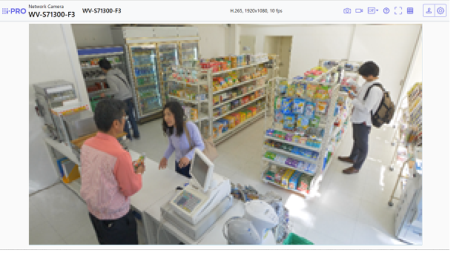
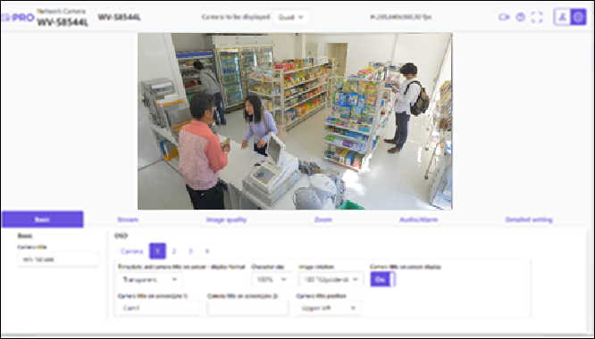
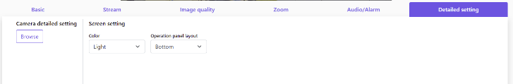

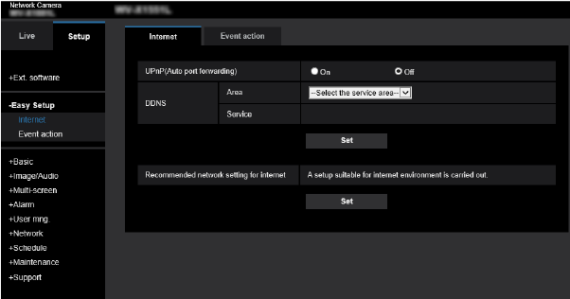
4-9. New GUI (Live Display)
Frequently used items can be set while watching the live image
Click “ Setup” button-> Display Setup panel.
When display the conventional Setup menu.
[Setup] -> [Detailed setting] -> [Camera detailed setting] -> [Browse]

Slide 26
5. AI Application

Slide 27
5-1. Overview
About “Pre-installed AI apps"
AI apps | Pre-install | KMS | License
AI-VMD | Yes | - | Free
AI Face Detection | No | Need | Free
AI People Detection | Yes | - | Free
AI Vehicle Detection | No | - | Free
AI Privacy Guard | No | - | Free
AI Non Mask Detection | No | - | Free
AI Occupancy Detection | No | - | Free
AI Sound Classification | Standard feature
AI Processor Activation License

Slide 28
5-1. Overview
Install up to 3 apps & Max. capacity will be 250MB
Max. 3 apps
AI-VMD
AI People Detection
AI Sound Classification
(Standard feature)
250MB
AI Processor
Activation License
AI application combination
As for the restrictions when installing multiple extension software applications on a camera, refer to the support information “Compatibility list for extension software <C0103>” at the link below.
https://i-pro.com/global/en/surveillance/training-support/support/technical-information

Slide 29
5-1. Overview
Set up tools for AI apps
AI apps | iCT | Web browser
AI-VMD
AI Face Detection |  | ‐
AI People Detection |  | ‐
AI Vehicle Detection |  | ‐
AI Privacy Guard
AI Non Mask Detection | No settings is required | No settings is required
AI Occupancy Detection

Slide 30


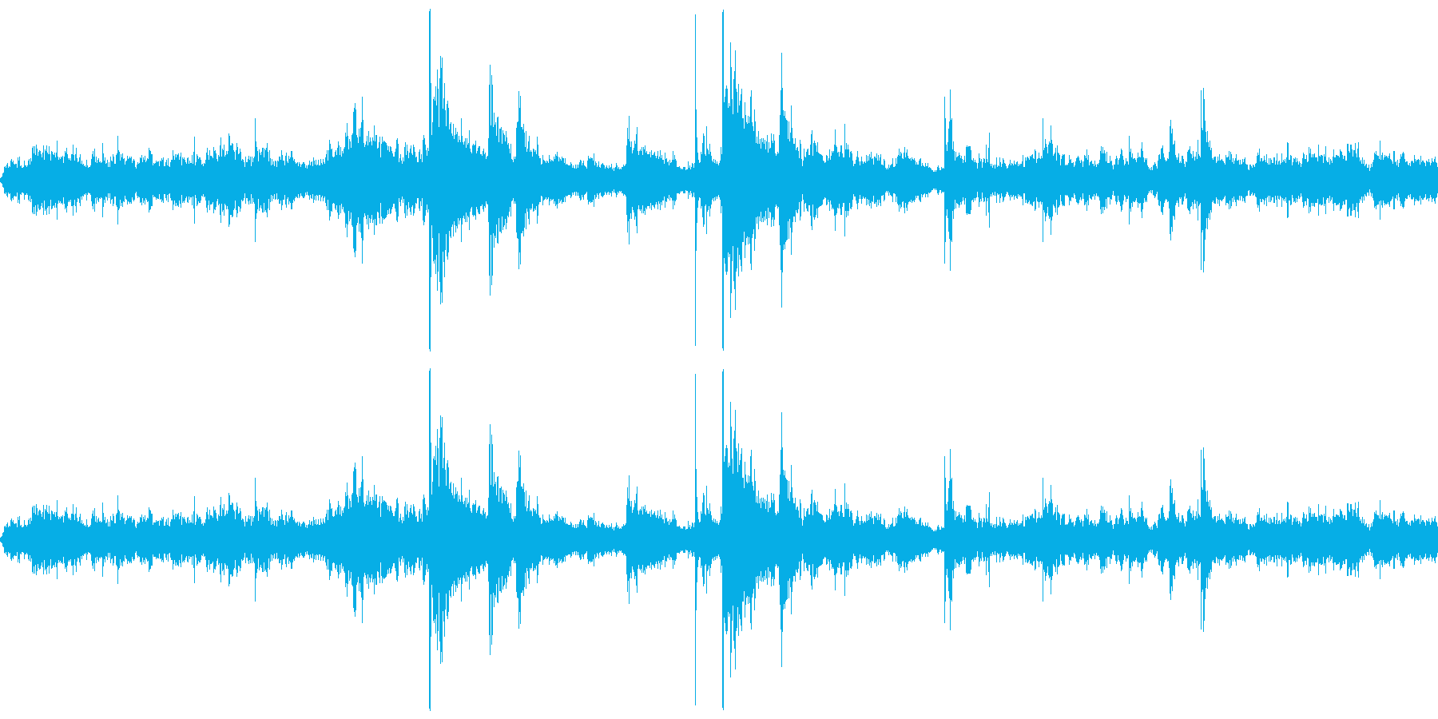



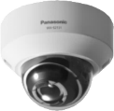
5-2. AI Sound Classification
Support identifying specific sound by AI
Gunshot
Daily noise
Gunshot
Vehicle horn
Identifying a specific sound
among other noises

Slide 31

5-2. AI Sound Classification
Spec comparison
Function | New model | Conventional model
Audio Detection | Yes | Yes
AI Sound classification | Yes | No
SD card recording triggered by Audio Detection | No | Yes
Spec of AI Sound classification
Item | Content
Classification target / Examples | 1. Gunshot | 3. Vehicle Horn
 | 2. Yell | 4. Glass break
Classification condition | The level of target sound is 6dB larger than ambient sound. (sound classification can be used in indoor and outdoor environments) Target sound continues more than a second. (except for gunshot)

Slide 32
5-2. AI Sound Classification
Detectable distance for AI Sound classification
Ambient noise level | Example of scene | Detectable distance (Guideline)
 |  | Yell / Glass break (90 - 110 dB) | Gunshot / Vehicle horn (110 - 130 dB)
70 dB | Noisy streets, main roads | 4 m (13 feet) | 15 m (49 feet)
60 dB | Ordinary conversation, quiet car | 8 m (26 feet) | 30 m (98 feet)
50 dB | Residential area, office in the daytime | 16 m (52 feet) | 50 m (164 feet) *1
40 dB | Residential area at night, library | 32 m (105 feet) | 50 m (164 feet) *1
*1 The detectable distance may change depending on the surrounding environment, such as when the building blocks it.
Microphone requirements for AI Sound classification
  Frequency characteristics: support 200 Hz to 8 KHz
  Omnidirectional microphone
Confirmed microphone
  Built-in mic (WV-S71300-F3)

Slide 33
5-2. AI Sound Classification
Restrictions
In the following cases, target sound may not be detected by AI sound identification.
Target sound is too short
Multiple types of target sounds occur at the same time (only one of them is detected)
It's raining (especially when rain drops hit the microphone directly)
Target sound is too quiet or too loud
Other sounds that are very similar to the target sound may be detected.
[Example]
Detects tire puncture as "gunshot"
If the sound of glass breaking and the impact sound is strong, it is detected as "gunshot".
Detects bird calls as “yell"
Detects an emergency vehicle siren as a “yell"
Detects the sound of tableware breaking as "glass break“

Slide 34

5-2. AI Sound Classification
Setting screen
Select On/Off.
Select detection sensitivity for the volume from Low/Middle/High.
Select sound for the target of alarm.
"Other" is detected by volume.
Select when there is no sound to be classified in the setting items.
It is not recommended to select "Other" in duplicate with other analytics target (such as a “Gunshot”).
When a gunshot actually occurs, “Gunshot" and “Other" are detected
and two alarms are notified.
In particular, when linking an alarm with the NX recorder, it is possible
that the “Gunshot" detection cannot be received because
the NX recorder has set a period during which notifications are not
continuously accepted (Alarm disarm duration [default : 2 seconds]).
In iCT V2.0 or later, you can adjust the judgment threshold of Gunshot/Yell/Vehicle horn/Glass break.
*In order to link the alarm with the NX recorder or ASM300, it is necessary to register the message ID of the alarm.
See next page.

Slide 35
[Ref.] Extension software alarm setting - Recorder Setting
Extension software alarm setting
Extension software alarm
Go to [REC & event]-> [Advanced setup] tab -> [Extension software alarm], and click “Setup” to open the [Extension software alarm] setup screen.
Set an ID for AI Sound Classification alarm in an available line from No.5 to 8.
No.
No.1-4: reserved for AI-VMD
No.5-8: available
Name
Enter the name of alarm.
Ex. “AI Sound Classification (Gunshot)”
Message ID
Enter an ID (Gunshot:70 / Glass break:71 / Vehicle Horn:72 / Yell:73) for AI Sound Classification alarm.

Slide 36


[Ref.] Extension software alarm setting - ASM300 Setting
Extension software alarm setting
Set an ID for AI Sound Classification alarm in an available line from No.5 to 8.
No.
No.1-4: reserved for AI-VMD
No.5-8: available
Intruder
Name
Enter the name of alarm.
Ex. “AI Sound Classification (Gunshot)”
Loitering
Direction
Cross Line
Message ID
Enter an ID (Gunshot:70 / Glass break:71 / Vehicle Horn:72 / Yell:73) for AI Sound Classification alarm.
User-defined 1
User-defined 2
User-defined 3
User-defined 4
Match the setting order of each message ID of No. 1 to No. 8 on the Extension software alarm setting screen of the recorder, and No. 1 to No. 8 of this setting screen.

Slide 37




5-3. AI-VMD
Detection mode
Intruder detection
Direction detection
Issues an alarm when a moving object enters the configured area.
Issues an alarm when a moving object enters the configured area and moves to the specified direction.
Loitering detection
Cross line detection
Issues an alarm when a moving object enters and stays at the configured area for a specified period.
Issues an alarm when an object moving to the specified direction crosses the configured line.

Slide 38
5-3. AI-VMD
Specification
Detection object | Human, Vehicle, Bicycle
Maximum number of simultaneous detection *1 | 40
Minimum detection size *2 | 24 pix
Maximum number of detection condition *3 | 2
Maximum number of detection area | 8 for each detection criteria, 16 in total
Maximum number of mask area | 8 for each detection criteria, 16 in total
Supported version (AI-VMD) | Ver.2.11 or later
*1 Depending on the size of moving object, the detecting situation and other conditions, it may not detect the objects up to the maximum number of detection.
*2 Minimum size is a theoretical value and does not guarantee the detection of objects of this size.
*3 The detection condition can be configured by setting the combination of "Detection area", "Detection object" and "Detection mode".

Slide 39
5-3. AI-VMD
Restrictions
The accuracy of image analysis may be affected by the environmental causes listed below.
Although the performance has been remarkably improved by AI technology, the causes of false positives / false negatives listed below are not 100 percent eliminated.
The difference in brightness between the background and the moving object is small
Shooting when the brightness of the image is low such as nighttime
The object is too small or too large
Shooting under the changeable light conditions such as outdoors or near windows and so forth
External lights such as sunlight or car headlights come into the shooting area
Flickering fluorescent lamps
The dome of the camera is sweating or has dirt on it
The object is moving straight toward the camera
The object is moving too fast or too slow
Too many moving objects are in the shooting area
The camera is shaking
The weather is extremely bad
Reflected light from a puddle or glass comes into the shooting area
Flags or vinyl and so forth are fluttering in the wind
Insects or animals come into the shooting area
The object on posters may be alarmed

Slide 40




5-4. AI Privacy Guard
Performs Blurring or Block processing to mask the face or person detected on the image in order to protect privacy.
Masking method : Blurring
Masking method : Block
Privacy Guard target : Face
AI Privacy Guard
Original
Privacy Guard target : Human
Privacy Guard target | Face/ Human
Masking method | Blurring / Block
AI Privacy Guard

Slide 41
5-4. AI Privacy Guard
Specification
Privacy Guard target | Face/Human
Target stream | Stream(1)/(2)/(3)/(4)/ Stream(2) & (4)
Masking method | Blurring / Block
Size *1 | 32 - 1400 pixels (FullHD camera)
Maximum number of persons | 99 persons
Range in the camera *2 | more than 2/3 of guard target
Direction *3 | Horizontal: within 90 degrees Vertical: within 45 degrees
Rotation *4 | ±within ±90 degrees
Color / Monochrome | Support both (including IR-LED)
*1 When [Privacy Guard target] =“Face”: Facial width, When [Privacy Guard target] =“ Human”: Body width
*2 The upper body including face needs to be captured on the image when [Privacy Guard target] is set to “Human”
*3 The angle of camera optical axis and a target object
*4 When regarding the vertical line of an image as 0 degree

Slide 42
5-4. AI Privacy Guard
Restrictions
Software specification related
- Target stream for AI Privacy Guard can be selected from Stream(1) to (4) or Stream(2)&Stream(4).
- “Stream(2) & Stream(4)” needs to be selected for [Target stream] when using AI Privacy Guard linked to NX recorder or WV-ASM300.
*When “Stream(2) & Stream(4)” is selected, "Stream (1)" and "Stream (2)" of the camera will have the same resolution.
Also, "Stream (3)" and "Stream (4)" will have the same resolution.
- JPEG(2) is NOT available when AI Privacy Guard is enabled. *JPEG(1) is available as an original image.
Performance related
- Blurring or Block may be applied on the area without “face” or “person”.
- Blurring or Block may be applied on dolls or posters.
- The size of the area where Blurring or Block performed may be larger than the actual size of a target object.
- Blurring or Block may NOT be performed in the following cases even if the conditions described above are met:
  The target object is out of focus.
  The target object is blurred.
  The target object is overexposed or underexposed.
  The target object is lying down or felled.

Slide 43
5-5. Frame rate limitation
S-Series with AI engine |  | AI Privacy Guard
 |  | Not installed | Installed
 |  |  | Function = ON | Function = OFF
AI-VMD | Not installed | Original image : Max. 30fps | Original image : Max. 10fps AI Privacy Guard image : Max. 10fps | Original image : Max. 30fps
 | Installed *1 | Original image : Max. 30fps | Original image : Max. 10fps AI Privacy Guard image : Max. 5fps | Original image : Max. 30fps
*1 After pressing "Use AI-VMD" on the AI-VMD setup screen
As for the restrictions when installing multiple extension software applications on a camera, refer to the support information “Compatibility list for extension software <C0103>” at the link below.
https://i-pro.com/global/en/surveillance/training-support/support/technical-information

Slide 44

5-6. Easy installation with Grid display
Add grid display button to the live image of the browser.
The grid display is useful when adjusting the angle of view in some extended software.
Number of pixels per grid
4K models | 5MP models | Full-HD models (i-PRO mini)
200 pixels | 133 pixels | 100 pixels
As for appropriate object size, refer to the support information “How to adjust viewing angle for extension software <C0320>” at the link below.
https://i-pro.com/global/en/surveillance/training-support/support/technical-information

Slide 45


5-6. Easy installation with Grid display
When is the grid display used?
Installation process | System design | Camera installation | Camera settings
 | Design the position of cameras | Adjust angle of view | Set application
Who | System Integrator | Installer | System Integrator
Tool | SDT | Grid display (browser) | iCT
Benefit | By immediately reflecting the settings in the simulation results, the work spent on system design can be reduced. | Effective when adjusting the angle of view of some extension software. | System Integrator can centrally manage settings related to the camera and apps.

Slide 46
6. Appearance

Slide 47

6. Appearance
WV-S71300-F3
Color
: i-PRO white
Finish
: PC resin / Aluminum die cast
Dimensions *1
: Size : 102 mm (W) x 48 mm (H) x 21 mm (D)
{4-1/64 inches (W) x 1-57/64 inches (H) x 53/64 inches (D)}
Weight *1
: Approx. 157 g {0.35 lbs}
*1 Without mount base

Slide 48
7. Standard Accessories

Slide 49
7. Standard Accessories
WV-S71300-F3
No. | Standard accessories | Qt.
1 | Installation Guide | 1 pc.
2 | Installation Procedure leaflet | 1 pc.
3 | Code label | 1 pc.
4 | Protective cover | 1 pc.
5 | Mounting seat | 1 pc.
6 | Mounting seat fixing screw (M3 x 6 mm {1/4 inches}) | 2 pcs.
7 | Wire fixing screws (M2 x 4 mm {5/32 inches}) | 1 pc.
8 | Safety wire | 1 pc.
9 | Washer | 1 pc.
10 | Spring washer | 1 pc.

Slide 50
8. Optional Accessories

Slide 51



8. Optional Accessories
There are no optional accessories.
*Mounting bracket / back plate must be procured separately.
Installation using mounting brackets
Installation using screw holes
Recommended dimensions for the back plate
Width : 60 mm
Height : 50 mm
Thickness : 2 mm
Material : Metal (Aluminum, Iron)

Slide 52
9. System Support Schedule

Slide 53
9. System Support Schedule
 | Mar. 2022 | Apr. 2022 | May. 2022 | Jun. 2022 | Jul. 2022
Camera release
NX Recorders
ASM300
i-PRO Active Guard (Multi-AI server)
iMA (PSV)
iCT
SDT
Video Insight
Genetec
Milestone
Camera hardware release
V5.00
V5.00
V1.3.1
V10.00
V3.00
V3.00
V7.9.2
SC5.10.4(+DP10.x) *T.B.D.
DP12.2 *T.B.D.

Slide 54
Appendix:
Image quality comparison

Slide 55
Summary
i-PRO S71300-F3
SD : OFF, iA : ON, AGC : 11
H265, VBR
30fps
MAX bitrate : 20480 kbps
image quality : 3
Smart coding : OFF
* Other setting parameters are default values.
AXIS M1065-LW
SD : OFF, AGC : 48dB
H264, VBR
30fps
image quality : 3
Zipstream : OFF
* Other setting parameters are default values.
Scoring method: Scored by deducting and adding points beginning with 3 points.

Slide 56




Day time Outdoor
Illuminance : 1000 lux
i-PRO S71300-F3
AXIS M1065-LW
3.0 points
1.0 points
Evaluation item | Score
Face visibility | -0.5
Sensitivity, S/N | +0
Brightness | +0
Resolution | +0.5
Color reproduction | +0
Evaluation item | Score
Face visibility | -0.5
Sensitivity, S/N | +0
Brightness | -0.5
Resolution | -0.5
Color reproduction | -0.5
Measured bit rate: 2534 kbps
Measured bit rate: 1955 kbps

Slide 57




Day time Indoor
Illuminance : 800 - 900 lux
i-PRO S71300-F3
AXIS M1065-LW
3.0 points
1.5 points
Evaluation item | Score
Face visibility | +0.5
Sensitivity, S/N | +0
Brightness | -0.5
Resolution | +0
Color reproduction | +0
Evaluation item | Score
Face visibility | -0.5
Sensitivity, S/N | +0
Brightness | -0.5
Resolution | -0.5
Color reproduction | +0
Measured bit rate: 1230 kbps
Measured bit rate: 1319 kbps

Slide 58




SD Day time
Illuminance: [Outside] 10000 - 20000 lux / [Inside] 400 lux
i-PRO S71300-F3
AXIS M1065-LW
2.5 points
2.5 points
Evaluation item | Score
Face visibility | +0
Sensitivity, S/N | +0
Brightness | -0.5
Resolution | +0
Color reproduction | +0
Evaluation item | Score
Face visibility | +0
Sensitivity, S/N | +0
Brightness | -0.5
Resolution | +0
Color reproduction | +0
Measured bit rate: 1858 kbps
Measured bit rate: 2152 kbps

Slide 59




Night time Outdoor
Illuminance: 5 - 15 lux
i-PRO S71300-F3
AXIS M1065-LW
3.0 points
1.5 points
Evaluation item | Score
Face visibility | +0.5
Sensitivity, S/N | +0
Brightness | -0.5
Resolution | +0
Color reproduction | +0
Evaluation item | Score
Face visibility | +0
Sensitivity, S/N | +0
Brightness | -0.5
Resolution | -0.5
Color reproduction | -0.5
Measured bit rate: 2302 kbps
Measured bit rate: 4459 kbps

Slide 60




Low light
Illuminance: 1 lux
i-PRO S71300-F3
AXIS M1065-LW
Around the edge of viewing angle is dark
2.5 points
0.5 points
Evaluation item | Score
Face visibility | +0
Sensitivity, S/N | +0
Brightness | -0.5
Resolution | +0
Color reproduction | +0
Evaluation item | Score
Face visibility | +0
Sensitivity, S/N | +0
Brightness | -0.5
Resolution | -1.0
Color reproduction | -1.0
Measured bit rate: 1201 kbps
Measured bit rate: 2133 kbps

Slide 61
Appendix:
Image quality restrictions

Slide 62




Restrictions: May differ from actual colors
i-PRO S71300-F3
AXIS M1065-LW
The leaves of the trees outside are dull in color
Occurrence condition
Around the angle of view
Subject: easily reflect infrared light contained in sunlight (such as leaves)

Slide 63
Version History

Slide 64
Version History
No | Update contents | Page No. | Version | Update
1 | 1st Version | - | 1.00 | 14. Feb. 2022
2 | Corrected streaming performance information. | P.23 | 1.01 | 10. Aug. 2022
3
4
5
6
7
8
9
10
11
12
13
14
15

