Slide 1
Video Surveillance Software WV-ASM300 series Ver.5.0 version up contents - April 2022 -
Model : WV-ASM300
Document Version : 1.00
Apr. 2022

Slide 2
Contents
Items​​ | Sheet​
1. Change the notation of the company | 2​
2. New product Support | 3​
3. New product Support - Multi-sensor camera | 4,5
Software Version No. : V5.0
Release date on the global site : Apr. 2022

Slide 3
1. Change the notation of the company
Improvement​
Video Surveillance Software
[ASM300]
Target
Product
Version
V5.0
The Panasonic notation that has been used will be changed to i-PRO or removed
Company name ​: Panasonic i-PRO Sensing Solutions Co., Ltd. → i-PRO Co., Ltd.​
Install Directory : %PROGRAMFILES(x86)%\Panasonic\ASM300
→ %PROGRAMFILES(x86)%\i-PRO\ASM300
Name of alarm protocol : Panasonic alarm protocol → TCP alarm notification
Panasonic Logo : can be displayed by the “Setting”-“System”-“GUI display setup”
→ The "i-PRO logo" cannot be displayed either.

Slide 4
2. New product Support
Target
Product
Video Surveillance Software
[ASM300]
Version
V5.0
Support AI Multi-sensor camera
WV-S8543 series, WV-S8544 series, WV-S8563 series, WV-S8564 series, WV-S8573 series, WV-S8574 series
Support i-PRO mini camera
WV-S71300-F3
Support AI Network camera (S series)
WV-S15500 series, WV-S15600 series, WV-S15700 series
WV-S22500 series, WV-S22600 series, WV-S22700 series
WV-S25500 series, WV-S25600 series, WV-S25700 series
Support NX series Recorder
WJ-NX400/NX300/NX200/NX100 v5.00

Slide 5
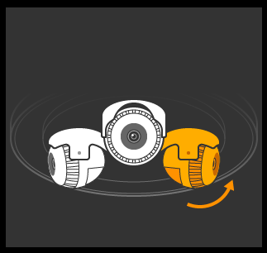
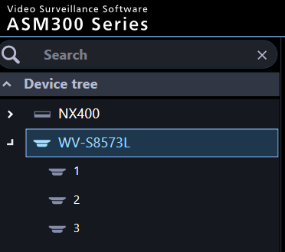
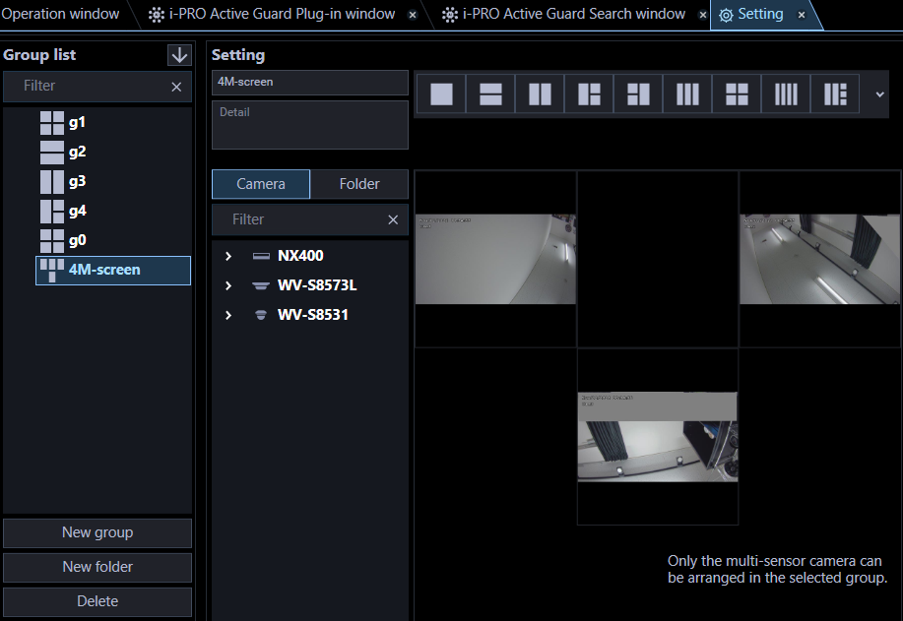
3. New product Support - Multi-sensor camera (1/2)
Target
Product
Video Surveillance Software
[ASM300]
Version
V5.0
The differences from the old multi-sensor camera (S8530/31, X8570/71) are as follows.
Supports 3-eyes camera models that has three camera units inside the cabinet
and 4M-screen (T-shaped layout) is also available.
The icon of the multi-sensor camera has changed.

Slide 6
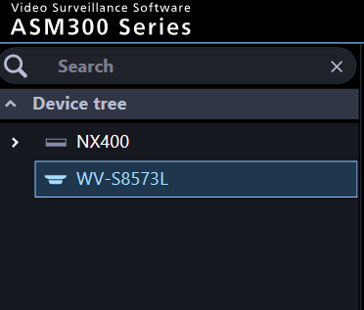
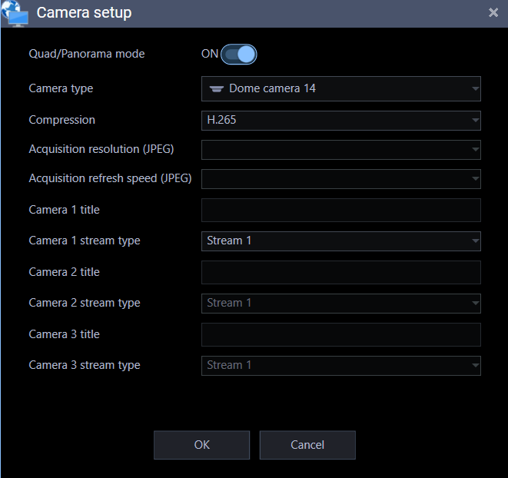
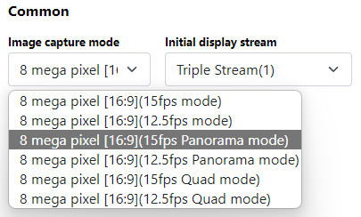
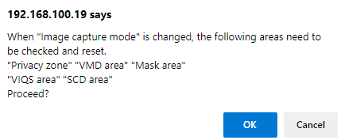
3. New product Support - Multi-sensor camera (2/2)
Target
Product
Video Surveillance Software
[ASM300]
Version
V5.0
Supports Quad / Panorama mode
In this mode, the three camera unit icon are not displayed.
It is necessary to match the settings on the
camera side such as the imaging capture mode.
If you change from Quad / Panorama mode
to normal mode (and vice versa), the registered
group and map settings will be cleared.

Slide 7
Version History

Slide 8
Version History
No | Update contents | Page No. | Version | Update
1 | 1st Version | - | 1.00 | 20.Apr.2022
2
3
4
5
6
7
8
9
10
11
12
13
14
15

