Slide 1
i-PRO Multi-AI System
Ver.1.3 version up contents
- February 2022 -
Ver.1.00
Feb. 2022

Slide 2
Overview
Target
Product
i-PRO Multi-AI System
V1.3
Feb.2022
Multi-AI plug-in for ASM300
V1.0
Feb.2022
Contents
Version upgrade item | Multi-AI System | ASM Plug-in | page
1. Support ASM300 |  |  | 2-5
2. Register the camera from the recorder |  | - | 6
3. Support Dashboard function (age / gender, people attribute, vehicle attribute) |  |  | 7-9
4. Search for similar faces |  |  | 10-14
5. i-PRO original alarm transmission / reception / setting |  |  | 15,16
6. Alarm processing (state management / patrol lamp extinguishing processing) |  |  | 17
7. Face timeline display |  |  | 18
8. multiple Multi-AI server registration |  |  | 19-21
9. Alarm result export function |  |  | 22,23
10. Remove the image update interval setting |  | - | 24
✓
✓
✓
✓
✓
✓
✓
✓
✓
✓
✓
✓
✓
✓
✓
✓
✓
✓

Slide 3

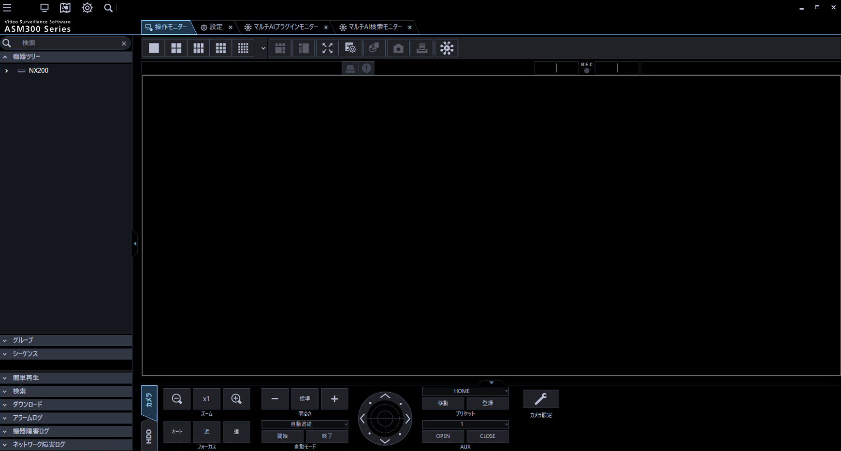
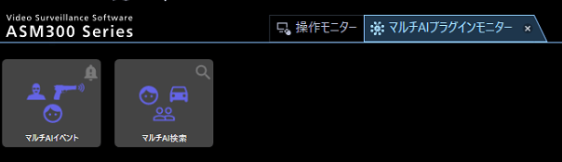

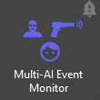
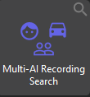
Support ASM300 (1/4)
Improvement
Launch ASM300 plug-in, Support Occupancy detection
ASM300 plugin configuration
Multi-AI Soft.:Ver.1.3
ASM plug-in:-
It is necessary to complete the installation and license registration of the ASM300 plug-in in advance.
After logging in to the WV-ASM300, click the ( Multi-AI plug-in) icon from the operation monitor.
Multi-AI plug-in window
Multi-AI plug-in monitor
If you want to search for faces, people, and vehicles using the feature information analyzed by the AI network camera, click the "Multi-AI Recording Search" icon.
If you want to display the information received by the alarm or search the alarm history, click the "Multi-AI Event Monitor" icon.

Slide 4
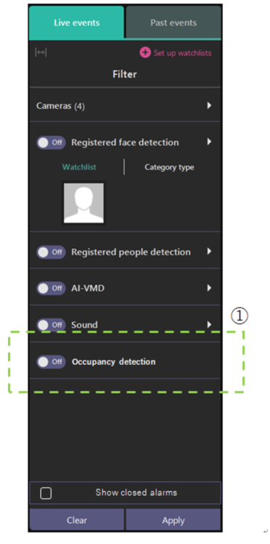
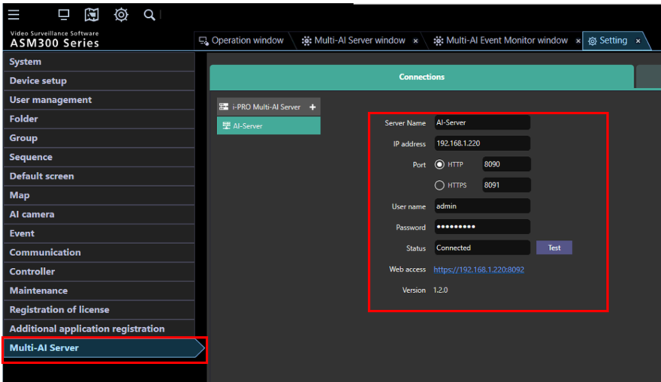

Support ASM300 (2/4)
■Support Occupancy detection
■Configuration on ASM300 plugin
(Live/Past events)
Show Occupancy detection events from AI-VMD/AI People Counting for 360-degree fisheye camera.
Available search filters include:
Registered face detection
Registered people detection
AI-VMD
Sound
Occupancy detection
Input Multi-AI server information and click [Test].
Enter the administrator user name and password, and port number when installing . If [Connected] is shown for [Status], click [Save].
Note) Up to 100 Multi-AI server can be registered.

Slide 5
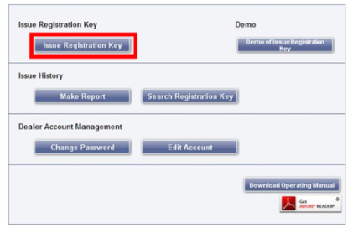
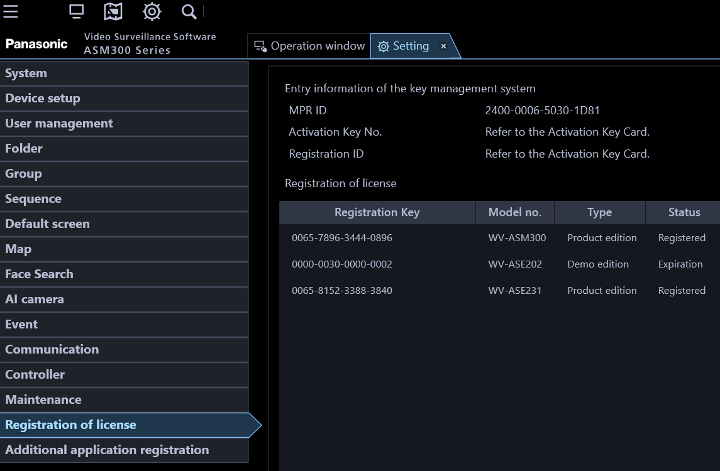
Support ASM300 (3/4)
The ASM300 plug-in requires to be activated by “Registration Key” issued by
KMS (Key Management System) before you start using.
1. Obtain the Registration Key
Start Operation Software of WV-ASM300 and login as administrator.
Confirm [MPRID] from WV-ASM300 [Setting] – [Registration of license].
Click [Issue Registration Key] button.
The ASM300 plug-in requires to be activated by “Registration Key” issued by KMS before you start using.
Select [Multi-AI plugin for ASM300] and follow the instructions on the screen to proceed.
[Activation Key No.] and [Registration ID] are as follows.
[Activation Key No.]: 0936-0065-0022-0208
[Registration ID]: B6B0-EACC
Access the URL for PC below and login.
https://kms.business.panasonic.net/ipkms/pc/home.htm
Please login as a temporary user using following User ID and password written on the web page.

Slide 6
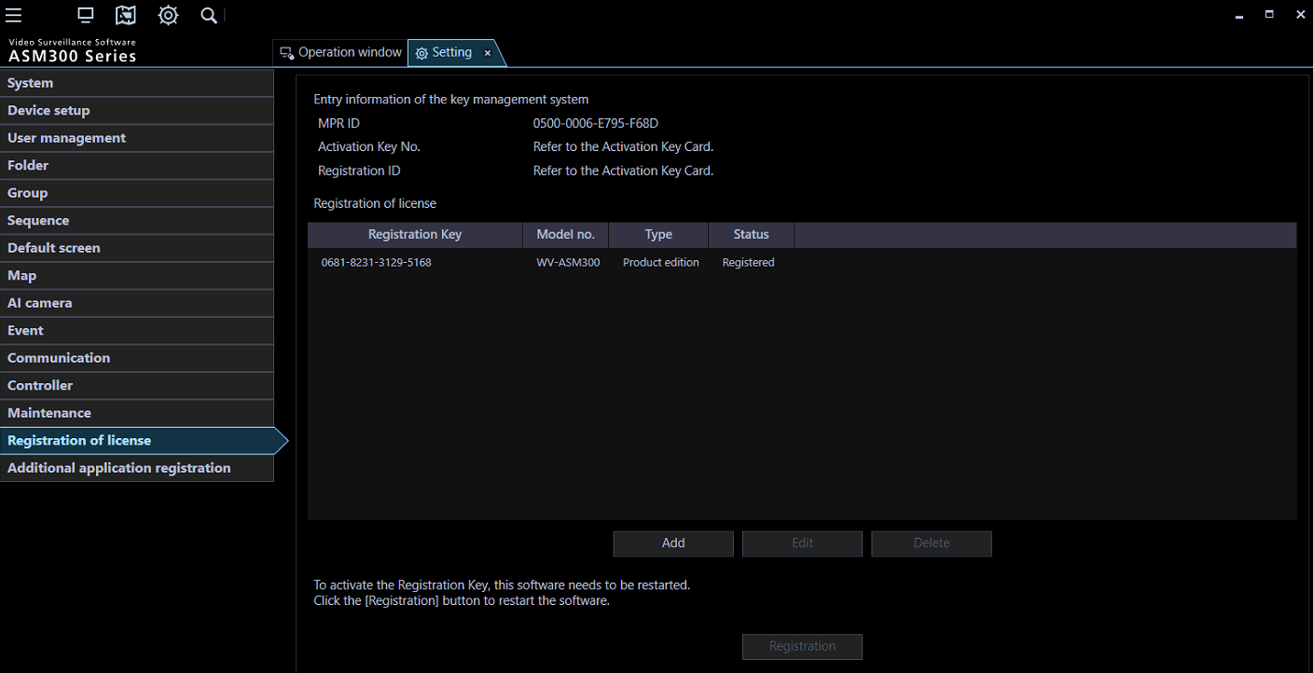

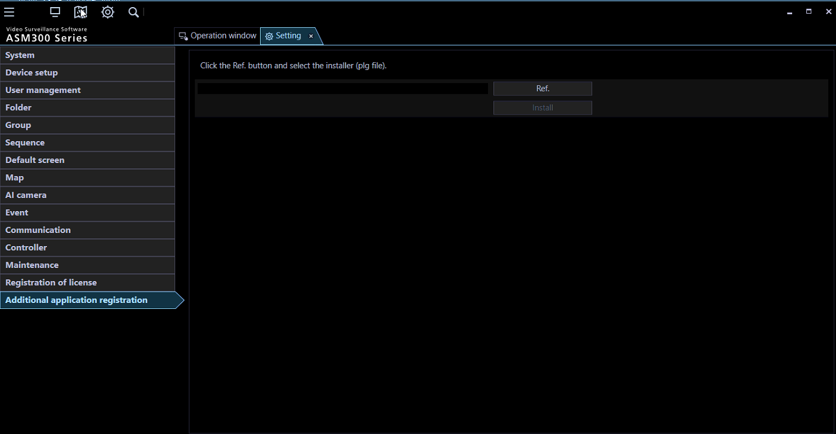
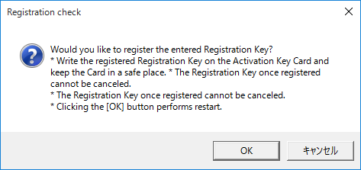
Support ASM300 (4/4)
2. Install Multi-AI plugin and license registration
Select [Registration of license] and click [Add]
Download the installer from https://i-pro.com/global/en/surveillance/training-support/documentation-database-list/.
Installation and configuration can be done from WV-ASM300.
Execute [EnablePlugin.bat] included in downloaded folder.
Start Operation Software of WV-ASM300 and login as administrator.
Open setting window.
Select [Additional application registration]. Click [Ref.],
select downloaded file “MultiAIPlugin.plg” and click [install].
Input [Registration Key] obtained in previous page and click [Input saving]
Click the [Registration] button after confirming the information of the entered "Registration Key".
Click the [OK] button.
Follow the instructions on the screen to proceed with the installation.

Slide 7
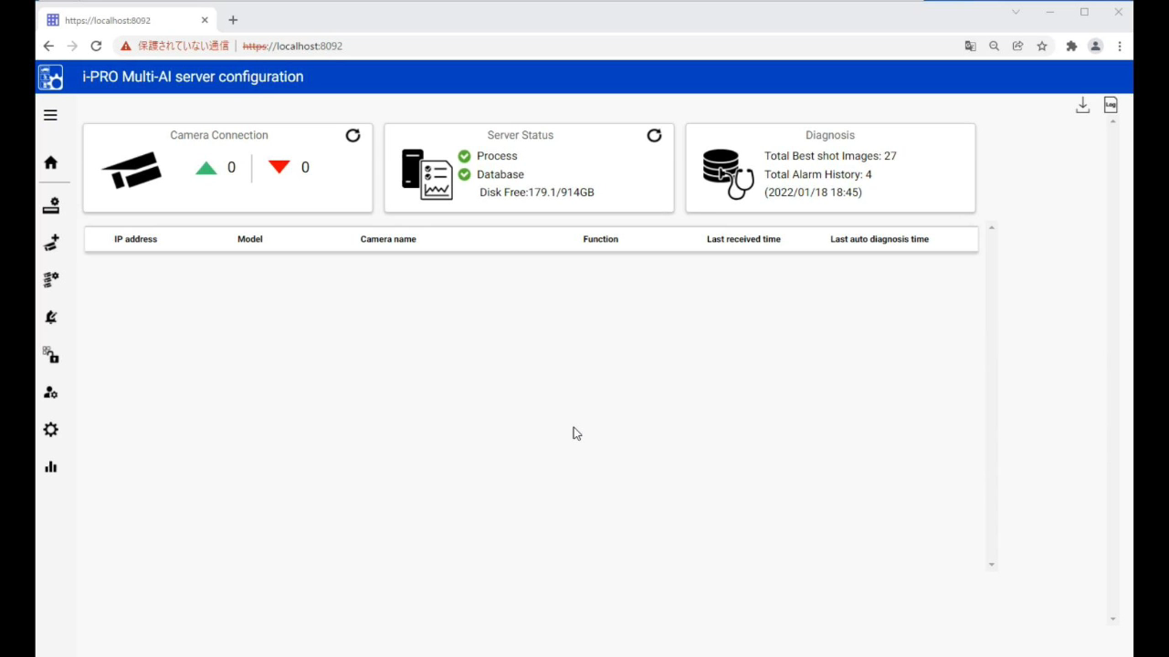
2. Register the camera from the recorder
Improvement
Register the camera registered to the NX series recorder in the Multi-AI system.
Multi-AI Soft.:Ver.1.3
ASM plug-in:-
1. Register the recorder
Top page of i-PRO Multi-AI server configuration
to the Registration page of recorder
Click "ADD" button.
Enter the IP address and ID/password of the recorder.
Confirm that the added recorder is displayed on the registration screen.
2. Register the camera under the NX series recorder to the Multi-AI system
Press the "ADD" button.
Click "Get from Recorder".
Select the camera and enter the ID/password for the connection.
Click "Reboot" button and save the changes to complete the registration.

Slide 8
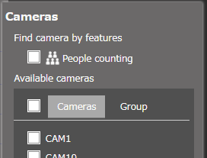
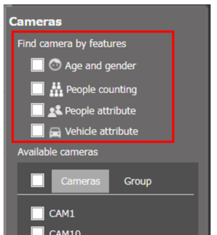
3. Support Dashboard function (Age & gender, People, Vehicle attribute) (1/3)
Improvement
The dashboard can now display various graphs for Age and Gender, People and vehicle attributes.
Multi-AI Soft.:Ver.1.3
ASM plug-in:-
It is now possible to select cameras for Age and gender, People attributes, and Vehicle attributes.
(2) Attributes on ver1.3
AI app | Type |  | Detail
AI Face Detection | Face | Gender | Male / Female
 |  | Age | Child(0-10) / Young adult(11-20) / Adult(21-30) / Adult(31-40) / Adult(41-50) / Adult(51-60) / Senior(61+)
AI People Detection | People | Gender | Male / Female
 |  | Age | Child(0-10) / Young adult(11-20) / Adult(21-60) / Senior(61+)
 |  | Hair type | long-hair/ short-hair / hat
 |  | Hair color | 5 (Black/Brown/White/Gray/Gold)
 |  | Sunglasses | Sunglass / No Sunglasses
 |  | Beard | Beard / No Beard
 |  | Top type | long-sleeves / short-sleeves
 |  | Top color | 11 (Black/Brown/White/Gray/Green/Red/Blue/Yellow/Orange/Purple/Pink)
 |  | Bottom type | short / long
 |  | Bottom color | 11 (Black/Brown/White/Gray/Green/Red/Blue/Yellow/Orange/Purple/Pink)
 |  | Mask | Mask / No Mask
AI Vehicle Detection | Vehicle | Type | 7 (Truck/Bus/SUV/Van/Sedan/Pick-up truck/Two wheels)
 |  | Color | 11 (black / brown / white / gray / orange / red / blue / yellow / green / purple / pink)
Apps for Dashboard | Multi-AI System
 | Ver1.2 | Ver1.3
AI-VMD / AI People Counting for 360-degree fisheye
AI Face Detection *1 | -
AI People Detection | -
AI Vehicle Detection | -
*1 The Dashboard requires V1.10 of this app.
✓
✓
✓
✓
✓
Changes in the camera selection menu
ver1.2
ver1.3

Slide 9
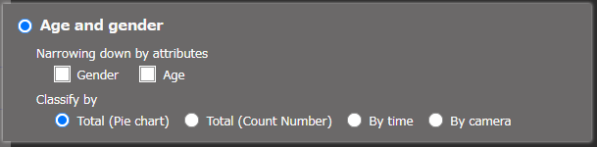
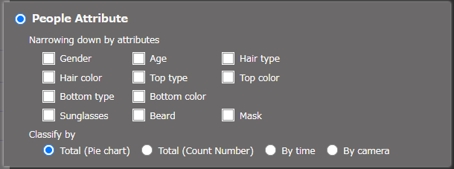
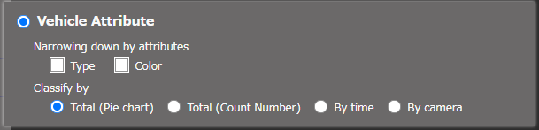
3. Support Dashboard function (Age & gender, People, Vehicle attribute) (2/3)
(2) Selection menus on ver1.3
Narrowing down by attribute
Gender | Age | What is displayed
- | - | Number of all faces detected
checked | - | Number and percentage of men and women
- | checked | Number and percentage of each age group
checked | checked | The number and percentage of the top 10 combinations of gender and age attributes with the highest number analysed.
You can select up to three attributes to be displayed.
Each attribute is classified as follows.
If you select more than one, it will show you the number and percentage of the top 10 most analysed combinations of those attributes.
For example, if you choose gender and the colour of the clothes, you can see in a ranking format up to the tenth place how many women have the most white tops or how many men have blue jackets.
Other combinations will be classified as "other".
If all are unselected, information on the number of all persons detected will be displayed.
Type | Color | What is displayed
- | - | Number of all vehicles detected
checked | - | Number and percentage of vehicle types
- | checked | Number and percentage of each vehicle colour
checked | checked | The number and percentage of the top 10 combinations of vehicle type and vehicle color attributes with the highest number analysed.

Slide 10
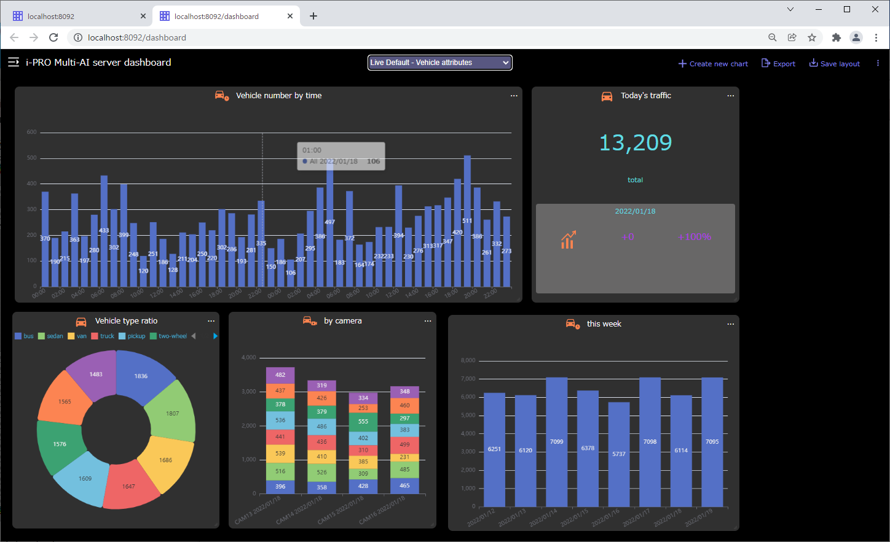
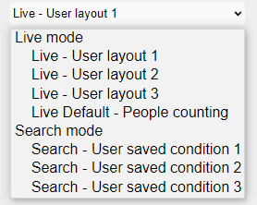
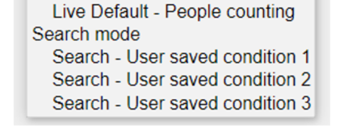
3. Support Dashboard function (Age & gender, people, vehicle attribute) (3/3)
(3) Addition of default layout menu
Display example of vehicle attributes
Live Default - Age & Gender
Live Default - People attributes
Live Default - Vehicle attributes

Slide 11
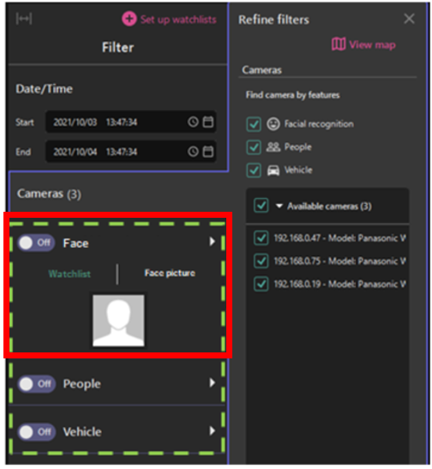
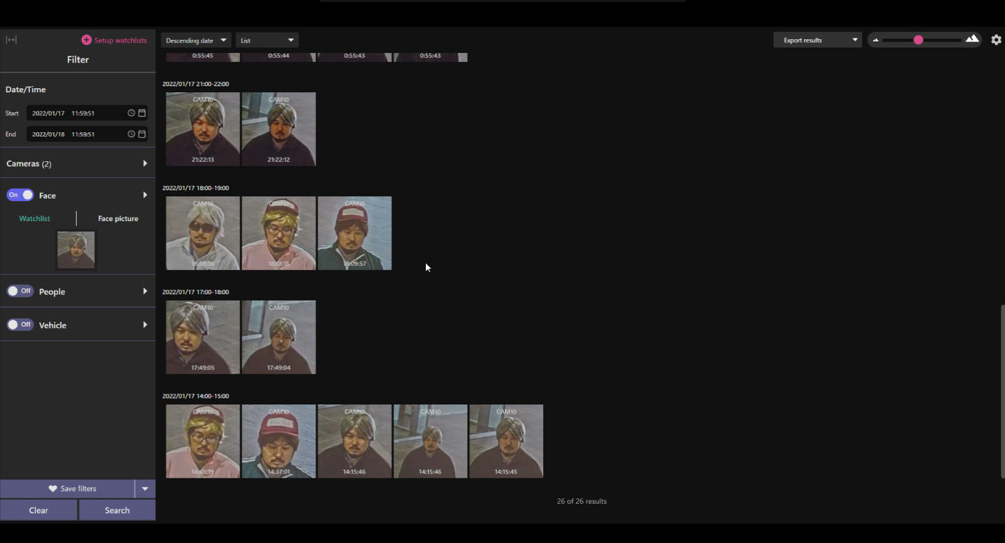
4. Supports similar face search function (1/5)
Improvement
Add a face search function to Recording search :
Outline
Multi-AI Soft.:Ver.1.3
ASM plug-in:Ver.1.0
Search
This function can be used when the multi-AI system can recognize a face image search result or a person image as a effective face.

Slide 12
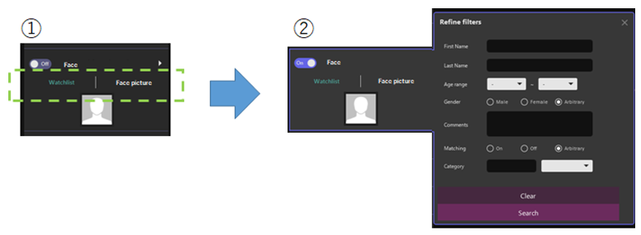
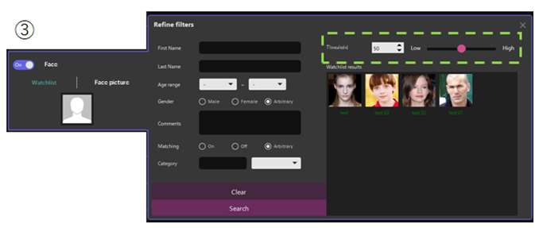


4. Supports similar face search function (2/5)
Improvement
Add a face search function to Recording search :
1. Select a face image from Watchlist
Multi-AI Soft.:Ver.1.3
ASM plug-in:Ver.1.0
Search from Watchlist.
Spinner and slider for threshold specification for thumbnail search
Select “Watchlist”
Set a filter in the detail menu and execute a search by pressing the "Search" button.
Further to the right, the window expands to show a list of results.

Slide 13
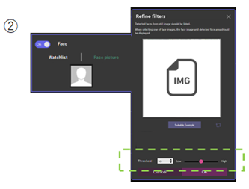
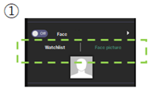
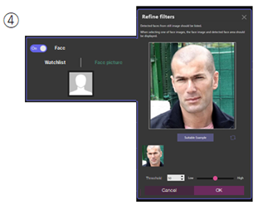
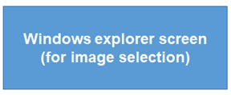

4. Supports similar face search function (3/5)
Improvement
Add a face search function to Recording search :
2. Select a face image from the image files
Multi-AI Soft.:Ver.1.3
ASM plug-in:Ver.1.0
Search from face images ("Face picture")
Select the image file that contains the face you want to search.
(Bmp, jpg, jpeg, png)
Spinner and slider for threshold specification for thumbnail search
Select "Face picture"
Click inside the image frame to pop up the Windows Explorer window.
The selected image file is inserted in the image selection frame, the detection of the face in the image starts, and the detected face is displayed on the lower side.

Slide 14
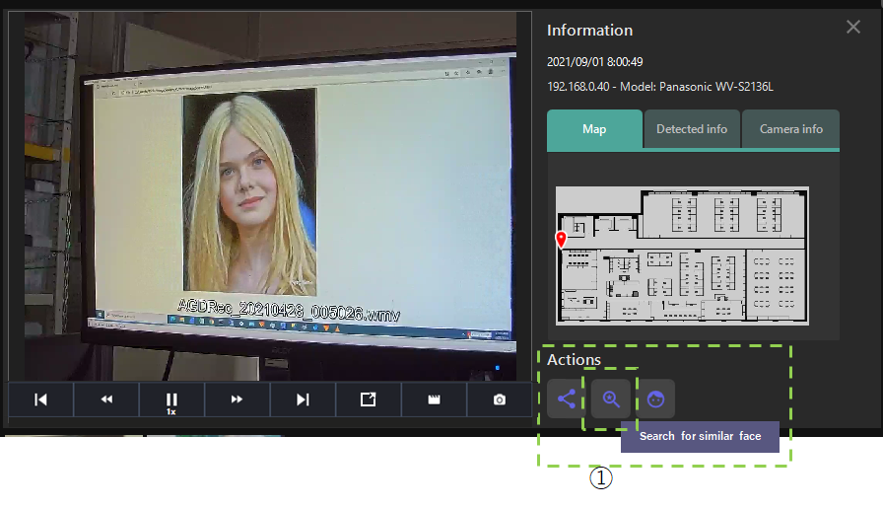
4. Supports similar face search function (4/5)
Improvement
Enhancement of Action button when playing from face thumbnail
Multi-AI Soft.:Ver.1.3
ASM plug-in:Ver.1.0
The Action button “Search for similar face” will be displayed, when playing back a video after clicking on a thumbnail of the search result using the Face filter.
This button is the same as the search button when searching for people.
The behavior after clicking is similar to the vehicle similarity search, and the action button is clicked to immediately search for similar faces.

Slide 15
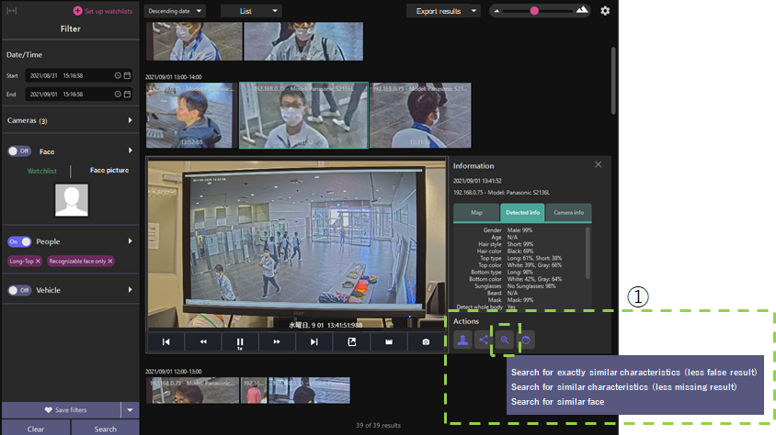
4. Supports similar face search function (5/5)
Improvement
Enhancement of Action buttons when playing People thumbnails
Multi-AI Soft.:Ver.1.3
ASM plug-in:Ver.1.0
When playing back the video after clicking the thumbnail of the search result by the People filter, the function of the Action button for searching is expanded so that a similar face can be searched using the detected face information.
This button is the same as the search button for face search, and the menu after clicking is "Search for similar face".
This menu will only be displayed when the face of the detected person has been detected. If no face has been detected, the Action button menu will remain as it is, but will only be displayed for the similarity search of the person.

Slide 16
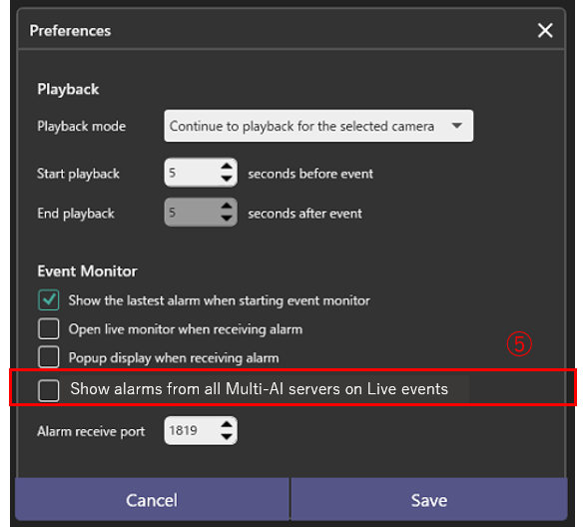

5. TCP alarm transmission / reception / setting (1/2)
Improvement
Supports TCP alarm (i-PRO proprietary alarm protocol)
Multi-AI Soft.:Ver.1.3
ASM plug-in:Ver.1.0
Set the ASM plug-in software to activate a pop-up alarm when a TCP alarm is received.
Click Preference icon.
Popup display when receiving alarm (Default: checked)
If you check and save, a pop-up will be displayed at the bottom right of the display when you receive your own alarm via the ASM300 SDK.
Others:
Open Live monitor when receiving alarm (Default: unchecked)
If you check and save, the live image of the corresponding camera will be opened when the original alarm is received via the SDK of ASM300.
Show alarms from all Multi-AI servers on Live events (Default: unchecked)
When unchecked, Live events show alarms only from selected Multi-AI server.
When checked, Live events show alarms from all Multi-AI servers including other than selected
Alarm receive port
Add a spin button to determine the port number for receiving alarms. The initial value is “1819”.

Slide 17
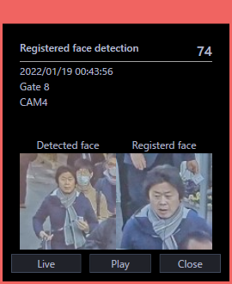
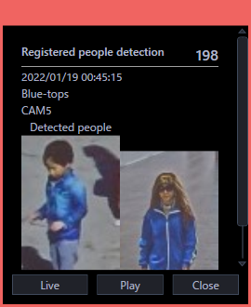
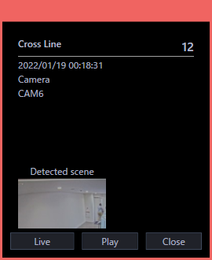
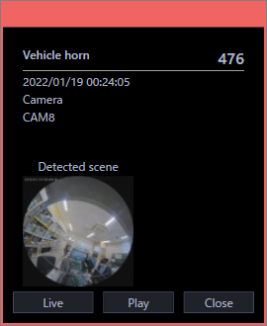
5. TCP alarm transmission / reception / setting (2/2)
Example screen capture of an alarm pop-up
The following alarm pops up.
AI Occupancy Detection (only received from “AI-VMD / AI People Counting for 360-degree fisheye”)
Registered face detection, Registered people detection
AI-VMD : Intruder, Loitering, Cross Line, Direction
Sound : Gunshot, Yell, Vehicle horn, Glass break, Audio detection

Slide 18
6. Alarm processing (state management / patrol lamp extinguishing processing)
Improvement
Add an Action button ("Actions for selected alarm") to be displayed when opening the individual alarm playback screen from the alarm list screen.
Multi-AI Soft.:Ver.1.3
ASM plug-in:Ver.1.0
Add a "Status" column to both the Live events and Past events tabs as an indicator of alarm acknowledgement status.
After clicking the Actions button, the following menu is displayed.
- Change status to dismissed
- Send CGI to camera (AUX close)
- Send CGI to camera (AUX open)
- Send CGI to camera (Alarm suspend)
Selecting each menu item will change the alarm status or send CGI to the camera to stop the patrol lamp.
After each alarm is acknowledged by the above action, the "Status" will change from "New" to "Dismissed".

Slide 19
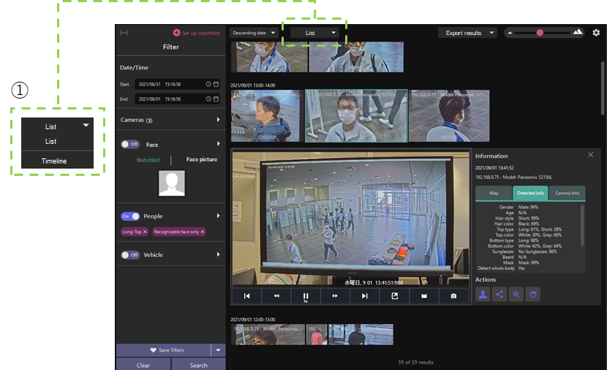
7. Face timeline display
Improvement
Face search results can be displayed on the timeline.
Multi-AI Soft.:Ver.1.3
ASM plug-in:Ver.1.0
A pull-down menu to switch between list and timeline view. （The default is the list view.)
The timeline view can only be switched when searching with the Face filter only, otherwise the timeline is greyed out and unavailable.
The timeline can also be displayed in the Event Monitor, but only if the alarm search is only showing Face filter results.

Slide 20
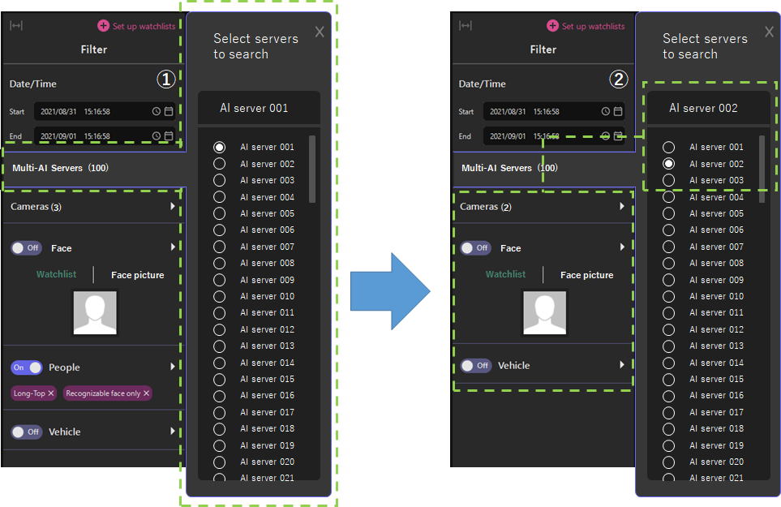
8. multiple Multi-AI server registration (1/3)
Improvement
Search Filter : When multiple Multi-AI servers are in operation, the display is switched to the cameras and apps registered in the server to be searched.
Multi-AI Soft.:Ver.1.3
ASM plug-in:Ver.1.0
Add a menu just above the cameras menu in the search filter to allow users to select a server to search when multiple Multi-AI servers are in operation. (This menu will not be displayed if only one multi-AI server is in operation)
If you select a different server from the server selection menu, the system immediately changes the server to be searched.
In this case, the number of cameras and the type of applications, Face watchlist and People watchlist registered in the filter menu will be changed to those operated by the selected server.
It is now possible to register multiple Multi-AI Servers, but the number of Multi-AI Servers that can be selected when searching remains unchanged at one.

Slide 21
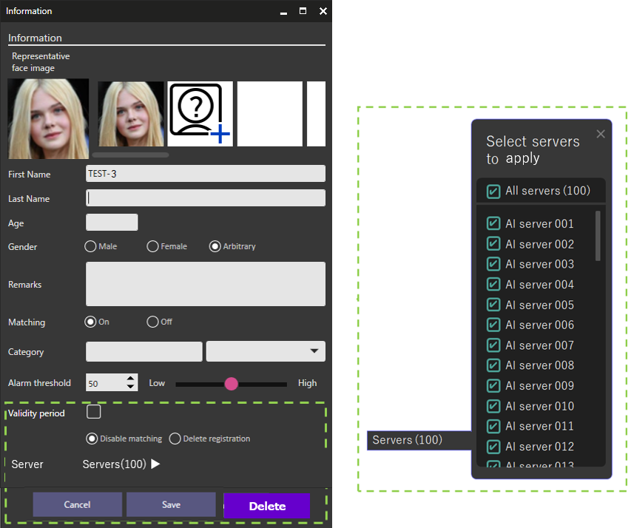
8. multiple Multi-AI server registration (2/3)
Improvement
Face Watchlist : Extend the ability to register face watchlists to multiple servers.
Multi-AI Soft.:Ver.1.3
ASM plug-in:Ver.1.0
On the screen for registering a new Face watchlist, a server selection menu is added to the bottom of the window to allow multiple AI servers to be selected.
The number of AI servers on which the face application is operated is shown in brackets.
When the menu is expanded, check boxes allow you to select individual servers to register.
By default, all are checked.
This feature is not supported for People watchlist. This is because we do not foresee a scenario where a common person feature (attribute) need to be added to the watchlist across multiple servers.

Slide 22
8. multiple Multi-AI server registration (3/3)
Note
The number of Watchlists increases with the number of servers, but they are independent of each other and cannot be linked.
There is no way to share a Watchlist or to link each between multiple Multi-AI servers
(There is no such thing as FacePRO).
A face in the Watchlist of one Multi-AI server will only work with the camera that has AI Face Detection registered in that Multi-AI server.
The same face image can be registered from a client to several Multi-AI servers, so if you want to match a face camera under another Multi-AI server, you can register it to the Watchlist of several Multi-AI servers at the same time.

Slide 23
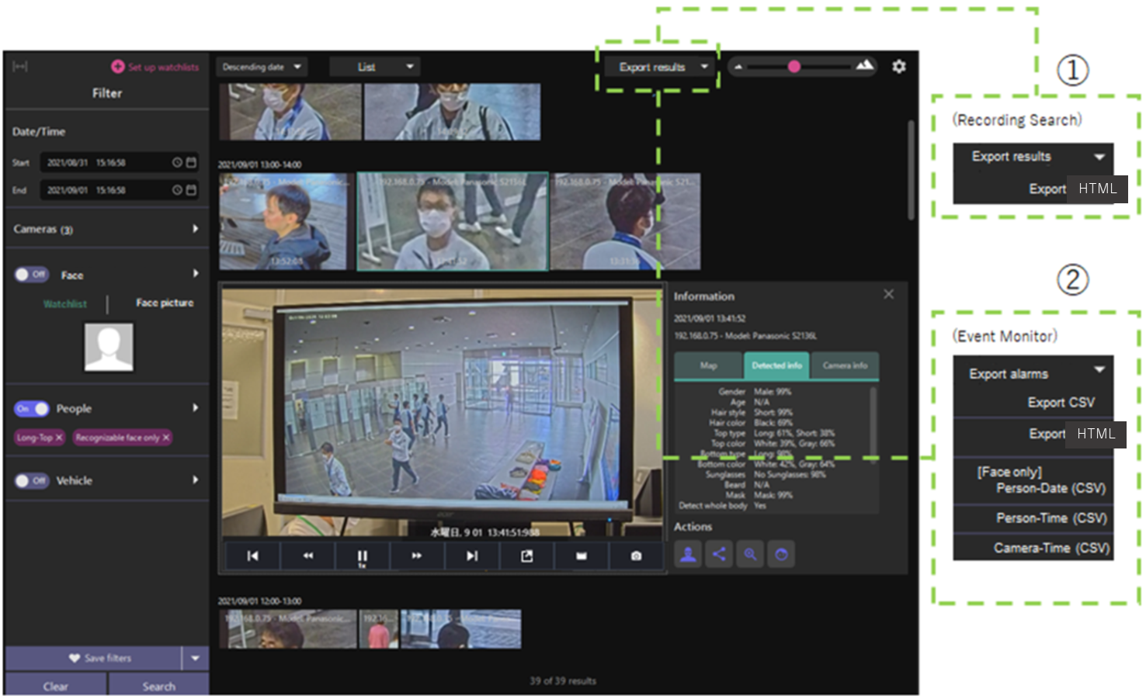

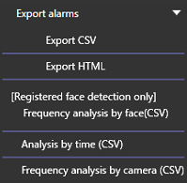
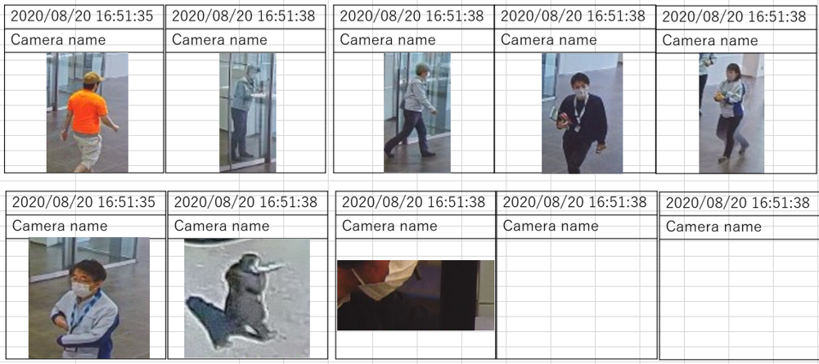
9. Alarm result export function (1/2)
Improvement
You can export the list of searched events and alarm results in csv or html format.
Multi-AI Soft.:Ver.1.3
ASM plug-in:Ver.1.0
Search result output: Outline
Output CSV or HTML file
Frequency analysis by face（CSV）
Based on the alarm search results, the number of alarm occurrences and the total number of alarm occurrences per day for registered faces are output.
Analysis by time（CSV）
Similarly, it outputs the number of occurrences per hour.
Frequency analysis by camera（CSV）
Similarly, the number of occurrences per hour for the camera is output.
(*)Information about cameras with 0 occurrences is not output.

Slide 24
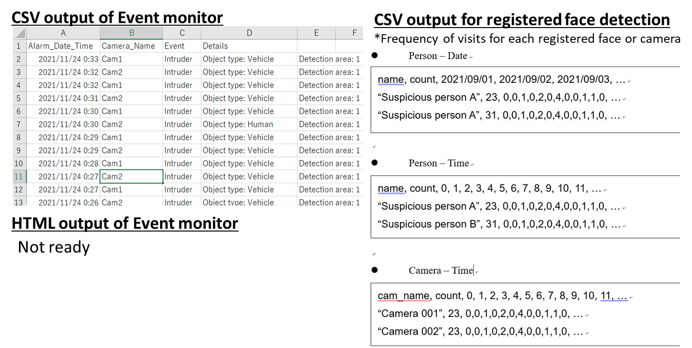
9. Alarm result export function (2/2)
Improvement
Search result output: Sample image
Multi-AI Soft.:Ver.1.3
ASM plug-in:Ver.1.0
Search result output: Sample image
1. HTML output of Recording search
2. CSV or HTML output of Event search

Slide 25
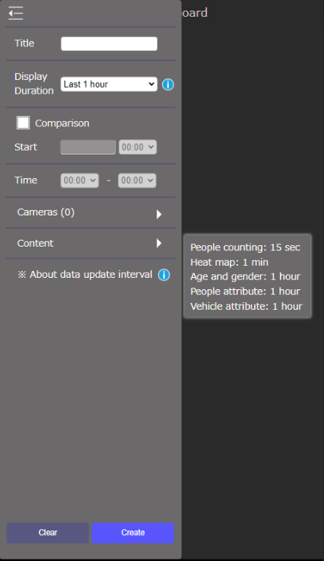
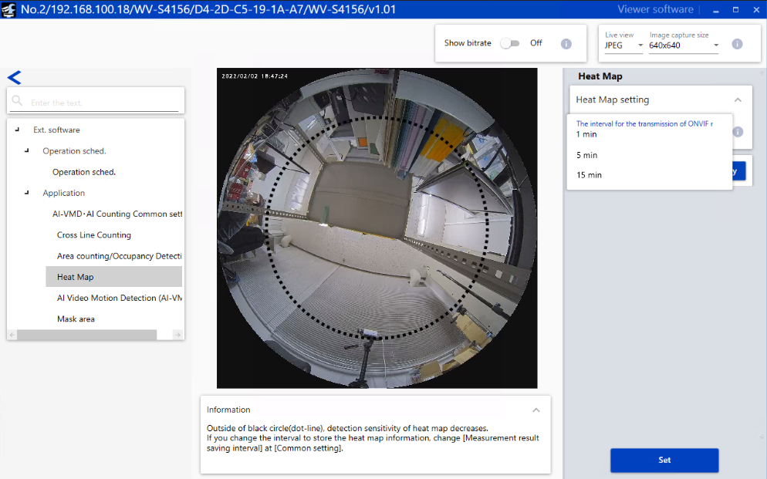
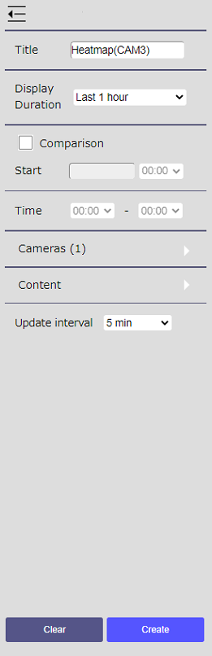
10. Remove the image update interval setting
Improvement
From the condition selection screen of the live mode of the dashboard, remove the image update interval setting. Some items can be changed by using iCT.
Multi-AI Soft.:Ver.1.3
ASM plug-in: -
<ver1.2>
<ver1.3>
Hover your mouse over the i symbol to see the description.
The update interval differs depending on the search target.
People count: 15 seconds, or 1 minute. (*)
Heatmap: 1 minute, 5 minutes, or 15 minutes. (*)
Age / Gender, Person Attribute, Vehicle Attribute: Fixed for 1 hour.
(*) Which setting is used depends on the setting value of "ONVIF Metadata transmission interval" on the camera body.

Slide 26
Version History

Slide 27
Version History
No | Update contents | Page No. | Version | Update
1 | 1st version | - | 1.00 | 3.Feb.2022
2
3
4
5
6
7
8
9
10
11

