Slide 1

AI 360-degree fisheye cameras
Model: WV-S4156 , WV-S4556L , WV-S4556LM
WV-S4176 , WV-S4576L , WV-S4576LM
Ver. 1.00

Slide 2
AI-360 degree fisheye cameras
Edge AI 360-degree fisheye camera that provides video surveillance without any blind spots, and business intelligence.
Key features
360 deg. in all directions
with high-performance fisheye lens
AI processor
for edge AI application
Supporting Industry standard protocols
Smart coding compatible with H.264 and H.265

Slide 3
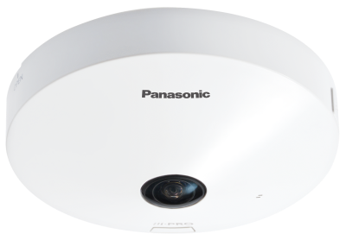
Models: AI-360 degree fisheye cameras
5MP model
Indoor
WV-S4156
Outdoor
WV-S4556L
Outdoor
(M12 connector)
WV-S4556LM
12MP model
Indoor
WV-S4176
Outdoor
WV-S4576L
Outdoor
(M12 connector)
WV-S4576LM

Slide 4
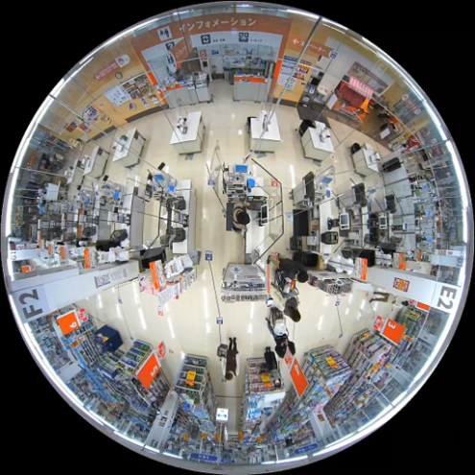
All directions with high-performance fisheye lens
With high-performance fish eye lens, the camera provides superior images up to;
2992 x 2992 pixels at 30 fps by 12MP models
2192 x 2192 pixels at 30 fps by 5MP models

Slide 5
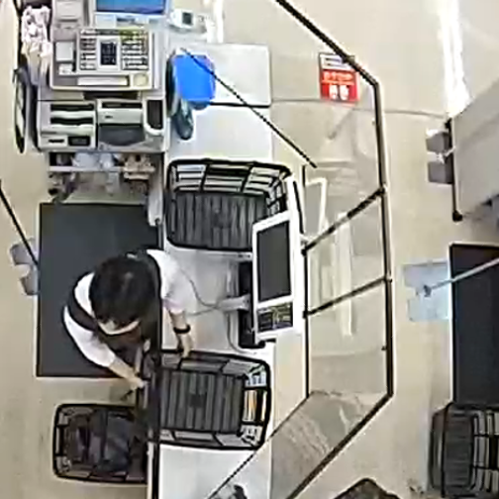
Sample footage: Fisheye mode
2192x2192 pix (5MP model)
Actual size footage

Slide 6
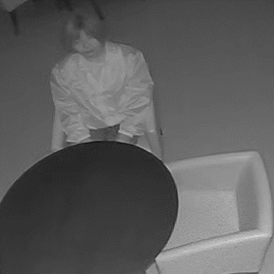
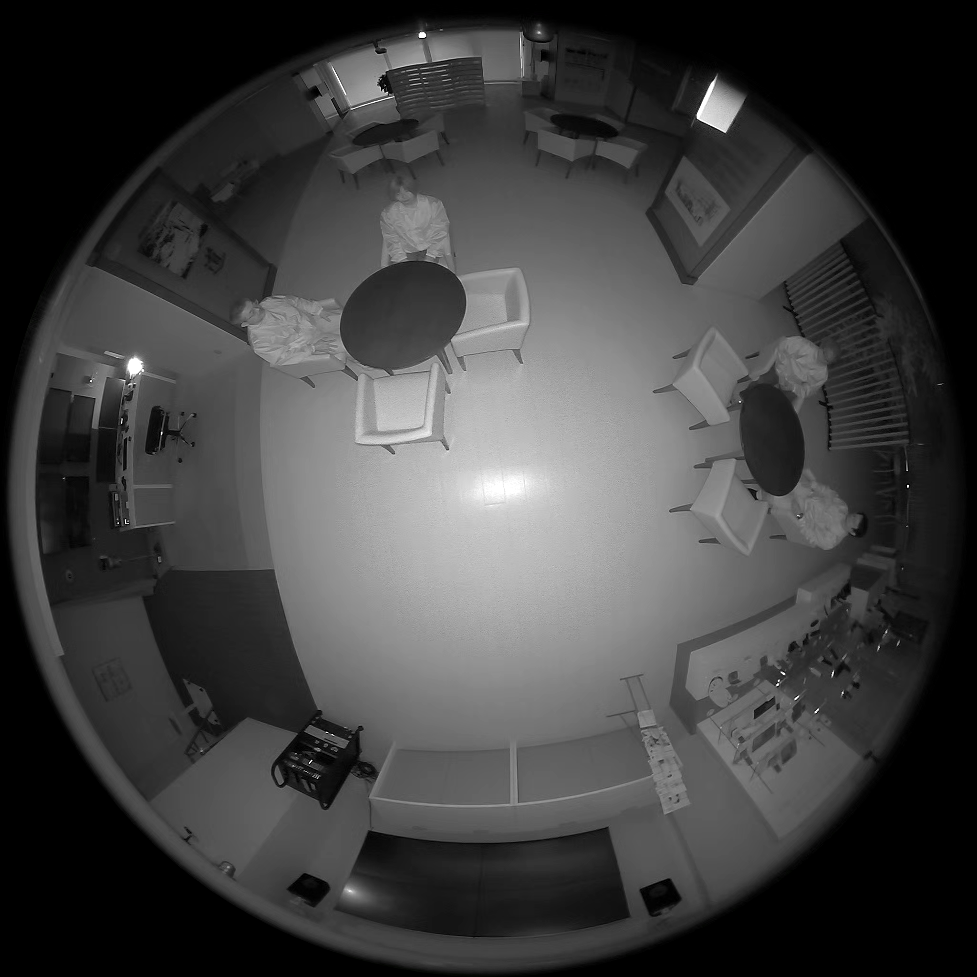
Sample footage: Fisheye mode with IR LED
Actual size footage
Outdoor models provides excellent image quality even in no-lighting scene by embedded IR LED
Sample: Fisheye mode in 2192x2192 pixels (5MP model)

Slide 7
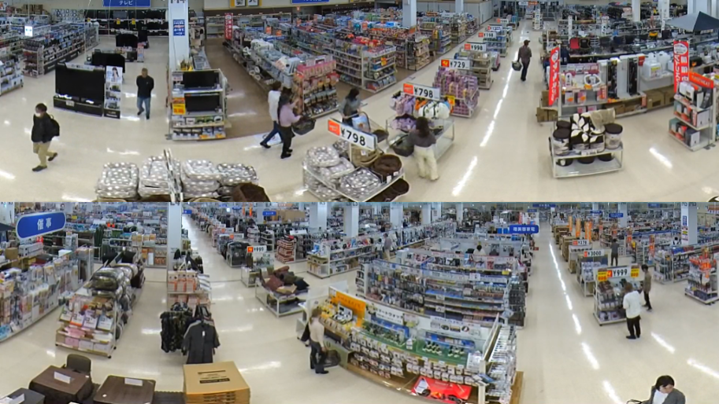
Sample footage: Double Panorama mode
Processing de-warping by the camera
De-warping in below modes
Double Panorama
Panorama
Quad PTZ
Single PTZ
Quad streams
Sample: Double Panorama mode
in 1920x1080 pix (5MP model)

Slide 8

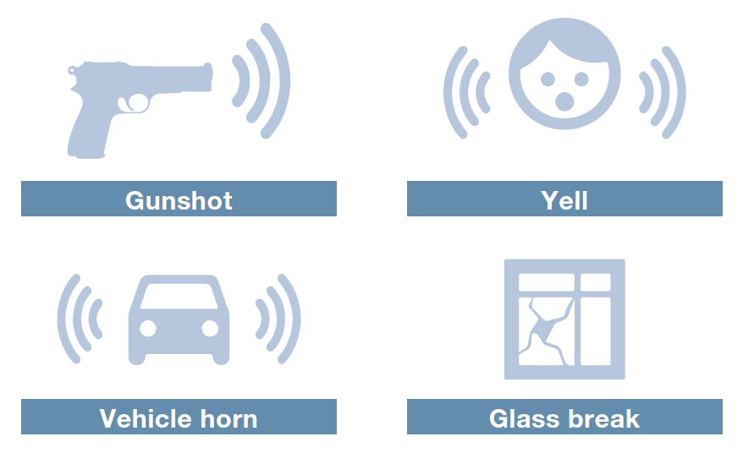
AI processor for edge AI application
Build-in AI processor enables the camera run applications on the device edge
Pre-installed AI-VMD / AI People Counting, and AI Privacy Guard
Detecting suspicious sound with built-in microphone (indoor models), with optional external microphone (outdoor models)

Slide 9
Pre-installed AI applications
The camera has pre-installed applications to offer following functions
AI Video Motion Detection
People Counting
Heat map
Occupancy detection
AI Privacy Guard

Slide 10
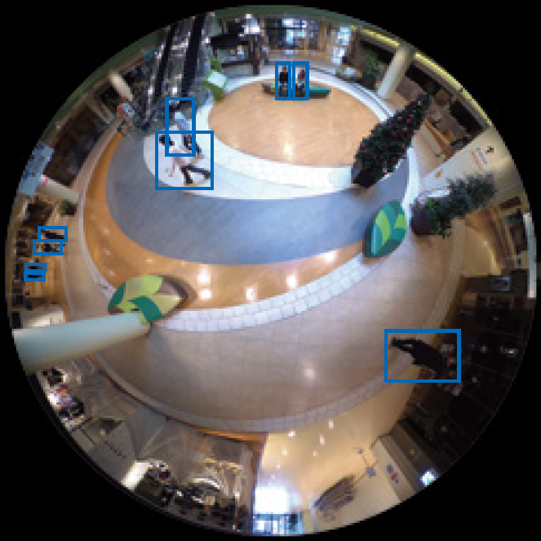
Pre-installed applications: AI Video Motion Detection
3 functions in detecting motion objects
Intruder detection:
  Issuing an alarm when a moving object enters a specified area.
Cross Line detection:
  Issuing an alarm when an
  object moving in the specified direction
  crosses a specified threshold.
Loitering detection:
  Issuing an alarm when a
  moving object enters a specified area and
  stays there for a specified amount of time.

Slide 11
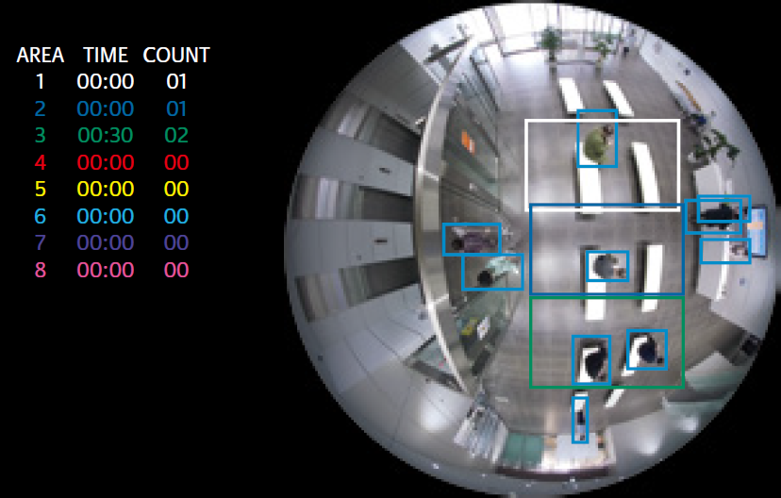
Pre-installed applications: People Counting
People Counting offers 2 modes to count up number of people.
Cross line counting
Area counting

Slide 12
Pre-installed applications: Heat map
Heap map counts up both passing and loitering people.
Passing
Loitering

Slide 13
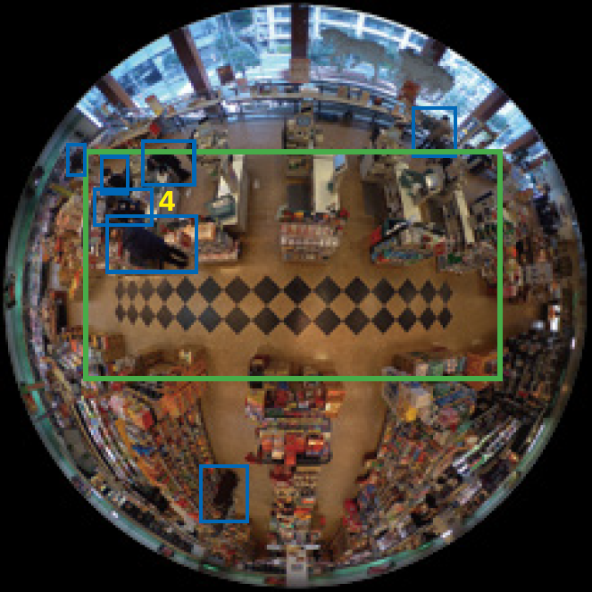
Pre-installed applications: Occupancy detection
Detecting congestions by counting number of people in specific area in specific period of time.

Slide 14
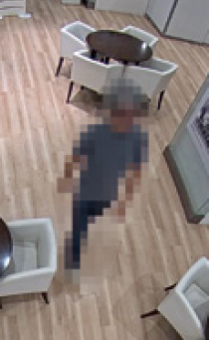
Pre-installed applications: AI Privacy Guard
Automatically pixelates the entire face or the figure of a person captured by the camera in real time.

Slide 15

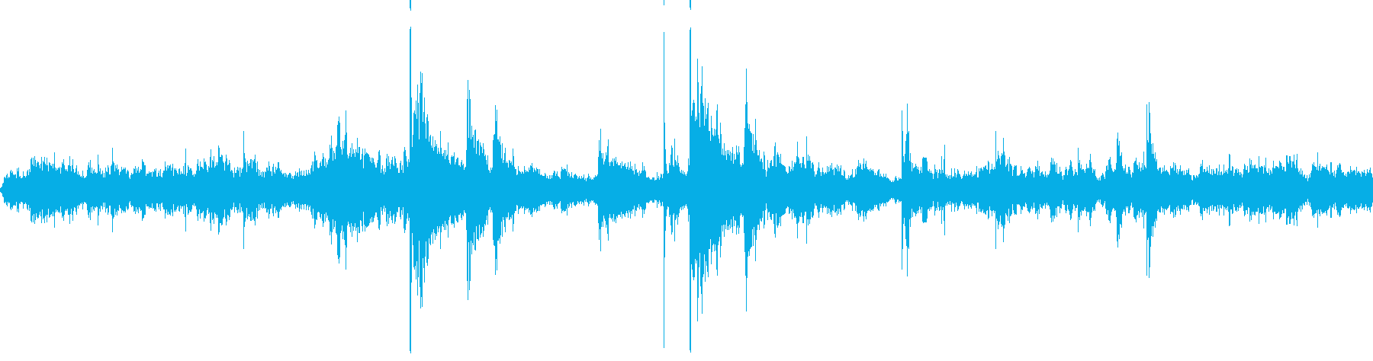

Detecting and classifying suspicious sound
Detecting and classifying suspicious sound as Gunshot, Yell, Vehicle horn, and Glass break.
Example: Gunshot sound
Gunshot sound comes to microphone (cameras built-in or external one)*
AI software (in AI network camera) detects and classifies the specific sound among other noises.
Sends alarms to VMS and/or operators etc..
* Upon camera models

Slide 16



Supporting industry standard protocols
Supporting industry standard protocols such as ONVIF, MQTT*, and H.265/H.264 for integrating/connecting with other devices and systems.
ONVIF is a trademark of ONVIF, Inc.
*May require updating firmware into the latest version.

Slide 17
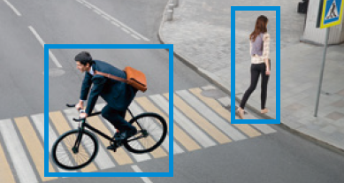




Smart coding compatible with H.264 and H.265
AI Smart Coding
Optimizing video compression to conserve network bandwidth and server storage capacities.
Bit rate
Conventional H.265
New i-PRO camera
Max.
50%
Smart coding
ON
AI smart coding
ON
16
Reduces bit rate by controlling the image quality of still areas, moving areas, and faces with AI engine.

