Slide 1
i-PRO Multi-AI System Ver.1.2 version up contents - January 2022 -
Ver.1.00
Jan. 2022

Slide 2
Overview
Target
Product
i-PRO Multi-AI System
Version
V1.2
Contents
Version upgrade item | Sheet
1. Support People counting app for 360 degree fisheye camera with AI engine | 2
2. Supports dashboard function (people counting) | 3,4
3. Camera group configuration | 5,6
4. User Management - User information for dashboard access - Authentication - Layout selection | 7-11
5. Improve operability of the camera registration screen | 12

Slide 3
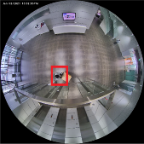
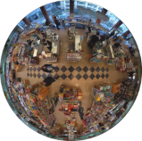
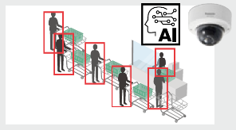
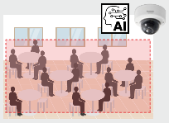
1. Support People counting app for 360 degree fisheye camera
Support new dedicated AI application for 360-degree camera
 | App. #1 : AI-VMD / AI People Counting
Function | AI-VMD | People Counting | Heat Map | Occupancy Detection
Detail | - Intruder detection - Line cross detection - Loitering detection | - Cross Line Counting - Area Counting | Visualization of loitering / passing | Make an alarm in case number of people exceeds designated value
Target object | People / Vehicle | People | People | People
Output data | Alarm | Meta information | Meta information | Alarm
Output method | ONVIF, CGI, Panasonic alarm protocol, Stream additional information | ONVIF *1, CGI, Stream additional information, HTTP POST, MQTT *2 | ONVIF *1, CGI | ONVIF, Panasonic alarm protocol, Stream additional information
30
25
*1 Data format is proprietary.
*2 Will be supported by firmware upgrade in the future.
Notes:
As you know, AI 360 degree fisheye camera support these AI apps.
These apps only can be set from iCT.
You can’t set these apps setting from browser(ブラウザ開いて見せる).
In this training, let me demonstrate how to set these apps.
Firstly, I’ll set the AI-VMD settings with iCT.
Please detect the AI fish camera by iCT as you can see here.
Then, Double-click the thumbnail of camera.
This is a schedule setings for apps.
The app default settings is 24-hour use, so you don't need to change cameras schedule settings.
Click “Common setting” from left menu.
Turn on the AI-VMD.
Then, Input the installed camera height.
This is a important point.
This height value greatly affects the accuracy, so actually measure it and enter it accurately. The height can be set in increments of 10 cm.
The other settings in the common settings can basically be left as the Default setting.
After setting the common settings, click the Set button as the bottom side.
Then, Click “AI-VMD”.
Firstly, please set area to detect.
Select Detection mode from Intruder or Loitering.
Select Detection object from Human or vehicle.
Then, Select the paint area from Detection area or line.
If you need, turn on the “Detailed settings”.
After the settings, Please test the app if the app works well.
Yokoyama san can you move to the area?
Finally, I could receive intruder alarms.

Slide 4
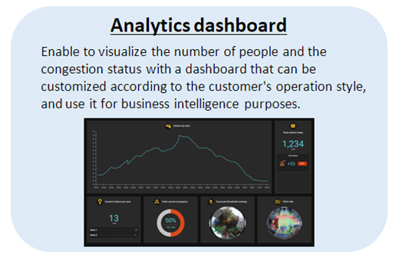
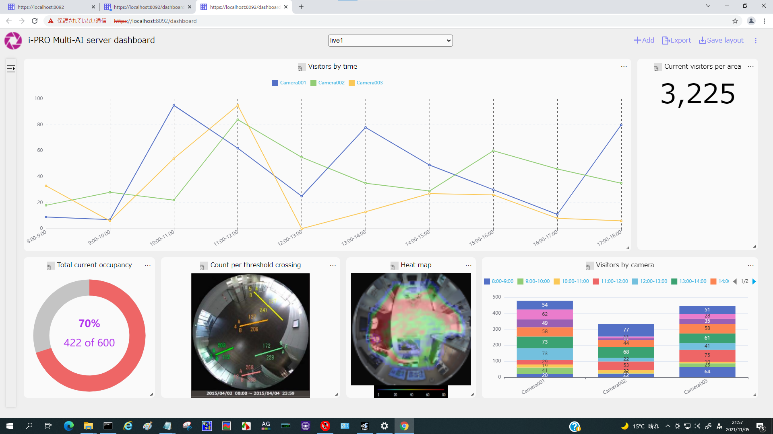
2. Supports dashboard function (people counting) (1/2)
Improvement
With the introduction of the dashboard, it is possible to visualize the number of people, congestion information according to the customer's needs and utilize it for business intelligence.
Ver.1.2
Live : People Counting Statistics

Slide 5
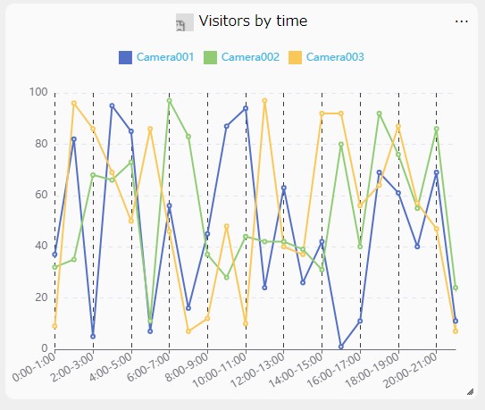
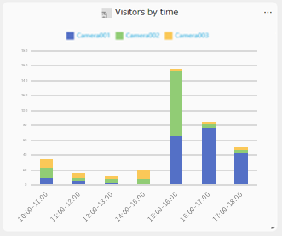
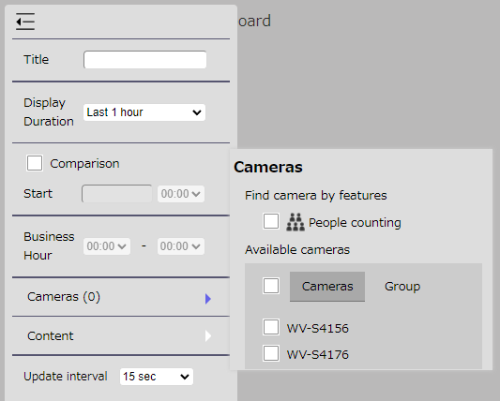
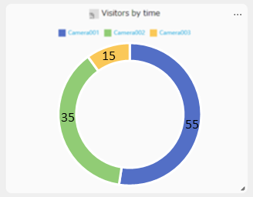
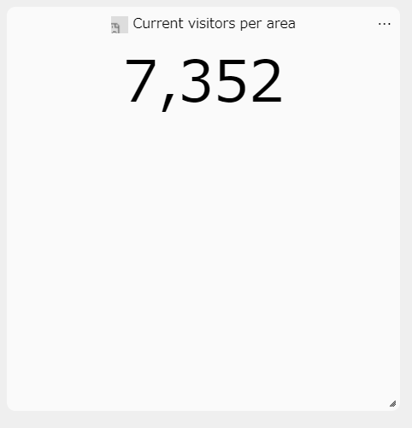
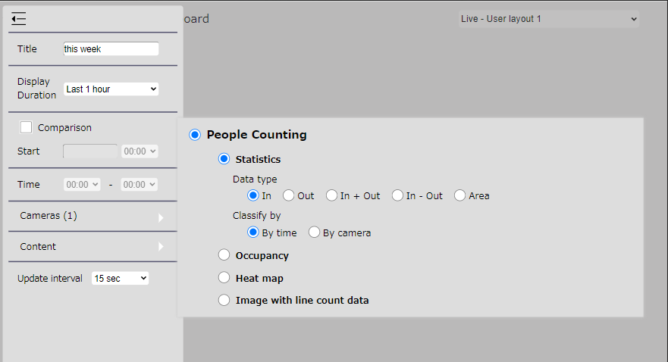
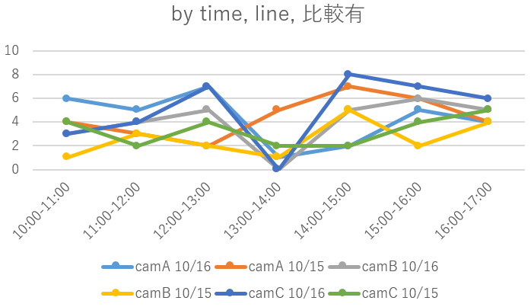
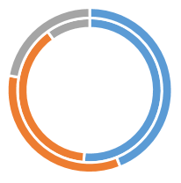
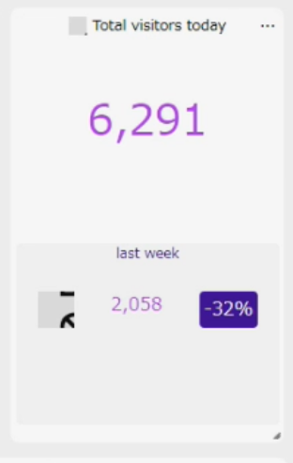
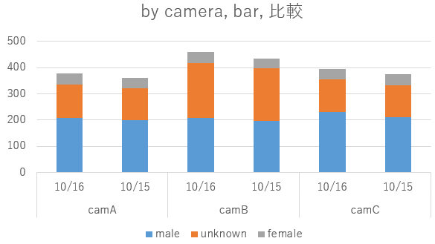
2. Supports dashboard function (people counting) (2/2)
Input Title, Duration and Operating Time
*Select Duration from 1h / 1day / 1week / 1 month.
Select type
Line
Bar
Pie
Number
Select Cameras / Group
*Up to 16 units / 16 groups
Check Comparison to display the data to be compared
Select parameters to make chart

Slide 6
3. Camera group configuration (1/2)
Improvement
Allow graphs to be displayed in groups on the dashboard
Ver.1.2
Select the camera or group for which you want to create a chart.
The number in parentheses to the right of “Camera” represents the number of currently selected cameras or groups.
If you press the ▶ on the right side, the following camera selection sub-window will be displayed.
Time
Available cameras
You can select the target for each camera or group. If you select “Camera” as the type, the camera names currently enabled by the multi-AI server will be displayed in a list.
If you select “Group” as the type, the group names currently created by the multi-AI server will be displayed in a list.
Those with a check mark will be the target of chart creation.
* The settings on the next page are required in advance.

Slide 7
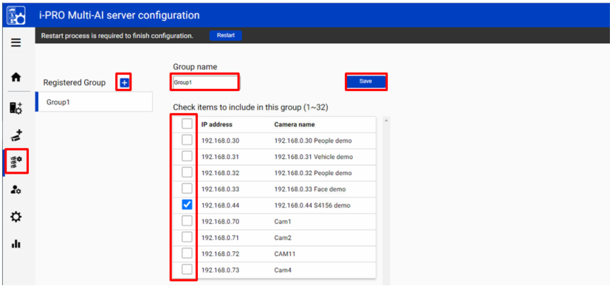
3. Camera group configuration (2/2)
When displaying a chart on the dashboard, it can be displayed as statistics for each group consisting of multiple cameras instead of statistics for each camera.
(2)
(3)
(5)
(1)
Click on the camera group
(4)
(2) Click the [+] button, (3) enter the group name, (4) check the camera with the people counting application, and (5) [Save].
Note) You can configure up to 16 groups.To delete a camera group, right-click the group and select [Delete Camera Group].

Slide 8
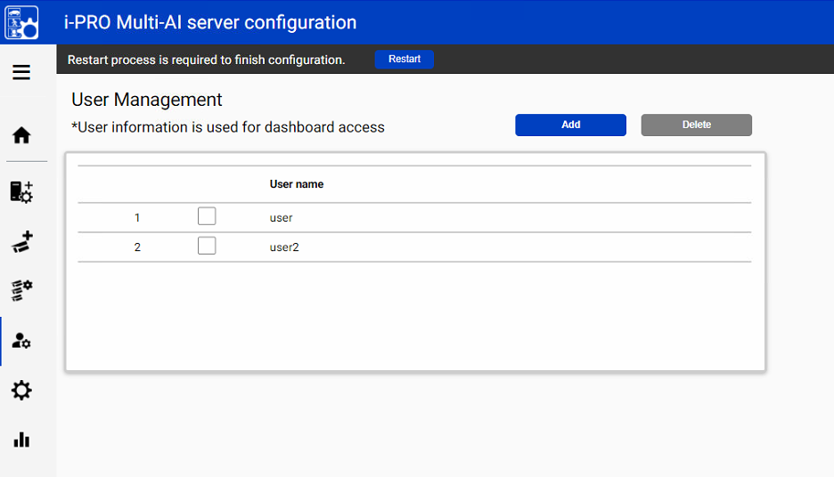
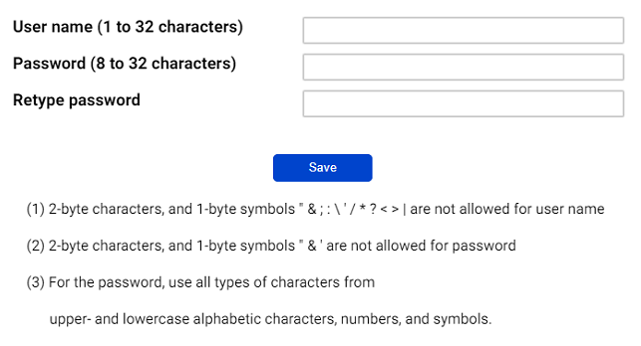
4. User Management (User information for dashboard access) - (1/5)
Improvement
customize the dashboard display for each user
Ver.1.2
Click User Management icon and [Add]
Enter [User name], [Password] and [Retype password]
and then [Save]
Note) User information can also be used for plugin connection.
[User name] set by install tool at 4.3.1 is shown as default.
[Password] is not shown.
If you forget password, delete the user and register again.

Slide 9
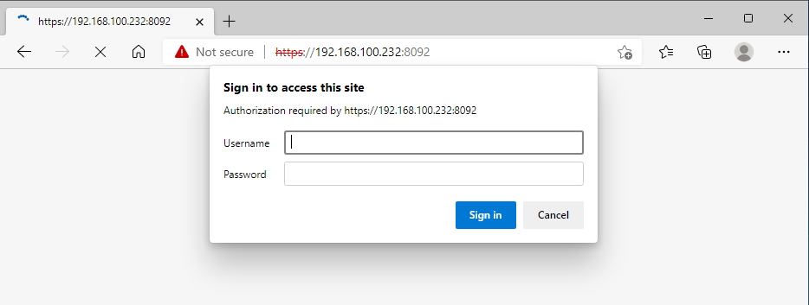
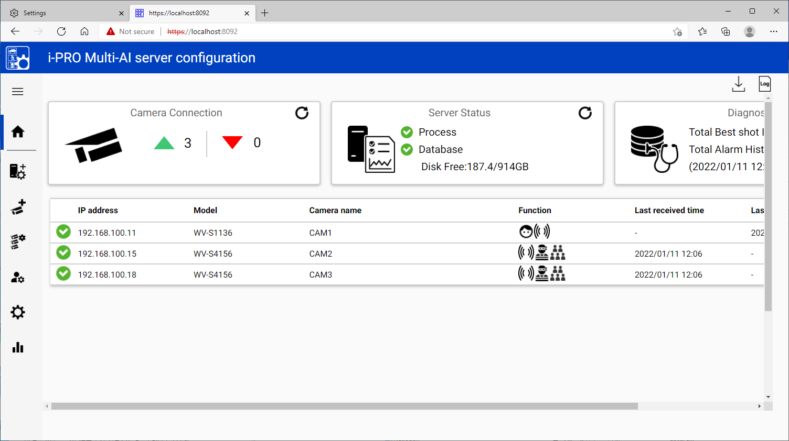
4. User Management - Authentication (2/5)
Enter your user information for authentication.
In case of access as an administrator:
To access as an administrator, enter the administrator user name and password set when installing the multi-AI server and press the “Sign in” button. After signing in as an administrator, click the dashboard icon to display the dashboard screen.
In case of access as a user:
When accessed by the user, the dashboard screen is
displayed directly.
In order to access as a user, it is necessary for the administrator to access the WEB configuration page and create a new user in advance. For details, refer to Setup Instructions. Up to 4 sessions can access the dashboard at the same time. When the number of sessions is exceeded, the following screen will be displayed. Please wait for other users to finish using dashboard and then try again.
There is no difference in the features available on the dashboard between administrators and users.

Slide 10
4. User Management - Layout (3/5)
Improvement
Allow users to save graph layouts on the dashboard
Ver.1.2
Layout selection pull-down
A pull-down menu to change the displayed layout.
If you select a layout under [Live Mode], it will be set to [Live Mode], and if you select a layout under [Search Mode], it will be set to [Search Mode]. There are [Custom Layout] and [Default Layout] as layout types.
Custom Layout
It is a layout that users can freely create and save. There are three [Live mode] and [Search Mode] respectively.
You can save the layout and set the name by selecting [Option menu] – [Save layout].

Slide 11
4. User Management - Layout (4/5)
Default Layout
This layout has multiple basic charts created in advance in [Live Mode]. One is defined for each type of AI application.
You can add or delete charts from the default layout and save it as accustom layout.
* The default layout can be displayed on up to 16 cameras with the additional target AI application installed.
Default Layout for People counting
Number | Title | Duration | Comparison | Type of chart | Classified by
1 | Today’s visitors by time | Today | - | Statistics Data type: In Line chart | By time
2 | Total visitors today | Today | Yesterday | Statistics Data type: In Count number | By time
3 | Current number of people | (The cumulative number of people from 8:00 AM to 8:00 PM) | - | Occupancy Total (Count number) | -
4 | Total visitors by camera | Today | - | Statistics Data type: In Bar chart | By camera
5 | Count per threshold crossing | Today | - | Image with line count data | -
6 | Heat map | Last 1 Hour | - | Heat map | Passing map

Slide 12
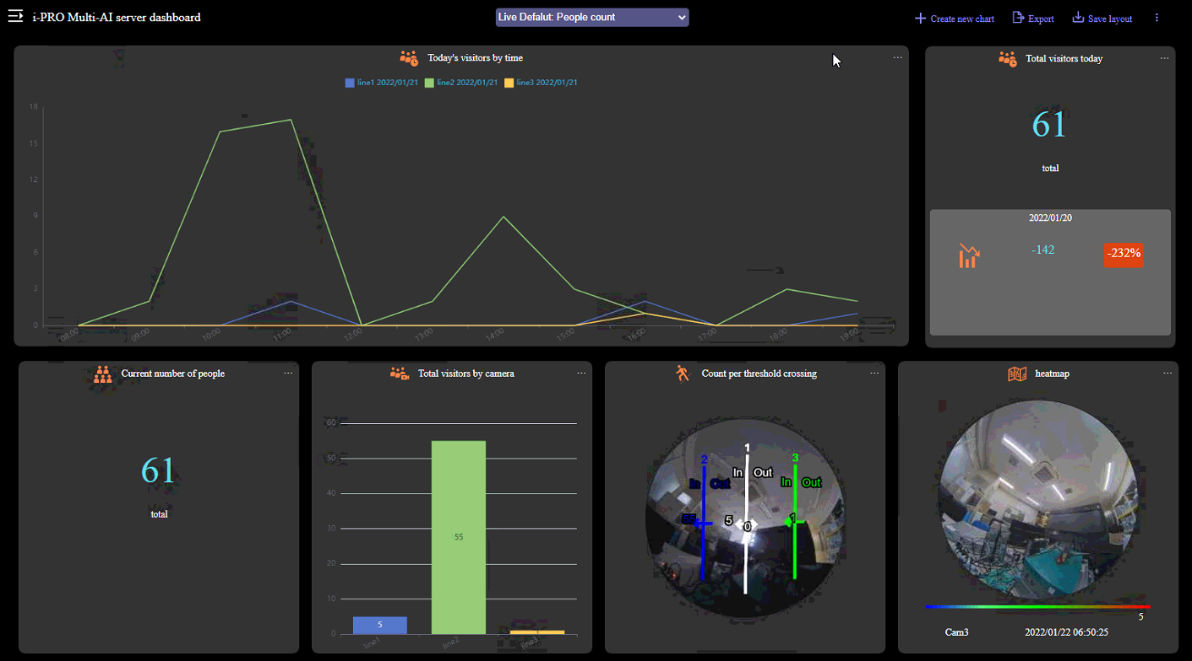
4. User Management - Layout (5/5)

Slide 13
5. Improve operability of the camera registration screen
Improvement
Add sorting function on the camera registration screen (IP Address, etc.)
Add check box to filter only unregistered cameras
Ver.1.2
Improvement of camera registration screen
(1) Added sorting function on the camera registration screen
* If VMS is not registered, only [Add Manually] is displayed.
(1)
(1)
(2)
(2)Show only unregistered cameras
(1)

Slide 14
Version History

Slide 15
Version History
No | Update contents | Page No. | Version | Update
1 | Preliminary version | - | 0.90 | 30.Nov.2021
2 | 1st version | - | 1.00 | 31.Jan.2022
3
4
5
6
7
8
9
10
11

