Slide 1
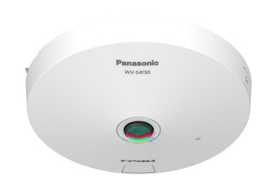
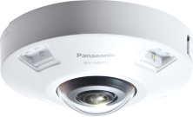
i-PRO 360-degree Fisheye Camera
with AI engine Material for SE
Model: WV-S4156 , WV-S4556L , WV-S4556LM
WV-S4176 , WV-S4576L , WV-S4576LM
Document Ver.1.06
Aug. 2022

Slide 2

Contents
Product Summary
Key Features
Specification Comparison
Other Specifications
AI Applications
Appearance
Standard Accessories
Optional Accessories
About icons
This icon is for brand new functions

Slide 3
1. Product Summary

Slide 4

1-1. Product Concept
By utilizing AI-based precision analytics, the new 360-degree camera can take advantage of high visibility, high compression, and various applications
360-degree camera with AI engine
Key features
High
Visibility
Intelligent Auto
- The visibility of blurring object (human and vehicles) has been improved by object detection.
5MP model
Release in Nov. 2021
High Compression
AI Smart Object Coding
- The object detection accuracy has been improved, and the non-detection area can be further compressed. (Approx. 50 % reduction compared to conventional models.)
Indoor
WV-S4156
Outdoor
WV-S4556L
Outdoor(transit)
WV-S4556LM
Release in Nov. 2021
12MP model
High
Accuracy
AI Analytics
- Support new dedicated AI application.
(AI-VMD, People Counting, Heat Map, Occupancy Detection, AI Privacy Guard, AI Sound Classification )
Indoor
WV-S4176
Outdoor
WV-S4576L
Outdoor(transit)
WV-S4576LM

Slide 5
1-2. Model Transition
5MP model
 | Conventional model |  |  | New model
Indoor | 1 | WV-S4151 |  | 1 | WV-S4156
Outdoor | 2 | WV-S4551L WV-S4551LM |  | 2 | WV-S4556L WV-S4556LM
Replace
12MP model
 | Conventional model |  |  | New model
Indoor (elementary model) | 1 | WV-X4172
Indoor | 1 | WV-X4173 |  | 1 | WV-S4176
Outdoor | 2 | WV-X4573L WV-X4573LM |  | 2 | WV-S4576L WV-S4576LM
Continue
Replace

Slide 6
2. Key Features

Slide 7
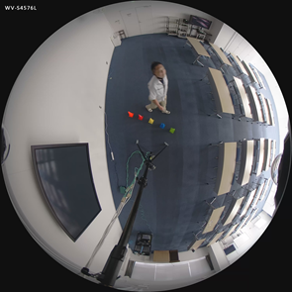
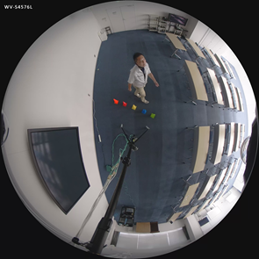
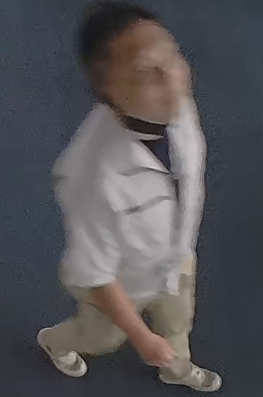
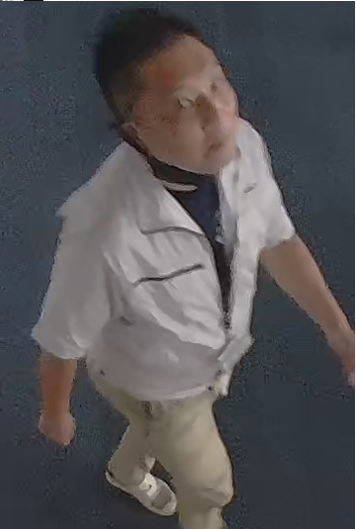
2-1. Intelligent Auto
Automatically optimize the image depending on the environment
The visibility of blurring object (human and vehicles) has been improved by object detection.
Intelligent Auto : OFF
Intelligent Auto : ON

Slide 8
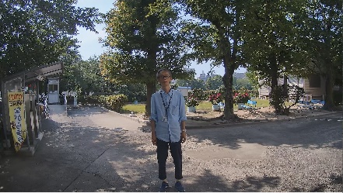
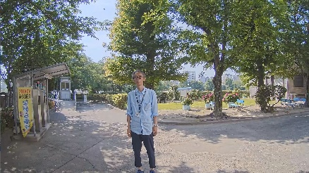


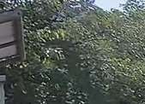
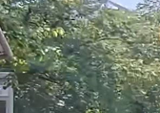
2-2. AI Smart Object Coding - Smart VIQS
Automatically control the compression rate depending on the environment
The object detection accuracy has been improved, and the non-detection area can be further compressed. (Approx. 50 % reduction compared to conventional models)
Conventional model
New model
Detects motion and automatically adjusts the image quality of moving objects to high and others to low.
Detects objects (face, human and vehicle) and adjusts the image quality of those objects to high and others to low.
Person on the image does not move
Image quality is adjusted to low
Camera detect “face” and “human”
Adjusts the image quality of the face area to high
Swaying tree is recognized as a moving object
Increase data amount
Swaying tree is NOT recognized as an object
Suppress data amount
Measured bit rate: 6733kbps
Measured bit rate: 3855kbps

Slide 9
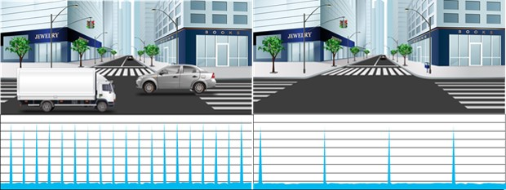
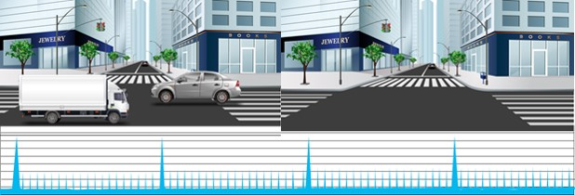
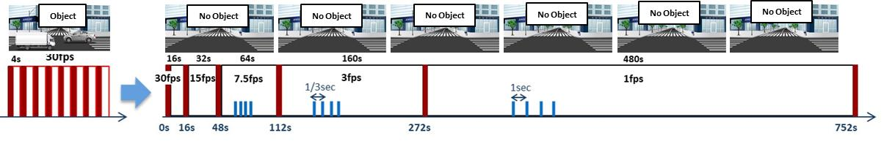
2-3. AI Smart Object Coding - GOP control
Control GOP using object detection instead of motion detection
Low / Mid
GOP control
Low (Variable GOP 1s-8s) | I-picture interval variable between 1sec-8sec by detected object (People and vehicles). *VBR only
Mid (Variable GOP 4s-16s) | I-picture interval variable between 4sec-16sec by detected object. *VBR only
Advanced (Fixed GOP 60s w/1s key-frame) | I-picture interval fixed at 60s, key-frame inserted at 1sec intervals regardless of detected object. *Selectable in all transfer modes
Frame rate control (Variable GOP 4s-16s w/frame rate control) | If there is no detected object, reduce the frame rate to 1 fps. I-picture interval variable between 4sec-16sec by detected object. *VBR only
Object
No Object
Advanced
Object
No Object
Frame rate control

Slide 10
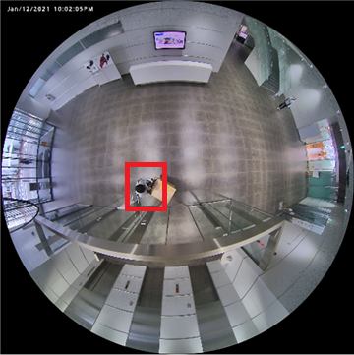

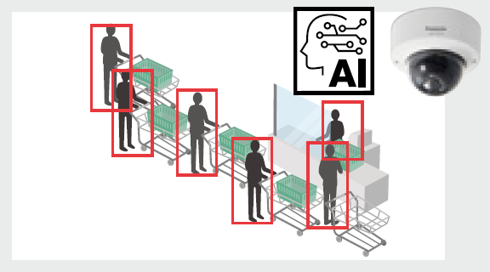
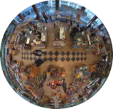
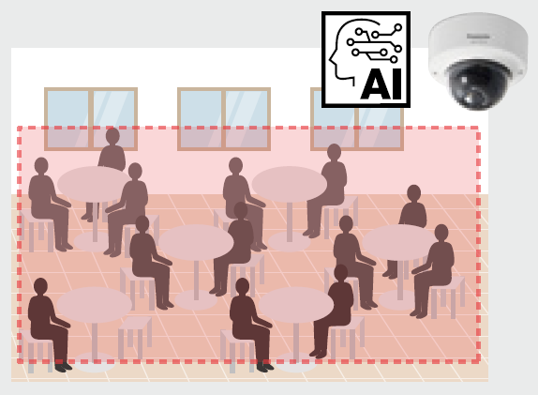




2-4. AI Analytics
Support new dedicated AI application for 360-degree camera
 | App. #1 : AI-VMD / AI People Counting |  |  |  | App. #2 : AI Privacy Guard | Standard feature
Function | AI-VMD | People Counting | Heat Map | Occupancy Detection | AI Privacy Guard | AI Sound Classification
Detail | - Intruder detection - Line cross detection - Loitering detection | - Cross Line Counting - Area Counting | Visualization of loitering / passing | An alarm is issued when the number of people exceeds the set value | Cover people on the video stream | Identifying a specific sound among other noises
Target object | People / Vehicle | People | People | People | People | Sound
Output data | Alarm | Meta information | Meta information | Alarm | Stream | Alarm
Output method | ONVIF, CGI, TCP alarm protocol, Additional information in video stream | ONVIF *1, CGI, Additional information in video stream, HTTP POST, MQTT *2 | ONVIF *1, CGI | ONVIF, TCP alarm protocol, Additional information in video stream | Stream | ONVIF, CGI, TCP alarm protocol, Additional information in video stream
30
25
*1 Data format is proprietary.
*2 Will be supported by firmware upgrade in the future.

Slide 11
3. Specification Comparison

Slide 12
3-1. Overview
Hardware specification
No change in hardware except increase of Flash ROM/Memory (in comparison with conventional 360-degree camera)
Software specification
 | New 360-degree camera (WV-S4156/WV-S4556L/WV-S4556LM/ WV-S4176/WV-S4576L/WV-S4576LM) | Conventional 360-degree camera (WV-S4151/WV-S4551L/WV-S4551LM/ WV-X4172/WV-X4173/WV-X4573L/WV-X4573LM)
Intelligent Auto | Yes (AI) | Yes (Non-AI)
Smart Coding | Smart VIQS (AI) GOP control (AI) | Auto VIQS (Non-AI) GOP control (Non-AI)
Scene change detection alarm | Standard feature | Option (i-VMD)
Audio alarm | Yes Detection by sound volume AI Sound Classification (Gunshot, Yell, Vehicle horn, Glass break) | No
Extension software | App. #1 : AI-VMD/People Counting/Heat Map/Occupancy Detection App. #2 : AI Privacy Guard | WV-SAE200W : i-VMD/People Counting (Non-AI) /Heat Map (Non-AI) WV-SAE303W : People Counting

Slide 13


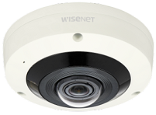
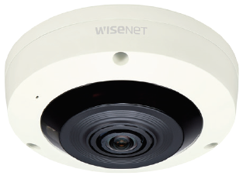
3-2. Comparison to other companies - vs Axis / Hanwha
5MP model
*1 H.265/H.264 Stream transmission: Off,
Display mode: fisheye/Panorama/Double panorama/Single PTZ/Quad PTZ
*2 WDR: Off, Display mode: only fisheye
 | i-PRO |  | Axis |  | Hanwha
 | Outdoor | Indoor | Outdoor | Indoor | Outdoor | Indoor
 | WV-S4556L WV-S4556LM | WV-S4156 | M3057-PLVE Mk II | M3067-P | XNF-8010RV XNF-8010RVM | XNF-8010R
Video Codec | H.265/H.264/JPEG |  | H.265/H.264/JPEG |  | H.265/H.264/JPEG
Image Sensor | 1/2.8” 5MP |  | 1/1.8” 6MP |  | 1/1.8" 6MP
Max Resolution | 2192x2192 |  | 2016x2016 |  | 2048x2048
Max Frame rate | H.265/H.264 : 30fps JPEG : 5fps (30fps *1) |  | H.265/H.264 : 30fps (60fps *2) JPEG : 30fps (60fps *2) |  | H.265/H.264 : 30fps JPEG : 15fps
Lens | F2.4 |  | F2.0 |  | F1.6
Angular Field of view | 186 deg. |  | 183 deg. | 185 deg. | 192 deg.
Dynamic range | 120dB |  | 120dB |  | 120dB
Sensitivity (color) | 0.15 lx |  | 0.16lx | 0.18lx | 0.1lx
Display mode (other than fisheye) | Panorama, Double panorama, Single PTZ, Quad PTZ 4Quad streams |  | Panorama, Double panorama, Single PTZ, Quad PTZ, Corner left/right, Double corner, Corridor |  | Panorama, Double Panorama, Single PTZ, Quad PTZ
Smart Coding | Smart VIQS / GOP control |  | Zipstream |  | WiseStream II
Audio | In(mic in), Out | In(built-in mic), Out | - |  | In(selectable), Out
AI processor | Yes |  | No |  | No
Video Analytics | AI-VMD, People Counting, Heat Map, Occupancy Detection, AI Privacy Guard , AI Sound Classification |  | VMD, active tampering alarm, Motion Guard, Fence Guard, Loitering Guard, People Counter, Occupancy Estimator, Queue Monitor, Tailgating Detector, Direction Detector, Random Selector |  | Defocus detection, Motion detection, Tampering, People counting, Heat map, Directional detection, Appear/Disappear, Enter/Exit, Loitering, Virtual line, Audio detection, Sound classification
IR-LED | Yes (10m) | - | Yes (20m) | - | Yes(15m)
Operating Temperature | -40 to +60 deg.C | -10 to +50 deg.C | -40 to +50 deg.C | 0 to +40 deg.C | -40 to +55 deg.C | -10 to +55 deg.C
Railway standard | EN50155-TX | - | - |  | EN50155 | -

Slide 14
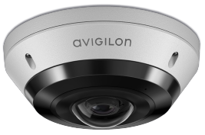
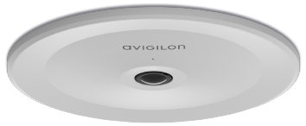
3-2. Comparison to other companies - vs Avigilon
5MP model
*1 H.265/H.264 Stream transmission: Off,
Display mode: fisheye/Panorama/Double panorama/Single PTZ/Quad PTZ
 | i-PRO |  | Avigilon
 | Outdoor | Indoor | Outdoor | Indoor
 | WV-S4556L WV-S4556LM | WV-S4156 | 8.0C-H5A-FE-DO1-IR | 8.0C-H5A-FE-DC1
Video Codec | H.265/H.264/JPEG |  | H.265/H.264/JPEG
Image Sensor | 1/2.8” 5MP |  | 1/1.8” 8MP
Max Resolution | 2192x2192 |  | 2048x2048
Max Frame rate | H.265/H.264 : 30fps JPEG : 5fps (30fps *1) |  | H.265/H.264 : 30fps JPEG : 30fps
Lens | F2.4 |  | F2.0
Angular Field of view | 186 deg. |  | 180 deg.
Dynamic range | 120dB |  | 120dB
Sensitivity (color) | 0.15 lx |  | 0.20lx
Display mode (other than fisheye) | Panorama, Double panorama, Single PTZ, Quad PTZ 4Quad streams |  | Adjustable dewarping
Smart Coding | Smart VIQS / GOP control |  | High Definition Stream Management
Audio | In(mic in), Out | In(built-in mic), Out | In(built-in mic), Out
AI processor | Yes |  | Yes
Video Analytics | AI-VMD, People Counting, Heat Map, Occupancy Detection, AI Privacy Guard , AI Sound Classification |  | Objects in Area, Loitering, Crossing Beam, Appears or Enters Area, Not Present in Area, Enter Area, Leave Area, Stops in Area, Direction Violated, Tamper Detection
IR-LED | Yes (10m) | - | Yes (17m) | -
Operating Temperature | -40 to +60 deg.C | -10 to +50 deg.C | -40 to +60 deg.C | -10 to +60 deg.C
Railway standard | EN50155-TX | - | -

Slide 15
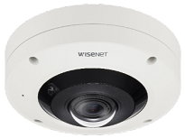
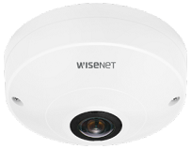
3-2. Comparison to other companies - vs Axis / Hanwha
12MP model
*1 H.265/H.264 Stream transmission: Off,
Display mode: fisheye/Panorama/Double panorama/Single PTZ/Quad PTZ
*2 WDR: Off, Display mode: only fisheye
 | i-PRO |  | Axis |  | Hanwha
 | Outdoor | Indoor | Outdoor | Indoor | Outdoor | Indoor
 | WV-S4576L WV-S4576LM | WV-S4176 | M3058-PLVE | M3068-P | XNF-9010RV XNF-9010RVM | QNF-9010
Video Codec | H.265/H.264/JPEG |  | H.264/JPEG | H.265/H.264/JPEG | H.265/H.264/JPEG
Image Sensor | 1/1.7” 12MP |  | 1/1.7” 12MP |  | 1/2.3” 12MP
Max Resolution | 2992x2992 |  | 2992x2992 | 2880x2880 | 3008x3008
Max Frame rate | H.265/H.264 : 30fps JPEG : 5fps (15fps *1) |  | H.265/H.264 : 15fps (30fps *2) JPEG : 15fps (30fps *2) |  | H.265/H.264 : 30fps JPEG : 30fps | H.265/H.264 : 30fps JPEG : 5fps
Lens | F1.9 |  | F2.2 | F2.8 | F2.2
Angular Field of view | 183 deg. |  | 181 deg. | 185 deg. | 187 deg.
Dynamic range | 84dB |  | 120dB |  | 120dB
Sensitivity (color) | 0.3 lx |  | 0.19lx | 0.32lx | 0.39lx
Display mode (other than fisheye) | Panorama, Double panorama, Single PTZ, Quad PTZ 4Quad streams |  | Panorama, Double panorama, Single PTZ, Quad PTZ, Corner left/right, Double corner, Corridor |  | Panorama, Double Panorama, Single PTZ, Quad PTZ
Smart Coding | Smart VIQS / GOP control |  | Zipstream |  | WiseStream II
Audio | In(mic in), Out | In(built-in mic), Out | - |  | In(selectable), Out | -
AI processor | Yes |  | No |  | No
Video Analytics | AI-VMD, People Counting, Heat Map, Occupancy Detection, AI Privacy Guard , AI Sound Classification |  | VMD, active tampering alarm, Motion Guard, Fence Guard, Loitering Guard, (People Counter, Occupancy Estimator, Queue Monitor, Tailgating Detector, Direction Detector, Random Selector) * ( ) Is for M3068-P only |  | Defocus detection, Motion detection, Tampering, People counting, Heat map (Directional detection, Appear/Disappear, Enter/Exit, Loitering, Virtual line, Audio detection, Sound classification) * ( ) Is for XNF-9010RV/XNF-9010RVM only
IR-LED | Yes (10m) | - | Yes (15m) | - | Yes (10m) | -
Operating Temperature | -40 to +60 deg.C | -10 to +50 deg.C | -40 to +50 deg.C | 0 to +40 deg.C | -40 to +60 deg.C | -10 to +40 deg.C
Railway standard | EN50155-TX | - | - |  | EN50155 | -

Slide 16
3-2. Comparison to other companies - vs Avigilon
12MP model
*1 H.265/H.264 Stream transmission: Off,
Display mode: fisheye/Panorama/Double panorama/Single PTZ/Quad PTZ
 | i-PRO |  | Avigilon
 | Outdoor | Indoor | Outdoor | Indoor
 | WV-S4576L WV-S4576LM | WV-S4176 | 12.0W-H5A-FE-DO1-IR | 12.0W-H5A-FE-DC1
Video Codec | H.265/H.264/JPEG |  | H.265/H.264/JPEG
Image Sensor | 1/1.7” 12MP |  | 1/2.3” 12MP
Max Resolution | 2992x2992 |  | 3008x3008
Max Frame rate | H.265/H.264 : 30fps JPEG : 5fps (15fps *1) |  | H.265/H.264 : 30fps JPEG : 30fps
Lens | F1.9 |  | F2.0
Angular Field of view | 183 deg. |  | 180 deg.
Dynamic range | 84dB |  | 120dB
Sensitivity (color) | 0.3 lx |  | 0.38lx
Display mode (other than fisheye) | Panorama, Double panorama, Single PTZ, Quad PTZ 4Quad streams |  | Adjustable dewarping
Smart Coding | Smart VIQS / GOP control |  | High Definition Stream Management
Audio | In(mic in), Out | In(built-in mic), Out | In(built-in mic), Out
AI processor | Yes |  | Yes
Video Analytics | AI-VMD, People Counting, Heat Map, Occupancy Detection, AI Privacy Guard , AI Sound Classification |  | Objects in Area, Loitering, Crossing Beam, Appears or Enters Area, Not Present in Area, Enter Area, Leave Area, Stops in Area, Direction Violated, Tamper Detection
IR-LED | Yes (10m) | - | Yes (12m) | -
Operating Temperature | -40 to +60 deg.C | -10 to +50 deg.C | -40 to +60 deg.C | -10 to +60 deg.C
Railway standard | EN50155-TX | - | -

Slide 17
3-3. Comparison with conventional models
5MP model
 | New 5MP Camera (WV-S4156 / S4556L / S4556LM) | Conventional 5MP Camera (WV-S4151 / S4551L / S4551LM) | Conventional 5MP Camera (WV-S4150 / S4550L / S4550LM)
Image capture mode | Fisheye / Double Panorama(DP) / Panorama(P) / Quad PTZ / Single PTZ / Fisheye + DP / Fisheye + P / Fisheye + Quad PTZ / Quad stream
Compression method | H.265[or H.264](1)(2) / JPEG(1)(2)
Dynamic range | Super-D 120dB |  | Super-D 108dB
Sensitivity (color) | 0.15lx |  | 0.3lx
Transmission mode | VBR / CBR / Framerate / Best Effort *Default : VBR |  | VBR / CBR / Framerate / Best Effort *Default : Framerate
Intelligent Auto | Yes (AI) | Yes (Non-AI)
Smart Coding | Smart VIQS (AI) / GOP control (AI) | Auto VIQS (Non-AI) / GOP control (Non-AI)
SD recording | Yes (JPEG / H.264 / H.265)
IO terminal / Monitor output | Yes
Power Source | PoE / DC12V
Scene change detection alarm | Standard feature | Option (WV-SAE200W)
Audio alarm | Yes (Audio Detection / AI Sound classification) | No
Extension software | App. #1 : AI-VMD / People Counting / Heat Map / Occupancy Detection App. #2 : AI Privacy Guard | WV-SAE200W : i-VMD / People Counting (Non-AI) / Heat map (Non-AI) WV-SAE303W : People Counting (Non-AI)
ONVIF | Profile S / G / T / M *1 | Profile S / G / T
FTP | No *2 |  | Yes
*1 Will declare profile M support after we got certified by ONVIF.
*2 SFTP will be supported by firmware upgrade in the future.

Slide 18
3-3. Comparison with conventional models
12MP model
 | New 12MP Camera (WV-S4176 / S4576L / S4576LM) | Conventional 12MP Camera (WV-X4172 / X4173 / X4573L / X4573LM) | Conventional 12MP Camera (WV-X4170 / X4171 / X4571L / X4571LM)
Image capture mode | Fisheye / Double Panorama(DP) / Panorama(P) / Quad PTZ / Single PTZ / Fisheye + DP / Fisheye + P / Fisheye + Quad PTZ / Quad stream
Compression method | H.265[or H.264](1)(2) / JPEG(1)(2)
Dynamic range | WDR 84dB |  | Super-D 108dB
Sensitivity (color) | 0.3lx
Transmission mode | VBR / CBR / Framerate / Best Effort *Default : VBR |  | VBR / CBR / Framerate / Best Effort *Default : Framerate
Intelligent Auto | Yes (AI) | Yes (Non-AI)
Smart Coding | Smart VIQS (AI) / GOP control (AI) | Auto VIQS (Non-AI) / GOP control (Non-AI)
SD recording | Yes (JPEG / H.264 / H.265)
IO terminal / Monitor output | Yes *WV-X4170 / X4172 is not supported
Power Source | PoE / DC12V *WV-X4170 / X4172: PoE only
Scene change detection alarm | Standard feature | Option (WV-SAE200W)
Audio alarm | Yes (Audio Detection / AI Sound classification) | No
Extension software | App. #1 : AI-VMD / People Counting / Heat Map / Occupancy Detection App. #2 : AI Privacy Guard | WV-SAE200W : i-VMD / People Counting (Non-AI) / Heat map (Non-AI) WV-SAE303W : People Counting (Non-AI) *WV-X4170 / X4172 is not supported
ONVIF | Profile S / G / T / M *1 | Profile S / G / T
FTP | No *2 |  | Yes
*1 Will declare profile M support after we got certified by ONVIF.
*2 SFTP will be supported by firmware upgrade in the future.

Slide 19
4. Other Specifications

Slide 20
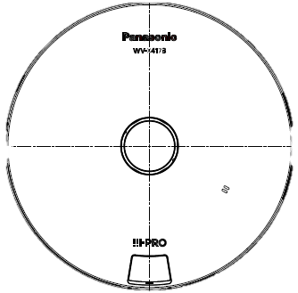
4-1. DORI
*1
5MP model
DORI coverage DORI (Detect, Observe, Recognize, Identify) is a standard system (EN-62676-4) for defining the ability of a camera to distinguish persons or objects within a covered area. This value does not indicate the performance of the camera.
The maximum distance at which a camera/lens combination can meet these criteria is shown below:
Distance to object in center image
Resolution : 2192 x 2192 |  | Unit : m | Unit : feet
Detect | 25ppm / 8ppf | 20.7 | 67.9
Observe | 62.5ppm / 19ppf | 8.3 | 27.2
Recognize | 125ppm / 38ppf | 4.1 | 13.5
Identify | 250ppm / 76ppf | 2.1 | 6.9
Identify
Recognize
Observe
Detect
Coverage radius when mounted at a height of 3m (10ft)
Resolution : 2192 x 2192 |  | Unit : m | Unit : feet
Detect | 25ppm / 8ppf | 38.0 | 124.7
Observe | 62.5ppm / 19ppf | 13.2 | 43.3
Recognize | 125ppm / 38ppf | 4.3 | 14.1
Identify | 250ppm / 76ppf | - | -
3m
(10ft)
Recognize
Detect
D O R I
Identify
Observe

Slide 21
4-1. DORI
*1
12MP model
DORI coverage DORI (Detect, Observe, Recognize, Identify) is a standard system (EN-62676-4) for defining the ability of a camera to distinguish persons or objects within a covered area. This value does not indicate the performance of the camera.
The maximum distance at which a camera/lens combination can meet these criteria is shown below:
Distance to object in center image
Resolution : 2992 x 2992 |  | Unit : m | Unit : feet
Detect | 25ppm / 8ppf | 29.9 | 98.1
Observe | 62.5ppm / 19ppf | 12.0 | 39.4
Recognize | 125ppm / 38ppf | 6.0 | 19.7
Identify | 250ppm / 76ppf | 3.0 | 9.8
Identify
Recognize
Observe
Detect
Coverage radius when mounted at a height of 3m (10ft)
Resolution : 2992 x 2992 |  | Unit : m | Unit : feet
Detect | 25ppm / 8ppf | 56.1 | 184.1
Observe | 62.5ppm / 19ppf | 20.6 | 67.6
Recognize | 125ppm / 38ppf | 8.4 | 27.6
Identify | 250ppm / 76ppf | 0.3 | 1.0
3m
(10ft)
Recognize
Detect
D O R I
Identify
Observe

Slide 22
4-2. Supported resolution
5MP model
*Underline is default value
*1
No. | Image capture mode | Stream (1) | Stream (2) | JPEG (1) | JPEG (2)
1 | Fisheye (Ceiling / Wall) | Fisheye 2192x2192 1280x1280 640x640 320x320 | Fisheye 1280x1280 640x640 320x320 | Fisheye 2192x2192 1280x1280 640x640 320x320 | Fisheye 1280x1280 640x640 320x320
 |  | Max 30(25) fps *1 | Max 30(25) fps *1 | Max 5(4.2) fps *2 | Max 5(4.2) fps *2
2 | Double Panorama (Ceiling) | Double Panorama 1920x1080 1280x720 640x360 320x180 | Double Panorama 1280x720 640x360 320x180 | Double Panorama 1920x1080 1280x720 640x360 320x180 | Double Panorama 1280x720 640x360 320x180
 |  | Max 30(25) fps *1 | Max 30(25) fps *1 | Max 5(4.2) fps *2 | Max 5(4.2) fps *2
3 | Panorama (Wall) | Panorama 1920x1080 1280x720 640x360 320x180 | Panorama 1280x720 640x360 320x180 | Panorama 1920x1080 1280x720 640x360 320x180 | Panorama 1280x720 640x360 320x180
 |  | Max 30(25) fps *1 | Max 30(25) fps *1 | Max 5(4.2) fps *2 | Max 5(4.2) fps *2
*1 Up to 15fps(12.5fps) when Super Dynamic level is set to 30 or more.
*2 When "Off is selected for each stream transmission" and "none of the conditions of *1 are met", maximum framerate is 30fps(25fps).

Slide 23
4-2. Supported resolution
5MP model
*1
No. | Image capture mode | Stream (1) | Stream (2) | JPEG (1) | JPEG (2)
4 | Quad PTZ (Ceiling / Wall) | Quad PTZ 1600x1200 1280x960 800x600 VGA QVGA | Quad PTZ 1280x960 VGA QVGA | Quad PTZ 1600x1200 1280x960 800x600 VGA QVGA | Quad PTZ 1280x960 VGA QVGA
 |  | Max 30(25) fps *1 | Max 30(25) fps *1 | Max 5(4.2) fps *2 | Max 5(4.2) fps *2
5 | Single PTZ (Ceiling / Wall) | Single PTZ 1600x1200 1280x960 800x600 VGA QVGA | Single PTZ 1280x960 VGA QVGA | Single PTZ 1600x1200 1280x960 800x600 VGA QVGA | Single PTZ 1280x960 VGA QVGA
 |  | Max 30(25) fps *1 | Max 30(25) fps *1 | Max 5(4.2) fps *2 | Max 5(4.2) fps *2
6 | Fisheye + Double Panorama (Ceiling) | Fisheye 2192x2192 1280x1280 640x640 320x320 | Double Panorama 1280x720 640x360 320x180 | Fisheye 2192x2192 1280x1280 640x640 320x320 | Double Panorama 1280x720 640x360 320x180
 |  | Max 30(25) fps *1 | Max 30(25) fps *1 | Max 5(4.2) fps *3 | Max 5(4.2) fps *3
*1 Up to 15fps(12.5fps) when Super Dynamic level is set to 30 or more.
*2 When "Off is selected for each stream transmission" and "none of the conditions of *1 are met", maximum framerate is 30fps(25fps).
*3 When "Off is selected for each stream transmission", maximum framerate is 15fps(12.5fps).

Slide 24
4-2. Supported resolution
5MP model
*1
No. | Image capture mode | Stream (1) | Stream (2) | JPEG (1) | JPEG (2)
7 | Fisheye + Panorama (Wall) | Fisheye 2192x2192 1280x1280 640x640 320x320 | Panorama 1280x720 640x360 320x180 | Fisheye 2192x2192 1280x1280 640x640 320x320 | Panorama 1280x720 640x360 320x180
 |  | Max 30(25) fps *1 | Max 30(25) fps *1 | Max 5(4.2) fps *3 | Max 5(4.2) fps *3
8 | Fisheye + Quad PTZ (Ceiling / Wall) | Fisheye 2192x2192 1280x1280 640x640 320x320 | Quad PTZ 1280x960 800x600 VGA QVGA | Fisheye 2192x2192 1280x1280 640x640 320x320 | Quad PTZ 1280x960 800x600 VGA QVGA
 |  | Max 30(25) fps *1 | Max 30(25) fps *1 | Max 5(4.2) fps *3 | Max 5(4.2) fps *3
9 | Quad Stream (Ceiling) | Single PTZ (Ch1-Ch4) 1280x960 800x600 VGA QVGA | Quad PTZ 1600x1200 1280x960 800x600 VGA QVGA
 |  | Max 30(25) fps *1 | Max 5(4.2) fps
*1 Up to 15fps(12.5fps) when Super Dynamic level is set to 30 or more.
*3 When "Off is selected for each stream transmission", maximum framerate is 15fps(12.5fps).

Slide 25
4-2. Supported resolution
12MP model
*Underline is default value
*1
No. | Image capture mode | Stream (1) | Stream (2) | JPEG (1) | JPEG (2)
1 | Fisheye (Ceiling / Wall) | Fisheye 2992x2992 2192x2192 1280x1280 640x640 320x320 | Fisheye 1280x1280 640x640 320x320 | Fisheye 2992x2992 2192x2192 1280x1280 640x640 320x320 | Fisheye 640x640
 |  | Max 30(25) fps *1 | Max 30(25) fps *1 | Max 5(4.2) fps *2 *3 | Max 5(4.2) fps *2 *3
2 | Double Panorama (Ceiling) | Double Panorama 2560x1440 1920x1080 1280x720 640x360 320x180 | Double Panorama 1920x1080 1280x720 640x360 320x180 | Double Panorama 2560x1440 1920x1080 1280x720 640x360 320x180 | Double Panorama 1920x1080 1280x720 640x360 320x180
 |  | Max 15(12.5) fps | Max 15(12.5) fps | Max 5(4.2) fps *3 | Max 5(4.2) fps *3
3 | Panorama (Wall) | Panorama 2560x1440 1920x1080 1280x720 640x360 320x180 | Panorama 1920x1080 1280x720 640x360 320x180 | Panorama 2560x1440 1920x1080 1280x720 640x360 320x180 | Panorama 1920x1080 1280x720 640x360 320x180
 |  | Max 15(12.5) fps | Max 15(12.5) fps | Max 5(4.2) fps *3 | Max 5(4.2) fps *3
*1 Up to 15fps(12.5fps) when Super Dynamic level is set to 30 or more.
*2 If the image capture mode is Fisheye while “Stream transmission” of Stream(1) or Stream(2) is set to “On”, max. 1fps is set for resolution
“2992 x 2992”, and max. 2 fps is set in 30fps mode and max. 2.1fps is set in 25fps mode for resolution “2192 x 2192”. (See page 27)
*3 When "Off is selected for each stream transmission", maximum framerate is 15fps(12.5fps).

Slide 26
4-2. Supported resolution
12MP model
*1
No. | Image capture mode | Stream (1) | Stream (2) | JPEG (1) | JPEG (2)
4 | Quad PTZ (Ceiling / Wall) | Quad PTZ 2560x1920 2048x1536 1600x1200 1280x960 800x600 VGA QVGA | Quad PTZ 1280x960 800x600 VGA QVGA | Quad PTZ 2560x1920 2048x1536 1600x1200 1280x960 800x600 VGA QVGA | Quad PTZ 1280x960 800x600 VGA QVGA
 |  | Max 15(12.5) fps | Max 15(12.5) fps | Max 5(4.2) fps *3 | Max 5(4.2) fps *3
5 | Single PTZ (Ceiling / Wall) | Single PTZ 2560x1920 *4 2048x1536 1600x1200 1280x960 800x600 VGA, QVGA | Single PTZ 1280x960 800x600 VGA QVGA | Single PTZ 2560x1920 *4 2048x1536 1600x1200 1280x960 800x600 VGA, QVGA | Single PTZ 1280x960 800x600 VGA QVGA
 |  | Max 15(12.5) fps | Max 15(12.5) fps | Max 5(4.2) fps *3 | Max 5(4.2) fps *3
6 | Fisheye + Double Panorama (Ceiling) | Fisheye 2992x2992 2192x2192 1280x1280 640x640, 320x320 | Double Panorama 1280x720 640x360 320x180 | Fisheye 2992x2992 2192x2192 1280x1280 640x640 320x320 | Double Panorama 1280x720 640x360 320x180
 |  | Max 15(12.5) fps | Max 15(12.5) fps | Max 5(4.2) fps | Max 5(4.2) fps
*3 When "Off is selected for each stream transmission", maximum framerate is 15fps(12.5fps).
*4 When “<Wall> Single PTZ” is selected for the image capture mode, 2560 x 1920 cannot be set to Stream(1) and JPEG(1).

Slide 27
4-2. Supported resolution
12MP model
*1
No. | Image capture mode | Stream (1) | Stream (2) | JPEG (1) | JPEG (2)
7 | Fisheye + Panorama (Wall) | Fisheye 2992x2992 2192x2192 1280x1280 640x640 320x320 | Panorama 1280x720 640x360 320x180 | Fisheye 2992x2992 2192x2192 1280x1280 640x640 320x320 | Panorama 1280x720 640x360 320x180
 |  | Max 15(12.5) fps | Max 15(12.5) fps | Max 5(4.2) fps | Max 5(4.2) fps
8 | Fisheye + Quad PTZ (Ceiling / Wall) | Fisheye 2992x2992 2192x2192 1280x1280 640x640 320x320 | Quad PTZ 1280x960 800x600 VGA QVGA | Fisheye 2992x2992 2192x2192 1280x1280 640x640 320x320 | Quad PTZ 1280x960 800x600 VGA QVGA
 |  | Max 15(12.5) fps | Max 15(12.5) fps | Max 5(4.2) fps | Max 5(4.2) fps
9 | Quad Stream (Ceiling) | Single PTZ (Ch1-Ch4) 1280x960 800x600 VGA QVGA | Quad PTZ 2560x1920 2048x1536 1600x1200 1280x960 800x600 VGA QVGA
 |  | Max 15(12.5) fps | Max 5(4.2) fps

Slide 28
Ref. JPEG refresh interval restrictions
12MP model
Image capture mode : Fisheye
 |  | JPEG(1) |  | JPEG(2)
 |  | 30fps mode | 25fps mode | 30fps mode | 25fps mode
JPEG(1) Resolution | 2992x2992 | 1fps | 1fps | 1fps | 1fps
 | 2192x2192 | 2fps | 2.1fps | 2fps | 2.1fps
 | 1280x1280 | 5fps | 4.2fps | 5fps | 4.2fps
 | 640x640 | 5fps | 4.2fps | 5fps | 4.2fps
 | 320x320 | 5fps | 4.2fps | 5fps | 4.2fps

Slide 29
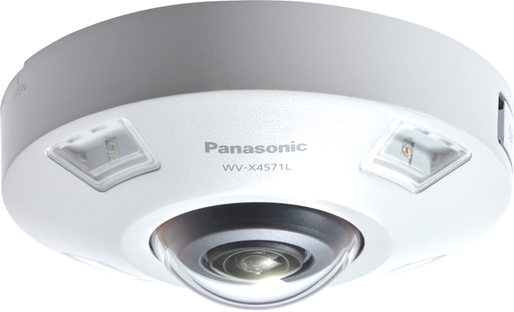
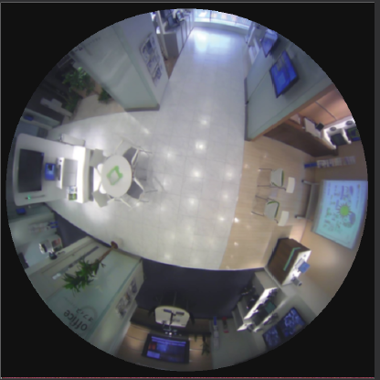
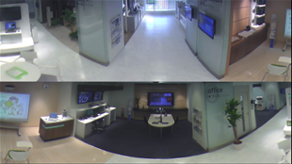
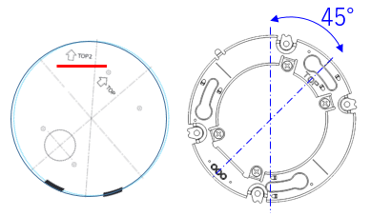
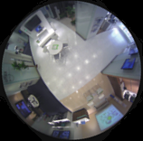
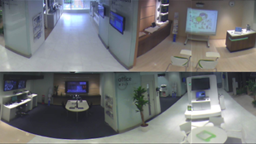
4-3. Important notice for Double Panorama Image cropping position
Conventional model *1
Front for Double Panorama
Front for Fisheye
TOP2
TOP
Cropping
position
New model
When using a double panorama, align the TOP2 direction of the template with the shooting direction
(upper direction of the screen).
*1 WV-S4150 / S4550L / S4550LM / X4170 / X4171 / X4571L / X4571LM

Slide 30
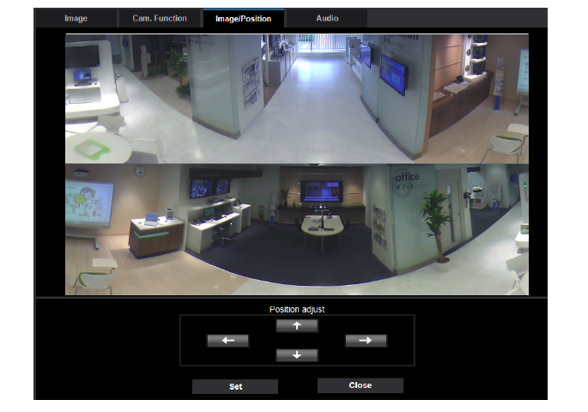
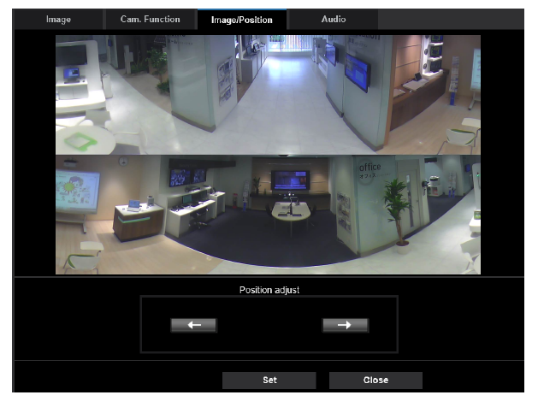
4-4. Limitation for position adjustment in Double Panorama
Conventional model *1
New model
Pan : Adjustable every 1 deg.
Tilt : Adjustable every 1 deg.
Pan : Every 90 deg. only
Tilt : Not adjustable
*1 WV-S4150 / S4550L / S4550LM / X4170 / X4171 / X4571L / X4571LM

Slide 31
4-5. Streaming Performance
Streaming performance
Number of concurrent access : 14 user
Max. Bandwidth : 50 Mbps
14 user
Bandwidth
Total bandwidth
less than
50 Mbps

Slide 32
5. AI Applications

Slide 33
5-1. Overview
About “Pre-install" and “License Free"
Contents |  | Pre-install | KMS | License
 | AI Sound Classification | Standard feature
APP #1 | AI-VMD / AI People Counting *Installed function: AI-VMD / People Counting / Heat Map / Occupancy Detection | Yes | No | Free
APP #2 | AI Privacy Guard | No | No | Free
 | AI Processor Activation License | Yes | No | Free
Install up to 3 apps & Max. capacity will be 150MB
APP #1
AI Processor
Activation License
Max. 3 apps
150MB
AI Sound Classification
(Standard feature)

Slide 34
5-1. Overview
AI application combination
*Below condition “Yes” + “AI Sound Classification” can be worked at the same time
 |  | #1 | #2
#1 | AI-VMD / AI People Counting *Installed function: AI-VMD / People Counting / Heat Map / Occupancy Detection |  | Yes
#2 | AI Privacy Guard | Yes
Notes
- All applications can be used simultaneously, but stream for privacy masking will be limited to 10fps.
As for the restrictions when installing multiple extension software applications on a camera, refer to the support information “Compatibility list for extension software <C0103>” at the link below.
https://i-pro.com/global/en/surveillance/training-support/support/technical-information

Slide 35
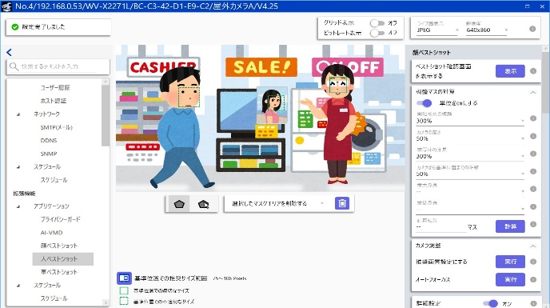
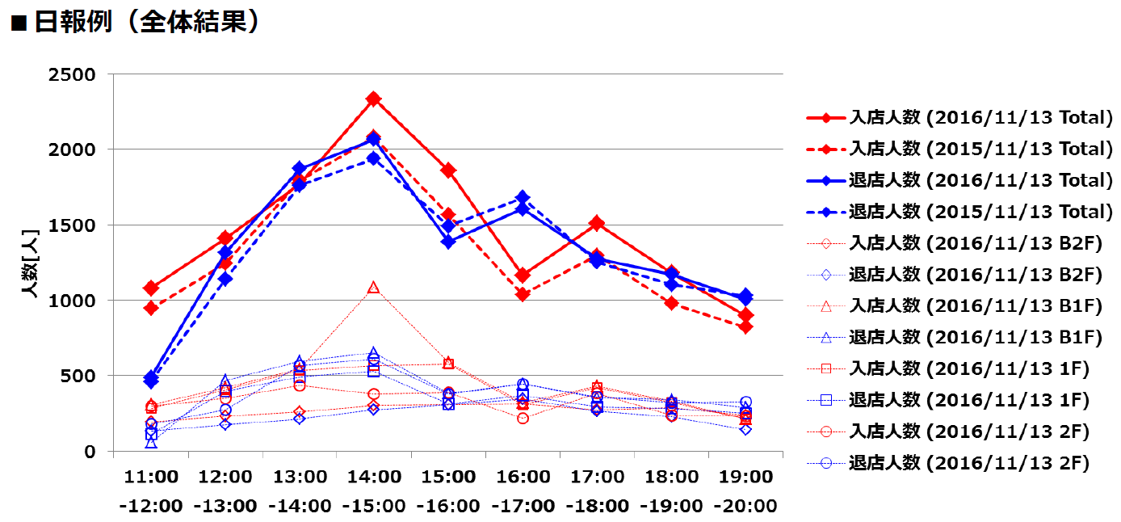

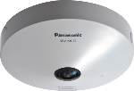
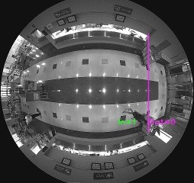
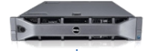
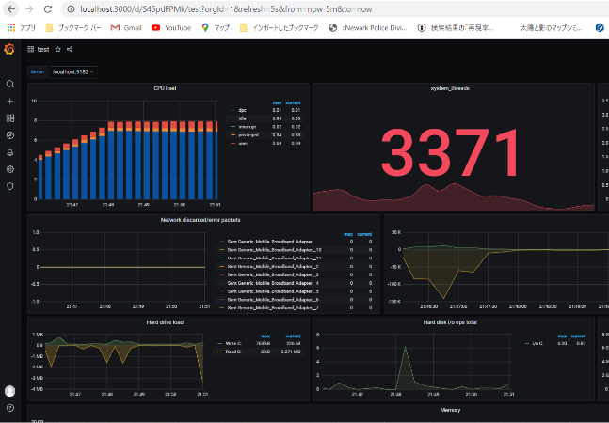

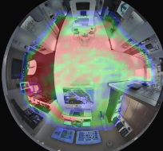
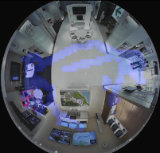
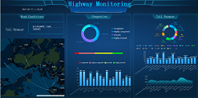

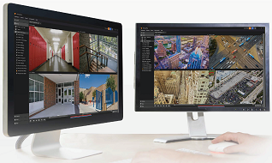
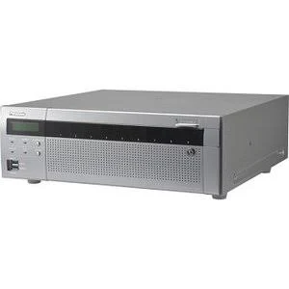
5-2. System support
iCT
BI Tool
MQTT *1
Multi-AI Server
VMS
NVR / ASM300
Web dashboard
of Multi-AI Server
(Can be viewed from other PCs)
3rd Party product
 |  | Application settings | People count data display |  | Heat map data display | Alarm reception *2
 |  |  | Cross Line Counting | Area Counting
iCT |  | Yes | Yes | Yes | No | No
Multi-AI Server (Web dashboard) |  | No | Yes | Yes | Yes | Yes
VMS | VI | No | Yes | No | No | Yes
 | Genetec | No | Yes | Yes | No | Yes
 | Milestone | No | No | No | No | Yes
NVR / ASM300 |  | No | No | No | No | Yes
BI Tool *3 |  | No | Yes (T.B.D) | Yes (T.B.D) | No (T.B.D) | No
*1 Will be supported by firmware upgrade in the future.
*2 Alarm example : AI-VMD, Occupancy Detection, AI Sound Classification
*3 Need to check the system operation of the third party product on site.

Slide 36
5-3. System comparison - iCT / Multi-AI Server
 | iCT | Multi-AI Server
Use case | Collect and view count result sometimes (once a week or month etc.) | Collect and view count result in real time
Supported functions | ・People Counting (Cross Line Counting / Area Counting) | ・People Counting (Cross Line Counting / Area Counting) ・Heat Map
Data collection method | Manual | Auto / Manual
Display in real time | Not supported | Supported

Slide 37
5-4. System comparison - People Counting / Heat Map
 |  |  | New application |  | Conventional application |  | Remarks
 |  |  | AI-VMD / AI People Counting |  | WV-SAE200W | WV-SAE303W
Function | People Counting | Cross Line Counting | Yes |  | Yes | Yes
 |  | Area Counting | Yes |  | No | No
 | Heat Map |  | Yes |  | Yes | No
Setting | Tool |  | iCT *1 |  | Camera browser | People Count Setting Tool | *1 Setup by camera browser will not be supported
Operation | Tool |  | iCT | Multi-AI Server (Web dashboard) | ASM300 | People Count Output Tool
 | People Counting | Data collection | Manual | Manual / Auto | Manual | Manual / Auto
 |  | Data display | Multi Display | Multi Display | Single Display | Multi Display *2 | *2 Display of data output by excel
 |  | Data output | Excel/CSV (T.B.D) | CSV/PDF (T.B.D) | - | Excel/CSV *3 | *3 Automatic data output function supported
 | Heat Map | Data collection | - | Manual / Auto | Manual | -
 |  | Data display | - | Multi Display | Single Display | -
 |  | Data output | - | CSV/PDF (T.B.D) | - | -

Slide 38
5-5. App. #1 : AI-VMD / AI People Counting Spec
Function | Item | New application (AI-VMD/People count/Heat map /AI Occupancy Detection) | Conventional application （i-VMD/People count/Heat map）
Common specification | Supported image capture mode | Fisheye Fisheye + Double Panorama Fisheye + Quad PTZ *Wall installation is not supported | Fisheye Fisheye + Panorama Fisheye + Double Panorama Fisheye + Quad PTZ
 | Frame rate limitation | 5MP model : Max. 30fps 12MP model : Max. 15fps | Max.30fps
 | Number of simultaneous detection | Max. 100 (People / Vehicle in total) *Vehicle is supported by AI-VMD only | Max. 32
 | Number of days to save people count / heat map data | Save people count and heat map data Built-in memory : Max. 1 day Save only people count data Built-in memory : Max. 92 days | Save people count and heat map data Built-in memory : Max. 1 day SD memory card : Max. 92 days

Slide 39
5-5. App. #1 : AI-VMD / AI People Counting Spec
Function | Item | New application (AI-VMD/People count/Heat map /AI Occupancy Detection) | Conventional application （i-VMD/People count/Heat map）
AI-VMD | Detected object | People / Vehicle (AI) *Bicycle is not supported | Moving object (Non-AI)
People Counting (Cross Line Counting) | Counted object | People (AI) | Moving object (Non-AI)
 | Number of line | Max. 8 lines | Max. 12 lines
People Counting (Area Counting) | Counted object | People (AI) | N/A
 | Number of area | Max. 8 areas | N/A
Heat Map | Counted object | People (AI) | Moving object (Non-AI)
Occupancy Detection | Counted object | People (AI) | N/A
 | Number of area | Max. 8 areas | N/A

Slide 40
5-6. App. #2 : AI Privacy Guard Spec
Function | Item | New application (AI Privacy Guard) | Conventional application (MOR)
AI Privacy Guard | Supported image capture mode | Fisheye Panorama Double panorama Single PTZ Quad PTZ | Fisheye Panorama Double panorama Single PTZ Quad PTZ Fisheye + Panorama Fisheye + Double panorama Fisheye + Quad PTZ
 | Frame rate limitation | Max. 15fps | 1fps
 | Number of simultaneous detection | Max. 100 | N/A
 | Detected object | People (AI) *Face is not supported | All moving objects (Non-AI)

Slide 41
5-7. Supported image capture mode
Mounting position | Image capture mode | AI-VMD | People Counting |  | Heat Map | Occupancy Detection | AI Privacy Guard
 |  |  | Cross Line Counting | Area Counting
Ceiling | Fisheye | Yes | Yes | Yes | Yes | Yes | Yes
 | Double Panorama | No | No | No | No | No | Yes
 | Quad PTZ | No | No | No | No | No | Yes
 | Single PTZ | No | No | No | No | No | Yes
 | Fisheye + Double Panorama | Yes | Yes | Yes | Yes | Yes | No
 | Fisheye + Quad PTZ | Yes | Yes | Yes | Yes | Yes | No
 | Quad stream | No | No | No | No | No | No
Wall | Fisheye | No | No | No | No | No | Yes
 | Panorama | No | No | No | No | No | Yes
 | Quad PTZ | No | No | No | No | No | Yes
 | Single PTZ | No | No | No | No | No | Yes
 | Fisheye + Panorama | No | No | No | No | No | No

Slide 42
6. Appearance

Slide 43
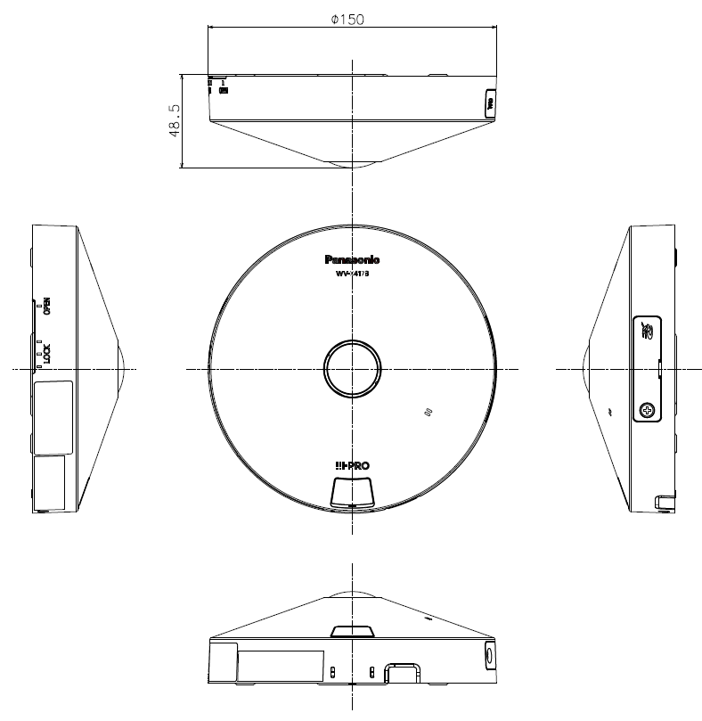
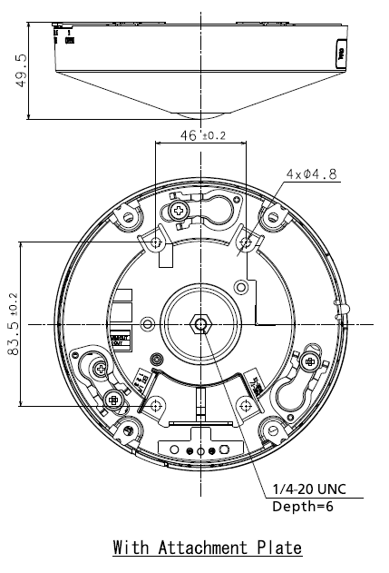
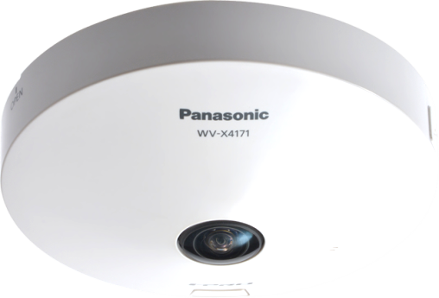
6. Appearance
WV-S4156 / WV-S4176
Color: i-pro white
Finish: ABS resin
Dimensions: ø150 mm × 49.5 mm (H)
{ø5-29/32 inches × 1-15/16 inches (H)}
Weight: Approx. 420 g {0.93 lbs}
Note: No change from current model except Color

Slide 44
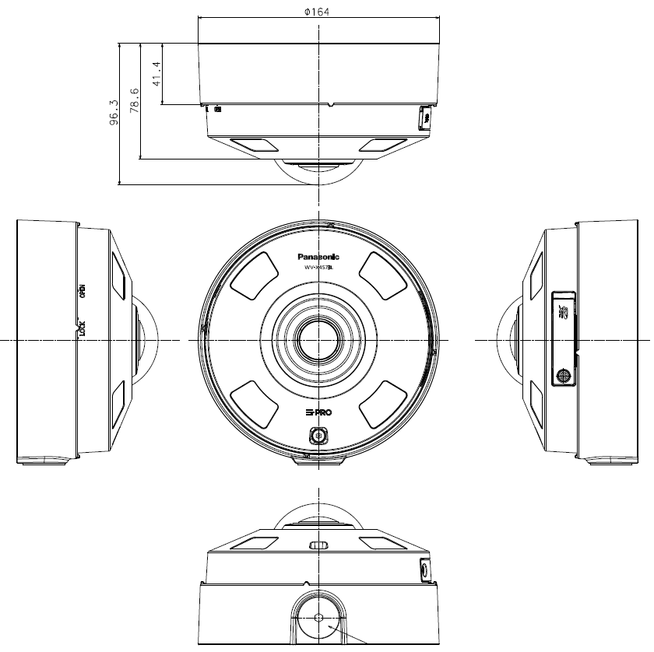
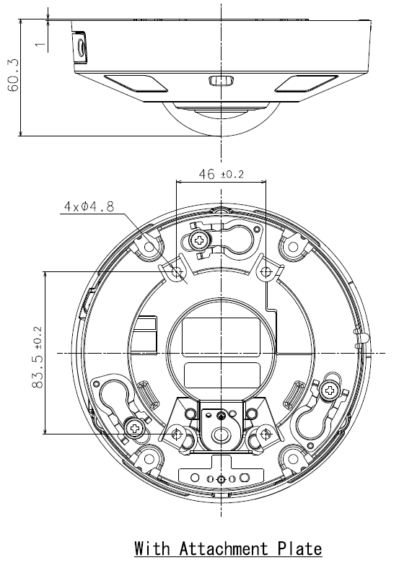
6. Appearance
WV-S4556L / WV-S4556LM / WV-S4576L / WV-S4576LM
Color: i-pro white
Finish: Aluminum die cast
Dimensions: ø164 mm × 96.3 mm (H)
{ø6-29/64 inches × 3-25/32 inches (H)}
Weight: Approx.1.3 kg {2.87 lbs} with Base bracket
Approx.880 g {1.94 lbs} with Attachment plate
Note: No change from current model except Color

Slide 45
7. Standard Accessories

Slide 46

7. Standard Accessories
WV-S4156 / WV-S4176
No. | Standard accessories | Qt.
1 | Installation Guide | 1 pc.
2 | Important Safety Instructions | 1 pc.
3 | Warranty card | 1 pc.
4 | Code label | 1 pc.
5 | Attachment plate | 1 pc.
6 | Audio cable | 1 pc.
7 | Power cable plug | 1 pc.
8 | External I/O terminal plug | 1 pc.
9 | Template A (for the attachment plate) | 1 pc.
10 | Cable tie | 2 pcs.
11 | Safety wire lug | 1 pc.
12 | Safety wire | 1 pc.
13 | Washer | 1 pc.
14 | Spring washer | 1 pc.
15 | Cable for easy kitting | 1 pc.
[Abolition Parts]
- CD-ROM

Slide 47

7. Standard Accessories
WV-S4556L / WV-S4576L
WV-S4556LM / WV-S4576LM
No. | Standard accessories | Qt.
1 | Installation Guide | 1 pc.
2 | Important Safety Instructions | 1 pc.
3 | Warranty card | 1 pc.
4 | Code label | 1 pc.
5 | Base bracket | 1 pc.
6 | Attachment plate | 1 pc.
7 | Fixing screws for attachment plate (M4 x 8 mm {5/16 inches}) | 5 pcs.
8 | Template A (for the attachment plate) | 1 pc.
9 | Template B (for the base bracket) | 1 pc.
10 | Waterproof tape | 1 pc.
11 | 4P alarm cable | 1 pc.
12 | 2P power cable | 1 pc.
13 | Bit (Hex wrench, screw size 6.35 mm {1/4 inches} T20) | 1 pc.
14 | RJ45 Waterproof connecter cover | 1 pc.
15 | RJ45 Waterproof connecter cap | 1 pc.
No. | Standard accessories | Qt.
1 | Installation Guide | 1 pc.
2 | Important Safety Instructions | 1 pc.
3 | Warranty card | 1 pc.
4 | Code label | 1 pc.
5 | Attachment plate | 1 pc.
6 | Template A (for the attachment plate) | 1 pc.
7 | Waterproof tape | 1 pc.
8 | 4P alarm cable | 1 pc.
9 | 2P power cable | 1 pc.
10 | Bit (Hex wrench, screw size 6.35 mm {1/4 inches} T20) | 1 pc.
[Abolition Parts]
- CD-ROM
[Abolition Parts]
- CD-ROM

Slide 48
8. Optional Accessories

Slide 49







8. Optional Accessories
WV-S4156 / WV-S4176
No. | Model No. | Image | Description
1 | WV-QJB500-W |  | Adaptor Box (i-PRO white) *1
2 | WV-QJB500-G |  | Adaptor Box (light gray) *1
3 | WV-QJB500-S |  | Adaptor Box (fine silver) *1
4 | WV-Q105A |  | Ceiling Mount Bracket *2
5 | WV-QCL100-W |  | Ceiling Mount Bracket
6 | WV-QCL101-W |  | Ceiling Mount Bracket
7 | WV-QWL500-W |  | Wall Mount Bracket (i-PRO white)
8 | WV-QWL500-G |  | Wall Mount Bracket (light gray)
*1 Refer to the Support Information page for the accessary combination required for installation.
*2 WV-Q105A is “for indoor use only” when installing on the ceiling.

Slide 50














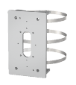
8. Optional Accessories
WV-S4556L / WV-S4576L
No. | Model No. | Image | Description
1 | WV-QCL501-W |  | Ceiling Mount Bracket (i-PRO white) *1
2 | WV-Q178 |  | Ceiling Mount Bracket (light gray) *1
3 | WV-Q121BS |  | Ceiling Mount Bracket (fine silver) *1
4 | WV-QWL501-W |  | Wall Mount Bracket (i-PRO white) *1
5 | WV-Q185 |  | Wall Mount Bracket (light gray) *1
6 | WV-Q122AS |  | Wall Mount Bracket (fine silver) *1
7 | WV-QAT500-W |  | Attachment Pipe Bracket (i-PRO white) *1
8 | WV-Q179 |  | Attachment Pipe Bracket (light gray) *1
9 | WV-Q123A |  | Attachment Pipe Bracket (fine silver) *1
No. | Model No. | Image | Description
10 | WV-QSR501-W |  | Mount Bracket (i-PRO white)
11 | WV-Q186 |  | Mount Bracket (light gray)
12 | WV-Q124 |  | Mount Bracket (fine silver)
13 | WV-QJB500-W |  | Adaptor Box (i-PRO white) *1
14 | WV-QJB500-G |  | Adaptor Box (light gray) *1
15 | WV-QJB500-S |  | Adaptor Box (fine silver) *1
16 | WV-QPL500-W |  | Pole Mount Bracket (i-PRO white) *1
17 | WV-Q182 |  | Pole Mount Bracket (light gray) *1
18 | WV-Q188 |  | Pole Mount Bracket (fine sliver) *1
*1 Refer to the Support Information page for the accessary combination required for installation.

Slide 51



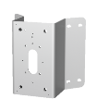

8. Optional Accessories
WV-S4556L / WV-S4576L
WV-S4556LM / WV-S4576LM
No. | Model No. | Image | Description
19 | WV-QCN500-W |  | Corner Mount Bracket (i-PRO white) *1
20 | WV-Q183 |  | Corner Mount Bracket (light gray) *1
21 | WV-Q189 |  | Corner Mount Bracket (fine silver) *1
22 | WV-Q105A |  | Ceiling Mount Bracket *2
23 | WV-QCL100-W |  | Ceiling Mount Bracket
24 | WV-QCL101-W |  | Ceiling Mount Bracket
25 | WV-QWL500-W |  | Wall Mount Bracket (i-PRO white)
26 | WV-QWL500-G |  | Wall Mount Bracket (i-PRO white)
No. | Model No. | Image | Description
1 | WV-QJB501-W |  | Base bracket (i-PRO white)
*1 Refer to the Support Information page for the accessary combination required for installation.
*2 WV-Q105A is “for indoor use only” when installing on the ceiling.

Slide 52
Appendix:
System Support Schedule

Slide 53
Each System Support Schedule - Camera
 | Indoor |  | Outdoor
 | 5MP model | 12MP model | 5MP model | 12MP model
 | WV-S4156 | WV-S4176 | WV-S4556L WV-S4556LM | WV-S4576L WV-S4576LM
Product release | Nov. 2021
NVR | V4.60 / E. Nov.
ASM300 | V4.40 / E. Nov.
PSV | V6.10 / E. Jul. (Released)
iCT | V2.30 / E. Nov.
SDT | V2.50 / E. Nov.
VI | V7.9 / Dec.
Genetec | 5.10.2.0 (DP10.7) / Dec.
Milestone | DP11.9 / E. Dec.

Slide 54
Each System Support Schedule - Application
 | App #1 |  |  |  |  | App #2 | Standard feature
 | AI-VMD | People Counting |  | Heat Map | Occupancy Detection | AI Privacy Guard | AI Sound Classification
 |  | Cross Line Counting | Area Counting
Product release | Nov. 2021
NVR | V4.60 / E. Nov. | Not support |  |  | V4.60 / E. Nov. | Not support | V4.60 / E. Nov.
ASM300 | V4.40 / E. Nov. | Not support |  |  | V4.40 / E. Nov. | Not support | V4.40 / E. Nov.
PSV | V7.00 / E. Jan. | Not support |  |  | V7.00 / E. Jan. | V6.10 / E. Jul. (Released) | V7.00 / E. Jan.
iCT | V2.30 / E. Nov.
SDT | V2.50 / E. Nov. |  |  |  |  |  | Not support

Slide 55
Each System Support Schedule - Application
 |  | App #1 |  |  |  |  |  | App #2 | Standard feature
 |  | AI-VMD | People Counting |  |  | Heat Map | Occupancy Detection | AI Privacy Guard | AI Sound Classification
 |  |  | Cross Line Counting | Area Counting
Product release |  | Nov. 2021
Multi-AI Server |  | V1.2.0 / M. Jan. |  |  |  |  |  | Not support | V1.2.0 / M. Jan.
 | Web dashboard | Not support | V1.2.0 / M. Jan. |  |  |  | Not support
 | plugin for VI | V1.1.0 / B. Dec. | Not support |  |  |  | V1.1.0 / B. Dec. | Not support | V1.1.0 / B. Dec.
 | plugin for Genetec | Not support
 | plugin for ASM300 | V1.0.0 / B. Feb. | Not support |  |  |  | V1.0.0 / B. Feb. | Not support | V1.0.0 / B. Feb.
VI |  | V7.9.1 / FY21 4Q |  | Not support |  |  | V7.9.1 / FY21 4Q | V7.9 / Dec.
 | VI Object Count plugin | Not support | V1.00 / Jul. (Released) *1 | Not support
Genetec |  | 5.10.3.0 (DP10.7) / E. Jan. |  |  | Not support |  | 5.10.2.0 (DP10.7) / Dec.
Milestone |  | DP11.9 / E. Dec. (T.B.D) | Not support |  |  |  |  | DP11.9 / E. Dec. (T.B.D)
*1 it is necessary to upgrade VI version (V7.9).

Slide 56
Appendix:
Image quality comparison (5MP model)

Slide 57
Summary
i-PRO S4556L
SD : ON, iA : ON, AGC : 11
H265, VBR, 30fps, MAX bitrate : 14336 kbps, image quality : 3
Smart coding : OFF
* Other setting parameters are default values.
i-PRO S4551L
SD : ON, iA : ON, AGC : 11
H265, VBR, 30fps, MAX bitrate : 14336 kbps, image quality : 3 Smart coding : OFF
* Other setting parameters are default values.
AXIS M3057-PLVE Mk II
SD : ON, AGC : 48dB
H264, VBR, 30fps, image quality : 3
Zipstream : OFF
* Other setting parameters are default values.
Hanwha XNF-8010RV
SD : ON, AGC : high
H265, VBR, 30fps, MAX bitrate : 2048 kbps
WiseStream : OFF
* Other setting parameters are default values.
Scoring method: Scored by deducting and adding points beginning with 3 points.

Slide 58












Day time Outdoor
Illuminance : 50000 – 90000 lux
i-PRO S4556L
i-PRO S4551L
AXIS M3057-PLVE Mk II
Hanwha XNF-8010RV
Low peripheral resolution and high distortion
3.5 points
3.5 points
3.5 points
3.5 points
Evaluation item | Score
Face visibility | +0.5
Sensitivity, S/N | +0
Brightness | +0
Resolution | +0
Color reproduction | +0
Evaluation item | Score
Face visibility | +0.5
Sensitivity, S/N | +0
Brightness | +0
Resolution | +0
Color reproduction | +0
Evaluation item | Score
Face visibility | +0.5
Sensitivity, S/N | +0
Brightness | +0
Resolution | +0
Color reproduction | +0
Evaluation item | Score
Face visibility | +0.5
Sensitivity, S/N | +0
Brightness | +0
Resolution | +0
Color reproduction | +0
Measured bit rate: 3122kbps
Measured bit rate: 3238kbps
Measured bit rate: 2292kbps
Measured bit rate: 4241kbps

Slide 59








Day time Indoor
Illuminance : 800 – 1000 lux
i-PRO S4556L
i-PRO S4551L
AXIS M3057-PLVE Mk II
Hanwha XNF-8010RV
3.5 points
3.5 points
4.5 points
3.5 points
Evaluation item | Score
Face visibility | +0.5
Sensitivity, S/N | +0
Brightness | +0
Resolution | +0
Color reproduction | +0
Evaluation item | Score
Face visibility | +0.5
Sensitivity, S/N | +0
Brightness | +0
Resolution | +0
Color reproduction | +0
Evaluation item | Score
Face visibility | +1.0
Sensitivity, S/N | +0
Brightness | +0
Resolution | +0.5
Color reproduction | +0
Evaluation item | Score
Face visibility | +0.5
Sensitivity, S/N | +0
Brightness | -0.5
Resolution | +0.5
Color reproduction | +0
Measured bit rate: 1489kbps
Measured bit rate: 1443kbps
Measured bit rate: 1080kbps
Measured bit rate: 2991kbps

Slide 60








SD Day time
Illuminance: [Outside] 90000lux / [Inside] 350lux
i-PRO S4556L
i-PRO S4551L
AXIS M3057-PLVE Mk II
Hanwha XNF-8010RV
Low peripheral resolution and high distortion
2.5 points
2.5 points
3.5 points
2.5 points
Evaluation item | Score
Face visibility | -0.5
Sensitivity, S/N | +0
Brightness | +0
Resolution | +0
Color reproduction | +0
Evaluation item | Score
Face visibility | -0.5
Sensitivity, S/N | +0
Brightness | +0
Resolution | +0
Color reproduction | +0
Evaluation item | Score
Face visibility | +0
Sensitivity, S/N | +0
Brightness | +0
Resolution | +0.5
Color reproduction | +0
Evaluation item | Score
Face visibility | -0.5
Sensitivity, S/N | +0
Brightness | +0
Resolution | +0
Color reproduction | +0
Measured bit rate: 1659kbps
Measured bit rate: 1377kbps
Measured bit rate: 1150kbps
Measured bit rate: 3510kbps

Slide 61








Night time Outdoor
Illuminance : 0.1 – 0.7 lux
i-PRO S4556L
i-PRO S4551L
AXIS M3057-PLVE Mk II
Hanwha XNF-8010RV
3.0 points
3.0 points
3.0 points
2.5 points
Evaluation item | Score
Face visibility | +0
Sensitivity, S/N | -0.5
Brightness | +0.5
Resolution | +0
Color reproduction | +0
Evaluation item | Score
Face visibility | +0
Sensitivity, S/N | -0.5
Brightness | +0.5
Resolution | +0
Color reproduction | +0
Evaluation item | Score
Face visibility | +0
Sensitivity, S/N | +1.0
Brightness | -1.0
Resolution | +0
Color reproduction | +0
Evaluation item | Score
Face visibility | +0
Sensitivity, S/N | -1.0
Brightness | +0.5
Resolution | +0
Color reproduction | +0
Measured bit rate: 2123kbps
Measured bit rate: 1731kbps
Measured bit rate: 342kbps
Measured bit rate: 4263kbps

Slide 62








Low light
Illuminance : 0.3 – 0.5 lux
i-PRO S4556L
i-PRO S4551L
AXIS M3057-PLVE Mk II
Hanwha XNF-8010RV
3.5 points
3.5 points
3.0 points
3.0 points
Evaluation item | Score
Face visibility | +0
Sensitivity, S/N | +0
Brightness | +0.5
Resolution | +0
Color reproduction | +0
Evaluation item | Score
Face visibility | +0
Sensitivity, S/N | +0
Brightness | +0.5
Resolution | +0
Color reproduction | +0
Evaluation item | Score
Face visibility | +0.5
Sensitivity, S/N | +0
Brightness | -1.0
Resolution | +0
Color reproduction | +0.5
Evaluation item | Score
Face visibility | +0
Sensitivity, S/N | -1.0
Brightness | +0.5
Resolution | +0
Color reproduction | +0.5
Measured bit rate: 1776kbps
Measured bit rate: 1855kbps
Measured bit rate: 237kbps
Measured bit rate: 4234kbps

Slide 63








IR-LED
Illuminance : 0.1 – 0.7 lux
i-PRO S4556L
i-PRO S4551L
AXIS M3057-PLVE Mk II
Hanwha XNF-8010RV
2.5 points
2.5 points
3.5 points
2.0 points
Evaluation item | Score
Face visibility | -0.5
Sensitivity, S/N | +0
Brightness | +0
Resolution | +0
Color reproduction | -
Evaluation item | Score
Face visibility | -0.5
Sensitivity, S/N | +0
Brightness | +0
Resolution | +0
Color reproduction | -
Evaluation item | Score
Face visibility | +0.5
Sensitivity, S/N | +0
Brightness | +0
Resolution | +0
Color reproduction | -
Evaluation item | Score
Face visibility | -0.5
Sensitivity, S/N | -0.5
Brightness | +0
Resolution | +0
Color reproduction | -
Measured bit rate: 2115kbps
Measured bit rate: 3910kbps
Measured bit rate: 712kbps
Measured bit rate: 4219kbps

Slide 64
Appendix:
Image quality comparison (12MP model)

Slide 65
Summary
i-PRO S4576L
SD : ON, iA : ON, AGC : 11
H265, VBR, 30fps, MAX bitrate : 20480 kbps, image quality : 3
Smart coding : OFF
* Other setting parameters are default values.
i-PRO X4573L
SD : ON, iA : ON, AGC : 11
H265, VBR, 30fps, MAX bitrate : 20480 kbps, image quality : 3
Smart coding : OFF
* Other setting parameters are default values.
AXIS M3058-PLVE
SD : ON, AGC : 48dB
H264, VBR, 30fps, image quality : 3
Zipstream : OFF
* Other setting parameters are default values.
Hanwha XNF-9010RV
SD : ON, AGC : high
H265, VBR, 30fps, MAX bitrate : 8192 kbps
WiseStream : OFF
* Other setting parameters are default values.
Scoring method: Scored by deducting and adding points beginning with 3 points.

Slide 66












Day time Outdoor
Illuminance : 50000 – 90000 lux
i-PRO S4576L
i-PRO X4573L
AXIS M3058-PLVE
Hanwha XNF-9010RV
4.5 points
4.5 points
3.5 points
2.0 points
Evaluation item | Score
Face visibility | +0.5
Sensitivity, S/N | +0
Brightness | +0
Resolution | +0.5
Color reproduction | +0.5
Evaluation item | Score
Face visibility | +0.5
Sensitivity, S/N | +0
Brightness | +0
Resolution | +0.5
Color reproduction | +0.5
Evaluation item | Score
Face visibility | +0.5
Sensitivity, S/N | -0.5
Brightness | +0
Resolution | +0.5
Color reproduction | +0
Evaluation item | Score
Face visibility | -0.5
Sensitivity, S/N | +0
Brightness | +0
Resolution | -0.5
Color reproduction | +0
Measured bit rate: 4032kbps
Measured bit rate: 4368kbps
Measured bit rate: 4835kbps
Measured bit rate: 2751kbps

Slide 67








Day time Indoor
Illuminance : 800 – 1000 lux
i-PRO S4576L
i-PRO X4573L
AXIS M3058-PLVE
Hanwha XNF-9010RV
4.0 points
4.0 points
3.0 points
2.5 points
Evaluation item | Score
Face visibility | +0.5
Sensitivity, S/N | +0
Brightness | +0
Resolution | +0
Color reproduction | +0.5
Evaluation item | Score
Face visibility | +0.5
Sensitivity, S/N | +0
Brightness | +0
Resolution | +0
Color reproduction | +0.5
Evaluation item | Score
Face visibility | +0.5
Sensitivity, S/N | -0.5
Brightness | +0
Resolution | -0.5
Color reproduction | +0
Evaluation item | Score
Face visibility | -0.5
Sensitivity, S/N | +0
Brightness | -0.5
Resolution | +0.5
Color reproduction | +0
Measured bit rate: 1515kbps
Measured bit rate: 1678kbps
Measured bit rate: 1779kbps
Measured bit rate: 1138kbps

Slide 68












SD Day time
Illuminance: [Outside] 90000lux / [Inside] 350lux
i-PRO S4576L
i-PRO X4573L
AXIS M3058-PLVE
Hanwha XNF-9010RV
3.0 points
3.0 points
2.5 points
2.0 points
Evaluation item | Score
Face visibility | -0.5
Sensitivity, S/N | +0
Brightness | +0
Resolution | +0.5
Color reproduction | +0
Evaluation item | Score
Face visibility | -0.5
Sensitivity, S/N | +0
Brightness | +0
Resolution | +0.5
Color reproduction | +0
Evaluation item | Score
Face visibility | -0.5
Sensitivity, S/N | -0.5
Brightness | +0
Resolution | +0.5
Color reproduction | +0
Evaluation item | Score
Face visibility | -0.5
Sensitivity, S/N | -0.5
Brightness | +0
Resolution | +0
Color reproduction | +0
Measured bit rate: 1751kbps
Measured bit rate: 1885kbps
Measured bit rate: 2692kbps
Measured bit rate: 1023kbps

Slide 69








Night time Outdoor
Illuminance : 0.4 – 0.7 lux
i-PRO S4576L
i-PRO X4573L
AXIS M3058-PLVE
Hanwha XNF-9010RV
3.5 points
3.5 points
2.5 points
1.0 points
Evaluation item | Score
Face visibility | +0
Sensitivity, S/N | +0
Brightness | +0.5
Resolution | +0
Color reproduction | +0
Evaluation item | Score
Face visibility | +0
Sensitivity, S/N | +0
Brightness | +0.5
Resolution | +0
Color reproduction | +0
Evaluation item | Score
Face visibility | +0
Sensitivity, S/N | +0
Brightness | -0.5
Resolution | +0
Color reproduction | +0
Evaluation item | Score
Face visibility | +0
Sensitivity, S/N | -1.0
Brightness | -0.5
Resolution | +0
Color reproduction | -0.5
Measured bit rate: 10896kbps
Measured bit rate: 10183kbps
Measured bit rate: 9371kbps
Measured bit rate: 419kbps

Slide 70








Low light
Illuminance : 0.5 – 1.0 lux
i-PRO S4576L
i-PRO X4573L
AXIS M3058-PLVE
Hanwha XNF-9010RV
3.5 points
3.5 points
2.5 points
2.5 points
Evaluation item | Score
Face visibility | +0
Sensitivity, S/N | +0
Brightness | +0.5
Resolution | +0
Color reproduction | +0
Evaluation item | Score
Face visibility | +0
Sensitivity, S/N | +0
Brightness | +0.5
Resolution | +0
Color reproduction | +0
Evaluation item | Score
Face visibility | +0.5
Sensitivity, S/N | +0
Brightness | -1.0
Resolution | +0
Color reproduction | +0
Evaluation item | Score
Face visibility | +0
Sensitivity, S/N | -1.0
Brightness | +0.5
Resolution | +0
Color reproduction | +0
Measured bit rate: 1776kbps
Measured bit rate: 1855kbps
Measured bit rate: 237kbps
Measured bit rate: 4234kbps

Slide 71












IR-LED
Illuminance : 0.4 – 0.7 lux
i-PRO S4576L
i-PRO X4573L
AXIS M3058-PLVE
Hanwha XNF-9010RV
2.5 points
2.5 points
3.5 points
1.5 points
Evaluation item | Score
Face visibility | -0.5
Sensitivity, S/N | +0
Brightness | +0
Resolution | +0
Color reproduction | -
Evaluation item | Score
Face visibility | -0.5
Sensitivity, S/N | +0
Brightness | +0
Resolution | +0
Color reproduction | -
Evaluation item | Score
Face visibility | +0.5
Sensitivity, S/N | +0
Brightness | +0
Resolution | +0
Color reproduction | -
Evaluation item | Score
Face visibility | -0.5
Sensitivity, S/N | -0.5
Brightness | -0.5
Resolution | +0
Color reproduction | -
Measured bit rate: 4792kbps
Measured bit rate: 5675kbps
Measured bit rate: 2626kbps
Measured bit rate: 394kbps

Slide 72
Appendix:
AI Sound Classification

Slide 73





AI Sound Classification
Support identifying specific sound by AI
Gunshot
Daily noise
Gunshot
Vehicle horn
Identifying a specific sound
among other noises

Slide 74

AI Sound Classification
Spec comparison
Function | New model | Conventional model
Audio Detection | Yes | Yes
AI Sound classification | Yes | No
SD card recording triggered by Audio Detection | No | Yes
Spec of AI Sound classification
Item | Content
Classification target / Examples | 1. Gunshot | 3. Vehicle Horn
 | 2. Yell | 4. Glass break
Classification condition | The level of target sound is 6dB larger than ambient sound. (sound classification can be used in indoor and outdoor environments) Target sound continues more than a second. (except for gunshot)

Slide 75
AI Sound Classification
Detectable distance for AI Sound classification
Ambient noise level | Example of scene | Detectable distance (Guideline)
 |  | Yell / Glass break (90 - 110 dB) | Gunshot / Vehicle horn (110 - 130 dB)
70 dB | Noisy streets, main roads | 4 m (13 feet) | 15 m (49 feet)
60 dB | Ordinary conversation, quiet car | 8 m (26 feet) | 30 m (98 feet)
50 dB | Residential area, office in the daytime | 16 m (52 feet) | 50 m (164 feet) *1
40 dB | Residential area at night, library | 32 m (105 feet) | 50 m (164 feet) *1
Microphone requirements for AI Sound classification
  Frequency characteristics: support 200 Hz to 8 KHz
  Omnidirectional microphone
Confirmed microphone
  Built-in mic (WV-S4156, WV-S4176)
  ECM-CS3 (SONY) *2, AT9904 (audio-technica) *2
*1 The detectable distance may change depending on the surrounding environment, such as when the building blocks it.
*2 may not be available in your region

Slide 76
AI Sound Classification
Restrictions
In the following cases, target sound may not be detected by AI sound identification.
Target sound is too short
Multiple types of target sounds occur at the same time (only one of them is detected)
It's raining (especially when rain drops hit the microphone directly)
Target sound is too quiet or too loud
Other sounds that are very similar to the target sound may be detected.
[Example]
Detects tire puncture as "gunshot"
If the sound of glass breaking and the impact sound is strong, it is detected as "gunshot".
Detects bird calls as “yell"
Detects an emergency vehicle siren as a “yell"
Detects the sound of tableware breaking as "glass break“

Slide 77

AI Sound Classification
Setting screen
Select On/Off.
Select detection sensitivity for the volume from Low/Middle/High.
Select sound for the target of alarm.
"Other" is detected by volume.
Select when there is no sound to be classified in the setting items.
It is not recommended to select "Other" in duplicate with other analytics target (such as a “Gunshot”).
When a gunshot actually occurs, “Gunshot" and “Other" are detected
and two alarms are notified.
In particular, when linking an alarm with the NX recorder, it is possible
that the “Gunshot" detection cannot be received because
the NX recorder has set a period during which notifications are not
continuously accepted (Alarm disarm duration [default : 2 seconds]).
In iCT V2.0 or later, you can adjust the judgment threshold of Gunshot/Yell/Vehicle horn/Glass break.
*In order to link the alarm with the NX recorder or ASM300, it is necessary to register the message ID of the alarm.
See next page.

Slide 78
Ref. Extension software alarm setting - Recorder Setting
Extension software alarm setting
Extension software alarm
Go to [REC & event]-> [Advanced setup] tab -> [Extension software alarm], and click “Setup” to open the [Extension software alarm] setup screen.
Set an ID for AI Sound Classification alarm in an available line from No.5 to 8.
No.
No.1-4: reserved for AI-VMD
No.5-8: available
Name
Enter the name of alarm.
Ex. “AI Sound Classification (Gunshot)”
Message ID
Enter an ID (Gunshot:70 / Glass break:71 / Vehicle horn:72 / Yell:73) for AI Sound Classification alarm.

Slide 79


Ref. Extension software alarm setting - ASM300 Setting
Extension software alarm setting
Set an ID for AI Sound Classification alarm in an available line from No.5 to 8.
No.
No.1-4: reserved for AI-VMD
No.5-8: available
Intruder
Name
Enter the name of alarm.
Ex. “AI Sound Classification (Gunshot)”
Loitering
Direction
Cross Line
Message ID
Enter an ID (Gunshot:70 / Glass break:71 / Vehicle horn:72 / Yell:73) for AI Sound Classification alarm.
User-defined 1
User-defined 2
User-defined 3
User-defined 4
Match the setting order of each message ID of No. 1 to No. 8 on the Extension software alarm setting screen of the recorder, and No. 1 to No. 8 of this setting screen.

Slide 80
Appendix:
Other Specifications

Slide 81




Easy Kitting for Indoor Model
Conventional model *1
Note : Easy Kitting for Outdoor model has been supported from current model
Change of packing specifications
Cable for easy kitting
(Standard Accessories)
New model
Kitting Window
*1 WV-S4150 / S4550L / S4550LM / X4170 / X4171 / X4571L / X4571LM

Slide 82


Frame rate mode setting
Conventional model *1
New model
25fps mode is added
*1 WV-S4150 / S4550L / S4550LM / X4170 / X4171 / X4571L / X4571LM

Slide 83


Restrictions on Super Dynamic / Wide dynamic range
If the Super Dynamic / Wide dynamic range level is set to 30 or more, maximum frame rate will be 15fps.
5MP model
Level Setting: Default=27
# Up to 30 fps transmission is available
Level | 27 | 28 | 29 | 30 | 31
Framerate | 30fps | 30fps | 30fps | 15fps | 15fps
Dynamic range *1 | 96dB | 102dB | 108dB | 114dB | 120dB
12MP model
Level Setting: Default=29
# Up to 30 fps transmission is available
Level | 29 | 30 | 31
Framerate | 30fps | 15fps | 15fps
Dynamic range *1 | 72dB | 78dB | 84dB
*1 : It is theoretical value and may change depending on an environment.

Slide 84
Note for time to refresh images during camera control (Pan/Tilt/Zoom)
5MP model measurement results
 | Conventional model （1600x1200） | New model （1600x1200） | AXIS （1600x1200）
 | WV-S4150 | WV-S4151 | M3057-PLVE
Quad PTZ | 0.13(s) | 0.31(s) | 0.18(s)
12MP model measurement results
 | Conventional model （2560x1920） | New model （2560x1920） | AXIS （2560x1920）
 | WV-X4171 | WV-X4573L | M3058-PLVE
Quad PTZ | 0.24(s) | 0.56(s) | 0.38(s)
Measurement PC spec. : HP Elite Desk 800 G5 SF (Core i7-9700/CPU 3GHz x8 core/Memory 16GB)

Slide 85

Privacy zone setting
Conventional model *1
New model
Privacy mask can be set by rectangle.
Privacy mask can be set by designating 4 points on the screen.
*1 WV-S4150 / S4550L / S4550LM / X4170 / X4171 / X4571L / X4571LM

Slide 86
Other changes
 | Conventional model | New model
Frame rate (When Monitor Output is Used) | - | When “Audio out” is set to “Monitor”, the frame rate may be reduced. After camera installation is completed, “Audio out” is set to “Audio”.
Double panorama | The number of pixels in the upper and lower images is same at all resolution. | 5MP Model [Resolution of 1280 x 720] Upper image : 1280 x 362 / Lower image : 1280 x 358 12MP Model [Resolution of 320 x 180] Upper image : 320 x 92 / Lower image : 320 x 88
Auto Pan (Image Refresh time) | Pan speed Approx. 6 deg. / sec Image refresh interval Approx. 1 deg. / step | Pan speed Approx. 6 deg. / sec Image refresh interval Approx. 2.4 deg. / step

Slide 87





Case where conventional 360-degree camera and new 360-degree camera are mixed
New system will not support conventional 360-degree camera
In the case conventional and new 360-degree camera are mixed, each software will be required
■conventional system
Conventional people count
(people count output tool)
Data collection
Auto / Manual
■conventional and new system mixed
Conventional people count
(people count output tool)
Data collection
Auto / Manual
New people count（iCT）
Data collection
Manual
Camera replaced

Slide 88

Output IF
 | App. #1 : AI-VMD / AI People Counting |  |  |  |  |  | Standard feature
Function | AI-VMD |  | People Counting |  | Heat Map | Occupancy Detection | AI Sound Classification
Output data | Alarm | Meta information | Meta information |  | Meta information | Alarm | Alarm
 |  | Detection frame | Count data | Detection frame | Heat map data
ONVIF | Yes | Yes | Yes *1 | No | Yes *1 | Yes | Yes
CGI | Yes | No | Yes | No | Yes | No | Yes
TCP alarm protocol | Yes | No | No | No | No | Yes | Yes
Additional information in video stream | Yes | Yes | Yes | Yes | No | Yes | Yes
HTTP POST | No | No | Yes | No | No | No | No
MQTT | No | No | Yes *2 | No | No | No | No
30
25
*1 Data format is proprietary.
*2 Will be supported by firmware upgrade in the future.

Slide 89
Version History

Slide 90
Version History
No | Update contents | Page No. | Version | Update
1 | 1st Version | - | 1.00 | 10.Sep.2021
2 | Corrected the system support information. | P.34 | 1.01 | 28.Sep.2021
3 | Corrected the AI ​​Privacy Guard support information of NVR / ASM300 to “Not support". | P.53 | 1.01 | 28.Sep.2021
4 | Added notes when extension software alarm setting. | P.78 | 1.01 | 1.Oct.2021
5 | Removed AI Privacy Guard from pre-installation. | P.32 | 1.01 | 1.Oct.2021
6 | Corrected the link page of the caution statement. | P.24 | 1.02 | 25.Oct.2021
7 | Corrected system support information. | P.34 | 1.02 | 25.Oct.2021
8 | Corrected support schedule of camera. | P.52 | 1.02 | 25.Oct.2021
9 | Corrected support schedule of application. | P.53, P.54 | 1.02 | 11.Nov.2021
10 | Corrected the linked URL. | P.33 | 1.02 | 12.Nov.2021
11 | Corrected Important notice for Double Panorama Image cropping position. | P.28 | 1.03 | 18.Nov.2021
12 | Corrected system support information. | P.34 | 1.03 | 24.Nov.2021
13 | Added description about supported image capture mode. | P.40 | 1.04 | 29.Nov.2021
14 | Corrected support schedule of camera. | P.52 | 1.04 | 9.Dec.2021
15 | Corrected support schedule of application. | P.54 | 1.04 | 9.Dec.2021

Slide 91
Version History
No | Update contents | Page No. | Version | Update
16 | Support company name change | - | 1.05 | 14. Jul. 2022
17 | Corrected streaming performance information. | P.30 | 1.06 | 10. Aug. 2022

