Slide 1
i-PRO Multi-AI System
Ver.1.1 version up contents
- November 2021 -
Ver.1.00
Dec. 2021

Slide 2
Overview
Target
Product
i-PRO Multi-AI System
Version
V1.1
Contents
Version upgrade item | Sheet
1. Displays the detected frame of the selected target | 1
2. Improve the display order of thumbnail search results | 2
3. Windows OS including ‘N’ is not supported | 3
4. Solve the time zone issues with the VI client | 4

Slide 3
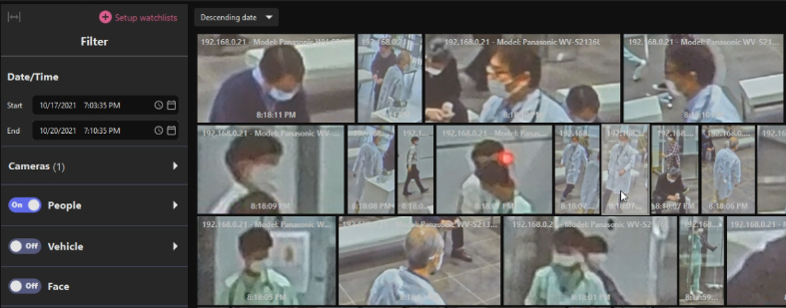
1. Displays the detected frame of the selected target
Improvement
The detection frame can be generated on the selected object to clarify the target.
V1.1
Dipslays a detected frame on the target object (the object on the thumbnail) when playing back a video by clicking a thumbnail in the thumbnail search result.
Note: This applies to Multi-AI plugin software for Video Insight only and it needs to be version 1.1.0 or later.
Select a target thumbnail

Slide 4
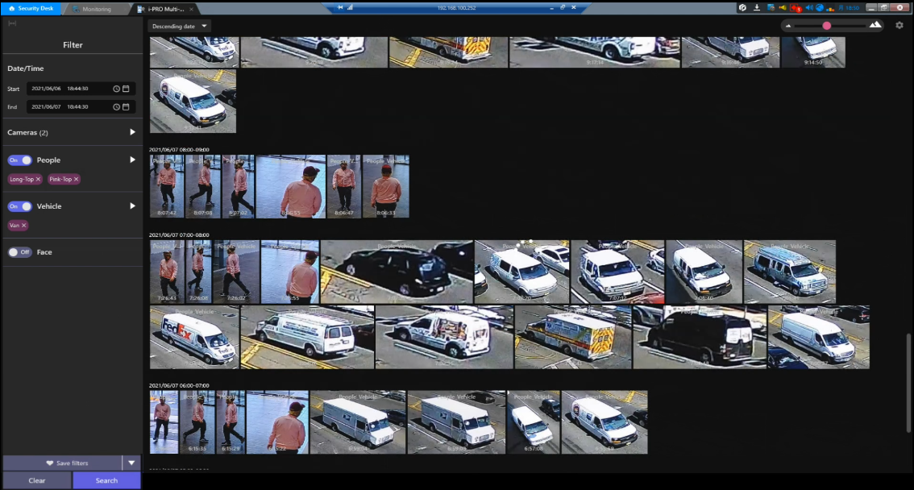
2. Improve the display order of thumbnail search results
Improvement
When the same search criteria are used in the thumbnail search results, the results are displayed in a certain ("faces, people and vehicles" ) order.
V1.1
The best shots of the search results are displayed on an hourly basis.
(e.g. 10:00-11:00, 11:00-12:00, 12:00-13:00)
Until now, the order in which the search results were displayed within an hour was timing-dependent, so that the order of "faces, people and vehicles" changed
even if the same search conditions were used.
As a result, it seemed that different results were displayed
for each search.
As of Ver.1.1, the order of "Face, Person, Vehicle" in the
same hour unit will be the same for the same search
condition.

Slide 5
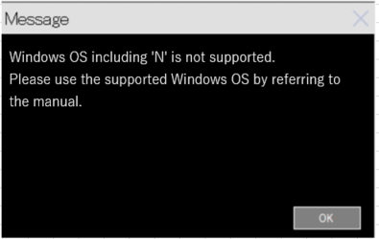
3. Windows OS including ‘N’ is not supported
Improvement
V1.1
Improve the checking of unsupported Windows OS in the installer
Since N-based OS such as Windows 10 Pro N is not subject to installation, it has been modified so that it will not be installed.

Slide 6
4. Solve the time zone issues with the VI client
Improvement
Solve the time zone issues when the settings are different between the VI client and Multi-AI system
V1.1
Time zone issues
When the multi-AI server / VI server and VI client are in different time zones, there is a problem that playback cannot be performed at the correct time. (The multi-AI server and the VIIP server must be in the same time zone.)
Before upgrade: If the multi-AI server / VI server and VI client are in different time zones, playback cannot be performed at the correct time.
After upgrade: Multi-AI server / VI server and VI client can play at the correct time even in different time zones.
Note: This applies to Multi-AI plugin software for Video Insight and it works with version 1.1.0 or later.

Slide 7
Version History

Slide 8
Version History
No | Update contents | Page No. | Version | Update
1 | 1st Version | - | 1.00 | 28.Dec.2021
2
3
4
5
6
7
8
9
10
11

