Slide 1
Video Surveillance Software ASM300 Ver.4.4 version up
- Nov. 2021 -
Ver.1.00
Nov. 2021

Slide 2
Overview
Target
Product
Video Surveillance Software [WV-ASM300]
Version
V4.4
Contents
Items
1. New Product Support | i-PRO S-series camera with AI engine WV-S1536LTN, S2536LTN, i-PRO 360 degree Fisheye camera with AI engine WV-S4156, WV-S4176, WV-S4556L, WV-S4576L NX series Recorder (WJ-NX400/300/200/100) - V4.60
2. Functional improvement | Addition of PC performance monitoring function
3. Functional improvement | Measures for the end of IE support in June 2022 (Supports Edge / IE mode)

Slide 3
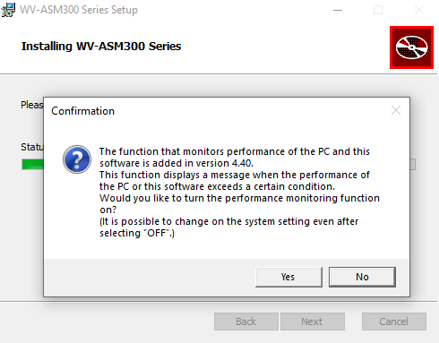
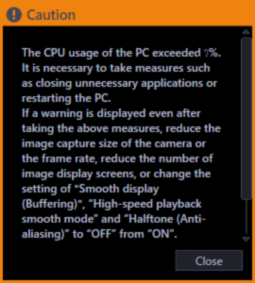
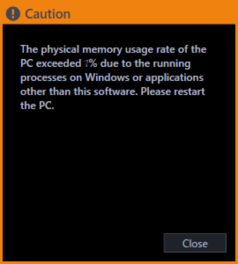
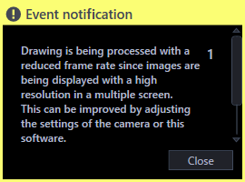
2. Addition of PC performance monitoring function (1/2)
Target
Product
Video Surveillance Software [WV-ASM300]
Version
V4.4
Improvement
Add a function to monitor CPU/Memory usage ratio and Drawing performance, and display a warning message when the conditions shown on the next page are exceeded.
Warning message
Drawing performance
Select whether to turn on the performance monitoring function when installing ASM300.
CPU usage
Physical memory usage

Slide 4
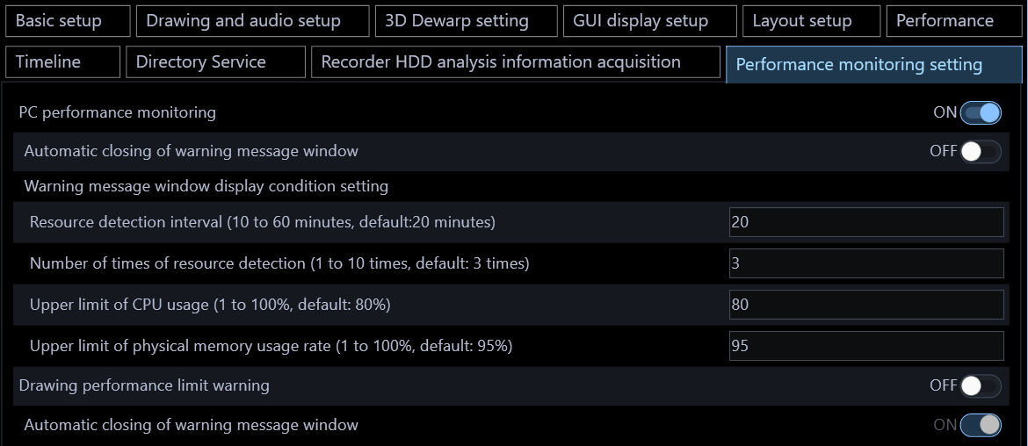
2. Addition of PC performance monitoring function (2/2)
Setting screen: [Setting] > [System] > [Performance monitoring setting]
Both "PC performance monitoring" and "Drawing Performance limit warning" are enabled when "ON". (Default depends on the selection at the time of installation)
In the case of the default value, "PC performance monitoring" measures 3 times every 20 minutes (the result is 1 hour later), and if the CPU usage rate is 80% or more for all 3 times, or if the memory usage rate is 95% or more for all three times, a warning message will be displayed.
When "Automatic close of warning message window" is set to "ON", the message is automatically closed (*).
(*) PC performance monitoring: 60 seconds (default: OFF)
Drawing performance limit warning: 5 seconds (default: OFF)

Slide 5
3. Measures for the end of IE support in June 2022 (1/3)
Target
Product
WV-ASM300 / ASM30
Version
V4.4
Improvement
When you access to the camera / recorder by right-clicking in the device tree, ASM start the browser set in "Designate a web browser app" or start it in Edge / IE mode.
"Browser start“ only appears if you are logged in as an administrator or as LV0 and LV1 users.
Supported versions of the web browser and restrictions will vary depending on the connected devices. Refer to the operating instructions of the devices for further information.
Browser to be launched
(Red: changes made this time)
ASM300 version | Camera / Recorder | Brower to be launched | Remarks
V1.00-V4.10 | All models | Internet Explore
V4.20/4.30 | New S-series camera | configured browser
 | Other camera, Recorder | Internet Explore
V4.40 or later | Cameras with multi-browser support | configured browser | New S cameras. Cameras released after Dec. 2021. For other cameras, please refer to page 6.
 | Cameras with multi-no browser support | Edge / IE mode
 | Recorder | Edge / IE mode | Security Trusted Site, compatibility view settings required

Slide 6
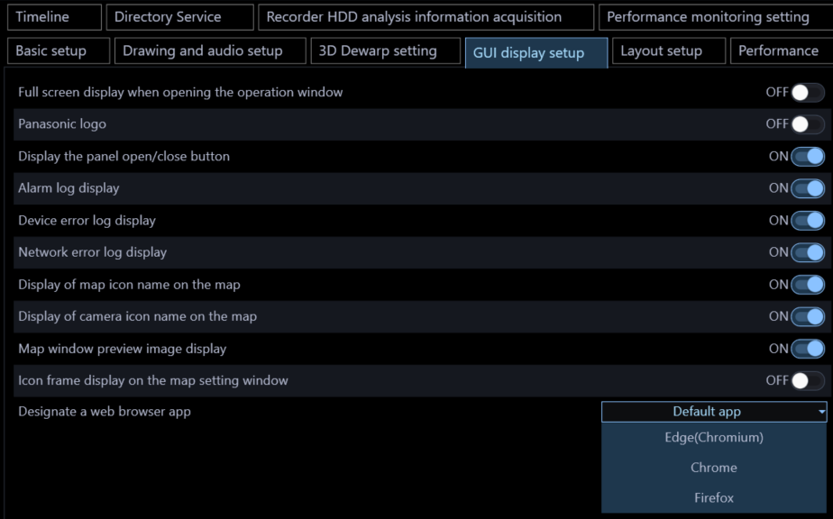
3. Measures for the end of IE support in June 2022 (2/3)
Setting screen: [Setting] > [System] > [GUI display setup]
[Selectable items]
Default app: Launch the app you have selected as your PC's web browser.
Edge (Chromium): Start Microsoft Edge (Chromium version).
Chrome: Launch Google Chrome.
Firefox: Start Mozilla Firefox.
(Note) If the set application is not installed, browser startup will not work.
This setting menu itself was added when ASM300-V4.20 supported the new S camera.

Slide 7
3. Measures for the end of IE support in June 2022 (3/3)
Multi-browser compatible camera and version
Refer to the following website for the browser support of our product after the support for Internet Explorer end.
https://i-pro.com/global/en/surveillance/training-support/support/technical-information
The following devices can be launched by any browser of Microsoft Edge, Google Chrome, or Firefox. Edge (IE mode) is activated for other devices (recorder, encoder, microphone, camera).
Model (camera) | Version
WV-X1551LN, WV-X1571LN, WV-X2251L, WV-X2271L, WV-X2551LN, WV-X2571LN | 1.60 or later
WV-S1552L, WV-S1572L, WV-S2252L, WV-S2272L, WV-S2552L, WV-S2572L, WV-S8531N, WV-X8571N | 1.60 or later
U-series camera | 1.40 or later
WV-S1111, WV-S1112, WV-S1131, WV-S1132, WV-S1511LN, WV-S1531LTN, WV-S2110, WV-S2111L, WV-S2130, WV-S2131L, WV-S2211L, WV-S2231L, WV-S2511LN, WV-S2531LN, WV-S2531LTN | 4.91 or later
WV-S3111L, WV-S3131L, WV-S3511L, WV-S3531L | 4.91 or later
WV-S6111, WV-S6130, WV-S6131, WV-S6530N, WV-S6532LN, WV-X6511N, WV-X6531N, WV-X6531NS, WV-X6533LN, WV-X6533LNS | 4.91 or later
Reference (as of November 2021)

Slide 8
Version History

Slide 9
Version History
No | Update contents | Page No. | Version | Update
1 | Preliminary version | - | 0.90 | 26.Oct.2021
2 | 1st Version | - | 1.00 | 30.Nov.2021
3
4
5
6
7
8
9
10
11

