Slide 1
Network Disk Recorder WJ-NX Series version up contents - November 2021 -
Model : WJ-NX400, WJ-NX300, WJ-NX200 , WJ-NX100
Ver.1.00
Nov. 2021

Slide 2
Contents
 | NX400 | NX300 | NX200 | NX100
New Product Support ( 360-degree Fisheye Camera with AI engine ) | Yes | Yes | Yes | Yes
Function improvement ( Support for the face detection frame display ) | Yes | Yes | Yes | Yes
Function improvement ( Enhance SSL communication ) | Yes | Yes | Yes | Yes
Version No. : V4.60
Release date(Web) : Nov. 2021

Slide 3
New Product Support
Target
Product
WJ-NX400, WJ-NX300, WJ-NX200, WJ-NX100
Version
V4.60
Contents
Support 360-degree Fisheye Camera with AI engine
Model : WV-S4156, WV-S4176, WV-S4556L, WV-S4576L
Limitations
For WV-S4176 and WV-X4576L, if the recording mode is set to "1-screen PTZ" and the installation
position is set to "Wall", the resolution cannot be set to 5M (2560x1920).
For WV-S4176 and WV-X4576L, if the compression method is set to MJPEG and the resolution is set to
9M (2992 x 2992) or 5M (2192 x 2192), depending on the settings of the camera side, the upper limit of
the recording frame rate could be 1 or 2 ips.
If the settings of Super dynamic and Wide dynamic range are changed, camera communication error may temporarily cause.
AI privacy guard recording is not supported.

Slide 4
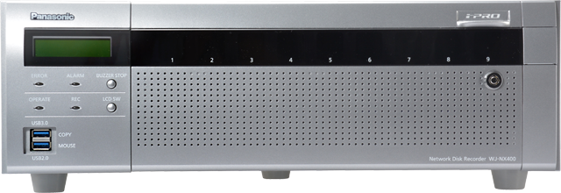
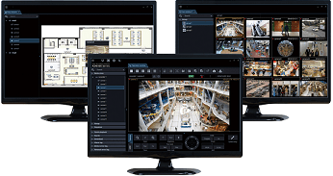
Function improvement
Target
Product
WJ-NX400, WJ-NX300, WJ-NX200, WJ-NX100
Version
V4.60
Contents
Support the face detection frame display
Keep additional information for the face detection in the video stream so that the ASM300 can display a
detection frame for the face detection.
*1 Additional Information for face detection was removed in a NVR with previous firmware versions(v4.50).
Notice :
The business intelligence function of the NX series NVR is not compatible with the New S series and AI cameras.
Live video
Recorded data
ASM300
:live video/recorded data
:information for face detection *1

Slide 5
Function improvement
Target
Product
WJ-NX400, WJ-NX300, WJ-NX200, WJ-NX100
Version
V4.60
Contents
Support TLS1.3 protocol
Allows to select of TLS which PC supports.

Slide 6
Version History

Slide 7
Version History
No | Update contents | Page No. | Version | Update
1 | 1st Version | All | 1.00 | 26.Nov.2021
2
3
4
5
6
7
8
9
10
11

