Slide 1
Video Surveillance Software ASM300 Ver.4.3 version up
Sep., 2021
Ver.1.00
Sep, 2021

Slide 2
Overview
Target
Product
Video Surveillance Software [WV-ASM300]
Version
V4.3
Contents
Items
1. New Product Support | New U-series camera WV-U1130A, U1132A, U1142A, U1532LA, U1542LA, U2130LA, U2132LA, U2140LA, U2142LA, U2530LA, U2532LA, U2540LA, U2542LA i-PRO S series camera with AI engine WV-S1536L, WV-S1536LN, WV-S2536L, WV-S2536LN NX series Recorder (WJ-NX400/300/200/100) - V4.50
2. Request from the market | The message ID for No.1-4 of Extension software alarms can be changed. (Separation of search item name "AI-VMD / i-VMD (HD600)“)

Slide 3
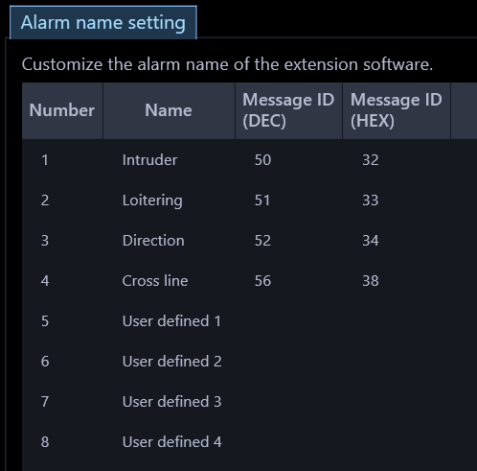
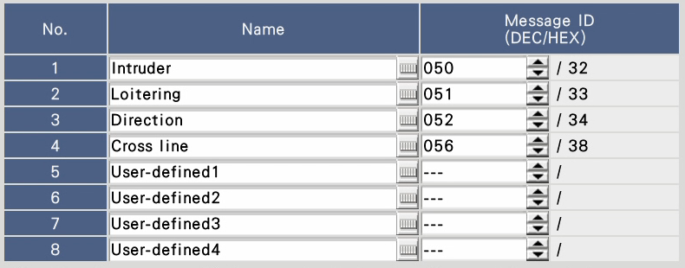
Extension software alarms
Target
Product
Video Surveillance Software [WV-ASM300]
Version
V4.3
Improvement
The message ID for No.1-4 of Extension software alarms can be changed to 32 to 175 in decimal.
Until up to V4.2, the message ID was fixed (50,51,52,56) for the Extension software alarms No.1 to No.4 and could not be edited, but from V4.30, the ID here can also be changed.
As a result, even when there are multiple types of extension software, the user can freely register alarm messages as much as the message ID is assigned, which enables flexible operation.
Match the message ID on this setting screen with the message ID received from the camera / recorder.
Also, match the setting order of each message ID of No. 1 to No. 8 on the Extension software alarm setting screen of the recorder, and No. 1 to No. 8 of this setting screen.

Slide 4
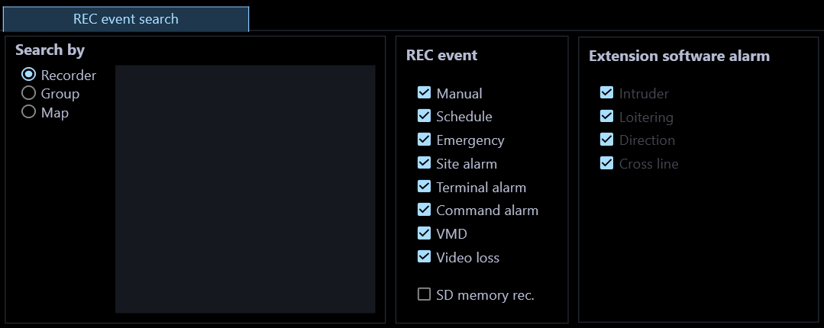
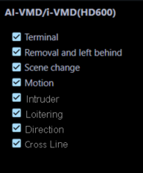
Extension software alarms
Target
Product
Video Surveillance Software [WV-ASM300]
Version
V4.3
Improvement
The search item name "AI-VMD / i-VMD(HD600)" has been divided into “Extension software alarm" and "i-VMD(HD600)" to make it easier to understand.
"Extension software alarm" refers to the AI-VMD alarm of the NX series recorder.
“i-VMD (HD600)" indicates the i-VMD (HD600) alarm of the HD600 series recorder.
The extension software alarms No. 1 to No. 8 on the previous page are applicable / displayed.
The i-VMD (HD600) item will not be displayed if the HD600 is not registered as a device.

Slide 5
Version History

Slide 6
Version History
No | Update contents | Page No. | Version | Update
1 | 1st Version | - | 1.00 | 30.Sep.2021
2
3
4
5
6
7
8
9
10
11

