Slide 1
Network Disk Recorder WJ-NX Series version up contents - August 2021 -
Model : WJ-NX400, WJ-NX300, WJ-NX200 , WJ-NX100
Ver.1.00
Aug. 2021

Slide 2
Contents
 | NX400 | NX300 | NX200 | NX100
New Product Support ( New U-series camera, i-PRO S series camera ) | Yes | Yes | Yes | Yes
Function improvement ( Extension software alarm ) | Yes | Yes | Yes | Yes
Function improvement ( Add the language for ) | Yes | Yes | Yes | Yes

Slide 3
New Product Support
Target
Product
WJ-NX400, WJ-NX300, WJ-NX200 , WJ-NX100
Version
V4.50
Contents
New U-series camera
Model : WV-U1130A, WV-U1132A, WV-U1142A, WV-U1532LA, WV-U1542LA, WV-U2130LA,
WV-U2132LA, WV-U2140LA, WV-U2142LA,WV-U2530LA, WV-U2532LA, WV-U2540LA, WV-U2542LA
Limitations
If the recording frame rate is set to 30 ips, the "Smart coding (GOP control)" cannot be used.
Conventional U series camera don’t support H.264 function. Don’t set H.264 as the compression method.
Conventional U series camera don’t support the security extension function.
Don’t set the connection method to HTTPS as the security settings between the recorder and the camera.
To set the recording frame rate to 30 ips/25 ips for conventional U series camera, select "(30 IPS)" in the camera registration options. Meanwhile, depending on the resolution settings, sub-monitor display or re-encoded distribution, it may not be possible to display on multiple screens. In addition, the sub-stream recording will not be included.
Support i-PRO S series camera with AI engine
Model : WV-S1536LTN, WV-S2536LTN

Slide 4
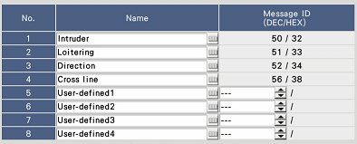
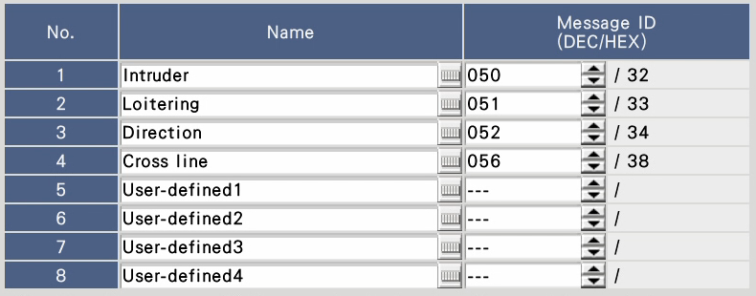
Function improvement
Target
Product
WJ-NX400, WJ-NX300, WJ-NX200, WJ-NX100
Version
V4.50
Contents
Can be changed the message ID (1-4) of Extension software alarm
[Message ID]
Enter a decimal number(000 to 255) in the Message ID fields of No. 1 to 8.
Default : Same value as V4.40 or before
V4.40 or before
V4.50 or later

Slide 5
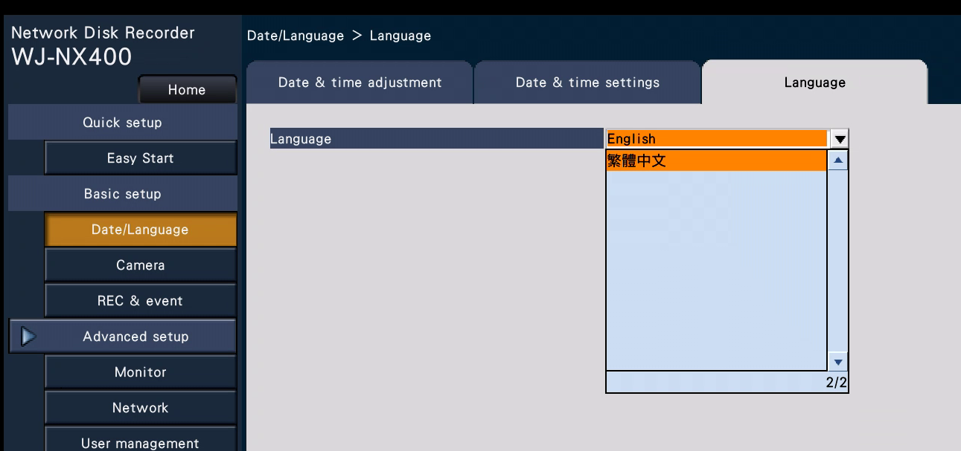
Function improvement
Target
Product
WJ-NX400, WJ-NX300, WJ-NX200, WJ-NX100
Version
V4.50
Contents
Add the to the language settings
[Language]
/ English/ Français/ Español/ Deutsch/ Italiano/ Русский/ Português/ ไทย/
Web browser:
Japanese/ English/ Français/ Español/ Deutsch/ Italiano/ Russian/ Português/ Thai/ Simplified Chinese/ Traditional Chinese

Slide 6
Version History

Slide 7
Version History
No | Update contents | Page No. | Version | Update
1 | 1st Version | All | 1.00 | 24.Aug.2021
2
3
4
5
6
7
8
9
10
11

