Slide 1
New U-series camera for SE ver.1.00
Model: WV-U1132A/ U2132LA/ U1532LA/ U2532LA/ WV-U1142A/ U2142LA/ U1542LA/ U2542LA
WV-U1130A/ U2130LA/ U2530LA/ U2140LA/ U2540LA
Ver. 1.00
Aug, 2021

Slide 2

Contents​
Improvement summary
Key Features
Product Lineup
Software
Supported Resolution
Specification Comparison
Support for camera function differences
Appearance
Bundled Items and Options
10. Appendix
About icons
This icon is for brand new functions

Slide 3
1. Improvement summary

Slide 4
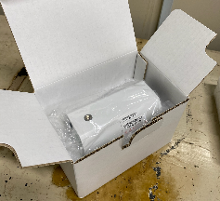
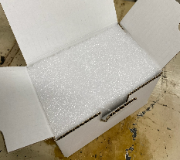
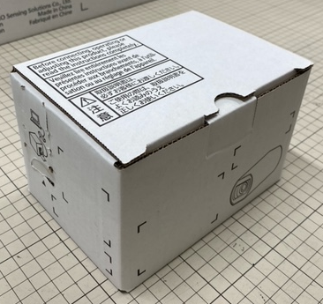
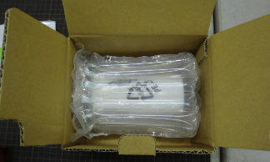
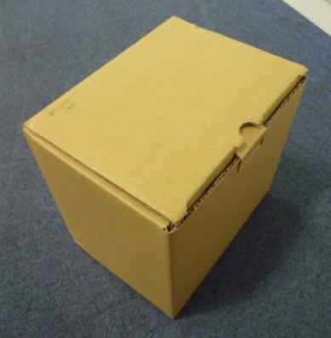
1-1. Software spec. and Packing box
Software specification
Slim down packing box
Item | New U-Series model | Conventional U-Series model
Video Codec ( Stream ) | H.265 or H.264 (1)(2)(3), JPEG(1)(2) | H.265 (1)(2)(3), JPEG(1)(2)
Secure communication ( Pre-installed certificate ) | Yes (GlobalSign ) | No
ONVIF Profile | Profile S, G, T | Profile G, T
Ex. WV-U1130A | New model WV-U1130A | Conventional model WV-U1130
Dimensions | 158X112X102mm | 178X145X120mm
Color | White | Brown
Easy Kitting | Yes | Yes
Carton box | 18 | 12
Image
EPE
AIRBAG
EPE : Expanded Poly-Ethylene
U11**
U21**
U15**
U25**

Slide 5
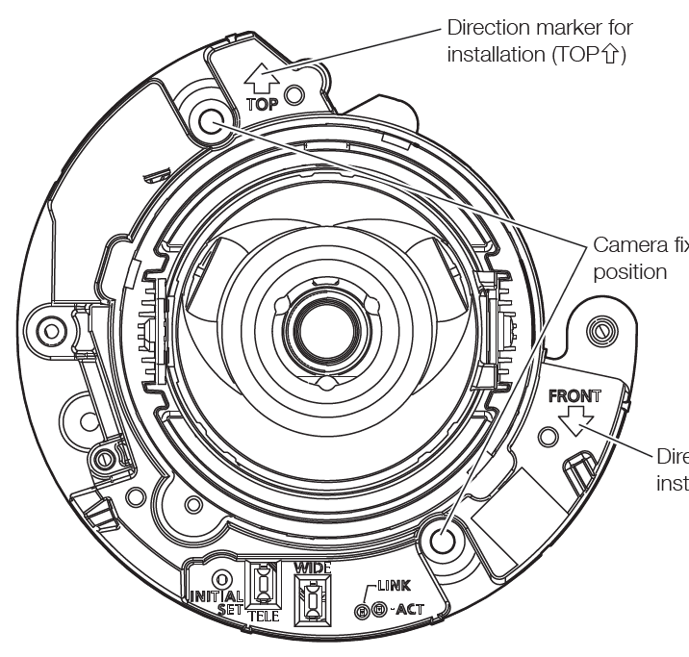
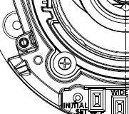


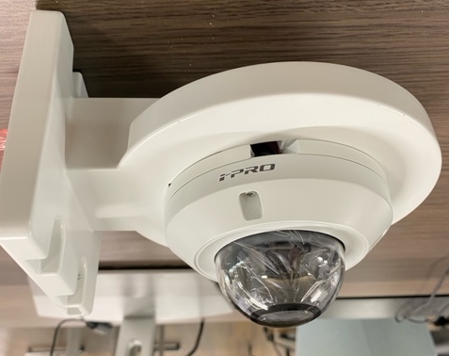
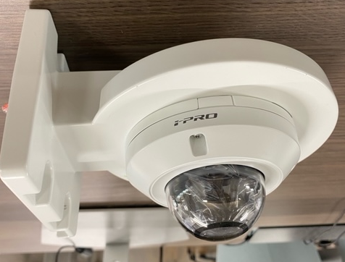
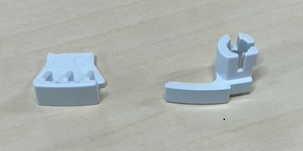
1-2. Installation
Set the PAN table in place with screw
  The PAN table can be fixed to the place with screws
  not to slip out of place when the dome cover is attached
  Support Model : WV-U2542LA/U2532LA
  WV-U2142LA/U2132LA
Cover the gap of the cable through-hole
When installing the camera using the bracket WV-QWL500
cover the gap of cable through-hole to protect the camera from insect and dust
Support Model : WV-U2542LA, WV-U2532LA
WV-U2540LA, WV-U2530LA
For WV-U2542LA
WV-U2532LA
For WV-U2540LA
WV-U2530LA
WV-U2530LA + WV-QWL500
U11**
U21**
U15**
U25**

Slide 6
2. Key Features

Slide 7
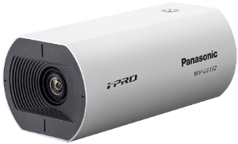
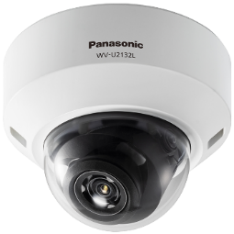
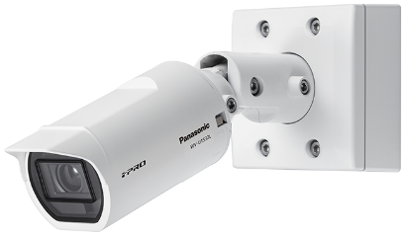
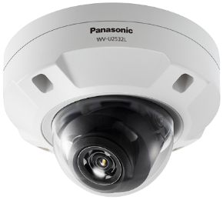
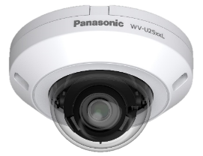
2. Key Features
New U series camera
2-1 Visibility
  Nighttime visibility (Low light, IR-LED)
  Super Dynamic
2-2 High Compression
  H.265 + Smart coding
2-3 Other features
  Easy Kitting
  Easy Installation and adjustment
  Corridor mode
WV-U1132A / WV-U1142A / WV-U1130A
(Indoor BOX)
WV-U2132LA / WV-U2142LA
(Indoor DOME)
WV-U1532LA / WV-U1542LA
(Outdoor BOX )
WV-U2532LA / WV-U2542LA
(Outdoor DOME)
WV-U2130LA / WV-U2140LA
WV-U2530LA / WV-U2540LA
(Fixed Indoor/Outdoor DOME)
U11**
U21**
U15**
U25**

Slide 8
2-1. Key Features (Visibility )
New U series camera
2-1 Visibility
  Nighttime visibility (Low light, IR-LED)
  Super Dynamic
2-2 High Compression
  H.265 + Smart coding
2-3 Other features
  Easy Kitting
  Easy Installation and adjustment
  Corridor mode
WV-U1132A / WV-U1142A / WV-U1130A
(Indoor BOX)
WV-U2132LA / WV-U2142LA
(Indoor DOME)
WV-U1532LA / WV-U1542LA
(Outdoor BOX )
WV-U2532LA / WV-U2542LA
(Outdoor DOME)
WV-U2130LA / WV-U2140LA
WV-U2530LA / WV-U2540LA
(Fixed Indoor/Outdoor DOME)

Slide 9
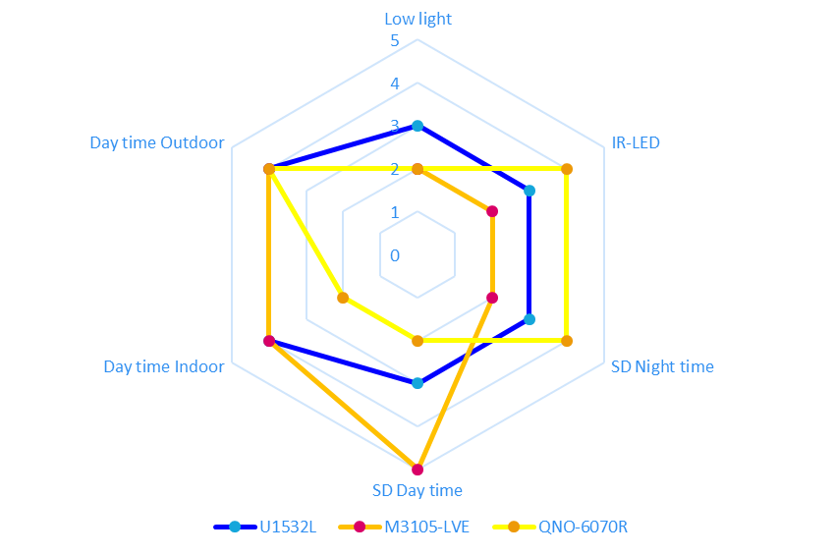
2-1. Visibility FHD ( Summary )
Compared to Axis and Hanwha, achieves overall superior image quality even at low bit rates
Evaluation by scene
Panasonic U2132L/U2132LA
Compression setting (common to all scenes, default setting): VBR H265, Image quality 3
Smartcoding = OFF, bitrate 6144 kbps
AXIS M3105-LVE
Compression setting (common to all scenes, default setting): VBR H264, compression 30
Zipstream = OFF, bitrate MAX
Hanwha QNO-6070R
Compression setting (common to all scenes, default setting): VBR H265, (no image quality setting items)
Wisestream = OFF, bitrate upper limit 2048 kbps
WDR = OFF
Internal use only

Slide 10
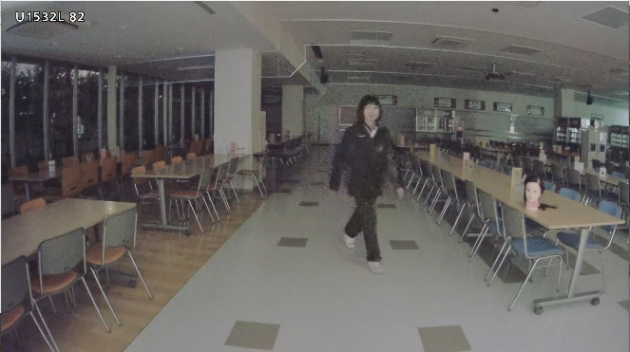
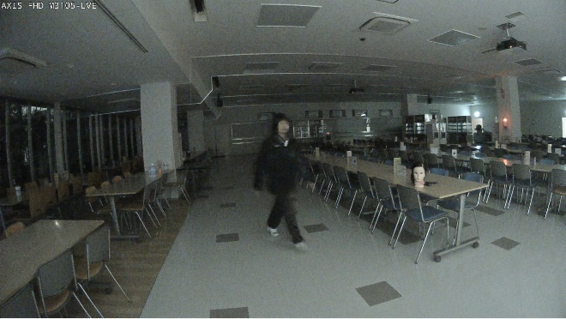
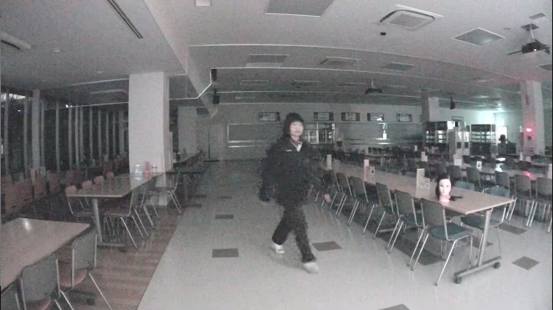
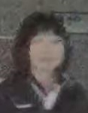
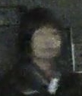
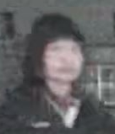
2-1. Night time visibility / Low light : 0.5-1 lux [FHD]
Comparison in a dark indoors
Panasonic U2132L/U2132LA
spec 0.1 lx (50 IRE)
AXIS M3105-LVE
spec 0.2 lx (50 IRE)
Hanwha QNO-6070R
spec 0.095 lx (30 IRE)
3 points
2 points
2 points
 | Comments | Score
Face visibility | Somewhat recognizable | +0
Sensitivity, S/N | Good sensitivity, noisy | +0
Brightness | Bright | +0
Resolution | Good | +0
Color reproduction | Slightly good | +0
 | Comments | Score
Face visibility | Somewhat recognizable | +0
Sensitivity, S/N | Slightly dark and noisy | +0
Brightness | Somewhat dark | +0
Resolution | Good | +0
Color reproduction | Good | +0
 | Comments | Score
Face visibility | Recognizable | +0
Sensitivity, S/N | Good sensitivity, slightly noisy | +0
Brightness | Bright | +0
Resolution | Good | +0
Color reproduction | Slightly bad | -1
U1132A
U2132LA
U1532LA
U2532LA
U1130A
U2130LA
U2530LA
Internal use only

Slide 11
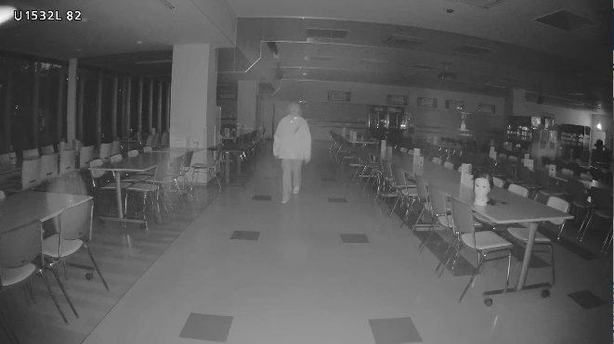
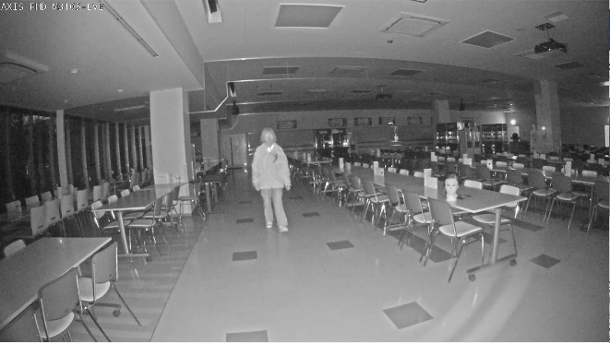
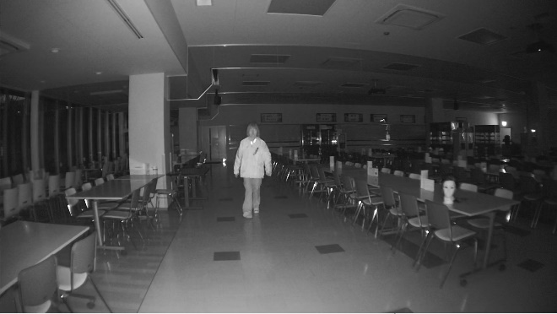
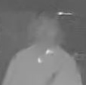
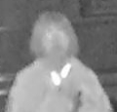
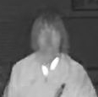
2-1. Night time visibility / IR-LED : 0.5-1 lux [FHD]
IR comparison
Panasonic U2132L/U2132LA
spec 30 m
AXIS M3105-LVE
spec 15 m
Hanwha QNO-6070R
spec 30 m
3 points
2 points
4 points
 | Comments | Score
Face visibility | Somewhat visible | +0
Sensitivity, S/N | Good sensitivity, Less noise, blurring | -1
Brightness | Bright | +0
Resolution | Somewhat good | +0
Color reproduction | -
 | Comments | Score
Face visibility | Somewhat visible | +0
Sensitivity, S/N | Good sensitivity, Noisy, Less blurring | +0
Brightness | Bright | +0
Resolution | Somewhat good | +0
Color reproduction | -
 | Comments | Score
Face visibility | Visible | +1
Sensitivity, S/N | Slightly dark, Less noise, Less blurring | +1
Brightness | Surrounding is slightly dark | -1
Resolution | Good
Color reproduction | - | +0
U1132A
U2132LA
U1532LA
U2532LA
U1130A
U2130LA
U2530LA
Internal use only

Slide 12
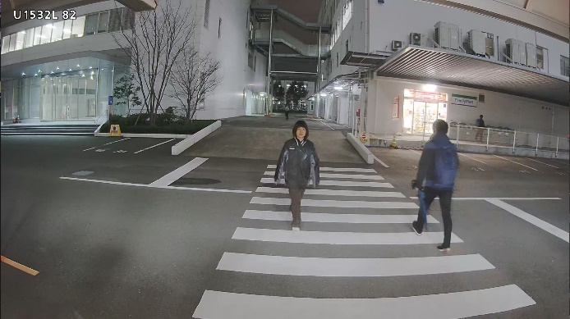
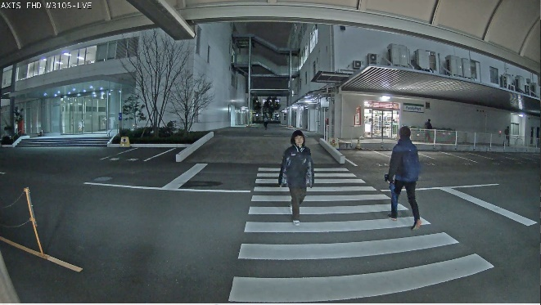
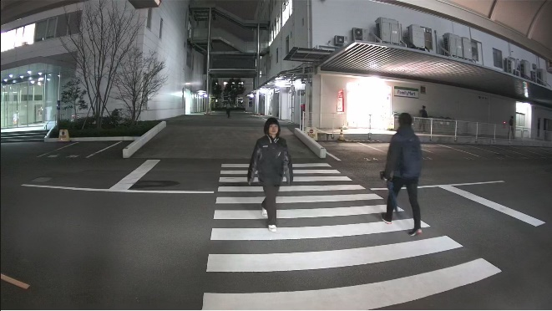
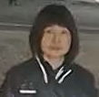

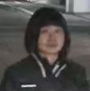
2-1. Night time visibility / Super Dynamics [FHD]
Comparison in the dark outdoors
Panasonic U2132L/U2132LA
spec 120 dB
AXIS M3105-LVE
spec 115 dB
Hanwha QNO-6070R
spec 120 dB
3 points
2 points
4 points
 | Comments | Score
Face visibility | Visible | +0
Sensitivity, S/N | Good sensitivity, Some noise | +0
Brightness | Bright | +0
Resolution | Good | +0
Color reproduction | Good | +0
 | Comments | Score
Face visibility | Somewhat visible | +0
Sensitivity, S/N | Good sensitivity, Noisy | -1
Brightness | Bright | +0
Resolution | Good | +0
Color reproduction | Slightly good | +0
 | Comments | Score
Face visibility | Visible | +0
Sensitivity, S/N | Good sensitivity, Less noise | +1
Brightness | Bright | +0
Resolution | Good | +0
Color reproduction | Good | +0
U1132A
U2132LA
U1532LA
U2532LA
U1130A
U2130LA
U2530LA
Internal use only

Slide 13
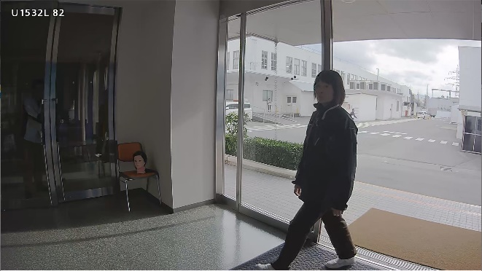
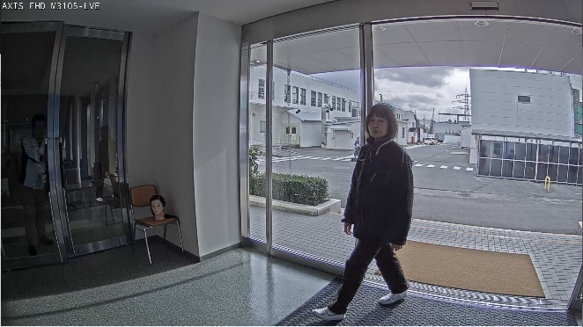
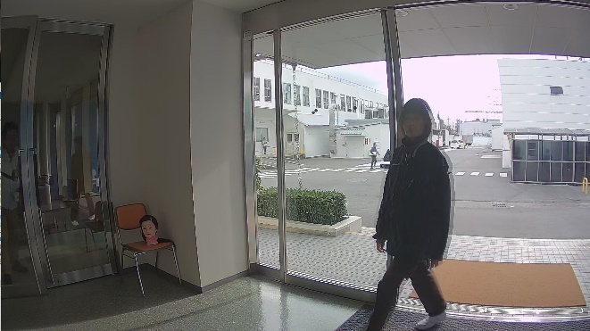
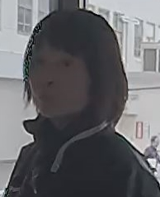
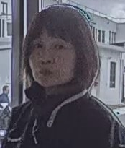
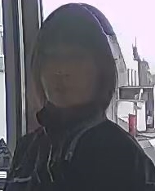
2-1. Day time visibility / Super Dynamics [FHD]
Comparison of how the face looks in backlight
Panasonic U2132L/U2132LA
spec 120 dB
AXIS M3105-LVE
spec 115 dB
Hanwha QNO-6070R
spec 120 dB
WDR : on
3 points
5 points
2 points
 | Comments | Score
Face visibility | Somewhat visible, Dark | +0
Sensitivity, S/N | Good | +0
Brightness | Dark part dark, Bright part bright | +0
Resolution | Good | +0
Color reproduction | Slightly good | +0
 | Comments | Score
Face visibility | Good visibility, Noisy | +1
Sensitivity, S/N | Good | +0
Brightness | Dark part bright, Bright part bright | +1
Resolution | Good | +0
Color reproduction | Good | +0
 | Comments | Score
Face visibility | Somewhat visible, Blurring | -1
Sensitivity, S/N | Good | +0
Brightness | Dark part bright, Bright part bright | +0
Resolution | Somewhat good | +0
Color reproduction | Slightly good | +0
U1132A
U2132LA
U1532LA
U2532LA
U1130A
U2130LA
U2530LA
Internal use only

Slide 14
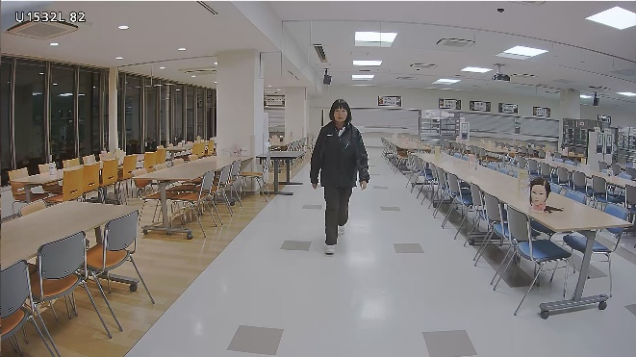
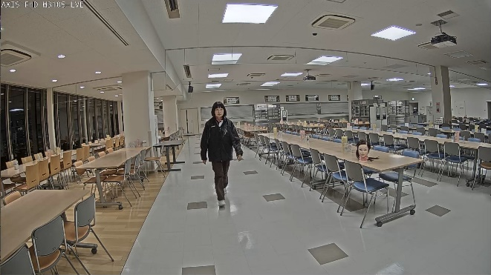
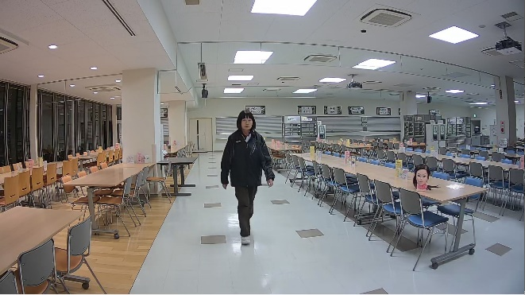
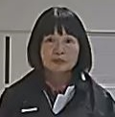
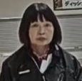
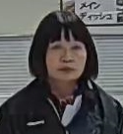
2-1. Day time visibility / Indoor [FHD]
Comparison in the bright indoors
Panasonic U2132L/U2132LA
spec 120 dB
AXIS M3105-LVE
spec 115 dB
Hanwha QNO-6070R
spec 120 dB
WDR : on
4 points
4 points
2 points
 | Comments | Score
Face visibility | Good visibility, Less noise | +1
Sensitivity, S/N | Good | +0
Brightness | Bright | +0
Resolution | Good | +0
Color reproduction | Slightly good | +0
 | Comments | Score
Face visibility | Visible, No noise | +1
Sensitivity, S/N | Good | +0
Brightness | Bright | +0
Resolution | Somewhat good | +0
Color reproduction | Good | +0
 | Comments | Score
Face visibility | Visible, Some blurring | +0
Sensitivity, S/N | Good | +0
Brightness | Bright | +0
Resolution | Good | +0
Color reproduction | Good | +0
U1132A
U2132LA
U1532LA
U2532LA
U1130A
U2130LA
U2530LA
Internal use only

Slide 15
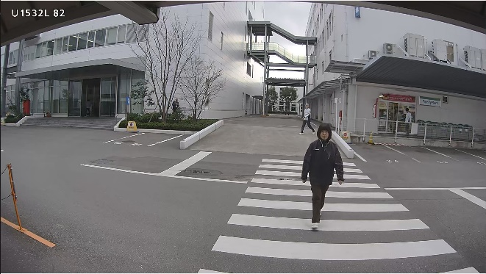
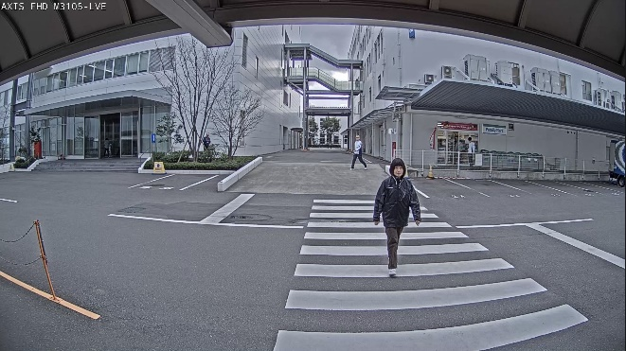
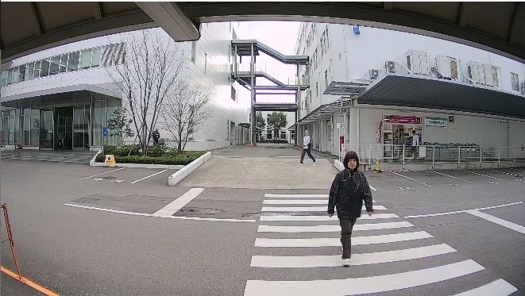
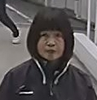
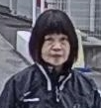

2-1. Day time visibility / Outdoor [FHD]
Comparison in the bright outdoors
Panasonic U2132L/U2132LA
spec 120 dB
AXIS M3105-LVE
spec 115 dB
Hanwha QNO-6070R
spec 120 dB
4 points
4 points
4 points
 | Comments | Score
Face visibility | Visible | +1
Sensitivity, S/N | Good | +0
Brightness | Usually | +0
Resolution | Good | +0
Color reproduction | Good | +0
 | Comments | Score
Face visibility | Visible | +1
Sensitivity, S/N | Good | +0
Brightness | Usually | +0
Resolution | Good | +0
Color reproduction | Good | +0
 | Comments | Score
Face visibility | Visible | +1
Sensitivity, S/N | Good | +0
Brightness | Usually | +0
Resolution | Good | +0
Color reproduction | Good | +0
U1132A
U2132LA
U1532LA
U2532LA
U1130A
U2130LA
U2530LA
Internal use only

Slide 16

2-1. Visibility 4MP ( Summary )
Compared to Axis and Hanwha, achieves overall superior image quality even at low bit rates
Evaluation by scene
Backlighting is inferior to AXIS, but better in other scenes
Panasonic U2142L/U2142LA
Compression setting (common to all scenes, default setting): VBR H265, Image quality 3
Smartcoding = OFF, bitrate 10240 kbps
AXIS M3106-LVE Mk2
Compression setting (common to all scenes, default setting): VBR H265, compression 30
Zipstream = OFF, bitrate 20000 kbps
Hanwha QNV-7080R
Compression setting (common to all scenes, default setting): VBR H265, (no image quality setting items)
Wisestream = OFF, bitrate upper limit 3584 kbps
WDR = Off
Internal use only

Slide 17






2-1. Night time visibility / Low light : under 0.3 lux [4MP]
Comparison in a dark indoors
Panasonic U2142L/U2142LA
spec 0.3 lx (50 IRE)
AXIS M3106-LVE Mk2
spec 0.3 lx (50 IRE)
Hanwha QNV-7080R
spec 0.15 lx (30 IRE)
3 points
2 points
4 points
 | Comments | Score
Face visibility | Somewhat recognizable | +0
Sensitivity, S/N | Good sensitivity, Noisy | +0
Brightness | Bright | +0
Resolution | Good | +0
Color reproduction | Good | +0
 | Comments | Score
Face visibility | Somewhat recognizable | +0
Sensitivity, S/N | Slightly dark, Noisy | -1
Brightness | Dark | +0
Resolution | Good | +0
Color reproduction | Good | +1
 | Comments | Score
Face visibility | Recognizable | +0
Sensitivity, S/N | Good sensitivity, Slightly noisy | +1
Brightness | Bright | +0
Resolution | Good | +0
Color reproduction | Slightly good | +0
U1142A
U2142LA
U1542LA
U2542LA
U2140LA
U2540LA
Internal use only

Slide 18







2-1. Night time visibility / IR-LED : under 0.1 lux [4MP]
IR comparison
Panasonic U2142L/U2142LA
spec 20 m
AXIS M3106-LVE Mk2
spec 15 m
Hanwha QNV-7080R
spec 30 m
3 points
3
points
3 points
 | Comments | Score
Face visibility | Somewhat visible | +0
Sensitivity, S/N | Noise and afterimage | -1
Brightness | Bright | +0
Resolution | Somewhat good | +0
Color reproduction | - | -
 | Comments | Score
Face visibility | Somewhat visible | +0
Sensitivity, S/N | Some sensitivity | +0
Brightness | Bright | +0
Resolution | Somewhat good | +0
Color reproduction | - | -
 | Comments | Score
Face visibility | Visible | +1
Sensitivity, S/N | Good | +0
Brightness | Surroundings are slightly dark | -1
Resolution | Good | +1
Color reproduction | - | -
U1142A
U2142LA
U1542LA
U2542LA
U2140LA
U2540LA
Internal use only

Slide 19






2-1. Night time visibility / Super Dynamics 5-10 lux [4MP]
Comparison in the dark outdoors
Panasonic U2142L/U2142LA
spec 102 dB
AXIS M3106-LVE Mk2
spec 100 dB
Hanwha QNV-7080R
spec 120 dB
WDR : on
4 points
3 points
4 points
 | Comments | Score
Face visibility | Somewhat visible | +0
Sensitivity, S/N | Good sensitivity, Some noise | +0
Brightness | Bright | +0
Resolution | Good | +0
Color reproduction | Good | +0
 | Comments | Score
Face visibility | Somewhat visible | +0
Sensitivity, S/N | Good sensitivity, Some noise | +0
Brightness | Bright | +0
Resolution | Somewhat bad | +0
Color reproduction | Good | +0
 | Comments | Score
Face visibility | Visible | +1
Sensitivity, S/N | Good sensitivity, Some noise | +0
Brightness | Bright | +0
Resolution | Good | +0
Color reproduction | Good | +0
U1142A
U2142LA
U1542LA
U2542LA
U2140LA
U2540LA
Internal use only

Slide 20






2-1. Day time visibility / Super Dynamics [4MP]
Comparison of how the face looks in backlight
Panasonic U2142L/U2142LA
spec 102 dB
AXIS M3106-LVE Mk2
spec 100 dB
Hanwha QNV-7080R
spec 120 dB
WDR : on
3 points
4 points
1 points
 | Comments | Score
Face visibility | Somewhat visible, Dark | -1
Sensitivity, S/N | Good | +0
Brightness | Dark part dark, Bright part bright | +0
Resolution | Good | +0
Color reproduction | Slightly good | +0
 | Comments | Score
Face visibility | Visible, Noisy | +1
Sensitivity, S/N | Good | +0
Brightness | Dark part bright, Bright part bright | +0
Resolution | Good | +0
Color reproduction | Slightly good | +0
 | Comments | Score
Face visibility | Somewhat visible, Blurring | -1
Sensitivity, S/N | Good | +0
Brightness | Dark part bright, Bright part bright | +0
Resolution | Somewhat good | +0
Color reproduction | Slightly good | +0
U1142A
U2142LA
U1542LA
U2542LA
U2140LA
U2540LA
Internal use only

Slide 21






2-1. Day time visibility / Indoor [4MP]
Comparison in the bright indoors
Panasonic U2142L/U2142LA
AXIS M3106-LVE MK2
Hanwha QNV-7080R
4 points
3 points
3 points
 | Comments | Score
Face visibility | Visible | +0
Sensitivity, S/N | Good | +0
Brightness | Bright | +0
Resolution | Good | +0
Color reproduction | Slightly good | +0
 | Comments | Score
Face visibility | Visible | +0
Sensitivity, S/N | Good | +0
Brightness | Bright | +0
Resolution | Somewhat good | +0
Color reproduction | Good | +0
 | Comments | Score
Face visibility | Visible | +0
Sensitivity, S/N | Good | +0
Brightness | Bright | +0
Resolution | Good | +0
Color reproduction | Slightly good | +0
U1142A
U2142LA
U1542LA
U2542LA
U2140LA
U2540LA
Internal use only

Slide 22






2-1. Day time visibility / Outdoor [4MP] Varifocal
Comparison in the bright outdoors
Panasonic U2142L/U2142LA
AXIS M3106-LVE MK2
Hanwha QNV-7080R
4 points
3 points
3 points
 | Comments | Score
Face visibility | Visible | +1
Sensitivity, S/N | Good | +0
Brightness | Bright | +0
Resolution | Good | +0
Color reproduction | Slightly good | +0
 | Comments | Score
Face visibility | Visible | +0
Sensitivity, S/N | Good | +0
Brightness | Slightly bright | +0
Resolution | Good | +0
Color reproduction | Good | +0
 | Comments | Score
Face visibility | Visible | +1
Sensitivity, S/N | Noisy | -1
Brightness | Slightly dark | +0
Resolution | Good | +0
Color reproduction | A little bad | +0
U1142A
U2142LA
U1542LA
U2542LA
U2140LA
U2540LA
Internal use only

Slide 23
2-2. Key Features ( High Compression )
New U series camera
2-1 Visibility
  Nighttime visibility (Low light, IR-LED)
  Super Dynamic
2-2 High Compression
  H.265 + Smart coding
2-3 Other features
  Easy Kitting
  Easy Installation and adjustment
  Corridor mode
WV-U1132A / WV-U1142A / WV-U1130A
(Indoor BOX)
WV-U2132LA / WV-U2142LA
(Indoor DOME)
WV-U1532LA / WV-U1542LA
(Outdoor BOX )
WV-U2532LA / WV-U2542LA
(Outdoor DOME)
WV-U2130LA / WV-U2140LA
WV-U2530LA / WV-U2540LA
(Fixed Indoor/Outdoor DOME)

Slide 24




2-2. High Compression ( Smart Coding )
Smart Coding
Bit rate reduction
  Data compression by H.265 + smart coding, up to 50% reduction compared with competitors' H.264 + proprietary technology.
  This security system maintains the quality of moving images while reducing bandwidth and storage costs.
  There are GOP Control, Auto VIQS, Frame rate control as smart coding functions of the U series camera.
M3105-LVE
with bitrate control
U2132L/U2132LA
with smart coding
Remarkable point :
  Data compression by H.265 + smart coding
  Up to 50% reduction on other companies' H.264 + proprietary technology.
Bandwidth reduction
50%
Benefit :
  It is less than half the bandwidth of other company (AXIS) camera.
  Reduce system costs by reducing recording costs.
 | Axis M3105-LVE | Panasonic WV-U2132L
Bitrate | 770kbps | 207kbps
* Data is the result of comparative shooting with the image quality aligned in the indoor test environment.
Please refer visibility comparison for bitrates in various scenes.
U11**
U21**
U15**
U25**
Internal use only

Slide 25



2-2. High Compression ( Spec. comparison )
Comparison at the highest compression setting of each company
Model | Bitrate(kbps) | Bit rate ratio (vs competitor) | Settings
Panasonic (H265) | 846kbps | --- | SD off, VBR Quality1 SC : advanced + auto VIQS
AXIS (H265) | 1853kbps | 46 % | WDR off, compression30 Zipstream extreme + daynamicGOP1023
Hanwha (H265) | 1779kbps | 48 % | WDR off, Maxbitrate2560kbps Wisestream High, daynamicGOV480
Panasonic
Axis
Hanwha
U11**
U21**
U15**
U25**
Internal use only

Slide 26
2-3. Key Features
New U series camera
2-1 Visibility
  Nighttime visibility (Low light, IR-LED)
  Super Dynamic
2-2 High Compression
  H.265 + Smart coding
2-3 Other features
  Easy Kitting
  Easy Installation and adjustment
  Corridor mode
WV-U1132A / WV-U1142A / WV-U1130A
(Indoor BOX)
WV-U2132LA / WV-U2142LA
(Indoor DOME)
WV-U1532LA / WV-U1542LA
(Outdoor BOX )
WV-U2532LA / WV-U2542LA
(Outdoor DOME)
WV-U2130LA / WV-U2140LA
WV-U2530LA / WV-U2540LA
(Fixed Indoor/Outdoor DOME)
U11**
U21**
U15**
U25**

Slide 27









2-3. Easy Kitting
“Easy Kitting Package” can reduce the Installation time
Kitting work without removing from the box
3 minutes can be reduced per a camera
Kitting Window
Current condition
U1132A/U1142A/U1130A
U1130A/2140A
U2530A/U2540A
U2532A/2542A
U2132LA/U2142LA
U1532A/U1542A
U11**
U21**
U15**
U25**

Slide 28


2-3. Simple installation and adjustment
Direct mounting without attachment plate
(U2132L, U2142L, U2130L, U2140L, U2530L, U2540L)
(U2132LA, U2142LA, U2130LA, U2140LA, U2530LA, U2540LA)
Motorized zoom and AF adjustment
(Varifocal lens model)
Direct fixing screws
Auto focus is automatically performed 3 seconds after releasing the TELE and WIDE buttons.
U11**
U21**
U15**
U25**

Slide 29




2-3. Corridor mode
9:16 Corridor mode
When 320x180 is set, U series cannot select 90 or 270 deg. (Corridor mode)
At corridor
Stair at the lobby
16 : 9
16 : 9
9 : 16 Corridor mode
9 : 16 Corridor mode
The pictures are an image of U2132L
U11**
U21**
U15**
U25**

Slide 30
3. Product Lineup

Slide 31







3-1. Product Lineup
Varifocal model: 8 models , Fixed focus model: 5 models
 | Varifocal lens |  |  |  | Fixed focus lens
shape | BOX |  | DOME |  | BOX |  | DOME
Environment resistance Resolution | Indoor | Outdoor | Indoor | Outdoor | Indoor | Outdoor | Indoor | Outdoor
4MP | U1142A | U1542LA | U2142LA | U2542LA |  |  | U2140LA | U2540LA
FHD | U1132A | U1532LA | U2132LA | U2532LA | U1130A |  | U2130LA | U2530LA
U11**
U21**
U15**
U25**

Slide 32
3-2. Model Number
Model Name | Model Number
Indoor Box Camera | WV-U1132A
Indoor Dome Camera | WV-U2132LA
1 | ２ | ３ | ４ | ５ | ６ | ７ | ８ | 9 | 10 | 11 | 12
W | V | - | U | 1 | 1 | 3 | 2 |  |  | A
W | V | - | U | 2 | 1 | 3 | 2 | L |  | A
 |  |  | Series | Form | Environment | Resolution | Serial number | Other Features |  | Minor Change | Region (J/H)
 |  |  | X : X series High - end S : S series High specification & High cost performance U : U series Entry V : V series Price competiveness | 9 : - 8 : Multi sensor 7 : PTZ(Aero) 6 : PTZ(Dome) 5 : PT 4 : 360 deg. 3 : Compact DOME 2 : Dome 1 : Box 0 : - | 9 : - 8 : - 7 : - 6 : - 5 : Outdoor Vandal 4 : Outdoor normal 3 : - 2 : Indoor Vandal 1 : Indoor normal 0 : - | 9 : - 8 : 6K(24MP) 7 : 4K (12MP) 6 : 5 : 5MP 4 : 4MP 3 : FHD 2 : 1 : HD 0 : - | 9 : 8 : 7 : 6 : 5 : 4 : 3 : 2 : 1 : 0 : | L : LED N : Rain wash coating (Non Raindrop) M : M12 W : Wireless F : Optical I/F V : With lens T : Long focal lens K : Fix lens |  | D : C : B : A :
Reserve
3rdgen.
2nd gen.
1st gen.
The numbers may overlap in S, X, U.
(Example) U (FHD): S1130, U1130
U11**
U21**
U15**
U25**

Slide 33
4. Software

Slide 34
4-1. Software feature ( FHD model )
 |  | New U series | Conventional U series | S series (S1131) | Comments
Streaming | Image capture mode | 16:9 (30fps) / 4:3 (30fps) 16:9 (25fps) / 4:3 (25fps) | 16:9 (30fps) / 4:3 (30fps) 16:9 (25fps) / 4:3 (25fps) | 16:9 (30fps) / 4:3 (30fps) *25fps mode is not in GUI
 | Stream | H.265 (or H264) (1) to (3), , JPEG(1)(2) | H.265 (1) to (3), JPEG(1)(2) | H.265 (or H.264) (1) to (4), JPEG(1)(2)(3)
 | Total bitrate | 25,600 kbps | 25,600 kbps | 51,200 kbps | The sum of the bit rates of each stream
 | Transmission priority | VBR/ Constant bitrate/ Frame rate/ Best effort *Default : VBR (Japanese PC : Frame rate) | VBR/ Constant bitrate/ Frame rate/ Best effort *Default : VBR (Japanese PC : Frame rate) | VBR/ Constant bitrate/Frame rate/ Best effort *Default : Frame rate
 | Smart Coding | Auto VIQS / GOP Control (With Frame rate ctrl) | Auto VIQS / GOP Control (With Frame rate ctrl) | Smart facial coding / Auto VIQS / GOP Control (With Frame rate ctrl)
Signal processing | Image rotation | 0°/ 90°/ 180° / 270° | 0°/ 90°/ 180° / 270° | 0°/ 90°/ 180° / 270° | U series cannot select 90 or 270 deg. , when 320x180 is set
 | Extra optical zoom | Yes | Yes | Yes
 | Lens distortion compensation | No | No | Yes
U1132A
U2132LA
U1532LA
U2532LA
U1130A

Slide 35
4-1. Software feature ( FHD model )
 |  | New U series | Conventional U series | S series (S1131) | Comments
Secure | GlobalSign Certificate pre-install | Yes | No | Yes
 | Data encryption | No | No | Yes
 | HTTPS | Yes | Yes | Yes
Other | Overlay image | No | No | Yes
 | Multi-screen | No | No | Yes
 | FTP Server | No | No | Yes
 | FTP Client (Send image to FTP server) | No | No | Yes
 | Send alarm image via e-mail | No | No | Yes
 | Maximum Users | 14 | 14 | 14
 | Supported OS | Windows 10, 8.1 | Windows 10, 8.1 | Windows10, 8.1, 7
 | Supported Browser | IE11, Edge, Chrome, Firefox | IE11, Edge, Chrome, Firefox | IE11, Edge, Chrome, Firefox
 | ONVIF | Profile S, G, T | Profile G, T | Profile S, G, T | S =< G =< T
 | Mobile | Smart phone, Tablet | Smart phone, Tablet | Smart hone, Tablet, Cellular phone
U1132A
U2132LA
U1532LA
U2532LA
U1130A

Slide 36
4-2. Software feature ( 4MP model )
 |  | New U series | Conventional U series | S series (S1131) | Comments
Streaming | Image capture mode | 16:9 (30fps) 16:9 (25fps) | 16:9 (30fps) 16:9 (25fps) | 16:9 (30fps) / 4:3 (30fps) *25fps mode is not in GUI | 4MP model does not support 4:3
 | Stream | H265 (or H264) (1) to (3), JPEG(1)(2) | H.265 (1) to (3), JPEG(1)(2) | H.265 (or H.264) (1) to (4), JPEG(1)(2)(3)
 | Total bitrate | 25,600 kbps | 25,600 kbps | 51,200 kbps | The sum of the bit rates of each stream
 | Transmission priority | VBR/ Constant bitrate/ Frame rate/ Best effort *Default : VBR (Japanese PC : Frame rate) | VBR/ Constant bitrate/ Frame rate/ Best effort *Default : VBR (Japanese PC : Frame rate) | VBR/ Constant bitrate/Frame rate/ Best effort *Default : Frame rate
 | Smart Coding | Auto VIQS / GOP Control (With Frame rate ctrl) | Auto VIQS / GOP Control (With Frame rate ctrl) | Smart facial coding / Auto VIQS / GOP Control (With Frame rate ctrl)
Signal processing | Image rotation | 0°/ 90°/ 180° / 270° | 0°/ 90°/ 180° / 270° | 0°/ 90°/ 180° / 270° | U series cannot select 90 or 270 deg. , when 320x180 is set
 | Extra optical zoom | Yes | Yes | Yes
 | Lens distortion compensation | No | No | Yes
U1142A
U2142LA
U1542LA
U2542LA

Slide 37
4-2. Software feature ( 4MP model )
 |  | New U series | Conventional U series | S series (S1131) | Comments
Secure | GlobalSign Certificate pre-install | Yes | No | Yes
 | Data encryption | No | No | Yes
 | HTTPS | Yes | Yes | Yes
Other | Overlay image | No | No | Yes
 | Multi-screen | No | No | Yes
 | FTP Server | No | No | Yes
 | FTP Client (Send image to FTP server) | No | No | Yes
 | Send alarm image via e-mail | No | No | Yes
 | Maximum Users | 14 | 14 | 14
 | Supported OS | Windows 10, 8.1 | Windows 10, 8.1 | Windows10, 8.1, 7
 | Supported Browser | IE11, Edge, Chrome, Firefox | IE11, Edge, Chrome, Firefox | IE11, Edge, Chrome, Firefox
 | ONVIF | Profile S, G, T | Profile G, T | Profile S, G, T | S =< G =< T
 | Mobile | Smart phone, Tablet | Smart phone, Tablet | Smart hone, Tablet, Cellular phone
U1142A
U2142LA
U1542LA
U2542LA

Slide 38
4-3. Image Menu / Menu comparison
The minimum image quality setting is available based on the simple setting concept
 |  | SPN310 | S1111 | U****/U****A
1 | SD On/Off Level | Yes (High / Normal / Off) | Yes (0-31) | Yes (0-31)
2 | BLC/HLC | Yes | Yes | Yes
3 | BLC Level | No | Yes (0-31) | No
4 | HLC Level | Yes (0-31) | Yes (0-31) | No
5 | Mask area | Yes | Yes | Yes
6 | Light control mode (Outdoor / Indoor) | Yes | Yes | Yes
7 | Brightness | Yes (0-63) | Yes (0-63) | Yes (0-63)
8 | Maximum gain | Yes (H / M / L / Off) | Yes (0-31) | Yes (0-11)
9 | Maximum shutter | Yes | Yes | Yes
10 | Light control speed | No | Yes (0-255) | No
11 | Day & Night | Yes | Yes | Yes
12 | Level (H / L), Dwell time | Yes | Yes | Yes
13 | White balance (ATW1, ATW2, AWC) | Yes | Yes | Yes
14 | Red gain / Blue gain | Yes (0-255) | Yes (0-255) | Yes (0-255)
15 | Mask area | No | Yes | No
16 | Adjustment speed | No | Yes (0-255) | No
17 | Intelligent auto (On / Off) | No | Yes | Yes
18 | Face priority / Motion priority level | Partially Yes (Face SD) | Yes (0-255) | No
19 | Auto contrast adjust (On / Off) | No | Yes | Yes
20 | Contrast level | No | Yes (0-255) | No
21 | Adaptive black stretch | No | Yes (0-255) | No
22 | Adaptive highlight stretch | Yes (On only) | Yes (0-255) | No
23 | Fog compensation On / Off & Level | Yes (On / Off 0-7) | Yes (On / Off 0-7) | Yes (On / Off 0-7)
24 | Chroma / Aperture / Pedestal level | Yes (0-255) | Yes (0-255) | Yes (0-255)
25 | Hue level | No | Yes | No
26 | DNR level | Yes (High / Low) | Yes (0-255) | Yes (0-255)
Reduction Item (Changes from WV-S1111)
BLC Level/HLC Level
Light control speed
(WB)Mask area
(WB)Adjustment speed
Face priority level
Motion priority level
Contrast level
Adaptive black stretch
Adaptive highlight stretch
Hue level
U11**
U21**
U15**
U25**

Slide 39

4-3. Image Menu / Menu comparison
Because of the simple setting concept, the minimum image quality setting is available.
/ WV-U***A
U11**
U21**
U15**
U25**

Slide 40
5. Supported Resolution

Slide 41
5-1. Supported Resolution
FHD model
Image capture mode | Stream(1) | Stream(2) | Stream(3) | JPEG(1) | JPEG(2)
16:9(30fps) 16:9(25fps) | 1920x1080 1280x720 640x360 320x180 | 1280x720 *1 640x360 320x180 | 640x360 320x180 | 1920x1080 1280x720 640x360 320x180 | 1280x720 640x360 320x180
4:3(30fps) 4:3(25fps) | 1600x1200 1280x960 640x480 320x240 | 1280x960 *2 640x480 320x240 | 640x480 320x240 | 1600x1200 1280x960 640x480 320x240 | 1280x960 640x480 320x240
Maximum frame rate (Use case) | 30fps | Off | Off | 3fps | 3fps
 | 30fps *3 | 30fps *3 | Off *4 | 1fps *5 | 1fps *5
 | 15fps | 15fps | 15fps | 3fps | 3fps
 | Off | Off | Off | 10fps | 30fps
Underline is default value
*1 1280x720 for Stream(2) is not available when setting 1920x1080 & 30fps for Stream(1)
*2 1280x960 for Stream(2) is not available when setting 1600x1200(1280x960) & 30fps for Stream(1)
*3 Smart Coding(GOP control/Auto VIQS) is not available when setting 30fps for Stream(1) or Stream(2)
*4 Stream(3) is not available when setting 30fps either Stream(1) or Stream(2)
*5 Max 1fps is available for JPEG when setting 30fps either Stream(1) or Stream(2)
U1132A
U2132LA
U1532LA
U2532LA

Slide 42
5-1. Supported Resolution
4MP model
Image capture mode |  | Stream(1) | Stream(2) | Stream(3) | JPEG(1) | JPEG(2)
2688x1520​ | 16:9(30fps) 16:9(25fps) | 2688x1520​ 1920x1080 640x360 320x180 | － | － | 2688x1520​ 1920x1080 640x360 320x180 | －
 | Maximum framerate | 30(25)fps | － | － | 3(3.1)fps | －
2560x1440 | 16:9(30fps) 16:9(25fps) | 2560x1440 1920x1080 640x360 320x180 | 1920x1080*3 640x360 320x180 | 640x360 320x180 | 2560x1440 1920x1080 640x360 320x180 | 1920x1080 640x360 320x180
 | Maximum framerate (Use case) | 30fps | Off | Off | 3fps | 3fps
 |  | 30fps *4 | 30fps *4 | Off *5 | 1fps *6 | 1fps *6
 |  | 15fps | 15fps | 15fps | 3fps | 3fps
 |  | Off | Off | Off | 10fps | 30fps
*1,*2
Underline is default value
*1 Smart Coding(GOP control/Auto VIQS):Off
*2 “90 deg.” and “270 deg.” cannot be set for Image rotation
*3 1920x1080 for Stream(2) is not available when setting 2560x1440 & 30fps for Stream(1)​
*4 Smart Coding(GOP control/Auto VIQS) is not available when setting 30fps for Stream(1) or Stream(2)
*5 Stream(3) is not available when setting 2560x1440 & 30fps for Stream(1)
*6 Max 1fps is available for JPEG when setting 30fps either Stream(1) or Stream(2)
U1142AL
U2142LA
U1542LA
U2542LA

Slide 43
5-2. Frame rate / Max bit rate
Default setting of Stream configuration
Item | Default setting for Non-Japanese PC
Transmission priority | VBR
Frame rate [Stream (1), (2)] | 30fps *
Frame rate [Stream (3)] | OFF
Image quality [Stream(1), (2), (3)] | 3
Max bit rate (per client) #Stream(1) | (4MP : 2560x1440) 10240 kbps* (FHD : 1920x1080) 6144 kbps*
Max bit rate (per client) #Stream(2) | (640x360) 1536 kbps*
Max bit rate (per client) #Stream(3) | (320x180) 768 kbps*
- “Frame rate*” is restricted by “Max bit rate (per client)*”. For this reason, the frame rate may be lower than the specified value when any value marked with an asterisk (*) is selected.
- The bit rate may be lower than the value when any value with an asterisk (*) on the right is selected.
U11**
U21**
U15**
U25**

Slide 44
5-3. Bitrate Table (H.265) [FHD]
* Please access to SSBD wiki for more details data.
http://10.75.24.156/en/index.php/h.265bitrate
(U series cameras are likely to be in Group 11.)
Recommended bit rate table of H.265 mode
Resolution | Image Quality | Frame Rate [fps]
 |  | 1 | 3 | 5 | 7.5 | 10 | 12 | 15 | 20 | 30
QVGA (320x180) | XF | 256 | 384 | 384 | 384 | 384 | 384 | 384 | 512 | 512
 | SF | 128 | 256 | 256 | 256 | 256 | 256 | 256 | 384 | 384
 | FQ | 96 | 192 | 192 | 192 | 192 | 192 | 224 | 224 | 320
 | NQ | 64 | 128 | 128 | 128 | 128 | 128 | 128 | 128 | 256
HVGAW (640x360) | XF | 384 | 512 | 512 | 512 | 512 | 640 | 640 | 768 | 768
 | SF | 256 | 384 | 384 | 384 | 384 | 448 | 448 | 640 | 640
 | FQ | 224 | 320 | 320 | 320 | 320 | 352 | 352 | 448 | 448
 | NQ | 128 | 256 | 256 | 256 | 256 | 256 | 256 | 384 | 384
HD (1280x720) | XF | 512 | 768 | 768 | 768 | 1024 | 1280 | 1280 | 1536 | 2048
 | SF | 448 | 640 | 640 | 640 | 768 | 896 | 896 | 1280 | 1536
 | FQ | 352 | 480 | 480 | 480 | 640 | 640 | 640 | 640 | 896
 | NQ | 256 | 384 | 384 | 384 | 512 | 512 | 512 | 512 | 768
FHD (1920x1080) | XF | 1024 | 1536 | 1536 | 1536 | 2048 | 2048 | 2048 | 3072 | 3072
 | SF | 768 | 1024 | 1024 | 1280 | 1536 | 1536 | 1536 | 2048 | 2048
 | FQ | 640 | 768 | 768 | 896 | 1280 | 1280 | 1280 | 1536 | 1536
 | NQ | 512 | 640 | 640 | 768 | 896 | 896 | 896 | 1280 | 1280
Unit : kbps
U1132A
U2132LA
U1532LA
U2532LA
U1130A

Slide 45
* Please access to SSBD wiki for more details data.
http://10.75.24.156/en/index.php/h.265bitrate
5-3. Bitrate Table (H.265) [4MP]
(U series cameras are likely to be in Group 11.)
Recommended bit rate table of H.265 mode
Resolution | Image Quality | Frame Rate [fps]
 |  | 1 | 3 | 5 | 7.5 | 10 | 12 | 15 | 20 | 30
QVGA (320x180) | XF | 256 | 384 | 384 | 384 | 384 | 384 | 384 | 512 | 512
 | SF | 128 | 256 | 256 | 256 | 256 | 256 | 256 | 384 | 384
 | FQ | 96 | 192 | 192 | 192 | 192 | 192 | 224 | 224 | 320
 | NQ | 64 | 128 | 128 | 128 | 128 | 128 | 128 | 128 | 256
HVGAW (640x360) | XF | 384 | 512 | 512 | 512 | 512 | 640 | 640 | 768 | 768
 | SF | 256 | 384 | 384 | 384 | 384 | 448 | 448 | 640 | 640
 | FQ | 224 | 320 | 320 | 320 | 320 | 352 | 352 | 448 | 448
 | NQ | 128 | 256 | 256 | 256 | 256 | 256 | 256 | 384 | 384
FHD (1920x1080) | XF | 1024 | 1536 | 1536 | 1536 | 2048 | 2048 | 2048 | 3072 | 3072
 | SF | 768 | 1024 | 1024 | 1280 | 1536 | 1536 | 1536 | 2048 | 2048
 | FQ | 640 | 768 | 768 | 896 | 1280 | 1280 | 1280 | 1536 | 1536
 | NQ | 512 | 640 | 640 | 768 | 896 | 896 | 896 | 1280 | 1280
WQHD (2560x1440) | XF | 2048 | 3072 | 3072 | 3584 | 4096 | 4096 | 4096 | 5120 | 5120
 | SF | 1536 | 2048 | 2048 | 2560 | 3072 | 3072 | 3072 | 3584 | 3584
 | FQ | 1280 | 1536 | 1536 | 1792 | 2048 | 2048 | 2048 | 2816 | 2816
 | NQ | 896 | 1280 | 1280 | 1280 | 1536 | 1536 | 1536 | 2048 | 2048
2688x1520 | XF | 2304 | 3328 | 3328 | 4096 | 4864 | 4864 | 4864 | 6144 | 6144
 | SF | 1792 | 2304 | 2304 | 3072 | 3584 | 3584 | 3584 | 4352 | 4352
 | FQ | 1280 | 1792 | 1792 | 2048 | 2304 | 2304 | 2304 | 3328 | 3328
 | NQ | 896 | 1536 | 1536 | 1536 | 1792 | 1792 | 1792 | 2304 | 2304
Unit : kbps
U1142AL
U2142LA
U1542LA
U2542LA

Slide 46
5-3. Bitrate Table (H.264) [FHD]
* Please access to SSBD wiki for more details data.
http://10.75.24.156/en/index.php/h.265bitrate
(U series cameras are likely to be in Group 11.)
Recommended bit rate table of H.264 mode
Resolution | Image Quality | Frame Rate [fps]
 |  | 1 | 3 | 5 | 7.5 | 10 | 12 | 15 | 20 | 30
QVGA (320x180) | XF | 384 | 512 | 512 | 512 | 512 | 512 | 512 | 768 | 768
 | SF | 256 | 384 | 384 | 384 | 384 | 384 | 384 | 512 | 512
 | FQ | 128 | 256 | 256 | 256 | 256 | 256 | 256 | 256 | 384
 | NQ | 64 | 128 | 128 | 128 | 128 | 128 | 128 | 128 | 256
HVGAW (640x360) | XF | 512 | 768 | 768 | 768 | 768 | 768 | 768 | 1024 | 1024
 | SF | 384 | 512 | 512 | 512 | 512 | 512 | 512 | 768 | 768
 | FQ | 256 | 384 | 384 | 384 | 384 | 384 | 384 | 512 | 512
 | NQ | 128 | 256 | 256 | 256 | 256 | 256 | 256 | 384 | 384
HD (1280x720) | XF | 768 | 1024 | 1024 | 1024 | 1536 | 1536 | 1536 | 2048 | 3072
 | SF | 512 | 768 | 768 | 768 | 1024 | 1024 | 1024 | 1536 | 2048
 | FQ | 384 | 512 | 512 | 512 | 768 | 768 | 768 | 768 | 1024
 | NQ | 256 | 384 | 384 | 384 | 512 | 512 | 512 | 512 | 768
FHD (1920x1080) | XF | 1536 | 2048 | 2048 | 2048 | 3072 | 3072 | 3072 | 4096 | 4096
 | SF | 1024 | 1536 | 1536 | 1536 | 2048 | 2048 | 2048 | 3072 | 3072
 | FQ | 768 | 1024 | 1024 | 1024 | 1536 | 1536 | 1536 | 2048 | 2048
 | NQ | 512 | 768 | 768 | 768 | 1024 | 1024 | 1024 | 1536 | 1536
Unit : kbps
U1132A
U2132LA
U1532LA
U2532LA
U1130A

Slide 47
* Please access to SSBD wiki for more details data.
http://10.75.24.156/en/index.php/h.265bitrate
5-3. Bitrate Table (H.264) [4MP]
(U series cameras are likely to be in Group 11.)
Recommended bit rate table of H.264 mode
Resolution | Image Quality | Frame Rate [fps]
 |  | 1 | 3 | 5 | 7.5 | 10 | 12 | 15 | 20 | 30
QVGA (320x180) | XF | 384 | 512 | 512 | 512 | 512 | 512 | 512 | 768 | 768
 | SF | 256 | 384 | 384 | 384 | 384 | 384 | 384 | 512 | 512
 | FQ | 128 | 256 | 256 | 256 | 256 | 256 | 256 | 256 | 384
 | NQ | 64 | 128 | 128 | 128 | 128 | 128 | 128 | 128 | 256
HVGAW (640x360) | XF | 512 | 768 | 768 | 768 | 768 | 768 | 768 | 1024 | 1024
 | SF | 384 | 512 | 512 | 512 | 512 | 512 | 512 | 768 | 768
 | FQ | 256 | 384 | 384 | 384 | 384 | 384 | 384 | 512 | 512
 | NQ | 128 | 256 | 256 | 256 | 256 | 256 | 256 | 384 | 384
FHD (1920x1080) | XF | 1536 | 2048 | 2048 | 2048 | 3072 | 3072 | 3072 | 4096 | 4096
 | SF | 1024 | 1536 | 1536 | 1536 | 2048 | 2048 | 2048 | 3072 | 3072
 | FQ | 768 | 1024 | 1024 | 1024 | 1536 | 1536 | 1536 | 2048 | 2048
 | NQ | 512 | 768 | 768 | 768 | 1024 | 1024 | 1024 | 1536 | 1536
WQHD (2560x1440) | XF | 3072 | 4096 | 4096 | 4608 | 6144 | 6144 | 6144 | 7168 | 7168
 | SF | 2048 | 3072 | 3072 | 3584 | 4096 | 4096 | 4096 | 5120 | 5120
 | FQ | 1536 | 2048 | 2048 | 2304 | 2560 | 2560 | 2560 | 3584 | 3584
 | NQ | 1024 | 1536 | 1536 | 1536 | 1792 | 1792 | 1792 | 2560 | 2560
2688x1520 | XF | 3584 | 4608 | 4608 | 5120 | 6912 | 6912 | 6912 | 8448 | 8448
 | SF | 2304 | 3584 | 3584 | 4096 | 4864 | 4864 | 4864 | 6400 | 6400
 | FQ | 1792 | 2304 | 2304 | 2816 | 3072 | 3072 | 3072 | 4352 | 4352
 | NQ | 1024 | 1792 | 1792 | 1792 | 2048 | 2048 | 2048 | 3072 | 3072
Unit : kbps
U1142AL
U2142LA
U1542LA
U2542LA

Slide 48
6. Specification Comparison

Slide 49



6-1. Spec. Comparison ( Indoor BOX FHD Vari Model )
 | Panasonic | Panasonic | AXIS | Hanwha
Series
Model# | U1132A | S1131 | M1145-L | QNO-6070R
Compression | H.265/H.264/JPEG | H.265/H.264/JPEG | H.264/MJPEG | H.265/H.264/MJPEG
IR-LED | No | No | Yes (15 m) | Yes (30 m)
WDR | 120 dB | 144 dB | ? | 120 dB
Min. Lux Color | 0.1 lx (50 IRE) | 0.01 lx | 0.4 lx | 0.095 lx (30 IRE)
Lens , [H FOV] | 2.5x Vari Motorized (H : 44 to 102 deg. (16:9)) | N/A | 3.5x Vari Motorized 34 to 95 deg. | 4.3x Vari Manual 32.4 to 103.8 deg.
Frame rate (max) | 15 fps (2 stream-) 30 fps (1 stream) | 30 fps (2 stream-) 60 fps (1 stream) | 30 fps | 30 fps
Stream | H265 : 3 streams JPEG : 2 streams | H.265 : 4 streams JPEG : 3 streams | Multiple | Multiple (Up to 3 profiles)
Audio | No | Yes | No | Yes
I/O | No | Yes | No | Yes
Monitor | No | Yes | ? | ?
SD card | micro SD | SD | micro SD | micro SD
iA | Support | Support | No | No
Intelligence | VMD + Scene change (free) | i-VMD | VMD | MD
Smart coding | Yes | Smart Facial coding | Zipstream | WiseStream
Secure Communication | Yes | Install | No | No
Operating Temperature | -10 deg. to 50 deg. (Power on range is 0 deg. to 50 deg.) | -10 deg. to 50 deg. | 0 deg. to 50 deg. | -30 deg. to 55 deg. *1
Power supply | PoE | PoE, DC12V | PoE | PoE, DC 12V
*1 Since it is an outdoor model, temperature comparison is excluded.
U1132A
Internal use only

Slide 50



6-2. Spec. Comparison ( Indoor DOME FHD Vari Model )
 | Panasonic | Panasonic | AXIS | Hanwha
Series
Model# | U2132LA | S2131L | M3105-L | QND-6070R
Compression | H.265/H.264/JPEG | H.265/H.264/JPEG | H.264/MJPEG | H.265/H.264/MJPEG
IR-LED | Yes (30 m) | Yes (30 m) | Yes (15 m) | Yes (20 m)
WDR | 120 dB | FHD : 144 dB / HD : 134 dB | 115 dB | 120 dB
Min. Lux Color | 0.1 lx (50 IRE) | FHD : 0.012 lx / HD : 0.008 lx | 0.2 lx (50 IRE) | 0.095 lx (30 IRE)
Lens , [H FOV] | 2.5x Vari Motorized (H : 43 to 100 deg. (16:9)) | 3.6x Vari Motorized FHD : 30 to 110 deg. | Fixed 115° | 4.3x manual 32.4 deg. to 103.8 deg.
Frame rate (max) | 15 fps (2 stream-) 30 fps (1 stream) | 30 fps (2 stream-) 60 fps (1 stream) | 30 fps | 30 fps
Stream | H265 : 3 streams JPEG : 2 streams | H.265 : 4 streams JPEG : 3 streams | Multiple (Up to 2) | Multiple (Up to 3 profiles)
Audio | No | Yes | No | Yes
I/O | No | Yes | Yes | Yes
Monitor | No | NTSC | ? | ?
SD card | micro SD | SD | micro SD | micro SD
iA | Support | Support | No | No
Intelligence | VMD + Scene change (free) | i-VMD | VMD | Motion detection
Smart coding | Yes | Smart Facial coding | Zipstream | Wise Stream
Secure Communication | Yes | Install | No | No
Operating Temperature | -10 deg. to 50 deg. (Power on range is 0 deg. to 50 deg.) | -10 deg. to 50 deg. | 0 deg. to 50 deg. | -10 deg. to 55 deg.
Power supply | PoE | PoE, DC12V | PoE | PoE, DC 12V
U2132LA
Internal use only

Slide 51


6-3. Spec. Comparison ( Outdoor BOX FHD Vari Model )
 | Panasonic | Panasonic | AXIS | Hanwha
Series
Model# | U1532LA | S1531LN | M1135-E | QNO-6070R
Compression | H.265/H.264/JPEG | H.265/H.264/JPEG | H.265/H.264/MJPEG | H.265/H.264/MJPEG
IR-LED | Yes (30 m) | Yes (40 m) | No | Yes (30 m)
WDR | 120 dB | 144 dB | 120 dB | 120 dB
Min. Lux Color | 0.1 lx (50 IRE) | 0.012 lx | 0.15 lx (50 IRE) | 0.095 lx (30 IRE)
Lens , [H FOV] | 2.5x Vari Motorized (H : 44 to 102 deg. (16:9)) | 3.6x Vari Motorized (H: 31 to 112 deg.) | Vari (H: 33 to 90 deg.) | 4.3x Vari Manual (H: 32.4 to 103.8 deg.)
Frame rate (max) | 15 fps (2 stream) 30 fps (1 stream) | 30 fps (2 stream) 60 fps (1 stream) | 30 fps 25 fps | 30 fps (H.265/H.264) 15 fps (MJPEG)
Stream | H265 : 3 streams JPEG : 2 streams | H.265 : 4 streams JPEG : 3 streams | Multi | Multi (Up to 3 profiles)
Audio | No | Yes | Yes | Yes
I/O | No | Yes | Yes | Yes
Monitor | No | Yes | ? | ?
SD card | micro SD | SD | micro SD | micro SD
iA | Support | Support | No | No
Intelligence | VMD + Scene change (free) | i-VMD | VMD | Motion detection
Smart coding | Yes | Smart Facial coding | Zipstream | WiseStream
Secure Communication | Yes | Install | No | No
Operating Temperature | -30 deg. to 50 deg. (Power on range is -20deg. to 50deg.) | -40 deg. to 50 deg. | -25 deg. to 50 deg. | -30 deg. to 55 deg.
Power supply | PoE | PoE, DC12V | PoE, DC8-28V | PoE, DC12V
U1532LA
Internal use only

Slide 52




6-4. Spec. Comparison ( Outdoor DOME FHD Vari Model )
 | Panasonic | Panasonic | AXIS | Hanwha
Series
Model# | U2532LA | S2531LN | M3105-LVE | QNV-6070R
Compression | H.265/H.264/JPEG | H.265/H.264/JPEG | H.264/MJPEG | H.265/H.264/MJPEG
IR-LED | Yes (30 m) | Yes (40 m) | Yes (15 m) | Yes (30 m)
WDR | 120 dB | 144 dB | 115 dB | 120 dB
Min. Lux Color | 0.1 lx (50 IRE) | 0.012lx | 0.2lx (50 IRE) | 0.095 lx (30 IRE)
Lens , [H FOV] | 2.5x Vari Motorized (H : 43 to 100 deg. (16:9)) | 3.6x Vari Motorized (H: 30 to 108 deg. (16:9)) | Fixed H: 115 deg. | 4.3x Vari manual H: 32.4 to 103.8 deg.
Frame rate (max) | 15 fps (2 stream) 30 fps (1 stream) | 30 fps (2 stream) 60 fps (1 stream) | 30 fps | H.265/H.264 : 30 fps MJPEG : 15 fps
Stream | H265 : 3 streams JPEG : 2 streams | H.265 : 4 streams JPEG : 3 streams | Multiple (Up to 2) | Multiple (Up to 3 profiles)
Audio | No | Yes | No | Yes
I/O | No | Yes | No | Yes
Monitor | No | NTSC | ? | ?
SD card | micro SD | SD | micro SD | micro SD
iA | Support | Support | No | No
Intelligence | VMD + Scene change (free) | i-VMD | VMD | Motion Detection
Smart coding | Yes | Smart Facial Coding | Zipstream | WiseStream
Secure Communication | Yes | Install | No | No
Operating Temperature | -30 deg. to 50 deg. (Power on range is -20deg. to 50deg.) | -40 deg. to 60 deg. | 0 deg. to 50 deg. | -30 deg. to 55 deg.
Power supply | PoE | PoE, DC12V | PoE | PoE, DC12V
U2532LA
Internal use only

Slide 53



6-5. Spec. Comparison ( Indoor BOX 4MP Vari Model )
 | Panasonic | Panasonic | AXIS | Hanwha
Series |  | No applicable model
Model# | U1142A |  | M1137 | QNO-7080R
Compression | H.265/H.264/JPEG |  | H.265/H.264/MJPEG | H.265/H.264/MJPEG
IR-LED | No |  | No | Yes (30 m)
WDR | 102 dB |  | 120 dB | 120 dB
Min. Lux Color | 0.3 lx (50 IRE) |  | 0.17 lx (50 IRE) | 0.15 lx (30 IRE)
Lens , [H FOV] | 2.5x Vari Motorized (H : 44 to 103 deg. (16:9)) |  | Vari (4MP H: 25-115 deg.) | 4.3x Motorized Varifocal (H: 26.0 – 109.7 deg.)
Frame rate (max) | 15 fps (2 stream-) 30 fps (1 stream) |  | 25 / 30 fps | H.265/H.264 : 20 fps (4M), 30 fps (2M)
Stream | H265 : 3 streams JPEG : 2 streams |  | Multiple | Multiple (Up to 3 profiles)
Audio | No |  | Yes | Yes
I/O | No |  | Yes | Yes
Model# | U1142A |  | M1137 | QNO-7080R
Monitor | No |  | ? | ?
SD card | micro SD |  | micro SD | micro SD
iA | Support |  | No | No
Intelligence | VMD + Scene change (free) |  | VMD | Motion Detection
Smart coding | Yes |  | Zipstream | WiseStream
Secure Communication | Yes |  | No | No
Operating Temperature | -10 deg. to 50 deg. (Power on range is 0 deg. to 50 deg.) |  | -20 deg. to 50 deg. | -30 deg. to 55 deg. *1
Power supply | PoE |  | PoE, 8-28V DC | PoE, 12V DC
U1142A
Internal use only

Slide 54

6-6. Spec. Comparison ( Indoor DOME 4MP Vari Model )
 | Panasonic | Panasonic | AXIS | Hanwha
Series |  | No applicable model
Model# | U2142LA |  | M3106-L mk2 | QND-7080R
Compression | H.265/H.264/JPEG |  | H.265/H.264/MJPEG | H.265/H.264/MJPEG
IR-LED | Yes (20 m) |  | Yes (15 m) | Yes (20 m)
WDR | 102 dB |  | 100 dB | 120 dB
Min. Lux Color | 0.3 lx (50 IRE) |  | 0.3 lx (50 IRE) | 0.15 lx (30 IRE)
Lens , [H FOV] | 2.5x Vari Motorized (H : 44 to 102 deg. (16:9)) |  | FIX H: 130 deg. | 4.3x motorized Varifocal H: 26.0 to 109.7 deg.
Frame rate (max) | 15 fps (2 stream-) 30 fps (1 stream) |  | 25/30 fps | H.265/H.264 : 20 fps (4M), 30 fps (2M)
Stream | H265 : 3 streams JPEG : 2 streams |  | Multiple (Up to 2) | Multiple (Up to 3 profiles)
Audio | No |  | No | Yes
I/O | No |  | No | Yes
Monitor | No |  | ? | ?
SD card | micro SD |  | micro SD | micro SD
iA | Support |  | No | No
Intelligence | VMD + Scene change (free) |  | VMD | Motion Detection
Smart coding | Yes |  | Zipstream | WiseStream
Secure Communication | Yes |  | No | No
Operating Temperature | -10 deg. to 50 deg. (Power on range is 0 deg. to 50 deg.) |  | 0 deg. to 50 deg. | -10 deg. to 55 deg.
Power supply | PoE |  | PoE | PoE, 12V DC
U2142LA
Internal use only

Slide 55


6-7. Spec. Comparison ( Outdoor BOX 4MP Vari Model )
 | Panasonic | Panasonic | AXIS | Hanwha
Series |  | No applicable model
Model# | U1542LA |  | M1137-E | QNO-7080R
Compression | H.265/H.264/JPEG |  | H.265/H.264/MJPEG | H.265/H.264/MJPEG
IR-LED | Yes (20 m) |  | No | Yes (30 m)
WDR | 102 dB |  | 120 dB | 120 dB
Min. Lux Color | 0.3 lx (50 IRE) |  | 0.17 lx (50 IRE) | 0.15 lx (30 IRE)
Lens , [H FOV] | 2.5x Vari Motorized (H : 44 to 102 deg. (16:9)) |  | Vari (4MP H: 25 to 115 deg.) | 4.3x Motorized Varifocal (H: 26.0 – 109.7 deg.)
Frame rate (max) | 15 fps (2 stream) 30 fps (1 stream) |  | 25/30 fps | H.265/H.264 : 20 fps (4M), 30 fps (2M)
Stream | H265 : 3 streams JPEG : 2 streams |  | Multiple | Multiple (Up to 3 profiles)
Audio | No |  | Yes | Yes
I/O | No |  | Yes | Yes
Monitor | No |  | ? | ?
SD card | micro SD |  | micro SD | micro SD
iA | Support |  | No | No
Intelligence | VMD + Scene change (free) |  | VMD | Motion Detection
Smart coding | Yes |  | Zipstream | WiseStream
Secure Communication | Yes |  | No | No
Operating Temperature | -30 deg. to 50 deg. (Power on range is -20deg. to 50deg.) |  | -25 deg. to 50 deg. | -30 deg. to 55 deg.
Power supply | PoE |  | PoE | PoE, 12V DC
U1542LA
Internal use only

Slide 56



6-8. Spec. Comparison ( Outdoor DOME 4MP Vari Model )
 | Panasonic | Panasonic | AXIS | Hanwha
Series |  | No applicable model
Model# | U2542LA |  | M3106-LVE Mk2 | QNV-7080R
Compression | H.265/H.264/JPEG |  | H.265/H.264/MJPEG | H.265/H.264/MJPEG
IR-LED | Yes (20 m) |  | Yes (15 m) | Yes (30 m)
WDR | 102 dB |  | 100 dB | 120 dB
Min. Lux Color | 0.3 lx (50 IRE) |  | 0.3 lx (50 IRE) | 0.15 lx (30 IRE)
Lens , [H FOV] | 2.5x Vari Motorized (H : 44 to 102 deg. (16:9)) |  | FIX (H: 130 deg.) | 4.3x motorized vari (H: 26 to 109.7 deg.)
Frame rate (max) | 15 fps (2 stream-) 30 fps (1 stream) |  | 25/30 fps | 4MP : 20 fps 2MP : 30 fps
Stream | H265 : 3 streams JPEG : 2 streams |  | Multiple (Up to 2) | Multiple (Up to 3 profiles)
Audio | No |  | No | Yes
I/O | No |  | No | Yes
Monitor | No |  | ? | ?
SD card | micro SD |  | micro SD | micro SD
iA | Support |  | No | No
Intelligence | VMD + Scene change (free) |  | VMD | Motion Detection
Smart coding | Yes |  | Zipstream | WiseStream
Secure Communication | Yes |  | No | No
Operating Temperature | -30 deg. to 50 deg. (Power on range is -20deg. to 50deg.) |  | -30 deg. to 50 deg. | -30 deg. to 55 deg.
Power supply | PoE |  | PoE | PoE, 12V DC
U2542LA
Internal use only

Slide 57


6-9. Spec. Comparison ( Indoor BOX FHD Fix Model )
 | Panasonic | Panasonic | AXIS | Hanwha
Series
Model# | U1130A | S1131 | M2025-LE | QNO-6010R
Compression | H.265/H.264/JPEG | H.265/H.264/JPEG | H.264/MJPEG | H.265/H.264/MJPEG
IR-LED | No | No | Yes (15 m) | Yes (20 m)
WDR | 120dB | 144dB | 115 dB | 120 dB
Min. Lux Color | 0.1 lx (50 IRE) | 0.01lx | 0.2 lx (50 IRE) | 0.15 lx
Lens , [H FOV] | Fix (H : 102 deg. (16:9)) | N/A | Fix H : 115 deg. | Fix H : 116 deg.
Frame rate (max) | 15fps (2 stream-) 30fps (1 stream) | 30fps (2 stream-) 60fps (1 stream) | 25/30 fps | 30 fps
Stream | H265 : 3 streams JPEG : 2 streams | H.265 : 4 streams JPEG : 3 streams | Multiple (Up to 2) | Multiple (Up to 3 profiles)
Audio | No | Yes | No | Yes
I/O | No | Yes | No | Yes
Monitor | No | Yes (NTSC) | ? | ?
SD card | micro SD | SD | micro SD | Micro SD
iA | Support | Support | No | No
Intelligence | VMD + Scene change (free) | i-VMD | VMD | Motion Detection
Smart coding | Yes | Smart Facial coding | Zipstream | WiseStream
Secure Communication | Yes | Install | No | No
Operating Temperature | -10 deg. to 50 deg. (Power on range is 0 deg. to 50 deg.) | -10 deg. to 50 deg. | -30 deg. to 50 deg. *1 | -30 deg. to 55 deg. *1
Power supply | PoE | PoE, DC12V | PoE | PoE, 12V DC
*1 Since it is an outdoor model, temperature comparison is excluded.
U1130A
Internal use only

Slide 58


6-10. Spec. Comparison ( Indoor DOME FHD Fix Model )
 | Panasonic | Panasonic | AXIS | Hanwha
Series |  | No applicable model
Model# | U2130LA |  | M3105-L | QND-6020R
Compression | H.265/H.264/JPEG |  | H.264/MJPEG | H.265/H.264/MJPEG
IR-LED | Yes (30 m) |  | Yes (15 m) | Yes (20 m)
WDR | 120 dB |  | 115 dB | 120 dB
Min. Lux Color | 0.1 lx (50 IRE) |  | 0.2 lx (50 IRE) | 0.15 lx
Lens , [H FOV] | Fixed (H : 100 deg. (16:9)) |  | Fixed H : 115 deg. | 3.6x fixed H : 86.48 deg.
Frame rate (max) | 15 fps (2 stream-) 30 fps (1 stream) |  | 30 fps | 30 fps
Stream | H265 : 3 streams JPEG : 2 streams |  | Multiple (Up to 2) | Multiple (Up to 3 profiles)
Audio | No |  | No | Yes
I/O | No |  | Yes | Yes
Monitor | No |  | ? | ?
SD card | micro SD |  | micro SD | micro SD
iA | Support |  | No | No
Intelligence | VMD + Scene change (free) |  | VMD | Motion detection
Smart coding | Yes |  | Zipstream | Wise Stream
Secure Communication | Yes |  | No | No
Operating Temperature | -10 deg. to 50 deg. (Power on range is 0 deg. to 50 deg.) |  | 0 deg. to 50 deg. | -10 deg. to 55 deg.
Power supply | PoE |  | PoE | PoE, DC 12V
U2132LA
Internal use only

Slide 59


6-11. Spec. Comparison ( Outdoor DOME FHD Fix Model )
 | Panasonic | Panasonic | AXIS | Hanwha
Series |  | No applicable model
Model# | U2530LA |  | M3105-LVE | QNV-6020R
Compression | H.265/H.264/JPEG |  | H.264/MJPEG | H.265/H.264/MJPEG
IR-LED | Yes (30 m) |  | Yes (15 m) | Yes (25 m)
WDR | 120 dB |  | 115 dB | 120 dB
Min. Lux Color | 0.1 lx (50 IRE) |  | 0.2lx (50 IRE) | 0.15 lx
Lens , [H FOV] | Fixed (H : 100 deg. (16:9)) |  | Fixed H: 115 deg. | Fixed H: 86.48 deg.
Frame rate (max) | 15 fps (2 stream) 30 fps (1 stream) |  | 30 fps | H.265/H.264 : 30 fps MJPEG : 15 fps
Stream | H265 : 3 streams JPEG : 2 streams |  | Multiple (Up to 2) | Multiple (Up to 3 profiles)
Audio | No |  | No | Yes
I/O | No |  | No | Yes
Monitor | No |  | ? | ?
SD card | micro SD |  | micro SD | micro SD
iA | Support |  | No | No
Intelligence | VMD + Scene change (free) |  | VMD | Motion Detection
Smart coding | Yes |  | Zipstream | WiseStream
Secure Communication | Yes |  | No | No
Operating Temperature | -30 deg. to 50 deg. (Power on range is -20deg. to 5 deg.) |  | 0 deg. to 50 deg. | -30 deg. to 55 deg.
Power supply | PoE |  | PoE | PoE, DC12V
U2532LA
Internal use only

Slide 60


6-12. Spec. Comparison ( Indoor DOME 4MP Fix Model )
 | Panasonic | Panasonic | AXIS | Hanwha
Series |  | No applicable model
Model# | U2140LA |  | M3106-L mk2 | QND-7010R
Compression | H.265/H.264/JPEG |  | H.265/H.264/MJPEG | H.265/H.264/MJPEG
IR-LED | Yes (20 m) |  | Yes (15 m) | Yes (20 m)
WDR | 102 dB |  | 100 dB | 120 dB
Min. Lux Color | 0.3 lx (50 IRE) |  | 0.3 lx (50 IRE) | 0.5 lx
Lens , [H FOV] | Fixed (H : 100 deg. (16:9)) |  | Fixed H : 130 deg. | Fixed H : 110.0 deg.
Frame rate (max) | 15 fps (2 stream-) 30 fps (1 stream) |  | 25/30 fps | H.265/H.264 : 20 fps (4M), 30 fps (2M)
Stream | H265 : 3 streams JPEG : 2 streams |  | Multiple (Up to 2) | Multiple (Up to 3 profiles)
Audio | No |  | No | Yes
I/O | No |  | No | Yes
Monitor | No |  | ? | ?
SD card | micro SD |  | micro SD | micro SD
iA | Support |  | No | No
Intelligence | VMD + Scene change (free) |  | VMD | Motion Detection
Smart coding | Yes |  | Zipstream | WiseStream
Secure Communication | Yes |  | No | No
Operating Temperature | -10 deg. to 50 deg. (Power on range is 0 deg. to 50 deg.) |  | 0 deg. to 50 deg. | -10 deg. to 55 deg.
Power supply | PoE |  | PoE | PoE, 12V DC
U2142LA
Internal use only

Slide 61


6-13. Spec. Comparison ( Outdoor DOME 4MP Fix Model )
 | Panasonic | Panasonic | AXIS | Hanwha
Series |  | No applicable model
Model# | U2540LA |  | M3106-LVE Mk2 | QNV-7020R
Compression | H.265/H.264/JPEG |  | H.265/H.264/MJPEG | H.265/H.264/MJPEG
IR-LED | Yes (20 m) |  | Yes (15 m) | Yes (25 m)
WDR | 102 dB |  | 100 dB | 120 dB
Min. Lux Color | 0.3 lx (50 IRE) |  | 0.3 lx (50 IRE) | 0.4 lx
Lens , [H FOV] | Fixed (H : 100 deg. (16:9)) |  | Fixed (H: 130 deg.) | Fixed (H : 81.0 deg.)
Frame rate (max) | 15 fps (2 stream-) 30 fps (1 stream) |  | 25/30 fps | 4MP : 20 fps 2MP : 30 fps
Stream | H265 : 3 streams JPEG : 2 streams |  | Multiple (Up to 2) | Multiple (Up to 3 profiles)
Audio | No |  | No | Yes
I/O | No |  | No | Yes
Monitor | No |  | ? | ?
SD card | micro SD |  | micro SD | micro SD
iA | Support |  | No | No
Intelligence | VMD + Scene change (free) |  | VMD | Motion Detection
Smart coding | Yes |  | Zipstream | WiseStream
Secure Communication | Yes |  | No | No
Operating Temperature | -30 deg. to 50 deg. (Power on range is -20deg. to 50deg.) |  | -30 deg. to 50 deg. | -30 deg. to 55 deg.
Power supply | PoE |  | PoE | PoE, 12V DC
U2542L
Internal use only

Slide 62
7. Support for camera function differences

Slide 63
7. Support for camera function differences
Regarding the differences in the functions of U series cameras, the following are supported by the recorder and ASM300.
 | U series cam | NX Recorder | ASM300
# of stream | H.265(4) is not supported | Stream4 cannot be selected
Corridor mode | 90/270deg is not supported when 320x180 is set for JPEG/H.264/H.265 | 90 / 270deg cannot be selected when 320x180 is set for JPEG/H.264/H.265
Audio | Audio is not supported | Audio cannot be set
SD card recording | Not supported for JPEG | JPEG cannot be selected for SD backup function | -
Data encryption | Data encryption is not supported | Secure function(data encryption) cannot be set
Resolution | 2048x1536 & 800x600 is not supported | 2048x1536 & 800x600 cannot be selected
Mask area setting | Number of divisions are difference to select mask area | Mask area can be set from the NX recorder.
U11**
U21**
U15**
U25**

Slide 64
8. Appearance

Slide 65




8-1. Indoor BOX
Installation is the same as Conventional U-series model ( U11** )
<Rear>
/
RJ45 Network connector
INITIAL SET button
ACT indicator
LINK indicator
WIDE/TELE Button : only vari model
(WV-U1132/U1142)
(WV-U1132A/U1142A)
Dimensions :
59mm(W) x 49mm(D) x 116 mm(L)
Weight : 155g
Color : i-PRO white
Wire engaging hole
Adjust the zoom ratio of the camera
U1132A
U1142A
U1130A

Slide 66


8-2. Varifocal lens Indoor DOME
Same design as conventional U-series model ( U21** )
Dimensions : Φ129.5mm x 101mm(H)
Weight : 350g
Color : i-PRO white
U2132LA
U2142LA

Slide 67



8-3. Outdoor BOX
Mounting dimensions are the same as conventional U-series Outdoor Box model
Dimensions : 112.5(W) x 112.5(H) x262(D)mm
Weight : Approx. 800g
Color : i-PRO white
How to remove the front cover
U1532LA
U1542LA

Slide 68


8-3. Outdoor BOX ( Parts and functions )
3 way of Installation ( mount the camera )
U series cannot use QV-Q120
Use this screw
Do not use this screw when mounting directly or when mounting to a junction box.
Remove the screw beforehand.
U1532LA
U1542LA

Slide 69



8-4. Outdoor DOME
Same size as conventional U-series model
Point
- Installation is the same as U25**
- Brackets are interchangeable
with the same mounting structure
Dimensions : Φ154mm x 103mm(H)
Weight : Approx. 1.2kg
Color : i-PRO white
TILT fixing screw
Horizontal (PAN) angle
Azimuth (YAW) angle
Vertical (TILT) angle
U2532LA
U2542LA

Slide 70



8-5. Fixed Indoor/Outdoor DOME
Design concept is “linear keynote” and “noiseless”.
Dimensions : Φ109mm x 62mm(H)
Weight : WV-U21** : 250g
WV-U25** : 270g
Color : i-PRO white
Points
- Size : The same external dimensions as U2**0/U2**0A model
- height : Thinnest IR-LED fixed dome in major industry!!
- Design : Indoor and outdoor are same design
U2130LA
U2140LA
U2530LA
U2540LA

Slide 71






8-6. Fixed Indoor/Outdoor DOME
Indoor
Outdoor
Shape to ensure
waterproof performance
Cable through hole
Raindrop shape (for outdoors)
There are three dome screws to ensure
outdoor waterproof performance.
U2130LA
U2140LA
U2530LA
U2540LA

Slide 72
9. Bundled Items and Options

Slide 73

9-1. Indoor BOX bundle Items
WV-U1132A, U1142A
The following parts are used during installation procedures.
No. | Item | Q’ty |  | No. | Item | Q’ty
1 | Installation Guide | 1 pc. |  | 5 | Safety wire | 1 pc.
2 | Important Safety Instructions | 1 pc. |  | 6 | Washer | 1 pc.
3 | Warranty card | 1 pc. |  | 7 | Spring washer | 1 pc.
4 | Code label *1 | 1 pc.
*1 This label may be required for network management. Use caution not to lose this label.
U1132A
U1142A

Slide 74
9-2. Indoor DOME bundle Items
WV-U2132LA, U2142LA
The following parts are used during installation procedures.
No. | Item | Q’ty |  | No. | Item | Q’ty
1 | Installation Guide | 1 pc. |  | 5 | Template | 1 pc.
2 | Important Safety Instructions | 1 pc. |  | 6 | Dome Cover Sheet *2 | 1 pc.
3 | Warranty card | 1 pc. |  | 7 | PAN table fixing screw | 1 pc.
4 | Code label *1 | 1 pc.
*1 This label may be required for network management. Use caution not to lose this label.
*2 When replacing the dome cover, use the dome cover sheet provided with the camera.
U2132LA
U2142LA

Slide 75
9-3. Outdoor BOX bundle Items
WV-U1532LA, U1542LA
The following parts are used during installation procedures.
No. | Item | Q’ty |  | No. | Item | Q’ty
1 | Installation Guide | 1 pc. |  | 5 | RJ45 waterproof connector cover | 1 pc.
2 | Important Safety Instructions | 1 pc. |  | 6 | RJ45 waterproof connector cap | 1 pc.
3 | Warranty card | 1 pc.
4 | Code label *1 | 1 pc.
*1 This label may be required for network management. Use caution not to lose this label.
U1532LA
U1542LA

Slide 76

9-4. Outdoor DOME bundled Items
WV-U2532LA, U2542LA
The following parts are used during installation procedures.
No. | Item | Q’ty |  | No. | Item | Q’ty
1 | Installation Guide | 1 pc. |  | 7 | Template | 1 sheet
2 | Important Safety Instructions | 1 pc. |  | 8 | RJ45 waterproof connector cover | 1 pc.
3 | Warranty card | 1 pc. |  | 9 | RJ45 waterproof connector cap | 1 pc.
4 | Code label *1 | 1 pc. |  | 10 | Bit (Hex wrench, screw size 6.35mm {1/4 inches} T20) | 1 pc.
5 | Attachment plate | 1 pc. |  | 11 | Attachment for the conduit | 1 pc.
6 | Fixing screws for attachment plate | 5 pc. |  | 12 | PAN table fixing screw | 1 pc.
*1 This label may be required for network management. Use caution not to lose this label.
U2532LA
U2542LA

Slide 77







9-5. Outdoor DOME bundle Items : Attachment for conduit
Piping connection is possible without using Base Bracket WV-Q193 (WV-QJB502-W)
U2532LA
U2542LA

Slide 78
9-6. Fixed Indoor DOME bundle Items
WV-U2130LA, U2140LA
The following parts are used during installation procedures.
No. | Item | Q’ty |  | No. | Item | Q’ty
1 | Installation Guide | 1 pc. |  | 5 | Template | 1 sheet
2 | Important Safety Instructions | 1 pc. |  | 6 | Cable for easy kitting *2 | 1 pc.
3 | Warranty card | 1 pc.
4 | Code label *1 | 1 pc.
*1 This label may be required for network management. Use caution not to lose this label.
*2 The cable for easy kitting is attached to the camera.
U2130LA
U2140LA

Slide 79
9-7. Fixed Outdoor DOME bundled Items
WV-U2530LA, U2540LA
The following parts are used during installation procedures.
No. | Item | Q’ty |  | No. | Item | Q’ty
1 | Installation Guide | 1 pc. |  | 5 | Template | 1 sheet
2 | Important Safety Instructions | 1 pc. |  | 6 | RJ45 waterproof connector cover | 1 pc.
3 | Warranty card | 1 pc. |  | 7 | RJ45 waterproof connector cap | 1 pc.
4 | Code label *1 | 1 pc. |  | 8 | Bit (Hex wrench, screw size 6.35mm {1/4 inches} T20) | 1 pc.
*1 This label may be required for network management. Use caution not to lose this label.
U2530LA
U2540LA

Slide 80







9-8. Options
Lens |  | Vari focal lens |  |  |  | Fixed lens
Type |  | BOX |  | DOME |  | BOX |  | DOME
 |  | Indoor | Outdoor | Indoor | Outdoor | Indoor | Outdoor | Indoor | Outdoor
Camera | 4MP
 | FHD
bracket
Dome
Smoke
Clear +
Clearsight
Smoke +
Clearsight
Smoke
Smoke
Smoke
U11**
U21**
U15**
U25**

Slide 81
10. Appendix
System Support Schedule

Slide 82
10. System Support Schedule​
Contents | Series | Supported / Not supported
Recorder | WJ-NX400, NX300, NX200, NX100 | Supported from June 2021 version up ( v4.5 or later )
Viewer | NX Viewer ( NX Series HDD Viewer ) | Supported
PC software | WV-ASM300 | Supported from June 2021 version up ( v4.3 or later )
Tool | iCT (i-PRO Configuration Tool) | Supported from Sept. 2021 version up ( v2.2 or later )
 | SDT (System Design Tool) | Supported from Sept. 2021 version up ( v2.4 or later )
Mobile application | Security Viewer | Supported
SDK | PS-API | Supported
DDNS | Viewnetcam | Supported
ONVIF | ONVIF | Supported ( profile G, profile S, profile T )
VMS | Video insight | Supported from Oct. 2021 ( IP Enterprise 7.8.5 or later )
 | Genetec | Supported ( SC5.10.1.0 or later )
 | Milestone | Supported from Oct. 2021 ( DP11.8 or later ) T.B.D
U11**
U21**
U15**
U25**

Slide 83
10. Appendix
Compression technology description

Slide 84

10. Extreme Compression
GOP Control
  Apply long term P frame in advanced mode: I-Frame interval is fixed every 60sec but long term P frame which enables to create image with only previous I-frame is inserted every 1 sec.
Auto VIQS
  Auto-VIQS (Variable Image Quality on Specified area) Control can automatically determine areas with and without motion and therefore reduces the data volume of those without motion. In the example below Auto-VIQS has realized two areas of importance that have a lot of movement (seen in red) and one area of little or no movement (see in yellow)
Stationary Area: Data size is reduced
Moving Area: Image quality maintained
Original Image
Example of separate stationary area and moving area
U11**
U21**
U15**
U25**

Slide 85
10. Extreme Compression
Frame rate control
  By dynamically controlling the frame rate in addition to the refresh interval depending on the presence or absence of motion, the bit rate at the time of scene shooting without motion is further reduced.
Pattern 1: Without Motion all the time
(Example: In case of Frame rate = 30fps)
Without Motion
Depending on the situation, the frame rate drops.
It will drop to 1 fps as maximum.
When 1 fps, the I frame interval becomes 480s.
The frame rate and I frame interval will be changed as a set, such as 30fps/16s, 15fps/32s, 7.5fps/64s, 3fps/160s and 1fps/480s.
i-frame
i-frame
i-frame
i-frame
i-frame
i-frame
P P P
P P P
P P P
P P P
P P
P P
P P
P P
・ ・
・ ・ ・ ・
・ ・ ・ ・
・ ・
・ ・
30fps
16s
15fps
32s
7.5fps
64s
3fps
160s
1fps
480s
Pattern 2: Motion restoration
Motion detected
No Motion again
When motion is detected, frame rate will be increased up to 30 fps (In case of Frame rate = 30 fps)
I frame interval will be changed between 4s and 16s depend on the situation whether there is motion.
When there is no more motion again, the operation of above Pattern 1 is repeated.
Without Motion
With Motion
Without Motion
i-frame
i-frame
i-frame
i-frame
i-frame
i-frame
i-frame
P P P
P P P
・ ・
P P P
・ ・ ・ ・
P P P
P P
P P
P P P
P P P
P P P
P P P
・ ・
・ ・
・ ・
・ ・
1fps
480s
1fps
30fps
4s
30fps
4s
30fps
16s
15fps
32s
U11**
U21**
U15**
U25**

Slide 86
10. Appendix
Image quality comparison with S series

Slide 87


10. Night time visibility / Low light : 0.5-1 lux [FHD]
Comparison with S series
Panasonic S2131L
spec 0.012 lx
＞
Panasonic U2132L/U2132LA
spec 0.1 lx
Same for New U-series FHD model
1590 kbps
1764 kbps
 | Which series is better?
Brightness | S
Less noise | S
Face visibility | S
Less afterimage | equivalent

Slide 88




10. Night time visibility / IR-LED : 0.5-1 lux [FHD]
Comparison with S series
Panasonic S2131L
spec 30 m
＞
Panasonic U2132L/U2132LA
spec 30 m
Same for New U-series FHD model
1183 kbps
552 kbps
 | Which series is better?
Brightness | S
Less noise | S
Face visibility | S
Less afterimage | equivalent

Slide 89




10. Night time visibility / Super Dynamics 5-10 lux [FHD]
Comparison with S series
Panasonic S2131L
spec 144 dB
＞
Panasonic U2132L/U2132LA
spec 120 dB
Same for New U-series FHD model
1691 kbps
1154 kbps
 | Which series is better?
Visibility in blight area | S
Visibility in dark area | S
Face visibility | S

Slide 90



10. Day time visibility / Super Dynamics [FHD]
Comparison with S series
Panasonic S2131L
spec 144 dB
＞
Panasonic U2132L/U2132LA
spec 120 dB
Same for New U-series FHD model
 | Which series is better?
Visibility in blight area | S
Visibility in dark area | S
Face visibility | equivalent

Slide 91





10. Day time visibility / Indoor [FHD]
Indoor illumination : 700 lx - 1000 lx
Comparison with S series
＞
Panasonic S2131L
spec 144 dB
=
Panasonic U2132L/U2132LA
spec 120 dB
Same for New U-series FHD model
 | Which series is better?
Brightness | equivalent
Less noise | equivalent
Face visibility | equivalent
sharpness | S

Slide 92



10. Day time visibility / Outdoor [FHD]
Comparison with S series
Outdoor illumination : 15000 lx - 30000 lx
Panasonic S2131L
spec 144 dB
=
Panasonic U2132L/U2132LA
spec 120 dB
 | Which series is better?
Brightness | equivalent
Less noise | equivalent
Face visibility | equivalent
sharpness | S (a bit too much)

Slide 93
Version History​
No | Update contents | Page No. | Version | Editor | Update
- | 1st Version |  | Ver.1.00 | H. Hattori | 25.Aug.2021
1
2
3
4
5
6
7
8
9
10
11
12

