Slide 1
Edge Recording
Ver.1.10
Aug. 2021

Slide 2
Target models
This document covers the camera models below.
In this document, "SD memory card" is used as a general term for SD, SDHC or SDXC type, unless otherwise noted.
Category | Camera Type | Model List | Supported Card
i-PRO EXTREME Series Group 1 | Box / Dome | S1111 / S1112 / S1131* / S1132* / S1432LH / S1511LN / S1531* S2111L / S2131* / S2132* / S2211L / S2231L / S2511LN / S2531* / S2532LH | SDXC/SDHC/SD
 | Compact Dome | S3111L / S3131L / S3511L / S3512LM / S3531L / S3532LM | micro SDXC
 | PTZ | S6111 / S6130* / S6131* / S6530* / S6532* / X6511N / X6531* / X6533* | SDXC/SDHC/SD
i-PRO EXTREME Series Group 2 | Box / Dome | S1550* / S1570* / S2250L / S2550* / S2270* / S2570L | SDXC/SDHC/SD
 | 360-degree | S4150 / S4550* / X4170* / X4171 / X4571* | SDXC/SDHC/SD
 | Multi-Sensor | S8530N / X8570 | SDXC/SDHC/SD
i-PRO EXTREME Series Group 3 (U Series) | Box / Dome | U1130 / U1132 / U1142 / U1532L / U1542L U2130L / U2132L / U2140L / U2142L / U2530L / U2532L / U2540L / U2542L | microSDXC/microSDHC/microSD
i-PRO EXTREME Series Group 4 | Box / Dome | S1552L / S1572L / S2252L / S2272L / S2552L / S2572L | SDXC/SDHC/SD
 | 360-degree | S4151 / S4551* / X4172 / X4173 / X4573* | SDXC/SDHC/SD
 | Multi-Sensor | S8531N / X8571N | SDXC/SDHC/SD
i-PRO with AI engine Series Group 1 | Box / Dome | X1551LN / X1571LN / X2251L / X2271L / X2551LN / X2571LN | SDXC/SDHC/SD
i-PRO with AI engine Series Group 2 | Box / Dome | S1136 / S1536 / S2136 / S2236L / S2536 | microSDXC/microSDHC/microSD
i-PRO SmartHD 4K | Box / Dome | SFV781L/SPV781L | SDXC/SDHC/SD
i-PRO SmartHD | Box / Dome | SW175 | SDHC/SD

Slide 3
Table of contents
1. Overview
2. SD recording settings
4. Backup for NVR
5. Other functions
6. i-PRO SD memory cards
3. View recorded data (H.265/H.264/JPEG)
5.1 Password Lock
5.2 Alteration detection
6.1 i-PRO SD memory card line-ups
6.1 Advantage of 3D NAND TLC
6.2 Reference : Estimated Recording Hours(H.264/H.265)
6.3 Reference : Replacement cycle (continuous recording)
4.1 SD memory backup with recorder (NX-NVR)
3.2 Replay / Download : Camera browser (H.265/H.264/JPEG)
3.3 Replay : ASM300
3.4 Download MP4 : ASM300
3.5 Replay SD recorded data : PC
1.1 Recording trigger
1.2 Comparison table for recording modes
2.1 Setup procedure
2.3 Set Image
2.4 Set VMD area
2.5 Set Schedule
2.6 Start manual recording
2.2 Set SD memory card recording
3.1 Overview

Slide 4
1. Overview

Slide 5
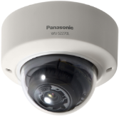
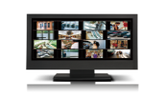
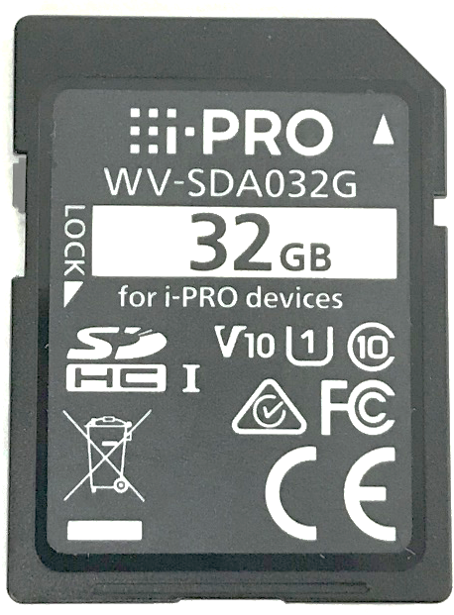
1.1 Recording trigger
Camera can save video to SD memory card triggered by several events
Available recording trigger events are Alarm, Manual and Schedule
Recording trigger
Replay / Download
Transmission priority:
Frame rate or CBR for most models (*)
When “VBR” or “Best effort” is set, it will be changed to “Frame rate”.
When “VBR” is set, “Max bit rate (per client) may be changed.
GOP Control:
Off
When the GOP Control is other than “Off”, it will be changed to “Off”.
Refresh interval:
No more than 1s
When “Refresh interval” is longer than “1s”, it will be changed to “1s”
Audio (in case 2 recording stream) :
When recording audio, recording stream2 must be “Off”
Pre alarm duration:
“Pre-alarm duration” differs depending on the bit rate.
Camera
Camera browser
Replay
Alarm
File download
Replay
ASM300
File download
Manual
PC
Schedule
Replay
Security Viewer
Password Lock
TBD
Alteration detection
File download
Network failure
NX-NVR
Download
When the camera loses network connection with NVR, starts recording to SD memory card for backup.
(*) refer to Appendix

Slide 6
1.2 Comparison table for recording modes
 | Camera Independent REC |  |  |  |  | Backup for NVR REC
Rec trigger | Alarm |  | Manual |  | Schedule | Network failure with NVR
Folder name in SD | M_ALARM, M_ALARM2 | ALARM | M_LOCAL, M_LOCAL2 | LOCAL | M_LOCAL, M_LOCAL2 | N_NWBKP
File format (*1) | .mp4 | .jpg | .mp4 | .jpg | .mp4 | .mp4
Video Encoder (*2) | H.265/H.264 | JPEG | H.265/H.264 | JPEG | H.265/H.264 | H.265/H.264
Audio Encoder | AAC-LC | - | AAC-LC | - | AAC-LC | AAC-LC
Max. Rec speed(*3) | 12Mbps (Panasonic SD) / 8Mbps (i-PRO SD)
Streaming condition (*3) | 24Mbps or less, 120fps or less, and 5 times or less. (3times or less with audio)
Setup | Setup camera browser |  |  |  |  | Setup NVR browser
Other conditions | Pre Recording: H.265/H.264 : Max. 120sec JPEG : 0-5frames Post Recording: H.265/H.264 : Max. 300sec JPEG : 10-3000frames |  | Note: Manual Recording will automatically restart if the camera reboots.
(*1) H.265/H.264 video data are saved in 20MB files.
(*2) If you want to change compression format of H.265/H.264 and JPEG, card re-formatting is required. H.265/H.264 file format is mp4.
(*3) In case of the SD memory card supports Class 10 with UHS-I. If the card support Class 6 to Class 10 without UHS-I, MAX. Rec speed is up to 6Mbps. Otherwise, recording may be intermittent. In a system using the ASM200, 14Mbps is the upper limit.

Slide 7
2. SD recording settings

Slide 8
2.1 Setup procedure
Setup procedure for SD memory card recording
This chapter explains the case where the recording trigger is a VMD alarm
Camera Setting
Camera Setting
2
3
4
Recording trigger
(A) Alarm input recording Automatically record when an alarm occurs | Yes | Yes | Yes | Yes
(B) Manual recording Manually record by operating browser buttons | Yes | Yes | --- | ---
(C) Schedule recording Record according to the specified day and time | Yes | Yes | --- | Yes
1
Image/Audi >
Image
Basic >
SD memory card
Alarm > VMD area
Schedule > Schedule

Slide 9
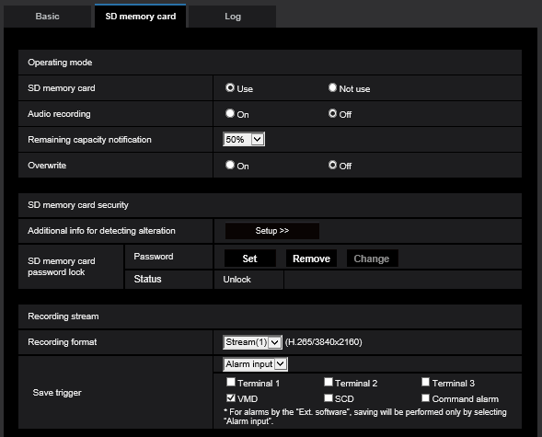
2.2 Set SD memory card recording
(A) Alarm input recording
(B) Manual recording
(C) Schedule recording
Display setup menu
(1) Basic > SD memory card
Select whether or not to save audio data when saving video data in MP4 format
Audio (in case 2 recording stream) :
When recording audio, recording stream2 must be “Off”
(2) Image/Audio > Image
(3) Alarm > VMD area
(4) Schedule > Schedule
Select a trigger to save images on the SD memory card
(A) Alarm input recording : Alarm input
(B) Manual recording : Manual
(C) Schedule recording : Schedule
Start Recording
End

Slide 10
2.2 Set SD memory card recording
(A) Alarm input recording
(B) Manual recording
(C) Schedule recording
Display setup menu
(1) Basic > SD memory card
Pre alarm duration:
“Pre-alarm duration” differs depending on the bit rate
(2) Image/Audio > Image
(A) Alarm input recording :
Set the duration to save image data on the SD memory card after an alarm occurrence
(3) Alarm > VMD area
(4) Schedule > Schedule
Start Recording
End

Slide 11
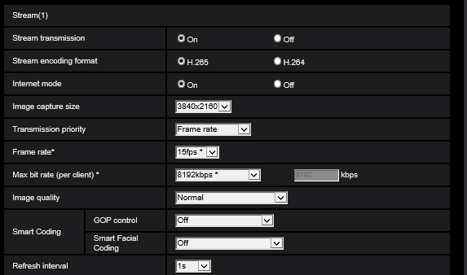
2.3 Set Image
(A) Alarm input recording
(B) Manual recording
(C) Schedule recording
Display setup menu
(1) Basic > SD memory card
(2) Image/Audio > Image
Frame rate or CBR
When “VBR” or “Best effort” is set, it will be changed to “Frame rate”
(3) Alarm > VMD area
When “VBR” is set, “Max bit rate (per client) may be changed
(4) Schedule > Schedule
When the GOP Control is other than “Off”, it will be changed to “Off”
Start Recording
Select an interval (I-frame interval; 0.2 - 5 seconds) to refresh the displayed H.265 (or H.264) images
When “Refresh interval” is longer than “1s”, it will be changed to “1s”
End

Slide 12
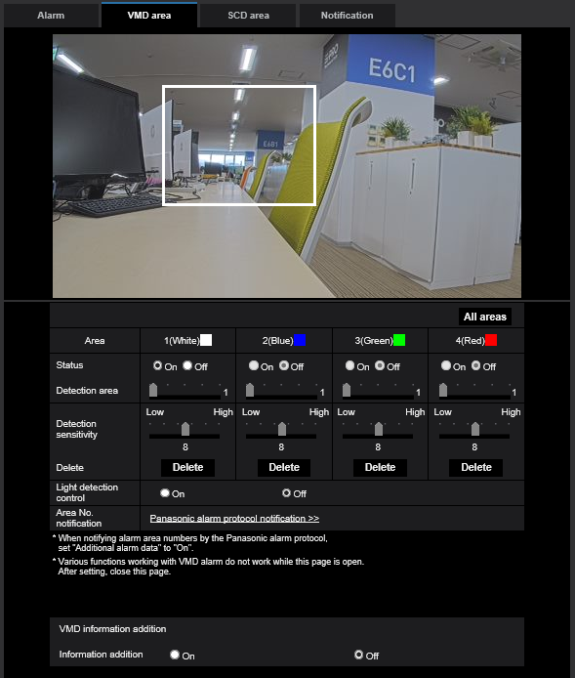
2.4 Set VMD area
(A) Alarm input recording
(B) Manual recording
(C) Schedule recording
Display setup menu
(1) Basic > SD memory card
(2) Image/Audio > Image
(3) Alarm > VMD area
Set status to “On”
Set [Detection area] and [Detection sensitivity] as necessary
(4) Schedule > Schedule
Start Recording
End

Slide 13
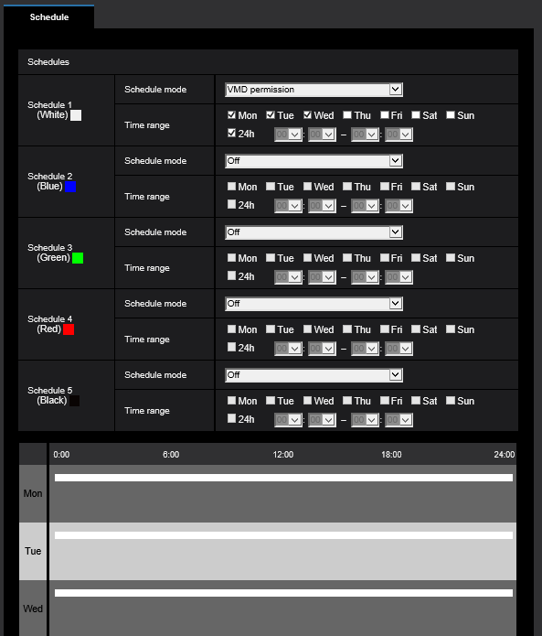
2.5 Set Schedule
(A) Alarm input recording
(B) Manual recording
(C) Schedule recording
Display setup menu
(A) Alarm input recording : VMD permission
(C) Schedule recording : Recording to SD (Recording stream)
(1) Basic > SD memory card
(2) Image/Audio > Image
Select days of a week by checking the respective checkboxes
(3) Alarm > VMD area
Set the recording time zone
(4) Schedule > Schedule
Start Recording
End

Slide 14
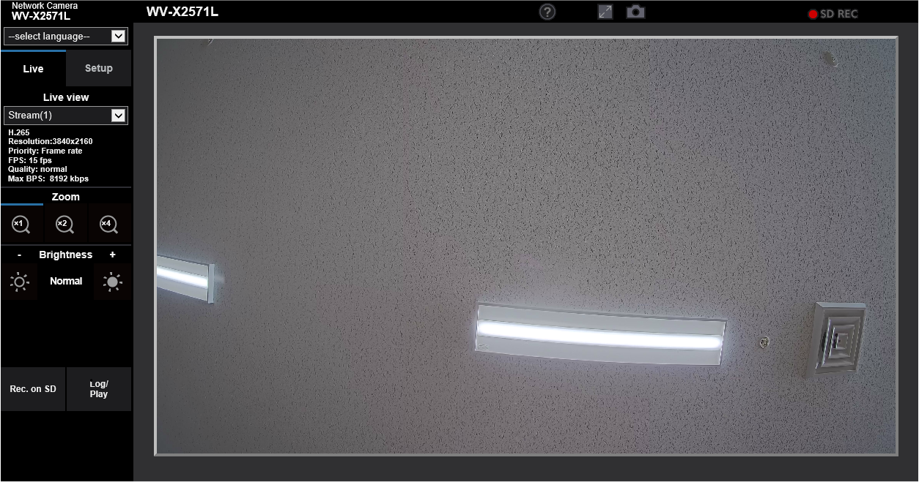
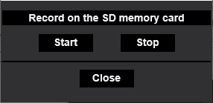
2.6 Start manual recording
(A) Alarm input recording
(B) Manual recording
(C) Schedule recording
Display setup menu
(1) Basic > SD memory card
Click the [Start] / [Stop] button to start / stop manual recording
(2) Image/Audio > Image
(3) Alarm > VMD area
(4) Schedule > Schedule
Start Recording
End

Slide 15
3. View recorded data (H.265/H.264)

Slide 16
3.1 Overview
View recorded data
Image Compression | Method | Camera browser | ASM300 | PC file Explorer
JPEG | Replay | YES | N/A | YES
 | Download/Copy | YES | N/A | YES
H.265/H.264 | Replay | YES | YES | YES (*)
 | Download/Copy | YES | YES | YES
→ 3.2
→ 3.5
→ 3.2
→ 3.5
→ 3.2
→ 3.3
→ 3.5
→ 3.2
→ 3.4
→ 3.5
(*) H.265 images on SD memory card may not be played on Windows 10 due to "Windows 10 Fall Creators Update(Version 1709 / RS3)
See [C0303] for detail (https://security.panasonic.com/training_support/support/technical_information/)
Notes:
- In case of "Backup for NVR REC", you can play back SD memory backup data on WJ-NX*** after the recorder get the video data from SD memory card automatically
- File format is "mp4", not "n3r" format

Slide 17
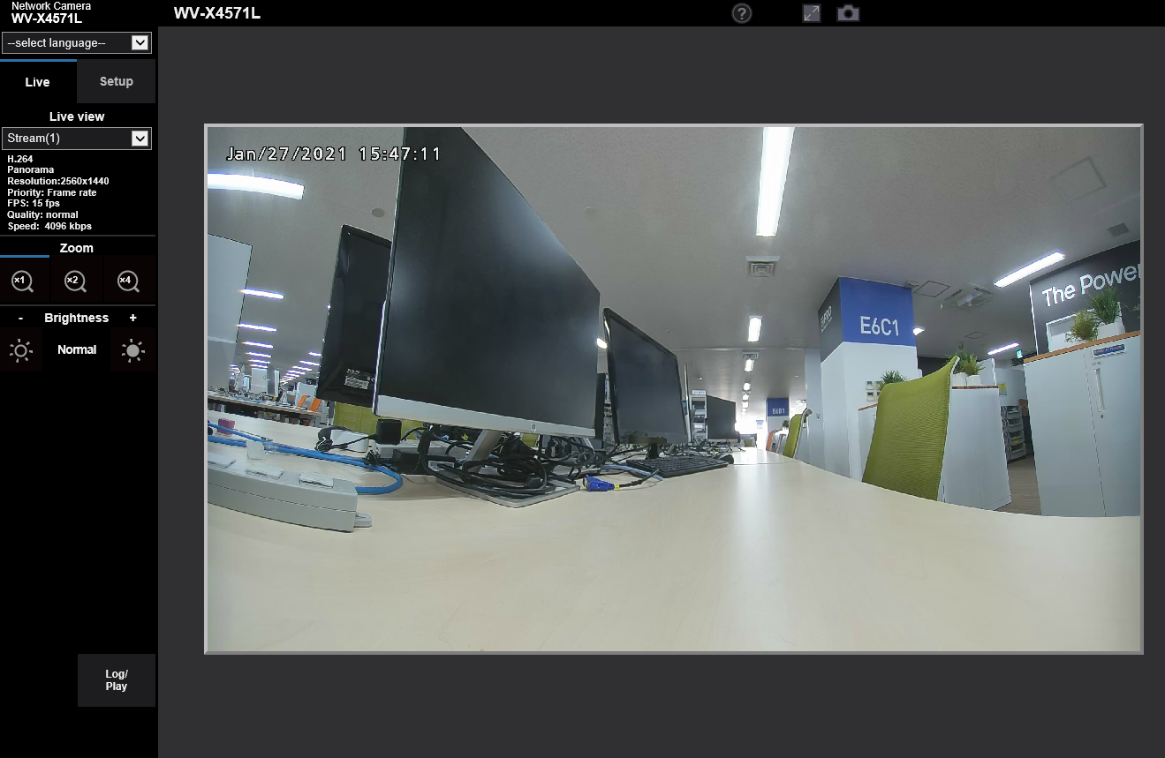
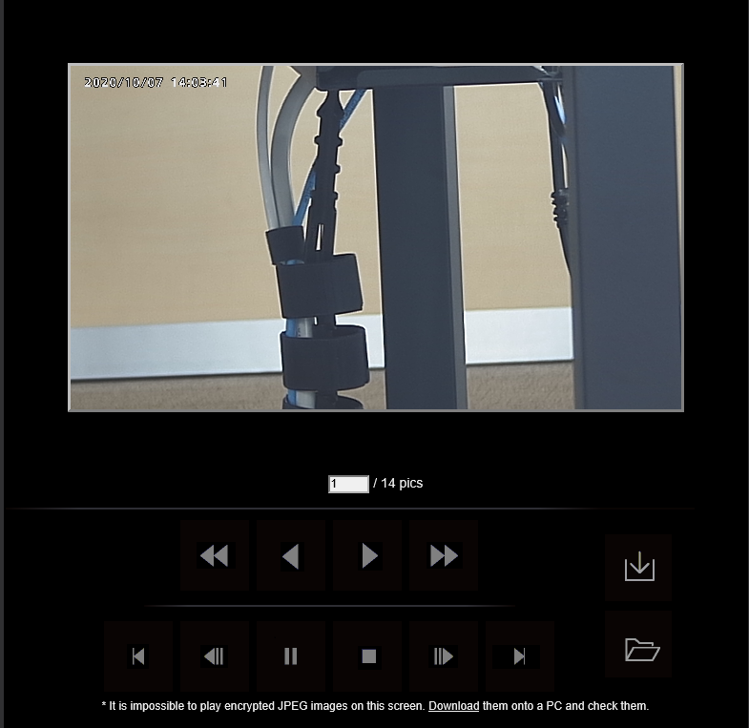
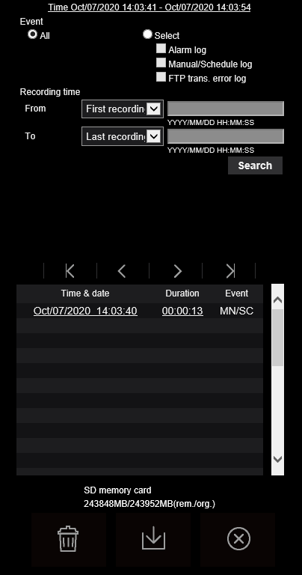
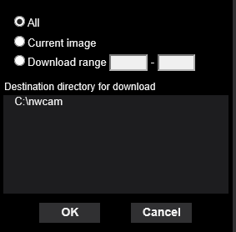
3.2 Replay / Download : Camera browser (H.265/H.264/JPEG)
Replay/download recorded image files on web browser
cvcv
Replay
Download
Destination directory can be changed in setup menu "Basic>Log"
Step1. Click [Log/Play] to show recorded data
Step2 : Select recorded data
Step3 : Replay
Step1 : Click download Icon
Notes:
- Only a single user can operate the log list window. Other users cannot access the log list window
- In this process, replay stream is output by TCP (over HTTP)

Slide 18
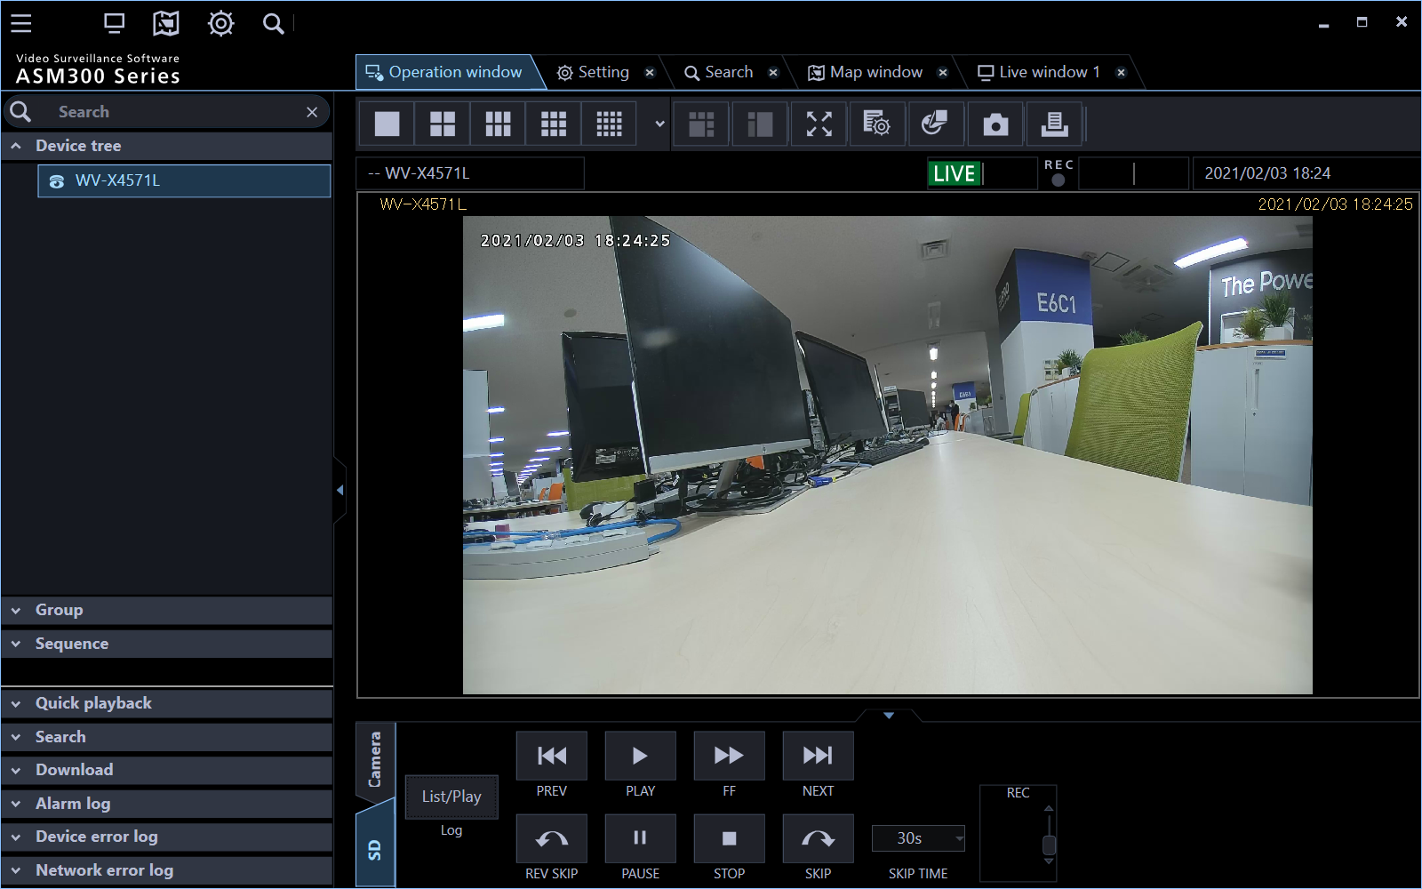
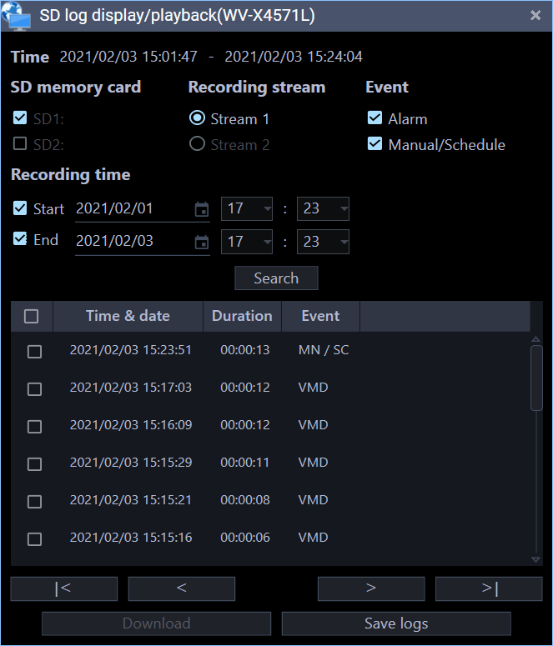
3.3 Replay : ASM300
Play on the operation monitor in ASM300
- In one of the camera, the playable Only one user (including browser access, etc.). During replay other users can not play
- It does not support audio replay
Live
Replay
Step3. Set search criteria to narrow down
Step4. Click replay target to start playing
Step1. Select camera and click [SD] tab
Live images will be switched to playback images
The live indication displayed in the information display area will turn to the playback indication.
Step2. Click [List/Play]

Slide 19
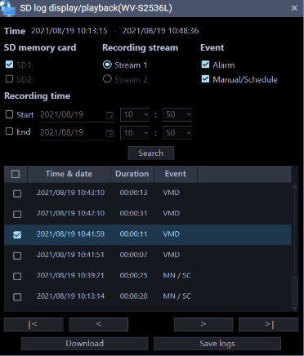
3.4 Download MP4 : ASM300
Download MP4 file from operation monitor of ASM300
- If multiple alarm occurs in the same file, different list is created, but when you download, the same file is downloaded
Download
Step3. Set search criteria to narrow down
Step1. Select camera and click [SD] tab
Step4. Select replay target, then click [Download]
Step4. Select replay target, then click [Download]
Step2. Click [List/Play]

Slide 20
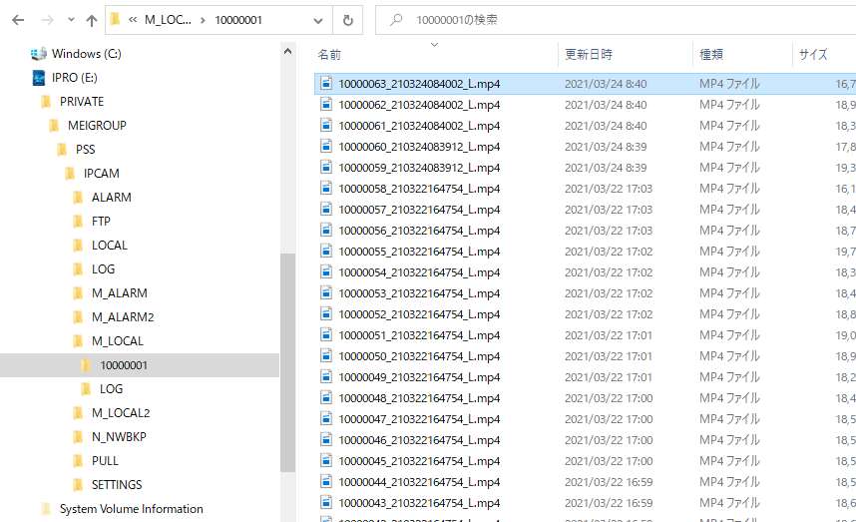
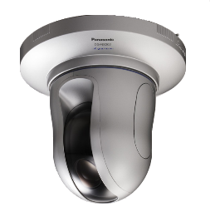
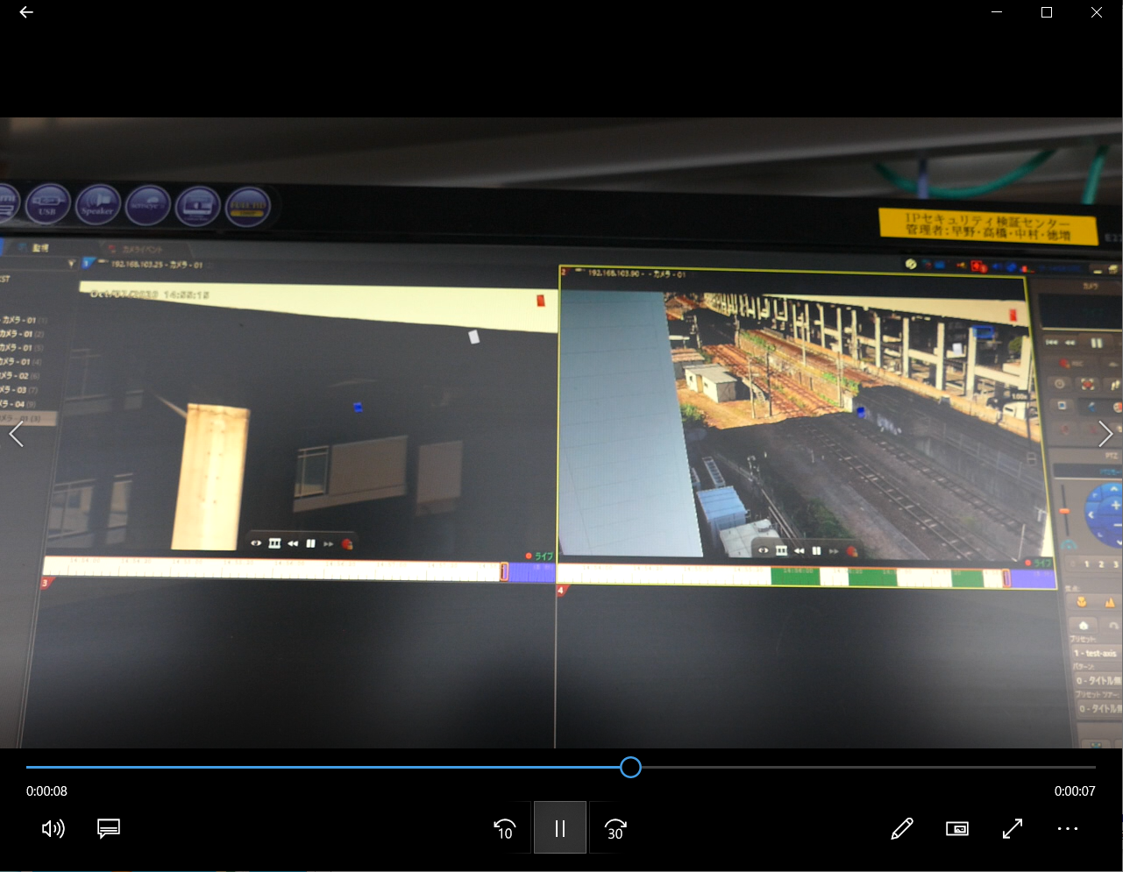
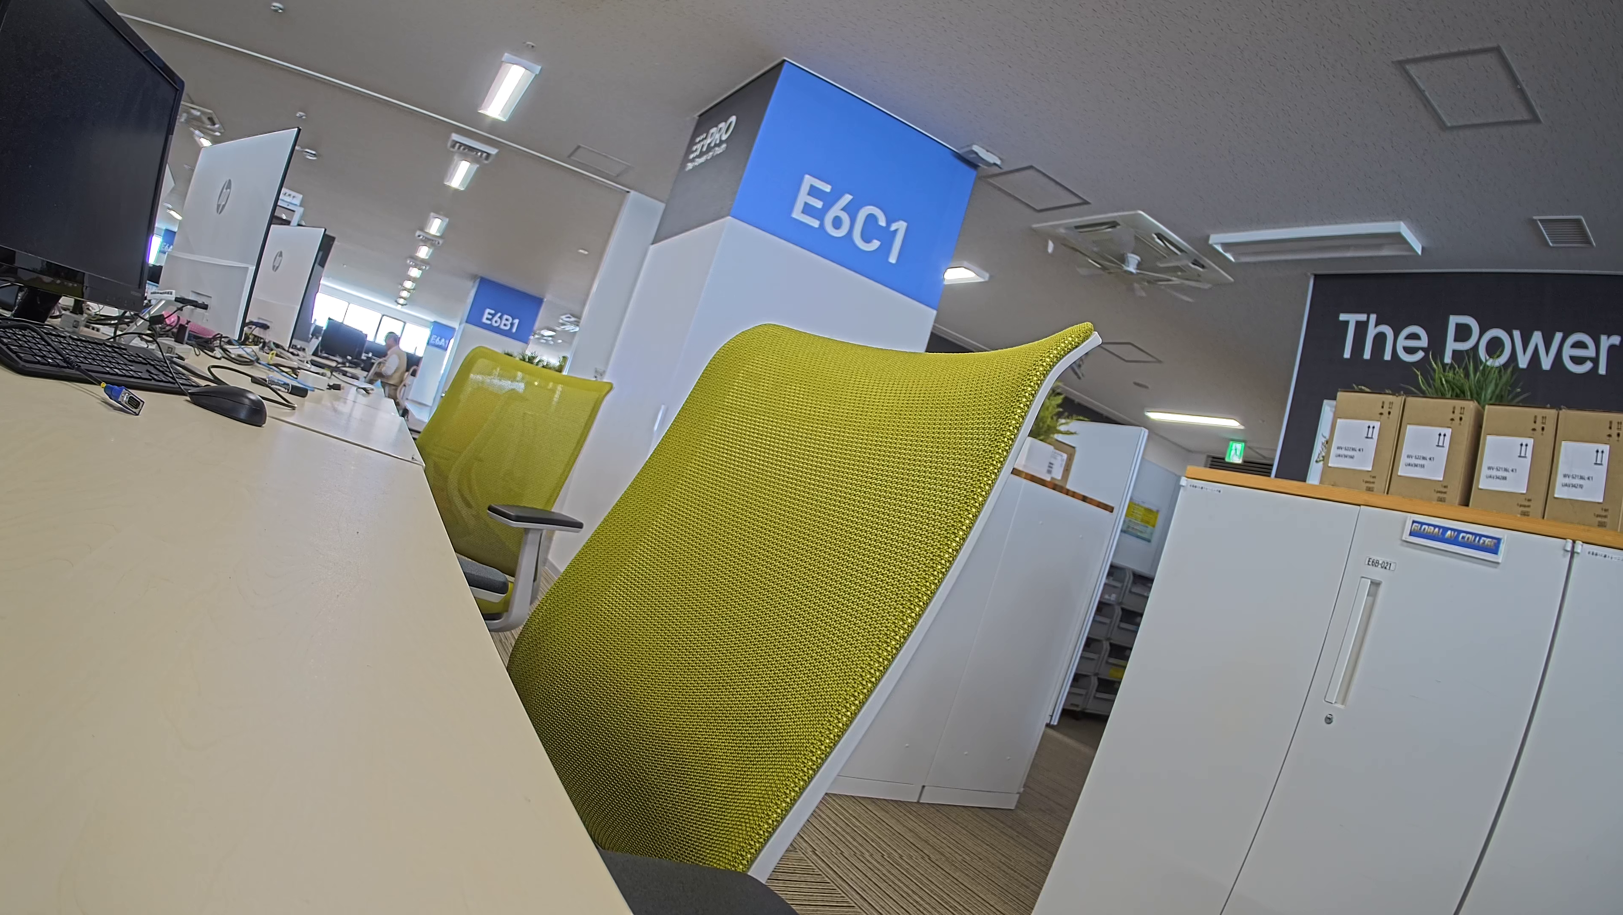
3.5 Replay SD recorded data : PC
Take out SD memory card and view images on the PC
Replay : one file
<Explorer>
Step1.
Take out SD memory card from camera,
and insert it to the PC
Step2. Double click mp4 file to replay
Note:
Refer to the camera's operating instructions for the folder structure in the SD memory card

Slide 21
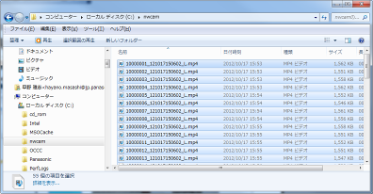
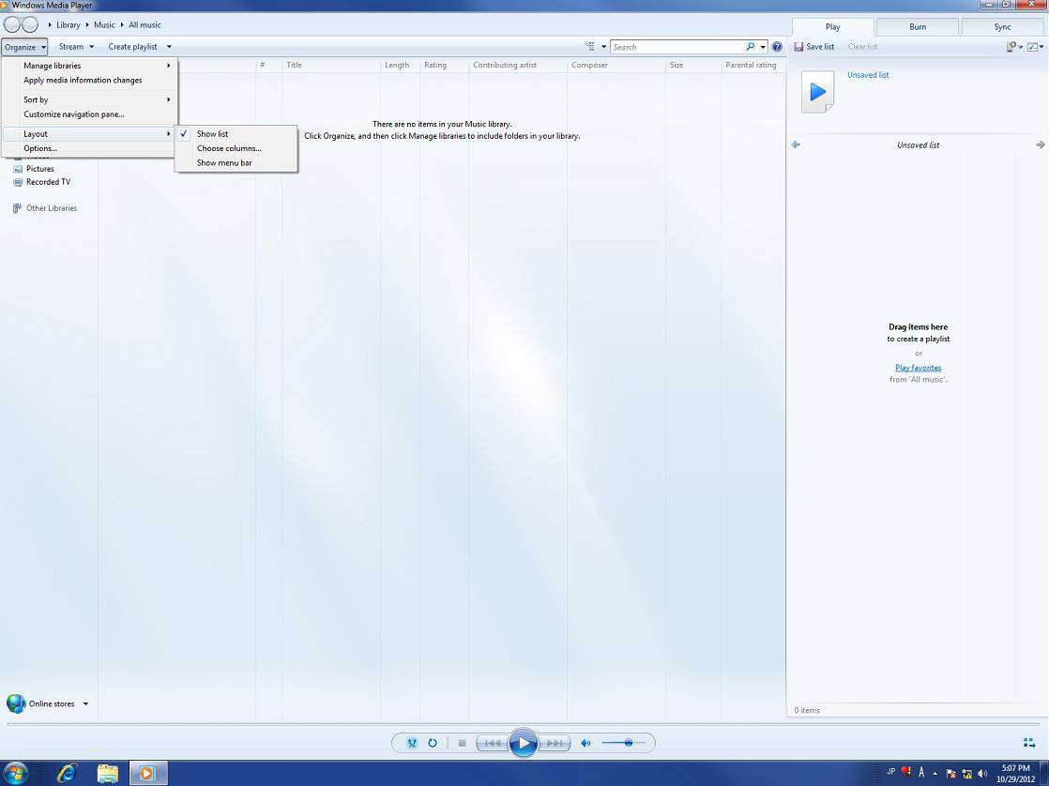
3.5 Replay SD recorded data : PC - Continuous playback
How to replay multiple files continuously with Windows Media Player
Replay : multiple files
<Explorer>
<Windows Media Player>
Viewer list
Step1.
Select all files to replay
Step2.
Drag and Drop the selected files to Viewer list

Slide 22
4. Backup for NVR

Slide 23
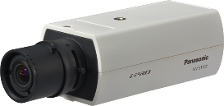
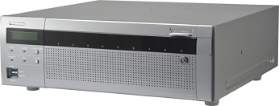
4. SD memory backup with recorder (NX-NVR)
Camera start recording to the SD memory card when it fails to communicate with NVR.
NVR retrieve the image from SD memory card a quarter past every hour.
1
Communication
Is disconnected
2
After the network is recovered :
The video data on the SD will be transmitted to the recorder automatically.
NX-NVR saves only image data to the HDD. Audio and VMD data will not be saved even SD has them
If the SD backup is used, set the operation mode of the SD memory card to "Overwrite On" from the camera side
It can also manually retrieve the image data from Maintenance > System management > Other

Slide 24
4.1.1 Set SD memory card recording
Display setup menu
(1) Camera
Basic > SD memory card
Select “Audio recording” “On”/”Off” for MP4 format.
Audio (in case 2 recording stream) :
When recording audio, recording stream2 must be “Off”
(2) Camera
Network > Advanced > NTP
(3) NX series recorder
REC & event > Advanced setup
(4) NX series recorder
Date/Language
(5) Recovery & Playback
<Do not change here>
End

Slide 25
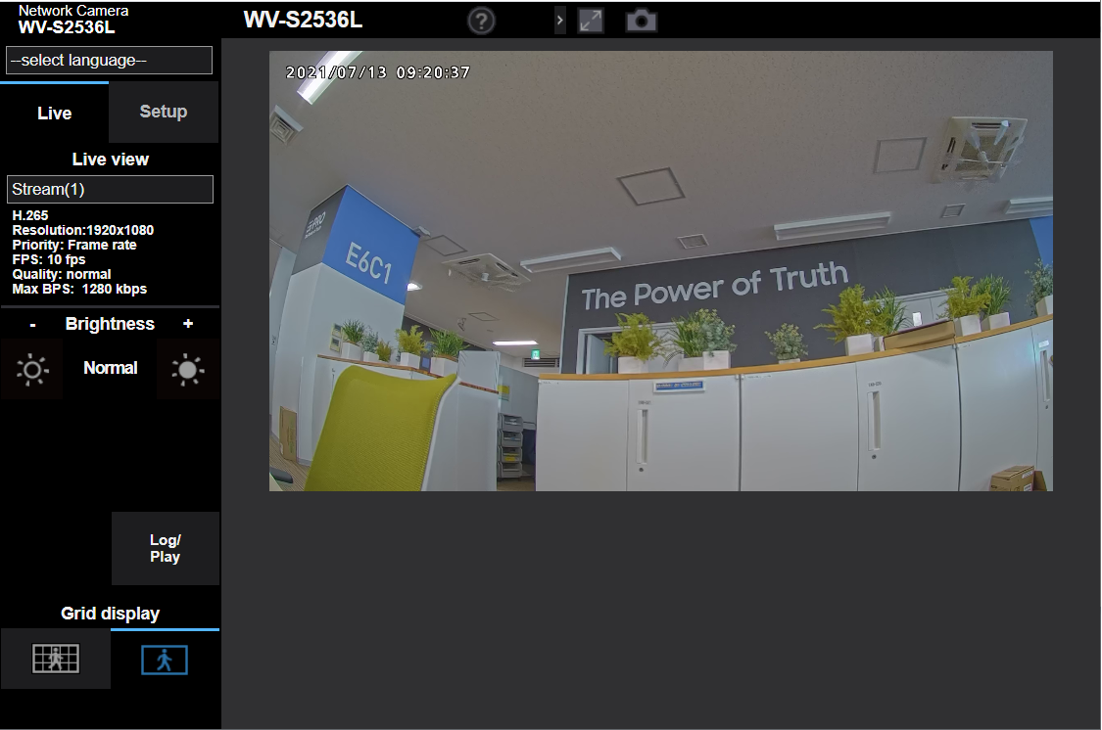
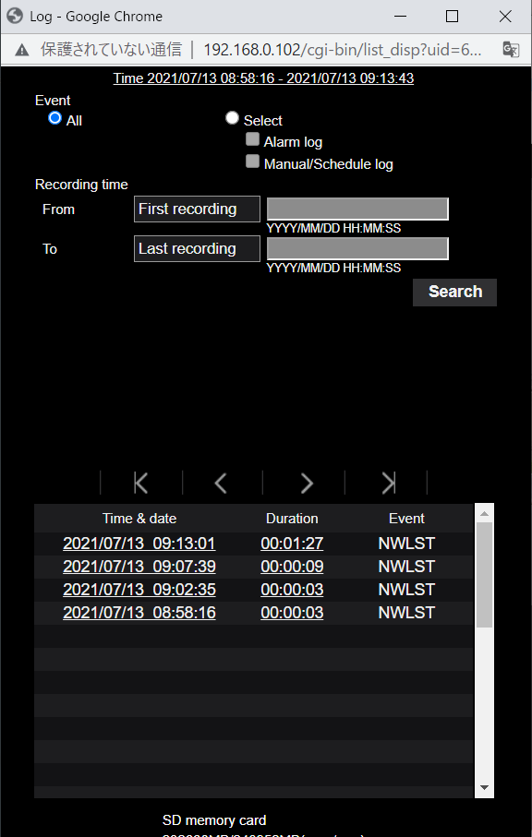
4.1.2 Check SD memory card recording
Display setup menu
(1) Camera
Basic > SD memory card
<OK>
Log window is displayed.
(2) Camera
Network > Advanced > NTP
(3) NX series recorder
REC & event > Advanced setup
(4) NX series recorder
Date/Language
Click “Log/Play” button
<NG>
Alarm message is displayed. Please check if the SDHC memory card is inserted correctly.
(5) Recovery & Playback
End

Slide 26
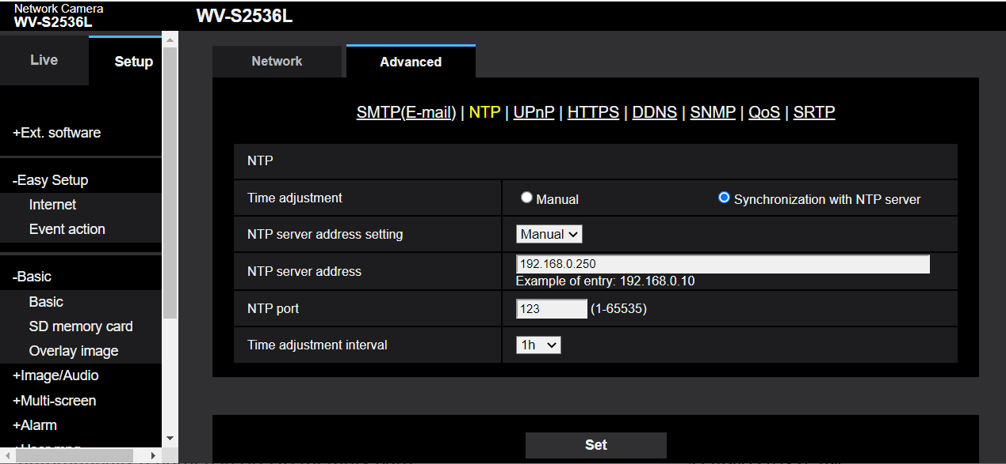
4.2 Set Camera’s time & date (time zone)
Display setup menu
(1) Camera
Basic > SD memory card
(2) Camera
Network > Advanced > NTP
Synchronization with NTP server
(3) NX series recorder
REC & event > Advanced setup
Manual
(4) NX series recorder
Date/Language
NX Recorder’s IP address
(5) Recovery & Playback
End

Slide 27
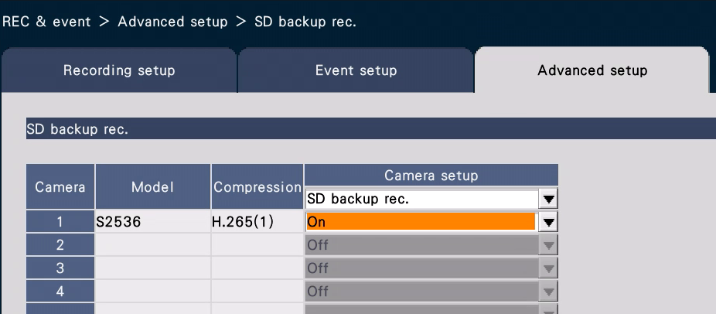
4.3 Set Recorder’s SD backup rec.
Display Camera setup menu
(1) Camera
Basic > SD memory card
(2) Camera
Network > Advanced > NTP
Select “ON”
(3) NX series recorder
REC & event > Advanced setup
Camera’s
Setup > Basic > SD memory card
(4) NX series recorder
Date/Language
When above setting is done on NX recorder,
”Network failure” is displayed (gray out)
in save trigger on the SD memory card of [Basic] setup menu of camera.
(5) Recovery & Playback
“Network failure”
End

Slide 28
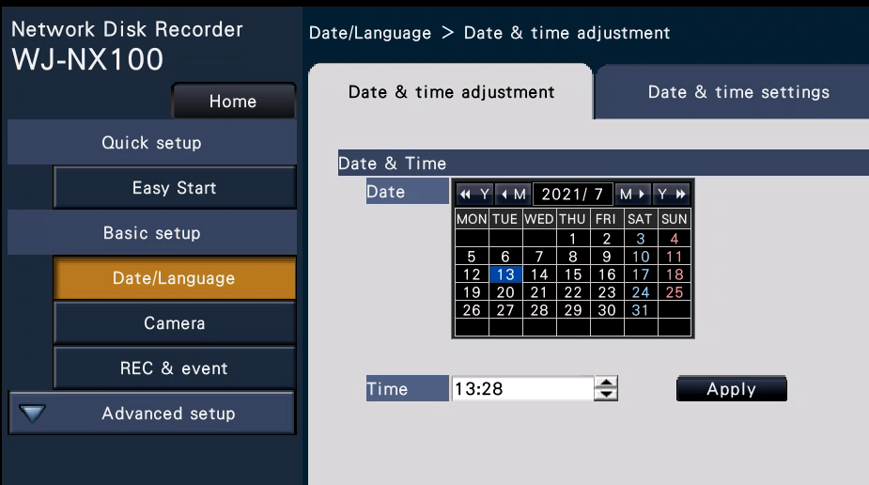
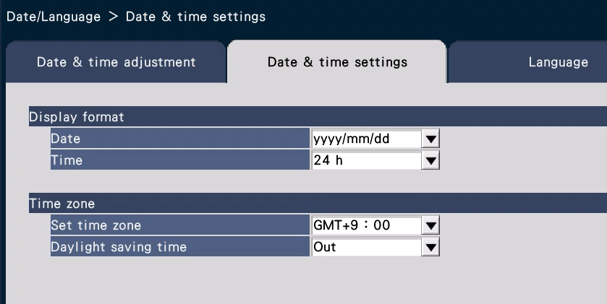
4.4 Set Recorder’s time & date (time zone)
Display setup menu
(1) Camera
Basic > SD memory card
(2) Camera
Network > Advanced > NTP
Time&date
(3) NX series recorder
REC & event > Advanced setup
(4) NX series recorder
Date/Language
(5) Recovery & Playback
End
Time zone

Slide 29
4.5.1 Recovery
Display setup menu
Image data backed up on the SD memory card during network failure can be transmitted to the recorder automatically.
(1) Camera
Basic > SD memory card
Automatically
During operation of recording, live displaying, playback, the data on the SD memory card can be automatically transmitted to the recorder without interrupting the operation.
Backup data on a camera included pre-recording data(*1) on SD memory card is transmitted one by one every hour(*2) in the case of NX series recorder.
[SD -> HDD] is displayed on the browser when Backup data on a camera is transmitted to NX series recorder.
(*1)A few seconds images before network failure is automatically recorded in SD memory card
(*2)The data recovery (transmission) start every an hour such time as “0:15, 1:15, 2:15, 3:15, ………, 23:15”
(2) Camera
Network > Advanced > NTP
(3) NX series recorder
REC & event > Advanced setup
(4) NX series recorder
Date/Language
(5) Recovery & Playback
End

Slide 30
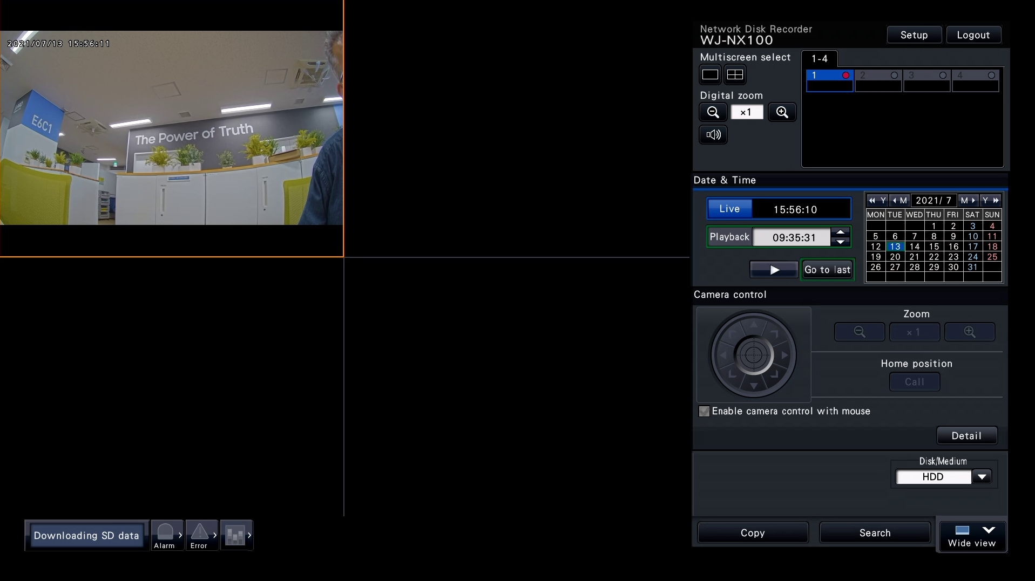
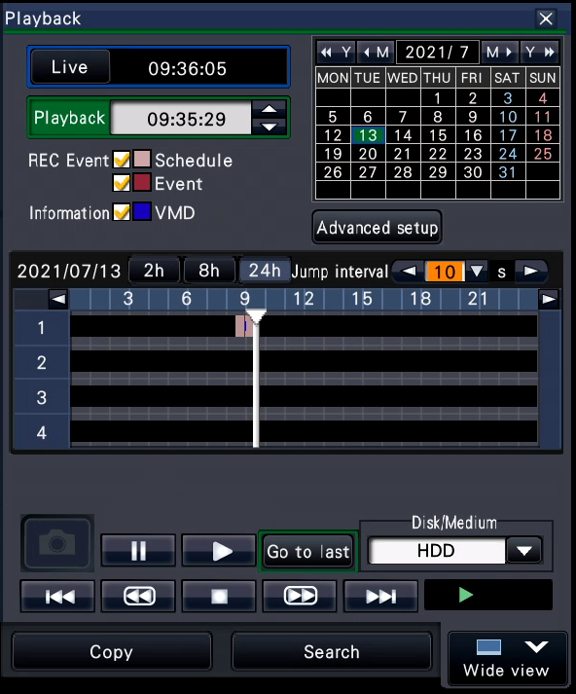
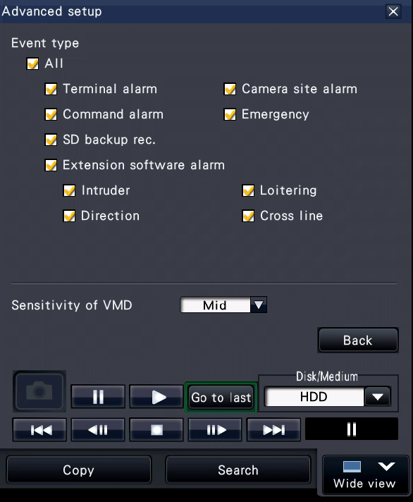
4.5.2 Playback ( NX series Recorder )
The data recovered on the recorder can be replayed as shown below
From the recorder’s Web browser : Search events
Display setup menu
(1) Camera
Basic > SD memory card
3.SD backup rec.
(2) Camera
Network > Advanced > NTP
(3) NX series recorder
REC & event > Advanced setup
(4) NX series recorder
Date/Language
1.Go to last
2.Advanced setup
(5) Recovery & Playback
End

Slide 31
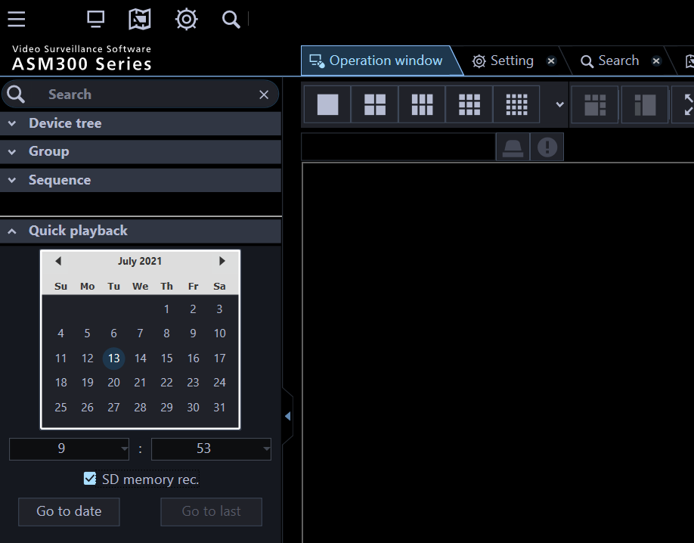
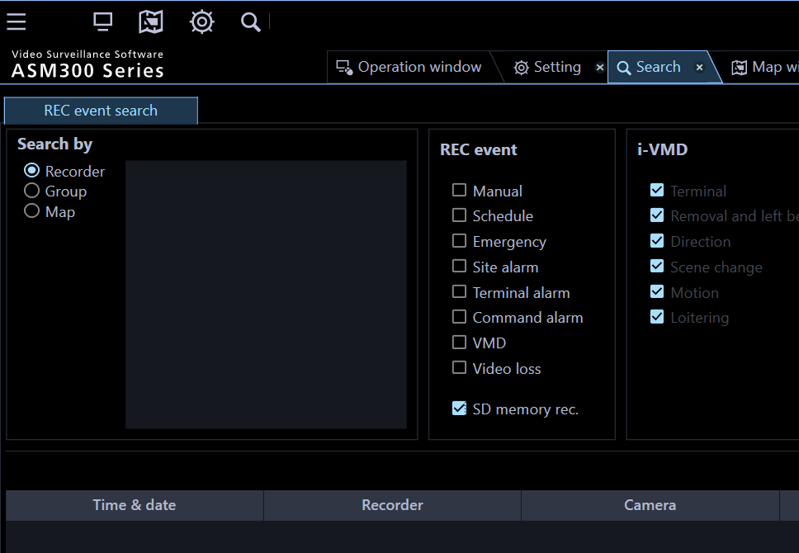
4.5.3 Playback ( ASM300 )
The data recovered on the recorder can be replayed as shown below
From ASM300 operation window : Quick Playback or Event Search
Display setup menu
(1) Camera
Basic > SD memory card
Quick Playback
Event Search
(2) Camera
Network > Advanced > NTP
(3) NX series recorder
REC & event > Advanced setup
1.Quick Playback
1.Search
(4) NX series recorder
Date/Language
(5) Recovery & Playback
2.SD memory rec.
2.SD memory rec.
End

Slide 32
5. Other functions

Slide 33
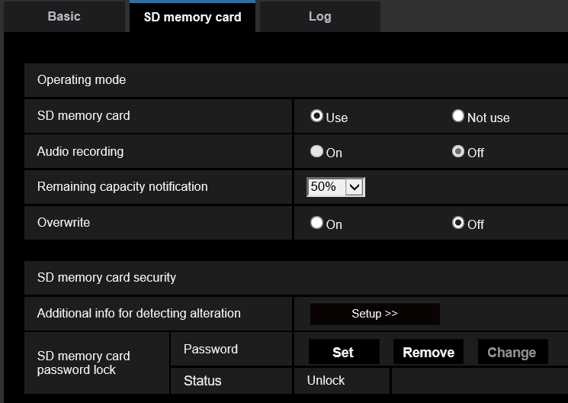
5.2 Password Lock
Setting a password for the SD memory card, devices other than i-PRO camera will be unable to write or read the SD memory card. It prevent the information leak even if SD memory card is stolen.
[Lock the SD memory card]
By set the password to SD memory card data, the data cannot be read or written by any other equipment except for i-PRO cameras.
Available number of characters: 4-32 characters
Unavailable characters: " & : ;
[Set] :set the password
[Remove] :remove the password
[Change] :change the password
Note:
- This function is supported when using SDHC or SDXC memory card.
‐To replay the data by PC, unlock the SD memory card by the camera before removing the SD card

Slide 34
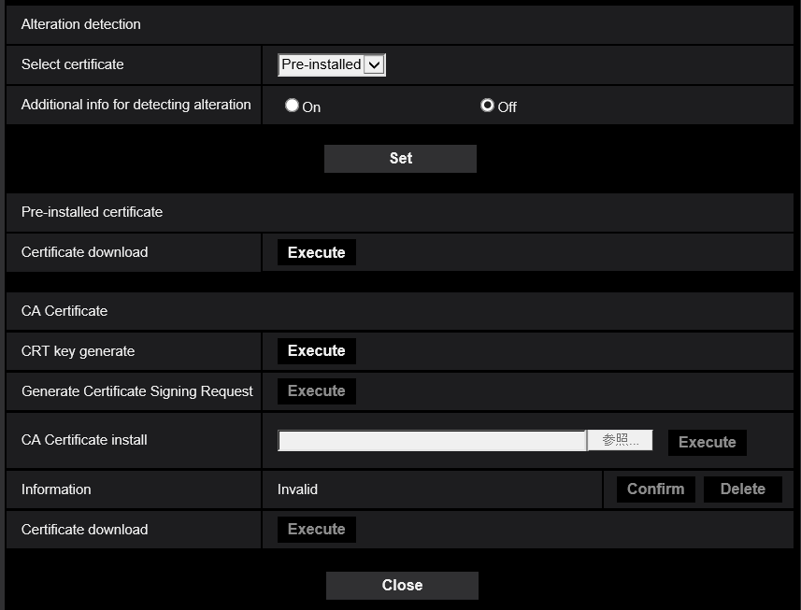
5.3 Alteration detection
Alteration detection supports video data (MP4 format) only and can be checked using “MP4IntegrityVerifier” software. To use Alteration detection Certificate is required. (Self-signed Certificate or CA Certificate)
改竄検知情報付加 | Audio | Available bit rate
Off | Off | 12288kbps
 | On | 8192kbps
On | Off | 8192kbps
 | On | 8192kbps
- Alteration detection is used for “Recording stream 1”, and “Off” must be selected for “Recording stream 2”.
- When Alteration detection is enabled, the maximum value of the available bit rate for “Stream” will be limited.
- To confirm alteration, you can download the software “MP4IntegrityVerifier” from website below
https://security.panasonic.com/support/info/

Slide 35
6. i-PRO SD memory cards

Slide 36
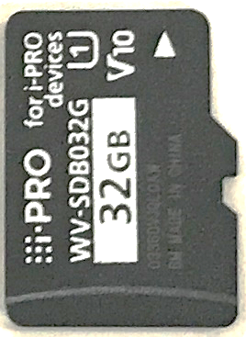
6.1 i-PRO SD memory card line-ups
https://security.panasonic.com/products_technology/products/function_extension_kits/i-pro_sd_memory_card/
Type | Capacity | SD Standard | Model number | Spec
SD Memory Card | 32GB | SDHC | WV-SDA032G | 3D NAND TLC Flash Approx. 3000 rewriting times Operating Temperature : -25 degrees c to +85 degree c | Speed Class : Class 10 / U1 /V10 Max. Read : 100MB/s Max. Write : 50MB/s
 | 64GB | SDXC | WV-SDA064G
 | 128GB |  | WV-SDA128G |  | Speed Class : Class 10 / U3 /V30 Max. Read : 100MB/s Max. Write : 50MB/s
 | 512GB |  | WV-SDA256G
Micro SD Memory Card | 32GB | Micro SDHC | WV-SDB032G |  | Speed Class : Class 10 / U1 /V10 Max. Read : 100MB/s Max. Write : 50MB/s
 | 64GB | Micro SDXC | WV-SDB064G
 | 128GB |  | WV-SDB128G |  | Speed Class : Class 10 / U3 /V30 Max. Read : 100MB/s Max. Write : 50MB/s
 | 256GB |  | WV-SDB256G

Slide 37
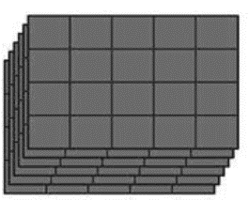
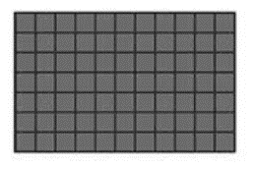
6.1 Advantage of 3D NAND TLC
3D NAND TLC realizes both high capacity and high endurance
Comparison among Flash memory types
High
High
capacity
capacity
High
endurance
endurance
SLC MLC TLC
(Single Level Cell) (Multi Level Cell) (Triple Level Cell)
2D NAND 3D NAND
Stored information size per cell by memory type
Memory Type | SLC | MLC | TLC
Stored Information/ Memory Cell | 1 bit / cell | 2 bits / cell | 3 bits / cell
Need smaller cell size for more capacity,
But smaller cell size reduce endurance
pile up cells can increase capacity
with keeping cell size

Slide 38
6.2 Reference : Estimated Recording Hours(H.264/H.265)
Unit: Hours
Band-width | Size of SD memory card
(kbps) | 32GB | 64GB | 128GB | 256GB | 512GB
64 | 1008.3 | 2070.7 | 4152.1 | 8343.9 | 15859.9
96 | 672.0 | 1380.1 | 2767.2 | 5560.8 | 10569.9
112 | 575.9 | 1182.7 | 2371.5 | 4765.6 | 9058.4
128 | 503.8 | 1034.7 | 2074.7 | 4169.3 | 7924.9
192 | 335.7 | 689.4 | 1382.3 | 2777.7 | 5279.9
224 | 287.6 | 590.7 | 1184.4 | 2380.2 | 4524.2
256 | 251.6 | 516.7 | 1036.0 | 2082.0 | 3957.4
320 | 201.1 | 413.1 | 828.3 | 1664.5 | 3163.9
352 | 182.8 | 375.4 | 752.8 | 1512.7 | 2875.4
384 | 167.5 | 344.0 | 689.8 | 1386.2 | 2634.9
448 | 143.5 | 294.7 | 590.9 | 1187.4 | 2257.0
480 | 133.9 | 275.0 | 551.3 | 1107.9 | 2105.9
512 | 125.5 | 257.7 | 516.7 | 1038.3 | 1973.7
640 | 100.2 | 205.9 | 412.8 | 829.6 | 1576.9
768 | 83.4 | 171.4 | 343.6 | 690.5 | 1312.4
896 | 71.4 | 146.7 | 294.1 | 591.1 | 1123.5
1024 | 62.4 | 128.2 | 257.0 | 516.5 | 981.8
1280 | 49.8 | 102.3 | 205.1 | 412.2 | 783.4
1536 | 41.4 | 85.0 | 170.5 | 342.6 | 651.2
1792 | 35.4 | 72.7 | 145.7 | 292.9 | 556.7
2048 | 30.9 | 63.4 | 127.2 | 255.6 | 485.8
3072 | 20.4 | 41.9 | 83.9 | 168.6 | 320.5
4096 | 15.1 | 31.1 | 62.3 | 125.1 | 237.9
6144 | 9.9 | 20.3 | 40.6 | 81.7 | 155.2
8192 | 7.2 | 14.9 | 29.8 | 59.9 | 113.9
10240 | 5.7 | 11.6 | 23.3 | 46.9 | 89.1
12288 | 4.6 | 9.5 | 19.0 | 38.2 | 72.6

Slide 39
6.3 Reference : Replacement cycle (continuous recording)
(1) i-PRO S series / X series HD/FHD model
Bandwidth (kbps) | SD Memory Card
 | WV-SDA032G | WV-SDA064G | WV-SDA128G | WV-SDA256G | WV-SDA512G
64 | 5-year | 5-year | 5-year | 5-year | 5-year
96
128
192
224
256
320
352
384
448
480
512
640
768
1,024
1,280
1,536
1,792
2,048 | 4-year 6-month
3,072 | 3-year
4,096 | 2-year 3-month
6,144 | 1-year 6-month | 3-year 10-month
8,192 | 1-year 1-month | 2-year 11-month
10,240 | 10-month + | 2-year 3-month + | 4-year 6-month + | 5-year + | 5-year +
12,288 | 9-month + | 1-year 11-month + | 3-year 10-month + | 5-year + | 5-year +
Please set the bitrate of recording stream
less than 6,144 kbps

Slide 40
6.3 Reference : Replacement cycle (continuous recording)
(2) i-PRO S series / X series 5M/4K model
Bandwidth (kbps) | SD Memory Card
 | WV-SDA032G | WV-SDA064G | WV-SDA128G | WV-SDA256G | WV-SDA512G
64 | 5-year | 5-year | 5-year | 5-year | 5-year
96
128
192
224
256
320
352
384
448
480
512
640
768
1,024
1,280
1,536
1,792
2,048 | 4-year 6-month
3,072 | 3-year
4,096 | 2-year 3-month
6,144 | 1-year 6-month | 3-year 10-month
8,192 | 1-year 1-month | 2-year 11-month
10,240 | 10-month + | 2-year 3-month + | 4-year 6-month + | 5-year + | 5-year +
12,288 | 9-month + | 1-year 11-month + | 3-year 10-month + | 5-year + | 5-year +
Please set the bitrate of recording stream less than 8,192 kbps

Slide 41
6.3 Reference : Replacement cycle (continuous recording)
(1) i-PRO U series model
Bandwidth (kbps) | SD Memory Card
 | WV-SDB032G | WV-SDB064G | WV-SDB128G | WV-SDB256G
64 | 5-year | 5-year | 5-year | 5-year
96
128
192
224
256
320
352
384
448
480
512
640
768
1,024
1,280
1,536
1,792
2,048 | 4-year 6-month
3,072 | 3-year
4,096 | 2-year 3-month
6,144 | 1-year 6-month | 3-year 10-month
8,192 | 1-year 1-month | 2-year 11-month
10,240 | 10-month + | 2-year 3-month + | 4-year 6-month + | 5-year +
12,288 | 9-month + | 1-year 11-month + | 3-year 10-month + | 5-year +
Please set the bitrate of recording stream
less than 6,144 kbps
Please set the bitrate of recording stream
less than 6,144 kbps

Slide 42
Appendix

Slide 43
Differences in support functions
There are differences in support functions depending on the model.
Category | Camera Type | Model List | Supported Card | # of Rec. stream on SD | VBR support in SD Rec.
i-PRO EXTREME Series Group 1 | Box / Dome | S1111 / S1112 / S1131* / S1132* / S1432LH / S1511LN / S1531* S2111L / S2131* / S2132* / S2211L / S2231L / S2511LN / S2531* / S2532LH | SDXC/SDHC/SD | 2 | -
 | Compact Dome | S3111L / S3131L / S3511L / S3512LM / S3531L / S3532LM | micro SDXC | 2 | -
 | PTZ | S6111 / S6130* / S6131* / S6530* / S6532* / X6511N / X6531* / X6533* | SDXC/SDHC/SD | 2 | -
i-PRO EXTREME Series Group 2 | Box / Dome | S1550* / S1570* / S2250L / S2550* / S2270* / S2570L | SDXC/SDHC/SD | 1 | -
 | 360-degree | S4150 / S4550* / X4170* / X4171 / X4571* | SDXC/SDHC/SD | 1 | -
 | Multi-Sensor | S8530N / X8570 | SDXC/SDHC/SD | 1 | -
i-PRO EXTREME Series Group 3 (U Series) | Box / Dome | U1130 / U1132 / U1142 / U1532L / U1542L U2130L / U2132L / U2140L / U2142L / U2530L / U2532L / U2540L / U2542L | microSDXC/microSDHC/microSD | 1 | -
i-PRO EXTREME Series Group 4 | Box / Dome | S1552L / S1572L / S2252L / S2272L / S2552L / S2572L | SDXC/SDHC/SD | 1 | -
 | 360-degree | S4151 / S4551* / X4172 / X4173 / X4573* | SDXC/SDHC/SD | 1 | -
 | Multi-Sensor | S8531N / X8571N | SDXC/SDHC/SD | 1 | -
i-PRO with AI engine Series Group 1 | Box / Dome | X1551LN / X1571LN / X2251L / X2271L / X2551LN / X2571LN | SDXC/SDHC/SD | 1 | -
i-PRO with AI engine Series Group 2 | Box / Dome | S1136 / S1536 / S2136 / S2236L / S2536 | microSDXC/microSDHC/microSD | 1 | Yes
i-PRO SmartHD 4K | Box / Dome | SFV781L/SPV781L | SDXC/SDHC/SD | 1 | -
i-PRO SmartHD | Box / Dome | SW175 | SDHC/SD | 1 | -

Slide 44
Related information
Contents | Media | URL
Support Information for SD memory card | - | SD_Memory_Card_1624504425.9162.pdf (panasonic.net)
Restriction on use of i-PRO SD Memory Card | - | i-PRO_SD_Restriction.pdf (psn-web.net)
Recording Hours on SD memory Card | H.264/H.265 | sd_h264h265-en.pdf (psn-web.net)
Estimated storable number | JPEG | sd_jpeg-en.pdf (psn-web.net)
Replacement Cycle (Guideline) | H.264/H.265 | SD_Mem_Card_Replacement_Cycle_H264H265_en.pdf (psn-web.net)
Replacement Cycle (Guideline) | JPEG | SD_Mem_Card_Replacement_Cycle_JPEG_en.pdf (psn-web.net)

Slide 45
Version History

Slide 46
Version History
No | Update contents | Page No. | Version | Update
1 | 1st Version | - | 1.00 | 26.Jul.2021
2 | Refine section 3 | P.15 - 20 | 1.10 | 23.Aug.2021
3 | Add “Related information” to Appendix | P.43 | 1.10 | 23.Aug.2021
4
5
6
7
8
9
10

