Slide 1

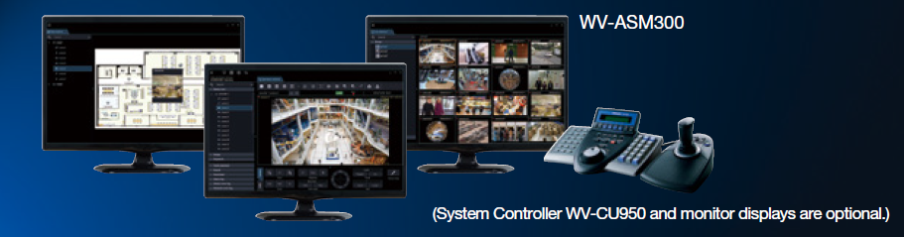
i-PRO Central Management Software
WV-ASM300 for SE ver.1.40
* This document is covering firmware version 1.40 of the ASM300.
15th May. 2018
Panasonic Corporation

Slide 2
Welcome & Disclaimer
This document, version 1.40, is based on product firmware version 1.40 of the i-PRO Central Management Software WV-ASM300.
Hence some of the specification & function detail might be changed without announcement.
This document is not cover all over about the product. Therefore, please utilize this document together with other materials such as “Release note” “Help” file “Specification Sheet” and “Product Presentation Material” so on as necessary.
These materials can be downloaded from the following website.
http://security.panasonic.com/download/
Also, Setup Procedure Videos are available through the “SSBD wiki” and “YouTube”.
SSBD Wiki：http://10.75.24.156/en/index.php/H.265_Video_Surveillance_Software#Training_materials
YouTube：https://www.youtube.com/watch?v=TUkUqGelzuU (This is URL of ASM300 Initial setup for your reference)

Slide 3

Version History
Update
No | Update contents | Page No. | Version | Editor | Update
- | 1st Version | All | 1.0 | - | 25.Nov.2016
1 | Updated New function of ASM300 | 21 | 1.1 | Onuki | 28.Dec.2016
2 | Update Additional feature | 23, 24 | 1.1 | Onuki | 28.Dec.2016
3 | Add “How to convert setting data from ASM200 to ASM300” | 47 - 51 | 2.0 | Yamani | 10. Feb. 2017
4 | Add “Note” regarding operation with Video Insight | 6 | 2.0 | Yamani | 13. Mar. 2017
5 | Change Company name | Cover | 2.01 | A. Yamani | 7. Apr. 2017
6 | Delete restriction regarding 90 days demo license (No restriction with Ver.1.01 onward) | 53 | 2.01 | A. Yamani | 7. Apr. 2017
7 | Update Model No. (Delete ASE233 and Z-ASE250) | 54 | 2.01 | A. Yamani | 7. Apr. 2017
9 | Added Firmware version up contents (For Ver.1.10) on June 2017 | 56 to 79 | 2.10 | A. Yamani | 7.Jul.2017
10 | Add WV-NX200 as an applicable model | 17, 20, 21, 22, 23, 24, 26 | 2.10 | A. Yamani | 7.Jul.2017
11 | Improvement: Possible to switch from 90 days demo to Free demo version | 53 | 2.10 | A. Yamani | 7.Jul.2017
12 | Added Firmware version up contents (For Ver.1.20) on Aug. 2017 | 81 to 90 | 2.20 | A. Yamani | 8.Sep.2017
13 | Added Firmware version up contents (For Ver.1.30) on Dec. 2017 | 90 to 123 | 2.30 | A. Yamani | 9.Feb.2018
14 | Added Firmware version up contents (For Ver.1.40) on May. 2018 | 124 to 137 | 1.40 | K. Minoda | 15.May.2018

Slide 4

Table of Content
1. Concept
2. Product Lineup/License scheme
3. Features
4. PC specification
5. GUI design
6. How to upgrade from WV-ASM200
7. Firmware version up items (for V.1.10)
8. Firmware version up items (for V.1.20)
9. Firmware version up items (for V.1.30)
10. Firmware version up items (for V.1.40)
New!

Slide 5
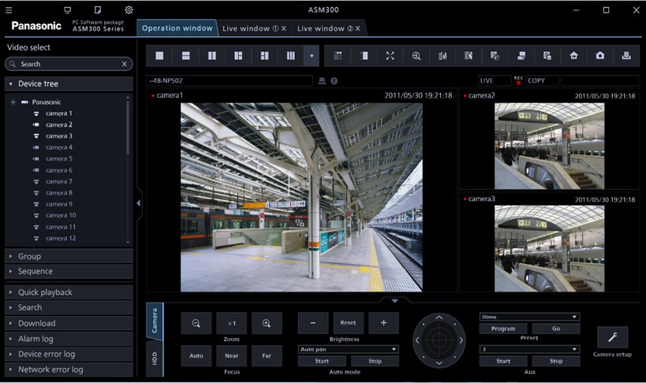

Concept
(1) Easy Installation
Set up whole system with one operation
  - Camera & NVR detection, registration, recording setting
  - Enable to set-up Off-line devices
(2) Smart Operation
New GUI and efficient operation
  - Simple and smooth operation
  - Efficient search function with NX series NVR (Thumbnail search)
New GUI (Flat & Simple)
(3) Remote & Secure
Multi stream recording and playback
  - Achieve narrow bandwidth by “multi-stream control” .
High secure communication in remote surveillance
  - Data communication encryption, Enhanced user PW rule
WV-ASM300 is i-PRO Central Management software to setup and operate connected devices such as cameras and recorders

Slide 6
Product Lineup
Model Name | Product Name | Outline
WV-ASM300(W) (WV-ASM300R, WV-ASM300CH) | Video Surveillance Software | Product + license
WV-ASM300UG(W) | Upgrade Software | Upgrade license (Only) from ASM200 to ASM300
WV-ASE306(W) * | Extension Software | VI Server option
WV-ASE202/203/204/ 205/231/(W) | Extension Software | Same option as ASM200 Function of ASE201 is already included in ASM200 software
WJ-NXC05W | Video Surveillance Software for Concurrent User License | Product + license * Except Japan and China
Optional license of ASM200 such as WV-ASE202, 203, 205, and ASE231 can be used with ASM300 by registering to ASM300 again.
WV-ASM300UG is supplied as Activation Key Card. (ASM300 software must be downloaded separately.)
After launching ASM300 , the software version-up of ASM200 will be terminated except for the repair of the defect.
*Note: There are restrictions, please refer to the “Help” file of ASM300 for the details.

Slide 7
License Scheme
ASE3xx
ASE2xx
Other Extension Software
ASE2xx
Current licenses (ASE20x) are used
as ASM300’s optional licenses.
ASE231
Face Search/Age gender
i-VMD function
ASE231
ASE205
Visibility Enhancement
ASE205
ASE204
Control WV-GXD400
ASE204
ASE203
Expand the max. number of devices
ASE203
ASE202/204
(Trial/90days)
ASE202
64 split screen
ASE202
WJ-NXC05W
ASE201
MAP/Live monitor
WV-CU950 controller
ASM300
ASM300
(Trial/90days)
ASE201
ASM300CL
(No extension license is supported)
ASE201
ASM200
ASM300UG
(Upgrade)
Buy
License
ASM300
(LITE)
Transfer base and option license from ASM200 to ASM300
by Upgrade license (ASE300UG)
ASE201 is included in
ASM300 base software
Concurrent License
(up to 5 users)
Trial license is
definite period
（Current scheme).
Limited function
(1NVR/16Cameras)
Not including ASE201
*Available Ver.1.30 onward
FirmwareVer.2.0
*For 90-day-trial version, please contact your nearest Panasonic representative. (Certain Country)

Slide 8
Combination of extension software
Single Monitor
Multi Monitor
Single Monitor
Multi Monitor
Max. # of screen is
16 (4x4)
Max. # of screen is
20 (4+16)
Max. # of screen is
64 ( 8x8 )
Max. # of screen is
68 ( 4+64 )
Up to 4 Live Windows and
up to 64(8x8) in a window
Live Window
Selectable Screen mode:
25 screen
36 screen
49 screen
64 screen
MAP Window
MAP Window
+
+
Operation Window
Operation Window
Operation Window
Operation window
Extension Software
WV-ASE202
WV-ASM300
WV-ASM300
Functions

Slide 9
Combination of extension software
Examples of Multiscreen combination ( Max. 68 Display available )
16 x 4 + 4 = 68
64 + 4 = 68
36 + 9 + 4 + 16 = 65
MAP Window
MAP Window
MAP Window
+
+
+
Operation window
Operation window
Operation window
Extension Software
WV-ASE202
Extension Software
WV-ASE202
Extension Software
WV-ASE202
WV-ASM300
WV-ASM300
WV-ASM300

Slide 10
Features
(1) Easy Installation
Set up whole system with one operation
  - Camera & NVR detection, registration, recording setting
  - Enable to set-up Off-line devices
(2) Smart Operation
New GUI and efficient operation
  - Simple and smooth operation
  - Efficient search function with NX400 (Thumbnail search)
(3) Remote & Secure
Multi stream recording and playback
  - Achieve narrow bandwidth by “multi-stream control”.
High secure communication in remote surveillance
  - Data communication encryption, Enhanced user PW rule

Slide 11
Easy Installation
The installer has become one.
Improve installation procedure as simply by changing Database software (Microsoft SQL Server for current ASM200).
  SQL installation which is necessary for ASM200 is no longer needed.

Slide 12
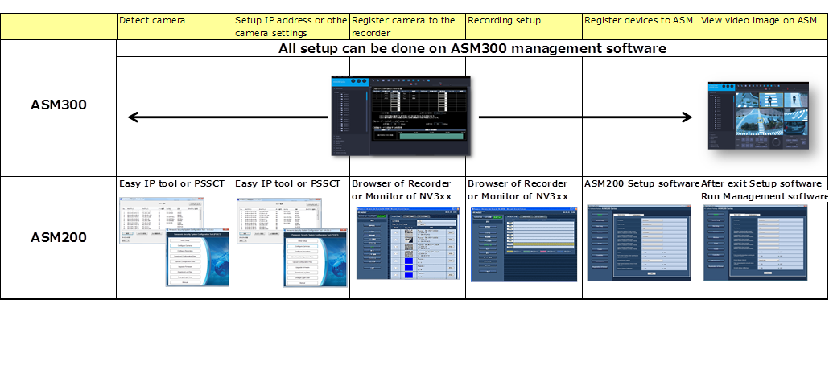
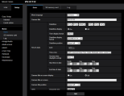
Unified configuration of camera, recorder and ASM300
New ASM300 software enable a whole setting from camera configuration to recorder configuration.
And you don’t need to run Setup software to change the configuration of devices and setting from ASM300.
All setup can be done on ASM300

Slide 13
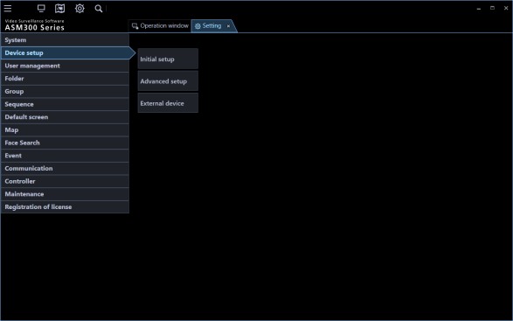
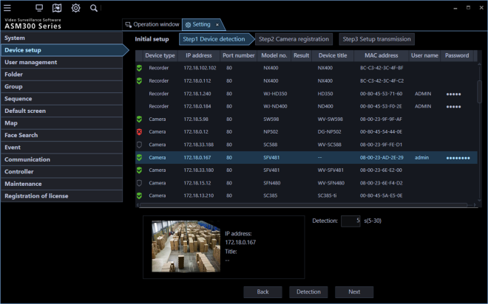
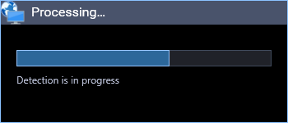
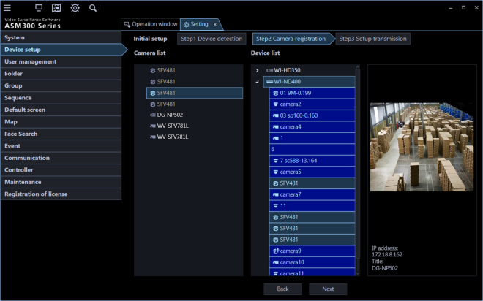
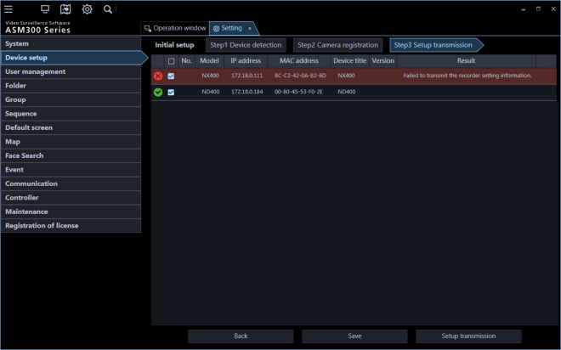
Easy installation; Setting menu (Initial Setup)
These operations are available only in case all devices are online (Connectable)
Select “Initial setup”
from “Device manager” menu
STEP1.
Auto device detection
(Support on-line devices only)
・It automatically detects the devices (Camera and recorder) on the same NW.
・If user ID and password are registered, registration can be done.
The detection progress window will be displayed and detection of devices connected to the network will start.
STEP2.
Register cameras to recorders
Allocate detected cameras to recorders
STEP3.
Send configuration data to devices
Send the setting data to the detected camera and recorder.
Attached picture is an image.

Slide 14
Features
(1) Easy Installation
Set up whole system with one operation
  - Camera & NVR detection, registration, recording setting
  - Enable to set-up Off-line devices
(2) Smart Operation
New GUI and efficient operation
  - Simple and smooth operation
  - Efficient search function with NX400 (Thumbnail search)
(3) Remote & Secure
Multi stream recording and playback
  - Achieve narrow bandwidth by “multi-stream control”.
High secure communication in remote surveillance
  - Data communication encryption, Enhanced user PW rule

Slide 15
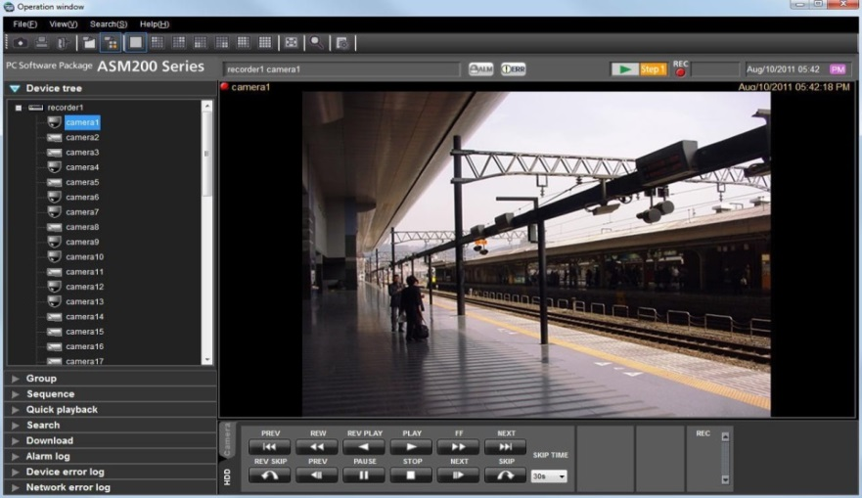
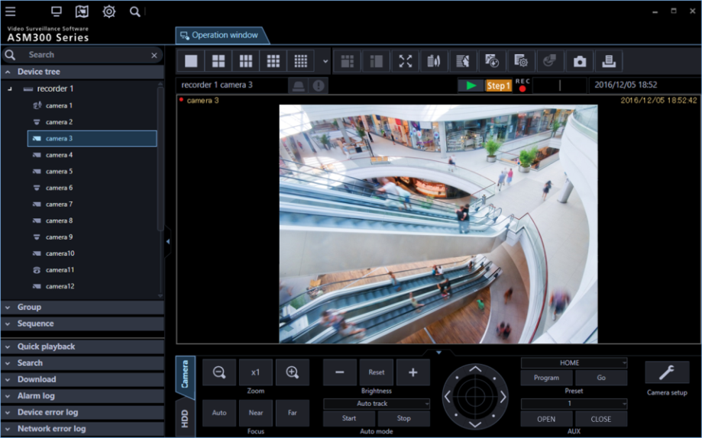
Smart Operation :
Simple & Flat
New GUI
Initial setup and advanced setup of recorder and camera (Necessary system setting can be done by only ASM300)
Integrate operation and setup as one software
Improve setting procedure by checking camera thumbnail (map, group, sequence)
キャプチャ
WV-ASM200
WV-ASM300
* Attached picture is an image.

Slide 16
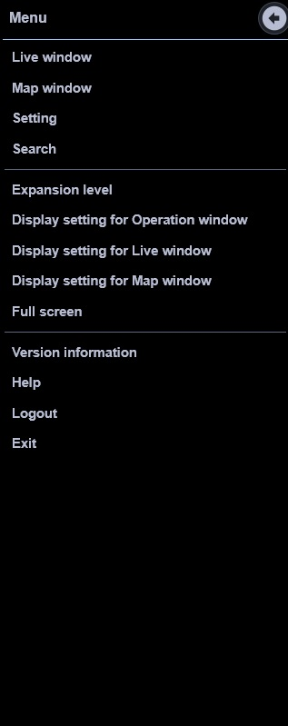

Smart Operation
Menu button：
Start-up of the various tabs and access a part of the traditional menu settings, etc.
Quick access button：
Live monitor, Map monitor, a tab start button for the main function of the setting
Tab window：
Switching the various monitors display in the tab.
Live, Map and Search tab can also be a separate window.
Attached picture is an image.

Slide 17

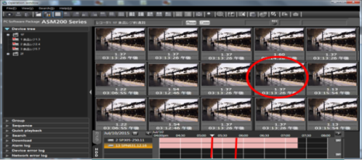
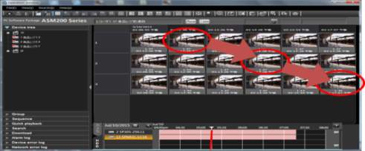


Smart Operation
Easy search and effective download
Thumbnail Search
Easy search to find what happened visually
Download improvement
MP4 direct download from NX series NVR / Queuing download
Thumbnail Search with NX400 and NX200
Download improvement
Thumbnails which relates with specific time are displayed.
- “Quick download” download all displayed channel
- Queuing download
- MP4 direct download from NX series NVR
One channel
Multi channel
MP4
ND400
+
ASM200
n3r
Convert
ND400
Reduce
Time
NX series NVR
+
ASM300
(1)MP4
MP4 (1)
MP4 (2)
NX series NVR
(2)MP4

Slide 18
Features
(1) Easy Installation
Set up whole system with one operation
  - Camera & NVR detection, registration, recording setting
  - Enable to set-up Off-line devices
(2) Smart Operation
New GUI and efficient operation
  - Simple and smooth operation
  - Efficient search function with NX400 (Thumbnail search)
(3) Remote & Secure
Multi stream recording and playback
  - Achieve narrow bandwidth by “multi-stream control”.
High secure communication in remote surveillance
  - Data communication encryption, Enhanced user PW rule

Slide 19





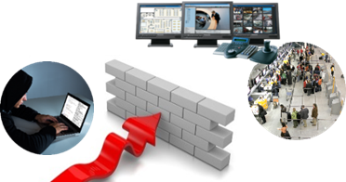
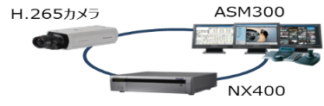
New Features: Dual recording/ Secured data
Support remote monitoring with secured & sub-stream recording
Center
ASM300
ASM300
Dual Recording
- Save higher resolution video for recording
- Use lower resolution for monitoring or multi display
- Lower bandwidth by H.265 compression
and smart coding technology
WAN
Store A
Store B
①
②
VGA
Stream
SXVGA
Download
x4ch
・・・
x4ch
VGA
VGA
Dual Rec/
Streaming
SXVGA(1.2Mbps)
SXVGA(1.2Mbps)
Protect line by SSL
Data encryption
Secured Data
- Secured data by SSL.
- Data encryption.

Slide 20

Secure Communication
 | Symantec certification | AES 256bit Encryption | Secret Sharing Scheme | Supported devices
 |  |  |  | i-PRO System
SSL Communication |  |  |  |  (between camera, NX series NVR and ASM300)
Data encryption | - |  |  |  (between camera and NX series NVR) (between camera and ASM300 *NX series NVR is necessary) (between NX series NVR and ASM300)
Device Certificate (*future function) |  | - | - |  (only between camera and NX series NVR)
Alteration Detection |  | - | - |  (with tool)
Pre-installed certification of Symantec realizes high reliability for SSL communication and high secured device certification
Encryption module of SSL meets FIPS 140-2 Level1, which is U.S. government computer security standard
Encryption of SSL and data encryption support latest “AES-256bit key” strong encryption (usually used 128bit long key)
Continuous Vulnerability Test contributes to find latest security risk and take measure against risk quickly
Panasonic applies secret sharing scheme to save resources of data encryption
When using secure communication function with NX series NVR, optional license will be required.
ASM300 doesn’t have Symantec Certification with software. As a client, ASM300 enable to connect with camera and NX series NVR by SSL communication
As a client, ASM300 also support Data encryption (actually decrypt data from camera) but it is necessary to use NX series NVR together
Alteration detection is available for footage which is saved in SD card and NX series NVR. You can download footage through camera/NX series NVR browser or ASM300. And with check tool*, you can check alteration.
*Footage from NX series NVR: NX viewer, Footage from SD card : Free tool
(Refer to the secure SE document for necessary license)

Slide 21
New function of ASM300
*Device is limited. Please refer another slide
Key points | Function | Version
 | One application (Set up + Operation) | V1.0
 | Easy system setup (Auto detection of camera*/ Recorder*) | V1.0
 | Easy setup of function (Camera*/ Recorder*) | V1.0
 | Setup off-line device* (Reduce configuration work at site) | V1.0
 | Easy download (Quick download and queue download) | V1.0
 | Thumbnail Search (Only used with NX400 and NX200) | V1.0
 | Sub-stream recording (Only used with NX400 and NX200) | V1.0
 | Map enhancement (Map tree / Pop-up static image/ Camera name / Number of camera is as twice as ASM200) | V1.0
 | New GUI design (Simple & effective operation) | V1.0
 | Enhanced secure (Data encryption, SSL, enhanced log-in PW / Auto log out) | V1.0
 | H.265 codec support | V1.0
 | Save UID of NX400 (1 UID for 1 operation PC, camera direct via recorder) | V1.0
Easy
Configuration
Function
Enhancement
Strong
Product

Slide 22
Difference from ASM200
Feature of extension software, WV-ASE201, such as Live Monitor, Map Monitor, System controller CU950, are included in standard software.
Operation manual is changed from “PDF” to “Help file”.
A lot of License variation.
  Free license for 1 recorder and 16 cameras
  Upgrade license for ASM200 license holder
  Concurrent Access license (Up to 5 client) (Ver. 2.0)
ASM300 consume only 1 UID of NX series NVR
  More number of ASM300 can connect with NX series NVR. 1 UID is applied only when live source is set as camera direct in ASM300. When live source is through recorder, consumed UID is as same as ASM200

Slide 23
Additional feature
No | Major item | Secondary item | Outline of the new function
1 | H.265 camera support | H.265 live & decode | Support live of H.265 stream
2 |  | Corridor support | Add new corridor layout (2, 3, 4 images)
3 | H.265 recorder support (NX series NVR) | H.265 playback decode | Support live and playback of H.265 stream
4 |  | Thumbnail search | New thumbnail search function
5 |  | Dual stream Rec. / Play | Playback dual stream recorded on the recorder. (When “Auto” setting, stream 1 is for single screen, stream 2 is for multi-screen.)
6 |  | Extended download unit | Extend the duration of download data (10 minutes → 30 minutes (NX400 is 60 minutes))
7 | Easy setup | System integration settings | The settings for camera and recorder can be set from ASM300. (Equivalent to conventional tool)
8 |  | One application | Enable to switch setup and operation by tab without turn off application
9 |  | Easy setup | Device setup by the Easy Setup (Camera detection, Allocation of camera to recorder and recorder setting)
10 | Secure | Communication encryption | Communication encryption by SSL between the camera and recorder.
11 |  | Enhanced user password | Enhance the strength of the user ID and password, delete the initial PW
12 | Improvement of the window | Tab structure | Tab structure in each set menu of Operation, Live, MAP and Search menu
13 |  | Integrate menu | Create new tab and integrate menu icon
14 | Download | Quick download | The video image can be downloaded during playback by right-clicking the playback image.
15 |  | Continuous download | Continuous download is supported by the queue function. (Conventional mode: Live only possible)
16 | MAP function | MAP tree structure | Necessary map and camera can be selected by tree type menu
17 |  | Installed camera icon | Increase the number of the camera icon in the MAP from 64 to128
18 |  | Still image display | Displaying a still image of the target camera by selecting the camera icon

Slide 24
Additional feature
No | Major item | Secondary item | Outline of the new function
19 | Save UID of NX series NVR |  | 1UID for 1 operation PC (Available only when the live source is a camera)
20 | Number of sequence registration |  | Increased the number of sequence setting from 10 to 20
21 | Improvement of electronic zoom operation for fixed camera |  | Support drag & drop and the wheel zoom to the electronic zoom of the fixed camera
22 | Stream control |  | Camera stream can be selected in right click menu on the Live screen
23 | User management |  | - Add LV0 (Administrator equivalent) authority who enables to configuration system like administrator (Except setting of another LV0 or administrator). - Administrator enables to select accessible
24 | GUI design |  | Re-new of the main screen of the operation and settings. Heat map, Format conversion, Face matching monitor is as conventional.

Slide 25
Specification
PC Monitoring Function | WV-ASM300 | WV-ASM200 | System 970 | IE Browser (Recorder)
Thumbnail search | Yes (with NX series NVR) | No | No | No (only supported on display)
Map Function | YES (No additional license is required) | YES (with ASE201) | YES | N/A
Controller (CU950) | YES (No additional license is required) | YES (with ASE201) | YES | N/A
GXD400 Control | YES (with ASE204) * only H.264 codec | YES (with ASE204) | YES | N/A
Fisheye De-warping | YES | YES | YES | N/A
Timeline Search | YES | YES | YES | N/A
File download | YES (n3r/MP4) * only NX series NVR | YES (n3r) | YES (n3r) | Yes (n3r/MP4)) * only NX series NVR
File converter (n3r->mp4) | Yes | Yes | No | N/A
i-VMD Display | YES (with ASE231) | YES (with ASE231) | YES (with ASE231) | N/A
Face Matching/Search | YES (with ASF900+ASE231) | YES (with ASF900+ASE231) | YES (with ASF900+ASE231) | N/A
Heat map / People Count | YES | YES | N/A | N/A
4K display | Yes (Normal view & cropping view) | Yes (Normal view & cropping view) | Yes (Normal view) | N/A
Visibility Enhancement | YES (with ASE205) | YES (with ASE205) | YES (with ASE903) | N/A
Multiscreen pattern | 1/4/9/16/25/36/49/64 (with ASE202) + Corridor mode | 1/4/9/16/25/36/49/64 (with ASE202) | 1/4/7/9/10/13/16 | 1/4
Max. # of Monitors per PC | 6 (Operation / Map / 4x Live) (with ASE202) | 6 (Operation / Map / 4x Live) (w/ ASE201/202) | 5 (Operation & Map / 4x Live) (w/ ASE902) | 1 (Operation)
Max. # of Live view per PC | 68 (with ASE202) | 68 (with ASE201 + ASE202) | 64 (with ASE902) | 4
License for Client PC | Normal license: 1x ASM200 supports 1x PC Access shared license: up to 5 users (next version up) | 1x ASM200 supports 1x PC | 1x ASM970 supports 64x PC clients | Not Required
OS | Windows 7/8.1/10 *Windows XP, Vista, 8 are not supported. | Windows Vista/7/8/8.1/10 *Windows XP is not supported. | WV-ASC970: Red Hat Enterprise Linux WV-ASM970: Windows XP/Vista/7/8/8.1/10 | Windows Vista/7/8
Alarm Action Programming | 1 action per one alarm but several action can be selected | 1 actions per one alarm | 10 actions per one alarm | Fixed action

Slide 26
PC Specification
 | H.264 Camera | H.265 Camera | 4K Camera
Supported OS* | Microsoft Windows 10 Pro 32 bit/64bit Microsoft Windows 8.1 Pro 32 bit/64bit Microsoft Windows 7 Professional SP1 32 bit/64bit ＊Windows Vista and Windows 8 are not supported. |  | Microsoft Windows 10 Pro 32 bit/64bit Microsoft Windows 8.1 Pro 32 bit/64bit
Computer | IBM PC/AT compatible
CPU | Intel Core i5-6500 or faster, Intel Core i7-6700 or faster | Intel® Core i7-6700 or more
Memory* | 4 GB or more | 8GB or more * Using the dual channel corresponding memory, it is the memory of the same performance and requires the use of in pairs. (Example : In the case of 8 GB, use 2pcs of 4 GB memory)
Required HDD space | 3 GB or more
Monitor | 1280x800 pixels or more (1920x1080 pixels or more recommended for Live monitor), 24bit True color or more (Full color recommended)
Graphic accelerator | VRAM512MB or more, compatible with DirectX9.0c or later |  | NVS510 (using a display port cable)
Network Interface* | 100/1000 Mbps Network interface card must be installed.
Supported Devices | Camera* | Direct | i-PRO series
 |  | via Recorder | i-PRO series
 | Recorder* | NVR | WJ-NX400 series, WJ-NX200 series, NV300 series, NV200 series, ND400 series, ND300 series, ND200 series, Video Insight Server ＊ASR500 is not supported
 |  | DVR | WJ-HD716/616, WJ-HD300A series
 | Encoder |  | WJ-GXE500,GXE100
 | Controller |  | WV-CU950
Max.Devices | Camera | Direct | 256
 |  | via Recorder | 32,000 (ASE203 x 4)
 |  | Via Encoder | 1280 (ASE203 x 4)
 | Recorder |  | 500 (ASE203 x 4)
 | Encoder |  | 320 (ASE203 x 4)
 | Decoder |  | 10 (ASE204)
 | Controller |  | 1
Supported image format |  |  | H.265, H.264, MPEG-4 (i-PRO series), M-JPEG
Max.Screen |  |  | 68 (ASE202)
There are separate restrictions in H.265 format of the use environment.
For restrictions in a variety of other conditions it is equivalent to ASM200.

Slide 27
GUI design
GUI design: Setup screen
- Device setting (Initial setup/Advanced setup)
- Group setting
- Sequence setting
- MAP setting
- User management, others

Slide 28
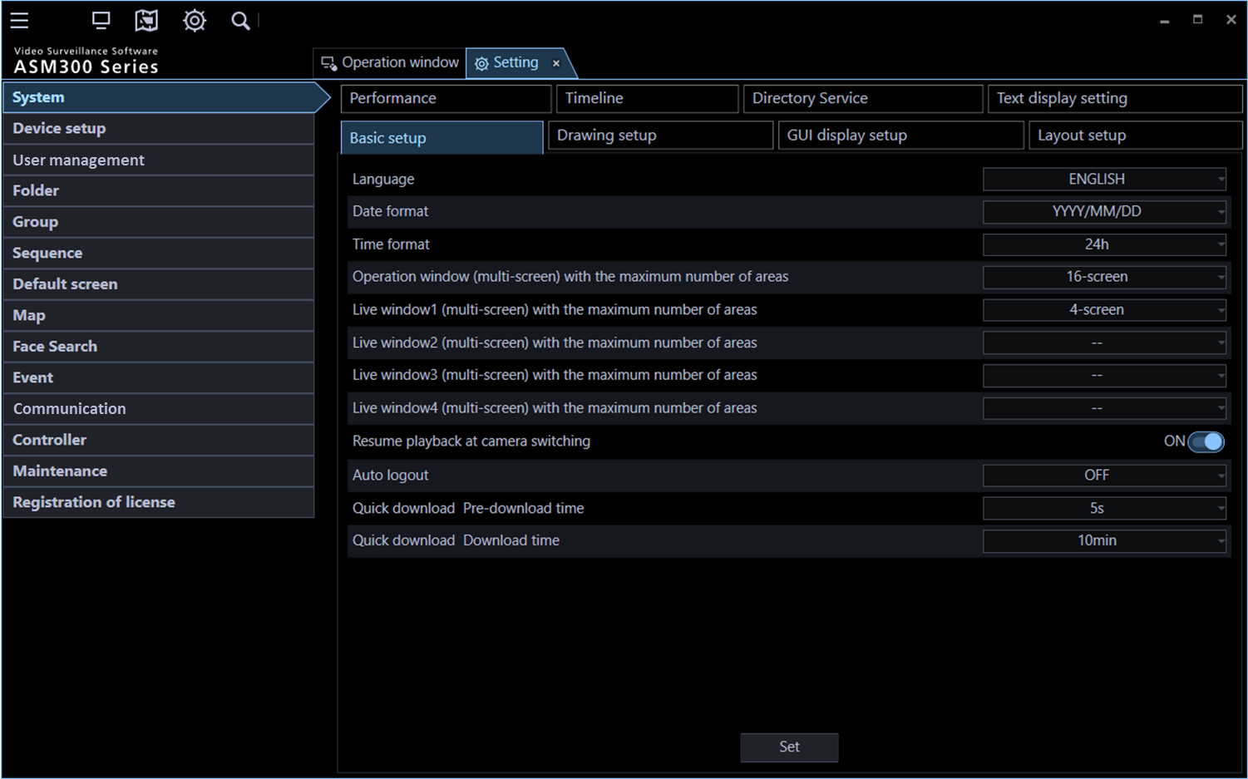
GUI - Setting menu -
Launch the “Setting Tab”
by pressing the "Setting" button from “quick access menu”.
Attached picture is an image.

Slide 29
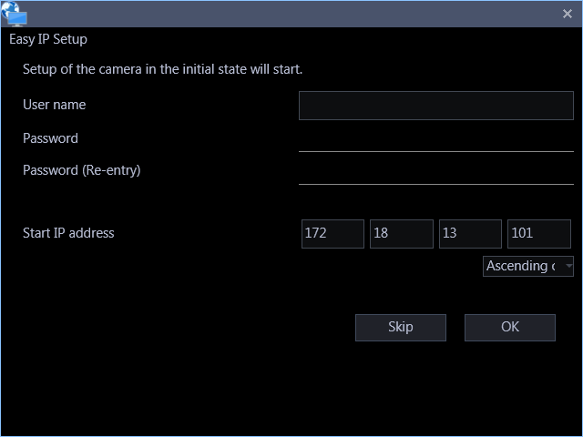
GUI: Easy installation; Setting menu (Initial Setup)
Easy IP Setup window will be displayed if there is a camera for which the initial settings are not yet configured .
Select “Initial setup”
from “Device manager” menu
STEP1.
Auto device detection
(Support on-line devices only)
・It automatically detects the devices (Camera and recorder) on the same NW.
・If user ID and password are registered, registration can be done.
The detection progress window will be displayed and detection of devices connected to the network will start.
STEP2.
Register cameras to recorders
Allocate detected cameras to recorders
STEP3.
Send configuration data to devices
Send the setting data to the detected camera and recorder.
Attached picture is an image.

Slide 30
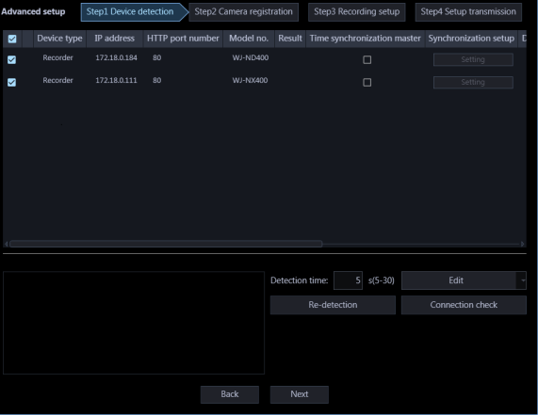
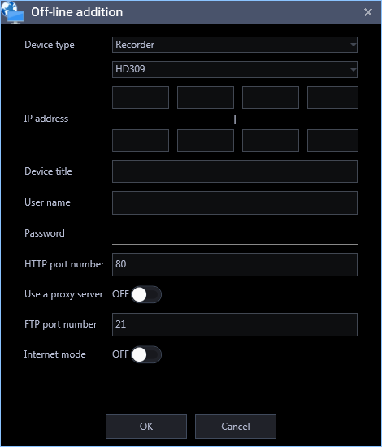
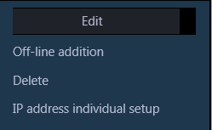
GUI: Setting menu (Advanced setting)
Select the "Advanced" from the device management menu.
STEP1.
Setting for on-line devices
(Auto device detection)
・ Auto-detect the devices (Camera and Recorder) on the same NW.
・ If user ID and password are registered, registration can be done.
Off-line devices can be registered manually.
If user name and password has not been registered yet, registration window will open. This registration is available for only online (This means, connected in same network) device.
・ Click and select [Off-line addition] from the pull-down menu at the lower right of the window.
・ Enter the IP address, Title, user ID and password to the devices (Camera and Recorder)
Attached picture is an image.

Slide 31
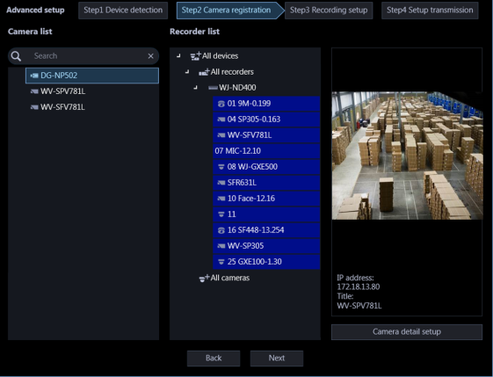
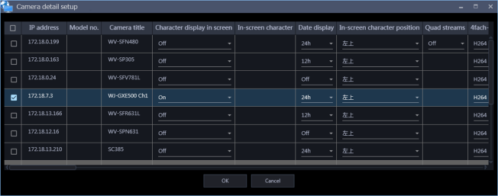
GUI: Setting menu (Advanced setting)
STEP2.
Register cameras to the recorders.
・For the detail setting of cameras, advanced setting is also available in different window.
・In addition, on-line cameras can be checked with the live image on setting window.
Camera advanced setting window
Camera can be set individually or collectively
Setting Items
Setting Item | Bulk Setting | Setting Item | Bulk Setting | Setting Item | Bulk Setting
IP Address |  | Stream (1)(2)(3)(4) resolution | YES | Indicator Display | YES
Model No. |  | Stream (1)/(2)/(3)/(4) maximum bit rate (for burst) | YES | Back light compensation (BLC) | YES
Camera Title |  | Stream (1)/(2)/(3)/(4) control period (for variable bit rate) | YES | Light amount control mode | YES
In-screen character display | YES | Stream (1)/(2)/(3)/(4) bit rate per client | YES | Auto Slow Shutter | YES
In-screen character |  | Refresh Interval | YES | Day & Night (IR/Electrical | YES
Date Display | YES | Installation Method | YES | VMD alarm | YES
In-screen character Display Position | YES | PT Flip ON/OFF | YES | Detection Sensitivity | YES
Quad streams |  | Super Dynamic (SD/WD) | YES | Microphone Sensitivity | YES
Stream (1)(2)(3)(4) transmission mode | YES | Dark area correction | YES
Attached picture is an image.

Slide 32
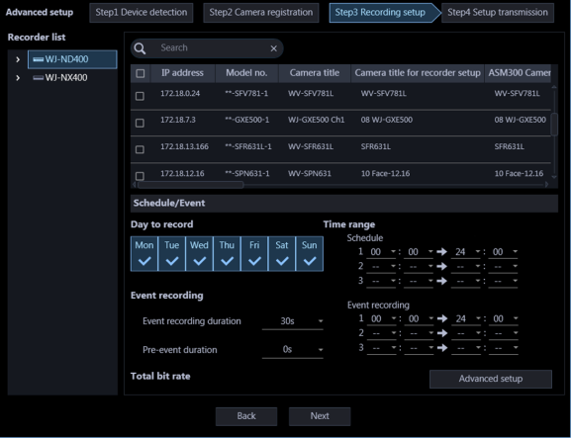
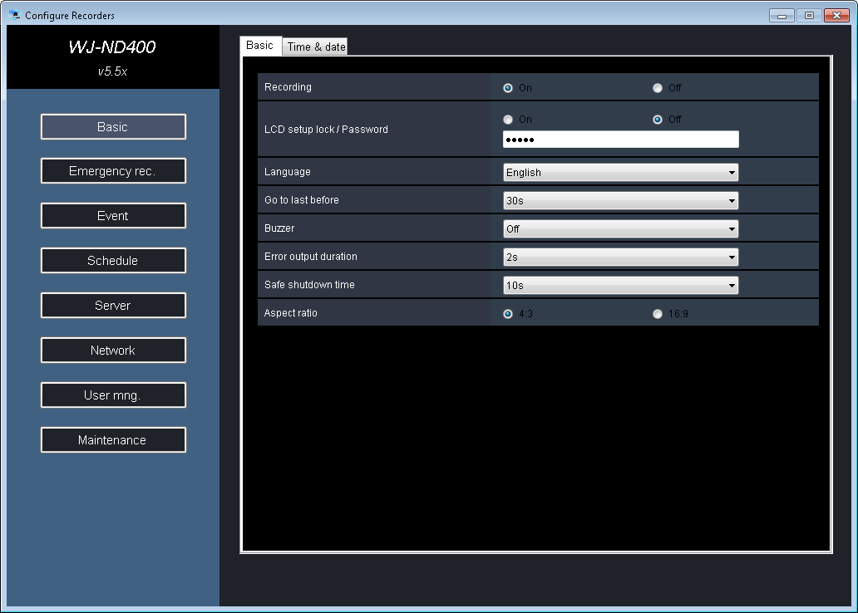
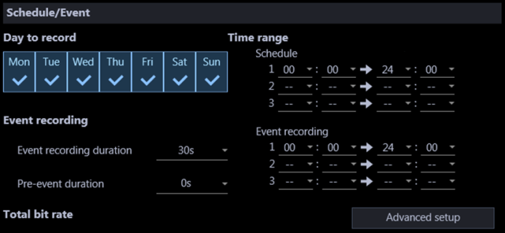
GUI: Setting menu ( Advanced setting)
STEP3.
Recorder setting
・Set up recording setting for camera of STEP2
・For the detail setting of recorders, advanced setting is also available in different window.
(ND400, NV250, NV300 and NX series NVR)
Recorder configuration tool
Launch the recorder configuration tool.
(Available recorder and firmware version is limited)
Recording setting
Enable to configure recording settings for individual recorder
(Only one program is supported)
Attached picture is an image.

Slide 33
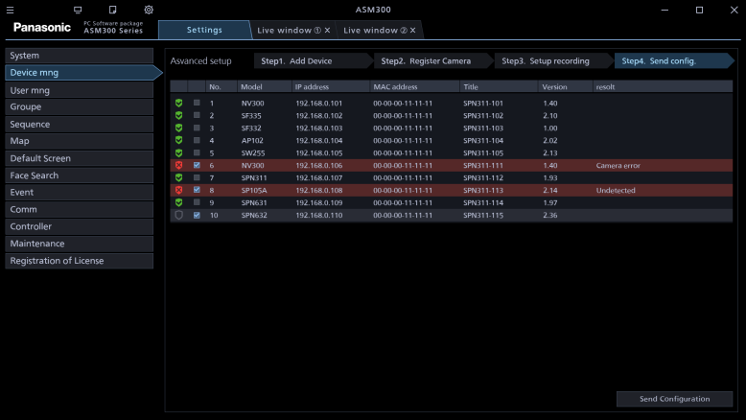
GUI: Setting menu (Advanced setting)
STEP4.
Send configuration data to devices & check status
- It sends the contents set by STEP1~ STEP3 to each devices.
- It is possible to confirm the transmission result.
Attached picture is an image.
Important Notice
There is a restriction by the equipment (Detectable device, device which can be set from ASM300) and the firmware version.
Refer to the next page for the compatible devices.
Compatible firmware will be the latest version firmware as of December 2016.
For conventional firmware version, please setup individually by web browser and PSSCT tool.
In case of setting off-line devices, please use it after confirming the device connection. ASM300 does not recognize connection of each device automatically.
Language, date and time settings are transffered as same as the setting of the ASM300.

Slide 34
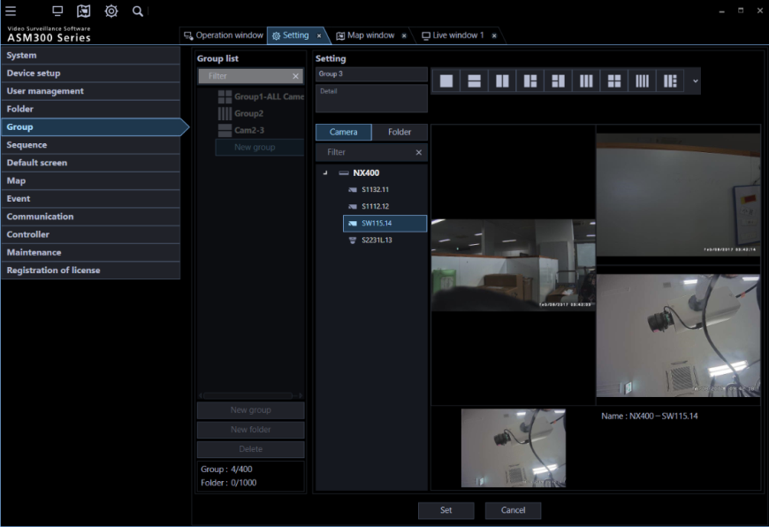
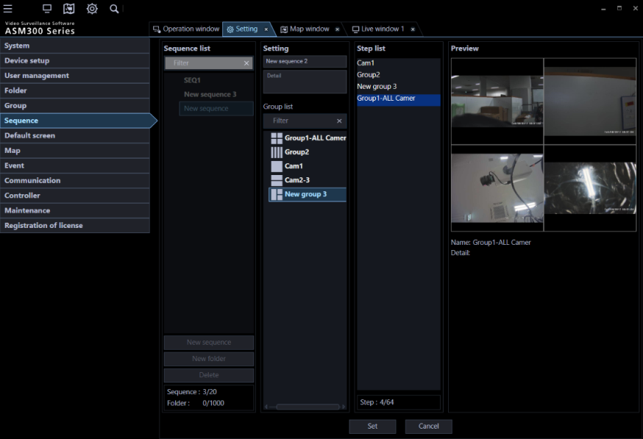
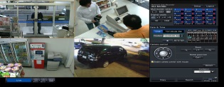


Functional Overview: Group /Sequence setting
[Setting policy] Set up each items from left to right (easy to see setting flow)
Group setting
Sequence setting
3
3
4
1
1
5
4
2
2
6
5
1. Click the "Group" in the left menu.
2. Click the "New Group". "New Group" will be displayed in the “Group list".
3. Enter the group and detail memo.
4. Select a layout that you want to use. Selected layout is displayed.
5. Select the camera from the tree, drag & drop it on the layout
6. Save it by click “Set“.
1. Click the “Sequence" in the left menu
2. Click the "New Sequence". "New Sequence" will be displayed in the “Sequence list".
3. Enter the sequence name, details and its duration
4. Select the camera from the tree, drag & drop it to “Step list”.
5. Save it by click “Set“.
Displayed picture is a sample

Slide 35
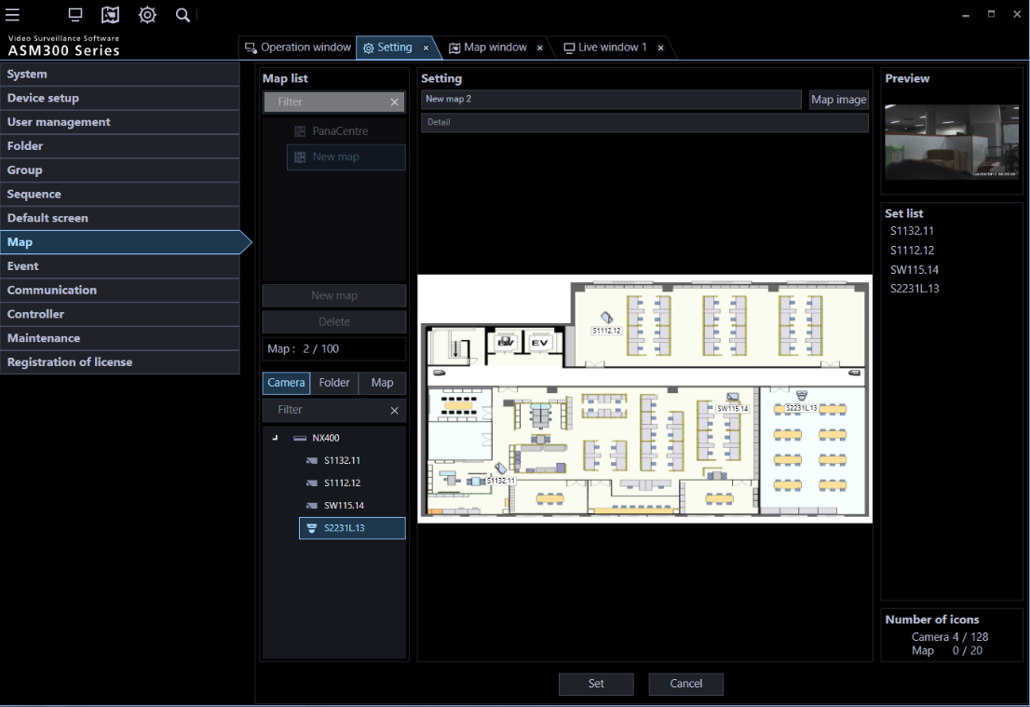
Functional Overview: MAP setting
[Setting policy] Unify the operability in the flow from the left side of the screen toward the right-hand side
MAP setting
1. Click the “map” of the left menu
2. Click the "New Map“ to display new map on the "Map List"
3. Enter the map name and its details, then read the map file
4. Select the camera or map, select the camera from the tree, drag & drop it on the map
5. Save it by click “Set"
3
1
2
4
5
Attached picture is an image.

Slide 36
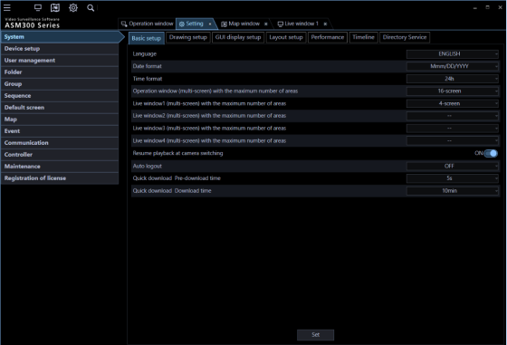
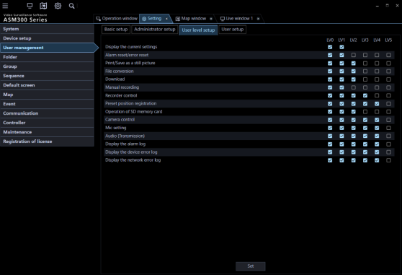
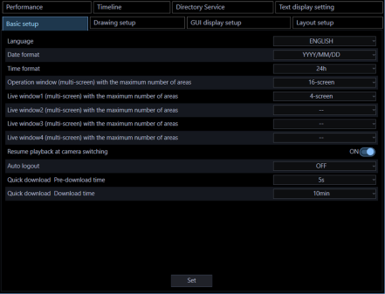
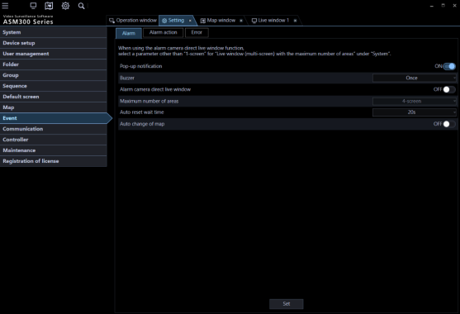
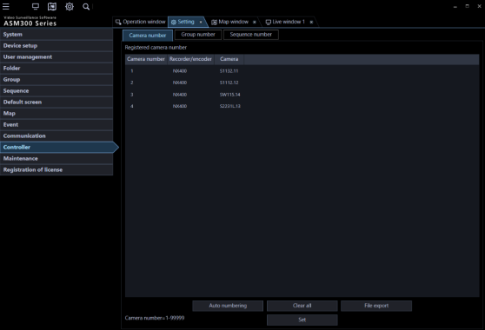
Functional Overview: Other setting items
System setting
User management
Menu is as almost same as ASM200.
New menu is added for new function
“LV0” (setting authority) newly added
Event setting
Other settings
Event action can be defined for each alarm event
Communication settings, controller, maintenance, etc. are the same as ASM200

Slide 37


Functional Overview: Other setting items
Alarm setting is as same as ASM200.
2 Alarm action are newly supported.
- Group display (as same as ASM200)
- PTZ preset (new)
- Buzzer sound(*) (new)
(*) you can select sound source

Slide 38
GUI : Operation screen
Operation screen
- Operation Monitor
- Live Monitor
- Map Monitor
- Thumbnail Search
- Download

Slide 39
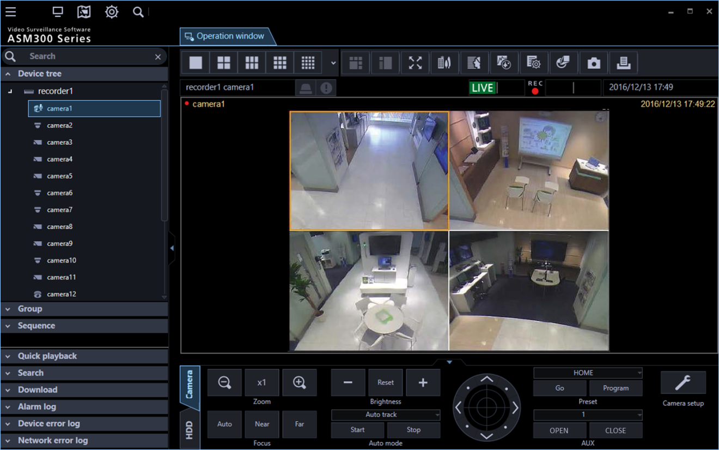
GUI: Operation Monitor
Point
By creating and selecting tab, you can switch setup menu, search, live & Map monitor.
Main operation menu is as same as ASM200.
(Device management menu, camera and recorder operation panel)
Add a device search function in the device management menu panel.
Improved the size and design of the operation panel and button.
Attached picture is an image.

Slide 40
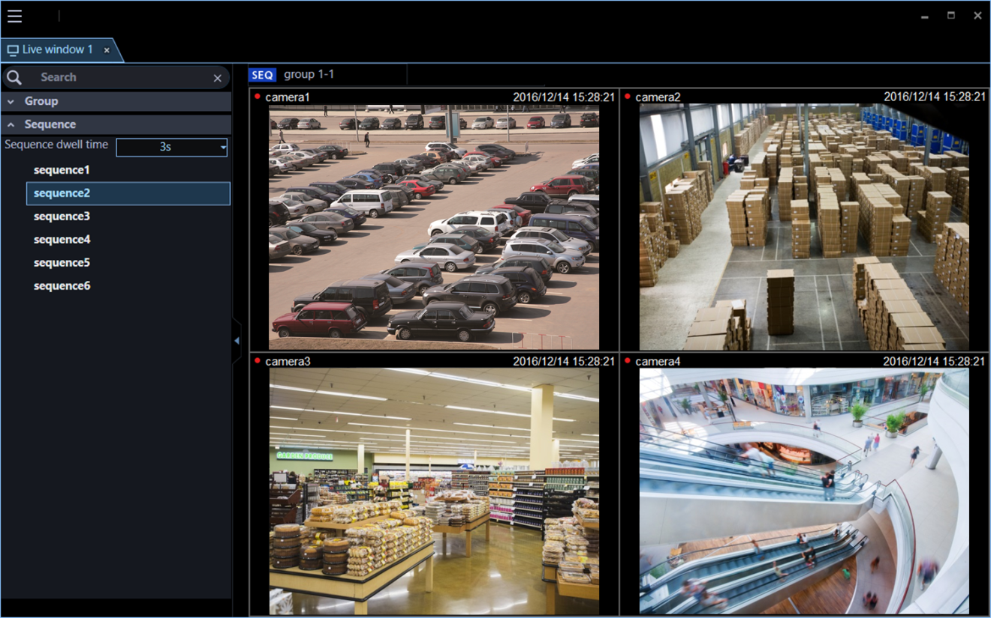
GUI: Live Monitor
Point
Add a group tree and the sequence tree. Simplify the video switching of the live monitor.
Full-screen display or independent monitor is also available as same as
Attached picture is an image.

Slide 41
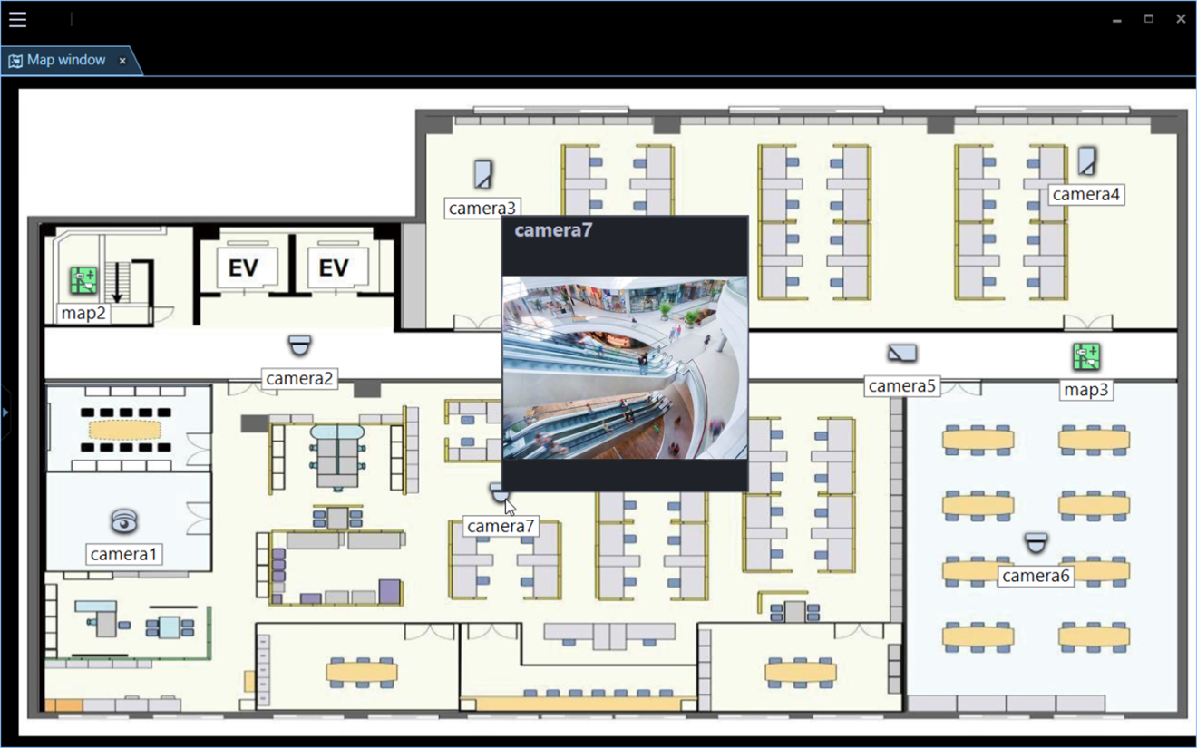
GUI: MAP Monitor
Display the still images at the timing of placing the mouse
Point
Apply tree structure for map and registered camera. You can find camera list of each map.
By selecting the camera icon, a still image of that camera is overlaid.
It increased the maximum number of icons that can be placed on the map from ASM200 (64→128pcs)
Full-screen display or independent monitor is also available as same as ASM200.
Attached picture is an image.

Slide 42
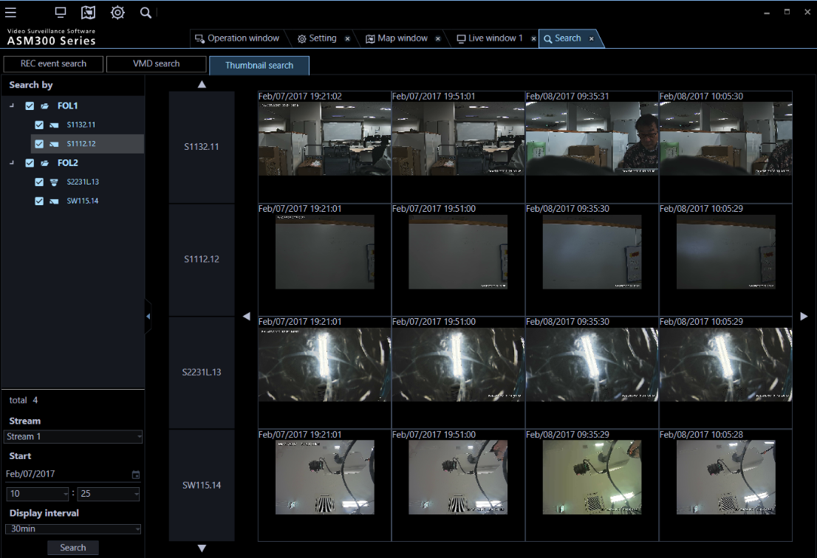
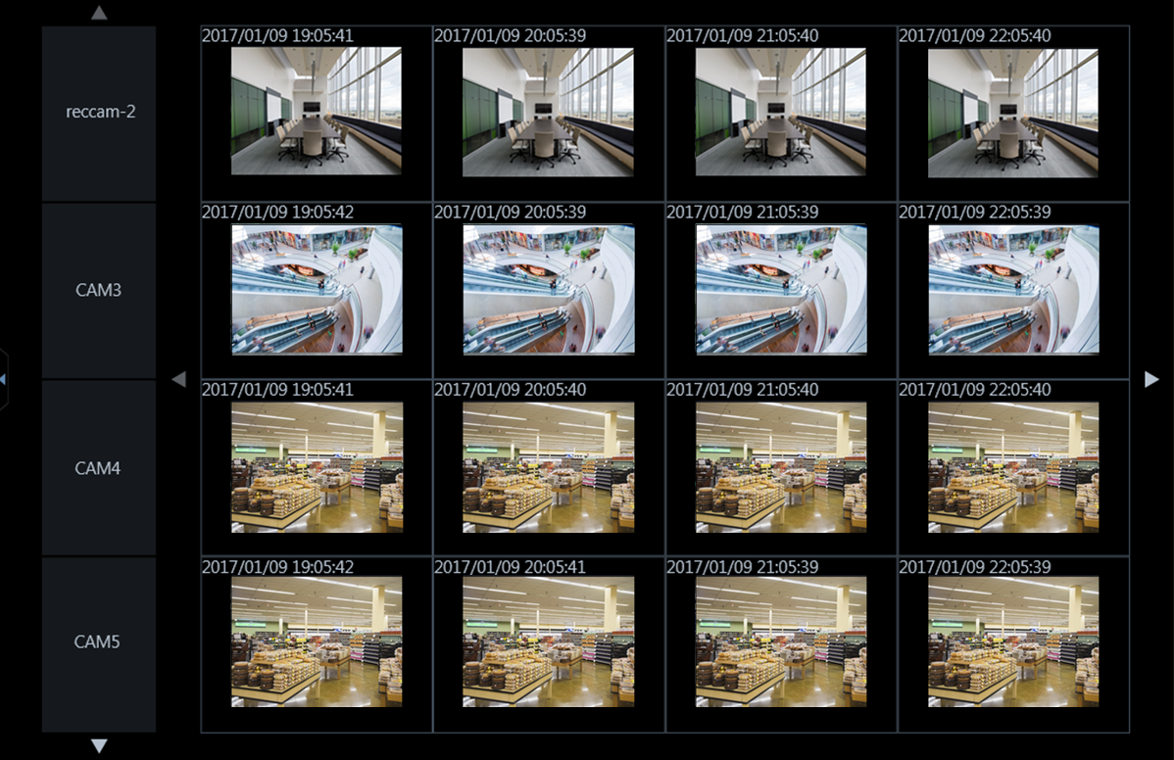

GUI: Thumbnail Search
Point
As an improvement of search performance, a thumbnail of single or multiple camera images can be displayed from the specified time. (1,5,10,15,30, 60min. and 120min.)
Time and date must be selected before search.
Attached picture is an image.

Slide 43
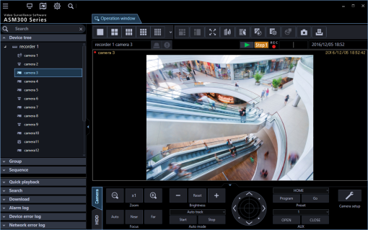
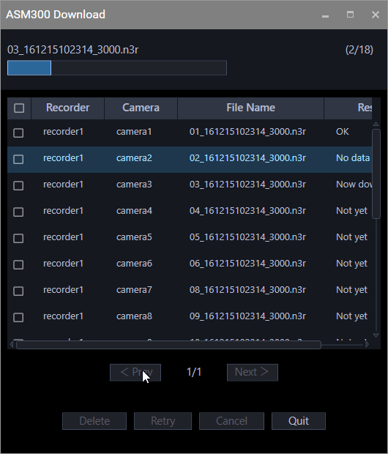
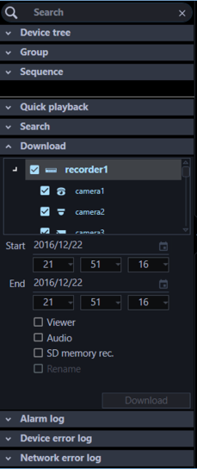
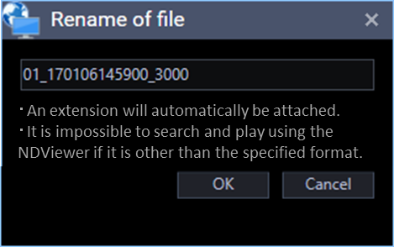
GUI: Download
Point
Queue files to be downloaded
You can download video by right-clicking on the screen during playback. (Download duration (period) has to be set in advance.)
It is possible to save by designating file name for one specified camera.
Continuous (queing) download is possible.
ASM300 can continue download even after ASM300 has closed.
Electronic Zoom
Download
Quick Download
Quick Download (All Images)
…
Quick download during playback
File name can be changed.
Attached picture is an image.

Slide 44
Functional Overview: Compatible Devices
Update
Target Devices |  | Auto Detection | Setting Info Accession | Advanced Setting | IP Add. Change
Recorder | ND400 | - |  |  | -
 | ND300 / ND200 / HD600 / HD300 | - |  | - | -
 | NX400 / NX300 / NX200 |  |  |  | 
 | NV300 |  |  |  | -
 | NV200 |  |  | - | -
Encoder | GXE500 / GXE100 |  |  |  | 
 | NT314 / NT304 | - |  | - | -
Microphone | SMR-10 |  |  |  | 
i-PRO Camera | UniS / S+ (*) / UniS2 / Amba (*) |  |  |  | 
 | H.265 Camera |  |  |  | 
 | Old Camera |  |  | - | -
Other Manufacturer’s Camera (Via Recorder) |  | - |  | - | -
*
Supported Camera
WV-SFN110/SFN130 WV-SFV110/SFV130 WV-SC588A WV-SW598A WV-SW396(396A)/397B(397N) WV-SC387A/SC588 WV-SW598 WV-SW397(397A) WV-SC385/SC386/SC387 WV-SW395(395A) | WV-SFN480 WV-SFV481 WV-SF448/SF438 WV-SW458 WV-SFV781L WV-SFV631L(631LT)/611L WV-SFN611L/SFN531 WV-SFV531 WV-SFR531 WV-SFN310A | WV-SFV310A WV-SFR310A/SFR311A WV-SFN311A WV-SFV311A/SFV311/SFV310 WV-SFN311/SFN310 WV-SFR311 WV-SFR310 WV-SW158/SW155 WV-SSF138/SF135/SF132/SF332 WV-SPV781L | WV-SPW631L/SPW631LT WV-SPW310 WV-SPW611L/SPW611 WV-SPN611/SPN631 WV-SFR631L/SFR611L WV-SPN531/SPN531A WV-SPW531AL WV-PW532L/SPW312L/SPW311AL WV-SPN311A/SPN311 WV-SPN310A/SPN310AV | WV-SPN310V/SPN310 WV-SP105A/SP102 WV-SW115/SW316L BB-SW374/SW175A/SW172A BB-ST165A/ST162A BB-SP104W BB-SC384B/SC382/SC364 | WV-S1131/S1132/S1111/S1112 WV-S1531LN/S1531LTN/S1511LN WV-S2531LN/S2531LTN/S2511LN WV-S2231L/S2211L/S2131L WV-S2111L/S2131/S2110/S2130 WV-X6531N/X6511N WV-S6311/S6130/S6131/S6530N WV-S4150/S4550L/S4550LM WV-X4170/X4171/X4571L/X4571LM

Slide 45

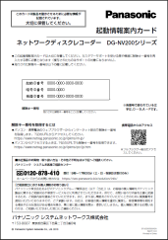
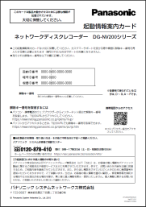
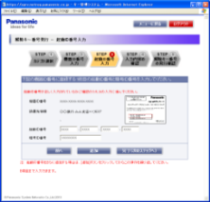
How to upgrade from WV-ASM200
Upgrade license is available for only customer who purchased WV-ASM200.
(Customers who had already issued a “Registration key number" in the key management system)
STEP1
Existing WV-ASM200
Activation Key card
of WV-ASM200
Obtain Registration Key(s) that you want to succeed from ASM200
Obtain New Registration Key from KMS Web
STEP２
NEW Activation Key card
for WV-ASM300UGW
Registration Key obtained at STEP1
Obtain New Registration Key(s) for ASM300
＋
STEP３
Install WV-ASM300
＋
Register Key
obtained at STEP2
Register the license(s)
for ASM300
UG is not permitted unless it is the same PC.
PC replacement is also conditional accepted.

Slide 46
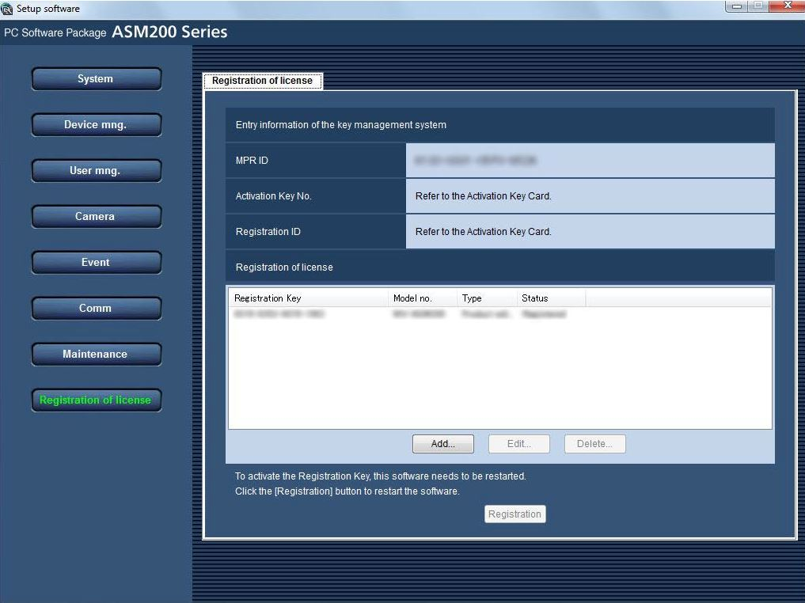
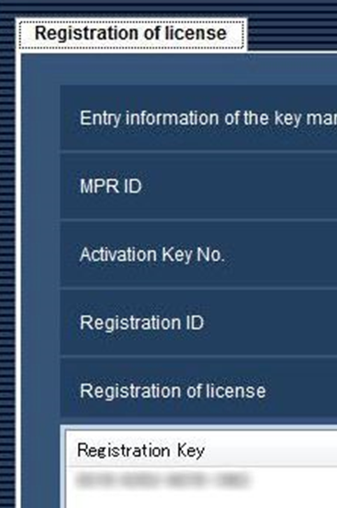
Registration Key No.
Before upgrading to ASM300, please note the registration key number of extended licenses in advance.
Same registration keys can be used after upgrading to ASM300.

Slide 47


How to convert setting data from AS200 to ASM300
1. Acquire setting data (Stedata_xxxx)
2. Install covert tool (DBConvert)
Conversion of setting data (Stedata_xxxx→Convetdate_xxxx)
3. Uninstall ASM200
4. Uninstall SQL Server of ASM200
Note: Better keep setting data of ASM200 just in case.
Note: Available DBCovert tool through the Panasonic Security website.
Note: DO NOT uninstall SQL Server before converting setting data.
ASM200
To obtain registration key, there are differences depends on type of license.
Obtain from KMS (Required ID and Password)
ASM300UG (Upgrade license)
ASM300 (Base)
ASM300 (Lite: Free license)
Access to Panasonic Global Website
http://security.panasonic.com/cgi-bin/security/ipro/download/tbookmarka_m.cgi?mm=2017022111361684
ASM300 (90 days demo license)
1. Install ASM300
2. Obtain registration key from KMS
3. Input registration key
4. Upload setting data (Convetdate_xxxx)
ASM300

Slide 48






How to convert setting data from AS200 to ASM300
Install “DBCONVERT.msi”
Step 2: Check the check box. Push “Next” button.
Step 3: When the installation is completed, the shortcut of “DBConvert" is created on the desktop.
Step 1:
Insert “DBCONVERT.msi” on PC.
“DBCONVERT.msi” is tool that convert ASM 200 setting data to ASM 300.
Start “DBCONVERT.msi” . Push “Next ” button.
When the installation is completed, the shortcut of “DBConvert" is created on the desktop.
Step 4: Push “Next” button.
Step 5: Push “Install” button. Start install this tool.

Slide 49




How to convert setting data from AS200 to ASM300
Convert Setting Data
Step 1:
Start “DBConvert". Push “File” button and select setting data of ASM200.
Step 2:
Push “Destination folder”. File name is displayed in blank space of “ASM300 setup file”.
Step 3: Push “Convert” button. Start “convert”.
Step 4: When conversion is completed, “Done” is displayed

Slide 50





How to convert setting data from AS200 to ASM300
Conversion to ASM300
Step 2: Next, uninstall “Microsoft SQL Server 2012”.
Step 3: Also uninstall the remaining SQL file
Step 1: Open “Programs and Features” of “Control Panel”.
At first, uninstall WV-ASM200.
Step 4: Setup WV-ASM300
Check the check box. Push “Next” button.
Step 5: Registration

Slide 51




How to convert setting data from AS200 to ASM300
Step 6: Input a user name and password.
Step 7: login ASM300
User Name
Password
Step 8: Select “Convertdata_xxx”.
Push “Open” button. The work is complete.
Step 8: Select “Maintenance”. Next, select “Save/Load”. Push “Load…” button.

Slide 52



ASM300 Software Licenses
ASM300 has 4 types of operating mode according to installation.
They are indicated on GUI of ASM300 then user can distinguish the mode.
Indicate operating mode at the upper left
ASM300 Operating GUI
Standard
(Pay)
90 days trial
(Free)
without option
90 days trial
(Free)
with options
Free Version
Limited functions
DEMO
DEMO
LITE
*Free version is distinguished as “LITE”
【Reference】 Free version of BB-HNP17 is named as “Lite”
Standard version: Network Camera Recorder with Viewer Software V4
Free version: Network Camera Recorder with Viewer Software Lite

Slide 53
License Relationship
Firstly, you have to select installation of 90 days demo version or Lite version
You can upgrade production license by purchasing license. However you can’t dispatch demo version and lite version within same PC.
About free “LITE” license
[Functional limitation]
Limited connectivity (1 Recorder and 16 Cameras)
Live monitor, Map monitor, CU950 are not supported
All extension license (Paid or free of charge) is not supported
The product label has a notation that it is a free version.
[Others]
KMS registration is required to use lite license.
Panasonic does not undertake any defect of failure related to the software itself.
When switching from 90 days demo to Free license, the license for Free version is required. And the system will be automatically initialized after the license is registered.
New!!
Ver.1.10 onward, it is possible to switch from 90 days demo to free license.
But opposite way is not supported.
DEMO
LITE
90 days demo
Trial License
WV-ASM300 (/CH)
Free License
(Oversea only)
(1 recorder and 16 cameras)
WV-ASM300 (/CH)
ASE3xx
ASE2xx
ASE202/204
(Trial/90days)
ASE231
ASE205
ASE204
ASE203
Production License
WV-ASM300 (/CH)
WV-ASM30(Japan only)
ASE202
ASE3xx
No extension license is supported
ASE2xx
ASE231
ASE205
ASE204
ASE203
ASE202

Slide 54
Comparison of ASM200/300 functions
 |  | Specification | ASM200 (Paid) | ASM300 (Paid) | ASM300 (90 days Trial) | ASM300 (Free license)
System Configuration | Camera | Std.256／Max.256*5 | 256 | 256 | 256 | 16 (Total of camera direct and via NVR）
 | NVR | Std.100／Max.100*5 | 100 | 100 | 100 | 1 (Cameras are registered at ports from 1ch to 16ch）
 | Encoder | Std.64 | 64 | 64 | 64 | 4 （In case of GXE100, up to 4ch)
 | Microphone | Std.256 | 256 | 256 | 256 | 16
 | User | 32 | 32 | 32 | 32 | 32
Free Extension License | Intelligence app. | Heatmap/People counting for 9M 360deg. Camera | Yes | Yes | Yes | No
 | Housing | PTZ control for MIKAMI Housing | Yes | Yes | Yes | No
 | Dewarp | for 360 degrees camera | Standard | Standard | Standard | Standard
Paid Extension License | ASE201 | Live monitor | Yes | Standard | Standard | No
 |  | MAP monitor
 |  | CU950
 | ASE202 | 4 monitors/64 multi-display | Yes | Yes | Yes | No
 | ASE203 | Additional NVRs | Yes | Yes | No | No
 | ASE204 | GXD400 link | Yes | Yes | Yes | No
 | ASE205 | Visibility Enhancement | Yes | Yes | No | No
 | ASE231 | Face Search | Yes | Yes | No | No
 | ASE232 | POS link （Asis only） | Yes | Yes | No | No
 | ASE306 | VI-Server link | Yes (Unofficial) | Yes | No | No
How to Activate and Register |  | License key No. | Unique key (AK、RegID） | Unique key （AK,RegID) | Common key （Registration Key） | Common key （AK、RegID）
 |  | Need to register to KMS system | Need | Need | No | Need
DEMO
LITE

Slide 55



How to get License / Registration Key
Choose “LITE” or “DEMO”
↓ ↓
ASM300 Software
(Base software)
Install
LITE
DEMO
Get from Global-site or Sale company’s local-site
MPR-ID
[ Lite ] Free License
(Common key number)
Activation Key: xxxx-xxxx-xxxx-xxxx
Registration ID: yyyy-yyyy
KMS
Registration key
SSBD informs AK.-number and Registration ID. (There is no license key card.)
Sales companies study the way to distribute key number.
[ Demo ] 90days demo trial License
(Common key number)
Registration key: xxxx-xxxx-xxxx-xxxx
Registration key
SSBD informs Registration key number only. (There is no license key card.)
Sales companies study the way to distribute key number. (Web or brochure etc)

Slide 56
Firmware version up items (for V1.10)

Slide 57
Firmware Version Up Contents
Firmware version 1.10
The following items are now available with Ver. 1.10 of WV-ASM300
No. | Update contents | Release Date | Version | Note
1 | Support New Network Video Recorder WJ-NX200. | 28th Jun. 2017 | Ver.1.10 | New Product Support
2 | Support V-series camera (WV-Vxxxx series). | 28th Jun. 2017 | Ver.1.10 | New Product Support (Certain country is not available.)
3 | Possible to set image rotation to camera. (0, 90, 180, 270 deg.) | 28th Jun. 2017 | Ver.1.10 | Improvement of Settings
4 | Possible to set on/off for ‘Smart coding (Advanced)’ setting. | 28th Jun. 2017 | Ver.1.10
5 | Possible to show detail explanation by tooltip window for system settings. | 28th Jun. 2017 | Ver.1.10
6 | Improve message for system settings. | 28th Jun. 2017 | Ver.1.10
7 | Fix of the left columns of the equipment setting list. | 28th Jun. 2017 | Ver.1.10 | Improvement of Device Registration
8 | Improve message for initial setup. | 28th Jun. 2017 | Ver.1.10
9 | Support device registration by FQDN (Fully Qualified Domain Name). | 28th Jun. 2017 | Ver.1.10
10 | Support device registration with the same address and different port number. | 28th Jun. 2017 | Ver.1.10
11 | Add “120 min.” as thumbnail search display interval. | 28th Jun. 2017 | Ver.1.10
12 | Possible to convert from n3r(H.265) to mp4(H.264). | 28th Jun. 2017 | Ver.1.10
13 | Possible to show video information on the video image. | 28th Jun. 2017 | Ver.1.10
14 | Allow migration from demo license (90 days) to Free (LITE) license. | 28th Jun. 2017 | Ver.1.10 | Compatibility of License (Certain country is not available.)
15 | Change default setting of the ‘Panasonic logo’ to ON. | 28th Jun. 2017 | Ver.1.10
16 | Improve NTP setting operation. | 28th Jun. 2017 | Ver.1.10
17 | Supports automatic execution of the viewer when CD / DVD is inserted into PC drive. | 28th Jun. 2017 | Ver.1.10

Slide 58
NX200 Support
Firmware version 1.10
No. | Function |  | ASM300
 |  |  | NX400 | NX200
1 | Max. Number of Camera |  | 128 | 32 (PAL) / 16 (NTSC)
2 | Number of UID |  | 16 | 16
3 | Network Microphone (SMR10) |  | NO | NO
4 | Supported Codec |  | MPEG/H.264/H.265 | MPEG/H.264/H.265
5 | Number of Terminal |  | 32 | 9
6 | Operation Window | Camera / Time & Date | YES | YES
 |  | Sound Collection Position | NO | NO
 |  | Display of Cropping Frame | YES | YES
 |  | Frame Display with Face (ASE231 is required) | YES | YES
 |  | Display AVMD Information (ASE231 is required) | YES | YES
 |  | Save a Still Picture | YES | YES
 |  | Print | YES | YES
 |  | Electric Zoom | YES | YES
 |  | Convert Fisheye Images to Single / Quad PTZ Image. | YES | YES

Slide 59
NX200 Support
Firmware version 1.10
No. | Function |  |  | ASM300
 |  |  |  | NX400 | NX200
7 | Initial setup | STEP1 | Device detection | YES | YES
 |  |  | IP address setting | YES | YES
 |  | STEP2 | Camera registration to recorder | 64/128 | 9/12/16/24/32*
 |  | STEP3 | Setup transmission | YES | YES
 | Advanced setup | STEP1 | Device detection | YES | YES
 |  |  | IP address setting | YES | YES
 |  |  | SSL | YES | YES
 |  | STEP2 | Camera registration to recorder (On-line) | 64/128 | 9/12/16/24/32*
 |  |  | Camera registration to recorder (Off-line) | 128 | 32*
 |  | STEP3 | ON/OFF setting of secure function | YES | YES
 |  |  | SSL | YES | YES
 |  | STEP4 | Setup transmission | YES | YES
* NTSC Model: Max.16 camera
PAL Model: Max. 32 camera

Slide 60
V-series Camera Support
Firmware version 1.10
Functional Compatibility: ASM300
i-PRO system & tool and other system (Recorder / VMS / Video Surveillance Software) |  |  | End of Jan. 2017 (ASM300 Ver. 1.00) | End of Mar. 2017 (ASM300 Ver. 1.03) | End of Jun. 2017 (ASM300 Ver. 1.10) | End of 2017 (TBD) (ASM300 Ver. 1.xx)
ASM300 | Codec | MJPEG | - | Y *8 *12 | Y *8 | Y *8
 |  | H.265 | - | - | - | Y *15
 |  | H.264 | - | Y *12 | Y | Y
 |  | Audio | - | Y *3 *9 | Y *3 *9 | Y *3 *9
 | PTZ control |  | - | Y (IR-PTZ) *22 | Y (IR-PTZ) *22 | Y (IR-PTZ) *22
 | VMD search |  | - | - | - | -
 | Camera detail setup |  |  | - | - | Y *15 *19
 | Internet mode (over HTTP) |  | - | - | - | -
 | Video Playback of SD Card, Download |  | - | - | - | -
ASM300 (Recorder registration) | Live image source: Recorder |  | - | Y | Y | Y
 | Live image source: Camera |  | - | - | Y* 7 | Y* 7
ASM300 (Camera direct registration) |  |  | - | - | - | -
Update plan and version up schedule is not fixed. SSBD may change contents without notification

Slide 61
V-series Camera Support
Firmware version 1.10
*1 : Support 640x480,320x240 and 640x360.
*2 : Support 1920x1080,1280x720 and 1280x960. Supported up to 30 ips
*3 : Supported G.726.
*4 : Only zoom and focus from Main monitor.
*5 : Detail compatibility is shown in “Functional compatibility and recorder registration procedure”
http://security.panasonic.com/cgi-bin/security/ipro/download/tbookmarka_m.cgi?m=%20&mm=2016122214473664
*6 : Support Static IP and DHCP. Auto (AutoIP) and Auto (Advanced) are not supported.
Supported Port No is 80, 1025 to 65535. Port No 1 to 79 and 81 to 1024 cannot be set.
*7 : “Time & date” and “REC indicator” are not shown on “Information display area. Only “Camera name” is shown.
*8 : Support “VGA/640x360 and QVGA. Auto is not supported. Supported from 1ips to 30ips for Refresh interval(JPEG). Less than 1ips cannot be selected.
*9 : “Audio output” is not supported. Only “Mic input” can be used.
*10: Latest camera software version as of End of Mar. 2017 :V1330L1, V1330LK, V2530L1, V2530LK, V1170 : Ver2.52, V6430L : Ver2.42(from 1st shipment)
*11: Support only RTP. RTSP and Internet mode are not supported.
*12: Support “Live image source: Recorder”. “Live image source: Camera” is not supported.
*13: Resolution and framerate of MJPEG cannot be changed. It depends on the setting value for Sub stream 1. Supported up to 5 ips
*14: VMD information is not shown
*15: Restrictions is still under study. Will be updated.
*16: Please find a chart of alternative model number
*17: Camera name will shown as SW559/SW558(V series Dome/Box camera) or SPV781L(4K camera)/SW598(IR-PTZ camera)
Please set live source setting “camera direct”.
*18: Enable to calculate with selecting SW559/558 or SPV781L/SW598 and referring bitrate table
*19: Only function that V series camera have
*20: 4K box doesn’t support MJPEG recording with NV300 and NX400 at first release. So you cannot use live stream of security viewer with via recorder
*21: Support 3840x2160, 1920x1080, 1280x720, 2560x1920, 2048x1536 and 1280x960.
*22: Support WV-CU650/WV-CU950
*23: NV200 doesn’t support 4K camera for recording

Slide 62
V-series Camera Support
Firmware version 1.10
Camera Registration by Recorder
As of June 2017, each recorder operates the V-series camera with the following camera model number. (V-series camera does not support H.265 codec)
NV300/NV200/ND400: Operate as formal model number of the V-series camera
NX400/NX200: Operate as alternative model number
Recorder | Supported Camera Model Number
NX400 | Register by using an Alternative Camera model number. WV-V2530LK -> SW559 (with Audio) WV-V1330LK, WV-V1330L1 and WV-V2530L1 -> SW558 (without Audio) WV-V1170 -> SPV781 (4K) WV-V6430L -> SW598 (PTZ)
NX200
NV300/NV200 | Support formal model number of the V-series camera (6 models). Support only H.264 codec
ND400

Slide 63
V-series Camera Support
Firmware version 1.10
Restrictions between ASM300 and the V-series camera
Not compliant with H.265.
Not compatible with Internet mode (Live image source: for camera).
It is assumed that the camera is registered in advance to the recorder. It does not support camera direct connection.
It is not compatible with camera setting change from ASM 300.
When JPEG is used, the video resolution and frame rate can not be specified from ASM. It is necessary to set in the camera browser.
The video stream setting on the camera side needs to be set specific to the V-series camera.
Other Restrictions of the V-series camera
Not compliant with SSL.
SD card can be inserted in camera, but SD function from ASM/Recorder is not supported.
VMD alarm transmission is not supported.
No AUX function.
Not support for ASM Date and Time display.

Slide 64


V-series Camera Support
Firmware version 1.10
Camera Setup of V-series Camera
1. Select “H.264H” or “H.264”.
2. Select “MJPEG.
3. Select “H.264H” or “H.264”.
1. Main Stream: Select “H.264H” or “H.264”.
2. Sub Stream1: Select “MJPEG”.
3. Sub Stream2: Select “H.264H” or “H.264”.

Slide 65



Image Rotation (Corridor mode)
Firmware version 1.10
Possible to set Image Rotation to Camera
Setting Procedure
1. Select the Resolution.
2. Select the Image Rotation.
When the resolution is [16:9], you can select “0” degrees or “180” degrees.
When the resolution is [9:16], you can select “90” degrees or “270” degrees.
■Note:
The default values after selecting resolution are “0” degree and “90” degrees, respectively.
This function works only when the camera has “Image rotation” setting function.

Slide 66


Smart Coding Settings
Firmware version 1.10
Possible to set “ON”/”OFF” for “Smart Coding (Advance)” setting
Add “Smart Coding (Advanced)" setting into the Detailed setting (Step 3 Recording setup).
It is effective only when stream (1) distribution mode is “Frame rate specification“, and compression is "H.265".

Slide 67


Tooltip Window
Firmware version 1.10
Possible to show detail explanation by “Tooltip window” for system setting
Go to [Setting] -> [System] -> [Basic setup]
-> [Description of setup items]
By moving the mouse over the setting button etc. and waiting for about 3 seconds, “Explanation" is displayed on the screen.
It disappears with moving the mouse.
“Description od setup items" is added to the Basic setup. Set it to “ON” to display it. (Default: ON)

Slide 68





Improve Message for System Settings
Firmware version 1.10
Add Message Display when setting is saved.
Add Warning Message when setting screen is moved while setting is not saved.
Click “Set”.
Click other settings.
Click other setting without saving
Shows one of the figures below.
Cancel
or
OK
Shift to the other window.

Slide 69




Equipment Setting List
Firmware version 1.10
Improve the operability of the setting by fixing the left column of the device setting list.
1. Initial setup – STEP 1
2. Advanced setup – STEP 1
Scrollable
Scrollable
Fixed Area
Fixed Area
Scroll Bar
Scroll Bar
3. Advanced setup – STEP 2 Camera detail setup
4. Advanced setup – STEP 3
Scrollable
Fixed Area
Scrollable
Scroll Bar
Fixed Area
Scroll Bar

Slide 70

Improvement for Initial Setup Message
Firmware version 1.10
Add the following message to obtain easier understanding the system situation.
This message will appear right after clicking “Next” button in Step1Device detection.

Slide 71



Device Registration by FQDN
Firmware version 1.10
Support device registration by FQDN (Fully Qualified Domain Name).
Previous Ver.1.03
Ver.1.10
1. Click Pull-down menu and select “Enter IP address”
1. Click Pull-down menu and select “Enter host name”
2. Enter specific Host Name
2. Enter specific IP address

Slide 72

Device Registration Improvement
Firmware version 1.10
Possible to register devices with the same IP address and different port number at “Step1 of Advanced setup”. Device addition in this case is possible only from "Add offline" screen.
Off-line addition
192.168.0.15
8001
192.168.0.15
8002
Enter IP address
Change Port number

Slide 73


Thumbnail Search
Firmware version 1.10
Add “120 min.” as thumbnail search display interval.

Slide 74

File Conversion
Firmware version 1.10
Possible to convert from “n3r (H.265)” to “mp4 (H.264)” or “wmv”.
  “n3r (H.265)” → “mp4 (H.264)”
  “n3r (H.265)” → “wmv”
There is no change on the screen.

Slide 75

Display Video Information
Firmware version 1.10
Possible to display information on the video image, such as “Bit rate”, “Receive frame rate” and “Display frame rate”. This function is aimed to help confirmation of equipment installation and just for a reference value.
Bit rate
* The Font Color can be changed. Please refer to the next slide for more details.
Receive frame rate.
Display frame rate.

Slide 76



Display Video Information
Firmware version 1.10
Displayed Text font color can be selected from 9 colors. (Default color: Orange)
Go to [Setting] -> [System] -> [Drawing setup] -> [Display video information] (Default: “OFF”)
When you change the setting to “ON”,
a confirmation message will be displayed.

Slide 77
License Migration
Firmware version 1.10
Allow migration from 90 days demo license to Free “LITE” license.
Possible to switch from 90 days demo to free “LITE” license.
DEMO
LITE
ASE3xx
90 days demo
Trial License
WV-ASM300 (/CH)
Free License
(1 recorder and 16 cameras)
WV-ASM300 (/CH)
ASE2xx
ASE202/204
(Trial/90days)
ASE231
ASE205
ASE204
ASE203
ASE202
No extension license is supported
ASE3xx
Production License
WV-ASM300 (/CH)
ASE2xx
ASE231
ASE205
ASE204
ASE203
ASE202
NOTE:
All information, including user information and device information, are initialized after moving to Free “LITE” license.

Slide 78


Panasonic Logo
Firmware version 1.10
Change the default setting of the “Panasonic logo” from “OFF” to “ON”. (Default: “ON”)
Go to [Setting] -> [System] -> [GUI display setup] -> [Panasonic logo]
“Panasonic” logo will be always displayed.

Slide 79


Download – Support “Autorun”
Firmware version 1.10
Supports “Autorun” of the viewer with CD-R or DVD-R that you directly wrote using the download function.
This is the behavior when “Viewer” is checked from Download function menu.
Media must be formatted in “UDF” format.
Set the download destination of the file to the root folder of the media.
ASM300 downloads the installer of the viewer when downloading files to rest of CD-R and DVD-R media.
[ASM300 - Download function]
[Viewer image]
Note: Depends on OS settings, the “Autorun” setting may be disabled. Please change to enable it manually as necessary.

Slide 80
Firmware version up items (for V1.20)

Slide 81
Firmware Version Up Contents
Firmware version 1.20
The following items are now available with Ver. 1.20 of WV-ASM300
No. | Update contents | Release Date | Firmware Version | Note
1 | Supports i-PRO Extreme PTZ cameras, model WV-S6131/S6111/S6530N/S6130 | Aug. 2017 | Ver. 1.20
2 | Following NX200 version upgrade (V1.10), enhance the following functions as ASM 300 functions. Supports i-PRO Extreme PTZ cameras, model WV-S6131/S6111/S6530N/S6130 Support 360-degree Network Microphone, model WV-SMR10 Support MP4 download Support AAC audio codec | Aug. 2017 | Ver. 1.20
3 | Following NX400 version upgrade (V1.1), enhance the following functions as ASM 300 functions. Supports i-PRO Extreme PTZ cameras, model WV-S6131/S6111/S6530N/S6130 | Aug. 2017 | Ver. 1.20
4 | Improve device registration | Aug. 2017 | Ver. 1.20
5 | Add setting for ON/OFF of Thumbnail image display on the MAP screen | Aug. 2017 | Ver. 1.20
6 | Add setting for ON/OFF of displaying of the camera icon range on the MAP screen | Aug. 2017 | Ver. 1.20
7 | Change content of message when setting change is saved | Aug. 2017 | Ver. 1.20

Slide 82




Support New Cameras
Firmware version 1.20
Support i-PRO Extreme PTZ cameras, model WV-S6131/S6111/S6530N and WV-S6130.
Outdoor 21x optical zoom
WV-S6530N
40x optical zoom (S6131/S6111)
21x optical wide angle zoom
(S6530N/S6130)
Intelligent Auto
High Sensitivity 0.015lx
Extreme Super Dynamic 144dB
Indoor 40x optical zoom
WV-S6131/S6111
Indoor 21x optical zoom
WV-S6130

Slide 83



Device Registration Improvement
Firmware version 1.20
New menu “Register devices to ASM300” has been added.
Possible to Device Detection and save only the device settings available on the ASM300.
Address:
172.18.0.91:80
Title
SP509
Newly added in “Device setup” menu
Click “Detection” to start available devices detection

Slide 84
Device Registration Improvement
Firmware version 1.20
■Purpose of Device Registration Function
It aims to provide a function that allows you to easily register installed equipment information to ASM 300 when installing ASM300 in an environment where all equipment settings such as camera and recorder are completed. This function should be familiar with people who uses ASM200.
■What the Device Registration Function can do (What is improved from ASM200)
Detect devices on the network (improved)
Register the device individually by input IP address manually
Multiple units can be registered / deleted in ASM300 at the same time. (improved)
Set and change the setting information of ASM300 side of the device registered in ASM300 and the detected device. (Display title, Video compression method, Setting of stream to be used, Video acquisition destination (camera, recorder, etc.))
This function is for only “registration device” on ASM300. Any setting will not be send to the device.

Slide 85

Device Registration Improvement (Menu)
Firmware version 1.20
Possible to check registered / detected devices in the list
Select devices to be registered / deleted at once
Specify an address and detect / register equipment
Detect devices on the network
Display the preview image of the selected camera
Registration of the device selected with the check box can be done collectively
Edit device information of registered / detected devices
Deletion of the device selected with the check box can be done at once

Slide 86


Map monitor improvement : Preview on Map Function
Firmware version 1.20
Camera image preview is displayed by placing the mouse cursor on the camera icon on the map monitor.
It is convenient function to check camera image quickly at map. However it may not be welcome by user who places many camera icon on map and prefers to use map for only “pure physical map”
So after version up, it is possible to stop the preview display by turning OFF the setting.

Slide 87


Map monitor improvement : Camera Border on Map Setting
Firmware version 1.20
ASM300 has a beautiful transparent icon which fits on map with shadow. However, if customer places many icons on same map, map icon will be overlapped. Any guidance is required.
So after version up, it is possible to display a frame on the camera icon for the purpose of assisting not to overlap the icon by bringing camera icons into close contact with each other.
The frame is not always displayed on the map monitor.
Setting: OFF
Setting: ON
No Frame on the camera icon
Frame on the camera icon
By edge as guidance, easy to place icons closely with avoiding overlap
Frame on the camera icon
No Frame on the camera icon

Slide 88

Map monitor improvement : Configuration menu
Firmware version 1.20
Tow additional menu have been added.
Preview on map
Camera border on map setting
Turn ON/OFF of camera preview display on Map screen
Turn ON/OFF of camera icon frame display on Map setting screen

Slide 89

Message Change when saving (improvement)
Firmware version 1.20
The following warning message will be displayed when you press the “Save" button on the setting screen which requires restart.
The message will display which do not reflect immediately items. And guide to reboot operation to reflect setting change. You can easily know which items are necessary to apply change by restart.
The applicable setting items are as follows.
  System: Basic setup
  Face search
  Event movement
  Communication
  Controller
  Maintenance

Slide 90
Firmware version up items (for V1.30)

Slide 91
Firmware Version Up Contents
Firmware version 1.30
The following items are now available with Ver. 1.30 of WV-ASM300
No. | Update contents | Release Date | Firmware Version | Note
1 | Support WV-S4150/S4550L, 5M 360 Fisheye camera | Dec. 2017 | Ver. 1.30
2 | Support new functions that NX series NVR is supported. Support WV-S4150/S4550L, 5M 360 Fisheye camera MP4 download Support AAC Support Network Microphone Support V-series camera (* Certain countries only) | Dec. 2017 | Ver. 1.30 | Related model and firmware version: NX400: Ver.2.00/Ver.2.10, NX300: Ver.1.00 onward NX200: Ver.2.00
3 | Concurrent User License | Dec. 2017 | Ver. 1.30 | Except Japan and China
4 | MP4 download | Dec. 2017 | Ver. 1.30
5 | Support AAC-LD | Dec. 2017 | Ver. 1.30
6 | Support H.265 Hardware Decode | Dec. 2017 | Ver. 1.30
7 | Support Panorama and Double Panorama display | Dec. 2017 | Ver. 1.30

Slide 92
NX400, NX300 and NX200 Support
Firmware version 1.30
No. | Function |  | ASM300
 |  |  | NX400 (Ver.2.00/Ver.2.10) | NX300 (Ver.1.00 onward) | NX200 (Ver.2.00)
1 | Max. Number of Camera |  | 128 | 32 | 32 (PAL) / 16 (NTSC)
2 | Number of UID |  | 16 | 16 | 16
3 | Network Microphone (SMR10) |  | YES | YES | YES (Ver.1.10 onward)
4 | Supported Codec |  | MPEG/H.264/H.265 | MPEG/H.264/H.265 | MPEG/H.264/H.265
5 | Number of Terminal |  | 32 | 16 | 9
6 | Operation Window | Camera / Time & Date | YES | YES | YES
 |  | Sound Collection Position | YES | YES | YES
 |  | Display of Cropping Frame | YES | YES | YES
 |  | Frame Display with Face (ASE231 is required) | YES | YES | YES
 |  | Display AVMD Information (ASE231 is required) | YES | YES | YES
 |  | Save a Still Picture | YES | YES | YES
 |  | Print | YES | YES | YES
 |  | Electric Zoom | YES | YES | YES
 |  | Convert Fisheye Images to Single / Quad PTZ Image. | YES | YES | YES

Slide 93
NX400, NX300 and NX200 Support
Firmware version 1.30
No. | Function |  |  | ASM300
 |  |  |  | NX400 (Ver.2.00/Ver.2.10) | NX300 (Ver.1.00 onward) | NX200 (Ver.2.00)
7 | Initial setup | STEP1 | Device detection | YES | YES | YES
 |  |  | IP address setting | YES | YES | YES
 |  | STEP2 | Camera registration to recorder | 64/128 | 16/24/32 | 9/12/16/24/32*
 |  | STEP3 | Setup transmission | YES | YES | YES
 | Advanced setup | STEP1 | Device detection | YES | YES | YES
 |  |  | IP address setting | YES | YES | YES
 |  |  | SSL | YES | YES | YES
 |  | STEP2 | Camera registration to recorder (On-line) | 64/128 | 16/24/32 | 9/12/16/24/32*
 |  |  | Camera registration to recorder (Off-line) | 128 | 32 | 32*
 |  | STEP3 | ON/OFF setting of secure function | YES | YES | YES
 |  |  | SSL | YES | YES | YES
 |  | STEP4 | Setup transmission | YES | YES | YES
* NTSC Model: Max.16 camera
PAL Model: Max. 32 camera

Slide 94



Support New Cameras
Firmware version 1.30
Support i-PRO Extreme 5M 360-deg. Fisheye cameras, model WV-S4150 and WV-S4550L.
Indoor model
WV-S4150
Outdoor Vandal with IR-LED
WV-S4550L
Good peripheral resolution by stereo projection lens
Improved Wide dynamic Range by 108dB
Built in IR-LED : Max. 10m Reach distance (only WV-S4550L)
Provide best image by “Intelligent Auto (iA)”
Support Various Dewarp mode
Enables to reduce bitrate by H.265 codec and new Smart Coding feature, “Frame rate control”
Provide High secure system by Symantec certificate
Easy Installation and adjustment by New attachment plate

Slide 95



Concurrent User License
Firmware version 1.30
Except Japan and China
Concurrent function gives access right to access the NX series NVR (NX400/NX300 and NX200) from several ASM300.
Up to 4 concurrent license can be registered in 1 NX series NVR.
Up to 5 PC can be used as ASM300 per 1 license.
Possible to access to the NX series NVR from specific ASM300
that is installed in different location.
Concurrent User License Kit No.: WJ-NXC05W
  Total 6 licenses are included (1 for NX series recorder, 5 for ASM)
Up to 5 PC (ASM) can be registered per one license. However, only 1 PC can be accessed out of 5 PCs.
ASM300:1
Accessing
ASM300:2
If several Concurrent licenses are registered, plural ASM300 can access to the NX series NVR at the same time according to a number of registered license. (Max. 4 ASM can be accessed)
Example:
1 license = 1x ASM300 out of 5x ASM300
2 licenses = 2x ASM300 out of 10x ASM300
3 licenses = 3x ASM300 out of 15x ASM300
4 licenses = 4x ASM300 out of 20x ASM300
NX series NVR
ASM300:3
ASM300:4
Concurrent License
Up to 4 licenses can be registered.
ASM300:5
* Please refer to the Operating Instructions (help file) of WV-ASM300 for more details.

Slide 96


Concurrent User License (Registration)
Firmware version 1.30
Except Japan and China
Enter the Registration Key that is issued from KMS.
Execute ASM300
Click “Registration”
Enter the Registration Key

Slide 97

Concurrent User License (Initial Login)
Firmware version 1.30
Except Japan and China
Only "local login (setting screen)" can be selected when using for the first time.
Only "ASM 300 administrator" can login (activate) "Local login (setting screen)".
Register the recorder to be licensed on the setting screen.
Newly added from Ver.1.30
* Display when registering by registration key of the Concurrent User License

Slide 98


Concurrent User License (Operation)
Firmware version 1.30
Except Japan and China
Select CL server which is NX series NVR
CL server settings is required in advance.
How to change the setting screen of the CAL server
  Enter the administrator user name and password.
  Select the local login (setting screen). * For the first time local login is displayed in pull down menu.
  Click “OK” to display the CL server setting screen.
Local Login
Display Concurrent setting screen in modal window.

Slide 99

Concurrent User License (Recorder setup)
Firmware version 1.30
Except Japan and China
Edit and delete license server (NX series NVR) can be made on “License recorder setup” menu.
Available Setup
Recorder setup:
Register CAL server
Communication:
Proxy server setting settings
Registration of license:
License registration screen

Slide 100


Concurrent User License (License Registration)
Firmware version 1.30
Except Japan and China
Up to 5 ASM300 can be registered to the license server (NX series NVR).
1. Input necessary information, such as “Address”, “User name”, “Password”, “Port number” and “Use a proxy server” of the license server.
Important:
Default Port number (SSL) to communicate between the license server is “443”.
It is possible to enter a number among 1 to 65535.
3. When download of the device information is successfully completed. The confirmation window will be displayed. Then click the “OK” button.
2. Click “Download of device information”. Device information will be downloaded based on entered settings.
Note:
When download of the device information is failed, confirm the content of the message indicated in window.
Check if the entered device information is correct. When the information has been edited correctly, the connected device or the version of the connected device may not be compatible with this software.

Slide 101


Concurrent User License (Login)
Firmware version 1.30
Except Japan and China
After license recorder registration is completed, the following login window will be displayed when executing the ASM300 software.
The operation window will be displayed when the acquisition of the license is completed.
1. Input “User name” and “Password”.
2. Select specific license recorder.
NX400 (192.168.0.250)
Important:
To use this software, constant connection between the PC and the license recorder is required.
If the connection is disconnected, the login window will be displayed again. It is required login again.
3. Click “OK” to login
Note:
The system is confirming access right between the PC and the license recorder every 30 sec..
If it can not connect certain number of times (5 times), it display a message, ends the application, and returns to the login screen.

Slide 102
Concurrent User License (Restrictions / License Migration)
Firmware version 1.30
Except Japan and China
Restriction:
When registering the Concurrent User License, it can not be registered licenses other than Heat map license. (ASE202 / ASE203 / ASE205 / ASE231 / ASE232 and ASE251)
License Migration:
ASM300
ASM300UG
* 1: Deactivate optional demonstration license other than heat map, initialize setting data.
* 2: Same as the transition from Demo to LITE. (Initialization of license and setting data)
YES
YES *1
YES *2
ASM300
90 days demo
Trial License
ASM300
Concurrent User License
ASM300
LITE (Free license)
YES

Slide 103





Failover Function
Firmware version 1.30
The recorder NX400, firmware version 2.00 supports Failover function.
ASM300 Version 1.30 also support this function. Possible to recognize condition of the slave recorder and display message after failover is made.
The license is required and the settings of the failover function are made for the slave recorder only.
ASM300
Switch
Failover Operation
The slave recorder monitors the state of each master recorder.
If the master recorder has an error, the slave recorder stops operation of the master recorder.
The slave recorder substitutes for the master recorder whose operation has been suspended and starts recording as the master recorder.

Slide 104

Failover - GUI image (Registration)
Firmware version 1.30
When registering as a slave recorder, icon will be displayed.

Slide 105



Failover - GUI image (On monitoring)
Firmware version 1.30
This is slave recorder.
During monitoring, icon will be displayed to recognize its condition.
Camera Live which is registered in the slave recorder image will not be displayed.
This is master recorder with normal operation.
Icon Information
On monitoring | Not monitoring *
* Due to system in trouble

Slide 106




Failover - GUI image (After switching)
Firmware version 1.30
The slave recorder becomes as a master recorder.
Under alternative operation, icon will be displayed to recognize its condition.
After re-acquiring the device information, icon will disappear.
The recorder in trouble. (Ex-master recorder)
Icon Information
On operating | Not operating *
The following message will display.
“Please re-acquire the device information of the master recorder.”
* Due to system in trouble

Slide 107


Support Hardware Decode
Firmware version 1.30
Go to [ Setting ] => [ System ] => [ Drawing setup ] => [ Decoding method (H.265) ]
Required PC Specification
CPU: Intel Core i7-6700 (Skylake) or later
OS: Windows 10
Click “Diag.” button to confirm whether your PC is suitable for Hardware Decoding.
If the PC specification is not suitable for Hardware decoding, the following message will be displayed.

Slide 108





Support Hardware Decode (Available case)
Firmware version 1.30
In order to use the H.265 hardware decoder, the PC (Built-in (on board) Display Port) and the display must be connected.
For the Built-in Display Port, it does not matter HDMI or Display Port interface, etc..
Connect PC (Built-in Display Port) and Monitor
H.265 hardware decoder can be used in combination with an built-in display Port and expansion graphic board.
The H.265 H/W encoder can be used even by connecting a monitor connected to the extension graphic board to the PC built-in display port, instead of connecting a monitor in left figure.
Extension Graphic Board
(NVIDIA NVS 510)
Connect PC (Built-in Display Port) and Monitor
Note: Impossible to use the H.265 hardware decoder when the display is connected only with the extension graphic board.

Slide 109







Support Panorama and Double Panorama
Firmware version 1.30
Ver.1.20 supports [ Fisheye ], [ Single PTZ ] and [ Quad PTZ ] display.
Ver.1.30 also support [ Panorama ] and [ Double Panorama ] display in addition.
1. Fisheye
Displayed without performing distortion correction as a fisheye image. (2192x2192 to 320x180 selectable)
2. Single PTZ
Display one specified area with electronic PTZ. Position of area to be displayed can be specified. (1600x1200~QVGA selectable)
3. Quad PTZ
Display the specified 4 areas with electronic PTZ. Position of 4 areas to be displayed can be specified. Distributed as 2 x 2 divided 1 image. (1600x1200～QVGA selectable)
4. Panorama
Displayed with distortion correction performed on the 180° horizontal angle view part of the center of a fisheye image. (1920x1080 to 320x180 selectable)
5. Double Panorama
Displayed with distortion correction performed on a 180° image for half of a fisheye image. (1920x1080 to 320x180 selectable)
ASM300 Ver.1.30 does support not only [ Fisheye ], [ Single PTZ ] and [ Quad PTZ ] display, but also [ Panorama ] and [ Double Panorama ] display.

Slide 110
Support Panorama and Double Panorama
Update
Firmware version 1.30
This contents are updated in Ver. 1.40.
Please refer to Ver.1.40.
The followings are available operation for the Panorama / Double Panorama mode.
 | Panorama | Double Panorama
Rotation | YES | YES
Click and Centering | NO | YES
Wheel Zoom | NO *1 | NO *2
Drag and Zoom | NO *1 | NO *2
*1 PTZ operation can not be performed because Panorama can not change the cutout position.
*2 Double panorama can not be zoomed because cutting position can not be changed.

Slide 111


Support Panorama and Double Panorama
Firmware version 1.30
Go to [ Setting ] => [ System ] => [ Drawing setup ] -> [ Fisheye display mode (Fisheye camera)]
Or right click on the image, then go to [Fisheye display menu ]
Selectable Dewarp mode
Fisheye
Single PTZ
Quad PTZ
Panorama
Double Panorama
Right click on the image, the select “Fisheye display menu”

Slide 112
Support Panorama and Double Panorama
Update
Firmware version 1.30
This contents are updated in Ver. 1.40.
Please refer to Ver.1.40.
Restriction:
When Panorama / Double Panorama is displayed, thinning display is performed at the maximum display frame rate shown in below. (Thinning display will be done for text in red.)
Image Capture mode | Resolution | Dewarp mode
 |  | Fisheye | Single PTZ | Quad PTZ | Panorama | Double Panorama
9M | 2992x2992 | 15 | 15 | 15 | 15→7.5 | 15→7.5
8M | 2816x2816 | 7.5 | 7.5 | 7.5 | 7.5 | 7.5
5M (Extreme series) | 2192x2192 | 30 | 30 | 30 | 30→15 | 30→15
4M | 2048x2048 | 30 | 30 | 30 | 30→15 | 30→15
9M | 1280x1280 | 30 | 30 | 30 | 30 | 301.3
8M | 1280x1280
5M | 1280x1280
4M | 1280x1280
1.3M /3M | 1280x960 | 30 | 30 | 30 | 30 | 30
Note: "30 → 15" means that fisheye images of 30 fps are thinned out at 15 fps and displayed. When receiving fish eye image of 15 fps, display it at 15 fps.
The display of the camera browser can be displayed without thinning out. It is a performance difference due to the difference in implementation method.

Slide 113

Improvement Pan/Tilt Movement
Firmware version 1.30
Pan/Tilt movement operation becomes smoother when the pointer is clicked at the specific potion to change angles.
Supported Dewarp mode
      Single PTZ
      Quad PTZ
      Panorama
      Double Panorama
V1.21 Before
Click on the image
Move instantly
V1.30 onward
Move smoothly like a PTZ camera
Click on the image

Slide 114


Fisheye Control Window (Resize function)
Firmware version 1.30
Freely change the window size of the Fisheye image from 180x180 to 360x360.
Also keep the position and size of the fisheye control and display it next time in the same place.
Min. size: 180x180
Max. size: 360x360

Slide 115

Design change of ID/PW Cell
Firmware version 1.30
To easier recognize of the brank area especially “User name” and “Password”, the background color of the cell has been changed.
Easy to recognize when “User name” and “Password” are empty.

Slide 116


Camera Icon Size of Map Monitor
Firmware version 1.30
Selectable from 5 types of camera icon display size of Map Monitor.
  100% (Default), 70%, 50%, 35% and 25%
Right click at anywhere on the map, “icon size” is displayed, then select suitable size.
100% (Default) | 70% | 50% | 35% | 25%
Note:
The change target is common size for each map. It is not possible to change size for each camera.
Only the camera icon is changed. The size if the map icon is fixed.
The size of the camera name displayed on the map window also changes in conjunction with changing the camera icon size.

Slide 117

GUI Design Change (Registration Information)
Firmware version 1.30
Recognize registered device information at glance.
Display Contents
  Camera
  Recorder
  Encoder
  Microphone
Registered number of device information will be displayed when holding the mouse cursor within the red frame area

Slide 118


GUI Design Change
Firmware version 1.30
Displayed name has been changed from “Model No.” to “Device Title”.
Inputted name in the “Device tile” will be displayed in the Device tree and the Device list instead of Model No.

Slide 119



GUI Design Change
Firmware version 1.30
Selectable whether the arrow mark display from the GUI display setup.
Selectable whether the arrow mark display.
Setting: OFF
Set “Display the panel open/close button” to “OFF”, the arrow mark will not be displayed.
Setting: ON

Slide 120







Design Change (Operation Display behavior)
Firmware version 1.30
Behavior of the operation display has been changed as bellow.
Back to the original size
V1.21 Before
Max.
Full
screen
Back
Back to the Max. size
V1.30 onward
Max.
Full
screen
Back

Slide 121


Support Sleeping Mode
Firmware version 1.30
When the recorder's HDD is sleeping at the start of playback, change the recording status display icon to the sleeping icon until it gets up.
It may take up to 30 seconds for a RAID configuration to get up.
While sleeping, all operations are invalidated.
Sleeping icon is displaying

Slide 122
Support V-series camera
Firmware version 1.30
(Certain country is not available)
The following items have been supported with Ver.1.30.
  Support H.265
  Support formal model number registration with “Initial setup”, “Advanced setup” and “Device setup”
  Possible to register from ASM300 to NX series NVR
    NX400: Ver.2.00 onward, NX300: Ver.1.00 onward, NX200: Ver.1.10 onward
  Possible direct camera registration
Functional Compatibility: ASM300
i-PRO system & tool and other system (Recorder / VMS / Video Surveillance Software) |  |  | End of Jan. 2017 (ASM300 Ver. 1.00) | End of Mar. 2017 (ASM300 Ver. 1.03) | End of Jun. 2017 (ASM300 Ver. 1.10) | End of Dec. 2017 (ASM300 Ver. 1.30)
ASM300 | Codec | MJPEG | - | Y *8 *12 | Y *8 | Y *8
 |  | H.265 | - | - | - | Y *15
 |  | H.264 | - | Y *12 | Y | Y
 |  | Audio | - | Y *3 *9 | Y *3 *9 | Y *3 *9
 | PTZ control |  | - | Y (IR-PTZ) *22 | Y (IR-PTZ) *22 | Y (IR-PTZ) *22
 | VMD search |  | - | - | - | -
 | Camera detail setup |  |  | - | - | Y *15 *19
 | Internet mode (over HTTP) |  | - | - | - | -
 | Video Playback of SD Card, Download |  | - | - | - | -
ASM300 (Recorder registration) | Live image source: Recorder |  | - | Y | Y | Y
 | Live image source: Camera |  | - | - | Y* 7 | Y* 7
ASM300 (Camera direct registration) |  |  | - | - | - | Y

Slide 123
V-series Camera Support
Firmware version 1.30
(Certain country is not available)
*1 : Support 640x480,320x240 and 640x360.
*2 : Support 1920x1080,1280x720 and 1280x960. Supported up to 30 ips
*3 : Supported G.726.
*4 : Only zoom and focus from Main monitor.
*5 : Detail compatibility is shown in “Functional compatibility and recorder registration procedure”
http://security.panasonic.com/cgi-bin/security/ipro/download/tbookmarka_m.cgi?m=%20&mm=2016122214473664
*6 : Support Static IP and DHCP. Auto (AutoIP) and Auto (Advanced) are not supported.
Supported Port No is 80, 1025 to 65535. Port No 1 to 79 and 81 to 1024 cannot be set.
*7 : “Time & date” and “REC indicator” are not shown on “Information display area. Only “Camera name” is shown.
*8 : Support “VGA/640x360 and QVGA. Auto is not supported. Supported from 1ips to 30ips for Refresh interval(JPEG). Less than 1ips cannot be selected.
*9 : “Audio output” is not supported. Only “Mic input” can be used.
*10: Latest camera software version as of End of Mar. 2017 :V1330L1, V1330LK, V2530L1, V2530LK, V1170 : Ver2.52, V6430L : Ver2.42(from 1st shipment)
*11: Support only RTP. RTSP and Internet mode are not supported.
*12: Support “Live image source: Recorder”. “Live image source: Camera” is not supported.
*13: Resolution and framerate of MJPEG cannot be changed. It depends on the setting value for Sub stream 1. Supported up to 5 ips
*14: VMD information is not shown
*15: Restrictions is still under study. Will be updated.
*16: Please find a chart of alternative model number
*17: Camera name will shown as SW559/SW558(V series Dome/Box camera) or SPV781L(4K camera)/SW598(IR-PTZ camera)
Please set live source setting “camera direct”.
*18: Enable to calculate with selecting SW559/558 or SPV781L/SW598 and referring bitrate table
*19: Only function that V series camera have
*20: 4K box doesn’t support MJPEG recording with NV300 and NX400 at first release. So you cannot use live stream of security viewer with via recorder
*21: Support 3840x2160, 1920x1080, 1280x720, 2560x1920, 2048x1536 and 1280x960.
*22: Support WV-CU650/WV-CU950
*23: NV200 doesn’t support 4K camera for recording

Slide 124

Firmware version up items (for V.1.40)
New!

Slide 125

Firmware Version Up Contents
New!
Firmware version 1.40
The following items are now available with Ver. 1.40 of WV-ASM300
No. | Update contents | Release Date | Firmware Version | Note
1 | Support New Camera : 9MP 360 degree camera | Apr.2018 | Ver.1.40 | 9MP: WV-X4170/X4171, X4571L,X4571LM
2 | Support 9MP 360 degree cameras and new authentication method on NX series Recorder NX200/NX300/NX400 Ver.2.20 | Apr.2018 | Ver.1.40 | 9MP: WV-X4170, X4171, X4571L, X4571LM support digest authentication
3 | Support 5MP/9MP 360 degree cameras on NV300,NV250 and ND400 | Apr.2018 | Ver.1.40 | 9MP: WV-X4170, X4171, X4571L, X4571LM 5MP: WV-S4150, S4550L, S4550LM
4 | Improve ASM300 login password complexity specification | Apr.2018 | Ver.1.40
5 | Supports H.265 hardware decoding for 9M 360 degree camera | Apr.2018 | Ver.1.40
6 | Customization of AUX and Preset names | Apr.2018 | Ver.1.40 | Improve GUI
7 | Support electronic zoom of panorama / double panorama display | Apr.2018 | Ver.1.40 | Improve GUI
8 | Adding a warning dialog at “Initial setup“ screen | Apr.2018 | Ver.1.40 | Improve GUI
9 | Change “Drawing setup" tab to “Drawing and audio setup“ tab | Apr.2018 | Ver.1.40 | Improve GUI
10 | Additional message at device detection failure | Apr.2018 | Ver.1.40 | Improve GUI

Slide 126
ASM300 login password complication
New!
Firmware version 1.40
Improve password complexity specification
Purpose:
Adaptation to the demands of the era requiring a more secure environment
A function to change the "password policy" is newly added on the user setting screen. (See next page)
When new installation of ASM 300 V 1.40, apply the new password policy (policy 1).
When upgrading from V 1.3x or earlier or when loading the settings, convention policy (policy 2) is applied.
The registered password can be used as it is even after policy change. New password policy after the policy change is apply from the new user registration and password change.
ASM300 Ver. 1.30 or earlier (Policy2)
ASM300 Ver. 1.40 or later (Pocily1)
To include two or more characters from the followings
(1) Capital letters or lowercase letters of the alphabet
(2) Numbers
(3) Special characters
(~! @ # $% ^ & * () _ + \ |} {] [<>., /? `)
To include three or more characters from the followings
(1) Capital letters of the alphabet
(2) Lowercase letters of the alphabet
(3) Numbers
(4) Special characters
(~! @ # $% ^ & * () _ + \ |} {] [<>., /? `)

Slide 127

ASM300 login password complication
New!
Firmware version 1.40
You can change password policy in "User management“ screen.
Go to “Setting” -> “User management” -> “ Basic setup” -> “Password policy”
Select from the drop-down list.

Slide 128


ASM300 login password complication
New!
Firmware version 1.40
If you change the policy with the setting on the previous page, the following confirmation dialog will be displayed.
Press "OK" to confirm the setting.
Press “OK”
Press “OK”

Slide 129
Support Hardware Decode
Update
Firmware version 1.40
Conditions for use of H.265 H / W decoding
Condition 1: CPU is Intel Core i 7-7700 or faster. (Kaby Lake)
Condition 2: OS is Windows 10 (version 1703, build 15063, Creators Update or later)
Condition 3: The PC built-in display output and display are connected
* The condition that the memory 8 GB (4 GB x 2) is required is the same as the software decode method.

Slide 130
Support Hardware Decode
Update
Firmware version 1.40
Supports H.265 hardware decoding for 9M 360 degree camera compatibility.
When H.265 H / W decoding is required
When displaying fisheye images of 9M resolution at 20 fps or more.
In S / W decoding, delay accumulates, and after several seconds it discards accumulated amount.
Resolution | Frame rate | Bit rate
2992x2992 | 30 fps | 10 Mbps
 | 20 fps | 10 Mbps
 | 15 fps | 8 Mbps
 | … | …
2192x2192 | 30 fps | 6 Mbps
 | 20 fps | 6 Mbps
 | 15fps | 4Mbps
 | … | …
Decode method
Hardware
Hardware
Software
Software
Software
Software
Software
Software
When the resolution is less than 9 M, H / W decoding is unnecessary if the frame rate is 15 fps or less.
However, when setting a high bit rate such as 24 Mbps, H / W decoding is necessary.

Slide 131




Customization of AUX and Preset names
New!
Firmware version 1.40
Different settings can be made for each camera.
The set preset name is not synchronized with the camera. It is applicable only on ASM 300.
(1) Select camera
(2) Right click after selecting the item, click "Edit" menu
Preset name
(3) A dialog for character string editing is displayed
AUX name
Number of characters: 1 to 20 letters
Input restriction: There is no restriction on character types including alphanumeric, Japanese and special characters.

Slide 132
Support Panorama and Double Panorama
Update
Firmware version 1.40
Restriction:
When Panorama / Double Panorama is displayed, thinning display is performed at the maximum display frame rate shown in below. (Thinning display will be done for text in red.)
Table: Display Conversion method and maximum display frame speed
Image Capture mode | Resolution | Dewarp mode
 |  | Fisheye | Single PTZ | Quad PTZ | Panorama | Double Panorama
9M (Extreme series) | 2992x2992 | 30(*1) | 30→15 | 30→15 | 30→7.5 | 30→7.5
9M | 2992x2992 | 15 | 15 | 15 | 15→7.5 | 15→7.5
8M | 2816x2816 | 7.5 | 7.5 | 7.5 | 7.5 | 7.5
5M (Extreme series) | 2192x2192 | 30 | 30 | 30 | 30→15 | 30→15
4M | 2048x2048 | 30 | 30 | 30 | 30→15 | 30→15
9M | 1280x1280 | 30 | 30 | 30 | 30 | 301.3
8M | 1280x1280
5M | 1280x1280
4M | 1280x1280
1.3M /3M | 1280x960 | 30 | 30 | 30 | 30 | 30
Updated!
Note: "30 → 15" means that fisheye images of 30 fps are thinned out at 15 fps and displayed. When receiving fish eye image of 15 fps, display it at 15 fps.
The display of the camera browser can be displayed without thinning out. It is a performance difference due to the difference in implementation method.
(* 1) In order to display at 30 fps, the H.265 hardware decoder is required.

Slide 133


Support Panorama and Double Panorama
Update
Firmware version 1.40
The followings are available operation for the Panorama / Double Panorama mode.
 | Panorama | Double Panorama
Rotation | YES | YES
Click and Centering | NO | YES
Wheel Zoom | YES | YES
Drag and Zoom | YES | YES
Updated!
Supports drag & zoom and wheel zoom

Slide 134

Adding a warning dialog at “Initial setup“ screen
New!
Firmware version 1.40
“Initial setup", one of the device registration functions, always involves changing the setting of the device when executed.
Therefore, in order to prevent unintentional change of the setting of the device, the warning dialog is displayed at the beginning of the “Initial setup“ screen.

Slide 135

“Drawing setup" tab is changed to “Drawing and audio setup"
New!
Firmware version 1.40
Tab name has been changed from “Drawing setup" to “Drawing and audio setup" in order to make it easy to find the “Audio ON / OFF" setting.

Slide 136


Additional message at device detection failure
New!
Firmware version 1.40
Device detection fails if Easy IP setup tool is activated. The following message will be displayed at the time of failure to let you know
図： ダイアログメッセージ（暫定案）

Slide 137
Thank you

