Slide 1
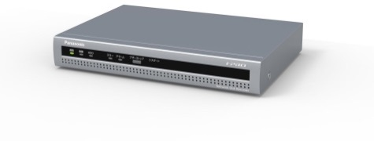
Network Disk Recorder Material for SE
Model: WJ-NX100
Ver.1.30
Sep. 2021

Slide 2
Contents
Product Concept
Key Features
Specification Comparison
Other Specifications
Appearance
Standard Accessories
Optional Accessories
Others

Slide 3
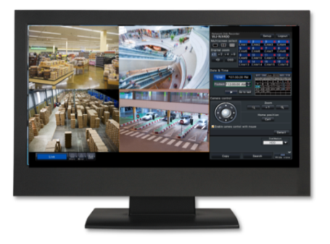


1. Product Concept
i-PRO 4CH-PoE compact recorder realizes the H.265 system with reliability and easy installation
Space saving installation and PoE Switch less connecting
Effective use of space by Vertical installation or Wall mounting
No PoE switch required with 4 PoE ports
Easy Setting
and Operation
Easy Installation/operation
Easy Connecting, Setting and Operation : PC less or with ASM300
Thumbnail Search
High
Compression
Pre-install HDD
Eco-writing
Pre-install HDD and High efficiency data reading/writing
Pre-installed 1x2TB HDD, 1x available slot for 2TB HDD
Eco-writing & Reduced failure occurrence probability
4CH PoE
NX100
NW
H265 High Compression
Significant reduction of storage space usage through H.265 and Smart Coding.
ASM300

Slide 4
2. Key Features
1. Space saving installation and Switch less connecting (PoE)
Effective use of space by Vertical installation or Wall mounting
No switch required with 4 PoE ports
2. Easy Installation/operation
Easy Connecting, Setting and Operation : PC less or with ASM300
Thumbnail Search
3. Pre-installed HDD and High efficiency data reading/writing
Pre-install HDD(2TBx1) ( Up to 4TB will be supported )
Eco-writing & Reduced in failure occurrence probability
4. H265 High Compression
Significant reduction of storage space usage through H.265 and Smart Coding

Slide 5

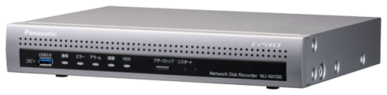
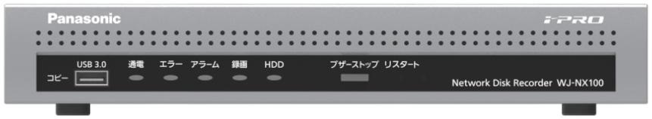
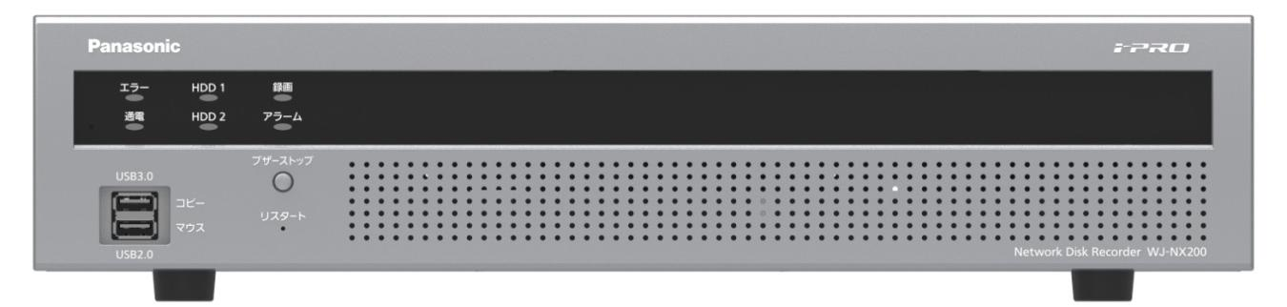
2-1. Space saving installation and Switch less connecting
Easy PoE Connecting (Switch less)
IEEE802.3af compliant
No need for PoE switching hub to connect camera
: Max 4 Cameras
Compact size that enables vertical installation or wall mounting
W(280 mm) x H(44 mm) x D(212 mm)
Can be installed in the backyard of small stores with little space
Vertical installation or wall mounting is possible using WV-Q202 (optional)
WJ-NX100
44mm (1-3/4 inches)
280mm (11-1/32 inches )
WJ-NX200
88mm
(3-7/16inches)
Vertical installation
Wall mounting
420mm (16-9/16 inches)

Slide 6
2. Key Features
1. Space saving installation and Switch less connecting (PoE)
Effective use of space by Vertical installation or Wall mounting
No switch required with 4 PoE ports
2. Easy Installation/operation
Easy Connecting, Setting and Operation : PC less or with ASM300
Thumbnail Search
3. Pre-installed HDD and High efficiency data reading/writing
Pre-install HDD(2TBx1) ( Up to 4TB will be supported )
Eco-writing & Reduced in failure occurrence probability
4. H265 High Compression
Significant reduction of storage space usage through H.265 and Smart Coding

Slide 7
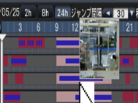
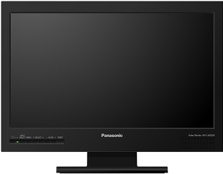
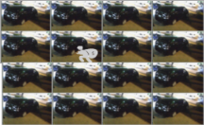


2-2. Easy Installation/operation
■Easy PC-less operation and setting
Easy connecting, setting and operation
Easy search
Easy setting and operation (PC less)
Find changing point by thumbnail display and playback it
setting
NX100
Camera
Easy setting from ASM300
Camera
setting
  Simplified workflow with three steps
  Step 1: Register cam. and change IP
  Step 2: Register cam to NVR
  Step 3: Schedule setting
setting
NX100
ASM300

Slide 8
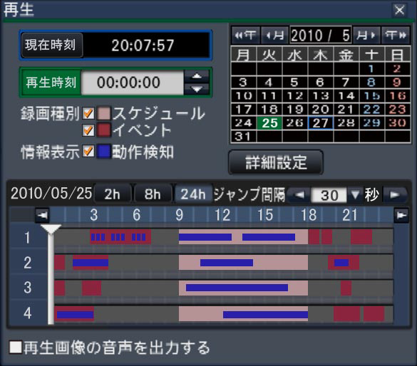
2-2. Easy Installation/operation
■Follow the easy setting procedure and GUI of the NX series
Easy operation such as search/ playback, camera switching/ enlarged display is possible using the supplied mouse
Switch live video with one click on the camera number
Display recorded video by specifying the date and time
Display the motion detection and alarm occurrence on the timeline by clicking the mouse
Support digital zoom(x1 to x8) using the mouse wheel

Slide 9


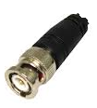
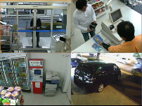
2-2. Easy Installation/operation
Main monitor (HDMI) and analogue sub monitor(PAL/NTSC)
Simultaneous display on both main monitor with 4K resolution and sub monitor
Main monitor
■ Layout of Main monitor and Operation panel
Operation panel
Area
(640x1080)
1-Screen
(4:3)
4-Screen
(4:3
Status display area
Operation panel
Area
(640x1080)
Video output
Main
Status display area
HDMI
Video output
Sub (BNC)
(locally procured)
(locally procured)
Sub monitor(PAL/NTSC)
■Layout of Sub monitor
Only the live images will be displayed
BNC cable (locally procured) is required
1-Screen
4-Screen
1
1 | 2
3 | 4

Slide 10
2-2. Easy Installation/operation
Layout on the main monitor
※ The default camera display positions are as follows:
1-screen (16:9) 4-screen (16:9) 1-screen (4:3) 4-screen (4:3)
3-screen (4:3) 3-screen 4-screen 2-screen
3-screen 4-screen 5-screen 6-screen
7-screen 4-screen (4:3) 4-screen (16:9)
Note : It is possible to change the camera image by dragging & dropping the number of the camera number panel
onto the desired display position.
The position of the camera display can be replaced by the right-click menu on the image.

Slide 11
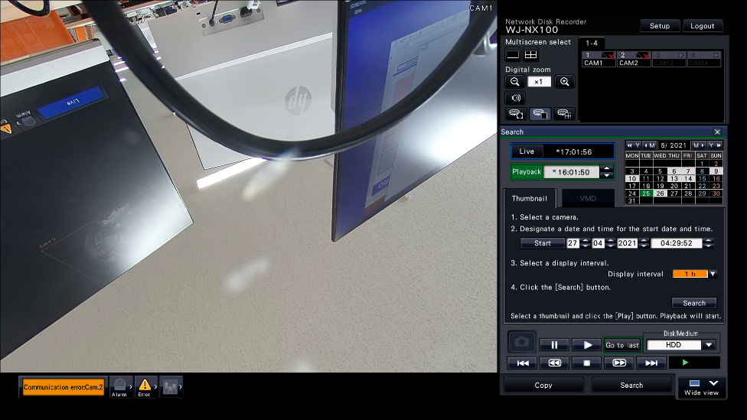
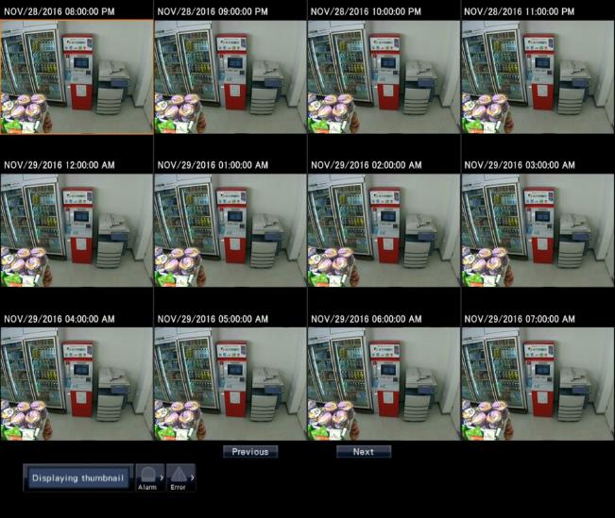
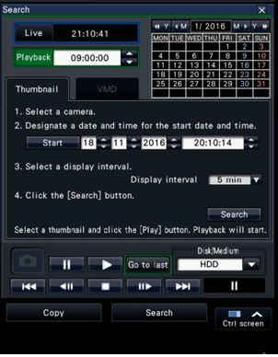
2-2. Easy Installation/operation
Thumbnail search provides to show thumbnails by search operation and makes possible to
playback associate video footage by clicking any thumbnail.
[Note]
You can not use this function from the Browser.
Can’t search with multiple cameras
It is necessary to select start date and time and display interval

Slide 12
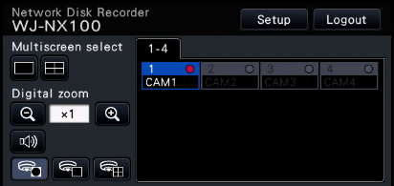



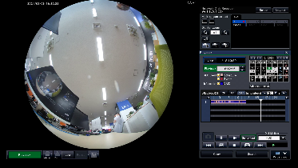
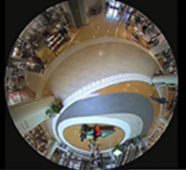
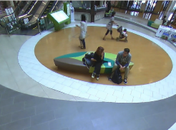
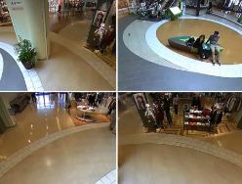
2-2. Easy Installation/operation
■Support correction display of live and recorded fisheye images without a PC
“Fisheye correction display button” appears only when the camera image is displayed on a 1-screen in the control screen
PTZ operation is possible on each split screen
Fisheye display button
1-screen PTZ display button
4-screen PTZ display button

Slide 13
2. Key Features
1. Space saving installation and Switch less connecting (PoE)
Effective use of space by Vertical installation or Wall mounting
No switch required with 4 PoE ports
2. Easy Installation/operation
Easy Connecting, Setting and Operation : PC less or with ASM300
Thumbnail Search
3. Pre-installed HDD and High efficiency data reading/writing
Pre-install HDD(2TBx1) ( Up to 4TB will be supported )
Eco-writing & Reduced in failure occurrence probability
4. H265 High Compression
Significant reduction of storage space usage through H.265 and Smart Coding

Slide 14
2-3. HDD pre-installed
Pre-Install 2.5 inch Serial ATA HDD ( 2TB Seagate )
An additional 2TB HDD can be installed (Up to 4TB)*1
Support RAID1
*1 Supported by service parts. Refer to https://youtu.be/cYp2jfMHL-s for how to install an additional HDD
 |  | i-PRO | Hanwha | HIK | Dahua
Model |  | NX100/2E | XRN-410S | DS-7604NI-E1/4P | DHI-NVR4104-P
HDD | Type ( Slot ) | 2.5 inch ×2 | 3.5inch x1 | 3.5inch x1 | 3.5inch x1
 | Capacity | Max.4TB(2TB x 2) *1 | Max.6TB | Max.4TB | SATA x1 (Max.10TB)
 | Shipment | Installed 2TB x 1 | Empty | Empty | Selectable
RAID |  | RAID1 | Not supported | Not supported | Not supported
Internal use only

Slide 15
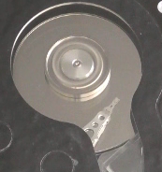
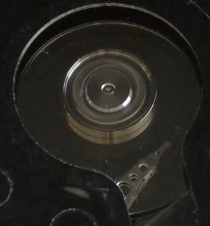
2-3. Eco-writing & Reduced in failure occurrence probability
Reduce the movement of a head to the utmost limit
WJ-NX100 can reduce the movement of a head to the utmost limit to access own HDD since it equips with
i-PRO proprietary file system. Thus WJ-NX100 achieves the high efficiency of writing control, and can
extend the life of HDDs.
Reduce the movement of a head to the utmost limit
Reduce fever of actuator motor
Reduce abrasion of motor
Other manufacture’s
NX100

Slide 16
2. Key Features
1. Space saving installation and Switch less connecting (PoE)
Effective use of space by Vertical installation or Wall mounting
No switch required with 4 PoE ports
2. Easy Installation/operation
Easy Connecting, Setting and Operation : PC less or with ASM300
Thumbnail Search
3. Pre-installed HDD and High efficiency data reading/writing
Pre-install HDD(2TBx1) ( Up to 4TB will be supported )
Eco-writing & Reduced in failure occurrence probability
4. H265 High Compression
Significant reduction of storage space usage through H.265 and Smart Coding

Slide 17
2-4. H265 High Compression
Recording performance
Through-put Max 96Mbps
Supported Image Resolution Max 12M pixel
Frame Rate Max 60ips
Supported Image Format H.265/H.264/JPEG
Scheduled Recording Mode Event recording (support 6 pattern)
Alarm Recording Terminal inputs, Camera alarms (Panasonic Alarm Protocol), Command alarms
■ Recording capacity
HDD operation mode | Max HDD Capacity | Recording days at 2.5 Mbps 4 Cameras (WV-S1131) H.265/SXVGA/FQ/10ips ((640Kbps/camera)
Single mode | 2TB | Around 65 days
 | 4TB (2TB x 2) | Around 130 days
RAID1 mode | 2TB | -----
 | 4TB (2TB x 2) | Around 65 days
Note : The recording days is an approximation and may vary depending on conditions such as
camera and image quality

Slide 18
2-4. Smart Coding for CBR
NX100 supports Smart coding (GOP control) for CBR (Frame Rate priority)
GUI setting via HDMI monitor output | NX100
Smart coding for VBR | Yes
Smart coding for CBR* | Yes
*Smart coding for CBR means transmission priority is Frame rate setting
Note: The setting method is different between “VBR” and “CBR”, please refer to the next slide for more details

Slide 19
2-4. Smart Coding
Operation | GOP control | Function
Playback | Advanced | Same as the non-smart coding camera whose I frame interval is 1 sec.(default) It takes 1 sec. to playback by treating Long term P as I frame. (Max 1s is also Fast Forwarding)
 | Mid | The maximum wait time is 16 sec . same as conventional model. (Since I frame interval is 16 sec.)
 | Low | The maximum wait time is 8 sec . same as conventional model. (Since I frame interval is 8 sec.)
Reverse Playback | Advance | NX100 shows I frame and "long term P frame".
 | Mid/Low | NX100 shows only image of I frame by skipping P frame picture
Live | Advanced/Mid/Low | Every time live screen is refreshed such as switching from playback window and changing display layout, NX 100 insert I frame by force not depending on setting of smart coding. So from first picture, NX100 can display live image and there is no broken images which waits i-frame. However, when secure license is registered and set “Data Encryption” of the camera, live image of main /sub monitor on the camera with data encryption enabled is only I-frame .

Slide 20
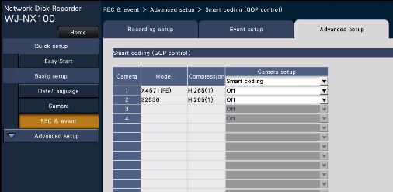
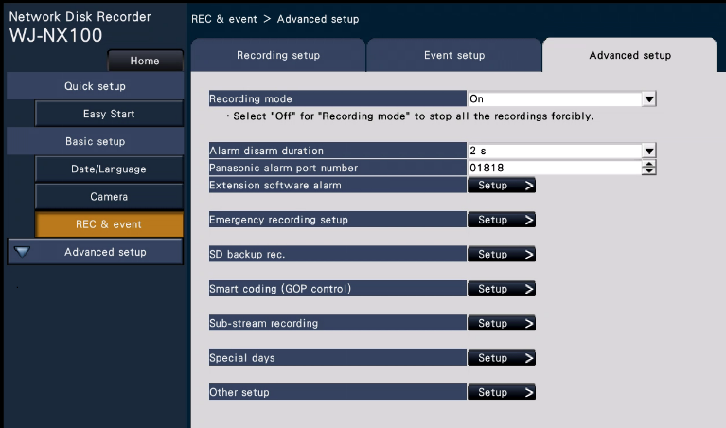
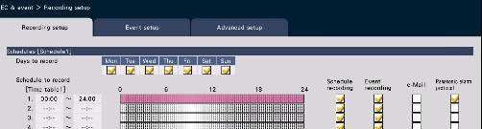
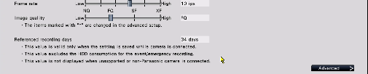
2-4. Smart Coding
CBR (Frame Rate) Setting
  Go to “REC & event” -> “Advanced setup” -> “Smart coding (GOP control)”
Choose “OFF” or “ON (Advanced)”
* It can set all at once , or can set each camera
Display the referenced recording days including smart coding camera bitrate information.
:

Slide 21
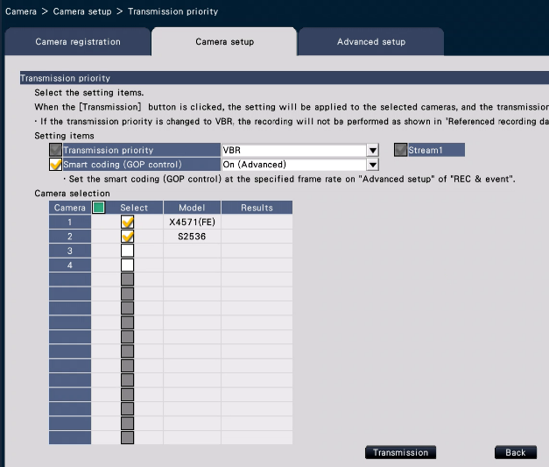
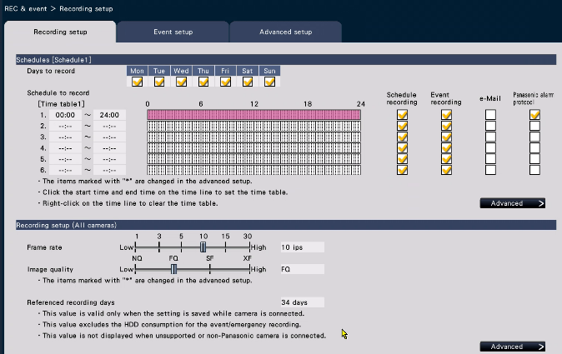
2-4. Smart Coding
VBR setting
  Go to “Camera” -> “Camera setup” -> “Transmission priority” -> “Setting items”
Check the applicable boxes
Reference recording days” may vary when VBR is selected

Slide 22


3. Specification Comparison
Comparison of NX100 & Hanwha other companies
 |  | i-PRO |  | i-PRO | Hanwha | HIK | Dahua
Model |  | NX200K/G | NX100/2E |  | XRN-410S | DS-7604NI-E1/4P | DHI-NVR4104-P
Design
Camera No. |  | 9CH(Max32CH) | 4CH |  | 4CH | 4CH | 4CH
Supported Image Format |  | H.265/H.264/JPEG | H.265/H.264/JPEG |  | H.265/H.264/JPEG | H.264/JPEG | H.264/JPEG
Maximum Recording Rate |  | In:192Mbps Out:192Mbps | In:96Mbps Out:96Mbps |  | In:50Mbps | In:40Mbps Out:80Mbps | 80Mbps
HDD | Type ( Slot ) | 3.5inch x2 | 2.5 inch x2 |  | 3.5inch x1 | 3.5inch x1 | 3.5inch x1
 | Capacity | Max.6TB/each | Max.4TB(2TB x 2) |  | Max.6TB | Max.4TB | SATA X1 (Max.4TB)
 | Shipment | Empty | Pre-installed 2TB x 1 |  | Empty | Empty | Selectable
RAID |  | Supported | Supported |  | Not Supported | Not Supported | Not Supported
USB IF |  | USB3.0 x 2 USB2.0 x 2 | USB3.0 x 1 USB2.0 x 1 |  | USB3.0 x 1 USB2.0 x 1 | USB3.0 x 1 USB2.0 x 1 | USB2.0 x 2
Built-in PoE |  | - | Yes (PoE+ : not support) |  | Yes (PoE+ : support) | Yes (PoE + :support) | Yes (PoE + :support)
Monitor out |  | HDMIx2, BNCx1 | HDMIx1, BNCx1 |  | HDMIx1, VGAx1 | HDMIx1, VGAx1 | HDMIx1, VGAx1
Alarm I/O |  | In:9 out:1 Control port:8 | In:2 out:1 Control port:5 |  | In:4 out:2 | In:4 out:1 | -
SSL |  | Yes | Yes |  | Yes | - | -
Power |  | AV100V | AC adapter |  | AC Adapter | AC Adapter | AC Adapter
Operating temperature |  | 5~45℃ | 5~45℃ |  | 0~40℃ | -10～55℃ | -10℃～+55℃
Dimensions |  | 420x88x300mm | 280x44x212mm |  | 300x48x209mm | 315x45x230mm | 205x45x205mm

Slide 23
3. Specification Comparison
Comparison of other NX models
 | NX100 | NX200 | NX300 | NX400
Supported Image Format | H.265,H.264,JPEG | H.265,H.264,JPEG | H.265,H.264,JPEG | H.265,H.264,JPEG
Max. number of CH | 4 CH | NTSC : 16 PAL : 32 | 32 CH | 1-64CH
Through put in | 96Mbps | 192Mbps | 256Mbps | 384Mbps
Through put out | 96Mbps | 192Mbps | 256Mbps | 256Mbps
Num. HDD | 2 | 2 | 4 | 9
Raid | Supported RAID Level1 | Supported RAID Level1 | Supported RAID Level1, 5, 6 | Supported RAID Level1,5,6
Extension unit | NO | NO | HXE400x2 | HXE400x5
Monitor out | HDMI x1 BNC x1 | HDMI x2 BNC x1 | HDMI x2 BNC x1 | HDMIx2 BNC x1
Transcode | 2user access | 2user access | 2user access | 2 user access
Sub-stream Rec. | Yes (All CH) | Yes (All CH) | Yes (All CH) | Yes (All CH)
PoE power supply | YES | NO | NO | NO
NAS back up | NO | NO | NO | YES *
Secure communication (Globalsign) | YES | YES | YES | YES
Face recognition | Yes (2cam) | Yes (2cam) | Yes (2cam) | NO
Failover between NVRs | NO | NO | NO | YES *
HDD long-life control | NO | NO | YES | YES *
Copy port/(USB port num.) | USB/(2) | USB/(4) | USB/(4) | USB/(4)
Dimensions | 280x44x212mm (1U) | 420x88x300mm (2U) | 420x88x370mm (2U) | 430x132x400mm (3U)
Easy Installation | Yes | Yes | Yes | Yes
RJ45 port (rear side) | 2 | 2 | 2 | 2
RJ45 maintenance port (front side) | 0 | 0 | 0 | 1
Alarm Source (Terminal inputs) | 2 | 9 | 9 | 32

Slide 24
4. Other Specifications
Overview
Item | Function | Note
External port | Alarm | Alarm Input: 2, Alarm Output: 1, Error Output: 2, Control etc: 3
 | HDMI | 1 port
 | Spot Output Connector | 1x 1 V [p-p] / 75 ˜ (BNC) NTSC /PAL (selectable in setup menu)
 | USB | 2 Front side: USB3.0 (Copy) Rear side: USB2.0 (Mouse)
 | Network | 4x 10BASE-T / 100BASE-TX / 1000BASE-T (RJ45), PoE(IEEE802.3af compliant)
HDD | Type | 2.5 inch Serial ATA HDD, Up to 2x HDDs can be installed.
 | Maximum Capacity | Up to 4TB(2TBx2*) will be supported (Installed HDD : 2TB x 1) *PGQW2331ZA/C1
 | RAID | RAID 1
Others | Power | DC48 V 1.7 A
 | Ambient Operating Temperature | Main body : +5 °C to +45 °C (41 °F to 113 °F) Mouse (provided) : +5 °C to +40 °C (41 °F to 104 °F)
 | Ambient Operating humidity | 5 % to 90 % (without condensation)
 | Size (W x H x D) | 280 mm(W) x 44 mm(H) x 212 mm(D) {11-1/32 inches (W) x 1-3/4 inches (H) x 8-11/32 inches (D)}
 | Weight | When no HDD is installed: 2.0 kg {4.6 lbs}

Slide 25
4. Other Specifications
Recording
Item | Function | Note
Setting | Scheduled Recording Mode | 16 schedules - Each schedule has two 24hour time tables - Each time table can be separated into max 6 slots
 | Recording Mode | Event, Schedule, Emergency
 | Sub-stream recording | 64 / 128 / 256 / 384 / 512 / 768 kbps
 | Pre-alarm Recording | Up to 15 seconds *When the delivery speed from the network camera is less than 4 Mbps.
Compression | Supported Image Format | H.265(HEVC), H.264, JPEG
 | Supported Audio Format | G.711 for Onvif, G.726 (ADPCM) 32 kbps, AAC-LC
Data format | Supported Data format | Original format(N3R/N3A), MP4
Re-encoding format | Re-encoding format: H.264 | H.265 stream is re-encoded to H.264 stream. Then H.264 stream is transmitted to outside. Support re-encoding for 2 user at same time.
Resolution | Supported Image Resolution (Depending on the camera) | •Aspect ratio [4 : 3] 4000x3000, 3072x2304, 2560x1920, 2048x1536, 1600x1200, 1280x960, 800x600, 640x480 •Aspect ratio [16 : 9] 3840x2160, 3072x1728, 2560x1440, 1920x1080, 1280x720, 640x360 •Aspect ratio [1 : 1] 2992x2992, 2816x2816, 2192x2192, 2048x2048, 1280x1280, 1440x1440(*), 1200x1200(*) •Aspect ratio [9 : 16] 2160x3840, 1728x3072, 1440x2560, 1080x1920, 720x1280, 360x640

Slide 26
4. Other Specifications
Network/Monitor
Item | Function | Note
Network | Network Interface | 10BASE-T / 100BASE-TX / 1000BASE-T (RJ45) Camera port : 10BASE-T / 100BASE-TX PC port : 10BASE-T / 100BASE-TX / 1000BASE-T
 | Port forwarding function | No
 | Supported Protocol | IPv4: TCP/IP, UDP/IP, HTTP, HTTPS, FTP, SMTP, DNS, NTP, SNMP, RTP, RTSP, ICMP, ARP IPv6: ICMPv6
 | No. of Simultaneous Users | 16 or less
 | Security Method | User authentication (ID and Password), Host authentication, Alteration detection, SSL/TLS
Monitor | Main monitor output (HDMI) | HDMI 4K UHD(3840x2160p) /30Hz, 4K UHD(3840x2160p) /25Hz, 1920x1080p /60Hz, 1920x1080p /50Hz, 1920x1080i /60Hz, 1920x1080i /50Hz
 | Spot Output Connector | 1x 1 V [p-p] / 75 ˜ (BNC) NTSC /PAL (selectable in setup menu)

Slide 27
4. Other Specifications
Main Unit Functions/Browser GUI
Item | Function | Note
Main Unit Functions | Multiscreen Mode | [Main monitor] •Control screen 4 split screen display •Wide view screen 2 / 3 / 4 split screen display, 1 screen sequence [Sub monitor] 1 screen sequence, 4 split screen display
 | Playback Control | PLAY, Rev PLAY, Pause, Stop, FF, FR, Prev Record, Next Record, Prev Image, Next Image, Go to Date, Go to Last (30 s), Time-saving playback
 | Search Mode | Search criteria : Time date, Playback by designating a timeline, VMD, Thumbnail
 | SD Memory Data Download | Images recorded in the SD card in the i-PRO series cameras can be transferred to the recorder automatically. (H.265/H.264)
Browser GUI | Display Mode | 1 / 4 screen
 | Playback Control | PLAY, Rev PLAY, Pause, Stop, FF, FR, Prev Record, Next Record, Prev Image, Next Image, Go to Date, Go to Last (30 s)
 | Search Mode | Search criteria: Time date, Event type, VMD, Camera number
 | Image Download | File Format: Original Format / MP4 Recorded data of selected camera and time range can be downloaded to a PC. Viewer software can be downloaded separately.

Slide 28
5. Appearance: Front side specification
① Copy port (USB3.0) [COPY] * Mouse connection is also available
Connect an external storage device (external Hard disk drive, USB memory) to this port and copy images and audio recorded on the hard disk drive
② Operation indicator [OPERATE] : Lights when the power is on
③ Error indicator [ERROR] : Blinks when an error that can become a problem for the recorder to run the system occurs
Blinks red: System error
Blinks orange: Thermal error, cooling fan malfunction, etc
Shows a solid light when automatically reset from an error status
④ Alarm indicator [ALARM] : Blinks when an alarm occurs, and lights when the alarm output stops. This indicator will go off when the [Reset] button
⑤ Recording indicator [REC] : Lights orange when recording is being performed
⑥ [HDD1]/[HDD2] indicator : Indicates the operational status (access/failure) of the respective hard disk drive
Blinks green : Indicates that the respective hard disk drive is being accessed
Lights red : Indicates that a fault (or an error) has occurred on a hard disk drive
Off : Indicates that the respective hard disk drive is not being accessed
⑦ Buzzer stop button [BUZZER STOP] : Press this button to stop the buzzer that started sounding at an alarm/error occurrence
⑧ Restart switch [RESTART] : Restarts the recorder. Insert a fine stick, like a paper clip and keep pressing for more than 5 seconds

Slide 29
5. Appearance: Rear side specification
Clamp mount (To prevent power cord disconnection)
Alarm/Control terminal [ALARM/CONTROL]
DC jack [DC IN]
Network port (Camera port) [CAMERA]
Network port (PC port) [PC]
SIGNAL GND terminal [SIGNAL GND]
Mouse connection port (USB2.0) [Mouse]The provided mouse is connected to this port.
Video output connector (BNC) [VIDEO]The default is PAL output.
Main monitor output connector (HDMI)[HDMI VIDEO/AUDIO]
Cooling fan outlet
Security wire hole

Slide 30
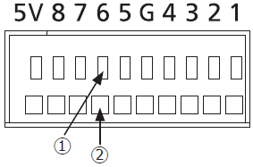
5. Appearance: ALARM/CONTROL, ALARM IN Terminal
ALARM/CONTROL Terminal on the rear side
Cable connections
①Press the button.
② Insert the cable all the way into the hole
and release the button.
Important:
Do not connect two or more wires to a single terminal
When connecting two or more wires, branch the wires outside the recorder before connection
Pin No. | Signal | Operation | Remarks
1 | Time adjustment I/O | According to the signal input from the other device, the time of the recorder will be adjusted to the hour based on the input time In addition, the signal is output at the setting time of the recorder and the time of other equipment is adjusted to the time of the recorder | Input : Non-voltage make contact input +3.3 V pull-up Approx. 23 kΩ Output : Open collector output 24 V DC max., –200 mA max.
2 | Alarm input 1 | Event action will be performed according to the settings | Non-voltage make contact input +3.3 V pull-up Approx. 23 kΩ
3 | Alarm input 2
4 | Emergency recording input | Starting emergency recording signal input
G | Signal ground
5 | Alarm output | Alarm signal will be supplied at an event occurrence | Open collector output 24 V DC max., –200 mA max.
6 | Camera error output | Signal output upon detection of a camera error
7 | HDD error output/ Recording error output | Signal output upon detection of an HDD error or recording error in this product
8 | Face matching output | Signal output at the occurrence of a face matching Alarm
5V | +5 V output | +5 V output | +5 V±0.5 V, 200 mA max.

Slide 31
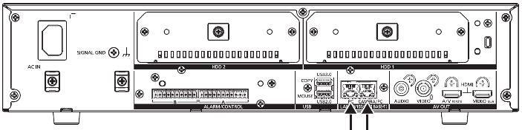

5. (Reference)NX200 : ALARM/CONTROL, ALARM IN Terminal
ALARM/CONTROL Terminal on the rear side
ALARM/CONTROL connector A socket
Pin No. | Signal | Operation | Remarks
A1 | Alarm input 1 | Event action will be performed according to the settings | Non-voltage make contact input +3.3 V pull-up Approx. 23 kΩ
A2 | Alarm input 2
A3 | Alarm input 3
A4 | Alarm input 4
A5 | Alarm input 5
A6 | Alarm input 6
A7 | Alarm input 7
A8 | Alarm input 8
A9 | Alarm input 9
A10 A11 | Alarm output | Alarm signal will be supplied at an event occurrence | Open collector output 24 V DC max., –200 mA max.
A11 | Signal ground

Slide 32
5. (Reference)NX200 : ALARM/CONTROL, ALARM IN Terminal
ALARM/CONTROL Terminal on the rear side
ALARM/CONTROL connector B socket
Pin No. | Signal | Operation | Remarks
B1 | Alarm reset input | Canceling the alarm display | Non-voltage make contact input +3.3 V pull-up Approx. 23 kΩ
B2 | Emergency recording input | Starting emergency recording signal input
B3 | Time adjustment I/O | According to the signal input from the other device, the time of the recorder will be adjusted to the hour based on the input time In addition, the signal is output at the setting time of the recorder and the time of other equipment is adjusted to the time of the recorder | Input : Non-voltage make contact input +3.3 V pull-up Approx. 23 kΩ Output : Open collector output 24 V DC max., –200 mA max.
B4 | Emergency recording input | A signal will be output upon detection of a disconnected Ethernet link or IP expiration of the DHCP | Open collector output 24 V DC max., –200 mA max.
B5 | Camera error output | Signal output upon detection of a camera error
B6 | HDD error output/ Recording error output | Signal output upon detection of an HDD error or recording error in this product
B7 | Recorder error output | Signal output upon detection of a recorder error
B8 | Face matching output | Signal output at the occurrence of a face matching alarm
B9 | +5 V output | +5 V output | +5 V±0.5 V, 200 mA max.
B10 | Signal ground

Slide 33

6. Standard Accessories
WJ-NX100/2E
No. | Standard accessories | Qt.
1 | CD-ROM*1 | 1 pc.
2 | Mouse | 1 pc.
3 | Installation Guide | 1 pc.
4 | Quick Reference Guide | 1 pc.
5 | Activation Key Card | 1 pc.
6 | Warranty card (U.S.A. only) | 1 pc.
7 | Cable Clamp | 1 pc.
8 | Power cord (3types included : B, F, G) B = Canada/US, F = EU, G = UK | 3 pcs.
9 | AC Adapter (100-220V ) | 1 pc.
10 | Cushion rubber (large)*2 | 1 pc.
11 | Cushion rubber (small)*2 | 2 pcs.
*1 The CD-ROM contains the Important Information and Quick Reference Guide (PDFs)
Make sure to read them when installing or setting the recorder
*2 A total of 3 cushion rubbers (large)/(small) are pasted onto one sheet of backing sheet ( Please peel them off before use )
Cushion rubbers are used for vertical installation

Slide 34
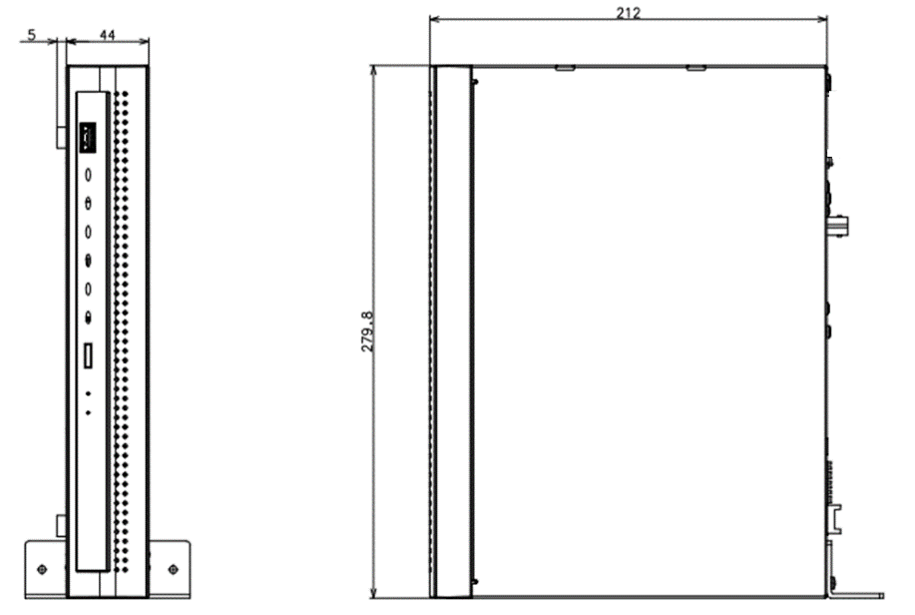
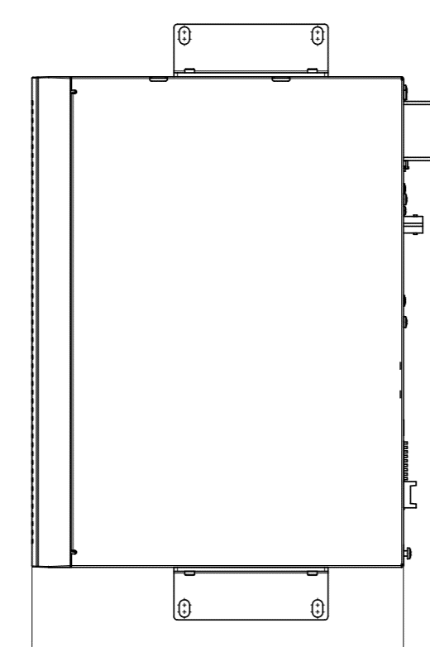
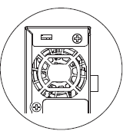
7. Optional Accessories
Installation bracket
Model No. | Product | Description
WV-Q202 |  | When installing WJ-NX100, WV-Q202 is used for vertical installation and wall mounting WJ-NX100 cannot be mounted in a rack using WV-Q202 When Vertical installation, attach the attached Cushion rubber Mount NX100 on the wall with cooling fan outlet not to face down, otherwise cooling effect will not work
Front
Vertical installation
Wall mount

Slide 35
7. Optional Accessories
Expansion Software
Model No. | Product | Description
WJ-NXF02, WJ-NXF02W | Business intelligent kit (For face detection) | Software license of face recognition for 2ch It is necessary to install the extension software WV-SAE200 which supports the face detection function. Extension software information can be found at the following address https://bizpartner.panasonic.net/extranet/file/compatibility-list-extension-software
WJ-NXS01, WJ-NXS01W WJ-NXS04, WJ-NXS04W | Expansion kit (For secure communication) | License for each 1ch, 4ch
Expansion HDD
Model No. | Product | Description
PGVF4976ZA/C1 | Expansion kit (For HDD) | 2TB HDD ( 2.5inch HDD Made by Seagate ) SATA cable, Cable clamp ( 2pcs. ), HDD fixing screw ( M3 L = 4 mm 4pcs. ) HDD replacement is also possible Refer to https://youtu.be/cYp2jfMHL-s for how to install an additional HDD

Slide 36
8. Others
Release schedule of tool software
Contents | Series | Supported / Not supported
Viewer | NX Viewer ( NX Series HDD Viewer ) | Supported
PC software | WV-ASM300 | Supported (v4.2 or later)
Tool | iCT (i-PRO Configuration Tool) | Supported (v2.0 or later)
 | SDT (System Design Tool) | Supported (v2.3 or later)
 | Security Recorder Calculator | Supported (v4.4 or later)
Mobile application | Security Viewer | Supported (v6.0 or later)
SDK | PS-API | Supported
DDNS | Viewnetcam | Supported
ONVIF | ONVIF | Supported (profile S)

Slide 37
Appendix:
- Network connection patterns-
- Monitor Live Display spec

Slide 38
Network connection pattern (Overview)
NX100
PoE port (4ch)
PC port
Cam
Cam
Cam
Switching Hub
PoE+ injector
PC
PTZ
Cam
Cam
PoE port : 10BASE-T / 100BASE-TX
PC port : 10BASE-T / 100BASE-TX / 1000BASE-T

Slide 39

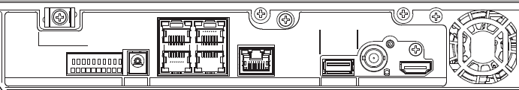


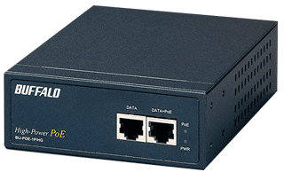

Camera network connection pattern
Camera A (PoE camera)
Camera C
(more than 100m away from NVR)
Camera port
PC port
Switching hub
PoE+ injector
GbE
Camera B (PoE+ camera)

Slide 40
Available monitors and stream selection
■Video Output
HDMI sub monitor is not available with NX100
■Camera stream selection by monitor type and multiscreen pattern
Video output | NX100 | NX200
Main monitor [HDMI] | Yes | Yes
Sub monitor [HDMI] | No | Yes
Sub monitor [BNC] | Yes | Yes
Monitor out |  |  | NX100 | NX200
Main monitor | HDMI (4K) | 1-screen, 2-screen, 1-screen seq. | Stream 1 | Stream 1
 |  | 3-screen, 4-screen | Stream 1 | Stream 1
 | HDMI (FHD) | 1-screen, 2-screen, 1-screen seq. | Stream 1 | Stream 1
 |  | 3-screen, 4-screen | Stream 2 | Stream 2
Sub monitor | HDMI (FHD) | 1-screen |  | Stream 1
 |  | 4-screen |  | Stream 2
 | BNC | 1-screen | Stream 2 | Stream 1
 |  | 4-screen | Stream 2 | Stream 2

Slide 41
Max. Live display framerate table on monitor(1/9)
■Monitor Usage Pattern1: Main Monitor(4K) Use Only
  <NX100>
  <Ref. NX200>
Unit : fps
Screen pattern [Main monitor] | camera stream | Camera resolution (H.264/H.265)
 |  | 12M | 9M/4K | 5M | 4M | 3M | 2M or less
1-screen | Stream 1 | 30 | 30 | 30 | 30 | 30 | 60
2-screen/1-screen seq. | Stream 1 | 15 | 30 | 30 | 30 | 30 | 60
3-screen/4-screen | Stream 1 | 10 | 15 | 30 | 30 | 30 | 30
Unit : fps
Screen pattern [Main monitor] | camera stream | Camera resolution (H.264/H.265)
 |  | 12M | 9M/4K | 5M | 4M | 3M | 2M or less
1-screen | Stream 1 | 30 | 30 | 30 | 30 | 30 | 60
2-screen/1-screen seq. | Stream 1 | 15 | 30 | 30 | 30 | 30 | 60
3-screen/4-screen | Stream 1 | 10 | 30 | 30 | 30 | 30 | 30

Slide 42
Max. Live display framerate table on monitor(2/9)
■Monitor Usage Pattern2: Main Monitor(FHD) Use Only
  <NX100>
  <Ref. NX200>
*1 : In case of sub stream rec off
*2 : In case of sub stream rec on
Unit : fps
Screen pattern [Main monitor] | camera stream | Camera resolution (H.264/H.265)
 |  | 12M | 9M/4K | 5M | 4M | 3M | 2M or less
1-screen | Stream 1 | 30 | 30 | 30 | 30 | 30 | 60
2-screen/1-screen seq. | Stream 1 | 15 | 30 | 30 | 30 | 30 | 60
3-screen/4-screen | Stream 2 |  |  |  |  |  | (30 *1 / 10 *2)
Unit : fps
Screen pattern [Main monitor] | camera stream | Camera resolution (H.264/H.265)
 |  | 12M | 9M/4K | 5M | 4M | 3M | 2M or less
1-screen | Stream 1 | 30 | 30 | 30 | 30 | 30 | 60
2-screen/1-screen seq. | Stream 1 | 15 | 30 | 30 | 30 | 30 | 60
3-screen/4-screen | Stream 2 |  |  |  |  |  | (30 *1 / 10 *2)

Slide 43
Max. Live display framerate table on monitor(3/9)
■Monitor Usage Pattern3: Main Monitor(4K) + Mobile Playback(Re-encoding*)
  * Re-encoding is used for playback on PC/mobile device with Chrome, Firefox, Edge, and PSV app
  <NX100>
  <Ref. NX200>
Unit : fps
Screen pattern [Main monitor] | camera stream | Camera resolution(H.264/H.265)
 |  | 12M | 9M/4K | 5M | 4M | 3M | 2M or less
1-screen | Stream 1 | 15 | 30 | 30 | 30 | 30 | 60
2-screen/1-screen seq. | Stream 1 | 5 | 15 | 15 | 15 | 15 | 30
3-screen/4-screen | Stream 1 | 5 | 10 | 15 | 15 | 15 | 30
Unit : fps
Screen pattern [Main monitor] | camera stream | Camera resolution(H.264/H.265)
 |  | 12M | 9M/4K | 5M | 4M | 3M | 2M or less
1-screen | Stream 1 | 15 | 30 | 30 | 30 | 30 | 60
2-screen/1-screen seq. | Stream 1 | 5 | 30 | 30 | 30 | 30 | 30
3-screen/4-screen | Stream 1 | 5 | 15 | 15 | 15 | 15 | 30

Slide 44
Max. Live display framerate table on monitor(4/9)
■Monitor Usage Pattern4: Main Monitor(FHD) + Mobile Playback(Re-encoding*)
  * Re-encoding is used for playback on PC/mobile device with Chrome, Firefox, Edge, and PSV app
  <NX100>
  <Ref. NX200>
*1 : In case of sub stream rec off
*2 : In case of sub stream rec on
Unit : fps
Screen pattern [Main monitor] | camera stream | Camera resolution(H.264/H.265)
 |  | 12M | 9M/4K | 5M | 4M | 3M | 2M or less
1-screen | Stream 1 | 15 | 30 | 30 | 30 | 30 | 60
2-screen/1-screen seq. | Stream 1 | 5 | 15 | 15 | 15 | 15 | 30
3-screen/4-screen | Stream 2 |  |  |  |  |  | (30 *1 / 10 *2)
Unit : fps
Screen pattern [Main monitor] | camera stream | Camera resolution(H.264/H.265)
 |  | 12M | 9M/4K | 5M | 4M | 3M | 2M or less
1-screen | Stream 1 | 15 | 30 | 30 | 30 | 30 | 60
2-screen/1-screen seq. | Stream 1 | 5 | 30 | 30 | 30 | 30 | 30
3-screen/4-screen | Stream 2 |  |  |  |  |  | (30 *1 / 10 *2)

Slide 45
Max. Live display framerate table on monitor(5/9)
■Monitor Usage Pattern5: Main Monitor(4K) + Sub Monitor(BNC)
  <NX100>
  <Ref. NX200>
Unit : fps
Screen pattern [Main monitor] | camera stream | Camera resolution(H.264/H.265)
 |  | 12M | 9M/4K | 5M | 4M | 3M | 2M or less
1-screen | Stream 1 | 30 | 30 | 30 | 30 | 30 | 60
2-screen/1-screen seq. | Stream 1 | 15 | 30 | 30 | 30 | 30 | 60
3-screen/4-screen | Stream 1 | 10 | 15 | 15 | 30 | 30 | 30
Unit : fps
Screen pattern [Main monitor] | camera stream | Camera resolution(H.264/H.265)
 |  | 12M | 9M/4K | 5M | 4M | 3M | 2M or less
1-screen | Stream 1 | 15 | 30 | 30 | 30 | 30 | 60
2-screen/1-screen seq. | Stream 1 | 5 | 30 | 30 | 30 | 30 | 30
3-screen/4-screen | Stream 1 | 5 | 15 | 15 | 15 | 15 | 30

Slide 46
Max. Live display framerate table on monitor(6/9)
■Monitor Usage Pattern5: Main Monitor(4K) + Sub Monitor(BNC)
  <NX100>Sub monitor (BNC)
  <Ref. NX200>Sub monitor (HDMI/BNC)
*1 : In case of sub stream rec off
*2 : In case of sub stream rec on
Unit : fps
Screen pattern [Sub monitor] | camera stream | Camera resolution(H.264/H.265)
 |  | 12M | 9M/4K | 5M | 4M | 3M | 2M or less
1-screen | Stream 2 | 1 | 1 | 1 | 1 | 1 | 60
1-screen seq. | Stream 2 | 1 | 1 | 1 | 1 | 1 | 30
4-screen | Stream 2 |  |  |  |  |  | (30 *1 / 10 *2)
Unit : fps
Screen pattern [Sub monitor] | camera stream | Camera resolution(H.264/H.265)
 |  | 12M | 9M/4K | 5M | 4M | 3M | 2M or less
1-screen | Stream 1 | 15 | 30 | 30 | 30 | 30 | 60
1-screen seq. | Stream 1 | 5 | 30 | 30 | 30 | 30 | 30
4-screen | Stream 2 |  |  |  |  |  | (30 *1 / 10 *2)

Slide 47
Max. Live display framerate table on monitor(7/9)
■Monitor Usage Pattern6: Main Monitor(FHD) + Sub Monitor(BNC)
  <NX100>
  <Ref. NX200>
*1 : In case of sub stream rec off
*2 : In case of sub stream rec on
Unit : fps
Screen pattern [Main monitor] | camera stream | Camera resolution(H.264/H.265)
 |  | 12M | 9M/4K | 5M | 4M | 3M | 2M or less
1-screen | Stream 1 | 30 | 30 | 30 | 30 | 30 | 60
2-screen/1-screen seq. | Stream 1 | 15 | 30 | 30 | 30 | 30 | 60
3-screen/4-screen | Stream 2 |  |  |  |  |  | (30 *1 / 10 *2)
Unit : fps
Screen pattern [Main monitor] | camera stream | Camera resolution(H.264/H.265)
 |  | 12M | 9M/4K | 5M | 4M | 3M | 2M or less
1-screen | Stream 1 | 15 | 30 | 30 | 30 | 30 | 60
2-screen/1-screen seq. | Stream 1 | 5 | 30 | 30 | 30 | 30 | 30
3-screen/4-screen | Stream 2 |  |  |  |  |  | (30 *1 / 10 *2)

Slide 48
Max. Live display framerate table on monitor(8/9)
■Monitor Usage Pattern6: Main Monitor(FHD) + Sub Monitor(BNC)
  <NX100>Sub monitor (BNC)
  <Ref. NX200>Sub monitor (HDMI/BNC)
*1 : In case of sub stream rec off
*2 : In case of sub stream rec on
Unit : fps
Screen pattern [Sub monitor] | camera stream | Camera resolution(H.264/H.265)
 |  | 12M | 9M/4K | 5M | 4M | 3M | 2M or less
1-screen | Stream 2 | 1 | 1 | 1 | 1 | 1 | 60
1-screen seq. | Stream 2 | 1 | 1 | 1 | 1 | 1 | 30
4-screen | Stream 2 |  |  |  |  |  | (30 *1 / 10 *2)
Unit : fps
Screen pattern [Sub monitor] | camera stream | Camera resolution(H.264/H.265)
 |  | 12M | 9M/4K | 5M | 4M | 3M | 2M or less
1-screen | Stream 1 | 15 | 30 | 30 | 30 | 30 | 60
1-screen seq. | Stream 1 | 5 | 30 | 30 | 30 | 30 | 30
4-screen | Stream 2 | - | - | 15 | 15 | 15 | (30 *1 / 10 *2)

Slide 49
Max. Live display framerate table on monitor(9/9)
■Monitor Usage Pattern7: Main Monitor + Sub Monitor(BNC) + Mobile Playback(Re-encoding*)
* Re-encoding is used for playback on PC/mobile device with Chrome, Firefox, Edge, and PSV app
<NX100>
  Performance Not Guaranteed (* no warning message or notification to user)

Slide 50
Version History

Slide 51
Version History
No | Update contents | Page No. | Version | Update
1 | 1st Version | - | 1.00 | 7.July.2021
2 | Update content | All | 1.10 | 26.July.2021
3 | Update content | P25, P35, P36-48 | 1.20 | 5.Aug.2021
4 | Update content | P34 | 1.30 | 9.Sep.2021
5
6
7
8
9
10

