Slide 1

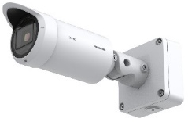
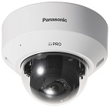
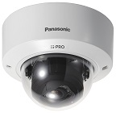

i-PRO FHD Fixed Network Camera
with AI engine Material for SE
Model: WV-S1136, WV-S2136, WV-S2136L, WV-S2236L
WV-S1536L, WV-S1536LN, WV-S2536L, WV-S2536LN
WV-S1536LTN, WV-S2536LTN
Document Ver.2.05
Aug. 2022

Slide 2

Contents
Product Summary
Key Features
Specification Comparison
Other Hardware Specifications
Other Software Specifications
AI Application
Appearance
Standard Accessories
Optional Accessories
About icons
This icon is for brand new functions
Indoor
This icon is for indoor cameras
Outdoor
This icon is for outdoor cameras

Slide 3
1. Product Summary

Slide 4






1-1. Targets for the New S series camera
Camera type
Multi-Sensor
Panoramic
PTZ
4K/5M FIX
FHD FIX
High end
Industry model
Q Series
P Series
X Series
Target
P Series
X Series
S Series
Middle
Middle Low
M Series
Q Series
U Series
*Explained in this document
Indoor
Outdoor

Slide 5
1-2. Camera Lineup
FHD model | Indoor | Indoor vandal resistant | Outdoor
 |  |  | Normal | with tele lens
BOX |  | -
 | WV-S1136 | - | WV-S1536L WV-S1536LN | WV-S1536LTN
 | Release in Jun. 2021 | - | Release in Sep. 2021 | Release in Nov. 2021
DOME
 | WV-S2136 WV-S2136L | WV-S2236L | WV-S2536L WV-S2536LN | WV-S2536LTN
 | Release in Jun. 2021 | Release in Jun. 2021 | Release in Sep. 2021 | Release in Nov. 2021
Indoor
Outdoor

Slide 6
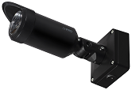

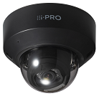
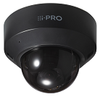

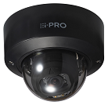
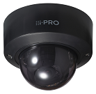

Ref. Model variation (Smoke Dome / Black)
 | Smoke Dome | Black color | Smoke Dome & Black color
Outdoor BOX |  | WV-S1536L-B WV-S1536LN-B
Indoor DOME | WV-S2136G WV-S2136LG | WV-S2136-B WV-S2136L-B | WV-S2136G-B WV-S2136LG-B
Vandal resistant Indoor DOME | WV-S2236LG | WV-S2236L-B | WV-S2236LG-B
Vandal resistant Outdoor DOME | WV-S2536LG WV-S2536LGN
Release schedule | Dec. 2021 | Dec. 2021 | Dec. 2021
*Please refer to "Appendix: Model variation (Smoke Dome / Black)" below for spec differences and additional accessories.
Indoor
Outdoor

Slide 7
1-3. Model Transition
 | Conventional model |  |  | New model
Indoor BOX | 4 | WV-S1111 / WV-S1112 WV-S1131 / WV-S1132 |  | 1 | WV-S1136
Indoor DOME | 5 | WV-S2110 / WV-S2111L WV-S2130 / WV-S2131 WV-S2131L |  | 2 | WV-S2136 / WV-S2136L
Indoor vandal resistant DOME | 2 | WV-S2211L WV-S2231L |  | 1 | WV-S2236L
Outdoor BOX | 3 | WV-S1511LN / WV-S1531LN WV-S1531LTN |  | 3 | WV-S1536L / WV-S1536LN WV-S1536LTN
Outdoor DOME | 3 | WV-S2511LN / WV-S2531LN WV-S2531LTN |  | 3 | WV-S2536L / WV-S2536LN WV-S2536LTN
Indoor
Outdoor

Slide 8
1-4. Product Concept
By utilizing AI-based high-precision analysis, new S series camera enables to archive the high visibility, high compression, and various attribute information extraction
Key features
High
Visibility
Intelligent Auto
- The visibility of backlit human has been remarkably improved by human detection (upper body) even in the situation where face detection is unavailable.
Blurless NR
- Suppress blurring when “People" move.
High Compression
AI Smart Object Coding
- The object detection accuracy has been improved, and the non-detection area can be further compressed. (Approx. 50 % reduction compared to conventional models.)
High
Analytics
AI Analytics
- Extraction of facial features and various identifying elements for people, vehicles, and sounds.
High
Simplicity
i-PRO Configuration Tool (iCT) V2.0
- Enhanced convenience by integrating camera and application settings into iCT.
Indoor
Outdoor

Slide 9
2. Key Features

Slide 10
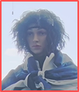
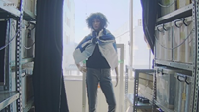

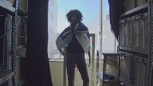
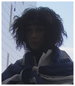
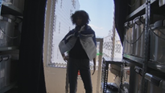
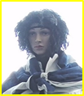
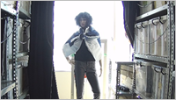
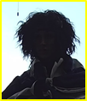
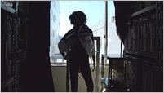
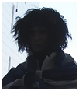
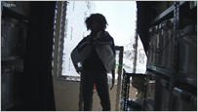
2-1. Intelligent Auto
Automatically optimize the image depending on the environment
The visibility of backlit human has been remarkably improved by human detection (upper body) even in the situation where face detection is difficult.
New model Face Priority Level: High | New model Face Priority Level: Low | Conventional model
SD ON
SD ON
SD ON
SD OFF
SD OFF
SD OFF
Indoor
Outdoor

Slide 11
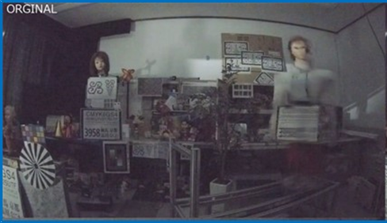
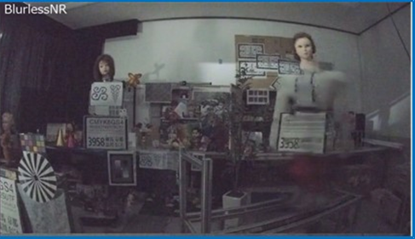
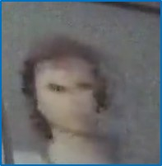
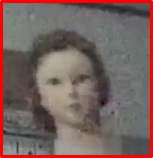
2-2. Blurless NR
Suppress blurring when “People” move
Conventional model
New model
move
move
It detects people and controls blur suppression with priority over noise reduction.
blurred Image
Less blur Image
Indoor
Outdoor

Slide 12
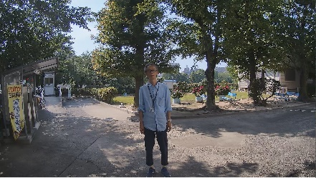
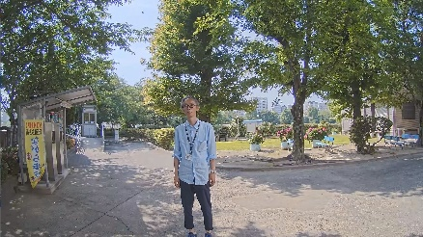


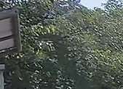
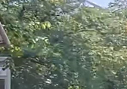
2-3. AI Smart Object Coding - Smart VIQS
Automatically control the compression rate depending on the environment
The object detection accuracy has been improved, and the non-detection area can be further compressed. (Approx. 50 % reduction compared to conventional models)
Conventional model
New model
Detects motion and automatically adjusts the image quality of moving objects to high and others to low.
Detects objects (face, human and vehicle) and adjusts the image quality of those objects to high and others to low.
Person on the image does not move
Image quality is adjusted to low
Camera detect “face” and “human”
Adjusts the image quality of the face area to high
Swaying tree is recognized as a moving object
Increase data amount
Swaying tree is NOT recognized as an object
Suppress data amount
Measured bit rate: 6733kbps
Measured bit rate: 3855kbps
Indoor
Outdoor

Slide 13
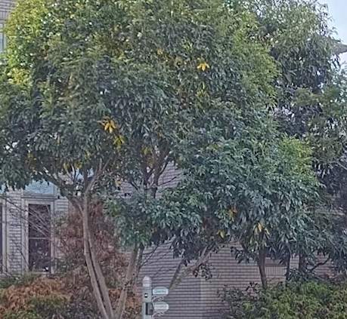
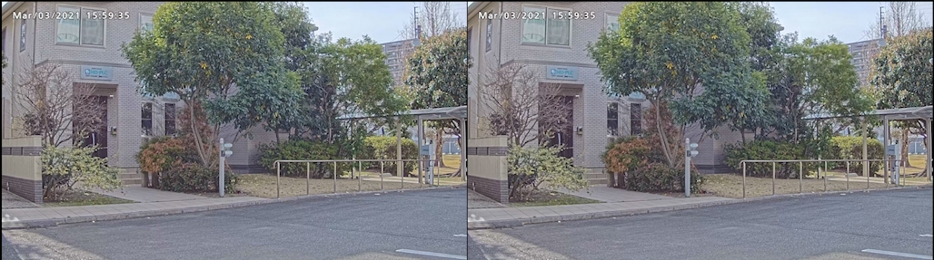
2-4. AI Smart Object Coding - Smart P-picture control
Automatically control the data volume of P-picture depending on the environment
With using AI-based object detection, the P-picture (forward predictive picture) data volume in areas, where no objects are detected, can be reduced
Hence, the movement of human and vehicle (important object) is displayed smoothly by reducing the data volume such as the shaking of trees (not important area).
the shaking of trees is not smooth
Smart P-picture control : OFF
Smart P-picture control : ON
Measured bit rate : 3179 kbps
Measured bit rate : 2219 kbps
Indoor
Outdoor

Slide 14
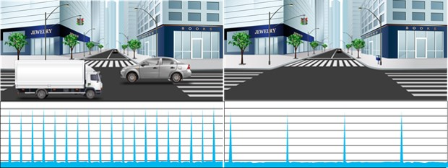
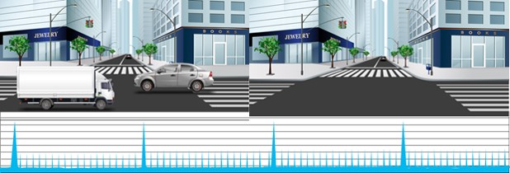
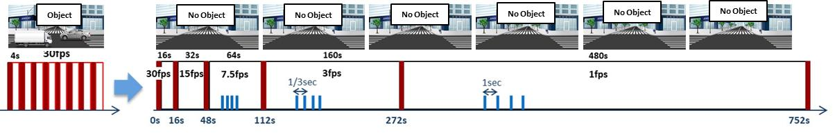
2-5. AI Smart Object Coding - GOP control
Control GOP using object detection instead of motion detection
Low / Mid
GOP control
Low (Variable GOP 1s-8s) | I-picture interval variable between 1sec-8sec by detected object (People and vehicles). *VBR only
Mid (Variable GOP 4s-16s) | I-picture interval variable between 4sec-16sec by detected object. *VBR only
Advanced (Fixed GOP 60s w/1s key-frame) | I-picture interval fixed at 60s, key-frame inserted at 1sec intervals regardless of detected object. *Selectable in all transfer modes
Frame rate control (Variable GOP 4s-16s w/frame rate control) | If there is no detected object, reduce the frame rate to 1 fps. I-picture interval variable between 4sec-16sec by detected object. *VBR only
Object
No Object
Advanced
Object
No Object
Frame rate control
Indoor
Outdoor

Slide 15
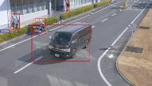




2-6. AI Analytics
Additionally support extraction of facial features and various elements to identify people, vehicle and sounds
 | New model | Conventional model
 |  | N/A
 |  | N/A
AI Face Detection
Detect face and cut out face image for best-shot
Extraction of facial features
Detect face and cut out face image for best-shot
AI People Detection
Extraction of various identifying elements for people
: 11 items 46 attributes
Age / Gender / Hair type / Tops type / etc.
AI Vehicle Detection
Extraction of various identifying elements for vehicles
: 2 items 17 attributes
Type / Color
AI-VMD
AI Privacy Guard
AI Sound Classification
i-VMD
Audio Detection
Others
Indoor
Outdoor

Slide 16
2-7. iCT V2.0
Achieve time saving by integrating camera and application settings into iCT
Conventional model
Camera settings
- IP address
etc.
Camera settings
- Plugin installation
- Resolution
etc.
App registration
- Register the
registration key
- Install the Ext. Soft.
VMS settings
- Camera registration
- Frame rate
etc.
Camera settings
- Image quality
adjustment
etc.
App settings
- Detection area
etc.
Installation report
iCT
Browser
VMS
Browser
Dedicated software
Integrated into iCT
New model (iCT V2.0)
Most of the settings can be configured by iCT.
So you don’t have to launch different tool one by one for each setting.
Camera settings
App registration / settings
Installation report
VMS settings
iCT
VMS
Significantly save time
(60% less than conventional)
Indoor
Outdoor

Slide 17
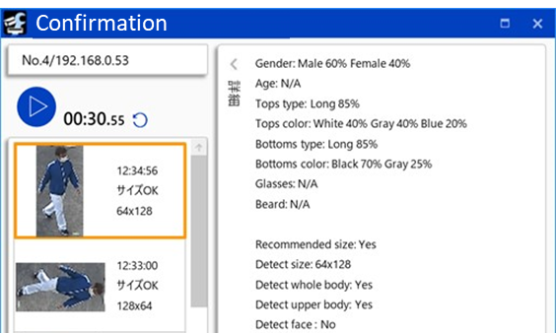
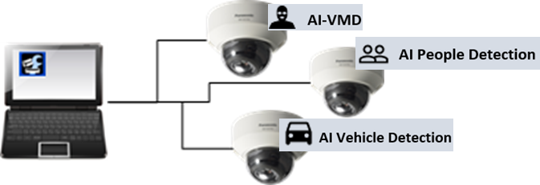
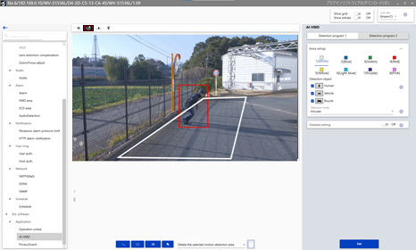
2-7. iCT V2.0 - AI application settings
Easy to demo of AI apps
Install and uninstall all camera applications
Adjust all application settings (see next page)
Indoor
Outdoor

Slide 18
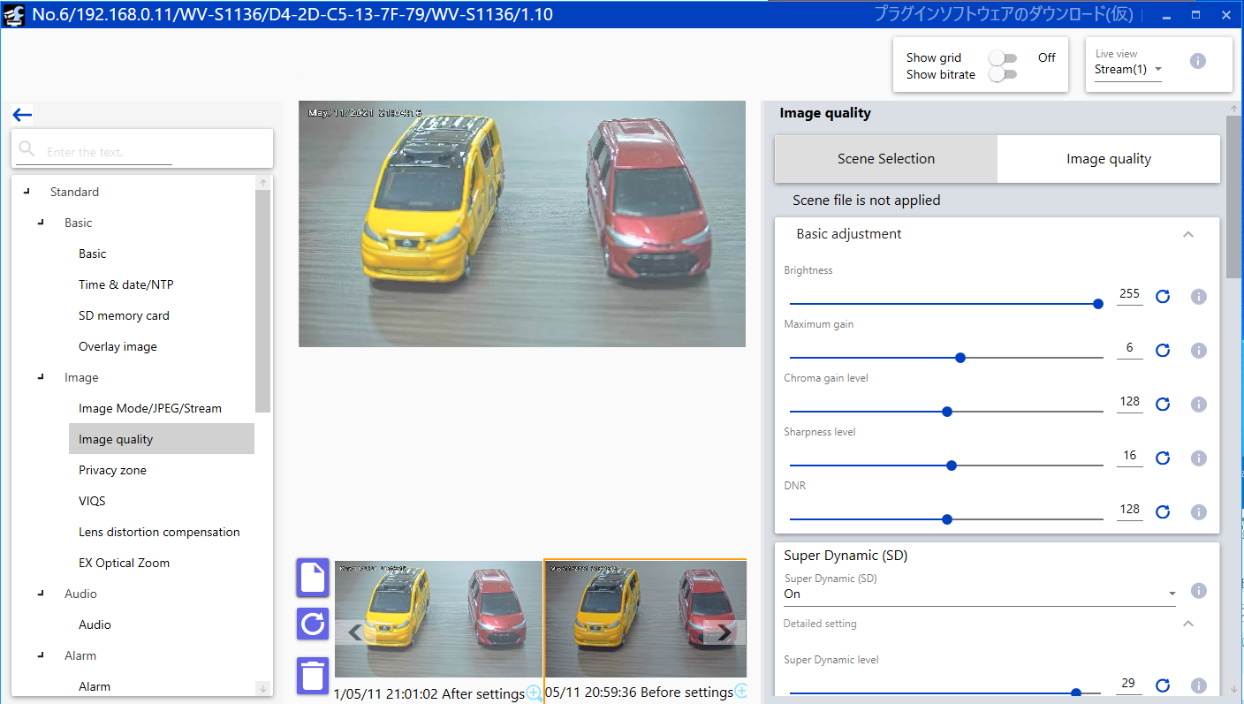
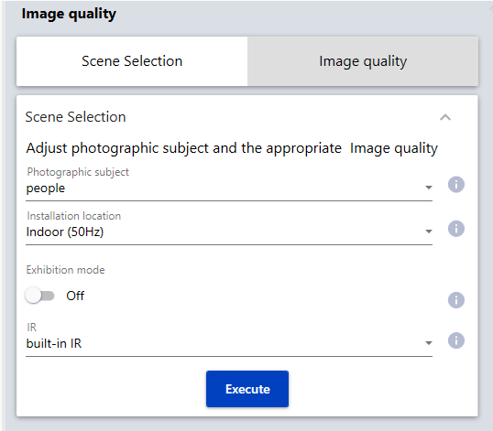
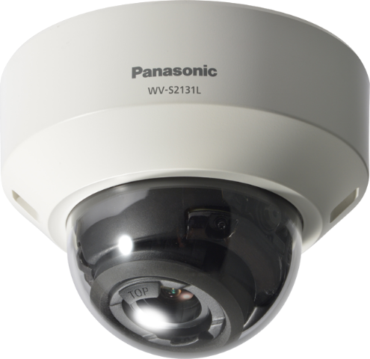
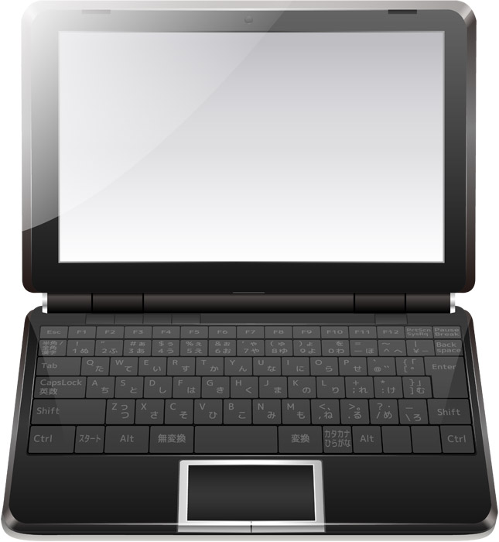
2-7. iCT V2.0 - Individual camera settings
Scene Selection
Settings and image thumbnails can be saved and restored
Adjust appropriate image quality by selecting 3 parameters
Most of camera settings can be set without Web browser
*Unavailable features
・Live page operation
of camera browser
・Download SD record
・Data encryption
・IEEE 802.1X settings
・Download root certificate
・IPv6 settings
Indoor
Outdoor

Slide 19
Ref. Set up tools for AI apps
AI apps |  | iCT V2.0 | Web browser
Apps name | Model number
AI-VMD | -
AI Privacy Guard | -
AI Non Mask Detection *Only sold in certain areas | WV-XAE203W | No settings is required | No settings is required
AI Occupancy Detection *Only sold in certain areas | WV-XAE207W
AI Face Detection | - |  | ‐
AI People Detection | - |  | ‐
AI Vehicle Detection | - |  | ‐
Indoor
Outdoor

Slide 20
3. Specification Comparison

Slide 21
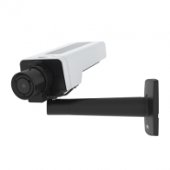

3-1. Comparison to other companies
Indoor BOX
*1 “Extension Software” and “SD recording” isn’t available.
*2 H.265/H.264 Stream transmission: Off
*3 WDR: Off
 | i-PRO | Axis | Hanwha
 | Indoor | Indoor | Indoor
 | WV-S1136 | P1375 | XNB-6005
Video Codec | H.265/H.264/JPEG | H.265/H.264/JPEG | H.265/H.264/JPEG
Image Sensor | 1/2.8” 2MP | 1/2.8” 2MP | 1/2” 2MP
Max. Resolution | 1920 x 1080 [16:9] 2048 x 1536 [4:3] *Super Resolution | 1920 x 1080 | 1920 x 1080
Max. Frame rate | H.265/H.264: 30fps (60fps *1) JPEG: 5fps (30fps *2) | H.265/H.264: 30fps (60fps *3) JPEG: 30fps | H.265/H.264: 60fps JPEG: 30fps
Lens | CS mount | Optical zoom: x2.9 F number: 1.2 Focal length: 2.8 - 8.0 mm | CS mount
Horizontal angle of view | - | Wide: 124 deg. / Tele: 42 deg. | -
Image rotation | Yes | Yes | Yes
Dynamic range | 144dB | 120dB | 150dB
Sensitivity (color) | 0.008 lx | 0.05lx | 0.006lx
Smart Coding | AI Smart Object Coding | Zipstream | WiseStreamⅡ
Analytics detection | Yes (Loitering, etc.) | Yes (Loitering, etc.) | Yes (Loitering, etc.)
Audio / IO terminal | Yes / Yes | Yes / Yes | Yes / Yes
IR-LED | No | No | No
Power Source | 12VDC, PoE | 12-28VDC, PoE | 12VDC, 24VAC, PoE
Operating Temperature | -10 to +50 deg.C | -10 to +55 deg.C | -10 to +55 deg.C
Indoor

Slide 22
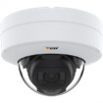
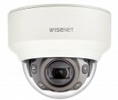
3-1. Comparison to other companies
Indoor DOME
*1 “Extension Software” and “SD recording” isn’t available.
*2 H.265/H.264 Stream transmission: Off
*3 WDR: Off
 | i-PRO | Axis | Hanwha
 | Indoor | Indoor | Indoor
 | WV-S2236L | P3245-LV | XND-6081RV
Video Codec | H.265/H.264/JPEG | H.265/H.264/JPEG | H.265/H.264/JPEG
Image Sensor | 1/2.8” 2MP | 1/2.8” 2MP | 1/2” 2MP
Max. Resolution | 1920 x 1080 [16:9] 2048 x 1536 [4:3] *Super Resolution | 1920 x 1080 | 1920 x 1080
Max. Frame rate | H.265/H.264: 30fps (60fps *1) JPEG: 5fps (30fps *2) | H.265/H.264: 30fps (60fps *3) JPEG: 30fps | H.265/H.264: 60fps JPEG: 30fps
Lens | Optical zoom: x3.1 F number: 1.3 Focal length: 2.9 - 9.0 mm | Optical zoom: x2.6 F number: 1.8 Focal length: 3.4 - 8.9 mm | Optical zoom: x3.4 F number: 1.4 - 3.6 Focal length: 2.8 - 12 mm
Horizontal angle of view | Wide: 114 deg. / Tele: 36 deg. | Wide: 100 deg. / Tele: 36 deg. | Wide: 119.5 deg. / Tele: 27.9 deg.
Image rotation | Yes | Yes | Yes
Dynamic range | 144dB | 120dB | 150dB
Sensitivity (color) | 0.009 lx | 0.1lx | 0.015lx
Smart Coding | AI Smart Object Coding | Zipstream | WiseStreamⅡ
Analytics detection | Yes (Loitering, etc.) | Yes (Loitering, etc.) | Yes (Loitering, etc.)
Audio / IO terminal | Yes / Yes | Yes / Yes | Yes / Yes
IR-LED | Yes (50m) | Yes (40m) | Yes (50m)
Power Source | 12VDC, PoE | PoE | 12VDC, PoE
Operating Temperature | -10 to +50 deg.C | 0 to +50 deg.C | -25 to +60 deg.C
Indoor

Slide 23


3-1. Comparison to other companies
Outdoor BOX
*1 “Extension Software” and “SD recording” isn’t available.
*2 H.265/H.264 Stream transmission: Off
*3 WDR: Off
 | i-PRO | Axis | Hanwha
 | Outdoor | Outdoor | Outdoor
 | WV-S1536LN | P1375-E | XNO-6080R
Video Codec | H.265/H.264/JPEG | H.265/H.264/JPEG | H.265/H.264/JPEG
Image Sensor | 1/2.8” 2MP | 1/2.8” 2MP | 1/2” 2MP
Max. Resolution | 1920 x 1080 [16:9] 2048 x 1536 [4:3] *Super Resolution | 1920 x 1080 | 1920 x 1080
Max. Frame rate | H.265/H.264: 30fps (60fps *1) JPEG: 5fps (30fps *2) | H.265/H.264: 30fps (60fps *3) JPEG: 30fps | H.265/H.264: 60fps JPEG: 30fps
Lens | Optical zoom: x3.1 F number: 1.3 Focal length: 2.9 - 9.0 mm | Optical zoom: x2.9 F number: 1.2 Focal length: 2.8 - 8.0 mm | Optical zoom: x4.3 F number: 1.4 Focal length: 2.8 - 12.0 mm
Horizontal angle of view | Wide: 117 deg. / Tele: 37 deg. [16:9] Wide: 82 deg. / Tele: 27 deg. [4:3] | Wide: 107 deg. / Tele: 42 deg. | Wide: 119.5 deg. / Tele: 27.9 deg.
Image rotation | Yes | Yes | Yes
Dynamic range | 144dB | 120dB | 150dB
Sensitivity (color) | 0.009 lx | 0.05lx | 0.015lx
Smart Coding | AI Smart Object Coding | Zipstream | WiseStreamⅡ
Analytics detection | Yes (Loitering, etc.) | Yes (Loitering, etc.) | Yes (Loitering, etc.)
Audio / IO terminal | Yes / Yes | Yes / Yes | Yes / Yes
IR-LED | Yes (50m) | No | Yes (50m)
Clear Sight coating | Yes | No | No
Resistance | IP66, IK10 | IP67, IP66, IK10 | IP67, IP66, IK10
Power Source | 12VDC, PoE | 12-28VDC, PoE | 12VDC, 24VAC, PoE
Operating Temperature | -40 to +60 deg.C | -40 to +60 deg.C | -40 to +55 deg.C
Outdoor

Slide 24
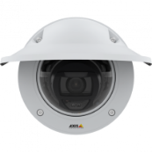
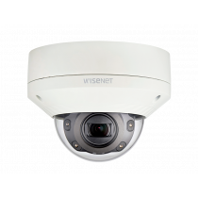
3-1. Comparison to other companies
Outdoor DOME
*1 “Extension Software” and “SD recording” isn’t available.
*2 H.265/H.264 Stream transmission: Off
*3 WDR: Off
 | i-PRO | Axis | Hanwha
 | Outdoor | Outdoor | Outdoor
 | WV-S2536LN | P3245-LVE *9mm model | XNV-6081R
Video Codec | H.265/H.264/JPEG | H.265/H.264/JPEG | H.265/H.264/JPEG
Image Sensor | 1/2.8” 2MP | 1/2.8” 2MP | 1/2” 2MP
Max. Resolution | 1920 x 1080 [16:9] 2048 x 1536 [4:3] *Super Resolution | 1920 x 1080 | 1920 x 1080
Max. Frame rate | H.265/H.264: 30fps (60fps *1) JPEG: 5fps (30fps *2) | H.265/H.264: 30fps (60fps *3) JPEG: 30fps | H.265/H.264: 60fps JPEG: 30fps
Lens | Optical zoom: x3.1 F number: 1.3 Focal length: 2.9 - 9.0 mm | Optical zoom: x2.6 F number: 1.8 Focal length: 3.4 - 8.9 mm | Optical zoom: x4.3 F number: 1.4 Focal length: 2.8 - 12.0 mm
Horizontal angle of view | Wide: 113 deg. / Tele: 36 deg. [16:9] Wide: 82 deg. / Tele: 26 deg. [4:3] | Wide: 100 deg. / Tele: 36 deg. | Wide: 119.5 deg. / Tele: 27.9 deg.
Image rotation | Yes | Yes | Yes
Dynamic range | 144dB | 120dB | 150dB
Sensitivity (color) | 0.009 lx | 0.1lx | 0.015lx
Smart Coding | AI Smart Object Coding | Zipstream | WiseStreamⅡ
Analytics detection | Yes (Loitering, etc.) | Yes (Loitering, etc.) | Yes (Loitering, etc.)
Audio / IO terminal | Yes / Yes | Yes / Yes | Yes / Yes
IR-LED | Yes (50m) | Yes (40m) | Yes (50m)
Clear Sight coating | Yes | No | No
Resistance | IP66, IK10 | IP66, IK10 | IP67, IP66, IP6K9K, IK10+
Power Source | 12VDC, PoE | PoE | 12VDC, 24VAC, PoE
Operating Temperature | -40 to +60 deg.C | -40 to +50 deg.C | -50 to +60 deg.C
Outdoor

Slide 25
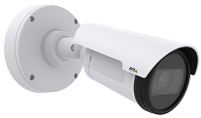
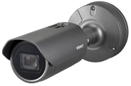
3-1. Comparison to other companies
Outdoor BOX (with tele lens)
*1 “Extension Software” and “SD recording” isn’t available.
*2 H.265/H.264 Stream transmission: Off
*3 WDR: Off
 | i-PRO | Axis | Hanwha
 | Outdoor | Outdoor | Outdoor
 | WV-S1536LTN | P1435-LE | XNO-6120R
Video Codec | H.265/H.264/JPEG | H.264/JPEG | H.265/H.264/JPEG
Image Sensor | 1/2.8” 2MP | 1/2.8” | 1/2” 2MP
Max. Resolution | 1920 x 1080 [16:9] 2048 x 1536 [4:3] *Super Resolution | 1920 x 1080 | 1920 x 1080
Max. Frame rate | H.265/H.264: 30fps (60fps *1) JPEG: 5fps (30fps *2) | H.264: 30fps (60fps *3) JPEG: 30fps | H.265/H.264: 60fps JPEG: 30fps
Lens | Optical zoom: x2.3 F number: 1.7 Focal length: 9.0 - 21.0 mm | Optical zoom: x2.2 F number: 1.85 Focal length: 10.0 - 22.0 mm | Optical zoom: x12 F number: 1.6 Focal length: 5.2 – 62.4 mm
Horizontal angle of view | Wide: 36 deg. / Tele: 15 deg. [16:9] Wide: 27 deg. / Tele: 11 deg. [4:3] | Wide: 34.5 deg. / Tele: 18 deg. | Wide: 54.58 deg. / Tele: 5.30 deg.
Image rotation | Yes | Yes | Yes
Dynamic range | 144dB | 120dB | 150dB
Sensitivity (color) | 0.015 lx | 0.16lx | 0.03lx
Smart Coding | AI Smart Object Coding | Zipstream | WiseStreamⅡ
Analytics detection | Yes (Loitering, etc.) | Yes (Loitering, etc.) | Yes (Loitering, etc.)
Audio / IO terminal | Yes / Yes | No / Yes | Yes / Yes
IR-LED | Yes (50m) | Yes (50m) | Yes (70m)
Clear Sight coating | Yes | No | No
Resistance | IP66, IK10 | IP67, IP66 | IP67, IP66, IK10
Power Source | 12VDC, PoE | PoE | 12VDC, 24VAC, PoE
Operating Temperature | -40 to +60 deg.C | -30 to +60 deg.C | -40 to +55 deg.C
Outdoor

Slide 26
3-1. Comparison to other companies
Outdoor DOME (with tele lens)
*1 “Extension Software” and “SD recording” isn’t available.
*2 H.265/H.264 Stream transmission: Off
*3 WDR: Off
 | i-PRO | Axis | Hanwha
 | Outdoor | Outdoor | Outdoor
 | WV-S2536LTN | P3245-LVE *22mm model | XNV-6120R
Video Codec | H.265/H.264/JPEG | H.265/H.264/JPEG | H.265/H.264/JPEG
Image Sensor | 1/2.8” 2MP | 1/2.8” 2MP | 1/2” 2MP
Max. Resolution | 1920 x 1080 [16:9] 2048 x 1536 [4:3] *Super Resolution | 1920 x 1080 | 1920 x 1080
Max. Frame rate | H.265/H.264: 30fps (60fps *1) JPEG: 5fps (30fps *2) | H.265/H.264: 30fps (60fps *3) JPEG: 30fps | H.265/H.264: 60fps JPEG: 30fps
Lens | Optical zoom: x2.3 F number: 1.7 Focal length: 9.0 - 21.0 mm | Optical zoom: x2.4 F number: 1.6 Focal length: 9.0 – 22.0 mm | Optical zoom: x12 F number: 1.6 Focal length: 5.2 – 62.4 mm
Horizontal angle of view | Wide: 36 deg. / Tele: 15 deg. [16:9] Wide: 27 deg. / Tele: 11 deg. [4:3] | Wide: 35 deg. / Tele: 15 deg. | Wide: 54.58 deg. / Tele: 5.30 deg.
Image rotation | Yes | Yes | Yes
Dynamic range | 144dB | 120dB | 150dB
Sensitivity (color) | 0.015 lx | 0.1lx | 0.03lx
Smart Coding | AI Smart Object Coding | Zipstream | WiseStreamⅡ
Analytics detection | Yes (Loitering, etc.) | Yes (Loitering, etc.) | Yes (Loitering, etc.)
Audio / IO terminal | Yes / Yes | Yes / Yes | Yes / Yes
IR-LED | Yes (50m) | Yes (40m) | Yes (70m)
Clear Sight coating | Yes | No | No
Resistance | IP66, IK10 | IP66, IK10 | IP67, IP66, IK10
Power Source | 12VDC, PoE | PoE | 12VDC, 24VAC, PoE
Operating Temperature | -40 to +60 deg.C | -40 to +50 deg.C | -40 to +55 deg.C
Outdoor

Slide 27
3-2. Comparison of new & conventional models
 | New model | Conventional model
Image capture mode | 16:9 (60fps / 50fps / 30fps / 25fps) 4:3 (30fps / 25fps / 15fps / 12.5fps) | 16:9 (60fps / 30fps) 4:3 (30fps)
Compression method | H.265[or H.264](1)(2) / JPEG(1)(2) | H.265[or H.264](1)(2) / JPEG(1)(2)(3)
Image rotation | 0 / 90 / 180 / 270 deg. *90, 270 deg. : “320 x 180” is not supported *90, 270 deg. : “60fps / 50fps” is not supported *90, 270 deg. : “4:3” is not supported | 0 / 90 / 180 / 270 deg. *90, 270 deg. : “4:3” is not supported
Camera title on screen (OSD) | Character no. : Max. 40 Line no. : Max. 2 Display size : 50% / 75% / 100% / 150% / 200% Display style : Transparent / Opaque | Character no. : Max. 20 Line no. : Max. 1 Display size : 100% / 150% / 200% Display style : Transparent
Stabilizer | No | Yes
Smart Coding | Smart VIQS / Smart P-picture control / GOP control | Auto VIQS / GOP control
SD recording | Number of recording streams : 1 Recording format : H.265 / H.264 / JPEG Transmission priority : Constant bit rate / VBR / Frame rate * “60fps / 50fps” is not supported | Number of recording streams : 2 Recording format : H.265 / H.264 / JPEG Transmission priority : Frame rate * “60fps” is not supported
Scene change detection alarm | Standard feature | Option (i-VMD)
Audio alarm | Yes (Audio Detection / AI Sound classification) | Yes (Audio Detection)
ONVIF | Profile S / G / T / M | Profile S / G / T
FTP | No *SFTP will be supported by firmware upgrade in Nov. 2021. | Yes
Image compression rate upon alarm detection | No | Yes
Support browser | Google Chrome / Firefox / Microsoft Edge (Only Chromium ver. ) | IE / Google Chrome / Firefox / Microsoft Edge
Indoor
Outdoor

Slide 28
4. Other Hardware Specifications

Slide 29
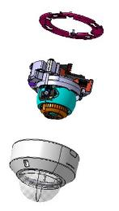
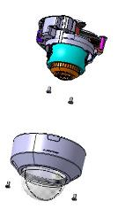
4-1. Installation method - Indoor DOME / Indoor Vandal resistant DOME
Conventional model
New model
Mounting with attachment plate
7 screws (=4+1+2)
Installation time : 196 sec
Fixing screws directly to ceilings
4 screws (=2+2)
Installation time : 144 sec
Indoor

Slide 30
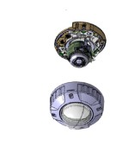


4-1. Installation method - Outdoor DOME
Conventional model
New model
Mounting with attachment plate & mount box
13 screws (=4+4+1+4)
Mounting with attachment plate
9 screws (=4+1+4)
Outdoor

Slide 31





4-2. Conduit support
New S series camera will be adopted a new side cover mechanism so that conduits can be connected as shown in the right picture.
Remove the side cover
Side cover
Insert the conduit (3/4 inches)
Support model
Indoor | Dome | WV-S2136 / WV-S2136L / WV-S2236L
Outdoor | Box | WV-S1536L / WV-S1536LN / WV-S1536LTN
 | Dome | WV-S2536L / WV-S2536LN / WV-S2536LTN
There is no fixing mechanism for piping such as screws.
Please fix with a saddle like the one on the left picture.
Indoor
Outdoor

Slide 32









4-3. Grommet support
Reduce installation time by threading the RJ45 connector directly into the grommet.
Conventional model (Pigtail)
New model (Grommet)
After passing the cable through the waterproof connector, it is necessary to caulk RJ45 connector.
Waterproof treatment is required even if not using a multi-cable.
RJ45 connector can thread the grommet
Water resistant treatment is not required when multi-cable is not used.
Need for space to house waterproof connectors
No need for space to house waterproof connectors
Grommet service life (design target) is 7 years
Outdoor

Slide 33


Ref. Note for using multi-cable
When using the audio and I/O terminal, use a multi-cable with grommet (WV-QCA501A).
Waterproofing is required to the multi-cable.
WV-QJB501-W is required to store the waterproof multi-cable.
Optional Accessories
WV-QCA501A
Optional Accessories
WV-QJB501-W
Outdoor

Slide 34


4-4. Sunshade rotation mechanism
U Series model
New S Series model
During image rotation 90 deg., the sunshade also rotates.
・ It is exposed to direct sunlight.
・ Water droplets such as rain tends to stick to the lens cover surface.
・ i-PRO logo also rotates.
Uses a sunshade (i-PRO logo) rotation mechanism.
* Please check the video posted on the following site for the installation image.
http://10.75.24.156/en/index.php/File:Corridor_setup_procedure.wmv
Outdoor

Slide 35




4-5. Dehumidification method - Outdoor BOX
Conventional model
New model
Heater
+ Dehumidification Device (ROSAL)
Heater + Dehumidification membrane
+ Moisture absorption gel
ROSAL electrolyzes water and actively discharges humidity outside.
Controlling of heater maintains constant humidity inside and outside.
Furthermore, absorption gel (humidity capacitor) prevents condensation.
ROSAL
Performance is equivalent to ROSAL
Dehumidification membrane *1
Fan
Moisture absorption gel *1
Heater
Heater
*1 Service life (design target) is 7 years
Outdoor

Slide 36


4-5. Dehumidification method - Outdoor DOME
Conventional model
New model
Heater
+ Dehumidification Device (ROSAL)
Heater + Dehumidification membrane
+ Moisture absorption gel
ROSAL electrolyzes water and actively discharges humidity outside.
Controlling of heater maintains constant humidity inside and outside.
Furthermore, absorption gel (humidity capacitor) prevents condensation.
Heater
Performance is equivalent to ROSAL
Heater
Fan
Dehumidification membrane *1
Moisture absorption gel *1
ROSAL
*1 Service life (design target) is 7 years
Outdoor

Slide 37


4-6. External button - Indoor / Outdoor DOME
Conventional model
New model
TELE button
[TELE] / [WIDE] / [SD Card ON/OFF]
Auto focus (AF) button
WIDE button
AF (Auto Focus) will work automatically when you push the WIDE or TELE button
[AF] / [TELE] / [WIDE]
Indoor
Outdoor

Slide 38
5. Other Software Specifications

Slide 39
5-1. DORI
*1
DORI (Detect, Observe, Recognize, Identify) is a standard system (EN-62676-4) for defining the ability of a camera to distinguish persons or objects within a covered area. This value does not indicate the performance of the camera.
The maximum distance at which a camera/lens combination can meet these criteria is shown below:
WV-S2136L
Indoor
Resolution : 1920 x 1080 |  | Tele : 36 deg. |  | Wide : 115 deg.
 |  | Unit : m | Unit : feet | Unit : m | Unit : feet
Detect | 25ppm / 8ppf | 118.2 | 387.7 | 24.5 | 80.3
Observe | 62.5ppm / 19ppf | 47.3 | 155.1 | 9.8 | 32.1
Recognize | 125ppm / 38ppf | 23.6 | 77.5 | 4.9 | 16.1
Identify | 250ppm / 76ppf | 11.8 | 38.8 | 2.4 | 8.0
WV-S2236L
Indoor vandal resistant
Resolution : 1920 x 1080 |  | Tele : 36 deg. |  | Wide : 114 deg.
 |  | Unit : m | Unit : feet | Unit : m | Unit : feet
Detect | 25ppm / 8ppf | 118.2 | 387.7 | 24.9 | 81.8
Observe | 62.5ppm / 19ppf | 47.3 | 155.1 | 10.0 | 32.7
Recognize | 125ppm / 38ppf | 23.6 | 77.5 | 5.0 | 16.4
Identify | 250ppm / 76ppf | 11.8 | 38.8 | 2.5 | 8.2
*1 Calculated with the camera installed horizontally
Indoor

Slide 40
5-1. DORI
*1
DORI (Detect, Observe, Recognize, Identify) is a standard system (EN-62676-4) for defining the ability of a camera to distinguish persons or objects within a covered area. This value does not indicate the performance of the camera.
The maximum distance at which a camera/lens combination can meet these criteria is shown below:
WV-S1536LN
Outdoor
Resolution : 1920 x 1080 |  | Tele : 37 deg. |  | Wide : 117 deg.
 |  | Unit : m | Unit : feet | Unit : m | Unit : feet
Detect | 25ppm / 8ppf | 114.8 | 376.5 | 23.5 | 77.2
Observe | 62.5ppm / 19ppf | 45.9 | 150.6 | 9.4 | 30.9
Recognize | 125ppm / 38ppf | 23.0 | 75.3 | 4.7 | 15.4
Identify | 250ppm / 76ppf | 11.5 | 37.7 | 2.4 | 7.7
WV-S2536LN
Outdoor
Resolution : 1920 x 1080 |  | Tele : 36 deg. |  | Wide : 113 deg.
 |  | Unit : m | Unit : feet | Unit : m | Unit : feet
Detect | 25ppm / 8ppf | 118.2 | 387.7 | 25.4 | 83.4
Observe | 62.5ppm / 19ppf | 47.3 | 155.1 | 10.2 | 33.4
Recognize | 125ppm / 38ppf | 23.6 | 77.5 | 5.1 | 16.7
Identify | 250ppm / 76ppf | 11.8 | 38.8 | 2.5 | 8.3
*1 Calculated with the camera installed horizontally
Outdoor

Slide 41
5-1. DORI
*1
DORI (Detect, Observe, Recognize, Identify) is a standard system (EN-62676-4) for defining the ability of a camera to distinguish persons or objects within a covered area. This value does not indicate the performance of the camera.
The maximum distance at which a camera/lens combination can meet these criteria is shown below:
WV-S1536LTN
Outdoor
(with tele lens)
Resolution : 1920 x 1080 |  | Tele : 15 deg. |  | Wide : 36 deg.
 |  | Unit : m | Unit : feet | Unit : m | Unit : feet
Detect | 25ppm / 8ppf | 291.7 | 956.9 | 118.2 | 387.7
Observe | 62.5ppm / 19ppf | 116.7 | 382.8 | 47.3 | 155.1
Recognize | 125ppm / 38ppf | 58.3 | 191.4 | 23.6 | 77.5
Identify | 250ppm / 76ppf | 29.2 | 95.7 | 11.8 | 38.8
WV-S2536LTN
Outdoor
(with tele lens)
Resolution : 1920 x 1080 |  | Tele : 15 deg. |  | Wide : 36 deg.
 |  | Unit : m | Unit : feet | Unit : m | Unit : feet
Detect | 25ppm / 8ppf | 291.7 | 956.9 | 118.2 | 387.7
Observe | 62.5ppm / 19ppf | 116.7 | 382.8 | 47.3 | 155.1
Recognize | 125ppm / 38ppf | 58.3 | 191.4 | 23.6 | 77.5
Identify | 250ppm / 76ppf | 29.2 | 95.7 | 11.8 | 38.8
*1 Calculated with the camera installed horizontally
Outdoor

Slide 42
5-2. Supported resolution
16:9
*Underline is default value
Image capture mode | Stream(1) | Stream(2) | Stream(3) | Stream(4) | JPEG(1) | JPEG(2)
16:9(60fps) *1 16:9(50fps) *1 | 1920x1080 1280x720 640x360 320x180 *2 | 1920x1080 1280x720 640x360 320x180 *2 | 1280x720 640x360 320x180 *2 | 640x360 320x180 *2 | 1920x1080 1280x720 640x360 320x180 *2 | 640x360
 | Max 60(50) fps | Max 10(8.3) fps | Max 10(8.3) fps | Max 10(8.3) fps | Max 5(4.2) fps *3 | Max 5(4.2) fps *3
16:9(30fps) 16:9(25fps) | 1920x1080 1280x720 640x360 320x180 *2 | 1920x1080 1280x720 640x360 320x180 *2 | 1280x720 640x360 320x180 *2 | 640x360 320x180 *2 | 1920x1080 1280x720 640x360 320x180 *2 | 640x360
 | Max 30(25) fps | Max 30(25) fps | Max 30(25) fps | Max 30(25) fps | Max 5(4.2) fps *3 | Max 5(4.2) fps *3
*1 “60fps/50fps” mode has the following restrictions.
- Extension Software isn’t available.
- SD recording isn’t available.
- “90 deg.” and “270 deg.” cannot be set for [Image rotation].
*2 “90 deg.” and “270 deg.” cannot be set for [Image rotation] when “320x180” is selected.
*3 When “Off” is selected for “Stream transmission”, maximum framerate is 30fps(25fps).
Indoor
Outdoor

Slide 43
5-2. Supported resolution
4:3
*1
Image capture mode | Stream(1) | Stream(2) | Stream(3) | Stream(4) | JPEG(1) | JPEG(2)
4:3(30fps) 4:3(25fps) | 1280x960 VGA QVGA | 1280x960 VGA QVGA | VGA QVGA | VGA QVGA | 1280x960 VGA QVGA | VGA
 | Max 30(25) fps | Max 30(25) fps | Max 30(25) fps | Max 30(25) fps | Max 5(4.2) fps *3 | Max 5(4.2) fps *3
4:3(15fps) *2 4:3(12.5fps) *2 | 2048x1536 | 1280x960 VGA QVGA | VGA QVGA | VGA QVGA | 2048x1536 1280x960 VGA QVGA | VGA
 | Max 15(12.5) fps | Max 15(12.5) fps | Max 15(12.5) fps | Max 15(12.5) fps | Max 5(4.2) fps *4 | Max 5(4.2) fps *4
*1 “90 deg.” and “270 deg.” cannot be set for [Image rotation] when “4:3” is selected.
*2 Extension Software isn’t available when “15fps/12.5fps” mode selected.
*3 When “Off” is selected for “Stream transmission”, maximum framerate is 30fps(25fps).
*4 When “Off” is selected for “Stream transmission”, maximum framerate is 15fps(12.5fps).
Indoor
Outdoor

Slide 44
5-3. Streaming Performance
Number of concurrent access : 14 user
Max. Bandwidth : 50 Mbps
14 user
Bandwidth
Total bandwidth
less than
50 Mbps
Indoor
Outdoor

Slide 45

5-4. Privacy zone setting
Conventional model
New model
Privacy zone can be set by rectangle.
Privacy zone can be set by designating 4 points on the screen.
Indoor
Outdoor

Slide 46
6. AI Application

Slide 47

6-1. Overview
About “Pre-install" and “License Free"
Contents |  | Pre-install |  | KMS | License
 |  | Until Aug. 2021 shipment | After Sep. 2021 shipment
 | AI Sound Classification | Standard feature
 | AI-VMD | Yes | Yes | No | Free
 | AI Privacy Guard | Yes | No | No | Free
 | AI Face Detection | No | No | Yes | Free
 | AI People Detection | No | Yes | No | Free
 | AI Vehicle Detection | No | No | No | Free
 | AI Processor Activation License | Yes | Yes | No | Free
Install up to 2 apps & Max. capacity will be 100MB
APP#1
*If you want to install another application, you need to uninstall the pre-installed application.
[Ex.] If you want to install “AI Vehicle Detection”.
1. Uninstall “AI-VMD”
2. Install “AI Vehicle Detection”
2 apps
AI Processor
Activation License
APP#2
AI Sound Classification
(Standard feature)
100MB
Indoor
Outdoor

Slide 48
Ref. Notification about pre-installed application
Until Nov. 2021 shipment, there is two important notification regarding pre-installed applications.
  Pre-installed will return back to "AI Privacy Guard" if factory reset is executed
    Countermeasure is to delete “AI privacy guard” and install “AI People detection” again.
  One description of ”AI Privacy Guard” remains in Operating Instructions
    Newer version, individual application name is deleted, will be published in a website after mid of Nov. 2021.
Indoor
Outdoor

Slide 49
6-1. Overview
There are some combination patterns that cannot be used at same time
*Below condition “Yes” + “AI Sound Classification” can be worked at the same time
 |  | #1 | #2 | #3 | #4 | #5
#1 | AI-VMD |  | Yes | No | Yes | Yes
#2 | Privacy Guard | Yes |  | Yes | Yes | Yes
#3 | AI Face Detection | No | Yes |  | No | No
#4 | AI People Detection | Yes | Yes | No |  | Yes
#5 | AI Vehicle Detection | Yes | Yes | No | Yes
As for the restrictions when installing multiple extension software applications on a camera, refer to the support information “Compatibility list for extension software <C0103>” at the link below.
https://i-pro.com/global/en/surveillance/training-support/support/technical-information
Indoor
Outdoor

Slide 50






6-2. AI Sound Classification
Support identifying specific sound by AI
Gunshot
Daily noise
Gunshot
Vehicle horn
Identifying a specific sound
among other noises
Indoor
Outdoor

Slide 51

6-2. AI Sound Classification
Spec comparison
Function | New model | Conventional model
Audio Detection | Yes | Yes
AI Sound classification | Yes | No
SD card recording triggered by Audio Detection | No | Yes
Spec of AI Sound classification
Item | Content
Classification target / Examples | 1. Gunshot | 3. Vehicle Horn
 | 2. Yell | 4. Glass break
Classification condition | The level of target sound is 6dB larger than ambient sound. (sound classification can be used in indoor and outdoor environments) Target sound continues more than a second. (except for gunshot)
Indoor
Outdoor

Slide 52
6-2. AI Sound Classification
Detectable distance for AI Sound classification
Ambient noise level | Example of scene | Detectable distance (Guideline)
 |  | Yell / Glass break (90 - 110 dB) | Gunshot / Vehicle horn (110 - 130 dB)
70 dB | Noisy streets, main roads | 4 m (13 feet) | 15 m (49 feet)
60 dB | Ordinary conversation, quiet car | 8 m (26 feet) | 30 m (98 feet)
50 dB | Residential area, office in the daytime | 16 m (52 feet) | 50 m (164 feet) *1
40 dB | Residential area at night, library | 32 m (105 feet) | 50 m (164 feet) *1
*1 The detectable distance may change depending on the surrounding environment, such as when the building blocks it.
Microphone requirements for AI Sound classification
  Frequency characteristics: support 200 Hz to 8 KHz
  Omnidirectional microphone
Confirmed microphone (may not be available in your region)
  ECM-CS3 (SONY), AT9904 (audio-technica)
Indoor
Outdoor

Slide 53
6-2. AI Sound Classification
Restrictions
In the following cases, target sound may not be detected by AI sound identification.
Target sound is too short
Multiple types of target sounds occur at the same time (only one of them is detected)
It's raining (especially when rain drops hit the microphone directly)
Target sound is too quiet or too loud
Other sounds that are very similar to the target sound may be detected.
[Example]
Detects tire puncture as "gunshot"
If the sound of glass breaking and the impact sound is strong, it is detected as "gunshot".
Detects bird calls as “yell"
Detects an emergency vehicle siren as a “yell"
Detects the sound of tableware breaking as "glass break“
Indoor
Outdoor

Slide 54

6-2. AI Sound Classification
Setting screen
Select On/Off.
Select detection sensitivity for the volume from Low/Middle/High.
Select sound for the target of alarm.
"Other" is detected by volume.
Select when there is no sound to be classified in the setting items.
It is not recommended to select "Other" in duplicate with other analytics target (such as a “Gunshot”).
When a gunshot actually occurs, “Gunshot" and “Other" are detected
and two alarms are notified.
In particular, when linking an alarm with the NX recorder, it is possible
that the “Gunshot" detection cannot be received because
the NX recorder has set a period during which notifications are not
continuously accepted (Alarm disarm duration [default : 2 seconds]).
In iCT V2.0 or later, you can adjust the judgment threshold of Gunshot/Yell/Vehicle horn/Glass break.
*In order to link the alarm with the NX recorder or ASM300, it is necessary to register the message ID of the alarm.
See next page.
Indoor
Outdoor

Slide 55
Ref. Extension software alarm setting - Recorder Setting
Extension software alarm setting
Extension software alarm
Go to [REC & event]-> [Advanced setup] tab -> [Extension software alarm], and click “Setup” to open the [Extension software alarm] setup screen.
Set an ID for AI Sound Classification alarm in an available line from No.5 to 8.
No.
No.1-4: reserved for AI-VMD
No.5-8: available
Name
Enter the name of alarm.
Ex. “AI Sound Classification (Gunshot)”
Message ID
Enter an ID (Gunshot:70 / Glass break:71 / Vehicle Horn:72 / Yell:73) for AI Sound Classification alarm.
Indoor
Outdoor

Slide 56


Ref. Extension software alarm setting - ASM300 Setting
Extension software alarm setting
Set an ID for AI Sound Classification alarm in an available line from No.5 to 8.
No.
No.1-4: reserved for AI-VMD
No.5-8: available
Intruder
Name
Enter the name of alarm.
Ex. “AI Sound Classification (Gunshot)”
Loitering
Direction
Cross Line
Message ID
Enter an ID (Gunshot:70 / Glass break:71 / Vehicle Horn:72 / Yell:73) for AI Sound Classification alarm.
User-defined 1
User-defined 2
User-defined 3
User-defined 4
Match the setting order of each message ID of No. 1 to No. 8 on the Extension software alarm setting screen of the recorder, and No. 1 to No. 8 of this setting screen.
Indoor
Outdoor

Slide 57




6-3. AI-VMD
Detection mode
Intruder detection
Direction detection
Issues an alarm when a moving object enters the configured area.
Issues an alarm when a moving object enters the configured area and moves to the specified direction.
Loitering detection
Cross line detection
Issues an alarm when a moving object enters and stays at the configured area for a specified period.
Issues an alarm when an object moving to the specified direction crosses the configured line.
Indoor
Outdoor

Slide 58
6-3. AI-VMD
Specification
Detection object | Human, Vehicle, Bicycle
Maximum number of simultaneous detection *1 | 40
Minimum detection size *2 | 24 pix
Maximum number of detection condition *3 | 2
Maximum number of detection area | 8 for each detection criteria, 16 in total
Maximum number of mask area | 8 for each detection criteria, 16 in total
Supported version (AI-VMD) | Ver.2.00 or later
*1 Depending on the size of moving object, the detecting situation and other conditions, it may not detect the objects up to the maximum number of detection.
*2 Minimum size is a theoretical value and does not guarantee the detection of objects of this size.
*3 The detection condition can be configured by setting the combination of "Detection area", "Detection object" and "Detection mode".
Indoor
Outdoor

Slide 59
6-3. AI-VMD
Restrictions
The accuracy of image analysis may be affected by the environmental causes listed below.
Although the performance has been remarkably improved by AI technology, the causes of false positives / false negatives listed below are not 100 percent eliminated.
The difference in brightness between the background and the moving object is small
Shooting when the brightness of the image is low such as nighttime
The object is too small or too large
Shooting under the changeable light conditions such as outdoors or near windows and so forth
External lights such as sunlight or car headlights come into the shooting area
Flickering fluorescent lamps
The dome of the camera is sweating or has dirt on it
The object is moving straight toward the camera
The object is moving too fast or too slow
Too many moving objects are in the shooting area
The camera is shaking
The weather is extremely bad
Reflected light from a puddle or glass comes into the shooting area
Flags or vinyl and so forth are fluttering in the wind
Insects or animals come into the shooting area
The object on posters may be alarmed
Indoor
Outdoor

Slide 60





6-4. AI Privacy Guard
Performs Blurring or Block processing to mask the face or person detected on the image in order to protect privacy.
Masking method : Blurring
Masking method : Block
Privacy Guard target : Face
AI Privacy Guard
Original
Privacy Guard target : Human
Privacy Guard target | Face/ Human
Masking method | Blurring / Block
AI Privacy Guard
Indoor
Outdoor

Slide 61
6-4. AI Privacy Guard
Specification
Privacy Guard target | Face/Human
Target stream | Stream(1)/(2)/(3)/(4)/ Stream(2) & (4)
Masking method | Blurring / Block
Size *1 | 60 - 1400 pixels (FullHD camera)
Maximum number of persons | 99 persons
Range in the camera *2 | more than 2/3 of guard target
Direction *3 | Horizontal: within 90 degrees Vertical: within 45 degrees
Rotation *4 | ±within ±90 degrees
Color / Monochrome | Support both (including IR-LED)
*1 When [Privacy Guard target] =“Face”: Facial width, When [Privacy Guard target] =“ Human”: Body width
*2 The upper body including face needs to be captured on the image when [Privacy Guard target] is set to “Human”
*3 The angle of camera optical axis and a target object
*4 When regarding the vertical line of an image as 0 degree
Indoor
Outdoor

Slide 62
6-4. AI Privacy Guard
Restrictions
Software specification related
- Target stream for AI Privacy Guard can be selected from Stream(1) to (4) or Stream(2)&Stream(4).
- “Stream(2) & Stream(4)” needs to be selected for [Target stream] when using AI Privacy Guard linked to NX recorder or WV-ASM300.
*When “Stream(2) & Stream(4)” is selected, "Stream (1)" and "Stream (2)" of the camera will have the same resolution.
Also, "Stream (3)" and "Stream (4)" will have the same resolution.
- JPEG(2) is NOT available when AI Privacy Guard is enabled. *JPEG(1) is available as an original image.
Performance related
- Blurring or Block may be applied on the area without “face” or “person”.
- Blurring or Block may be applied on dolls or posters.
- The size of the area where Blurring or Block performed may be larger than the actual size of a target object.
- Blurring or Block may NOT be performed in the following cases even if the conditions described above are met:
  The target object is out of focus.
  The target object is blurred.
  The target object is overexposed or underexposed.
  The target object is lying down or felled.
Indoor
Outdoor

Slide 63
6-5. Frame rate limitation
S-Series with AI engine |  | AI Privacy Guard
 |  | Not installed | Installed
 |  |  | Function = ON | Function = OFF
AI-VMD | Not installed | Original image : Max. 30fps | Original image : Max. 10fps AI Privacy Guard image : Max. 10fps | Original image : Max. 30fps
 | Installed *1 | Original image : Max. 30fps | Original image : Max. 10fps AI Privacy Guard image : Max. 5fps | Original image : Max. 30fps
*1 After pressing "Use AI-VMD" on the AI-VMD setup screen
As for the restrictions when installing multiple extension software applications on a camera, refer to the support information “Compatibility list for extension software <C0103>” at the link below.
https://i-pro.com/global/en/surveillance/training-support/support/technical-information
Indoor
Outdoor

Slide 64

6-6. Easy installation with Grid display
Add grid display switching to the live image of the browser.
The grid display is effective when adjusting the angle of view of some extended software.
Number of pixels per grid
X-Series |  | S-Series
4K models | 5MP models | Full-HD models
200 pixels | 133 pixels | 100 pixels
As for appropriate object size, refer to the support information “How to adjust viewing angle for extension software <C0320>” at the link below.
https://i-pro.com/global/en/surveillance/training-support/support/technical-information
Indoor
Outdoor

Slide 65

6-6. Easy installation with Grid display
Indoor
Outdoor

Slide 66
7. Appearance

Slide 67


7. Appearance
WV-S1136
Color
: i-PRO white
Finish
: PC / ABS resin
Dimensions
: Size : 75 mm (W) x 57 mm (H) x 146 mm (D)
{2-15/16 inches (W) x 2-1/4 inches (H) x 5-3/4 inches (D)}
Weight
: Approx. 370 g {0.82 lbs}
Indoor

Slide 68

7. Appearance
WV-S2136 / WV-S2136L
Color
: i-PRO white
Finish
: [Main body] ABS resin
[Dome cover] Acrylic resin
Dimensions
: ø129.5 mm x 101 mm (H) {ø5-3/32 inches x 3-31/32 inches (H)}
: Dome radius 40 mm {1-9/16 inches}
Weight
: Approx. 470 g {1.04 lbs}
Indoor

Slide 69

7. Appearance
WV-S2236L
Color
: i-PRO white
Finish
: [Main body] ABS resin
[Dome cover] Acrylic resin
Dimensions
: ø129.5 mm x 102.5 mm (H) {ø5-3/32 inches x 4-1/32 inches (H)}
: Dome radius 41.5 mm {1-5/8 inches}
Weight
: Approx. 570 g {1.26 lbs}
Indoor

Slide 70


7. Appearance
WV-S1536L / WV-S1536LN / WV-S1536LTN
GND line
(locally procured)
Add M3×8 mm {5/16 inches}
with spring washer
Color
: i-PRO white
Finish
: Aluminum die cast and resin
Dimensions
: Size : 133 mm (W) x 133 mm (H) x 383 mm (D)
{5-1/4 inches (W) x 5-1/4 inches (H) x 15-3/32 inches (D)}
Weight
: Approx. 2.4 kg {5.3 lbs}
Outdoor

Slide 71


7. Appearance
WV-S2536L / WV-S2536LN / WV-S2536LTN
GND line
(locally procured)
Add M3×6 mm
{1/4 inches}
Color
: i-PRO white
Finish
: [Main body] Aluminum die cast
[Dome cover] Polycarbonate resin
Dimensions
: ø154 mm x 105 mm (H) {ø6-1/16 inches x 4-1/8 inches (H)}
: Dome radius 42 mm {1-21/32 inches}
Weight
: Approx. 1.1 kg {2.43 lbs}
Outdoor

Slide 72
8. Standard Accessories

Slide 73
8. Standard Accessories
WV-S1136
No. | Standard accessories | Qt.
1 | Installation Guide | 1 pc.
2 | Important Safety Instructions | 1 pc.
3 | Warranty card | 1 pc.
4 | Code label | 1 pc.
5 | Power cord plug | 1 pc.
6 | Mount base | 1 pc.
7 | Safety wire lug | 1 pc.
8 | Wire lug fixing screws (M2.5 x 8 mm {5/16 inches}) | 2 pcs.
9 | Safety wire | 1 pc.
10 | Washer | 1 pc.
11 | Spring washer | 1 pc.
[Abolition Parts]
- CD-ROM
Indoor

Slide 74
8. Standard Accessories
WV-S2136 / WV-S2136L / WV-S2236L
No. | Standard accessories | Qt.
1 | Installation Guide | 1 pc.
2 | Important Safety Instructions | 1 pc.
3 | Warranty card | 1 pc.
4 | Code label | 1 pc.
5 | EXT I/O terminal plug | 1 pc.
6 | Template A | 1 sheet
7 | Power cord plug | 1 pc.
8 | Bit (Hex wrench, screw size 6.35 mm {1/4 inches} T10) <only WV-S2236L> | 1 pc.
[Abolition Parts]
- CD-ROM
Indoor

Slide 75
8. Standard Accessories
WV-S1536L / WV-S1536LN / WV-S1536LTN
No. | Standard accessories | Qt.
1 | Installation Guide | 1 pc.
2 | Installation procedure leaflet | 1 pc.
3 | Important Safety Instructions | 1 pc.
4 | Warranty card | 1 pc.
5 | Code label | 1 pc.
6 | Adapter box | 1 pc.
7 | Adapter box mounting pin | 1 pc.
8 | Mounting screw (M4 x 8mm {5/16 inches}) | 2 pcs.
9 | Grommet cover | 1 pc.
10 | Grommet | 2 pcs.
11 | RJ45 cap | 1 pc.
12 | Rain wash coating label <only WV-S1536LN / WV-S1536LTN> | 1 pc.
[Abolition Parts]
- CD-ROM
Outdoor

Slide 76
8. Standard Accessories
WV-S2536L / WV-S2536LN / WV-S2536LTN
No. | Standard accessories | Qt.
1 | Installation Guide | 1 pc.
2 | Installation procedure leaflet | 1 pc.
3 | Important Safety Instructions | 1 pc.
4 | Warranty card | 1 pc.
5 | Code label | 1 pc.
6 | Attachment plate | 1 pc.
7 | Fixing screw for attachment plate (M4 x 8mm {5/16 inches}) | 5 pcs.
8 | Template | 1 sheet
9 | Attachment for the conduit | 1 pc.
10 | Cable for easy kitting | 1 pc.
11 | Bit (Hex wrench, screw size 6.35 mm {1/4 inches} T20) | 1 pc.
12 | Grommet | 2 pcs.
13 | RJ45 cap | 1 pc.
14 | Rain wash coating label <only WV-S2536LN / WV-S2536LTN> | 1 pc.
[Abolition Parts]
- CD-ROM
- Base bracket
--> Which was a Standard Accessories on the conventional model, is now
available as an Optional Accessories “WV-QJB501-W” on the new model.
Outdoor

Slide 77
9. Optional Accessories

Slide 78












9. Optional Accessories
WV-S2136 / WV-S2136L
No. | Model No. | Image | Description
1 | WV-CF5SA |  | Dome cover (Smoke type)
2 | WV-Q124 |  | Mount bracket (Fine silver )
3 | WV-QSR501W |  | Mount bracket (i-PRO white)
4 | WV-QJB500-S |  | Adaptor Box (fine silver) *1
5 | WV-QJB500-G |  | Adaptor Box (light gray) *1
6 | WV-QJB500-W |  | Adaptor Box (i-PRO white) *1
7 | WV-Q105A |  | Ceiling Mount Bracket
8 | WV-Q174B |  | Ceiling mount bracket (White)
9 | WV-QEM100-W |  | Ceiling mount bracket (i-PRO white)
No. | Model No. | Image | Description
10 | WV-QCL100-W |  | Ceiling Mount Bracket
11 | WV-QCL101-W |  | Ceiling Mount Bracket
12 | WV-QWL500-G |  | Wall Mount Bracket (light gray)
13 | WV-QWL500-W |  | Wall Mount Bracket (i-PRO white)
*1 Refer to the Support Information page for the accessary combination required for installation.
Indoor

Slide 79

9. Optional Accessories
WV-S2236L
No. | Model No. | Image | Description
1 | WV-CR1S |  | Dome cover (Smoke type)
2 | WV-Q124 |  | Mount bracket (Fine silver )
3 | WV-QSR501W |  | Mount bracket (i-PRO white)
4 | WV-QJB500-S |  | Adaptor Box (fine silver) *1
5 | WV-QJB500-G |  | Adaptor Box (light gray) *1
6 | WV-QJB500-W |  | Adaptor Box (i-PRO white) *1
7 | WV-Q105A |  | Ceiling Mount Bracket
8 | WV-Q174B |  | Ceiling mount bracket (White)
9 | WV-QEM100-W |  | Ceiling mount bracket (i-PRO white)
No. | Model No. | Image | Description
10 | WV-QCL100-W |  | Ceiling Mount Bracket
11 | WV-QCL101-W |  | Ceiling Mount Bracket
12 | WV-QWL500-G |  | Wall Mount Bracket (light gray)
13 | WV-QWL500-W |  | Wall Mount Bracket (i-PRO white)
*1 Refer to the Support Information page for the accessary combination required for installation.
Indoor

Slide 80







9. Optional Accessories
WV-S1536L / WV-S1536LN / WV-S1536LTN
No. | Model No. | Image | Description
1 | WV-Q188 |  | Pole mount bracket (Fine silver)
2 | WV-Q182 |  | Pole mount bracket (light gray)
3 | WV-QPL500-W |  | Pole mount bracket (i-PRO white)
4 | WV-Q189 |  | Corner mount bracket (Fine silver)
5 | WV-Q183 |  | Corner mount bracket (light gray)
6 | WV-QCN500-W |  | Corner mount bracket (i-PRO white)
7 | WV-QCA500A |  | RJ45 Ethernet cable
8 | WV-QCA501A |  | I/O cable
The following options that were supported by the conventional model will not be supported by the new model.
・WV-Q120A
・WV-QJB500-W
Outdoor

Slide 81












9. Optional Accessories
WV-S2536L / WV-S2536LN / WV-S2536LTN
No. | Model No. | Image | Description
1 | WV-Q121B |  | Ceiling mount bracket (Fine silver) *1
2 | WV-Q178 |  | Ceiling mount bracket (light gray) *1
3 | WV-QCL501-W |  | Ceiling mount bracket (i-PRO white) *1
4 | WV-Q122A |  | Wall mount bracket (Fine silver) *1
5 | WV-Q185 |  | Wall mount bracket (light gray) *1
6 | WV-QWL501-W |  | Wall mount bracket (i-PRO white) *1
7 | WV-Q123A |  | Pipe mount bracket (Fine silver) *1
8 | WV-Q179 |  | Pipe mount bracket (light gray) *1
9 | WV-QAT500-W |  | Pipe mount bracket (i-PRO white) *1
No. | Model No. | Image | Description
10 | WV-Q124 |  | Mount bracket (Fine silver)
11 | WV-Q186 |  | Mount bracket (light gray)
12 | WV-QSR501-W |  | Mount bracket (i-PRO white)
13 | WV-QJB500-S |  | Adaptor box (Fine silver) *1
14 | WV-QJB500-G |  | Adaptor box (light gray) *1
15 | WV-QJB500-W |  | Adaptor box (i-PRO white) *1
16 | WV-Q188 |  | Pole mount bracket (Fine silver) *1
17 | WV-Q182 |  | Pole mount bracket (light gray) *1
18 | WV-QPL500-W |  | Pole mount bracket (i-PRO white) *1
*1 Refer to the Support Information page for the accessary combination required for installation.
Outdoor

Slide 82










9. Optional Accessories
WV-S2536L / WV-S2536LN / WV-S2536LTN
No. | Model No. | Image | Description
19 | WV-Q189 |  | Corner mount bracket (Fine silver) *1
20 | WV-Q183 |  | Corner mount bracket (light gray) *1
21 | WV-QCN500-W |  | Corner mount bracket (i-PRO white) *1
22 | WV-Q193 |  | Base bracket (light gray)
23 | WV-QJB501-W |  | Base bracket (i-PRO white)
24 | WV-Q7118 |  | Sun shade (Light gray) *1
25 | WV-QSR500-W |  | Sun shade (i-PRO white) *1
26 | WV-Q169A |  | Ceiling Mount Bracket (Fine silver)
27 | WV-QEM500-W |  | Ceiling Mount Bracket (i-PRO white)
No. | Model No. | Image | Description
28 | WV-Q105A |  | Ceiling Mount Bracket *2
29 | WV-QCL100-W |  | Ceiling Mount Bracket [millimeter screw] (i-PRO white) *2
30 | WV-QCL101-W |  | Ceiling Mount Bracket [inches screw] (i-PRO white) *2
31 | WV-QWL500-G |  | Wall mount bracket (Light gray)
32 | WV-QWL500-W |  | Wall mount bracket (i-PRO white)
33 | WV-CW7CN |  | Dome cover (Clear type with ClearSight coating)
34 | WV-CW7S |  | Dome cover (Smoke type)
35 | WV-CW7SN |  | Dome cover (Smoke type with ClearSight coating)
36 | WV-QCA500A |  | RJ45 Ethernet cable
37 | WV-QCA501A |  | I/O cable
*1 Refer to the Support Information page for the accessary combination required for installation.
*2 it is “for indoor use only” when installing on the ceiling.
Outdoor

Slide 83
Appendix:
System Support Schedule

Slide 84
Each System Support Schedule
 | Indoor |  | Outdoor |  | Outdoor (with tele lens)
 | Box | Dome | Box | Dome | Box | Dome
 | WV-S1136 | WV-S2136 WV-S2136L WV-S2236L | WV-S1536L WV-S1536LN | WV-S2536L WV-S2536LN | WV-S1536LTN | WV-S2536LTN
Product release | Jun. 2021 | Jun. 2021 | Sep. 2021 | Sep. 2021 | Nov. 2021 | Nov. 2021
NVR | V4.40 / B. Jul. | V4.40 / B. Jul. | V4.40 / B. Jul. | V4.40 / B. Jul. | V4.50 / E. Aug. | V4.50 / E. Aug.
ASM300 | V4.20 / E. Jun. | V4.20 / E. Jun. | V4.30 / M. Sep. | V4.30 / M. Sep. | V4.30 / M. Sep. | V4.30 / M. Sep.
PSV | V6.00 / E. Jun. | V6.00 / E. Jun. | V6.00 / E. Jun. | V6.00 / E. Jun. | V6.00 / E. Jun. | V6.00 / E. Jun.
iCT | V2.00 / E. Jun. | V2.00 / E. Jun. | V2.00 / E. Jun. | V2.00 / E. Jun. | V2.00 / E. Jun. | V2.00 / E. Jun.
SDT | V2.30 / E. Jun. | V2.30 / E. Jun. | V2.40 / E. Sep. | V2.40 / E. Sep. | V2.40 / E. Sep. | V2.40 / E. Sep.
VI | V7.8.3 / B. Jun. | V7.8.3 / B. Jun. | V7.8.3 / B. Jun. | V7.8.3 / B. Jun. | V7.8.3 / B. Jun. | V7.8.3 / B. Jun.
Genetec | 5.10.1.0 / B. Aug. | 5.10.1.0 / B. Aug. | 5.10.1.0 / B. Aug. | 5.10.1.0 / B. Aug. | 5.10.1.0 / B. Aug. | 5.10.1.0 / B. Aug.
Milestone | DP11.6a / E. Jun. | DP11.6a / E. Jun. | DP11.6a / E. Jun. | DP11.6a / E. Jun. | DP11.6a / E. Jun. | DP11.6a / E. Jun.
Indoor
Outdoor

Slide 85
Each System Support Schedule
 | Supported Ver (Schedule) | Multi-AI Server | AI Analytics |  |  | Camera Function
 |  |  |  |  |  | Picture Quality (incl. iA, Blurless NR) | AI Smart object Coding
 |  |  | AI-VMD | AI Privacy Guard | AI Sound Classification |  | Smart VIQS | Smart P-picture control
NVR | V4.40(B/Jul.) | N | Y | Y | Y | Y | Y | Y
ASM300 | V4.20(E/Jun.) | N | Y | Y | Y | Y | Y | Y
PSV | V6.00(E/Jun.) | N | Y | Y | Y | Y | Y | Y
iCT | V2.00(E/Jun.) | Y *1 | Y | Y | Y | Y | Y | Y
SDT | V2.30(E/Jun.) | Y *1 | Y | Y | - | - | - | -
VI | V7.8.3(B/Jun.) | Y | Y *2 | Y *2 | Y (w/ Multi-AI) | Y | Y | Y
Genetec | V5.10.1.0(B/Aug.) | Y | Y *2 | Y *2 | Y | Y | Y | Y
Milestone | DP11.6(Jun.) | N | Y *2 | N *2 | N (T.B.D) | Y | Y | Y
*1: Configuration for AI Face, AI People & AI Vehicle detection is supported
*2: Refer the next page in detail
Indoor
Outdoor

Slide 86
Detailed features of the apps available in each VMS
AI analytics | Function | Details | Video Insight V7.8.3.223 | Genetec (Security Center SC5.10/ Config Tool、Security Desk 5.10.0.0) | Milestone (XProtect Corporate 2020 R1/Device Pack 11.5)
AI-VMD | Intruder | Receive Alarm | Y (Need to setup on rules) | Y | Y
 |  | Can be judged by Detection object type(Human,Vehicle,Bicycle) | N | Y *Add V5.10.0.0 | Y *Add DP11.5
 |  | Set from VMS GUI | Y *add V7.8.1 | N | N
 | Loitering | Receive Alarm | Y (Need to setup on rules) | Y | Y
 |  | Can be judged by Detection object type (Human,Vehicle,Bicycle) | N | Y *Add V5.10.0.0 | Y *Add DP11.5
 |  | Set from VMS GUI | Y *add V7.8.1 | N | N
 | Direction | Receive Alarm | Y (Need to setup on rules) | Y | Y
 |  | Can be judged Detection object by type (Human,Vehicle,Bicycle) | N | Y *Add V5.10.0.0 | Y *Add DP11.5
 |  | Set from VMS GUI | Y *add V7.8.1 | N | N
 | Cross line | Receive Alarm | Y (Need to setup on rules) | Y | Y
 |  | Can be judged by Detection object type (Human,Vehicle,Bicycle) | N | Y *Add V5.10.0.0 | Y *Add DP11.5
 |  | Set from VMS GUI | Y *add V7.8.1 | N | N
 | Distinguish detected area | Receive Distinguish detected area | Y *add V7.8.0 | N | N
 |  | Set from VMS GUI | Y *add V7.8.1 | N | N
 | Graphic object overlay | View with Graphic object overlay | Y | N | Y *Bounding box only
 |  | Overlay detection object type(Human,Vehicle,Bicycle) | Y | N | N
 |  | On / Off on VMS | Y | N | Y
AI Privacy Guard | Privacy Gurad stream Face/Human | Receive in live video(Biurring,Block) | Y | Y | Y
 |  | Receive in record video(Biurring,Block) | Y | Y | Y
 |  | Set from VMS GUI | N | N | N
 | Record both of Privacy Gurad stream and non Privacy Gurad stream | Privacy guard ON / OFF stream can be recorded / played back. | Y | Y (*AuxiliaryArchiver function is required.） | N
Indoor
Outdoor

Slide 87
Appendix: Image quality comparison (Indoor BOX)

Slide 88
Summary
i-PRO S1136
SD : ON, iA : ON, AGC : 6
H265, VBR, 30fps, MAX bitrate : 20480 kbps, image quality : 3
Smart coding : OFF
* Other setting parameters are default values.
i-PRO S1131
SD : ON, iA : ON, AGC : 6
H265, VBR, 30fps, MAX bitrate : 20480 kbps, image quality : 3
Smart coding : OFF
* Other setting parameters are default values.
AXIS P1375
SD : ON, AGC : 48dB
H265, VBR, 30fps, image quality : 3
Zipstream : OFF
* Other setting parameters are default values.
Hanwha XNB-6005
SD : ON, AGC : high
H265, VBR, 30fps, MAX bitrate : 2048 kbps
WiseStream : OFF
* Other setting parameters are default values.
Scoring method: Scored by deducting and adding points beginning with 3 points.
Indoor

Slide 89








Day time Outdoor
Illuminance : 15000 lux
i-PRO S1136
i-PRO S1131
AXIS P1375
Hanwha XNB-6005
4.5 points
4 points
4.5 points
4 points
Evaluation item | Score
Face visibility | +1
Sensitivity, S/N | +0
Brightness | +0
Resolution | +0.5
Color reproduction | +0
Evaluation item | Score
Face visibility | +0.5
Sensitivity, S/N | +0
Brightness | +0
Resolution | +0.5
Color reproduction | +0
Evaluation item | Score
Face visibility | +0
Sensitivity, S/N | +0
Brightness | +0.5
Resolution | +0.5
Color reproduction | +0.5
Evaluation item | Score
Face visibility | +1.0
Sensitivity, S/N | +0
Brightness | +0
Resolution | +0
Color reproduction | +0
Measured bit rate: 1708kbps
Measured bit rate: 1375kbps
Measured bit rate: 1696kbps
Measured bit rate: 1867kbps
Indoor

Slide 90








Day time Indoor
Illuminance : 600 – 800 lux
i-PRO S1136
i-PRO S1131
AXIS P1375
Hanwha XNB-6005
5 points
3.5 points
5 points
3.5 points
Evaluation item | Score
Face visibility | +1
Sensitivity, S/N | +0
Brightness | +0
Resolution | +0.5
Color reproduction | +0.5
Evaluation item | Score
Face visibility | +0.5
Sensitivity, S/N | +0
Brightness | -0.5
Resolution | +0.5
Color reproduction | +0
Evaluation item | Score
Face visibility | +1
Sensitivity, S/N | +0
Brightness | +0
Resolution | +0.5
Color reproduction | +0.5
Evaluation item | Score
Face visibility | -0.5
Sensitivity, S/N | +0
Brightness | -0.5
Resolution | +0
Color reproduction | +0.5
Measured bit rate: 810kbps
Measured bit rate: 982kbps
Measured bit rate: 971kbps
Measured bit rate: 1107kbps
Indoor

Slide 91












SD Day time
Illuminance: [Outside] 15000 lux / [Inside] 250 lux
i-PRO S1136
i-PRO S1131
AXIS P1375
Hanwha XNB-6005
5 points
2.5 points
5 points
2 points
Evaluation item | Score
Face visibility | +1
Sensitivity, S/N | +0
Brightness | +0.5
Resolution | +0.5
Color reproduction | +0
Evaluation item | Score
Face visibility | -0.5
Sensitivity, S/N | +0
Brightness | +0
Resolution | +0
Color reproduction | +0
Evaluation item | Score
Face visibility | +1
Sensitivity, S/N | +0
Brightness | +0.5
Resolution | +0.5
Color reproduction | +0
Evaluation item | Score
Face visibility | -0.5
Sensitivity, S/N | +0
Brightness | -0.5
Resolution | +0
Color reproduction | +0
Measured bit rate: 1581kbps
Measured bit rate: 1504kbps
Measured bit rate: 1887kbps
Measured bit rate: 1904kbps
Indoor

Slide 92








Night time Outdoor
Illuminance : 0.2 – 1.0 lux
i-PRO S1136
i-PRO S1131
AXIS P1375
Hanwha XNB-6005
4.5 points
4.5 points
4.5 points
1 points
Evaluation item | Score
Face visibility | +0
Sensitivity, S/N | +0
Brightness | +0.5
Resolution | +0.5
Color reproduction | +0.5
Evaluation item | Score
Face visibility | +0
Sensitivity, S/N | +0
Brightness | +0.5
Resolution | +0.5
Color reproduction | +0.5
Evaluation item | Score
Face visibility | +0
Sensitivity, S/N | +0
Brightness | +0.5
Resolution | +0.5
Color reproduction | +0.5
Evaluation item | Score
Face visibility | -0.5
Sensitivity, S/N | -1
Brightness | -0.5
Resolution | +0.5
Color reproduction | -0.5
Measured bit rate: 765kbps
Measured bit rate: 1119kbps
Measured bit rate: 861kbps
Measured bit rate: 1908kbps
Indoor

Slide 93








Low light
Illuminance : 0.07 – 0.1 lux
i-PRO S1136
i-PRO S1131
AXIS P1375
Hanwha XNB-6005
3.5 points
2.5 points
3 points
1 points
Evaluation item | Score
Face visibility | +0
Sensitivity, S/N | +0
Brightness | +0.5
Resolution | +0
Color reproduction | +0
Evaluation item | Score
Face visibility | +0
Sensitivity, S/N | -0.5
Brightness | +0
Resolution | +0
Color reproduction | +0
Evaluation item | Score
Face visibility | +0
Sensitivity, S/N | +0
Brightness | +0
Resolution | +0
Color reproduction | +0
Evaluation item | Score
Face visibility | -0.5
Sensitivity, S/N | -1
Brightness | +0
Resolution | +0
Color reproduction | -0.5
Measured bit rate: 337kbps
Measured bit rate: 1480kbps
Measured bit rate: 309kbps
Measured bit rate: 1899kbps
Indoor

Slide 94
Appendix: Image quality comparison (DOME)

Slide 95
Summary
i-PRO S2136L *1
SD : ON, iA : ON, AGC : 11
H265, VBR, 30fps, MAX bitrate : 20480 kbps, image quality : 3
Smart coding : OFF
* Other setting parameters are default values.
i-PRO S2131L *1
SD : ON, iA : ON, AGC : 11
H265, VBR, 30fps, MAX bitrate : 20480 kbps, image quality : 3
Smart coding : OFF
* Other setting parameters are default values.
AXIS P3245-LVE
SD : ON, AGC : 48dB
H265, VBR, 30fps, image quality : 3
Zipstream : OFF
* Other setting parameters are default values.
Hanwha XNV-6081R
SD : ON, AGC : high
H265, VBR, 30fps, MAX bitrate : 2048 kbps
WiseStream : OFF
* Other setting parameters are default values.
Scoring method: Scored by deducting and adding points beginning with 3 points.
Indoor
Outdoor
*1 Image quality equivalent to the outdoor model

Slide 96








Day time Outdoor
Illuminance : 50000 – 90000 lux
i-PRO S2136L
i-PRO S2131L
AXIS P3245-LVE
Hanwha XNV-6081R
5 points
4 points
5 points
3 points
Evaluation item | Score
Face visibility | +1
Sensitivity, S/N | +0
Brightness | +0
Resolution | +0.5
Color reproduction | +0.5
Evaluation item | Score
Face visibility | +0.5
Sensitivity, S/N | +0
Brightness | +0
Resolution | +0.5
Color reproduction | +0
Evaluation item | Score
Face visibility | +1
Sensitivity, S/N | +0
Brightness | +0
Resolution | +0.5
Color reproduction | +0.5
Evaluation item | Score
Face visibility | +0.5
Sensitivity, S/N | +0
Brightness | -0.5
Resolution | +0
Color reproduction | +0
Measured bit rate: 2804kbps
Measured bit rate: 2803kbps
Measured bit rate: 2334kbps
Measured bit rate: 1993kbps
Indoor
Outdoor

Slide 97








Day time Indoor
Illuminance : 600 – 800 lux
i-PRO S2136L
i-PRO S2131L
AXIS P3245-LVE
Hanwha XNV-6081R
5 points
3.5 points
5 points
3 points
Evaluation item | Score
Face visibility | +1
Sensitivity, S/N | +0
Brightness | +0
Resolution | +0.5
Color reproduction | +0.5
Evaluation item | Score
Face visibility | +0.5
Sensitivity, S/N | +0
Brightness | -0.5
Resolution | +0.5
Color reproduction | +0
Evaluation item | Score
Face visibility | +1
Sensitivity, S/N | +0
Brightness | +0
Resolution | +0.5
Color reproduction | +0.5
Evaluation item | Score
Face visibility | +0.5
Sensitivity, S/N | +0
Brightness | -0.5
Resolution | +0
Color reproduction | +0
Measured bit rate: 840kbps
Measured bit rate: 1209kbps
Measured bit rate: 1209kbps
Measured bit rate: 1365kbps
Indoor
Outdoor

Slide 98












SD Day time
Illuminance: [Outside] 50000 – 90000 lux / [Inside] 500 lux
i-PRO S2136L
i-PRO S2131L
AXIS P3245-LVE
Hanwha XNV-6081R
5 points
2.5 points
5 points
3.5 points
Evaluation item | Score
Face visibility | +1
Sensitivity, S/N | +0
Brightness | +0.5
Resolution | +0.5
Color reproduction | +0
Evaluation item | Score
Face visibility | -0.5
Sensitivity, S/N | +0
Brightness | +0
Resolution | +0
Color reproduction | +0
Evaluation item | Score
Face visibility | +1
Sensitivity, S/N | +0
Brightness | +0.5
Resolution | +0.5
Color reproduction | +0
Evaluation item | Score
Face visibility | +0
Sensitivity, S/N | +0
Brightness | +0.5
Resolution | +0
Color reproduction | +0
Measured bit rate: 1827kbps
Measured bit rate: 1903kbps
Measured bit rate: 1532kbps
Measured bit rate: 1909kbps
Indoor
Outdoor

Slide 99








Night time Outdoor
Illuminance : 0.2 – 1.0 lux
i-PRO S2136L
i-PRO S2131L
AXIS P3245-LVE
Hanwha XNV-6081R
4.5 points
3 points
4.5 points
2 points
Evaluation item | Score
Face visibility | +0.5
Sensitivity, S/N | +0
Brightness | +0.5
Resolution | +0.5
Color reproduction | +0
Evaluation item | Score
Face visibility | -0.5
Sensitivity, S/N | +0
Brightness | +0
Resolution | +0.5
Color reproduction | +0
Evaluation item | Score
Face visibility | +0.5
Sensitivity, S/N | +0
Brightness | +0.5
Resolution | +0.5
Color reproduction | +0
Evaluation item | Score
Face visibility | +0
Sensitivity, S/N | -0.5
Brightness | -0.5
Resolution | +0.5
Color reproduction | -0.5
Measured bit rate: 511kbps
Measured bit rate: 1004kbps
Measured bit rate: 783kbps
Measured bit rate: 1882kbps
Indoor
Outdoor

Slide 100








Low light
Illuminance : 0.02 – 0.1 lux
i-PRO S2136L
i-PRO S2131L
AXIS P3245-LVE
Hanwha XNV-6081R
3.5 points
2.5 points
3 points
1.5 points
Evaluation item | Score
Face visibility | +0
Sensitivity, S/N | +0
Brightness | +0.5
Resolution | +0
Color reproduction | +0
Evaluation item | Score
Face visibility | +0
Sensitivity, S/N | -0.5
Brightness | +0
Resolution | +0
Color reproduction | +0
Evaluation item | Score
Face visibility | +0
Sensitivity, S/N | +0
Brightness | +0
Resolution | +0
Color reproduction | +0
Evaluation item | Score
Face visibility | -0.5
Sensitivity, S/N | -1
Brightness | +0
Resolution | +0
Color reproduction | +0
Measured bit rate: 653kbps
Measured bit rate: 2965kbps
Measured bit rate: 275kbps
Measured bit rate: 1863kbps
Indoor
Outdoor

Slide 101








IR-LED
Illuminance : 0.02 – 0.07 lux
i-PRO S2136L
i-PRO S2131L
AXIS P3245-LVE
Hanwha XNV-6081R
4.5 points
2 points
4.5 points
2 points
Evaluation item | Score
Face visibility | +1.0
Sensitivity, S/N | +0
Brightness | +0
Resolution | +0.5
Color reproduction | -
Evaluation item | Score
Face visibility | -0.5
Sensitivity, S/N | +0
Brightness | -0.5
Resolution | +0
Color reproduction | -
Evaluation item | Score
Face visibility | +1.0
Sensitivity, S/N | +0
Brightness | +0
Resolution | +0.5
Color reproduction | -
Evaluation item | Score
Face visibility | -0.5
Sensitivity, S/N | +0
Brightness | -0.5
Resolution | +0
Color reproduction | -
Measured bit rate: 860kbps
Measured bit rate: 1961kbps
Measured bit rate: 1426kbps
Measured bit rate: 1251kbps
Indoor
Outdoor

Slide 102
Appendix: Image quality comparison (with tele lens)

Slide 103
Summary
i-PRO S2536LTN
SD : ON, iA : ON, AGC : 11
H265, VBR, 30fps, MAX bitrate : 20480 kbps, image quality : 3
Smart coding : OFF
* Other setting parameters are default values.
i-PRO S2531LTN
SD : ON, iA : ON, AGC : 11
H265, VBR, 30fps, MAX bitrate : 20480 kbps, image quality : 3
Smart coding : OFF
* Other setting parameters are default values.
Hanwha XNO-6120R
SD : ON, AGC : high
H265, VBR, 30fps, MAX bitrate : 2048 kbps
WiseStream : OFF
* Other setting parameters are default values.
Scoring method: Scored by deducting and adding points beginning with 3 points.
Outdoor

Slide 104









Day time Outdoor
Illuminance : 50000 – 90000 lux
i-PRO S2536LTN
i-PRO S2531LTN
Hanwha XNO-6120R
4.5 points
3 points
3.5 points
Evaluation item | Score
Face visibility | +1.0
Sensitivity, S/N | +0
Brightness | +0
Resolution | +0.5
Color reproduction | +0
Evaluation item | Score
Face visibility | +0.5
Sensitivity, S/N | +0
Brightness | -0.5
Resolution | +0
Color reproduction | +0
Evaluation item | Score
Face visibility | +0.5
Sensitivity, S/N | +0
Brightness | +0
Resolution | +0
Color reproduction | +0
Measured bit rate: 5408kbps
Measured bit rate: 3996kbps
Measured bit rate: 3768kbps
Outdoor

Slide 105






Day time Indoor
Illuminance : 800 – 1000 lux
i-PRO S2536LTN
i-PRO S2531LTN
Hanwha XNO-6120R
4.5 points
2 points
3 points
Evaluation item | Score
Face visibility | +1.0
Sensitivity, S/N | -0.5
Brightness | +0
Resolution | +0.5
Color reproduction | +0.5
Evaluation item | Score
Face visibility | +0.5
Sensitivity, S/N | -0.5
Brightness | -0.5
Resolution | -0.5
Color reproduction | +0
Evaluation item | Score
Face visibility | +0.5
Sensitivity, S/N | +0
Brightness | -0.5
Resolution | -0.5
Color reproduction | +0.5
Measured bit rate: 2199kbps
Measured bit rate: 2218kbps
Measured bit rate: 2609kbps
Outdoor

Slide 106









SD Day time
Illuminance: [Outside] 50000 – 90000 lux / [Inside] 350 lux
i-PRO S2536LTN
i-PRO S2531LTN
Hanwha XNO-6120R
4.5 points
2 points
4 points
Evaluation item | Score
Face visibility | +1.0
Sensitivity, S/N | +0
Brightness | +0
Resolution | +0.5
Color reproduction | +0
Evaluation item | Score
Face visibility | -0.5
Sensitivity, S/N | +0
Brightness | -0.5
Resolution | +0
Color reproduction | +0
Evaluation item | Score
Face visibility | +1.0
Sensitivity, S/N | +0
Brightness | +0
Resolution | +0
Color reproduction | +0
Measured bit rate: 1919kbps
Measured bit rate: 2809kbps
Measured bit rate: 3021kbps
Outdoor

Slide 107









Night time Outdoor
Illuminance : 5 – 15 lux
i-PRO S2536LTN
i-PRO S2531LTN
Hanwha XNO-6120R
3 points
2 points
2 points
Evaluation item | Score
Face visibility | +0
Sensitivity, S/N | +0
Brightness | +0
Resolution | +0
Color reproduction | +0
Evaluation item | Score
Face visibility | +0
Sensitivity, S/N | +0
Brightness | -0.5
Resolution | -0.5
Color reproduction | +0
Evaluation item | Score
Face visibility | +0
Sensitivity, S/N | -0.5
Brightness | +0
Resolution | -0.5
Color reproduction | +0
Measured bit rate: 1441kbps
Measured bit rate: 1627kbps
Measured bit rate: 3635kbps
Outdoor

Slide 108






Low light
Illuminance : 0.1 lux less than
i-PRO S2536LTN
i-PRO S2531LTN
Hanwha XNO-6120R
3.5 points
2 points
2 points
Evaluation item | Score
Face visibility | +0
Sensitivity, S/N | +0
Brightness | +0
Resolution | +0
Color reproduction | +0.5
Evaluation item | Score
Face visibility | +0
Sensitivity, S/N | -0.5
Brightness | -0.5
Resolution | +0
Color reproduction | +0
Evaluation item | Score
Face visibility | +0
Sensitivity, S/N | -1.0
Brightness | +0
Resolution | +0
Color reproduction | +0
Measured bit rate: 5504kbps
Measured bit rate: 3288kbps
Measured bit rate: 3707kbps
Outdoor

Slide 109









IR-LED
Illuminance : 0.01 lux less than
i-PRO S2536LTN
i-PRO S2531LTN
Hanwha XNO-6120R
4 points
2 points
4 points
Evaluation item | Score
Face visibility | +0.5
Sensitivity, S/N | +0
Brightness | +0
Resolution | +0.5
Color reproduction | -
Evaluation item | Score
Face visibility | -0.5
Sensitivity, S/N | +0
Brightness | -0.5
Resolution | +0
Color reproduction | -
Evaluation item | Score
Face visibility | +0.5
Sensitivity, S/N | +0
Brightness | +0
Resolution | +0.5
Color reproduction | -
Measured bit rate: 8870kbps
Measured bit rate: 2183kbps
Measured bit rate: 3751kbps
Outdoor

Slide 110
Appendix:
Model variation (Smoke Dome / Black)

Slide 111
Camera Lineup
 | Smoke Dome | Black color | Smoke Dome & Black color
Outdoor BOX |  | WV-S1536L-B WV-S1536LN-B
Indoor DOME | WV-S2136G WV-S2136LG | WV-S2136-B WV-S2136L-B | WV-S2136G-B WV-S2136LG-B
Vandal resistant Indoor DOME | WV-S2236LG | WV-S2236L-B | WV-S2236LG-B
Vandal resistant Outdoor DOME | WV-S2536LG WV-S2536LGN
Release schedule | Dec. 2021 | Dec. 2021 | Dec. 2021

Slide 112






Optional Accessories Lineup
 | Wall Mount Bracket | Wall Mount Bracket | Mount Bracket | Pole Mount Bracket | Embedded Ceiling Mount Bracket | Ceiling Mount Bracket
 | WV-QWL500-B | WV-QWL501-B | WV-QSR501-B | WV-QPL500-B | WV-QEM100-B | WV-QCL100-B WV-QCL101-B
Outdoor BOX | - | - | - | Yes | - | -
Indoor DOME | Yes | - | Yes | - | Yes | Yes
Vandal resistant Indoor DOME | Yes | - | Yes | - | Yes | Yes
Vandal resistant Outdoor DOME | Yes | Yes | Yes | Yes | - | -

Slide 113
Changes from the base model
 |  | Base model |  |  | Model variation
Smoke Dome | Dome Cover | WV-S2136(L) WV-S2236L WV-S2536L | Clear Dome |  | WV-S2136(L)G WV-S2236LG WV-2536LG(N) | Smoke Dome
 | IR-LED |  | 70m (30IRE) 50m (50IRE) |  |  | 50m (30IRE) 35m (50IRE)
 | Sensitivity (color) |  | 0.007lx (30IRE) 0.009lx (50IRE) |  |  | 0.018lx (30IRE) 0.025lx (50IRE)
Black color | Main body color | WV-S1536L(N) WV-S2136(L) WV-S2236L | i-PRO white |  | WV-S1536L(N)-B WV-S2136(L)-B WV-S2236L-B | Black
Smoke Dome & Black color | Main body color | WV-S2136(L) WV-S2236L | i-PRO white |  | WV-S2136(L)G-B WV-S2236LG-B | Black
 | Dome Cover |  | Clear Dome |  |  | Smoke Dome
 | IR-LED |  | 70m (30IRE) 50m (50IRE) |  |  | 50m (30IRE) 35m (50IRE)
 | Sensitivity (color) |  | 0.007lx (30IRE) 0.009lx (50IRE) |  |  | 0.018lx (30IRE) 0.025lx (50IRE)

Slide 114
Version History

Slide 115
Version History
No | Update contents | Page No. | Version | Update
1 | 1st Version | - | 1.00 | 27.Apr.2021
2 | Removed the item regarding the restriction on 4:3 resolution. | P.20 - 22, P.42 | 1.01 | 6.May.2021
3 | Corrected the description of classification condition. | P.49 | 1.01 | 6.May.2021
4 | Corrected the microphone requirements for AI Sound classification. | P.50 | 1.01 | 6.May.2021
5 | Corrected the figure of the conventional model. | P.28 | 1.10 | 18.May.2021
6 | Corrected the support schedule for “Temporary solution on NX recorder and ASM300”. | - | 1.10 | 18.May.2021
7 | Corrected the description. | P.12 | 1.10 | 22.Jun.2021
8 | Corrected the description. | P.15 | 1.10 | 22.Jun.2021
9 | Added iCT V2.0 related explanation. | P.16 – 18 | 1.10 | 22.Jun.2021
10 | Added description about streaming performance. | P.43 | 1.10 | 22.Jun.2021
11 | Added a list of appropriate object sizes. | P.63 | 1.10 | 22.Jun.2021
12 | Added system support schedule. | P.83, P.84 | 1.10 | 22.Jun.2021
13 | Added notes when setting analytics target. | P.52 | 1.10 | 22.Jun.2021
14 | Removed “Low end” from the figure. | P.3 | 1.10 | 29.Jun.2021
15 | Removed “Temporary solution on NX recorder and ASM300”. | - | 2.00 | 9.Jul.2021

Slide 116
Version History
No | Update contents | Page No. | Version | Update
16 | Added outdoor model to “Camera Lineup”. | P.4 | 2.00 | 9.Jul.2021
17 | Added outdoor model to “Model Transition”. | P.6 | 2.00 | 9.Jul.2021
18 | Added outdoor model to “Comparison to other companies”. | P.22 - P.25 | 2.00 | 9.Jul.2021
19 | Added outdoor model to “Installation method”. | P.29 | 2.00 | 9.Jul.2021
20 | Added support model. | P.30 | 2.00 | 9.Jul.2021
21 | Added explanation about “Gourmet support”. | P.31, P.32 | 2.00 | 9.Jul.2021
22 | Added explanation about “Sunshade rotation mechanism”. | P.33 | 2.00 | 9.Jul.2021
23 | Added explanation about “Dehumidification method”. | P.35 | 2.00 | 9.Jul.2021
24 | Added outdoor model to “DORI”. | P.39, P.40 | 2.00 | 9.Jul.2021
25 | Added outdoor model to “Appearance”. | P.68, P.69 | 2.00 | 9.Jul.2021
26 | Added outdoor model to “Standard Accessories”. | P.73, P.74 | 2.00 | 9.Jul.2021
27 | Added outdoor model to “Optional Accessories”. | P.78 - P.80 | 2.00 | 12.Jul.2021
28 | Added explanation about “Each System Support Schedule”. | P.82 | 2.00 | 12.Jul.2021
29 | Corrected explanation about “Each System Support Schedule”. | P.83 | 2.00 | 12.Jul.2021
30 | Updated the confirmed version of VI. | P.84 | 2.00 | 13.Jul.2021

Slide 117
Version History
No | Update contents | Page No. | Version | Update
31 | Corrected explanation about “Easy installation with Grid display”. | P.63, P.64 | 2.00 | 27.Jul.2021
32 | Added outdoor (with tele lens) model to “Image quality comparison”. | P.101 - P.108 | 2.00 | 27.Jul.2021
33 | Removed the notes because it officially supports ONVIF M. | P.26 | 2.01 | 1.Oct.2021
34 | Corrected SFTP support schedule. | P.26 | 2.01 | 1.Oct.2021
35 | Added notes when extension software alarm setting. | P.55 | 2.01 | 1.Oct.2021
36 | Corrected information about pre-installed application. | P.46 | 2.01 | 4.Oct.2021
37 | Added notification about pre-installed application. | P.47 | 2.01 | 4.Oct.2021
38 | Added outdoor box model to “Dehumidification method ”. | P.34 | 2.02 | 30.Nov.2021
39 | Corrected explanation about “Dehumidification method - Outdoor DOME”. | P.35 | 2.02 | 30.Nov.2021
40 | Added explanation about “Model variation (Smoke Dome / Black)”. | P.5, P.109 - P.112 | 2.02 | 13.Dec.2021
41 | Added explanation about “External button”. | P.36 | 2.03 | 18.Jan.2022
42 | Support company name change | - | 2.04 | 14. Jul. 2022
43 | Corrected streaming performance information. | P.43 | 2.05 | 10. Aug. 2022
44
45

