Slide 1
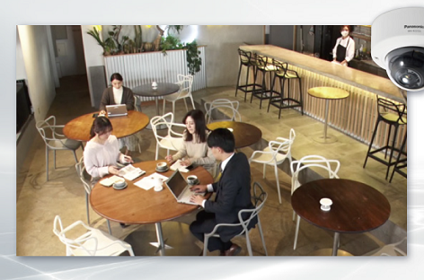
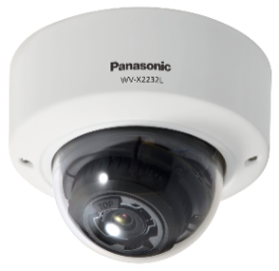
AI Occupancy Detection Application
Material for SE
App: AI Occupancy Detection
Document Ver.1.02
Jul. 2022

Slide 2
Contents
Product Description
Setting Guide
Concept
Key Features
Specification
Restrictions
Setting Flow
Camera Setting
Recorder Setting
ASM300 Setting

Slide 3
Product Description

Slide 4
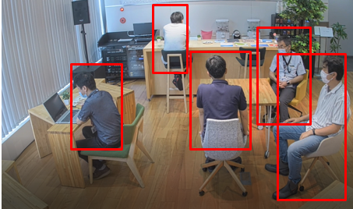
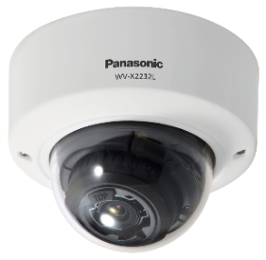


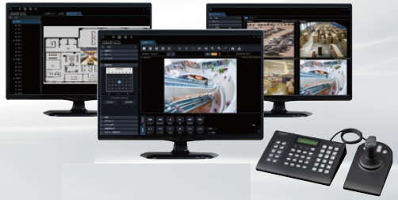

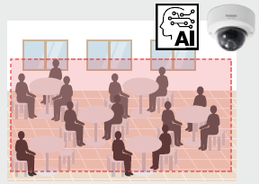
1. Concept
Occupancy Detection
Automatically detect “occupancy” and issue an alarm
Key Features
System linkage
Enable linkage with various systems by utilizing a range of alarm output interfaces
*Sample image of Occupancy Detection
Model | WV-XAE207W
Product name | AI Occupancy Detection
Supported cameras | i-PRO with AI engine 5MP models WV-X1551LN / WV-X2251L / WV-X2551LN i-PRO with AI engine 4K models WV-X1571LN / WV-X2271L / WV-X2571LN
Transmission of people number
Transmit the data on the number of people to the HTTP server on a regular basis
Data on the number of people

Slide 5




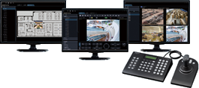


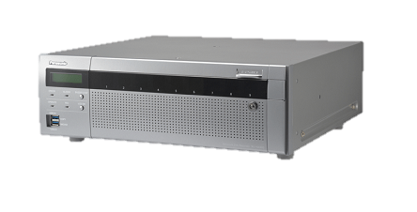
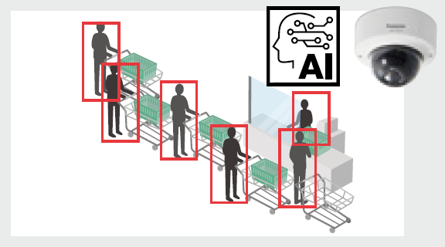
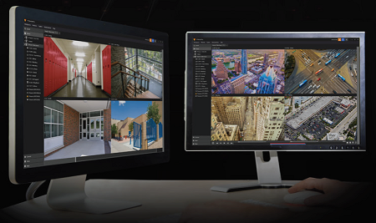
2. Key Features – System linkage
Linkage with video surveillance system
Enable linkage with other systems by utilizing various alarm output interfaces
Video data /
TCP alarm protocol notification
Occupancy Detection
Video Management Software
WV-ASM300
Network Disk Recorder
NX Series
VIDEO INSIGHT
Video data /
Additional information on the stream

Slide 6
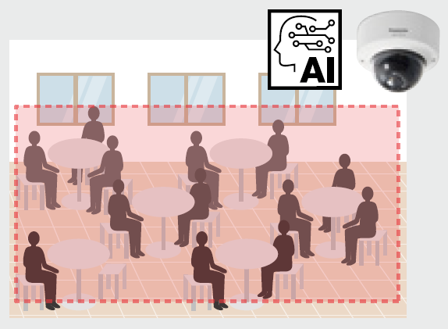
2. Key Features – Transmission of people number
Utilization of the data on the number of people
Transmit the data on the number of people to the HTTP server on a regular basis
Occupancy Detection
Dedicated application
Data on the number of people
HTTP server
* HTTP server required
Currently 5 people. 3 more people can enter.
Developing applications utilizing the data on the number of people enables suggestions for various solutions
Ex. Limits on the number of people
in a staff lounge
Refer to “WV-XAE207W External Interface Specification <C0319>” at the link below for the detail of HTTP transmission data.
https://i-pro.com/global/en/surveillance/training-support/support/technical-information

Slide 7
3. Specification
Detection Standard *1
Occupancy detection method | Performs occupancy detection when the number of people in a detection area reaches the configured value(a) for a certain period of time(b).
Subject size | 5MP models | Shoulder width: 43 - 1870 pix
 | 4K models | Shoulder width: 64 - 2800 pix
Max. number of detection | 40 people
Detectable angle of view | Angle of depression: within 45°
Installation site | Indoors including under the eaves
Illuminance | 50 lux or more around a subject
(*1) Note that those are theoretical
values and are not guaranteed.
Application Specifications
Detection area | Up to 4 areas
Detection number of people (a) | 1-40 people per area
Detection time (b) | 1-600 seconds per area
HTTP transmission destination | Up to 4 destinations
HTTP transmission interval | Select from 1min, 5min, 10min, 15min, 30min, and 60min
Supported browser | Mozilla Firefox / Google™ Chrome™ / Microsoft Edge

Slide 8

4. Restrictions
Software specification related
This application does not work when “90°” or “270°” is selected for [Image rotation].
This application does not perform occupancy detection in a privacy zone.
Performance related
Occupancy detection may not be performed properly when:
- only less than two-thirds of a subject body from shoulder to
head is captured
- a subject is lying down
Occupancy detection may be performed on the following objects:
- dolls, human in a poster, and so on
2/3 of the body from shoulder to head
Other
As for the restrictions when installing multiple extension software applications on a camera, refer to the support information “Compatibility list for extension software <C0103>” at the link below.
https://i-pro.com/global/en/surveillance/training-support/support/technical-information

Slide 9
Setting Guide

Slide 10
1. Setting Flow
The following flowchart describes the required settings for the linkage with NX series recorder and WV-ASM300 system.
Preparation
Install the extension software “WV-XAE207W” on the camera.
*For details, refer to the instruction manuals of WV-XAE207W
https://i-pro.com/global/en/surveillance/training-support/documentation-database-list
Camera setting
Configure occupancy detection setting, schedule, and TCP alarm protocol notification.
Recorder setting
Configure extension software alarm, camera site alarm, schedule, and TCP alarm protocol notification.
ASM300 setting
Configure extension software alarm and TCP alarm protocol reception.

Slide 11
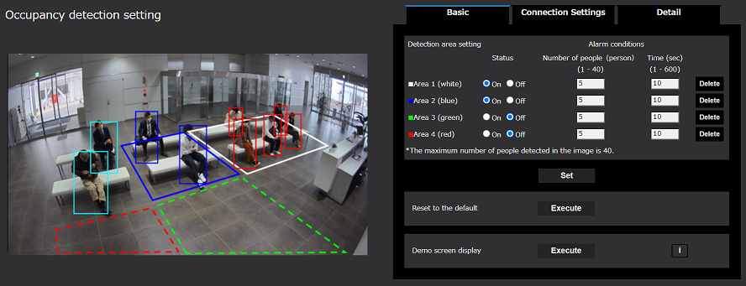
2. Camera Setting
Configure occupancy detection setting, schedule, and TCP alarm protocol notification.
*As for occupancy detection setting (Connection Settings / Detail) and TCP alarm protocol notification setting, refer to the “Reference” pages described later.
Occupancy detection setting (Basic)
Setup -> Ext. software-> AI Occupancy detection -> Basic
Detection area setting
Up to 4 polygon areas (with up to 16 sides) can be set.
Set whether or not to enable the occupancy detection.
Alarm conditions (Number of people)
Set the number of people to satisfy the condition for alarm generation in each area.
Configurable range: 1- 40 people
*Occupancy detection may not be performed properly when
the number of people set in each area exceeds 40 in total, as
the maximum detection number is 40.
Displays frames on the configured detection areas and the people detected.
People detection (red) : People in the area where an alarm has occurred
People detection (blue) : People in the detection areas
People detection (light blue) : People not in any detection areas
Alarm conditions (Time)
Set the time to satisfy the condition for alarm generation in each area.
Configurable range: 1 - 600 seconds

Slide 12
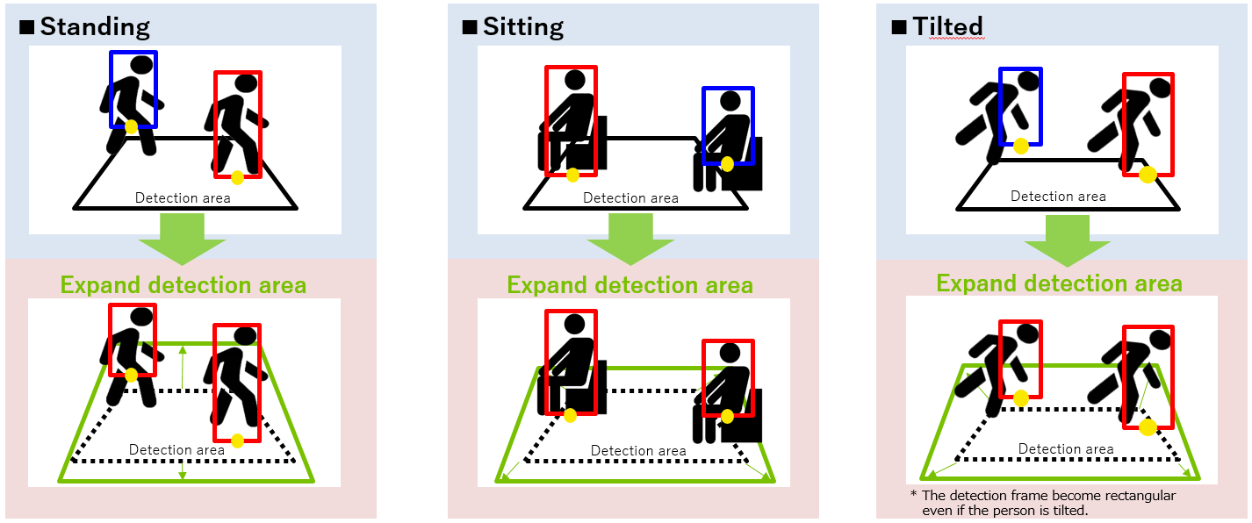
Reference : Notes on detection area setting
As a detection frame varies depending on the posture of a subject, set detection areas widely to fully cover the target area. This application recognizes the center bottom of a detection frame as its position. Set a detection area so that the center bottom of a detection frame is inside the detection area.

Slide 13
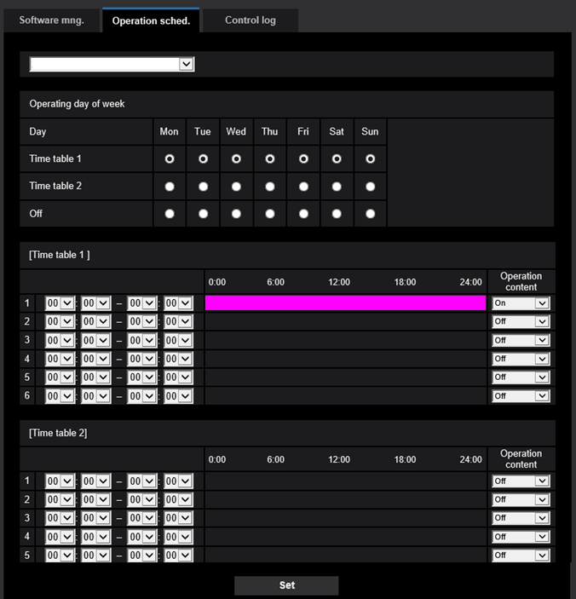
2. Camera Setting
Schedule setting
Setup -> Ext. software -> Operation sched.
*Default setting = 24-hour operation
AI Occupancy Detection
Extension software
Select “AI Occupancy Detection”.
Operating day of week
Select the day of week to activate AI Occupancy Detection for “Time table 1” and “Time table 2”.
AI Occupancy Detection does not operate on the day of week with “Off” selected.
Time table
Set the time to activate AI Occupancy Detection and operation content(On/Off). Up to 6 operating times can be set respectively for [Time table 1] and [Time table 2].

Slide 14
3. Recorder Setting
Configure extension software alarm, camera site alarm, schedule, and TCP alarm protocol notification. *As for the settings other than extension software alarm, refer to the “Reference” pages described later.
Extension software alarm setting
Extension software alarm
Go to [REC & event]-> [Advanced setup] tab -> [Extension software alarm], and click “Setup” to open the [Extension software alarm] setup screen.
Set an ID for AI Occupancy Detection alarm in an available line from No.5 to 8.
No.
No.1-4: reserved for AI-VMD
No.5-8: available
Name
Enter the name of alarm.
Ex. “AI Occupancy Detection (Area 1)”
Message ID
Enter an ID(Area 1-4: 98-101) for AI Occupancy Detection alarm.

Slide 15
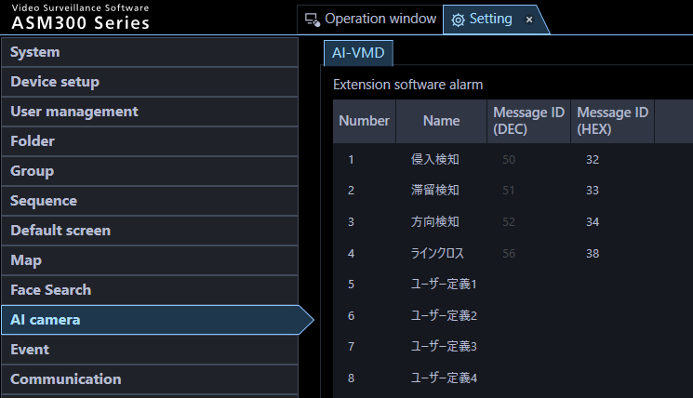

4. ASM300 Setting
Configure extension software alarm and TCP alarm protocol reception.
*As for TCP alarm protocol reception setting, refer to the “Reference” pages described later.
Extension software alarm setting
Setting -> AI camera -> AI-VMD
Set an ID for AI Occupancy Detection alarm in an available line from No.5 to 8.
No.
No.1-4: reserved for AI-VMD
No.5-8: available
Intruder
Name
Enter the name of alarm.
Ex. “AI Occupancy Detection (Area 1)”
Loitering
Direction
Cross Line
Message ID
Enter an ID(Area 1-4: 98-101) for AI Occupancy Detection alarm.
User-defined 1
User-defined 2
User-defined 3
User-defined 4

Slide 16
Reference:
Occupancy detection setting (Connection Settings)

Slide 17
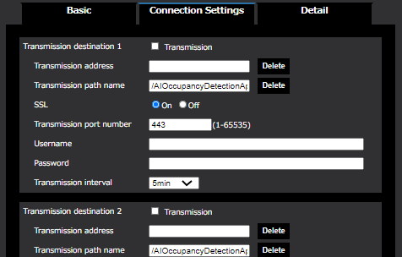
Occupancy detection setting (Connection Settings)
Setup -> Ext. software-> AI Occupancy detection -> Connection Settings
Transmission address
Set the IP address or host name of the HTTP server for transmission.
Transmission path name
Enter the path name of the destination.
SSL
Select whether or not to use SSL for transmission.
Transmission port number
Set the port number of the destination.
Username
Enter the user name for the authentication with the destination.
Transmission destination 1-4
The data on the number of people can be sent individually to up to four destinations through HTTP. Setting items for those four destinations are the same.
*Check “Transmission” to perform transmission.
Password
Enter the password for the authentication with the destination.
Transmission interval
Select the transmission interval from 1min, 5min, 10min, 15min, 30min, and 60min.

Slide 18
Overview of HTTP transmission data
Parameter name | Parameter value | Description
CameraIPaddress | (0~255).(0~255).(0~255).(0~255) | IP address of a camera
Time | Date and time (UTC) | Date and time (format: yyyy/mm/dd hh:mm:ss) Ex. In case of 12:35:00 on August 29, 2013 Japan time, “2013/08/29 03:35:00”
TimeZone | -1200~+1300 | Time difference from UTC Ex. In case of Osaka, Sapporo, and Tokyo: +0900
SummerTime | 0, 1 | Summer time setting 0: Not summer time, 1: Summer time
All.list | [“date and time(UTC)”, average number of people detected, number of people detected at the fixed time] | Statistics for occupancy on the entire screen Date and time: date and time information on a minute-by-minute basis Average number of people detected: average number of people detected per minute (from xx:xx:00 to xx:xx:59) Number of people detected at the fixed time: The number of people detected at the point of every “xx:xx:00”
All.current | 0~40 | The number of people detected on the entire screen at the time of transmission
Area1.list Area2.list Area3.list Area4.list | [“date and time(UTC)”, average number of people detected, number of people detected at the fixed time] | Statistics for occupancy on each detection area Date and time: date and time information on a minute-by-minute basis Average number of people detected: average number of people detected per minute (from xx:xx:00 to xx:xx:59) Number of people detected at the fixed time: The number of people detected at the point of every “xx:xx:00”
Area1.current Area2.current Area3.current Area4.current | 0~40 | The number of people detected on each detection area at the time of transmission
Refer to “WV-XAE207W External Interface Specification <C0319>” at the link below for the detail of HTTP transmission data
https://i-pro.com/global/en/surveillance/training-support/support/technical-information

Slide 19
Reference:
Occupancy detection setting (Detail)

Slide 20
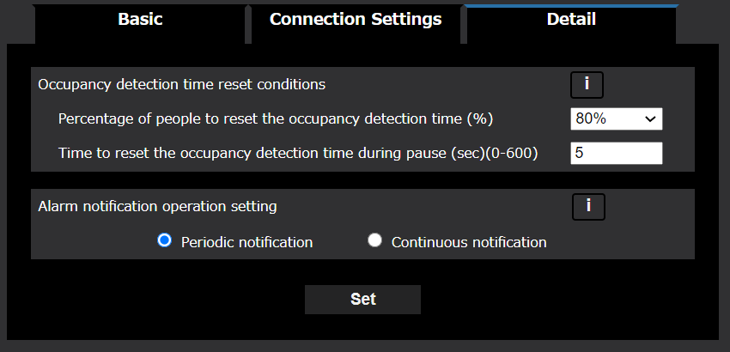
Occupancy detection setting (Detail)
Setup -> Ext. software-> AI Occupancy detection -> Detail
Occupancy detection time reset conditions
Alarm detection timer counts up to the time set in “Alarm conditions (Time)”.
Giving flexibility in “Occupancy detection time reset conditions” has allowed this application to recognize the occupancy even when the number of people detected temporarily decreases due to overlapping.
Although “Occupancy detection time reset conditions” can be changed on this screen, we basically recommend using it in default setting.
Default setting and its behavior
The number of people detected (d) | Behavior of alarm detection timer
[M] ≤ d | Starts counting up
d < [N] | Resets
[N] ≤ d < [M] | Pauses (resets after 5 seconds)
Alarm notification operation setting
Configure the alarm notification when “Alarm conditions (Number of people)” is continuously satisfied after detecting an occupancy.
Periodic notification : Notifies at the interval set in “Alarm
conditions (Time)”
Continuous notification: Notifies at the interval set in “Alarm
deactivation time” of a camera *1
M: Alarm conditions (Number of people)
N: Alarm conditions (Number of people) x 80%
*1 After an alarm for a detection area, alarms for all detection areas are not notified until "Alarm deactivation time" passes.
It will be improved from the version released in the future, and "Alarm deactivation time" will be applied only to the area where occupancy is detected.

Slide 21
Reference:
Alarm Linkage Procedure

Slide 22
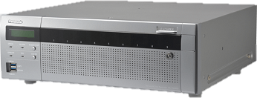
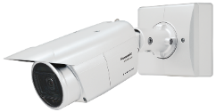

Setting Flow
Camera Setting
This section describes the required settings for the linkage with video surveillance system using TCP alarm protocol notification.
(1)
TCP alarm
System Configuration (Ex.)
Recorder Setting
Extension
software
Recorder
Camera site alarm
Camera
NX series
(2)
(2)
WV-XAE207W
WV-X1551LN
Schedule
.ext
192.168.0.250
Alarm notification
Monitoring software
192.168.0.21
TCP alarm
(1)
ASM300
(3)
ASM300 Setting
(3)
192.168.0.200
Alarm reception

Slide 23
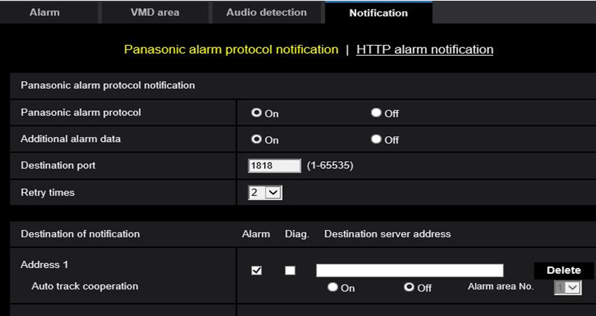
Camera Setting – TCP alarm protocol notification
Setup -> Alarm -> Notification -> TCP alarm protocol notification
Camera Setting
TCP alarm
Set [TCP alarm protocol] to “On”
Recorder Setting
Set [Additional alarm data] to “On”
Camera site alarm
Schedule
Tick “Alarm” and input IP address of NVR
TCP alarm
192.168.0.250
ASM300 Setting
Alarm reception

Slide 24
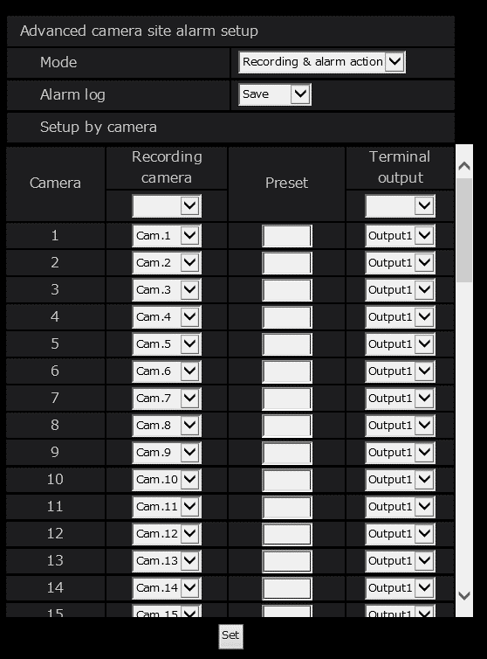
Recorder Setting – Camera site alarm
Setup -> REC & event -> Event setup -> Camera site alarm
Camera Setting
TCP alarm
Set the [Mode] option to “Recording & alarm action”
Recorder Setting
Camera site alarm
Schedule
TCP alarm
ASM300 Setting
Alarm reception

Slide 25
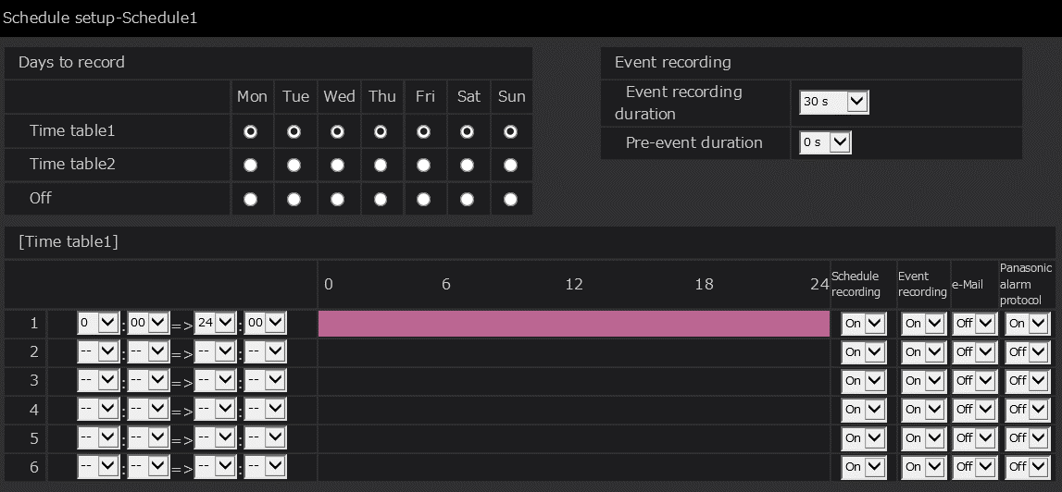
Recorder Setting – Schedule
Setup -> REC & event -> Recording setup -> Schedule
Camera Setting
TCP alarm
Recorder Setting
Set [TCP alarm protocol] to “On”
Camera site alarm
Schedule
Set [Event recording] to “On”
TCP alarm
ASM300 Setting
Alarm reception

Slide 26
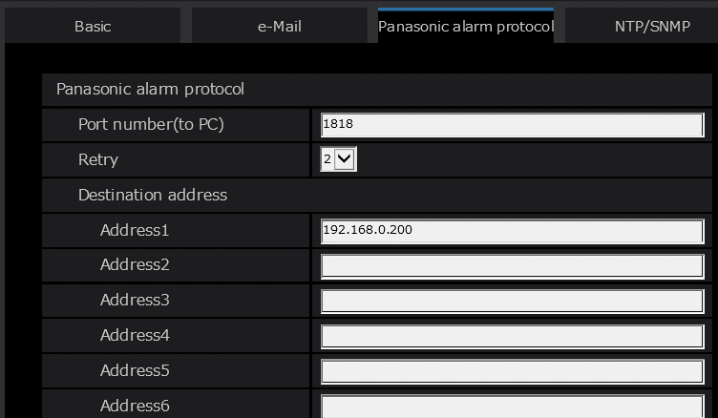
Recorder Setting – TCP alarm protocol
Setup -> Network -> TCP alarm protocol
Camera Setting
TCP alarm
Recorder Setting
Camera site alarm
Schedule
TCP alarm
Enter the IP address of the PC on which ASM300 is installed.
ASM300 Setting
Alarm reception

Slide 27
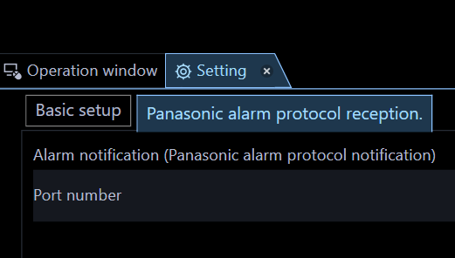
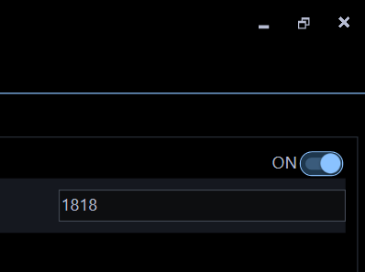
ASM300 Setting – TCP alarm protocol reception
Setting -> Communication -> TCP alarm protocol reception
Camera Setting
TCP alarm
Set [Alarm notification (TCP alarm protocol notification)] to “ON”
Recorder Setting
Camera site alarm
Schedule
TCP alarm
ASM300 Setting
Alarm reception

Slide 28
Version History

Slide 29
Version History
No | Update contents | Page No. | Version | Update
1 | 1st Version | - | 1.00 | 22.Mar.2021
2 | Corrected release date of the firmware corresponding "Alarm deactivation time" for each detection area. |  | 1.01 | 3.Jun.2021
3 | Support company name change | - | 1.02 | 14. Jul. 2022
4
5
6
7
8
9
10

