Slide 1
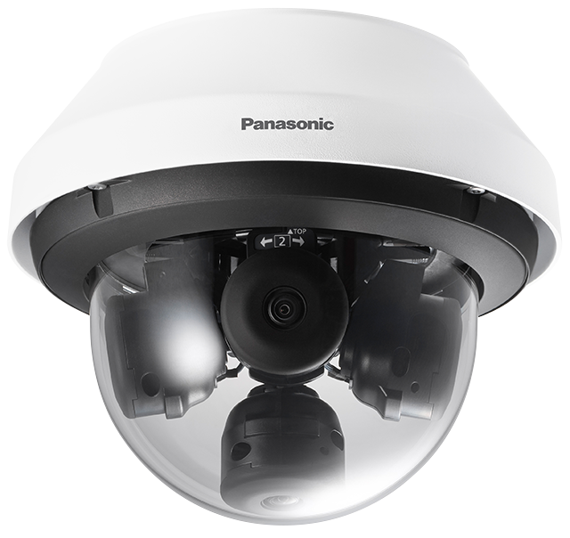
i-PRO Multi-sensor Camera
Material for SE
Model: WV-S8531N, WV-X8571N
Document Ver.1.01
Jul. 2022

Slide 2
Contents
Product Concept
Key features
Specification Comparison
Other Specifications
Appearance
Standard Accessories
Optional Accessories

Slide 3
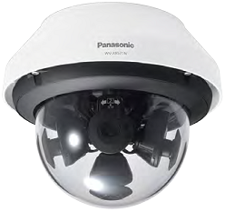
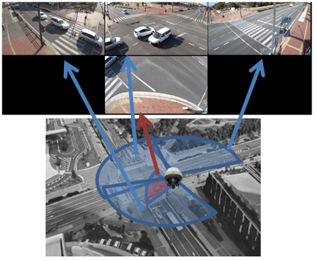
1. Product Concept
High resolution and monitoring with less blind spots at intersections and building periphery
Key features
New FHD / 4K Camera
High Visibility
Wide range tilt angle adjustment mechanism
- Four repositionable lenses with easy adjustment include a wide range tilt angle mechanism minimizes blind spots.
Intelligent Auto
- Automatically adjusts to the optimum image according to the shooting scene.
High Compression
Smart Coding
- Longer recording with less HDD capacity compared to any H.264 based compression technologies.
Continuous view assistance
- Automatically adjusts to the optimum field of view according to the shooting pattern (camera layout / shooting range).
Easy setting
- Easily set up with a smartphone or tablet device via Wi-Fi connection. *Sold separately Wi-Fi USB adapter is required.
High Simplicity
New
LINE UP: 2 models
 | Outdoor
FHD model | WV-S8531N
4K model | WV-X8571N

Slide 4
2. Key features - Continuous view assistance
Automatically optimizes the field of view according to the shooting pattern
After selecting camera layout and shooting range and adjusting the camera position with the position adjust sheet, user can automatically adjust. ^{*1}
Work time (Field of view adjustment)
Approx. 20 min
Approx. 6 min
Previous model (WV-S8530N/WV-X8570N)
Two cameras display the same area.
Manual adjustment is difficult and time-consuming.
New model (WV-S8531N/WV-X8571N)
1/3
Uses motorized zoom^{*2} to automatically adjust the field of view according to the cameras layout and shooting range.
^{*1} Refer to “Appendix” for details. (See page 17)
^{*2} 4K model adjusts the field of view by electronic zoom.

Slide 5
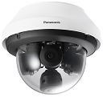
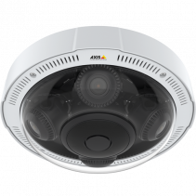
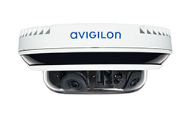
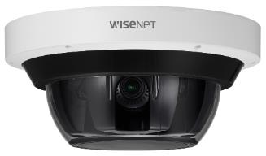
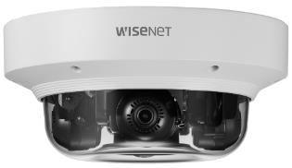
3. Specification Comparison
Comparison to other companies (FHD model)
*1 H.265/H.264 Stream transmission: Off
 | i-PRO | Axis | Avigilon | Hanwha
 | Outdoor | Outdoor | Outdoor | Outdoor
 | WV-X8531N | P3717-PLE | 12C-H4A-4MH-360 | PNM-9084RQZ | PNM-9084QZ
Video Codec | H.265/H.264/JPEG | H.264/JPEG | H.265/H.264/JPEG | H.265/H.264/JPEG
Image Sensor | 1/2.8” 2MP x 4 | 1/2.8” 2MP x 4 | 1/2.8” 3MP x 4 | 1/2.8" 2MP x 4
Max. Resolution | 1920 x 1080 | 1920 x 1080 | 2048 x 1536 | 1920 x 1080
Max. Frame rate | H.265/H.264: 30fps JPEG: 5fps (30fps *1) | H.264: 30fps JPEG: 30fps | H.265/H.264: 20fps JPEG: unknown | H.265/H.264: 60fps JPEG: 30fps
Lens | Optical zoom: x2.5 F number: 2.0 - 3.0 Focal length: 2.9 - 7.3 mm | Optical zoom: x2.0 F number: 1.8 - 2.6 Focal length: 3.0 - 6.0 mm | Optical zoom: x1.4 F number: 1.2 - 1.6 Focal length: 2.8 - 4.0 mm | Optical zoom: x3.1 F number: 1.6 – 2.9 Focal length: 3.2 - 10.0 mm | Optical zoom: x2.0 F number: 2.2 – 3.1 Focal length: 3.0 – 6.0 mm
Horizontal angle of view | Wide: 104 deg. / Tele: 45 deg. | Wide: 96 deg. / Tele: 49 deg. | Wide: 103 deg. / Tele: 72 deg. | Wide: 109 deg. / Tele: 33.2 deg. | Wide: 107 deg. / Tele: 56.3 deg.
Swing Eye | Yes | No | No | No
Corridor | No | Yes | No | Yes
Dynamic range | Super-D: 120dB | Forensic WDR: unknown | true WDR: 100dB | WDR: 120dB
Sensitivity (color) | 0.05 lx | 0.17lx | 0.025lx | 0.05lx | 0.04lx
Smart Coding | GOP control / AUTO VIQS | Zipstream | HDSM SmartCodec | WiseStreamⅡ
Analytics detection | No (only VMD) | Option (Loitering, etc.) | Yes (Loitering, etc.) | Yes (Loitering, etc.)
Clear Sight coating | Yes | No | No | No
Audio / IO terminal | No / No | Option / Option | Yes / Yes | Yes / Yes
IR-LED | No | Yes (15m) | Option (30m) | Yes (30m) | No
Power Source | PoE+ | PoE+ | PoE+ / DC24V / AC24V With IR: PoE++ | PoE++ / DC12V | PoE++
Operating Temperature | -40 to +60 deg.C | -30 to +50 deg.C | -10 to +50 deg.C | -40 to +55 deg.C

Slide 6
3. Specification Comparison
Comparison to other companies (4K model)
*1 H.265/H.264 Stream transmission: Off
 | i-PRO | Avigilon
 | Outdoor | Outdoor
 | WV-X8571N | 32C-H4A-4MH-360
Video Codec | H.265/H.264/JPEG | H.265/H.264/JPEG
Image Sensor | 1/1.8” 8MP x 4 | 1/2.5” 8MP x 4
Max. Resolution | 3840 x 2160 | 3840 x 2160
Max. Frame rate | H.265/H.264: 15fps JPEG: 5fps (15fps *1) | H.265/H.264: 10fps JPEG: unknown
Lens | Optical zoom: x1.0 F number: 1.6 Focal length: 4.6 mm | Optical zoom: x1.3 F number: 1.8 - 1.8 Focal length: 4.0 – 5.2 mm
Horizontal angle of view | 97 deg. | Wide: 101 deg. / Tele: 70 deg.
Swing Eye | Yes | No
Corridor | No | No
Dynamic range | Super-D: 120dB | true WDR: 100dB
Sensitivity (color) | 0.12 lx | 0.2lx
Smart Coding | GOP control / AUTO VIQS | HDSM SmartCodec
Analytics detection | No (only VMD) | Yes (Loitering, etc.)
Clear Sight coating | Yes | No
Audio / IO terminal | Yes (only Input) / Yes | Yes / Yes
IR-LED | No | Option (30m)
Power Source | PoE+ / DC12V | PoE+ / DC24V / AC24V With IR: PoE++
Operating Temperature | -40 to +60 deg.C | -40 to +60 deg.C

Slide 7
3. Specification Comparison
Comparison of new & Previous models (FHD model)
 | New FHD model (WV-S8531N) | Previous FHD model (WV-S8530N)
Image capture mode | 16:9(30fps) / 16:9(25fps) | 16:9(30fps) / 4:3(30fps)
Compression method | H.265[or H.264](1)(2) / JPEG(1) | H.265[or H.264](1)(2) / JPEG(1)(2)
Optical zoom | x2.5 *Motorized zoom | x1.8 *Manual zoom
Min. adjustment deg. (PAN/TILT/YAW) | PAN / TILT/ YAW : 2.5 deg. | PAN : 2.5 deg. , TILT / YAW : 5.0 deg.
Dynamic range | Super-D 120dB | Super-D 108dB
Sensitivity (color) | 0.05lx | 0.09lx
Maximum user number | 24 | 24
Transmission mode | VBR / CBR / Framerate / Best Effort *Default : VBR | VBR / CBR / Framerate / Best Effort *Default : Framerate
Smart Coding | GOP Control / Auto VIQS *only stream(1) | GOP Control / Auto VIQS
Intelligent Auto | Yes | Yes
SD recording | Yes (H.265 / H.264) | Yes (H.265 / H.264)
IO terminal | No | No
Power Source | PoE+ | PoE
Power Consumption | 390mA / 22W | 210mA / 10.1W
ONVIF | Profile S / G | Profile S / G
FTP | No | Yes
Continuous view assistance | Yes | No

Slide 8
3. Specification Comparison
Comparison of new & Previous models (4K model)
 | New 4K model (WV-X8571N) | Previous 4K model (WV-X8570N)
Image capture mode | 16:9(15fps) / 16:9(12.5fps) | 16:9(15fps)
Compression method | H.265[or H.264](1)(2) / JPEG(1) | H.265[or H.264](1)(2) / JPEG(1)(2)
Optical zoom | x1.0 | x1.0
Min. adjustment deg. (PAN/TILT/YAW) | PAN / TILT/ YAW : 2.5 deg. | PAN : 2.5 deg. , TILT / YAW : 5.0 deg.
Dynamic range | Super-D 120dB | Super-D 108dB
Sensitivity (color) | 0.12lx | 0.12lx
Maximum user number | 24 | 24
Transmission mode | VBR / CBR / Framerate / Best Effort *Default : VBR | VBR / CBR / Framerate / Best Effort *Default : Framerate
Smart Coding | GOP Control / Auto VIQS *only stream(1) | GOP Control / Auto VIQS
Intelligent Auto | Yes | Yes
SD recording | Yes (H.265 / H.264) | Yes (H.265 / H.264)
IO terminal | Yes | Yes
Power Source | PoE+ / DC12V | PoE
Power Consumption | [PoE+] 350mA / 20W [DC12V] 1.2A / 15W | 265mA / 12.95W
ONVIF | Profile S / G | Profile S / G
FTP | No | Yes
Continuous view assistance | Yes | No

Slide 9
4. Other Specifications
DORI
DORI (Detect, Observe, Recognize, Identify) is a standard system (EN-62676-4) for defining the ability of a camera to distinguish persons or objects within a covered area. This value does not indicate the performance of the camera.
The maximum distance at which a camera/lens combination can meet these criteria is shown below:
*1
WV-S8531N
FHD model
Resolution : 1920 x 1080 |  | Tele : 45 deg. |  | Wide : 104 deg.
 |  | Unit : m | Unit : feet | Unit : m | Unit : feet
Detect | 25ppm / 8ppf | 92.7 | 304.2 | 30.0 | 98.4
Observe | 62.5ppm / 19ppf | 37.1 | 121.7 | 12.0 | 39.4
Recognize | 125ppm / 38ppf | 18.5 | 60.8 | 6.0 | 19.7
Identify | 250ppm / 76ppf | 9.3 | 30.4 | 3.0 | 9.8
WV-X8571N
4K model
Resolution : 1920 x 1080 |  | 97 deg.
 |  | Unit : m | Unit : feet
Detect | 25ppm / 8ppf | 67.9 | 222.9
Observe | 62.5ppm / 19ppf | 27.2 | 89.2
Recognize | 125ppm / 38ppf | 13.6 | 44.6
Identify | 250ppm / 76ppf | 6.8 | 22.3
*1 Calculated with the camera installed horizontally

Slide 10
4. Other Specifications
Supported Resolution (FHD model)
*Underline is default value
*1
Image capture mode | Camera | Stream(1) | Stream(2) | JPEG(1)
16:9 30fps mode(25fps mode) | Cam.1 - Cam.4 *1 | 1920x1080 1280x720 *2 | 1280x720 *2 640x360 320x180 | 1920x1080 1280x720 640x360 320x180
 |  | Max 30(25) fps | Max 30(25) fps | Max 5(4.2) fps *3
*1 Image capture size and frame rate settings etc, are common to Cam.1 - Cam.4.
*2 Cannot set 1280x720 resolution for both stream (1) and stream (2).
*3 When "Off” is selected for each stream transmission, maximum framerate is 30fps(25fps).

Slide 11
4. Other Specifications
Supported Resolution (4K model)
*Underline is default value
Image capture mode | Camera | Stream(1) | Stream(2) | JPEG(1)
16:9 15fps mode(12.5fps mode) | Cam.1 - Cam.4 *1 | 3840x2160 2560x1440 1920x1080 | 1280x720 640x360 320x180 | 3840x2160 2560x1440 1920x1080 1280x720 640x360 320x180
 |  | Max 15(12.5) fps | Max 15(12.5) fps | Max 5(4.2) fps *2
*1 Image capture size and frame rate settings etc, are common to Cam.1 - Cam.4.
*2 When "Off” is selected for each stream transmission, maximum framerate is 15fps(12.5fps).

Slide 12
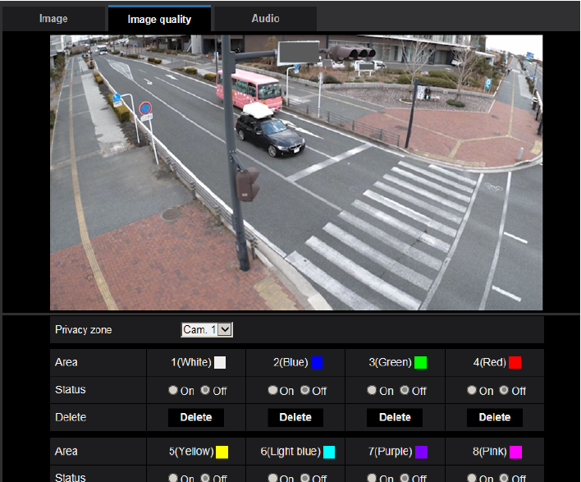
4. Other Specifications
Privacy zone setting
Previous model (WV-S8530N/WV-X8570N)
New model (WV-S8531N/WV-X8571N)
Privacy zone can be set by rectangle.
Privacy zone can be set by designating 4 points on the screen.

Slide 13
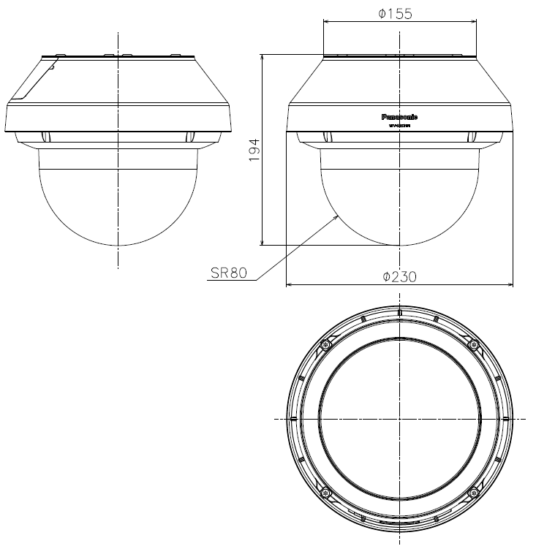
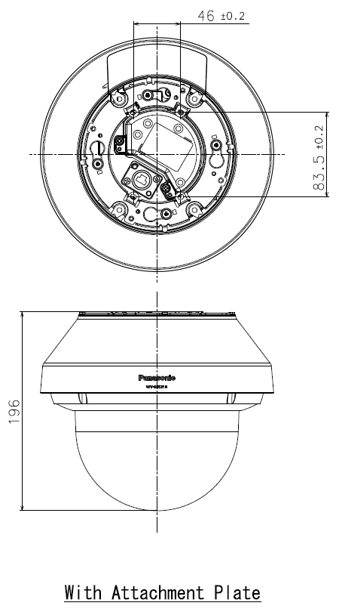
5. Appearance
WV-S8531N
Color
: i-pro white
Finish
: Aluminum die cast
Dimensions
: ø230 mm x 196 mm (H) {ø9-1/16 inches x 7-23/32 inches (H)}
: Dome radius 80 mm {3-5/32 inches}
Weight
: Approx. 2.7 kg {5.96 lbs}
Note: No change from previous model except Color

Slide 14
5. Appearance
WV-X8571N
Color
: i-pro white
Finish
: Aluminum die cast
Dimensions
: ø230 mm x 196 mm (H) {ø9-1/16 inches x 7-23/32 inches (H)}
: Dome radius 80 mm {3-5/32 inches}
Weight
: Approx. 2.8 kg {6.17 lbs}
Note: No change from previous model except Color

Slide 15
6. Standard Accessories
WV-S8531N
No. | Standard accessories | Qt.
1 | Installation Guide | 1 pc.
2 | Important Safety Instructions | 1 pc.
3 | Warranty card | 1 pc.
4 | Code label | 1 pc.
5 | Attachment plate | 1 pc.
6 | Template A (for the attachment plate) | 1 sheet
7 | Waterproof tape | 1 pc.
8 | RJ45 waterproof connector cover | 1 pc.
9 | RJ45 waterproof connector cap | 1 pc.
10 | Bit (Hex wrench, screw size 6.35 mm {1/4 inches} T20) | 1 pc.
11 | Wire lug plate | 1 pc.
12 | Extended safety wire | 1 pc.
13 | Rain wash coating label | 1 pc.
[Abolition Parts]
- CD-ROM
- Base bracket *Lineup as Optional Accessories (See page 16)

Slide 16
6. Standard Accessories
WV-X8571N
No. | Standard accessories | Qt.
1 | Installation Guide | 1 pc.
2 | Important Safety Instructions | 1 pc.
3 | Warranty card | 1 pc.
4 | Code label | 1 pc.
5 | Attachment plate | 1 pc.
6 | Template A (for the attachment plate) | 1 sheet
7 | Waterproof tape | 1 pc.
8 | RJ45 waterproof connector cover | 1 pc.
9 | RJ45 waterproof connector cap | 1 pc.
10 | Bit (Hex wrench, screw size 6.35 mm {1/4 inches} T20) | 1 pc.
11 | Wire lug plate | 1 pc.
12 | Extended safety wire | 1 pc.
13 | Rain wash coating label | 1 pc.
14 | Ferrite core | 1 pc.
No. | Standard accessories | Qt.
15 | 4P alarm cable | 1 pc.
16 | 2P power cable | 1 pc.
[Abolition Parts]
- CD-ROM
- Base bracket *Lineup as Optional Accessories (See page 16)

Slide 17
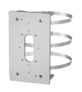
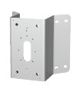
7. Optional Accessories
WV-S8531N / WV-X8571N
No. | Model No. | Image | Description
10 | WV-QSR502A-W |  | Mount Bracket (i-PRO white)
11 | WV-Q187 |  | Mount Bracket (light gray)
12 | WV-QPL500-W |  | Pole Mount Bracket (i-PRO white) *1
13 | WV-Q182 |  | Pole Mount Bracket (light gray) *1
14 | WV-Q188 |  | Pole Mount Bracket (fine sliver) *1
15 | WV-QCN500-W |  | Corner Mount Bracket (i-PRO white) *1
16 | WV-Q183 |  | Corner Mount Bracket (light gray) *1
17 | WV-Q189 |  | Corner Mount Bracket (fine silver) *1
18 | WV-Q105A |  | Ceiling Mount Bracket *2
19 | WV-QJB501-W |  | Base bracket (i-PRO white)
No. | Model No. | Image | Description
1 | WV-QCL501-W |  | Ceiling Mount Bracket (i-PRO white) *1
2 | WV-Q178 |  | Ceiling Mount Bracket (light gray) *1
3 | WV-Q121BS |  | Ceiling Mount Bracket (fine silver) *1
4 | WV-QWL501-W |  | Wall Mount Bracket (i-PRO white) *1
5 | WV-Q185 |  | Wall Mount Bracket (light gray) *1
6 | WV-Q122AS |  | Wall Mount Bracket (fine silver) *1
7 | WV-QAT500-W |  | Attachment Pipe Bracket (i-PRO white) *1
8 | WV-Q179 |  | Attachment Pipe Bracket (light gray) *1
9 | WV-Q123A |  | Attachment Pipe Bracket (fine silver) *1
*1 Refer to the Support Information page for the accessary combination required for installation.
*2 WV-Q105A is “for indoor use only” when installing on the ceiling.

Slide 18
Appendix:
Continuous view assistance

Slide 19
Continuous view assistance - Flowchart
Follow the below steps to complete the field of view adjustment using “Continuous view assistance”.
Open the setup screen
Open the screen for [Easy installation].
Select a layout
Select a layout of cameras for image capturing.
Select a shooting range
Select a shooting range from 360°, 270°, or 180°.
Adjust horizontal position
Manually adjust the horizontal (PAN) position of cameras using position adjustment sheet.
Auto adjust zoom
Automatically adjusts the zoom according to the camera layout and shooting range.

Slide 20
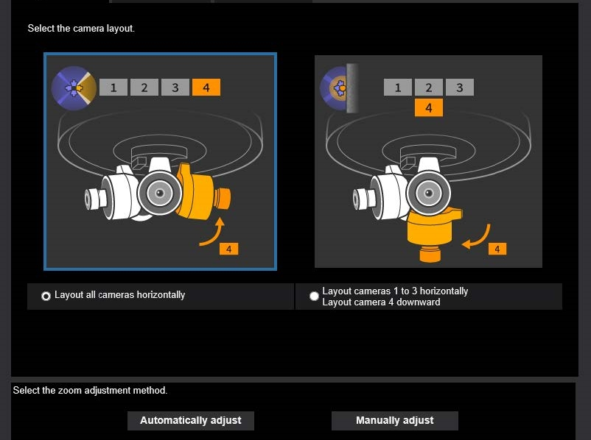
Open the setup screen
When connecting via LAN
[Setup] -> [Easy Setup] -> [Easy installation]
Open the setup screen
Connect through a Wi-Fi USB adapter
Connect a Wi-Fi USB adapter (locally procured) to the USB terminal.
Accessing the camera from a tablet or smartphone opens the layout selection menu.
Select a layout
Select a shooting range
Adjust horizontal position
*Use a verified Wi-Fi USB adapter.
For the verification information and how to establish wireless
LAN communication, refer to the below technical information.
Auto adjust zoom
https://www.psn-web.net/ssbu-t/Support/usbad_info_en4.pdf

Slide 21
Select a layout
Open the setup screen
1. Select a layout for image capturing
- Layout all cameras horizontally
- Layout cameras 1 to 3 horizontally
Layout camera 4 downward
2. Clicking “Automatically adjust” button opens the screen for selecting a shooting range.
Select a layout
Select a shooting range
*Automatic adjustment is based on the angle (= 80 °) where the vertical (TILT) angle of the camera is the most upward.
In other cases, fine-tune the zoom manually as needed.
1
Adjust horizontal position
2
Auto adjust zoom

Slide 22
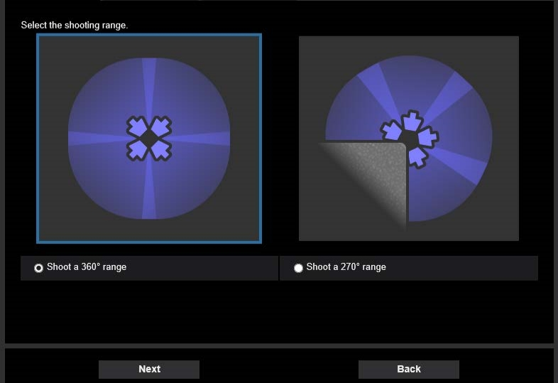
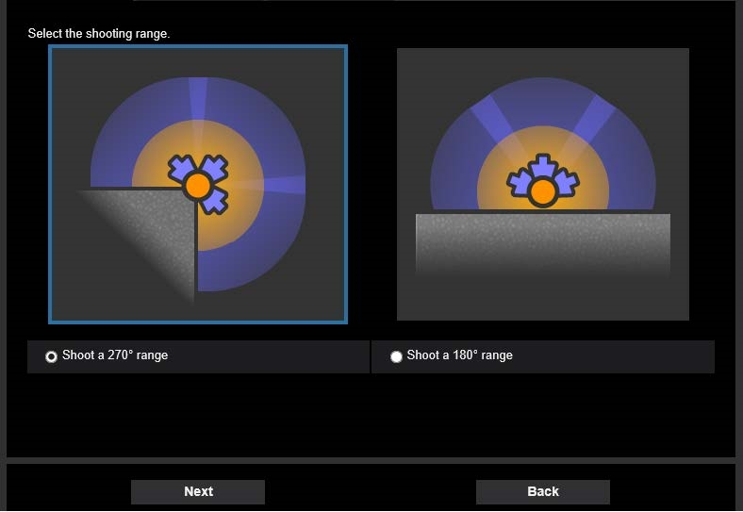
Select a shooting range
In case of “Layout all cameras horizontally”
In case of “Layout cameras1 to 3 horizontally Layout camera 4 downward”
Open the setup screen
Select a layout
Select a shooting range
3
3
Adjust horizontal position
4
4
3. Select a shooting range from 360°, 270°, or 180°.
4. Clicking “Next” button opens the window for camera direction adjustment.
Auto adjust zoom

Slide 23
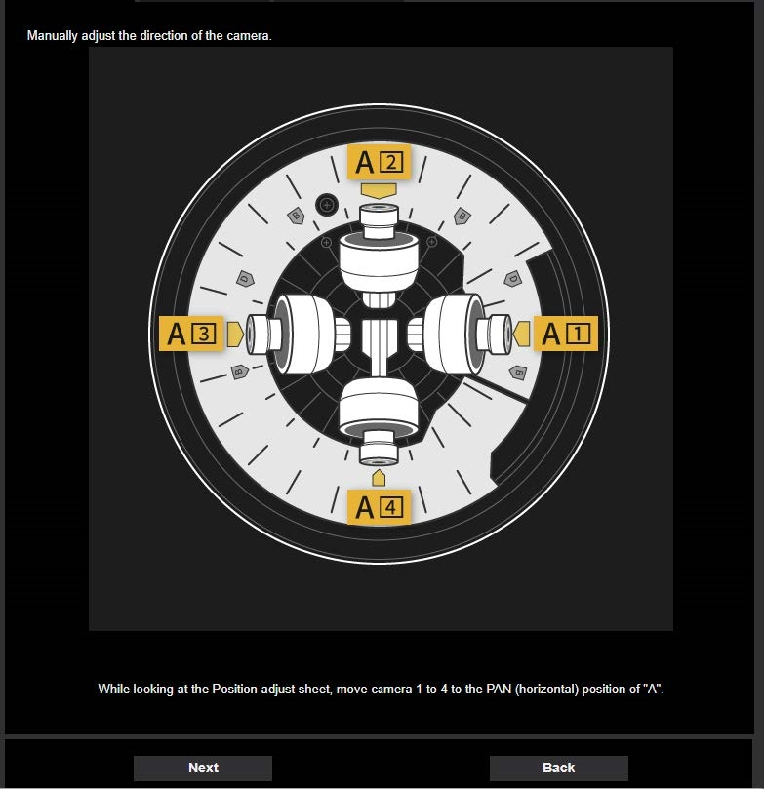
Adjust horizontal position
5. Manually adjust the horizontal (PAN) position of cameras using position adjust sheet attached in the product.
*Remove the sheet after the setting is completed as it may
cause reflection of light that can affect the image quality.
[Layout all cameras horizontally]
For 360° view - Position[A]
For 270° view - Position[B]
[Layout cameras1 to 3 horizontally/Layout camera 4 downward]
For 270° view - Position[C]
For 180° view - Position[D]
6. Clicking the “Next” button executes automatic zoom adjustment.
Open the setup screen
5
Select a layout
Select a shooting range
Adjust horizontal position
6
Auto adjust zoom
*In the above sample screen, [Layout all cameras horizontally]
and [Shoot a 360° range] are selected.

Slide 24
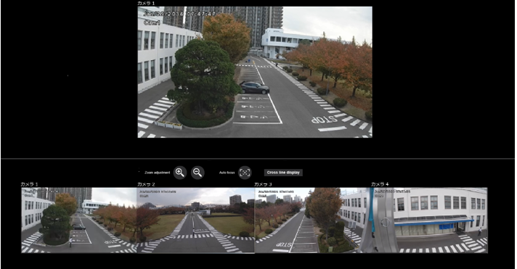
Auto adjust zoom
7. Automatically adjusts the zoom according to the camera layout and shooting range.
*FHD model performs focus adjustment as well.
*Adjusting the zoom in order from Camera 1.
Open the setup screen
Select a layout
Select a shooting range
8. If needed, manually fine-adjust the zoom after automatic adjustment.
Adjust horizontal position
8
Auto adjust zoom

Slide 25
Appendix:
Image quality comparison (FHD model)

Slide 26
Summary
i-PRO S8531N
i-PRO S8530N
SD : ON, iA : ON, AGC : 9
H265, VBR, 30fps, MAX bitrate : 20480 kbps, image quality : 3
Smart coding : OFF
* Other setting parameters are default values.
AXIS P3717-PLE
SD : ON, AGC : 48dB
H264, VBR, 30fps, image quality : 3
Zipstream : OFF
* Other setting parameters are default values.
Avigilon 12C-H4A-4MH-360
SD : ON, AGC : 72dB
H264, VBR, 20fps, MAX bitrate : 12000 kbps, image quality : 6
HDSM SmartCodec : OFF
* Other setting parameters are default values.
Hanwha PNM-9084QZ
SD : ON, AGC : high
H265, VBR, 30fps, MAX bitrate : 10000 kbps
WiseStream : OFF
* Other setting parameters are default values.
Scoring method: Scored by deducting and adding points beginning with 3 points.

Slide 27
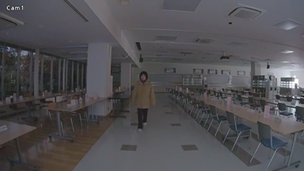
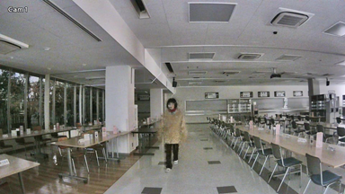
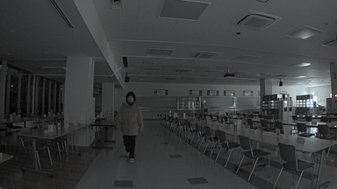
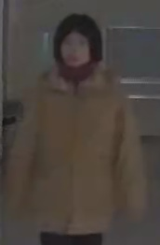
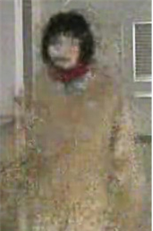
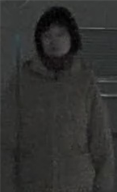
Low light (Illuminance : 0.3 – 0.7 lux)
i-PRO S8531N
i-PRO S8530N
AXIS P3717-PLE
3 points
2.5 points
3 points
Evaluation item | Score
Face visibility | -0.5
Sensitivity, S/N | +0.5
Brightness | +0
Resolution | +0
Color reproduction | +0
Evaluation item | Score
Face visibility | -0.5
Sensitivity, S/N | -1
Brightness | +1
Resolution | +0
Color reproduction | +0
Evaluation item | Score
Face visibility | +0
Sensitivity, S/N | +0.5
Brightness | -0.5
Resolution | +0
Color reproduction | +0
Measured bit rate: 710kbps
Measured bit rate: 1412kbps
Measured bit rate: 1189kbps

Slide 28
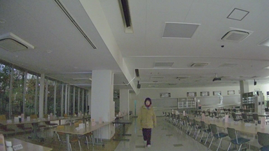
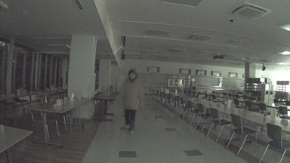
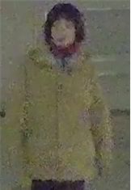
Low light (Illuminance : 0.3 – 0.7 lux)
i-PRO S8531N
Avigilon 12C-H4A-4MH-360
Hanwha PNM-9084QZ
3 points
3 points
1.5 points
Evaluation item | Score
Face visibility | -0.5
Sensitivity, S/N | +0.5
Brightness | +0
Resolution | +0
Color reproduction | +0
Evaluation item | Score
Face visibility | +0
Sensitivity, S/N | -1
Brightness | +0.5
Resolution | +0
Color reproduction | +0.5
Evaluation item | Score
Face visibility | -0.5
Sensitivity, S/N | -1
Brightness | +0
Resolution | +0
Color reproduction | +0
Measured bit rate: 710kbps
Measured bit rate: 5067kbps
Measured bit rate: 6488kbps

Slide 29
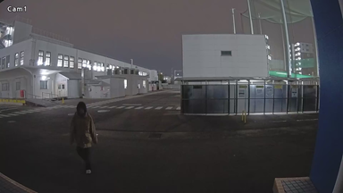
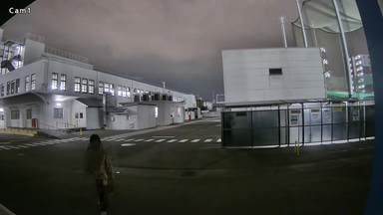
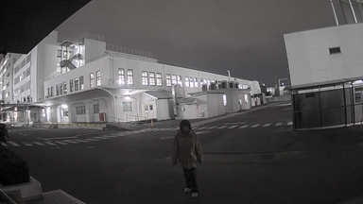
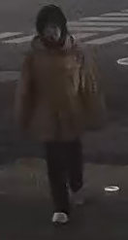
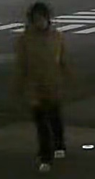
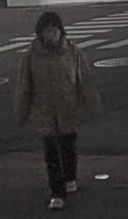
Night time Outdoor (Illuminance : 0.3 – 0.7 lux)
i-PRO S8531N
i-PRO S8530N
AXIS P3717-PLE
4.5 points
2 points
4.5 points
Evaluation item | Score
Face visibility | +0
Sensitivity, S/N | +0.5
Brightness | +0.5
Resolution | +0
Color reproduction | +0.5
Evaluation item | Score
Face visibility | -0.5
Sensitivity, S/N | -0.5
Brightness | -0.5
Resolution | +0
Color reproduction | +0.5
Evaluation item | Score
Face visibility | +0
Sensitivity, S/N | +0.5
Brightness | +0.5
Resolution | +0
Color reproduction | +0.5
Measured bit rate: 649kbps
Measured bit rate: 606kbps
Measured bit rate: 1100kbps

Slide 30
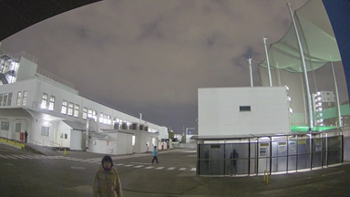
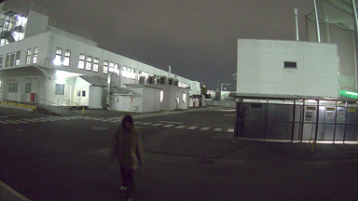
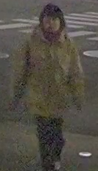
Night time Outdoor (Illuminance : 0.3 – 0.7 lux)
i-PRO S8531N
Avigilon 12C-H4A-4MH-360
Hanwha PNM-9084QZ
4.5 points
3 points
2.5 points
Evaluation item | Score
Face visibility | +0
Sensitivity, S/N | +0.5
Brightness | +0.5
Resolution | +0
Color reproduction | +0.5
Evaluation item | Score
Face visibility | +0
Sensitivity, S/N | -1
Brightness | +0.5
Resolution | +0
Color reproduction | +0.5
Evaluation item | Score
Face visibility | -0.5
Sensitivity, S/N | -0.5
Brightness | +0
Resolution | +0
Color reproduction | +0.5
Measured bit rate: 649kbps
Measured bit rate: 2686kbps
Measured bit rate: 6552kbps

Slide 31
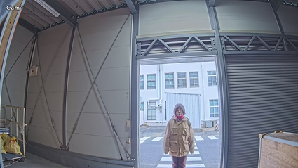
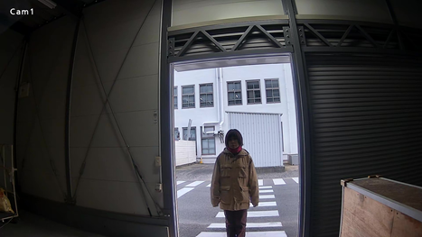
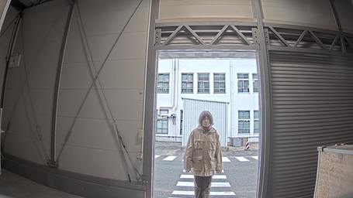
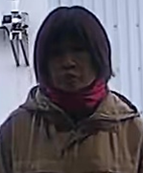
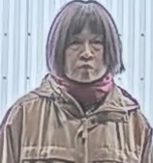
SD Day time
i-PRO S8531N
i-PRO S8530N
AXIS P3717-PLE
4.5 points
2 points
4.5 points
Evaluation item | Score
Face visibility | +0
Sensitivity, S/N | +0
Brightness | +1
Resolution | +0
Color reproduction | +0.5
Evaluation item | Score
Face visibility | -1
Sensitivity, S/N | +0
Brightness | -0.5
Resolution | +0
Color reproduction | +0.5
Evaluation item | Score
Face visibility | +1
Sensitivity, S/N | +0
Brightness | +1
Resolution | +0
Color reproduction | -0.5
Measured bit rate: 1059kbps
Measured bit rate: 736kbps
Measured bit rate: 1466kbps

Slide 32
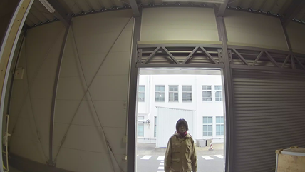
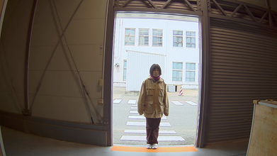
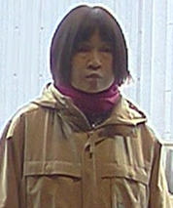
SD Day time
i-PRO S8531N
Avigilon 12C-H4A-4MH-360
Hanwha PNM-9084QZ
4.5 points
2.5 points
3.5 points
Evaluation item | Score
Face visibility | +0
Sensitivity, S/N | +0
Brightness | +1
Resolution | +0
Color reproduction | +0.5
Evaluation item | Score
Face visibility | +0
Sensitivity, S/N | +0
Brightness | +0
Resolution | -0.5
Color reproduction | +0
Evaluation item | Score
Face visibility | +0.5
Sensitivity, S/N | +0
Brightness | +0
Resolution | +0
Color reproduction | +0
Measured bit rate: 1059kbps
Measured bit rate: 646kbps
Measured bit rate: 3397kbps

Slide 33
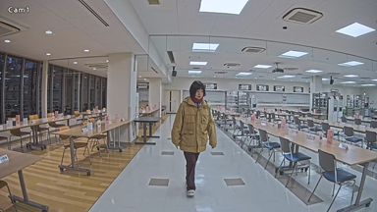
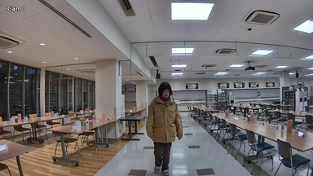
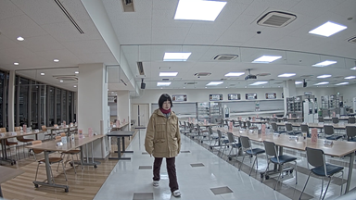
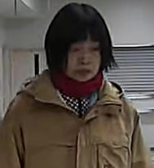
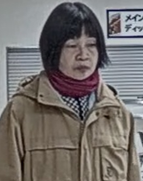
Day time Indoor
i-PRO S8531N
i-PRO S8530N
AXIS P3717-PLE
4.5 points
3 points
4.5 points
Evaluation item | Score
Face visibility | +0.5
Sensitivity, S/N | +0
Brightness | +0.5
Resolution | +0
Color reproduction | +0.5
Evaluation item | Score
Face visibility | +0
Sensitivity, S/N | +0
Brightness | -0.5
Resolution | +0
Color reproduction | +0.5
Evaluation item | Score
Face visibility | +1
Sensitivity, S/N | +0
Brightness | +0.5
Resolution | +0
Color reproduction | +0
Measured bit rate: 1302kbps
Measured bit rate: 1036kbps
Measured bit rate: 1516kbps

Slide 34
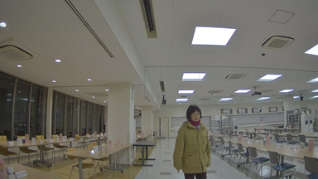
Day time Indoor
i-PRO S8531N
Avigilon 12C-H4A-4MH-360
Hanwha PNM-9084QZ
4.5 points
2.5 points
3.5 points
Evaluation item | Score
Face visibility | +0.5
Sensitivity, S/N | +0
Brightness | +0.5
Resolution | +0
Color reproduction | +0.5
Evaluation item | Score
Face visibility | +0
Sensitivity, S/N | +0
Brightness | +0
Resolution | -0.5
Color reproduction | +0
Evaluation item | Score
Face visibility | +0
Sensitivity, S/N | +0
Brightness | +0
Resolution | +0
Color reproduction | +0.5
Measured bit rate: 1302kbps
Measured bit rate: 604kbps
Measured bit rate: 1461kbps

Slide 35
Day time Outdoor
i-PRO S8531N
i-PRO S8530N
AXIS P3717-PLE
4.5 points
3 points
4.5 points
Evaluation item | Score
Face visibility | +0.5
Sensitivity, S/N | +0
Brightness | +0.5
Resolution | +0.5
Color reproduction | +0
Evaluation item | Score
Face visibility | +0
Sensitivity, S/N | +0
Brightness | -0.5
Resolution | +0
Color reproduction | +0.5
Evaluation item | Score
Face visibility | +0.5
Sensitivity, S/N | +0
Brightness | +0.5
Resolution | +0.5
Color reproduction | +0
Measured bit rate: 6016kbps
Measured bit rate: 3662kbps
Measured bit rate: 4766kbps

Slide 36
Day time Outdoor
i-PRO S8531N
Avigilon 12C-H4A-4MH-360
Hanwha PNM-9084QZ
4.5 points
2 points
3.5 points
Evaluation item | Score
Face visibility | +0.5
Sensitivity, S/N | +0
Brightness | +0.5
Resolution | +0.5
Color reproduction | +0
Evaluation item | Score
Face visibility | -0.5
Sensitivity, S/N | +0
Brightness | +0
Resolution | -0.5
Color reproduction | +0
Evaluation item | Score
Face visibility | +0.5
Sensitivity, S/N | +0
Brightness | +0
Resolution | +0
Color reproduction | +0
Measured bit rate: 6016kbps
Measured bit rate: 2553kbps
Measured bit rate: 9207kbps

Slide 37
Appendix:
Image quality comparison (4K model)

Slide 38
Summary
i-PRO X8571N
i-PRO X8570N
SD : ON, iA : ON, AGC : 9
H265, VBR, 30fps, MAX bitrate : 20480 kbps, image quality : 3
Smart coding : OFF
* Other setting parameters are default values.
Avigilon 32C-H4A-4MH-360
SD : ON, AGC : 63dB
H264, VBR, 8fps, MAX bitrate : 20000 kbps, image quality : 6
HDSM SmartCodec : OFF
* Other setting parameters are default values.
Scoring method: Scored by deducting and adding points beginning with 3 points.

Slide 39
Low light (Illuminance : 0.3 – 0.7 lux)
i-PRO X8571N
i-PRO X8570N
Avigilon 32C-H4A-4MH-360
3 points
3 points
1 points
Evaluation item | Score
Face visibility | +0
Sensitivity, S/N | +0
Brightness | +0
Resolution | +0
Color reproduction | +0
Evaluation item | Score
Face visibility | +0.5
Sensitivity, S/N | -1
Brightness | +0.5
Resolution | +0
Color reproduction | +0
Evaluation item | Score
Face visibility | -1
Sensitivity, S/N | -1
Brightness | +0
Resolution | +0
Color reproduction | +0
Measured bit rate: 1092kbps
Measured bit rate: 13088kbps
Measured bit rate: 19270kbps

Slide 40
Night time Outdoor (Illuminance : 0.7 – 1.0 lux)
i-PRO X8571N
i-PRO X8570N
Avigilon 32C-H4A-4MH-360
4 points
5 points
2 points
Evaluation item | Score
Face visibility | +0.5
Sensitivity, S/N | +0.5
Brightness | +0
Resolution | +0
Color reproduction | +0
Evaluation item | Score
Face visibility | +1
Sensitivity, S/N | +0.5
Brightness | +0.5
Resolution | +0
Color reproduction | +0
Evaluation item | Score
Face visibility | +0
Sensitivity, S/N | -1
Brightness | +0
Resolution | +0
Color reproduction | +0
Measured bit rate: 694kbps
Measured bit rate: 1566kbps
Measured bit rate: 19475kbps

Slide 41
SD Day time
i-PRO X8571N
i-PRO X8570N
Avigilon 32C-H4A-4MH-360
4.5 points
2 points
4 points
Evaluation item | Score
Face visibility | +1
Sensitivity, S/N | +0
Brightness | +0.5
Resolution | +0
Color reproduction | +0
Evaluation item | Score
Face visibility | -0.5
Sensitivity, S/N | +0
Brightness | -0.5
Resolution | +0
Color reproduction | +0
Evaluation item | Score
Face visibility | +1
Sensitivity, S/N | +0
Brightness | +0
Resolution | +0
Color reproduction | +0
Measured bit rate: 1744kbps
Measured bit rate: 2652kbps
Measured bit rate: 2108kbps

Slide 42
Day time Indoor
i-PRO X8571N
i-PRO X8570N
Avigilon 32C-H4A-4MH-360
3.5 points
3 points
3.5 points
Evaluation item | Score
Face visibility | +0.5
Sensitivity, S/N | +0
Brightness | +0
Resolution | +0
Color reproduction | +0
Evaluation item | Score
Face visibility | +0
Sensitivity, S/N | +0
Brightness | +0
Resolution | +0
Color reproduction | +0
Evaluation item | Score
Face visibility | +1
Sensitivity, S/N | +0
Brightness | +0
Resolution | -0.5
Color reproduction | +0
Measured bit rate: 1836kbps
Measured bit rate: 3248kbps
Measured bit rate: 2915kbps

Slide 43
Day time Outdoor
i-PRO X8571N
i-PRO X8570N
Avigilon 32C-H4A-4MH-360
4.5 points
3.5 points
2 points
Evaluation item | Score
Face visibility | +1.5
Sensitivity, S/N | +0
Brightness | -0.5
Resolution | +0.5
Color reproduction | +0
Evaluation item | Score
Face visibility | +0
Sensitivity, S/N | +0
Brightness | -0.5
Resolution | +0.5
Color reproduction | +0.5
Evaluation item | Score
Face visibility | +0
Sensitivity, S/N | +0
Brightness | +0
Resolution | -0.5
Color reproduction | -0.5
Measured bit rate: 8672kbps
Measured bit rate: 8464kbps
Measured bit rate: 13663kbps

Slide 44
Version History

Slide 45
Version History
No | Update contents | Page No. | Version | Update
1 | 1st Version | - | 1.00 | 1.Mar.2021
2 | Support company name change | - | 1.01 | 14. Jul. 2022
3
4
5
6
7
8
9
10

