Slide 1
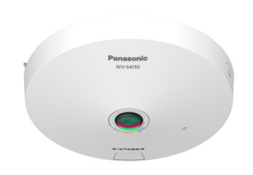
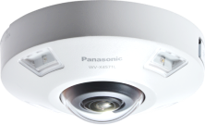
i-PRO 360-degree Fisheye Camera
Material for SE
Model: WV-S4151 , WV-S4551L , WV-S4551LM WV-X4172 , WV-X4173 , WV-X4573L , WV-X4573LM
Document Ver.1.01
Jul. 2022

Slide 2
Contents
Product Concept
Specification Comparison
Other Specifications
Appearance
Standard Accessories
Optional Accessories

Slide 3
1. Product Concept
High visibility & compression for TCO reduction & efficient monitoring
Key features
High Visibility
Intelligent Auto
- Automatically adjusts to the optimum image quality parameter according to
the shooting scene.
High Compression
Smart Coding
- Longer recording and less storage space compared to any H.264 based
compression techniques.
- New self-learning ROI* encoding (Auto VIQS) dynamically detects motion areas to
keep vehicles and humans in good picture quality while lowering your bandwidth.
*Region of Interest
New 5MP / 12MP Camera
LINE UP: 7 models
 | Indoor | Outdoor | Outdoor (transit)
5MP model | WV-S4151 | WV-S4551L | WV-S4551LM
12MP model | WV-X4172 / WV-X4173 | WV-X4573L | WV-X4573LM
Indoor
Outdoor

Slide 4
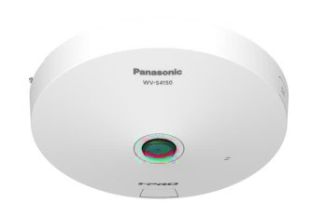
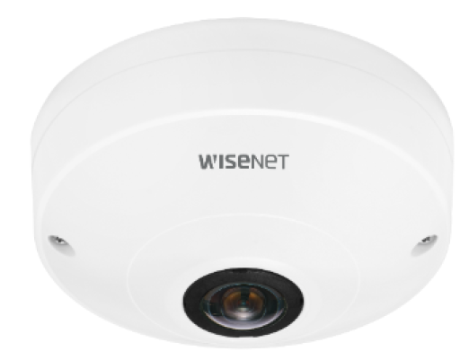
2. Specification Comparison
Comparison to other companies (5MP model)
*1 H.265/H.264 Stream transmission: Off,
Display mode: fisheye/Panorama/Double panorama/Single PTZ/Quad PTZ
*2 WDR: Off, Display mode: fisheye
 | i-PRO |  | Axis |  | Hanwha
 | Outdoor | Indoor | Outdoor | Indoor | Outdoor | Indoor
 | WV-S4551L WV-S4551LM | WV-S4151 | M3057-PLVE | M3067-P | XNF-8010RV XNF-8010RVM | QNF-8010
Video Codec | H.265/H.264/JPEG |  | H.264/JPEG | H.265/H.264/JPEG | H.265/H.264/JPEG
Image Sensor | 1/2.8” 5MP |  | 1/1.8” 6MP |  | 1/1.8" 6MP
Max Resolution | 2192x2192 |  | 2048x2048 | 2016x2016 | 2048x2048
Max Frame rate | H.265/H.264 : 30fps JPEG : 5fps (30fps *1) |  | H.265/H.264 : 30fps (60fps *2) JPEG : 30fps (60fps *2) |  | H.265/H.264 : 30fps JPEG : 15fps
Lens | F2.4 |  | F2.0 |  | F1.6 | F2.5
Angular Field of view | 186 deg. |  | 185 deg. |  | 192 deg. | 187 deg.
Dynamic range | Super-D 120dB |  | WDR 120dB |  | WDR 120dB
Sensitivity (color) | 0.15 lx |  | 0.16lx | 0.18lx | 0.1lx | 0.2lx
Display mode (other than fisheye) | Panorama, Double panorama, Single PTZ, Quad PTZ 4Quad streams |  | Panorama, Double panorama, Single PTZ, Quad PTZ, Corner left/right, Double corner, Corridor |  | Panorama, Double Panorama, Single PTZ, Quad PTZ
Smart Coding | GOP control / AUTO VIQS |  | Zipstream |  | WiseStreamⅡ
Audio | In(mic in), Out | In(built-in mic), Out | In, Out (Optional support) |  | In(mic in/line in /built-in mic), Out | -
SD memory card | 1 (SDXC,SDHC,SD) |  | 1 (microSDHC, microSD) | 1 (microSDXC, microSDHC, microSD) | 2 (microSDXC, microSDHC, microSD) | 1 (microSDXC, microSDHC, microSD)
IR-LED | Yes (10m) | - | Yes (20m) | - | Yes(15m) | -
Operating Temperature | -40 to +60 deg.C | -10 to +50 deg.C | -40 to +50 deg.C | 0 to +40 deg.C | -40 to +55 deg.C | -10 to +55 deg.C
Railway standard | EN50155-TX | - | - |  | EN50155 | -

Slide 5
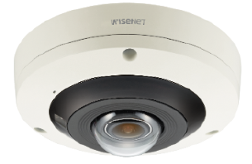
2. Specification Comparison
Comparison to other companies (12MP model)
*1 H.265/H.264 Stream transmission: Off,
Display mode: fisheye/Panorama/Double panorama/Single PTZ/Quad PTZ
*2 WDR: Off, Display mode: fisheye
 | i-PRO |  |  | Axis |  | Hanwha
 | Outdoor | Indoor |  | Outdoor | Indoor | Outdoor | Indoor
 | WV-X4573L WV-X4573LM | WV-X4172 | WV-X4173 | M3058-PLVE | M3068-P | PNF-9010RV PNF-9010RVM | PNF-9010R
Video Codec | H.265/H.264/JPEG |  |  | H.264/JPEG | H.265/H.264/JPEG | H.265/H.264/JPEG
Image Sensor | 1/1.7” 12MP |  |  | 1/1.7” 12MP |  | 1/1.7” 12MP
Max Resolution | 2992x2992 |  |  | 2992x2992 | 2880x2880 | 2992x2992
Max Frame rate | H.265/H.264 : 30fps JPEG : 5fps (15fps *1) |  |  | H.265/H.264 : 15fps (30fps *2) JPEG : 15fps (30fps *2) |  | H.265/H.264 : 20fps JPEG : 15fps
Lens | F1.9 |  |  | F2.2 | F2.8 | F2.2
Angular Field of view | 183 deg. |  |  | 181 deg. | 185 deg. | 180 deg.
Dynamic range | WDR 84dB |  |  | WDR 120dB |  | WDR 120dB
Sensitivity (color) | 0.3 lx |  |  | 0.19lx | 0.32lx | 0.3lx
Display mode (other than fisheye) | Panorama, Double panorama, Single PTZ, Quad PTZ 4Quad streams |  |  | Panorama, Double panorama, Single PTZ, Quad PTZ, Corner left/right, Double corner, Corridor |  | Panorama, Double Panorama, Single PTZ, Quad PTZ
Smart Coding | GOP control / AUTO VIQS |  |  | Zipstream |  | WiseStreamⅠ
Audio | In(mic in), Out | - | In(built-in mic), Out | In, Out (Optional support) |  | In(mic in/line in/built-in mic), Out
SD memory card | 1 (SDXC,SDHC,SD) |  |  | 1 (microSDHC, microSD) | 1 (microSDXC, microSDHC, microSD) | 1 (microSDXC, microSDHC, microSD)
IR-LED | Yes (10m) | - |  | Yes (15m) | - | Yes(15m)
Operating Temperature | -40 to +60 deg.C | 0 to +40 deg.C | -10 to +50 deg.C | -40 to +50 deg.C | 0 to +40 deg.C | -40 to +55 deg.C | -10 to +55 deg.C
Railway standard | EN50155-TX | - |  | - |  | -

Slide 6
2. Specification Comparison
Comparison of new & current models (5MP model)
 | New 5MP Camera (WV-S4151 / S4551L / S4551LM) | Current 5MP Camera (WV-S4150 / S4550L / S4550LM)
Image capture mode | Fisheye / Double Panorama(DP) / Panorama(P) / Quad PTZ / Single PTZ Fisheye + DP / Fisheye + P / Fisheye + Quad PTZ / Quad stream | Fisheye / Double Panorama(DP) / Panorama(P) / Quad PTZ / Single PTZ Fisheye + DP / Fisheye + P / Fisheye + Quad PTZ / Quad stream
Compression method | H.265[or H.264](1)(2) / JPEG(1)(2) | H.265[or H.264](1)(2) / JPEG(1)(2)
Dynamic range | Super-D 120dB | Super-D 108dB
Sensitivity (color) | 0.15lx | 0.3lx
Maximum user number | 14 | 14
Transmission mode | VBR / CBR / Framerate / Best Effort *Default : VBR | VBR / CBR / Framerate / Best Effort *Default : Framerate
Smart Coding | GOP Control / Auto VIQS | GOP Control / Auto VIQS
Intelligent Auto | Yes | Yes
SD recording | Yes (JPEG / H.264 / H.265) | Yes (JPEG / H.264 / H.265)
IO terminal / Monitor output | Yes | Yes
Power Source | PoE / DC12V | PoE / DC12V
Scene change detection alarm | Optional (WV-SAE200W) | Optional (WV-SAE200W)
Extension function software | WV-SAE200W / WV-SAE303W | WV-SAE200W / WV-SAE303W
ONVIF | Profile S / G / T | Profile S / G / T
FTP | No | Yes
Image compression rate upon alarm detection | No | Yes

Slide 7
2. Specification Comparison
Comparison of new & current models (12MP model)
 | New 12MP Camera (WV-X4172 / X4173 / X4573L / X4573LM) | Current 12MP Camera (WV-X4170 / X4171 / X4571L / X4571LM)
Image capture mode | Fisheye / Double Panorama(DP) / Panorama(P) / Quad PTZ / Single PTZ Fisheye + DP / Fisheye + P / Fisheye + Quad PTZ / Quad stream | Fisheye / Double Panorama(DP) / Panorama(P) / Quad PTZ / Single PTZ Fisheye + DP / Fisheye + P / Fisheye + Quad PTZ / Quad stream
Compression method | H.265[or H.264](1)(2) / JPEG(1)(2) | H.265[or H.264](1)(2) / JPEG(1)(2)
Dynamic range | WDR 84dB | Super-D 108dB
Sensitivity (color) | 0.3lx | 0.3lx
Maximum user number | 14 | 14
Transmission mode | VBR / CBR / Framerate / Best Effort *Default : VBR | VBR / CBR / Framerate / Best Effort *Default : Framerate
Smart Coding | GOP Control / Auto VIQS | GOP Control / Auto VIQS
Intelligent Auto | Yes | Yes
SD recording | Yes (JPEG / H.264 / H.265) | Yes (JPEG / H.264 / H.265)
IO terminal / Monitor output | Yes *WV-X4172 is not supported | Yes *WV-X4170 is not supported
Power Source | PoE / DC12V *WV-X4172: PoE only | PoE / DC12V *WV-X4170: PoE only
Scene change detection alarm | Optional (WV-SAE200W) | Optional (WV-SAE200W)
Extension function software | WV-SAE200W / WV-SAE303W *WV-X4172 is not supported | WV-SAE200W / WV-SAE303W *WV-X4170 is not supported
ONVIF | Profile S / G / T | Profile S / G / T
FTP | No | Yes
Image compression rate upon alarm detection | No | Yes

Slide 8
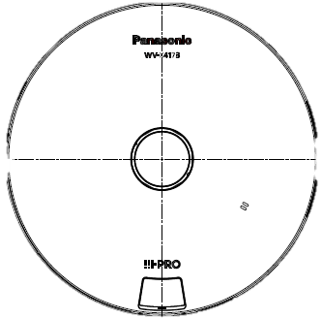
3. Other Specifications
DORI (5MP model)
DORI coverage DORI (Detect, Observe, Recognize, Identify) is a standard system (EN-62676-4) for defining the ability of a camera to distinguish persons or objects within a covered area. This value does not indicate the performance of the camera.
The maximum distance at which a camera/lens combination can meet these criteria is shown below:
Distance to object in center image
Resolution : 2192 x 2192 |  | Unit : m | Unit : feet
Detect | 25ppm / 8ppf | 20.7 | 67.9
Observe | 62.5ppm / 19ppf | 8.3 | 27.2
Recognize | 125ppm / 38ppf | 4.1 | 13.5
Identify | 250ppm / 76ppf | 2.1 | 6.9
Identify
Recognize
Observe
Detect
Coverage radius when mounted at a height of 3m (10ft)
Resolution : 2192 x 2192 |  | Unit : m | Unit : feet
Detect | 25ppm / 8ppf | 38.0 | 124.7
Observe | 62.5ppm / 19ppf | 13.2 | 43.3
Recognize | 125ppm / 38ppf | 4.3 | 14.1
Identify | 250ppm / 76ppf | - | -
3m
(10ft)
Recognize
Detect
D O R I
Identify
Observe

Slide 9
3. Other Specifications
DORI (12MP model)
DORI coverage DORI (Detect, Observe, Recognize, Identify) is a standard system (EN-62676-4) for defining the ability of a camera to distinguish persons or objects within a covered area. This value does not indicate the performance of the camera.
The maximum distance at which a camera/lens combination can meet these criteria is shown below:
Distance to object in center image
Resolution : 2992 x 2992 |  | Unit : m | Unit : feet
Detect | 25ppm / 8ppf | 29.9 | 98.1
Observe | 62.5ppm / 19ppf | 12.0 | 39.4
Recognize | 125ppm / 38ppf | 6.0 | 19.7
Identify | 250ppm / 76ppf | 3.0 | 9.8
Identify
Recognize
Observe
Detect
Coverage radius when mounted at a height of 3m (10ft)
Resolution : 2992 x 2992 |  | Unit : m | Unit : feet
Detect | 25ppm / 8ppf | 56.1 | 184.1
Observe | 62.5ppm / 19ppf | 20.6 | 67.6
Recognize | 125ppm / 38ppf | 8.4 | 27.6
Identify | 250ppm / 76ppf | 0.3 | 1.0
3m
(10ft)
Recognize
Detect
D O R I
Identify
Observe

Slide 10
3. Other Specifications
Supported Resolution (5MP model)
*1
No. | Image capture mode | Stream (1) | Stream (2) | JPEG (1) | JPEG (2)
1 | Fisheye (Ceiling / Wall) | Fisheye 2192x2192 1280x1280 640x640 320x320 | Fisheye 1280x1280 640x640 320x320 | Fisheye 2192x2192 1280x1280 640x640 320x320 | Fisheye 1280x1280 640x640 320x320
 |  | Max 30(25) fps *1 | Max 30(25) fps *1 | Max 5(4.2) fps *2 | Max 5(4.2) fps *2
2 | Double Panorama (Ceiling) | Double Panorama 1920x1080 1280x720 640x360 320x180 | Double Panorama 1280x720 640x360 320x180 | Double Panorama 1920x1080 1280x720 640x360 320x180 | Double Panorama 1280x720 640x360 320x180
 |  | Max 30(25) fps *1 | Max 30(25) fps *1 | Max 5(4.2) fps *2 | Max 5(4.2) fps *2
3 | Panorama (Wall) | Panorama 1920x1080 1280x720 640x360 320x180 | Panorama 1280x720 640x360 320x180 | Panorama 1920x1080 1280x720 640x360 320x180 | Panorama 1280x720 640x360 320x180
 |  | Max 30(25) fps *1 | Max 30(25) fps *1 | Max 5(4.2) fps *2 | Max 5(4.2) fps *2
*1 Up to 15fps(12.5fps) when Super Dynamic level is set to 30 or more.
*2 When "Off is selected for each stream transmission" and "none of the conditions of *1 are met", maximum framerate is 30fps(25fps).

Slide 11
3. Other Specifications
Supported Resolution (5MP model)
*1
No. | Image capture mode | Stream (1) | Stream (2) | JPEG (1) | JPEG (2)
4 | Quad PTZ (Ceiling / Wall) | Quad PTZ 1600x1200 1280x960 800x600 VGA QVGA | Quad PTZ 1280x960 VGA QVGA | Quad PTZ 1600x1200 1280x960 800x600 VGA QVGA | Quad PTZ 1280x960 VGA QVGA
 |  | Max 30(25) fps *1 | Max 30(25) fps *1 | Max 5(4.2) fps *2 | Max 5(4.2) fps *2
5 | Single PTZ (Ceiling / Wall) | Single PTZ 1600x1200 1280x960 800x600 VGA QVGA | Single PTZ 1280x960 VGA QVGA | Single PTZ 1600x1200 1280x960 800x600 VGA QVGA | Single PTZ 1280x960 VGA QVGA
 |  | Max 30(25) fps *1 | Max 30(25) fps *1 | Max 5(4.2) fps *2 | Max 5(4.2) fps *2
6 | Fisheye + Double Panorama (Ceiling) | Fisheye 2192x2192 1280x1280 640x640 320x320 | Double Panorama 1280x720 640x360 320x180 | Fisheye 2192x2192 1280x1280 640x640 320x320 | Double Panorama 1280x720 640x360 320x180
 |  | Max 30(25) fps *1 | Max 30(25) fps *1 | Max 5(4.2) fps *3 | Max 5(4.2) fps *3
*1 Up to 15fps(12.5fps) when Super Dynamic level is set to 30 or more.
*2 When "Off is selected for each stream transmission" and "none of the conditions of *1 are met", maximum framerate is 30fps(25fps).
*3 When "Off is selected for each stream transmission", maximum framerate is 15fps(12.5fps).

Slide 12
3. Other Specifications
Supported Resolution (5MP model)
*1
No. | Image capture mode | Stream (1) | Stream (2) | JPEG (1) | JPEG (2)
7 | Fisheye + Panorama (Wall) | Fisheye 2192x2192 1280x1280 640x640 320x320 | Panorama 1280x720 640x360 320x180 | Fisheye 2192x2192 1280x1280 640x640 320x320 | Panorama 1280x720 640x360 320x180
 |  | Max 30(25) fps *1 | Max 30(25) fps *1 | Max 5(4.2) fps *3 | Max 5(4.2) fps *3
8 | Fisheye + Quad PTZ (Ceiling / Wall) | Fisheye 2192x2192 1280x1280 640x640 320x320 | Quad PTZ 1280x960 800x600 VGA QVGA | Fisheye 2192x2192 1280x1280 640x640 320x320 | Quad PTZ 1280x960 800x600 VGA QVGA
 |  | Max 30(25) fps *1 | Max 30(25) fps *1 | Max 5(4.2) fps *3 | Max 5(4.2) fps *3
9 | Quad Stream (Ceiling) | Single PTZ (Ch1-Ch4) 1280x960 800x600 VGA QVGA | Quad PTZ 1600x1200 1280x960 800x600 VGA QVGA
 |  | Max 30(25) fps *1 | Max 5(4.2) fps
*1 Up to 15fps(12.5fps) when Super Dynamic level is set to 30 or more.
*3 When "Off is selected for each stream transmission", maximum framerate is 15fps(12.5fps).

Slide 13
3. Other Specifications
Supported Resolution (12MP model)
*1
No. | Image capture mode | Stream (1) | Stream (2) | JPEG (1) | JPEG (2)
1 | Fisheye (Ceiling / Wall) | Fisheye 2992x2992 2192x2192 1280x1280 640x640 320x320 | Fisheye 1280x1280 640x640 320x320 | Fisheye 2992x2992 2192x2192 1280x1280 640x640 320x320 | Fisheye 640x640
 |  | Max 30(25) fps *1 | Max 30(25) fps *1 | Max 5(4.2) fps *2 *3 | Max 5(4.2) fps *2 *3
2 | Double Panorama (Ceiling) | Double Panorama 2560x1440 1920x1080 1280x720 640x360 320x180 | Double Panorama 1920x1080 1280x720 640x360 320x180 | Double Panorama 2560x1440 1920x1080 1280x720 640x360 320x180 | Double Panorama 1920x1080 1280x720 640x360 320x180
 |  | Max 15(12.5) fps | Max 15(12.5) fps | Max 5(4.2) fps *3 | Max 5(4.2) fps *3
3 | Panorama (Wall) | Panorama 2560x1440 1920x1080 1280x720 640x360 320x180 | Panorama 1920x1080 1280x720 640x360 320x180 | Panorama 2560x1440 1920x1080 1280x720 640x360 320x180 | Panorama 1920x1080 1280x720 640x360 320x180
 |  | Max 15(12.5) fps | Max 15(12.5) fps | Max 5(4.2) fps *3 | Max 5(4.2) fps *3
*1 Up to 15fps(12.5fps) when Super Dynamic level is set to 30 or more.
*2 If the image capture mode is Fisheye while “Stream transmission” of Stream(1) or Stream(2) is set to “On”, max. 1fps is set for resolution “2992 x 2992”,
and max. 2 fps is set in 30fps mode and max. 2.1fps is set in 25fps mode for resolution “2192 x 2192”. (See page 15)
*3 When "Off is selected for each stream transmission", maximum framerate is 15fps(12.5fps).

Slide 14
3. Other Specifications
Supported Resolution (12MP model)
*1
No. | Image capture mode | Stream (1) | Stream (2) | JPEG (1) | JPEG (2)
4 | Quad PTZ (Ceiling / Wall) | Quad PTZ 2560x1920 2048x1536 1600x1200 1280x960 800x600 VGA QVGA | Quad PTZ 1280x960 800x600 VGA QVGA | Quad PTZ 2560x1920 2048x1536 1600x1200 1280x960 800x600 VGA QVGA | Quad PTZ 1280x960 800x600 VGA QVGA
 |  | Max 15(12.5) fps | Max 15(12.5) fps | Max 5(4.2) fps *3 | Max 5(4.2) fps *3
5 | Single PTZ (Ceiling / Wall) | Single PTZ 2560x1920 *4 2048x1536 1600x1200 1280x960 800x600 VGA, QVGA | Single PTZ 1280x960 800x600 VGA QVGA | Single PTZ 2560x1920 *4 2048x1536 1600x1200 1280x960 800x600 VGA, QVGA | Single PTZ 1280x960 800x600 VGA QVGA
 |  | Max 15(12.5) fps | Max 15(12.5) fps | Max 5(4.2) fps *3 | Max 5(4.2) fps *3
6 | Fisheye + Double Panorama (Ceiling) | Fisheye 2992x2992 2192x2192 1280x1280 640x640, 320x320 | Double Panorama 1280x720 640x360 320x180 | Fisheye 2992x2992 2192x2192 1280x1280 640x640 320x320 | Double Panorama 1280x720 640x360 320x180
 |  | Max 15(12.5) fps | Max 15(12.5) fps | Max 5(4.2) fps | Max 5(4.2) fps
*3 When "Off is selected for each stream transmission", maximum framerate is 15fps(12.5fps).
*4 When “<Wall> Single PTZ” is selected for the image capture mode, 2560 x 1920 cannot be set to Stream(1) and JPEG(1).

Slide 15
3. Other Specifications
Supported Resolution (12MP model)
*1
No. | Image capture mode | Stream (1) | Stream (2) | JPEG (1) | JPEG (2)
7 | Fisheye + Panorama (Wall) | Fisheye 2992x2992 2192x2192 1280x1280 640x640 320x320 | Panorama 1280x720 640x360 320x180 | Fisheye 2992x2992 2192x2192 1280x1280 640x640 320x320 | Panorama 1280x720 640x360 320x180
 |  | Max 15(12.5) fps | Max 15(12.5) fps | Max 5(4.2) fps | Max 5(4.2) fps
8 | Fisheye + Quad PTZ (Ceiling / Wall) | Fisheye 2992x2992 2192x2192 1280x1280 640x640 320x320 | Quad PTZ 1280x960 800x600 VGA QVGA | Fisheye 2992x2992 2192x2192 1280x1280 640x640 320x320 | Quad PTZ 1280x960 800x600 VGA QVGA
 |  | Max 15(12.5) fps | Max 15(12.5) fps | Max 5(4.2) fps | Max 5(4.2) fps
9 | Quad Stream (Ceiling) | Single PTZ (Ch1-Ch4) 1280x960 800x600 VGA QVGA | Quad PTZ 2560x1920 2048x1536 1600x1200 1280x960 800x600 VGA QVGA
 |  | Max 15(12.5) fps | Max 5(4.2) fps

Slide 16
3. Other Specifications
JPEG refresh interval restrictions (12MP model)
Image capture mode : Fisheye
 |  | JPEG(1) |  | JPEG(2)
 |  | 30fps mode | 25fps mode | 30fps mode | 25fps mode
JPEG(1) Resolution | 2992x2992 | 1fps | 1fps | 1fps | 1fps
 | 2192x2192 | 2fps | 2.1fps | 2fps | 2.1fps
 | 1280x1280 | 5fps | 4.2fps | 5fps | 4.2fps
 | 640x640 | 5fps | 4.2fps | 5fps | 4.2fps
 | 320x320 | 5fps | 4.2fps | 5fps | 4.2fps

Slide 17
3. Other Specifications
Frame rate mode setting
Current model
New model
25fps mode is added

Slide 18
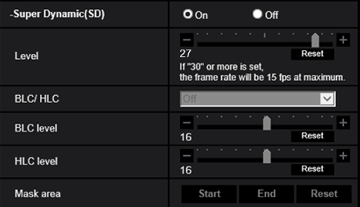
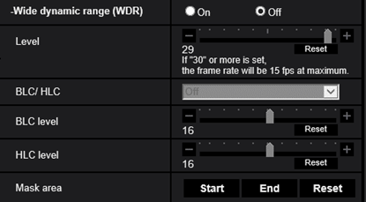
3. Other Specifications
Restrictions on Super Dynamic / Wide dynamic range
If the Super Dynamic / Wide dynamic range level is set to 30 or more, maximum frame rate will be 15fps.
5MP model
Level Setting: Default=27
# Up to 30 fps transmission is available
Level | 27 | 28 | 29 | 30 | 31
Framerate | 30fps | 30fps | 30fps | 15fps | 15fps
Dynamic range *1 | 96dB | 102dB | 108dB | 114dB | 120dB
12MP model
Level Setting: Default=29
# Up to 30 fps transmission is available
Level | 29 | 30 | 31
Framerate | 30fps | 15fps | 15fps
Dynamic range *1 | 72dB | 78dB | 84dB
*1 : It is theoretical value and may change depending on an environment.

Slide 19
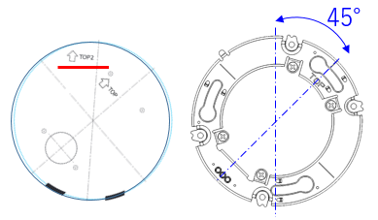
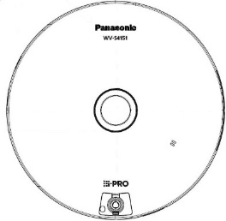
3. Other Specifications
Important notice for Double Panorama Image cropping position
Current model
When using a double panorama, align the TOP2 direction of the template with the shooting direction
(upper direction of the screen).
Cropping
position
TOP2
TOP
New model
Cropping
position

Slide 20
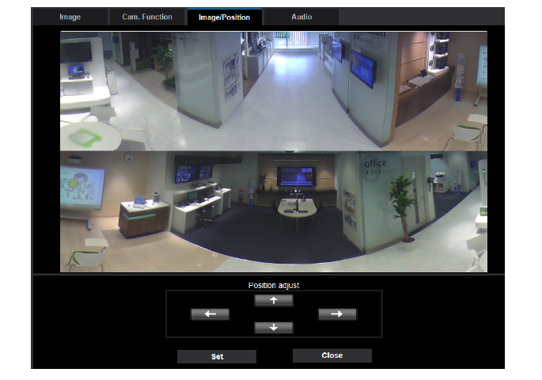
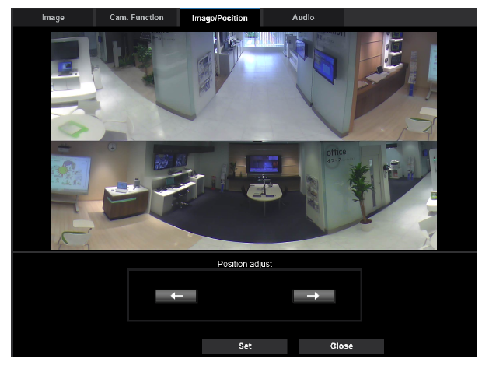
3. Other Specifications
Limitation for position adjustment in Double Panorama
Current model
New model
Pan : Adjustable every 1 deg.
Tilt : Adjustable
Pan : Every 90 deg. only
Tilt : Not adjustable

Slide 21
3. Other Specifications
Note for time to refresh images during camera control (Pan/Tilt/Zoom)
5MP model measurement results
 | Current model （1600x1200） | New model （1600x1200） | AXIS （1600x1200）
 | WV-S4150 | WV-S4151 | M3057-PLVE
Quad PTZ | 0.13(s) | 0.31(s) | 0.18(s)
12MP model measurement results
 | Current model （2560x1920） | New model （2560x1920） | AXIS （2560x1920）
 | WV-X4171 | WV-X4573L | M3058-PLVE
Quad PTZ | 0.24(s) | 0.56(s) | 0.38(s)
Measurement PC spec. : HP Elite Desk 800 G5 SF (Core i7-9700/CPU 3GHz x8 core/Memory 16GB)

Slide 22
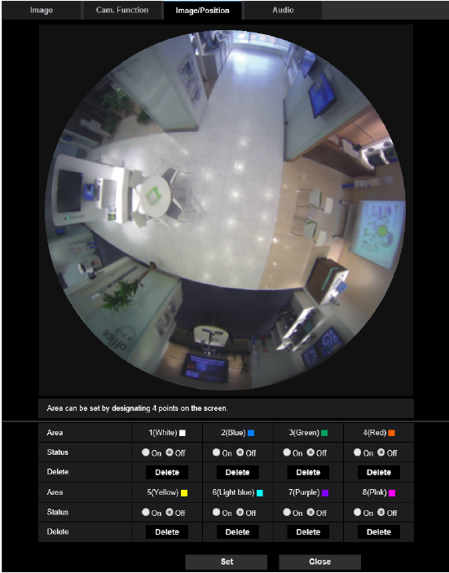
3. Other Specifications
Privacy mask setting
Current model
New model
Privacy mask can be set by rectangle.
Privacy mask can be set by designating 4 points on the screen.

Slide 23
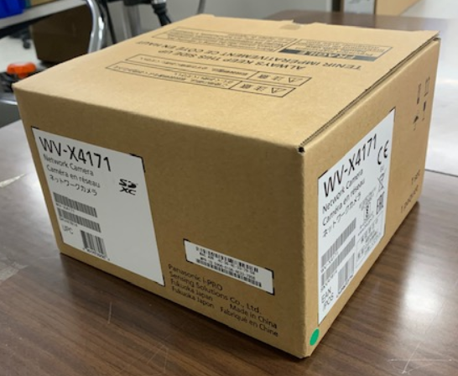
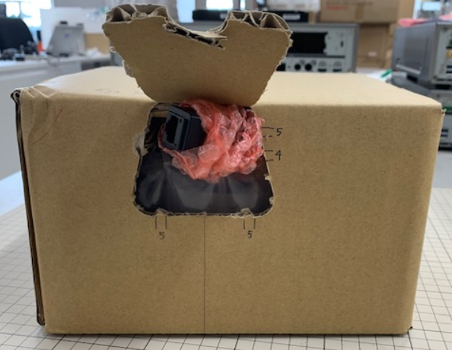
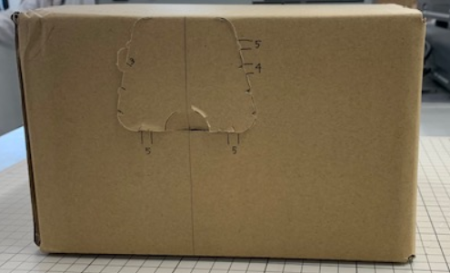
3. Other Specifications
Easy Kitting for Indoor Model
Current model
Note : Easy Kitting for Outdoor model has been supported from current model
Change of packing specifications
Cable for easy kitting
(Standard Accessories)
New model
Kitting Window

Slide 24
3. Other Specifications
Other changes
 | Current model | New model
Frame rate (When Monitor Output is Used) | - | When “Audio out” is set to “Monitor”, the frame rate may be reduced. After camera installation is completed, “Audio out” is set to “Audio”.
Double panorama | The number of pixels in the upper and lower images is same at all resolution. | 5MP Model [Resolution of 1280 x 720] Upper image : 1280 x 362 / Lower image : 1280 x 358 12MP Model [Resolution of 320 x 180] Upper image : 320 x 92 / Lower image : 320 x 88
Auto Pan (Image Refresh time) | Pan speed Approx. 6 deg. / sec Image refresh interval Approx. 1 deg. / step | Pan speed Approx. 6 deg. / sec Image refresh interval Approx. 2.4 deg. / step

Slide 25
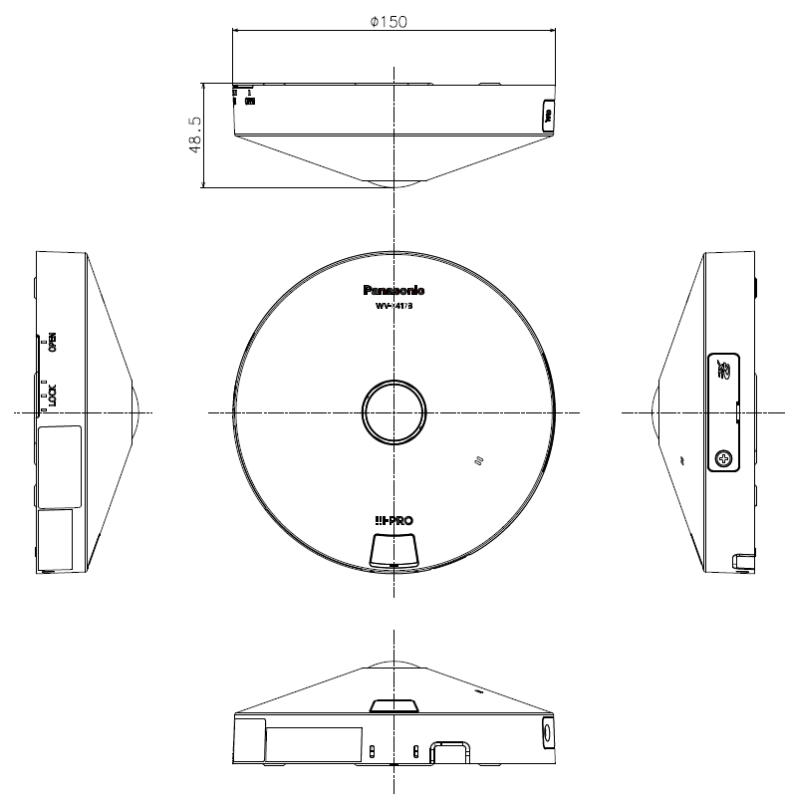
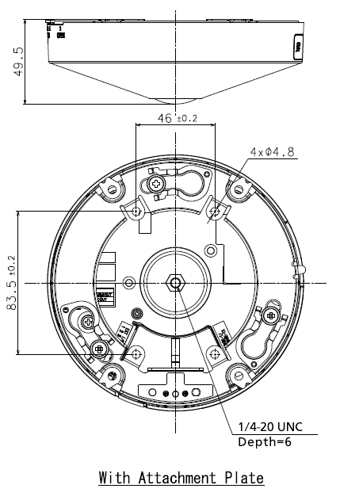
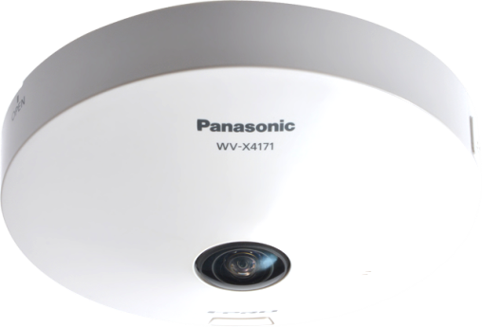
4. Appearance
WV-S4151 / WV-X4172 / WV-X4173
Color: i-pro white
Finish: ABS resin
Dimensions: ø150 mm × 49.5 mm (H)
{ø5-29/32 inches × 1-15/16 inches (H)}
Weight: Approx. 420 g {0.93 lbs}
WV-X4172 : N/A
Note: No change from current model except Color

Slide 26
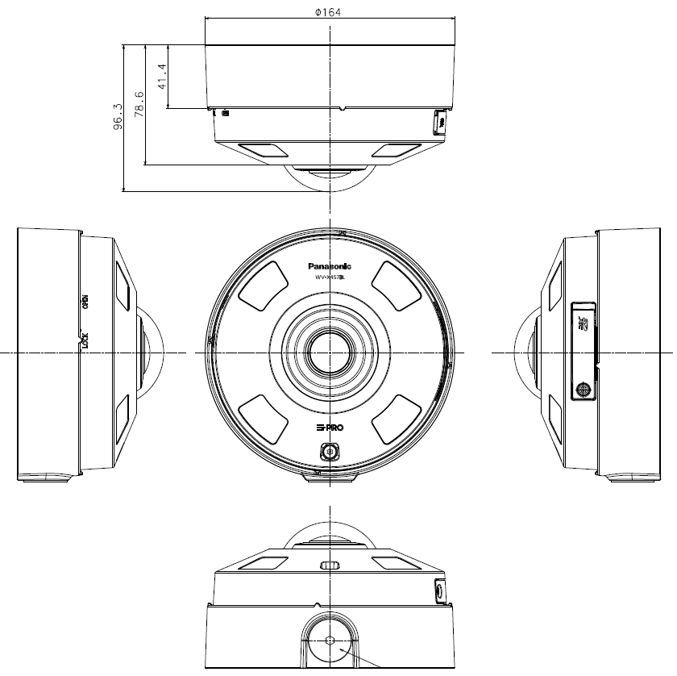
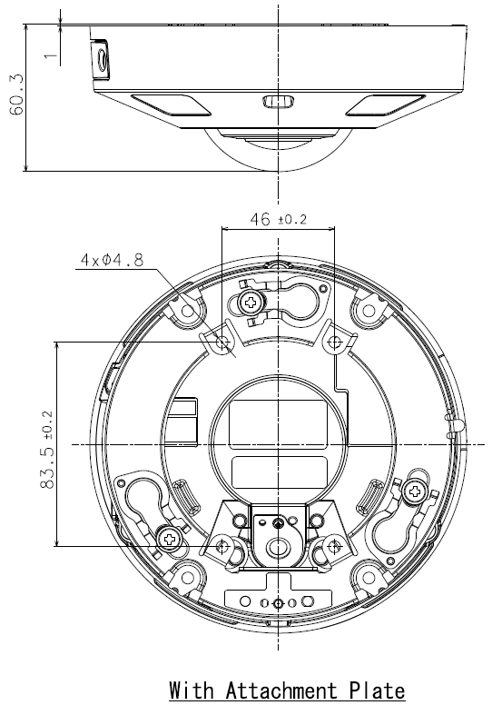
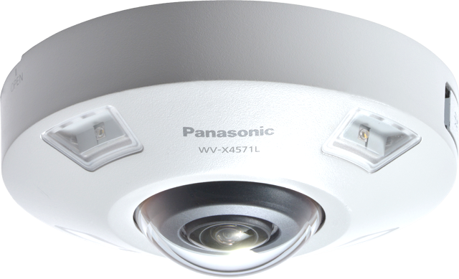
4. Appearance
WV-S4551L / WV-S4551LM / WV-X4573L / WV-X4573LM
Color: i-pro white
Finish: Aluminum die cast
Dimensions: ø164 mm × 96.3 mm (H)
{ø6-29/64 inches × 3-25/32 inches (H)}
Weight: Approx.1.3 kg {2.87 lbs} with Base bracket
Approx.880 g {1.94 lbs} with Attachment plate
Note: No change from current model except Color

Slide 27
5. Standard Accessories
WV-S4151 / WV-X4173
WV-X4172
No. | Standard accessories | Qt.
1 | Installation Guide | 1 pc.
2 | Important Safety Instructions | 1 pc.
3 | Warranty card | 1 pc.
4 | Code label | 1 pc.
5 | Attachment plate | 1 pc.
6 | Audio cable | 1 pc.
7 | Power cable plug | 1 pc.
8 | External I/O terminal plug | 1 pc.
9 | Template A (for the attachment plate) | 1 pc.
10 | Cable tie | 2 pcs.
11 | Safety wire lug | 1 pc.
12 | Safety wire | 1 pc.
13 | Washer | 1 pc.
14 | Spring washer | 1 pc.
15 | Cable for easy kitting | 1 pc.
No. | Standard accessories | Qt.
1 | Installation Guide | 1 pc.
2 | Important Safety Instructions | 1 pc.
3 | Warranty card | 1 pc.
4 | Code label | 1 pc.
5 | Attachment plate | 1 pc.
6 | Template A (for the attachment plate) | 1 pc.
7 | Cable for easy kitting | 1 pc.
[Abolition Parts]
- CD-ROM
[Abolition Parts]
- CD-ROM

Slide 28
5. Standard Accessories
WV-S4551L / WV-X4573L
WV-S4551LM / WV-X4573LM
No. | Standard accessories | Qt.
1 | Installation Guide | 1 pc.
2 | Important Safety Instructions | 1 pc.
3 | Warranty card | 1 pc.
4 | Code label | 1 pc.
5 | Base bracket | 1 pc.
6 | Attachment plate | 1 pc.
7 | Fixing screws for attachment plate (M4 x 8 mm {5/16 inches}) | 5 pcs.
8 | Template A (for the attachment plate) | 1 pc.
9 | Template B (for the base bracket) | 1 pc.
10 | Waterproof tape | 1 pc.
11 | 4P alarm cable | 1 pc.
12 | 2P power cable | 1 pc.
13 | Bit (Hex wrench, screw size 6.35 mm {1/4 inches} T20) | 1 pc.
14 | RJ45 Waterproof connecter cover | 1 pc.
15 | RJ45 Waterproof connecter cap | 1 pc.
No. | Standard accessories | Qt.
1 | Installation Guide | 1 pc.
2 | Important Safety Instructions | 1 pc.
3 | Warranty card | 1 pc.
4 | Code label | 1 pc.
5 | Attachment plate | 1 pc.
6 | Template A (for the attachment plate) | 1 pc.
7 | Waterproof tape | 1 pc.
8 | 4P alarm cable | 1 pc.
9 | 2P power cable | 1 pc.
10 | Bit (Hex wrench, screw size 6.35 mm {1/4 inches} T20) | 1 pc.
[Abolition Parts]
- CD-ROM
[Abolition Parts]
- CD-ROM

Slide 29
6. Optional Accessories
WV-S4151 / WV-X4172 / WV-X4173
No. | Model No. | Image | Description
1 | WV-QJB500-W |  | Adaptor Box (i-PRO white) *1
2 | WV-QJB500-G |  | Adaptor Box (light gray) *1
3 | WV-QJB500-S |  | Adaptor Box (fine silver) *1
4 | WV-Q105A |  | Ceiling Mount Bracket *2
5 | WV-QCL100-W |  | Ceiling Mount Bracket
6 | WV-QCL101-W |  | Ceiling Mount Bracket
7 | WV-QWL500-W |  | Wall Mount Bracket (i-PRO white)
8 | WV-QWL500-G |  | Wall Mount Bracket (light gray)
*1 Refer to the Support Information page for the accessary combination required for installation.
*2 WV-Q105A is “for indoor use only” when installing on the ceiling.

Slide 30
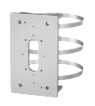
6. Optional Accessories
WV-S4551L / WV-X4573L
No. | Model No. | Image | Description
1 | WV-QCL501-W |  | Ceiling Mount Bracket (i-PRO white) *1
2 | WV-Q178 |  | Ceiling Mount Bracket (light gray) *1
3 | WV-Q121BS |  | Ceiling Mount Bracket (fine silver) *1
4 | WV-QWL501-W |  | Wall Mount Bracket (i-PRO white) *1
5 | WV-Q185 |  | Wall Mount Bracket (light gray) *1
6 | WV-Q122AS |  | Wall Mount Bracket (fine silver) *1
7 | WV-QAT500-W |  | Attachment Pipe Bracket (i-PRO white) *1
8 | WV-Q179 |  | Attachment Pipe Bracket (light gray) *1
9 | WV-Q123A |  | Attachment Pipe Bracket (fine silver) *1
No. | Model No. | Image | Description
10 | WV-QSR501-W |  | Mount Bracket (i-PRO white)
11 | WV-Q186 |  | Mount Bracket (light gray)
12 | WV-Q124 |  | Mount Bracket (fine silver)
13 | WV-QJB500-W |  | Adaptor Box (i-PRO white) *1
14 | WV-QJB500-G |  | Adaptor Box (light gray) *1
15 | WV-QJB500-S |  | Adaptor Box (fine silver) *1
16 | WV-QPL500-W |  | Pole Mount Bracket (i-PRO white) *1
17 | WV-Q182 |  | Pole Mount Bracket (light gray) *1
18 | WV-Q188 |  | Pole Mount Bracket (fine sliver) *1
*1 Refer to the Support Information page for the accessary combination required for installation.

Slide 31
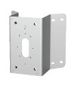
6. Optional Accessories
WV-S4551L / WV-X4573L
WV-S4551LM / WV-X4573LM
No. | Model No. | Image | Description
19 | WV-QCN500-W |  | Corner Mount Bracket (i-PRO white) *1
20 | WV-Q183 |  | Corner Mount Bracket (light gray) *1
21 | WV-Q189 |  | Corner Mount Bracket (fine silver) *1
22 | WV-Q105A |  | Ceiling Mount Bracket *2
23 | WV-QCL100-W |  | Ceiling Mount Bracket
24 | WV-QCL101-W |  | Ceiling Mount Bracket
25 | WV-QWL500-W |  | Wall Mount Bracket (i-PRO white)
26 | WV-QWL500-G |  | Wall Mount Bracket (i-PRO white)
No. | Model No. | Image | Description
1 | WV-QJB501-W |  | Base bracket (i-PRO white)
*1 Refer to the Support Information page for the accessary combination required for installation.
*2 WV-Q105A is “for indoor use only” when installing on the ceiling.

Slide 32
Appendix:
Image quality comparison (5MP model)

Slide 33
Summary
i-PRO S4551L
SD : ON, iA : ON, AGC : 11
H265, VBR, 30fps, MAX bitrate : 20480 kbps, image quality : 3
Smart coding : OFF
* Other setting parameters are default values.
i-PRO S4550L
SD : ON, iA : ON, AGC : 11
H265, VBR, 30fps, MAX bitrate : 20480 kbps, image quality : 3 Smart coding : OFF
* Other setting parameters are default values.
AXIS M3057-PLVE
SD : ON, AGC : 48dB
H264, VBR, 30fps, image quality : 3
Zipstream : OFF
* Other setting parameters are default values.
Hanwha XNF-8010RV
SD : ON, AGC : high
H265, VBR, 30fps, MAX bitrate : 4608 kbps
WiseStream : OFF
* Other setting parameters are default values.
Scoring method: Scored by deducting and adding points beginning with 3 points.

Slide 34
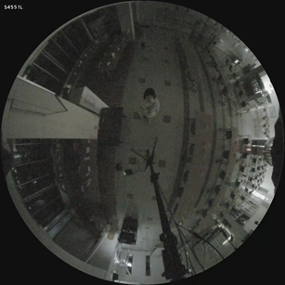
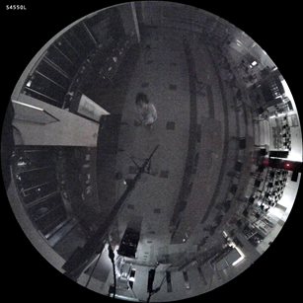
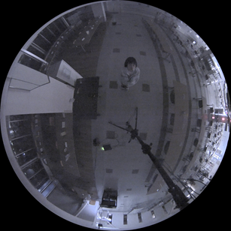
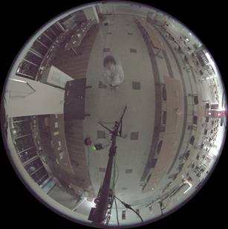
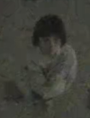
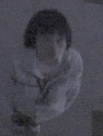
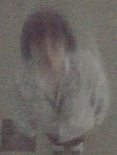
Low light (Illuminance : 0.3 – 0.7 lux)
i-PRO S4551L
i-PRO S4550L
AXIS M3057-PLVE
Hanwha XNF-8010RV
3 points
2 points
4 points
3 points
Evaluation item | Score
Face visibility | +0
Sensitivity, S/N | +0
Brightness | +0
Resolution | +0
Color reproduction | +0
Evaluation item | Score
Face visibility | +0
Sensitivity, S/N | -1
Brightness | +0
Resolution | +0
Color reproduction | +0
Evaluation item | Score
Face visibility | +0
Sensitivity, S/N | +0
Brightness | +1
Resolution | +0
Color reproduction | +0
Evaluation item | Score
Face visibility | +0
Sensitivity, S/N | -1
Brightness | +1
Resolution | +0
Color reproduction | +0
Measured bit rate: 1498kbps
Measured bit rate: 16405kbps
Measured bit rate: 7044kbps
Measured bit rate: 4122kbps

Slide 35
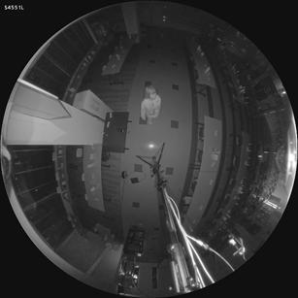
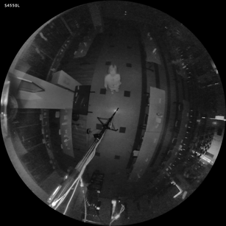
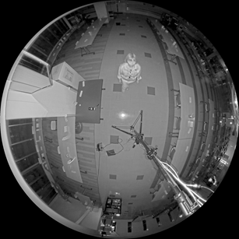
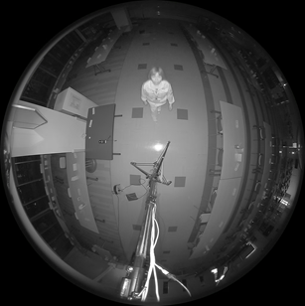
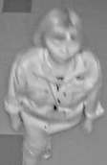
IR-LED
i-PRO S4551L
i-PRO S4550L
AXIS M3057-PLVE
Hanwha XNF-8010RV
10m
6m
1m
10m
6m
1m
3 points
1 points
4 points
4 points
Evaluation item | Score
Face visibility | +0
Sensitivity, S/N | +0
Brightness | +0
Resolution | +0
Color reproduction | +0
Evaluation item | Score
Face visibility | +0
Sensitivity, S/N | -1
Brightness | -1
Resolution | +0
Color reproduction | +0
Evaluation item | Score
Face visibility | +0
Sensitivity, S/N | +1
Brightness | +0
Resolution | +0
Color reproduction | +0
Evaluation item | Score
Face visibility | +1
Sensitivity, S/N | +0
Brightness | +0
Resolution | +0
Color reproduction | +0
Measured bit rate: 2866kbps
Measured bit rate: 10475kbps
Measured bit rate: 1488kbps
Measured bit rate: 2662kbps

Slide 36
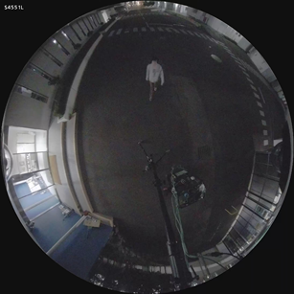
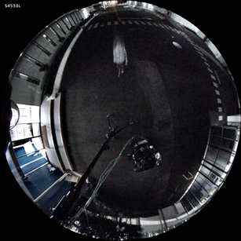
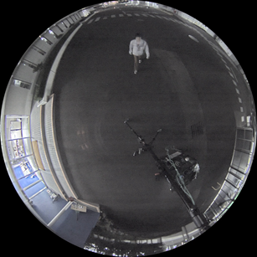
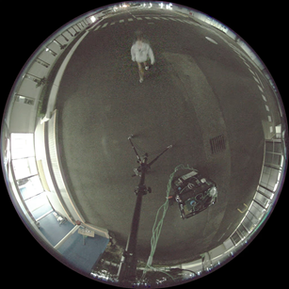
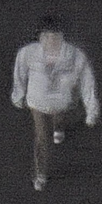
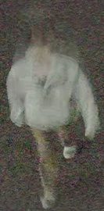
Night time Outdoor (Illuminance : 0.7 – 10 lux)
i-PRO S4551L
i-PRO S4550L
AXIS M3057-PLVE
Hanwha XNF-8010RV
3 points
1 points
3 points
2 points
Evaluation item | Score
Face visibility | +0
Sensitivity, S/N | +0
Brightness | +0
Resolution | +0
Color reproduction | +0
Evaluation item | Score
Face visibility | -1
Sensitivity, S/N | -1
Brightness | +0
Resolution | +0
Color reproduction | +0
Evaluation item | Score
Face visibility | +0
Sensitivity, S/N | -1
Brightness | +1
Resolution | +0
Color reproduction | +0
Evaluation item | Score
Face visibility | +0
Sensitivity, S/N | -1
Brightness | +0
Resolution | +0
Color reproduction | +0
Measured bit rate: 1757kbps
Measured bit rate: 14188kbps
Measured bit rate: 22951kbps
Measured bit rate: 4212kbps

Slide 37
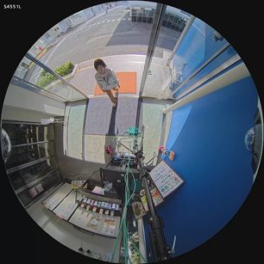
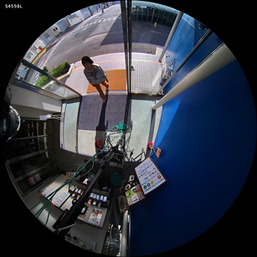
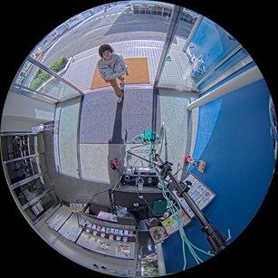
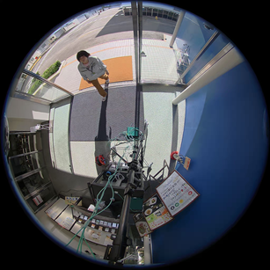
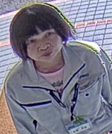
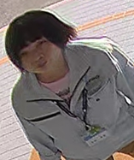
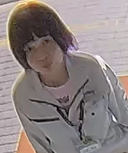
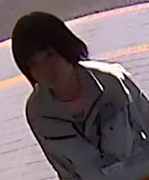
SD Day time
i-PRO S4551L
i-PRO S4550L
AXIS M3057-PLVE
Hanwha XNF-8010RV
Low peripheral resolution and high distortion
3 points
2 points
3 points
2 points
Evaluation item | Score
Face visibility | +0
Sensitivity, S/N | +0
Brightness | +0
Resolution | +0
Color reproduction | +0
Evaluation item | Score
Face visibility | -1
Sensitivity, S/N | +0
Brightness | +0
Resolution | +0
Color reproduction | +0
Evaluation item | Score
Face visibility | +0
Sensitivity, S/N | +0
Brightness | +0
Resolution | +0
Color reproduction | +0
Evaluation item | Score
Face visibility | -1
Sensitivity, S/N | +0
Brightness | +0
Resolution | +0
Color reproduction | +0
Measured bit rate: 3196kbps
Measured bit rate: 2813kbps
Measured bit rate: 4484kbps
Measured bit rate: 4271kbps

Slide 38
Day time Indoor
i-PRO S4551L
i-PRO S4550L
AXIS M3057-PLVE
Hanwha XNF-8010RV
Low peripheral resolution and high distortion
3 points
3 points
4 points
4 points
Evaluation item | Score
Face visibility | +0
Sensitivity, S/N | +0
Brightness | +0
Resolution | +0
Color reproduction | +0
Evaluation item | Score
Face visibility | +0
Sensitivity, S/N | +0
Brightness | +0
Resolution | +0
Color reproduction | +0
Evaluation item | Score
Face visibility | +1
Sensitivity, S/N | +0
Brightness | +0
Resolution | +0
Color reproduction | +0
Evaluation item | Score
Face visibility | +1
Sensitivity, S/N | +0
Brightness | +0
Resolution | +0
Color reproduction | +0
Measured bit rate: 2400kbps
Measured bit rate: 1531kbps
Measured bit rate: 2341kbps
Measured bit rate: 3315kbps

Slide 39
Day time Outdoor
i-PRO S4551L
i-PRO S4550L
AXIS M3057-PLVE
Hanwha XNF-8010RV
Low peripheral resolution and high distortion
3 points
2 points
3 points
3 points
Evaluation item | Score
Face visibility | +0
Sensitivity, S/N | +0
Brightness | +0
Resolution | +0
Color reproduction | +0
Evaluation item | Score
Face visibility | +0
Sensitivity, S/N | +0
Brightness | -1
Resolution | +0
Color reproduction | +0
Evaluation item | Score
Face visibility | +0
Sensitivity, S/N | +0
Brightness | +0
Resolution | +0
Color reproduction | +0
Evaluation item | Score
Face visibility | +0
Sensitivity, S/N | +0
Brightness | +0
Resolution | +0
Color reproduction | +0
Measured bit rate: 11681kbps
Measured bit rate: 8146kbps
Measured bit rate: 9340kbps
Measured bit rate: 4225kbps

Slide 40
Appendix:
Image quality comparison (12MP model)

Slide 41
Summary
i-PRO X4573L
SD : OFF(*Evaluating "SD Day time" : On), iA : ON, AGC : 11
H265, VBR, 30fps, MAX bitrate : 20480 kbps, image quality : 3
Smart coding : OFF
* Other setting parameters are default values.
i-PRO X4571L
SD : OFF(*Evaluating "SD Day time" : On), iA : ON, AGC : 11
H265, VBR, 30fps, MAX bitrate : 20480 kbps, image quality : 3
Smart coding : OFF
* Other setting parameters are default values.
AXIS M3058-PLVE
SD : OFF(*Evaluating "SD Day time" : On), AGC : 45dB
H264, VBR, 30fps, image quality : 3
Zipstream : OFF
* Other setting parameters are default values.
Hanwha PNF-9010RV
SD : OFF(*Evaluating "SD Day time" : On), AGC : high
H265, VBR, 30fps, MAX bitrate : 5120 kbps
WiseStream : OFF
* Other setting parameters are default values.
Scoring method: Scored by deducting and adding points beginning with 3 points.

Slide 42
Low light (Illuminance : 0.3 – 0.7 lux)
i-PRO X4573L
i-PRO X4571L
AXIS M3058-PLVE
Hanwha PNF-9010RV
3 points
2 points
2 points
1 points
Evaluation item | Score
Face visibility | +0
Sensitivity, S/N | +0
Brightness | +0
Resolution | +0
Color reproduction | +0
Evaluation item | Score
Face visibility | +0
Sensitivity, S/N | -1
Brightness | +0
Resolution | +0
Color reproduction | +0
Evaluation item | Score
Face visibility | +0
Sensitivity, S/N | +0
Brightness | -1
Resolution | +0
Color reproduction | +0
Evaluation item | Score
Face visibility | +0
Sensitivity, S/N | -1
Brightness | +0
Resolution | +0
Color reproduction | -1
Measured bit rate: 8679kbps
Measured bit rate: 16091kbps
Measured bit rate: 3912kbps
Measured bit rate: 5944kbps

Slide 43
IR-LED
i-PRO X4573L
i-PRO X4571L
AXIS M3058-PLVE
Hanwha PNF-9010RV
10m
6m
1m
10m
6m
1m
3 points
3 points
3 points
1 points
Evaluation item | Score
Face visibility | +0
Sensitivity, S/N | +0
Brightness | +0
Resolution | +0
Color reproduction | +0
Evaluation item | Score
Face visibility | +0
Sensitivity, S/N | +0
Brightness | +0
Resolution | +0
Color reproduction | +0
Evaluation item | Score
Face visibility | +0
Sensitivity, S/N | +0
Brightness | +0
Resolution | +0
Color reproduction | +0
Evaluation item | Score
Face visibility | -1
Sensitivity, S/N | +0
Brightness | -1
Resolution | +0
Color reproduction | +0
Measured bit rate: 14271kbps
Measured bit rate: 4445kbps
Measured bit rate: 3611kbps
Measured bit rate: 775kbps

Slide 44
Night time Outdoor (Illuminance : 0.7 – 10 lux)
i-PRO X4573L
i-PRO X4571L
AXIS M3058-PLVE
Hanwha PNF-9010RV
3 points
2 points
3 points
2 points
Evaluation item | Score
Face visibility | +0
Sensitivity, S/N | -1
Brightness | +1
Resolution | +0
Color reproduction | +0
Evaluation item | Score
Face visibility | +0
Sensitivity, S/N | -1
Brightness | +0
Resolution | +0
Color reproduction | +0
Evaluation item | Score
Face visibility | +0
Sensitivity, S/N | +0
Brightness | +0
Resolution | +0
Color reproduction | +0
Evaluation item | Score
Face visibility | +0
Sensitivity, S/N | -1
Brightness | +0
Resolution | +0
Color reproduction | +0
Measured bit rate: 12115kbps
Measured bit rate: 5359kbps
Measured bit rate: 6211kbps
Measured bit rate: 4813kbps

Slide 45
SD Day time (SD : ON)
i-PRO X4573L
i-PRO X4571L
AXIS M3058-PLVE
Hanwha PNF-9010RV
Low peripheral resolution
and high distortion
3 points
3 points
3 points
2 points
Evaluation item | Score
Face visibility | +0
Sensitivity, S/N | +0
Brightness | +0
Resolution | +0
Color reproduction | +0
Evaluation item | Score
Face visibility | +0
Sensitivity, S/N | +0
Brightness | +0
Resolution | +0
Color reproduction | +0
Evaluation item | Score
Face visibility | +0
Sensitivity, S/N | +0
Brightness | +0
Resolution | +0
Color reproduction | +0
Evaluation item | Score
Face visibility | -1
Sensitivity, S/N | +0
Brightness | +0
Resolution | +0
Color reproduction | +0
Measured bit rate: 7090kbps
Measured bit rate: 4127kbps
Measured bit rate: 7889kbps
Measured bit rate: 2784kbps

Slide 46
Day time Indoor
i-PRO X4573L
i-PRO X4571L
AXIS M3058-PLVE
Hanwha PNF-9010RV
Low peripheral resolution
and high distortion
3 points
3 points
3 points
2 points
Evaluation item | Score
Face visibility | +0
Sensitivity, S/N | +0
Brightness | +0
Resolution | +0
Color reproduction | +0
Evaluation item | Score
Face visibility | +0
Sensitivity, S/N | +0
Brightness | +0
Resolution | +0
Color reproduction | +0
Evaluation item | Score
Face visibility | +0
Sensitivity, S/N | +0
Brightness | +0
Resolution | +0
Color reproduction | +0
Evaluation item | Score
Face visibility | -1
Sensitivity, S/N | +0
Brightness | +0
Resolution | +0
Color reproduction | +0
Measured bit rate: 2685kbps
Measured bit rate: 2919kbps
Measured bit rate: 3626kbps
Measured bit rate: 1234kbps

Slide 47
Day time Outdoor
i-PRO X4573L
i-PRO X4571L
AXIS M3058-PLVE
Hanwha PNF-9010RV
Low peripheral resolution
and high distortion
4 points
3 points
3 points
2 points
Evaluation item | Score
Face visibility | +1
Sensitivity, S/N | +0
Brightness | +0
Resolution | +0
Color reproduction | +0
Evaluation item | Score
Face visibility | +0
Sensitivity, S/N | +0
Brightness | +0
Resolution | +0
Color reproduction | +0
Evaluation item | Score
Face visibility | -1
Sensitivity, S/N | +0
Brightness | +0
Resolution | +1
Color reproduction | +0
Evaluation item | Score
Face visibility | -1
Sensitivity, S/N | +0
Brightness | +0
Resolution | +0
Color reproduction | +0
Measured bit rate: 8350kbps
Measured bit rate: 6827kbps
Measured bit rate: 12311kbps
Measured bit rate: 3925kbps

Slide 48
Version History

Slide 49
Version History
No | Update contents | Page No. | Version | Update
1 | 1st Version | - | 1.00 | 21.Jan.2021
2 | Support company name change | - | 1.01 | 14. Jul. 2022
3
4
5
6
7
8
9
10

