Slide 1
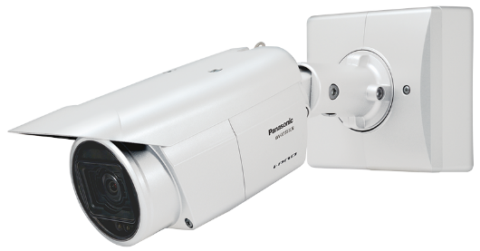
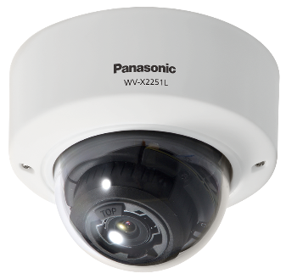
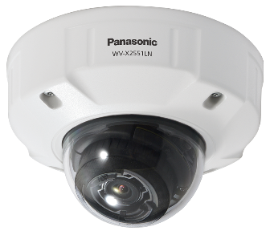
i-PRO 5MP & 4K
Fixed Network Camera Material for SE
Model: WV-S1552L , WV-S2552L , WV-S2252L WV-S1572L , WV-S2572L , WV-S2272L
Document Ver.1.02
Jul. 2022

Slide 2
Contents
Product Concept
Key features
Specification Comparison
Other Software Specifications
Appearance
Standard Accessories, Optional Accessories

Slide 3
1. Product Concept
High visibility & compression for TCO reduction & efficient monitoring
Key features
High Visibility
Intelligent Auto
The visibility of backlit human has been remarkably improved by human detection (upper body) even in the situation where face detection is unavailable.
High Compression
Smart Coding
The object detection accuracy has been improved, and the non-detection area can be further compressed. approx. 50 % reduction compared to current models.
(With Auto VIQS enabled)
Current Models H.265
New Models
H.265
Max.
50%
Smart coding
ON
Smart coding
ON
New 5MP / 4K Camera
LINE UP: 6 models
 | Outdoor BOX | Outdoor DOME | Indoor DOME
5MP model | WV-S1552L | WV-S2552L | WV-S2252L
4K model | WV-S1572L | WV-S2572L | WV-S2272L
Outdoor BOX
Outdoor DOME
Indoor DOME

Slide 4
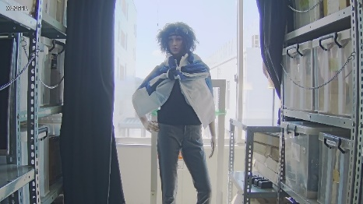
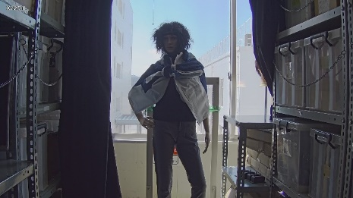
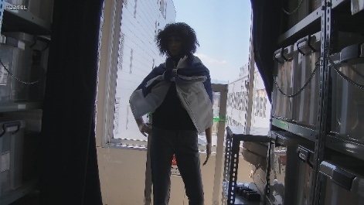
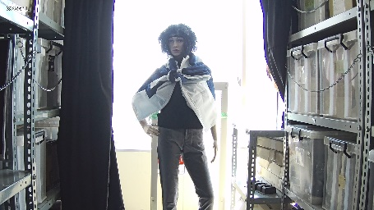
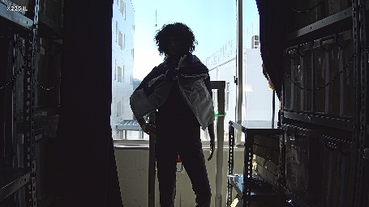
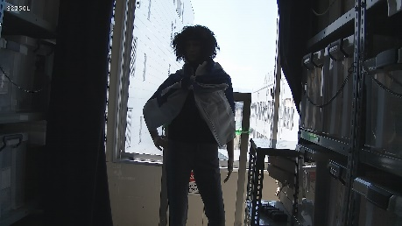
2. Key features - Intelligent Auto
Automatically optimizes the image depending on the environment
The visibility of backlit human has been remarkably improved by human detection (upper body) even in the situation where face detection is unavailable.
New model (WV-S1552L) Face Priority Level: High | New model (WV-S1552L) Face Priority Level: Low | Current model (WV-S1550L)
SD ON
SD ON
SD ON
SD OFF
SD OFF
SD OFF

Slide 5
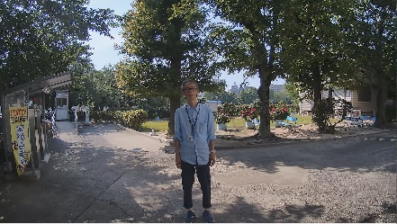
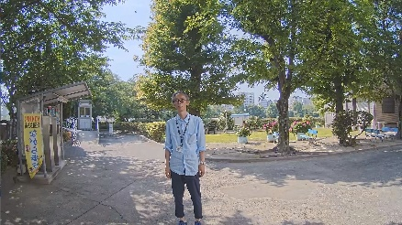
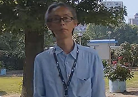
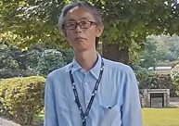
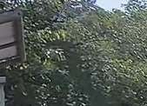
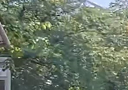
2. Key features - Smart Coding
Automatically controls the compression rate depending on the environment
The object detection accuracy has been improved, and the non-detection area can be further compressed. (approx. 50 % reduction compared to current models)
[Current models]
[New models]
Detects motion and automatically adjusts the image quality of moving objects to high and others to low.
Detects objects (face, human and vehicle) and adjusts the image quality of those objects to high and others to low.
Person on the image does not move
image quality is adjusted to low
Camera detect “face” and “human”
Adjusts the image quality of the face area to high
Swaying tree is recognized as a moving object
Increase Data amount
Swaying tree is NOT recognized as an object
Suppress Data amount
Measured bit rate: 6733kbps
Measured bit rate: 3855kbps

Slide 6
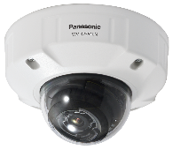
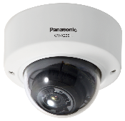
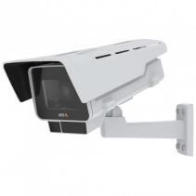
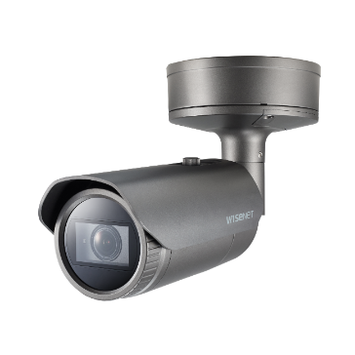
3. Specification Comparison
Comparison to other companies (5MP model)
*1 Super resolution imaging
*2 H.265/H.264 Stream transmission: Off
*3 Capture mode HDTV 720p, WDR: Off
 | WV-S1552L | WV-S2552L | WV-S2252L | AXIS P1377-LE | Hanwha XNO-8080R
Codec | H.265/H.264/JPEG |  |  | H.265/H.264/JPEG | H.265/H.264/JPEG
Max Resolution | 2560 x 1440 (3072 x 1728 *1) [16:9] 2560 x 1920 (3072 x 2304 *1) [4:3] |  |  | 2688 x 1512 [16:9] 2592 x 1944 [4:3] | 2560 x 1440 [16:9] 2560 x 1920 [4:3]
Max Frame rate | H.265/H.264 : 30fps JPEG : 5fps (30fps *2) |  |  | H.265/H.264 : 30fps (180fps *3) JPEG : 30fps (180fps *3) | H.265/H.264 : 30fps JPEG : 30fps
Dynamic range | 132dB |  |  | 120dB | 120dB
Lens | Optical zoom: x3.1 F number: 1.3 - 2.5 Focal length: 2.9 - 9mm |  |  | Optical zoom: x2.8 F number: 1.2 - Focal length: 2.8 - 8mm | Optical zoom: x2.5 F number: 1.2 - Focal length: 3.7 - 9.4mm
Sensitivity (color) | 0.07lx |  |  | 0.13lx | 0.07lx
Horizontal angle of view | Wide:106 deg. / Tele:34 deg. | Wide:103 deg. / Tele:33 deg. | Wide:105 deg. / Tele:33 deg. | Wide:90 deg. / Tele:38 deg. | Wide:100.2 deg. / Tele:38.7 deg.
Audio codec | AAC, G.711, G.726 |  |  | AAC, G.711, G.726, Opus, LPCM | AAC, G.711, G.726
SD memory card | 1 (SDXC,SDHC,SD) |  |  | 1 (microSDXC, microSDHC, microSD) | 1 (microSDXC, microSDHC, microSD)
Smart coding | GOP control / AUTO VIQS |  |  | Zipstream | WiseStreamⅡ
IR-LED | Yes (40m) |  | Yes (30m) | Yes (50m) | Yes (50m)
Operating temperature | –40 °C to +60 °C |  |  | –40 °C to +60 °C | -40°C to +55°C

Slide 7
3. Specification Comparison
Comparison to other companies (4K model)
*1 H.265/H.264 Stream transmission: Off
 | WV-S1572L | WV-S2572L | WV-S2272L | AXIS P1378-LE | Hanwha PNO-9080R
Codec | H.265/H.264/JPEG |  |  | H.265/H.264/JPEG | H.265/H.264/JPEG
Max Resolution | 3840x2160 [16:9] |  |  | 3840 x 2160 [16:9] | 4096 x 2160 [16:9] 4000 x 3000 [4:3]
Max Frame rate | H.265/H.264 : 30fps JPEG : 5fps (30fps *1) |  |  | H.265/H.264 : 30fps JPEG : 30fps | H.265/H.264 : 30fps JPEG : 15fps
Dynamic range | 132dB |  |  | 120dB | 120dB
Lens | Optical zoom: x2.0 F number:1.5 - Focal length: 4.3 - 8.6mm |  |  | Optical zoom: x2.5 F number: 1.5 - Focal length: 3.9 - 10mm | Optical zoom: x2.2 F number:1.6 - Focal length: 4.5 - 10mm
Sensitivity (color) | 0.09lx |  |  | 0.15lx | 0.3lx
Horizontal angle of view | Wide:104 deg. / Tele:53 deg. | Wide:101 deg. / Tele:52 deg. | Wide:101 deg. / Tele:52 deg. | Wide:115 deg. / Tele:45 deg. | Wide:100.3 deg. / Tele:45.6 deg.
Audio codec | AAC, G.711, G.726 |  |  | AAC, G.711, G.726, Opus, LPCM | AAC, G.711, G.726
SD memory card | 1 (SDXC,SDHC,SD) |  |  | 1 (microSDXC, microSDHC, microSD) | 1 (microSDXC, microSDHC, microSD)
Smart coding | GOP control / AUTO VIQS |  |  | Zipstream | WiseStreamⅠ
IR-LED | Yes (40m) |  | Yes (30m) | Yes (50m) | Yes (40m)
Operating temperature | –40 °C to +60 °C |  |  | –40 °C to +60 °C | -40°C to +55°C

Slide 8
3. Specification Comparison
Comparison of new & current models (5MP models)
 | New 5MP Camera (WV-S1552L, S2552L, S2252L) | Current 5MP Camera (WV-S1550L, S2550L, S2250L)
Aspect ratio / Capture mode | 16:9(30fps) / 16:9(25fps) / 4:3(30fps) / 4:3(25fps) | 16:9(30fps) / 4:3(30fps)
Compression method | H.265 (or H.264) (1)-(4), JPEG(1)(2) | H.265 (or H.264) (1)-(4), JPEG(1)(2)
Image rotation | 0 / 90 / 180 / 270 deg. *90, 270 deg. : “320 x 180(H.265/H.264/JPEG)” is not supported *90, 270 deg. : “4:3” is not supported | 0 / 90 / 180 / 270 deg. *90, 270 deg. : “320 x 180(H.264)” is not supported *90, 270 deg. : “4:3” is not supported
Maximum user number | 14 | 14
Transmission mode | VBR/CBR/Framerate/Best Effort *Default : VBR | VBR/CBR/Framerate/Best Effort *Default : Framerate
Smart Coding | GOP Control / Auto VIQS | GOP Control / Auto VIQS
Intelligent Auto | Yes | Yes
Audio | Yes | Yes
SD recording | Yes (JPEG, H.264, H.265) | Yes (JPEG, H.264, H.265)
IR LED | Yes | Yes
IO terminal/Video Out | Yes | Yes
Scene change detection alarm | Standard feature | Optional (i-VMD)
Extension function software | i-VMD (type7) | i-VMD (type6)
ONVIF | Profile S, G, T | Profile S, G, T
FTP | No | Yes
Image compression rate upon alarm detection | No | Yes

Slide 9
3. Specification Comparison
Comparison of new & current models (4K models)
 | New 4K camera (WV-S1572L, S2572L, S2272L) | Current 4K Camera (WV-S1570L, S2570L, S2270L)
Aspect ratio / Capture mode | 16:9(30fps) / 16:9(25fps) | 16:9(30fps) / 16:9(15fps)
Compression method | H.265 (or H.264) (1)-(4), JPEG(1)(2) | H.265 (or H.264) (1)-(4), JPEG(1)(2)
Image rotation | 0 / 90 / 180 / 270 deg. *90, 270 deg. : “320 x 180(H.265/H.264/JPEG)” is not supported *90, 270 deg. : Max 15fps | 0 / 90 / 180 / 270 deg. *90, 270 deg. : “320 x 180(H.264)” is not supported *90, 270 deg. : “16:9(30fps)” is not supported
Maximum user number | 14 | 14
Transmission mode | VBR/CBR/Framerate/Best Effort *Default : VBR | VBR/CBR/Framerate/Best Effort *Default : Framerate
Smart Coding | GOP Control / Auto VIQS | GOP Control / Auto VIQS
Intelligent Auto | Yes | Yes
Audio | Yes | Yes
SD recording | Yes (JPEG, H.264, H.265) | Yes (JPEG, H.264, H.265)
IR LED | Yes | Yes
IO terminal/Video Out | Yes | Yes
Scene change detection alarm | Standard feature | Optional (i-VMD)
Extension function software | i-VMD (type7) | i-VMD (type6)
ONVIF | Profile S, G, T | Profile S, G, T
FTP | No | Yes
Image compression rate upon alarm detection | No | Yes

Slide 10
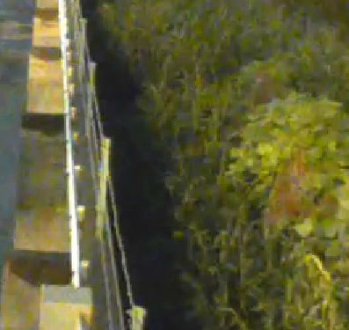
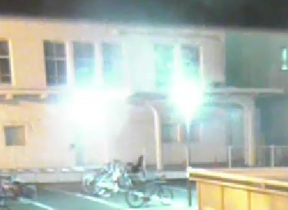
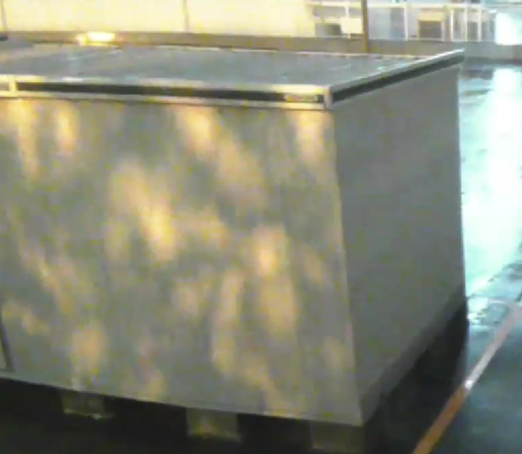
3. Specification Comparison
Comparison of new & current i-VMD (Detection accuracy)
Object detection reduced the false positive alarm rate.
Detection accuracy
Swaying trees and plants
Light
Shadow and reflection
 | New i-VMD (Type7) | Current i-VMD (Type6)
True positive | 80.2 % | 78.9 %
False negative | 19.8 % | 21.1 %
False positive | 2.4 % | 22.3 %
Sample cases of scenes
where false negatives and false positives can occur
Notes:
#1 The percentages above is a comparison result based on PIPS's original evaluation video assuming the actual environment
(shaking of plants / animals / light and shadow / rain / fluctuation in lighting, etc.).
#2 The performance described above is the result when human, vehicle and bicycle are checked for detection target.
#3 The definition of false positive alarm rate is the percentage of the cases where an object other than detection target (human, vehicle, bicycle) is detected.
If an object is detected correctly as a detection target in one scene, it will be counted as a true positive alarm, but if an object which is NOT the detection target is detected in the
same scene, a false positive alarm will be counted as well.
#4 If TP: a times, FN: b times, FP: c times, Its rate is defined by TP = a / (a ​​+ b), FN = b / (a ​​+ b), FP = c / (a ​​+ b + c).
*TP : True positive FN : False negative FP : False positive

Slide 11
3. Specification Comparison
Comparison of new & current i-VMD (Specification)
 |  | New i-VMD (New 5MP/4k Camera) | Current i-VMD (Current 5MP/4k Camera)
Type of i-VMD |  | Type7 | Type6
Detection mode | Intruder | Yes | Yes
 | Loitering | Yes | Yes
 | Direction | Yes | Yes
 | Cross line | Yes | Yes
 | Object (left / removed) | No | Yes
 | Scene change | Yes (Standard feature) | Yes
Supported aspect ratio |  | 16:9 | 16:9 / 4:3
Maximum number of simultaneous detection^{(*1)} |  | 40 | 32
Minimum detection size^{(*2)} |  | 5MP:38pix / 4K:48pix | 5MP:38pix / 4K:48pix
Registerable number of detection program^{(*3)} |  | 2 | 2
Registerable number of detection area |  | 8 for each detection program (16 in total) | 8 for each detection program (16 in total)
Registerable number of mask area |  | 8 for each detection program (16 in total) | 8 for each detection program (16 in total)
(*1) Depending on the size of moving object, the detecting situation and other conditions, it may not detect the objects up to the maximum number of detection.
(*2) The minimum detection sizes above are theoretical values and we do not guarantee the performance in detecting the objects of those sizes.
(*3) The detection condition can be configured by setting the combination of "Detection area", "Detection object" and "Detection mode".

Slide 12
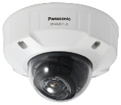
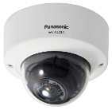
4. Other Software Specifications
DORI (5MP model)
DORI coverage DORI (Detect, Observe, Recognize, Identify) is a standard system (EN-62676-4) for defining the ability of a camera to distinguish persons or objects within a covered area. This value does not indicate the performance of the camera.
The maximum distance at which a camera's tele and wide can meet these criteria is shown below:
*1
WV-S1552L
Outdoor Box
Resolution : 3072 x 1728 *2 |  | Tele : 34 deg. |  | Wide : 106 deg.
 |  | Unit : m | Unit : feet | Unit : m | Unit : feet
Detect | 25ppm | 200.96 | 659.32 | 46.3 | 151.90
Observe | 62.5ppm | 80.38 | 263.73 | 18.52 | 60.76
Recognize | 125ppm | 40.19 | 131.86 | 9.26 | 30.38
Identify | 250ppm | 20.1 | 65.93 | 4.63 | 15.19
WV-S2552L
Outdoor Dome
Resolution : 3072 x 1728 *2 |  | Tele : 33 deg. |  | Wide : 103 deg.
 |  | Unit : m | Unit : feet | Unit : m | Unit : feet
Detect | 25ppm | 207.42 | 680.51 | 48.87 | 160.34
Observe | 62.5ppm | 82.97 | 272.20 | 19.55 | 64.14
Recognize | 125ppm | 41.48 | 136.10 | 9.77 | 32.07
Identify | 250ppm | 20.74 | 68.05 | 4.89 | 16.03
WV-S2252L
Indoor Dome
Resolution : 3072 x 1728 *2 |  | Tele : 33 deg. |  | Wide : 105 deg.
 |  | Unit : m | Unit : feet | Unit : m | Unit : feet
Detect | 25ppm | 207.42 | 680.51 | 47.14 | 154.67
Observe | 62.5ppm | 82.97 | 272.20 | 18.86 | 61.87
Recognize | 125ppm | 41.48 | 136.10 | 9.43 | 30.93
Identify | 250ppm | 20.74 | 68.05 | 4.71 | 15.47
*1 Calculated with the camera installed horizontally
*2 Super resolution imaging

Slide 13
4. Other Software Specifications
DORI (4K model)
DORI coverage DORI (Detect, Observe, Recognize, Identify) is a standard system (EN-62676-4) for defining the ability of a camera to distinguish persons or objects within a covered area. This value does not indicate the performance of the camera.
The maximum distance at which a camera's tele and wide can meet these criteria is shown below:
*1
WV-S1572L
Outdoor Box
Resolution : 3840 x 2160 |  | Tele : 53 deg. |  | Wide : 104 deg.
 |  | Unit : m | Unit : feet | Unit : m | Unit : feet
Detect | 25ppm | 154.04 | 505.37 | 60.00 | 196.86
Observe | 62.5ppm | 61.61 | 202.15 | 24.00 | 78.74
Recognize | 125ppm | 30.81 | 101.07 | 12.00 | 39.37
Identify | 250ppm | 15.40 | 50.54 | 6.00 | 19.69
WV-S2572L
Outdoor Dome
Resolution : 3840 x 2160 |  | Tele : 52 deg. |  | Wide : 101 deg.
 |  | Unit : m | Unit : feet | Unit : m | Unit : feet
Detect | 25ppm | 157.46 | 516.61 | 63.31 | 207.71
Observe | 62.5ppm | 62.99 | 206.64 | 25.32 | 83.08
Recognize | 125ppm | 31.49 | 103.32 | 12.66 | 41.54
Identify | 250ppm | 15.75 | 51.66 | 6.33 | 20.77
WV-S2272L
Indoor Dome
Resolution : 3840 x 2160 |  | Tele : 52 deg. |  | Wide : 101 deg.
 |  | Unit : m | Unit : feet | Unit : m | Unit : feet
Detect | 25ppm | 157.46 | 516.61 | 63.31 | 207.71
Observe | 62.5ppm | 62.99 | 206.64 | 25.32 | 83.08
Recognize | 125ppm | 31.49 | 103.32 | 12.66 | 41.54
Identify | 250ppm | 15.75 | 51.66 | 6.33 | 20.77
*1 Calculated with the camera installed horizontally

Slide 14
4. Other Software Specifications
Supported Resolution (5MP model)
*1
Mode | Stream(1) | Stream(2) | Stream(3) | Stream(4) | JPEG(1) | JPEG(2)
16:9(30fps) 16:9(25fps) | 3072x1728 2560x1440 | 3072x1728 2560x1440 1920x1080 1280x720 640x360 320x180 | 1280x720 640x360 320x180 | 1280x720 640x360 320x180 | 3072x1728 2560x1440 1920x1080 1280x720 640x360 320x180 | 640x360
 | Max 30(25) fps | Max 30(25) fps | Max 30(25) fps | Max 30(25) fps | Max 5(4.2) fps | Max 5(4.2) fps
4:3(30fps) 4:3(25fps) | 3072x2304 2560x1920 | 3072x2304 2560x1920 1280x960 800x600 VGA 400x300 QVGA | VGA QVGA | VGA QVGA | 3072x2304 2560x1920 1280x960 800x600 VGA 400x300 QVGA | VGA
 | Max 30(25) fps | Max 30(25) fps | Max 30(25) fps | Max 30(25) fps | Max 5(4.2) fps | Max 5(4.2) fps
*2
*2 *3
*2
*4
*4
*4
*4
*5
*5
*5
*5
*6
*6
*4
*2
*4
*2 *3
*5
*5
*5
*5
*6
*6
*1 The resolution of JPEG(1) should be set to the same resolution as Stream(1), (2), (3), (4) or JPEG(2)
Ex: 320x180 cannot be selected for JPEG(1) if it is not selected for either Stream(1) to (4)
*2 When the resolution is selected as following, maximum framerate is 15fps(12.5fps) for all streams.
- 3072x1728(3072x2304), 2560x1440(2560x1920) of stream(2) - 1280x720 of stream(4)
*3 2560x1440(2560x1920) of stream(2) can be selected in case of stream(1) is set to 2560x1440(2560x1920).
*4 “90 deg.” and “270 deg.” cannot be set for [Image rotation] when “320x180” or “4:3” is selected.
*5 Up to 15fps(12.5fps) when Super Dynamic level is set to 30 or more.
*6 When "Off is selected for each stream transmission" and "none of the conditions of *5 are met", maximum framerate is 30fps(25fps).

Slide 15
4. Other Software Specifications
Supported Resolution (4K model)
*1
Mode |  | Stream(1) | Stream(2) | Stream(3) | Stream(4) | JPEG(1) | JPEG(2)
16:9(30fps) 16:9(25fps) |  | 3840x2160 2560x1440 | 3840x2160 2560x1440 1920x1080 1280x720 640x360 320x180 | 1280x720 640x360 320x180 | 1280x720 640x360 320x180 | 3840x2160 2560x1440 1920x1080 1280x720 640x360 320x180 | 640x360
 | (A) | Max 30(25) fps | Max 15(12.5) fps | Max 15(12.5) fps | Max 15(12.5) fps | Max 5(4.2) fps | Max 5(4.2) fps
 | (B) | Max 15(12.5) fps | Max 30(25) fps | Max 30(25) fps | Max 30(25) fps
*2
*2 *3
*2
*4
*4
*4
*4
*5
*6
*7
*7
*5
*6
*6
*6
*1 The resolution of JPEG(1) should be set to the same resolution as Stream(1), (2), (3), (4) or JPEG(2)
Ex: 320x180 cannot be selected for JPEG(1) if it is not selected for either Stream(1) to (4)
*2 When the resolution is selected as following, maximum framerate is 15fps(12.5fps) for all streams.
- 3072x1728, 2560x1440 of stream(2)
- 1280x720 of stream(4)
*3 2560x1440 of stream(2) can be selected in case of stream(1) is set to 2560x1440.
*4 “90 deg.” and “270 deg.” cannot be set for [Image rotation] when “320x180” is selected.
*5 The maximum frame rates of Stream(1) to JPEG(2) are either the combination of (A) or (B).
*6 Under the following settings, maximum framerate is 15fps(12.5fps).
- “90 deg.” or “270 deg.” is selected for [Image rotation].
- Super Dynamic level is set to 30 or more.
- installed with i-VMD.
*7 When "Off is selected for each stream transmission" and "none of the conditions of *6 are met", maximum framerate is 30fps(25fps).

Slide 16
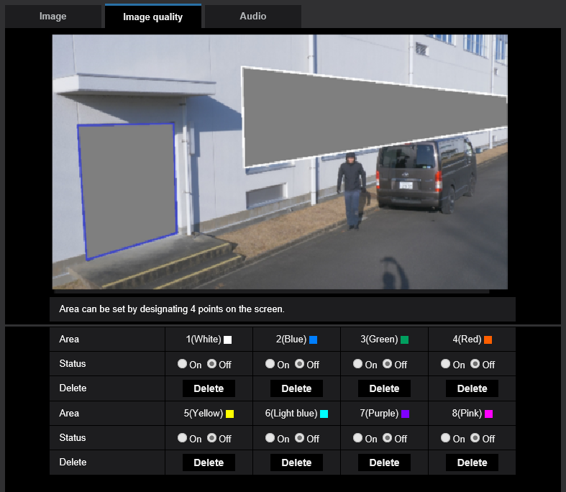
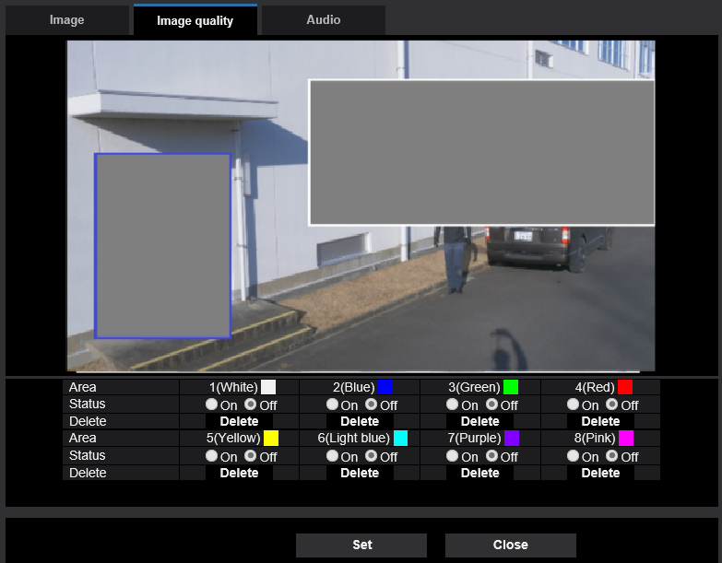
4. Other Software Specifications
Privacy mask setting
Current Models
Privacy mask can be set by designating 4 points on the screen.
Privacy mask can be set by rectangle.

Slide 17
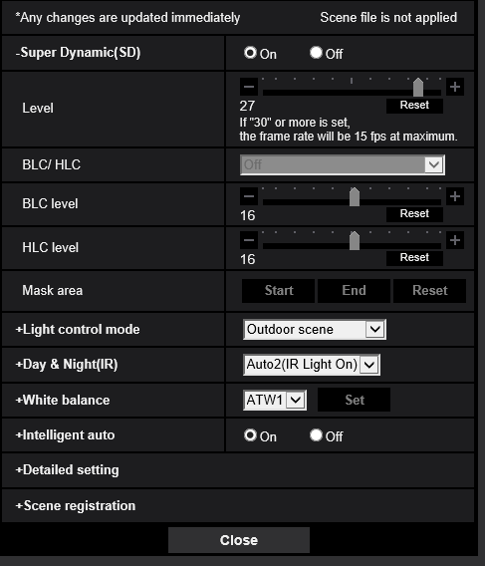
4. Other Software Specifications
Restrictions on Super Dynamic
If the Super Dynamic level is set to 30 or more, maximum frame rate will be set to 15fps.
Level Setting: Default=27
# Up to 30 fps transmission is available
Level | 27 | 28 | 29 | 30 | 31
Framerate | 30fps | 30fps | 30fps | 15fps | 15fps
Dynamic range *1 | 108dB | 114dB | 120dB | 126dB | 132dB
*1 : It is theoretical value which is not equal to actual one as it depends on an environment.

Slide 18
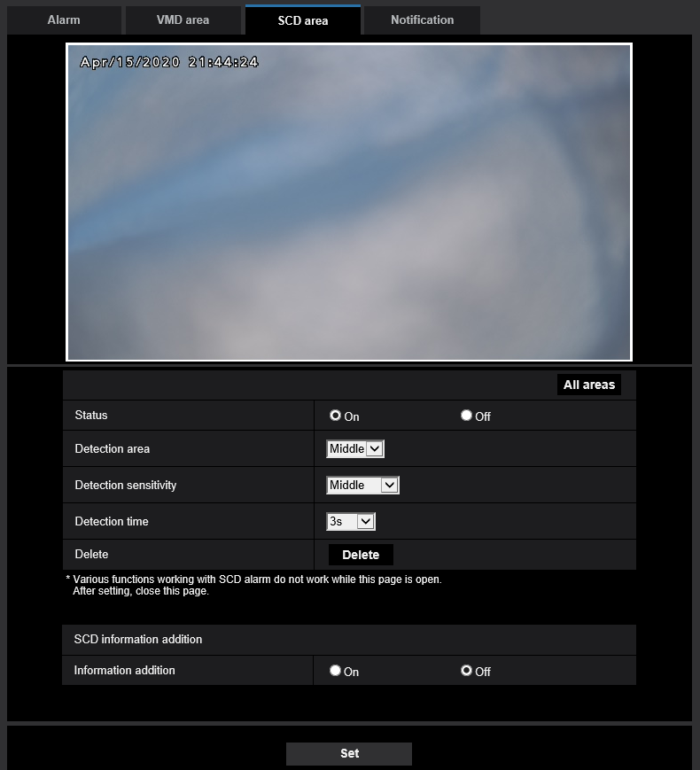
4. Other Software Specifications
SCD (scene change detection) alarm settings
SCD alarm has been added as a standard feature.
Area setting
: Configure the area for SCD alarm. (Up to 1 area)
Detection area
: Select the detection sensitivity from “Low”, “Middle” and “High”.
Default is “Middle”.
Detection sensitivity
: Select the detection area to detect the subject motion
from “Very low”, “Low”, “Middle” and “High”.
Default is “Middle”.
Detection time
: Select the time to issue an alarm from 3s, 5s, 10s, 30s, 1min.
Default is 3s.
SCD information addition
: Determine whether to attach the SCD information to
the streaming data. (On / Off)

Slide 19
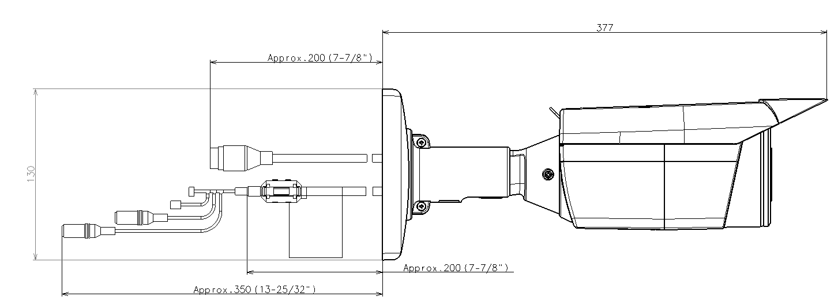
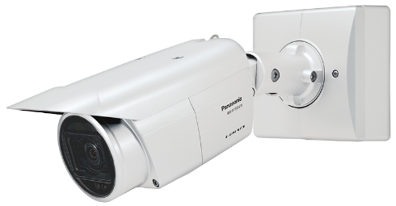
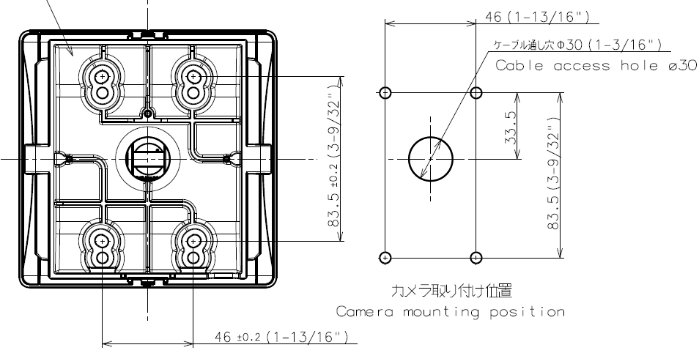
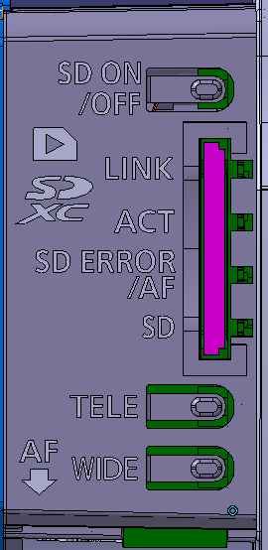
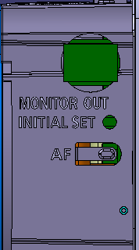
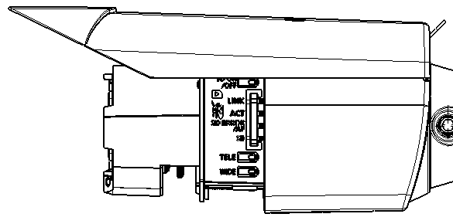
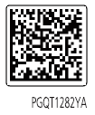
5. Appearance
WV-S1552L / WV-S1572L
Added ferrite core
1. Appearance
- Color
- i-PRO White
- Size/Weight
3. Installation Layout (same as conventional models)
- Size : 133mm(W) x 133mm(H) x 377mm(L)
{5-1/4 inches(W) x 5-1/4 inches(H) x 14-27/32 inches(L)}
- Weight : 2.2kg {4.85 lbs}
2. Indicator, Button Layout (same as conventional models)
Side A
SD ON /OFF button
Side B
LINK Indicator
MONITOR OUT terminal
ACT Indicator
Side A
SD ERROR / AF Indicator
INITIAL SET button
SD MOUNT Indicator
AF button
4. Other Changes
- Deleted QR code
Side B
TELE button
WIDE button

Slide 20
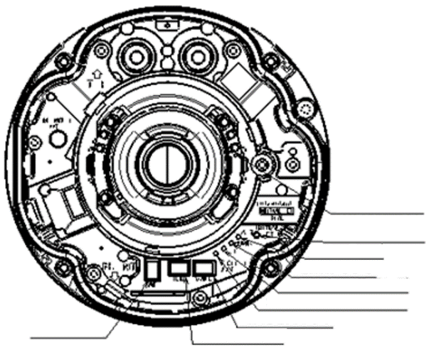
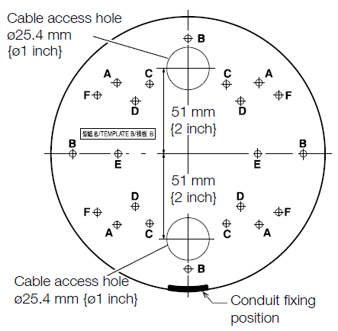
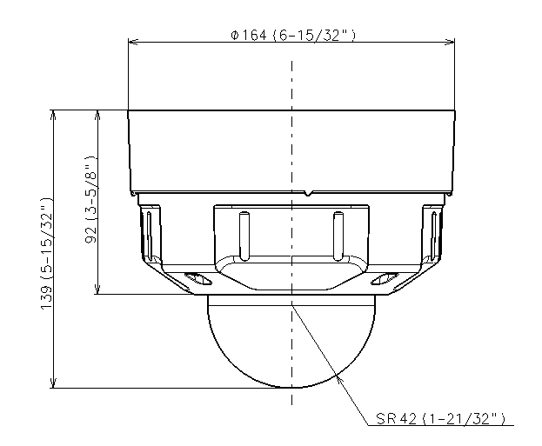
5. Appearance
WV-S2552L / WV-S2572L
1. Appearance
- Color
- i-PRO White
- Size/Weight
2. Indicator, button Layout
(same as conventional models)
3. Installation Layout
(same as conventional models)
- Size : ø164mm x 139mm (H)
{ø6-15/32 inches x 5-15/32 inches (H)}
- Weight : 1.6kg {3.53 lbs}
SD memory card warning
/error indicator
INITIAL SET button
ACT indicator
LINK indicator
SD MOUNT indicator
SD ERROR/AF indicator
AF button
WIDE button
TELE button
SD ON/OFF button
4. Other Changes
- Deleted QR code
SD slot

Slide 21
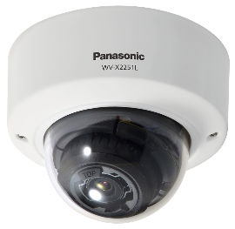
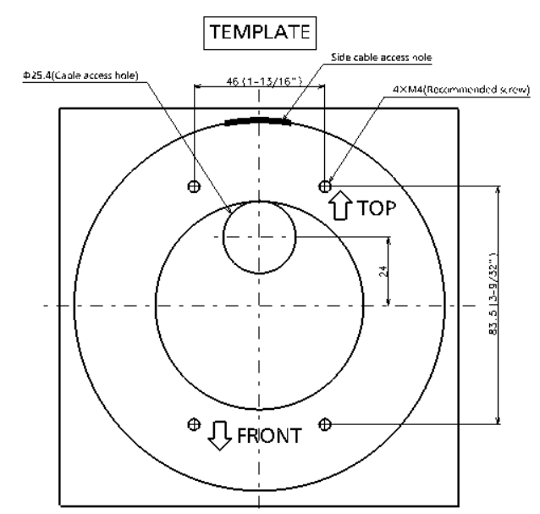
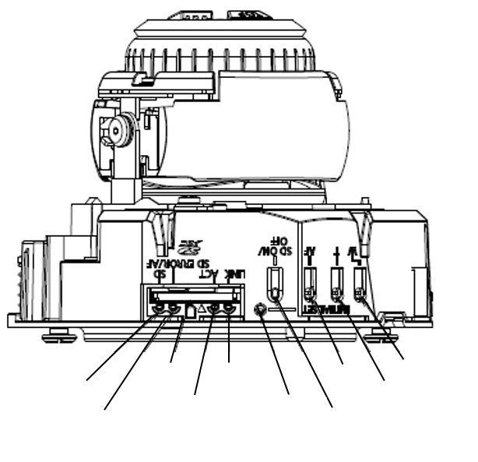
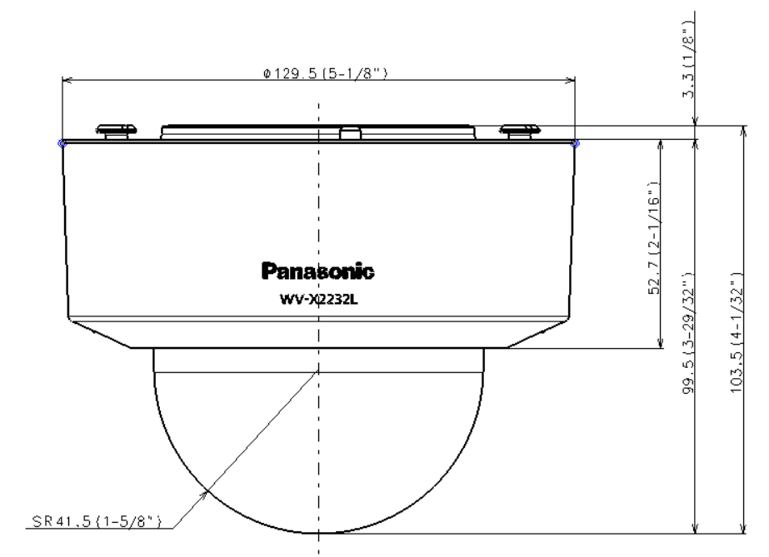
5. Appearance
WV-S2252L / WV-S2272L
1. Appearance
- Color
- i-PRO White
2. Indicator, button Layout
(same as conventional models)
3. Installation Layout
(same as conventional models)
- Size/Weight
- Size : ø129.5mm x 103.5mm(H)
{ø5-1/8 inches x 4-1/16 inches (H)}
- Weight : 830g {1.83 lbs}
4. Other Changes
- Deleted QR code
SD slot
LINK indicator
AF button
WIDE button
SD MOUNT indicator
INITIAL SET
button
TELE button
SD ERROR/AF indicator
ACT indicator
SD ON/OFF button
Changed the material of dome cover to die-cast

Slide 22
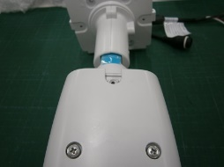
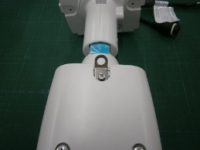
6. Standard Accessories, Optional Accessories
WV-S1552L / WV-S1572L Standard accessories
No. | Standard accessories | Qt. |  | No. | Standard accessories | Qt.
1 | Installation Guide | 1 pc. |  | 9 | 4P alarm cable | 1 pc.
2 | Warranty card | 1 pc. |  | 10 | 2P power cable | 1 pc.
3 | Code label | 1 pc. |  | 11 | Safety wire | 1 pc.
4 | Camera mount bracket cover | 2 pcs. |  | 12 | ClearSight Coating label | 1 pc.
5 | Camera mount bracket cover fixing screw (M3 x 6 mm {1/4 inches}) | 3 pcs. |  | 13 | IMPORTANT SAFETY INSTRUCTIONS | 1 pc.
6 | RJ45 waterproof connector cover | 1 pc. |  | 14 | Adapter box | 1 pc.
7 | RJ45 waterproof connector cap | 1 pc. |  | 15 | Mounting screws (M5 x 20 mm {25/32 inches}) (of them, 1 for spare) | 5 pcs.
8 | Waterproof tape | 1 pc. |  | 16 | Adapter box mounting screw (M4 x 35 mm {1-3/8 inches}) | 1 pc.
[Abolition Parts]
- CD-ROM
- Safety wire lug
Attached to the main body
Before
After

Slide 23
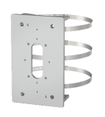
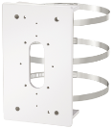
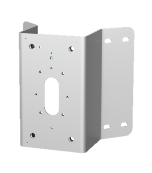
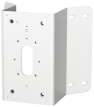
6. Standard Accessories, Optional Accessories
WV-S1552L / WV-S1572L Optional accessories
No. | Model Number | Image | Model Name
1 | WV-Q188 |  | Pole mount bracket (Fine silver)
2 | WV-QPL500-W |  | Pole mount bracket (i-PRO white)
3 | WV-Q189 |  | Corner mount bracket (Fine silver)
4 | WV-QCN500-W |  | Corner mount bracket (Corner mount bracket)

Slide 24
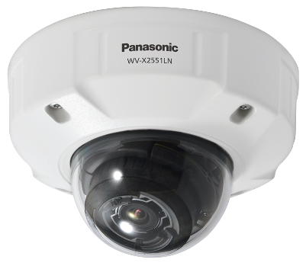
6. Standard Accessories, Optional Accessories
WV-S2552L / WV-S2572L Standard accessories
No. | Standard accessories | Qt. |  | No. | Standard accessories | Qt.
1 | Installation Guide | 1 pc. |  | 10 | Bit (Hex wrench, screw size 6.35 mm {1/4 inches} T20) | 1 pc.
2 | Warranty card | 1 pc. |  | 11 | Template A (for the attachment plate) | 1 pc.
3 | IMPORTANT SAFETY INSTRUCTIONS | 1 pc. |  | 12 | Template B (for the base bracket) | 1 pc.
4 | Code label | 1 pc. |  | 13 | Waterproof tape | 1 pc.
5 | Base bracket | 1 pc. |  | 14 | 4P alarm cable | 1 pc.
6 | Attachment plate | 1 pc. |  | 15 | 2P power cable | 1 pc.
7 | Fixing screws for attachment plate (M4 × 8 mm {5/16 inches}) | 5 pcs. |  | 16 | MONITOR OUT conversion plug | 1 pc.
8 | RJ45 waterproof connector cover | 1 pc. |  | 17 | ClearSight Coating label | 1 pc.
9 | RJ45 waterproof connector cap | 1 pc.
[Abolition Parts]
- CD-ROM

Slide 25
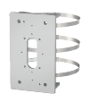
6. Standard Accessories, Optional Accessories
WV-S2552L / WV-S2572L Optional accessories
No. | Model Number | Image | Model Name
1 | WV-CW7S |  | Dome cover (Smoke type)
2 | WV-CW7SN |  | Dome cover (Smoke type with clear sight coating)
3 | WV-Q105A |  | Ceiling mount bracket *1
4 | WV-Q7118 |  | Sun shade (Light gray)
5 | WV-QSR500-W |  | Sun shade (i-PRO white)
6 | WV-QCL501-W |  | Ceiling mount bracket (i-PRO white)*2
7 | WV-Q121B |  | Ceiling mount bracket (Fine silver )*2
8 | WV-QWL501-W |  | Wall mount bracket (i-PRO white)*2
9 | WV-Q122A |  | Wall mount bracket (Fine silver )*2
No. | Model Number | Image | Model Name
10 | WV-QAT500-W |  | Pipe mount bracket (i-PRO white)*2
11 | WV-Q123A |  | Pipe mount bracket (Fine silver )*2
12 | WV-QSR501-W |  | Mount bracket (i-PRO white)*2
13 | WV-Q124 |  | Mount bracket (Fine silver )*2
14 | WV-QPL500-W |  | Pole mount bracket (i-PRO white)*2
15 | WV-Q188 |  | Pole mount bracket (Fine silver ) *2
16 | WV-QCN500-W |  | Corner mount bracket (i-PRO white)*2
17 | WV-Q189 |  | Corner mount bracket (Fine silver ) *2
18 | WV-QWL500-W |  | Wall mount bracket (i-PRO white)*2
*1 WV-Q105A is “for indoor use only” when installing on the ceiling.
*2 Refer to the Support Information page for the accessary combination required for installation.

Slide 26
6. Standard Accessories, Optional Accessories
WV-S2252L / WV-S2272L Standard accessories
No. | Standard accessories | Qt. |  | No. | Standard accessories | Qt.
1 | Installation Guide | 1 pc. |  | 6 | Power cord plug (*1) | 1 pc.
2 | Warranty card | 1 pc. |  | 7 | EXT I/O terminal plug (*1) | 1 pc.
3 | Code label | 1 pc. |  | 8 | MONITOR OUT conversion plug | 1 pc.
4 | Attachment plate | 1 pc. |  | 9 | Bit (Hex wrench, screw size 6.35 mm {1/4 inches} T20) | 1 pc.
5 | Template A (for the attachment plate) | 1 pc. |  | 10 | IMPORTANT SAFETY INSTRUCTIONS | 1 pc.
*1: The power cord plug and EXT I/O terminal plug are attached to the camera.
[Abolition Parts]
- CD-ROM

Slide 27
6. Standard Accessories, Optional Accessories
WV-S2252L / WV-S2272L Optional accessories
No. | Model Number | Image | Model Name
1 | WV-Q105A |  | Ceiling Mount Bracket
2 | WV-CR1S |  | Dome cover (Smoke type)
3 | WV-Q174B |  | Ceiling mount bracket (White)
4 | WV-QEM100-W |  | Ceiling mount bracket (i-PRO white)
5 | WV-QWL500-W |  | Wall mount bracket (i-PRO white)

Slide 28
Appendix:
Image quality comparison (4K model)

Slide 29
Summary
i-PRO S2572L
Compression setting (common to all scenes, default setting)
SD : ON, iA : ON
H265, VBR, 30fps, MAX bitrate : 24576 kbps, image quality : 3
Smartcoding : OFF
AXIS P1378
Compression setting (common to all scenes, default setting)
SD : ON
H265, VBR, 30fps, image quality : 3
Zipstream : OFF
Scoring method: Scored by deducting and adding points beginning with 3 points.

Slide 30
Low light (Illuminance : 0.3 – 0.7 lux)
i-PRO S2572L
AXIS P1378
4 points
3 points
 | Comments | Score
Face visibility | Visible | +0
Sensitivity, S/N | Good | +0
Brightness | Very bright | +1
Resolution | Good | +0
Color reproduction | Color development is good | +0
 | Comments | Score
Face visibility | Visible | +0
Sensitivity, S/N | Good | +0
Brightness | Bright | +0
Resolution | Good | +0
Color reproduction | Color development is good | +0
Measured bit rate: 4226kbps
Measured bit rate: 1006kbps

Slide 31
IR-LED
i-PRO S2572L
AXIS P1378
4 points
4 points
 | Comments | Score
Face visibility | Visible | +0
Sensitivity, S/N | Good | +0
Brightness | Bright | +0
Resolution | Very Good | +1
Color reproduction | - | +0
 | Comments | Score
Face visibility | High visibility | +1
Sensitivity, S/N | Good | +0
Brightness | Bright | +0
Resolution | Good | +0
Color reproduction | - | +0
Measured bit rate: 1080kbps
Measured bit rate: 1217kbps

Slide 32
SD Night time (Illuminance : 3 – 10 lux)
i-PRO S2572L
AXIS P1378
3 points
3 points
 | Comments | Score
Face visibility | Visible | +0
Sensitivity, S/N | Good | +0
Brightness | Bright | +0
Resolution | Good | +0
Color reproduction | Color development is good | +0
 | Comments | Score
Face visibility | High visibility, Slightly noisy | +0.5
Sensitivity, S/N | There is noise on the road | -0.5
Brightness | Bright | +0
Resolution | Good | +0
Color reproduction | Color development is good | +0
Measured bit rate: 2673kbps
Measured bit rate: 7493kbps

Slide 33
SD Day time
i-PRO S2572L
AXIS P1378
5 points
5 points
 | Comments | Score
Face visibility | High visibility | +1
Sensitivity, S/N | Good | +0
Brightness | Bright | +0
Resolution | Very good | +1
Color reproduction | Color development is good | +0
 | Comments | Score
Face visibility | High visibility | +1
Sensitivity, S/N | Good | +0
Brightness | Bright | +0
Resolution | Very good | +1
Color reproduction | Color development is good | +0
Measured bit rate: 3144kbps
Measured bit rate: 3365kbps

Slide 34
Day time Indoors
i-PRO S2572L
AXIS P1378
5 points
4 points
 | Comments | Score
Face visibility | High visibility | +1
Sensitivity, S/N | Good | +0
Brightness | Bright | +0
Resolution | Very good | +1
Color reproduction | Color development is good | +0
 | Comments | Score
Face visibility | High visibility | +1
Sensitivity, S/N | Good | +0
Brightness | Bright | +0
Resolution | Good | +0
Color reproduction | Color development is good | +0
Measured bit rate: 3138kbps
Measured bit rate: 4334kbps

Slide 35
Day time Outdoors
i-PRO S2572L
AXIS P1378
4 points
5 points
 | Comments | Score
Face visibility | Visible | +0
Sensitivity, S/N | Good | +0
Brightness | Bright | +0
Resolution | Very good | +1
Color reproduction | Color development is good | +0
 | Comments | Score
Face visibility | High visibility | +1
Sensitivity, S/N | Good | +0
Brightness | Bright | +0
Resolution | Very good | +1
Color reproduction | Color development is good | +0
Measured bit rate: 6094kbps
Measured bit rate: 7394kbps

Slide 36
Version History

Slide 37
Version History
No | Update contents | Page No. | Version | Update
- | 1st Version | - | 1.00 | 9.Nov.2020
1 | Added JPEG Max frame rate | P.5, P.6 | 1.01 | 21.Jan.2021
2 | Added the information regarding maximum frame rate when “Off” is selected for “Stream transmission” | P.13, P.14 | 1.01 | 21.Jan.2021
3 | Support company name change | - | 1.02 | 14. Jul. 2022
4
5
6
7
8
9
10

