Slide 1
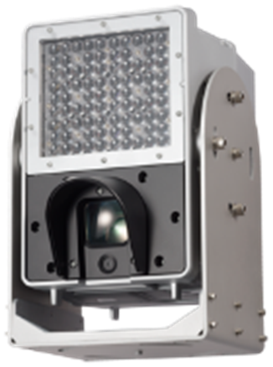
X5 series Vehicle Capture Camera
for SE ver.1.03
Model: WV-X5550LT, X5550LTPJ

Slide 2
Welcome & Disclaimer
This document, Ver. 1.00, is based on product under development.
Hence some of the specification & function detail might be changed without announcement.
This document is not cover all over about the product. Therefore, please utilize this document together with other materials such as “Installation Guide”, “Operating Instructions”, “Quick Reference Guide” “Specification Sheet” and “Product Presentation Material” so on as necessary.
These materials will be downloaded from the following website.
https://bizpartner.panasonic.net/extranet/
There are slides with “Internal use only” mark on the bottom right. It is describing competitors information. Therefore, please handle it with care.

Slide 3
Revision History
No | Update contents | Page No. | Version | Editor | Update
- | 1st Version |  | Ver.1.00 | S. Sugawara | July.2020
1 | Add planning information about changing power connector specification. Add Q&A | P.15 P.43. 44 | Ver.1.01 | S. Sugawara | Aug.2020
2 | Modify planning information about changing power connector specification. Add Q&A | P.15 P.43. 44 | Ver.1.02 | S. Sugawara | Aug.2020
3 | Add Ref slide | P.50-51 | Ver.1.03 | S. Sugawara | Sep.2020

Slide 4
Contents
Introduction
Main Feature
SPEC comparison
Appearance
Accessories
Preparations for installation
Installation conditions
System configuration example
Performance limitation
Consideration
Specification
Setup menu
System Updates
Model Number
Q&A
Differences from i-PRO series camera
Tool
Reference

Slide 5
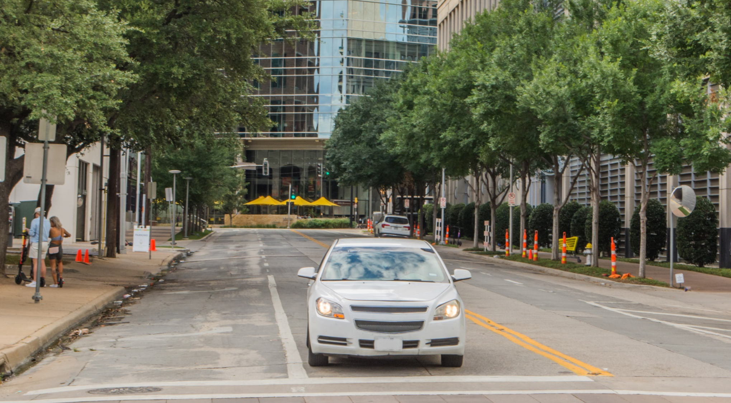

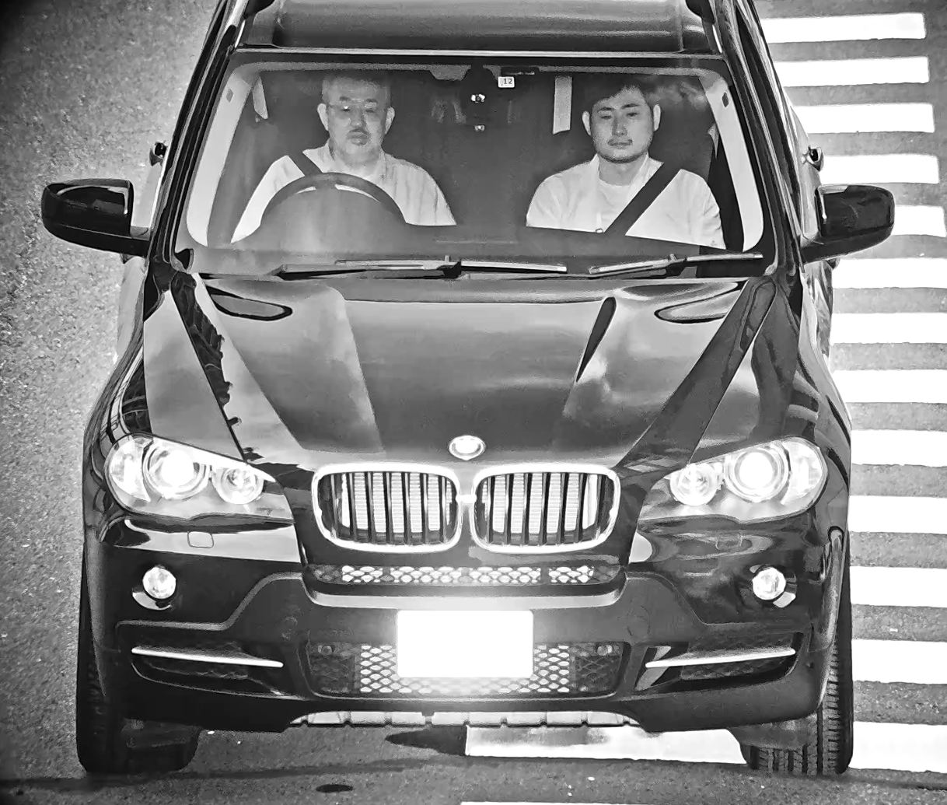

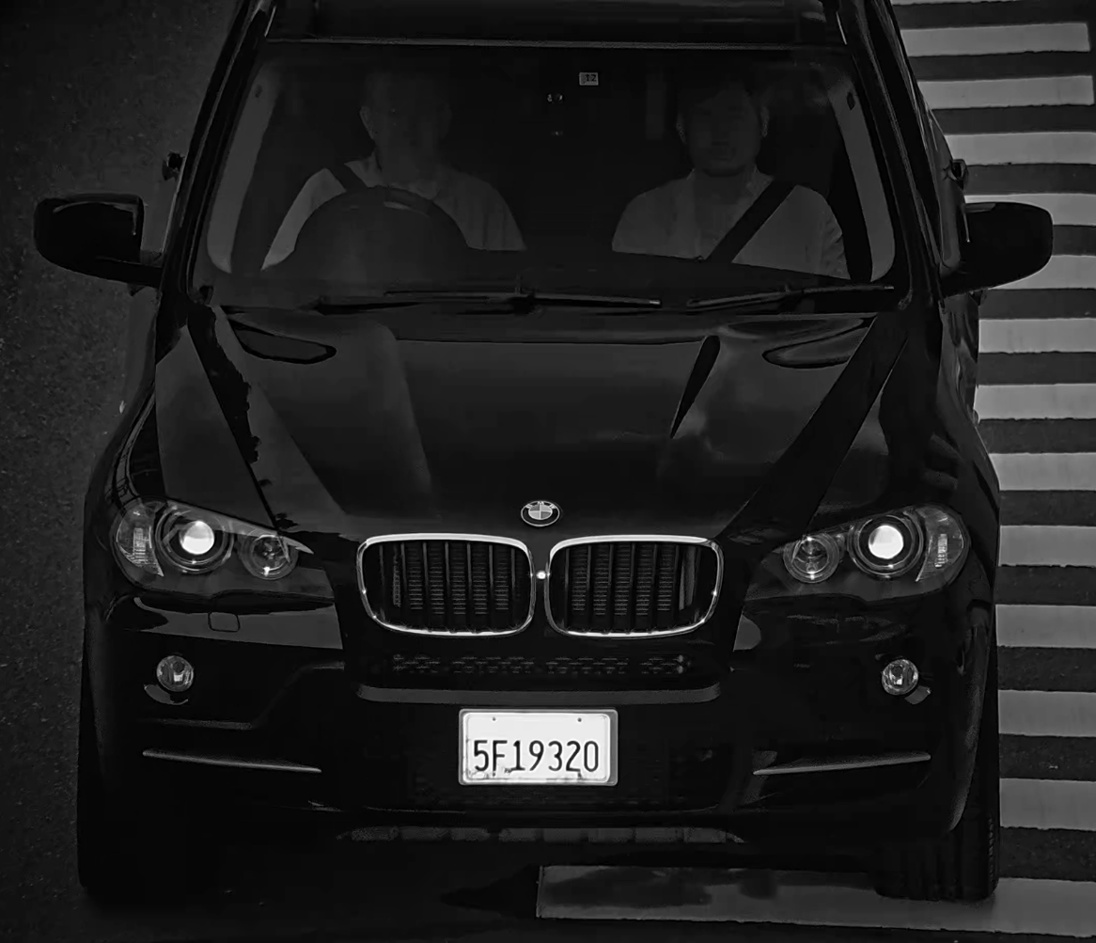

1. Introduction
Vehicle Capture Camera
WV-X5550LT
(Made in China)
WV-X5550LTPJ
(Made in Japan)
Enable to shorten investigation time, by quickly searching target vehicle with the capturing occupant and license image simultaneously.

Slide 6

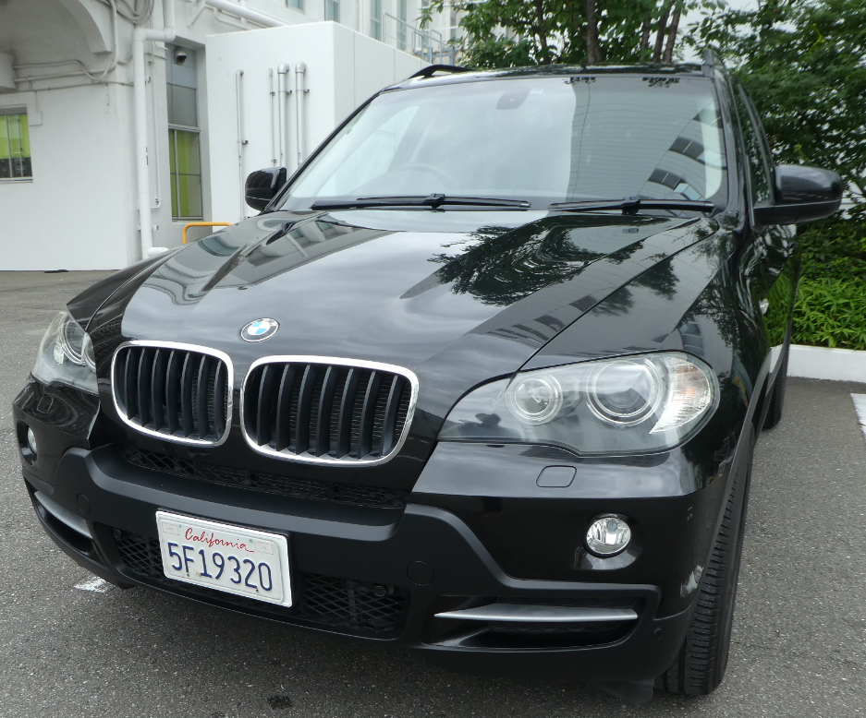
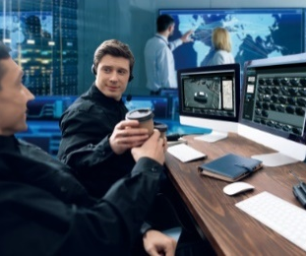
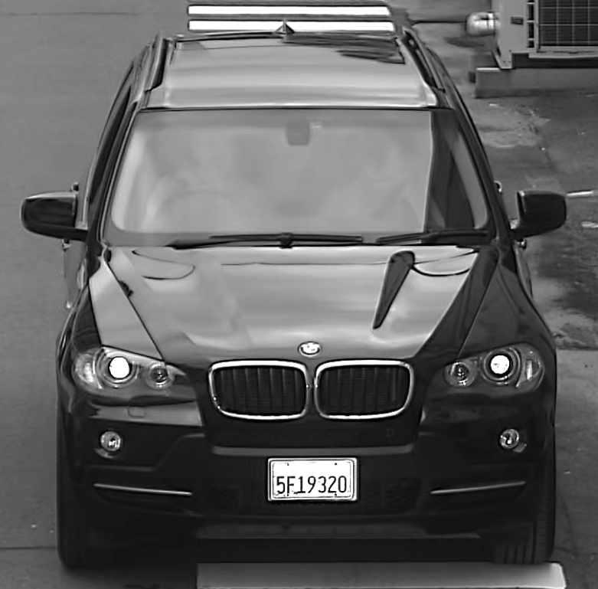
1. Introduction
Current
New
Searching a target with only capturing license plate spends a lot of time.
Capturing license plate with occupant
helps to reduce time for searching target.
？
Main Feature
Dual Source Function
Capturing Clear Image Function
High Reliability
Usability

Slide 7
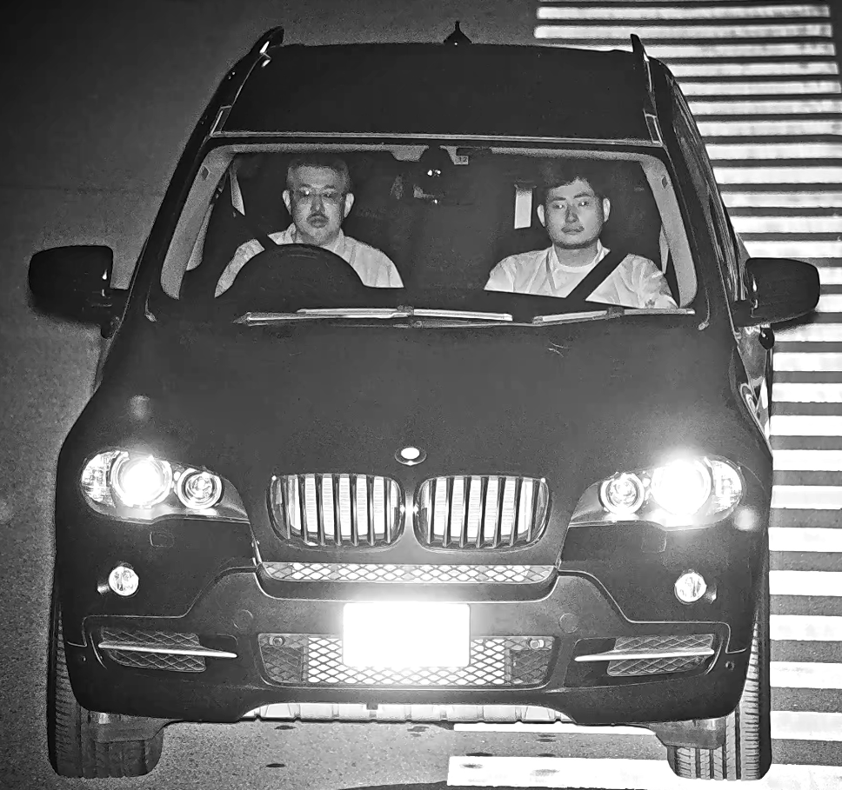

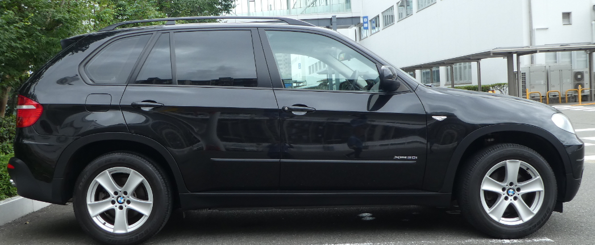
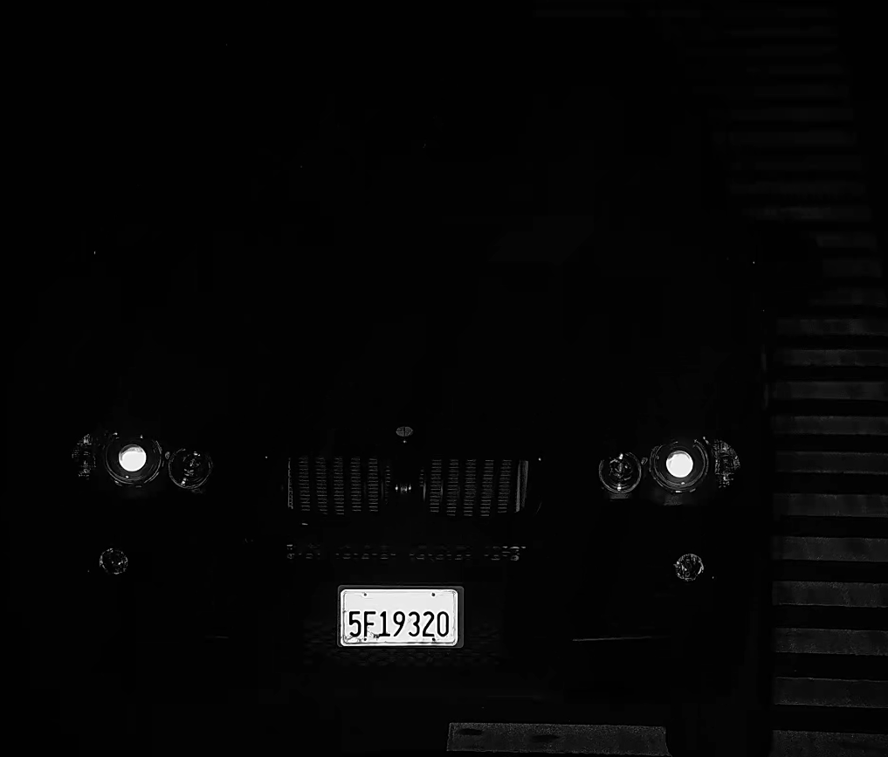
2. Main Feature “Dual Source Function”
It can capture occupant and license plate image simultaneously.
Illuminates IR to identify occupant as source1
at max. 15 fps with 1/1000 shutter speed.
Day
Night
source1
source2
Optimize IR to suppress reflection
to identify license plate as source2
at max. 15 fps with 1/4000 shutter speed.

Slide 8
2. Main Feature “Capturing Clear Image Function” (1/2)
Special mechanism including 4 factors realizes capturing clear image function.
WV-X5550LT
WV-X5550LTPJ
Powerful IR
WV-X5550LT
WV-X5550LTPJ
Day time
Night time
Powerful and Compact IR
complies eye-safety standard.
CMOS
CMOS
BPF
sun
lens
lens
Cut reflection
Cutting visible
light filter
Cutting visible
light filter
PLF
IR
IR
Cut Head light
Switch filter
Polarized Filter (PLF) on day time
Switch
between PLF and BPF
Automatically.
Band-Pass Filter (BPF) on night time
It cut sunlight reflection from
curved windshield.
Even in strong headlights,
It suppresses the flare from headlight.

Slide 9
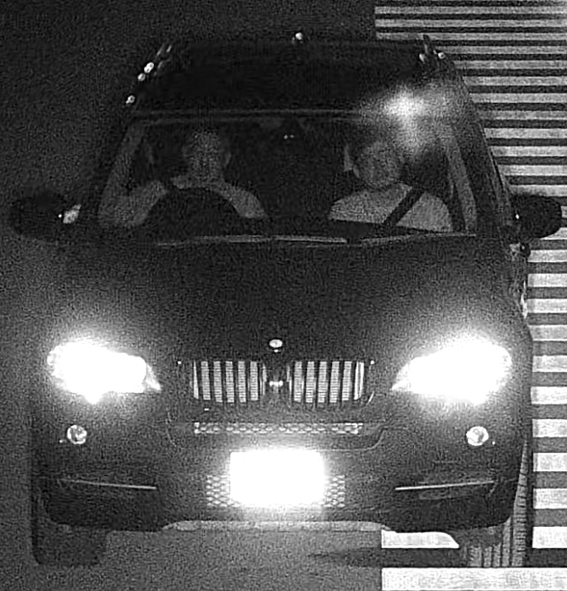
2. Main Feature “Capturing Clear Image Function” (2/2)
Image comparison with Normal camera.
WV-X5550LT / WV-X5550LTPJ |  | Normal Camera WV-S1531(with external IR)
Occupant | License
Day
Day
Day
Night
Night
Night

Slide 10

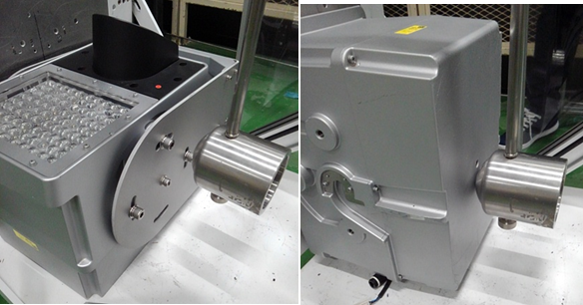

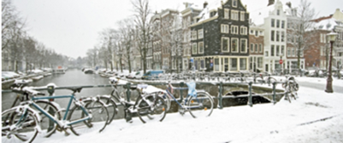
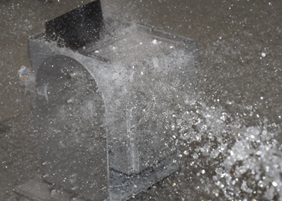
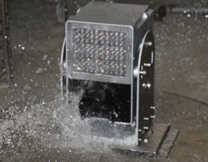

2. Main Feature “High Reliability”
It achieves high endurance and long life usage under tough environment.
Temperature
Vandal resistant – IK10 (IEC 62262)
[Except for front panels]
Temperature : -40℃ to +60℃ {-40℉ to +140℉}
Humidity : 10 % to 100 %
Water resistant – IP66 (IEC 60529)
Type 4X(UL50E),NEMA 4X

Slide 11
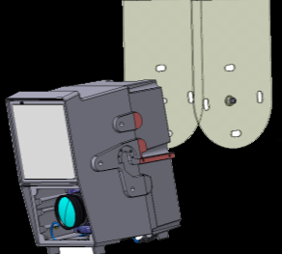
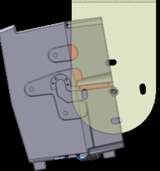
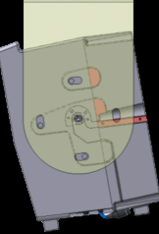
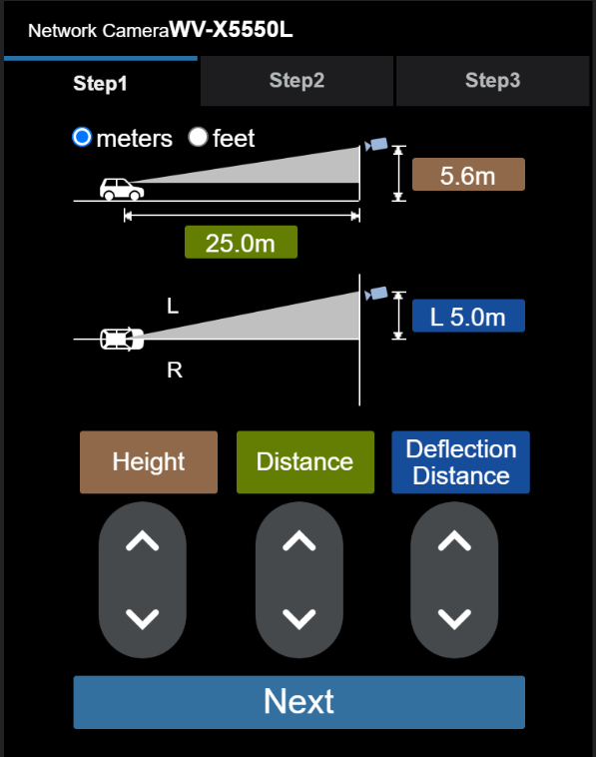
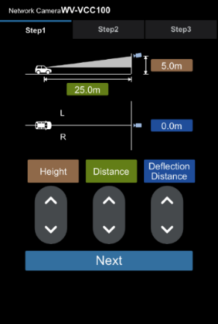
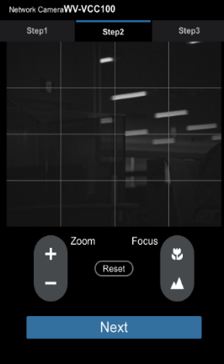
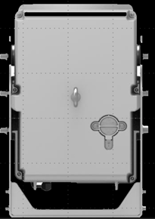


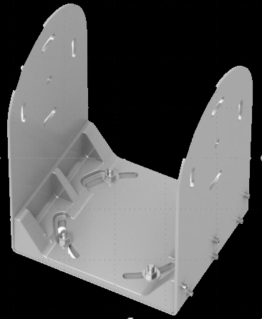
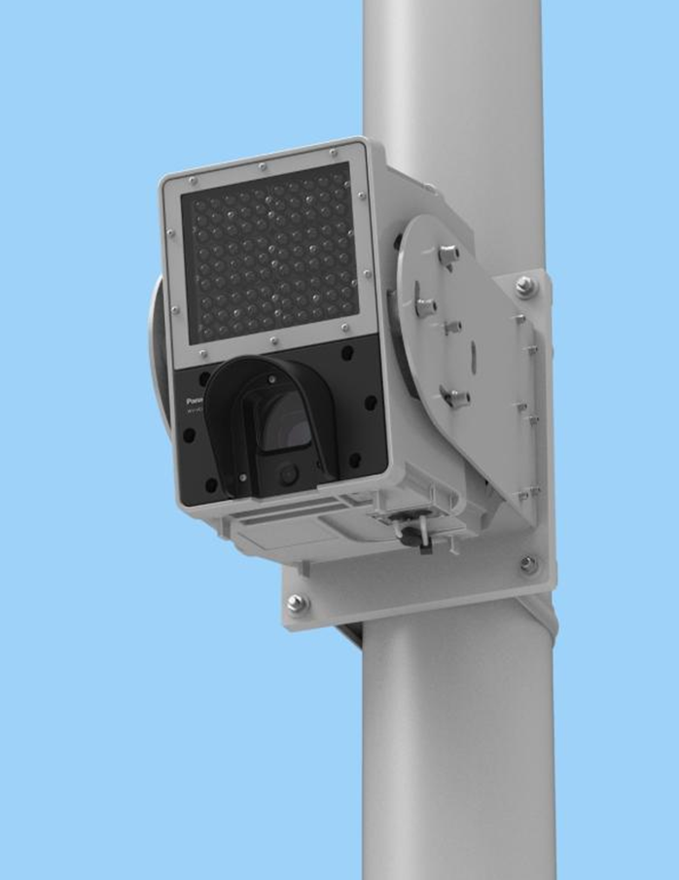
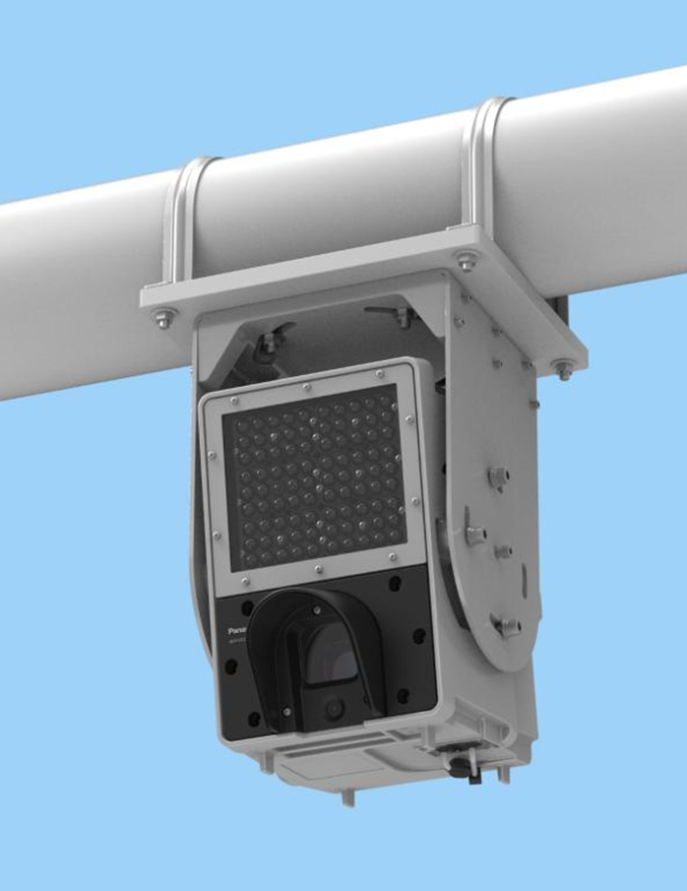
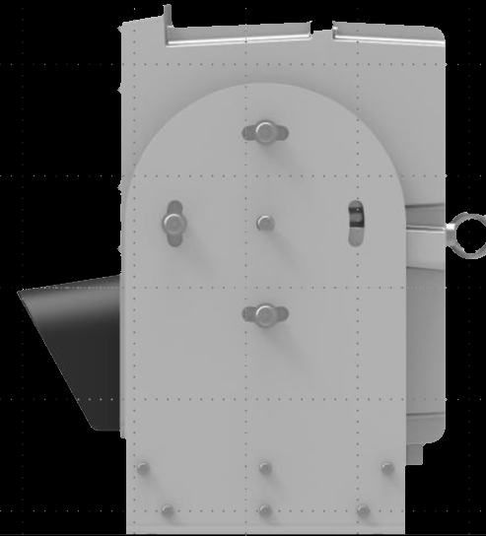



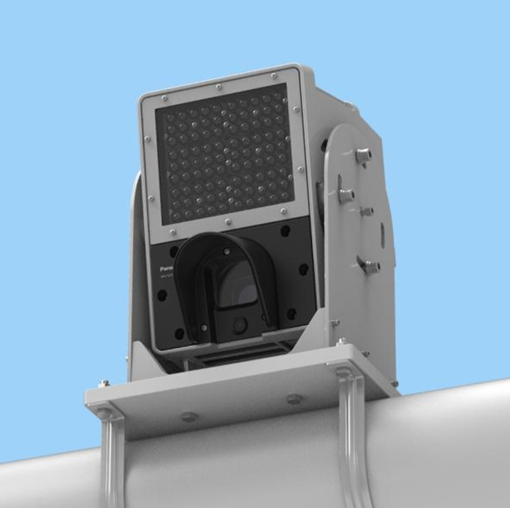
2. Main Feature “Usability”
Easy Installation and Easy setting help to reduce installing time and cost.
Easy Installation
Easy Setting
Easy hanging structure
Zoom,Focus position and PLF rotation angle
are set automatically by using Easy setting
with your mobile via Wi-Fi.
Easy Pan/Tilt adjustment structure
Ceiling
Tilt
Pan
Pole
Insert USB Wi-Fi device.
Just input horizontal & vertical distance between vehicle and camera.
Top

Slide 12

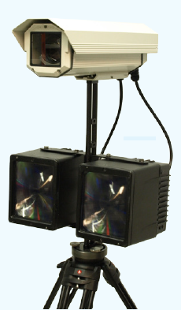



3. SPEC comparison
 |  | Panasonic WV-X5550LT, WV-X5550LTPJ | Opto Precision Front-Foto-System (FFS) | GATEKEEPER GKR-1088 | NEC unknown | Storenet SECURE EYE-Z12HD-8LD
Occupant visualization |  | Yes (w/ 855nm NIR-LED | Yes w/ 808nm NIR-Laser light | Yes w/ Visible flash light | Yes | Yes (Option)
 |  |  | Yes (Option : LPR software) | No | No | No
Number visualization
Sensor | ONE | 5MP, BW (Global Shutter) | 4.2MP, BW | 2MP (1600x1200) | unknown | 2MP, CL (Global Shutter)
 | Double | --- | --- | --- | --- | ---
Frame Rate |  | 15fps(source1): Face 15fps(source2):License plate | 30fps | 30fps | unknown | 30fps
 |  | 30fps(source1): Face only
Sensor size |  | 2/3 | private | private | unknown | 1/1.9
Lens |  | 51-85mm (x1.7) / 2-3.35inch Motorized zoom, focus | 85mm | Varifocal lens | unknown | 7-84mm / 0.28-3.31inch Motorized Varifocal
Video Compression |  | JPEG, H.265, H.264 | MJPG | unknown | unknown | HD-SDI
Intelligent auto (iA) |  | Yes | No | No | No | Image sharpening Device (Option)
Environmental resistance |  | IP66 -40～+60°C(-40~140°F) | IP65 -30°C～＋50°C(-22~122°F) | IP67 -35~+60°C(-31~140°F) | unknown | IP55 -10°C～+50°C(14~122°F)
Hydrophilic coat |  | none
LPR app |  | No | No | No | unknown | No
Capture effective range |  | 20m～30m / 1 lane (66~98feet) | 20m / 1 lane (66feet) | A few meters(feet) / 1 lane | A few meters(feet) / 1 lane | 10m～100m (32~328feet) *A separate LED is required for long distances
Correspondence speed |  | Dual mode:120km/h (75miles/h) Effective frame capturing both occupant and license Is 2-4. Single mode:160km/h (100miles/h) Effective frame capturing both occupant and license is 4-6. | Unknown | Under 30Km/h (under 19miles/h) | 20km/h (12miles/h) | unknown
Internal use only

Slide 13
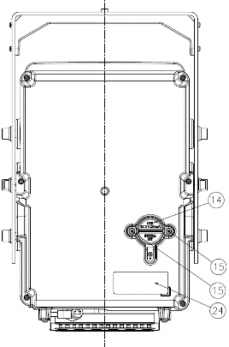
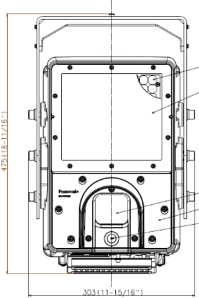
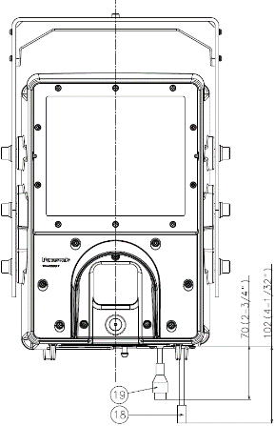
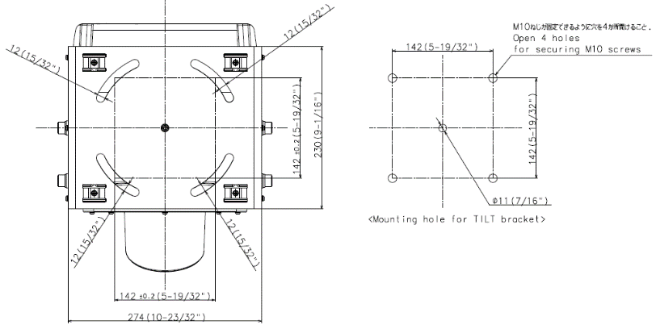
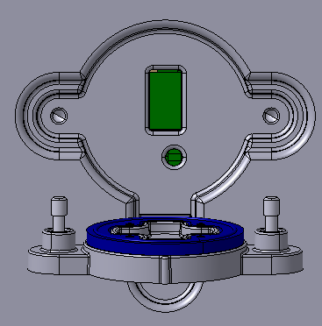
4. Appearance
1. Appearance specifications
■Color：Silver
■Dimensions：303 mm (W) x 475 mm (H) x 368 mm (L)
{11.93 inch (W) x 18.7 inch (H) x 14.49inch (L)}
■Weight：
Main body : Approx. 11.5 kg {25.39 lbs}
With TILT bracket : Approx. 16.0 kg {35.32 lbs}
(Ceiling mount)
3. Installation specifications
2. Display/switch specifications
USB terminal
INITIAL SET button

Slide 14
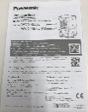
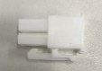
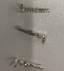
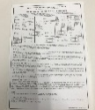
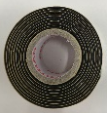
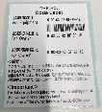
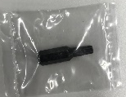
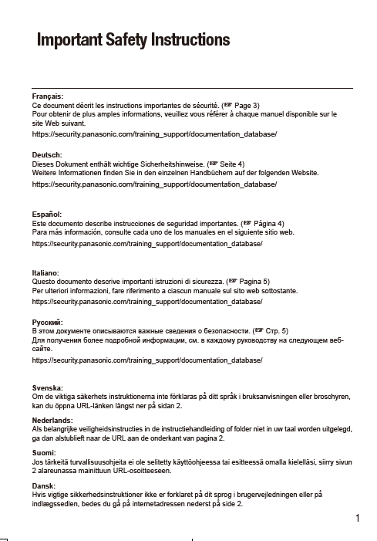
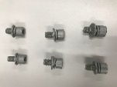
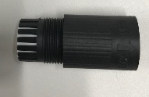
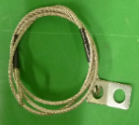
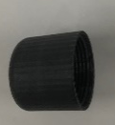
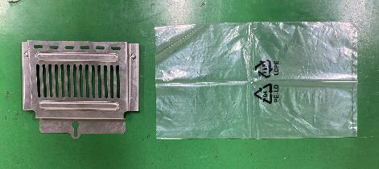
5. Accessory
Bundled accessories list. There are not accessories option.
No | image | Item | Qty
1 |  | Installation Guide | 1
2 |  | Warranty card | 1
3 |  | Code label | 1
4 |  | Important safety instructions | 1
5 |  | RJ45 waterproof connector cover for LAN cable | 1
6 |  | RJ45 waterproof connector cap for LAN cable | 1
No | image | Item | Qty
7 |  | 24V AC power supply connector kit | 1
8 |  | Water proof tape for 24V AC power supply | 1
9 |  | Bit(Hex wrench, screw size 6.35mm{1/4 inches T20}) to open back of cover | 1
10 |  | Hexagon screw (M10*20mm){25/32 inches} | 6
11 |  | Safety wire to prevent falling camera | 1
12 |  | Cable cover to house power cable | 1

Slide 15
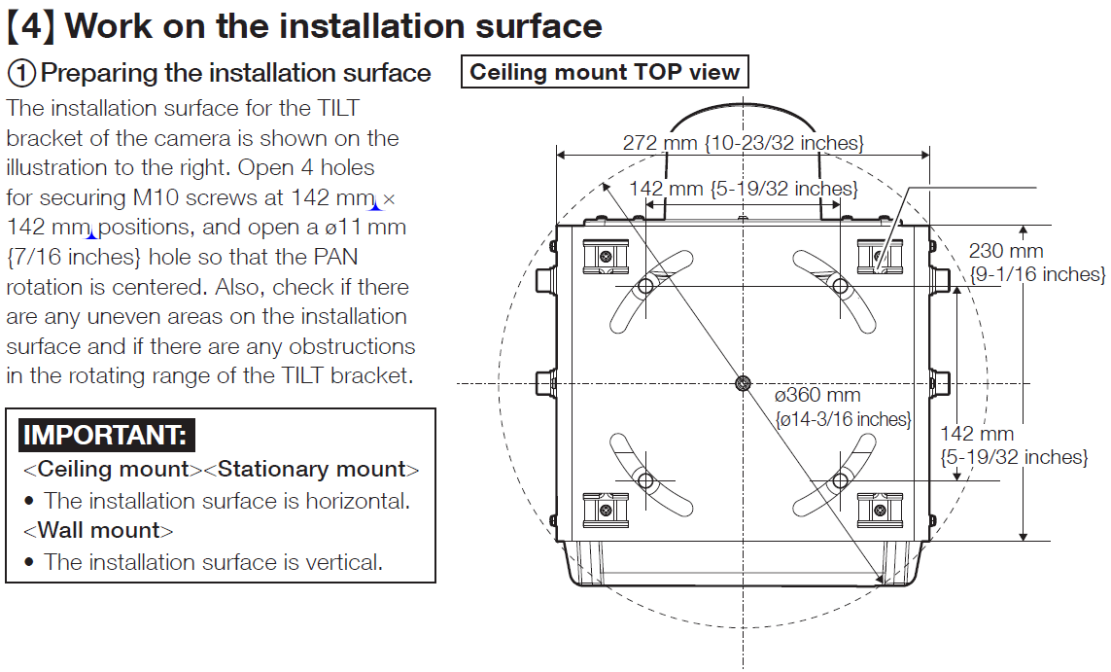
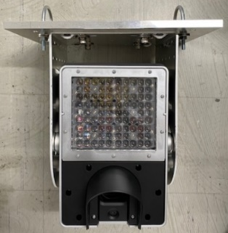
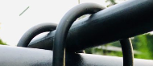
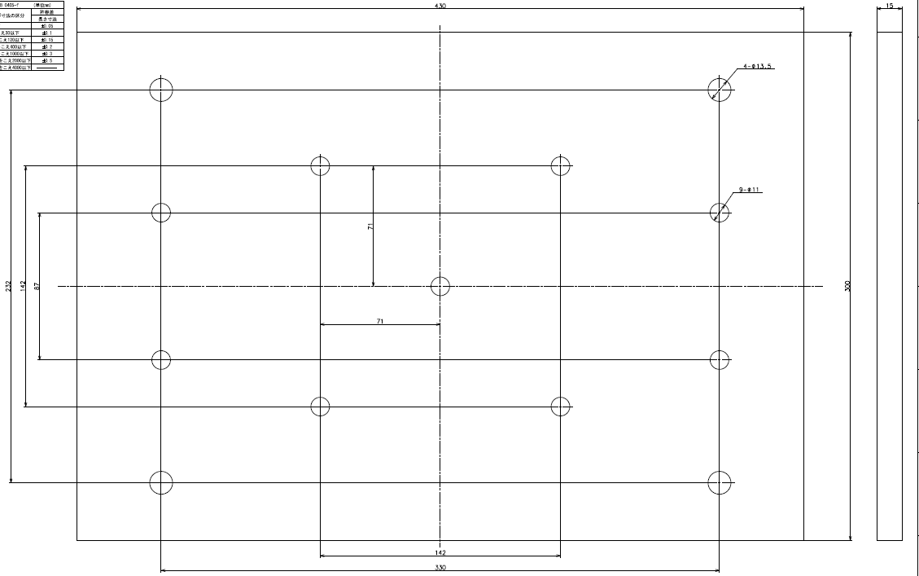
6. Preparations for installation (1/2)
U-Bolt / Aluminum Plate should be prepared at customer side.
U-Bolt
Aluminum Plate
[Note]
this drawing design of Aluminum plate is sample,
and we don’t warrant this bracket quality.
Please check and draw it based on pole size.

Slide 16




6. Preparations for installation (2/2)
Power / cable / connector also should be prepared at customer side.
[Note]
AC connector should be assembled by yourself.
Sample
commercial power source depends on region
Set of goods
Step1
: Assemble contact for camera cable,
and connector for your power cable too.
Step2
: spool waterproof tape to
connector with contact
120V AC
Power code(8ft.)
Ref. Contact and connector specification
will be changed (T.B.D / plan Jan.20)
Power
１：24V AC LIVE (Brown)
2：24V AC NEUTRAL (Blue)
3：Grand (Black)
Connector
1
2
3
Cable
contact
Connector is water proof, therefore,
You don’t need to spool water proof tape to connector

Slide 17

7. Installation condition
Check installation condition, and install the camera
our recommendation :install the camera at 4.5-5.8m height (14.76-19.03ft) with tilt angle 7-10 degree.
* If the camera will be installed on slope, Tilt angle should be added based on slope angle.
[Note]
・lane width for your reference -> USA:3.66m(144.1inch), Germany/France:3.75m(147.6inch), Japan:3.5m(137.8inch)
・Minimum height of gantry required for 4.80m(15.75feet) {Europe4.5m(14.76feet), US 4.9m(16.08feet), UK5.35m(17.55feet),
Japan 4.6m)(15.09feet)}based on survey
= allowed Maximum height of vehicle{4.30m(14.11feet)}+ vertical movement{0.2m(0.66feet)}+ margin{0.3m(0.98feet)}

Slide 18


8. System configuration example
Occupant and license image captured by camera can be available for analysis via Video Insight, Genetec or Milestone VMS.
Client for Maintenance
(VI /Genetec / Milestone / Web browser)
Occupants : Rec. stream, Live stream
License Number : Rec. stream, Live stream
Recording Server
(VI / Genetec / Milestone)
Image analysis server
(Ex. VI LPR option)
[Note]
・X5 series camera doesn’t support to connect
with NX recorder, ASM software and ASF950.

Slide 19















9. Performance limitation
Following performance limitation affects image quality.
Restriction | Image example
In the case of entering sunlight or reflection from vehicles hoods to the camera directly.
In the case of windshield angle is more than 50 degrees. (bus, truck, etc.)
In the case of windshield with a special film*as below. - cut more than 85% of 855nm NIR or - reflect IR or - Polarized film
Out of recommended installation condition. (horizontal distance, vertical distance, height)
Restriction | Image example
In heavy snow or rain.
Over specification of capturing vehicle speed (120km/h/15fps mode or 160km/h/30fps mode)
Water drops or stains on the glass surface of the camera.
Difficult to see characters, due to license condition. (painted too reflective material or dirty on or one of character is not printed by reflective material etc.)
Coexistence area of reflective and non-reflective plates (In some cases, you can shoot the reflective type with Source2 and the non-reflective type with Source1)

Slide 20

10. Consideration
It is important to understand following consideration, and should explain to customer.
The image quality will be bad, when the reflection happens due to an obstruction (like insect, etc.) between the camera and subject.
Since the IR lighting is blinking, it affects the images captured by other CCTV. (blinking image)
There are black vertical lines on both sides of image because of differences between sensor capturing size and resolution size.
Set the image quality of Source 2 in accordance with the reflective or non-reflective license plate.
(Brightness, max gain, max shutter) its depending on your regions. (default setting is for reflective license plate)
The Easy installation function cannot be used in case of out of recommended installation conditions.
In that case, manual adjustment is required.
After Easy installation, the angle of view (Zoom/Focus) should be checked again for your operation.
Resolution size | Black vertical line | Effective Resolution
2560x1920 | 64pixel x2 | 2432x1920
1600x1200 | 40pixel x2 | 1520x1200
1280x960 | 32pixel x2 | 1216x1200
640x480 | 16pixel x2 | 608x480
[Note] aspect ratio is supported 4:3 only.

Slide 21
11. Specification (1/3)
Default value
Image |  | WV-X5550LT / WV-X5550LTPJ
Image capture mode |  | Dual sources [4:3] (15fps mode) / Dual sources [4:3] (12.5fps mode) Single source [4:3] (30fps mode) / Single source [4:3] (25fps mode)
Number of stream |  | H.265（or H.264） (1)(2), JPEG(1)(2) x 2Source ( when image capture mode set Dual Sources mode)
H.265/H.264 | Transmission priority | VBR / Frame rate
 | Frame rate | Dual sources mode [15fps mode] stream1 – 15fps fixed, stream2 – 1 / 3 / 7.5/ 10/ 15fps [12.5fps mode] stream1 – 12.5fps fixed, stream2 – 1 / 3.1 / 6.25/ 8.3/ 12.5fps Single source mode [30fps mode] stream1 – 30fps fixed, stream2 – 1 / 3 / 7.5/ 10/ 15/ 30fps [25fps mode] stream1 – 25fps fixed, stream2 – 1 / 3.1 / 6.25/ 8.3/ 12.5/ 25fps
 | Bitrate | 64kbps / 128kbps/ 256kbps/ 384kbps/ 512kbps/ 768kbps/ 1024kbps/ 1536kbps/ 2048kbps/ 3072kbps/ 4096kbps/ 6144kbps/ 8192kbps/ 10240kbps/ 12288kbps/ 14336kbps/ 16384kbps/ 20480kbps/ 24576kbps/ --FREE ENTRY--
 | Image quality | Frame rate: Motion priority / Normal / Quality priority VBR : 0 Super fine / 1 Fine / 2/ 3/ 4/ 5 Normal/ 6/ 7/ 8/ 9 Low
JPEG | Transmission type | PULL(One shot JPEG ) / PUSH (Motion JPEG)
 | Refresh interval | Dual sources mode [15 fps mode] 0.1fps/ 0.2fps/ 0.33fps/ 0.5fps/ 1fps/ 3fps/ 5fps/ 10fps/ 15fps [12.5 fps mode] 0.08fps / 0.17fps / 0.28fps / 0.42fps / 1fps / 3.1fps / 4.2fps / 8.3fps / 12.5fps Single source mode [30 fps mode] 0.1fps/ 0.2fps/ 0.33fps/ 0.5fps/ 1fps/ 3fps/ 5fps/ 10fps/ 15fps/ 30fps [25 fps mode] 0.08fps/ 0.17fps/ 0.28fps/ 0.42fps/ 1fps/ 3.1fps/ 4.2fps/ 5fps/ 8.3fps / 12.5fps / 25fps

Slide 22
11. Specification (2/3)
camera | WV-X5550LT / WV-X5550LTPJ
Scanning system | Progressive Global shutter
Intelligent auto | On / Off
Multi 0 sampling dynamic range | 120db * 2 types of images, the driver's face image (source 1) and the license plate image (source 2), are output simultaneously from this unit. This spec is the maximum exposure ratio of Source 1 and Source 2.
Maximum gain | The level can be set in the range of 0 to 11. (default source1:9, source2:3)
Auto contrast adjust | On/ Off
Adaptive black stretch | The level can be set in the range of 0 to 255. (default:128)
Back light compensation (BLC) /High light compensation(HLC) | BLC/ HLC/ Off The level can be set in the range of 0 to 31. (only when Intelligent auto: Off)
Light control mode setting | Outdoor scene/ Fix shutter
Shutter speed | [15 fps/30 fps mode] 1/30 Fix, 1/60 Fix, 1/120 Fix,1/250 Fix, 1/500 Fix, 1/1000 Fix, 1/1500 Fix, 1/2000 Fix, 1/3000 Fix, 1/4000 Fix,1/10000 Fix [12.5 fps/25 fps mode] 1/25 Fix, , 1/50 Fix, 1/100 Fix, ,1/250 Fix, 1/500 Fix, 1/1000 Fix, 1/1500 Fix, 1/2000 Fix, 1/3000 Fix, 1/4000 Fix,1/10000 Fix
Maximum shutter | [15 fps/30 fps mode] Max.1/10000s, Max.1/4000s, Max.1/3000s, Max.1/2000s, Max.1/1500s, Max.1/1000s, Max.1/500s,Max.1/250s, Max.1/120s, Max.1/60s, Max.1/30s [12.5 fps/25 fps mode] Max.1/10000s, Max.1/4000s, Max.1/3000s, Max.1/2000s, Max.1/1500s, Max.1/1000s, Max.1/500s,Max.1/250s, Max.1/100s, Max.1/50s, Max.1/25s

Slide 23
11. Specification (3/3)
camera | WV-X5550LT / WV-X5550LTPJ
Day & Night | Auto*/ Day/ Night *The level can be set in the range of 0 to 9. *4 The output from the camera is a black and white signal. Use a polarizing filter when using day mode and use an band pass filter when using night mode.
IR LED Light | On / Off The level can be set in the range of 0 to 255.
Network | WV-X5550LT / WV-X5550LTPJ
Network | 10Base-T, 100Base-TX , RJ45 connector
Bandwidth control | Unlimited/ 64 kbps/ 128 kbps/ 256 kbps/ 384 kbps/ 512 kbps/768 kbps/ 1024 kbps/ 2048 kbps/ 4096 kbps/ 6144 kbps/8192 kbps/ 10240 kbps/ 12288kbps/ 15360 kbps/ 20480 kbps/ 25600 kbps/30720 kbps/ 35840 kbps/ 40960 kbps/ 51200 kbps / 61440kbps
Protocol | IPv6： TCP／IP, UDP／IP, HTTP, HTTPS, DNS, NTP, DHCPv6, RTP, MLD, ICMP, ARP IPv4： TCP／IP, UDP／IP, HTTP, HTTPS, RTSP, RTP, RTP／RTCP, DHCP, DNS, NTP, IGMP, ICMP, ARP
Band width control | User authentication / Host authentication / HTTPS
ONVIF | Profile S

Slide 24


12. Set up menu (1/2)
◆ Live page
- It is possible to select the following three display mode.
「Dual : 2screen display」、「1: Source1 screen display」、 「2: Source2 screen display 」
Display on dual
Display on 1
Display on 2

Slide 25

12. Set up menu (1/2)
No | menu |  | outline
1 | Easy Set up | Easy installation | Easy Setting function
2 | Basic | Basic | Day Setting / Plug-In etc.
3 | Image | Image | Resolution Setting / Bitrate / Framerate etc.
 |  | Image Quality | Brightness Setting / Sean file Setting / Image Setting / Zoom & Focus etc.
4 | Alarm | Notification | Alarm Setting.
5 | User mng | User auth. | User Registration etc.
 |  | Host auth. | Host authorization Setting etc.
6 | Network | Network | IP address Setting etc.
 |  | Advanced | HTTPS / NTP etc.
7 | Schedule | Schedule | Schedule Setting of Sean file.
8 | Maintenance | System log | Camera Log.
 |  | Upgrade | Camera Firmware Update.
 |  | Status | USB and Camera Status.
 |  | Default reset | Initialize Settings.
 |  | Data | Upload and download Setting file.
9 | Support | OSS | OSS software in camera.

Slide 26



12. Set up menu “Easy Setting”
Adjust the angle of view automatically by inputting installation condition with mobile.
<Preparation>: Please register as an administrator or user.
1. Attach the USB-Wi-Fi adapter to the camera, and connect it to the Wi-Fi USB adapter.
・SSID: “product number serial number”
・password: “cam _serial number“
2. Access following URL and connect to the camera with Google Chrome. (http://192.168.12.10)
STEP1
STEP2
STEP3
Height
：installation height of the camera.
Manually adjust the zoom and focus for detail, if needed.
Distance
：distance from the camera
installation position to vehicle.
Deflection
Distance
：installation position to the center
of the road lane.
Zoom in
About 3.5m
Zoom out
Click NEXT and calculation about the Zoom, Focus and polarization
filter rotation angle will start automatically.
[Note]
Please input parameters especially deflection distance “L” and “R”.
Otherwise, the image quality will be bad.
Focus near
Focus far
RESET to step1 setting ( if you don’t set step1, default value –zoomx1.0, to set )
Unplug USB adapter and lock.

Slide 27

12. Set up menu “Basic”
Time & date setting and viewer software setting.

Slide 28
12. Set up menu “Image” (1/7)
◆ Image Capture Mode
◆ Dual sources [4:3](15fps mode ) / Dual sources [4:3](12.5fps mode)
Source 1 : image for occupant @ 15fps or 12.5fps
Source 2 : image for license plate @ 15fps or 12.5fps
※support Max. 120km/h / In this mode, you can capture both occupant and the license plate image at the same time.
◆Single source [4:3](30fps mode) / Single source [4:3](25fps mode)
Source 1 : image for inside a car @ 30fps or 25fps
Source 2 : none
※support Max. 160km/h. In this mode, occupant image can be captured at 30 fps. Image for license plate isn’t available.
 | Source1 (for occupant) |  |  |  | Source2 (for license plate)
Image capture mode | Stream(1) | Stream(2) | JPEG(1) | JPEG(2) | Stream(1) | Stream(2) | JPEG(1) | JPEG(2)
Dual Sources [4:3] (15fps mode) | 2560x1920/ 1600x1200/ 1280x960 15fps fixed | 1280x960/ VGA Max 15fps | 1280x960/ VGA Max 5fps | VGA Max 5fps | 2560x1920/ 1600x1200/ 1280x960 15fps fixed | 1280x960/ VGA Max 15fps | 1280x960/ VGA Max 5fps | VGA Max 5fps
Dual Sources [4:3] (12.5fps mode) | 2560x1920/ 1600x1200/ 1280x960 15fps fixed | 1280x960/ VGA Max 12.5fps | 1280x960/ VGA Max 4.2fps | VGA Max 4.2fps | 2560x1920/ 1600x1200/ 1280x960 12.5fps fixed | 1280x960/ VGA Max 12.5fps | 1280x960/ VGA Max 4.2fps | VGA Max 4.2fps
Single Source [4:3] (30fps mode) | 2560x1920/ 1600x1200/ 1280x960 30fps fixed | 1280x960/ VGA Max 30fps | 1280x960/ VGA Max 5fps | VGA Max 5fps | - | - | - | -
Single Source [4:3] (25fps mode) | 2560x1920/ 1600x1200/ 1280x960 25fps fixed | 1280x960/ VGA Max 25fps | 1280x960/ VGA Max 4.2fps | VGA Max 4.2fps | - | - | - | -

Slide 29

12. Set up menu “Image” (2/7)
◆ Image setting (1/3)
Default value
Image capture mode:
Dual sources [4:3](15fps mode)
/ Dual sources [4:3](12.5fps mode)
/ Single source [4:3](30fps mode)
/ Single source [4:3](25fps mode)
[Note]
・To change the setting from Dual sources mode to Single source mode or from Single source mode to Dual sources mode, restart of camera happen.
・In Single source mode, the Source2 item in the video settings will not be displayed.
Initial display stream:
Dual Stream(2) / Dual JPEG(2) / Source1 stream(1) / Source1 stream(2) / Source1 JPEG(1) / Source2 stream(1) / Source2 stream(2) / Source2 JPEG(1)
All stream setting :
stream encoding format , Internet mode and Multicast TTL is common setting.

Slide 30

12. Set up menu “Image” (3/7)
◆ Image setting (2/3)
Default value
Transmission priority:
VBR / Frame rate
Frame rate:
- stream(1) frame rate is 15 fps fixed
※when Dual sources mode
※If image capture mode is “Single source mode” ,
frame rate is 30fps fixed)
- stream(2) frame rate is selectable follow
15fps / 10fps / 7.5fps / 3fps / 1fps
[Note]
・Recommendation setting about Transmission priority, Bitrate and image quality is default. And Image sample in the document is captured by default setting.

Slide 31

12. Set up menu “Image” (4/7)
◆ Image setting (3/3)
Source1 – stream1 setting
Source2 – stream1 setting
※Not displayed in Single source mode.
Source1 – stream2 setting
Source2 – stream2 setting
※Not displayed in Single source mode.

Slide 32

12. Set up menu “Image” (5/7)
◆ Image quality setting – Image adjust (1/2)
Default value
Source1 / Source2
Switches the image quality setting of Source1 and Source2.
Light control mode
Outdoor scene / Fixed shutter
(Fixed shutter - 1/30fixes, 1/60fixed, 1/120fixed, 1/250fixed,
1/500fixed, 1/500fixed, 1/1000fixed, 1/1500fixed,
1/2000fixed, 1/3000fixed, 1/4000fixed, 1/10000fixed)
※1/1500, 1/3000 are added parameters
Maximum shutter
Max 1/10000s, Max 1/4000s, Max 1/3000s, Max 1/2000,
Max 1/1500s, Max 1/1000, Max 1/500, Max 1/250,
Max 1/120s, Max 1/60s, Max 1/30s
※The slow shutter is deleted to capture the moving vehicle

Slide 33

12. Set up menu “Image” (6/7)
◆ Image quality setting – Image adjust (2/2)
Default value
・Day & Night (Common setting)
Auto / Day / Night *Common setting items for Source1 and source2
- level : 0 - 5 - 9
0: 0.1lux, 5: 300lux, 9:10,000lux
*You can set the illumination level that automatically switches when Auto is set.
Dwell time : 1min / 2min / 3min / 5min *switching time
・IR Light
On / Off
[Note] When turned off, the image becomes dark.
Intensity control : On/ Off *Sets the whiteout suppression function
・Scene File
This camera holds 3 scene files at default setting.
1: sunny –A scene file with settings suitable for daytime.
2: cloudy – A scene file with settings suitable for daytime.
3: night – A scene file with settings suitable for night time.

Slide 34

12. Set up menu “Image” (7/7)
◆ Image quality setting – Zoom/Focus adjustment
Shared screen design with easy installation screen
Auto Focus can be set on this screen.

Slide 35

12. Set up menu “Alarm”
◆ Alarm - notification
Original alarm notification HTTP alarm notification can be set
Alarm type
・HW ERROR :
Notifies when the built-in fan or IR Light fails.
・USB Wi-Fi ：
Notify when USB Wi-Fi is inserted.
*This function is added to enhance security.
Detects unintended USB Wi-Fi insertion by the user.

Slide 36

12. Set up menu “User mng.”
◆ User mng. – User auth.
User auth.
・ User auth. : On / Off (not change)
・ Guest User : Use / Not use （Change）
*From the viewpoint of security,
we set values changed the initial values.
If User Authentication is set to Off, you will be
a Guest user. Please set the Guest user authority at
Access level. (Since there was no Guest User in the
existing, it is possible to implement all except setting
value change)

Slide 37

12. Set up menu “Network” (1/2)
◆ Network - Network
・Bandwidth control(bit rate)
Unlimited / 64kbps / 128kbps / 256kbps / 384kbps / 512kbps/
768kbps / 1024kbps / 12288kbps / 15360kbps / 20480kbps/
2560kbps / 30720kbps / 35840kbps / 40960kbps / 51200kbps/
61440kbps
Add 61440kbps parameter
Total bandwidth 60Mbps
[Note]
・ Total bandwidth can be shared with user number.
*Maximum user number is 14.
・ Recommended co-current user is 3 or 4.

Slide 38

12. Set up menu “Network” (2/2)
◆ Network – Advanced (HTTPS)
HTTPS configuration
・When set to HTTPS, 16Mbps transmission
limitation was removed.
(Total bandwidth 60Mbps)
・ TLS 1.2 support (TLS 1.0/1.1 not support)

Slide 39

12. Set up menu “Schedule”
Schedule mode
・You can register the schedule of the scene file.
・Only Schedule 5 can be set to restart.
Ex. With scene file
1. Register Schedule 1
Select Schedule mode and set scene file (ex. Sunny)
Check all days and time(starting time is sunrise time
after 30min, finishing time is sunset before 30min)
2. Register Schedule 2
Select Schedule mode and set scene file (ex. Night)
Check all days and time(starting time is sunset time
before 30min, finishing time is sunrise after 30min)

Slide 40


12. Set up menu “Maintenance”
System log
200 logs can be saved
Status
・Displays the USB interface status.
・It is possible to disable the USB interface.
Factory initialization is required to activate after
setting to disable.
*same to multi-sensor camera specification

Slide 41


12. Set up menu “Support - OSS”
・This is Open Source Software license information which is used for X5 series camera.

Slide 42





















13. System updates
system | Additional development | Scheduled release time
Software Update | ・Additional application function ・Face detection / Face extraction ・Send the best shot image ・Face meta information output | T.B.D
Vehicle search server | ・Tuning for image (front capture image etc.) ・Resolution support, etc. | T.B.D
LPR server (VI) | ・Simultaneous playback of 2 sources | Scheduled to be supported after Nov. 2020 (VI server Update)
Face server | ・Improved accuracy for IR images ・Supports partial concealment ・AI high image quality, etc. | T.B.D
Source1
Source2

Slide 43
14. Model number
W | V |  | X | 5 | 5 | 5 | 0 | L | T
W | V |  | X | 5 | 5 | 5 | 0 | L | T | P | J
 |  |  | Series | Form | Environment | Resolution | Serial number | Other features |  | Minor Change | Region (J/H)
 |  |  | X:X series High - end S:S series High specification & High cost performance V:V series Price competiveness U:U series Basic | 9：- 8：Multi sensor 7：PTZ(Aero) 6：PTZ(Dome) 5：VCC 4：360 deg. 3：Compact DOME 2：Dome 1：Box 0 : - | 9：- 8：- 7：- 6：Outdoor salt damage resistance 5：Outdoor Vandal 4：Outdoor normal 3：- 2：Indoor Vandal 1：Indoor normal 0：- | 9 : - 8 : - 7 : 4K (12MP) 6 : - 5 : 5~6MP 4 : 4MP 3 : FHD 2 : 1 : HD 0 : - | 9 : 8 : 7 : 6 : 5 : 4 : 3 : 2 : 1 : 0 : | L : LED N : Rain wash coating (Non Raindrop) M : M12 W : Wireless F : Optical I/F V : With lens T : Long focal lens K : Fix lens |  | D : C : B : A :
Reserve
3rdgen.
2nd gen.
1st gen.

Slide 44
15. Q&A (1/3)
No | Category | Question | Answer
1 | Principal | What makes the camera to be able to capture occupant? | Day: Visualizing with strong IR, removing harmful sunlight with Polarization filter, and improving visibility with image processing technology. Night: Visualizing with strong IR, removing headlight from car with both Band-Pass filter, and improving visibility with image processing technology.
2 | Specification | What is upper limitation of running car speed to capture? | Dual Sources mode: 120km(75miles)/h at 15fps as maximum Single Source mode:160km(100miles)/h at 30fps as maximum
3 |  | Is it possible to capture completely? | No. Please check P.17 “Performance limitation”
4 |  | Which shutter type Global or Rolling? | Global Shutter.
5 |  | How many lanes can the camera capture? | 1 lane.
6 |  | Is there any effect when camera installed at site? | Please check P.18 “Consideration”
7 |  | Is there any effect for those who see camera directly? | No effect, and camera complies eye-safe standards (IEC62471). *detail is Ref. “IEC62471”
8 |  | Does the any brightness surround camera affect it’s performance? | Special Mechanism (Q&A No.1) minimizes noise from brightness.
9 |  | Does the image blur happen when the camera is shacked by wind or vehicle passing? | Even if the camera doesn’t have stabilization function, of course, video image is affected. But, picture image isn’t affected due to high shutter speed.
10 |  | Does the brightness or shadow pointing on the road affect to the camera image? | It rarely affects image quality.
11 |  | How does time information setting is used? | Time information setting is implemented in stream and used for log and alarm.
12 |  | Is clear sight coating available for the camera? | No, Performance decrease, and it protect from attaching water and stain with sun shade of glass.
13 |  | Does the camera capture occupants in back seat? | Camera doesn’t support.

Slide 45

15. Q&A (2/3)
No | Category | Question | Answer
14 | Specification | What is the threshold-value of illuminance for shifting between Polarization filter on daytime and Band-pass filter on nighttime? | Default value is around 300lux (Level5), and you can adjust this threshold-value at 10 levels. (range: 0.1lux at level 0 ~ 10,000lux at level 9)
15 |  | Which area does the illuminance sensor detect for? near sensor or near focusing target area? | Detection area is wide range as below figure, and camera sensor calculates average illuminance in the detection area.
16
 |  | Is the VCC equipped with Grounding terminal or surge protection in any lightning strikes? | Camera had durability against 4KV of induced lightning, not direct lightning by connecting GND cable to ground earth.
 |  | What is the upper limitation to capture occupants with special film of windshields? | Please check P.17 “Performance limitation”
17 |  | Which area the IR direct to? | It depends on the installation condition. For example, 3.6m (141.7inch) diameter circle for when distance between camera and vehicle is 25m (984.3inch).
18 | Installation | What it will happen, in the case that cameras will be installed both side of the road and focus on same area. | Target image quality may become overexposure, if these camera’s IR are synchronized together.
19 |  | Is portable type available? Or can it be installed in any transportable equipment. | It is not available for portable type. And Please ask PIPS, if customer wants to install it in transportable equipment.
WV-X5550LT
WV-X5550LTPJ
detection area

Slide 46
15. Q&A (3/3)
No | Category | Question | Answer
20 | Installation | Is the camera able to use to capture at the gate such as parking lot, car pool or entrance? | Depending on installation condition.
21 |  | Does the customer have to prepare USB dongle for easy installation by themselves? | Yes. Please check P.45 “Reference”
22 | System Integration | Does the camera have Best shot function or OCR function? | No, it’s just a camera which send 2 streams both occupant and license plate image.
23 |  | Does the camera integrate with VMS? | Yes, it integrates with Video Insight, Milestone and Genetec.
24 |  | Does the camera integrate with ASF950? | No, and currently no plan to integrate with ASF950.
25 |  | Does the camera integrate with NVR? | No, it doesn’t.
26 | Legal | Does this camera violate one’s privacy? | the conscious of compliance is increasing. On the other hands, the demands of analytics is also increasing. PIPS wants to respond to this expectation. In addition, PIPS has to take care for secure in aspect of technology and operation. As for technology, It complies Data encryption and secure communication to protect date leak. As for operation, we supports customer to be able to manage user authorization.
27 | Competitor | What is competitor’s situation? | Giant CCTV manufacture such as Axis and Hanwha don’t offer similar products. Please check P.10 “Spec comparison”.
28 |  | What is strong points of the camera? | Please check P.3-P.9 “Introduction”.

Slide 47
16. Differences from i-PRO series camera
New functions or setting for only X5 series camera.
No | menu |  | outline
1 | Easy Set up | Easy installation | Easy Setting function
2 | Image | Image | Capturing mode function(Dual Source mode)
3 | Network | Network | Bandwidth control -> max value 60Mbps (current i-PRO series is 50Mbps) -> Https transmission max value 60Mpbs (current i-PRO series is 16Mbps)
X5 series camera doesn’t support following functions or setting of i-PRO series camera.
No | menu |  | outline
4 | Basic | Basic | Time display Setting / multi screen / digital zoon in live view / Select language in live view
5 | Image | Image | Image rotation setting / Image stabilization setting Image quality and resolution setting for JPEG. Stream Setting for “QVGA”(delete), transmission type “CBR”, “Best effort” (delete) and framerate of stream1 “except MAX” (delete), framerate of stream2”except 1,3,5,7,15,30”(delete) / Smart Coding function
 |  | Image Quality | Image quality for Super dynamic “Slow Shutter”(delete),” flicker less mode”(delete), “Smog compensation” (delete), “White balance” (delete), “Color phase”(delete) Zoom and focus setting for “scale configuration” (delete),”EX zoom” (delete),”focus frame setting” (delete),”shifting color and white”(delete)
6 | Alarm | Notification | VMD function / alarm input function / privacy zone setting
7 | Network | Advanced | FTP / mail / UPnP / DDNS / SNMP/ protocol
8 | Other |  | pre-install certification / 802.1x and data encrypt function

Slide 48
17. Tool
Check if X5 series camera can connect some supporting tools.
Tools | Connect or not
IP Setting software | Yes
i-PRO Configuration Tool (iCT) | No
System Design Tool | No
Panasonic Security Viewer | No
PS-API (SDK) | No

Slide 49
18. Ref. USB adapter
Verified Wi-Fi USB adapter for Easy Setting.
Manufacture name | Model number | Remarks
TP-Link Technologies Co., Ltd. | TL-WN823N V2 | Adaptors are available in the following areas; USA, Canada, Europe, Russia, Ukraine, Australia and other countries*
Net gear | AC600
* Note
Please refer to the web page as below
TP-Link https://www.tp-link.com/us/choose-your-location.html
Netgear https://www.netgear.com/home/products/networking/wifi-adapters/A6100.aspx
Information about USB-Wi-Fi will be posted on the CS support page.

Slide 50




18. Ref. Scene File
Differences between “Default setting” , ”Sunny” , “Cloudy “ ,and ”Night”.
- Recommendation is the default setting.
- There are 3 scene files, only source1 is different(See the figure below)
Sunny ：this scene file is suitable to sunny daytimes with not many clouds.
Guideline) illuminance is more than 1000000lux case.
Cloudy ：this scene file is suitable to cloudy daytimes.
Guideline) in the case cloud is occupied more than 90%.
Night ：this file is suitable to night-times. Guideline) illuminance is below 300lux.
Default setting
Sunny
Cloudy
Night
：differences

Slide 51





18. Ref. “What is Effective frame”?
Effective frame is the frame image which includes both occupants and license images
Image Pattern capturing occupants or license
Image capturing area of X5 series
Pattern “A”
Pattern “B”
Pattern “C”
11
・・・・・
・・・・・
11
11
Pattern “A”
Pattern “B”
Pattern “C”
n frame
Only image which include both occupants and license is pattern ”B”
Effective frame
Pattern “A”
Pattern “B”
Pattern “C”
Occupants : N/A
License : OK
Occupants : OK
License : OK
Occupants : OK
License : N/A
Capturing mode | Dual (15fps) | Single (30fps)
Effective frame | 2 ~ 4 for 120km/h (0 ~ 3 for 160km/h) | 6 ~ 8 for 120km/h 4 ~ 6 for 160km/h

Slide 52
18. Ref. IEC62471
IEC62471 is eye-safety standard for LED radiation which classifies with following figure
And, X5 series camera is classified as Risk Group2.
Risk Group | Note
Risk Group0 (Exempt) | Lamp and LED never affect biological danger.
Risk Group1 | Action restriction will happen, but lamp and LED never affect biological danger.
Risk Group2 | It may feel uncomfortable due to high-light but lamp and LED never affect biological danger.
Risk Group3 | Lamp and LED may affect biological danger.
Ref. How to classify Risk Group
- Risk Group is classified by measuring spectral irradiance and spectral radiance.
Measured Value is used for comparing to limitation value for lithographic exposure, for example UV, blue light and red light
which is more danger than other kinds of light.

Slide 53


