Slide 1
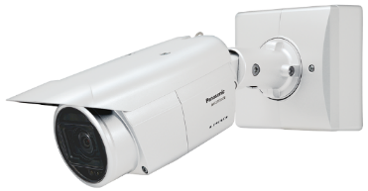
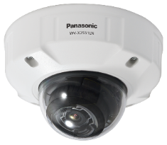
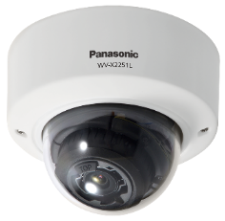
i-PRO Extreme Fixed Network Camera with AI Engine for SE
Document Ver.1.13
Jul. 2022

Slide 2
Contents
Product Concept
Key Features
AI Intelligent Auto
AI Smart Coding
Extension Software
AI-VMD Application
AI Privacy Guard Application
3rd Party Application
Specification Comparison
Appearance
Standard Accessories, Options
Other Software Specification
Cameras
Extension Software

Slide 3
1. Product Concept
Network camera with built-in “AI engine”
Perform video analysis inside the camera and provide solutions that meet a wide range of customer needs.
Key features
AI Function
Supports extension software
Allows additional installation of up to 3 applications.
Allows application development by third parties using application development kit.
Intelligent Auto
Recognizes “Face”, “Human” and “Vehicle” and optimizes the images according to the environment.
High Compression
Smart Coding
Compared to conventional models ^{*1} :
Reduces costs by reducing recording capacity by approximately 50 percent.
(With Auto VIQS and Smart Coding enabled)
*1 : Comparison to i-PRO Extreme series cameras
Conventional Models H.265
i-PRO with AI engine
Max.
50%
Smart coding
ON
Smart coding
ON
Reliability
i-PRO Quality
Ensure performance, Image quality and reliability.

Slide 4
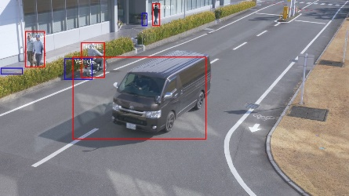
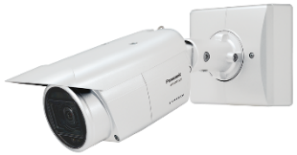
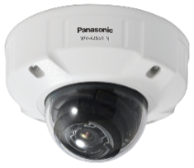
1. Product Concept
What’s i-PRO with AI engine?
Recognizes “Face”, “Human” and “Vehicle” using AI function inside the camera and optimizes the image depending on the environment
Up to 3 installations of extension software is possible
We provide Software Development Kit (i-PRO Camera SDK) to outside 3rd parties
Install
Extension Software
- AI-VMD
- AI Privacy Guard
- 3rd Party Application
Recognizes “Face”, “Human” and “Vehicle” and automatically optimizes the image
Recognition Image
New i-PRO with AI engine
LINE UP: 6 models
 | Outdoor BOX | Outdoor DOME | Indoor DOME
5MP model | WV-X1551LN | WV-X2551LN | WV-X2251L
4K model | WV-X1571LN | WV-X2571LN | WV-X2271L
Outdoor BOX
Outdoor DOME
Indoor DOME

Slide 5
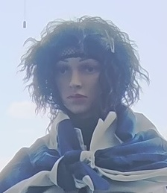
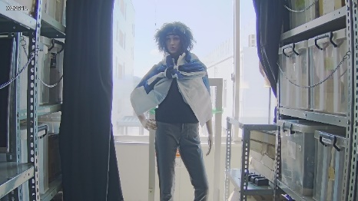
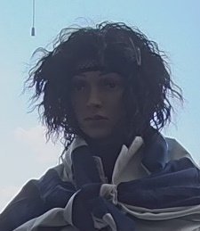
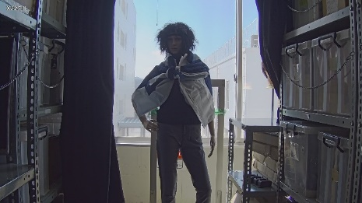
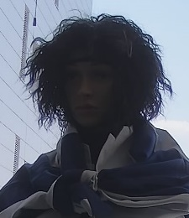
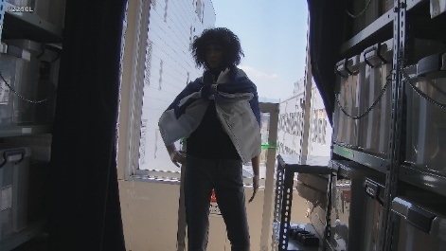
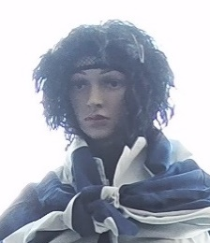
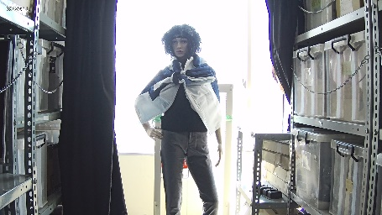
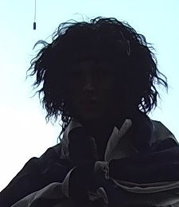
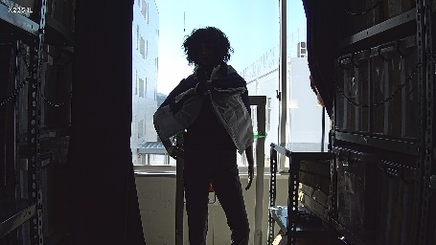
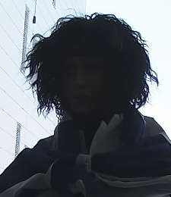
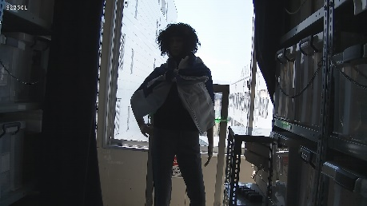
2. Key features - AI Intelligent Auto
Recognizes “Face”, “Human” and “Vehicle” and automatically optimizes the image depending on the environment
The visibility of backlit human has been remarkably improved by human detection (upper body) even in the situation where face detection is unavailable.
i-PRO with AI engine (WV-X1551LN) Face Priority Level: High | i-PRO with AI engine (WV-X1551LN) Face Priority Level: Low | Conventional model
SD ON
SD ON
SD ON
SD OFF
SD OFF
SD OFF

Slide 6
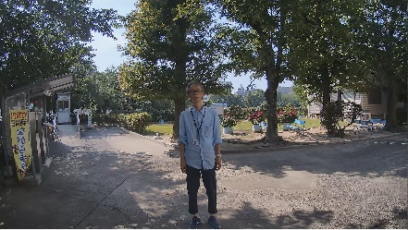
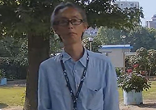
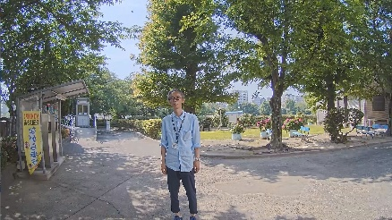
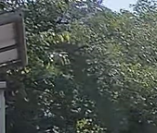
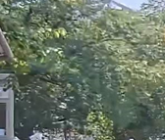
2. Key features - AI Smart Coding
Recognizes “Face”, “Human” and “Vehicle” and automatically controls the compression rate depending on the environment.
Conventional models
H.265
i-PRO with AI engine
H.265
Conventional models: Detects motion and automatically adjusts the image quality of moving objects to high and others to low.
i-PRO with AI engine : Detects objects (face, human and vehicle) and adjusts the image quality of those objects to high and others to low.
Max.
50%
Object detection by AI improve the detection accuracy and compression rate in other areas.
(approx. 50 percent compared to conventional models)
Smart coding
ON
Smart coding
ON
[Conventional models]
[i-PRO with AI engine]
Person on the image does not move
image quality is adjusted to low
Camera detect “face” and “human”
Adjusts the image quality of the face area to high
Swaying tree is recognized as a moving object
Increase Data amount
Swaying tree is NOT recognized as an object
Suppress Data amount
Measured bit rate: 6733kbps
Measured bit rate: 3855kbps

Slide 7
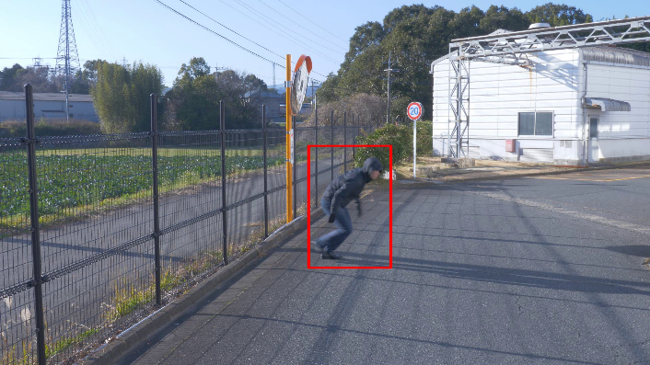
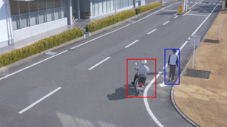
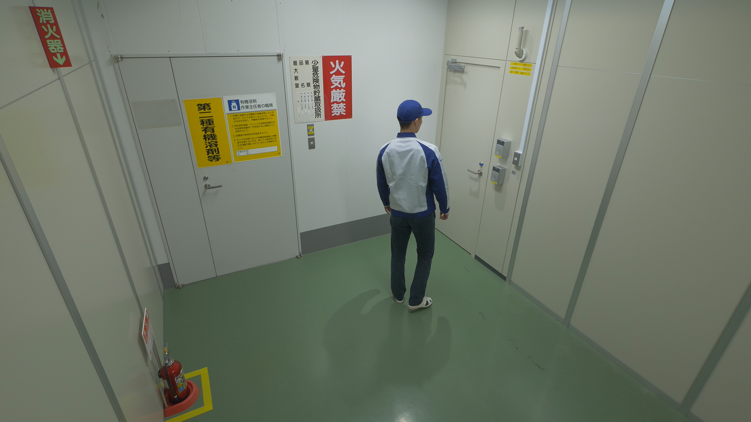
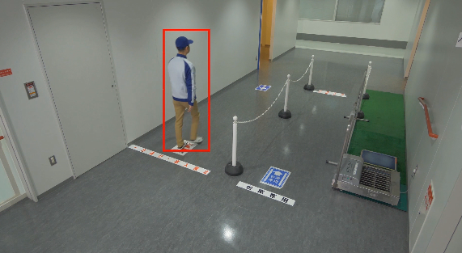
3. Extension Software – AI-VMD Application
AI-VMD : Improved the accuracy by utilizing AI object detection in addition to the current i-VMD.
Intruder detection
Direction detection
Issues an alarm when a moving object enters the configured area.
Issues an alarm when a moving object enters the configured area and moves to the specified direction.
Loitering detection
Cross line detection
Issues an alarm when a moving object enters and stays at the configured area for a specified period.
Issues an alarm when an object moving to the specified direction crosses the configured line.
*Supported: Scene change detection / NOT Supported: Object detection (left) and Object detection (removed)

Slide 8
3. Extension Software – AI-VMD Application
Specification Comparison
 |  | AI-VMD (WV-XAE200W) | Reference: i-VMD (WV-SAE200W)
Detection method |  | i-VMD + AI object detection | i-VMD
Detection mode | Intruder | Yes | Yes
 | Loitering | Yes | Yes
 | Direction | Yes | Yes
 | Cross line | Yes | Yes
 | Object (left / removed) | N/A | Yes
 | Scene change | N/A (Installed on i-PRO with AI engine) | Yes
Detection object |  | Human, Vehicle, Bicycle | N/A
Maximum number of simultaneous detection^{(*1)} |  | 40 | 8 ^{(*2)}
Minimum detection size^{(*3)} |  | 20pix | 24pix
Registerable number of detection condition^{(*4)} |  | 2 | 2
Registerable number of detection area |  | 8 for each detection criteria, 16 in total | 8 for each detection criteria, 16 in total
Registerable number of mask area |  | 8 for each detection criteria, 16 in total | 8 for each detection criteria, 16 in total
(*1) Depending on the size of moving object, the detecting situation and other conditions, it may not detect the objects up to the maximum number of detection.
(*2) Maximum number of simultaneous detection for Panoramic camera is 32.
(*3) The minimum detection sizes above are theoretical values and we do not guarantee the performance in detecting the objects of those sizes.
(*4) The detection condition can be configured by setting the combination of "Detection area", "Detection object" and "Detection mode".

Slide 9
3. Extension Software – AI-VMD Application
Improvements from the current i-VMD (WV-SAE200W)
AI object detection related
Improved the true positive alarm rate/ Reduced the false positive alarm rate
Output of the classification of detected objects
Setup related
Easy Setup
Detection object setting
Detection sensitivity setting

Slide 10
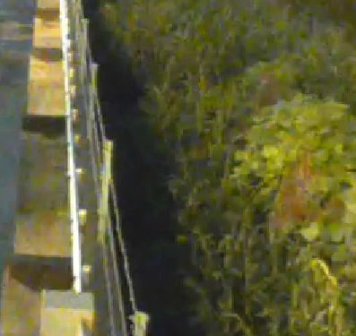
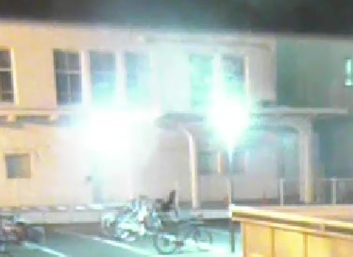
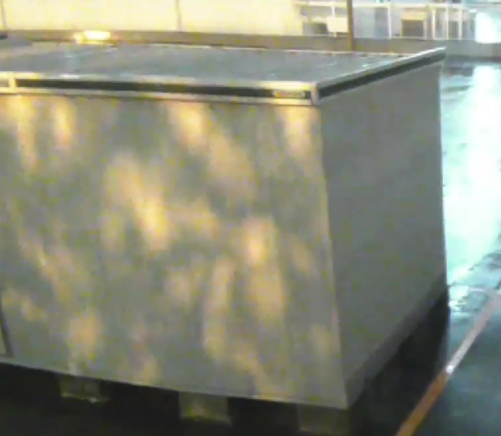
3. Extension Software – AI-VMD Application
Improvements from the current i-VMD (WV-SAE200W)
1. Improved the true positive alarm rate/ Reduced the false positive alarm rate
The false positive alarm rate has been remarkably reduced by utilizing AI technology, and besides, true positive alarm rate has been improved.
With AI technology, AI-VMD recognizes only human, vehicle and bicycle as detection objects, and eliminate other objects from
detection target.
Detection accuracy
 | AI-VMD | i-VMD
True positive | 86.7 % | 78.9 %
False negative | 13.3 % | 21.1 %
False positive | 6.6 % | 22.3 %
Swaying trees and plants
Light
Shadow and reflection
The occurrence rate of false positive alarm on the scenes above has been reduced remarkably by utilizing AI technology.
Notes:
#1 The percentages above is a comparison result based on PIPS's original evaluation video assuming the actual environment
(shaking of plants / animals / light and shadow / rain / fluctuation in lighting, etc.).
#2 The performance described above is the result when human, vehicle and bicycle are checked for detection target.
#3 The definition of false positive alarm rate is the percentage of the cases where an object other than detection target (human, vehicle, bicycle) is detected.
If an object is detected correctly as a detection target in one scene, it will be counted as a true positive alarm, but if an object which is NOT the detection target is detected in the
same scene, a false positive alarm will be counted as well.

Slide 11
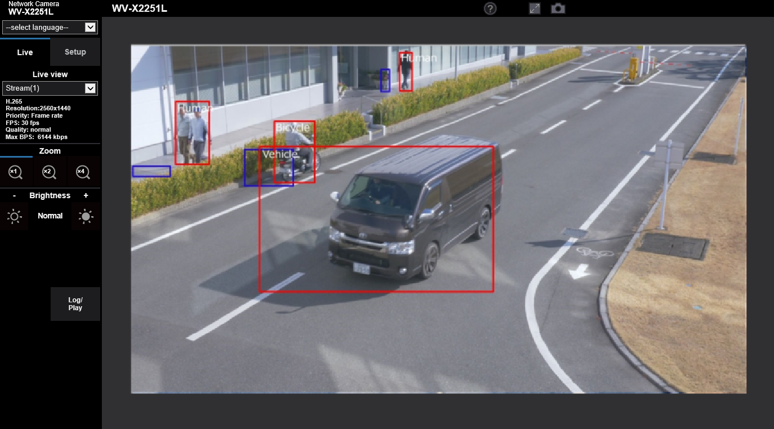
3. Extension Software – AI-VMD Application
Improvements from the current i-VMD (WV-SAE200W)
2. Output of the classification of detected objects
Sends the output of object classification (human, vehicle and bicycle) to the following destination:
Camera browser display, TCP alarm protocol, Mail notification and so on.
Example: Intruder (Human)
INTRUDER ALARM HUMAN
Example: Direction (Vehicle)
DIRECTION ALARM VEHICLE
Example: Cross line (Bicycle)
CROSS LINE ALARM BICYCLE
* As we apply the ONVIF classification rule to the classification of detection object, both bicycle and motorcycle are defined as “Bicycle”.

Slide 12
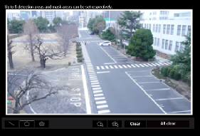
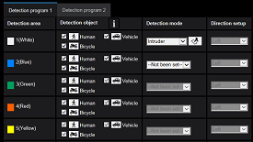
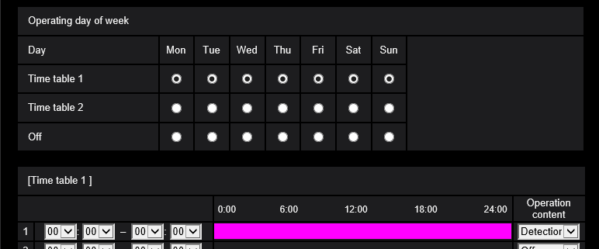
3. Extension Software – AI-VMD Application
Improvements from the current i-VMD (WV-SAE200W)
3. Easy Setup
License installation
Intruder detection will be automatically activated when the license is installed.
Note: Setting needs to be changed to select the detection mode other than intruder.
No need to set Mask area / Depth
AI realized reducing false positive alarms. This saves the steps for mask area setting and depth setting which are necessary in the conventional models.
Note: For further reduction in the number of false positive alarm, set mask area and depth additionally depending on the environment.
Easy Setup for image quality
Basically, image quality adjustment is unnecessary.
Note: If the detection accuracy of AI-VMD is lower than expected, execute "Batch change to the appropriate setting”. This can improve the accuracy.
Items changed in bulk
- Super Dynamic: Off - Light control speed: 8
- White balance adjusting speed: 8 - Digital noise reduction: 128
- Intelligent Auto: Off - Auto contrast adjust: Off
(1)
Reduce the configuration steps by half
Compared to conventional models
Easy Setup allows for less steps for configuration (Automatically configures the basic settings)
Items automatically configured concurrently with the license installation
Current flow
New flow
(Easy Setup)
License installation
License installation
(Automatically activates:
- Intruder detection
- 24-hour schedule registration)
All area settings
Intruder detection registration
24-hour schedule registration
(1)
(2)
Image quality setting
Image quality setting
i-VMD activation
i-VMD activation
(3)
(2)
i-VMD Setup
AI-VMD
Easy Setup
(3)
Schedule setting
Schedule setting
Output setting
Output setting

Slide 13
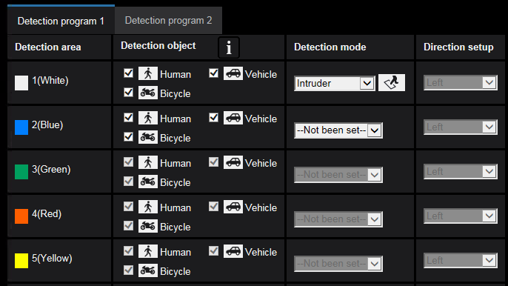
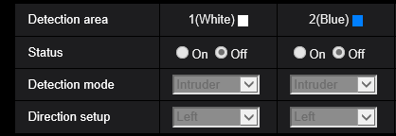
3. Extension Software – AI-VMD Application
Improvements from the current i-VMD (WV-SAE200W)
4. Detection object setting
Select the object to be detected with AI from “Human”, “Vehicle” and Bicycle” in the “Detection objects” section.
Added icons for detection object
i-VMD
Setup screen of i-VMD (WV-SAE200W)
*without detection object options

Slide 14
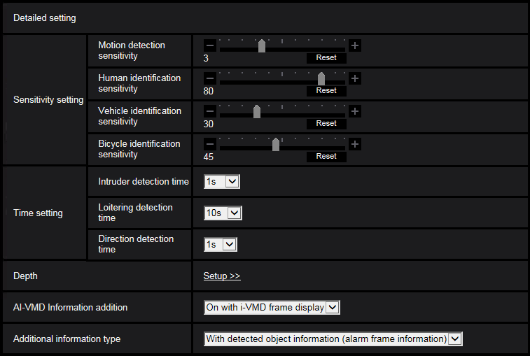
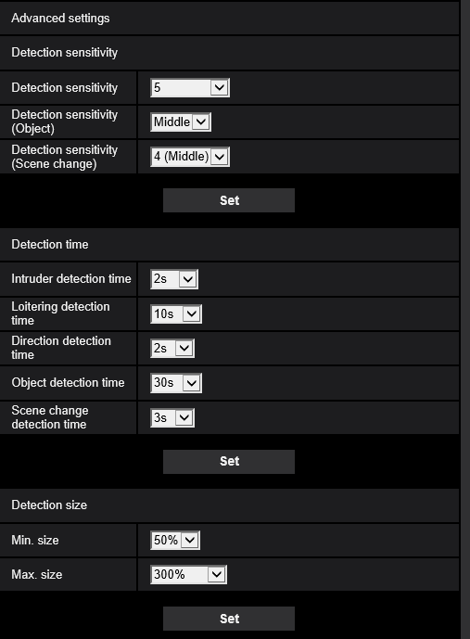
3. Extension Software – AI-VMD Application
Improvements from the current i-VMD (WV-SAE200W)
5. Detection sensitivity setting
Added the screen for detection sensitivity setting of each detecting object (human, vehicle and bicycle)
Added slider bars for detection sensitivity
i-VMD
Setup screen of i-VMD (WV-SAE200W)
* without detection sensitivity setting for each object
Note: “Motion detection sensitivity” works in common for all the detecting targets Human, Vehicle and Bicycle.

Slide 15
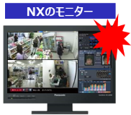
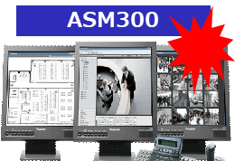
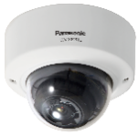
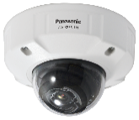
3. Extension Software – AI-VMD Application
System linkage
Expanded the system linkage functions which are partly supported by conventional i-VMD alarm.
i-PRO with AI engine
(with AI-VMD installed)
NX Recorder
NX recorder’s monitor
WV-ASM300
Alarm notification
Detects the target objects assigned for alarm: human, vehicle and bicycle
Supported in July, 2020
When connected to Network Disk Recorder
When connected to WV-ASM300
 | AI-VMD | i-VMD (WV-SAE200W)
Timeline | Yes | No
Playback VMD | Yes | No
Search filter | Yes | No
 | AI-VMD | i-VMD (WV-SAE200W)
Timeline | Yes | Yes
Playback VMD | Yes | No
Search filter | Yes | Yes*
*Partly supported

Slide 16
3. Extension Software – AI-VMD Application
Restrictions
The accuracy of image analysis may be affected by the environmental causes listed below.
Although the performance has been remarkably improved by AI technology, the causes of false positives / false negatives listed below are not 100 percent eliminated.
The difference in brightness between the background and the moving object is small
Shooting when the brightness of the image is low such as nighttime
The object is too small or too large
Shooting under the changeable light conditions such as outdoors or near windows and so forth
External lights such as sunlight or car headlights come into the shooting area
Flickering fluorescent lamps
The dome of the camera is sweating or has dirt on it
The object is moving straight toward the camera
The object is moving too fast or too slow
Too many moving objects are in the shooting area
The camera is shaking
The weather is extremely bad
Reflected light from a puddle or glass comes into the
shooting area
Flags or vinyl and so forth are fluttering in the wind
Insects or animals come into the shooting area
Detection accuracy
 | AI-VMD | i-VMD
True positive | 86.7 % | 78.9 %
False negative | 13.3 % | 21.1 %
False positive | 6.6 % | 22.3 %

Slide 17
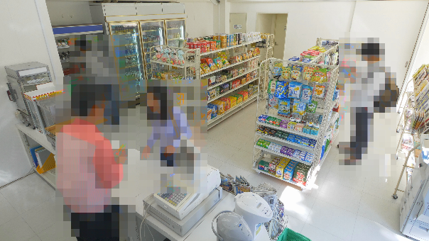
3. Extension Software – AI Privacy Guard Application
AI Privacy Guard
Performs Blurring or Block processing to mask the face or person detected on the image in order to protect privacy.
Masking method : Blurring
Masking method : Block
Privacy Guard target : Face
AI Privacy Guard
Original
Privacy Guard target : Human
Privacy Guard target | Face/ Human
Masking method | Blurring / Block
AI Privacy Guard

Slide 18
3. Extension Software – AI Privacy Guard Application
Privacy Guard Target Guide
Size *1 |  | 5MP Camera | 43 to 1870pixel 51 to 2240pixel (super resolution imaging)
 |  | 4K Camera | 64 to 2800pixel
Max. number of simultaneous processing |  | 99 people
Shooting range |  | Two-thirds of the target object needs to be captured on the image *2
Color/black and white |  | Supports both (including with IR-LED)
When “Face” is selected for [Privacy Guard target] | Direction *3 | Right and left: Within 90° Up and down: Within 45°
 | Rotation *4 | Within +/-90°
*1 When [Privacy Guard target] =“Face”: Facial width
When [Privacy Guard target] =“ Human”: Body width
*2 The upper body including face needs to be captured on the image when [Privacy Guard target] is set to “Human”.
*3 The angle of camera optical axis and a target object
*4 When regarding the vertical line of an image as 0 degree
Blurring or Block may NOT be performed in the following cases even if the conditions described above are met:
- The target object is out of focus.
- The target object is blurred.
- The target object is overexposed or underexposed.
- The target object is lying down or felled.

Slide 19
3. Extension Software – AI Privacy Guard Application
Restrictions
Software specification related
- Target stream for AI Privacy Guard can be selected from Stream(1) to (4) or Stream(2)&Stream(4).
- “Stream(2)&Stream(4)” needs to be selected for [Target stream] when using AI Privacy Guard linked to NX recorder or WV-ASM300.
*When “Stream(2) & Stream(4)” is selected, "Stream (1)" and "Stream (2)" of the camera will have the same resolution.
Also, "Stream (3)" and "Stream (4)" will have the same resolution.
- The maximum frame rate of original image^{(a)}/ AI Privacy Guard image^{(b)} is determined by model, when AI Privacy Guard is enabled.
5MP Camera: ^{(a)}30fps / ^{(b)}15fps 4K Camera: ^{(a)}15fps / ^{(b)}15fps
- When installed with AI-VMD, the frame rate of AI Privacy Guard image will be limited to 10fps regardless of model.
- JPEG(2) is NOT available when AI Privacy Guard is enabled.
*JPEG(1) is available as an original image.
Performance related
- Blurring or Block may be applied on the area without “face” or “person”.
- Blurring or Block may be applied on dolls or posters.
- The size of the area where Blurring or Block performed may be larger than the actual size of a target object.

Slide 20
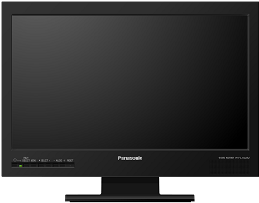
3. Extension Software – AI Privacy Guard Application
Sample system configuration 1 (Camera / Recorder)
Camera can simultaneously deliver both original image and AI Privacy Guard image.
Records images with original image and AI Privacy Guard image assigned to the separate channels
[Live] Original image (Strema1/3)
Original image (Stream1/3)
[Play back] Original image (Ex: CH1)
AI privacy guard image (Stream2/4)
NX recorder
[Live] AI Privacy Guard image (Stream2/4)
<Sample stream settings>
Stream 1 : 1920x1080 /30fps
Stream 2 : 1920x1080 /30fps
Stream 3 : 1280x720 /30fps
Stream 4 : 1280x720 /30fps
[Play back] AI Privacy Guard image (Ex: CH2)
Cameras with AI privacy guard installed
HDMI monitor
Displays Stream1 or 2 in case of displaying 1-screen live image Displays Stream3 or 4 in case of displaying multi-screen live images
Sample setting of user authentication in recorder
Camera |  | User A | User B | User C
CH1 | Camera1 (Original image) | Permission for viewing = Yes | Permission for viewing = No | Permission for viewing = Yes
CH2 | Camera1 (AI Privacy Guard image) | Permission for viewing = Yes | Permission for viewing = Yes | Permission for viewing = Yes
CH3 | Camera2 (Original image) | Permission for viewing = Yes | Permission for viewing = No | Permission for viewing = No
CH4 | Camera2 (AI Privacy Guard image) | Permission for viewing = Yes | Permission for viewing = Yes | Permission for viewing = No
* In recorder’s setting, permission for viewing original/ AI Privacy Guard images can be set individually for per user.

Slide 21
3. Extension Software – AI Privacy Guard Application
Sample system configuration 2 (Camera / Recorder / WV-ASM300)
Camera can simultaneously deliver both original image and AI Privacy Guard image.
Records images with original image and AI Privacy Guard image assigned to the separate channels
Original image (Stream1)
Original image (Ex: CH1)
AI privacy guard image (Stream2)
NX recorder
AI Privacy Guard image (Ex: CH2)
Cameras with AI privacy guard installed
Original image (Stream1/3)
WV-ASM300
AI privacy guard image (Stream2/4)
Displays Stream1 or 3(2 or 4) depending on the number of split-screens in case of [Stream type]= [AUTO].
WV-ASM300 User authentication
Camera |  | User with authentication for viewing original image | User without authentication for viewing original image
CH1 | Camera1(Original image) | Permission for viewing = Yes | Permission for viewing = No
CH2 | Camera1(AI Privacy Guard image) | Permission for viewing = Yes | Permission for viewing = Yes
CH3 | Camera2(Original image) | Permission for viewing = Yes | Permission for viewing = No
CH4 | Camera2(AI Privacy Guard image) | Permission for viewing = Yes | Permission for viewing = Yes
* In WV-ASM300 setting, “AI Privacy Guard image switching” has been added to the items which can be set for per user in “User level setup” tab.
Users with “AI Privacy Guard image switching” permission can view the original images.

Slide 22
3. Extension Software – 3rd Party Application
i-PRO CAMERA SDK made it possible to develop user-specific applications *1
Installing developed applications on our network camera enables you to use the network camera that runs user-specific applications.
User Application
.ext
Install
i-PRO
CAMERA
SDK
User
AI Model *2
User-specific application file
Free of charge)
*1 : For further information, refer to our i-PRO Camera Application Platform at https://i-pro.com/global/en/surveillance/i-pro-application-platform
*2 : Not needed when developing the applications without AI models.

Slide 23
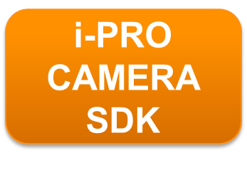
3. Extension Software – 3rd Party Application
SDK contains “SDK main unit” and the “Tool” for AI processor as below.
i-PRO CAMERA SDK
SDK
Manual
Develop environment manual
Sample code
API manual
Header/Libraries
Tool (for AI processor) *1
AI model convert tools*2
AI model compression tools*3
*1 : Not provided for developing the application without AI processor.
*2 : Converts the models developed using open-source deep learning libraries such as Caffe, Tensorflow and ONNX to the models that can be operated in our i-PRO with AI engine.
*3 : Used for pruning the AI models developed using open-source deep learning libraries such as Caffe and Tensorflow.
Increase in processing speed and the effect of size compression can be expected by pruning.

Slide 24
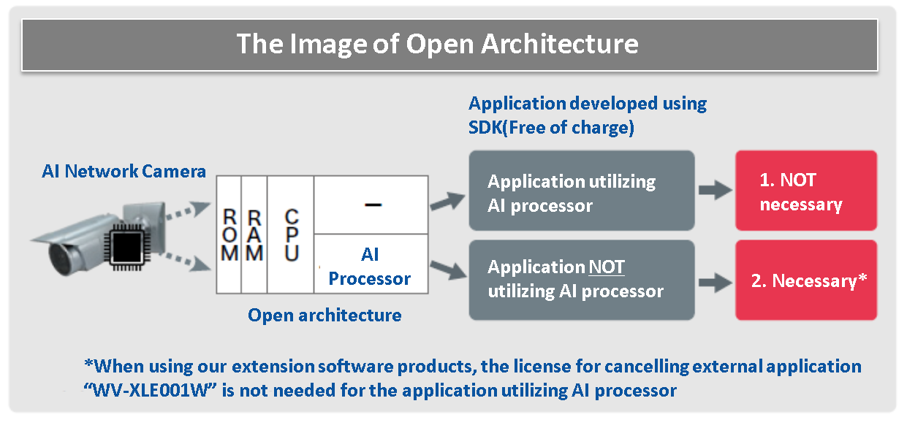
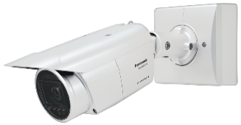
3. Extension Software – 3rd Party Application
WV-XLE001W is needed for the application utilizing AI processor
Operation of the application utilizing AI processor will force-quit if you do not register “WV-XLE001W” the license for enabling AI processor within 90 days after starting the operation, after installing the application.
License for enabling AI processor
(WV-XLE001W)
i-PRO with AI engine
Application NOT utilizing AI processor
AI
processor
Application
utilizing AI processor
*When using our extension software products, the license for enabling AI processor
“WV-XLE001W” is not needed even if the application is utilizing AI processor
Up to 3 applications can be installed on i-PRO with AI engine
Only 1 registration of the license for enabling AI processor is needed even when you install 3 additional applications on your camera.
The performance of each application may be affected depending on the CPU/AI processor usage of each application.
* There is no impact on the basic performance of the camera such as the decrease in frame rate.
* We have confirmed that there is no impact on each application’s performance when AI-VMD and AI Privacy Guard are installed.

Slide 25
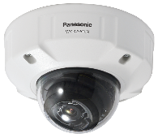
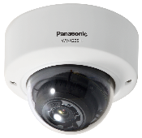
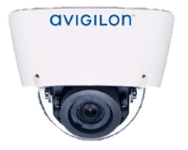
4. Specification Comparison
Comparison to other companies (5MP model)
 | WV-X1551LN | WV-X2551LN | WV-X2251L | Avigilon 4.0C-H5A-DO1-IR | Hanwha PNV-A7081R
Codec | H.265/H.264/JPEG |  |  | H.265/H.264/JPEG | H.265/H.264/JPEG
Output resolution | 2560 x 1440 16:9 (3072x1728 16:9 *1) |  |  | 2560 x 1440 16:9 | T.B.C
Dynamic range | 132dB |  |  | 126dB | 120dB
Lens | Optical zoom: x3.1 F number: 1.3 - 2.5 Focal distance: 2.9 - 9mm |  |  | F number : 1.3 - Focal distance: 3.3 - 9mm | F number: 1.6 - Focal distance: 4.5 - 10mm
Sensitivity (color) | 0.07lx |  |  | 0.03lx | 0.009lx
Horizontal angle of view | Wide:106° / Tele:34° | Wide:103° / Tele:33° | Wide:105° / Tele:33° | Wide:92° / Tele:34° | Wide:111.6° / Tele:46.2°
Audio codec | Yes (AAC, G.711, G.726) |  |  | Yes (G.711) | Yes
SD memory card | 1 (SDXC,SDHC,SD) |  |  | 1 (microSD) | 1 (microSD)
Smart coding | Yes (GOP control / AUTO VIQS/Smart facial coding) |  |  | HDSM Smart codec | Wise StreamⅡ
IR-LED | Yes (40m) |  | Yes (30m) | Yes (30m) | Yes
Monitor out | Yes |  |  | No | No
AI engine | Yes |  |  | Yes | Yes
*1 Super resolution imaging
Internal use only

Slide 26
4. Specification Comparison
Comparison to other companies (4K model)
 | WV-X1571LN | WV-X2571LN | WV-X2271L | Avigilon 8.0C-H5A-DO1-IR | Hanwha PNV-A9081R
Codec | H.265/H.264/JPEG |  |  | H.265/H.264/JPEG | H.265/H.264/JPEG
Output resolution | 3840x2160 16:9 |  |  | 3840x2160 16:9 | 3840x2160 16:9
Dynamic range | 132dB |  |  | 120dB | 120dB
Lens | Optical zoom: x2.0 F number:1.5- Focal distance: 4.3-8.6mm |  |  | F number:1.8 - Focal distance: 4.9 - 8mm | F number: 1.6 - Focal distance: 4.5 - 10mm
Sensitivity (color) | 0.09lx |  |  | 0.055lx | 0.05lx
Horizontal angle of view | Wide:104° / Tele:53° | Wide:101° / Tele:52° | Wide:101° / Tele:52° | Wide:92° / Tele:52° | Wide:101.4° / Tele:45.5°
Audio codec | Yes (AAC, G.711, G.726) |  |  | Yes (G.711) | Yes
SD memory card | 1 (SDXC,SDHC,SD) |  |  | 1 (microSD) | 1 (microSD)
Smart coding | Yes (GOP control / AUTO VIQS/Smart facial coding) |  |  | HDSM Smart codec | Wise StreamⅡ
IR-LED | Yes (40m) |  | Yes (30m) | Yes (30m) | Yes (30m)
Monitor out | Yes |  |  | No | Yes
AI engine | Yes |  |  | Yes | Yes
Internal use only

Slide 27
4. Specification Comparison
Comparison of new & current models (5MP model)
 | i-PRO 5MP camera with AI engine (WV-X1551LN, X2551LN, X2251L) | Current 5MP Camera (WV-S1550L, S2550L, S2250L)
Aspect ratio / Capture mode | 16:9(30fps) / 16:9(25fps) | 16:9(30fps) / 4:3(30fps)
Compression method | H.265 (or H.264) (1)-(4), JPEG(1)(2) | H.265 (or H.264) (1)-(4), JPEG(1)(2)
Max fps | Max 30fps | Max 30fps
Corridor mode | 0°/ 90°/ 180° / 270° *90° rotation and 270° rotation do not support the image capture size “320x180” | 0°/ 90°/ 180° / 270° *90° rotation and 270° rotation do not support the image capture size “320x180 (H.264)” *90° rotation and 270° rotation do not support the image capture mode “4:3”
Maximum user number | 14 | 14
Transmission mode | VBR/CBR/Framerate/Best Effort | VBR/CBR/Framerate/Best Effort
Smart Coding | Smart Facial Coding (with AI) / Auto VIQS (With AI) / GOP Control (with Frame rate ctrl) | Auto VIQS / GOP Control
IR LED | Yes | Yes
IO terminal/Video Out | Yes | Yes
Audio | Yes | Yes
Intelligent Auto | Yes (with AI) | Yes
VMD | Yes | Yes
Scene change detection alarm | Standard feature | Optional (WV-SAE200W)
SD recording | Yes (JPEG, H.264, H.265) | Yes (JPEG, H.264, H.265)
ONVIF | Profile S, G, T | Profile S, G, T
Extension function software | AI-VMD Application (WV-XAE200W) AI Privacy Guard Application (WV-XAE201W) Third Party Application | i-VMD (WV-SAE200W)

Slide 28
4. Specification Comparison
Comparison of new & current models (4K model)
 | i-PRO 4K camera with AI engine (WV-X1571LN, X2571LN, X2271L) | Current 4K Camera (WV-S1570L, S2570L, S2270L)
Aspect ratio / Capture mode | 16:9(30fps) / 16:9(25fps) | 16:9(30fps) / 16:9(15fps)
Compression method | H.265 (or H.264) (1)-(4), JPEG(1)(2) | H.265 (or H.264) (1)-(4), JPEG(1)(2)
Max fps | Max 30fps | Max 30fps
Corridor mode | 0°/ 90°/ 180° / 270° *90° rotation and 270° rotation do not support the image capture size “320x180” *15fps in maximum when “90°” or “270°” is selected for [Image rotation]. | 0°/ 90°/ 180° / 270° *90° rotation and 270° rotation do not support the image capture size “320x180 (H.264)” *90° rotation and 270° rotation do not support the image capture mode “16:9(30fps)”
Maximum user number | 14 | 14
Transmission mode | VBR/CBR/Framerate/Best Effort | VBR/CBR/Framerate/Best Effort
Smart Coding | Smart Facial Coding (with AI) / Auto VIQS (With AI) / GOP Control (with Frame rate ctrl) | Auto VIQS / GOP Control
IR LED | Yes | Yes
IO terminal/Video Out | Yes | Yes
Audio | Yes | Yes
Intelligent Auto | Yes (with AI) | Yes
VMD | Yes | Yes
Scene change detection alarm | Standard feature | Optional (WV-SAE200W)
SD recording | Yes (JPEG, H.264, H.265) | Yes (JPEG, H.264, H.265)
ONVIF | Profile S, G, T | Profile S, G, T
Extension function software | AI-VMD Application (WV-XAE200W) AI Privacy Guard Application (WV-XAE201W) Third Party Application | i-VMD (WV-SAE200W)

Slide 29
4. Specification Comparison
DORI (5MP model)
DORI coverage DORI (Detect, Observe, Recognize, Identify) is a standard system (EN-62676-4) for defining the ability of a camera to distinguish persons or objects within a covered area.
This value does not indicate the performance of the camera.
The maximum distance at which a camera's tele and wide can meet these criteria is shown below:
*1
WV-X1551LN
Outdoor Box
Resolution : 3072 x 1728 *2 |  | Tele : 34° |  | Wide : 106°
 |  | Unit : m | Unit : feet | Unit : m | Unit : feet
Detect | 25ppm | 200.96 | 659.32 | 46.3 | 151.90
Observe | 62.5ppm | 80.38 | 263.73 | 18.52 | 60.76
Recognize | 125ppm | 40.19 | 131.86 | 9.26 | 30.38
Identify | 250ppm | 20.1 | 65.93 | 4.63 | 15.19
WV-X2551LN
Outdoor Dome
Resolution : 3072 x 1728 *2 |  | Tele : 33° |  | Wide : 103°
 |  | Unit : m | Unit : feet | Unit : m | Unit : feet
Detect | 25ppm | 207.42 | 680.51 | 48.87 | 160.34
Observe | 62.5ppm | 82.97 | 272.20 | 19.55 | 64.14
Recognize | 125ppm | 41.48 | 136.10 | 9.77 | 32.07
Identify | 250ppm | 20.74 | 68.05 | 4.89 | 16.03
WV-X2251L
Indoor Dome
Resolution : 3072 x 1728 *2 |  | Tele : 33° |  | Wide : 105°
 |  | Unit : m | Unit : feet | Unit : m | Unit : feet
Detect | 25ppm | 207.42 | 680.51 | 47.14 | 154.67
Observe | 62.5ppm | 82.97 | 272.20 | 18.86 | 61.87
Recognize | 125ppm | 41.48 | 136.10 | 9.43 | 30.93
Identify | 250ppm | 20.74 | 68.05 | 4.71 | 15.47
*1 Calculated with the camera installed horizontally
*2 Super resolution imaging

Slide 30
4. Specification Comparison
DORI (4K model)
DORI coverage DORI (Detect, Observe, Recognize, Identify) is a standard system (EN-62676-4) for defining the ability of a camera to distinguish persons or objects within a covered area.
This value does not indicate the performance of the camera.
The maximum distance at which a camera's tele and wide can meet these criteria is shown below:
*1
WV-X1571LN
Outdoor Box
Resolution : 3840 x 2160 |  | Tele : 53° |  | Wide : 104°
 |  | Unit : m | Unit : feet | Unit : m | Unit : feet
Detect | 25ppm | 154.04 | 505.37 | 60.00 | 196.86
Observe | 62.5ppm | 61.61 | 202.15 | 24.00 | 78.74
Recognize | 125ppm | 30.81 | 101.07 | 12.00 | 39.37
Identify | 250ppm | 15.40 | 50.54 | 6.00 | 19.69
WV-X2571LN
Outdoor Dome
Resolution : 3840 x 2160 |  | Tele : 52° |  | Wide : 101°
 |  | Unit : m | Unit : feet | Unit : m | Unit : feet
Detect | 25ppm | 157.46 | 516.61 | 63.31 | 207.71
Observe | 62.5ppm | 62.99 | 206.64 | 25.32 | 83.08
Recognize | 125ppm | 31.49 | 103.32 | 12.66 | 41.54
Identify | 250ppm | 15.75 | 51.66 | 6.33 | 20.77
WV-X2271L
Indoor Dome
Resolution : 3840 x 2160 |  | Tele : 52° |  | Wide : 101°
 |  | Unit : m | Unit : feet | Unit : m | Unit : feet
Detect | 25ppm | 157.46 | 516.61 | 63.31 | 207.71
Observe | 62.5ppm | 62.99 | 206.64 | 25.32 | 83.08
Recognize | 125ppm | 31.49 | 103.32 | 12.66 | 41.54
Identify | 250ppm | 15.75 | 51.66 | 6.33 | 20.77
*1 Calculated with the camera installed horizontally

Slide 31
5. Appearance
WV-X1551LN / WV-X1571LN
Added ferrite core
1. Appearance
- Color
- i-PRO White
- Size/Weight
Added ferrite core
3. Installation Layout (same as conventional models)
- Size 133mm(W) x 133mm(H) x 377mm(L)
- Weight 1.7kg
2. Indicator, Button Layout (same as conventional models)
Side A
SD ON /OFF button
Side B
LINK Indicator
MONITOR OUT terminal
ACT Indicator
Side A
SD ERROR / AF Indicator
INITIAL SET button
SD MOUNT Indicator
AF button
4. Other Changes
- Deleted QR code
Side B
TELE button
WIDE button

Slide 32
5. Appearance
WV-X2551LN / WV-X2571LN
2. Indicator, button Layout (same as conventional models)
1. Appearance
- Color
- i-PRO White
- Size/Weight
3. Installation Layout (same as conventional models)
- Size ø164mm × 139mm (H)
- Weight 1.6kg
SD memory card warning
/error indicator
INITIAL SET button
ACT indicator
LINK indicator
SD MOUNT indicator
SD ERROR/AF indicator
AF button
WIDE button
TELE button
4. Other Changes
- Deleted QR code
SD ON/OFF button
SD slot

Slide 33
5. Appearance
WV-X2251L / WV-X2271L
1. Appearance
- Color
- i-PRO White
3. Installation Layout (same as conventional models)
2. Indicator, button Layout (same as conventional models)
- Size/Weight
- Size: ∅129.5mm × 103.5mm(H)
- Weight: 830g
WIDE button
4. Other Changes
- Deleted QR code
SD MOUNT indicator
SD slot
LINK indicator
AF button
TELE button
INITIAL SET
button
SD ERROR/AF indicator
ACT indicator
SD ON/OFF button
Changed the material of dome cover to die-cast

Slide 34
6. Standard Accessories, Optional Accessories
WV-X1551LN / WV-X1571LN Standard accessories
No. | Standard accessories | Qt. |  | No. | Standard accessories | Qt.
1 | Installation Guide | 1 pc. |  | 9 | 4P alarm cable | 1 pc.
2 | Warranty card | 1 pc. |  | 10 | 2P power cable | 1 pc.
3 | Code label | 1 pc. |  | 11 | Safety wire | 1 pc.
4 | Camera mount bracket cover | 2 pc. |  | 12 | ClearSight Coating label | 1 pc.
5 | Camera mount bracket cover fixing screw (M3 x 6 mm {1/4 inches}) | 3 pc. |  | 13 | IMPORTANT SAFETY INSTRUCTIONS | 1 pc.
6 | RJ45 waterproof connector cover | 1 pc. |  | 14 | Adapter box | 1 pc.
7 | RJ45 waterproof connector cap | 1 pc. |  | 15 | Mounting screws (M5 x 20 mm {25/32 inches}) (of them, 1 for spare) | 5 pc.
8 | Waterproof tape | 1 pc. |  | 16 | Adapter box mounting screw (M4 x 35 mm {1-3/8 inches}) | 1 pc.
Safety wire lug
[Abolition Parts]
- CD-ROM
- Safety wire lug
Attached to the main body
Before
After

Slide 35
6. Standard Accessories, Optional Accessories
WV-X1551LN / WV-X1571LN Optional accessories
No. | Model Number | Image | Model Name
1 | WV-Q188 |  | Pole mount bracket (Fine silver)
2 | WV-QPL500-W |  | Pole mount bracket (i-PRO white)
3 | WV-Q189 |  | Corner mount bracket (Fine silver)
4 | WV-QCN500-W |  | Corner mount bracket (Corner mount bracket)

Slide 36
6. Standard Accessories, Optional Accessories
WV-X2551LN / WV-X2571LN Standard accessories
No. | Standard accessories | Qt. |  | No. | Standard accessories | Qt.
1 | Installation Guide | 1 pc. |  | 10 | Bit (Hex wrench, screw size 6.35 mm {1/4 inches} T20) | 1 pc.
2 | Warranty card | 1 pc. |  | 11 | Template A (for the attachment plate) | 1 pc.
3 | IMPORTANT SAFETY INSTRUCTIONS | 1 pc. |  | 12 | Template B (for the base bracket) | 1 pc.
4 | Code label | 1 pc. |  | 13 | Waterproof tape | 1 pc.
5 | Base bracket | 1 pc. |  | 14 | 4P alarm cable | 1 pc.
6 | Attachment plate | 1 pc. |  | 15 | 2P power cable | 1 pc.
7 | Fixing screws for attachment plate (M4 × 8 mm {5/16 inches}) | 5 pc. |  | 16 | MONITOR OUT conversion plug | 1 pc.
8 | RJ45 waterproof connector cover | 1 pc. |  | 17 | ClearSight Coating label | 1 pc.
9 | RJ45 waterproof connector cap | 1 pc.
[Abolition Parts]
- CD-ROM

Slide 37
6. Standard Accessories, Optional Accessories
WV-X2551LN / WV-X2571LN Optional accessories
No. | Model Number | Image | Model Name
1 | WV-CW7S |  | Dome cover (Smoke type)
2 | WV-CW7SN |  | Dome cover (Smoke type with clear sight coating)
3 | WV-Q105A |  | Ceiling mount bracket *1
4 | WV-Q7118 |  | Sun shade (Light gray)
5 | WV-QSR500-W |  | Sun shade (i-PRO white)
6 | WV-QCL501-W |  | Ceiling mount bracket (i-PRO white)*2
7 | WV-Q121B |  | Ceiling mount bracket (Fine silver )*2
8 | WV-QWL501-W |  | Wall mount bracket (i-PRO white)*2
9 | WV-Q122A |  | Wall mount bracket (Fine silver )*2
No. | Model Number | Image | Model Name
10 | WV-QAT500-W |  | Pipe mount bracket (i-PRO white)*2
11 | WV-Q123A |  | Pipe mount bracket (Fine silver )*2
12 | WV-QSR501-W |  | Mount bracket (i-PRO white)*2
13 | WV-Q124 |  | Mount bracket (Fine silver )*2
14 | WV-QPL500-W |  | Pole mount bracket (i-PRO white)*2
15 | WV-Q188 |  | Pole mount bracket (Fine silver ) *2
16 | WV-QCN500-W |  | Corner mount bracket (i-PRO white)*2
17 | WV-Q189 |  | Corner mount bracket (Fine silver ) *2
18 | WV-QWL500-W |  | Wall mount bracket (i-PRO white)*2
*1 WV-Q105A is “for indoor use only” when installing on the ceiling.
*2 Refer to the Support Information page for the accessary combination required for installation.

Slide 38
6. Standard Accessories, Optional Accessories
WV-X2251L / WV-X2271L Standard accessories
No. | Standard accessories | Qt. |  | No. | Standard accessories | Qt.
1 | Installation Guide | 1 pc. |  | 6 | Power cord plug (*1) | 1 pc.
2 | Warranty card | 1 pc. |  | 7 | EXT I/O terminal plug (*1) | 1 pc.
3 | Code label | 1 pc. |  | 8 | MONITOR OUT conversion plug | 1 pc.
4 | Attachment plate | 1 pc. |  | 9 | Bit (Hex wrench, screw size 6.35 mm {1/4 inches} T20) | 1 pc.
5 | Template A (for the attachment plate) | 1 pc. |  | 10 | IMPORTANT SAFETY INSTRUCTIONS | 1 pc.
*1: The power cord plug and EXT I/O terminal plug are attached to the camera.
[Abolition Parts]
- CD-ROM

Slide 39
6. Standard Accessories, Optional Accessories
WV-X2251L / WV-X2271L Optional accessories
No. | Model Number | Image | Model Name
1 | WV-Q105A |  | Ceiling Mount Bracket
2 | WV-CR1S |  | Dome cover (Smoke type)
3 | WV-Q174B |  | Ceiling mount bracket (White)
4 | WV-QEM100-W |  | Ceiling mount bracket (i-PRO white)
5 | WV-QWL500-W |  | Wall mount bracket (i-PRO white)

Slide 40
7. Other Software Specifications - Cameras
Supported Resolution (5MP model)
*1
Mode | Stream(1) | Stream(2) | Stream(3) | Stream(4) | JPEG(1) | JPEG(2)
16:9(30fps) | 3072x1728 2560x1440 | 3072x1728 2560x1440 1920x1080 1280x720 640x360 320x180 | 1280x720 640x360 320x180 | 1280x720 640x360 320x180 | 3072x1728 2560x1440 1920x1080 1280x720 640x360 320x180 | 640x360
 | Max 30fps | Max 30fps | Max 30fps | Max 30fps | Max 5 fps | Max 5 fps
16:9(25fps) | Resolution: Same as above
 | Max 25fps | Max 25fps | Max 25fps | Max 25fps | Max 4.2 fps | Max 4.2 fps
*2
*2 *3
*2
*4
*4
*4
*4
*1 The resolution of JPEG(1) should be set to the same resolution as Stream(1), (2), (3), (4) or JPEG(2)
Ex: 320x180 cannot be selected for JPEG(1) if it is not selected for either Stream(1) to (4)
*2 When the resolution is selected as following, maximum framerate is to be 15fps(12.5fps) for all streams.
- 3072x1728, 2560x1440 of stream(2)
- 1280x720 of stream(4)
*3 2560x1440 of stream(2) can be selected in case of stream(1) is set to 2560x1440.
*4 “90°” and “270°” cannot be set for [Image rotation] when “320x180” is selected.

Slide 41
7. Other Software Specifications - Cameras
Supported Resolution (4K model)
*1
Mode |  | Stream(1) | Stream(2) | Stream(3) | Stream(4) | JPEG(1) | JPEG(2)
16:9(30fps) |  | 3840x2160 2560x1440 | 3840x2160 2560x1440 1920x1080 1280x720 640x360 320x180 | 1280x720 640x360 320x180 | 1280x720 640x360 320x180 | 3840x2160 2560x1440 1920x1080 1280x720 640x360 320x180 | 640x360
 | (A) | Max 30fps | Max 15fps | Max 15fps | Max 15fps | Max 5fps | Max 5fps
 | (B) | Max 15fps | Max 30fps | Max 30fps | Max 30fps
16:9(25fps) |  | Resolution: Same as above
 | (A) | Max 25fps | Max 12.5fps | Max 12.5fps | Max 12.5fps | Max 4.2 fps | Max 4.2fps
 | (B) | Max 12.5fps | Max 25fps | Max 25fps | Max 25fps
*2
*2 *3
*2
*4
*4
*4
*4
*5
*6
*5
*6
*6
*6
*5
*6
*5
*6
*6
*6
*1 The resolution of JPEG(1) should be set to the same resolution as Stream(1), (2), (3), (4) or JPEG(2)
Ex: 320x180 cannot be selected for JPEG(1) if it is not selected for either Stream(1) to (4)
*2 When the resolution is selected as following, maximum framerate is to be 15fps(12.5fps) for all streams.
- 3072x1728, 2560x1440 of stream(2)
- 1280x720 of stream(4)
*3 2560x1440 of stream(2) can be selected in case of stream(1) is set to 2560x1440.
*4 “90°” and “270°” cannot be set for [Image rotation] when “320x180” is selected.
*5 The maximum frame rates of Stream(1) to JPEG(2) are either the combination of (A) or (B).
*6 Up to 15fps(12.5fps) when “90°” or “270°” is selected for [Image rotation].

Slide 42
7. Other Software Specifications - Cameras
Frame rate limitation
5MP model |  | AI Privacy Guard
 |  | Not installed | Installed
 |  | - | Function = ON | Function = OFF
AI-VMD | Not installed | Original image: Max. 30fps | Original image : Max. 30fps AI Privacy Guard image：Max. 15fps | Original image : Max. 30fps
 | Installed | Original image: Max. 30fps | Original image : Max. 30fps AI Privacy Guard image：Max. 10fps | Original image : Max. 30fps
4K model |  | AI Privacy Guard
 |  | Not installed | Installed
 |  | - | Function = ON | Function = OFF
AI-VMD | Not installed | Original image: Max. 30fps | Original image : Max. 15fps AI Privacy Guard image ：Max. 15fps | Original image : Max. 30fps
 | Installed | Original image: Max. 15fps | Original image : Max. 15fps AI Privacy Guard image ：Max. 10fps | Original image : Max. 15fps
*1
*1
*2
*2
*1 15fps in maximum when “90°” or “270°” is selected for [Image rotation], or depending on the resolution.
*2 7.5fps in maximum when “90°” or “270°” is selected for [Image rotation].

Slide 43
7. Other Software Specifications - Cameras
Privacy mask setting
Current Models
Privacy mask can be set by designating 4 points on the screen.
Privacy mask can be set by rectangle.

Slide 44
7. Other Software Specifications - Cameras
Restrictions on Super dynamic
Adjusting the super dynamic level to 30 or more sets the frame rate to 15fps at maximum.
Level Setting: Default=27
# Up to 30 fps transmission is available
Level | 27 | 28 | 29 | 30 | 31
Framerate | 30fps | 30fps | 30fps | 15fps | 15fps
Dynamic range *1 | 108dB | 114dB | 120dB | 126dB | 132dB
*1 : Those are design values and they can change depending on the environment.

Slide 45
7. Other Software Specifications - Cameras
SCD (scene change detection) alarm settings
SCD alarm has been added as a standard feature.
- Area setting : Configure the area for SCD alarm
(Up to 1 area)
- Detection sensitivity : Select the detection sensitivity from “Low”, “Middle” and “High”. Default is “Middle”.
- Detection area : Select the detection area to detect the subject motion from “Very low”, “Low”, “Middle” and “High”. Default is “Middle”.
- Detection time : Select the time to issue an alarm from 3s, 5s, 10s, 30s, 1min.
Default is 3s.
- SCD information addition : Determine whether to attach the SCD information to the streaming data. (On / Off)

Slide 46
7. Other Software Specifications – Extension Software
Manage Extension Software
Added the setting screen of extension software on Setup screen.
Allows installation of up to 3 additional extension software applications.
Install additional applications
Information such as version will be displayed when the installation is done.
AI-VMD and AI Privacy Guard:
Trial period is 90 days after installation. You can use them without regular license activation for the first 90 days.
To start regular operation, obtain Registration Key from KMS and finish registration.
Setup menu links of additionally installed applications are displayed (3 apps max)
Clicking on the link opens the setup menu.

Slide 47
7. Other Software Specifications – Extension Software
Schedule of Extension Software
Added schedule setting screen for extension software
This made it possible to set the schedule of each additional application.
Sample: Screen of AI-VMD Setting
Manage the schedule with “Operating day of week” and above 2 time tables

Slide 48
Appendix

Slide 49
Image quality comparison (5MP model) vs Avigilon

Slide 50
Summary
Has advantages compared to Avigilon.
i-PRO X2551L
Compression setting (common to all scenes, default setting)
SD : ON, iA : ON
H265, VBR, MAX bitrate : 10240 kbps, Image quality : 3 Smartcoding : OFF
Avigilon 4.0C-H5A-DO1-IR
Compression setting (common to all scenes, default setting)
SD : ON
H265, VBR, MAX bitrate : 36000kbps, 20fps, image quality : 6
Scoring method: Scored by deducting and adding points beginning with 3 points.
Internal use only

Slide 51
Low light (Illuminance: 0.3lux)
i-PRO X2551L
Avigilon 4.0C-H5A-DO1-IR
3 points
3 points
 | Comments | Score
Face visibility | Somewhat visible | +0
Sensitivity, S/N | Good | +0
Brightness | Bright | +0
Resolution | Good | +0
Color reproduction | Color development is slightly good | +0
 | Comments | Score
Face visibility | Somewhat visible | +0
Sensitivity, S/N | Good, Very noisy | +0
Brightness | Bright | +0
Resolution | Good | +0
Color reproduction | Color development is slightly good | +0
Measured bit rate: 807kbps
Measured bit rate: 3043kbps
Internal use only

Slide 52
IR-LED
i-PRO X2551L
Avigilon 4.0C-H5A-DO1-IR
3 points
3 points
 | Comments | Score
Face visibility | Visible | +0
Sensitivity, S/N | Good | +0
Brightness | Good | +0
Resolution | Good | +0
Color reproduction | - | -
 | Comments | Score
Face visibility | Visible | +0
Sensitivity, S/N | Good, Noisy | +0
Brightness | Good | +0
Resolution | Good | +0
Color reproduction | - | -
Measured bit rate: 886kbps
Measured bit rate: 2332kbps
Internal use only

Slide 53
SD Night time (Illuminance: 5-10lux)
i-PRO X2551L
Avigilon 4.0C-H5A-DO1-IR
3 points
3 points
 | Comments | Score
Face visibility | Somewhat visible | +0
Sensitivity, S/N | Good | +0
Brightness | Bright | +0
Resolution | Good | +0
Color reproduction | Color development is good | +0
 | Comments | Score
Face visibility | Somewhat visible | +0
Sensitivity, S/N | Good, Slightly noisy | +0
Brightness | Bright | +0
Resolution | Good | +0
Color reproduction | Color development is good | +0
Measured bit rate: 856kbps
Measured bit rate: 3468kbps
Internal use only

Slide 54
SD Day time
i-PRO X2551L
Avigilon 4.0C-H5A-DO1-IR
4 points
3 points
 | Comments | Score
Face visibility | Visible, Slightly blurry | +1
Sensitivity, S/N | Good | +0
Brightness | Dark part bright, Bright part bright | +0
Resolution | Fair | +0
Color reproduction | Color development is good | +0
 | Comments | Score
Face visibility | Visible, Slightly blurry | +0
Sensitivity, S/N | Good | +0
Brightness | Dark part bright, Bright part bright | +0
Resolution | Somewhat good | +0
Color reproduction | Color development is good | +0
Measured bit rate: 2411kbps
Measured bit rate: 5300kbps
Internal use only

Slide 55
Day time Indoors
i-PRO X2551L
Avigilon 4.0C-H5A-DO1-IR
4 points
3 points
 | Comments | Score
Face visibility | High visibility | +1
Sensitivity, S/N | Good | +0
Brightness | Bright | +0
Resolution | Good | +0
Color reproduction | Color development is good | +0
 | Comments | Score
Face visibility | High visibility, Noisy | +0
Sensitivity, S/N | Good | +0
Brightness | Bright | +0
Resolution | Good | +0
Color reproduction | Color development is good | +0
Measured bit rate: 1517kbps
Measured bit rate: 4450kbps
Internal use only

Slide 56
Day time Outdoors
i-PRO X2551L
Avigilon 4.0C-H5A-DO1-IR
4 points
3 points
 | Comments | Score
Face visibility | High visibility | +1
Sensitivity, S/N | Good | +0
Brightness | Fair | +0
Resolution | Good | +0
Color reproduction | Color development is good | +0
 | Comments | Score
Face visibility | Visible, Noisy | +0
Sensitivity, S/N | Good | +0
Brightness | Fair | +0
Resolution | Good | +0
Color reproduction | Color development is good | +0
Measured bit rate: 3122kbps
Measured bit rate: 10330kbps
Internal use only

Slide 57
Image quality comparison (4K model) vs Avigilon

Slide 58
Summary
Has advantages compared to Avigilon.
i-PRO X2571L
Compression setting (common to all scenes, default setting)
SD : ON, iA : ON
H265, VBR, MAX bitrate : 24576 kbps, Image quality : 3 Smartcoding : OFF
Avigilon 8.0C-H5A-DO1-IR
Compression setting (common to all scenes, default setting)
SD : ON
H265, VBR, MAX bitrate : 36000kbps, 30fps, image quality : 6
Scoring method: Scored by deducting and adding points beginning with 3 points.
Internal use only

Slide 59
Low light (Illuminance: 0.3lux)
i-PRO X2571L
Avigilon 8.0C-H5A-DO1-IR
3 points
3 points
 | Comments | Score
Face visibility | Somewhat visible | +0
Sensitivity, S/N | Good, Slightly blurry | +0
Brightness | Bright | +0
Resolution | Good | +0
Color reproduction | Color development is good | +0
 | Comments | Score
Face visibility | Somewhat visible | +0
Sensitivity, S/N | Good, Slightly noisy | +0
Bright | Bright | +0
Resolution | Good | +0
Color reproduction | Color development is good | +0
Measured bit rate: 1320kbps
Measured bit rate: 7104kbps
Internal use only

Slide 60
IR-LED
i-PRO X2571L
Avigilon 8.0C-H5A-DO1-IR
4 points
3 points
 | Comments | Score
Face visibility | High visibility | +1
Sensitivity, S/N | Noisy | +0
Brightness | Bright | +0
Resolution | Good | +0
Color reproduction | Color development is good | +0
 | Comments | Score
Face visibility | Visible | +0
Sensitivity, S/N | Good | +0
Brightness | Dark | +0
Resolution | Good | +0
Color reproduction | Color development is good | +0
Measured bit rate: 2676kbps
Measured bit rate: 2090kbps
Internal use only

Slide 61
SD Night time (Illuminance: 5-10lux)
i-PRO X2571L
Avigilon 8.0C-H5A-DO1-IR
4 points
3 points
 | Comments | Score
Face visibility | High visibility | +１
Sensitivity, S/N | Good, Slightly noisy | +0
Brightness | Bright | +0
Resolution | Good | +0
Color reproduction | Color development is good | +0
 | Comments | Score
Face visibility | Visible | +0
Sensitivity, S/N | Good, Slightly blurry | +0
Brightness | Bright | +0
Resolution | Good | +0
Color reproduction | Color development is good | +0
Measured bit rate: 3839kbps
Measured bit rate: 6827kbps
Internal use only

Slide 62
SD Day time
i-PRO X2571L
Avigilon 8.0C-H5A-DO1-IR
4 points
3 points
 | Comments | Score
Face visibility | High visibility | +1
Sensitivity, S/N | Good | +0
Brightness | Bright | +0
Resolution | Somewhat good | +0
Color reproduction | Color development is good | +0
 | Comments | Score
Face visibility | Visible | +0
Sensitivity, S/N | Good, Slightly blurry | +0
Brightness | Bright | +0
Resolution | Somewhat good | +0
Color reproduction | Color development is good | +0
Measured bit rate: 2708kbps
Measured bit rate: 9127kbps
Internal use only

Slide 63
Day time Indoors
i-PRO X2571L
Avigilon 8.0C-H5A-DO1-IR
4 points
3 points
 | Comments | Score
Face visibility | High visibility | +1
Sensitivity, S/N | Good | +0
Brightness | Bright | +0
Resolution | good | +0
Color reproduction | Color development is good | +0
 | Comments | Score
Face visibility | Visible | +0
Sensitivity, S/N | Good | +0
Brightness | Bright | +0
Resolution | good | +0
Color reproduction | Color development is good | +0
Measured bit rate: 1578kbps
Measured bit rate: 4338kbps
Internal use only

Slide 64
Day time Outdoors
i-PRO X2571L
Avigilon 8.0C-H5A-DO1-IR
4 points
4 points
 | Comments | Score
Face visibility | High visibility | +1
Sensitivity, S/N | Good | +0
Brightness | Bright | +0
Resolution | good | +0
Color reproduction | Color development is good | +0
 | Comments | Score
Face visibility | High visibility | +1
Sensitivity, S/N | Good | +0
Brightness | Bright | +0
Resolution | good | +0
Color reproduction | Color development is good | +0
Measured bit rate: 5029kbps
Measured bit rate: 24453kbps
Internal use only

Slide 65
Image quality comparison (4K model) vs Hanwha

Slide 66
Summary
Has advantages compared to Hanwha.
i-PRO X2571L
Compression setting (common to all scenes, default setting)
SD : ON, iA : ON
H265, VBR, MAX bitrate : 24576 kbps, Image quality : 3 Smartcoding : OFF
Hanwha PND-A9081R
Compression setting (common to all scenes, default setting)
SD : ON
H265, VBR, MAX bitrate : 12288kbps, 30fps
Scoring method: Scored by deducting and adding points beginning with 3 points.
Internal use only

Slide 67
Low light (Illuminance: 0.3-0.7lux)
i-PRO X2571L
Hanwha PND-A9081R
4 points
2 points
 | Comments | Score
Face visibility | Somewhat visible | +0
Sensitivity, S/N | Good | +0
Brightness | Bright | +1
Resolution | Good | +0
Color reproduction | Color development is good | +0
 | Comments | Score
Face visibility | Somewhat visible | +0
Sensitivity, S/N | Slightly bad, Noisy | -1
Bright | Dark | +0
Resolution | Somewhat good | +0
Color reproduction | Color development is good | +0
Measured bit rate: 4226kbps
Measured bit rate: 10952kbps
Internal use only

Slide 68
IR-LED
i-PRO X2571L
Hanwha PND-A9081R
4 points
2 points
 | Comments | Score
Face visibility | Visible | +0
Sensitivity, S/N | Good, Slightly noisy | +0
Brightness | Bright | +0
Resolution | Good | +1
Color reproduction | - | +0
 | Comments | Score
Face visibility | Face is blurred | -1
Sensitivity, S/N | Good, Noisy | +0
Brightness | Bright | +0
Resolution | Somewhat good | +0
Color reproduction | - | +0
Measured bit rate: 1080kbps
Measured bit rate: 5921kbps
Internal use only

Slide 69
SD Night time (Illuminance: 3-10lux)
i-PRO X2571L
Hanwha PND-A9081R
3 points
2 points
 | Comments | Score
Face visibility | Somewhat visible | +0
Sensitivity, S/N | Good | +0
Brightness | Bright | +0
Resolution | Good | +0
Color reproduction | Color development is slightly good | +0
 | Comments | Score
Face visibility | Somewhat visible | +0
Sensitivity, S/N | Good | +0
Brightness | Bright | +0
Resolution | Slightly poor | -1
Color reproduction | Color development is slightly good | +0
Measured bit rate: 2673kbps
Measured bit rate: 6115kbps
Internal use only

Slide 70
SD Day time
i-PRO X2571L
Hanwha PND-A9081R
5 points
4 points
 | Comments | Score
Face visibility | High visibility | +1
Sensitivity, S/N | Good | +0
Brightness | Bright | +0
Resolution | Good | +1
Color reproduction | Color development is slightly good | +0
 | Comments | Score
Face visibility | Somewhat visible and dark | +0
Sensitivity, S/N | Good | +0
Brightness | Bright | +0
Resolution | Good | +1
Color reproduction | Color development is good | +0
Measured bit rate: 3144kbps
Measured bit rate: 11429kbps
Internal use only

Slide 71
Day time Indoors
i-PRO X2571L
Hanwha PND-A9081R
5 points
3 points
 | Comments | Score
Face visibility | High visibility | +1
Sensitivity, S/N | Good | +0
Brightness | Bright | +0
Resolution | Good | +1
Color reproduction | Color development is slightly good | +0
 | Comments | Score
Face visibility | Visible | +0
Sensitivity, S/N | Good | +0
Brightness | Bright | +0
Resolution | Somewhat good | +0
Color reproduction | Color development is slightly good | +0
Measured bit rate: 3138kbps
Measured bit rate: 6223kbps
Internal use only

Slide 72
Day time Outdoors
i-PRO X2571L
Hanwha PND-A9081R
4 points
3 points
 | Comments | Score
Face visibility | Visible | +0
Sensitivity, S/N | Good | +0
Brightness | Bright | +0
Resolution | Good | +1
Color reproduction | Color development is slightly good | +0
 | Comments | Score
Face visibility | Somewhat visible | +0
Sensitivity, S/N | Good | +0
Brightness | Bright | +0
Resolution | Somewhat good | +0
Color reproduction | Color development is slightly good | +0
Measured bit rate: 6094kbps
Measured bit rate: 6222kbps
Internal use only

Slide 73
Reliability

Slide 74
Countermeasures against Heat
Overheat protection technology to make the most of AI engine
Our various improvements in hardware structure has made it possible to efficiently release heat to outside. This allows for avoiding camera from overheating and making the most of AI engine.
DOME
Conventional camera
New camera
BOX
Conventional camera
New camera
Changed the number of camera housing material from 2 to 1 in order to improve heat conductivity
Body design has been improved to have more space for cool-sheet which releases heat effectively
Increased the number of cool-sheet from 1 to 2

Slide 75
AI-VMD

Slide 76
Case Example of False Positive Alarm Reduction
Case example: Reduction on the false positive alarm issued to headlight
AI-VMD
Conventional i-VMD
Recognized the headlight as a moving object, which caused a false positive alarm.
Recognized a vehicle and is issuing an alarm

Slide 77
Accuracy Comparison (5MP model)
Comparison to our conventional model and other company models
Detection accuracy
 | AI-VMD | i-VMD | Avigilon (4.0C-H5A-DO1-I)
True positive | 86.7% | 78.9% | 85.6%
False negative | 13.3% | 21.1% | 14.4%
False positive | 6.6% | 22.3% | 21.2%
Notes:
#1 The percentages above is a comparison result based on PIPS's original evaluation video
assuming the actual environment
(shaking of plants / animals / light and shadow / rain / fluctuation in lighting, etc.).
#2 The performance described above is the result when human, vehicle and bicycle are checked
for detection target.
#3 The definition of false positive alarm rate is the percentage of the cases where an object
other than detection target (human, vehicle, bicycle) is detected.
If an object is detected correctly as a detection target in one scene, it will be counted as
a true positive alarm, but if an object which is NOT the detection target is detected
in the same scene, a false positive alarm will be counted as well.
Swaying trees and plants
Light
Shadow and reflection
Sample cases of scenes
where false negatives and false positives can occur
Internal use only

Slide 78
Accuracy Comparison (4K model)
Comparison to our conventional model and other company models
Detection accuracy
 | AI-VMD | i-VMD | Avigilon (8.0C-H5A-D1-IR) | Hanwha (PNO-A9081R)
True positive | 87.8% | 73.7% | 84.3% | 67.2%
False negative | 12.2% | 26.3% | 15.7% | 32.8%
False positive | 4.2% | 7.1% | 8.2% | 0.0%
Notes:
#1 The percentages above is a comparison result based on PIPS's original evaluation video
assuming the actual environment
(shaking of plants / animals / light and shadow / rain / fluctuation in lighting, etc.).
#2 The performance described above is the result when human, vehicle and bicycle are checked
for detection target.
#3 The definition of false positive alarm rate is the percentage of the cases where an object
other than detection target (human, vehicle, bicycle) is detected.
If an object is detected correctly as a detection target in one scene, it will be counted as
a true positive alarm, but if an object which is NOT the detection target is detected
in the same scene, a false positive alarm will be counted as well.
Swaying trees and plants
Light
Shadow and reflection
Sample cases of scenes
where false negatives and false positives can occur
Internal use only

Slide 79
Compatibility with Specific Camera Version
Caution
Refer to the below for the combination of camera and AI-VMD versions and the behavior in each case.
 |  | Camera
 |  | V1.00 | V1.11 or later
AI-VMD | V1.00
 | V1.20 or later
When operating a camera V1.11 or later with AI-VMD V1.00 installed, “1.00 (Version error)” will be displayed as follows in [Ext. software] page> [Software mng.] tab> [Software version].
When operating a camera V1.00 with AI-VMD V1.20 or later installed, the camera does not display any notification about version error.
1.00 ( Version error )

Slide 80
AI Privacy Guard

Slide 81
Sample Process of Capturing a Subject #1
The above images are the example of blurring processing on the face when a person appears from behind the shielding object.
Blurring will not be performed when only a part of face is captured.

Slide 82
Sample Process of Capturing a Subject #1 (with a face mask)
The above images are the example of blurring processing on the face when a person wearing a face mask appears from behind the shielding object.
As the amount of information on the face is small in case of wearing a face mask, large part of face needs to be captured on the image for performing blurring compared to the case without a face mask.

Slide 83
Sample Process of Capturing a Subject #2
The above images are the example of blurring processing on the face when a human with bicycle appears from behind the shielding object.
Blurring will not be performed when only a part of face is captured.

Slide 84
About pre-installed application

Slide 85
Overview
About “Pre-install" and “License Free"
Contents |  | Pre-install |  | KMS | License
 |  | Until Aug. 2021 shipment | After Sep. 2021 shipment
 | AI Sound Classification | Standard feature
 | AI-VMD | Yes | Yes | No | Free
 | AI Privacy Guard | Yes | No | No | Free
 | AI Face Detection | No | No | Yes | Free
 | AI People Detection | No | Yes | No | Free
 | AI Vehicle Detection | No | No | No | Free
 | AI Processor Activation License | Yes | Yes | No | Free
Install up to 3 apps & Max. capacity will be 150MB
3 apps
APP#1
AI Processor
Activation License
APP#2
AI Sound Classification
(Standard feature)
150MB

Slide 86
Ref. Notification about pre-installed application
Until Nov. 2021 shipment, there is two important notification regarding pre-installed applications.
Pre-installed will return back to "AI Privacy Guard" if factory reset is executed
Countermeasure is to delete “AI privacy guard” and install “AI People detection” again.
One description of ”AI Privacy Guard” remains in Operating Instructions
Newer version, individual application name is deleted, will be published in a website after mid of Nov. 2021.

Slide 87
Version History

Slide 88
Version History
No | Update contents | Page No. | Version | Update
- | 1st Version |  | 1.00 | 10.Jul.2020
1 | Added the description of scoring method | P.50 | 1.01 | 21.Jul.2020
2 | Changed “AI processor” to “AI engine” | P.3, P.23 - P.25,P.74 | 1.01 | 21.Jul.2020
3 | Changed the page titles | P.2, P.5, P.6 | 1.01 | 21.Jul.2020
4 | Changed “AI Network Camera” to “i-PRO with AI engine” | P.1, P.4, P.15, P.23, P.24 | 1.01 | 21.Jul.2020
5 | Added the information regarding “Maximum number of simultaneous detection for Panoramic camera” as (*2) | P.8 | 1.01 | 27.Jul.2020
6 | Added the descriptions of sample images | P.81 - P.83 | 1.01 | 27.Jul.2020
7 | Replaced the illustrations from Japanese ones to English ones | P.32, P.32 | 1.01 | 27.Jul.2020
8 | Changed “Accurate alarm” to “True positive” Changed “Alarm failure” to “True negative” Changed “False alarm” to “False positive” | P.10, P.16, P.77 | 1.01 | 29.Jul.2020
9 | Modified the description of “WV-XLE001” to “the license for enabling AI engine” | P.24 | 1.01 | 29.Jul.2020
10 | Modified the restrictions on “Corridor mode” regarding 90° rotation and 270° rotation | P.27 | 1.01 | 30.Jul.2020
11 | Removed the item regarding the restriction on Viewnetcam | P.19 | 1.02 | 3.Aug.2020
12 | Added framerate and dynamic range of each Super dynamic level | P.44 | 1.02 | 3.Aug.2020

Slide 89
Version History
No | Update contents | Page No. | Version | Update
13 | Corrected "True negative" to "False negative" | P.10, P.16, P.77 | 1.03 | 4.Sep.2020
14 | Corrected the website name to i-PRO Camera Application Platform | P.22 | 1.03 | 4.Sep.2020
15 | Corrected "AI engine" to "AI processor" | P.23, P.24 | 1.03 | 4.Sep.2020
16 | Added specification comparison information on 4K models | P.26 | 1.10 | 24.Sep.2020
17 | Added information on 4K models DORI | P.30 | 1.10 | 24.Sep.2020
18 | Added description of supported resolutions for 4K models | P.41 | 1.10 | 24.Sep.2020
19 | Added description of frame rate limitation | P.42 | 1.10 | 24.Sep.2020
20 | Added image quality comparison of 4K models | P.57-P.72 | 1.10 | 24.Sep.2020
21 | Added description of AI-VMD compatibility with specific camera version | P.79 | 1.10 | 24.Sep.2020
22 | Corrected the items on restrictions | P.19 | 1.10 | 24.Sep.2020
23 | Added supplemental information on image rotation for the current 5M models | P.27 | 1.10 | 24.Sep.2020
24 | Added description of supported resolutions for 5MP models | P.40 | 1.10 | 24.Sep.2020
25 | Added information on 4K models | P.1, P.4, P.31-39 | 1.10 | 24.Sep.2020
26 | Corrected detection accuracy results | P.10, P.16, P.77 | 1.11 | 2.Oct.2020
27 | Added detection accuracy results for 4K models | P.78 | 1.11 | 2.Oct.2020

Slide 90
Version History
No | Update contents | Page No. | Version | Update
28 | Corrected description of AI-VMD compatibility with specific camera version | P.79 | 1.11 | 8.Oct.2020
29 | Corrected the items on restrictions | P.40, P.42 | 1.11 | 14.Oct.2020
30 | Added information about pre-installed application | P.84 - P.86 | 1.12 | 4.Oct.2021
31 | Support company name change | - | 1.13 | 14. Jul. 2022

Slide 91
Thank you

