Slide 1
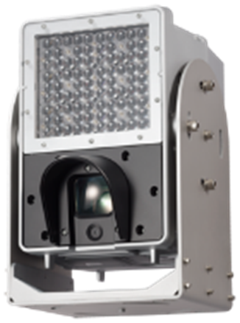
X5 series Vehicle Capture Camera
for POC manual ver.1.05
Model: WV-X5550LT, X5550LTPJ

Slide 2
Contents
This guide is for you to support X5 series camera POC.
1. Differences in each generation model
2. POC preparation (Firmware upgrade, Installation condition, System layout)
*make sure before doing POC
3. Installation case
4. Parameter Setting Overview
5. Parameter Detail Setting
6. Example of testing
7. Performance limitation
8. Consideration
9. Q&A
10. Know-how
11. Reference

Slide 3
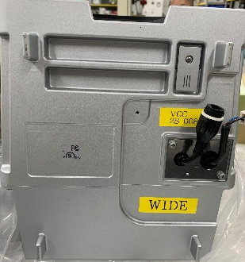
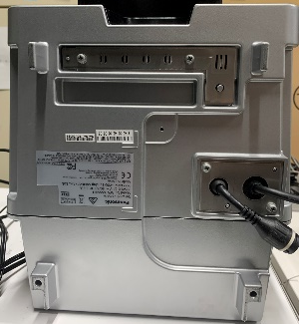
1. Differences in each generation model
Confirm the generation of your model. There are some differences in each model.
Appearance | Prototype Sample (PS) |  | Engineering Sample (ES) |  | Mass Production Sample (MP)
Easy Installation function | non-available |  |  |  | Yes (available)
Polarization filter rotation Setting | Yes (Need to set up, whenever it reboots) |  |  |  | No (Inc. Easy installation function)
Day/Night setting | on/off (Auto is not supported) |  | Auto(Default)/on/off
Accessories | No, there are not cable-cover, safety-wire (Need to prepare by yourself) |  |  |  | Yes
front
Bottom
front
Bottom
front
Bottom
No i-PRO logo
i-PRO logo
No serial number
No label
Serial number
label
Serial number
label
No logo
Panasonic logo
Panasonic logo
Panasonic logo

Slide 4
2. POC preparation
Before starting POC, following items should be prepared.
2-1. firmware update
2-2. installation condition
2-3. System layouts
PS
PS
ES
MP
PS
ES
MP
2-1. firmware update procedure outline
PS
Preparation
  Firmware
    x5550l_V100ECS.img * “x5550l_V100ES.img” is also available.
    firm_safe_091.img (no disclose)
    firm_amboot_091.img (no disclose)
  Vehicle Capture Camera
  AC power
  LAN cable
Procedure
  Connect all items. (X5 series Camera, AC power and LAN cable)
  Update Firmware

Slide 5
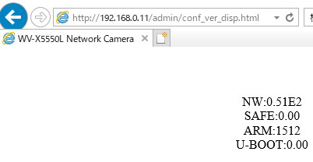
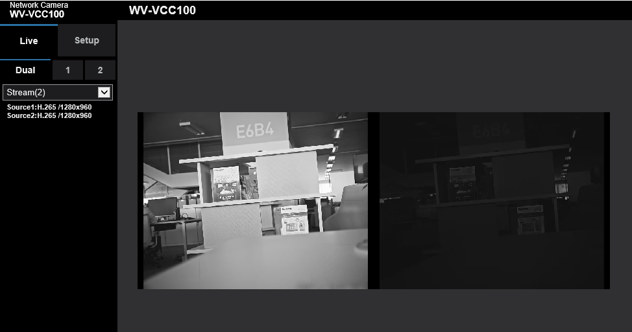
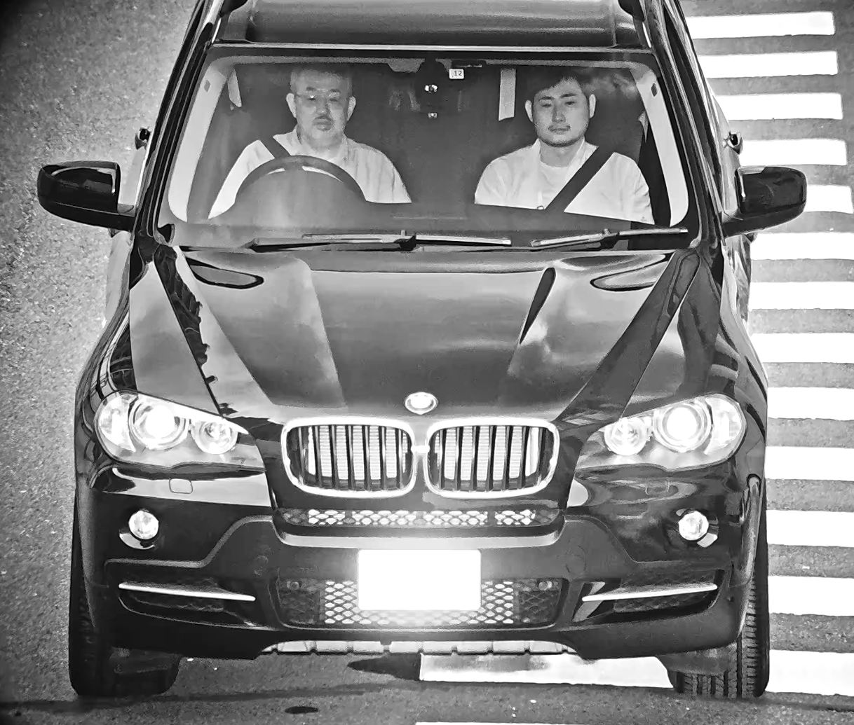
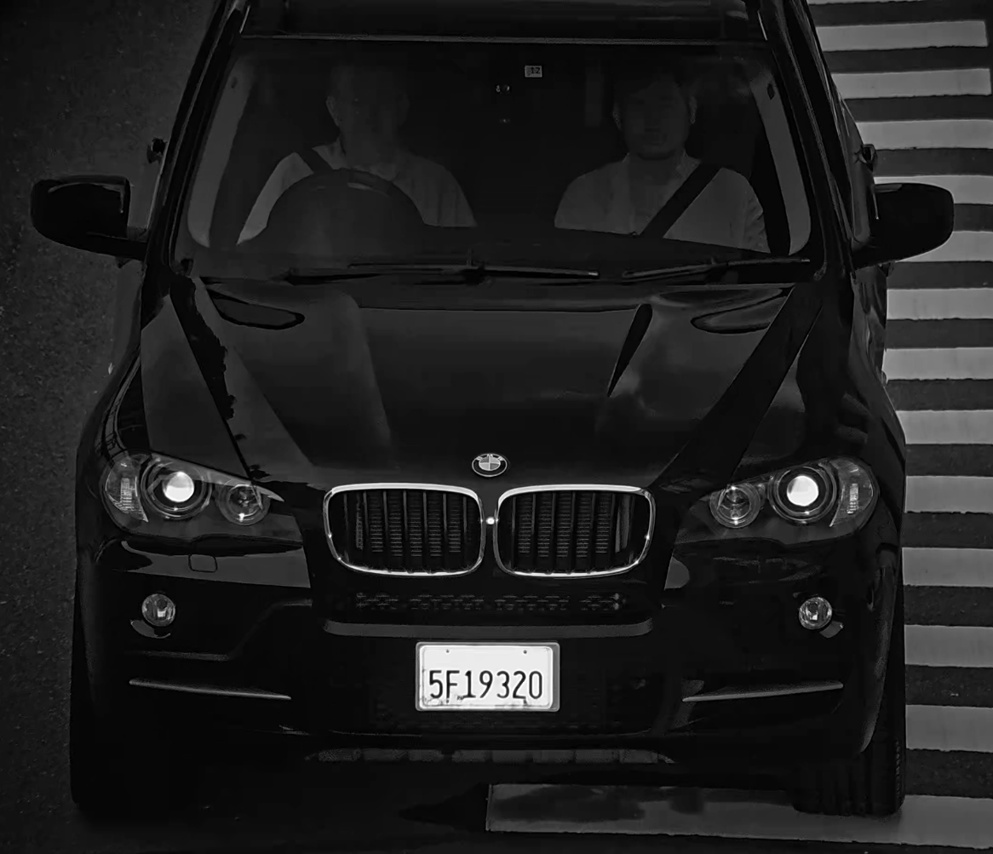
2. POC preparation : “2-1 firmware update (1/2)”
PS
Access following URL via IE, and confirm firmware version.
http://cam.ip.address/admin/conf_ver_disp.html (ID: admin /Password : Admin12345)
Access following URL via IE.
http://cam.ip.address/ (ID: admin /Password : Admin12345)

Slide 6
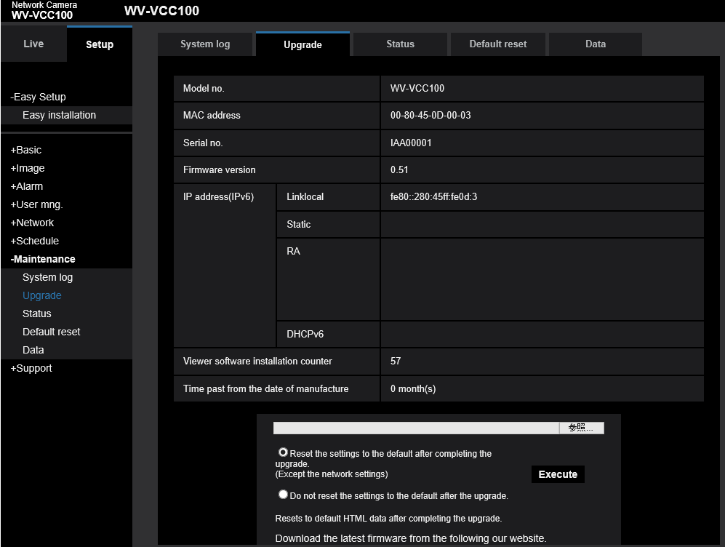
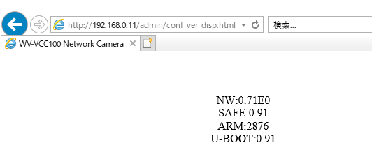
2. POC preparation : “firmware update (2/2)”
PS
Select “Setup” and “Upgrade”
Upgrade with 3files, and make sure to put the check for the item “Reset the settings to the default after completing the upgrade”
Note：Don’t turn off the power in proceeding for amboot and safe version up.
Update Firmware with three files in right order on next page.
1.Upgarade with firm_safe_091.img
2.Upgarade with firm_amboot_091.img
3.Upgarade with x5550l_V100ECS.img
Confirm updated version.
http://cam.ip.address/admin/conf_ver_disp.html
(ID: admin /Password : Admin12345)
Important!
Must check here.

Slide 7
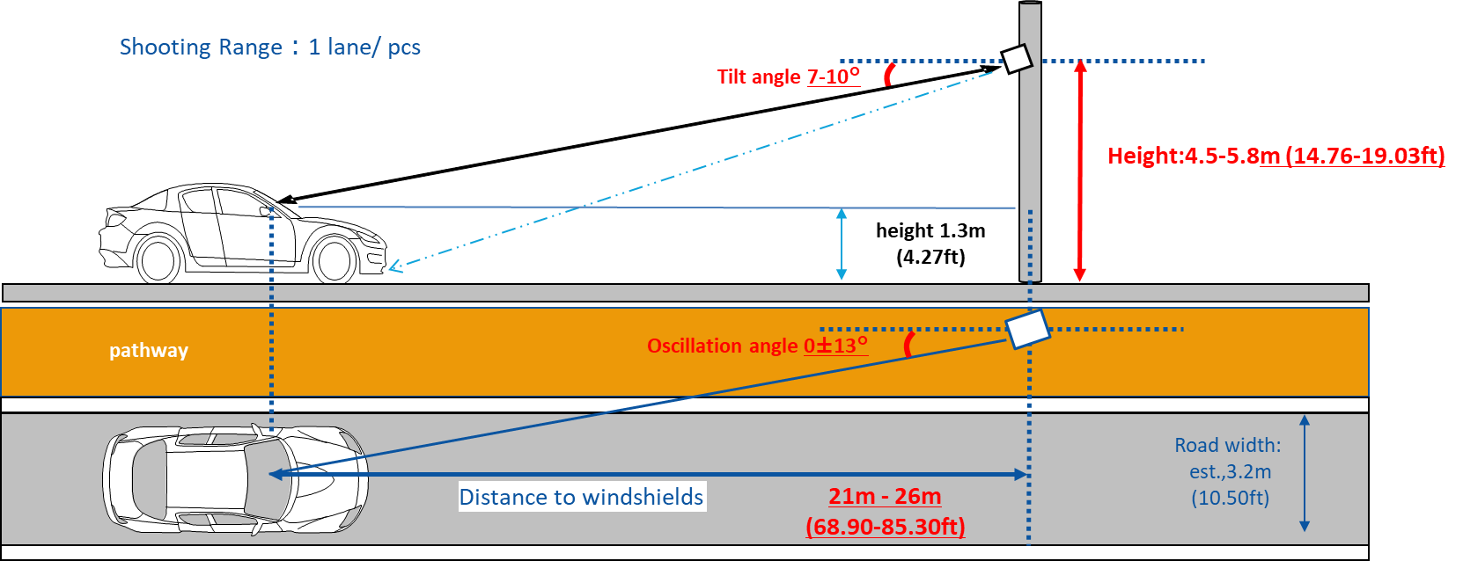
2. POC preparation : “2-2 Installation condition”
PS
ES
MP
Check installation condition, and install the camera
our recommendation :install the camera at 4.5-5.8m height (14.76-19.03ft) with tilt angle 7-10 degree.
* If the camera will be installed on slope, Tilt angle should be added based on slope angle.
[Note]
・lane width for your reference -> USA:3.66m(144.1inch), Germany/France:3.75m(147.6inch), Japan:3.5m(137.8inch)
・Minimum height of gantry required for 4.80m(15.75feet) {Europe4.5m(14.76feet), US 4.9m(16.08feet), UK5.35m(17.55feet),
Japan 4.6m)(15.09feet)}based on survey
= allowed Maximum height of vehicle{4.30m(14.11feet)}+ vertical movement{0.2m(0.66feet)}+ margin{0.3m(0.98feet)}

Slide 8
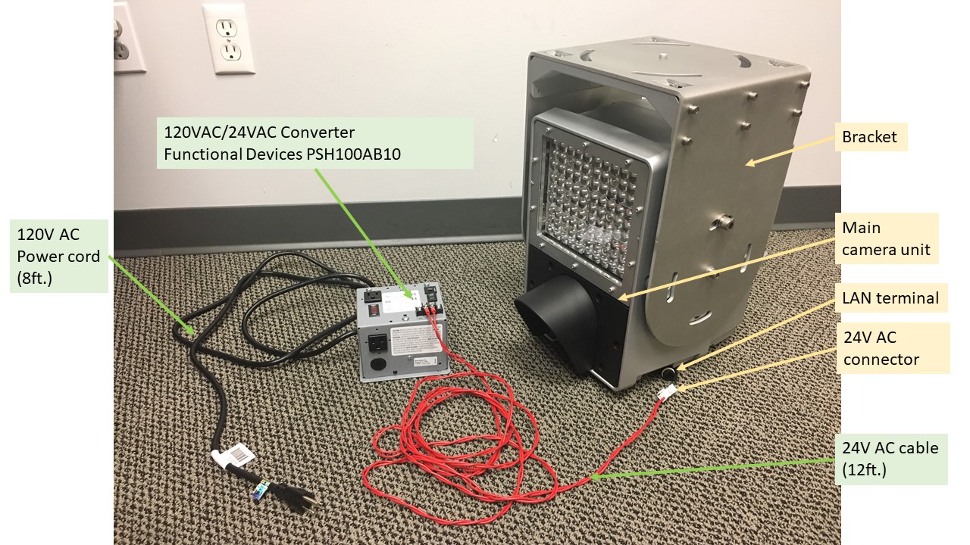
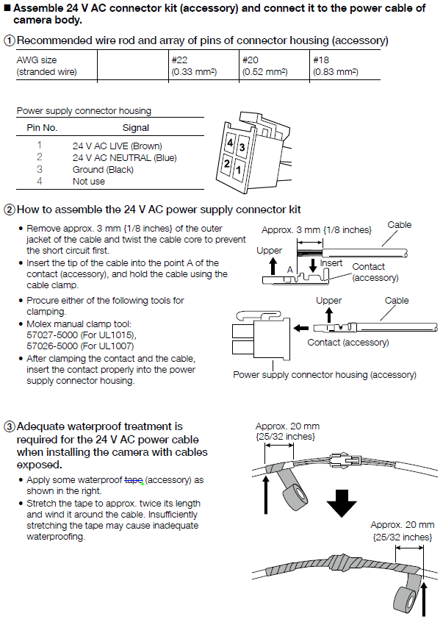
2. POC preparation : “2-3 System layout”
PS
ES
MP
Check system layout, some items (red) are prepared by yourself
Switching hub
Note
PC
VMS
LAN
Power Assemble
is needed
Comply your power standards

Slide 9
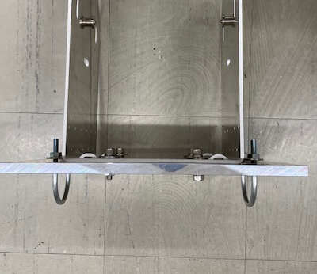
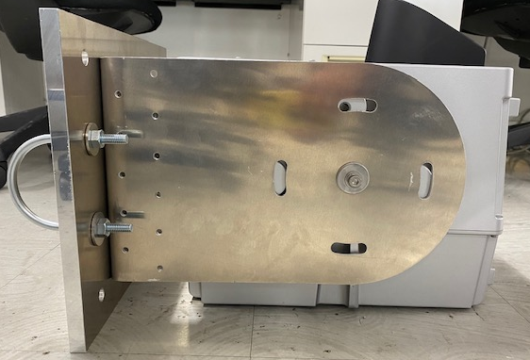
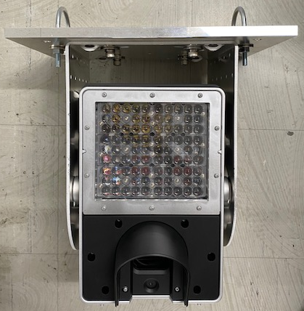
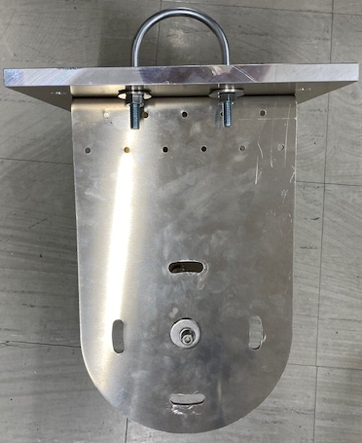
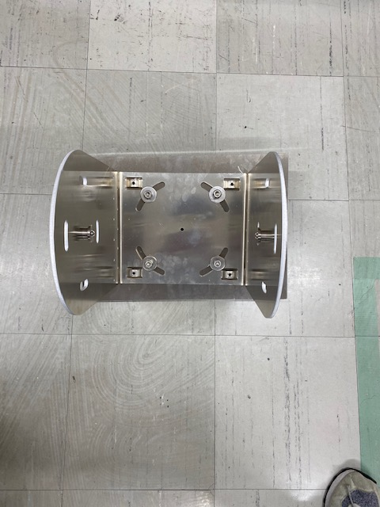
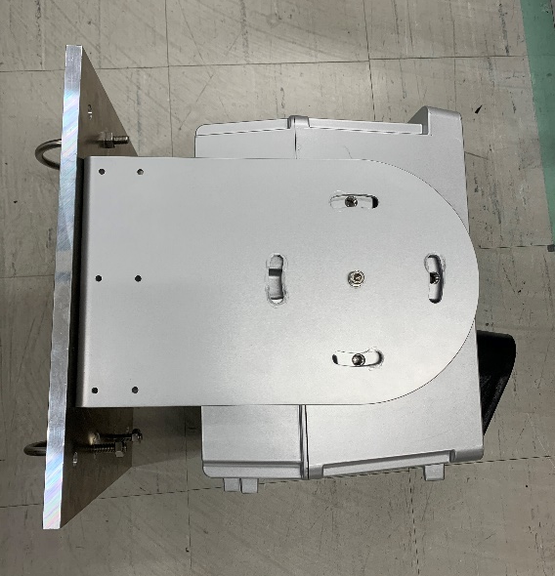
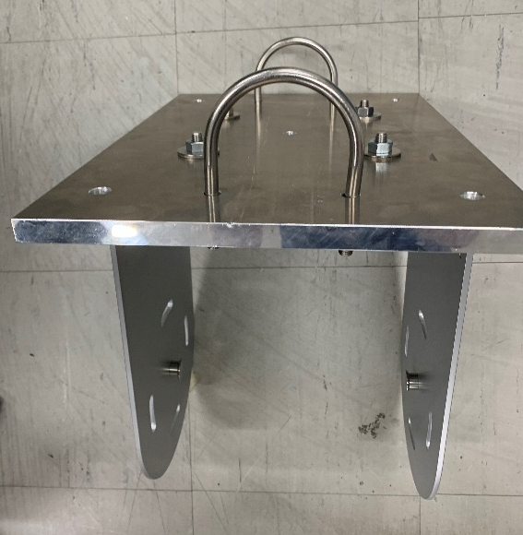
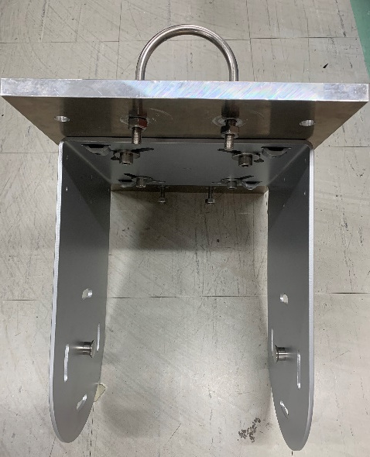
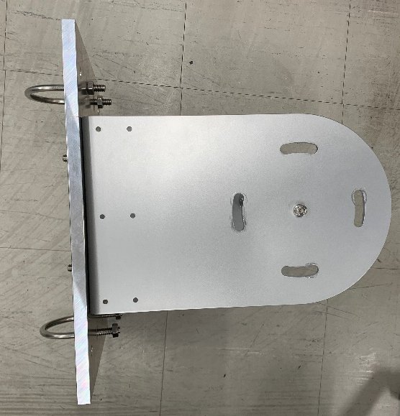
3. Installation method
Ceiling mount
Need to prepare the mounting plate
U-bolt
Wall mount

Slide 10
4. Parameter Setting Overview
Setting flow for each model
Recommended installation condition? | Focus target is on road ?
- | Yes
- | No
- | Yes
- | No
Yes | -
No | Yes
No | No
5-1
Time
5-2
Video
5-3
Zoom & focus
5-4
Polarization
filter
5-5
Day/Night
Schedule
5-6
Source 2
PS
Manual zoom
Auto focus
Manual focus
Prototype
Manual zoom & focus
ES
Manual zoom
Auto focus
Manual focus
Engineering sample
Manual zoom & focus
MP
Easy setting (include manual adjust)
Mass production
Manual zoom
Auto focus
Manual focus
Manual zoom & focus

Slide 11
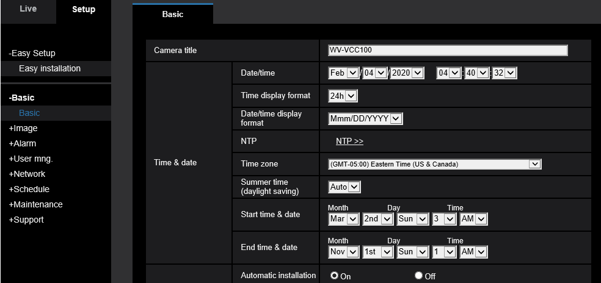
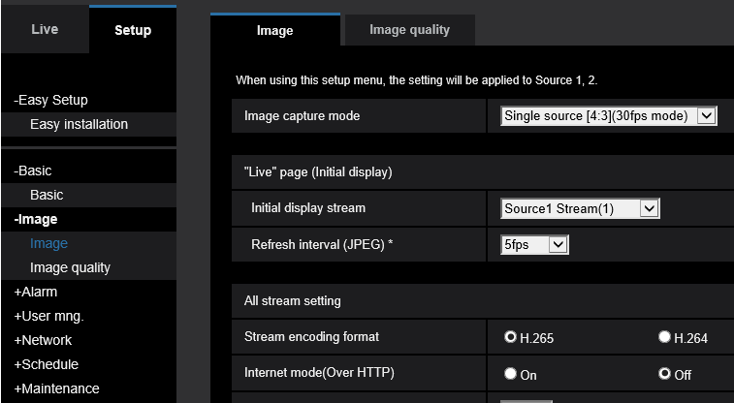
5-1 & 5-2. Time & Video
PS
ES
MP
5-1. Time setting
5-2. Video setting
Set up “date”, ”time zone” and “summer time”
Set up “image capture mode”
Dual sources[4:3](15fps mode)
→ 2ch 15fps mode
Dual sources[4:3](12.5fps mode)
→ 2ch 12.5fps mode
Single sources[4:3](30fps mode)
→ 1ch 30fps mode (for inside vehicle)
Single sources[4:3](25fps mode)
→ 1ch 25fps mode (for inside vehicle)
RTSP streaming URL
Source1 (occupant) :rtsp://ip.addr/Src/MediaInput/stream_1/ch_1
Source2 (number) : rtsp://ip.addr/Src/MediaInput/stream_1/ch_2
*Source2 is available only in [Dual source 15fps mode / Dual source 12.5fps mode].

Slide 12
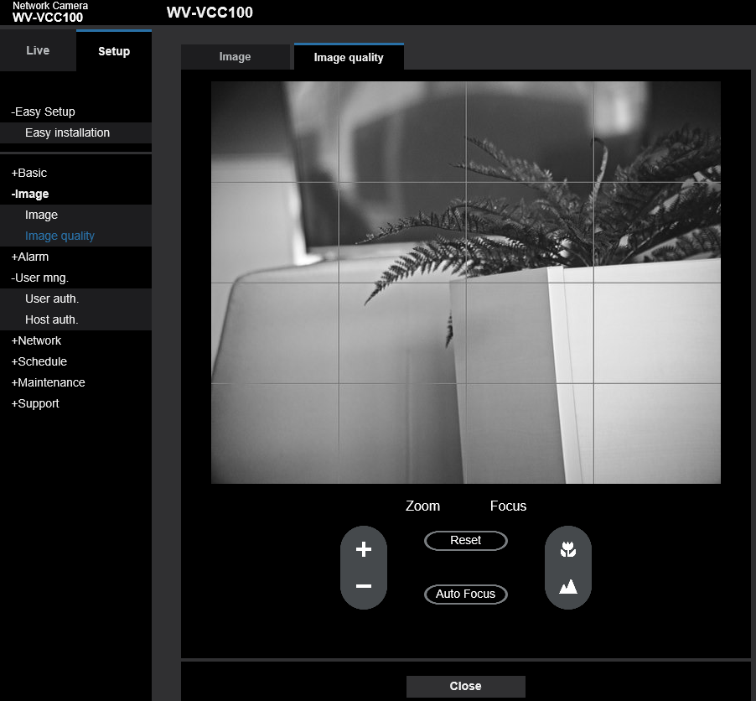
5-3a. Zoom & Focus [by Manual & Auto]
PS
ES
MP
Manual Zoom
Adjust with “Zoom (+/-)”
*Available zoom range : x1.0 ~ x1.7
Auto and Manual Focus
If focusing target (cars) placed on the road
Click “Auto Focus”
Other cases and fine tuning
Adjust with “Focus (+/-)”
[Note]
Refer to P.13 Zoom & Focus How to confirm

Slide 13
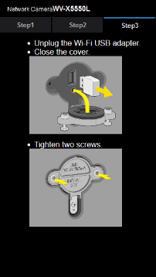
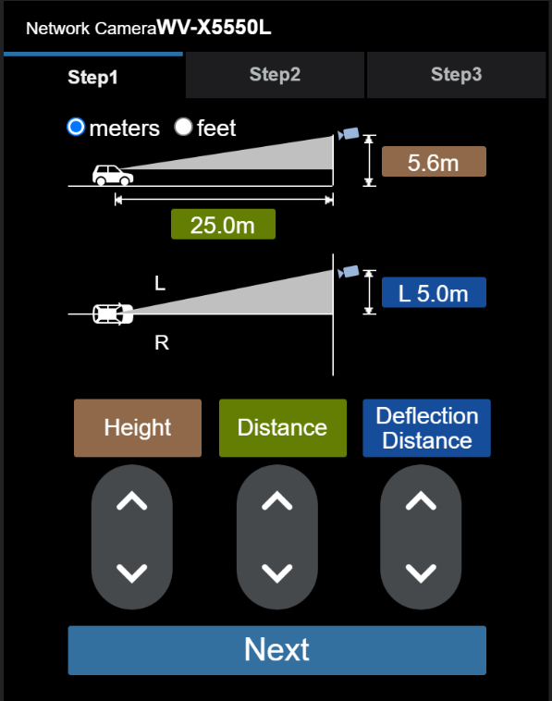
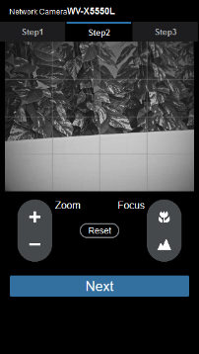

5-3b. Zoom & Focus [with Easy Setting]
MP
Preparation
1. Please register an administrator or user.
2. Insert the USB Wi-Fi adapter to the camera, and connect your device to the Wi-Fi network of camera.
・SSID: “product number serial number” ・Password: “cam _serial number”
3. Access following URL with your browser. (http://192.168.12.10)
Back side of the camera
STEP1
STEP2
STEP3
Set the each parameters
Fine tune manually if necessary, the zoom and focus
Height
：installation height of the camera.
Distance
：distance from the camera
installation position to vehicle.
Zoom in
Focus near
About 3.5m
Zoom out
Focus far
Deflection
Distance
：installation position to the center
of the road lane.
RESET to step1
*If step1 wasn’t set,
default value zoomx1.0 will be set.
Click “NEXT”
the Zoom, Focus and polarization filter rotation angle settings will start automatically.
Click “NEXT”
[Note]
Please input all parameters especially deflection distance “L” and “R”.
Otherwise, the image quality will be bad.
[Note]
Refer to P.13 Zoom & Focus How to confirm.
Unplug the adapter
Close the cap

Slide 14
5-3c. Zoom & Focus [How to confirm]
PS
ES
MP
[Note]
You can refer to the zoom scale
based on the distance to the target from the camera
Preparation
Step1. Check the camera live stream on VLC.
Step2. Adjust “Zoom” to fit the road width and execute auto focus.
Zoom
Step3. Record the stream with passing vehicle on VLC.
Step4. Play back the video frame by frame and Check the occupant image on VLC.
-> if need more configuration, execute manual zoom(+/-) and back to Step3.
-> if no problem, move to Step6.
Focus
Step5. Record the stream with passing vehicle on VLC.
Step6. Play back the video frame by frame and Check the occupant image on VLC.
-> if the blur happens, execute manual focus(+/-) and back to Step5.
-> if no problem, finish settings.
Distance | 21m 68.89ft | 22m 72.17ft | 23m 75.45ft | 24m 78.74ft | 25m 82.02ft | 26m 85.30ft
Zoom scale | X1.22 | X1.27 | X1.35 | X1.4 | X1.45 | X1.5

Slide 15
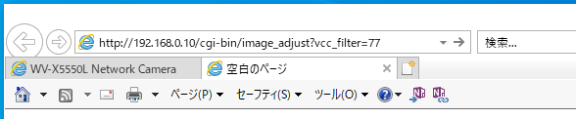
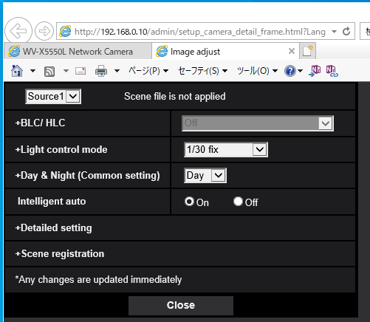
5-4. Polarization filter
PS
PS
ES
ES
Adjust the angle of Polarization filter rotation on web page.
Access the following URL.
  http://[cam IP address]/cgi-bin/image_adjust?vcc_filter=77
If the screen is displayed, it was done.
[Note]
This setting is required, whenever the camera reboots.
* followings are rebooting case.
- Change source mode - Scheduled rebooting (if activate) - Firmware version up
- Update parameters - Initialize parameters - Rebooting - Power On/Off
This setting is not required for MP model.
* CGI command can be used, however it is not recommended. Please request PIPS support.

Slide 16
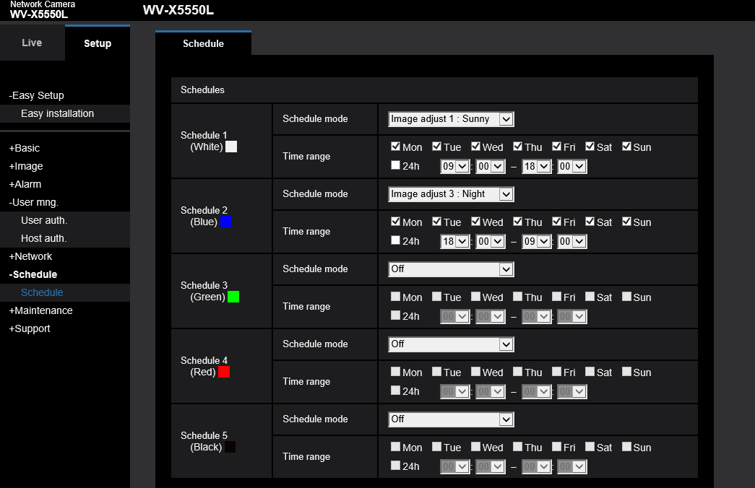
5-5. Day & Night schedule
PS
Set up schedule for shifting day and night mode.
Day mode is activated after sunrise, and Night mode is activated before sunset.

Slide 17
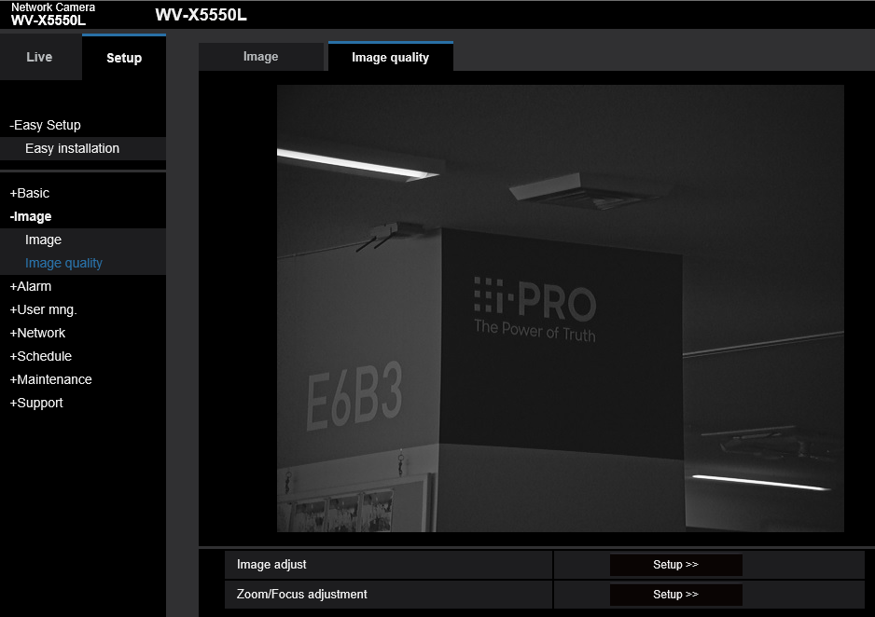
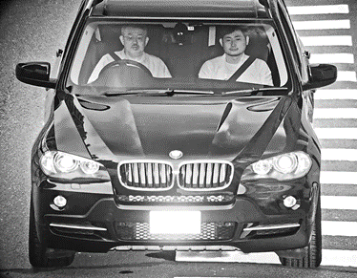
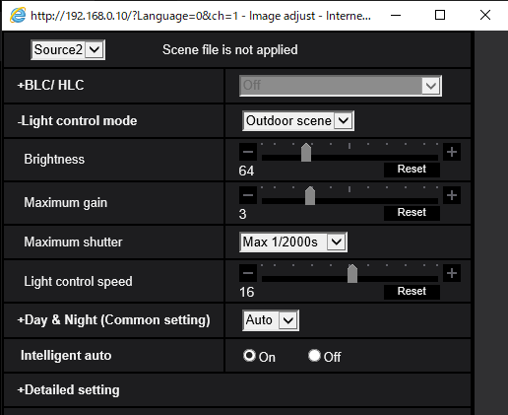
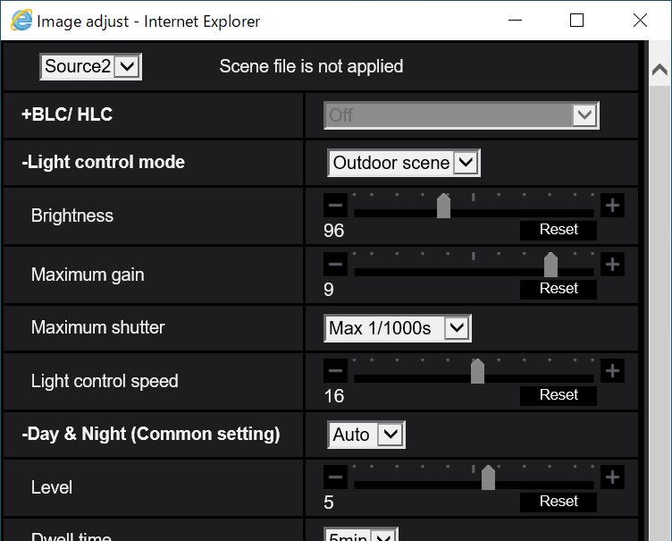
5-6. Source 2 [for license plates reflection]
PS
ES
MP
Based on your region, set up the source 2 for non-reflective license plates.
There are two types of license plates, reflective and non-reflective one.
The default setting is for reflective one. Therefore, edit the parameters to proper settings if necessary.
Edit specific parameters.
If you want brighter or darker, adjust the Brightness.
Parameters | Reflective | Non-reflective
Brightness | 64 | 96
Maximum gain | 3 | 9
Maximum Shutter | Max1/2000s | Max1/1000s

Slide 18
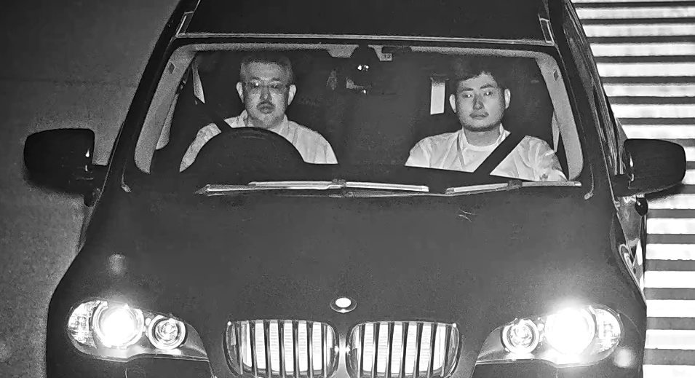
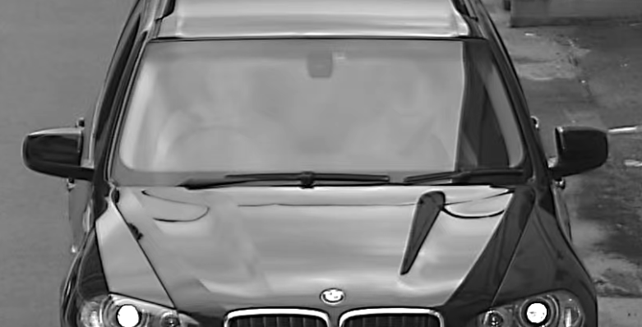
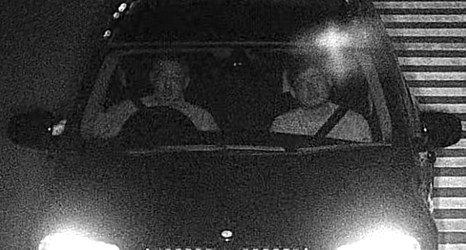
6. Example of testing
Followings are good or not good example captured by X5 series camera.
 | Day | Night
Good
Not Good

Slide 19
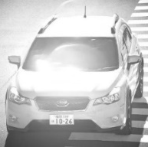
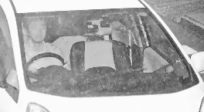
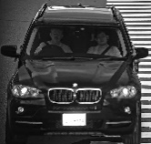
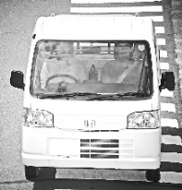
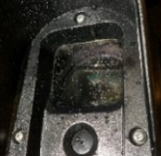
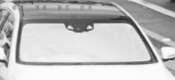


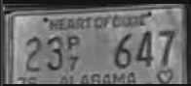



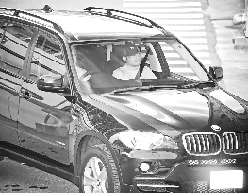
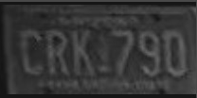

7. Performance limitation
Following performance limitation affects image quality.
Restriction | Image example
In the case of entering sunlight or reflection from vehicles hoods to the camera directly.
In the case of windshield angle is more than 50 degrees. (bus, truck, etc.)
In the case of windshield with a special film*as below. - cut more than 85% of 855nm NIR or - reflect IR or - Polarized film
Out of recommended installation condition. (horizontal distance, vertical distance, height)
Restriction | Image example
In heavy snow or rain.
Over specification of capturing vehicle speed (120km/h/15fps mode or 160km/h/30fps mode)
Water drops or stains on the glass surface of the camera.
Difficult to see characters, due to license condition. (painted too reflective material or dirty on or one of character is not printed by reflective material etc.)
Coexistence area of reflective and non-reflective plates (In some cases, you can shoot the reflective type with Source2 and the non-reflective type with Source1)

Slide 20
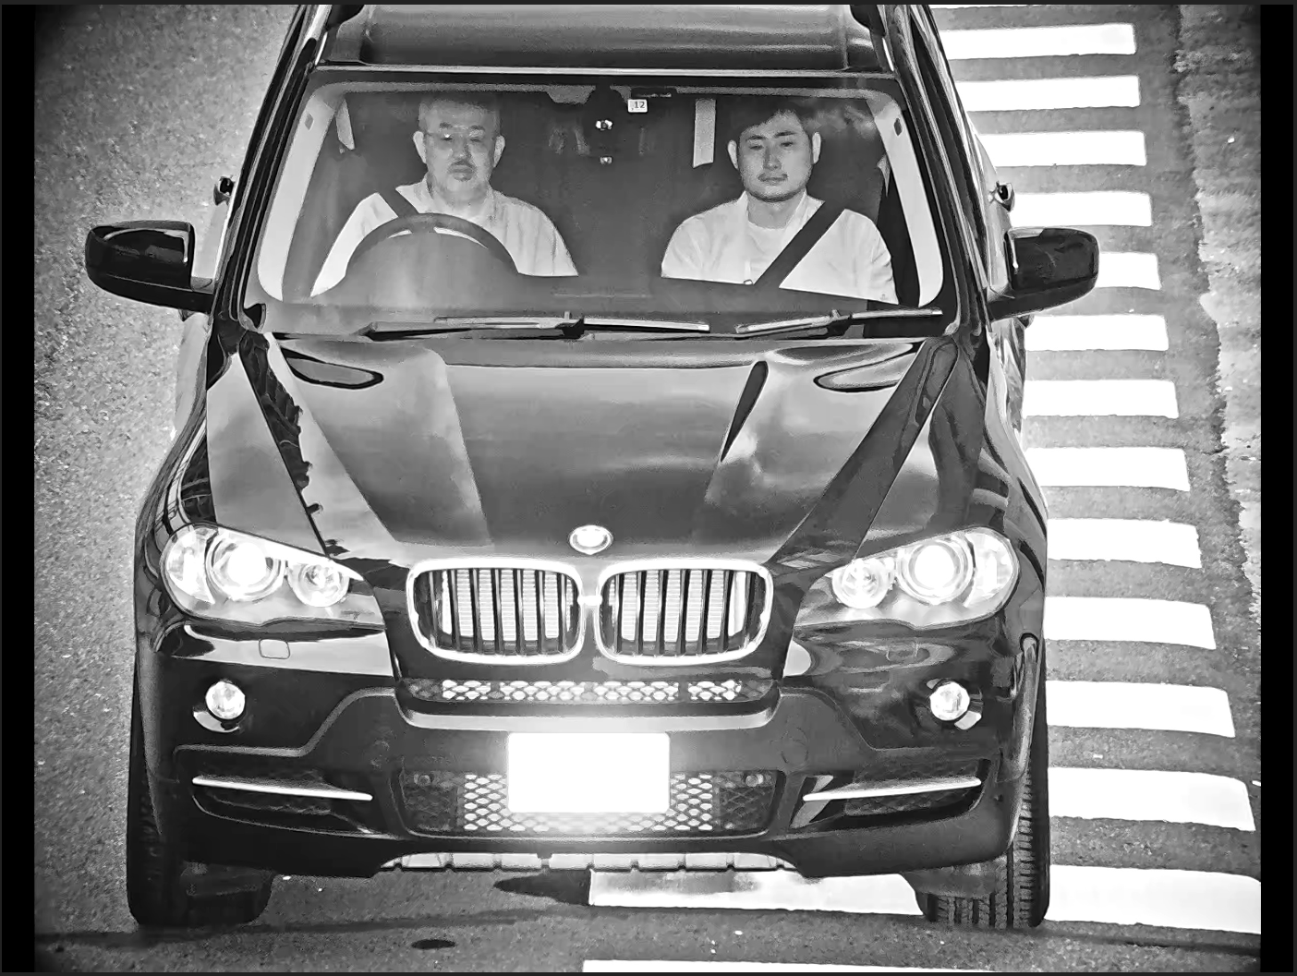
8. Consideration
It is important to understand following consideration, and should explain to customer.
The image quality will be bad, when the reflection happens due to an obstruction (like insect, etc.) between the camera and subject.
Since the IR lighting is blinking, it affects the images captured by other CCTV. (blinking image)
There are black vertical lines on both sides of image because of differences between sensor capturing size and resolution size.
Set the image quality of Source 2 in accordance with the reflective or non-reflective license plate.
(Brightness, max gain, max shutter) its depending on your regions. (default setting is for reflective license plate)
The Easy installation function cannot be used in case of out of recommended installation conditions.
In that case, manual adjustment is required.
After Easy installation, the angle of view (Zoom/Focus) should be checked again for your operation.
Resolution size | Black vertical line | Effective Resolution
2560x1920 | 64pixel x2 | 2432x1920
1600x1200 | 40pixel x2 | 1520x1200
1280x960 | 32pixel x2 | 1216x1200
640x480 | 16pixel x2 | 608x480
[Note] aspect ratio is supported 4:3 only.

Slide 21
9. Q&A (1/3)
No | Category | Question | Answer
1 | Principal | What makes the camera to be able to capture occupant? | Day: Visualizing with strong IR, removing harmful sunlight with Polarization filter, and improving visibility with image processing technology. Night: Visualizing with strong IR, removing headlight from car with both Band-Pass filter, and improving visibility with image processing technology.
2 | Specification | What is upper limitation of running car speed to capture? | Dual Sources mode: 120km(75miles)/h at 15fps as maximum Single Source mode:160km(100miles)/h at 30fps as maximum
3 |  | Is it possible to capture completely? | No. Please check P.17 “Performance limitation”
4 |  | Which shutter type Global or Rolling? | Global Shutter.
5 |  | How many lanes can the camera capture? | 1 lane.
6 |  | Is there any effect when camera installed at site? | Please check P.18 “Consideration”
7 |  | Is there any effect for those who see camera directly? | No effect, and camera complies eye-safe standards (IEC62471).
8 |  | Does the any brightness surround camera affect it’s performance? | Special Mechanism (Q&A No.1) minimizes noise from brightness.
9 |  | Does the image blur happen when the camera is shacked by wind or vehicle passing? | Even if the camera doesn’t have stabilization function, of course, video image is affected. But, picture image isn’t affected due to high shutter speed.
10 |  | Does the brightness or shadow pointing on the road affect to the camera image? | It rarely affects image quality.
11 |  | How does time information setting is used? | Time information setting is implemented in stream and used for log and alarm.
12 |  | Is clear sight coating available for the camera? | No, Performance decrease, and it protect from attaching water and stain with sun shade of glass.
13 |  | Does the camera capture occupants in back seat? | Camera doesn’t support.

Slide 22
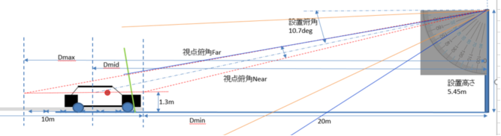
9. Q&A (2/3)
No | Category | Question | Answer
14 | Specification | What is the threshold-value of illuminance for shifting between Polarization filter on daytime and Band-pass filter on nighttime? | Default value is around 300lux (Level5), and you can adjust this threshold-value at 10 levels. (range: 0.1lux at level 0 ~ 10,000lux at level 9)
15 |  | Which area does the illuminance sensor detect for? near sensor or near focusing target area? | Detection area is wide range as below figure, and camera sensor calculates average illuminance in the detection area.
16
 |  | Is the VCC equipped with Grounding terminal or surge protection in any lightning strikes? | Camera had durability against 4KV of induced lightning, not direct lightning by connecting GND cable to ground earth.
 |  | What is the upper limitation to capture occupants with special film of windshields? | Please check P.17 “Performance limitation”
17 |  | Which area the IR direct to? | It depends on the installation condition. For example, 3.6m (141.7inch) diameter circle for when distance between camera and vehicle is 25m (984.3inch).
18 | Installation | What it will happen, in the case that cameras will be installed both side of the road and focus on same area. | Target image quality may become overexposure, if these camera’s IR are synchronized together.
19 |  | Is portable type available? Or can it be installed in any transportable equipment. | It is not available for portable type. And Please ask PIPS, if customer wants to install it in transportable equipment.
WV-X5550LT
WV-X5550LTPJ
detection area

Slide 23
9. Q&A (3/3)
No | Category | Question | Answer
20 | Installation | Is the camera able to use to capture at the gate such as parking lot, car pool or entrance? | Depending on installation condition.
21 |  | Does the customer have to prepare USB dongle for easy installation by themselves? | Yes. Please check P.45 “Reference”
22 | System Integration | Does the camera have Best shot function or OCR function? | No, it’s just a camera which send 2 streams both occupant and license plate image.
23 |  | Does the camera integrate with VMS? | Yes, it integrates with Video Insight, Milestone and Genetec.
24 |  | Does the camera integrate with ASF950? | No, and currently no plan to integrate with ASF950.
25 |  | Does the camera integrate with NVR? | No, it doesn’t.
26 | Legal | Does this camera violate one’s privacy? | the conscious of compliance is increasing. On the other hands, the demands of analytics is also increasing. PIPS wants to respond to this expectation. In addition, PIPS has to take care for secure in aspect of technology and operation. As for technology, It complies Data encryption and secure communication to protect date leak. As for operation, we supports customer to be able to manage user authorization.
27 | Competitor | What is competitor’s situation? | Giant CCTV manufacture such as Axis and Hanwha don’t offer similar products. Please check P.10 “Spec comparison”.
28 |  | What is strong points of the camera? | Please check P.3-P.9 “Introduction”.

Slide 24
10. Know-how
Know- how
- Q) How can we reduce clouds shadow in windshields?
- A) At 1st step, reduce TILT angle of VCC below 9 °, 2nd step, rotate polarized filter along with angle of camera to windshields.
* if you want to operate rotating polarized filter, please let PIPS SE member know.
- Q) How can we focus truck or bus, not sedan or SUV type of car?
- A) this camera focus sedan and SUV only basically, but it may improve capturing by lowering installation height of camera.
* if you get such a demand, please let us know first. And we should check actual performance on the POC.
- Q) How can we capture both reflective and non-reflective license on time?
- A) Please check reflective type for source 2, non-reflective type for source1.
- Q) How can we avoid blinking for CCTV? (P.19 consideration)
- A) Please re-set the angle of CCTV for not overlapping the IR focusing are (Q&A No.16)
Trouble shooting
- Solution if the issue losing frame data happen.
1) Change bitrate (14Mbps -> 16Mbps -> 20Mbps), 2) Change image setting (Quality1 -> Quality3 )
- Solution if zoom and focus doesn’t work.
1) Clear browser’s cache (Internet Explorer : Tools → Internet Options → General → History → Clear History )

