Slide 1
AI Privacy Guard [WV-XAE201W]
Setting Guide
Document Ver.1.04
Jul. 2022

Slide 2
Contents
Introduction
Camera setup
System Linkage
  NX series
  WV-ASM300

Slide 3
Introduction

Slide 4
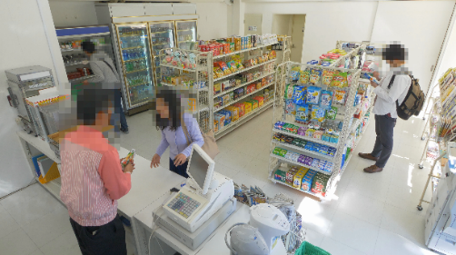


Introduction
What is “AI Privacy Guard”?
The function that detects human and face utilizing AI and performs blurring or block processing
  Protects privacy of the people captured on the image
Privacy Guard: Privacy Guard target = Face
Original
Privacy Guard: Privacy Guard target = Human

Slide 5
Overview of AI Privacy Guard
Setting Parameters
Privacy Guard Target Guide
Privacy Guard target | Face / Human
Target stream | Stream(1) Stream(2) Stream(3) Stream(4) Stream(2)&Stream(4)
Masking method | Blurring / Block
Size *1 |  | 5MP Camera | 43 to 1870pixel 51 to 2240pixel (super resolution imaging)
 |  | 4K Camera | 64 - 2800pixel
Max. number of simultaneous processing |  | 99 people
Shooting range |  | Two-thirds of the target object is caught on camera
Color/Black and white |  | Supports both (including with IR-LED)
When “Face” is selected for “Privacy Guard target” | Direction*2 | Right and left: Within 90° Up and down: Within 45°
 | Rotation *3 | Within +/-90°
*1. Select “Stream(2)&Stream(4)” to use AI Privacy Guard linked with our Network recorders or WV-ASM300.
*2. When “Stream(2)&Stream(4)” is selected, the resolution of Stream(1) and Stream(2) will be the same value. Also the resolution of Stream(3) and Stream(4) will be the same value.
*3. Refer to the “Restrictions” described later in this document for the framerate restrictions.
*1. When [Privacy Guard target] =“Face”: Facial width
When [Privacy Guard target] =“Human”: Body width
*2. The angle of camera optical axis and the target face
*3. The angle of the target face when the vertical line of an image is regarded as 0 degree
Note: There are cases where Blurring / Block may NOT be performed even if the conditions described above are met. Also, Blurring / Block can be performed even if those conditions are NOT met.

Slide 6
Points to note
Blurring / Block may be performed on the area without “Face” or “Human”.
Blurring / Block may be performed on dolls or posters.
The size of the area where Blurring / Block has been performed may be larger than the actual size of a target object.
When no face is captured on the image, Blurring / Block may NOT be performed even if “Human” is selected for [Privacy Guard target].
In the following cases, Blurring / Block may NOT be performed even when the conditions are met:
  The target face or Human is out of focus.
  The target face or Human is overexposed or underexposed.
  The target face or Human is blurred.
  The target object is lying down or felled.

Slide 7
Restrictions
The maximum frame rate of original image^{(a)}/ AI Privacy Guard image^{(b)} is determined by model, when AI Privacy Guard is enabled.
5MP Camera: ^{(a)}30fps / ^{(b)}15fps 4K Camera: ^{(a)}15fps / ^{(b)}15fps
When installed with AI-VMD, the frame rate of AI Privacy Guard image will be limited to 10fps regardless of model.
JPEG(2) is NOT available when AI Privacy Guard is enabled.
*JPEG(1) is available as an original image.
The parameters [Max.2/30s] to [Max.16/25s] are NOT available in [Maximum shutter] when AI Privacy Guard is enabled.
“On(Framerate control)” is NOT available in [Smart Coding] - [GOP control] when AI Privacy Guard is enabled.

Slide 8
Camera setup

Slide 9
Preparation
Upgrade firmware
Upgrade your camera’s firmware to the latest version.
Install the extension software
Install AI Privacy Guard on the camera.
Configure the network
Setup the network of your camera based on the operating system in use.
Open the camera browser
Select “AI Privacy Guard” in “Ext. software”
Go on to the AI Privacy Guard setting
*Refer to the instruction manual of the camera in use.​
https://i-pro.com/global/en/surveillance/training-support/documentation-database-list ​
​*Refer to the instruction manual of the extension software.
https://i-pro.com/global/en/surveillance/training-support/documentation-database-list ​

Slide 10
AI Privacy Guard setting
Set the each item depending on the intended use
[Privacy Guard target] : Select the target for Blurring or Block.
- Off (default) : Does not perform Blurring or Block
- Face : Performs Blurring or Block on the target identified as “Face”
- Human : Performs Blurring or Block on the target identified as “Human”
[Target stream] : Select the stream to perform Blurring or Block
- Off (default) : Does not perform Blurring or Block in any streams
- Stream(1) to Stream(4) : Performs Blurring or Block only in the selected stream
- Stream(2)&Stream(4) : Performs Blurring or Block in Stream(2) and Stream(4).
[Masking method] : Select a Masking method from Blurring or Block
Points to note
When [Stream(2)&Stream(4)] is selected:
The resolution for Stream(1) and Stream(2) will be the same value. Also the resolution for Stream(3) and Stream(4) will be the same value.
When using AI Privacy Guard linked to NX Series or WV-ASM300:
[Stream(2)&Stream(4)] needs to be selected for [Target stream]

Slide 11
Cooperation with NX Series

Slide 12
Overview of cooperation with recorders
Concept
Assign the stream for original image and the one for AI privacy guard image separately to 2 channels. *Channels for 2 cameras will be occupied.
Available function
Display the AI privacy guard image as a live image
Select the image to display at alarm occurrence from the original image or AI privacy guard image.
Select whether or not to display the original image according to the “User management” setting.
Conditions for use
Recorder : NX Series version 4.0 or later
Camera : i-PRO Network camera with AI engine
Compression method : H.264 or H.265
AI Privacy Guard is installed on the camera and necessary settings are completed.
  As recorders does not support the function to install a software and perform its settings.
* Although the [AI privacy guard recording camera] setting can be performed as long as an AI camera is registered even if AI Privacy Guard is not installed on the camera, Blurring or Block will not be performed.

Slide 13
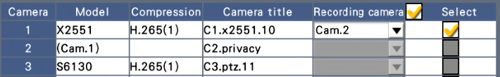
Set the camera number for AI privacy guard recording
Setting procedure
Register cameras by detecting automatically or setting manually
Click “Setup >” in [AI privacy guard recording camera]
Set the camera number in [Recording camera] of the original recording camera in which you would like to perform AI privacy guard recording
Click the [OK] button
Ex. When “Camera 2” is set in [Recording camera] of Camera 1:
The image from Camera 1 with AI privacy guard performed will be added as Camera 2.
* Equipped with the function to assign or clear multiple cameras in bulk.

Slide 14
AI privacy guard recording #1 of 2
Recording setting
Original image recording uses Stream 1 and AI privacy guard recording uses Stream 2.
AI privacy guard recording operates according to the recording and scheduling settings of the paired original image recording camera.
In case of sub-stream recording, the original image recording uses Stream 3 and AI privacy image recording uses Stream 4.
SD backup recording is supported only by the original image recording (Stream 1).
The cameras for original image recording and AI privacy guard recording can be assigned separately to the different recording groups in [Recording group setup].
*The function to set two groups of recording and assign each camera to either one. Also, by setting an HDD used for recording of each group, operating in different recording periods is possible.

Slide 15
AI privacy guard recording #2 of 2
Event recording
Setting “Event” in the camera for original image recording applies the same setting to the paired camera for AI privacy guard recording. (“Event” cannot be set alone in the camera for AI privacy guard recording. )
Camera site alarm will be recorded as an alarm from the camera for original image recording
  The camera for AI privacy guard recording will not be displayed in the alarm logs.

Slide 16
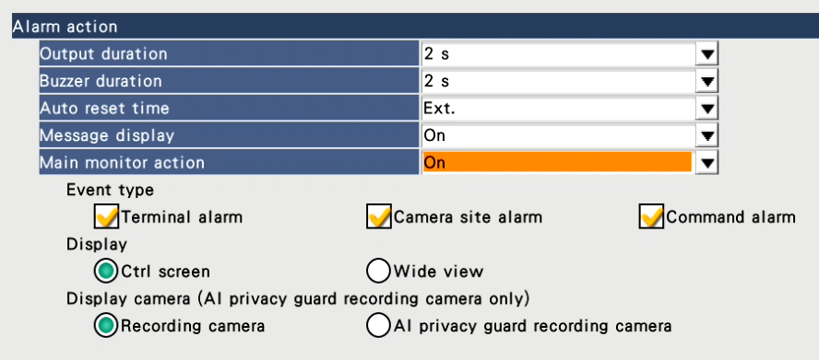
Live image display on the monitor
Streams used for single screen display
The camera for original image recording uses Stream(1) and the camera for AI privacy guard recording uses Stream (2)
Streams used for multi-screen display
The camera for original image recording uses Stream(3) and the camera for AI privacy guard recording uses Stream (4)
Event action
Setting in [Main monitor action] can be changed with the camera for original image recording.
Displays the image of “Recording camera”(without AI privacy guard) or “AI privacy guard recording camera”(with AI privacy guard) according to the setting in [Display camera].

Slide 17
User management
Authorization for displaying live image or recorded image can be set in [Camera image display] of each camera.
  [*] is attached to the camera number of original image recording camera associated with the camera for AI privacy guard recording on the user management screen.
Checkboxes for checking/ unchecking in bulk
Functions to uncheck all the cameras for original image recording (with [*]) in bulk for the case where there are many applicable cameras listed.

Slide 18
Reference : User authentication
User operation | Necessary authorization for operation
Live display | [Camera image display]
Search and playback | [Camera image display] + [Search and playback]
Copy the recorded images to USB | [Copy]
Download via web browser | [Copy] + [Camera image display] + [Search and playback]
*The copied/ downloaded images can be played on the recorder using NX viewer or the dedicated viewer software without user authorization.
  Assign a password to the n3r file as needed.
*The data in HDD can be played using HDD viewer without user authorization.
  Assign a password when removing HDD as needed.

Slide 19
Cooperation with WV-ASM300

Slide 20


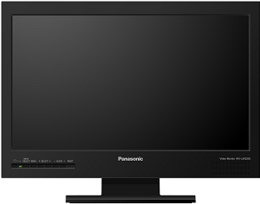


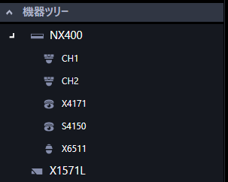
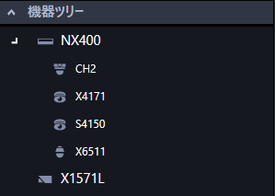


Overview of cooperation with WV-ASM300
Supports selection of original image and AI privacy guard image
Camera linkage
Original / AI privacy guard
Recorder : Live/ Play back
Original image (Stream1)
Original image
(Camera: ex.CH1)
AI privacy guard image (Stream2)
Recorder
AI privacy guard image
(AI privacy guard camera: ex.CH2)
Cameras with AI privacy guard
Original image (Stream1)
ASM300
AI privacy guard image (Stream2)
Camera stream : Live
Authorization for "AI privacy guard Image switching"
Log in as a user with authorization
Camera stream : Acquires both original image and AI privacy guard image (Stream1 and Stream2)
  Acquires “Stream 1” or “Stream 3” when “AUTO” is selected, .
Recorder(CH) : Camera for original image recording(CH1), Camera for AI privacy guard recording(CH2)
w/ authorization
w/o authorization
Log in as a user without authorization
Camera stream : Acquires AI privacy guard image (Stream2)
  Acquires “Stream 2” or “Stream 4 when “AUTO” is selected.
Recorder(CH) : Camera for AI privacy guard recording(CH2)

Slide 21
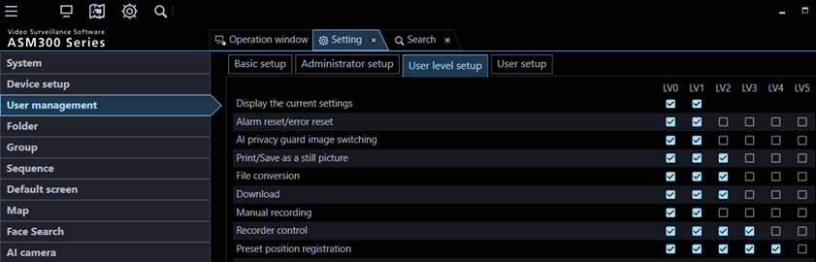
Setting procedure
Conditions for use
WV-ASM300 version 3.0 or later
Camera : i-PRO Network camera with AI engine
Compression method : H.264(1) or H.265(1)
AI Privacy Guard is installed on the camera and necessary settings are completed.
  As WV-ASM300 does not support the function to install a software and perform its settings.
Procedure
Register camera and recorder as usual
Settings related to AI privacy guard for camera or recorder cannot be performed in WV-ASM300.
Configure the settings in your recorder or camera in advance.
- Access the AI camera and set [Target stream] to “Stream (2) & Stream (4)
- Link the channel (for AI privacy guard recording) in the recorder setting
[Setting] [User management] [User level setup] tab
Set the user level for “AI privacy guard image switching”
Switching to the original image for live display or playing back images will be possible.
Default user level

Slide 22
Behavior according to the user authorization #1 of 5
Select the stream on the image display area
When selecting the stream, the image with or without AI privacy guard is displayed according to the user authorization.
Select the stream
Stream 1/2
Select “1” for the user with authorization, select “2” for the user without authorization.
Stream 3/4
Select “3” for the user with authorization, select “4” for the user without authorization.
Reset to the previous setup
Returns to the stream previously set in “Device setup” on the setup window.
Note:
Stream can be selected:
- Stand-alone camera
- Camera registered in recorder (Live image source : Camera)
Stream cannot be selected:
- Camera registered in recorder (Live image source : Recorder)

Slide 23
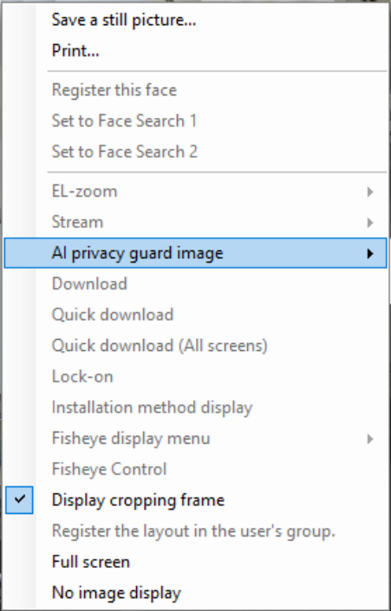

Behavior according to the user authorization #2 of 5
Switch between “On” and “Off” of [AI privacy guard image] on the image display area
In case of the user with authorization, switching between the image with AI privacy guard or the image without AI privacy guard is possible on the menu displayed by right-clicking.
- In case of the user without authorization, [AI privacy guard image] is not active being greyed out.
- When the both images of the original image recording camera and its associated AI privacy guard recording camera are displayed on the multi-screen, switching on/off of one of the images clears the other image.
- Image switching with [AI privacy guard image] is temporary and will not be saved. However, this excludes cameras with [Live image source] set to [Recorder].

Slide 24
Behavior according to the user authorization #3 of 5
Group sequence display
The displayed images vary depending on the user authorization.
NX400
CH1
(Original)
NX400
CH2
(AI privacy guard)
sequence setup
User with authorization
X1574L
(Original
Stream1)
NX400
S4150
NX400
CH1
(Original)
NX400
CH2
(AI privacy guard)
X1574L
NX400
S4150
Black image
NX400
CH2
(AI privacy guard)
User without authorization
X1574L
(Stream2)
NX400
S4150
*A notification will be displayed on the screen for the user encountering a black image because of not having the authorization.

Slide 25
Behavior according to the user authorization #4 of 5
Live display and playback of recorded images after the alarm occurrence
The displayed image varies depending on the user authorization.
Camera linkage
Original / AI privacy guard
Original image
(Camera: ex.CH1)
Original image (Stream1)
AI privacy guard image (Stream2)
AI privacy guard image
(AI privacy guard camera: ex.CH2)
Alarm notification
Recorder
Alarm notification
Cameras with AI privacy guard
Original image (Stream1)
ASM300
AI privacy guard image (Stream2)
Alarm notification
Case | User without authorization | User with authorization
Receive an alarm notification from the camera under the Recorder | AI privacy guard image (CH2) | Original image (CH1)
Receive an alarm notification from the camera registered directly in WV-ASM300 | AI privacy guard image (Stream 2) | Original image (Stream 1)

Slide 26
Behavior according to the user authority #5 of 5
Map window
Either the original image or the AI privacy guard image will be displayed as a preview image from the camera depending on the user authorization.
SD memory card recording
The SD operation panel is displayed for the user without authorization
Download
Displaying the channel for original image and downloading recorded images are not available for the user without authorization.
  Note: The N3R/MP4 file of original images that the user with authorization downloaded can be converted to the standard format or operated in NX Viewer without AI privacy guard. Please be careful when handling the file.
System log
System log will be filed when the user without authorization for [AI privacy guard image switching] starts the group operation or sequence operation with the original image recording camera.

Slide 27
Points to note on Advanced setup
Device detection
When recorder is selected in the device list, the image from the camera registered in CH1 will be displayed as a preview image. However, when the camera for AI privacy guard recording is registered in CH1, the image from the original image recording camera will be displayed as a preview image.

Slide 28
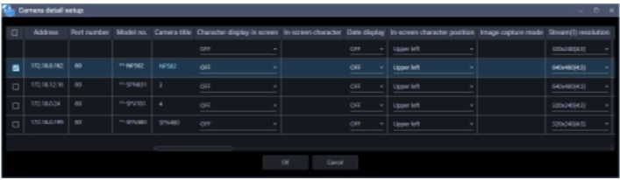
Points to note on Advanced setup
Camera registration
[Delete] cannot be selected on the pop-up menu displayed by right-clicking for the associated original image recording camera and AI privacy guard recording camera.
The setting of the camera for AI privacy guard recording cannot be edited in [Camera detail setup].

Slide 29
Points to note on Advanced setup
Recording setup
For AI privacy guard recording camera, change of the settings other than "Camera title for recorder setup" and "ASM300 camera title" in [Recording setup list] is unavailable.
The original image recording camera cannot select M-JPEG for the compression method of live images.
Select stream type from [AUTO] [ Stream 1/2] [Stream 3/4] for the cameras with AI privacy guard application (WV-XAE201W) installed.
The original image recording camera is displayed in [Linked camera] of AI privacy guard recording camera.

Slide 30
Points to note on Advanced setup
Device registration
Acquire device information again if AI privacy guard is installed after registering the cameras.
Acquire device information again if AI privacy guard recording is set in the recorder.
When recorder is selected in the device list, the image from the camera registered in CH1 will be displayed as a preview image. However, when the camera for AI privacy guard recording is registered in CH1, the image from the original image recording camera will be displayed as a preview image.
For AI privacy guard recording camera, change of the settings other than "Camera title for recorder setup" and "ASM300 camera title" in [Recording setup list] is unavailable.
For the camera with AI privacy guard installed, change of the settings in “Acquisition resolution (JPEG)” and “Acquisition refresh speed (JPEG)” is unavailable.
Recorder
Camera

Slide 31
Points to note on user management
Displayable camera
Regarding the original image recording camera and AI privacy guard recording camera, checking one will check the other as well. Also, unchecking one unchecks the other as well.

Slide 32
Version History

Slide 33
Version History
No | Update contents | Page No. | Version | Update
- | 1st Version |  | 1.00 | 10.Jul.2020
1 | Corrected typos in the entire document | All | 1.01 | 27.Jul.2020
2 | Removed the item regarding the restriction on Viewnetcam | P.7 | 1.02 | 3.Aug.2020
3 | Corrected the items on restrictions | P.7 | 1.03 | 25.Sep.2020
4 | Support company name change | - | 1.04 | 14. Jul. 2022
5
6
7
8
9
10
11
12

Slide 34
Thank you

