Slide 1
AI-VMD
Installation & Setting Guide
Document Ver.1.21
Jul. 2022

Slide 2
Contents
Introduction
Overview of AI-VMD
Preparation
Camera Installation
Configuration of Detection Function
Operation Check
Maintenance
Points of attention

Slide 3
Introduction

Slide 4
Introduction
Purpose
This document is intended to provide guidelines for the installation and configuration of AI-VMD (V2.11 or later).
The performance of AI-VMD should highly depend on the on-site environment such as camera position, angle of view and surrounding environment.
We recommend the appropriate installation and the configuration based on this guidelines to get the best performance.
Goal
Targeting to acquire the following skills.
Determining the area where the customer wants to detect
Planning the camera position based on the floor plans and on-site environment
Installing cameras at the appropriate angle
Simulating the cases of false negatives and false positives
Configuring AI-VMD
Resolving site-specific problems

Slide 5
Overview of AI-VMD

Slide 6
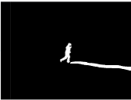
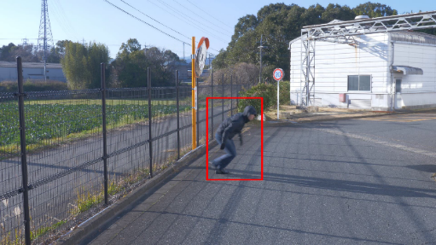
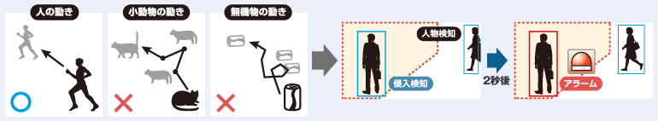
Overview of AI-VMD (1)
Basic specification of AI-VMD
Detection object
Human / Vehicle (four wheeler) / Motorcycle or bicycle (two wheeler)
Detecting function
- Intruder
Detects the moving object that enters the configured area
- Loitering
Detects the moving object that enters the configured area and stays there for a specified period.
- Direction
Detects the moving object that moves to the specified direction in the configured area.
- Cross line
Detects the moving object that crosses the configured area, moving to the specified direction.
Motion information
(Motion detection)
AI object detection information
Extracts only the object information of detection target from the motion information by utilizing AI object detection information
Realized the improvement in accuracy by remarkably reducing false alarm compared to i-VMD
Alarm example (Intruder)
Detecting Flow
Tracks all the motions of objects(moving objects) on the image
A moving object in the detection area keeps moving over the specified period.
Confirms that the moving object is a detection target
Issues an alarm judging that a detection object has got into the detection area.
Motion Detection
An object gets into the configured area
Confirmed to be a detection target
Alarm!
アラーム

Slide 7

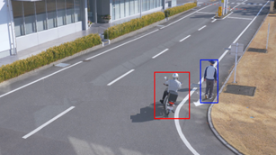
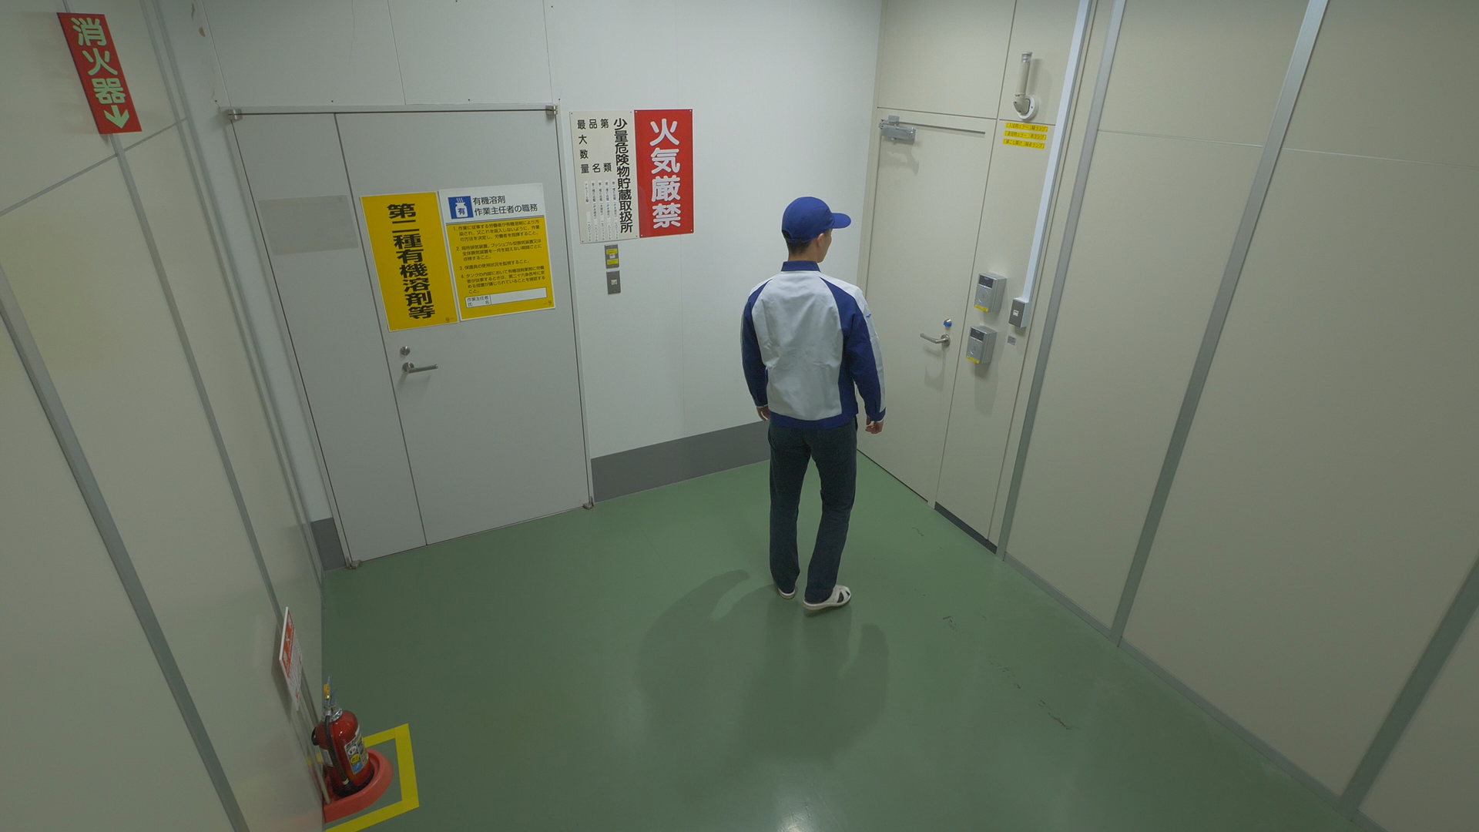
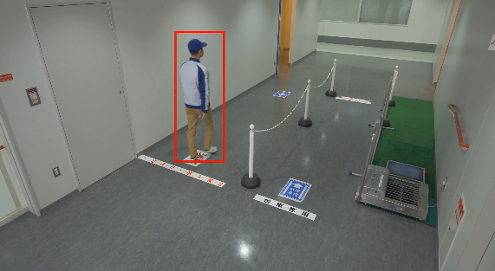
Overview of AI-VMD (2)
Sample images of each detection function
Intruder
Direction
Issues an alarm when a moving object enters the designated area.
Issues an alarm when a moving object enters the designated area and moves to the specified direction.
Loitering
Cross line
Issues an alarm when a moving object enters the designated area and stays there for a specified period.
Issues an alarm when an object moving to the specified direction crosses the designated line.

Slide 8
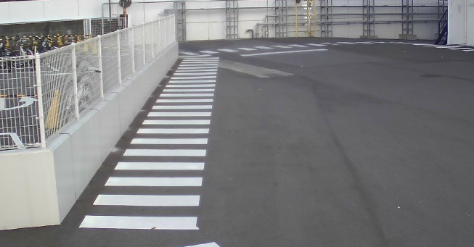


Overview of AI-VMD (3)
How AI-VMD detects motion
This page describes the outline of motion detection which is one of the detection functions of AI-VMD.
*The concept of AI-VMD is the same as i-VMD
A detection indicator will be displayed when detecting a moving object on the image.
Whether a moving object is inside of the detection area or not is determined by whether the center bottom of detection indicator is inside of the area or not.
The moving object is outside of detection area
The moving object is inside of detection area
Detection area
Detection area
Detection indicator
Detection indicator
●
●
Center bottom of the detection indicator is outside of detection area
Center bottom of the detection indicator is inside of the detection area
*Alarm will NOT be issued when a moving object is outside of detection area even if it is recognized as a detection object.
*Alarm will be issued when a moving object is inside of the detection area and is recognized as a detection object.

Slide 9
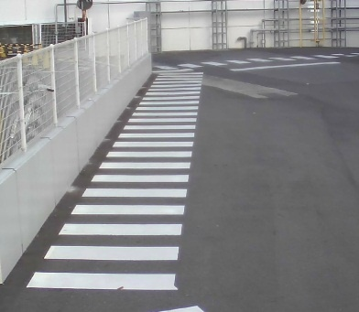


Reference : Detection Indicator
Detected
Mask area
NOT detected
Mask area
●
●
Detection area
Detection area
The size of a detected object is the size of the displayed detection frame.
Therefore, if the detection frame is expanded due to shadows and so on, the size of the object determined is being larger than the
actual size.
As long as the center bottom of the detection frame is in the detection area, the size of an object will be determined to be the same as the detection frame even in the case where the detection frame is partly on the mask area.
As long as the center bottom of the detection frame is in the detection area, a target object for detection will be detected even if the object is in the mask area. (as in the image on the left)
In case of a shadow extending toward the mask area, the moving object may not be detected. (as in the image on the right)

Slide 10





Overview of AI-VMD (4)
Behaviors in each area
Operation image
The behavior of alarm frames (blue frame/ red frame) and AI frame (green frame) differ depending on the area.
Operation in mask area
NOT detect
NOT alarm
Recognizes
The behaviors of AI-VMD in each area
Mask area
 | Detect (blue frame) | Alarm (red frame) | Recognize (green frame)
Mask area | - | - | Yes
Undefined | Yes | - | Yes
Detection area | Yes | Yes | Yes
Operation in undefined area
Detects
NOT alarm
Recognizes
Undefined
Detection area
Operation in detection area
Detects
Alarms
Recognizes
* AI-VMD checks an object with AI object detection information and issues an alarm when it is a detection object. (The frame turns from blue to red)
About “AI frame (green frame)”
displayed when AI frame is selected in [Additional information type] setting.
constantly displayed on an object detected by AI-VMD with or without motion.
intended to be used for operation check and adjustment when installing cameras.
- AI frame display hides alarm frames (blue frame/red frame). *Note that alarm notification is active.
- AI frame appears on all areas.

Slide 11
Reference : Condition for alarm generation
Under the following conditions, AI-VMD checks a moving object with “AI object detection information” and issues an alarm, when it is judged to be a detection object.
Mask area
Detection mode | Condition for alarm generation
Intruder | A moving object enters Undefined /Detection area and stays there longer than intruder detection time. (The frame turns from blue to red)
Loitering | A moving object enters Detection area and stays there longer than loitering detection time. (The frame turns from blue to red)
Direction | A moving object enters Detection area and keeps moving toward the designated direction for longer than direction detection time. (The frame turns from blue to red)
Cross line | A moving object crosses the detection line. (The frame turns from blue to red)
Undefined
Detection area
Mask area
Undefined
Detection line
B <- A

Slide 12
Preparation

Slide 13
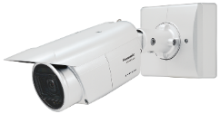

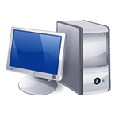
Preparation
Camera
System Configuration (Ex.)
1. Upgrade firmware
Upgrade your camera’s firmware to the latest version.
2. Install the extension software.
Install the extension software [WV-XAE200] on the camera.
3. Configure the network
Setup the network of your camera based on the operating system in use.
Camera
Extension software
WV-X1551LN
WV-XAE200W
*Refer to the instruction manuals of the camera in use.
  https://i-pro.com/global/en/surveillance/training-support/documentation-database-list
.ext
Network switch
*Refer to the instruction manuals of the extension software.
JPEG /H.265
Recording
Alarm notification
https://i-pro.com/global/en/surveillance/training-support/documentation-database-list
Recorder
Monitoring software
NX series
ASM300

Slide 14
Camera Installation

Slide 15
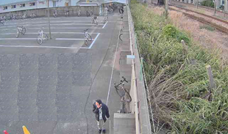
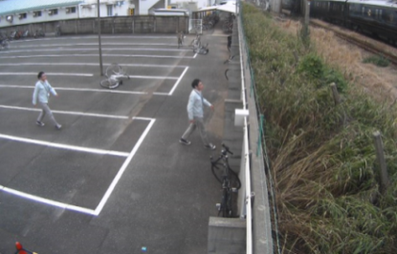
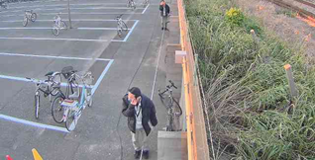


Basic information for installation
Guideline for installation
Item |  |  |  | Value
Mounting height |  |  |  | 3 m or more
Tilt angle |  |  |  | 10 - 45 °
Detection size (*1) | Pixel |  |  | 90 - 360 pix
 |  | Vertical angle of view ratio | 5MP model | 1/16 - 1/4
 |  |  | 4K model | 1/24 - 1/6
 | PPM | Human / Motorcycle or bicycle |  | 57 - 225 PPM
 |  | Vehicle |  | 45 - 180 PPM
Illuminance (*2) |  |  |  | 3 lx or more
Tilt angle
1/16
Camera
Vertical angle of view
Downward angle relative to the horizontal plane
1/4
Sample image of detection size
(5MP model)
(*1) Confirmation on site is needed as it differs depending on the environment.
(*2) The effective detection distance between the camera and a subject is 10m
as a guide regardless of the model, when built-in IR-LED is ON.
1. Recommended
2. Not recommended
Camera direction
We recommend mounting the camera so that the people captured move across the angle of view.
1. Crosswise direction (Recommended)
The motion amount of an object on the image is large enough
2. Lengthwise direction (Not recommended)
The motion amount of an object on the image is small
2
1
Intrusion routes

Slide 16


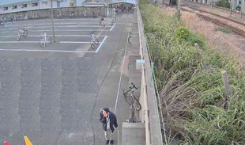
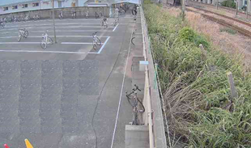
Reference : Guideline for detection area setting (5MP model)
Detection accuracy will be improved by setting the detection area within the “Recommended area” as below.
Recommended area
The height of a detection object is 1/4 – 1/16 of vertical angle of view
Detectable area
The area found to be detectable as a result of operation check.*
The height of a detection object is 1/16 – 1/20 of vertical angle of view.
Recommended area
Detectable area
*Confirmation on site is needed as it differs depending on the environment.
- 1/4 of vertical angle of view
- Horizontal angle of view=11m
- 1/16 of vertical angle of view
- Horizontal angle of view=45m
- 1/20 of vertical angle of view
- Horizontal angle of view=57m
Camera installation example
Distance between camera and object: approx. 6.5m
Distance between camera and object: approx. 27m
Mounting height | 3.5m
Vertical / horizontal angle of view | 43/80°
Tilt angle | 20°
Object height | 1.6m
1/16
1/4

Slide 17
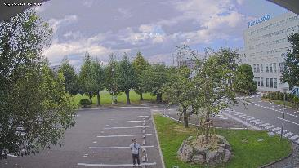
Reference : Guideline for detection area setting (4K model)
Detection accuracy will be improved by setting the detection area within the “Recommended area” as below.
Recommended area
The height of a detection object is 1/6 – 1/24 of vertical angle of view
Detectable area
The area found to be detectable as a result of operation check.*
The height of a detection object is 1/24 – 1/30 of vertical angle of view.
Recommended area
Detectable area
*Confirmation on site is needed as it differs depending on the environment.
- 1/6 of vertical angle of view
- Horizontal angle of view=17m
- 1/24 of vertical angle of view
- Horizontal angle of view=68m
- 1/30 of vertical angle of view
- Horizontal angle of view=85m
Camera installation example
Distance between camera and object: approx. 7.5m
Mounting height | 4.6m
Vertical / horizontal angle of view | 43/80°
Tilt angle | 10°
Object height | 1.6m
1/6

Slide 18
Configuration of Detection Function

Slide 19
Setup flow
Configure AI-VMD following the steps below.
Open the setup screen
Open the setup screen of AI-VMD
Area setting
Set the detection area and detection conditions for detecting moving objects using AI-VMD
Image quality setting
Set the parameters of AI-VMD image quality setting
Detailed setting
Set the detection sensitivity, detection time and the size of detection target for AI-VMD
Schedule setting
Set the operation schedule of AI-VMD
Required
Alarm setting
Optional
Set the operations linked with AI-VMD alarm

Slide 20
Open the setup screen
Once you install the software of AI-VMD, [AI-VMD] menu will be added on [Setup]> [-Ext. software]> [Software mng.] in the camera setting menu.
Open the setup screen
Clicking on the [AI-VMD] menu or the [Setup >>] button opens “AI-VMD setup menu”
Area setting
Image quality setting
Detailed setting
Schedule setting
AI-VMD setup menu
Alarm setting

Slide 21
Area setting
Set the detection area and detection conditions to detect moving objects using AI-VMD
Open the setup screen
Up to 2 detection programs with the combinations of detection area and detection condition can be set as "Detection program 1" and "Detection program 2"
Area setting
Up to 8 detection areas and 8 mask areas can be set respectively for each detection program
Select the object to be detected from “Human”, “Vehicle” and Bicycle”
Image quality setting
Detailed setting
Select a detection mode from “Intruder”, “Loitering”, “Direction” and “Cross line”.
Schedule setting
Alarm setting

Slide 22
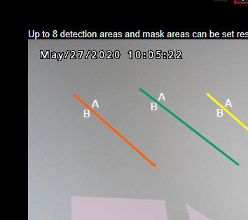
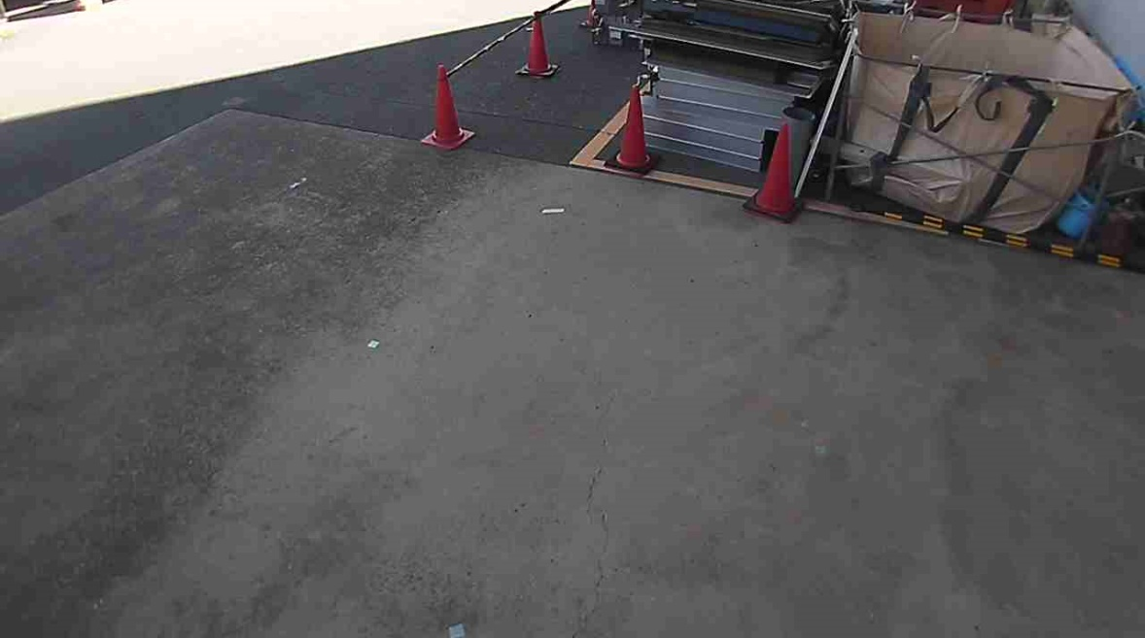
Area setting｜Set the detection area
Configure the area for detecting moving objects using AI-VMD (detection line in case of “Cross line”).
Note: Basically, mask area setting is unnecessary.
Set the mask area depending on the usage environment as an additional setting as needed.
Further reduction on false positives / false negatives is possible.
Open the setup screen
Area setting
Generate an alarm when a moving object is detected within the detection area designated by painting or when the moving object crosses the designated detection line.
Image quality setting
Detailed setting
To start painting, select a painting method from [Detection area(Polygon)] or [CROSS LINE] in [Paint type] and paint on [Camera video screen] by dragging mouse.
Note: As a default, the entire area is designated as “Detection area 1” just after installing AI-VMD.
Schedule setting
●
Detection area
Alarm setting

Slide 23
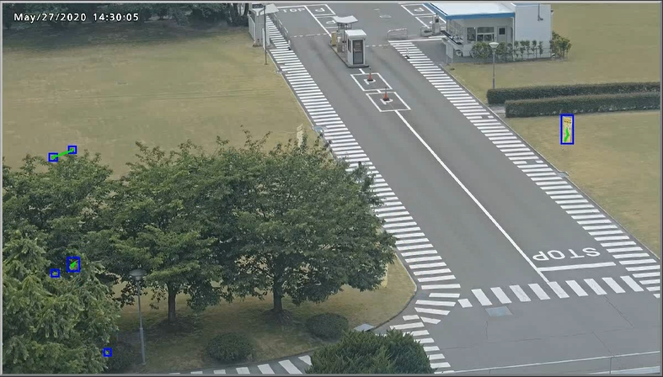
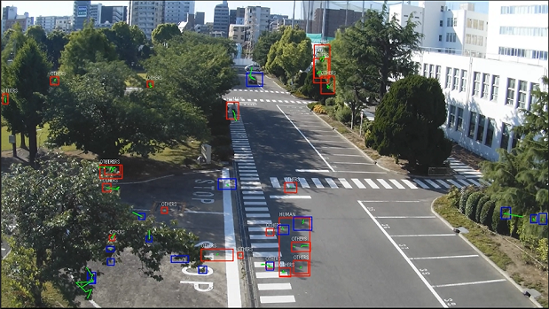
Area setting｜Set the mask area
Reduction on false positives / false negatives is possible in the following scenes by setting mask areas.
Open the setup screen
Sample scene of false positive reduction
If a flag on which a human figure is described flutters, a false positive can be issued.
For preventing such case, designating a mask area to cover the appropriate area can reduce false positive generation.
Sample scene of false negative reduction
As the maximum number of moving objects that can be detected is 40, the number of objects detected can temporary exceed the maximum number when there are multiple moving objects (such as shaking trees) outside of the detection area. This can result in false negatives inside of the detection area.
For preventing such case, designating a mask area to cover the appropriate area can reduce false negatives.
Area setting
Image quality setting
Flag fluttering can cause a false positive
Mask area
Detailed setting
Mask area
Generating many alarm frames by detecting shaking trees can result in false negatives in the detection area.
Schedule setting
●
Detection area
●
Detection area
Alarm setting
Undefined area
Undefined area

Slide 24
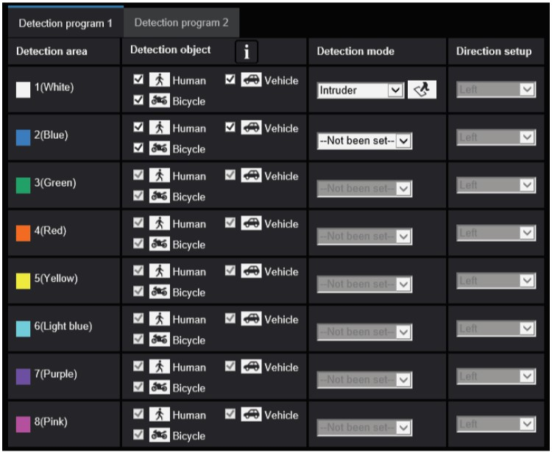
Area setting｜Set the detection conditions
Select the detection object and detection mode for AI-VMD.
Open the setup screen
2 detection conditions can be configured using [Detection program 1] or [Detection program 2]. These 2 detection conditions can be performed together or separately by setting schedule.
Select the detection mode for each detection area or detection line.
Detection mode
- Intruder
- Loitering
- Direction
- Cross line
Note: As a default, intruder is selected for [Detection area 1] just after the AI-VMD installation.
Setting change is needed for using the mode other than Intruder.
Area setting
Image quality setting
Check the object to be detected.
Detection object
- Human
- Bicycle (motorcycle and bicycle)
- Vehicle (car, bus and truck)
Note: When multiple detection objects are candidates for an object, the name of the detection object will be displayed in the priority sequence of vehicles, bicycles and humans.
Detailed setting
Select the direction to be detected when [Cross line] is selected for detection mode.
Schedule setting
Alarm setting

Slide 25
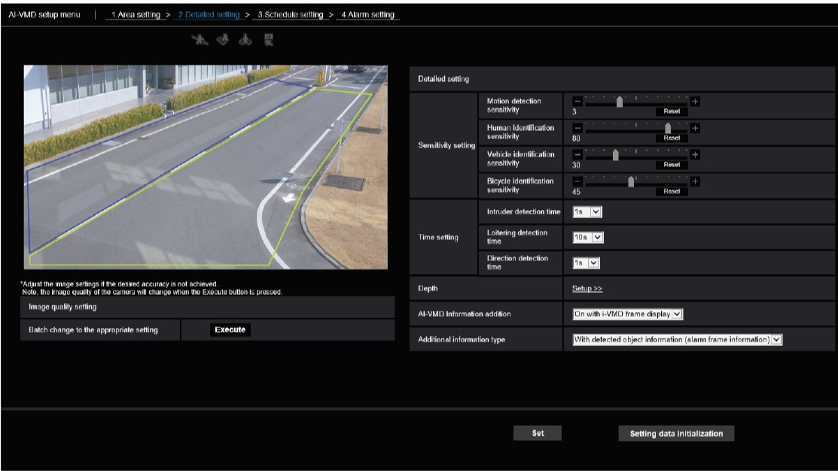
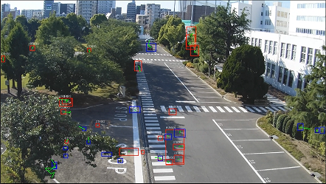
Image quality setting
Set the parameters of AI-VMD image quality setting
Open the setup screen
Batch change to the appropriate setting
Clicking on the [Execute] button changes the parameters of AI-VMD image quality setting in bulk.
Note: Try this setting change if the recognition accuracy is lower than expectations.
Area setting
Image quality setting
Detailed setting
Schedule setting
Important
- Note that if a value larger than "Max. 1/30 s" is selected for [Maximum shutter] on the [Setup]> [Image/Audio]> [Image quality]> [Image adjust], the detection accuracy may deteriorate.
Alarm setting

Slide 26
Image quality setting｜Adjust the image quality
Adjust the parameters of AI-VMD image quality setting
Note: Basically, image quality adjustment is unnecessary.
If the detection accuracy is lower than expectations, adjust the image quality from the following viewpoints.
Open the setup screen
Area setting
Clicking the [Execute] button in [Batch change to the appropriate setting] automatically sets the image quality parameters related to AI-VMD in bulk.
Items changed in bulk
Super Dynamic: Off
Light control speed: 8
White balance adjusting speed: 8
Bulk configuration of image quality
Image quality setting
Digital noise reduction: 128
Intelligent Auto: Off
Auto contrast adjust: Off
Detailed setting
The entire image can become dark and the detection accuracy may decrease if there is strong light at night such as headlight or street lamp.
The image brightness can be adjusted by setting mask areas on the bright areas.
Set mask areas for brightness adjustment
(countermeasure against strong light)
Schedule setting
Focus adjustment
Detection accuracy may decrease due to out-of-focus blur.
Correcting focus will improve the detection accuracy.
Alarm setting

Slide 27
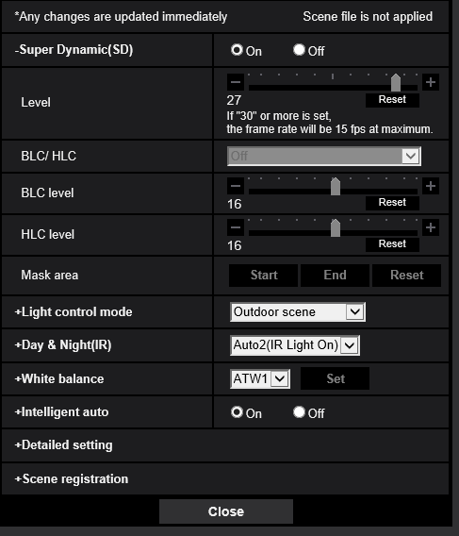
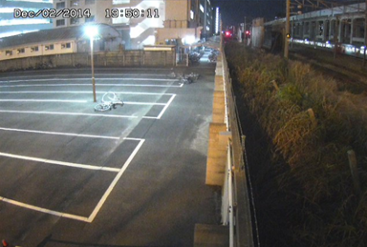
Image quality setting｜Set mask areas for brightness adjustment
Set mask areas for brightness adjustment (countermeasure against strong light)
Open the setup screen
The entire image can become dark and the detection accuracy may deteriorate if there is strong light at night such as headlight or street lamp.
The image brightness can be adjusted by setting mask areas on the bright areas with strong light.
Area setting
How to setup
Image/Audio Image quality Image adjust Super Dynamic: Off Click the [Start] button in “Mask area”
Image quality setting
Street lights
Detailed setting
Schedule setting
Alarm setting

Slide 28
Image quality setting ｜Adjust the focus
Focus adjustment
Open the setup screen
As out-of-focus blur can result in the decrease in detection accuracy, adjust the focus referring to the followings.
Focus adjustment during night-time when the illuminance is low is recommended as the appropriate focus position varies depending on the illuminance.
Refer to the instruction manuals for the lens in use as adjusting method varies depending on the type of lens.
Use auto-focus function referring to the instruction manuals for the camera in use.
Check the description on Day & Night setting on the next page.
When the image is switched from color to black and white under low illuminance, the focus may move due to
the optical characteristics.
Area setting
Image quality setting
Detailed setting
Schedule setting
Alarm setting

Slide 29
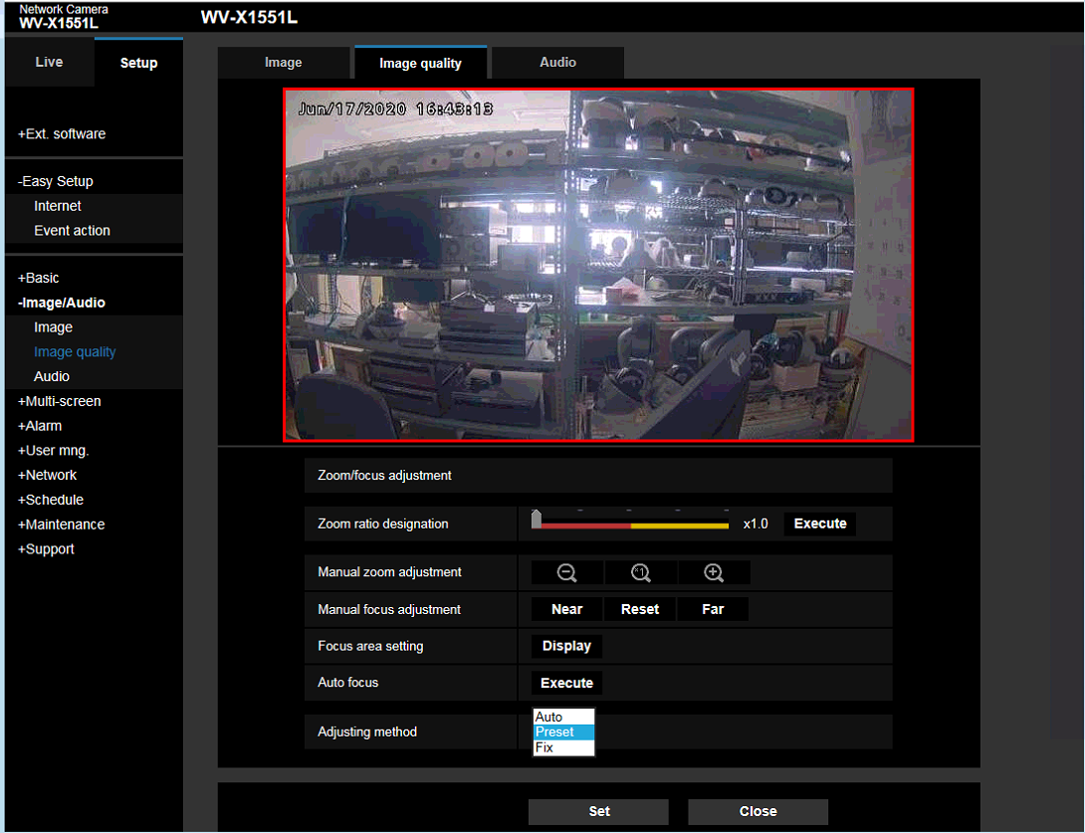
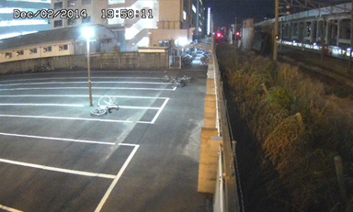
Reference : Day & Night setting
When the image is switched from color to black and white under low illuminance, the focus may move due to the optical characteristics.
In this case, select [Auto] or [Preset] for [Day & Night(IR)], which enables auto-focus adjustment. (Once the focus is corrected, the focus will not be adjusted automatically according to the illumination level change.)
Preset setting
In order to shorten the invalid period of AI-VMD operation, we recommend selecting [Preset] in [Adjusting method].
How to setup
Image/Audio Image quality Zoom/Focus adjustment
Adjusting method Select [Preset] in the drop-down menu.
The focus position set in Color or Black & White mode the last time is automatically memorized as the preset position.
Set the preset position both in Color mode and Black & White mode at night makes it easier to adjust to the appropriate focus position.
Remarks
AI-VMD is disabled during Auto-focus operation (manual operation / black & white switching).
Re-learning after camera control
Re-learning is required as the image changes greatly after the camera control. Avoid capturing moving objects as much as possible for about 3 minutes until learning finishes.

Slide 30
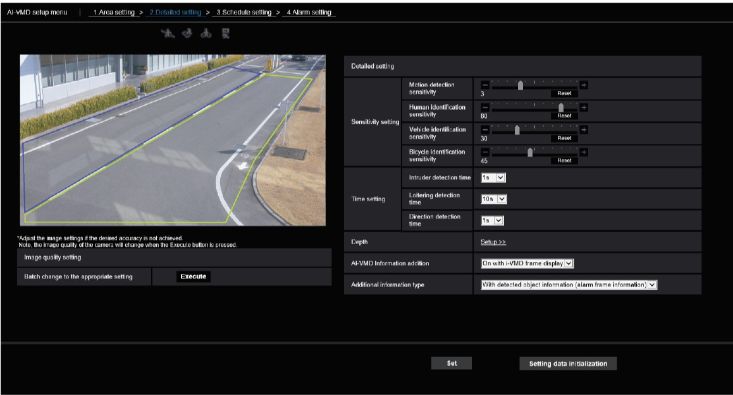
Detailed setting
Set the detection sensitivity, detection time and the size of detection target for AI-VMD.
Open the setup screen
Sensitivity setting
Set the sensitivity of AI-VMD.
This setting is common to all the detection conditions.
Area setting
Time setting
Set the time from detecting an object to issuing an alarm.
Image quality setting
Depth
Set the detection depth.
This setting is common to all the detection conditions. Clicking [Setup >>] displays the [Depth setting] menu.
Detailed setting
Schedule setting
AI-VMD information addition
Determine whether to attach the AI-VMD information to images, and whether to display the frame and track on the live images in web browser.
Note: AI-VMD information can be recorded in NX series recorders. Selecting “On” for maintenance efficiency is recommended.
Additional information type
Set the type of AI-VMD information added to image data.
AI-VMD information
- Alarm frame (blue frame/ red frame)
- AI frame (green frame)
Alarm setting

Slide 31
Detailed setting｜Adjust the detection accuracy
Adjust the detection accuracy of AI-VMD
Note: Basically, sensitivity setting and depth setting are unnecessary.
If the detection accuracy is lower than expectations, adjust those settings from the following viewpoints.
Open the setup screen
Area setting
[False positive] AI-VMD may detect animals by mistake.
[False negative] Detection may not work properly when the difference in brightness between the background and the moving object is small.
Detection accuracy can be improved by adjusting detection sensitivity.
Detection sensitivity adjustment
Image quality setting
By setting depth, AI-VMD can exclude the object which has been detected as “Human” but obviously not the size of “Human” from the target for alarm.
Detailed setting
Depth setting
Schedule setting
Alarm setting

Slide 32
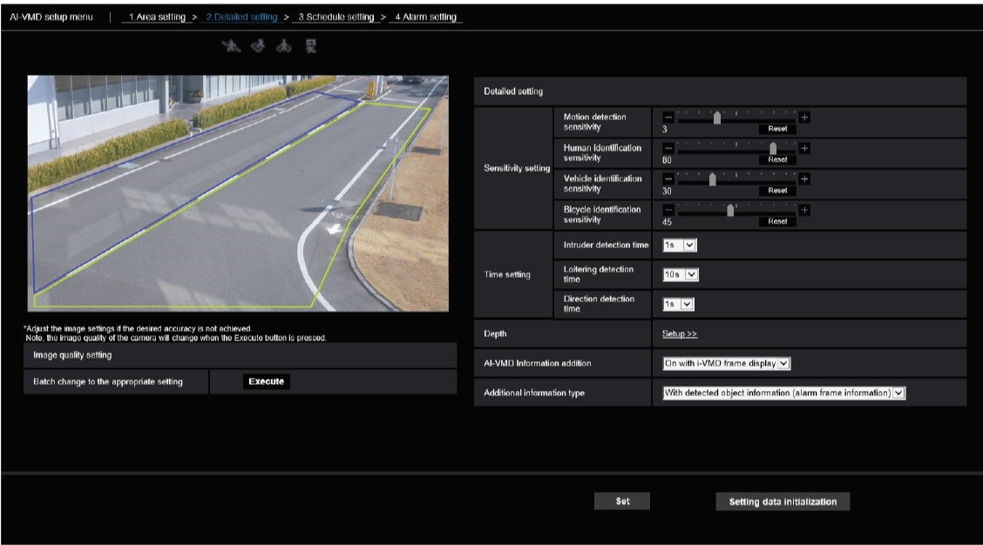
Detailed setting｜Set the detection sensitivity
Motion detection sensitivity
Set the sensitivity for the object motion to be detected.
Although the greater the value is, the higher the detection sensitivity becomes, the occurrence rate of false detection increases.
Note: The greater the value is, the more blue frames appear.
Set the detection sensitivity of AI-VMD.
Open the setup screen
Human, vehicle and bicycle identification sensitivity
Set the sensitivity for the identification of each object: human, vehicle and bicycle.
Although the greater the value is, the higher the sensitivity for the identification of objects becomes, the occurrence rate of false identification increases.
Note: The greater the value is, the more false positives can be issued.
Area setting
Image quality setting
When adjusting the detection sensitivity/ identification sensitivity, set the [AI-VMD information addition] to “On with AI-VMD frame display”.
Detailed setting
When adjusting detection sensitivity;
Set the [Additional information type] to “With detection object information (alarm frame information)”.
When adjusting identification sensitivity;
Set the [Additional information type] to “With detection object information (AI frame information)”.
Schedule setting
Either alarm frames(blue / red) or AI frames(green) will be displayed depending on the setting in [Additional information type].
For reducing false positives
Check if target objects for detection are identified correctly while displaying AI frames.
If they are not identified correctly, adjust the identification sensitivity of the object identified incorrectly by lowering the value.
For reducing false negatives
- Check if target objects for detection are identified with green frames while displaying AI frames. If the identification does not seem to be working well, adjust the identification sensitivity of the target object by increasing the value.
- Check if targets objects are detected with blue frames while displaying alarm frames.
If the detection does not seem to be working well, adjust the motion detection sensitivity by increasing the value.
Alarm setting

Slide 33
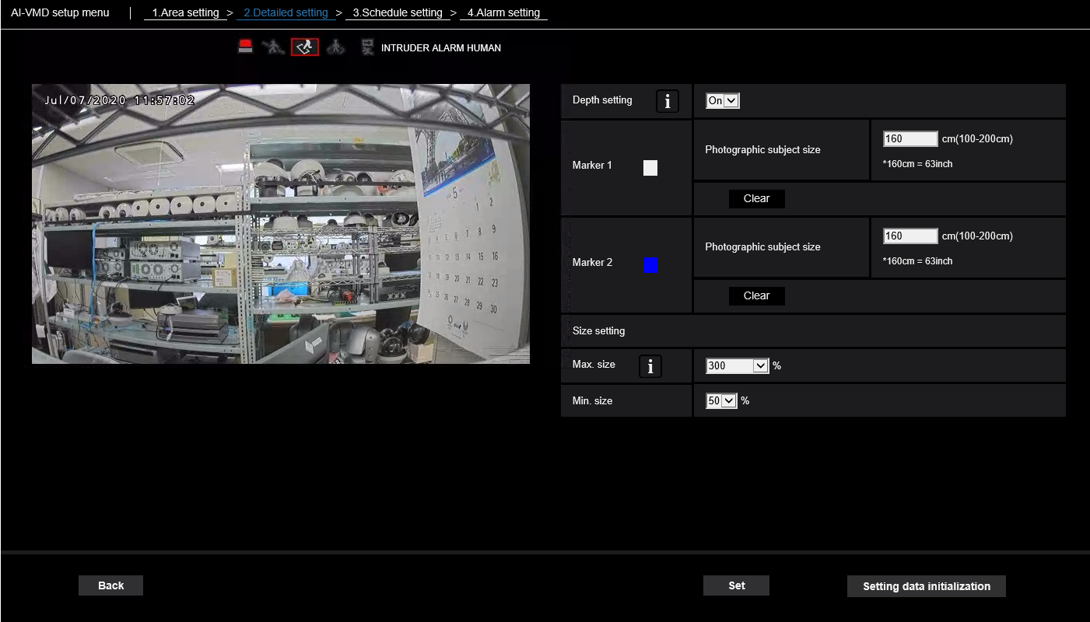
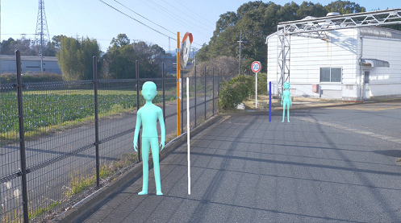
Detailed setting ｜Set the depth
Set the depth for AI-VMD.
Open the setup screen
Depth setting
Select “On” for [Depth setting].
Marker setting
Draw 2 markers (Marker 1 and Marker 2) on the drawing area. And then, enter sizes in [Photographic subject size] of both Marker 1 and Marker 2.
Note: Draw markers at two points in the drawing area; one on the near side and the other in the far side. If those two markers are close to each other, the depth information may not be set correctly.
Area setting
Image quality setting
Detailed setting
Size setting
Alarm will be issued only to the human detected in the range of maximum size ratio to minimum size ratio.
Note: Operating with default setting is recommended.
Schedule setting
* By setting depth, AI-VMD can exclude the object which has been detected as “Human” but obviously not the size of “Human” from the target for alarm.
* Depth setting works only for “Human” and is not applied to “Vehicle” and “Bicycle”.
Alarm setting

Slide 34

Schedule setting
Set the operation schedule of AI-VMD.
Open the setup screen
Operating day of week
Select the day of week to activate AI-VMD.
Select the day of week to activate AI-VMD on both “Time table 1” and “Time table 2”.
AI-VMD does not operate on the day of week with “Off” selected.
Area setting
Time table
Set the time to activate AI-VMD and the operation content(detection setting).
Up to 6 operation time can be set respectively for [Time table 1] and [Time table 2].
Image quality setting
Detailed setting
Schedule setting
* As a default setting, 24-hour operation is registered for “Detection program 1” and “Detection program 2”.
* The schedules for “Detection program 1” and “Detection program 2” can be set (operate) overlapped.
Alarm setting

Slide 35
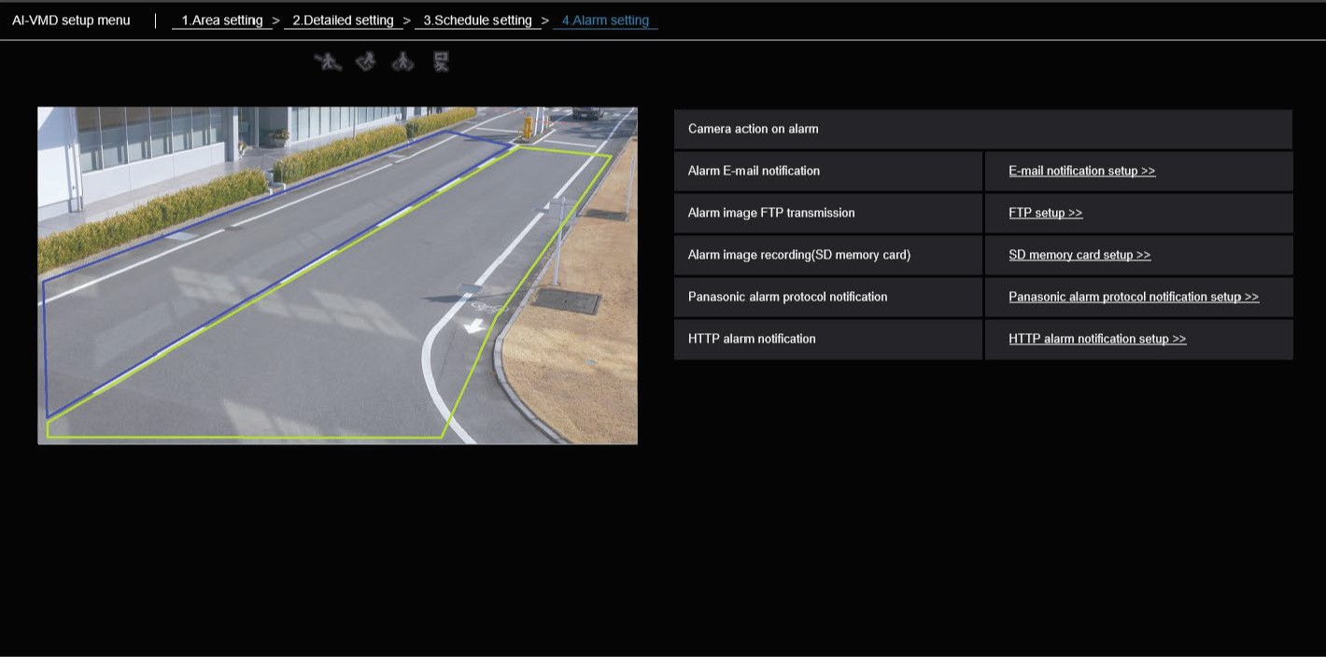
Alarm setting
Set the operations linked with AI-VMD alarm.
Alarm E-mail notification
Clicking “E-mail notification setup >>] displays a setting screen related to the e-mail when an alarm occurs as a new window.
Open the setup screen
Alarm image FTP transmission
Clicking “FTP setup >>” displays a setting screen related to FTP transmission when an alarm occurs as a new window.
Area setting
Alarm image recording(SD memory card)
Clicking “SD memory card setup >>” displays a setting screen related to SD memory card recording when an alarm occurs as a new window.
Image quality setting
TCP alarm protocol notification
Clicking “TCP alarm protocol notification setup >>” displays a setting screen related to TCP alarm protocol notification when an alarm occurs as a new window.
Detailed setting
Schedule setting
HTTP alarm notification
Clicking “HTTP alarm notification setup >>” displays a setting screen related to HTTP alarm notification when an alarm occurs as a new window.
* For linking with NX recorders or WV-ASM300, TCP alarm protocol notification needs to be configured.
Alarm setting

Slide 36
Operation Check

Slide 37
Reference : Sample operation check on intruder detection
Prior confirmation
Time synchronization
Synchronize the time of the camera, NX recorder and WV-ASM300
Alarm log recording setting
Collecting alarm logs from WV-ASM300 is recommended
(The maximum number of logs from WV-ASM300 is tens of thousands and the ones from NX recorders is thousand.)
Operation check
Test classification | Items to check | Checklist | Human motion
On-site confirmation | Crosswise direction | Confirm the true positive alarm occurrence in near side / middle / far side (ex. 10/ 15/ 20m) of detection area. | Cross alone
 | Lengthwise direction | Confirm the true positive alarm occurrence by moving from the near side to the far side. | Walk alone
 |  |  | Walk 3 abreast
 |  | Confirm the true positive alarm occurrence by moving from the far side to the near side. | Walk alone
 |  |  | Walk 3 abreast
 | Detection area boundary | Confirm the true positive alarm occurrence by walking on the boundary of detection area. Confirm that a false positive alarm does not occur due to the shadows of people walking near the boundary. | Walk alone
1-week test operation | False positive alarm | Confirm the false positive alarm occurrence caused by the environmental changes such as brightness at night, lighting fluctuations, headlights and the change in the weather. | -

Slide 38
Maintenance

Slide 39
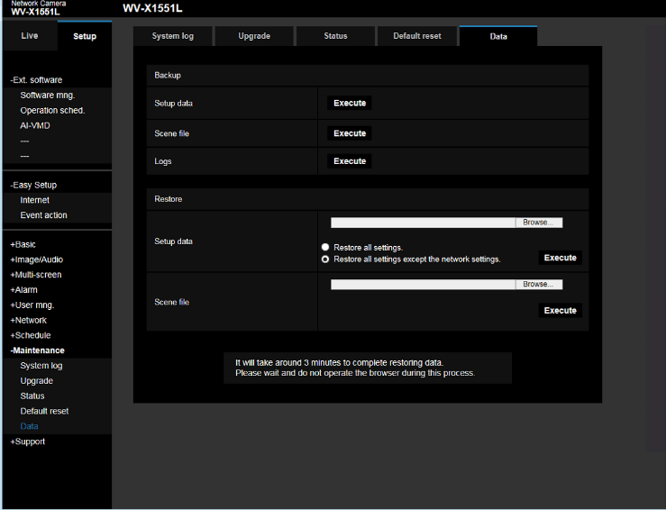
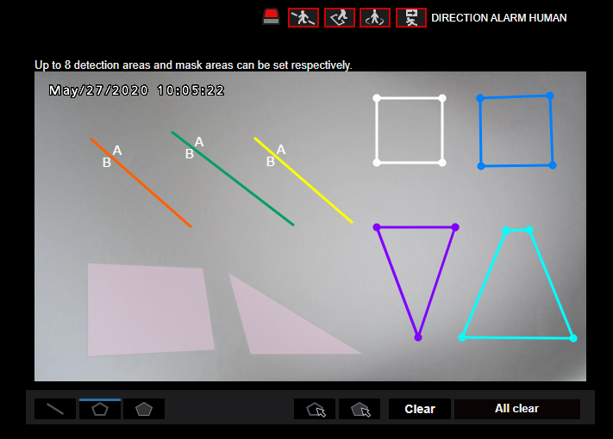
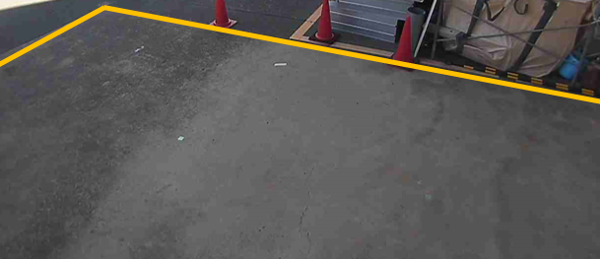
Maintenance
We recommend saving the setting data for repair and maintenance
Back up the configuration data
Setup
Maintenance
Data
Generate a file by executing backing up the setting data.
Capture the images of Detection areas and Mask areas
Setup
Extension software
AI-VMD
Capture each setting screen using the functions of your PC

Slide 40
Points of Attention

Slide 41
Points of attention
Factors that affect accuracy
The environmental factors below can affect the detection accuracy.
Lighting conditions
Subject conditions
The difference in brightness between the background and the moving object is small
Luminance level of image is too low (During nighttime, etc.)
The luminance level of the shooting area is subject to change (outdoors, by the window, etc.)
Outside light such as sunlight and headlight enters the shooting area.
Fluorescent light is flickering
Reflected light from a puddle or glass come into the shooting area
The object is moving too fast or too slow
The object is too small or too large
The object is moving straight toward the camera
There are too many moving objects in the shooting area
Multiple target objects (human, vehicle, bicycle) are coming and going
Shadows interfere in the detection area.
An insect or an animal is captured as a subject
Environmental conditions
The camera is shaking
The weather is extremely bad
The dome of the camera is sweating or has dirt on it
Flags or vinyl and so forth are fluttering in the wind

Slide 42
Points of attention
Other precautions
If there are factors for false detection on the image such as trees shaking, roads (with moving cars), water surfaces(with reflected light), etc., you can set mask areas to reduce false detections.
When setting up AI-VMD, configure the area setting so that it suits the installation condition of the camera and the expected movement of photographic subjects, and then check if the camera operates appropriately during the daytime and night.
False detection may occur for about 1 minute after turning on the camera, changing the camera settings or changing the angle of view of the camera.
As long as detection objects exist in the detection area, an alarm occurs at specified intervals. Thus, e-mails and TCP alarm protocols are also notified at specified intervals.

Slide 43
Appendix

Slide 44
Procedure for Alarm Linkage Setting

Slide 45
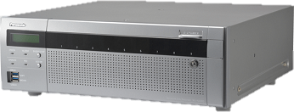
Setup flow
Camera Settings
To perform event recording on the recorder or pop-up alarm notification on WV-ASM300 triggered by AI-VMD, configure the alarm linkage in the following order: 1. Camera, 2. NX series recorder and 3. WV-ASM300.
(1)
TCP alarm
Recorder Settings
System Configuration (Ex.)
Site alarm
Recorder
Extension software
Camera
NX series
(2)
Schedule
(2)
WV-XAE200W
WV-X1551LN
.ext
192.168.0.250
Recording
192.168.0.21
Alarm notification
Monitoring software
TCP alarm
(1)
ASM300
(3)
ASM300 Settings
(3)
Alarm reception
192.168.0.200

Slide 46
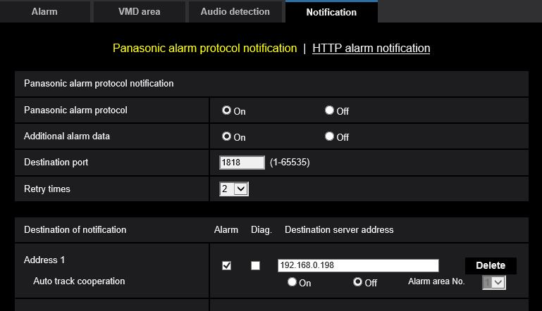
Camera Settings | TCP alarm
Setup > Alarm > Notification > TCP alarm protocol notification
Camera Settings
TCP alarm
Recorder Settings
Set [TCP alarm protocol] to “On”
Site alarm
Schedule
Recording
Tick “Alarm” and input IP address of NVR
TCP alarm
ASM300 Settings
192.168.0.250
Alarm reception

Slide 47
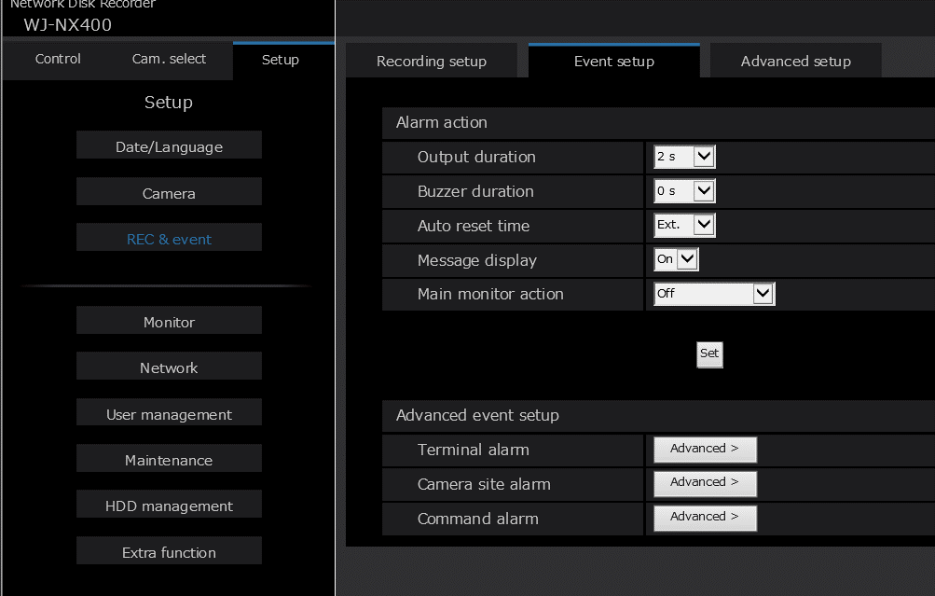
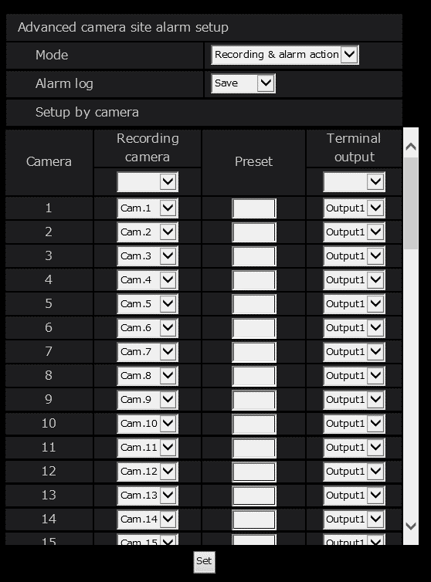
Recorder Settings | Site alarm
Setup > REC & event > Event setup > Camera site alarm
Camera Settings
TCP alarm
Set the [Mode] option to “Recording & alarm action”
Recorder Settings
Site alarm
Schedule
Recording
TCP alarm
ASM300 Settings
Alarm reception

Slide 48
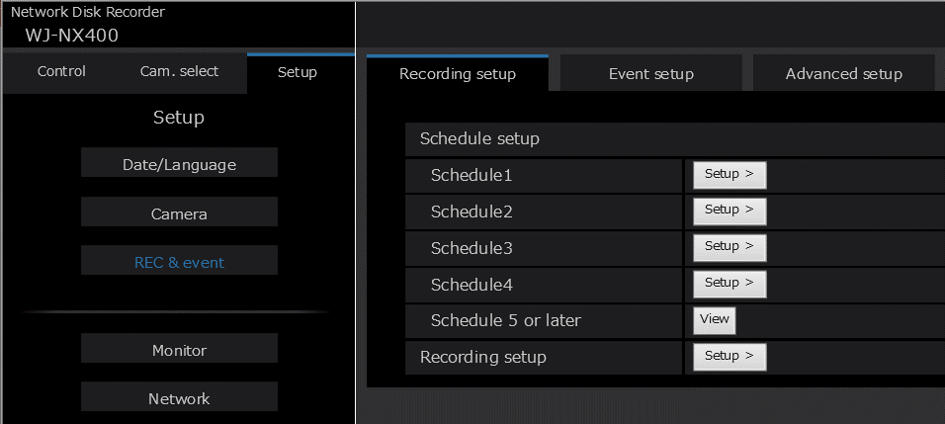
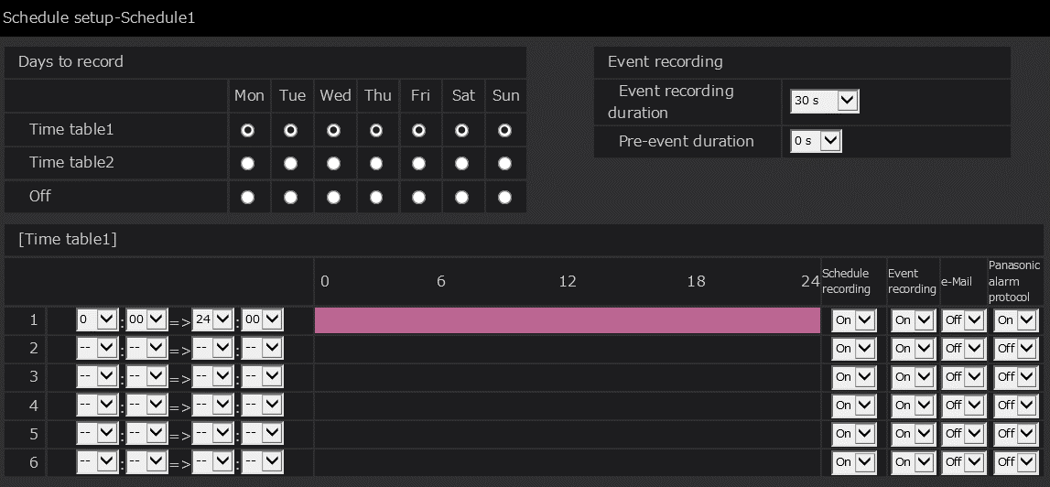
Recorder Settings | Schedule
Setup > REC & event > Recording setup > Schedule
Camera Settings
TCP alarm
Recorder Settings
Site alarm
Schedule
Recording
Set [TCP alarm protocol] to “On”
TCP alarm
ASM300 Settings
Set [Event recording] to “On”
Alarm reception

Slide 49
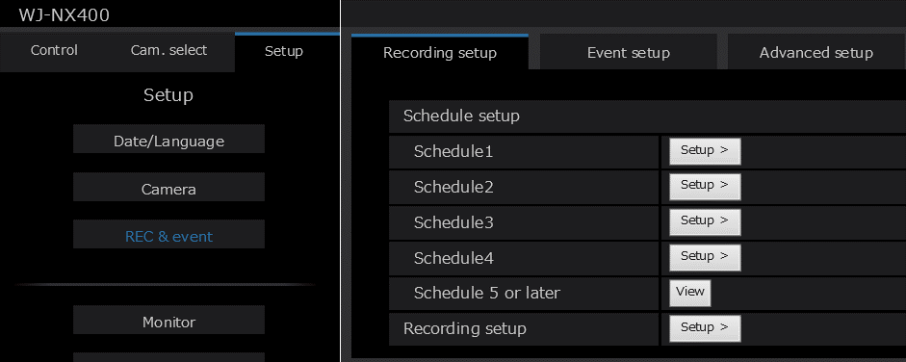
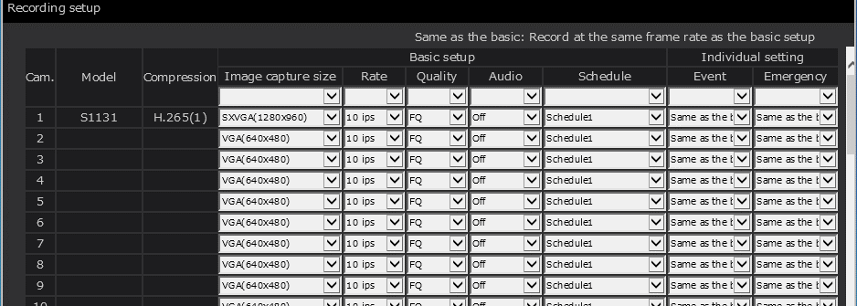
Recorder Settings | Recording
Setup > REC & event > Recording setup
Camera Settings
TCP alarm
Recorder Settings
Site alarm
Schedule
Recording
TCP alarm
Set proper schedule to target cameras
ASM300 Settings
Alarm reception

Slide 50
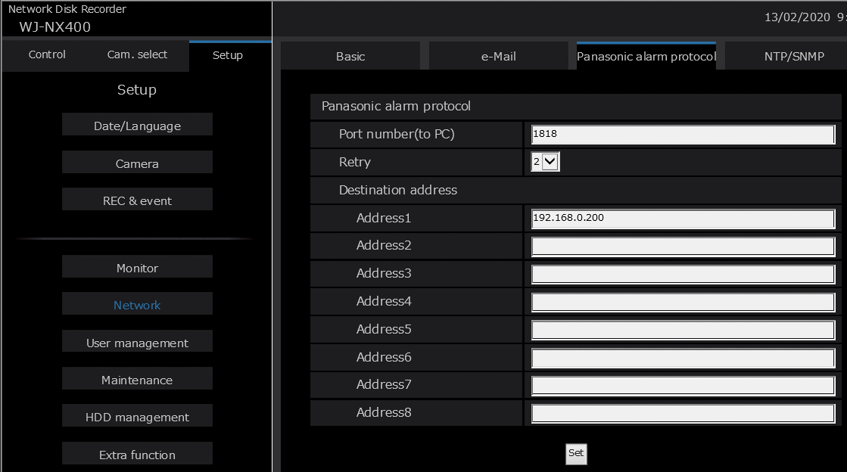
Recorder Settings | TCP alarm
Setup > Network > TCP alarm protocol
Camera Settings
TCP alarm
Recorder Settings
Site alarm
Schedule
Type ASM300 IP Address here.
This is Alarm destination.
Recording
TCP alarm
ASM300 Settings
Alarm reception

Slide 51
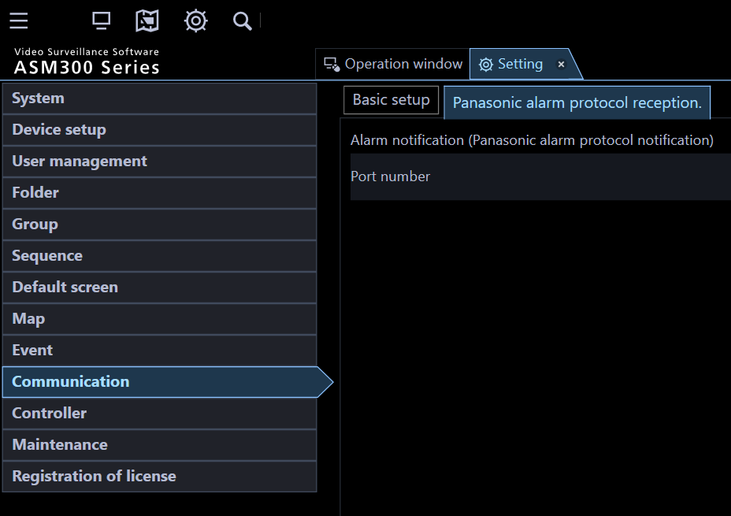
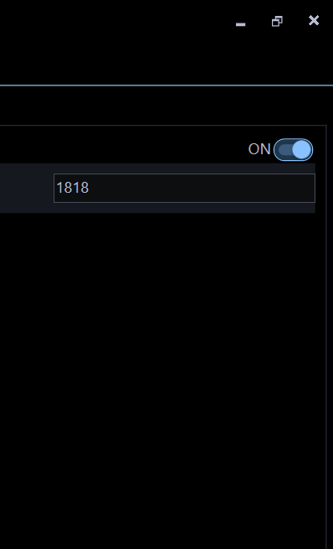
ASM300 Settings | Alarm reception
Setting > Communication > TCP alarm protocol reception
Camera Settings
TCP alarm
Recorder Settings
Site alarm
Set [Alarm notification (TCP alarm protocol notification)} to “ON”
Schedule
Recording
TCP alarm
ASM300 Settings
Alarm reception

Slide 52
Reference : Security setting
TCP alarm protocol always uses the 1818 TCP port.
When some security settings are enabled, this TCP port might be closed.
[Example of security setting]
-Windows fire wall
-PC security software
-Network security (Router, Proxy server)
In these cases, please change the security setting as necessary.
If this TCP port is used by another application, the alarm and error pop-up message will not display on the screen of ASM300 software.

Slide 53
AI-VMD with external IR illuminator

Slide 54
AI-VMD with external IR illuminator
Illumination distance of embedded IR-LED is 40M or 30M(*), but the recommended distance from camera to object for AI-VMD is up to 10M with embedded IR-LED
(*) 40M: WV-X1551LN, WV-X2551LN, WV-X1571LN, WV-X2571LN 30M: WV-X2251L, WV-X2271L
Based on simple internal test result under certain condition (please refer next page onwards), the recommended distance for AI-VMD should be extended to 40M or more at 3x zoom viewing angle with external IR illuminator which has higher illumination power than embedded IR-LED.

Slide 55
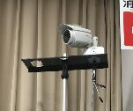
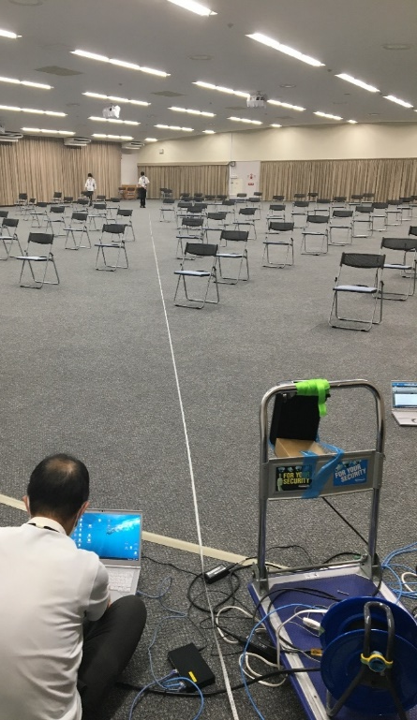
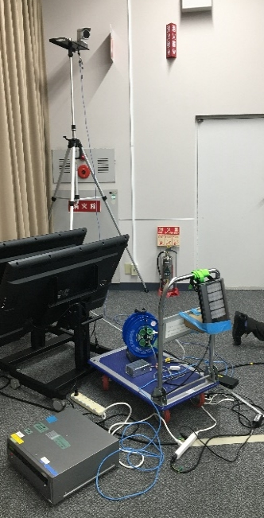
Simple internal test condition
Environment
Indoor (3F hall at P3 building in Fukuoka office)
0.02 Lux (Closed the curtain & turned off the lights in the hall)
Equipment
Camera : WV-X1551LN
External IR illuminator: Raytec VAR2-i16-1
https://www.rayteccctv.com/downloads/1481551691VARIO2_i16_-1_Infra-Red_Datasheet.pdf
Camera installation: 2.5M height
External IR installation: 0.8M height
WV-X1551LN
External IR
Simple installation

Slide 56
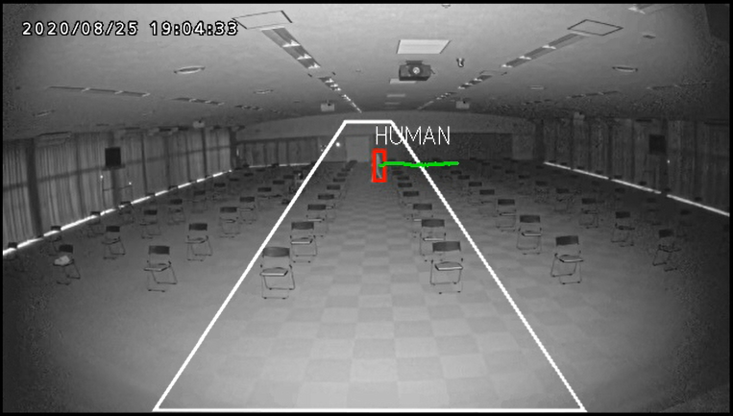


Test result
x1 viewing angle with Embedded IR
x1 viewing angle with External IR
x3 viewing angle with External IR

Slide 57
Test result
The recommended distance for AI-VMD should be extended to 40M or more at 3x zoom viewing angle with external IR-LED which has higher illumination power than embedded IR-LED.
Recommended
object movement
NOT recommended
object movement
Camera’s zoom ratio | IR illuminator | Move right <-> left to camera | Move straight to camera | Remarks
x1 | Embedded | 20.5M | 14.4M | Recommended up to 10M
 | External | 26.5M | 18.4M | -
X3 | External | 40.0M(*) | - | (*)Max diagonal distance in the hall
Move right <-> left to cam
Move straight to cam

Slide 58
Improve AI-VMD detection accuracy

Slide 59

Overview
*1
*2
*1 it is necessary to upgrade camera version (V1.50).
*2 The percentages above is a comparison result based on PIPS's original evaluation video assuming the actual environment.
(shaking of plants / animals / light and shadow / rain / fluctuation in lighting, etc.).

Slide 60

Improvement scene

Slide 61

Improvement scene

Slide 62

Improvement scene

Slide 63
Version History

Slide 64
Version History
No | Update contents | Page No. | Version | Update
- | 1st Version |  | 1.00 | 10.Jul.2020
1 | Added “Procedure for Alarm Linkage Setting” to appendix | P.43 - P.52 | 1.01 | 21.Jul.2020
2 | Changed “Accurate alarm” to “True positive” Changed “Alarm failure” to “True negative” Changed “False alarm” to “False positive” | P.5, P.22, P.23, P.31, P.32, P.37 | 1.01 | 29.Jul.2020
3 | Corrected the maximum value of detection size Corrected the value of horizontal angle of view and distance between camera and object in case of detection size = 1/4 of vertical angle of view | P.15, P.16 | 1.02 | 27.Aug.2020
4 | Corrected "True negative" to "False negative" | P.5, P.22, P.23, P.31, P.32 | 1.03 | 4.Sep.2020
5 | Added and modified “Guideline for installation” height / detection size | P.15 | 1.10 | 2.Oct.2020
6 | Added "Guideline for detection area setting" of 4K model | P.17 | 1.10 | 2.Oct.2020
7 | Added about effective detection distance in embedded IR-LED environment | P.15 | 1.10 | 2.Oct.2020
8 | Added about AI-VMD evaluation in IR-LED environment | P.53 - P.57 | 1.10 | 2.Oct.2020
9 | Removed notes on browser use | P.20 | 1.10 | 29.Jan.2021
10 | Corrected the explanation about the AI ​​frame | P.10 | 1.11 | 9.Feb.2021
11 | Added explanation of condition for alarm generation | P.11 | 1.11 | 9.Feb.2021
12 | Removed Notes on “Loitering”. Because it was improved in AI-VMD(V2.11) or later | - | 1.20 | 20.Dec.2021
13 | Added explanation of Improve AI-VMD detection accuracy | P.58 - P.62 | 1.20 | 20.Dec.2021
14 | Support company name change | - | 1.21 | 14. Jul. 2022
15

