Slide 1
WV-ASF950 Camera angle adjustment
Jun. 2020
Panasonic i-PRO Sensing Solutions Co., Ltd.

Slide 2
Easy Camera Setup Tool
Camera angle adjustment tool: One click setup solution by PTZ camera
When you use PTZ camera, you can setup angle of view by one click from the tool.
(It control PTZ automatically for detected face)
WV-S6130
Adjustment tool
2

Slide 3
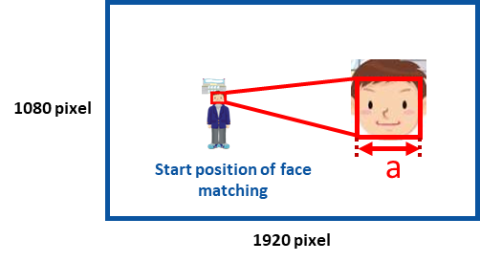
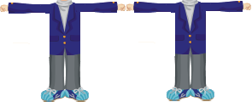
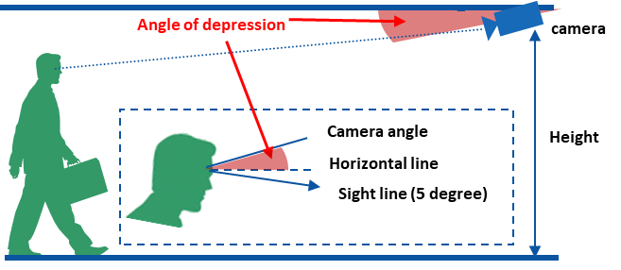
Recommended camera angle of view
This is common for both registered detection & unregistered detection function.
We recommend a location where the person can walk straight towards the camera to capture the front face as much as possible.
The face width becomes 60 pixels or more by setting the field angle of about 3.5 m width which is twice the width widening both hands as a standard of field angle at the face detection start position.
1) Face width(‘a’) ≥ 60 pixels
《Recommended camera view angle》
2) 5 deg. ≤ (Angle of depression) ≤ 10 deg.
3

Slide 4
Example of camera installation position 1
1. Position to installing a camera
Shot the subject face from the front as much as possible. Lower the position of the camera as much as possible by using such as a pole.
=> The face height is expected to be 1.6 m above the floor, and set the camera at 2.4 m above the floor.
The angle of depression of the camera at the face detection position should be within about 10 °.
=> Because Arctan [4.5 / 0.8] ≈ 10 °, so it is determined that the face detection end position is 4.5 m and the face detection start position is 8.5 m.
At the face detection start position, adjust the angle of view so that the width of the adult male face becomes 60 pixels.
=> The field angle width of the face detection start position is about 3.5 m. It is almost twice the distance when you spread both hands.
Ceiling
Gate
Make a distance as far as possible.
Lower the camera
as far as possible
entrance (Outside)
Start point
End point
15°
camera
Direction of movement
5° - 10°
0.8 m
(2.6ft)
1.6 m
(5.2ft)
2.4 m
(7.8ft)
Face detection area
Floor
Toward the store
4.5 m (14.8ft)
8.5 m (27.9ft)
4

Slide 5
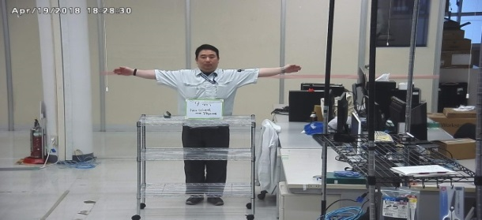
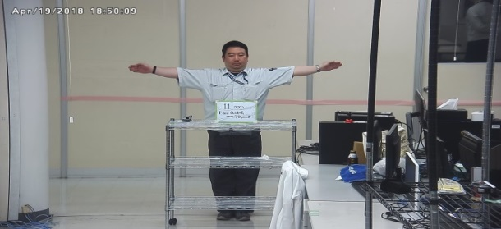
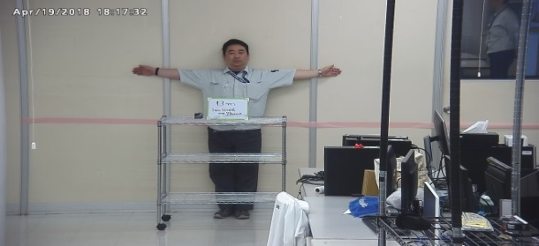
Example of camera installation position 2
2. Face width, distance between camera and subject
Face detection
End point
Distance from face detection start position
Face detection Start point
5m (16.4ft)
7m (23ft)
8.5m (27.9ft)
11m (36ft)
13m (42.6ft)
0.2m
(0.65ft)
0.8m
Angle of depression | 38° |  |  | 14.9° |  | 10.1° | 6.5° | 5.1°
2.4m
(7.9ft)
1.6m
Recommended range of installation
Entrance
Face width at face detection start position (farthest position): 60 pixels or more
Angle of depression at face detection end position (nearest position): 10 ° or less
Field angle image ( : suitable)
9 m
11 m
13 m
9m 29.5ft
11m
36ft
13m
42.6ft
◯
◯
◯
The angle of view at the face detection start position (the furthest position) is roughly twice (3.5 meters) of the width of widening both hands.
5

Slide 6
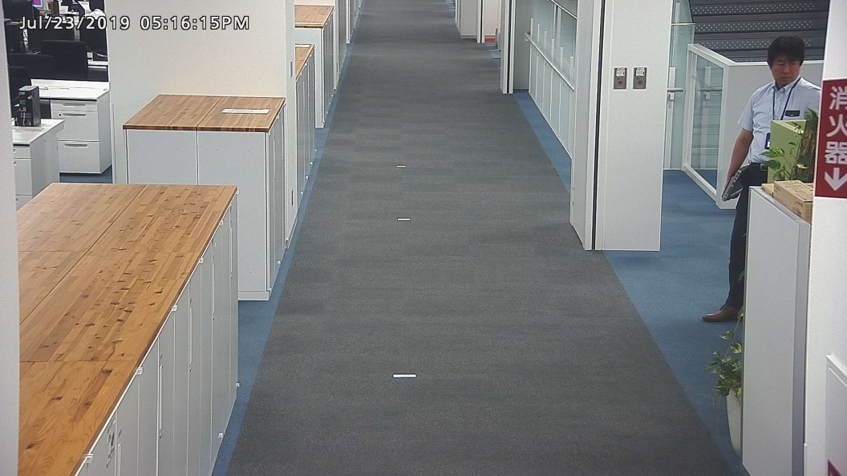
Camera angle adjustment for Unregistered face detection
Problem case1 | Countermeasure
No alarm triggered when unregistered person passes through the face detection camera | This is because ASF950 received less than 5 best shot images. In order to increase the number of captured best shot images, decrease the angle of depression about 5 to 8 degree by moving the camera installation position away from the face detection area or lower the camera installation height
Increase the captured best shot images as much as possible at this face detection area.
6

Slide 7
Camera angle adjustment for Unregistered face detection
Reference: Depression angle difference according to the distance between camera & subject
Recommended range of camera installation
Distance from start position of face detection
5m
7m
9m
11m
13m
15m
3.0m
1.6m
Angle of depression |  |  |  |  | 11.3° |  | 8.8° |  | 7.3° |  | 6.1° |  | 5.3°
Start position of face detection
Face detection area
Best shot
Estimated face detection area required is about 6.0m or more
= Walking speed (about 1.2m/s) x Travel time (5s)
7

Slide 8
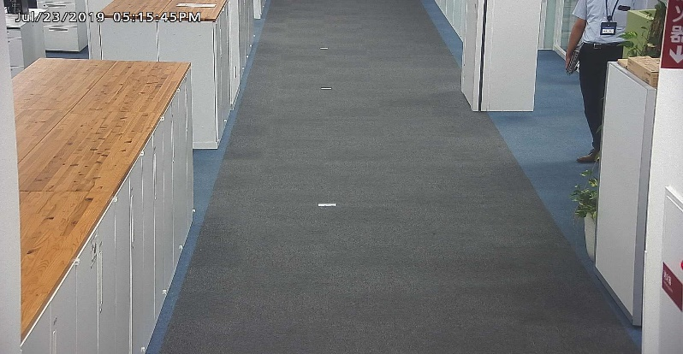
Camera angle adjustment for Unregistered face detection
Problem case2 | Countermeasure
False alarm triggered In other words, registered person is recognized as unregistered person. | This is because similarity score is lower due to side face even ASF950 receives 5 best shot images. In order to increase the similarity score, try to capture front face and avoid capturing side face. Control the people flow Adjust camera angle by increasing the angle of depression within 10deg or zooming in.
<Before>
<After>
Adjust the camera angle
8

Slide 9
Suitable environments for registered face & unregistered face detection
On top of camera angle adjustment, please consider these items.
Locations where no more than 8 people can pass through at the same time.
Locations where people are constantly moving and no congestion occurs
Indoors with the stable luminance (brightness) level
9

Slide 10
Recommended camera and tested lens
Select megapixel network cameras and lenses for face recognition function from the following combinations.
By the firmware update, i-PRO EXTREME camera (yellow letters) will be able to detect masked face.
Lens |  |  |  |  |  | Camera
 |  |  |  |  |  | 1/2.8 inch | 1/3 inch |  | -
Maker | Model Name | Day/ Night | Sensor Size (inch) | Resolution | Focal Length (mm) | WV-S1132 WV-S1131 WV-S1112 WV-S1111 | WV-SPN531A WV-SPN631 | WV-SPN310A WV-SPN311A WV-SPN611 | WV-S6130 WV-S2531LTN WV-SFV631LT WV-SC385
FUJINON | YV3.3x15SR4A-SA2 *2 YV3.3x15SR4A-SA2L | D/N | 1/2.7 | 3MP | 15-50 | *3 |  |  | n/a
 | YV3.3x15SA-SA2 *2 YV3.3x15SA-SA2L | Day | 1/3 | 3MP | 15-50 | *5 |  |  | n/a
 | DV10x8SR4A-SA1 *1*2 DV10x8SR4A-SA1L *1 | D/N | 1/2 | 3MP | 8-80 |  |  |  | n/a
 | YV10x5HR4A-SA2 YV10x5HR4A-SA2L *2 | D/N | 1/3 | 1.3MP | 5-50 | *5 | *4 |  | n/a
TAMRON | M13VG550 | Day | 1/3 | 1.3MP | 5-50 | *5 | *4 | *3 | n/a
 | M13VG850IR | D/N | 1/2.7 | 3MP | 8-50 |  |  |  | n/a
Do not change camera settings and angle of view (Pan, Tilt, Zoom and Focus) after installation / setting is complete.
*1 : Since this lens is the C-mount type, the C/CS-mount lens adaptor is necessary.
*2 : The lens without L (short cable type) will be discontinued and will be replaced with L (long cable type) model.
*3 : This is the brightest combination at the recommended angle of view of face recognition.
*4 : Because it is a 1.3 MP compatible lens, please note that sharpness will be imparted when using imaging mode 3 MP.
However, it does not affect the accuracy of face recognition.
*5 : Vignetting occurs at the wide end because the sensor size is different. Please refrain from using at the WIDE end.
As of July 2018
Most suitable
suitable
acceptable
10

Slide 11
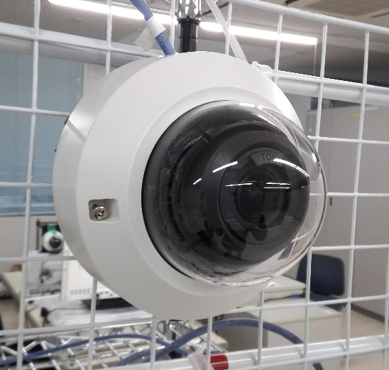
Supported dome cameras with limited condition
1. Dome -Wall mount
Camera | Model | Image setting | Installation
1. Dome | WV-S2130 WV-S2131 WV-S2131L WV-S2231L WV-S2531LN | Super D: OFF iA: ON Shutter: 1/100 | Wall mount
2. Compact Dome | WV-S3131L WV-S3531L | Super D: OFF iA: ON Shutter: 1/100 | Wall mount
2. Compact Dome -Wall mount
Please check recommended camera installation position at next page.
11

Slide 12
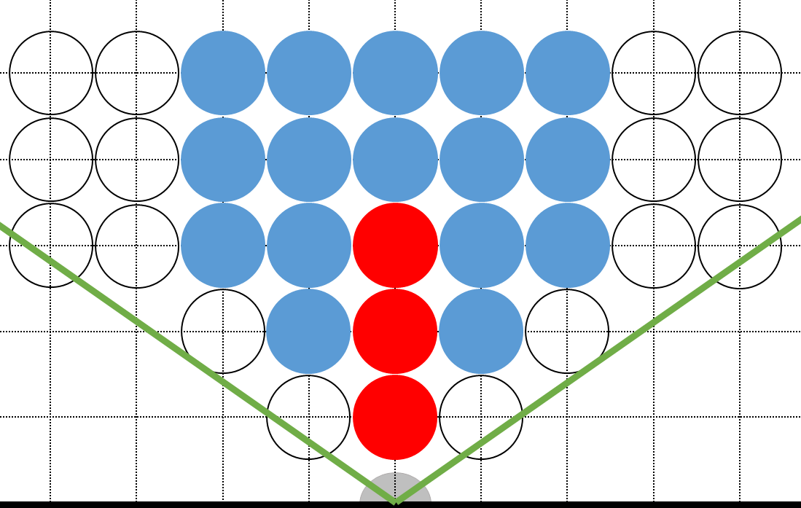
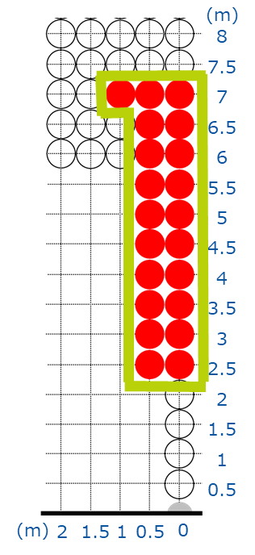
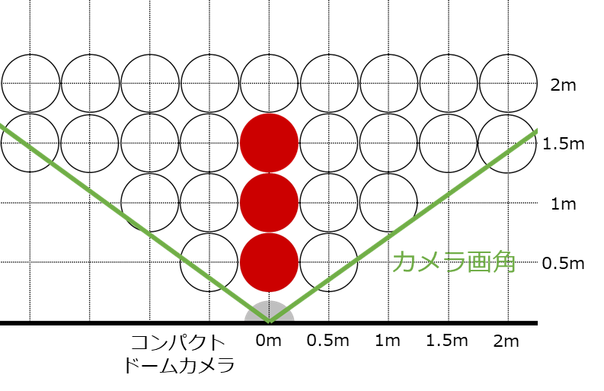
Supported dome cameras with limited condition
Recommended camera installation position
 | Angle of view | Distance from camera to face | Angle of side face (from front camera to face) | Installation height | Depression angle
1. Dome | Wide edge | From 0.5m to 2m | Front face only | height of face | 0 deg
 | Tele edge | From 2.5m to 7m | Right&Left: up to 50cm | within “height of face” + 1m | 0 to 10 deg
2. Compact Dome | Fixed focal length | From 0.5m to 1.5m | Front face only | height of face | 0 deg
1. Dome -Wide edge
1. Dome -Tele edge
2. Compact Dome
2m
1.5m
From camera to face
From camera to face
Wall mounted
camera
1m
Wall mounted
camera
0.5m
0.5
1.5
0
1
2m
From camera to face
From front camera to face
From front camera to face
：recommended
：recommended
*It is need to stop at this recommended area
*It is need to stop at this recommended area
Wall mounted
camera
From front camera to face
：recommended
12

Slide 13
Revision History
Ver. | Date | Changes | Page
1.0 | Dec. 2018 | first edition | -
1.1 | Jun. 2020 | Add new pages: Supported dome cameras with limited condition | 11,12

Slide 14
Thank you

