Slide 1
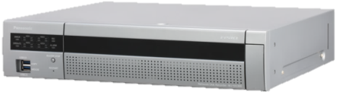
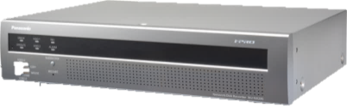
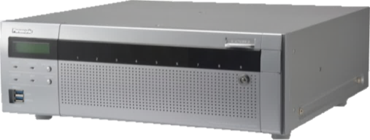
Network Disk Recorder
WJ-NX400/NX300/NX200
for SE Ver. 4.10
This document is covering following firmware and models.
  NX400 version 2.00 / 2.10/2.20/2.30/2.40/2.50/3.00/3.10/3.20/4.00
  NX300 version 2.00/2.20/2.30/2.40/2.50/3.00/3.10/3.20/4.00
  NX200 version 2.00/2.20/2.30/2.40/2.50/3.00/3.10/3.20/4.00
30th Sept. 2020
Panasonic i-Pro Sensing Solutions Co., LTD

Slide 2
Welcome & Disclaimer
This document, Ver. 4.00 is updated from previous version. And it is covering newly released firmware version 4.00 of the WJ-NX400, NX300, and NX200.
From this document Ver. 2.20, the contents of three recorder models have been integrated into one NX series NVR SE document. And it is covering version 2.00 onward.
For the earlier information of above version, please refer to previous documents.
Hence some of the specification & function detail might be changed without announcement.
This document is not cover all over about the product. Therefore, please utilize this document together with other materials such as “Installation Guide”, “Operating Instructions”, “Quick Reference Guide” “Specification Sheet” and “Product Presentation Material” so on as necessary.
These materials can be downloaded from the following website. https://security.panasonic.com/training_support/documentation_database/
https://bizpartner.panasonic.net/extranet/

Slide 3
Version History
No | Update contents | Page No. | Version | Editor | Update
- | Ver.2.20, First integrated SE material all NX series NVR (NX400, NX300 and NX200) |  | Ver.2.20 | H. Hattori | 13.May.2018
1 | Support i-PRO Extreme Multi-Sensor cameras ( WV-X8530N and WV-S8530N ) | P62 | Ver2.30 | H. Hattori | 21.Nov.2018
2 | Multi-sensor camera compatible | P63,P64 | Ver2.30 | H. Hattori | 21.Nov.2018
3 | Support i-PRO Extreme 5-megapixel cameras ( WV-S2550L, S2250L and S1550L ) | P65 | Ver2.30 | H. Hattori | 21.Nov.2018
4 | HDD format / removal without stopping recording | P66,P67 | Ver2.30 | H. Hattori | 21.Nov.2018
5 | The camera partitioning function | P68 | Ver2.30 | H. Hattori | 21.Nov.2018
6 | Support i-PRO Extreme Compact Dome Cameras( WV-S3531L,-S3511L and other ) | P71 | Ver2.40 | H. Hattori | 21.Nov.2018
7 | Measure the network transmission/reception speed | P72, P73 | Ver2.40 | H. Hattori | 21.Nov.2018
8 | Password New rule compliant | P74 | Ver2.40 | H. Hattori | 21.Nov.2018
9 | HDD remaining capacity display and notification function | P75 | Ver2.40 | H. Hattori | 21.Nov.2018
10 | Emergency audio recording function | P76, P77 | Ver2.40 | H. Hattori | 21.Nov.2018
11 | High quality setting of business intelligence | P78 | Ver2.40 | H. Hattori | 21.Nov.2018
12 | Maintaining the aspect ratio of full screen display | P79 | Ver2.40 | H. Hattori | 21.Nov.2018
13 | Test mode of rear panel output terminal | P82 | Ver2.50 | H. Hattori | 30.July.2019
Notes:
288kmph= カトリーナ：280 km/h
伊勢湾台風=270km/h

Slide 4
Version History
No | Update contents | Page No. | Version | Editor | Update
14 | HTTP download support for n3r files larger than 2 GB | P83 | Ver2.50 | H. Hattori | 30.July.2019
15 | Function addition from other models | P84 | Ver2.50 | H. Hattori | 30.July.2019
16 | Support i-PRO Extreme IR-PTZ Cameras, model WV-X6533LN and WV-S6532LN. | P87 | Ver3.00 | H. Hattori | 30.July.2019
17 | Support i-PRO Extreme 4K-Standard Cameras, model WV-S1570L -S2570L and -S2270L. | P88 | Ver3.00 | H. Hattori | 30.July.2019
18 | Add camera settings | P89,90,91,92 | Ver3.00 | H. Hattori | 30.July.2019
19 | Add operation mode not using stream 2 | P93 | Ver3.00 | H. Hattori | 30.July.2019
20 | Support for multi-browser (Chrome, Firefox, Edge) | P96 | Ver3.10 | H. Hattori | 20.Jan.2020
21 | Addition of communication error detection function | P97 | Ver3.10 | H. Hattori | 20.Jan.2020
22 | Changes to thumbnail screen specifications | P98 | Ver3.10 | H. Hattori | 20.Jan.2020
23 | Improved SNMP settings | P99 | Ver3.10 | H. Hattori | 20.Jan.2020
24 | Deleting camera registration information in units of pages | P101 | Ver3.10 | H. Hattori | 20.Jan.2020
25 | Improvement of the number of cameras connected | P102 | Ver3.10 | H. Hattori | 20.Jan.2020
26 | Improved notification function during RAID operation | P103 | Ver3.10 | H. Hattori | 20.Jan.2020
Notes:
288kmph= カトリーナ：280 km/h
伊勢湾台風=270km/h

Slide 5
Version History
No | Update contents | Page No. | Version | Editor | Update
27 | Support i-PRO Extreme U-Series Cameras, model WV-U*****. | P106,107,108,109,110,111 | Ver3.20 | H. Hattori | 10.July.2020
28 | Add error type related to NAS backup [NX400] | P112 | Ver3.20 | H. Hattori | 10.July.2020
29 | Support i-PRO Extreme AI Cameras, model WV-X*****. | P115 | Ver4.00 | H. Hattori | 10.July.2020
30 | Support for the AI motion detection application (WV-XAE200W) | P116,117,118,119,120 | Ver4.00 | H. Hattori | 10.July.2020
31 | Support for the AI privacy guard recording(WV-XAE201W) | P121,122,123,124,125,126 | Ver4.00 | H. Hattori | 10.July.2020
32 | Fixed the model name of AI Camera | P115 | Ver4.01 | H. Hattori | 30.July.2020
33 | Support i-PRO Extreme 4K AI Cameras, model WV-X*****. | P129 | Ver4.10 | H. Hattori | 30.Sept.2020
34 | Camera restrictions affecting the NVR | P130 | Ver4.10 | H. Hattori | 30.Sept.2020
35 | TLS version selection for HTTPS server | P131 | Ver4.10 | H. Hattori | 30.Sept.2020
36 | Change the authentication method of the web server | P132 | Ver4.10 | H. Hattori | 30.Sept.2020
37 | Add ONVIF JPEG resolution | P133 | Ver4.10 | H. Hattori | 30.Sept.2020
38
Notes:
288kmph= カトリーナ：280 km/h
伊勢湾台風=270km/h

Slide 6



Specification Comparison chart
 | NX400 |  | NX300 | NX200
 | Standard (No camera additional kit) | with camera additional kits (over 65 cameras)
Compression | H.265,H.264 | H.265,H.264 | H.265,H.264 | H.265,H.264
Max. number of CH | 1-64CH | 65-96CH (1 kit) 96-128CH (2 kits) | 32 CH | NTSC：16 PAL ：32
Through put in | 384Mbps | 384Mbps | 256Mbps | 192Mbps
Through put out | 256Mbps | 256Mbps | 256Mbps | 192Mbps
Dimension | 3U | 3U | 2U | 2U
Num. HDD | 9 | 9 | 4 | 2
Raid | 1*,5,6 | 1*,,5,6 | 1, 5, 6 | 1
Extension unit | HXE400x5 | HXE400x5 | HXE400x2 | NO
Monitor out | HDMIx2 | NO | HDMI x2 | HDMI x2
Transcode | 2 user access | NO | 2user access | 2user access
Sub-stream Rec. | Yes (Full CH) | NO | Yes (Full CH) | Yes (Full CH)
PoE inside | NO | NO | NO | NO
NAS back up | YES * | NO | NO | NO
Secure (Symantec) | YES | YES | YES | YES
Face recognition | NO | NO | Yes (2cam) | Yes (2cam)
Failover between NVRs | YES * | YES | NO | NO
HDD Stand-by control | YES * | YES | YES | NO
Copy port/(USB port num.) | USB/(4) | USB/(4) | USB/(4) | USB/(4)
Dimensions | 430x132x400mm | 430x132x400mm | 420x88x370mm | 420x88x300mm
Easy Installation | Yes | Yes | Yes | Yes
RJ45 port (rear side) | 2 | 2 | 2 | 2
RJ45 maintenance port (front side) | 1 | 1 | 0 | 0
NX400
NX300
NX200
* Ver.2.20 onward

Slide 7
Firmware version up items
(For NX400 Ver.2.00/2.10, NX300/NX200 Ver.2.00)

Slide 8
Firmware Version Up Contents
NX400 : Firmware version 2.00
NX300 : Firmware version 2.00
NX200 : Firmware version 2.00
The following items are now available with WJ-NX400 Ver.2.00 and NX300/NX200 Ver.2.00.
No. | Update contents | Release Date | Firmware Version | Note
1 | Add HDD Stand-by Control Mode | Dec. 2017 | Ver. 2.00
2 | Support Hardware RAID1 Function | Dec. 2017 | Ver. 2.00 | RAID5 and 6 were available from first production.
3 | Support NAS Backup Function | Dec. 2017 | Ver. 2.00 | The license is required. (Free)
4 | Support Failover Function | Dec. 2017 | Ver. 2.00 | The license is required. (Free)
5 | Camera Group Recording | Dec. 2017 | Ver. 2.00
6 | Support SMR10/SMR10N3 | Dec. 2017 | Ver. 2.00
7 | Time-saving Playback | Dec. 2017 | Ver. 2.00
8 | MP4 Download | Dec. 2017 | Ver. 2.00
9 | Corridor Aspect Layout | Dec. 2017 | Ver. 2.00
10 | Flexible setting of Sub-stream recording | Dec. 2017 | Ver. 2.00
11 | Support V-series cameras: WV-V1170/V1330/V2530 and V6430 | Dec. 2017 | Ver. 2.00 | Certain country is not available V-series cameras.
NX400
NX300
NX200

Slide 9
Firmware Version Up Contents
NX400 : Firmware version 2.10
NX300 : Firmware version 2.00
NX200 : Firmware version 2.00
The following items are now available with WJ-NX** Series
No. | Update contents | Release Date | Firmware Version | Note
1 | Support ASM Concurrent License Kit | Dec. 2017 | NX400 : Ver.2.10 NX300 : Ver.2.00 NX300 : Ver.2.00 | WJ-NXC05W must be installed to be controlled by WV-ASM300CLW.
2 | Support HDD Viewer Software | Dec. 2017 | NX400 : Ver.2.10 NX300 : Ver.2.00 NX300 : Ver.2.00
3 | Support WV-S4150, WV-S4550L and WV-S4550LM | Dec. 2017 | NX400 : Ver.2.10 NX300 : Ver.2.00 NX300 : Ver.2.00
4 | Support Energy Efficient Ethernet (IEEE802.3az) Switch | Dec. 2017 | NX400 : Ver.2.10 NX300 : Ver.2.00 NX300 : Ver.2.00 | It is relating our SE News-00005. Not necessary to set Energy Efficient Function to “OFF”.
NX400
NX300
NX200

Slide 10


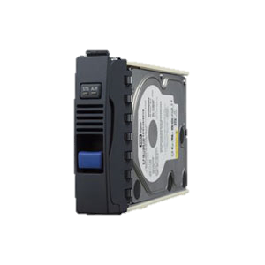
HDD Stand-by Control Mode
NX400 : Firmware version 2.00
NX300 : Firmware version 2.00
NX200 : Firmware version 2.00
HDD is managed individually to reduce a HDD operation time
Active : Motor-On, Head-Read / Write
Idle : Motor-On, Head-home position
(Ready for next access HDD)
Stand-by : Motor-Off, Head-home position
WJ-NX400/NX300 can manage the status of each HDD using three state.
1st is the active state which is ready accessed by WJ-NX400/NX300 to a HDD.
2nd is the idle state, it indicates the state which is ready for next access.
3rd is the stand-by status, it indicates the state stopping a motor.
Note: In the case of the RAID configuration, it is operated for each unit
Active
idle
Stand-by
Note: Necessary quantity of HDD to enable this control mode is as follows.
  Single mode: 3 HDDs or more
  RAID1: 6 HDDs or more
  RAID5/6: 3 Units or more
* Actually, the status of this operation can not be confirmed with HDD LED Indicator of the recorder.
* There is possible to confirm the time difference from the Hour meter of the recorder GUI.
NX400
NX300

Slide 11
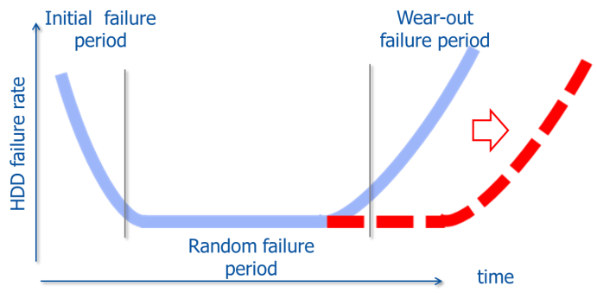
HDD Stand-by Control Mode
NX400 : Firmware version 2.00
NX300 : Firmware version 2.00
NX200 : Firmware version 2.00
WJ-NX400/NX300 can extend the life of HDDs by reducing the movement of a head and managing HDDs individually.
Status | Active | Idle | Stand-by
HDD Operation Time Count | Count up |  | No count
During stand-by, control to stop the HDD motor drive.
During stand-by, no count the HDD operating time managed by the application.
Note:
When searching and playing back the video recorded on the standby HDD it will be in the same state as “Idle“ condition. Meanwhile, the operation time is counted.
Even if it becomes “Idle”, it will automatically back to “Stand-by” if there is no operation for a certain time (70 min.)
Once a day, automatically 70 minutes will be changed from "Stand-by" to “Idle“ condition.
When searching and playing back HDD in “Stand-by” condition, it may take time until the corresponding HDD becomes “Idle". (Approx. 30 sec.) Therefore, it is not recommend to use this control mode when real-time property is required for search / playback.
The recommended replacement HDD operating time is still 18,000 H. It does not guarantee HDD non-failure during the period, it does not extend the life of the HDD itself. It is control to prolong the arrival time to 18,000 H as much as possible.
Once rebuild the RAID structure, the hour meter will be lost
NX400
NX300

Slide 12
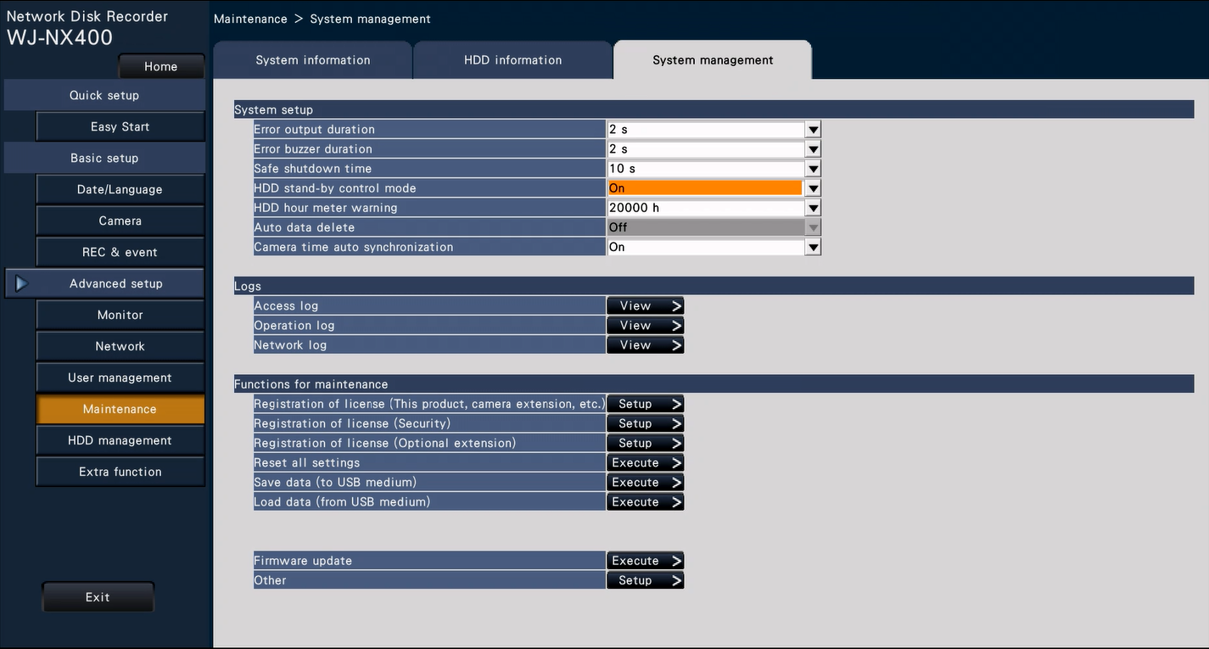
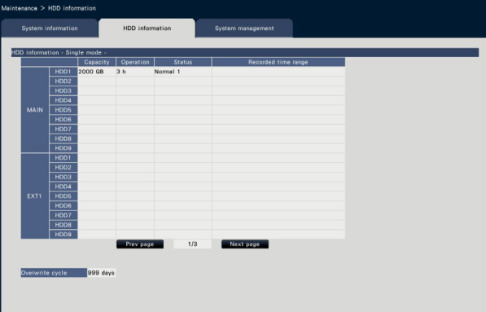
HDD Stand-by Control Mode (Setup)
NX400 : Firmware version 2.00
NX300 : Firmware version 2.00
NX200 : Firmware version 2.00
Go to [Setup] -> [Advanced setup] -> [Maintenance] -> [System management] -> [HDD stand-by control mode]
Set to “ON” to use HDD stand-by control mode.
To confirm HDD operation time, go to [Setup] -> [Advanced setup] -> [Maintenance] -> [HDD information]
The operation time of each HDD can be confirmed. And especially operation time of HDD3 is obviously different.
(In case of three HDD are installed)
Example:
HDD1 = 10h
HDD2 = 10h
HDD3 = 0h
* The above GUI image is NX300. This is just for reference.
NX400
NX300

Slide 13
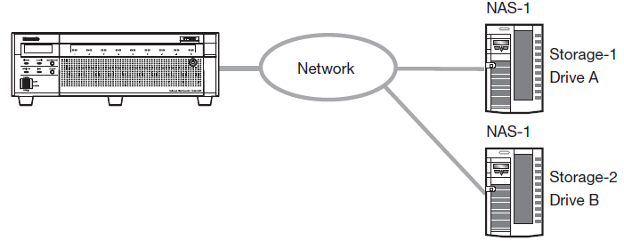
NAS Backup Function
NX400 : Firmware version 2.00
NX300 : Firmware version 2.00
NX200 : Firmware version 2.00
The recording data can be backed up in the NAS drive. (License is required)
Up to 2 NAS drives can be set as storage.
Cameras subject to backup and a schedule can also be set.
Performance Requirement
n3r: Max. 30Mbps
mp4: Max. 15Mbps
* The backup speed will be depends on recording settings and network environment.
Two Backup method
Schedule backup
Manual backup
Supported Format: n3r(a)/mp4
Supported Protocol: NFSv3
Important:
Create a mount path before using the NAS drive.
Refer to the operation manual of NAS drive to create the directory and HDD installation.
After mounting the NAS drive, the following directory will be created on the mount path.
  NXR/bkup/ : Directory for scheduled backup
  NXR/data/ : Directory for manual backup
For the data copied to the NAS, it is not possible to playback on the recorder. Also, it is not possible to display the list of backup data on the recorder or the PC web browser. Playback the backup data with viewer software.
Note: Direct backup from the camera to the NAS server cannot be made.
NX400

Slide 14
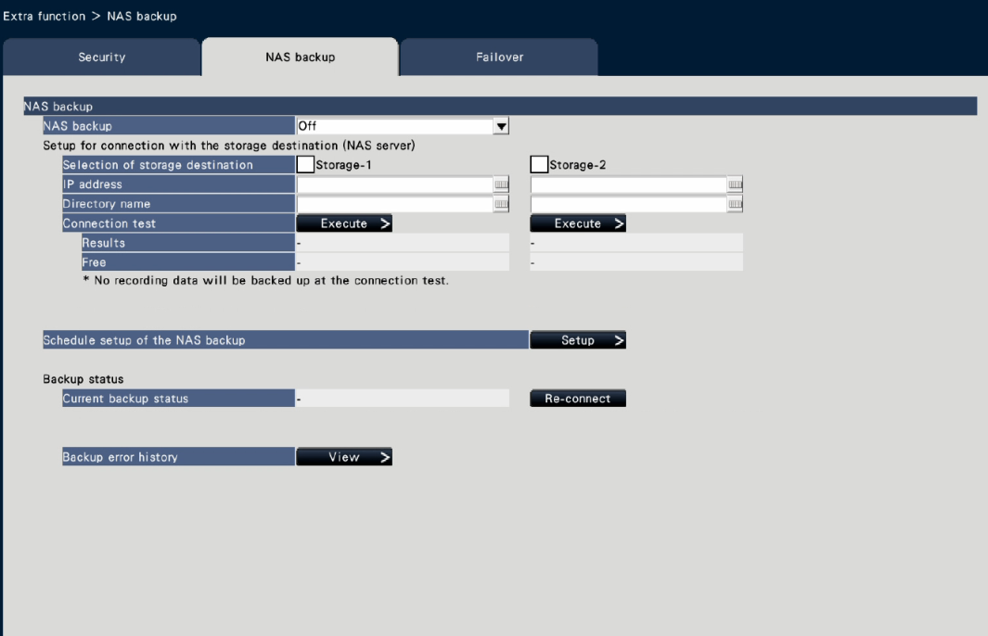
NAS Backup Function
NX400 : Firmware version 2.00
NX300 : Firmware version 2.00
NX200 : Firmware version 2.00
The register the options, the “Registration Key” is required that obtained from KMS.
Enter the following Activation Key No. and the registration ID.
  Activation Key No.: 1572-0060-030B-1234
  Registration ID: 25D2-36AB
To configure, go to [Setup]
-> [Advanced setup] -> [Extra functions]
-> [NAS backup]
* The NAS backup screen will be displayed shown in the figure right.
Two NAS serves can be set.
* If one remaining capacity falls below a certain value, the other storage is started to save.
Operation Confirmed Models:
No. | Brand Name | Model Number | Remarks
1 | Synology | DiskStation DS1817+ | 8 bays, Max. 96TB (12TB x 8)
2 | Synology | DiskStation DS216+II | 2 bays, Max. 24TB (12TB x 2)
NX400

Slide 15

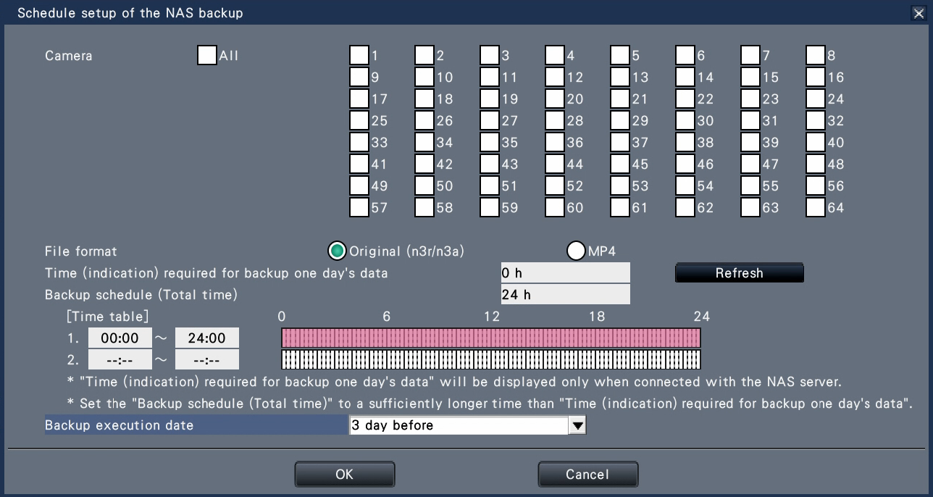
NAS Backup Function - Schedule settings -
NX400 : Firmware version 2.00
NX300 : Firmware version 2.00
NX200 : Firmware version 2.00
Possible to set up to two time tables.
Go to [Setup] -> [Advanced setup] -> [Extra functions] -> [NAS backup] -> [Schedule setup of the NAS backup]
2. Select the target camera
3. Select File format
1. Click [Setup] of “Schedule setup of the NAS backup”.
4. Set a time zone
Display the approximate time when backup data of one day's recorded data of the selected camera is backed up at 5 Mbps. Actual backup time will vary more or less.
Note:
To backup specific data and time, please conduct manual backup. Please refer to the next slide and operating instructions for more details.
5. Select “Backup execution data”.
* 1 day before / 2 days before / 3 days before
6. Click “OK”
NX400

Slide 16
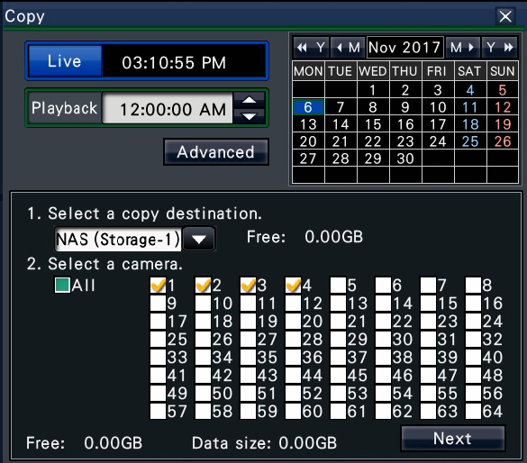
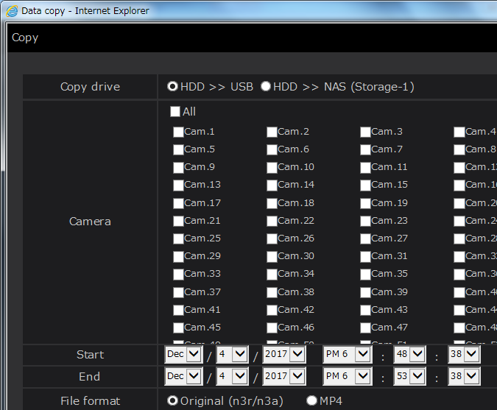
NAS Backup Function - Manual Backup -
NX400 : Firmware version 2.00
NX300 : Firmware version 2.00
NX200 : Firmware version 2.00
Data can be backed up to the NAS manually by selecting the NAS as the copy destination of the copy panel by Main monitor and PC Browser.
Main Monitor
PC Browser
Select [NAS (Storage-1)] or [NAS (Storage-2)] as the copy destination of the copy panel and click the [OK] button, then click the [OK] button when the confirmation window is displayed.
Select [NAS (Storage-1)] or [NAS (Storage-2)] as the copy destination of the copy panel, and click the [Copy] button.
Click the [Copy] button on the operation panel of the main monitor.
Click the [Control] tab on the top page of the operation window, then click the [Copy] button of the copy box.
NX400

Slide 17
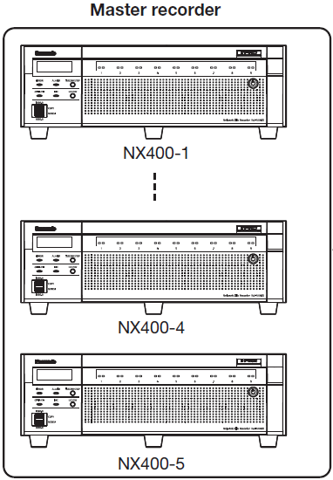
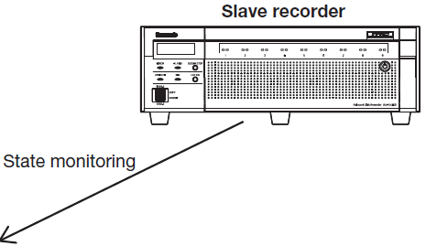
Failover Function
NX400 : Firmware version 2.00
NX300 : Firmware version 2.00
NX200 : Firmware version 2.00
The stand-by recorder substitutes for the recorder in operation (Master recorder, Max.5 units) and continues recording if the master recorder has an error.
Failover Operation
The slave recorder monitors the state of each master recorder.
If the master recorder has an error, the slave recorder stops operation of the master recorder.
The slave recorder substitutes for the master recorder whose operation has been suspended and starts recording as the master recorder.
The license is required and the settings of the failover function are made for the slave recorder only.
Failover Operation Condition
When the slave recorder can not communicate with the master recorder.
When there is no HDD or HDD unit that can be written to by the master recorder.
When executing the failover function manually in the setup menu.
NX400

Slide 18
Failover Function
NX400 : Firmware version 2.00
NX300 : Firmware version 2.00
NX200 : Firmware version 2.00
Important:
The settings of the failover function are made for the slave recorder only.
Up to 5 master recorders can be set for one slave recorder.
The software versions of the slave recorder and master recorder must be same.
The slave recorder and master recorder must be installed in same network environmental.
The number of additional camera licenses and secure communication licenses registered in the slave recorder must be equal or exceed the number of licenses that the master recorders have.
The slave recorder have to have same number of secure license of more.
Must be same RAID settings
Additional Camera License
Secure License
RAID settings
Slave Master | Single | RAID1 | RAID5 | RAID6
Single | YES | NO | NO | NO
RAID1 | NO | YES | NO | NO
RAID5 | NO | NO | YES | NO
RAID6 | NO | NO | NO | YES
Slave Master | 64CH | 96CH | 128CH
64CH | YES | YES | YES
96CH | NO | YES | YES
128CH | NO | NO | YES
Slave Master | Less than X | Above X
Secure CH: X | NO | YES
The slave recorder have to have same number of camera license of more.
If a slave recorder with registered additional camera licenses switches to a master recorder that does not have an additional camera license, the slave recorder will lose its additional camera license registration. If necessary, register the additional camera license to the slave recorder again. Make sure to safely store the additional camera license registration key number.
NX400

Slide 19
Failover Function
NX400 : Firmware version 2.00
NX300 : Firmware version 2.00
NX200 : Firmware version 2.00
The slave recorder can not perform recording, playback, camera operation and camera setting etc. during failover operation. Camera settings that were already set are deleted.
Operation will not be switched while HDD management screen is displayed.
It may take time until a communication error with the master recorder is detected and failover is executed.
To failover complete, it takes Approx. 3 to Max. 5 min.
If an error occurs in the master recorder within 1 hour of changing its settings, a slave recorder with the pre-change settings can operate as the master recorder.
Failover may also be executed when a communication error occurs in the slave recorder for a certain period of time.
To setup the master recorder for the setting which requires to restart such as license registration, set the "Failover setup" of the slave recorder to Off once. Set it to On after restarting the master recorder.
Recovery work appropriate for the system operation is required by the system administrator when the recording is switched over by the failover function to the slave recorder.
NX400

Slide 20
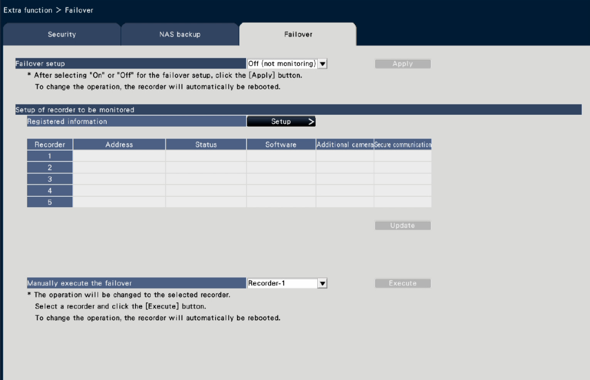
Failover Function – Reg. Key / Setup GUI
NX400 : Firmware version 2.00
NX300 : Firmware version 2.00
NX200 : Firmware version 2.00
The register the options, the “Registration Key” is required that obtained from KMS.
Enter the following Activation Key No. and the registration ID.
  Activation Key No.: 1574-0060-030C-1234
  Registration ID: 264E-7A59
This is Free license, however registration is required.
To configure, go to [Setup] -> [Advanced setup] -> [Extra functions] - > [Failover]
* The Failover screen will be displayed shown in the figure right.
Note:
Monitoring target master recorders are WJ-NX400 series only.
The recorder whose HDD operation mode (single/Mirroring/RAID5/RAID6) is different from the slave recorder's HDD operation mode can not be set as the master recorder for monitoring.
The camera group recording operates according to the camera group recording setting set in the slave recorder. The camera group recording setting of the master recorder is not inherited.
NX400

Slide 21
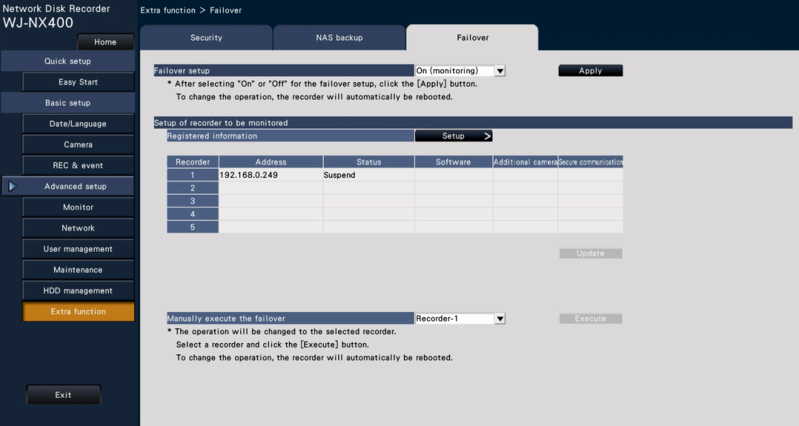
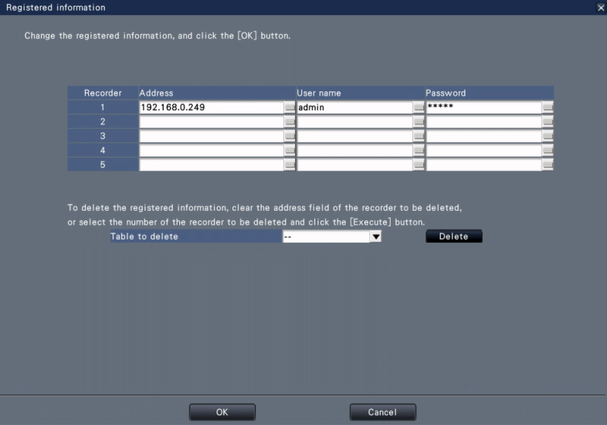
Failover Function – Setup Procedure
NX400 : Firmware version 2.00
NX300 : Firmware version 2.00
NX200 : Firmware version 2.00
The followings are setup procedure for the Failover.
1. Select “On (monitoring)”
5. Click “Apply”
* The system will automatically reboot.
3. Enter IP address, User name and Password of the targeted master recorders
2. Click “Setup” of Registered information.
* Setup GUI will be displayed as shown in the figure right.
Registered information will be displayed after the step 4.
4. Click “OK”
NX400

Slide 22
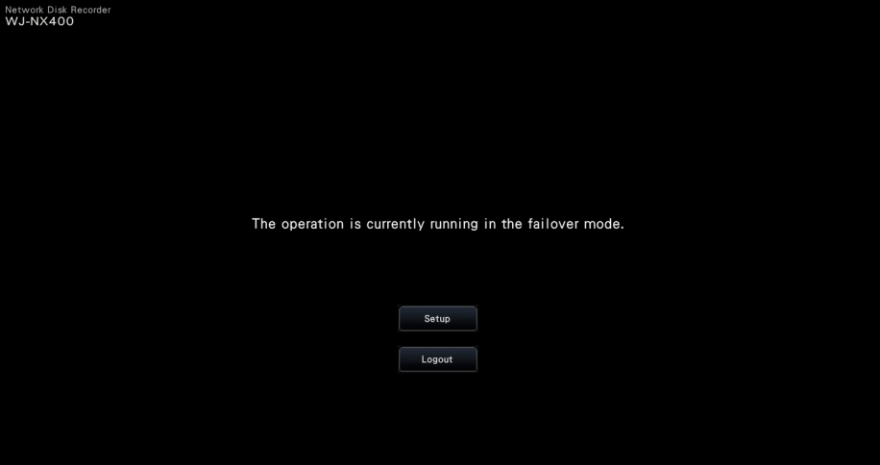
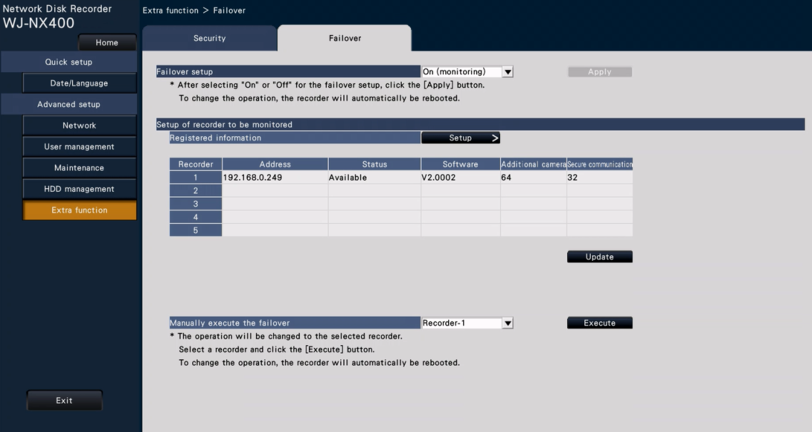
Failover Function – GUI and Status check
NX400 : Firmware version 2.00
NX300 : Firmware version 2.00
NX200 : Firmware version 2.00
The following is displaying during the Failover mode, and available setup menu.
Status condition:
1. Available: On monitoring, Failover possible
2. Not available: Mismatching of Version / License,
User name and Password, etc.
3. Suspend: Failover setup is “OFF”
Click “Setup” to display setup menu.
Click “Update” to confirm current status of each master recorder.
NX400

Slide 23



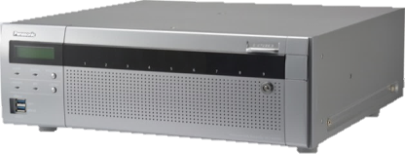

Camera Group Recording
NX400 : Firmware version 2.00
NX300 : Firmware version 2.00
NX200 : Firmware version 2.00
Camera group recording function allows to set two groups of saving recording period for each camera group at each installation locations.
Area (A)
Recording for area(A) : Saving period 180days
Camera 1
Camera 2
Set up 2 camera group
HDD1
HDD2
HDD3
Camera 3
Camera 4
Area (B)
Camera 5
Camera 6
WJ-NX400
HDD4
Recording for area(B) : Saving period 30days
Camera 7
Available setup value of the recording period:
Unlimited/ 1 day/ …/ 10 days/ 14 days/ 30 days/45 days/ 60 days/ 90 days/ 120 days/ 150 days/180 days/ 184 days
Default: Unlimited
NX400
NX300

Slide 24
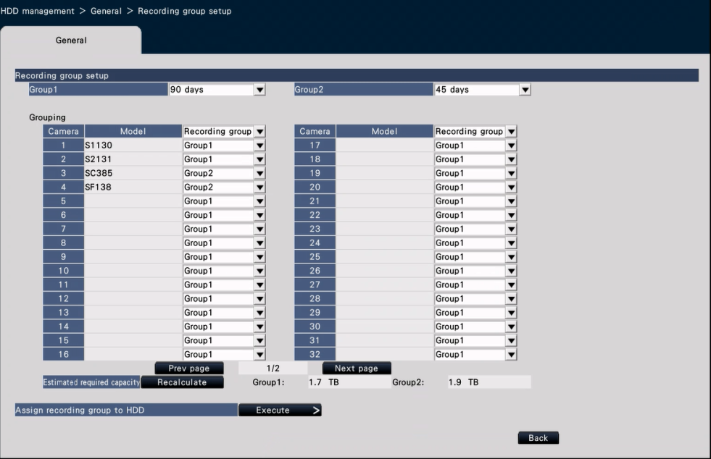
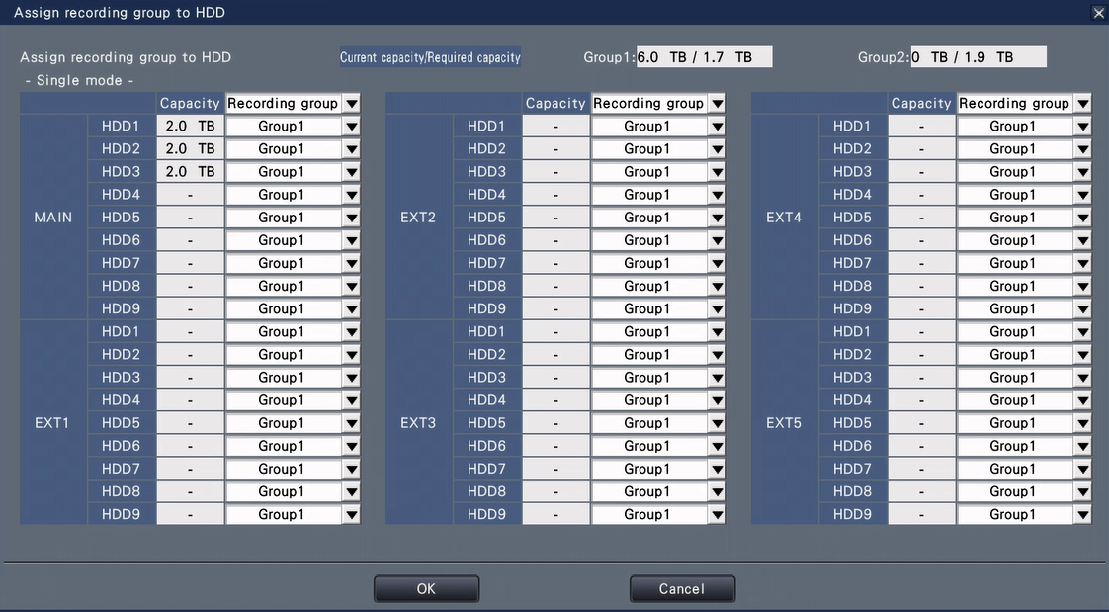
Camera Group Recording - Setup
NX400 : Firmware version 2.00
NX300 : Firmware version 2.00
NX200 : Firmware version 2.00
Go to [Setup] -> [Advanced setup] -> [HDD management] -> [General] -> [Recording group setup] -> Click the [Execute] button on the [Recording group setup]
1. Set the recording period of each group
2. Set the recording period group of each group
5. Set the recording group of each HDD.
3. Click the [Recalculate] button to calculate estimated required capacity of each group and display it.
6. Click [OK]
Please refer to the Operating Instructions for more details.
4. Click the [Execute >] button on the "Assign recording group to HDD".
NX400
NX300

Slide 25
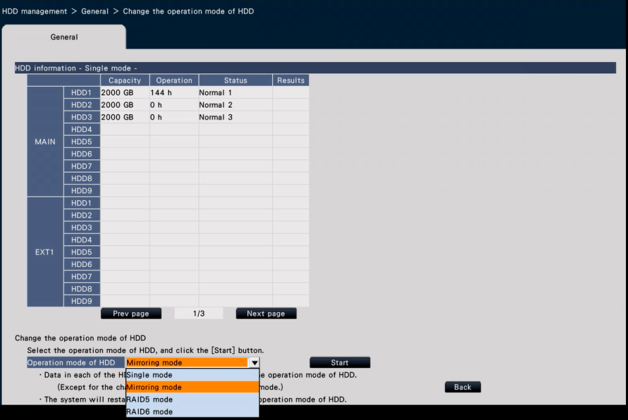
RAID1 (Mirroring) Function
NX400 : Firmware version 2.00
NX300 : Firmware version 2.00
NX200 : Firmware version 2.00
In this mode, the same images and audio from the cameras will be recorded on the 2 HDDs of this product.
When one of the 2 HDDs is replaced with a new one, it is possible to copy data on the other HDD to the replaced HDD.
To configure, go to [Setup] -> [Advanced setup] -> [HDD management] - > [General] -> [Change the operation mode of HDD]
* The "Change the operation mode of HDD" screen will be displayed shown in the figure right.
Select the desired operation mode of HDD, then click [Start]
NX400
NX300
NX200

Slide 26
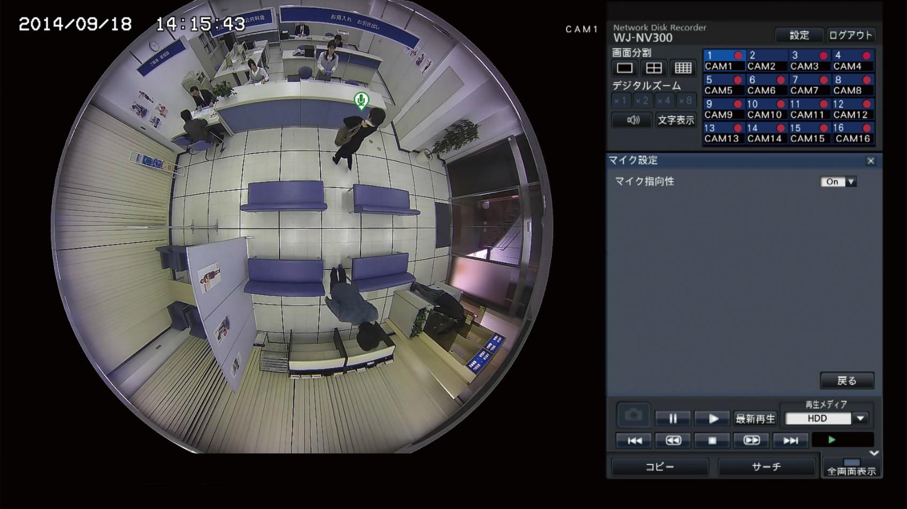
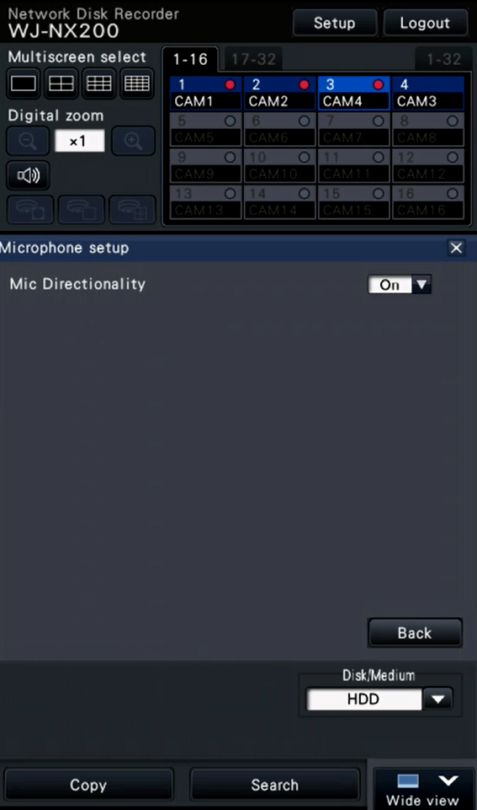
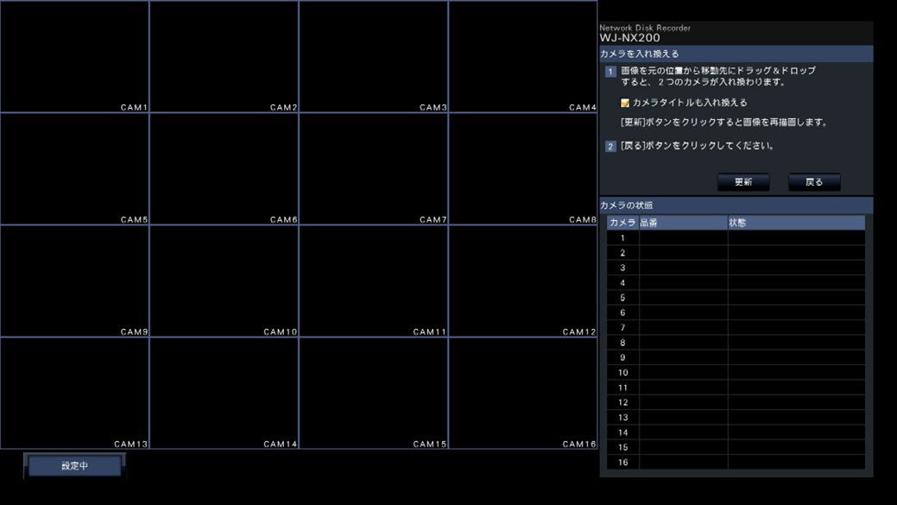

Support SMR10/SMR10N3
NX400 : Firmware version 2.00
NX300 : Firmware version 2.00
NX200 : Firmware version 2.00
WJ-NX400
It is possible to specify the sound collection position with one point icon
Enable microphone directionality from microphone setup
Important:
The registration is required for both microphone and fisheye camera. The registration of the network microphone by itself cannot perform recording or audio output.
Operation with the network microphone is allowed only when the image compression method of the fisheye camera is selected for H.264.
Sound pick up is still available outside the specified location.
Sound playback from specified position of SMR10 is supported only main monitor of NX recorder. (Browser does not support)
Number of selectable position is two. (Also ASM300 supports two position)
NX400
NX300
NX200

Slide 27
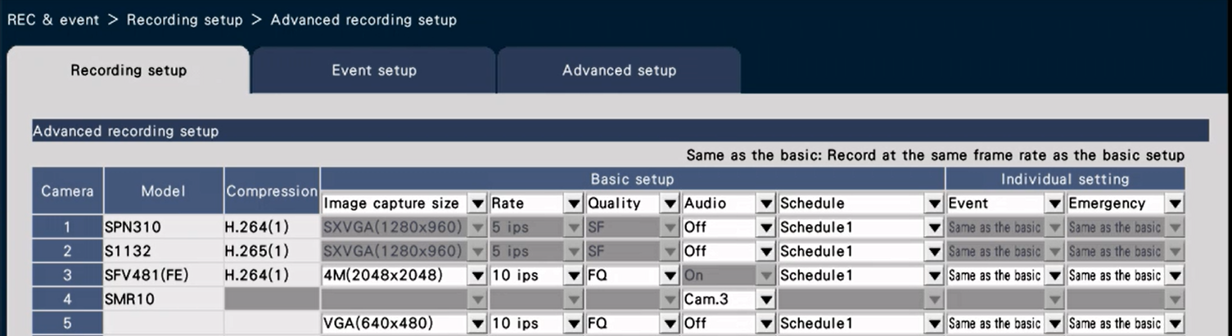
Support SMR10/SMR10N3 (Settings)
NX400 : Firmware version 2.00
NX300 : Firmware version 2.00
NX200 : Firmware version 2.00
Go to “Basic setup” -> “REC & event” -> “Recording setup” -> “Advanced recording setup”
1. Registration for one camera per SMR10 microphone
2. Can be set as audio channel of one specific camera
“Microphone sensitivity” can be adjusted. Go to [Setup] -> [Basic setup] -> [Camera] -> [Camera setup] -> [Microphone sensitivity]
  Setting value: 0 (High) / 1 / 2 / 3 (Default) / 4 / 5 (Low)
* Attached picture is an image.
NX400
NX300
NX200

Slide 28
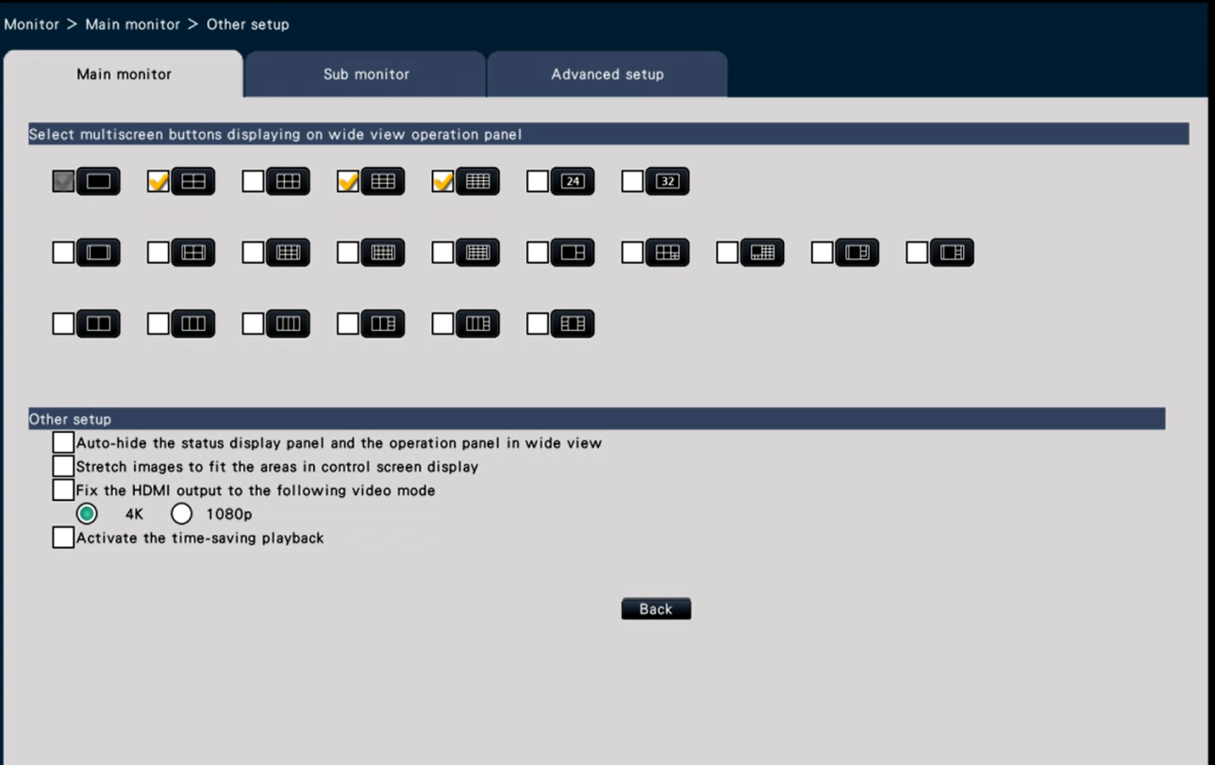
Time-saving Playback (Settings)
NX400 : Firmware version 2.00
NX300 : Firmware version 2.00
NX200 : Firmware version 2.00
Go to “Advanced setup” -> “Monitor” -> “Main monitor” -> “Other setup”
If you check ”Activate the time-saving playback", you will see a shortcut playback ON / OFF check displayed on the playback control of the operation screen
NX400
NX300
NX200

Slide 29
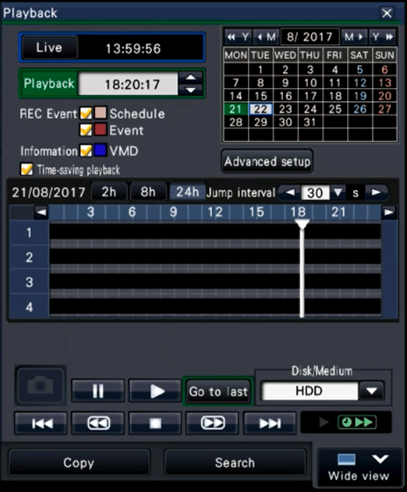
Time-saving Playback (GUI / Functions)
NX400 : Firmware version 2.00
NX300 : Firmware version 2.00
NX200 : Firmware version 2.00
Turn ON / OFF the function in the “Time-saving playback" checkbox
* Also possible to change during playback
Outline of the Function
No. | Items | Remarks
1 | Applicable operation | HDD playback on monitor 1x speed playback only, All video format i-PRO cameras only (OnVIF cameras are excluded) * No playback in Time-saving playback during distortion correction
2 | Time-saving playback Playback speed | Single screen: 1x to 4x speed 2/3/4-screen: 1x to 2x speed * 5 or more images are not supported Maximum speed may not be reached depending on resolution In 4x screen mode, if there is only one camera with movement, playback speed is 1x.
3 | Accuracy of motion detection | If there is no movement in a few sec., play at high speed
4 | Audio | No audio during time-saving playback
NX400
NX300
NX200

Slide 30
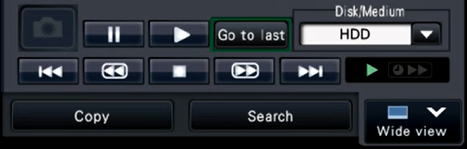
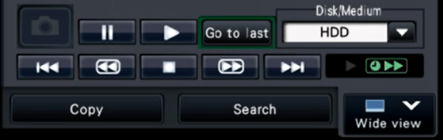
Time-saving Playback (GUI / Status Indication)
NX400 : Firmware version 2.00
NX300 : Firmware version 2.00
NX200 : Firmware version 2.00
Status Indication of Time-saving Playback
1x speed Playback
* During there is movement
Time-saving (High speed) Playback
* During there is no movement
Single screen: 4x playback
2/3/4 screen: 2x playback
* Attached picture is an image.
NX400
NX300
NX200

Slide 31
MP4 download (Video, Audio)
NX400 : Firmware version 2.00
NX300 : Firmware version 2.00
NX200 : Firmware version 2.00
Outline of the Function
No. | Items | Remarks
1 | Recording condition | Video: H.264/H.265 Audio: AAC-LC, G.726/G.711
2 | Number of concurrent operation | 2 operations * Total number operation of Copy / Browser Download / ASM Download
3 | File split condition | 1 file / per Max. 1H * When it meets the condition on the right, it is split at that point
4 | Others | Playback with Windows Media Player 12 or higher is assumed (However, NX Viewer is required for playback of H.265 video) No re-encode recorded video / audio
 | Recording Condition |  | MP4 Output result
 | Video | Audio
1 | H.264/H.265 | AAC-LC | Video and Audio
2 | H.264/H.265 | G.726/G.711 360-degree microphone | Video only
3 | JPEG | N/A | Error
MP4 File splitting condition
1. Reached an hour
2. Detected following condition change
Camera / Format / Resolution / Encryption / Smart Coding / Time zoon
3. Detects a long unrecorded period (30 seconds)
NX400
NX300
NX200

Slide 32
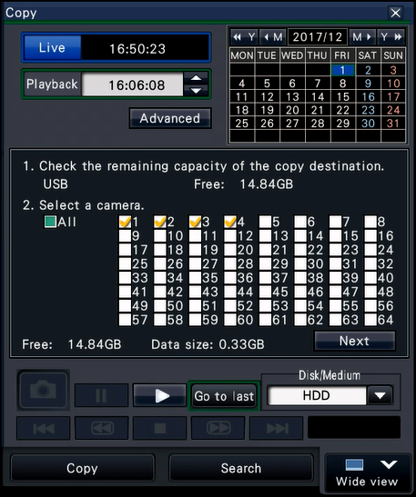
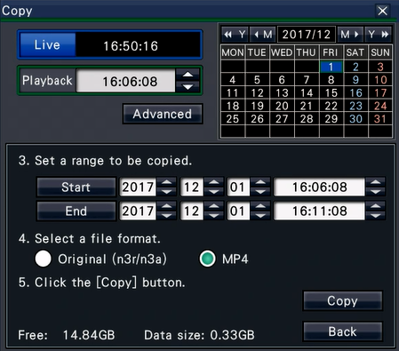
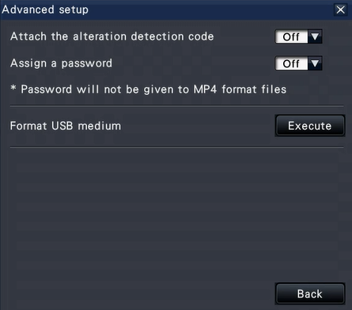
MP4 download (Operation GUI)
NX400 : Firmware version 2.00
NX300 : Firmware version 2.00
NX200 : Firmware version 2.00
MP4 Copy function
Insert a medium in advance, otherwise “Please insert a medium” message will be displayed after clicking “Copy” button.
Advanced setup
Alteration detection code: Support
Assign a password: Non support (In case of MP4 is selected)
4. Click [ Advanced ] as necessary
2. Click [ Next ]
1. Click [ Copy ] tab
3. Select file format
5. Click [ Copy ]
* Copying using a browser is also possible (conditions are equivalent to the above monitor operation)
NX400
NX300
NX200

Slide 33
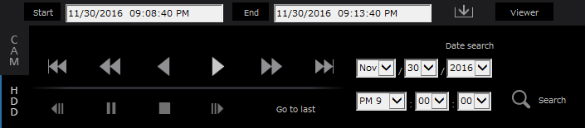
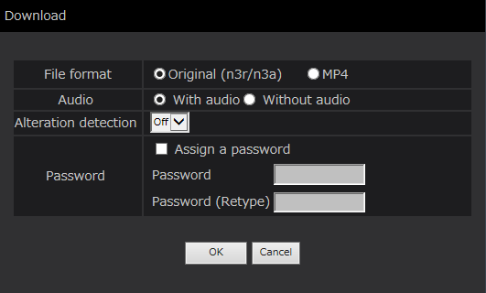
MP4 download (Operation GUI / Browser )
NX400 : Firmware version 2.00
NX300 : Firmware version 2.00
NX200 : Firmware version 2.00
Download operation by Browser
4. Click the [ Download ] button
The "Download" window will be displayed.
2. Click the [ Start ] button where the download is to start
5. Select file format
1. Click the [ HDD ] tab
3. Click the [ End ] button where the download is to end
6. Advanced setup
Alteration detection code: Support
Assign a password: Non support (In case of MP4 is selected)
7. Click [ OK ]
NX400
NX300
NX200

Slide 34
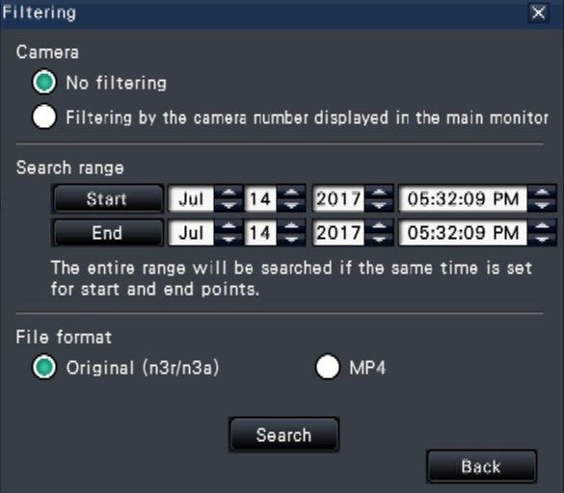
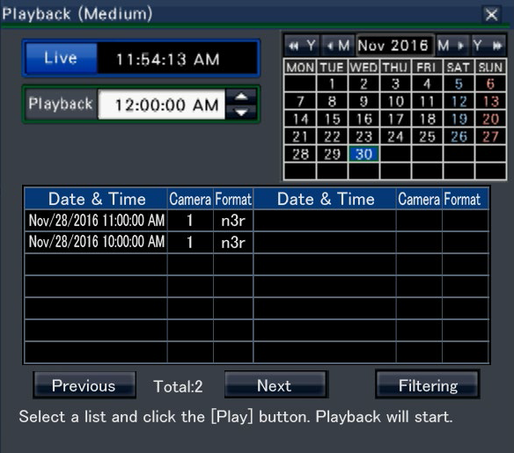
MP4 download (Operation GUI)
NX400 : Firmware version 2.00
NX300 : Firmware version 2.00
NX200 : Firmware version 2.00
MP4 Playback copied images (USB)
1. Insert the USB device into the NX400
2. Select [ USB ] of the “Disk/Medium”
The media playback panel will be displayed. Also logs are displayed in the list
Select desired File format
4. Click [ Search ] button.
3. Click [ Filtering ] button to filter the number of the copied data displayed on the list.
The filtering panel will be displayed.
5. Select the line with the desired date & time, and click
the playback button.
NX400
NX300
NX200

Slide 35
Corridor Aspect Layout
NX400 : Firmware version 2.00
NX300 : Firmware version 2.00
NX200 : Firmware version 2.00
The following screen layouts are available (In case of using Full HD monitor)
2-screen layout
3-screen layout
4-screen layout
1 | 2
1 | 2 | 3
1 | 2 | 3 | 4
(960x1080)
(640x1080)
(480x1080)
5-screen layout
6-screen layout
7-screen layout
1 | 2 | 3
 |  | 4
 |  | 5
1 | 2 | 3 | 4
 |  |  | 5
 |  |  | 6
1 | 4 | 5
2 |  | 6
3 |  | 7
(640x360)
(480x360)
(640x360)
(640x360)
(640x1080)
(480x1080)
(640x1080)
NX400
NX300
NX200

Slide 36
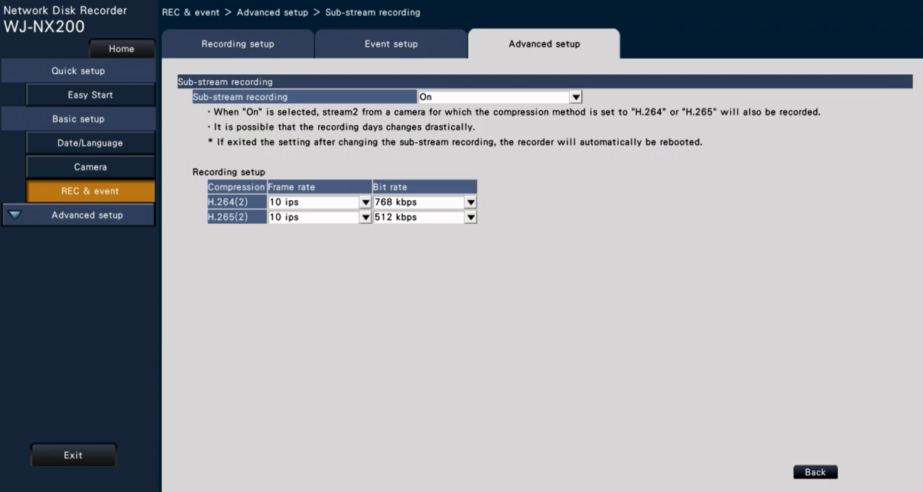
Flexible setting of Sub-stream recording
NX400 : Firmware version 2.00
NX300 : Firmware version 2.00
NX200 : Firmware version 2.00
Detail setting of Sub-streaming recording is available : Frame rate and Bit rate
Go to [ Setup ] -> [ REC & EVENT ] -> [ Advanced setup ] -> [ Sub-stream recording ]
[Sub-stream recording]
Set On/Off of the sub-stream recording.
On: Uses the sub-stream recording.
Off: Does not use the sub-stream recording.
Default: Off
[Frame rate]
Select the frame rate of the sub-stream recording.
1 ips/ 3 ips/ 5 ips/ 10 ips
Default: 10 ips
[Bit rate]
Select the bit rate of the sub-stream recording.
64 kbps, 128 kbps, 256 kbps, 384 kbps, 512 kbps, 768 kbps
Default: H.264(2) 768 kbps,
H.265(2) 512 kbps
WJ-NX400
“Recording setup” menu has been added
* Attached picture is an image.
NX400
NX300
NX200

Slide 37

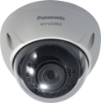

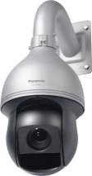

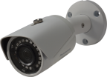
Support New Cameras
NX400 : Firmware version 2.00
NX300 : Firmware version 2.00
NX200 : Firmware version 2.00
Support V-series cameras, model WV-V1170/V1330/V2530 and V6430.
4K Box camera
WV-V1170
Fixed Dome camera
WV-V2530L1/V2530LK
Fixed Bullet/Varifocal Bullet camera
WV-V1330K/V1330L1
IR-LED PTZ camera
WV-V6430L
* Certain country is nor available V-series cameras.
NX400
NX300
NX200

Slide 38


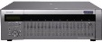
ASM Concurrent License
NX400 : Firmware version 2.10
NX300 : Firmware version 2.00
NX200 : Firmware version 2.00
Concurrent function gives access right to access the NX series NVR from several ASM300.
Up to 4 concurrent license can be registered in 1 NX series NVR.
Up to 5 PC can be used as ASM300 per 1 license.
Possible to access to the NX series NVR from specific ASM300
that is installed in different location.
Concurrent User License Kit No.: WJ-NXC05W
  Total 6 licenses are included
  (1 for NX series recorder, 5 for ASM)
Up to 5 PC (ASM) can be registered per one license. However, only 1 PC can be accessed out of 5 PCs.
ASM300:1
Accessing
Concurrent License
Up to 4 licenses can be registered.
ASM300:2
If several Concurrent licenses are registered, plural ASM300 can access to the NX series NVR at the same time according to a number of registered license. (Max. 4 ASM can be accessed)
Example:
1 license = 1x ASM300 out of 5x ASM300
2 licenses = 2x ASM300 out of 10x ASM300
3 licenses = 3x ASM300 out of 15x ASM300
4 licenses = 4x ASM300 out of 20x ASM300
ASM300:3
NX series NVR
ASM300:4
ASM300:5
Important: Ver.1.30 onward of ASM300 supports this function.
* Please refer to the Operating Instructions (help file) or SE material of WV-ASM300 for more details.
NX400
NX300
NX200

Slide 39
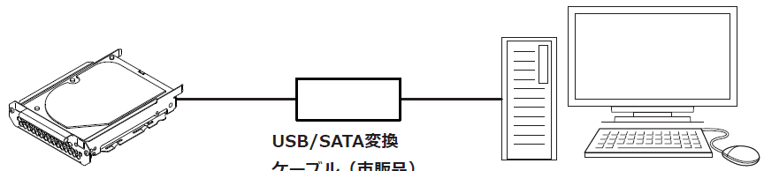
Support HDD Viewer
NX400 : Firmware version 2.10
NX300 : Firmware version 2.00
NX200 : Firmware version 2.00
HDD Viewer is Software to play video / audio stored on HDD removed from the NX series Network Video Recorder on a PC.
System Configuration:
  PC (Installed HDD Viewer Software)
  USB/SATA Convertor Cable
  HDD (Removed from NVR)
PC Specification:
OS: Win.7, Win.8.1 and Win.10
CPU: Intel Core i7-860 or above
Memory: more than 4GB
Monitor: 1024x768 pixels or more, 24-bit True color or better
USB port
USB/SATA Conversion Cable
* Available in the Local Market
Important
If the PC does not meet above system requirements, it may cause problems such as slow imaging.
Win RT, Win 7 and MS Edge are not supported.
Use in the Desktop when using Win 8.1,
HDD
(Removed from the recorder)
PC with HDD Viewer software is copied
Note: HDDs running RAID5/RAID6 mode cannot be played on the HDD viewer.
NX400
NX300
NX200

Slide 40
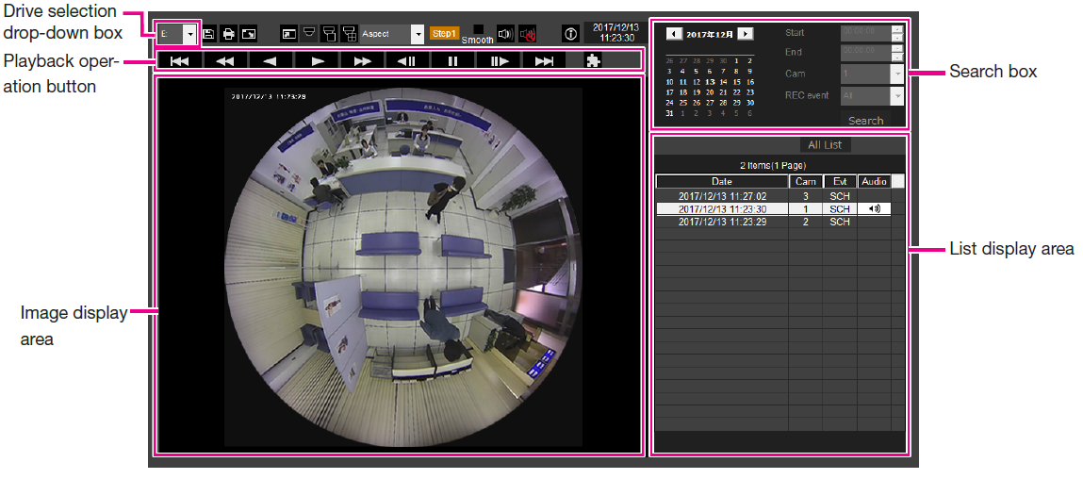
GUI: HDD Viewer Software
NX400 : Firmware version 2.10
NX300 : Firmware version 2.00
NX200 : Firmware version 2.00
Selectable Event
All event
Command alarm
Emergency
Schedule
SD memory backup
Camera site alarm
Terminal alarm
After selection of the drive, the list of all events is displayed with the latest record first
*Page display for every 100
NX400
NX300
NX200

Slide 41
Comparison (HDD Viewer vs. NX Viewer)
NX400 : Firmware version 2.10
NX300 : Firmware version 2.00
NX200 : Firmware version 2.00
No. | Function |  | Description | HDD Viewer | NX Viewer
0-1 | Operation Environmental | OS | Windows7 Pro SP1 / Windows 8.1 Pro / Windows 10 Pro | YES | YES
0-2 |  | Applicable HDD | Recorded HDD by NX series NVR | YES | ---
1-1 | List Management | File / HDD Selection | Specify the image file / folder | N/A | YES
1-2 |  |  | Select HDD | YES | N/A
1-3 |  |  | Manage list and display the list | YES | YES
1-4 |  | Refine Playback Function | Refine playback list by specified criteria | YES | YES
2-1 | Image Control | Image Playback | Playback image (JPEG/H.264/H.265) | YES | YES
2-2 |  |  | Display playback date and time | YES | YES
2-3 |  |  | Change the record to be playback | YES | YES
2-4 |  |  | Correct the image of 360-deg. Camera and play it | YES | YES
2-5 |  | Image Display Size Adjustment | Enlarge the window display | YES | YES
2-6 |  |  | Returns the enlarged window display to the original size | YES | YES
2-7 |  |  | Display the image maximized to the whole window | YES | YES
NX400
NX300
NX200

Slide 42
Comparison (HDD Viewer vs. NX Viewer)
NX400 : Firmware version 2.10
NX300 : Firmware version 2.00
NX200 : Firmware version 2.00
No. | Function |  | Description | HDD Viewer | NX Viewer
2-8 | Image Control | Image Display Method | Adjust the playback speed of video | YES | YES
2-9 |  |  | Change I frame skip display | YES | YES
2-10 |  |  | Change the playback direction of video | YES | YES
2-11 |  |  | Display the playback speed of video | YES | YES
2-12 |  |  | Adjust the image display ratio | YES | YES
2-13 |  |  | Electronic zoom display | YES | YES
2-14 |  |  | Change the playback position of the image with the slider | N/A | YES
2-15 |  | Still Image Saving | Save the displayed image as a JPEG still image | YES | YES
2-16 |  | Print Function | Call the OS function to print the display image | YES | YES
3-1 | Audio Control | Audio Playback | Play audio synchronously with the video | YES | YES
3-2 |  |  | Synchronously play network microphone sound according to video | YES | YES
4-1 | Network Microphone | Sound Collection | Control network microphone panels | YES | YES
4-2 |  |  | Specify sound collection position on the video and play it | YES | YES
5-1 | Secure | Image Encryption Control | Decrypt encrypted data and playback it | YES | YES
6-1 | File Expansion Function | Alteration Detection | Perform simple alteration detection | N/A | YES
6-2 |  | File Export | Save video / audio as N3R/N3A file | YES | N/A
NX400
NX300
NX200

Slide 43
HDD Viewer (Basic Procedure)
NX400 : Firmware version 2.10
NX300 : Firmware version 2.00
NX200 : Firmware version 2.00
Preparation
Set password for HDD viewer.
  Go to [Setup] -> [Advanced setup] -> [ Maintenance ] -> [HDD information] -> [Set password for HDD viewer]
Acquire HDD viewer software.
  Go to [Setup] -> [Advanced setup] -> [ Maintenance ] -> [HDD information] -> [Save HDD viewer (to USB medium)]
1. Remove the HDD from the recorder
2. Connect the removed HDD to the PC
3. Search / Playback by HDD Viewer
NX400
NX300
NX200

Slide 44
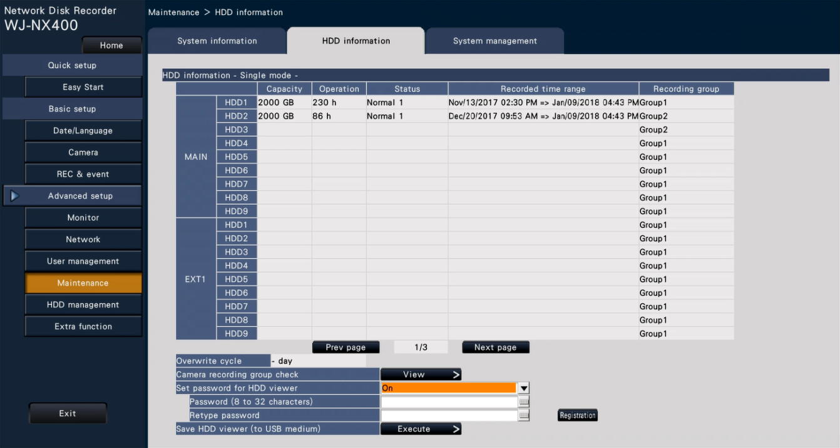
HDD Viewer (PW setting)
NX400 : Firmware version 2.10
NX300 : Firmware version 2.00
NX200 : Firmware version 2.00
Before removing the HDD from the recorder, set the password for the HDD viewer.
  Go to [Setup] -> [Advanced setup] -> [Maintenance] -> [HDD information] -> [Set password for HDD viewer]
  Set the password per recorder. Individual setting cannot be done for each HDD.
Note:
For password information, normal HDD is written at the time of removal operation (Not written to playback only and error disc)
When inserting the removed HDD into a different recorder, it is possible to play it regardless of password setting.
Removed HDD with NX400 before Ver.2.10, it can be played without a password
Removed HDD with NX300/NX200 before Ver.2.10, it can be played without a password
1. Set password for HDD viewer to “ON”.
2. Enter the “Password”, then click “Register.
NX400
NX300
NX200

Slide 45
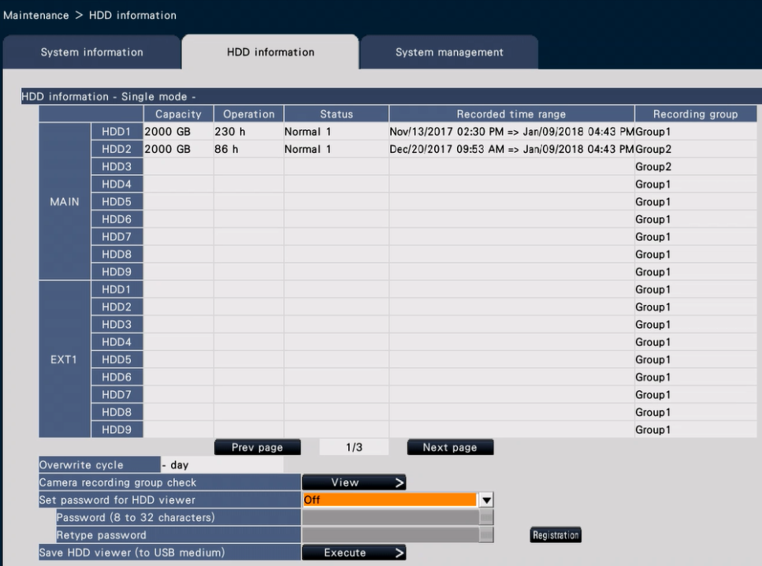
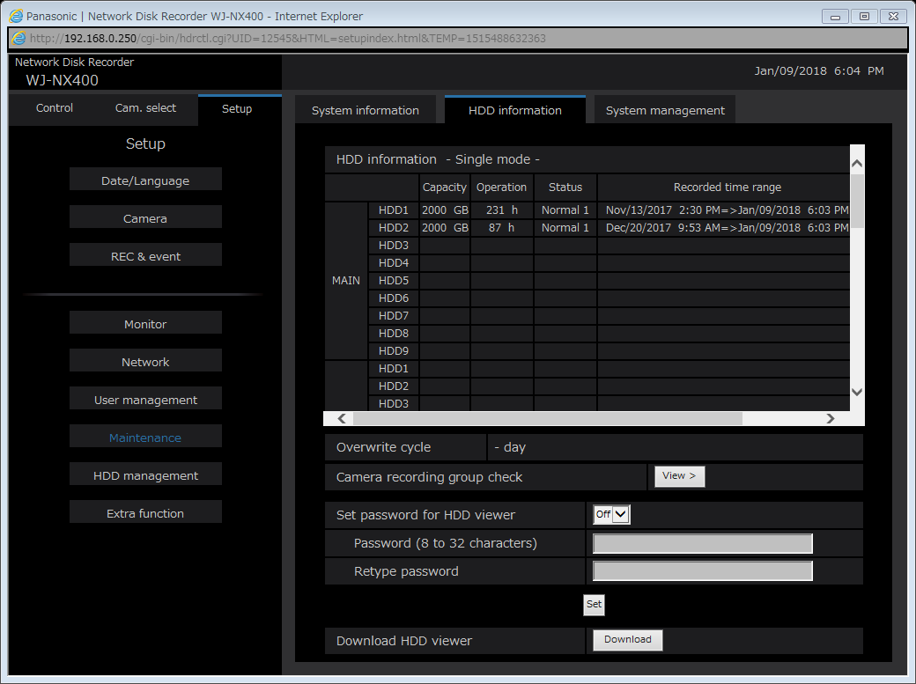
HDD Viewer (Copy and Browser Download)
NX400 : Firmware version 2.10
NX300 : Firmware version 2.00
NX200 : Firmware version 2.00
HDD viewer software can be downloaded from both recorder and browser
  Recorder (Main unit)
  Go to [Setup] -> [Advanced setup] -> [Maintenance] -> [HDD information] -> [Set HDD viewer (to USB medium)]
  Browser
  Go to [Setup] -> [Advanced setup] -> [Maintenance] -> [HDD information] -> [Download HDD viewer]
Click “Execute” to copy to USB medium
Click “Download” to download to PC
* The above GUI image is NX400. This is just for reference.
NX400
NX300
NX200

Slide 46
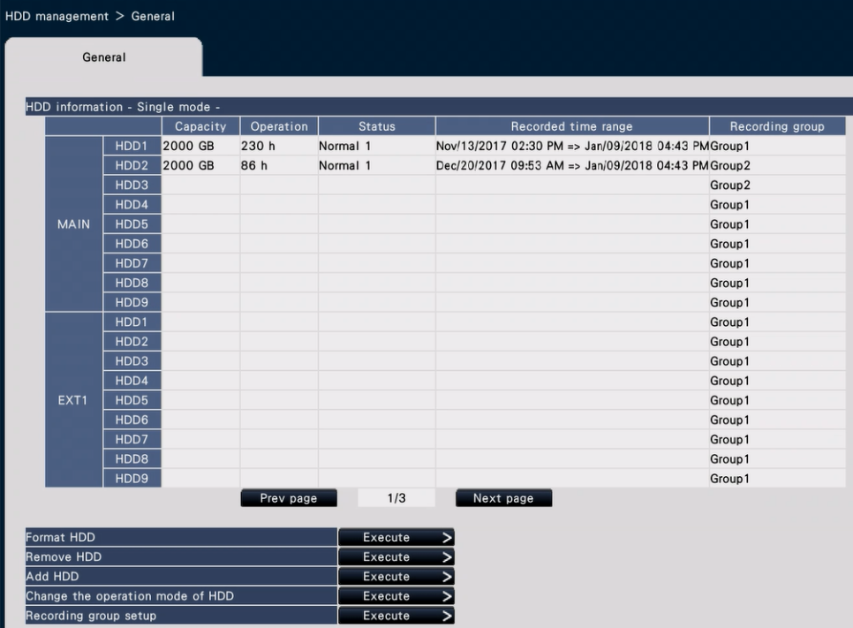
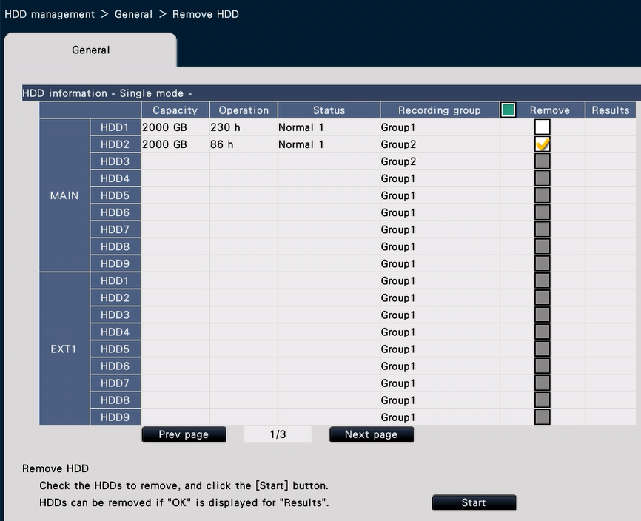
HDD Viewer (HDD Removal)
NX400 : Firmware version 2.10
NX300 : Firmware version 2.00
NX200 : Firmware version 2.00
Go to [Setup] -> [Advanced setup] -> [HDD management] -> [General] -> [Remove HDD]
2. Select “HDD” want to remove
1. Click “Remove HDD”
3. Click “Start” to remove it
Note: HDDs running RAID5/RAID6 mode cannot be played on the HDD viewer.
* The above GUI image is NX300. This is just for reference.
NX400
NX300
NX200

Slide 47

HDD Viewer Software
NX400 : Firmware version 2.10
NX300 : Firmware version 2.00
NX200 : Firmware version 2.00
After copying HDD viewer to USB or downloaded to PC, unzip “NX_HDD_Viewer.zip”
When unzipped, “NxHddViewer_Install-less” folder is created.
Remove HDD, and connect USB-SATA conversion cable to PC, then double click “NxHddViewer.exe” to execute the software. (The HDD viewer can be used without installation)
← Double click to execute the software
NX400
NX300
NX200

Slide 48






HDD Viewer (Tested USB/SATA Convertor by SSBD)
NX400 : Firmware version 2.10
NX300 : Firmware version 2.00
NX200 : Firmware version 2.00
Operation confirmed models
CENTURY
CRAISU3S6G | CSDRU3B6G | CROSU31S
Startech
SATDOCKU3S | SDOCKU33EBV | SDOCKU33EF
NX400
NX300
NX200

Slide 49




Support New Cameras
NX400 : Firmware version 2.10
NX300 : Firmware version 2.00
NX200 : Firmware version 2.00
Support i-PRO Extreme 5M 360-deg. Fisheye cameras, model WV-S4150 and WV-S4550L.
Indoor model
WV-S4150
Outdoor Vandal with IR-LED
WV-S4550L
Good peripheral resolution by stereo projection lens
Improved Wide dynamic Range by 108dB
Built in IR-LED : Max. 10m Reach distance (only WV-S4550L)
Provide best image by “Intelligent Auto (iA)”
Support Various Dewarp mode
Enables to reduce bitrate by H.265 codec and new Smart Coding feature, “Frame rate control”
Provide High secure system by Symantec certificate
Easy Installation and adjustment by New attachment plate
NX400
NX300
NX200

Slide 50
Firmware version up items
(For NX400/ NX300/NX200 Ver.2.20)

Slide 51
Firmware Version Up Contents
NX400 : Firmware version 2.20
NX300 : Firmware version 2.20
NX200 : Firmware version 2.20
The following items are now available with version 2.20 of the WJ-NX400/NX300/NX200.
No. | Update contents | Release Date | Firmware Version | Note
1 | Support WV-S4170, WV-S4171, WV-S4571L and WV-S4571LM | Mar.2018 | NX400 : Ver.2.20 NX300 : Ver.2.20 NX200 : Ver.2.20
2 | Static Routing | Mar.2018 | NX400 : Ver.2.20 NX300 : Ver.2.20 NX200 : Ver.2.20 | This is similar function which was installed in WJ-ND400.
3 | Face frame manual adjustment at face image registration | Mar.2018 | NX300 : Ver.2.20 NX200 : Ver.2.20
4 | Improve camera setting for the Extreme camera (Adaptive black stretch, Back light compensation ) | Mar.2018 | NX400 : Ver.2.20 NX300 : Ver.2.20 NX200 : Ver.2.20
5 | Digest authentication | Mar.2018 | NX400 : Ver.2.20 NX300 : Ver.2.20 NX200 : Ver.2.20 | Reinforcement of secure
6 | Other improvement items | Mar.2018 | NX400 : Ver.2.20 NX300 : Ver.2.20 NX200 : Ver.2.20
NX400
NX300
NX200

Slide 52



Support New Cameras
NX400 : Firmware version 2.20
NX300 : Firmware version 2.20
NX200 : Firmware version 2.20
New!
Support i-PRO Extreme 9M 360-deg. Fisheye cameras, model WV-S4171 and WV-S4571L.
Indoor model
WV-S4171
Outdoor Vandal with IR-LED
WV-S4571L
Good peripheral resolution by stereo projection lens
Improved Wide dynamic Range by 108dB
Built in IR-LED : Max. 10m Reach distance (only WV-S4571L)
Provide best image by “Intelligent Auto (iA)”
Support Various Dewarp mode
Enables to reduce bitrate by H.265 codec and new Smart Coding feature, “Frame rate control”
Provide High secure system by Symantec certificate
Easy Installation and adjustment by New attachment plate
NX400
NX300
NX200

Slide 53


Static routing
NX400 : Firmware version 2.20
NX300 : Firmware version 2.20
NX200 : Firmware version 2.20
New!
Added "Static route" settings which was installed in WJ-ND400
Usage example (2 port operation)
192.168.10.1
192.168.10.200
Router
PC
192.168.1.1
PC Port
192.168.1.250
Recorder
By setting the Static Route settings as shown below, recording of this camera becomes possible.
Static route: On
Address: 10.100.10.0
Gateway: 192.168.0.1
Camera/PC Port
192.168.0.250
192.168.0.1
Router
HUB
10.100.10.1
192.168.0.101
10.100.10.101
Camera1
Camera2
NX400
NX300
NX200

Slide 54


Face frame manual adjustment
NX300 : Firmware version 2.20
NX200 : Firmware version 2.20
New!
Added function to move face frame with mouse operation (Drag & Drop)
Before
adjustment
During
the move
After
adjustment
The face frame of the face image to be registered is misaligned.
Mouse down inside the frame to grab the frame, Drag and move the eye and nose into the frame.
(Expansion / reduction of the frame is impossible)
Confirmed with mouse drop.
After this, register by double click as before.
NX300
NX200

Slide 55


Improve camera setting
NX400 : Firmware version 2.20
NX300 : Firmware version 2.20
NX200 : Firmware version 2.20
New!
Adaptive black stretch
Added level value to Adaptive black stretch parameter
For Extreme before ：Off, On
For Extreme ：0, 16, 32, 48, … , 240, 255, Reset
After sending the above values to other than the Extreme camera, "Not compatible" is displayed in the result column.
When “Off” or “On” is transmitted to the Extreme camera, "Not compatible" is displayed in the result column.
Back light compensation
Change command to send to the camera, also support Extreme camera
NX400
NX300
NX200

Slide 56
Digest authentication (1/3)
NX400 : Firmware version 2.20
NX300 : Firmware version 2.20
NX200 : Firmware version 2.20
New!
Change the authentication method between recorder and camera from “Basic authentication” to “Digest authentication” with high security.
Basic authentication
Digest authentication
Recorder
Camera
Recorder
Camera
http://192.168.0.10/
ID/PW
http://192.168.0.10/
Random number generation
Authentication
HTTP/1.1 401 Unauthorized
HTTP/1.1 200 OK
Encoding ID / PW based on random number
http://192.168.0.10/
It is possible to prevent eavesdropping and data tampering from occurring during communication.
HTTP/1.1 200 OK
NX400
NX300
NX200

Slide 57

Digest authentication (2/3)
NX400 : Firmware version 2.20
NX300 : Firmware version 2.20
NX200 : Firmware version 2.20
New!
Added authentication method setting for each camera
"Authentication" menu added so that the authentication method can be set for each camera.
Selectable Authentication method: Digest, Digest or Basic, Basic
NX400
NX300
NX200

Slide 58
Digest authentication (3/3)
NX400 : Firmware version 2.20
NX300 : Firmware version 2.20
NX200 : Firmware version 2.20
New!
Notes:
When upgrading to the new firmware version, “Setting value" will carry over according to the registered camera's model number.
Also, uploading the setting data downloaded with the recorder before V2.20 to the recorder of the new firmware is the same.
  If you operate the camera with the authentication method set to “Basic”, a communication error (authentication error) will occur.
Model | Selectable Settings | Default
Digest authentication certified camera | Digest, Digest or Basic, Basic | Digest
Digest authentication non-compliant camera（NS202A, GXE500, HCM, etc.） | Basic （Fixed） | Basic
ONVIF | Digest, Digest or Basic, Basic | Digest or Basic
NX400
NX300
NX200

Slide 59




Other improvement items
NX400 : Firmware version 2.20
NX300 : Firmware version 2.20
NX200 : Firmware version 2.20
New!
Add online user information display to setting menu
Add input limit of unusable port number
Suppression of erroneous operation of setting initialization
The online user information display which was installed in the ND400 was restored in maintenance> system information
For port numbers (50000 to 50255) that can not be used in the NX series, added a guard so that it can not be set as HTTP port number etc. from this firmware.
In order to reduce the risk of setting initialization due to erroneous operation, the layout of the menu was changed from this firmware
NX400
NX300
NX200

Slide 60
Firmware version up items
(For NX400/ NX300/NX200 Ver.2.30)

Slide 61
Firmware Version Up Contents
NX400 : Firmware version 2.30
NX300 : Firmware version 2.30
NX200 : Firmware version 2.30
The following items are now available with version 2.30 of the WJ-NX400/NX300/NX200.
No. | Update contents | Release Date | Firmware Version | Note
1 | Support WV-X8530N and WV-S8530N. | July 2018 | NX400 : Ver.2.30 NX300 : Ver.2.30 NX200 : Ver.2.30
2 | Multi-sensor camera compatible | July 2018 | NX400 : Ver.2.30 NX300 : Ver.2.30 NX200 : Ver.2.30
3 | Support WV-S2550L, S2250L and S1550L. | July 2018 | NX400 : Ver.2.30 NX300 : Ver.2.30 NX200 : Ver.2.30
4 | HDD format / removal without stopping recording | July 2018 | NX400 : Ver.2.30 NX300 : Ver.2.30 NX200 : Ver.2.30
5 | The camera partitioning function | July 2018 | NX400 : Ver.2.30 NX300 : Ver.2.30 NX200 : Ver.2.30
NX400
NX300
NX200

Slide 62


Support New Cameras
NX400 : Firmware version 2.30
NX300 : Firmware version 2.30
NX200 : Firmware version 2.30
New!
Support i-PRO Extreme Multi-Sensor cameras, model WV-X8530N and WV-S8530N.
WV-X8570N : 4 x 4K(33MP) iA H.265 Multi-Sensor Camera
4 x True 4K high resolution(33MP) 3840x2160 15fps
Combining H.265 compression with Smart Coding technology
WV-S8530N : 4 x FHD(8MP) iA H.265 Multi-Sensor Camera
4 x Full HD(8MP) 1600x1200 / 1920x1080 30fps
Usability - Easy setting
Others
Wide range tilt angle adjustment mechanism
Four repositionable lenses enables to monitoring at minimize blind spots
WV-X8570N
WV-S8530N
NX400
NX300
NX200

Slide 63
Multi-sensor camera compatible 1/2
NX400 : Firmware version 2.30
NX300 : Firmware version 2.30
NX200 : Firmware version 2.30
Camera Detection Assist Function
The recorder will automatically register 4 cameras for each multi-sensor camera.
Register the multi-sensor camera preferentially to the younger number over other cameras.
Notes:
Set the following values for each camera number of the same camera.
Camera authentication
Compression and capture size of camera images
Recording settings (audio encoding format) *for WV-X8570N only.
SD backup setup
Security between this product and cameras (connection, data encryption setting)
MJPEG cannot be selected for compression of images.
The SD backup of WV-X8570N is available only when its compression of images is H.265(1) and image capture size is WQHD(2560x1440).
Auto-IP address assignment is only available for S8530-1 or X8570-1.
The settings may not be reflected if you set and send values for multiple camera numbers of the same camera. If an error occurs, select a camera number that the error occurs and send the setting again.
The VMD alarm of the camera can not be set on the recorder. Set the VMD alarm of the camera on the VMD area tab of the setting menu on the camera side.
A license for four cameras is required for each multi-sensor camera.
NX400
NX300
NX200

Slide 64



Multi-sensor camera compatible 2/2
NX400 : Firmware version 2.30
NX300 : Firmware version 2.30
NX200 : Firmware version 2.30
Layout for multi-sensor camera
The recorder adds a T layout of 4: 3 and 16: 9 for full screen display of the main monitor.
Add button
16:9
4:3
NX400
NX300
NX200

Slide 65



Support New Cameras
NX400 : Firmware version 2.30
NX300 : Firmware version 2.30
NX200 : Firmware version 2.30
New!
Support i-PRO Extreme 5-megapixel cameras, model WV-S2550L, S2250L and S1550L.
5-megapixel images up to 30 fps
iA (intelligent Auto)
Super Dynamic 120dB
Color night vision (0.0044 to 0.07 lx)
H.265 Smart Coding
Outdoor Vandal with IR-LED
WV-S2550L
Indoor Vandal with IR-LED
WV-S2250L
Outdoor Vandal Box with IR-LED
WV-S1550L
NX400
NX300
NX200

Slide 66



NX400 : Firmware version 2.30
NX300 : Firmware version 2.30
NX200 : Firmware version 2.30
HDD format / removal without stopping recording
HDD format and HDD can be removed without stopping recording.
Maintenance> "HDD maintenance" is newly added to the HDD information, and the menu related to "HDD viewer" is transferred to it.
Current menu
New menu
NX400
NX300
NX200

Slide 67

NX400 : Firmware version 2.30
NX300 : Firmware version 2.30
NX200 : Firmware version 2.30
HDD format / removal without stopping recording
Format HDD
Select a HDD to format and click the [Start]
button to format the HDD.
Notes:
When a hard disk drive is formatted, all the recorded images
will be erased.
HDDs with "Playback only" or "Added" status only can be
selected.
After starting to format the HDD, copying, downloading and backing up to NAS in process will stop.
Remove HDD
Check HDDs to remove and click the [Start] button to display the confirmation window of the
password for the HDD viewer. When the entered value and the setting match, the HDD is removed.
Notes:
HDDs in recording cannot be selected. If the HDD stand-by control mode is On, a HDD following the HDD in recording also cannot be selected. If the operation mode of HDDs is the mirroring mode, one of the two HDDs in recording may be removed.
After starting to format the HDD, copying, downloading and backing up to NAS in process will stop.
NX400
NX300
NX200

Slide 68



NX400 : Firmware version 2.30
NX300 : Firmware version 2.30
NX200 : Firmware version 2.30
The camera partitioning function
The camera partitioning function is added.
Select which control range each camera should follow.
Common setting : The camera follows "User level settings"
of "User management>Basic".
Individual setting : The camera follows camera partitioning
settings set for each user.
Individual setting
Click the [Setup >] button to set the camera partitioning individually.
Set availability of image display and camera operation in each
camera for the assigned user.
Common setting
Individual setting
View/Operate : Enables display of live/recorded
images and camera operation.
View : Enables display of live/recorded images,
but disables camera operation.
Off : Disables display of live/recorded images and
camera operation.
NX400
NX300
NX200

Slide 69
Firmware version up items
(For NX400/ NX300/NX200 Ver.2.40)

Slide 70
Firmware Version Up Contents
NX400 : Firmware version 2.40
NX300 : Firmware version 2.40
NX200 : Firmware version 2.40
The following items are now available with version 2.40 of the WJ-NX400/NX300/NX200.
No. | Update contents | Release Date | Firmware Version | Note
1 | Support i-PRO Extreme Compact Dome Cameras, model WV-S3531L, -S3511L, -S3131L and -S3111L. | Nov. 2018 | NX400 : Ver.2.40 NX300 : Ver.2.40 NX200 : Ver.2.40
2 | Measure the network transmission/reception speed. | Nov. 2018 | NX400 : Ver.2.40 NX300 : Ver.2.40 NX200 : Ver.2.40
3 | Password New rule compliant | Nov. 2018 | NX400 : Ver.2.40 NX300 : Ver.2.40 NX200 : Ver.2.40
4 | HDD remaining capacity display and notification function. | Nov. 2018 | NX400 : Ver.2.40 NX300 : Ver.2.40 NX200 : Ver.2.40
5 | Emergency audio recording function. | Nov. 2018 | NX400 : Ver.2.40 NX300 : Ver.2.40 NX200 : Ver.2.40
6 | High quality setting of business intelligence. | Nov. 2018 | NX300 : Ver.2.40 NX200 : Ver.2.40
7 | Maintaining the aspect ratio of full screen display | Nov. 2018 | NX400 : Ver.2.40 NX300 : Ver.2.40 NX200 : Ver.2.40
NX400
NX300
NX200

Slide 71


Support New Cameras
NX400 : Firmware version 2.40
NX300 : Firmware version 2.40
NX200 : Firmware version 2.40
New!
Support i-PRO Extreme Compact Dome Cameras,
model WV-S3531L, -S3511L, -S3131L and -S3111L.
Outdoor Vandal with IR-LED
WV-S3531L, WV-S3511L
Indoor with IR-LED
WV-S3131L, WV-S3111L
Full HD 1080p 60fps / HD 720p 60 fps
iA (intelligent Auto)
Extreme Super Dynamic 144dB (FHD model) / 134dB(HD model)
Color night vision 0.0019 to 0.03 lx(FHD model) / 0.0013 to 0.02 lx(HD model)
H.265 Smart Coding
Built-in IR LED
Corridor mode
NX400
NX300
NX200

Slide 72


Measure the network transmission/reception speed 1/2
NX400 : Firmware version 2.40
NX300 : Firmware version 2.40
NX200 : Firmware version 2.40
A function to measure the network transmission/reception speed has been added.
Used to measure the amount of network traffic transmitted from the recorder.
Click the [Execute] button and execute from the confirmation window displayed. After configuration is
completed, measuring starts.
A menu is added to "Maintenance> System management> Other functions".
The result of measurement will be displayed
after measurement finishes.
GUI
Notes:
Measurement is made from about 8 seconds after setting is done and will continue measuring for 10 seconds.
Status display area of operation screen will display ” Measuring” while measuring.
NX400
NX300
NX200

Slide 73


Measure the network transmission/reception speed 2/2
NX400 : Firmware version 2.40
NX300 : Firmware version 2.40
NX200 : Firmware version 2.40
A menu is added to the "System Management" tab of "Maintenance".
The result of measurement will be displayed
after measurement finishes.
BROWSER
Notes:
The result of measurement is the sum of all network ports.
The result of measurement is only for reference. It may differ depending on the network environment.
NX400
NX300
NX200

Slide 74
Password New rule compliant
NX400 : Firmware version 2.40
NX300 : Firmware version 2.40
NX200 : Firmware version 2.40
The password must be between 8-32 characters including the half width alphanumeric and the symbol.
Also, for the password, use three or more types of characters from upper- and lowercase alphabetic characters, numbers, and symbols.
Set a password which does not include the user name.
Notes:
The rule is also applied to the menu which sets the camera's password.
NX400
NX300
NX200

Slide 75


HDD remaining capacity display and notification function
NX400 : Firmware version 2.40
NX300 : Firmware version 2.40
NX200 : Firmware version 2.40
View HDD remaining capacity function has been added
A menu is added to "Maintenance> HDD information".
Notes:
Remaining capacity displayed does not include capacity used to manage data.
Therefore, the displayed HDD capacity is less than the actual amount.
Remaining capacity will displayed as 0GB if the whole space of the HDD
is used up by recording data.
HDD Remaining capacity notice
Set the notification timing for when the remaining
capacity of HDD becomes low compared to the total capacity.
There are E-mail notification and original notification.
Off : Does not perform HDD remaining capacity notice.
1%,2%...10% : Notifies when remaining capacity becomes below the set value.
Off, 1%, 2%, 3% … , 10%
NX400
NX300
NX200

Slide 76


Emergency audio recording function 1/2
NX400 : Firmware version 2.40
NX300 : Firmware version 2.40
NX200 : Firmware version 2.40
It is a function to record the sound of cameras that have not been set for recording only at emergency recording
If audio recording is not set for the camera, select whether to record audio only during
emergency recording.
Off : Does not record audio even during emergency recording.
On : Records audio only during emergency recording. (G.726 format)
On (AAC-LC) : Records audio only during emergency recording. (AAC-LC format)
30s, 1min, 3min, 5min, 10
min, 15min, 30min, Manual, Ext.
Off, On, On(AAC-LC)
NX400
NX300
NX200

Slide 77
Emergency audio recording function 2/2
NX400 : Firmware version 2.40
NX300 : Firmware version 2.40
NX200 : Firmware version 2.40
Notes:
Cameras that do not support audio functions , audio will not be recorded even when it is set to a value other than “Off”.
Depending on the timing when emergency recording is started, audio may be recorded at the end of the previous recording data just before the emergency recording.
Actual operation when emergency recording setting is used with audio incompatible or AAC-LC noncompliant camera is as shown in the table below
Camera type | Emergency recording
 | Off | On | On(AAC-LC)
Panasonic (audio non-compatible) | Off | Off | Off
Panasonic (AAC-LC not compatible) | Off | G.726 | G.726
Panasonic (AAC / G.726 compatible) | Off | G.726 | AAC-LC
Third-party cameras | Off | Off | Off
NX400
NX300
NX200

Slide 78

High quality setting of business intelligence
NX300 : Firmware version 2.40
NX200 : Firmware version 2.40
It is setting to raise the bit rate of the camera used for business intelligence function.
A menu is added to "Extension Functions> Business Intelligence".
Notes:
The bit rate corresponding to Off / On
in High Quality mode is as shown
in the table on the right.
Representative part number / compression method | High Quality mode Off ｜ On
SP304V / H.264 | 4096 kbps | 4096 kbps
SPN310V / H.264 | 3072 kbps
S1110V / H.264 | 3072 kbps
S1110V / H.265 | 2048 kbps
NX300
NX200

Slide 79


Maintaining the aspect ratio of full screen display
NX400 : Firmware version 2.40
NX300 : Firmware version 2.40
NX200 : Firmware version 2.40
A function to keep the aspect ratio for the full screen display has been added.
Keep the aspect ratio for the full screen display (Except during live sequence)
For “multiscreen select” of each wide view except for live sequence, select whether to change the aspect ratio
of the displayed area if the aspect ratio of the image is different from the displayed area.
Checked：Keeps aspect ratio (Does not change the ratio automatically)
Not checked：Does not keep aspect ratio (Changes the ratio automatically)
Default：Not checked
□全画面表示でアスペクト比を維持する（ライブシーケンス時除く）
Not checked (Default)
= Does not keep aspect ratio
Checked
= keep aspect ratio
Screen division pattern
Camera
image
16:9
4 pictures (portrait)
NX400
NX300
NX200

Slide 80
Firmware version up items
(For NX400/ NX300/NX200 Ver.2.50)

Slide 81
Firmware Version Up Contents
NX400 : Firmware version 2.50
NX300 : Firmware version 2.50
NX200 : Firmware version 2.50
The following items are now available with version 2.50 of the WJ-NX400/NX300/NX200.
No. | Update contents | Release Date | Firmware Version | Note
1 | Test mode of rear panel output terminal | Mar. 2019 | NX400 : Ver.2.50 NX300 : Ver.2.50 NX200 : Ver.2.50
2 | HTTP download support for n3r files larger than 2 GB | Mar. 2019 | NX400 : Ver.2.50 NX300 : Ver.2.50 NX200 : Ver.2.50
3 | Function addition from other models | Mar. 2019 | NX400 : Ver.2.50 NX300 : Ver.2.50 NX200 : Ver.2.50
NX400
NX300
NX200

Slide 82

Test mode of rear panel output terminal
NX400 : Firmware version 2.50
NX300 : Firmware version 2.50
NX200 : Firmware version 2.50
Terminal output test function has been added.
Outputs a signal from ALARM/CONTROL connector on the rear panel of the recorder.
Maintenance > System management > Other
GUI
2 s, 5 s, 10 s
NX400 | NX300/NX200
Time adjustment output Network error output HDD error output Camera error output Recording error output Recorder error output Outage processing end output Alarm output 1 Alarm output 2 Alarm output 3 Alarm output 4 | Time adjustment output Network error output Camera error output HDD / Recording error output Recorder error output Face matching output Alarm output
NX400
NX300
NX200
Notes:
Terminal output test function has been added.
［Terminal output test］
Outputs a signal from ALARM/CONTROL connector on the rear panel of the recorder.
Terminal: Selects the terminal at which to output the signal.
Test output duration: Select the duration over which the signal is output as 2 seconds, 5 seconds, or 10 seconds.
The signal will be output from the selected terminal when executed from the confirmation screen that is displayed by clicking [Execute] button. Page 71

Slide 83
HTTP download support for n3r files
NX400 : Firmware version 2.50
NX300 : Firmware version 2.50
NX200 : Firmware version 2.50
Browser will be able to download even if n3r file is over 2GB
When the size of the file being downloaded exceeds 2GB, the file will be divided automatically, and the
downloading is continued as a different file from the point at which the file division occurred.
 |  | Conventional specification | New specification
n3r | File name | The start date/time and acquisition time will be given in the specified period | Corrected value is given to the actual start/end time of the download target
 | Download data over 2GB | Downloaded up to 2GB only | Data is divided by 2GB and the remaining data is also downloaded (※)
MP4 | File name | Corrected value is given to the actual start/end time of the download target | (No change)
 | Download data over 2GB | Split at 2GB and download the remaining data | (No change)
It will be the same Spec.
as downloading with MP4
※The camera1 is downloaded by designating “20:00:00 → 20:50:00 of 2019/01/11”, “with audio”, and “unique format (n3r / n3a)”.
If it exceeds 2GB in 30 minutes, the following 4 files will be downloaded in order.
001_190111200000_3000_ff_00_28.n3r
001_190111200000_3000_ff_00_28.n3a
001_190111203000_2000_ff_00_28.n3r
001_190111203000_2000_ff_00_28.n3a
※When downloading files, you need to register the address on the Internet Explorer trusted site. (Same as MP4)
NX400
NX300
NX200
Notes:
Description has been added in section “Download recorded images currently being played”, step 6.
Note:
●When the size of the file being downloaded exceeds 2GB, the file will be divided automatically, and the downloading is continued as a different file from the point at which the file division occurred.

Slide 84
Function addition from other models
NX400 : Firmware version 2.50
NX300 : Firmware version 2.50
NX200 : Firmware version 2.50
Smart coding function and audio function have been added to [Easy Start].
［Smart coding (GOP control)］
Select when you use the smart coding (GOP control) function of the camera.
On(Advanced) ：Uses the smart coding.
Off ：Does not use the smart coding.
Default ：Off
Refer to "readme.txt" for model numbers and version information of cameras that have the smart
coding (GOP control) function.
Added a function to make login impossible for a certain period of time after 10 consecutive failures at login by browser (product security requirement)
NX400
NX300
NX200

Slide 85
Firmware version up items
(For NX400/ NX300/NX200 Ver.3.00)

Slide 86
Firmware Version Up Contents
NX400 : Firmware version 3.00
NX300 : Firmware version 3.00
NX200 : Firmware version 3.00
The following items are now available with version 3.00 of the WJ-NX400/NX300/NX200.
No. | Update contents | Release Date | Firmware Version | Note
1 | Support i-PRO Extreme IR-PTZ Cameras, model WV-X6533LN and WV-S6532LN. | July. 2019 | NX400 : Ver.3.00 NX300 : Ver.3.00 NX200 : Ver.3.00
2 | Support i-PRO Extreme 4K-Standard Cameras, model WV-S1570L -S2570L and -S2270L. | July. 2019 | NX400 : Ver.3.00 NX300 : Ver.3.00 NX200 : Ver.3.00
3 | Add camera settings | July. 2019 | NX400 : Ver.3.00 NX300 : Ver.3.00 NX200 : Ver.3.00
4 | Add operation mode not using stream 2 | July. 2019 | NX400 : Ver.3.00 NX300 : Ver.3.00 NX200 : Ver.3.00
NX400
NX300
NX200

Slide 87


Support New Cameras
NX400 : Firmware version 3.00
NX300 : Firmware version 3.00
NX200 : Firmware version 3.00
Support i-PRO Extreme IR-PTZ Cameras,
model WV-X6533LN and WV-S6532LN.
Full HD 1920x1080p 60fps
Long distance IR illumination
Intelligent Zoom Stabilization with 40x optical zoom
Color night vision 0.001 to 0.015 lx
iA (intelligent Auto)
ClearSight Coating
Durable Pan/Tilt gear mechanism
IP66, IK10 certified
WV-X6533LN WV-S6532LN
NX400
NX300
NX200

Slide 88




Support New Cameras
NX400 : Firmware version 3.00
NX300 : Firmware version 3.00
NX200 : Firmware version 3.00
Support i-PRO Extreme 4K-Standard Cameras,
model WV-S1570L -S2570L and -S2270L.
Outdoor box WV-S1570L
Outdoor Vandal dome
WV-S2570L
Indoor Vandal dome
WV-S2270L
New 4K 3840x2160/30fps
iA ( intelligent Auto )
Extreme Super Dynamic 120dB
Color night vision 0.006 to 0.09 lx
H.265 Smart Coding
Built-in IR LED
Corridor mode
( Added resolution “8M ( 2160x3840 )” )
Notes:
When the recording frame rate of H.265(1) or H.264(1) is set to “30ips”, 3 to 24 live display (H.265(2) or H.264(2)) becomes 15fps .
※When the recording frame rate is “15 ips” or less, the live display is 30 fps.
When SD backup recording is on, you can not use recording settings with a bit rate of 14 Mbps.
NX400
NX300
NX200

Slide 89

Add camera settings (1/4)
NX400 : Firmware version 3.00
NX300 : Firmware version 3.00
NX200 : Firmware version 3.00
Added the following three items to the camera setting menu
“Self return”, “Advanced individual camera setup” and “Schedule” are added to [Camera Setup] tab.
NX400
NX300
NX200

Slide 90

Add camera settings (Self return) (2/4)
NX400 : Firmware version 3.00
NX300 : Firmware version 3.00
NX200 : Firmware version 3.00
The function to change the Self return function setting of camera is added
Select the self-return function for individual cameras and transfer it to the camera to change
the camera settings.
Off
Home position
Auto track
Auto pan
Preset sequence
Patrol
10s, 20s, 30s, 1min, 2min, 3min,
5min, 10min, 20min, 30min, 60min
NX400
NX300
NX200

Slide 91

Add camera settings (VMD alarm) (3/4)
NX400 : Firmware version 3.00
NX300 : Firmware version 3.00
NX200 : Firmware version 3.00
The function for setting the motion detection alarm of individual cameras is added
Select the motion detection area and detection sensitivity for each camera and transmit the information to
the cameras to change the camera settings.
Select the camera you want to set in the pull-down menu
Preset position (1 to 8) or "except the preset positions" can be selected.
Unlike other camera settings, the VMD area setting screen is a mechanism to synchronize with the camera settings.
Click the upper left and lower right of the rectangle to draw. (Not a drug)
The color coding of area lines like the camera browser and the representation of dotted lines are not supported.
※The image capture mode of the 360-deg.fisheye camera is not supported except for the fisheye mode.
NX400
NX300
NX200

Slide 92

Add camera settings（Schedule） (4/4)
NX400 : Firmware version 3.00
NX300 : Firmware version 3.00
NX200 : Firmware version 3.00
Camera schedule can be set without PC (Schedule 1 to Schedule 4 can be set)
Select the Schedule mode and Schedule range for individual cameras and transfer to the camera to
change the camera settings.
Off
Alarm permission(Terminal alarm1,2,3)
Alarm permission(Terminal alarm1)
Alarm permission(Terminal alarm2)
Alarm permission(Terminal alarm3)
VMD permission
Preset position1
Preset position2
:
Preset position8
NX400
NX300
NX200

Slide 93

Add operation mode not using stream 2
NX400 : Firmware version 3.00
NX300 : Firmware version 3.00
NX200 : Firmware version 3.00
Added modes not using H.265 (2) or H.264 (2) for monitor live display
If “Do not use stream 2 of camera with each function of this recorder” is switched to ON, H.264(2) and
H.265(2) are not used. (Useful when using stream 2 with ASM300.)
  ※ Because the recording display stream is used for monitor display, live images may not be displayed on the monitor
  depending on the multi-screen display pattern if the recording resolution is high.
  (You will see an illustration called “This resolution is NOT supported”.)
  Also, if the recording frame rate is high, I frame may be displayed.
NX400
NX300
NX200

Slide 94

Firmware version up items
(For NX400/ NX300/NX200 Ver.3.10)
New!

Slide 95
Firmware Version Up Contents
NX400 : Firmware version 3.10
NX300 : Firmware version 3.10
NX200 : Firmware version 3.10
New!
The following items are now available with version 3.10 of the WJ-NX400/NX300/NX200.
No. | Update contents | Release Date | Firmware Version | Note
1 | Support for multi-browser (Chrome, Firefox, Edge) | Jan. 2020 | NX400 : Ver.3.10 NX300 : Ver.3.10 NX200 : Ver.3.10
2 | Addition of communication error detection function | Jan. 2020 | NX400 : Ver.3.10 NX300 : Ver.3.10 NX200 : Ver.3.10
3 | Changes to thumbnail screen specifications | Jan. 2020 | NX400 : Ver.3.10 NX300 : Ver.3.10 NX200 : Ver.3.10
4 | Improved SNMP settings | Jan. 2020 | NX400 : Ver.3.10 NX300 : Ver.3.10 NX200 : Ver.3.10
5 | Deleting camera registration information in units of pages | Jan. 2020 | NX400 : Ver.3.10 NX300 : Ver.3.10 NX200 : Ver.3.10
6 | Improvement of the number of cameras connected | Jan. 2020 | NX400 : Ver.3.10 NX300 : Ver.3.10 NX200 : Ver.3.10
7 | Improved notification function during RAID operation | Jan. 2020 | NX400 : Ver.3.10 NX300 : Ver.3.10
NX400
NX300
NX200

Slide 96
Support for multi-browser (Chrome, Firefox, Edge)
NX400 : Firmware version 3.10
NX300 : Firmware version 3.10
NX200 : Firmware version 3.10
Verification results with browsers other than Internet Explorer (IE) on firmware version 3.10 or later
Documents displayed at the following addresses describes the verification test results about
non-Internet Explorer (IE) browser of network disk recorder firmware version V3.10 or later,
and it is NOT guaranteed to be compatible with the other function.
https://www.psn-web.net/ssbu-t/Support/Verification_Result_Multi-browser_for_recorders_en.pdf
NX400
NX300
NX200

Slide 97

Addition of communication error detection function
NX400 : Firmware version 3.10
NX300 : Firmware version 3.10
NX200 : Firmware version 3.10
Added communication error detection function for live image display stream
A communication error will be detected when the image data of “Stream 2” of the multi-screen
live image display stream cannot be received from the camera.
※ It remains in the log at the time of recovery
NX400
NX300
NX200

Slide 98


Changes to thumbnail screen specifications
NX400 : Firmware version 3.10
NX300 : Firmware version 3.10
NX200 : Firmware version 3.10
“1 min” and “10 min” are added to the thumbnail search display interval.
When you select a thumbnail image, the date and time of that thumbnail will be automatically displayed in the start date and time (start point) field.
NX400
NX300
NX200

Slide 99

Improved SNMP setting (1)
NX400 : Firmware version 3.10
NX300 : Firmware version 3.10
NX200 : Firmware version 3.10
Support SNMP v3 in SNMP setup.
The following items are added to
the list of items(SNM setup).
SNMPv1/v2
SNMPv3
SNMPv1/v2/v3
Setting item |  | Available range | Default
SNMP setup | SNMP version | SNMPv1/v2, SNMPv3, SNMPv1/v2/v3 | SNMPv1/v2
 | SNMPv1/v2 - Community | (Text will be entered.) | (Blank)
 | SNMPv3 - User name | (Text will be entered.) | (Blank)
 | SNMPv3 – Authentication method | MD5, SHA1 | MD5
 | SNMPv3 – Encryption method | DES, AES | DES
 | SNMPv3 - Password | (Text will be entered.) | (Blank)
NX400
NX300
NX200

Slide 100



Improved SNMP setting (2)
NX400 : Firmware version 3.10
NX300 : Firmware version 3.10
NX200 : Firmware version 3.10
The oldest date and the latest date and time of the recorded data can be acquired.
NX400
NX300
NX200

Slide 101

Deleting camera registration information in units of pages
NX400 : Firmware version 3.10
NX300 : Firmware version 3.10
NX200 : Firmware version 3.10
When deleting camera registration information, options that can be deleted on a page-by-page basis are added.
NX400
NX300
NX200

Slide 102
Improvement of the number of cameras connected
NX400 : Firmware version 3.10
NX300 : Firmware version 3.10
NX200 : Firmware version 3.10
The upper limit of the number of cameras connected in Internet mode during SSL communication has been improved.
■Before improvement
(Before Ver3.00)
 | NX400 | NX300 | NX200
【reference】 Maximum number of registered cameras | 128units | 32units | 24units
Internet mode for SSL communication Maximum number of connected cameras | 4units | 4units | 4units
■After improvement
(V3.10 or later)
 | NX400 | NX300 | NX200
【reference】 Maximum number of registered cameras | 128units | 32units | 24units
Internet mode for SSL communication Maximum number of connected cameras | 32units | 32units | 24units
If the number exceeds the above, communication may become unstable. We recommend that you use the number within the listed number.
Even if 32 cameras with “SSL communication ON + Internet mode” are registered, the remaining 96 cameras can be used in combinations other than “SSL communication ON + Internet mode” (such as “SSL communication OFF + Internet mode”).
NX400
NX300
NX200

Slide 103



Improved notification function during RAID operation
NX400 : Firmware version 3.10
NX300 : Firmware version 3.10
During RAID operation, the number of the down HDD is added to the E-mail notification, original notification, and log.
  The following descriptions are changed to “Error logs”.
"y" indicates the HDD (hard disk drive) number.
NX400
NX300

Slide 104
Firmware version up items
(For NX400/ NX300/NX200 Ver.3.20)
New!

Slide 105
Firmware Version Up Contents
NX400 : Firmware version 3.20
NX300 : Firmware version 3.20
NX200 : Firmware version 3.20
New!
The following items are now available with version 3.20 of the WJ-NX400/NX300/NX200.
No. | Update contents | Release Date | Firmware Version | Note
1 | Support i-PRO Extreme U-Series Cameras, model WV-U*****. | July 2020 | NX400 : Ver.3.20 NX300 : Ver.3.20 NX200 : Ver.3.20
2 | Add error type related to NAS backup [NX400] | July 2020 | NX400 : Ver.3.20
NX400
NX300
NX200

Slide 106

Support New Cameras (1/6)
NX400 : Firmware version 3.20
NX300 : Firmware version 3.20
NX200 : Firmware version 3.20
Add the model name of U series camera to Model menu of Advanced recording setup
WV-U1130, WV-U1132, WV-U1142, WV-U1532L, WV-U1542L, WV-U2130L, WV-U2132L,
WV-U2140L, WV-U2142L, WV-U2530L, WV-U2532L, WV-U2540L, WV-U2542L
When the compression method is MJPEG,
16: 9 and 9:16 parameters are added
NX400
NX300
NX200

Slide 107



Support New Cameras (2/6)
NX400 : Firmware version 3.20
NX300 : Firmware version 3.20
NX200 : Firmware version 3.20
The setting of H.265 30fps (25fps) is valid only when sending with 1 stream
To set the recording frame rate to 30ips / 25ips, select "(30IPS)" in the camera registration options.
Option | Selectable frame rate | Multi-screen live stream
 | 1 ~ 15 ips | Stream2
(30IPS) | 25, 30 ips | Divert recording stream（※）
※ Depending on the recording resolution type, live images may
not be displayed on the screen with a large number of screens
NX400
NX300
NX200

Slide 108

Support New Cameras (3/6)
NX400 : Firmware version 3.20
NX300 : Firmware version 3.20
NX200 : Firmware version 3.20
Availability of live display when (30IPS) is selected in the option item
1. Use only main monitor with NX400 / NX300 / NX200
Screen patterns(Main) | 2560x1440 | 1920x1080～1280x*** | 640x***
1-screen | Yes | yes | Yes
1-screen live sequence | Yes | yes | Yes
2-screen | Yes | yes | Yes
3-screen, 4-screen | Yes | yes | Yes
4-screen live sequence | 4K：Yes, 1080p：Display I-Frame | yes | Yes
5-screen - 7-screen | Display I-Frame | yes | Yes
9-screen - 16-screen | No | yes | Yes
24-screen - 64-screen | No | No | Yes
Yes : Can be displayed at the set rate
No : Not displayable (black display on the right)
4K : Main monitor outputs 4K
1080P : Main monitor outputs 1080p
NX400
NX300
NX200

Slide 109
Support New Cameras (4/6)
NX400 : Firmware version 3.20
NX300 : Firmware version 3.20
NX200 : Firmware version 3.20
Availability of live display when (30IPS) is selected in the option item
2. Use of main monitor and sub monitor of NX400/NX300/NX200 (Or use re-encoding transmission)
Screen patterns(Main) | 2560x1440 | 1920x1080～1280x*** | 640x***
1-screen | Yes | Yes | Yes
1-screen live sequence | Yes | Yes | Yes
2-screen | Yes | Yes | Yes
3-screen, 4-screen | Display I-Frame | Yes | Yes
4-screen live sequence | 4K : Display I-Frame, 1080p : No | 4K : Yes, 1080p : No | Yes
5-screen - 7-screen | No | No | Yes
9-screen - 16-screen | No | No | Yes
24-screen - 32-screen | No | No | Yes
Screen patterns (Sub) | 2560x1440 | 1920x1080～1280x*** | 640x***
1-screen | Yes | yes | Yes
1-screen live sequence | Yes | yes | Yes
4-screen | Display I-Frame | yes | Yes
4-screenlive sequence | No | yes | Yes
9-screen - 32-screen | No | No | Yes
NX400
NX300
NX200

Slide 110
Support New Cameras (5/6)
NX400 : Firmware version 3.20
NX300 : Firmware version 3.20
NX200 : Firmware version 3.20
Availability of live display when (30IPS) is selected in the option item
3. Use of NX400/NX300/NX200 main monitor and sub monitor and re-encoding transmission
Screen patterns(Main) | 2560x1440 | 1920x1080～1280x*** | 640x***
1-screen | Yes | Yes | Yes
1-screen live sequence | Display I-Frame | Yes | Yes
2-screen | Display I-Frame | Yes | Yes
3-screen, 4-screen | Display I-Frame | Yes | Yes
4-screen live sequence | 4K : Display I-Frame, 1080p : No | 4K : Yes, 1080p : No | Yes
5-screen - 7-screen | No | No | Yes
9-screen - 16-screen | No | No | Yes
24-screen - 32-screen | No | No | Yes
Screen patterns (Sub) | 2560x1440 | 1920x1080～1280x*** | 640x***
1-screen | Yes | yes | Yes
1-screen live sequence | Display I-Frame | yes | Yes
4-screen | Display I-Frame | yes | Yes
4-screenlive sequence | No | yes | Yes
9-screen - 32-screen | No | No | Yes
NX400
NX300
NX200

Slide 111


Support New Cameras (6/6)
NX400 : Firmware version 3.20
NX300 : Firmware version 3.20
NX200 : Firmware version 3.20
Display the items restricted by the specifications of the U-series camera in the
information dialog
Image rotation is not possible if the resolution of any stream is set to 320x180
When trying to set the vertical resolution, the following dialog is displayed.
When any of the stream distribution settings of streams 1 to 3 is On, the maximum transmission rate of JPEG is
3 fps. When trying to set the compression method to MJPEG, the following dialog is displayed.
U series camera does not support secure extension function,
so you cannot select HTTPS communication or set data encryption to "On“
NX400
NX300
NX200

Slide 112



Add error type related to NAS backup
NX400 : Firmware version 3.20
If the backup to the NAS is not completed within one day, the following error behavior will be executed ( Previously, information was only saved in the Backup error history )
The event error display area
Backup error history
Other error actions are as follows
E-mail notification
Panasonic alarm protocol
Error buzzer sounds
Indicator on the front of the recorder
Displayed on the LCD on the front of
the recorder (NX400 only)
Show web browser dialog
Error log
The following description is added to “Error logs”
Description | Display of the status display panel | Error log | Front LCD Display | Output from connector
NAS backup Interrupted | NAS backup Interrupted : Storage-n | NAS backup Interrupted : Storage-n | ERR NAS BACKUP | -
NX400
NX300
NX400

Slide 113
Firmware version up items
(For NX400/ NX300/NX200 Ver.4.00)
New!

Slide 114
Firmware Version Up Contents
NX400 : Firmware version 4.00
NX300 : Firmware version 4.00
NX200 : Firmware version 4.00
New!
The following items are now available with version 4.00 of the WJ-NX400/NX300/NX200.
No. | Update contents | Release Date | Firmware Version | Note
1 | Support i-PRO Extreme AI Cameras, model WV-X*****. | July 2020 | NX400 : Ver.4.00 NX300 : Ver.4.00 NX200 : Ver.4.00
2 | Support for the AI motion detection application (WV-XAE200W) | July 2020 | NX400 : Ver.4.00 NX300 : Ver.4.00 NX200 : Ver.4.00
3 | Support for the AI privacy guard recording(WV-XAE201W) | July 2020 | NX400 : Ver.4.00 NX300 : Ver.4.00 NX200 : Ver.4.00
NX400
NX300
NX200

Slide 115

Support New Cameras
NX400 : Firmware version 4.00
NX300 : Firmware version 4.00
NX200 : Firmware version 4.00
Add the model name of AI camera to Model menu of Registered information
WV-X1551LN, WV-X2251L, WV-X2551LN
Suffixes such as LN are not displayed
NX400
NX300
NX200

Slide 116
Support for the AI-VMD application 1/5
Support for the AI motion detection application (WV-XAE200W)
Overview
Alarms detected by the AI motion detection application of the camera (extended software alarm) are notified to
the recorder as Panasonic alarm protocols, and then the recorder performs event operation.
Function
· Receive the Extension software alarm and record the event.
· Search by specifying the alarm type of the Extension software.
· Record in the alarm log that the Extension software alarm has been received.
Terms of use
To use the extension software alarms 1 to 4, the extension software WV-XAE200W must be installed on the
camera and settings must be completed.
NX400
NX300
NX200

Slide 117


Support for the AI-VMD application 2/5
NX400 : Firmware version 4.00
NX300 : Firmware version 4.00
NX200 : Firmware version 4.00
Add Extension software alarm
* The i-VMD alarm of the existing camera is recorded as a "camera site alarm" as before.
*The Extension software alarm 1-8 are distinguished by the Panasonic alarm protocol message ID.
*Panasonic alarm protocols other than the message ID set in the Extension software alarm menu are recorded as camera site alarms.
Type (after support) | Trigger
Terminal alarm | Recording triggered by a terminal alarm
Camera site alarm | Recording triggered by Panasonic alarm protocol
Command alarm | Cgi command（/cgi-bin/comalarm.cgi）Recording triggered by a command alarm
Extension software alarm | Recording triggered by Panasonic alarm protocol
Type
Terminal alarm
Camera site alarm
Command alarm
NX400
NX300
NX200

Slide 118



Support for the AI-VMD application 3/5
NX400 : Firmware version 4.00
NX300 : Firmware version 4.00
NX200 : Firmware version 4.00
Search for recorded Extension software alarm
Recorded event search on main monitor
Recorded event search on PC web browser
Screen change has been made to [Advanced setup] and Event type added.
*When the message ID is set, the set alarm name is displayed in
the event type and REC event.
*User-defined 1 to user-defined 4 are displayed when the message ID
of the extension software alarm is set.
Screen change has been made to REC event search and the following event types are added.
*When the message ID is set, the set alarm name is displayed in
the event type and REC event.
*User-defined 1 to user-defined 4 are displayed when the
message ID of the extension software alarm is set.
NX400
NX300
NX200

Slide 119


Support for the AI-VMD application 4/5
NX400 : Firmware version 4.00
NX300 : Firmware version 4.00
NX200 : Firmware version 4.00
Description has been added to Event action
Event action
· Start event recording*1
· Display event information on the main monitor*2
· Display the alarm icon on a web browser*2
· Record the alarm logs*2
*1 The extension software alarm is displayed by name. Alarms notified by
message IDs that are not set are displayed as "Undefined".
*2 The extension software alarm notified by message IDs that are not set is
recorded as camera site alarm.
NX400
NX300
NX200

Slide 120

Support for the AI-VMD application 5/5
NX400 : Firmware version 4.00
NX300 : Firmware version 4.00
NX200 : Firmware version 4.00
Alarm log for Extension software alarm
· Add function-enhancing software alarms 1-8.
· All alarm log displays for alarms notified by the camera are as
shown on the right.
※The alarm log for extended software alarms, event information display, event
type, and REC event are displayed with the set name.
※Alarms other than the set message ID are displayed in the alarm log as unknown
extension software alarms.
NX400
NX300
NX200

Slide 121
Support for the AI privacy guard recording 1/6
NX400 : Firmware version 4.00
NX300 : Firmware version 4.00
NX200 : Firmware version 4.00
Support for the AI privacy guard recording (WV-XAE201W)
Overview
Assign the stream for original image and the one for AI privacy guard image separately to 2 channels.
*Channels for 2 cameras will be occupied.
Function
· Display the AI privacy guard image as a live image.
· Select the image to display at alarm occurrence from the original image or AI privacy guard image.
· Select whether or not to display the original image according to the “User management” setting.
Terms of use
AI Privacy Guard is installed on the camera and necessary settings are completed.
As recorders does not support the function to install a software and perform its settings.
NX400
NX300
NX200

Slide 122


Support for the AI privacy guard recording 2/6
NX400 : Firmware version 4.00
NX300 : Firmware version 4.00
NX200 : Firmware version 4.00
Setting procedure
Register cameras by detecting automatically or setting manually and Click “Setup >” in [AI privacy guard recording
camera].
Click “Setup >” in [AI privacy guard recording camera] and Click the [OK] button.
Ex. When “Camera 2” is set in [Recording camera] of Camera 1:
The image from Camera 1 with AI privacy guard performed will be
added as Camera 2.
* Equipped with the function to assign or clear multiple cameras in bulk.
NX400
NX300
NX200

Slide 123
Support for the AI privacy guard recording 3/6
NX400 : Firmware version 4.00
NX300 : Firmware version 4.00
NX200 : Firmware version 4.00
AI privacy guard recording
Recording setting
· Original image recording uses Stream 1 and AI privacy guard recording uses Stream 2.
· AI privacy guard recording operates according to the recording and scheduling settings of the paired original
image recording camera.
· In case of sub-stream recording, the original image recording uses Stream 3 and AI privacy image recording
uses Stream 4.
· SD backup recording is supported only by the original image recording (Stream 1).
· The cameras for original image recording and AI privacy guard recording can be assigned separately to the
different recording groups in [Recording group setup].
*The function to set two groups of recording and assign each camera to either one. Also, by setting an HDD used for recording of
each group, operating in different recording periods is possible.
NX400
NX300
NX200

Slide 124

Support for the AI privacy guard recording 4/6
NX400 : Firmware version 4.00
NX300 : Firmware version 4.00
NX200 : Firmware version 4.00
Streams used for single screen display
The camera for original image recording uses Stream(1) and the camera for AI privacy guard recording uses Stream (2).
Streams used for multi-screen display
The camera for original image recording uses Stream(3) and the camera for AI privacy guard recording uses Stream (4).
Event action
· Setting “Event” in the camera for original image recording applies the same setting to the paired camera for AI
privacy guard recording.
(“Event” cannot be set alone in the camera for AI privacy guard recording. )
· Camera site alarm will be recorded as an alarm from the camera for
original image recording.
· The camera for AI privacy guard recording will not be displayed in
the alarm logs.
· Displays the image of “Recording camera”(without AI privacy guard) or
“AI privacy guard recording camera”(with AI privacy guard) according
to the setting in [Display camera].
NX400
NX300
NX200

Slide 125
Support for the AI privacy guard recording 5/6
NX400 : Firmware version 4.00
NX300 : Firmware version 4.00
NX200 : Firmware version 4.00
User management
Authorization for displaying live image or recorded image can be set in [Camera image display] of each camera.
[*] is attached to the camera number of original image recording camera associated with the camera for AI privacy
guard recording on the user management screen.
Checkboxes for checking/ unchecking in bulk
Functions to uncheck all the cameras for original image recording (with [*]) in bulk for the case where there are many applicable cameras listed.
NX400
NX300
NX200

Slide 126
Support for the AI privacy guard recording 6/6
NX400 : Firmware version 4.00
NX300 : Firmware version 4.00
NX200 : Firmware version 4.00
Reference : User authentication
*The copied/ downloaded images can be played on the recorder using NX viewer or the dedicated viewer
software without user authorization.
  Assign a password to the n3r file as needed.
*The data in HDD can be played using HDD viewer without user authorization.
  Assign a password when removing HDD as needed.
User operation | Necessary authorization for operation
Live display | [Camera image display]
Search and playback | [Camera image display] ＋ [Search and playback]
Copy the recorded images to USB | [Copy]
Download via web browser | [Copy] + [Camera image display] ＋ [Search and playback]
NX400
NX300
NX200

Slide 127
Firmware version up items
(For NX400/ NX300/NX200 Ver.4.10)
New!

Slide 128
Firmware Version Up Contents
NX400 : Firmware version 4.10
NX300 : Firmware version 4.10
NX200 : Firmware version 4.10
New!
The following items are now available with version 4.00 of the WJ-NX400/NX300/NX200.
No. | Update contents | Release Date | Firmware Version | Note
1 | Support i-PRO Extreme 4K AI Cameras, model WV-X*****. | Sept. 2020 | NX400 : Ver.4.10 NX300 : Ver.4.10 NX200 : Ver.4.10
2 | Camera restrictions affecting the NVR | Sept. 2020 | NX400 : Ver.4.10 NX300 : Ver.4.10 NX200 : Ver.4.10
3 | TLS version selection for HTTPS server | Sept. 2020 | NX400 : Ver.4.10 NX300 : Ver.4.10 NX200 : Ver.4.10
4 | Change the authentication method of the web server | Sept. 2020 | NX400 : Ver.4.10 NX300 : Ver.4.10 NX200 : Ver.4.10
5 | Add ONVIF JPEG resolution | Sept. 2020 | NX400 : Ver.4.10 NX300 : Ver.4.10 NX200 : Ver.4.10
NX400
NX300
NX200

Slide 129


Support New Cameras
NX400 : Firmware version 4.10
NX300 : Firmware version 4.10
NX200 : Firmware version 4.10
Add the model name of 4K AI camera to Model menu of Registered information
WV-X1571LN, WV-X2271L, WV-X2571LN ( Suffixes such as LN are not displayed)
Added 4K UHD (3840x2160), 8M (2160x3840)
to JPEG resolution
NX400
NX300
NX200

Slide 130
Camera restrictions affecting the NVR
NX400 : Firmware version 4.10
NX300 : Firmware version 4.10
NX200 : Firmware version 4.10
4K AI Camera( WV-X1571LN, -X2571LN, -X2271L ) restrictions that affect the operation of the NVR
If the recording frame rate is set to 30 ips/25 ips, the frame rate of multi-screen monitor display will drop to 15 ips/12.5 ips.
When the resolution is 4KUHD (3840x2160) or 8 M (2160x3840) and the compression mode is H.265 (Smart coding Off),
the image quality of 25 ips and more is set; for XF and H.264,the image quality of 10 ips and more is set; for XF, the image quality
of 25 ips and more is set; for SF, the code rate exceeds 12 Mbps, so the SD backup cannot be run. In addition, even if these settings
are changed during SD backup, the bit rate will not change and thus the recording will not be done properly.
When the AI Privacy Guard recording is used, the frame rate of multi-screen monitor display will drop to 15 ips/12.5 ips.
When the portrait is selected in the resolution settings, the maximum frame rate of AI privacy guard recording and multi-screen
monitor display will be 7.5 ips/6.25 ips.
If 25 fps or 30 fps is set for stream 1 on the camera side, the maximum recording frame rate for stream 3 and stream 4 will be 15 ips.
If the resolution of stream 4 is HD (1280x720), the maximum recording frame rate will be 15 ips.
When the compression method is MJPEG and the resolution is 4KUHD (3840x2160), WQHD (2560x1440), 8M (2150x3840) or
4M (1440x2560), the maximum recording frame rate may be 1 ips depending on the settings of the camera.
NX400
NX300
NX200

Slide 131

TLS version selection for HTTPS server
NX400 : Firmware version 4.10
NX300 : Firmware version 4.10
NX200 : Firmware version 4.10
Change the supported TLS version when connecting to the recorder's Web server via HTTPS from a PC or other device
Default: Checked
TLS version (Server) | ～V4.00 | V4.10 or later
TLS 1.0 | Yes | -
TLS 1.1 | Yes | Yes（Selectable）
TLS 1.2 | Yes | Yes
NX400
NX300
NX200

Slide 132




Change the authentication method (web server)
NX400 : Firmware version 4.10
NX300 : Firmware version 4.10
NX200 : Firmware version 4.10
Change the authentication method when connecting to the recorder with a web browser such as IE and Chrome
* Only for authentication method when accessing Web browser
Browser | ～ V4.00 | V4.10 or later
IE
Chrome
NX400
NX300
NX200

Slide 133
Add ONVIF JPEG resolution
NX400 : Firmware version 4.10
NX300 : Firmware version 4.10
NX200 : Firmware version 4.10
Added a 16: 9 aspect ratio parameter to the resolutions that can be selected for JPEG recording with ONVIF cameras
JPEG resolution | ～ V4.00 | V4.10 or later
VGA(640x480) | Yes | Yes
SXVGA(1280x960) | Yes | Yes
HVGAW(640x360) | - | Yes
HD(1280x720) | - | Yes
FHD(1920x1080) | - | Yes
NX400
NX300
NX200

Slide 134
Thank you

