Slide 1
1. This document can be disclosed to Panasonic Sales Partners 2. The specs might be changed without notice since it’s still under development.
For Panasonic Sales Company and Business Partner only
Panasonic HD Visual Communication System
Difference of Video Conferencing
and Web Conferencing
This document is describing comparison of Video Conferencing and Web Conferencing.
This information is as of November 2016.
Panasonic System Networks Co., Ltd.
HDVC Business Promotion Department, AV Systems Business Unit
Nov. 2016

Slide 2
Introduction
This document is describing comparison of Video Conferencing and Web Conferencing.
Video Conferencing and Web Conferencing to achieve a meeting with a remote location.
It seems the same purpose, but there are differences such as use cases, benefit and disadvantage so on.
Depends on the use cases, it better to choose suitable one.

Slide 3
Differences (Video Conferencing and Web Conferencing)
The followings are differences between Video Conferencing and Web Conferencing
■ Video Conferencing
Install at the meeting room
Operates in multiple number of people to each other
■ Web Conferencing
Use PC
One person operating as a basic
Meeting Room Operation
Desk Operation
 | Video Conferencing | Web Conferencing
Operation | Multiple person | One person
Equipment | Codec, Camera, Microphone | PC, Web Camera, Microphone Speaker
Video Quality | Good | Normal
Audio Quality | Good | Normal
Initial Cost | Normal | Good (Inexpensive)
Initial Cost of Web Conferencing will be lower than Video Conferencing, but it is not suitable for multiple participation meeting and wide / large meeting room.

Slide 4
User’s Voice of Web Conferencing (Trouble case)
The followings are actual user’s voices of the Web Conferencing who had trouble while operating.
■ Preparation
Troublesome settings. It need to be connected the Web Camera, Microphone and Speakers to the PC at every time before starting conference. Unless knowing everything, can not prepare for the conference.
Connection test is required before starting the conference. Otherwise, there is case that connection cannot be made. Therefore, spend a lot of times for preparation.
Need to make the invitation in advance. It is time-consuming.
■ Operation
There is advantage that always can use the latest version, but it may change operability due to version up. Therefore, it need to confirm operability and connection test in advance.
Content sharing and Camera control are operated on the PC, it is needed how to do that. Otherwise, can not respond to the conference.
■ Functions
Video and Audio quality are not satisfied. Especially Audio quality, it may occur voice interruption, echo and howling.
Even if the sharing of video content, it is not smooth movement.
HDVC can be solved the above things!!

Slide 5
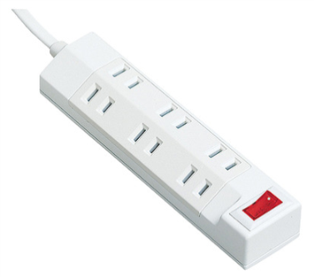
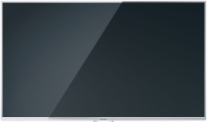
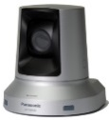
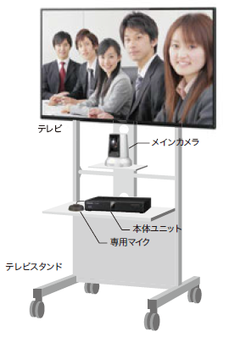
HDVC Advantage “Easy Settings/Preparation”
Just the Power Turn ON. Ready in 1 min.
Connect the display, codec and the camera to the power strip.
Can be operated by switching ON/OFF operation of the centralized switch on the power strip. It is very simple operation.
Note: When the power is OFF also, there is no need to perform the power OFF operation in the HDVC.
Display
HDVC
Power Strip with centralized switch
PTZ Camera
Display
PTZ Camera
LAN Cable x 1
Codec
Stand
Microphone
Power Source x 1
Only required LAN cable and Power source connection

Slide 6
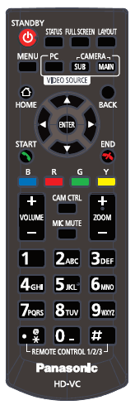
HDVC Advantage “Easy Operation”
Intuitively operation with Remote Controller
It looks like a TV/DVD Player Remote Controller.
Intuitively operation can be made without manual.
Register and store connection site to the contact list.
Also register frequent call site to the one-touch dial (up to 5 sites) in advance, then easy to make a conference.
PC content sharing is also a simple operation by pressing PC button.
The one-touch dial can be registered not only single site, but also multiple sites.

Slide 7
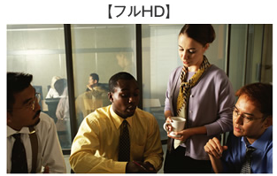
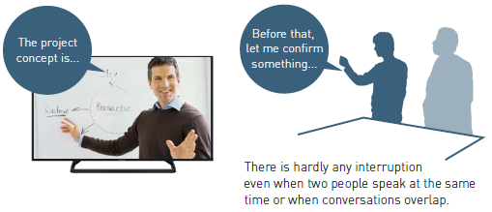
HDVC Advantage “High Video/Audio Quality, Stable Connection”
Confident with Video and Audio Quality
The HDVC provides High Video and Audio Quality as a performance of the dedicated conferencing system. Also provides stress-free communication as if you were all in the same room.
[ Full HD Resolution ]
1
Full-HD 108/60p Resolution
Displayed images are as clear as Full-HD TV images and allow for effective visual communication.
2
Broadband Stereo Full Duplex Audio
[ Easy to hear even when two people talk simultaneously ]
There are hardly any delays or interruptions even when two people speak at the same time. You can enjoy smooth, natural conversations as if you were all in the same room.
3
Stress-free Conference with AV-QoS Rate Control
Even if the bandwidth decreases after communication starts, clear communication is maintained according to the communication line condition.

Slide 8
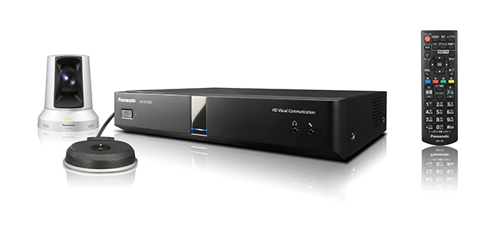
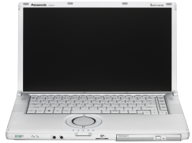
Comparison “Procedure until becomes connection done”
＜ HDVC ＞
＜ Web Conferencing ＞
Power ON the Display, Camera and the HDVC.
Select desired connection site from the one-touch dial by using remote controller.
Power ON the PC.
Input ID and Password in Windows.
Connect Web Camera, Microphone and Speakers to the PC.
Execute the Internet browser.
Access to the URL of the Web Conferencing, and input ID and Password to login.
Select conference room to enter.
Estimated Total Time: Approx. 2 min.
Estimated Total Time: Approx. 5 min.
In case of Web Conferencing, it requires a several steps to until becomes connection done. HDVC requires minimum steps.
Note: Depends on type of Web Conferencing, the connection procedure will be different. The above estimated time is just for your reference.

Slide 9
Advantage of Web Conferencing “Vs. HDVC”
When comparing Web Conferencing and Video Conferencing, there are following advantages from the functions point of view.
■ Multiple Simultaneous Connections
There is Multiple Simultaneous Connection service, such as 20 sites or 50 sites stuff like a that.
Note: The running cost will be increased depend on number of connectivity.
■ Internet Accessibility
Web Conferencing is available basically whenever there is Internet access.
Note: In case of video conferencing, if the connection condition does not match such as router and Firewall so on, the communication can not be made.
■ External Connection
Web Conferencing is possible to easy connect both Internal and External through the Internet. Also possible to connect from the invitation of the e-mail.
Note: In case of video conferencing, if the connection condition does not match such as router and Firewall so on, the communication can not be made.
If the above operation is frequently required, Web Conferencing is effective.

Slide 10
Function Comparison
The followings are function differences.
 | Video Conferencing | Web Conferencing
System Image
Service Style | On-premises Service (Home Installation) | Cloud Service / On-premises Service
Use Scene | Conduct conference through internal intranet / Internet with Display/Codec | Conduct conference through Internet with PC
Network | Intranet, VPN, Internet | Internet
Places | Meeting Room (Multiple Participant) | Desk, Meeting Room (P to P)
Operation | Remote Controller | Internet Browser
Stability | Stable (Hardware Processing) | Non-stable (Software Processing)
Quality | High Quality Video, High Quality Audio | Difficult to obtain good quality
Multi-device | Smartphone, Tablet, PC | Smartphone, Tablet, PC
PC Literacy | Not necessary | Necessary
Long Meeting | Suitable | Not suitable
Manufacturers | Cisco, Polycom, Lifesize, Panasonic, etc. | Cisco, V-cube, etc.

Slide 11
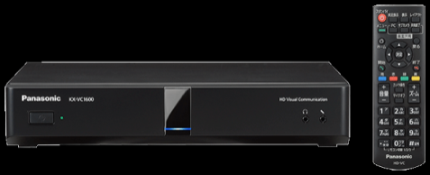
Function Comparison
 | Video Conferencing (HDVC) | Web Conferencing (V-CUBE)
System Image
Video Conferencing | YES | YES
Content Sharing | YES | YES
Whiteboard | NO | YES
File Transfer | NO | YES
Chat | NO | YES
Recording | YES (Utilize 3rd party equipment) | YES
Mobile Connectivity | YES | YES
Audio Conferencing | NO | YES
Scheduler Cooperation | NO | YES
Web Conferencing is a feature-rich such as edit and annotation can be made during content sharing.

Slide 12
Function Comparison
Video Conferencing and Web Conferencing to achieve a meeting with a remote location, and possible to reduce transportation cost and time. It seems the same purpose, but there are some benefit and disadvantage.
 | Video Conferencing | Web Conferencing
Cost | Initial Introduction Cost (+ Maintenance Cost) | Initial Introduction Cost + Monthly Fee (Flat-rate, Metered-rate)
Benefit | High Quality Video and Audio Stable Connection Easy Remote Controller Operation Quick Start-up and available soon | Available whenever there is Internet access Multifunctional (Content Sharing, Chat) Always available latest features
Disadvantage | Need to purchase equipment as initial introduction Need to replace if the system is getting old Difficult to expand the system | Difficult to ensure stable connection depend on the internet condition and PC literacy Not suitable for multiple participant It is necessary to select the conference venue in order not to bother around
General Overview | Although initial introduction cost is needed, ensure high quality video / audio and stable connection | Due to inexpensive initial introduction cost, it is easy to introduce and try
 | Possible to utilize important meeting | Utilize joint work in the field level

Slide 13
Cost Comparison
The followings are estimated cost in Japan for the reference.
 | V-CUBE
Service Type | V-CUBE Meeting
 | Flat-rate
 | Smart Plus (5 sites) | Standard (10 sites) | Premium 20 (20 sites)
Initial Introduction Cost | 45,000 JPY (USD 450) | 45,000 JPY (USD 450) | 45,000 JPY (USD 450)
Monthly Fee | 50,000 JPY (USD 500) | 79,900 JPY (USD 799) | 119,900 JPY (USD 1,199)
Yearly Fee | 600,000 JPY (USD 6,000) | 958,800 JPY (USD 9,588) | 1,438,800 JPY (USD 14,388)
Total Cost in 5 years | 3,000,000 JPY (USD 30,000) | 4,794,000 JPY (USD 47,940) | 7,194,000 JPY (USD 71,940)
(Tax exclude)
1 USD = 100 JPY
Initial Introduction Cost of Video Conferencing is expensive, Web Conferencing is commonly referred to and inexpensive.
However, running costs will occur every month with Web Conferencing.
When look at the total cost of the 5 years period, there is no difference between the cost cases, such as those commonly referred.
You need to confirm in the total cost when you compare the cost!!

Slide 14
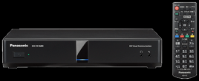
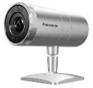
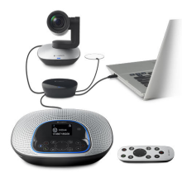
Cost Comparison
The following is cost comparison for the equipment in Japan for the reference. (Tax exclude)
Video Conferencing
Approx. 540,000 JPY (USD 5,400) * Display exclude
＋
HDVC (VC1300)
Camera (AW-VC2) Microphone (VCA002)
Display
Web Conferencing
Approx. 120,000 JPY (USD 1,200)
Approx. 150,000 JPY (USD 1,500)
Approx. 270,000 JPY (USD 2,700)
* Display exclude
＋
Display
PC
Camera, Microphone / Speakers
When comparing Initial Introduction Cost for the equipment, Video Conferencing is expensive, Web Conferencing seems inexpensive.
However, running costs will occur every month with Web Conferencing.
You need to confirm in the total cost when you compare the cost!!

Slide 15
Conclusion
When comparing Video Conferencing and Web Conferencing, Web Conferencing seems inexpensive cost for introduction and rich features more that Video Conferencing.
However, Video Conferencing has an advantage such as High Quality Video/Audio and stable connection as basic functions of video conferencing.
Depends on the purpose of use and utilization scene, choose suitable one whether use Video Conferencing or Web Conferencing
Please explain the difference of the characteristics of the Web Conferencing and Video Conferencing to the customers. It is important things to obtain their understanding.
The benefit of the Video Conferencing is “High Quality Video/Audio”, ”Stable Connection” and “Easy Operation”.

Slide 16
Reference (Major Web Conferencing)
V-CUBE: V-CUBE Meeting
https://www.v-cubes.com/
The innovation leader in 5 continents.
No.1 market share for Video Conferencing, Web Conferencing and Cloud Market in 8 years.
There is Max.50 sites Multiple Simultaneous Connection as a line-up
Support iOS and Android (Smartphone, Tablet)
Optional Multifunctional: Audio Conferencing Cooperation, Cooperation with Polycom VC, Cooperation with Scheduler, etc.
Cisco: WebEX Meeting Center
http://www.cisco.com/
An American multinational corporation technology company, and the largest networking company in the world.
There is Mac. 5000 Multiple Simultaneous Connection as a line-up.
Support iOS and Android (Smartphone, Tablet)
Integrated voice conferencing and VoIP can be used in combination with a phone call (WebFx Connect Cooperation)
Support 12 languages

