Slide 1
1. This document can be disclosed to Panasonic Sales Partners 2. The specs might be changed without notice since it’s still under development.
For Panasonic Sales Company and Business Partner only
Panasonic HD Visual Communication System
Codec Comparison
This document is describing about product comparison with other VC systems based on datasheet, catalogue and actual test result by PSN.
This information is as of August 2016.
HDVC’s applicable model and firmware version are as follows.
KX-VC2000: Ver. 4.50
KX-VC1600/1300/1000: Ver.4.30
Note: The specification of KX-VC2000 might be changed without notice since it’s still under development.
Panasonic System Networks Co., Ltd.
HDVC Business Promotion Department, AV Systems Business Unit
Aug, 2016

Slide 2
Key Features of Panasonic HDVC
Product Line-up
Multi-Point Leader Model KX-VC2000
Enhanced Model KX-VC1600
Basic Model KX-VC1300
Point to Point Model KX-VC1000
HDVC Mobiles
16-Site Connection
Expandable up to 24-Site Connection
FHD Support
Triple Monitor
Dual Network
6-Site Connection
Expandable up to 10-Site Connection
FHD Support
Triple Monitor
Dual Network
4-Site Connection
FHD Support
Dual Monitor
Point to Point Connection
Expandable up to 4-Site Connection
FHD Support
(Windows/iOS/Android)
Key Features
High Image Quality: FHD (1920x1080), 60 Frame Rate
Max. 24-site (KX-VC2000) / 10-Site (KX-VC1600) Connection
Dual Stream with 1080p/30fps (Available Triple Monitor Output)
Multi-Device Support (Windows/iPad/iPhone/Android)
Dual Network: Easy to configure different Network Environmental

Slide 3
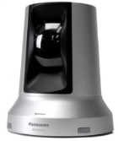
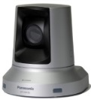
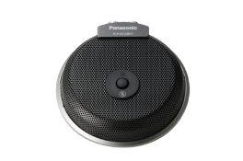
HDVC System Line-up
Codec
KX-VC2000
KX-VC1600
KX-VC1300
FHD
16-Site Connection * Expandable up to 24-Site
Dual Network
Triple Monitor
FHD
6-Site Connection * Expandable up to 10-Site
Dual Network
Triple Monitor
FHD
4-Site Connection
Dual Monitor
Camera
KX-VC1000
GP-VD151
GP-VD131
FHD (1080/60p)
X 12 Optical Zoom, X 10 Digital Zoom
FHD (1080/60p)
X 3 Optical Zoom, X 4 Digital Zoom
FHD
Point to Point Connection
* Expandable up to 4-Site
Microphone
KX-VCA001
KX-VCA002
Digital Boundary Microphone
Up to 4 microphones connection
Max. Pickup Range: Approx. 3m (radius), 360 degrees
Analog Boundary Microphone
Max. Pickup Range: Approx. 2m (radius), 360 degrees
Licenses
KX-VCS304: Add 4-site connection (For KX-VC1600)
KX-VCS305: Add 4-site connection (For KX-VC2000)
KX-VCS314: Add 4-site connection (For KX-VC1000)
KX-VCS351: Mobile Control in IP mode
KX-VCS352: Mobile Control in IP mode (For KX-VC2000)
KX-VCS701/703: NAT Traversal Service for Codec
KX-VCS781/783: NAT Traversal Service for Windows
KX-VCS711/733: NAT Traversal Service for iOS/Android
KX-VCS302: ALM (One-way Transmission)
KX-VCS402: Dual Monitor Activation (For KX-VC1000)

Slide 4
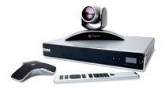
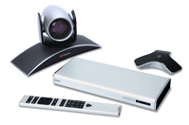
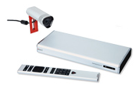
Polycom Videoconferencing System

Slide 5
Polycom (Real Presence series)
●: standard, ▲: option, -: not supported
 | Panasonic HDVC |  |  |  | Polycom Real Presence
Model | VC2000 | VC1600 | VC1300 | VC1000 | Group700 | Group500-720 | Group500-1080 | Group300 | Debut
Microphone | 4 (Digital) | 4 (Digital) | 4 (Digital) | 1 | 3 | 2 | 2 | 2 | 1
1080p | ● | ● | ● | ● | ▲ | ▲ | ● | ▲ | ●
Embedded MCU | ●(16) ▲(20) ▲(24) | ●(6) ▲(10) | ●(4) | ▲(4) | ▲(8) 720p | ▲(6) 720p | ▲(6) 720p | - | -
Max. bandwidth | 24Mbps | 18Mbps | 18Mbps | 18Mbps | 6Mbps | 6Mbps | 6Mbps | 3Mbps | 4Mbps
Dual Stream | ● (H.239/BFCP) | ● (H.239/BFCP) | ● (H.239/BFCP) | ● (H.239/BFCP) | ● (H.239/BFCP) | ● (H.239/BFCP) | ● (H.239/BFCP) | ● (H.239/BFCP) | ●
Multi Monitor | ●(3) | ●(3) | ●(2) | ●(1) ▲(2) | ●(3) | ●(2) | ●(2) | ▲（2) | -
Camera connection | ●(2) (HDMI) | ●(2) (HDMI) | ●(2) (HDMI) | ●(2) (HDMI) | ●(2) | ●(1) | ●(1) | ●(1) | ●(1)
Dual Network | ● | ● | - | - | - | - | - | - | -
Mobile | ● | ● | ● | ● | ● | ● | ● | ● | ●
ISDN | - | - | - | - | - | - | - | - | -

Slide 6
Polycom (HDX series)
●: standard, ▲: option, -: not supported
 | Panasonic HDVC |  |  |  | Polycom HDX
Model | VC2000 | VC1600 | VC1300 | VC1000 | HDX8000 |  | HDX7000 |  | HDX6000
 |  |  |  |  | HDX8000-720 | HDX8000-1080 | HDX7000-720 | HDX7000-1080 | HDX6000-720 | HDX6000-720V
Microphone | 4 (Digital) | 4 (Digital) | 4 (Digital) | 1 | 3 | 3 | 2 | 2 | 1 | ▲ camera embedded mic
1080p | ● | ● | ● | ● | ▲ | ● | ▲ | ● | ▲ only received | ▲ only received
Embedded MCU | ●(16) ▲(20) ▲(24) | ●(6) ▲(10) | ●(4) | ▲(4) | ▲(4) | ▲(4) | - | - | - | -
Max. bandwidth | 24Mbps | 18Mbps | 18Mbps | 18Mbps | 6Mbps | 6Mbps | 4Mbps | 4Mbps | 2Mbps | 2Mbps
Dual Stream | ● (H.239/BFCP) | ● (H.239/BFCP) | ● (H.239/BFCP) | ● (H.239/BFCP) | ● | ● | ● | ● | ● | ●
Multi Monitor | ●(3) | ●(3) | ●(2) | ●(1) ▲(2) | ●(2) | ●(2) | ●(2) | ●(2) | - | -
Camera connection | ●(2) (HDMI) | ●(2) (HDMI) | ●(2) (HDMI) | ●(2) (HDMI) | ●(2) | ●(2) | ●(1) | ●(1) | ●(1) | ●(1)
Dual Network | ● | ● | - | - | - | - | - | - | - | -
Mobile | ● | ● | ● | ● | ● | ● | ● | ● | ● | ●
ISDN | - | - | - | - | ▲ | ▲ | ▲ | ▲ | - | -

Slide 7
Key Features of Polycom VC
Product Line-up
Group700
Group 500
Group 300
Desktop for Windows Mobile for iOS/Android
Multi-site connection
FHD/HD support
Multi-site connection
FHD/HD support
P to P connection
HD support
Key Features
High Image Quality: FHD (1920x1080), 60 Frame Rate
Embedded MCU: 4-site connection (FHD), 8-site connection (HD) (Group700)
Dual Stream with 1080p/60fps (Available Triple Monitor Output)
H.264 SVC support, Low Bit Rate connection (512k bps: 720p/30fps)
Multi Device Support (Windows/iOS/Android)

Slide 8
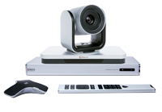
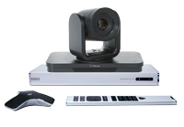
Group 700/500/300 System Line-up
Group700 FHD – EagleEye IV Camera Model
Group500 HD – EagleEye IV Camera Model
FHD
Multi-site connection (FHD: 4/HD: 8)
Triple Monitor
Assorted Connectivity with AV equipment
HD
Multi-site connection (FHD: 4/HD: 6)
Triple Monitor
Assorted Connectivity with AV equipment
Group500 FHD – EagleEye IV Camara Model HD – EagleEye IV Camera Model
Group300 FHD - EagleEye Acoustic Camera Model HD - EagleEye Acoustic Camera Model
FHD, HD
Multi-site connection (FHD: 4/HD: 6)
Dual Monitor
FHD, HD
Multi-site connection (HD: 4/SD: 6)
Dual Monitor

Slide 9
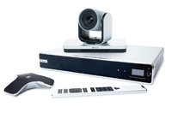
Group 700/500/300 System Line-up
1080p License
1080p License
2nd Monitor License
Embedded MCU License
Embedded MCU License
1080p License
Group700
Group500
Group300
All HD models can be upgraded to FHD version by license.
User Licenses
1/5/25/50/100
Mobile for iOS/Android
An application for iOS/Android is free of charge same as HDVC Mobile
Desktop for Windows

Slide 10
HDVC Advantages VS. Polycom
Multipoint connection function: Max. 8-site (HD) / 4-site (FHD)
HDVC is capable up to 24-site (VC2000) / 10-site (VC1600) multipoint connection for both SD and HD quality.
Only available CP4 screen layout during 8-site / 6-site multiple connection.
HDVC supports various screen layout, such as CP10, CP13, CP15, CP16, etc.
Max. bandwidth can be set up to 6Mbps. Available bandwidth per site will be 800kbps in case of 8-site multi-point connection as maximum.
HDVC can be set 24Mbps (VC2000)/18Mbps (VC1600) as Max. bandwidth. And possible to operate with Max. 4.8Mbps (VC2000)/3.6Mbps (VC1600) per site in case of 6-site multi-point connection.
Only high-end model Group700 is available sub-camera function.
All HDVC series have sub-camera function as standard.
Impossible to expand to multipoint connection with Group300.
Even entry model VC1000, it is possible to make up to 4-site multipoint connection with optional license. Basic model VC1300 is standard.

Slide 11
HDVC Advantages VS. Polycom
“Dial-out” can not be made when initiating call from host to multiple remote site at once.
All HDVC series have sub-camera function as standard.
A Video firewall, Conference Management / Authorization Server (CMA Server) and CMA License are required when connecting mobiles from the outside. Initial investment is higher.
HDVC is possible connect from the outside without having build complex network environmental by NAT Traversal Service.

Slide 12
Polycom’s Advantages
Support direct connection with Skype for Business.
Support H.264 SVC. It is possible to make stable connection and ensuring video quality to match bandwidth (Different Speed Compatible).
WUXGA (1920x1200) supports for content sharing.
HDVC support 1820x1080 as maximum.
Optical 12x zoom and 72 degrees angle of field camera as line-up.
GP-VD151: 12x zoom, 56.3 degrees, GP-VD131: 3x zoom, 85 degrees
Rich Audio / Video input and output interfaces, easy collaboration with external equipment.
TV Conference Control by the tablet with wireless connection (Smart Pairing)
Point to Point direct connection with mobile each are can be made. (Windows)
HDVC Mobile does not support direct connection each other.

Slide 13
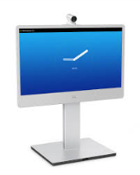
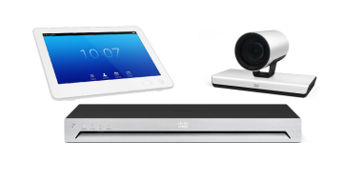
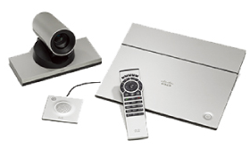
Cisco Videoconferencing System

Slide 14
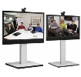
Cisco (TelePresence series)
●: standard, ▲: option, -: not supported
 | Panasonic HDVC |  |  |  | Cisco TelePresence
Model | VC2000 | VC1600 | VC1300 | VC1000 | SX80 | SX20 | SX10 | MX300/MX200
Microphone | 4 (Digital) | 4 (Digital) | 4 (Digital) | 1 | 8 | 2 | 1 | 2
1080p | ● | ● | ● | ● | ● | ▲ | ● | ●
Embedded MCU | ●(16) ▲(20) ▲(24) | ●(6) ▲(10) | ●(4) | ▲(4) | ▲(5) 720p | ▲(4) w576p | - | ▲(4) w576p
Max. bandwidth | 24Mbps | 18Mbps | 18Mbps | 18Mbps | 10Mbps | 6Mbps | 3Mbps | 6Mbps
Dual Stream | ● (H.239/BFCP) | ● (H.239/BFCP) | ● (H.239/BFCP) | ● (H.239/BFCP) | ● (H.239/BFCP) | ● (H.239/BFCP) | ● (BFCP only) | ● (H.239/BFCP)
Multi Monitor | ●(3) | ●(3) | ●(2) | ●(1) ▲(2) | ●(3) | ▲(2) | - | -
Camera connection | ●(2) (HDMI) | ●(2) (HDMI) | ●(2) (HDMI) | ●(2) (HDMI) | ●(5) | ●(1) | ●(1) only embedded | ●(1)
Dual Network | ● | ● | - | - | - | - | - | -
Mobile | ● | ● | ● | ● | ● | ● | ● | ●
ISDN | - | - | - | - | ▲ | ▲ | ▲ | ▲

Slide 15
Key Features of CISCO VC
Product Line-up
TelePresence SX80
TelePresence SX20
TelePresence MX300
Cisco Jabber Video for TelePresence （Mobile）
Multi-site connection
FHD/HD support
Multi-site connection
FHD/HD support
Multi-site connection
FHD/HD support
Key Features
High Image Quality: FHD (1920x1080), 60 Frame Rate, Max. 5-site Multi-point connection
Dual Stream Function (Triple Monitor Output)
Support transcoding for both Audio and Video in embedded MCU model
Multi Device Support (Windows/Mac/iOS and Android)
Solution with Cisco Unified Communication Manager

Slide 16
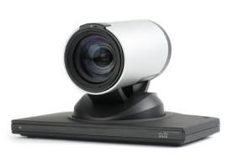
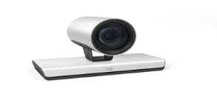
C40/SX20/Quick Set C20 System Line-up
TelePresence SX80
TelePresence SX20
TelePresence MX300
FHD (Option), HD
Multi-site connection: Different Speed connection (5-site / Option)
Triple Monitor Output
Assorted Connectivity with AV equipment
FHD (Option), HD
Multi-site connection: Different Speed connection (4-site / Option)
Dual Monitor Output
FHD, HD
Multi-site connection: Different Speed connection (4-site / Option)
PrecisionHD 1080p x4 Zoom Camera
PrecisionHD 1080p x12 Zoom Camera
Precision 60 Camera
FHD (1080/30p)
X4 Optical Zoom
FHD (1080/60p)
X12 Optical Zoom
FHD (1080/60p)
X10 Optical Zoom

Slide 17
HDVC Advantages VS. CISCO
An expensive MCU is mandatory required when making more than 5-site multi-point connection.
HDVC is capable up to 24-site (VC2000) / 10-site (VC1600) multipoint connection for both SD and HD quality.
Optional TANDBERG Video Communication Server Expressway is required when connecting mobiles from the outside. Initial investment is higher.
HDVC is possible connect from the outside without having build complex network environmental by NAT Traversal Service.
Resolution goes down to w576p (1024x576)/30fps when making 4-site multipoint connection. (SX20)
In case of 5-site multi-point connection, it becomes 720p/30fps. (SX80)
HDVC is available 1080p/30fps even in 10-site multipoint connection.
In case of HD (720p) resolution, it is available up to 24-site multiple connection.
Sub-camera function is available only high-end model.
All HDVC series have sub-camera function as standard.

Slide 18
CISCO’s Advantages
Embedded MCU supports transcoding. Suitable resolution can be obtained made to meet available bandwidth of connection site. (Different Speed Communication by each site)
SX80 supports for the latest video codec H.265.
Max. resolution in dual stream is 1080p60 + 1080p30.
HDVC supports Max. 1080p30 + 1080p30.
Optical 12x zoom and 72 degrees angle of field camera as line-up.
GP-VD151: 12x zoom, 56.3 degrees, GP-VD131: 3x zoom, 85 degrees
Support Multi Devices, also support Mac. (Windows/Max/iOS and Android)
Rich Audio / Video input and output interfaces, easy collaboration with external equipment.
Support Auto Settings and Telephony coordination as solution with Cisco Unified Communication Manager.

Slide 19
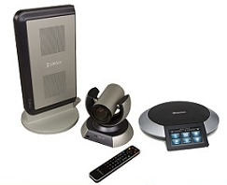
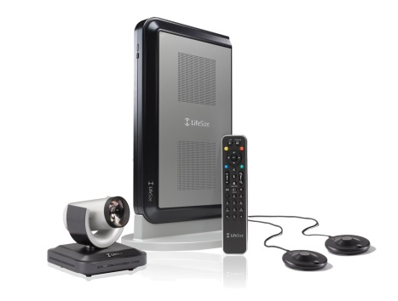
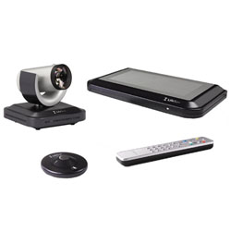
Lifesize Videoconferencing System

Slide 20
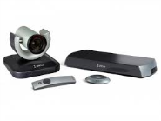
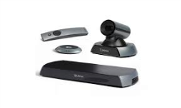
Lifesize
●: standard, ▲: option, -: not supported
 | Panasonic HDVC |  |  |  | LifeSize
Model | VC2000 | VC1600 | VC1300 | VC1000 | Room220 | Team220 | Express220 | Icon600 | Icon400
Microphone | 4 (Digital) | 4 (Digital) | 4 (Digital) | 1 | 2 MicPod | 2 MicPod | 2 MicPod | 2 MicPod | 1 MicPod
1080p | ● | ● | ● | ● | ● | ● | ● | ● | ●
Embedded MCU | ●(16) ▲(20) ▲(24) | ●(6) ▲(10) | ●(4) | ▲(4) | ●(8) | ●(4) | - | - Cloud cooperation | - Cloud cooperation
Max. bandwidth | 24Mbps | 18Mbps | 18Mbps | 18Mbps | 8Mbps | 6Mbps | 4Mbps | 6Mbps | 6Mbps
Dual Stream | ● (H.239/BFCP) | ● (H.239/BFCP) | ● (H.239/BFCP) | ● (H.239/BFCP) | ● (H.239/BFCP) | ● (H.239/BFCP) | ● | ● (H.239/BFCP) | ● (H.239/BFCP)
Multi Monitor | ●(3) | ●(3) | ●(2) | ●(1) ▲(2) | ●(2) | ●(2) | ●(2) | ●(2) | -
Camera connection | ●(2) (HDMI) | ●(2) (HDMI) | ●(2) (HDMI) | ●(2) (HDMI) | ●(2) | ●(2) | ●(1) | ●(1) | ●(1)
Dual Network | ● | ● | - | - | - | - | - | - | -
Mobile | ● | ● | ● | ● | ● | ● | ● | ● | ●
ISDN | - | - | - | - | - | - | - | - | -

Slide 21
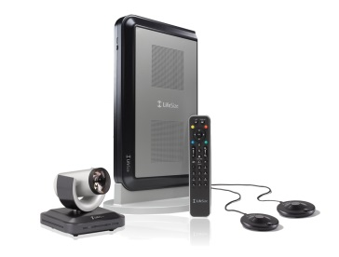
Key Features of Lifesize VC
Product Line-up
Room220
Team220
Express220
ClearSea Windows/Mac/ iOS/Android
Multi-site connection
FHD/HD support
Multi-site connection
FHD/HD support
P to P connection
FHD/HD support
Key Features
High Image Quality: FHD (1920x1080), 30 Frame Rate, Max. 8-site Multi-point connection
Support Different Speed Communication
Dual Stream Function (Dual Monitor Output)
Multi Device Support (Windows/Mac/Android/iOS)
Interoperability with Microsoft Lync/Office Communication Server

Slide 22
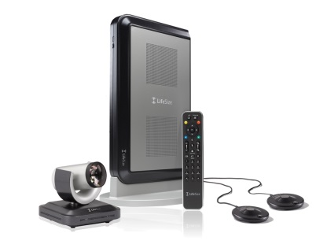
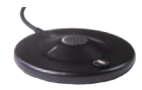
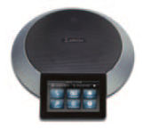
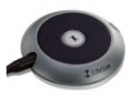
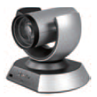
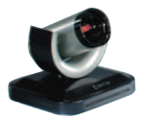
Room/Team/Express220 System Line-up
Room220
Team220
FHD, HD
Multi-site connection: Different Speed connection (FHD 6-site / HD 8-site)
Dual Monitor Output
Assorted Connectivity with AV equipment
FHD, HD
Multi-site connection: Different Speed connection (FHD 4-site / HD 4-site)
Dual Monitor Output
Lifesize MicPod CD Quality Microphone Unit * Not available for Room 220
Express220
Lifesize Phone 2nd Generation High Performance Speakerphone
FHD, HD
P to P connection
Dual Monitor Output
Lifesize Phone Digital MicPod Lifesize Phone Extension Microphone Unit
Lifesize Camera 10x
Lifesize Camera 200
FHD (1080/30p)
X10 Optical Zoom
FHD (1080/30p)
X4 Optical Zoom

Slide 23
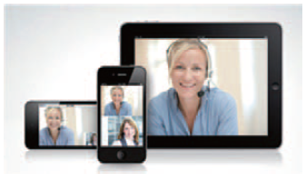
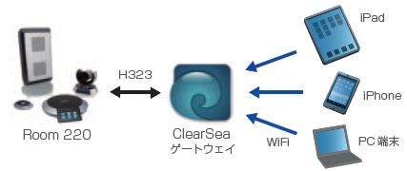
Room/Team/Express220 System Line-up
Room220
Team220
Express220
Possible to connect to ISDN with optional Lifesize Networker
Audio Conference Function is available as optional function via ISDN
Multi Device Support : ClearSea
Supported Device: Windows/Mac/Android/iOS
Max. Resolution: 720p/15fps
Available Bandwidth: 384kbps
Communicate with Multi Devices via ClearSea Gateway

Slide 24
HDVC Advantages VS. Lifesize
Multipoint connection function: Max. 8-site (SD/HD)
HDVC is capable up to 24-site (VC2000) / 10-site (VC1600) multipoint connection for both SD and HD quality.
1080p/60fps does not support.
Triple monitor function does not support.
“ClearSea” Gateway is required to communicate with mobile devices. Initial investment is higher.
HDVC is possible connect from the outside without having build complex network environmental by NAT Traversal Service.
Support Different Speed Communication. But only available CP1 screen layout. Non-voice activation function.
HDVC supports both Different Speed Communication and Voice Activation function.

Slide 25
HDVC Advantages VS. Lifesize
Although available CP8 screen layout, but Max. 4-site can be displayed.
HDVC can be displayed all 8-site in CP8 screen layout, and supports various screen layout, such as CP10, CP13, CP15, CP16 and more.
Only high-end model is available sub-camera function.
All HDVC series have sub-camera function as standard.
Max. Resolution in dual streaming is 1080p/15 + 720p/5.
HDVC supports 1080p/30 + 1080p/30.

Slide 26
Lifesize’s Advantages
Cooperate with LifeSize cloud, possible to connect with Skype for Business.
Embedded MCU supports transcoding. Suitable resolution can be obtained made to meet available bandwidth of connection site. (Different Speed Communication by each site)
Support Audio conferencing (IP/Analogue)
Rich Audio / Video input and output interfaces, easy collaboration with external equipment.
Support Multi Devices, also support Mac.

Slide 27
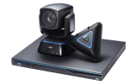
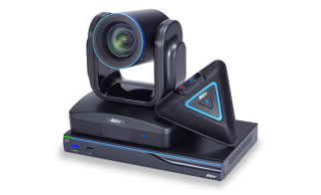
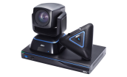
AVer Videoconferencing System

Slide 28
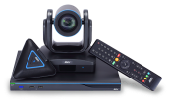
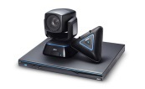
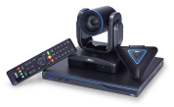
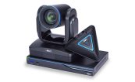
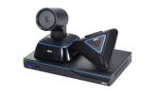
AVer
●: standard, ▲: option, -: not supported
 | Panasonic HDVC |  |  |  | AVer
Model | VC2000 | VC1600 | VC1300 | VC1000 | EVC950 | EVC900 | EVC350 | EVC300 | EVC150 | EVC130
Microphone | 4 (Digital) | 4 (Digital) | 4 (Digital) | 1 | 4 | 4 | 4 | 4 | 4 | 4
1080p | ● | ● | ● | ● | ● | ● | ● | ● | ● | -
Embedded MCU | ●(16) ▲(20) ▲(24) | ●(6) ▲(10) | ●(4) | ▲(4) | ●(10) | ●(10) | ●(4) ▲(6) ▲(8) ▲(10) | ●(4) ▲(6) ▲(8) ▲(10) | - | -
Max. bandwidth | 24Mbps | 18Mbps | 18Mbps | 18Mbps | 4Mbps | 4Mbps | 4Mbps | 4Mbps | 4Mbps | 4Mbps
Dual Stream | ● (H.239/BFCP) | ● (H.239/BFCP) | ● (H.239/BFCP) | ● (H.239/BFCP) | ● (H.239/BFCP) | ● (H.239/BFCP) | ● (H.239/BFCP) | ● (H.239/BFCP) | ● (H.239/BFCP) | ● (H.239/BFCP)
Multi Monitor | ●(3) | ●(3) | ●(2) | ●(1) ▲(2) | ●(2) | ●(2) | ●(2) | ●(2) | - | -
Camera connection | ●(2) (HDMI) | ●(2) (HDMI) | ●(2) (HDMI) | ●(2) (HDMI) | ●(1) (DVI(HDMI), VGA) | ●(1) (DVI(HDMI), VGA) | ●(1) (DVI(HDMI), VGA) | ●(1) (DVI(HDMI), VGA) | ●(1) (VGA) | ●(1) (VGA)
Dual Network | ● | ● | - | - | - | - | - | - | - | -
Mobile | ● | ● | ● | ● | ● | ● | ● | ● | - | -
ISDN | - | - | - | - | - | - | - | - | - | -

Slide 29
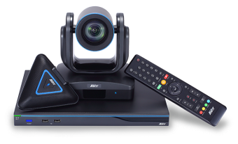
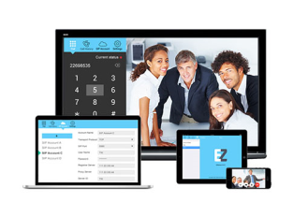
Key Features of AVer
Product Line-up
EVC950
EVC350
EVC150
EVC130
EZMeetup
Windows/Mac/ iOS/Android
Multi-site connection
FHD/HD support
Multi-site connection
FHD/HD support
P to P connection
FHD/HD support
P to P connection
FHD/HD support
Key Features
High Image Quality: FHD (1920x1080), 30 Frame Rate
Embedded MCU: Up to 10-site multi-point connection. Support Dual Stream. (Possible Dual Monitor Output)
Optical 16x zoom camera (61 degree angle of field)
Can be recorded to the USB flash memory, and playback function
Support Multi Devices (Windows/iOS/Android and Mac)

Slide 30
HDVC Advantages VS. AVer
An expensive MCU is mandatory required when making more than 11-site multi-point connection.
HDVC is capable up to 24-site (VC2000) / 10-site (VC1600) multipoint connection for both SD and HD quality.
EVC950 support Max. 10-site multi-point connection. Max. bandwidth can be set up to 4Mbps. Available bandwidth per site will be 444kbps in case of 10-site multi-point connection as maximum.
HDVC can be set 24Mbps (VC2000)/18Mbps (VC1600) as Max. bandwidth. And possible to operate with Max. 2.6Mbps (VC2000)/2Mbps (VC1600) per site in case of 10-site multi-point connection.
EVC950 can be obtained HD resolution in 4-site multi-point connection. 480p in 10-site multi-point connection. FHD is available only when making Point to Point connection.
HDVC can be obtained HD resolution even in 10-site multi-point connection.
1080p/60fps does not support.
Triple monitor function does not support.
No sub-camera function. (Only one camera)
Dual Network does not support.

Slide 31
HDVC Advantages VS. AVer
EVC150/EVC130 support up to WSXGA (1440x900) for content sharing.
HDVC support Max. FHD resolution as standard.
Max. Resolution in dual streaming is 1080p/30 + 720p/30.
HDVC supports 1080p/30 + 1080p/30.
EVC150 cannot be expand for multi-point connection.

Slide 32
AVer’s Advantages
Possible to record to USB flash memory.
HDVC requires 3rd party devices for recording solution.
Optical 16x zoom and 61 degrees angle of field camera as line-up.
GP-VD151: 12x zoom, 56.3 degrees, GP-VD131: 3x zoom, 85 degrees
Whiteboard function is available with optional application (EZDraw: iOS/Android)
Support Wake up On LAN/PPPoE as network function.
Remote operation can be made through the web console and management. (Web Tool)
Support Multi Devices, also support Mac.
3-year warranty (1 year for Cables, Remote Controller and AC Adaptor)

Slide 33
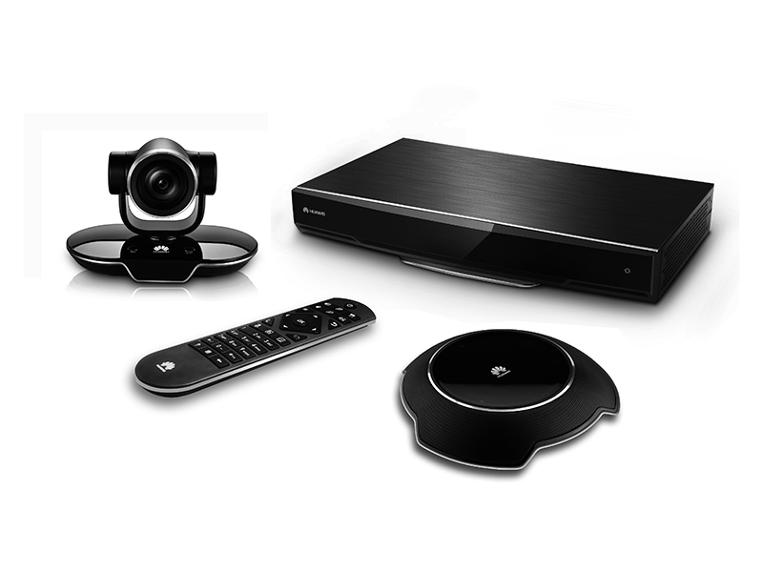
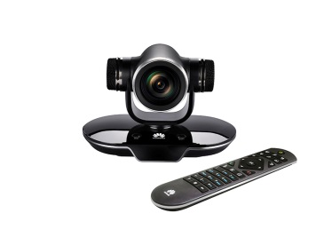
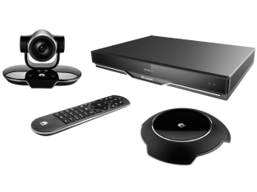
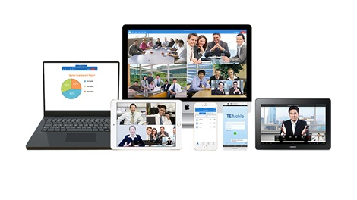
Huawei Videoconferencing System

Slide 34
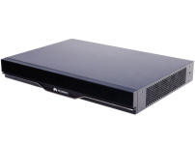
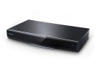
Huawei
●: standard, ▲: option, -: not supported
 | Panasonic HDVC |  |  |  | Huawei
Model | VC2000 | VC1600 | VC1300 | VC1000 | TX50 | TE60 | TE50/TE40 | TE30
Microphone | 4 (Digital) | 4 (Digital) | 4 (Digital) | 1 | 1 | 1 | 1 | 1
1080p | ● | ● | ● | ● | ●(30fps) ▲(60fps) | ●(30fps) ▲(60fps) | ●(30fps) ▲(60fps) | ●(30fps) ▲(60fps)
Embedded MCU | ●(16) ▲(20) ▲(24) | ●(6) ▲(10) | ●(4) | ▲(4) | - | ●(9) | ●(6) | -
Max. bandwidth | 24Mbps | 18Mbps | 18Mbps | 18Mbps | 8Mbps | 8Mbps | 8Mbps | 4Mbps
Dual Stream | ● (H.239/BFCP) | ● (H.239/BFCP) | ● (H.239/BFCP) | ● (H.239/BFCP) | ● | ● | ● | ●
Multi Monitor | ●(3) | ●(3) | ●(2) | ●(1) ▲(2) | ●(3) | ●(2) | ●(2) | -
Camera connection | ●(2) (HDMI) | ●(2) (HDMI) | ●(2) (HDMI) | ●(2) (HDMI) | ●(1) | ●(2) | ●(1) | ●(1) HDMI no input
Dual Network | ● | ● | - | - | ● | ● | - | -
Mobile | ● | ● | ● | ● | - | - | - | -
ISDN | - | - | - | - | - | - | - | -

Slide 35
Key Features of Huawei
Product Line-up
TX50
TE60/TE50/TE40
TE30
TE Desktop/Mobile Videoconferencing Soft Client
Windows/Mac/ iOS/Android
P to P connection
FHD/HD support
Triple Monitor
Multi-site connection
FHD/HD support
Dual Monitor
P to P connection
FHD/HD support
All-in-one model
Key Features
High Image Quality: FHD (1920x1080), 30 Frame Rate at 384kbps/site
Embedded MCU: Up to 9-site (TE60) / 6-site (TE50/40) multi-point connection. Support Dual Stream. (Possible Dual Monitor Output)
Support H.265 (TX50) and H.264SVC (TX50/TE60/TE50/TE40 and TE30)
Wi-Fi connectivity (Network / Microphone)
Support Multi Devices (Windows/iOS/Android and Mac)

Slide 36
HDVC Advantages VS. Huawei
Support 1080p/60fps, but it is optional. 1080p/30fps is standard.
HDVC support 1080p/60fps as standard.
An expensive MCU is mandatory required when making more than 10-site multi-point connection. TX50 does not have embedded MCU function.
HDVC is capable up to 24-site (VC2000) / 10-site (VC1600) multipoint connection for both SD and HD quality.
Impossible to expand to multipoint connection with TE30.
Even entry model VC1000, it is possible to make up to 4-site multipoint connection with optional license.

Slide 37
Huawei’s Advantages
Support Ultra-low bandwidth consumption: H.265 technology for encoding and decoding (TX50 only)
Also support H.264SVC (TX50 and all TE series).
HDVC does not support these video codec.
Wi-Fi connectivity (Network / Microphone)
Smart Voice Dialing function (TE30 only)
Support Multi Devices, also support Mac.
Possible integration with MS Lync
4K Ultra-HD Video Camera (VPC800-4K) as line-up.

Slide 38
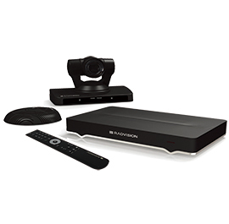
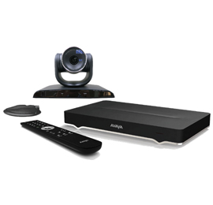
AVAYA Videoconferencing System

Slide 39
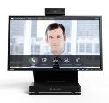
Avaya
●: standard, ▲: option, -: not supported
 | Panasonic HDVC |  |  |  | Avaya Scopia
Model | VC2000 | VC1600 | VC1300 | VC1000 | XT5000 | XT4300 | XT Exective 240
Microphone | 4 (Digital) | 4 (Digital) | 4 (Digital) | 1 | 2 | 1 | 1
1080p | ● | ● | ● | ● | ● | ● | ●
Embedded MCU | ●(16) ▲(20) ▲(24) | ●(6) ▲(10) | ●(4) | ▲(4) | ●(4) ▲(9) | ▲（4） | ▲（4）
Max. bandwidth | 24Mbps | 18Mbps | 18Mbps | 18Mbps | 6Mbps ▲(12M) | 4Mbps ▲(12M) | 6Mbps ▲(12M)
Dual Stream | ● (H.239/BFCP) | ● (H.239/BFCP) | ● (H.239/BFCP) | ● (H.239/BFCP) | ● | ● | ●
Multi Monitor | ●(3) | ●(3) | ●(2) | ●(1) ▲(2) | ●(2) | ●(2) | ●(1) 23.6 inch LED Built-in
Camera connection | ●(2) (HDMI) | ●(2) (HDMI) | ●(2) (HDMI) | ●(2) (HDMI) | ▲(2) | ●(1) | ●(1)
Dual Network | ● | ● | - | - | ● | ● | ●
Mobile | ● | ● | ● | ● | ● | ● | ●
ISDN | - | - | - | - | ▲ Scopia GW | ▲ Scopia GW | ▲ Scopia GW

Slide 40
Key Features of Avaya
Product Line-up
XT5000
XT4300
SCOPIA Desktop/Mobile
Windows/Mac/ iOS/Android
Multi-site connection
FHD/HD support
Multi-site connection
FHD/HD support
Key Features
High Image Quality: FHD (1920x1080), 60 Frame Rate
Embedded MCU: Up to 9-site multi-point connection. Standard equipped with a strong H.264SVC to packet resistant
Can be recorded to the USB flash memory, and playback function
Support Multi Devices (Windows/iOS/Android and Mac)
Support Dual Connection (Intranet/Internet)

Slide 41
HDVC Advantages VS. Avaya
An expensive MCU is mandatory required when making more than 10-site multi-point connection.
HDVC is capable up to 24-site (VC2000) / 10-site (VC1600) multipoint connection for both SD and HD quality.
XT5000 supports Max. 9-site multi-point connection. Max. bandwidth can be set up to 6Mbps. Available bandwidth per site will be 750kbps in case of 9-site multi-point connection as maximum.
HDVC can be set 24Mbps (VC2000)/18Mbps (VC1600) as Max. bandwidth. And possible to operate with Max. 3Mbps (VC2000)/2.25Mbps (VC1600) per site in case of 9-site multi-point connection.
Pick up range of standard microphone for XT4300 is 180 degrees. (Upgradable to 360 degrees with option)
Pick up range of digital microphone is 360 degrees.
Max. two microphones can be connected. (XT5000)
Triple monitor function does not support.
No sub-camera function with XT4300.
All HDVC support sub-camera function even entry model KX-VC1000.
Encryption can be made up to 4-site (XT5000)

Slide 42
Avaya’s Advantages
Support H.264SVC video codec. Stable connection and suitable video quality based on available bandwidth can be possible.
Dual Network is supported even in entry model XT4300. (Option).
KX-VC1300/VC1000 do not support dual network, but it capable connect both internal and external in 1 NIC.
Support G.719 (20kHz) audio codec.
Possible to record to USB flash memory and can playback. (XT5000: Standard, XT4300: Option) (During the recording, there is limitation of up to seven sites as maximum.)
HDVC requires 3rd party devices for recording solution.
Support Multi Devices, also support Mac.
Point to Point direct connection with mobile each are can be made. (Windows)
HDVC Mobile does not support direct connection each other.
Remote Controller Application is available by free of charge.

Slide 43
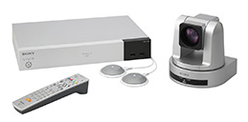
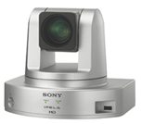
SONY Videoconferencing System

Slide 44
SONY (PCS series)
●: standard, ▲: option, -: not supported
 | Panasonic HDVC |  |  |  | SONY PCS
Model | VC2000 | VC1600 | VC1300 | VC1000 | XG100S | XG77S | XG100 | XG77 | XC1
Microphone | 4 (Digital) | 4 (Digital) | 4 (Digital) | 1 | 6 | 6 | 6 | 6 | 1
1080p | ● | ● | ● | ● | ● | ▲ | ● | ▲ | ▲
Embedded MCU | ●(16) ▲(20) ▲(24) | ●(6) ▲(10) | ●(4) | ▲(4) | ▲（6） ▲（9） | ▲（6） | ▲（6） ▲（9） | ▲（6） | -
Max. bandwidth | 24Mbps | 18Mbps | 18Mbps | 18Mbps | 16Mbps | 4Mbps | 16Mbps | 4Mbps | 4Mbps
Dual Stream | ● (H.239/BFCP) | ● (H.239/BFCP) | ● (H.239/BFCP) | ● (H.239/BFCP) | ● | ● | ● | ● | ●
Multi Monitor | ●(3) | ●(3) | ●(2) | ●(1) ▲(2) | ●(3) | ●(2) | ●(3) | ●(2) | -
Camera connection | ●(2) (HDMI) | ●(2) (HDMI) | ●(2) (HDMI) | ●(2) (HDMI) | ●(2) | ●(2) | ●(2) | ●(2) | ●(1)
Dual Network | ● | ● | - | - | ● | - | ● | - | -
Mobile | ● | ● | ● | ● | ● Windows not supported | ● Windows not supported | ● Windows not supported | ● Windows not supported | ● Windows not supported
ISDN | - | - | - | - | ▲ Yes Restrictions | ▲ Yes Restrictions | ▲ Yes Restrictions | ▲ Yes Restrictions | -

Slide 45
Key Features of SONY VC
Product Line-up
Multi-Point Support Model PCS-XG100
Point to Point Model PCS-XG77
Camera Integrated Model PCS-XC1
Mobile Access Software
(FHD support)
(HD support)
(HD support)
(Android/iPad/iPhone)
Key Features
High Image Quality: FHD (1920x1080), 60 Frame Rate
Multi-point Max. 9 site, expandable to 16-site by cascade connection (XG100)
Dual Stream with 1080p/30fps (Available Triple Monitor Output)
Embedded recording function with HD quality, and it can be recorded to the USB flash memory
Multi Device Support (iPad/iPhone/Android)

Slide 46
HDVC Advantages VS. SONY
Multipoint connection function (Embedded): Max. 9-site. Expandable to Max. 16-site with Multi-point Connection Application PCS-MCS1.
HDVC is capable up to 24-site (VC2000) / 10-site (VC1600) multipoint connection for both SD and HD quality.
Different Speed Communication does not support. Available resolution will be fixed depends on low bandwidth connection site.
HDVC supports Different Speed Communication. It can be operated at the optimum image quality to suit the bandwidth.
Windows does not support as mobile device.
Mobile can not be connected from the outside of the Internet environmental.
HDVC is possible connect from the outside without having build complex network environmental by NAT Traversal Service.
Impossible to expand to multipoint connection with XG77S.
Even entry model VC1000, it is possible to make up to 4-site multipoint connection with optional license. Basic model VC1300 is standard.

Slide 47
HDVC Advantages VS. SONY
HD is not available during cascade connection (10 to 16-site connection).
HDVC supports HD even in 24-site multi-point connection. Supports FHD (1080p) in 10-site connection.
Only CP1 screen layout is available during cascade connection.
HDVC supports various screen layout, such as CP10, CP13, CP15, CP16 and more.
Optional license is required to obtain FHD for content sharing (XG77/XC1)
HDVC supports FHD resolution in content sharing as standard.
Impossible to access to the internet environmental from outside when using Android / iOS such kinds of mobile devices.
HDVC supports “Call through NAT” function and NAT Traversal Service.

Slide 48
SONY’s Advantages
Possible to establish router-less network environmental by PPPoE function.
HDVC does not support PPPoE function.
PandPandP (Simultaneous display of Content, Remote site and Local site) is available in sprit screen layout.
HDVC supports “Content + Remote” or “Content + Local”.
PinP display (Content + Remote site) is available during content sharing.
HDVC supports only “Content + Local”. Not for “Content + Remote”.
Annotation is possible into Presentation image / Camera image by utilizing pen tablet.
Possible to record to USB flash memory, and easy playback by Quick Time.
HDVC requires 3rd party devices for recording solution.
Through the Web Console, codec and camera control can be made.
Web console of HDVC can be made settings. Not available control function.
Optical 12x (Digital 12x) camera comes with as standard, an it support 71 degree angle of field and dynamic range.
Rich Audio / Video input and output interfaces, easy collaboration with external equipment.

Slide 49
ClearOne Videoconferencing System

Slide 50
ClearOne
●: standard, ▲: option, -: not supported
 | Panasonic HDVC |  |  |  | ClearOne
Model | VC2000 | VC1600 | VC1300 | VC1000 | Collaborate Pro 900 | Collaborate Pro 600 | Collaborate Pro 300 | Collaborate Versa 100
Microphone | 4 (Digital) | 4 (Digital) | 4 (Digital) | 1 | 1 (Converge Pro 840T Mixer Beamforming Mic Arrays) | 1 (Chat 150C Mic Arrays) | 1 (Chat 150C Speakerphone) | 1 (Chat 150)
1080p | ● | ● | ● | ● | ● | ● | ● | ●
Embedded MCU | ●(16) ▲(20) ▲(24) | ●(6) ▲(10) | ●(4) | ▲(4) | ●(4) ▲(9) | ●(4) ▲(9) | - | -
Max. bandwidth | 24Mbps | 18Mbps | 18Mbps | 18Mbps | 6Mbps | 6Mbps | 6Mbps
Dual Stream | ● (H.239/BFCP) | ● (H.239/BFCP) | ● (H.239/BFCP) | ● (H.239/BFCP) | ● (H.239) | ● (H.239) | ● (H.239) | -
Multi Monitor | ●(3) | ●(3) | ●(2) | ●(1) ▲(2) | ●(2) | ●(2) | ●(2) | -
Camera connection | ●(2) (HDMI) | ●(2) (HDMI) | ●(2) (HDMI) | ●(2) (HDMI) | ● (USB/HDMI) | ● (USB/HDMI) | ● (USB) | ● (USB)
Dual Network | ● | ● | - | - | - | - | - | -
Mobile | ● | ● | ● | ● | ● | ● | ● | ●
ISDN | - | - | - | - | - | - | - | -

Slide 51
HDVC Advantages VS. ClearOne
Multipoint connection function: Max. 4-site (Collaboration Pro 600/900)
HDVC is capable up to 24-site (VC2000) / 10-site (VC1600) multipoint connection for both SD and HD quality.
Different Speed Communication does not support. Available resolution will be fixed depends on low bandwidth connection site.
HDVC supports Different Speed Communication. It can be operated at the optimum image quality to suit the bandwidth.
Only H.239 is supported for dual streaming.
HDVC supports both H.239 and BFCP.
Dual Network does not support.
VC2000/VC1600 have two LAN interface, and easy to establish different network environmental. Also avoid Expensive Initial Investment.

Slide 52
ClearOne’s Advantages
Brings the benefit of both traditional videoconferencing and cloud video collaboration.
Spontania video collaboration meeting with up to 25 participants joining from PC, mobile devices and room endpoints.
Up to 4 presenters sharing content at the same time.
Two-year warranty with support and maintenance include as standard.

Slide 53
Grandstream Videoconferencing System

Slide 54
Grandstream
●: standard, ▲: option, -: not supported
 | Panasonic HDVC |  |  |  | Grandstream
Model | VC2000 | VC1600 | VC1300 | VC1000 | GVC3200 | GVC3202
Microphone | 4 (Digital) | 4 (Digital) | 4 (Digital) | 1 | 1 (Built-in) | 1 (Built-in)
1080p | ● | ● | ● | ● | ● | ●
Embedded MCU | ●(16) ▲(20) ▲(24) | ●(6) ▲(10) | ●(4) | ▲(4) | ●(9) (FHD: 4/HD: 5/SD: 9) | ●(3)
Max. bandwidth | 24Mbps | 18Mbps | 18Mbps | 18Mbps | 4Mbps | 4Mbps
Dual Stream | ● (H.239/BFCP) | ● (H.239/BFCP) | ● (H.239/BFCP) | ● (H.239/BFCP) | ● (H.239/BFCP) | ● (H.239/BFCP)
Multi Monitor | ●(3) | ●(3) | ●(2) | ●(1) ▲(2) | ●(3) | ●(2)
Camera connection | ●(2) (HDMI) | ●(2) (HDMI) | ●(2) (HDMI) | ●(2) (HDMI) | ● (VGA/HDMI) | ● (VGA/HDMI)
Dual Network | ● | ● | - | - | - | -
Mobile | ● | ● | ● | ● | ● | ●
ISDN | - | - | - | - | - | -

Slide 55
HDVC Advantages VS. Grandstream
Multipoint connection function: Max. 4-site (Collaboration Pro 600/900)
HDVC is capable up to 24-site (VC2000) / 10-site (VC1600) multipoint connection for both SD and HD quality.
Different Speed Communication does not support. Available resolution will be fixed depends on low bandwidth connection site.
HDVC supports Different Speed Communication. It can be operated at the optimum image quality to suit the bandwidth.
Dual Network does not support.
VC2000/VC1600 have two LAN interface, and easy to establish different network environmental. Also avoid Expensive Initial Investment.

Slide 56
Grandstream’s Advantages
Support Skype, Skype for Business, Google Hangouts, etc.
It is based on Android, offers full access to all video conferencing apps in the Google Play Store.
Built-in Wi-Fi.
Possible to control by tablet through the Bluetooth. (App. is available)
Built-in Recording function is also available.

