Slide 1
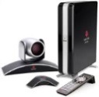
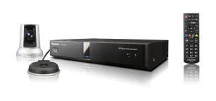
HDVC Case Study Real Estate-1
<Key Point> Realize the presentation function at a low price than the existing
Polycom MCU. Polycom terminal also left behind that can be utilized
Background
History of introduction
Considered replacement of RMX1000 that passed four years after the introduction.
Conducted a demonstration and get a high evaluation.
Since cost performance is high, introduced was one year ahead of schedule from the December 2016.
Branch E
HDX6000
6-site (9-set) Dec. 2015
Simultaneous installation
Group Intranet
Osaka（ＭＡＩＮ）
VC1600
Tokyo（ＭＡＩＮ）
VC1600
Branch B
VC1300
Tokyo（ＳＵＢ）
VC1600
Branch C
VC1300
Branch A
VC1300
Osaka（ＳＵＢ）
VC1600
Tokyo（SUB）
VC1300
Branch D
VC1300
Introduction
Use of HDVC
Configuration
Further Plan
- Tokyo 3pcs ・Osaka２
- Branch A, B, C, D
Total :6-site
- President talk
- Sales meeting
- Staff meeting
- KX-VC1600 4pcs
- KX-VC1300 5pcs
- GP-VD151 1pcs / GP-VD131 8pcs
Updated approach to
group companies.
(48 companies)

