Slide 1
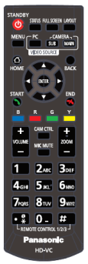
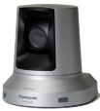
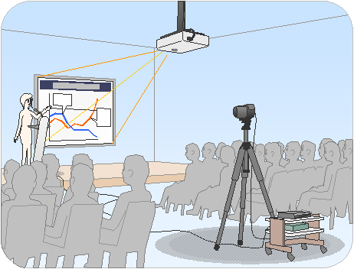
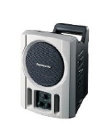
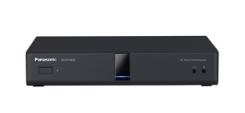
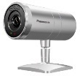
HDVC Case Study Distribution-2
＜Key Point＞ Easy operation by Remote Control Unit
Configuration
Key Point
■Sapporo HQ
GP-VD131
KX-VCA001×２
-Simple, Intuitive operation
with easy-to-use remote
control unit.
Projector
Speaker
KX-VC1600
５～６Mbps
IP-VPN
1Mbps
1Mbps
1Mbps
■Tokyo
■Osaka
■Branch A
■Branch B
■Branch C
1Mbps
1Mbps
Projector
1
２
1
２
1
２
1
２
３
4
５
３
３
３
4
５
６
６
4
５
６
4
５
６
KX-VC1300
Speaker
KX-VC1300
KX-VC1300
KX-VC1300
KX-VC1300
GP-VD131
KX-VCA001×２
AW-VC2
KX-VCA002
AW-VC2
KX-VCA002
AW-VC2
KX-VCA002
AW-VC2
KX-VCA002
Introduction
Use of HDVC
Configuration
- Sapporo HQ
-Tokyo ・Osaka
- Branch A ・Branch B
- Branch C Total 6-site
- Executive meetings
- Sales meeting
- Service meeting
- KX-VC1600 2pcs - KX-VC1300 4pcs
- GP-VD131 2pcs - AW-VC2 4pcs
- KX-VCA001 4pcs - KX-VCA002 4pcs

