Slide 1

1. This document can be disclosed to Panasonic Sales Partners
2. The specs might be changed without notice since it’s still under development.
For Panasonic Sales Company and Business Partner only
Actual Case Study
for Trouble Shooting
Ver. 1.1
Panasonic System Networks Co., Ltd.
Security System Business Division

Slide 2
History of Revision
Doc. Ver. | Contents | Date of Issue | Remarks
Ver. 1.0 | Issue of First Edition | 9th July 2014
Ver. 1.1 | Add and change of Version Information. 1. Camera control information (P9,10) 2. Audio & Video Codec solution (e.g. Kedacom TS6210) (P11) 3. HDVC mobile connection (P12) 4. NAT Traversal Mode with D-Link (P20) | 16th August 2015
Page 1

Slide 3

Case Study (Actual Case Example)
Case 1
Symptom : No Communication
Cause :
Incorrect network settings on Main Unit (Unit IP, Subnet Mask and Gateway)
Action : Set correct settings
One Point Advice
Double check both Router and Main Unit setting before connecting
Case 2
Symptom : Packet Loss
Cause :
Wrong Router Configuration
Action : Set configuration as follows
      Duplex Auto
      Speed Auto
Note: In case of packet loss or low bandwidth problem occurred during connection, please change the setting as follows.
duplex full, speed 100
Page 2

Slide 4

Case Study (Actual Case Example)
Case 3
One Point Advice
Symptom : Packet Loss
Cause :
The customer is using VDSL.
The VDSL is an “Asymmetric” type service same as ADSL. The Bandwidth (Downstream or Upstream) could be lower than the specify bandwidth.
Action : Check with ISP
Confirm type of the Internet connection
Confirm contract and actual Bandwidth for both downstream and upstream with ISP
Case 4
One Point Advice
?
Symptom : Packet Loss
Cause :
Defective Router
Action : Replace Router
Router back up is required
Make sure to Back up your data
Page 3

Slide 5
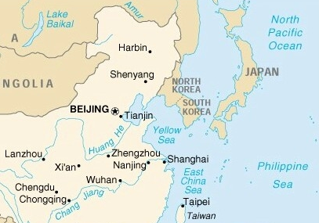
Case Study (Actual Case Example)
Case 5
One Point Advice
Run Trace route first
Then, run “Ping” to each routing point
Symptom : High Packet Loss
Cause :
Bad routing (Bad system condition at one or more routing points)
Action : Escalate to the ISP to request route change
Convenient Command
ip domain-lookup
ip name-server 8.8.8.8
Before
After
Page 4

Slide 6

Case Study (Actual Case Example)
Case 6
On Site A firewall, ALG is turned on and it is disturbing SIP communication between Site A and Site B.
Symptom :
No Connection through the Internal Network
Cause :
ALG on Site A Firewall disturbed SIP communication
Action :
Turned off ALG feature for SIP packets
Inter-Company VPN
Firewall Juniper SSG120
Firewall Juniper 550M
Intranet
Intranet
VLAN
Details of Problem and Solution :
When calling from Site B to Site A, at Site A side starts to ring.
Site A answer by pressing start button then see banner only on the screen. After that, error message appears.
Same problem happen when called from Site A then Site B answers.
Finally by turning ALG “OFF” for SIP packets on Site A Firewall then unit start working well and the problem resolved.
ALG = Application Layer Gateway
Page 5

Slide 7

Case Study (Actual Case Example)
Case 7
No image displayed due to damaged mini HDMI cable
Please inform customers to handle HDMI cable with care
Connection method
HDMI A type
HDMI Main
HDMI Sub
HDMI mini type
HDVC back panel
Case example
Connector for camera on the mini HDMI cable side is damaged due to being pulled by forced.
  (Connector part completely fell off and the copper wire are exposed)
Recommended operation method
Make sure to disconnect the HDMI cable before moving or cleaning the camera.
When HDMI cable is short in case of the sub-camera, It is recommended to use a longer cable
  (if cable is too long you may need an HDMI repeater) .
Page 6

Slide 8
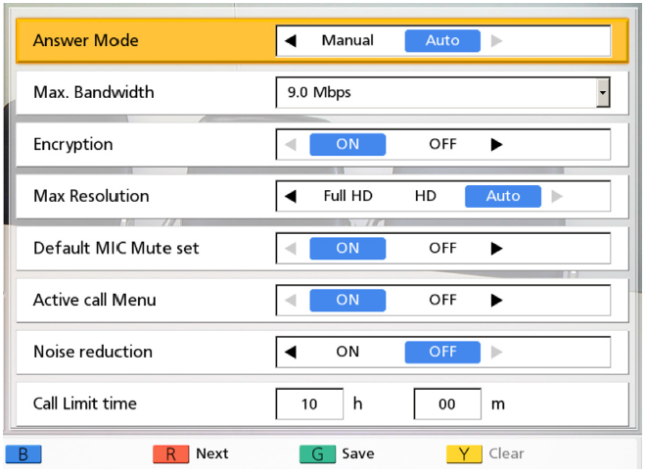
Case Study (Actual Case Example)
Case 8
One Point Advice
Confirm your internet line condition (Bandwidth)
Example: If your line is 4M/4M bandwidth, set Maximum Bandwidth as 4.0 Mbps.
Symptom : High Packet Loss
Cause :
Because of improper setting of the Max. Bandwidth. The system will try to reach up to selected Max. Bandwidth as limit, even actual line does not have enough bandwidth. In fact, if the line condition might be unstable, then will have high packet loss.
Action : Change Maximum Bandwidth based on contracted Internet line.
The following IP rate can be selected.
The factory default setting is 「9M」.
9.0 Mbps
8.0 Mbps
7.0 Mbps
6.0 Mbps
5.0 Mbps
4.0 Mbps
3.0 Mbps
2.0 Mbps
1.2 Mbps
1.0 Mbps
768kbps
512kbps
256kbps
Factory Default
Select specific IP rate based on contracted Internet line.
Page 7

Slide 9

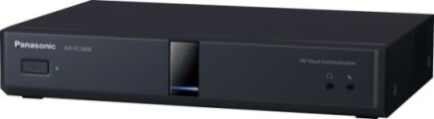
Case Study (Actual Case Example)
Case 9
One Point Advice
Symptom : Low Bandwidth
  Site A to Site B = 2～6Mbps
  Site B to Site A = 1～2Mbps
Cause :
Auto negotiation failed due to use of 10BASE-T Switching Hub (Insufficient specification), system runs with 10Mbps half mode.
Action : Change Switching Hub to proper specification type. (100BASE-TX)
  Both Site A and Site B = 8.7Mbps with no loss
Confirm equipment specification
Recommended Switching Hub
= 100BASE-TX, 10BASE-T/100BASE-TX
Ｉｎｔｅｒｎｅｔ
HDVC Unit
Router
Switching Hub
Page 8

Slide 10

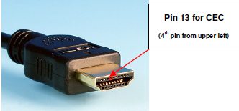
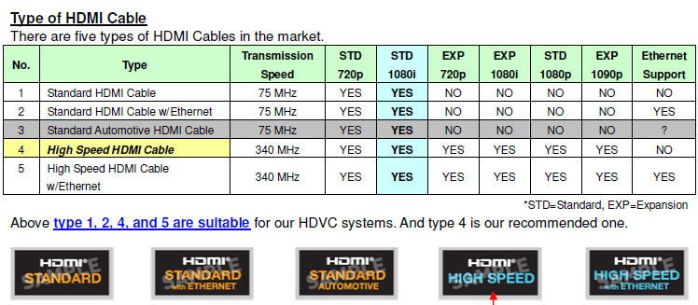
Case Study (Actual Case Example)
This is new!
Case 10
Symptom : out of camera control
Cause :
HDMI cable quality
Action : To change HDMI cable. We would like to recommend you to use Panasonic brand HDMI cable as much as possible, or use reliable brand in your market and select "HIGH SPEED" type. You can see type label on the package.
Page 9

Slide 11

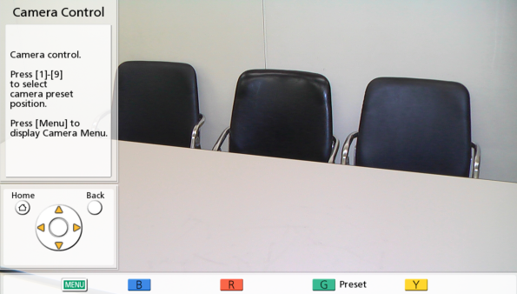
Case Study (Actual Case Example)
This is new!
Case 11
Symptom : Back to default (Auto) after restart camera VD131/VD130
Cause :
No save the camera setting (brightness, white balance etc.) to preset manually
Action : Pick up from user manual page No.12
The ‘home position’ refers to the position to which the lens moves first when the unit’s power has been turned on. The home position settings (position, brightness, white balance and focus) are the same as the preset 5 settings. To change any of the home position settings, register them in preset 5.
1) Change the setting
2) Register them in Preset 5
Change the setting
Register preset No.5 which is used after the camera restart
Page 10

Slide 12
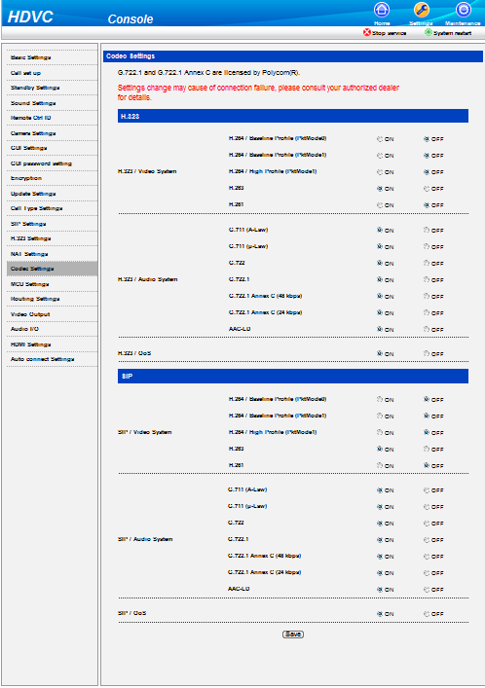

Case Study (Actual Case Example)
This is new!
Case 12
Symptom :
No sound and lower video quality when HDVC communicate Kedacom TS6210
Cause :
(1) No audio at HDVC site: Kedacom
has defect the audio negotiation
by G.711a-low/u-low
(2) Lower video quality at HDVC site:
Kedacom has defect the H.264
video negotiation.
Action :
To change the Audio/Video codec on HDVC web-cosole for avoiding the Kedacom defect.
H.263 : ON
H.264/H.261 : OFF
G.711(A/u-Law):OFF
H.263 : ON
H.264/H.261 : OFF
G.711(A/u-Law):OFF
(*) H.264 /Baseline Profile (Pktmode0)
can not be changed to OFF on HDVC GUI.
Kedacom TS6210
Page 11

Slide 13
Case Study (Actual Case Example)
This is new!
Case 13
Symptom :
No connection by HDVC mobile through mobile communication
Cause :
Mobile ISP has symmetric NAT feature and the packet is cut by NAT Traversal mode.
Action :
The HDVC mobile software is updated to Ver3.1.
country | Mobile carrier | Result Ver3.0 Ver3.1
Singapore | Singtel | NG | OK
 | Starhup | NG | OK
 | M1 | NG | OK
Vietnam | MobiPhone | NG | OK
Thailand | TRUE | NG | OK
 | AIS | OK | OK
Philippines | Glove | NG | OK

Slide 14
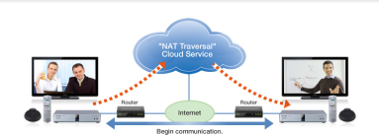
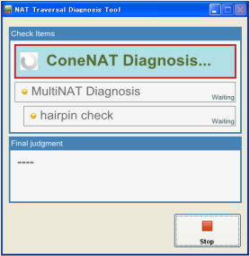
Case Study (Actual Case Example)
NAT Traversal Service
This is important NOTICE!!
A Customer’s Site Survey is important activity before installing actual systems to avoid any unnecessary issues from happening and reduce installation time.
What you should do is ;
Confirm customer’s Internet Environmental by using NAT Traversal Diagnosis Tool. This tool confirm the Internet Connection Compatibility with Easy Connection Service.
Confirm customer’s Internet Condition such as ISP name, Line Type (Optical Fiber or ADSL, etc) and available Bandwidth (Both Up/Down).
Confirm whether SIP-ALG function is working on router? If the answer is YES, change to Disable it.
Confirm whether Firewall is working on router? If the answer is YES, all necessary ports have to be opened up. *Refer to port information for the details.
Main Menu
Diagnosis Screen
Page 13

Slide 15
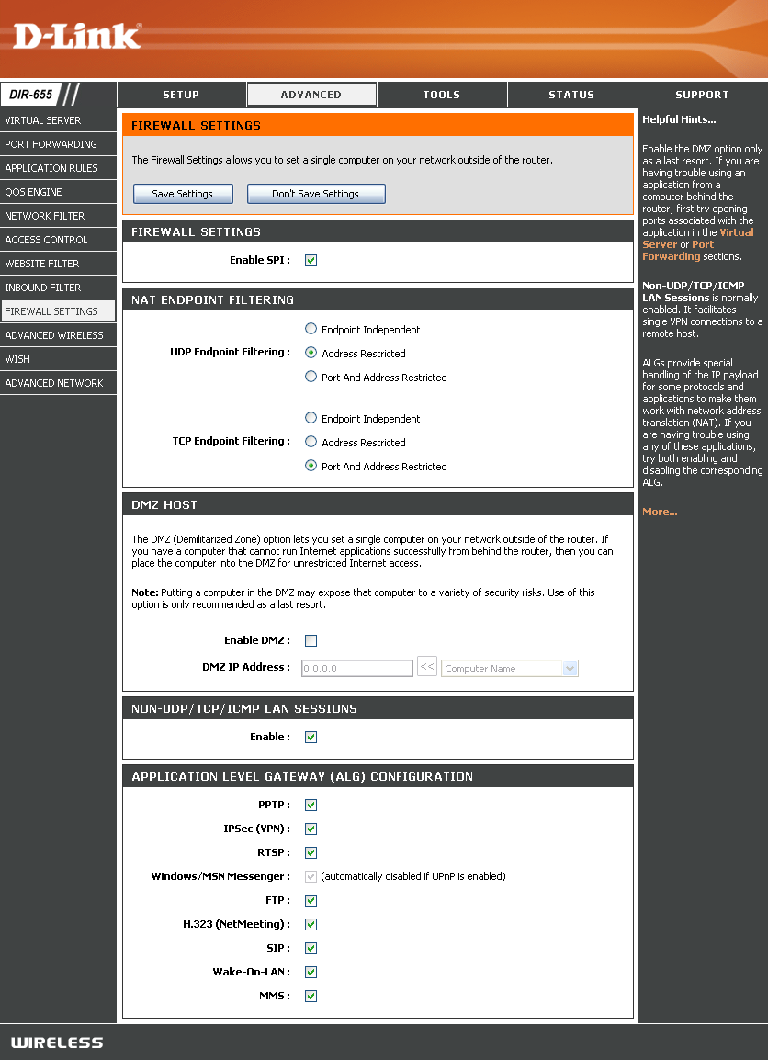
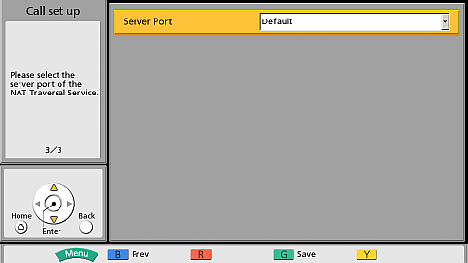
Case Study (Actual Case Example)
NAT Traversal Service
Case 1
One Point Advice
Confirm the router setting whether SIP-ALG function is enable.
Depends on the router model, the setting menu and setting method are different.
Symptom :
Terminal ID not assigned or No Communication
Cause :
SIP-ALG (Session Initiation Protocol – Application Layer Gateway) is working on the router. SIP-ALG may change SIP message. Because of this message change, HDVC can not communicate properly.
Action :
Change SIP-ALG function to disable
or change Server Port No. from “5060” to “15060” at HDVC GUI menu.
The figure in below is one of example.
(Router model D-Link DIR-655)
ALG Configuration Menu
Server Port
Default:5060
Alternate:15060
Change to Disable as necessary
Page 14

Slide 16

Case Study (Actual Case Example)
NAT Traversal Service
Case 2
One Point Advice
Symptom : No Communication
Cause :
Customer used PC software based Router. The EC require Panasonic approved router, or router which is confirmed in locally.
Action :
Replace the router to approved / confirmed one by Panasonic.
Use Panasonic approved routers to avoid any unnecessary issues from happening.
Panasonic Approved / Confirmed Routers
Area | Router
Japan | YAMAHA RTX1200 / NVR500 / RTX1100 Buffalo WHR-G301N / WZR-HP-G302H, WHR-HP-G300N NEC PA-WR8170N-ST / PA-WR8700N-HP / PA-WR8750N-HP
Overseas | Linksys E1000 / E4200 NETGEAR N300 / N750 TP-Link TL-R410 D-Link DIR-655 Buffalo WHR-HP-G300N
Page 15

Slide 17

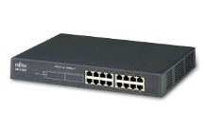
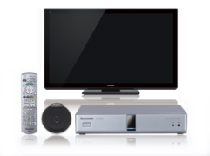

Case Study (Actual Case Example)
NAT Traversal Service
Case 3
One Point Advice
Confirm whether exist Firewall in the network
Confirm possibility of Firewall setting change with Customer’s IT manager
Bypass a Firewall
Symptom : Terminal ID not assigned
Cause :
Firewall disturbed connection to the SIP server.
But Firewall setting change won’t allow due to security issue.
Action : Place the router for EC to bypass the Firewall to avoid any disturbance by Firewall feature for HDVC communication.
Before
After
Internet
Internet
TA
TA
Firewall
Firewall
Router for EC
HUB
HUB
Router for EC
HDVC
HDVC
Page 16

Slide 18
Case Study (Actual Case Example)
NAT Traversal Service
Case 4
One Point Advice
Symptom :
Packet Loss / No Image / Disconnect
Cause :
Insufficient bandwidth for communication due to low bandwidth availability or many PC users are using same internet line, so on.
HDVC is needed minimum 256kbps for both Video and Audio communication. If the available bandwidth during communication is below 256kbps, it cannot be seen any images (Maybe Black) or it can not see any information when going to connection status screen.
Action :
Assign specific bandwidth for HDVC communication.
Please discuss with customer’s IT manager to conduct it.
Confirm connection status to understand actual status during connection, and confirm actual image quality level whether accept.
Connection Status Screen
These information are changing real time bases.
If the bandwidth below 256kbps, it cannot be seen any images
Displaying Connection Status
1. Press [Status] twice.
2. Then press [R] to display next screen
Page 17

Slide 19
Case Study (Actual Case Example)
NAT Traversal Service
Case 5
One Point Advice
Confirm customer’s network environmental in advance whether specific IP address is needed for HDVC connection.
Symptom :
Terminal ID not assigned
Cause :
Customer’s network environmental was not DHCP condition. It is needed to assign fixed IP Address for HDVC system.
Action :
Assign fixed IP address to the HDVC system.
Note: Basically, Recommended Network Settings for Easy Connection is “Auto” for both IP Address and DNS Server.
Basic Settings
Assign Specific IP Address
Input specific IP address as necessary
Input IP address of DNS server as necessary
Page 18

Slide 20
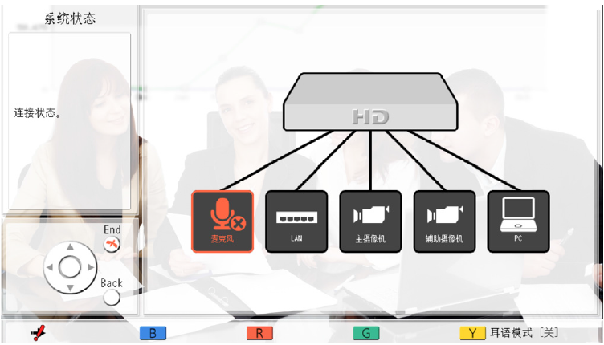
Case Study (Actual Case Example)
NAT Traversal Service
Case 6
One Point Advice
Confirm LAN cable connection and LAN cable condition.
Confirm Firewall and SIP-ALG settings as necessary.
* There is possibility that have to contact ISP side depends on Network environmental.
Symptom :
Error “0700 000b” “0500 0008” displayed
An “X” mark is displayed on LAN icon
Cause :
This is an error code that the system could not register to SIP server. There is possibility that the router or the LAN cables is not connected correctly to the HDVC system or because of Firewall and SIP ALG feature are working on the router.
Connection Status Screen
Action :
Confirm physical cable connection between HDVC and router or HUB.
Confirm physical cable condition whether there is no damage.
Confirm Firewall and SIP-ALG feature are enable or not. If it is existing, try disable it.
Note: Confirm to ISP side as necessary if there is no problem in locally.
If “X” mark on LAN icon, you will see error “0700 000b” “0500 0008”
X
Press [Status] once to go to above screen.
Page 19

Slide 21


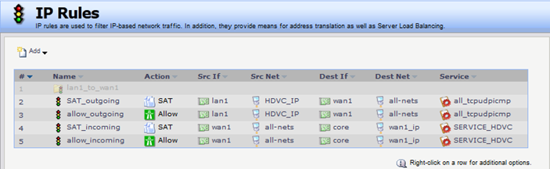
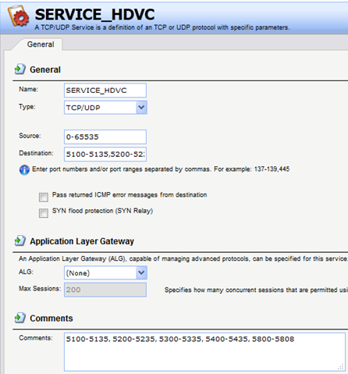
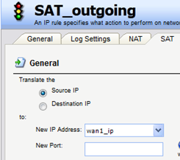
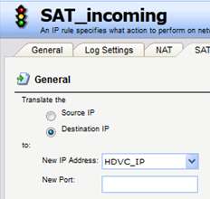
Case Study (Actual Case Example)
This is new!
NAT Traversal Service
Case 7
TA
Internet
Symptom : Terminal ID is assigned but no communication
Cause :
  Firewall disturbed connection to the STUN server.
  D-Link Firewall has symmetric NAT feature.
Action : IP rules for both outgoing and incoming are
registered on the firewall.
Firewall
D-Link DFL2560
HDVC
  Below D-Link Firewall models are same with this setup.
  DFL-260
  DFL-260E
  DFL-800
  DFL-860
  DFL-860E
  DFL-1600 / DFL-1660
  DFL-2560 / DFL-2560G
1) Set up IP rules on Firewall
(*) Both SAT rule and Allow rule are needed.
These are rules
for outgoing
3) Set up Service on Firewall
These are rules
for incoming
2) Set up SAT on Firewall
(*) SAT means static NAT setting on this firewall.
Source: 0-65535
Destination: 5100-5135
5200-5235
5300-5335
5400-5435
5800-5808
ALG: NONE
Translate “Source IP” to WAN IP address on outgoing
Translate “Destination IP” to HDVC IP address on incoming
Page 20

Slide 22
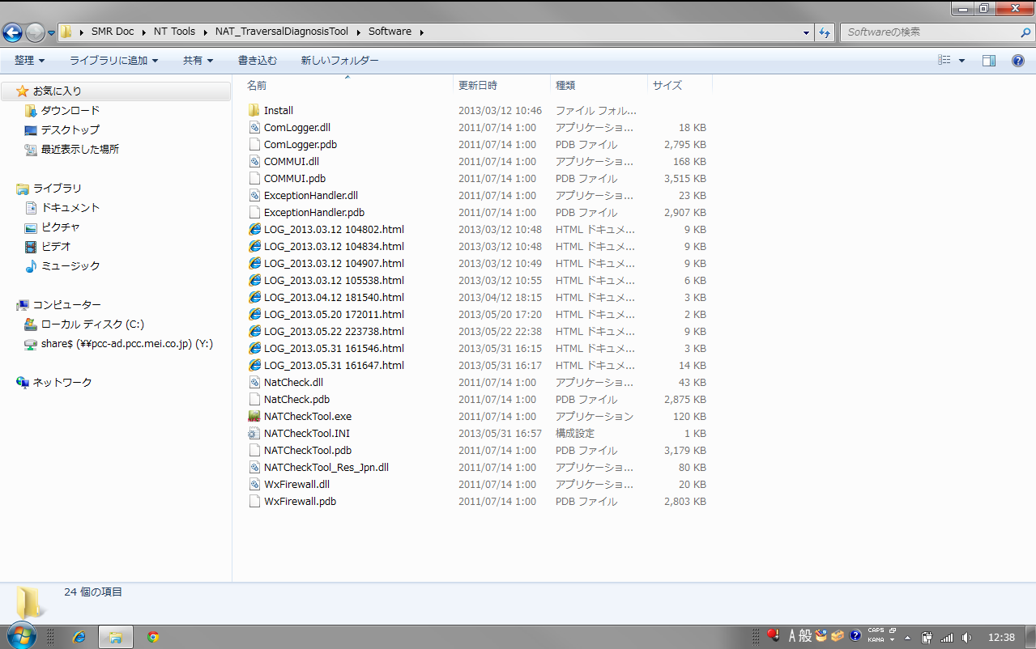


Necessary Logs for Investigation
NAT Traversal Service
When the problem cannot be solved, and needs help, please acquire following Logs to make investigation better.
NAT Traversal Diagnosis Tool Log :
Recognize detailed information of test result from this log such a communication status with SIP server, NAT type and Multi NAT so on. A Log file is existing in the same folder of tool.
These are Log files.
Recognize more details of this test result
Main Menu
Diagnosis Screen
History Logs :
Recognize HDVC’s call history, error history and operation history so on. It can be saved all history Log files to USB Flash memory from GUI operation.
Contents of Logs
 | File name | contents
1 | config.xml | Configuration data
2 | address.xml | Address data
3 | callhist.xml | Call history
4 | alm_log.csv | Error log
5 | opr_log.csv | User operation log
6 | inf_log.csv | HDVC management log
7 | debug_log.txt | System log
[ Procedure ]
Go to “Menu” -> “Settings”
-> “Admin login”
*Default Password is “00000000”
-> “Save log”
*Insert USB memory to HDVC
Page 21

Slide 23

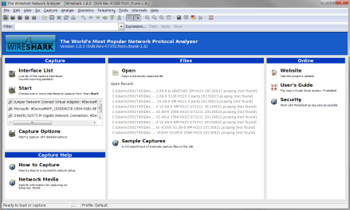
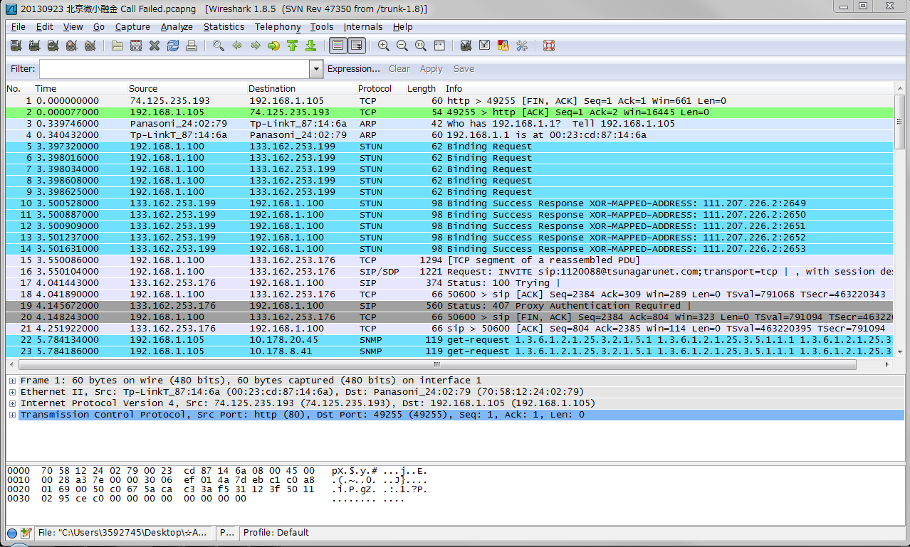
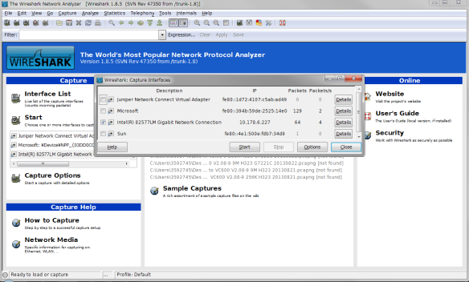
Necessary Logs for Investigation
Advanced
Wireshark Capture :
A Wireshark is free download capture software.
http://www.wireshark.org/download.html
By utilizing Wireshark, entire network communication status can be recognized.
[ Required Items]
PC
Wireshark Software
Mirroring HUB
LAN Cables (2-3 pcs.)
[ Basic Network Configuration to use Wireshark]
Mirroring HUB
Internet
Router for EC
HDVC
Use Mirroring Port especially for PC.
PC for Capture + Wireshark
Sample : Captured Data
Click “Interface List” to select specific Interface for the capturing
Main Screen
You can see entire network communication Status
Click “Start” after selecting the interface
Page 22

Slide 24

Thank You !
Panasonic System Networks Co., Ltd.
Security System Business Division

