Slide 1
1. This document can be disclosed to Panasonic Sales Partners 2. The specs might be changed without notice since it’s still under development.
For Panasonic Sales Company and Business Partner only
Trouble Shooting
Ver.4.00
Panasonic System Networks Co., Ltd.
Security System Business Division

Slide 2
History of Revision
Doc. Ver. | Contents | Date of Issue | Remarks
Ver. 4.00/4.10 | Issue of First Edition | Nov. 2014
Page 1

Slide 3
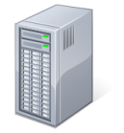
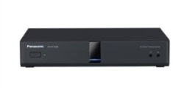
Basic Procedure of Trouble Shooting
The following is basic trouble shooting procedure.
1. Acquire detailed information of the trouble
Model Number and Firmware version. System and Network Configuration.
Detail of the Phenomenon, date and time when the problem is occurred.
Frequency of occurrence, site information and connection method.
Any others.
2. Analysis of the trouble
Confirm reproducibility.
Confirm problem relations whether relating with Hardware or Network.
Note: In case of sort-time noise of Video / Audio, there is possibility that it is relating with insufficient Bandwidth or delay.
3. Acquirement of History Logs from HDVC, MPCS
It possible to acquire through the Web Console.
Depends on hardware and Network Environmental, it is possible remote access.
Also possible to acquire by using USB Flash Memory.
Note: In case of the system with NAT Traversal Service connection and MPCS, it may not be used remote access.
Please grasp history logs at onsite.
Page 2

Slide 4
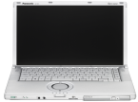
Acquirement of History Logs
The followings are acquirement method of History Logs.
 | Method | Type | Remarks
HD Visual Communication System | USB Flash Memory | Onsite | Most easy way to acquire history logs. It is better way when LAN connection impossible with PC.
 | Web Console | Onsite | Utilize this method in case of NAT Traversal Service connection site and IP mode with Static NAT setting site.
 |  | Remote | Remote access can be made with INTRANET and VPN environmental.
Multi-point Connection Software (MPCS) | Web Console | Onsite | Utilize this method in case of NAT Traversal Service connection.
 |  | Remote | Remote access can be made with INTRANET and VPN environmental.
Through the Web Console (Both Remote and Onsite)
By USB Flash Memory (Onsite only)
Remote Access
Local Access
(Onsite)
USB Flash Memory
Page 3

Slide 5
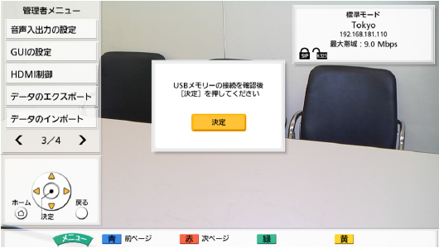
Log Acquirement by USB Flash Memory
The followings are Log acquirement procedure by using USB Flash Memory.
[ Procedure ] 1. Insert USB Flash Memory to HDVC.
2. Go to “Menu” => “Settings” => “Admin Login” => “Data Export”.
3. Select “USB”, then save the logs.
4. Remove USB Flash Memory after confirming data backup succeeded.
Back Side
USB Flash Memory
Downloaded File name will be as follows.
[ File Name ] hdvclogall_<version>_<IP address>_YYMMDD_HHMISS.tar
(Compressed File)
Data Export
Note: USB Mass Storage Class （FAT16/FAT32 Format) supported
The following USB Flash Memory can not be used.
U3 Smart Drive
USB Flash Memory with Security function
Formatted by NTFS type
Various LUN (Logical Unit Number)
Various Partition
Inefficient Memory Capacity (Required more than 5M Byte)
Page 4

Slide 6
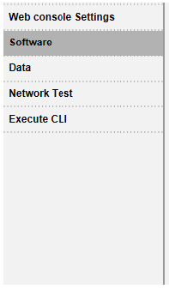
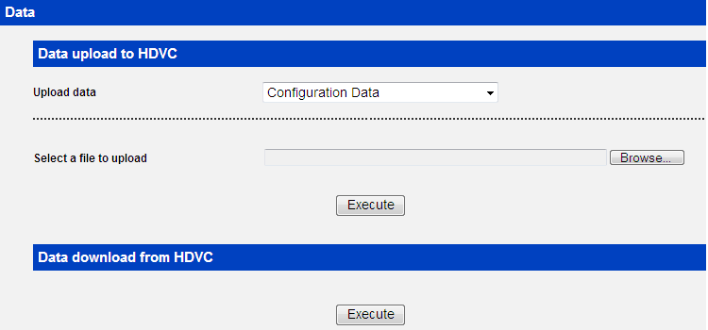
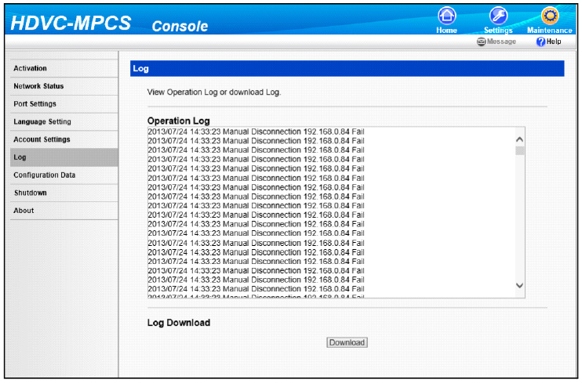
Log Acquirement Through Web Console
The followings are Log acquirement procedure through Web Console.
HDVC
MPCS
①
①
②
②
You can download the archive file that contains Configuration Data, Contact List, Local site data, and log data.
If you click "Execute" and specify a location to save the file, the archive file will be downloaded.
The name of the file downloaded is "hdvclogall_XXXX.tar".
The "XXXX" portion of the file name varies depending on the software version, IP address and the date of the download (YYMMDD_HHMMSS).
Example> hdvclogall_V3_10_Rev1_192.168.1.10_131007_205008.tar
③
You can confirm or obtain the history log.
1. Click the "Maintenance" screen selecting tab.
• The maintenance screen is displayed.
2. Click "Log" in the maintenance menu list.
• The log screen is displayed.
3. Click "Download" to obtain the history log.
• The screen to confirm the saving of the history log is displayed.
4. Save the file.
• The history log file is downloaded, and the log screen is displayed.
Page 5

Slide 7
Contents of History Logs
The followings are contents of History Logs.
 | File name | contents | Remark
1 | config.xml | Configuration data | Xml format data, it contains various parameters. Direct editing is NOT recommended to avoid data corrupt and serious problem. e.g. Wrong IP address may happen no connection.
2 | address.xml | Address data | Xml format data. Direct editing is NOT recommended to avoid data corrupt. Please use address book editor when you edit address data.
3 | callhist.xml | Call history | It contains recent 30 calls for both Outgoing and Incoming, <HistType>0:Outgoing 1:Incoming
4 | alm_log.csv | Error log | HDVC store the log when HDVC found error. e.g. No video input device [HDMI1], network down, network up
5 | opr_log.csv | User operation log | User operations, e.g. When/to Whom he called/disconnected.
6 | inf_log.csv | HDVC management log | Internal log on HDVC.
7 | debug_log.txt | System log | Detail log with more information. (*)Because of limited log area, log period has a limit. It depend on the usage. It might be less than 30 minute. Then urgent log fetch is required.
Page 6

Slide 8
Data Import / Export via USB Flash Memory
Several data of call history, Log data, setting data, Address book data can be imported / exported via USB memory by remote controller operation.
1. Applicable Data of Import and Export
< Logs > * Export only Histories (Call, Error, User Operation), Logs (Syslog, μcode logs, etc.)
< Setting Data > Data (Configuration, Select Local Site), Contact List
2. Method < by USB Flash Memory > Operated by Remote Controller Go to “Menu” => “Settings” => “Admin Login” => “Data Export” or “Import” < by PC (Web Console) > Connect PC and HDVC.
* Please refer to Remote Maintenance section for the details.
Page 7

Slide 9
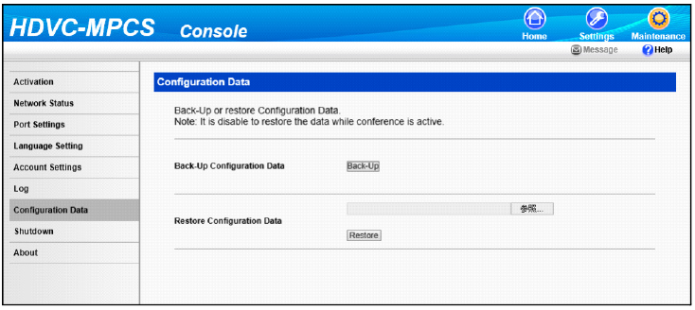
Data Backup / Restore of MPCS
Backup and Restore of MPCS Configuration Data can be made.
1. Applicable Data of Backup
< Setting Data > Configuration Data, Contact List
2. Method < by PC (Web Console) > Connect PC and HDVC.
Go to “Maintenance” => Configuration Data” => “Backup” or “Restore”
* Please refer to Remote Maintenance section for the details.
Page 8

Slide 10
Thank You !
Panasonic System Networks Co., Ltd.
Security System Business Division

