Slide 1
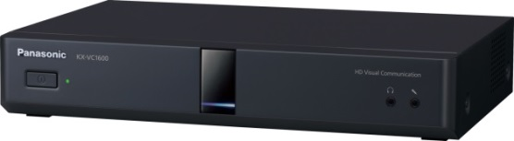
1. This document can be disclosed to Panasonic Sales Partners
2. The specs might be changed without notice since it’s still under development.
For Panasonic Sales Company and Business Partner only
Activation Key Card
Ver.4.20
Panasonic System Networks Co., Ltd.
Security System Business Division

Slide 2
History of Revision
Doc. Ver. | Contents | Date of Issue | Remarks
Ver. 4.00/4.10 | Issue of First Edition | Nov. 2014
Ver.4.20 | Add New Activation Key information (KX-VCS351) | Aug. 2015 | Page 03 and 04
Page 1

Slide 3



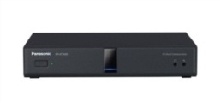
Administration Scheme of AK Card
The administration scheme will be based on the SSBD AK software administration scheme.
The card which provides the Registration Key No. needs to be purchased from a sales company before hands.
Sales Company
PSN Factory
4
Sell
AK Card
1
Info input for manufacture
(Model No. & quantity)
AK Card admin system
5
Payment
3
Manufacture AK Card
2
・AK No.
・Reg. ID
Generate & Transfer
Internet
6
Sell
AK Card
7
Payment
Sier / Dealer
9
Download
Registration Key No.
10
Input the Registration Key No. in the unit
8
Login
・MPR ID
・A.K No Input
・Reg. ID
By inputting the Registration Key No.
(16-digit) in the unit, the software gets
activated.
End user
MPR ID
Page 2

Slide 4





Activation Key Card
The followings are Activation Key Card Line-up.
Applicable Device | Model No. | Description | Remarks
HD Visual Communication System KX-VC1300/VC1600 | KX-VCS304 | Add. 4 points (For VC1600)
 | KX-VCS701 KX-VCS703 | License for NAT Traversal Service 1 year License / 3 years License
 | KX-VCS351 | Mobile License Control Activation Key | Register to HDVC, then possible to connect HDVC Mobile for Windows, iOS and Android in IP mode.
Multi-Points Connection Software (MPCS) | KX-VCM206 / 208 / 212 / 216 | License for MPCS 6, 8, 12 and 16 ports
 | KX-VCMS001 | Add. 4 points | Available for 8 and 12 ports license. (Not for 6 ports and 16 ports)
 | KX-VCS701 KX-VCS703 | License for NAT Traversal Service 1 year License / 3 years License | Same Activation Key Card with HDVC System
HDVC Mobile for Android and iOS | KX-VCS751 KX-VCS753 | License for NAT Traversal Service 1 year License / 3 years License 5keys | It is required minimum 1 year license key even in case of use IP mode connection only.
HDVC Mobile for Windows | KX-VCS781 KX-VCS783 | License for NAT Traversal Service 1 year License / 3 years License 1key | It is required minimum 1 year license key even in case of use IP mode connection only.
This is new!
Issue of Registration Key and Registration Method are different depends on type of Activation Key.
3 Month Free Trial Key is available, and it comes with HDVC main unit. (A piece of paper is inside of box.)
1 License Key for HDVC 1 License Key for Mobile (Android/iOS) 1 License Key for Windows
Page 3

Slide 5
Activation Key Card
Issue of Registration Key and Registration Method are different depends on type of Activation Key.
Necessary Information is also different depends on type of Activation Key.
There are two kinds of URL to issue of Registration Key.
 | Type | Model No. (Example) | Necessary Information | URL | Remarks
1 | Optional Function Key | KX-VCS304 (Add. 4 sites for KX-VC1600) | Activation Key No. Registration ID MPR-ID of HDVC | https://kms.business.panasonic.net/hdcomkms/pc/home.htm | To Access KMS Web Site, ID and Password are required. Also it is needed register your information in advance. Please contact your local Panasonic Sales Company.
2 | Mobile License Control | KX-VCS351
3 | MPCS Registration | KX-VCM206/208 KX-VCM212/216 KX-VCMS001 | Activation Key No. Registration ID MAC Address of MPCS Server
4 | NAT Traversal Service for HDVC | KX-VCS701/703 | Activation Key No. Registration ID MPR-ID of HDVC | https://www.tsunagarunet.com/hdcom/main | This Web Site allows to access both End User and Sier/Dealers
5 | NAT Traversal Service for MPCS |  | Activation Key No. Registration ID MAC Address of MPCS Server
6 | NAT Traversal Service for Mobiles | KX-VCS751/753 KX-VCS781/783 | Activation Key No. Registration ID | No needs to issue Registration Key. Just follow the diagram on the display to activate NAT Traversal Service available.
This is new!
After having Registration Key (16 Digits) on the Web Site, please make a note. Then input it to HDVC or MPCS Server to activate.
Page 4

Slide 6
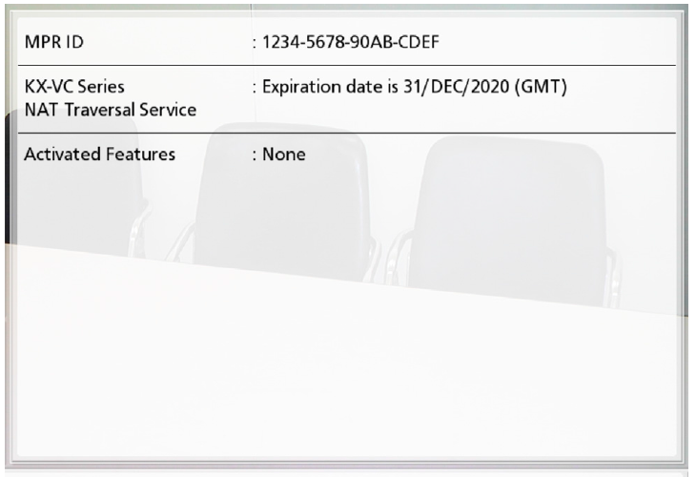
Confirmation of MPR-ID
There are 3 ways to confirm MPR-ID.
  From the Carton Box of HDVC
  From the serial number plate on the back side of HDVC.
  Go to “Menu” => “Settings” => “Enhancement” by using remote controller.
* MPR-ID: A unique number provide to each terminal. It is needed to get Registration Key No..
Page 5

Slide 7
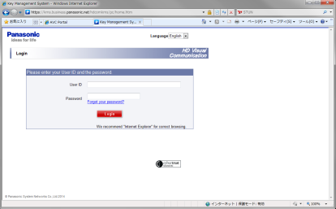
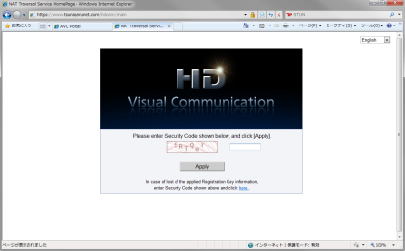
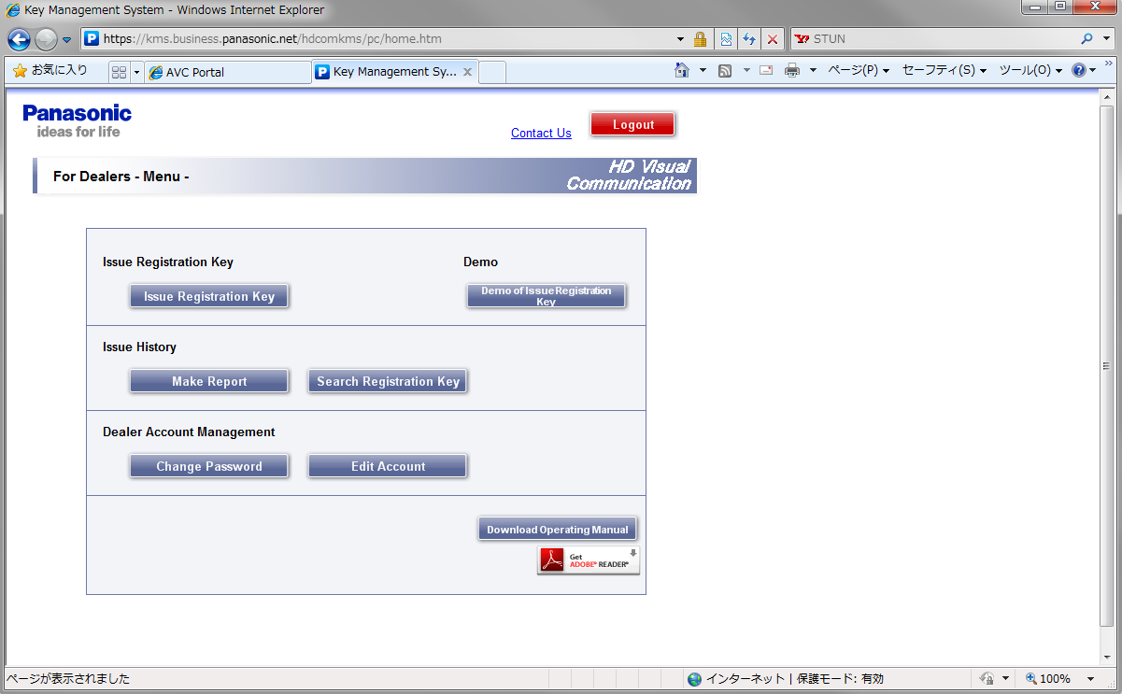
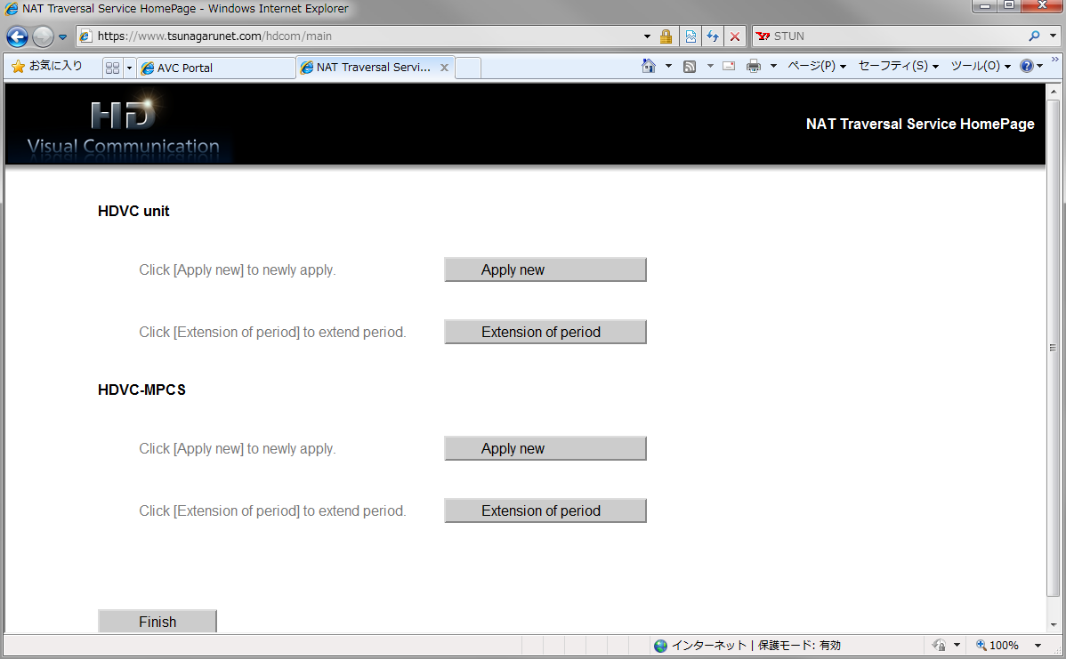
Issue of Registration Key
There are 2 kinds of Web Site to issue registration key.
  For Optional Functions and MPCS Registration
    https://kms.business.panasonic.net/hdcomkms/pc/home.htm
    Note: It is needed User ID and Password to access. (Please contact to your local Panasonic Sales Company to get them.)
  For NAT Traversal Service (HDVC and MPCS, Except HDVC Mobiles)
    https://www.tsunagarunet.com/hdcom/main
For Optional Functions and MPCS Registration
For NAT Traversal Service (HDVC and MPCS)
Enter User ID and Password
Choose specific menu to issue registration key
Click here to issue registration key
Page 6

Slide 8
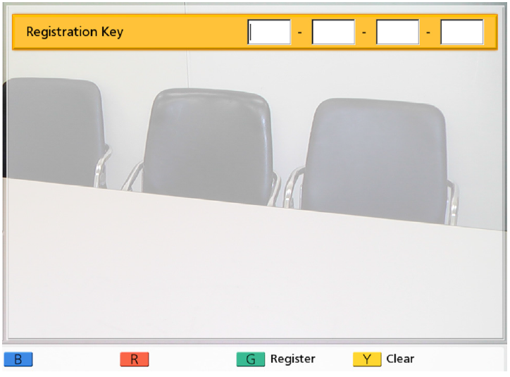
Activation Procedure of HDVC
The following is Activation Procedure for HDVC.
The procedure is same for both Optional Function and NAT Traversal Service.
[ Procedure ]
To perform the activation, you must obtain a Registration Key.
Go to “Menu” => “Settings” => “Admin Login” => “Enhancement”, then press [G] (Green Button).
Enter the 16-digit registration key.
Press [G] (Green Button).
  A dialogue box to confirm the saving of settings and system restart after saving is displayed.
Select “YES” and press [Enter].
  The system will automatically restart to reflect changes to system settings.
  Note: If the registration key you entered is invalid, “Failed Registration Key code authentication.” is displayed.
①
②
Please confirm Internet Access ready when making NAT Traversal Service registration. It is needed to access to System Administration Server in cloud during activation.
To expand service term of NAT Traversal service, it can be made through above specific Web site. But it is not necessary to input Registration Key same as initial activation.
Page 7

Slide 9
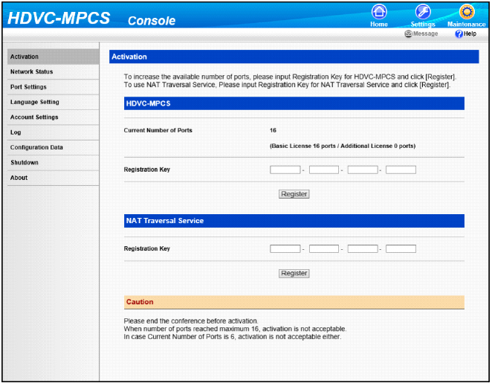
Activation Procedure of MPCS
The following is Activation Procedure for MPCS.
[ Procedure ]
To perform the activation, you must obtain a Registration Key.
Click the “Maintenance” screen selecting tab.
Click “Activation” in the maintenance menu list.
Enter the Registration Key.
  Note: In case of NAT Traversal Service, both License Registration and NAT Traversal Service Registration are required.
Click “Register”.
  A message to confirm the performing of activation is displayed.
Click “OK”
  Activation is performed, and a message to show the completion of license registration is displayed.
Click “OK”
  The activation screen is displayed.
Please confirm Internet Access ready when making NAT Traversal Service registration. It is needed to access to System Administration Server in cloud during activation.
To expand service term of NAT Traversal service, it can be made through above specific Web site. But it is not necessary to input Registration Key same as initial activation.
Page 8

Slide 10




Release Service and Re-registration (Mobiles)
The following is procedure to Release Service and Re-registration in case of lost, broken or replacement of mobile device.
< Necessary Information for Re-registration >
Activation Key Information when register in beginning.
1. Activation Key No. 2. Registration ID
Terminal ID (Seven Digit Number) when registered.
Note: In case of using 3 Month Trial Key, the procedure is same as subscribed version.
Internet connection is required to proceed “Release Service” and “Re-registration”.
In case of service term expired, it can not be made.
“Release Service” is mandatory required to proceed “Re-registration”. It is impossible to do this uninstall of application.
STEP 1
Go to “Menu” => “Settings” => “Release Service”
* Data linking of MAC Address of Device and Terminal ID will be released at KMS Administration Server.
STEP 2
Go to “Menu”=> “Settings” => “Service Registration”
* Data linking of MAC Address of Device and Terminal ID will be create at KMS Administration Server.
Note: The terminal ID (7 digit number) and expiration date
will be same as the original ones.
KMS Administration Server
KMS Administration Server
Internet
Previous Devices
Internet
New Devices
Page 9

Slide 11
Activation Key Transaction
Transaction means the AK transfers from one unit to another.
Transaction will be prohibited unless specific reason such as follows.
  Replacement of the mother board.
  Swap with Link Unit for repairing purpose.
[ Activation Key Transaction Flow ]
A transaction request email will be sent to Overseas FE (CS) section from the sales company with following Information:
2. Overseas FE section changes the system setup to allow the transaction.
3. The transaction acceptance will be reported from FE section to the SIer/Dealer via sales company.
4. The SIer/Dealer download the AK by using the new MPR ID.
<Dealer Name> XXXXXXXXXXXX
<User ID> XXXXXXXX
<Activation Key No.> XXXX-XXXX-XXXX-XXXX
<Registration ID> XXXXXXXX
<MPR ID of the former unit> XXXX-XXXX-XXXX-XXXX
These steps must be completed within 3 days.
Page 10

Slide 12

Activation Key Transaction Scheme
4
Inform former HDVC MPR ID, A.K No., Reg. ID
1
Send the HDVC unit
Sales Company
(CS)
5
PSN changes the data link, and inform to the sales company
6
Sales company inform to the Sier / Dealer
2
The sales company confirms returned unit
3
The sales company gets the following info from the Sier / Dealer
(Former MPR ID , A.K No.. Reg. ID )
ＰＳＮ
7
Login and input the new information.
(New MPR ID, A.K No., Reg. ID)
Sier/Dealer
KMS
8
New Registration Key
* The “A.K No.” stands for “Activation Key No.” and “Reg. ID” stands for “Registration No.”
Page 11

Slide 13

Thank You !
Panasonic System Networks Co., Ltd.
Security System Business Division

