Slide 1
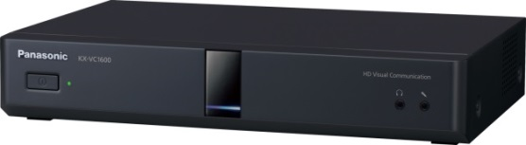
1. This document can be disclosed to Panasonic Sales Partners
2. The specs might be changed without notice since it’s still under development.
For Panasonic Sales Company and Business Partner only
Firmware Version Up
Ver.4.00
Panasonic System Networks Co., Ltd.
Security System Business Division

Slide 2
History of Revision
Doc. Ver. | Contents | Date of Issue | Remarks
Ver. 4.00/4.10 | Issue of First Edition | Nov. 2014
Page 1

Slide 3
Version Up Method by Devices
The followings are version up method comparison by Devices.
 | Software Fee | Version Up Method | Remarks
HD Visual Communication Systems KX-VC1300/VC1600 | Free of Charge | Server Download Method | Version up via Internet.
 |  | USB Memory Method | Version up by using USB Flash Memory Device.
 |  | PC Method | Version up through the PC.
Multi-Points Connection Software （MPCS） | Subscribed | Onsite at MPCS Server site | Activation Key for version up is required.
HDVC Mobile for Android | Free of Charge | Update from Google Play
HDVC Mobile for iOS | Free of Charge | Update from Apple Store
HDVC Mobile for Windows | Free of Charge | Download updated software from “Panasonic.net” web site | http://panasonic.net/psn/products/hdvc/product/index.html
Page 2

Slide 4
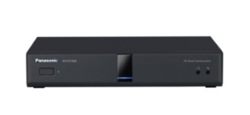

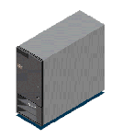
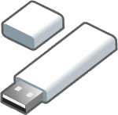

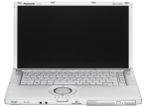
Philosophy of HDVC Version Up
The followings are Basic Philosophy of HDVC Version Up.
  Operating System Part: Free Update
  Optional Functions Part: Conducted by Subscribed Activation Key
< Formation of Software >
Operating System
By upgrading the operating system, an optional feature also upgraded at the same time.
HDVC
Optional Functions
Add. 4 points (For VC1600) NAT Traversal Service (Easy Connection)
VC1300/VC1600
Activation Key
There are three method to update the Operating System as follows.
1. Server Download Method
2. USB Memory Method
3. PC Method
Version up via Internet
Version up by USB Flash Memory Device
Version up through the PC
It takes approximately 20 min to complete as maximum.
Internet
USB Flash Memory
D-Sub9Pin
RS-232C (Straight Type)
LAN (Cross Cable)
Page 3

Slide 5
HDVC software update Procedure (Server Download)
This page shows software update procedure via Internet (Sever Download)
Necessary Settings in advance
Setting of DNS Server
The DNS server setting is necessary to check for upgrades and to download the latest software from the network.
IP Address of Proxy Server
Port Number of Proxy Server
Internet
The HDVC access to Software Download Server to download available software.
VC1300/VC1600
Software Download Server
1. Connect Internet Line Cable to HDVC
Set IP Address, Subnet Mask and Default Gateway.
If the HDVC cannot access to the Internet, software update can not be made.
2. Set necessary setting by remote controller
DNS Server, IP Address and Port Number of Proxy Server.
3. Go to Admin. Menu: Proceed Software Update via Internet
In this software update process, HDVC automatically reboots twice.
(This process takes approximately 10 minutes, but it may take up to 20 minutes.)
System data (NW settings, contact list, etc.) will be succeeded to the up-graded firmware
4. Check Software Version after version up completion
Press “Status” button, then confirm installed software version.
Page 4

Slide 6

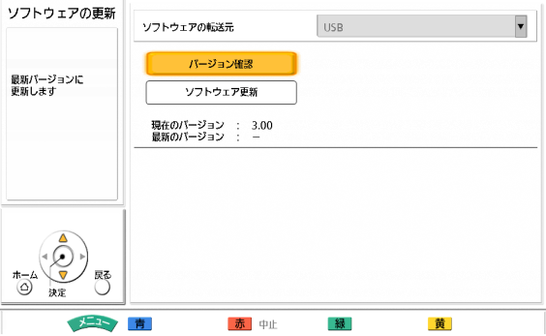
HDVC software update Procedure (by USB memory stick)
This page shows software update procedure by USB memory stick.
Insert USB memory stick into USB port on the back side.
USB memory stick
・
Note: USB Mass Storage Class （FAT16/FAT32 Format) supported
1. Store a update software into the root directory of USB memory stick.
  Store version up firmware only. Do not change file name.
2. Access “admin. Login” menu and select “software update”.
  In this software update process, HDVC automatically reboots twice.
  (This process takes approximately 10 minutes, but it may take up to 20 minutes.)
  System data (NW settings, contact list, etc.) will be succeeded to the up-graded firmware.
Click “Software up-dates” to check any new version of software available.
(It verifies USB root directory software with HDVC software.)
Once any new version software exists, press “Update software now”, and execute software update.
3. Once software update is completed, please check its software version.
  Check the software version on the “System Info.” screen.
Page 5
Page 5

Slide 7
HDVC software update Procedure (by PC)
This page shows software update procedure by PC.
D-Sub9Pin
RS-232C (Straight Type)
＜PC, Terminal Emulator and Web Browser＞
OS ： Windows 7
Terminal Emulator: Tera Term Ver.4.64
Internet Explorer version 10
Web Port open is required.
Use Web Console to update software.
LAN (Cross Cable)
1. Web Port open to allow PC access
  Temporally Open: 60 min. (Change by Remote Controller or CLI)
  Permanently Open: Change by CLI * Web Port will be always opened even conducting power OFF/ON.
< ID and Password for CLI access >
User ID: admin
Password: HDVC_admin
2. Back up Configuration data and Contact List after accessing by Web Console
  This is to avoid un-expendable cases.
3. Proceed version up from Web Console.
  In this software update process, HDVC automatically reboots twice.
  This process takes approximately 10 minutes
  System data (NW settings, contact list, etc.) will be succeeded to the up-graded firmware
4. Check Software Version after version up completion
  Press “Status” button, then confirm installed software version.
Page 6

Slide 8
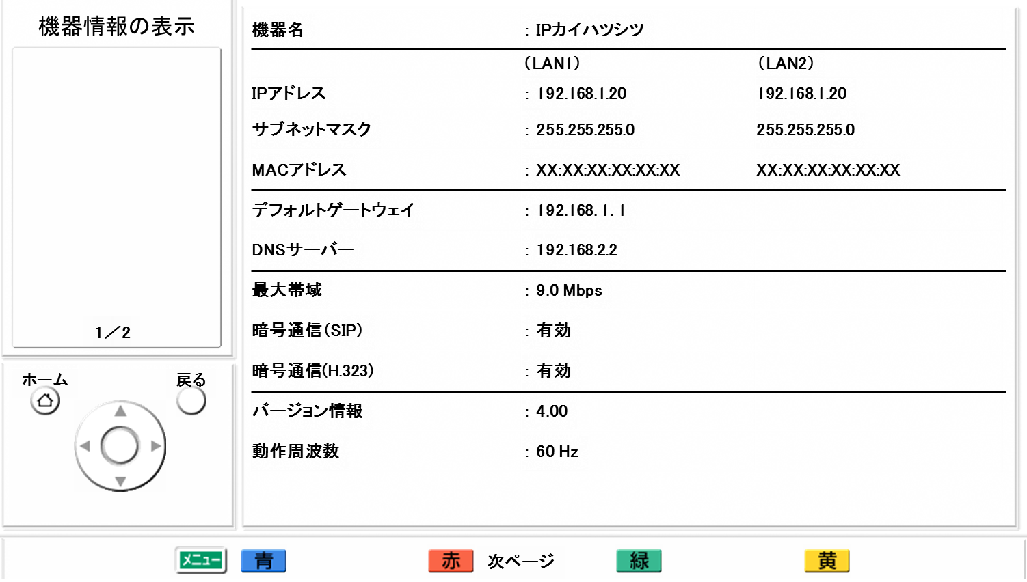
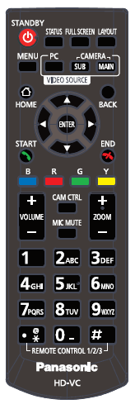
HDVC Status Check
The system information can be confirmed by pressing [Status] key of the remote controller.
  Press [ STATUS ] key twice to display the Network and Firmware information.
  The unit information display screen is displayed over 2 to 3 screens. To view all the items, press [R] to move to the next page, and press [B] to move to the previous page.
[ STATUS ] Key
System Information
Name
Tokyo
IP Address
Subnet Mask
MAC address
Default Gateway
DNS Server Address
Max. Bandwidth
Encryption (SIP)
HOME
BACK
Encryption (H.323)
Software version
Frequency
Page 7

Slide 9

Thank You !
Panasonic System Networks Co., Ltd.
Security System Business Division

