Slide 1
1. This document can be disclosed to Panasonic Sales Partners 2. The specs might be changed without notice since it’s still under development.
For Panasonic Sales Company and Business Partner only
CLI Function
(Command Line Input)
Ver.4.20
Panasonic System Networks Co., Ltd.
Security System Business Division

Slide 2
History of Revision
Doc. Ver. | Contents | Date of Issue | Remarks
Ver. 4.00/4.10 | Issue of First Edition | Nov. 2014
Page 1

Slide 3
Outline of CLI Function
CLI allows installer to configure HDVC system over Serial Cable (RS-232) and Telnet.
The CLI provides many features which are not supported by GUI.
Connect PC to HDVC using Serial Cable. The Cable must be “Straight” type.
Recommended Terminal Emulator Application
Tera term version 4.64
＜RS-232C Port Settings＞
Baud rate: 38400
Data: 8 bit
Parity: none
Stop: 1 bit
Flow control: none
HDVC
CLI
RS-232C (Straight Type)
VC1600/1300
D-Sub 9 pins
＜User ID and Password＞
User ID: admin
Password: HDVC_admin
Note: Please use USB-Serial Convertor depends on available interface of the PC.
Item | Main Functions
Control Command | Service Stop, Configuration Data Back-up, Web Port Open, System Inititilization Ping, Back-up Logs, etc.
Acquirement / Setting Command | Various settings that can be done by remote control, LAN mode (Auto/100M FULL), Web / CLI Password, Default Max. Bandwidth, Microphone Mute Mode, etc.
Page 2

Slide 4
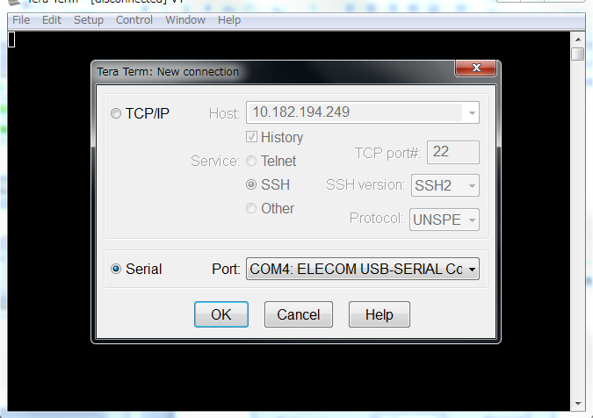
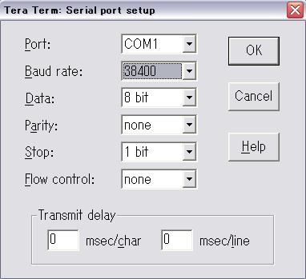
Basic Procedure of CLI
1. Connect RS-232C (Serial) cable to the Main Unit and PC.
Note1: Use “Straight” RS-232C cable.
Note2: Use USB Serial Converter (D-Sub 9pin) If your PC does not have Serial Port.
2. Start Tera Term
When you start Tera Term, you will be asked to choose how to connect.
Choose “Serial” then select proper “Port” as shown in Figure.1
3. Go to “Setup → Serial port…” from the Menu then configure Tera Term serial port as shown in Fgure.2.
Change Baud rate to “38400” from “9600”
Figure 1. New Connection
Figure 2. Serial port setup
Page 3

Slide 5
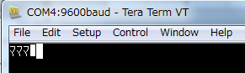
Basic Procedure of CLI
4. After you configure “Serial port…” setting, press Enter several times on the Tera Term console to show login prompt. If you get proper configuration, you will see following login prompt.
Figure 3. HDVC Login prompt
4-1. If you see scrambled letters as you pressing Enter key, Serial Port configuration like Baud rate is wrong. Check configuration in “Setup → Serial port…”.
If you see nothing on the console when you press Enter key, first of all check cables are properly
connected. If connection has no problem, Port setting in “Setup → Serial port…” probably wrong.
Figure 4. Scrambled letters
Figure 5. Nothing displayed on the Console
Page 4

Slide 6
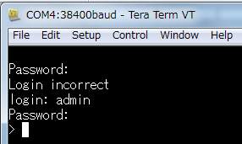
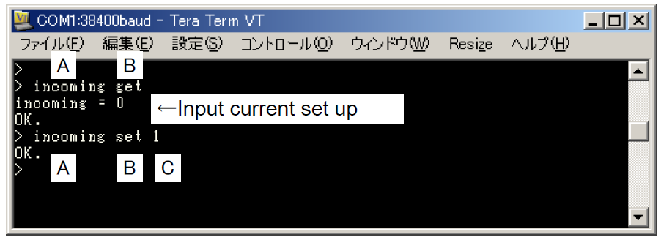
Basic Procedure of CLI
5. Type following username and password to login to the system.
login: “admin”
password: “HDVC_admin”
Note: Some of CLI commands only available in the Maintenance Mode.
Figure 6. Login success.
6. Sample 1: How to execute command.
Table 1. and Figure 7. show some command examples.
Command | Description
webport open | Open web port temporarily.
httpenable set defenable 1 | Open web port permanently
network get | Show network settings.
Table 3. CLI command list
A: Command Name
B: set: change set up
get: input current set up value
C: Set up value or parameter set up value
Figure 7. command example.
Page 5

Slide 7
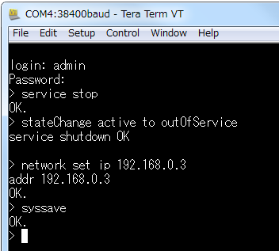
Basic Procedure of CLI
7. Sample 2: How to execute command.
Some command needs HDVC system to get into the Maintenance Mode. To go to maintenance mode, type “service stop”.
For example, network set command need HDVC to be in the Maintenance Mode.
Table 2. Some CLI Commands example
in Maintenance Mode
Command | Description
network set | Configure network setttings
mode3d set | Enable/disable 3D feature
Icondisp set | Disable connection icon warding.
Figure 7. Command example in Maintenance Mode
8. You need to execute “syssave” command to save changes.
Note: If you restart system without “syssave” all changes will be discarded.
Page 6

Slide 8
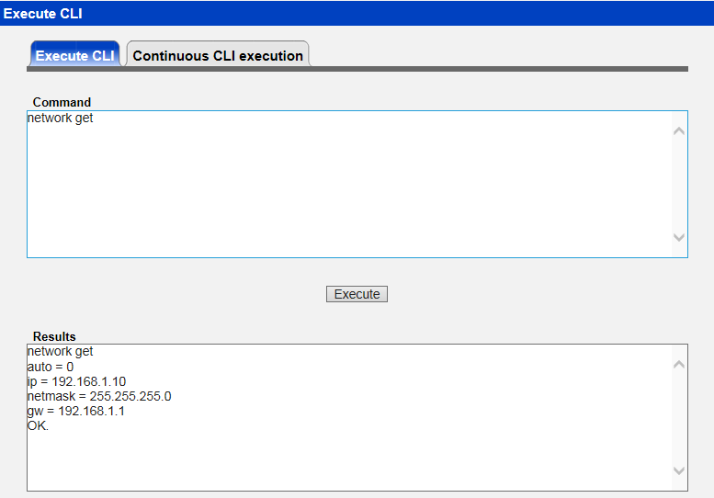
Execute CLI through Web Console
It can be executed CLI commands of HDVC remotely through the Web Console.
①
②
Enter the CLI command, and then click "Execute".
Note> Enter key is ignored.
The result is displayed sequentially under the previous results.
Check the latest results by operating the scroll bar.
Supplement> Status notification from HDVC will be displayed each time.
Note> The oldest results will be deleted if displayed results is more than 500 lines.
Displayed results are cleared when jumping to another page.
Page 7

Slide 9
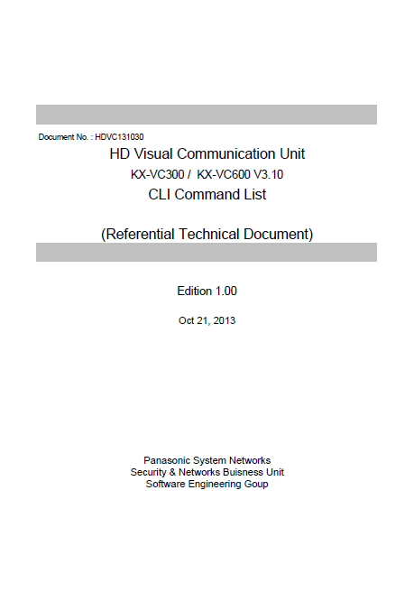
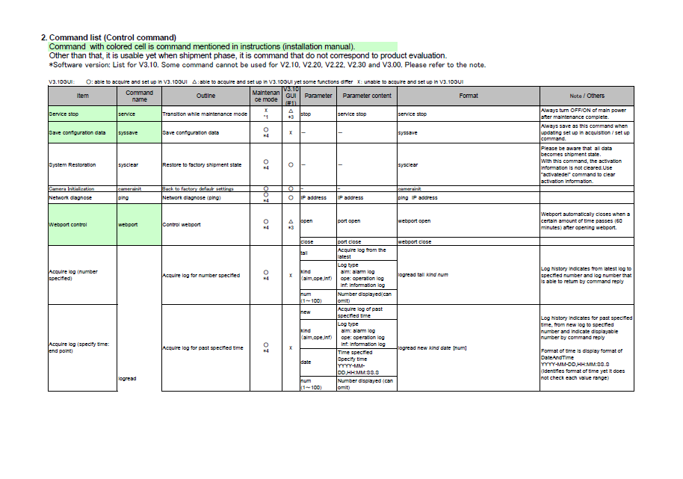
CLI Command List
All available command lists are described in other Technical Document.
KX-VC1300 / 1600 V4.20
CLI Command List
Page 8

Slide 10
Outline of using Telnet
Default of Telnet port is Well Known Port (Port23) and changeable.
(Range of port number is from 20000 to 29999 by CLI command.)
Telnet port is close at default. It will be open when rebooting the equipment after open-setting by CLI/Web console.
Command for Telnet Port Open:
“telnet open” --- Temporarily open (60 min.)
“telnetenable set 1” --- Always open after restarting the system
Telnet login can be made by only admin user.
Telnet is not operated by normal Linux command but by specific shell/command table.
All CLI commands of HDVC can be used.
Exclusive control with other interface, such as GUI, Web console, cannot be made.
Telnet port does not have encryption function.
Input IP address of HDVC
CLI
HDVC
LAN Connection
INTRANET
VC1600/1300
Choose “Telnet”
Page 9

Slide 11
Thank You !
Panasonic System Networks Co., Ltd.
Security System Business Division

