Slide 1


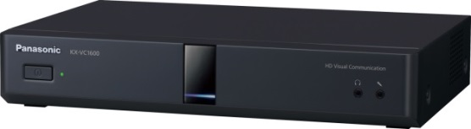

1. This document can be disclosed to Panasonic Sales Partners
2. The specs might be changed without notice since it’s still under development.
For Panasonic Sales Company and Business Partner only
MPCS
(Multi-points Connection Software)
Version 2.00/2.10
Panasonic System Networks Co., Ltd.
Security System Business Division

Slide 2
History of Revision
Doc. Ver. | Contents | Date of Issue | Remarks
Ver. 2.00/2.10 | Issue of First Edition | Nov. 2014
Page 1

Slide 3
Table of Contents
1
Overview of MPCS
2
MPCS Key Feature Overview
3
MPCS Specification Detail
4
MPCS Settings
5
MPCS Operation
6
Linux Installation
7
MPCS Installation
Page 2

Slide 4
MPCS Key Features Overview
MPCS Ver.2.0/2.1 provides simple Multi-Party Conferencing environment to HDVC network.
One Concurrent Conference Room for IP Mode and NAT Traversal Service (Easy Connection) mode. IP Mode and NAT Traversal Service (Easy Connection) Mode work simultaneously. (New)
Two-encoder accommodates lower and higher bandwidth endpoints simultaneously. (New)
Up to 16 Participants in a Conference Room.
HDVC, Android/iOS and PC Application are supported. (New)
Panasonic Proprietary Solution. (Other vendor’s VCs are not tested)
Two Conference Room Operation mode are available
Normal Mode:
  Permission required to join to the conference in advance. Various Conference Operations are supported for Administrator while Conferencing.
Ad-Hoc Mode:
  Anybody can join to the conference. Available Conference Operations for Administrator are Show/Hide site name and Dial in / Dial out only.
Available access Interface
Web Console and API (External Control Interface) are available.
Page 3

Slide 5
























System Diagram Overview (Two Encoder)
Star Network Diagram provides effective bandwidth usage
Target Network is Internet, Intranet and VPN
Both IP and Easy Connect Mode supported simultaneously.
2. Integrated two images
MPCS
Server
Image for
HD Endpoint
Image for SD Endpoint
3. Send Integrated images
HDVC
HDVC
1. Higher bandwidth devices send HD image.
4. HD image sent to higher bandwidth devices
Network
1. Lower bandwidth devices send SD image
4. SD image sent to lower bandwidth devices
HDVC
Mobile Solutions
Page 4

Slide 6
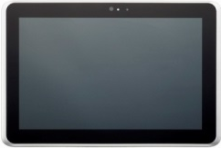






System Diagram Overview (IP mode + NAT Traversal Service)
MPCS provides HDVC Mobile Solution Multi-Party Conference environment
NAT Traversal Servers
IP Mode Video/Audio
NAT Traversal Service Video/Audio
WiFi Router
SIP
Mobile Solution
HDVC
Router
WiFi Router
Router
Mobile Solution
MPCS V2.0
HDVC
WiFi Router
LAN
Corporate Network
HDVC
Mobile Solution
IP Mode
Page 5

Slide 7











System Outline
1. Improve multi-Point connection AV quality
HD (High Definition) AV quality @512kbps (Lower Bandwidth Operation)
AV-QoS makes system configured with Internet with reducing network cost.
Supports Dual Speed with eliminating influence from lower speed network sites.
2. Easy 16 sites connection of HDVCs and Tablets
Participate meetings via tablets on business trip in easy & economical manner.
HDVC in Intranet can easily be connected to outside via NAT Traversal Service.
Support Dual Networks to communicate with internal Intranet & outside Internet.
Head Office
SD Image
Overseas
Offices
Multi-Points Connection
MPCS Ver.2.0/2.1
Dual
Network
Easy Connection
Business
Customers
Intranet
IP-VPN
NAT Traversal
Internet
WiFi/4G-LTE/WiMax
HDVC mobile
HD Image
Note
HDVC mo bile also support IP mode connection
Max.
16sites
Branch Offices
Tablet / Smart Phone
(Android Terminal)
Max. 16 sites with HD quality, One Meeting Room
Page 6

Slide 8





















System Outline (Multi-point Connection)
Select line-up to meet customer’s needs
Multi-Points
Connection
MPCS
@Own Desk | Meeting Space | Conference Room
Smart Phone (Android / iOS) | Tablet / Windows PC | HDVC
Head Office
Max. 16 sites Connection
(One Meeting Room)
HDVC
Router
Sales Office
Router
Internal Intranet
(VPN network)
HDVC
Mobile
NAT Traversal Service
Internet
Router
NAT Traversal
Service Mode
Branch
Office
Router
Router
HDVC Mobile
IP Mode
Tablet
Wireless LAN
Access Point
HDVC
HDVC
Smart Phone
Page 7

Slide 9


System Outline (Multi-point Connection AV Quality)
Provide HD quality @512kbps lower bandwidth per site (MPCS transmission rate) in Multi-Points Connection operation.
<Required bandwidth at MPCS center site>
Ver.1.0 : 1Mbps x 16 sites = 16 Mbps
Ver.2.0/2.1 : 512kbps x 16 sites = 8Mbps
Provide HD quality with half of bandwidth Required.
AV quality improved by H.264 high profile. Router load also reduced with less packet process.
Note: in case combination use of HDVC mobile V.2.0 or HDVC V3.0 (or earlier), H.264 base line operation to be applied.
Multi-Points
Connection
（MPCS）
<4 partition(CP4)Screen Image>
HD Quality
(720P)
1280
Intranet/VPN
HDVC@720p image
HDVC@4SIF image
or
HDVC” Easy Connection” Service
640
480
NAT Traversal Service
360
HD Quality @512kbps
720
240
320
270
HDVC
HDVC
HDVC
HDVC Mobile @QVGA (Horizon)
HDVC Mobile @QVGA (Vertical)
SD, HD Image : Composed image of different definition will be displayed to adapt Dual Speed or multi definition images.
This function works together with MPCS Ver.2.0/2.1 and HDVC ver.3.1 onward.
HDVC mobile Ver.2.0 will be connected in SD quality and H.264 baseline profile.
Page 8

Slide 10

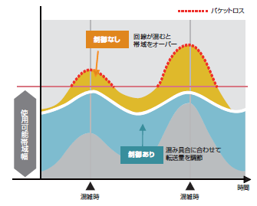
System Outline (Multi-point Connection AV Quality)
HDVC core technology, AV-QoS works on multi-Points connection for better AV quality & stable internet connection.
Multi-Points connection software (MPCS) Ver.2.0/2.1 supports dual networks. IP mode and NAT traversal mode works simultaneously. AV-QoS works on both networks.
Multi-Points
Connection Software
（MPCS）
AV-QoS Technology
Packet Loss
<Bandwidth Estimation>
This is a core technology to prevent packet loss and to minimize AV data cut-off nor block noise.
No control
TX data excess BW
at NW congestion
Intranet/VPN
HDVC Easy Connection Service
<ARQ (Packet re-send control>
Core technology to re-transmit lost packet and to prevent AV cut-off or block noise.
NAT Traversal Service
Available Bandwidth
With control
Adjust TX data Rate
with NW congestion
Congestion
Congestion
time
Congestion
Note Although HDVC QoS applies FEC as packet loss recovery technology, this FEC won’t be applied for multi-points connection (MPCS) in order to improve AV quality at lower bandwidth operation.
Note MPCS TX resolution and frame rate is fixed, and it controls AV quality based on bandwidth.
HDVC
HDVC
HDVC
This function works together with MPCS Ver.2.0/2.1 and HDVC ver.3.1 onward, and won’t work at combination use of HDVC mobile Ver.1.0 nor HDVC Ver.3.0 (or earlier version).
Note FIR QoS control will be applied at combination use of HDVC mobile Ver.1.0 or HDVC Ver.3.0 (or earlier version).
Page 9

Slide 11


System Outline (Multi-point Connection AV Quality)
Optimize AV quality when low band width sites or mobile terminals are in multi-points connection. (HD, SD mixed)
  MPCS automatically analyzes bandwidth from each terminal, and adjusts image quality in such HD for HDVC or SD for HD mobile. Resolution of HD or SD can be assigned for each screen layout (CP1 to CP16).
SD and HD Encoder selection will be done as following.
  HDVC Mobile for Android/iOS will be connected to SD encoder regardless of its bandwidth settings.
  HDVC and HDVC Mobile for Windows will be connected to the encoder based on their bandwidth settings.
  If HDVC and HDVC Mobile fro Windows bandwidth settings are above HD encoder setting, they will be connected to HD encoder.
  If not, they will connected to SD encoder. If endpoint bandwidth setting is lower than 256kbps, the endpoint can not connect to MPCS.
Resolution | BW setting | TX resolution | QoS apply
HD | 2Mbps – 512kbps | HD(720p)/30fps | 512kbps or up
SD | 1.5Mbps – 374kbps | SD(w432p)/20fps | 256kbps or up
Multi-Points Connection
(MPCS)
Ex : CP4
Ex : CP8
Note SD image BW setting needs to be lower than HD image BW setting. (HD 720p : 1280 x 720, SD w432p : 768 x 432)
MPCS requires BW need to be set for each of HD and SD connection.
HD or SD setting won’t be changed during communication.
SD image
HD Image
PC resolution | VGA | SVGA | HD, XGA, WXGA1/2
HD | 640 x 480 | 800 x 608 | 1280 x 720
SD | 640 x 480 | 640 x 480 | 768 x 432 (w432p)
HDVC
Mobile
HDVC
Narrow Bandwidth
Wide Bandwidth
Note: PC image of contents sharing to be re-sized in resolution above.
Note: HD or up of PC image sharing requires HDVC ver.3.0 or up.
Recommended is to set overseas HDVC (usually low BW) in SD group. HDVC mobile to be connected in SD group.
Page 10

Slide 12
System Outline (Multi-point Connection AV Quality)
B/W set : 1Mbps
B/W set : 2Mbps
Connection
@1Mbps
Multi-Point SW
(HDVC-MPCS)
HDVC
Described below is the relationship between bandwidth and resolution of Multi-Point Connection SW (MPCS) by dual speed HD group and SD group.
HDVC
Resolution : HD
Bandwidth : 1Mbps
Bandwidth
512kbps
Equal or lower than SD group BW setting
SD resolution Group
Multi-Point SW
(HDVC-MPCS)
Resolution : SD
Bandwidth : 512kbps
Bandwidth
2Mbps
Equal or higher than SD group BW setting
HD resolution group
Resolution and frame rate of MPCS TX image are fixed, and it controls image quality based on the bandwidth.
1M
2M
512K
1.5M
Line Rate
600K
1.16M
1.75M
2.3M
Line Rate
458K
600K
1.75M
Bandwidth per site
IP Rate
512K
1M
1.5M
2M
Bandwidth per site
IP Rate
384K
512K
1.5M
HD(720p)
30fps
w432p
20fps
< HD Resolution Group >
< SD Resolution Group >
Available BW Setting : 512Kbps - 2Mbps
Available BW Setting : 384Kbps - 1.5Mbps
Page 11

Slide 13


System Outline (Multi-point Connection AV Quality)
Consider the combination below as MPCS Ver.2.0/2.1 basic system configuration.
Multi-Points Connection SW
(HDVC-MPCS)
HDVC
HDVC Mobile
＋
＋
Ver.2.0/2.1
Ver.3.1 onward
Ver.2.0 onward
Note: Ver.3.0 or earlier version of HDVC (includes VC500) can be connected to MPCS, but under some condition applied.
Note: HDVC mobile Ver.1.0 can not be connected to MPCS Ver.2.0/2.1.
Described below are major conditions applied to connect HDVC Ver.3.0 or earlier version (includes VC500).
These particular HDVCs can’t send HD image at 512kbps, the resolution on the other side come down.
AV-QoS to provide stable connection on internet won’t work.
MCPS TX image to these particular HDVC will be via H.264 baseline profile, then won’t provide improved quality of image.
TX packet amount to MPCS won’t be decreased, then load on MPCS center router won’t be reduced.
Page 12

Slide 14

System Outline
Provides up-to 16 sites of HDVCs and tablets multi-points video conference.
  MPCS Ver.2.0/2.1 will provide multi-site tele-conference not only with HDVC but with tablets, smart phones and Windows PC.
HDVC mobile Ver.2.0 onward supports IP mode connection.
Tablet, smart phones and Windows PC will work under intranet or
VPN network like HDVC via Wi-Fi connection.
HDVC-Mobile also can join MPCS multi-site conference.
Up-to 16 of HDVC and Mobile
Multi-Point SW
(MPCS)
Wireless is the maximum benefit of Tablet or Smart Phones. Join the meeting from anywhere your are.
In addition, many valuable information and image can be shared from its out-sight camera.
Intranet/VPN
Wi-Fi
AP
Note: Communication between HDVC-Mobile need to be via MPCS.
Note: Recommended is IEEE802.11n for HDVC-Mobile Wi-Fi connection.
Note: HDVC-Mobile connection will be in SD image group.
HDVC
HDVC
HDVC
Mobile
This function works together with MPCS Ver.2.0/2.1, HDVC, and HDVC-Mobile Ver.2.0 onward.
(For HDVC, recommended is to up-grade to Ver.3.1 or later version.)
Page 13

Slide 15

System Outline
Up-to 16 sites multi-point conference is available also with HDVC “NAT Traversal / Easy Connection” service.
  With using “NAT Traversal / Easy Connection” service, Tablet terminals or smart phone can join to MPCS multi-points conference from outside via carrier service.
Up-to 16 of HDVC and Mobile
“NAT Traversal / Easy Connection” service. now supports Multi- Points Connection (MPCS). Register activation key as same as HDVC.
Multi-Points Connection (MPCS) requires network bandwidth concerned design as a center machine.
Each of MPCS and HDVC requires confirmed router for “NAT Traversal / Easy Connection” service.
Assigned one Terminal ID to MPCS
Multi-Point
Communication Software
（MPCS）
Intranet/VPN
NAT Traversal Service
通信キャリア
“NAT Traversal / Easy Connection” service price reference
MPCS/HDVC $30.00/month/unit
HDVC mobile $2.50/month/unit
Ask dealers for exact pricing
HDVC
HDVC
HDVC Mobile
This function works together with MPCS Ver.2.0/2.1, HDVC, and HDVC-Mobile Ver.2.0 onward.
(For HDVC, recommended is to up-grade to Ver.3.1 or later version.)
Page 14

Slide 16

System Outline
Multi-Points Connection (MPCS) supports dual operation of Intranet/VPN and “NAT Traversal / Easy Connection” service.
  As example, Intranet/VPN is dedicated for internal HDVC connection, and use “Easy Connection / NAT traversal” service via Internet for outside connection, such as overseas sites, customer’s sites, or HDVC mobiles on business trip.
Multi-Points Connection
(MPCS)
Note: 2 NICs (LAN ports) are required for this dual NW operation.
One terminal ID (7-digits) to be assigned.
Bandwidth concerned NW design required as a center machine.
HDVC
“Easy Connection” Service
Intranet/VPN
Inter-connection
NAT Traversal Service
LTE/WiMAX/
Wi-Fi
Wi-Fi
AP
ISP
Inter-connection via MPCS
HDVC
HDVC
No connection between HDVC mobiles only.
HDVC
HDVC
HDVC
mobile
HDVC
mobile
overseas
customer
Operation by IP address
Operation by Terminal ID (7-digits)
Page 15

Slide 17
System Outline (Others)
Other features for Multi-Points Connection System (MPCS) are described below.
Ad-hoc mode dial out function by remote control operation
Once a moderator calls into MPCS meeting room, he/she can dial out to pre-assigned profile members (max. 10 profiles) by remote control operation. At the end of the conference, he/she also can have all members disconnected by remote control operation.
<Operation>
Dial out : While a moderator is connected to MPCS, dial #101～110 from a remote controller.
Disconnect : a moderator to dial #199 from a remote controller.
Note : It is required to pre-assign attendee’s IP address in the MPCS profiles. (#101-#110, max.10 profiles)
Note : It is possible to re-access same profile number in case that there is any un-answered attendees.
Note : Even after a meeting starts by Web console operation, this function will be available.
Note : The profile numbers #101-#110 (max.10 profiles) can be accessed either by Web console or ad-hoc mode calling out function.
Encryption function during meetings
Encryption key can be set-up to prevent any un-authorized attendees join the meeting.
Only when the encryption key matches to the one on MPCS, HDVC or HDVC mobile terminals can
be connect.
This will be useful to secure security both for Intranet/VPN connection and for Internet connection.
Ad-hoc mode automatic start function
It is possible to set Ad-hoc mode automatic start mode, which is MPCS to be at Ad-hoc mode
when MPCS is booted up or re-started. This is useful when MPCS re-started right after power failure.
Page 16

Slide 18
System Outline (Others)
Max. number of registration members in one profile
Both for normal mode and for ad-hoc mode, max. number of registration members is expanded from 16 members to 32 members.
At the ad-hoc mode calling out from profile, priority to dial will be from top to the bottom, or to the max. number of connection assigned by MPCS license.
Traffic display function
Sending and receiving bit rates, frame rates, resolution, and packet loss rate of the sites connected to the MPCS can be verified on the Web console screen.
SIP connection by TCP protocol in normal mode
In order to adapt to various routers, SIP connection by TCP protocol is also available.
(“NAT Traversal Easy Connection” service use TCP protocol.)
Dial out check all function
Check all connection sites when dial out from MPCS Web console becomes available.
External control interface commands
To be matched to MPCS Ver.2.0/2.1 additional functions, external control commands are added accordingly.
Web console adapted browser change
Browsers adapted to MPCS Web console are changed to IE8.0 （Windows7）、IE10 （Windows7 and8）、Firefox.
Page 17

Slide 19





MPCS Licenses
MPCS is a software Product. Registration Key is required for Activation.
The Registration Key can be obtained from KMS system.
KMS URL: https://eww.netreg.panasonic.co.jp/hdcomkms/pc/
Products | Main Unit | Notes
MPCS Activation Keys
“NAT Traversal / Easy Connection” Service Activation Keys |  | One activation key is required for one MPCS. IP mode and “NAT Traversal / Easy Connection” service Dual NW operation requires two NIC (LAN ports).
“NAT Traversal / Easy Connection” Service (HDVC Mobile for Android / iOS) Activation Keys |  | The software to be downloaded from Google Play / Apple Store as free of charge. IP mode only use also requires minimum one year activation key registration.
“NAT Traversal / Easy Connection” Service (HDVC Mobile for Windows) Activation Keys |  | The software to be downloaded from Pansonic.net web site as free of charge. IP mode only use also requires minimum one year activation key registration.
KX-VCM206 ( 6 sites)
KX-VCM208 ( 8 sites)
KX-VCM212 (12 sites)
KX-VCM216 (16 sites)
KX-VCMS001 (add. 4 sites)
Multi-Points Connection Software
(HDVC-MPCS)
KX-VCS701 (for 1 year)
KX-VCS703 (for 3 year)
Multi-Points Connection Software
(HDVC-MPCS)
HDVC
KX-VCS711 (for 1 year)
KX-VCS713 (for 3 years)
Tablet /Smart Phone
（Android / iOS）
KX-VCS781 (for 1 year)
KX-VCS783 (for 3 years)
Windows PC
Page 18

Slide 20
MPCS Specification
Item |  |  |  | Specification | Note
Concurrent conferencing |  |  |  | One Conference Room | Two encoder for Wide and Narrow bandwidth at same time.
Number of participants |  |  |  | Up to 16 | Panasonic HDVC, Panasonic PC Application and Panasonic Android/iOS application are supported.
Connection mode |  |  |  | IP Mode and NAT Traversal Service (Easy Connection) Mode | To activate both mode need two Network Interface Card.
Maximum bandwidth |  |  |  | 2.0Mbps(IP Rate) 1920kbps (Video) 80kbps (Audio)
Call control | Protocol |  |  | SIP (UDP and TCP) | TCP support is new feature at MPCS ver.2.0
 | Connection methods |  |  | Dial-in Dial-out by Web Console and API
Video | Tx | Video Codec |  | H.264 Baseline Profile Level 3.1 H.264 High Profile Level 3.1
 |  | Video Resolution |  | 720p(1280x720) / w432p (768 x 432) | Maximum resolution and frame rate is 720@30p
 |  | PC Resolution |  | VGA, SVGA, XGA, 720p
 | Rx | Video Codec |  | H.264 Baseline Profile Level 1.3 thru 3.1 H.264 High Profile Level 3.1
 |  | Video Resolution |  | 720p, 4SIF, w432p, w288p, VGA, QVGA
 |  | PC Resolution |  | VGA, SVGA, XGA, 720p
 | RTP format |  |  | Single NAL Unit Mode Non-Interleaved Mode
 | QoS |  |  | Yes for HDVC Ver.3.1
 | Layout |  | CPN | CP1/CP4/CP6/CP8/CP10/CP13/CP16 | CP stands for Continuous Presence. The number represents the Number of Windows.
Audio | Audio Codec |  |  | G.722, G722.1C
 | RTP/cycle |  |  | 20msec
 | QoS |  |  | Yes for HDVC Ver.3.1 and Android App.
(*) When only one HDVC with version 2.2, 2.21 or 2.3 connected to the Conference Room, the unit will be disconnected in 30 seconds due to no video data transmission from the MPCS.
Page 19

Slide 21
MPCS Specification
Item |  | Specification | Note
Encryption |  | Yes
Camera control |  | No
Screen layout | Layout | CP1 CP4 CP6 CP8 CP10 CP13 CP16
 | What is displayed | Mixed video mode Video of participants is mixed and displayed. | MPCS integrates received image then send it to each participants. All participants receive same image.
 | Image switching | Voice Activated (VA) Fixed Layout (in order of arrival) Manual Control via Web/API Auto (Automatically changing the layout)
Web UI | Setting/Management | Basic settings of MPCS Conference management（Status Display, Profile management） Conference mode setting
 | Operation | Start a conference (Dial-Out) Terminate a conference Layout control Display location control
 | Log | Log download
 | Language | Japanese, English | Additional Languages are considered in future version
License management |  | By Activation Key | Function activation(6/8/12/16 ports), and additional 4 ports activation
Page 20

Slide 22
1
Overview of MPCS
2
MPCS Key Feature Overview
3
MPCS Specification Detail
4
MPCS Settings
5
MPCS Operation
6
Linux Installation
7
MPCS Installation
Page 21

Slide 23
Screen Layout Settings
Seven screen layouts are available based on settings and number of participants.
1
2
2
2
1
1
3
1
3
3
4
4
4
5
6
5
6
7
8
1
2
1
2
3
1
2
3
4
4
5
5
6
7
8
3
4
5
6
6
7
8
9
9
10
11
12
7
8
9
10
10
11
12
13
13
14
15
16
Screen Layout Option. Auto, Fixed and Manual available.
  Auto : System decides number of windows based on number of participants.
  Fixed : Admin. decide number of windows before start conference.
  Manual : Allow admin. to change while conferencing (Normal Mode only)
Displaying Position Option. Voice Activation, Fixed and Manual available.
  Voice Activation : Speaking party to 1st place (top left). Other party's location number decrement accordingly.
  Fixed : Participants placed in joined order????
  Manual : Admin. to change where to place while conf. (Normal Mode only)
Page 22

Slide 24
Video Quality Settings
MPCS Bandwidth Setting determines MPCS Video Quality.
MPCS Bandwidth | Resolution for Camera | Maximum Frame rate for Camera
256kbps | w288p (512x288) | 10fps
384kbps | w432p (768x432) | 20fps
512kbps | 720p (1280x720) | 20fps
768kbps | 720p (1280x720) | 20fps
1.0Mbps | 720p (1280x720) | 20fps
1.5Mbps | 720p (1280x720) | 20fps
2.0Mbps | 720p (1280x720) | 30fps
Resolution for PC Screen Sharing is independent from MPCS Bandwidth. HDVC sends PC Image without modifying it. 720p (720x1280), XGA(1024x768), SVGA(800x600) and VGA(640x480) are supported. Narrow bandwidth reduces frame rate to keep original PC resolution. Users with HDVC Ver.3.0 or older have to press PC button then ‘*10’ to share PC Screen. After finish PC Screen Sharing, Press Main button then ‘*11’. (HDVC Ver.3.1 does not need thus operation)
Frame Rate for Camera and PC Screen Sharing will be decreased to keep Contents Resolution based on how much contents is busy.
Page 23

Slide 25
Other Settings
Total Bandwidth setting allows administrator to activate bandwidth usage warning. Administrator will get warning when MPCS uses more bandwidth than the value set as Total Bandwidth.
SIP Port number allows administrator to change SIP Port Number for Easy Connect. This settings is to avoid SIP ALG, SIP fixup and Packet Inspection affects on SIP Communication between MPCS and Easy Connect SIP Server.
Note: SIP Port number setting for IP Mode not available.
  Interval for VA Switching
  Window Switching Interval for Voice Activation.
Page 24

Slide 26
Conference Mode
MPCS has two types of Conference Room called “Normal” and “Ad-Hoc” Mode. They are available exclusively.
Normal Mode allows pre-registered parties in the Profile to join the conference. Web Console provides following settings for Normal Mode.
  Encryption Setting and Encryption Key
  Connecting Endpoint (Pre-registered allowed participants)
  Manual Control Enable/Disable (Need to enable for following two options)
  Screen Layout (Manual Control need to be enabled)
    Auto, CP1, CP4, CP6, CP8, CP10, CP13, CP16 are available. If the Manual Control is Disabled, Auto will be applied.
  Displaying Position Switching. (Manual Control need to be enabled)
    Voice Activation and Manual available. If the Manual Control Disabled, Fixed will be applied.
  Endpoint Bandwidth for HD and SD encoder.
  Site Name Display for HD and SD encoder.
Page 25

Slide 27
Conference Mode
Ad-Hoc Mode allows anybody to join to the conference. Web Console provides following settings for Ad-Hoc mode.
  Screen Layout (Auto/Fixed)
  Voice Activation.
    Speaking Party comes to top left when speaking if enabled.
  Auto start Ad-hoc mode upon server start.
  Voice Activated Switching
  Encryption setting and Encryption Key.
  Endpoint Bandwidth for HD and SD encoder.
  Endpoint Screen Layout for HD and SD encoder.
    CP1, CP4, CP6, CP8, CP10, CP13, CP16 are available.
  Site Name Display for HD and SD encoder.
  Note: HD and SD encoder settings are presented separately.
Page 26

Slide 28
Conference Mode (Operation While Conference)
While Conferencing in Normal Mode and Ad-Hoc Mode, there are some options to change conference room settings.
Normal Mode provides various sort of options while video conferencing.
  Invite party in Allowed List, Disconnect current connected participant
  Display Position Switching
    Top (top left), Bottom (bottom right) and Hide are available.
    If Manual Control Disabled in the Profile, this option is not available and Displaying Position is set to Fixed. (order of join to the conf.)
  Mute/Unmute
    If Manual Control Disabled in the Profile, this option is not available.
  Screen Layout for HD and SD encoder.
    Auto, CP1, CP4, CP6, CP8, CP10, CP13, CP16 are available.
    If Manual Control is disabled when start conference, this option is not available and Screen Layout setting is set to Auto.
  Site Name Display for HD and SD encoder.
  Note: HD and SD encoder settings are presented separately.
Page 27

Slide 29
Conference Mode (Operation While Conference)
Ad-Hoc Mode provides fewer options while video conferencing.
  Invite party by Contact List and IP, Disconnect current connected participant
  Site Name Display for HD and SD encoder
  Note: HD and SD encoder settings are presented separately.
Page 28

Slide 30
1
Overview of MPCS
2
MPCS Key Feature Overview
3
MPCS Specification Detail
4
MPCS Settings
5
MPCS Operation
6
Linux Installation
7
MPCS Installation
Page 29

Slide 31
Operation Flow
Start
Set Option and Select whom to dial out
Start Normal Mode Conf.
Start Ad-Hoc Mode Conf.
Available Operation
Dial Out / Dial In
Change Displaying position
Mute/Un-mute
Site Name Display
Change Screen Layout
Terminate Conference
Available Operation
Dial Out / Dial In
Site Name Display
Terminate Conference
Page 30

Slide 32
Contents of Operation
Login
Status Screen
Basic
Settings
Profile
Settings
Login
  Login to the System
Status Screen
  Show Status of the System
Basic Settings
  Settings for Bandwidth Warning Threshold, SIP Port number, Window Switching Interval and some Ad-Hoc Mode settings
Profile Settings
  Profile Settings for Normal Mode
Page 31

Slide 33
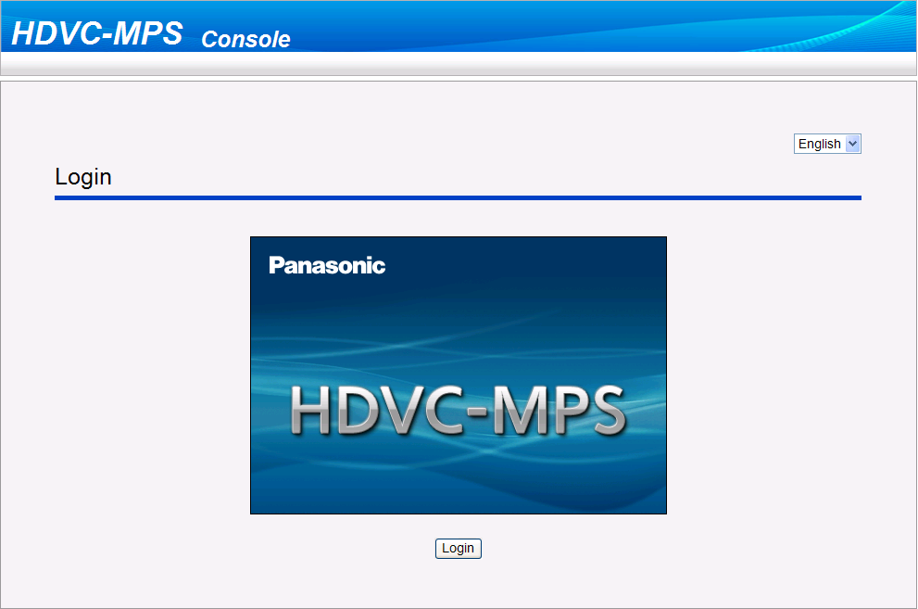
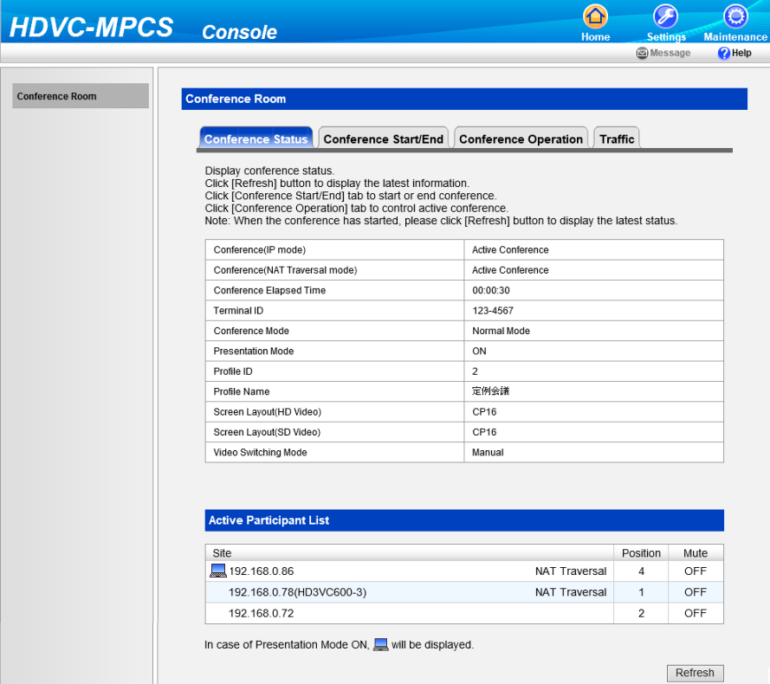
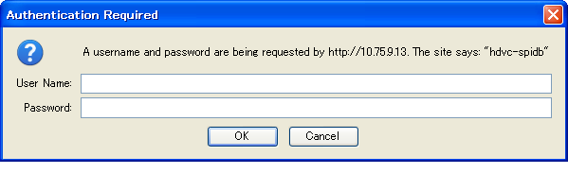
Login
Access http://127.0.0.1/hdvc_mpcs/index.cgi on your browser.
Press “Settings” to go to Basic Settings Screen
After you login you will see this screen.
Input username and password then Click OK button
To Refresh Status
Page 32

Slide 34
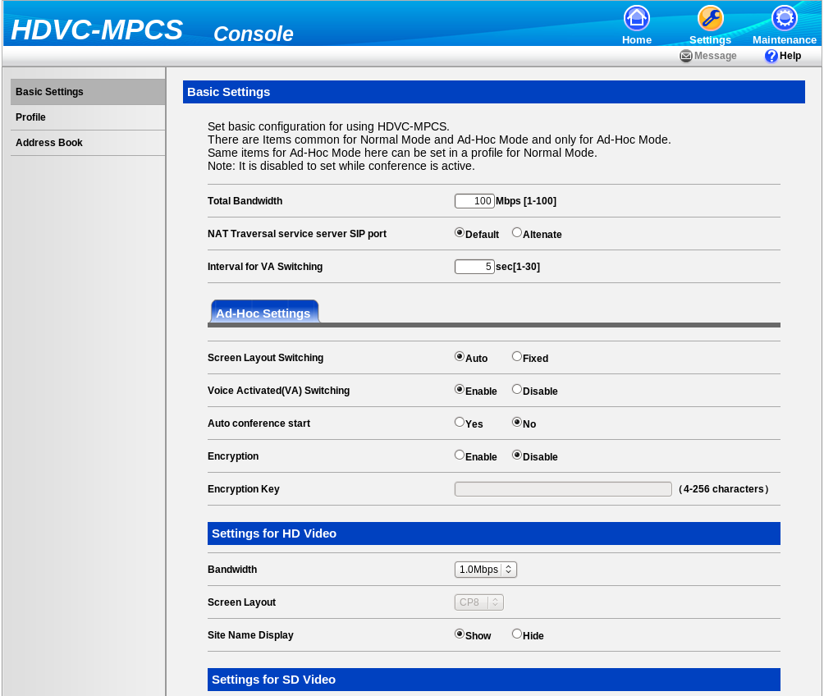
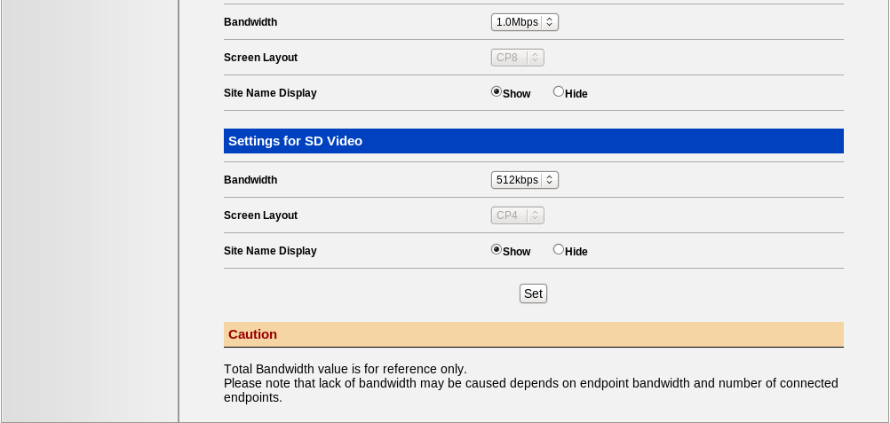
Basic Settings
Go to Profile setting.
Go to Address book.
Click to save changes.
Page 33

Slide 35
Basic Settings
Settings |  |  | Descriptions
Basic Settings
 | Total Bandwidth |  | When System bandwidth usage exceed this threshold, alert goes off in the Web Console.
 | NAT Traversal service server SIP port |  | Allow user to change SIP Port number to avoid conflict with other application and SIP ALG feature. Default = 5060. Alternate = 15060.
 | Interval for VA Switching |  | Window switching interval for Voice Activation.
Ad-Hoc Settings
 | Screen Layout Switching |  | Auto let server decide screen layout based on number of participants automatically. Fixed let admin. Decide fixed layout.
 | Voice Activated(VA) Switching |  | Bring talking party to left top of the screen automatically.
 | Auto conference start |  | Start Ad-hoc conference upon server start-up.
 | Encryption |  | Encrypt audio and video data.
 | Encryption Key |  | Encryption key.
Setting for HD Video
 | Bandwidth |  | Bandwidth setting for HD encoder.
 | Screen Layout |  | Screen layout setting for HD encoder. Screen Layout Switching should be set to Fixed.
 | Site Name Display |  | Display site name on the screen.
Setting for SD Video
 |  | Bandwidth | Bandwidth setting for SD encoder.
 |  | Screen Layout | Screen layout setting for SD encoder. Screen Layout Switching should be set to Fixed.
 |  | Site Name Display | Display site name on the screen.
Page 34

Slide 36
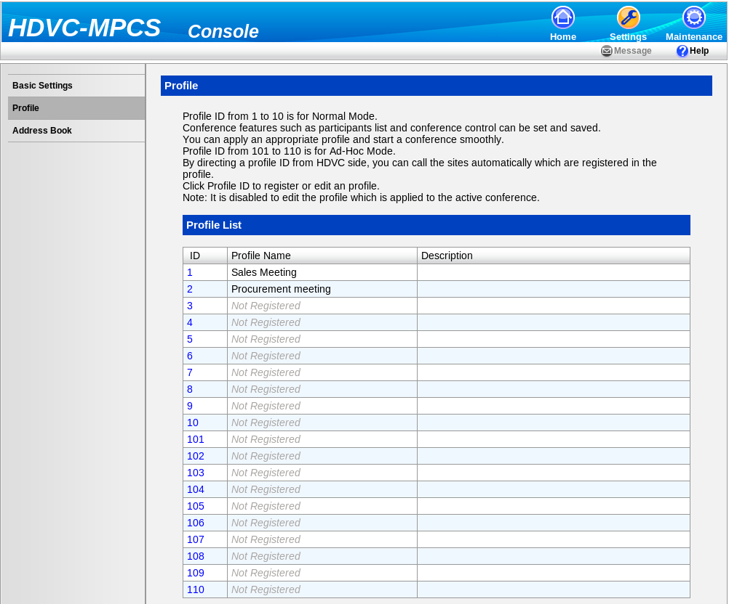
Profile Settings (Normal mode only)
ID 1 to 10 are for Normal Mode.
Press ID to edit Profile.
Page 35

Slide 37
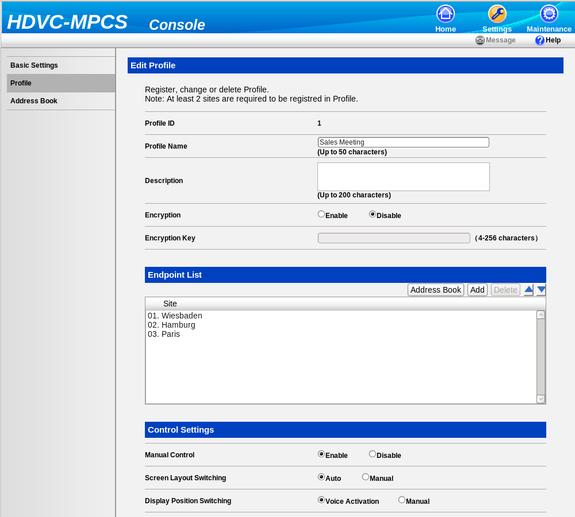
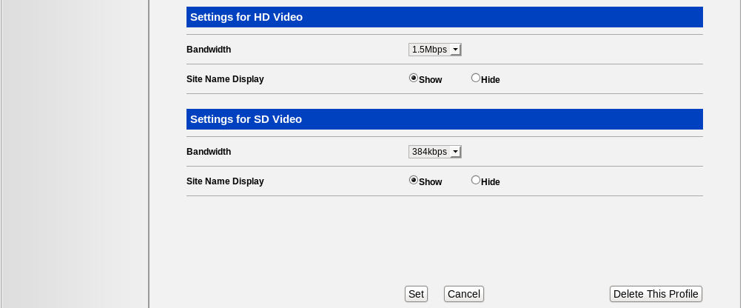
Profile Settings (Normal mode only)
Listed endpoint are allowed to participate conference.
Option to allow operation from Web Console while conferencing.
SD and HD Codec settings
Press Set to save changes
Page 36

Slide 38
Profile Settings (Normal mode only)
Settings |  | Descriptions
Edit Profile
 | Profile ID | ID of profile. Can not change.
 | Profile Name | Set profile name up to fifty letters. Blank is allowed.
 | Description | Description for Profile. Optional.
 | Encryption | On/Off Encryption of audio / video data
 | Encryption key | Pre-shared key for encryption
Endpoint List
 | Sites | List of allowed party to join to the conference. You can add using Address book or specifying IP Address.
Control Settings
 | Manual Control | Enable ➔ Following “Screen Layout” and “Display Position Switching” will be selectable. Disable ➔ “Screen Layout” will be Auto and “Display Position Switching” will be Auto.
 | Screen Layout Switching | Auto ➔ Decide screen layout based on number of participants automatically. Manual ➔ Allow administrator to select screen layout when start conference.
 | Display Position Switching | Voice activated ➔ Speaking party will be displayed on top left of the screen automatically. Manual ➔ Allow administrator to change displaying position via Web Console while conferencing.
Page 37

Slide 39
Profile Settings (Ad-Hoc mode only)
Profile for Ad-Hoc Mode allow participants to initiate call to endpoint who are listed in the Profile.
101 to 110 are for Ad-Hoc Mode.
Press ID to edit Profile.
Page 38

Slide 40
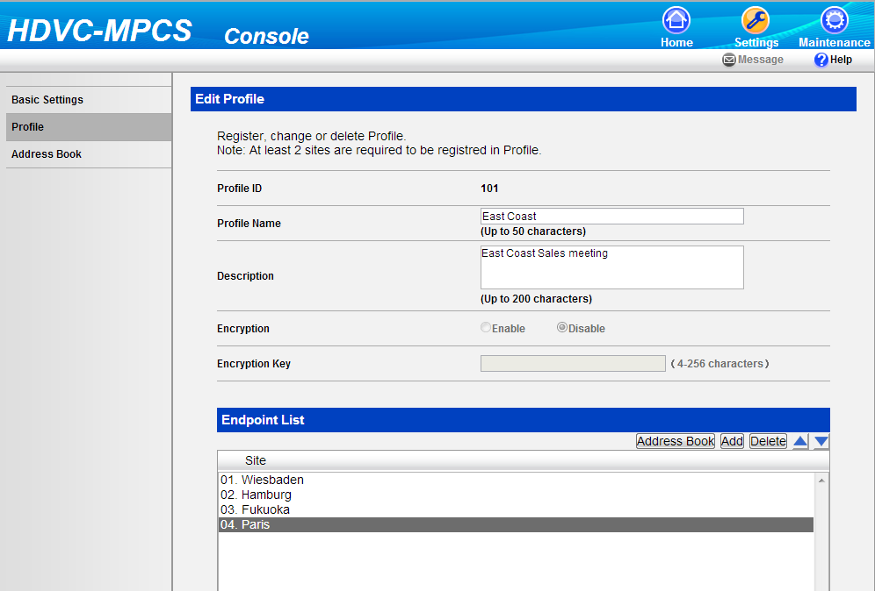
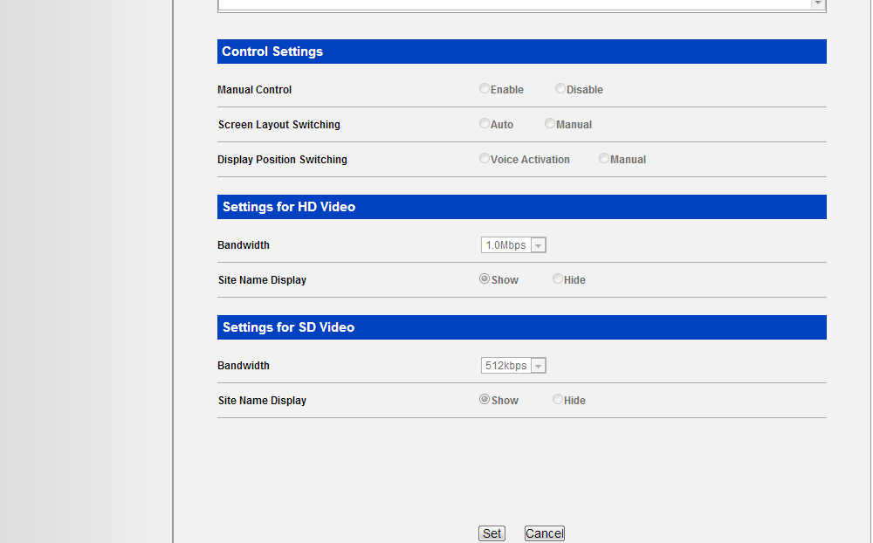
Profile Settings (Ad-Hoc mode only)
While Ad-Hoc conferencing, Pressing ‘#’ and Profile ID then MPCS will dial out to these listed party.
E.g. If you would like to dial out using Profile ID 101, press #101.
Press set to save changes.
Page 39

Slide 41
Start Conference
Normal Mode
Starts
Go to Home Screen
Start/End
Conference
Ad-Hoc Mode
Starts
Go to Home Screen
  Start/End Tab is available in Home Screen
Start/End Conference
  Start Conference by choosing “Normal” or “Ad-Hoc” Mode
Normal Mode
  Only listed party in Allowed List can join to the conference. Various options available while conferencing
Ad-Hoc Mode
  Anyone can join to the conference. Fewer options available while conferencing.
Page 40

Slide 42
Go to Home Screen
Press “Home” to go to Home Screen. Start/End Conference available there.
Page 41

Slide 43
Go to Start/End Conference Screen
Press “Conference Start/End” Tab
Page 42

Slide 44
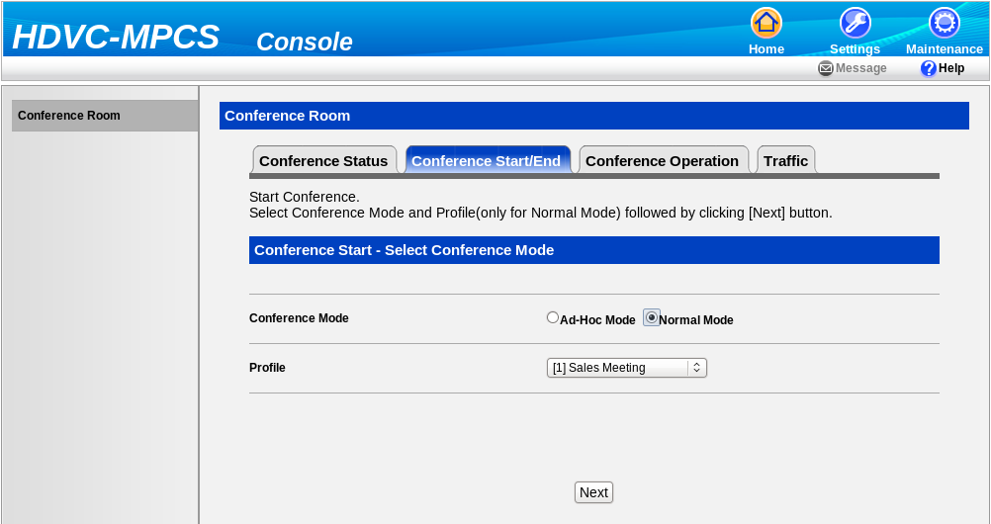
Choose Conference Mode
1. Select “Ad-hoc” mode or “Normal Mode”
2. Select “Profile” if you choose “Normal Mode”
3. Press Next
Page 43

Slide 45
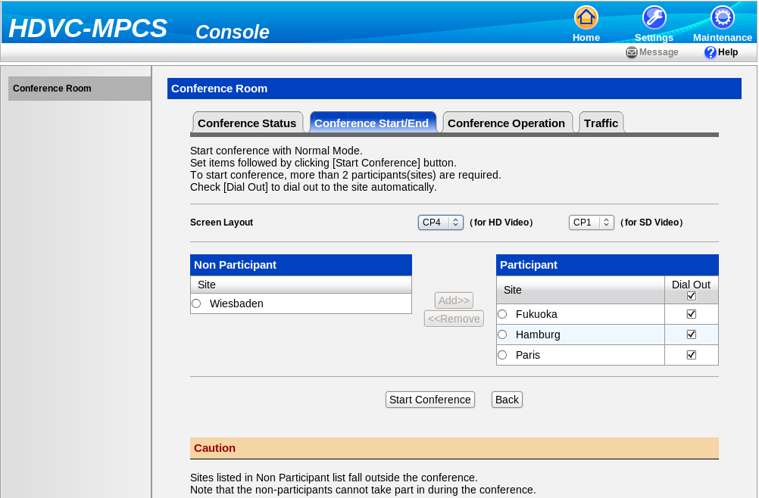
Start Normal Mode Conference
Choose number of Windows
for two encoders.
Listed here cannot join
Press start to initiate conference
Tick to dial
Listed here allowed to join
Page 44

Slide 46
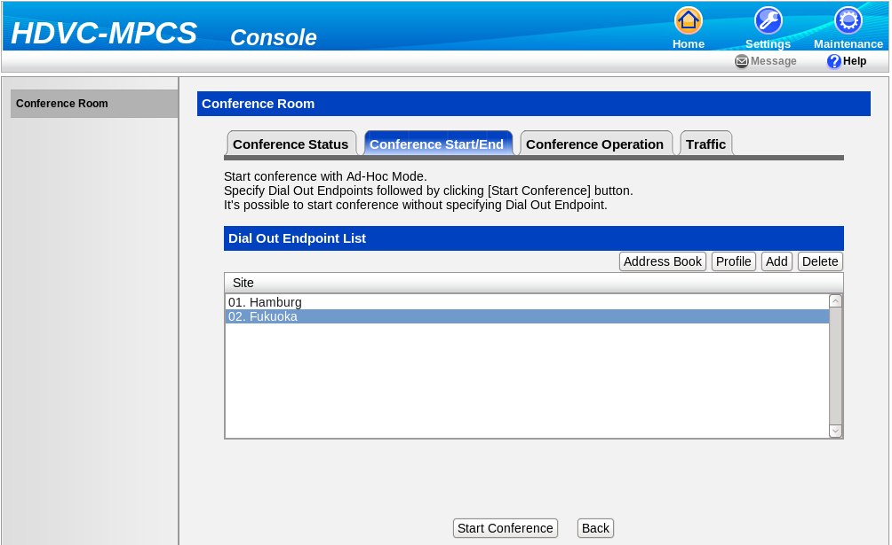
Start Ad-Hoc Mode Conference
Add/delete endpoints to dial out
MPCS dial out to these listed party when conference starts
Page 45

Slide 47
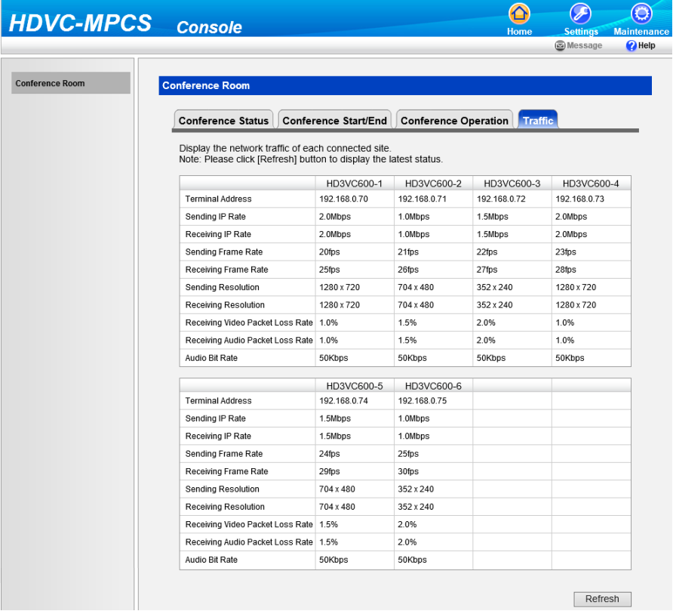
Start Screen
After you start conference you will see this screen.
Page 46

Slide 48
How to Operate While Conference
Status Screen
Change Settings
End Conference
Status Screen
  Show current Conference Status
Change Settings
  Normal Mode and Ad-Hoc Mode provide difference options.e
End Conference
  Terminate Conference
Page 47

Slide 49
Status Screen
Choose Conference Operation to change Conference Settings.
Choose Conference Start/End Tab to terminate Conference
Page 48

Slide 50
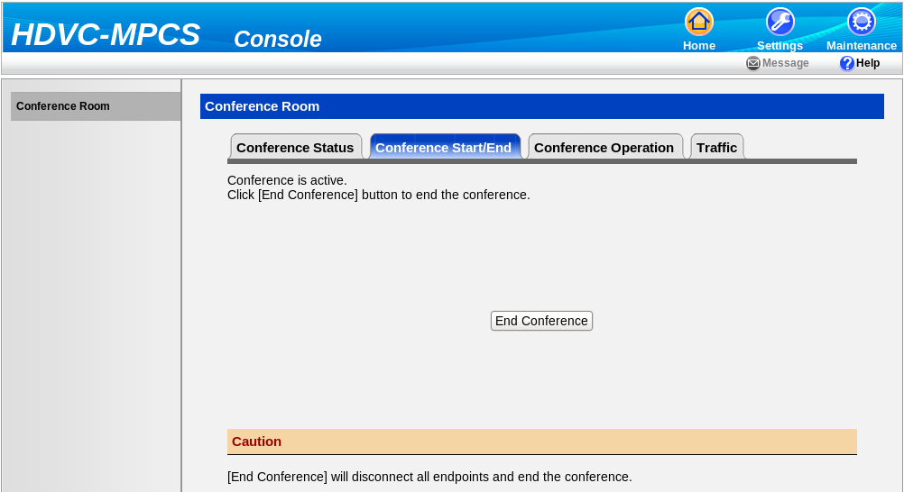
End Conference
Press End Conference button to terminate Conference
Page 49

Slide 51
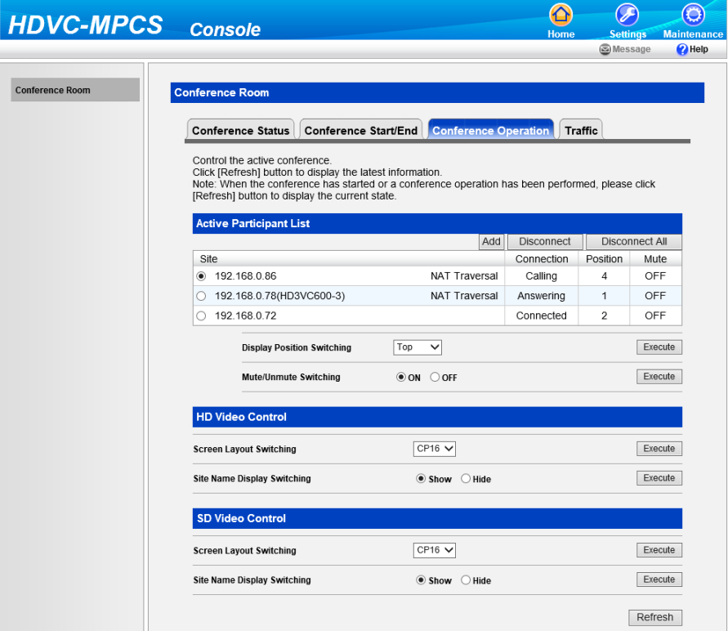
Operate Normal Mode Conference
Add/Disconnect Terminals
Choose which site to be operated.
Choose which site to be operated.
Change displaying position
Change displaying position
Mute/Un-mute.
Mute/Un-mute.
Change Screen Layout of HD encoder.
Change Screen Layout of HD encoder.
Show/Hide Site name of HD encoder.
Show/Hide Site name of HD encoder.
Change Screen Layout of SD encoder.
Change Screen Layout of SD encoder.
Show/Hide Site name of SD encoder.
Show/Hide Site name of SD encoder.
Page 50

Slide 52
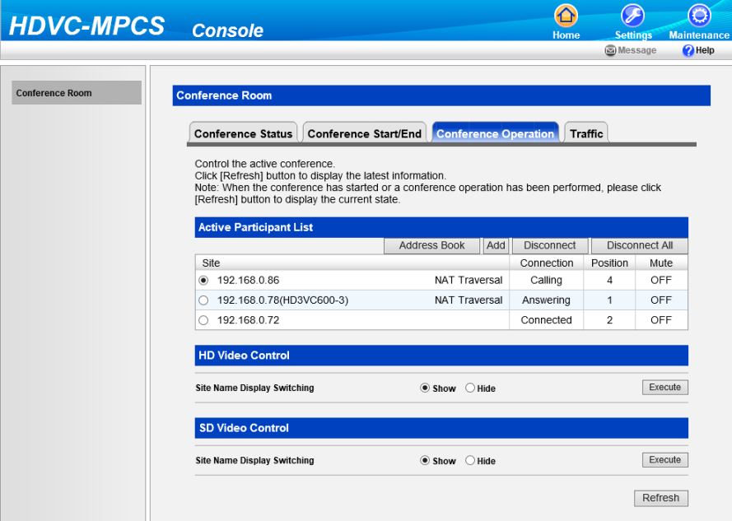
Operate Ad-Hoc Mode Conference
Add/Disconnect Terminals
Choose which site to be operated.
Show/Hide Site name of HD encoder.
Show/Hide Site name of SD encoder.
Page 51

Slide 53
Maintenance Tab
Activation
  Add Activation Key to system
Network Status
  Show Network Status
Port Settings
  Static NAT Port Settings for Panasonic NAT Traversal Service
Language Settings
  Change Language. English and Japanese are supported.
Account Settings
  Manage user account
Log
  Show system log data
Configuration Data
  Backup and Restore settings
Shutdown
  Shutdown MPCS Software and/or Sever.
About
  Display MPCS Firmware version and AAA
Page 52

Slide 54
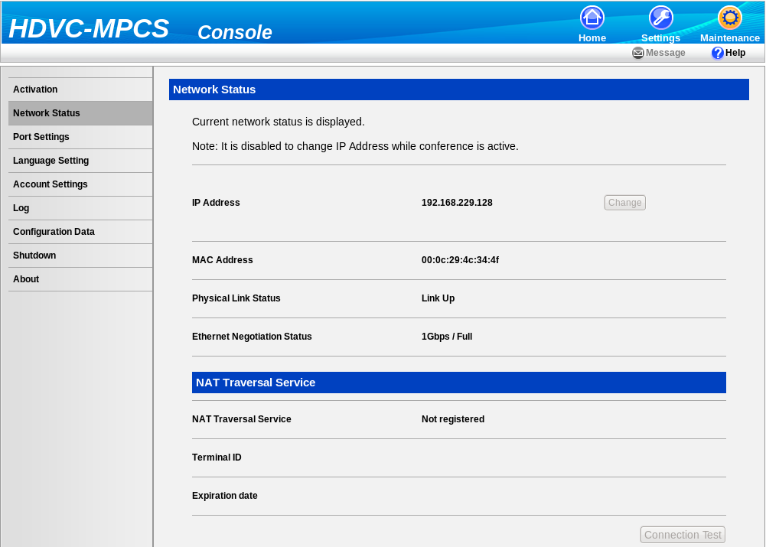
Go to Maintenance Tab
Click here to go to Maintenance
Page 53

Slide 55
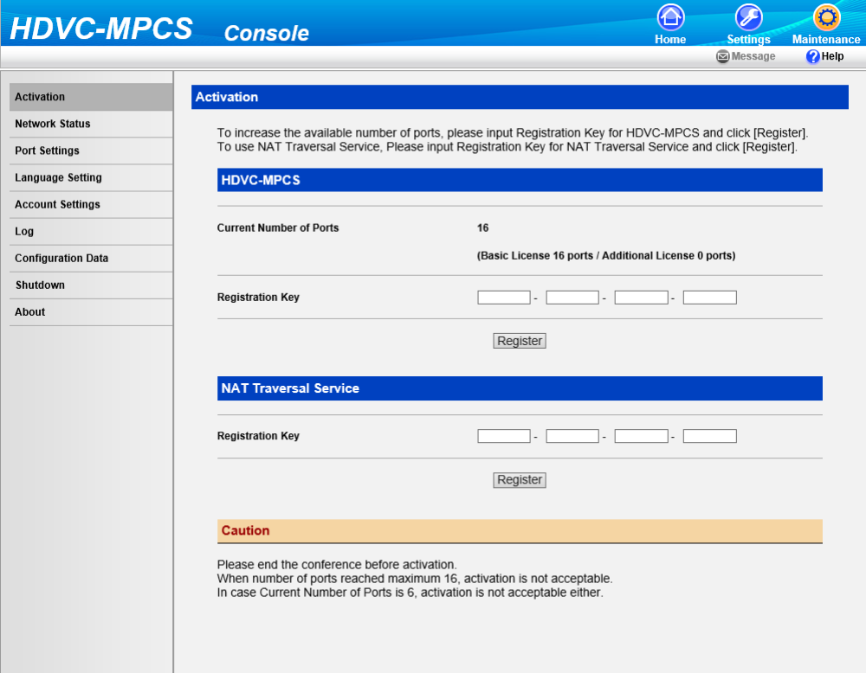
Activation Tab
License for MPCS Activation and Port number expansion.
License for Panasonic NAT Traversal Service
Page 54

Slide 56
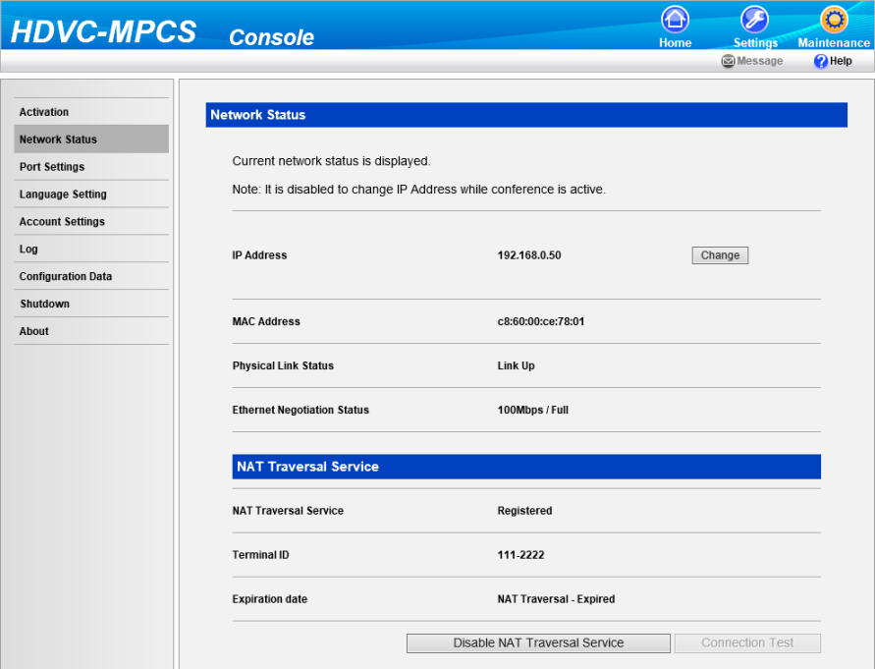
Network Status
Click here to change IP Address for IP Mode
Execute connection test for Panasonic NAT Traversal Service.
This button will be displayed only when Panasonic NAT Traversal Service license is expired.
55
Page 55

Slide 57
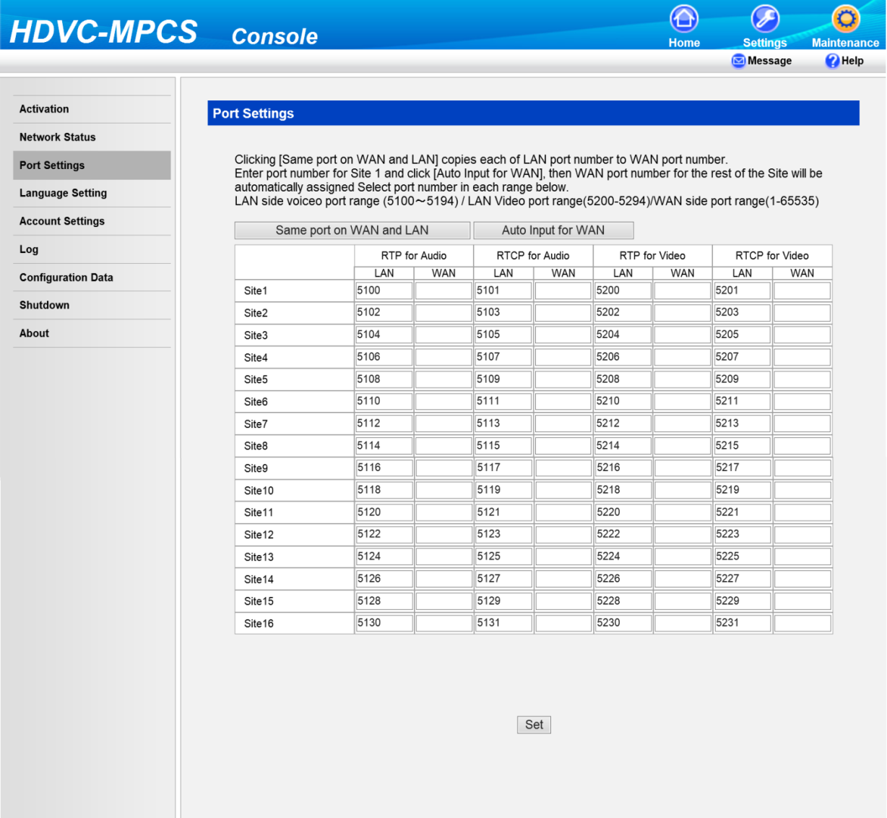
Port Settings
To activate Panasonic NAT Traversal Service, need to fill following table.
Also need to configure “Port Forwarding” on Router.
Page 56

Slide 58
1
Overview of MPCS
2
MPCS Key Feature Overview
3
MPCS Specification Detail
4
MPCS Settings
5
MPCS Operation
6
Linux Installation
7
MPCS Installation
Page 57

Slide 59
Server Specification
Two Server Machines have been tested
Item1 |  | Entry Model | Middle / High Model
CPU | Model Name | Intel CPU Core i7 or Xeon E3-1280 or greater | Intel CPU Xeon X5690 or greater
 | CPU Core Clock (GHz) | 3.4 | 3.46
 | # of CPUs | 1 | 1
 | # of CPU Cores | 4 | 6
 | # of CPU Threads | 8 | 12
 | CPU L2 Cache(MB) | 8 | 12
Main Memory(GB) |  | 8GB or more | 8GB or more
Tested model |  | HP Pavilion PC h8-1280jp ( JPY 87,430) | HP DL160 G6 (JPY 438,900)
Configuration and Applicable Model matrix
Bandwidth per a site | # of Conference room and Participants mixture | 6 Connections | 8 Connection | 12 Connections | 16 Connections
1Mbps | 1 Conf. room (HDVC + Android/iOS/Windows)* | Entry Model | Entry Model | Middle / High Model | Middle / High Model
2Mbps | 1 Conf. room (HDVC + Android/iOS/Windows) | Entry Model | Middle / High Model | Middle / High Model | Middle / High Model
(*) HDVC + Android describe situation that HDVC and Android Soft Client are mixed in conference room.
Since HDVC and Android send different resolution image, need lots more computational power on server side when they are mixed in a conference room.
Page 58

Slide 60






Server Network Configuration
Point for Designing Network.
To activate only IP Mode, Configure IP on I/F for IP Mode and assign Gateway for another subnet.
To activate both IP and NAT Traversal Mode, Specify Router to access internet as Default Gateway. Also need to configure Static IP Route of Linux for LAN Access.
I/F for NAT Traversal Service
Router (Default Gateway)
I/F for IP Mode
Subnet A
Subnet C
Subnet B
Router
(Gateway for other Subnet)
Page 59

Slide 61
Operating System Selection
Supported Operating System
  CentOS_6.2_final 64bit
  CentOS_6.4_final 64bit
  Red Hat Enterprise Linux Server release 6.2 64bit
  Red Hat Enterprise Linux Server release 6.4 64bit
 | Cent OS | Red Hat Linux
Price | Free of Charge | US$ 1,000 / year / server
Support | Incident Base US$ 2,500 / 3 Incidents
Cent OS Ver.6.2 x86 64bit version is available at following URI and File name
  http://vault.centos.org/6.2/isos/x86_64/
  “CentOS-6.2-x86_64-bin-DVD1.iso”
Note :
HDVC-MPCS activation is not guaranteed on version other than recommended one and on Linux environment which is installed from unsupported Linux distribution.
Page 60

Slide 62
Get Linux Operating System
CentOS
  OS Location
    Go to http://www.centos.org/ to download DVD ISO image
  OS Version
    Choose Right version Ver.6.2 final 64bit.
    Choose Right version Ver.6.4 final 64bit.
Red Hat Enterprise Linux
  OS Location
    Go to http://http://www.redhat.com to purchase product
  OS Version
    Choose Right version Ver.6x 64bit
Page 61

Slide 63
Browsers for Web Console
Supported Browsers for HDVC-MPCS
  Windows Internet Explorer 8.0 (only Windows7)
  Windows Internet Explorer 10.0
  Mozilla Firefox 23
Note :
Windows Internet Explorer 9.0, Google Chrome™ are not supported in MPCS V2.1.
Windows XP is not supported as platform to be operated browser.
Memo :
According to browser for use, display position such as text display, ruled line, input operation area, list display, pull-down menu and so on, and part of processing might be different.
Page 62

Slide 64
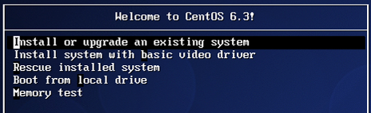
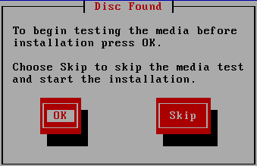
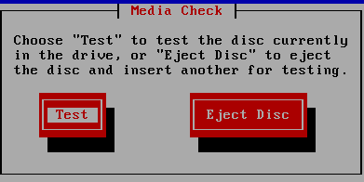
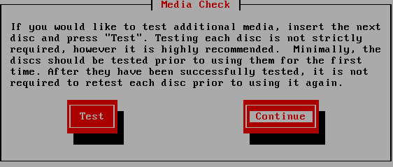
CentOS Installation
Insert CentOS DVD and Boot Up the Server.
To boot from DVD you may need to change Server BIOS setting.
Proceed installation by following instruction hereunder.
1. Choose this then press [Enter] key
2. If you wan to test Media, Choose [OK] then press [Enter] key. You can skip this if you want. (go next page)
3. Choose [Test] then press [Enter] key
4. Choose [Continue] then press [Enter] key
Page 63

Slide 65

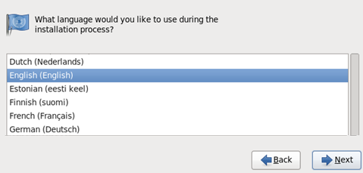
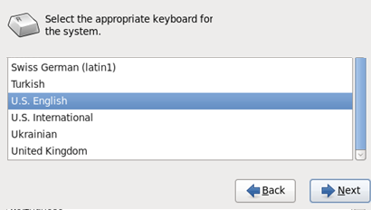
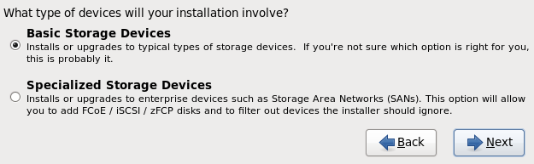
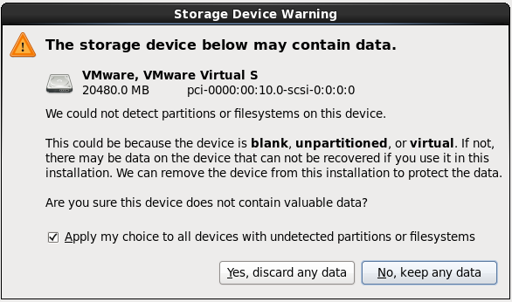
CentOS Installation
1. Click [Next]
2. Choose English then Click Next
4. Choose Basic Storage Devices then Click Next
3. Choose Preferred Keyboard Layout then Click Next
5. Click “yes, discard any data”
Page 64

Slide 66
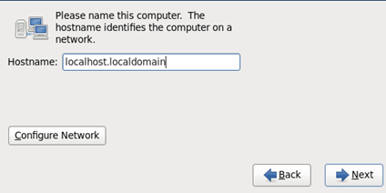
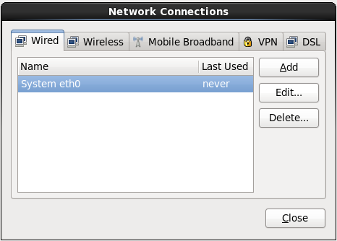
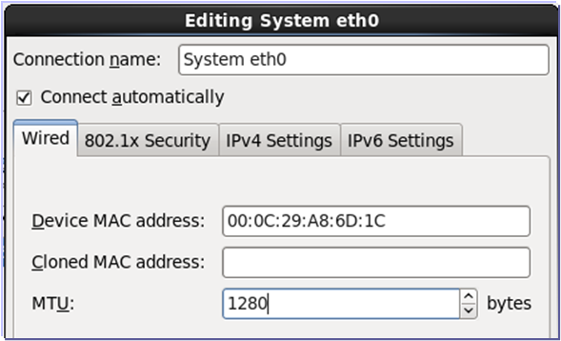
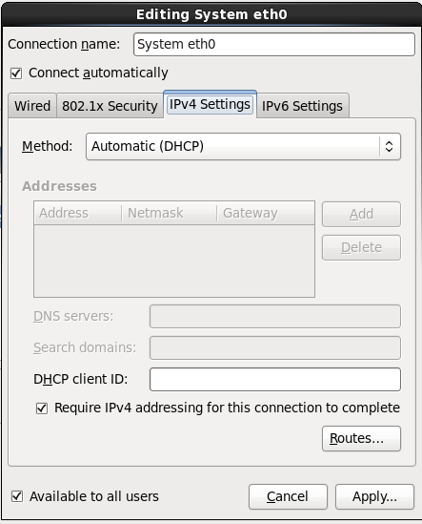
CentOS Installation
1. Click Configure Network
2. Choose Network Interface then Click Edit. If you install two I/F, do same settings for two I/F.
4. Choose “Automatic” or “Manual”. If you want to use DHCP, select Automatic. If you want to specify IP Address, select Manual.
3. Tick “Connect automatically” Input 1280 on MTU, then select “IPv4 Settings” Tab
5. If you choose Automatic, Click Apply button.
65
Page 65

Slide 67
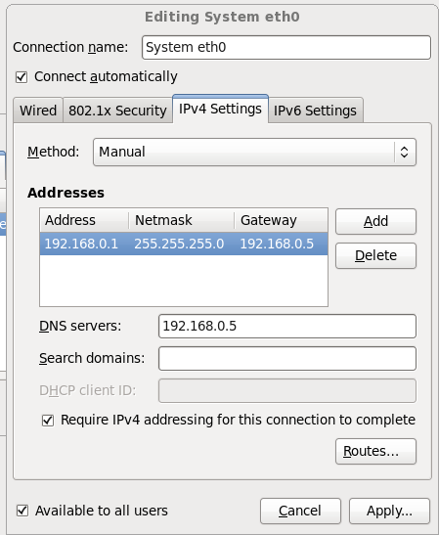
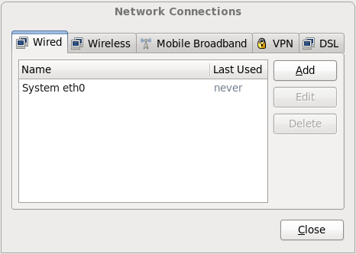
CentOS Installation
2. Click Close
1. If you choose Manual, Click Add button then Specify IP, Subnet mask and Gateway. After that Click Apply button
3. Click Next
Page 66

Slide 68
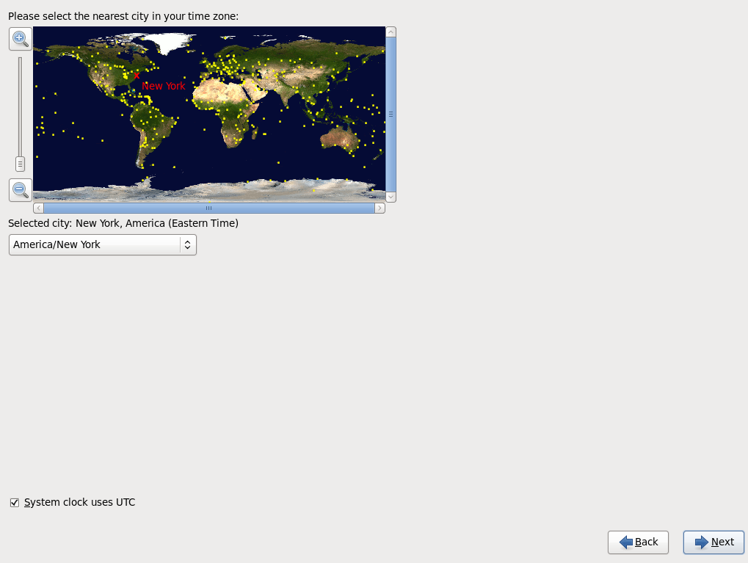
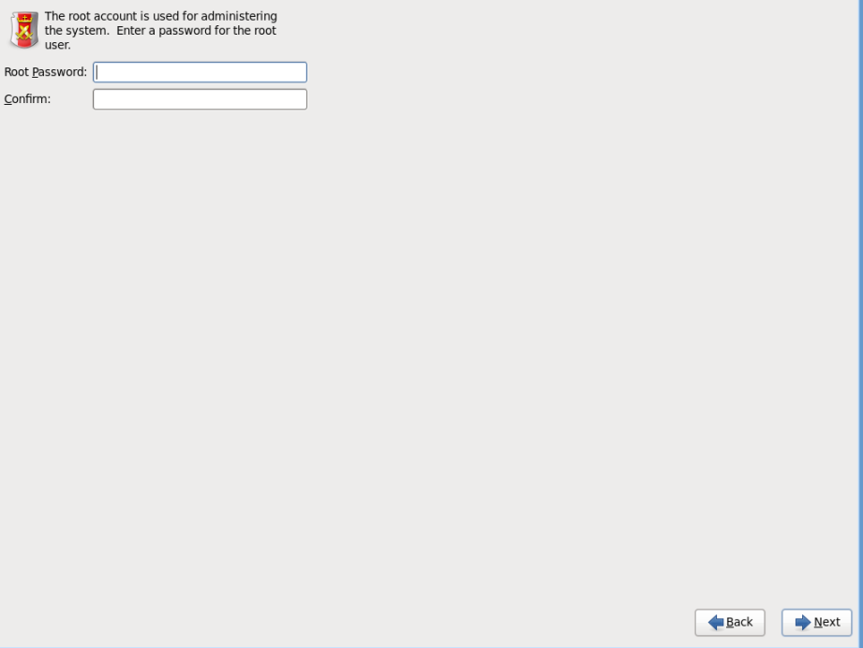
CentOS Installation
Choose Time Zone
Choose root password
(root = administrator)
Choose your Time Zone then click Next button
Input Password for root (administrator)
Remark:
Select Strong Password. No personal information like Birthday, anniversaries. Avoid any easy to guess letters. More letters is better.
Please note that the weakest point in any security is usually password.
1. Select preferred time zone
2. Click Next
Input Password then Click Next.
Page 67

Slide 69
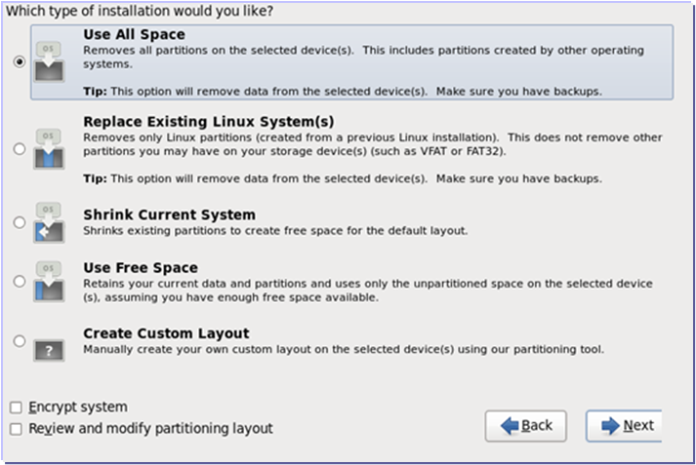
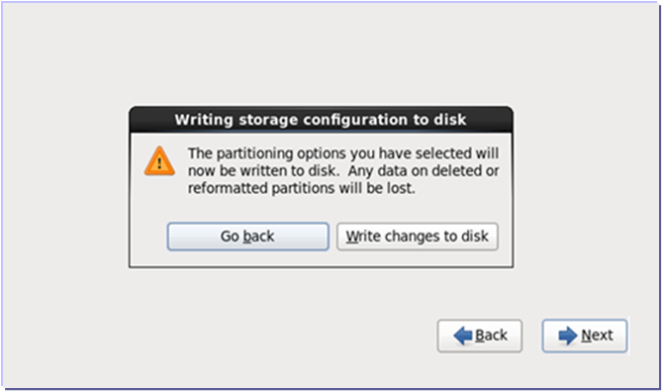
CentOS Installation
Installation type selection
Flashing modification to disk
Choose “Use All Space” then click Next button
Click “Write changes to disk” button
1. Choose “Use All Space”
3. Click “Write changes to disk”
2. Click Next
Page 68

Slide 70
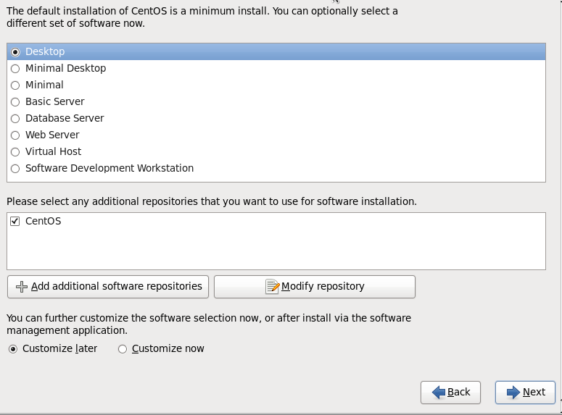
CentOS Installation
Choose “Desktop” then click “Next”
1. Choose “Desktop”
2. Click Next
Page 69

Slide 71
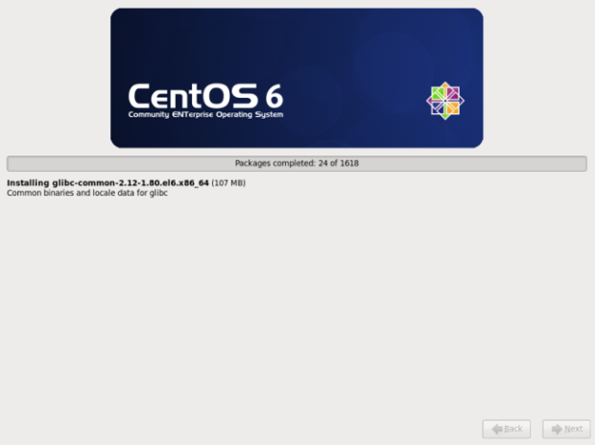
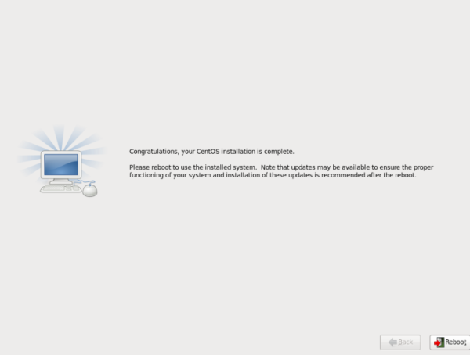
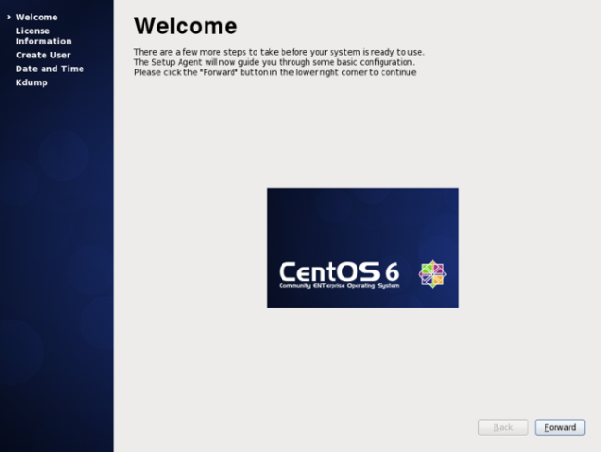
CentOS Installation
Wait Installation to be done
Wait Installation to be done
Click Reboot to restart the system
Click Reboot to restart the system
Wait package installation to be done
Click Reboot to restart the system.
2. Click Reboot
Remove DVD from DVD Drive
Remove DVD from DVD Drive
Continue Installation
System may boot up from DVD again.
Please remove DVD media before system
Boot up.
After system restart, Click Forward button
3. Click Forward
Page 70

Slide 72
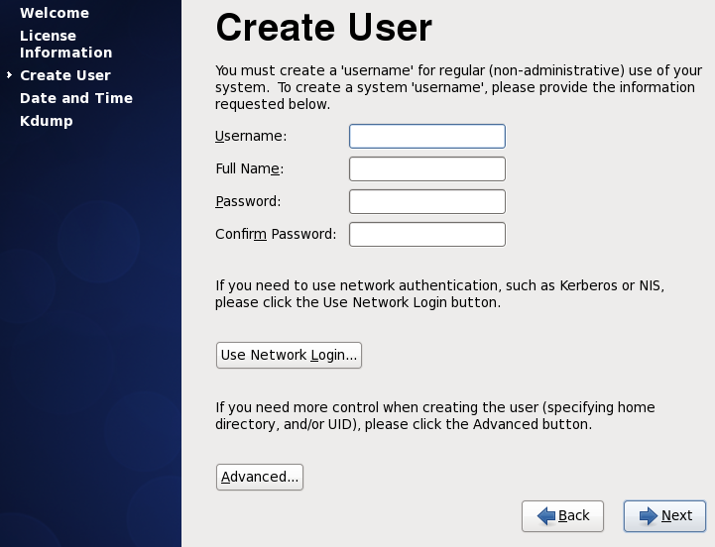
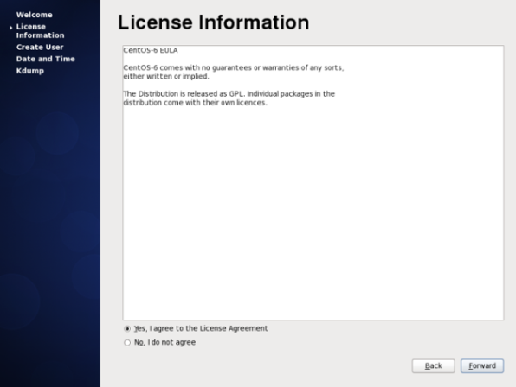
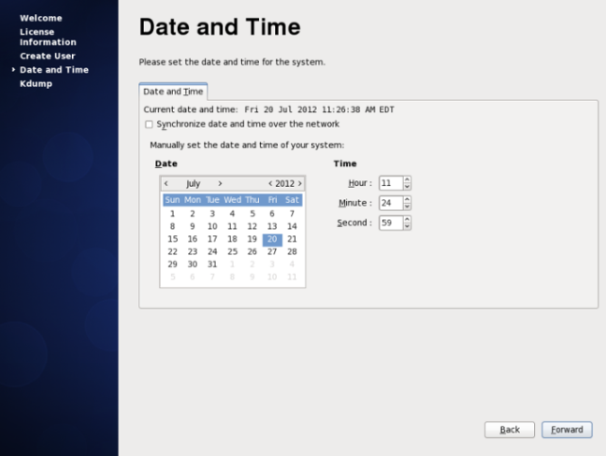
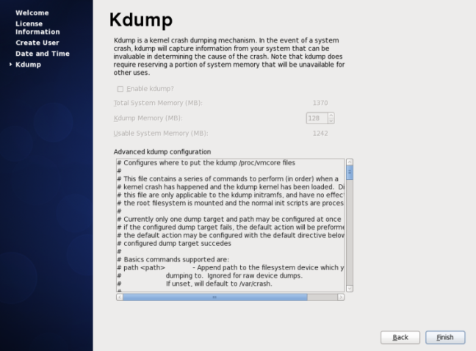
CentOS Installation
Agree to End User License Agreement
Skip Create User
Choose “Yes, I agree to the License Agreement”
then Click Forward
1. Choose Yes
3. Click Forward then answer Yes to Dialog
2. Click Forward
Set date and time
Kdump activation. You can skip it.
Configure Date and Time then click Forward
Click forward
4. Click Forward
5. Click Forward
Page 71

Slide 73
1
Overview of MPCS
2
MPCS Key Feature Overview
3
MPCS Specification Detail
4
MPCS Settings
5
MPCS Operation
6
Linux Installation
7
MPCS Installation
Page 72

Slide 74




MPCS Installation
1. Select Other to login to system as root
3. Type your password then Click Log In
2. Type “root” here then click Log In
4. Click Close
Page 73

Slide 75


MPCS Installation
1. Insert CentOS Ver.6.2 Installation Disk 1. You will see following pop up.
If you do not see pop up, re-insert Disk or go to Appendix around end of this document.
2. Insert MPCS Installation media then you may see following file manager window
Page 74

Slide 76



MPCS Installation
1. Configure Installation Environment
2. Double Click yumsetup.sh
3. Click Run in Terminal. You will see new window pop up. Wait until the window closed. It will take around minutes. If pop up window close within few seconds, you may failed to mound DVD. See Appendix for how to Mount DVD.
1. Double Click yumsetup
2. Configure Installation Environment
4. Double Click ethflwctrl_setup
5. Double Click ethflwctrl_setup.sh
Page 75

Slide 77


MPCS Installation
3. Start Install additional Packages
4. Double Click RPM
5. Double Click hdvc-mpcs-0.1-0.0.x86_64.rpm
Page 76

Slide 78




MPCS Installation
1. Click Continue Anyway
Need to Wait for a while.
2. Click Install
Wait for a while
After you finish installation you will see two icons named as following on desktop.
  1. Start_HDVC-MPCS.sh
  2. Uninstall_HDVC-MPCS.sh
3. Click Install
4. After installation double click
yumrestore.sh” to restore yum setting
Page 77

Slide 79


MPCS Installation
1. Click Application
3. Type “ifconfig” and press enter then you will see MAC
Address Information. This MAC address is required to register
MPCS License.
2. Click Terminal
Page 78

Slide 80


MPCS Installation
NAT Traversal Service License Registration
1. Go to web site
https://www.tsunagarunet.com/hdcom/main
2. Issue license by following instruction. MAC Address and License card information are required.
3. You will receive 16 digits Registration ID. Do not lost this information.
Page 79

Slide 81





MPCS Installation
Start Configuring MPCS
Select your language
1. Click here to open Web Browser
2. Type “127.0.0.1/hdvc_mpcs/index.cgi”
then press Enter
3. Select Language
4. Click Next
3. You will see Web Console on the Browser
Input Registration Keys
Input user/passwd for Web Console login.
7. Enter MPCS administrator information here.
Username and Password must be 6 to 16 letters.
5. Enter MPCS 16-digit Registration Key
6. Click Next
8. Click Next
Page 80

Slide 82


MPCS Installation
Input IP Address of your system
1. Enter IP Address for IP Mode
2. Press Finish then you are ready to use MPCS
Page 81

Slide 83

MPCS Installation
Key Registration of NAT Traversal Service
To connect to NAT Traversal Service by using HDVC-MPCS, it is necessary to register the registration key.
Registration key should be acquired by using MAC address of PC that install activation key card information and HDVC-MPCS to NAT Traversal Service server in advance.
Click in the order of maintenance – activation on Web console, and display the following screen.
1. Go to Maintenance Tab → Activation.
2. Enter Registration Key and Press Register.
Input Registration Key
Input Registration key, acquired from server, at input position of Registration key for NAT Traversal Service.
NAT Traversal Service is activated by clicking registration button below input column.
Page 82

Slide 84

MPCS Installation
Port Registration of NAT Traversal Service
Port that is used for NAT Traversal Service is set. In the initial status, input boxes for WAN side are blanks before assigned WAN port number as follows.
1. Go to Maintenance → Port Settings.
2. Configure Port Settings. This information is required to configure “Port Forwarding” settings on your Router.
Unless port settings are performed, NAT Traversal Service can not be used.
As for 6 ports model, it is necessary to be set 6 ports by all means. In case of auto input, 6 ports are set automatically.
As for other models, regardless of current maximum number of ports, 16 ports settings are required. In addition, in case of auto input, 16 ports settings are performed automatically.
Additionally, in case automatic setting is performed by clicking “Same port on WAN and LAN”, each of LAN port number is copied to WAN port number. Besides, in case of entering port number for Site1 and clicking “Auto input for WAN”, WAN port number for the rest of the Site will be automatically assigned sequential number.
Press “Same port on WAN and LAN” to fill port information automatically.
Page 83

Slide 85


MPCS Installation
Connection Test of NAT Traversal Service
HDVC-MPCS have function for NAT Traversal Service connection test, to confirm connectivity in case of setting and failure.
This test can not be executed, if NAT Traversal Service is not activated and NAT Traversal port settings are not performed.
Click “Connection Test”
If you want to perform test, click button within encircling red line in the figure above.
Test start after clicking the button. The following screen is displayed during the test.
Periodically click “Refresh” button.
(Screen is not switched automatically.)
And if you want to stop test, please click “Stop” button.
Click “Refresh”
Page 84

Slide 86

MPCS Installation
Connection Test of NAT Traversal Service
If screen switch to the following screen after clicking “Refresh” button, test is completed.
If you click “Show Results” button, port check result is displayed.
* If you click “Back” on this screen, screen is returned to network status screen. After returning to network status screen, you can not shift to this screen again. So, please note this. (If you want to confirm detailed test result, please perform test again.)
Page 85

Slide 87

MPCS Installation
Connection Test of NAT Traversal Service
On this screen, check result for each port is displayed. Meaning of result is as follows.
  S：Success
  U：Undefined
  F：Fail
In case all ports are filled with “S”, test is successful. (All ports are confirmed to be connectable.)
In addition, as for detail of this result (S/U/F) viewpoint, please refer to “E03-03_v200doc_NAT Traversal Service Connection Test Manual”.
*If you click “Back” button on this screen, screen is shifted to network status screen.
After that, you can't shift to this screen again. So, please note this. If you want to confirm connection result again, please perform test again.
Page 86

Slide 88
MPCS Installation
Recommended Router for NAT Traversal Service
The following routers are already confirmed operation check at PSN.
Area | Router
Japan | YAMAHA RTX1200 / RTX3500
Overseas and Japan | CISCO 2951 / 1941
Note:
When using CISCO router, restriction, that No.5100 port can't pass STUN check, is found. In spite of when NAT Traversal connection test result is failed, if connection is performed, No.5100 port also pass properly (cause is unknown.). When setting MPCS port (refer to 4.2), please set except No.5100 port.
Page 87

Slide 89
MPCS Installation
Sample Configuration for NAT Traversal Service
The following is sample configuration of CISCO1941. In addition, please note that there may be necessary for this sample to be corrected according to customer’s network environment.
version 15.0
!
enable password password
!
no ipv6 cef
ip source-route
ip cef
!
ip domain name cisco
ip inspect name firewall https
ip inspect name firewall dns
ip inspect name firewall tcp
ip inspect name firewall udp
ip inspect name firewall icmp
!
multilink bundle-name authenticated
!
crypto pki token default removal timeout 0
!
license udi pid CISCO1941/K9 sn 12345678
!
archive
log config
hidekeys
!
redundancy
!
interface GigabitEthernet0/0
no ip address
duplex auto
speed auto
pppoe enable group global
pppoe-client dial-pool-number 1
no cdp enable
!
!
interface GigabitEthernet0/1
ip address 172.16.100.254 255.255.255.0
ip nat inside
ip virtual-reassembly
ip tcp adjust-mss 1356
duplex auto
speed auto
!
!
interface Dialer1
mtu 1438
ip address negotiated
ip access-group A-security in
ip nat outside
ip inspect firewall out
ip virtual-reassembly
encapsulation ppp
dialer pool 1
dialer-group 1
ppp authentication chap callin
ppp chap hostname USER@ocn.ne.jp
ppp chap password USERPassword
no cdp enable
Page 88

Slide 90
MPCS Installation
ip forward-protocol nd
!
no ip http server
no ip http secure-server
!
no ip nat service sip tcp port 5060
ip nat inside source list 1 interface Dialer1 overload
ip nat inside source static udp 172.16.100.100 5101 interface Dialer1 5101
ip nat inside source static udp 172.16.100.100 5102 interface Dialer1 5102
ip nat inside source static udp 172.16.100.100 5103 interface Dialer1 5103
ip nat inside source static udp 172.16.100.100 5104 interface Dialer1 5104
ip nat inside source static udp 172.16.100.100 5105 interface Dialer1 5105
ip nat inside source static udp 172.16.100.100 5106 interface Dialer1 5106
ip nat inside source static udp 172.16.100.100 5107 interface Dialer1 5107
ip nat inside source static udp 172.16.100.100 5108 interface Dialer1 5108
ip nat inside source static udp 172.16.100.100 5109 interface Dialer1 5109
ip nat inside source static udp 172.16.100.100 5110 interface Dialer1 5110
ip nat inside source static udp 172.16.100.100 5111 interface Dialer1 5111
ip nat inside source static udp 172.16.100.100 5112 interface Dialer1 5112
ip nat inside source static udp 172.16.100.100 5113 interface Dialer1 5113
ip nat inside source static udp 172.16.100.100 5114 interface Dialer1 5114
ip nat inside source static udp 172.16.100.100 5115 interface Dialer1 5115
ip nat inside source static udp 172.16.100.100 5116 interface Dialer1 5116
ip nat inside source static udp 172.16.100.100 5117 interface Dialer1 5117
ip nat inside source static udp 172.16.100.100 5118 interface Dialer1 5118
ip nat inside source static udp 172.16.100.100 5119 interface Dialer1 5119
ip nat inside source static udp 172.16.100.100 5120 interface Dialer1 5120
ip nat inside source static udp 172.16.100.100 5121 interface Dialer1 5121
ip nat inside source static udp 172.16.100.100 5122 interface Dialer1 5122
ip nat inside source static udp 172.16.100.100 5123 interface Dialer1 5123
ip nat inside source static udp 172.16.100.100 5124 interface Dialer1 5124
ip nat inside source static udp 172.16.100.100 5125 interface Dialer1 5125
ip nat inside source static udp 172.16.100.100 5126 interface Dialer1 5126
ip nat inside source static udp 172.16.100.100 5127 interface Dialer1 5127
ip nat inside source static udp 172.16.100.100 5128 interface Dialer1 5128
ip nat inside source static udp 172.16.100.100 5129 interface Dialer1 5129
ip nat inside source static udp 172.16.100.100 5130 interface Dialer1 5130
ip nat inside source static udp 172.16.100.100 5131 interface Dialer1 5131
ip nat inside source static udp 172.16.100.100 5132 interface Dialer1 5132
ip nat inside source static udp 172.16.100.100 5200 interface Dialer1 5200
ip nat inside source static udp 172.16.100.100 5201 interface Dialer1 5201
ip nat inside source static udp 172.16.100.100 5202 interface Dialer1 5202
ip nat inside source static udp 172.16.100.100 5203 interface Dialer1 5203
ip nat inside source static udp 172.16.100.100 5204 interface Dialer1 5204
ip nat inside source static udp 172.16.100.100 5205 interface Dialer1 5205
ip nat inside source static udp 172.16.100.100 5206 interface Dialer1 5206
ip nat inside source static udp 172.16.100.100 5207 interface Dialer1 5207
ip nat inside source static udp 172.16.100.100 5208 interface Dialer1 5208
ip nat inside source static udp 172.16.100.100 5209 interface Dialer1 5209
ip nat inside source static udp 172.16.100.100 5210 interface Dialer1 5210
ip nat inside source static udp 172.16.100.100 5211 interface Dialer1 5211
ip nat inside source static udp 172.16.100.100 5212 interface Dialer1 5212
ip nat inside source static udp 172.16.100.100 5213 interface Dialer1 5213
ip nat inside source static udp 172.16.100.100 5214 interface Dialer1 5214
ip nat inside source static udp 172.16.100.100 5215 interface Dialer1 5215
ip nat inside source static udp 172.16.100.100 5216 interface Dialer1 5216
ip nat inside source static udp 172.16.100.100 5217 interface Dialer1 5217
ip nat inside source static udp 172.16.100.100 5218 interface Dialer1 5218
ip nat inside source static udp 172.16.100.100 5219 interface Dialer1 5219
ip nat inside source static udp 172.16.100.100 5220 interface Dialer1 5220
ip nat inside source static udp 172.16.100.100 5221 interface Dialer1 5221
ip nat inside source static udp 172.16.100.100 5222 interface Dialer1 5222
ip nat inside source static udp 172.16.100.100 5223 interface Dialer1 5223
ip nat inside source static udp 172.16.100.100 5224 interface Dialer1 5224
ip nat inside source static udp 172.16.100.100 5225 interface Dialer1 5225
ip nat inside source static udp 172.16.100.100 5226 interface Dialer1 5226
ip nat inside source static udp 172.16.100.100 5227 interface Dialer1 5227
ip nat inside source static udp 172.16.100.100 5228 interface Dialer1 5228
ip nat inside source static udp 172.16.100.100 5229 interface Dialer1 5229
ip nat inside source static udp 172.16.100.100 5230 interface Dialer1 5230
ip nat inside source static udp 172.16.100.100 5231 interface Dialer1 5231
ip route 0.0.0.0 0.0.0.0 Dialer1
!
ip access-list extended A-security
permit udp any any range 5101 5132
permit udp any any range 5200 5231
!
access-list 1 permit 172.16.100.0 0.0.0.255
dialer-list 1 protocol ip permit
Page 89

Slide 91
MPCS Installation
Configure Port Settings on your Router
Following Port need to port forward to MPCS IP Address which configured to access to Internet.
Table: Ports has to be port forwarded to MPCS IP Address
Data Type | External Port | Internal Port | Protocol
Audio | 5100-5131 | 5100-5131 | UDP
Video | 5200-5231 | 5200-5231 | UDP
SIP | 5060, 15060 | 5060, 15060 | UDP and TCP
Page 90

Slide 92
Appendix
Trouble Shooting

Slide 93

How to Mount DVD
1. Double Click “Computer”
2. Right Click DVD Icon. If you don’t see this Icon, you probably
have problem with your drive or media.
3. Click “Mount”
Page 92

Slide 94

How to Check IP Address
1. Click Application
3. Type “ifconfig” and press enter then you will see
IP Address information
2. Click Terminal
Page 93

Slide 95




How to Configure IP Address After Install
1. Go to System -> Preference -> Network Connections.
2. Click Add button or select existing interface
then press Edit.
3. Tick Connect Automatically and Available to all users
then Go to IPv4 Settings Tab.
4. Click Add button, input necessary information
then Click Apply button. After that, click Close to
finish setting.
Page 94

Slide 96

How to Enable Network After Install
If still you have problem with network….
1. Click Application
Check network interface is recognized by CentOS.
3. Execute “ifconfig –a”
If network device is recognized by system, you will see eth0, eth1, eth2… depends on number of interfaces you have. If you see only lo, device is not recognized. You may need to install extra interface card or replace server.
2. Click Terminal
Page 95

Slide 97

How to Enable Network After Install
Result of “ifconfig –a” command tells you interface situation.
Example of network interface not configured. IP Address is not assigned and interface is not activated.
Example for properly configured network interface
If you don’t properly configure IP Address, you won’t see this line
If network interface is physically not connected or network interface is turned off by software, you won’t see the word “UP”
Page 96

Slide 98

How to Enable Network After Install
1. Execute “gedit /etc/sysconfig/network-scripts/ifcfg-eth0” if you would like to use eth1, replace “eth0” with “eth1” on above command
2. After you edit file, save it then restart system to reflect changes.
If ONBOOT=no, interface will not be activated when server start
Input necessary information like this. If you do not need GW, you can remove GATEWAY line.
If you don’t need DNS< you can remove these lines.
Page 97

Slide 99


How to Enable Network After Install
1. You can also use setup command to change interface settings
Page 98

Slide 100

How to Change Name “eth0” and “eth1”, etc.
1. Execute ifconfig –a to see current situation
Show how to change eth2 to eth1
2. Edit /etc/udev/rules.d/70-persistent-net.rules
Page 99

Slide 101

How to Change Name “eth0” and “eth1”, etc.
3. Change setting and save it.
Delete this line if you think this is useless
Change eth2 to eth0 (change as you want)
Page 100

Slide 102

How to Change Name “eth0” and “eth1”, etc.
4. Remove ifcfg-eth0, ifcfg-eth1, ifcfg-eth2 etc in /etc/sysconfig/network-scripts
5. Restart system
6. Start over IP address setup
Page 101

Slide 103

How to Change Keyboard Setting
1. Execute setup command on the console terminal
2. Execute Keyboard configuration then select desired one
Actual setting is written in
/etc/sysconfig/keyboard
Page 102

Slide 104
Other Linux Commands
Command | Description | Example
passwd | Change password | passwd <- change current user’s password passwd username <- change Other user’s password
adduser | Add user | adduser username
top | Show CPU usage. Stop with ‘q’ | top
df | Show disk usage | df –h
ps | Show process | ps aux
less | Show file content | less /etc/sysconfig/network-scripts/ifcfg-eth0
halt | Turn off system
reboot | Restart system
Page 103

Slide 105

Thank You !
Panasonic System Networks Co., Ltd.
Security System Business Division

