Slide 1

1. This document can be disclosed to Panasonic Sales Partners
2. The specs might be changed without notice since it’s still under development.
For Panasonic Sales Company and Business Partner only
NAT Traversal Service
(Easy Connection)
Ver.4.00
Panasonic System Networks Co., Ltd.
Security System Business Division

Slide 2
History of Revision
Doc. Ver. | Contents | Date of Issue | Remarks
Ver. 4.00/4.10 | Issue of First Edition | Nov. 2014
Page 1

Slide 3




Outline of NAT Traversal Service
Panasonic NAT Traversal Service (Easy Connection) provides following
features and benefits.
NAT Traversal capability using STUN (Simple Traversal of UDP through NATs) Server.
Terminal ID like “7-digit numbers” easy addressing via Panasonic SIP Server.
Static Public IP address is not required.
Provide easy connection utilizing NAT Traversal and Terminal ID like addressing.
Encryption feature available to provide secure communication (Alphanumeric 4 to 256 characters)
Activation Key is required. Two Types of the Key are available. (1 Year and 3 Years Services)
NAT Traversal Servers
(Easy Connection)
STUN Server
SIP Server
Router
Router
HDVC Series
HDVC Series
Page 2

Slide 4


Outline of NAT Traversal Service
1. Registration
HDVC registers itself to SIP Server with
Activation Information. SIP Server assign
7-Digit Terminal ID to HDVC.
The 7-Digit Terminal ID is fixed ID and
won’t be changed until activation key term
expires.
SIP Server: Has feature to map Terminal ID and IP
address. Also relay SIP communication among end points.
2. Test NAT Specification
HDVC figures out router specification by
Communicating with STUN server.
By analyzing return from STUN server
HDVC understands specification of router
and possibility to traverse NAT.
3. Communication
When HDVC makes a call with 7-digit
Terminal ID, two HDVC Systems start
communicating via SIP server over
SIP protocol.
Two HDVC systems transmit both Audio
and Video data directly. HDVC traverse
NAT utilizing revealed router specification
in 2nd step.
STUN (Session Traversal Utilities for NAT) is a standardized set of methods and a network protocol to allow an end host to discover its public IP address if it is located behind a NAT. It is used to permit NAT Traversal for applications of real-time voice, video, messaging, and other interactive IP communications.
1. Registration
SIP
2. Test NAT Specification
STUN
3. Communication
SIP
AV Data
Internet
Internet
Internet
STUN
Server
SIP
Server
STUN
Server
SIP
Server
STUN
Server
SIP
Server
HDVC registers IP to SIP Server then receive 7-digit Terminal ID
HDVC find out how to traverse NAT based on STUN response
AV Data traverse NAT
SIP goes through Server
Page 3

Slide 5
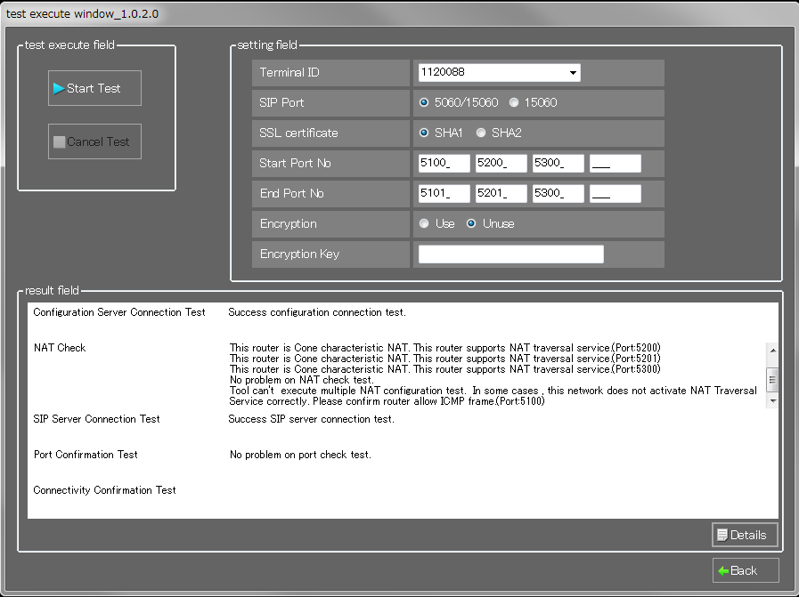
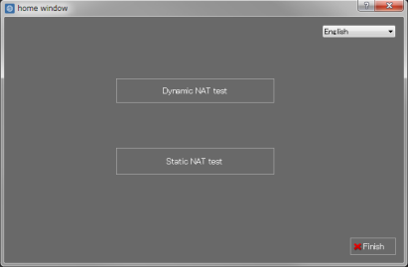




Setting Up (Network Survey)
Panasonic NAT Traversal Service (Easy Connection) won’t works with all types of Routers. So first of all, Panasonic Recommend to use Panasonic Investigated Router.
If there is difficulty to use Panasonic investigated router, you need to do Network Survey
in advance to minimize risk of failure.
NAT Traversal Check Tool
This tool confirm the internet connection Compatibility with Panasonic
NAT Traversal Service (Easy Connection).
NAT Traversal Service (Easy Connection) Network Topology
Internet
Main Menu
1. Strongly recommend to
use investigated router.
Diagnosis Screen
TEST Course
Dynamic NAT Test (Regular Course)
Static NAT Test
(Advanced Course)
TEST Menu
Configuration Server Connection Test
NAT Check
SIP Server Connection Test
Port Confirmation Test
Connectivity Confirmation Test
2. Execute NAT Traversal
Check Tool here
Note 1: Make sure Internet connection ready before starting the test.
Note 2: In case of Static NAT test, it is required router setting depends on its network environmental.
Page 4

Slide 6
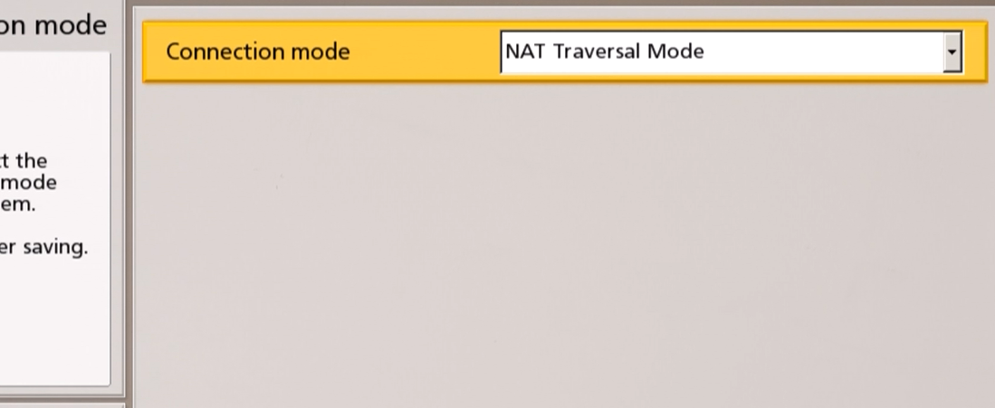
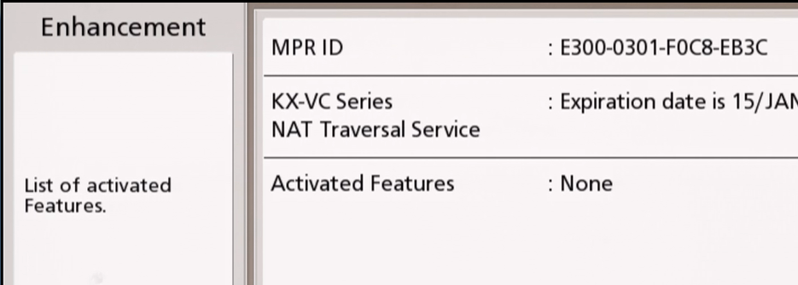
Setting Up
Initial setting (Mode Selection)
Encryption Key Setting
Select NAT Traversal Mode while initial boot up or by going to “Menu” => “Settings” => “Admin” => “Connection Mode”
Go to “Menu” => “Settings” => “Admin Menu” => “Encryption” then set Access mode to User.
If you would like to use encryption, input desired Encryption key.
The system will restart after changing connection mode.
Network Settings
Access mode should be “User” .
This is for user to change Encryption key by Local Site.
Go to “Menu” => “Settings” => “Network Settings” then Assign IP Address.
Confirm HDVC MPR-ID
Go to “Menu” => “Settings” => “Enhancement”. You will see MPR-ID on the Screen. Keep displayed MPR-ID for next step.
Fig: MPR-ID in Enhancement Screen
Page 5

Slide 7
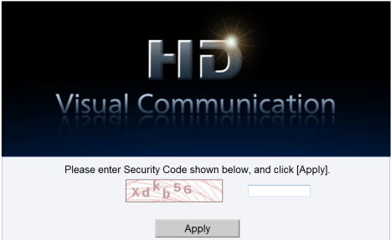
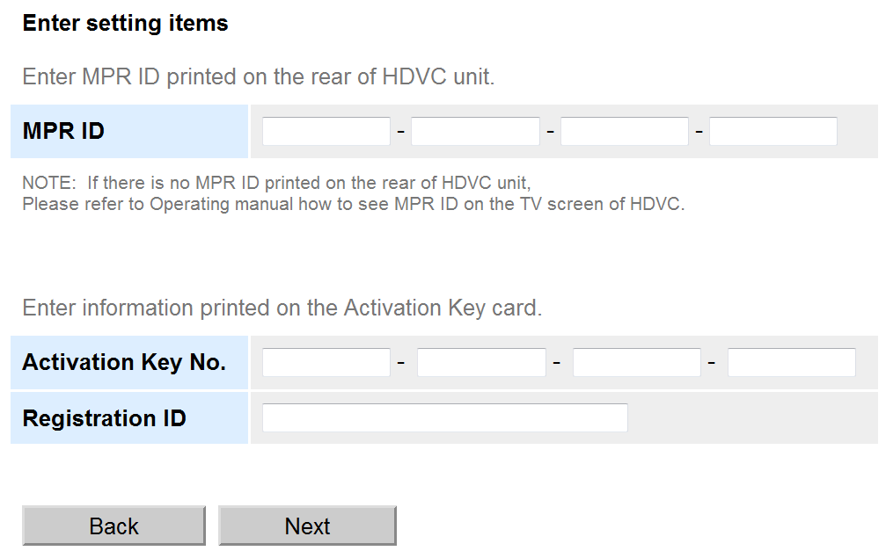
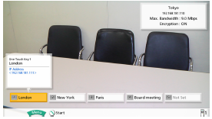
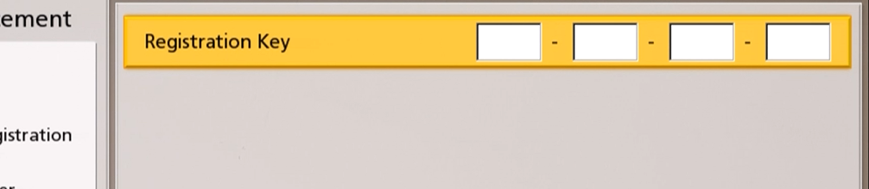
Setting Up
Activate the System
1. Go to “NAT Traversal service” Web page from PC.
https://www.tsunagarunet.com/hdcom/main
2. Follow the instruction in the Web Page to issue
Registration Key
4. After you enter Registration Key, system will restart.
5. If you see Terminal ID Assigned on the System, Setup successfully complete.
3. To install registration key to HDVC, go to “Menu” => “Settings” => “Admin” => “Enhancement” then Press Green button (Guide Menu on the screen says, Green assigned to Add feature). Input 16 digits Registration Key then Press [G] and select [Yes] to save changes.
NAT Traversal mode
Atlanta
1234567
Max Bandwidth:4.0Mbps
Encryption:ON
Fig: How terminal ID Displayed.
Page 6

Slide 8
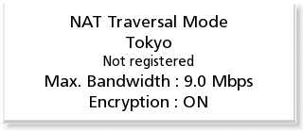
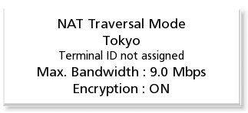
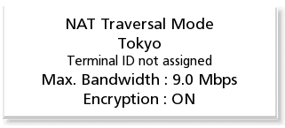
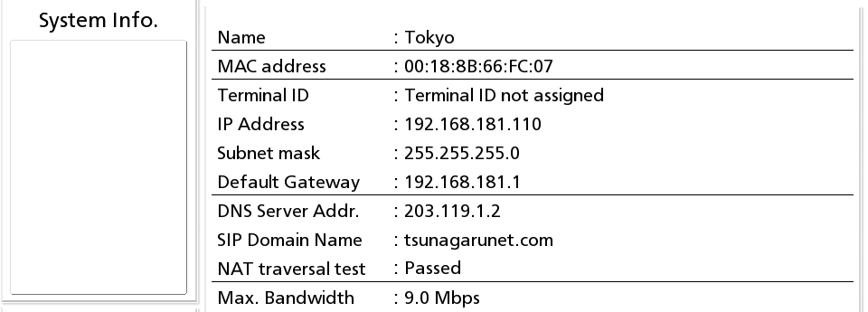
Trouble Shooting
Case 1: Not registered
Case 3: Terminal ID Not Assigned
If you have seen following status message on the screen, It means HDVC system has failed to communicate with Panasonic SIP Server.
Fig: Right above status indicator
Registration No. is not installed on the system. Follow NAT Traversal Service Setup to install Registration No. to the System.
Press Status Button twice to see System Info.
Case 2: Terminal ID Not Assigned
If NAT Traversal Test is Passed
HDVC could communicate with STUN Server
and router specification test result is good.
But failed to connect to SIP Server.
SIP communication is disturbed by some reason.
If NAT Traversal Test is Failed
HDVC could not communicate with neither SIP
server nor STUN Server.
Internet Connection may not have been presented.
Fig: Right above status indicator
System failed to registered to the Panasonic Easy Connect Service. Check Status Screen about situation. Detail is in next page.
Page 7

Slide 9
Trouble Shooting
Case 4: Terminal ID Not Assigned
Reason of HDVC Communication failure may be following reason.
Please check it step by step to solve the problem.
1. Internet Connection is not presented. Check Internet Connection.
2. IP setting on the HDVC is wrong. Check IP, Subnet Mask and DNS setting
3. SIP ALG is working on router. Disable it.
  * Depends on the router model, the setting menu and setting method are different.
4. Necessary Port is closed by Firewall. Open Necessary Port up.
Intended Purpose |  | Protocol | Use Port Number | Remarks
SIP | SIP | TCP | 50000~50999 | Destination Port: 5060
 | BFCP | TCP | 5800~5808 (VC1600 (9 ports) / VC1300 (3 ports)) Setting range: 5800~5890 | Max. 1 port is required for 1 session
Audio | RTP/RTCP | UDP | 5100~5135 (VC1600 (36 ports) / VC1300 (12 ports)) Setting range: 5100~5164 | RTCP Port: RTP port + 1 4 ports per 1 stream is required (RTP + RTCP + Alternatives of Session change (RTP + RTCP))
Video | RTP/RTCP | UDP | 5200~5235 (VC1600 (36 ports) / VC1300 (12 ports)) Setting range: 5200~5264
Video (Sub) | RTP/RTCP | UDP | 5400~5435 (VC1600 (36 ports) / VC1300 (12 ports)) Setting range: 5400~5464
Camera | RTP | UDP | 5300~5335 (VC1600 (36 ports) / VC1300 (12 ports)) Setting range: 5300~5364
NAT Traversal Service | NAT Traversal Service (DNS) | UDP | Any (32768~61000) | It is needed for server address settlement of NAT Traversal server (Admin. Server)
 | NAT Traversal Service (Download of Config. Info.) | TCP + SSL | Any (32768~61000) | It is needed for downloading of configuration information from NAT Traversal server (Admin. Server)
Page 8

Slide 10
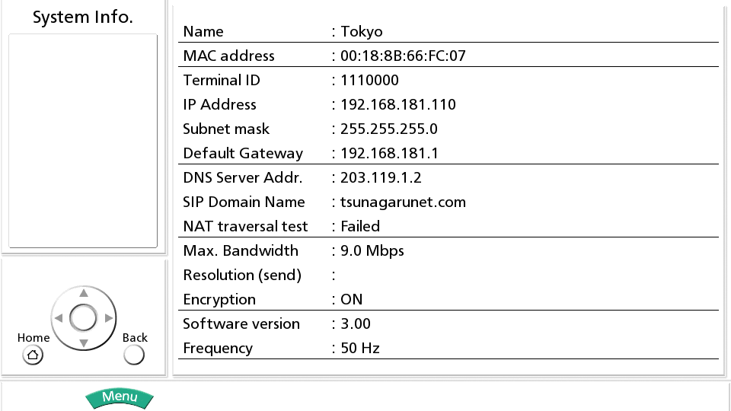
Trouble Shooting
Case 5: Terminal ID Assigned but Call Failed
If Terminal ID is assigned but Call Failed, Press “Status” button twice to see System Info.
If you have seen “NAT Traversal Test : Failed”, System failed to establish call because NAT specification is not suitable with Panasonic Easy Connection Service.
Try Static NAT Setting (IP mode) to resolve this issue.
Page 9

Slide 11
Restriction of NAT Traversal Service
Use Panasonic investigated routers to avoid any unnecessary issues from happening.
  HDVC series support NAT Traversal using STUN Server. But does not support all sorts of NAT mechanisms. If a router equips with a unsupported NAT mechanism, Panasonic Easy Connect service won’t work. This is the reason why Panasonic recommends to use approved router.
Connect one HDVC system to one router. Also install One router between HDVC and Internet
  If multiple HDVC systems are connected under the one router, connection may be interrupted.
  HDVC does not fully support multiple NAT. Connection may be failed.
Do not enable Firewall Feature on the router. It probably disturb connection
No interoperability with other SIP server. Also no connectivity with HDVC working in IP Mode.
Internet
Router
Page 10

Slide 12
Investigated Router List
As of Sep. 2014
Area | Router
Japan | YAMAHA RTX1200 / NVR500 / RTX1100 Buffalo WHR-G301N / WZR-HP-G302H / WHR-HP-G300N / WZR-300HP / BHR-4GRV NEC PA-WR8170N-ST / PA-WR8700N-HP / PA-WR8750N-HP
USA | Linksys E1000 / E4200 NETGEAR N300 / N750
Europe | Lancom 1711 VPN Linksys E1000 / E420 NETGEAR N300 / N750
India | *TBC
China | TP-Link TL-R470T+ / TL-WR340 / TL-SF1008p / TL-R478 H3C ER3100 / E3260 / ER4200
Singapore | Linksys E4200
Hong Kong | NETGEAR N300
Taiwan | Buffalo WHR-HP-G300N
Thailand | Linksys E1000
Australia | *TBC
New Zealand | Linksys E1000
UAE | Linksys E4200 *TBC
Russia | Linksys E1000
Mexico | TELEMEX *TBC
Brazil | *TBC
Panama | Linksys E1000
Indonesia | Linksys E1200
Viet Nam | Linksys RV042 / EA6700
Malaysia | *TBC
Page 11

Slide 13

Thank You !
Panasonic System Networks Co., Ltd.
Security System Business Division

