Slide 1
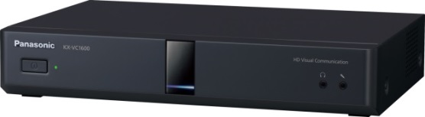
1. This document can be disclosed to Panasonic Sales Partners
2. The specs might be changed without notice since it’s still under development.
For Panasonic Sales Company and Business Partner only
ALM
(Application Layer Multicast)
Ver.4.20
Panasonic System Networks Co., Ltd.
Security System Business Division

Slide 2
History of Revision
Doc. Ver. | Contents | Date of Issue | Remarks
Ver. 4.20 | Issue of First Edition | Aug. 2015
Page 1

Slide 3

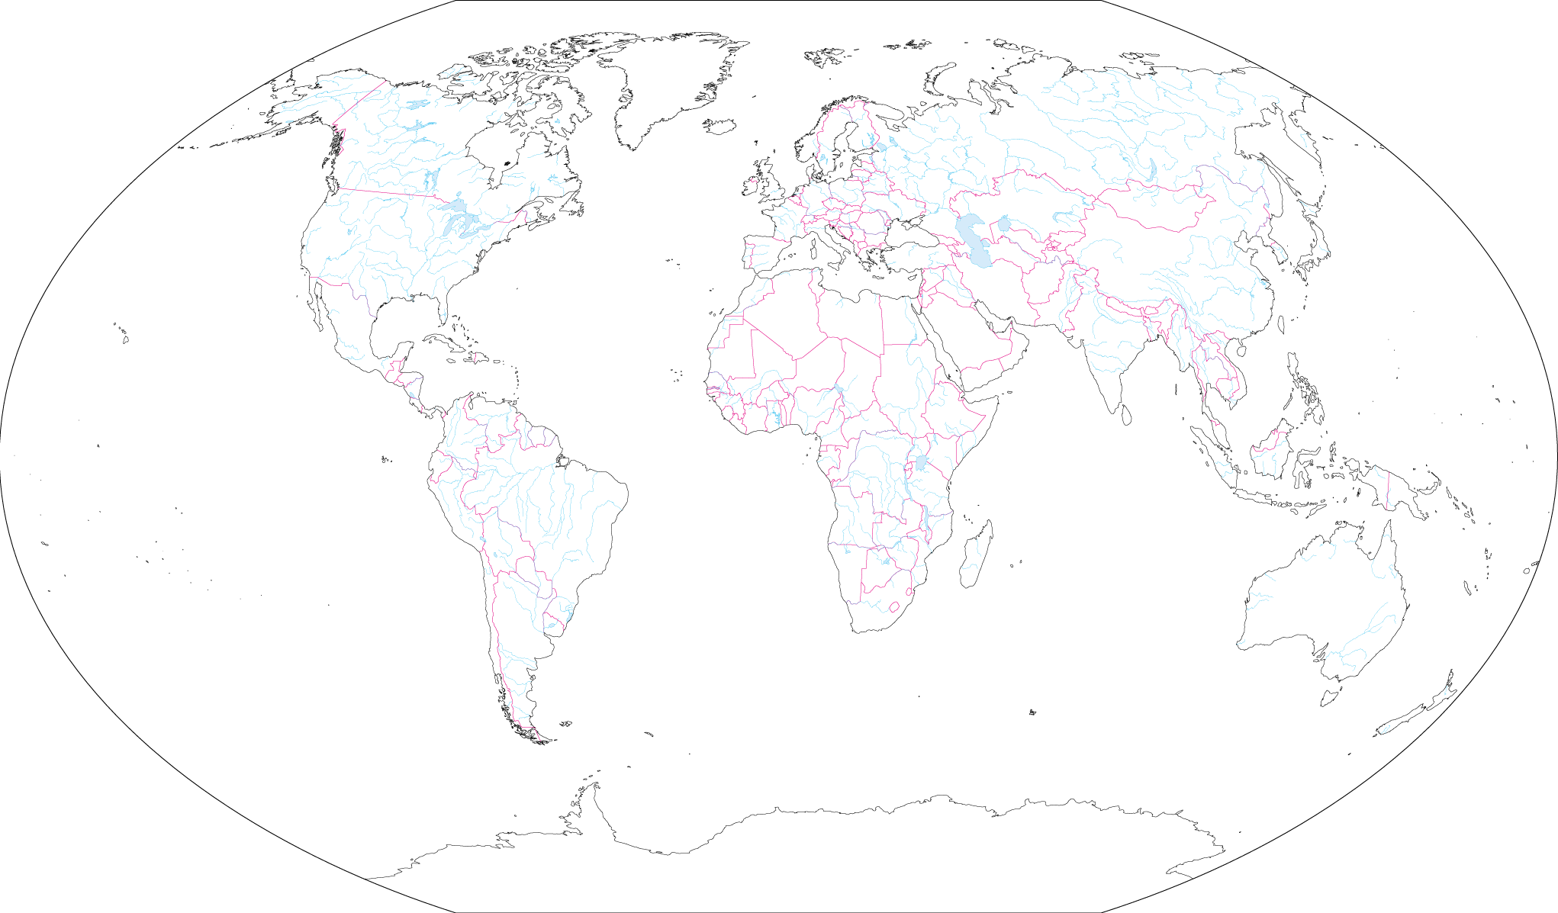









Outline
Multicasting Solution by using HD Visual Communication.
Up to 30 sites with Full HD Resolution
Cost saving of Network (Server less, Min. Bandwidth Requirement: 2Mbps/site for FHD)
High Video/Audio Quality
NW Cost Saving
Easy Operation
Provide High Video and Audio Quality with Full HD Resolution same as ordinary videoconferencing.
Server less solution
Stress Free for Network with unique Multicasting method (Application Layer Multicast)
Easy Operation by HDVC’s Remote Controller
Easy creation of Multicast Tree
Page 2

Slide 4











Target Customer
Category | Place |  | Video Delivery (Multicast) | Video Transmission
Business Enterprise (Manufacture, Finance, Construction） | Office |  | ◎
 | Factory |  | ◎
 | Construction site |  | ◎ | △
 | Bank |  | ◎ | △
 | Communication Station |  |  | ◎
 | Broadcasting Station |  |  | ◎
Government | Government Office |  | ◎
 | Police Dept. |  | ◎
 | Fire Dept. |  | ◎
 | Prison |  |  | ◎
 | Court |  |  | ◎
Service Business (Outlet, Distribution) | Hotel |  | ◎ | ○
 | Party Hall |  | ◎ | ◎
 | Casino |  | ○ | ◎
 | Distribution Center |  | ◎ | ○
 | Railway Station |  | ◎ | ◎
 | Airport |  | ◎ | ◎
Medical | Hospital |  | ○
 | Nursing Care Facility
 | Home Care
Education | School |  | ◎
 | Cram School |  | ◎ | ◎
 | Training / Church |  | ◎ | ◎
Others | House
 | Parking Area |  |  | △
Video Delivery Market
Multicasting System
HQ
Office
Multicast
Office
Vertical (Education) Market
Remote Education System
Remote Lecture
Cram School / Internal Training
Church Market
教会
Multicast
・・・
Branch
Branch
Page 3
Page 3

Slide 5
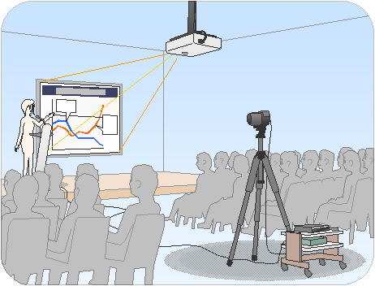




Use Case 1
Morning Assembly / Policy Meeting
The Vision of Company president and Company’s Goal can transmit to each employees in real time
1
Local Office A
Screen
Projector
Internet
Camera
Branch Office A
Local Office B
Microphone
2
HDVC
Local Office C
Router
Head Quarters
Branch Office B
Local Office D
Page 4

Slide 6


Use Case 2
Remote Education / Company Internal Training
Explanation of New Product and Internal Staff Training can be made to share the information easily with branch office.
Camera
Projector
Screen
Internet
Branch Office A / Branch School A
Wireless
Microphone
HDVC
Router
Head Quarters / School
Branch Office B / Branch School B
Page 5

Slide 7

System & Network Outline
Features: Up to 30 sites Multicast / Add, Escape and Reconversion of Multicast Tree
Supported Connection Mode: IP mode (Not supported for Static NAT and NAT Traversal Service mode)
Recommended Network: Intranet, VPN (Closed Network) *Encryption is not supported.
Distribution Method: Bucket bridge (IN x 1, OUT x 2)
Connection Method: Full Mesh
License: Required at all sites (KX-VCS302)
Max. Video Quality: Full HD (1080p)
Minimum Required Bandwidth:
1Mbps / site for HD, 2Mbps / site for Full HD
15
7
16
17
8
18
3
19
1
9
20
4
10
21
22
Projector
Internet
11
23
Screen
5
24
Camera
2
12
25
Microphone
13
26
6
27
HDVC
14
28
29
Router
30
Page 6

Slide 8



Network Requirement
Full Mesh Type Network is essential.
It is adapting two trees distribution structure for making Multicast route (Multicast Tree).
Note: When trouble is occurred during connection such as network failure, fixed route multicasting method can not be guaranteed to re-establish the multicast route (multicast tree) and keep connection. Full Mesh does support.
（フルメッシュ型ネットワークが必須です）
Full Mesh Type Network
When trouble is occurred
(Re-establish the multicast route)
VC1600
Disconnect
VC1600
Branch Office B
Branch Office B
HQ
HQ
Change Multicasting route
Intranet
(Closed Network)
Intranet
(Closed Network)
Sales Office A
Sales Office A
Branch Office A
Branch Office A
Sales Office B
Sales Office B
Branch Office C
Sales Office C
Branch Office C
Sales Office C
Page 7

Slide 9
Network (Multicast Tree and Node)
Relationship of Multicast Tree and Node Positioning
< Multicast Tree >
It is defining the arrangement of the terminals in the one-way multicasting system
Distribute Video + Audio data / Arrangement of the receiving and relay terminals
Configuration: Max.31 sites (Distribution terminal: 1 system, Relay / Receiving terminals: 30 systems, up to 5 levels)
Performs the data transfer between the respective terminal in bucket bridge, therefore the initial route must be determined before starting connection.
When the trouble is occurred during connection:
  When the relay terminal is disconnected during connection due to network failure so on, the system automatically re-establish multicast tree to keep connection.
Terminal Type | Description
Distribution Terminal | Node of the Top, distribute video and audio data.
Relay Terminal | Relay (Transfer) received video and audio data from the upper node to the lower node.
Receiving Terminal | Receive video and audio data from the upper node.
< Multicast Setting File >
Available Settings: GUI or Web Console
Multicast Tree (Initial Distribution Route): Up to 10 different multicast trees can be set
Max. IP rate and Max. Resolution, etc.
Interface Setting of the distribution site (XML format)
Page 8

Slide 10





Network (Multicast Tree and Node ID)
Receiving Terminals
15
< Node ID >
Distribution terminal position of the multicast tree is displayed in the Node ID
Relay Terminals
7
23
3
19
11
27
17
1
9
25
Distribution Terminal
5
21
Multicast Tree: 0-30
Distribution Terminal: 0
Relay Terminals: 1-14
Receiving Terminals: 1-30
Node ID: 0
13
29
16
8
24
4
20
2
12
28
18
10
26
6
22
14
30
Max.31 sites (Distribution terminal: 1 system, Relay / Receiving terminals: 30 systems, up to 5 levels)
Page 9

Slide 11

Network (Multicast Tree and Node ID)
Node ID Relationship
Host node of terminal No.7: Terminal 3
Upper node of terminal 5: Terminal 0 and 1
3
7
1
11
5
9
13
4
8
Node ID: 0
2
12
6
10
Guest node of terminal 6: Terminal 10
14
Lower node of terminal 2: Terminal 4,6,8,12,10 and 14
Node | Description
Host node | Distribute or Transfer video and audio data to own site terminal
Guest node | Destination terminals to distribute or transfer video and audio data
Upper node | Distribute or Transfer video and audio data to own site terminal or the Upper node of the Host node to be transferred
Lower node | Distribute video and audio data, or guest node of the destination to be transferred, or lower node of the guest node
Page 10

Slide 12
Bandwidth and Resolution, Audio Codec
Relationship between Bandwidth and Max. Resolution
Max. Resolution Bandwidth | Full HD (1080/30p) | HD (720/60p)
5Mbps | ○ (Recommended)
4Mbps | ○ (Recommended)
3Mbps | ○ (Recommended)
2Mbps | ○ (Recommended) | ○ (Recommended)
1.2Mbps |  | ○ (Recommended)
1Mbps |  | ○ (Recommended)
Supported Resolution: 1080p and 720p only
Does not support for 1080i.
However, 1080i receiving is possible as receiving or relay terminal.
< Important >
Recommended bandwidth described in the left diagram is for receiving only per site. For the case of the distribution, bandwidth requirement will be double. Because the host terminals distribute the data to two guest terminals at same time.
Relationship between Bandwidth and Audio Codec
Bandwidth | Audio Codec
4Mbps and above | AAC-LD (96Kbps×2ch)
4Mbps below | AAC-LD (64Kbps×2ch)
Always it will be output in 2 channels
(L/R separate input is possible from RCA input)
< Audio Input >
Distribution site: Microphone’s pickup will be monaural sound.
(L/R separate input is possible from RCA input)
Relay / Receiving site: It will be invalid during distribution due to one-way multicast distribution.
< Audio Output >
Distribution site: Audio output is disabled.
Relay / Receiving site: Same as normal mode.
Page 11

Slide 13
Screen Layout
Available Screen Layout
Distribution site: Display only own site
(When PC content sharing is made, display own PC content)
  Single Monitor : Own site
  Dual Monitor : Own site + Own site (Clone image output)
Relay / Receiving site: Display only received image
  Single Monitor : Remote site
  Dual Monitor : Remote site + Remote site (Clone image output)
Available Resolution of HDMI output:
  VC1600 HDMI1: Depends on settings, HDMI2: 1080i
  VC1300 HDMI1: 1080p, HDMI2: 1080i
< Notice >
During connection, it can not be made any calling / receiving from receiving and relay terminals.
(Embedded MCU function does not work when the system in ALM function mode.)
ALM function does not support dual stream.
Page 12

Slide 14
Operation Flow
Distribution Terminal
Receiving / Relay Terminal
    Multicast Tree Settings (Create initial distribution route)
Create Multicast Tree and setting files
    Preparation for Distribution (Connection Check (Call-over))
Choose Multicast Tree, then press “Start” button.
=> Start Call over
(Press “End” button to cancel Call Over)
Delivery Incoming: Sound ringtone once at the time of call reception (Auto Answering)
Reply incoming response to distribution terminal
(It will be manual answering while system in stand-by or other
than Home screen)
Move to distribution mode
    Data Distribution Start
Start data distribution automatically when all terminals are answered.
(Even if all terminals could not answer, the system will re-try
in 90 sec. by re-establish Multicast Tree.)
Send distribution route information (Data receiving terminal, Transferred terminal)
Command distribution start
Start AV stream transfer
    * The system not in the Multicast Tree file can not join when starting call over is conducted.
Receive distribution route information
Prepare for receiving / transfer (Response reply)
Start a bucket relay delivery
    End
Press “End” button
Command distribution end (End AV stream transfer)
End receiving / transfer, then back to normal mode
* Receiving / Relay terminal can not disconnect themselves by remote controller to avoid operation mistake by receiving / relay terminal site.
Page 13

Slide 15
Receiving Terminal Abnormal Withdrawal
If the receiving terminal is abnormally detached, the system re-establish multicast tree to the guest terminals to continue distribution.
  The distribution terminal detect abnormal condition (Power down, Network failure, etc.) of the receiving terminals by ALM heartbeat function after starting distribution. The distribution terminal detect receiving terminal in abnormal if the receiving terminal can not receive the data in certain period times (Interval / The number of Retries: each 250ms / 15 times), then remove from delivery target as abnormal withdrawal.
If the receiving terminal can not receive video / audio data in 60 sec., exit the delivery reception to migrate to the normal mode.
Terminal 5 Abnormal Withdrawal
7
×
7
3
3
1
11
1
11
Abnormal detection
5
5
Distribution Terminal
Distribution Terminal
×
9
9
Node ID: 0
Node ID: 0
Manage all receiving terminals by ALM Heartbeat Function
13
Terminal 13 upgraded as host node
13
4
8
4
8
2
12
2
12
6
10
6
10
14
14
If the abnormal withdrawal terminal was relay terminal, distribution route under the its relay terminal will be changed.
  Bigger node number’s terminal will be upgraded as host node.
Although video is displayed stopped for a while, it will be retuned right after changing distribution route is completed.
Page 14

Slide 16
Automatic Recovery
The terminal with abnormal withdrawal will automatically recover and receive the data by ALM Heartbeat Function of the distribution terminal when the system is back to normal condition.
  It is automatically assigned to the lowest node number that is a free of the multicast tree.
Terminal 5 Recovered
Terminal 5 Recovered
○
3
7
3
7
1
Terminal 13 upgraded as host node
11
1
11
Distribution Terminal
5
5
9
Distribution Terminal
9
Node ID: 0
Node ID: 0
Receiving Terminal (Automatic Recovery)
Manage all receiving terminals by ALM Heartbeat Function
13
Terminal 13 upgrade as host node
○
13
4
8
4
8
2
12
2
12
6
10
6
10
14
14
The system with following conditions can not be made automatic recovery.
  Manually disturbed, Version Mismatch, Encryption Enable, Other VC endpoint, Forced withdrawal from distribution terminal (Delete from the multicast tree) / Non-activated terminal / Any other connection failure, etc.
Page 15

Slide 17
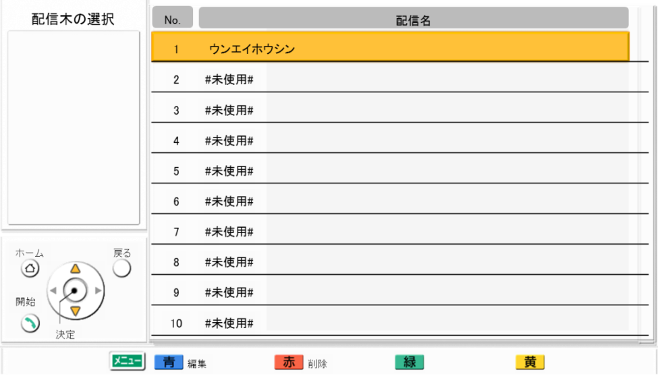
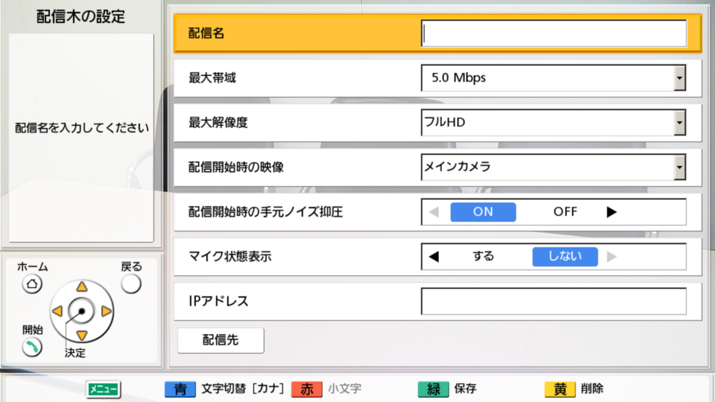
GUI Image (Multicast Tree)
Multicast Tree Settings: Go to “Admin Login” => “Multicast Settings”
Up to 10 Multicast Tress can be set
Multicast Tree Sel.
Multicast Name
Menu | Content / Remarks
No. | Choose Multicast Tree destination can be distributed.
Multicast Name | Setting of Multicast Tree Name
Choose specific created Multicast Tree and press “Start” button, then distribution will be started.
Menu | Content / Remarks
Multicast Name | Setting of Multicast Tree Name
Max. Bandwidth | 5,4,3,2,1.2,1Mbps
Max. Resolution | Full HD / HD
Multicast Default Video | Main Camera / Sub Camera / PC
Multicast Def. Noise Reduction | ON / OFF
MIC detection | ON / OFF
IP Address | Input IP Address
Target | Change to registration screen
Multicast Tree Sel.
Multicast Name
Max. Bandwidth
Max. Resolution
Multicast Default Video
Multicast Def. Noise Reduction
MIC detection
IP Address
Note:
Both LAN1 and LAN2 interface can be used for ALM function on VC1600.
But suimaltinious operation is not supported.
Routing setting is required when LAN2 interface is used.
Target
Page 16

Slide 18
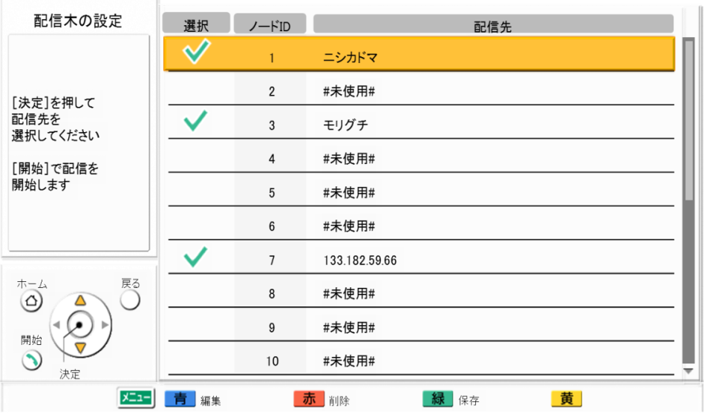
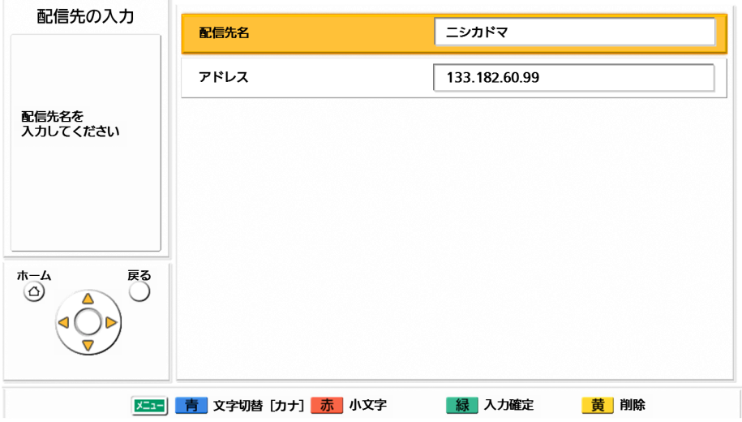
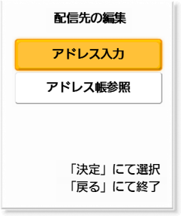
GUI Image (Multicast Tree)
Multicast Tree Settings: Go to “Admin Login” => “Multicast Settings”
Multicast Tree Sel.
Select.
Node ID
Multicast Target
Menu | Content / Remarks
Selection | Choose Multicast Tree destination can be distributed.
Node ID | Position of Multicast Tree inside
Multicast Target | Display site name
Up to 30 sites can be set
Multicast Target
Multicast Target Name
Menu | Content / Remarks
Multicast Target Mame | Input Site Name
IP Address | Input IP Address
IP Address
Input IP Address
Registration Procedure:
Input IP Address (Direct input)
Import from Address Book
Applicable (Supported) IP Address Information:
IP Address with IPv4 style and SIP protocol
* Non supported IP Address information will be displayed with
gray out in the address book list.
Import Add. Book
Page 17

Slide 19
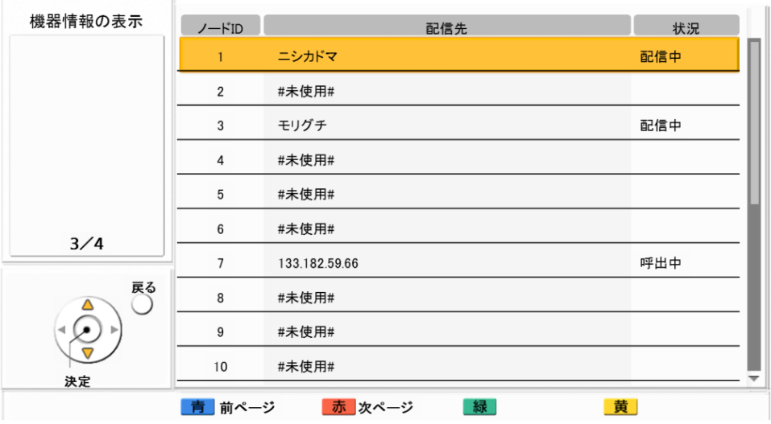
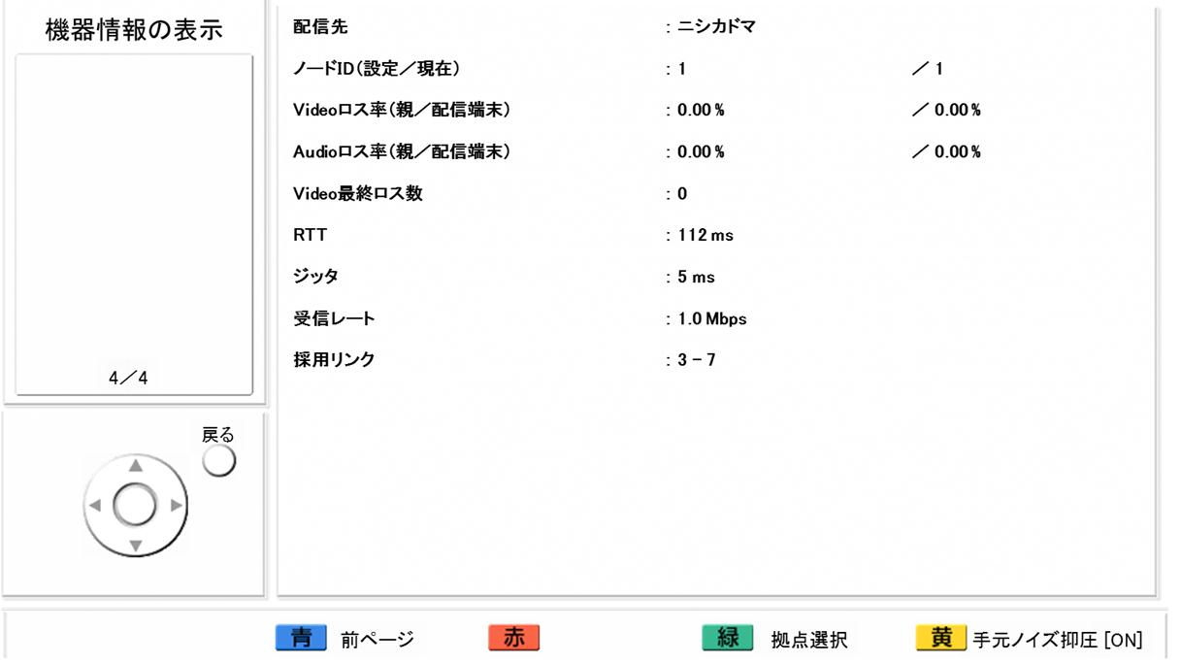
GUI Image (Connection Status)
Connection Status Display: Go to “Admin Login” =>
It can be confirmed such as transmit resolution, transmit frame rate and connection status from the remote site.
(Display receiving connection status from one upper level terminal of the multicast tree.)
Screen of Connection Status
System info.
[Choose site where you want to check the status]
Menu | Content / Remarks
Multicast Target | Distribution Site Name
Node ID (Set / Current) | Assigned Terminal ID in Multicast Tree file / Position of the Multicast Tree by node ID
Video Loss (Host / Multicast Term.) | Link loss ratio of video from the host terminal / Total loss ratio of video from distribution terminal
Audio Loss (Host / Multicast Term.) | Link loss ratio of audio from the host terminal / Total loss ratio of audio from distribution terminal
RTT | Estimated RTT value from the host terminal
Jitter | Jitter from the host terminal
Receive Rate | Reception IP rate (Average )
Link Used | Display node ID of the host / guest terminal
System info.
Multicast Target
Node ID (Set/Current)
Video Loss (Host/Multicast Term.)
Audio Loss (Host/Multicast Term.)
RTT
Jitter
Receive Rate
Link Used
[Back to Previous Menu]
Display connection status of the each site
(You can check the connection status display of each site by pressing [Site] (Green button))
Page 18

Slide 20

Thank You !
Panasonic System Networks Co., Ltd.
Security System Business Division

