Slide 1
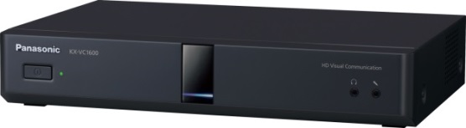
1. This document can be disclosed to Panasonic Sales Partners
2. The specs might be changed without notice since it’s still under development.
For Panasonic Sales Company and Business Partner only
Network Environmental
(Connection mode and Pattern, Network and Settings, etc.)
Ver.4.20
Panasonic System Networks Co., Ltd.
Security System Business Division

Slide 2
History of Revision
Doc. Ver. | Contents | Date of Issue | Remarks
Ver. 4.00/4.10 | Issue of First Edition | Nov. 2015
Ver. 4.15 | Increase Max. number of Routing tables (10 sites -> 50 sites) | Feb. 2015 | Page 18, 28, 44, 48
Ver. 4.20 | Add Max. Bandwidth Setting per site Bandwidth setting per site for each LAN interface can be made | Aug. 2015 | Page 08
 | Add IPv6 Support | Aug. 2015 | Page 54
 | Add Encryption Improvement in SIP Encryption setting can be set individually in SIP | Aug. 2015 | Page 55
Page 1

Slide 3
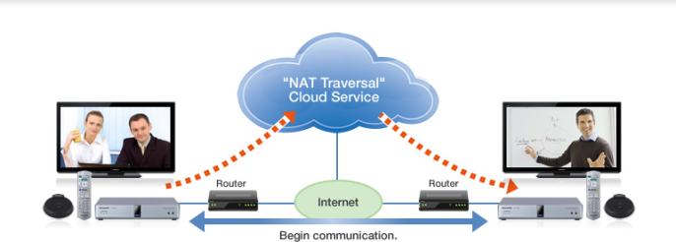




Connection Mode
HD Visual Communication system support followings 2 connection mode.
Choose suitable connection mode depends on customer’s requirement.
Mode | IP mode (Standard) | NAT Traversal Service mode (Easy Connection)
Outline | Connect HDVC, MPCS (Multi-point Connection Software) and Mobile Devices by using INTRANET (Closed Network: Corporate network or IP-VPN) and Internet (Internet VPN environmental so on) Static Private IP address is required. Operation by DHCP may be possible to use, but IP address might be changed with specific condition. Support Static NAT function as standard. | This is Panasonic proprietary cloud service system . Utilize Terminal ID (7 digit numbers like a telephone number) to make call to HDVC, MPCS (Multi-point Connection Software) and Mobile Devices. A License (Subscribed) is mandatory required. Static Public IP address is not required. Required Panasonic confirmed (recommended) router to use in NAT Traversal Service environmental to avoid any unexpected problem. It does not support in Firewall environmental. Not support multiple device operation under one router. (Multiple connection does not support under the same router.)
Remarks | Common connection mode in Video Conference system category. There is interoperability with other VC systems. Support both SIP and H.323 protocol. | Easy to connect from out side of office. Utilize communication with business partners and Overseas site anytime. No Interoperability with other VC systems. Support SIP protocol only.
INTRANET
Internet VPN
Page 2

Slide 4

















Connection Mode
Mode | IP mode (Standard) | NAT Traversal Service mode (Easy Connection)
Network Configuration
IP Network | INTRANET (Closed Network: Corporate Network, IP-VPN) Internet (Internet VPN, etc.) | Internet
Calling by | IP Address | Terminal ID (7 digit numbers like a telephone number)
VC1600
Site B
VC1600
Site A
Router
NAT Traversal Service
Router
Head Office
Head Office
INTRANET
Router
Internet
Site B
（Windows）
Wi-Fi
ISP
Router
LTE/Wi-Fi/
WiMAX
iOS
Site C
Windows
Site A
Business Partner
Android
Windows
iOS
Android
Page 3

Slide 5
Connection Mode and Pattern
The following diagram shows possible connection pattern of HDVC system.
There are 7 patterns and can be selected communication protocol such as SIP or H.323.
 | IP mode |  |  |  |  | NAT Traversal mode
 | Public IP Direct | Static NAT (Port Forward) | Internet VPN | Corporate Network (WAN) | Intranet (LAN) | NAT Traversal Service (Easy Connection)
Available Protocol | SIP / H.323 | SIP / H.323 | SIP / H.323 | SIP / H.323 |  | SIP only
Internet | YES | YES | YES | NO |  | YES
Static IP | YES (Public IP) | YES (Public IP) | YES (Public IP) | YES (Local IP) |  | NO*
Router | NO | YES | YES | NO |  | YES
Configuration | NO | YES (Port Forwarding) | YES (Little complicated) | NO |  | NO*
Security | Low | Mid. | High | High |  | Mid.
Interoperability | YES | YES | YES | YES |  | NO
Total Cost (Internet, Router, maintenance, etc.) | Little Costly (Public IP) | Little Costly (Public IP) | Relatively Costly | --- |  | Relatively Reasonable
Remarks | Easiest | Most Common | Secure |  |  | An activation key is required. (License) Support Panasonic systems only.
Connection
Type
* Depends on Network environmental, some settings change are required.
Page 4

Slide 6






Connection Mode (Multi Protocols Support)
HDVC support Multi Protocols Connection such as IP mode and NAT Traversal Service mode at same time.
Mode | IP mode and NAT Traversal Service mode
Network Configuration
IP Network | INTRANET + Internet
Calling | IP Address + Terminal ID (7 digit numbers)
NAT Traversal Service Group
Use Terminal ID
IP mode Group
Use IP address
Router
Router
VC1600
Site A
NAT Traversal Service
Site B
Head Office
Router
Internet
INTRANET
Site B
(Windows)
Site C
(Windows)
Router
ISP
LTE/Wi-Fi/
WiMAX
Wi-Fi
Business Partner
Site A
Windows
Site D
(Tablet PC)
iOS
Android
Page 5

Slide 7
Supported Bandwidth / Rate Control
Minimum Required IP rate (Both Audio and Video Transmission)
  2 points connection : 256Kbps
  Multiple connection : 256kbps x # of connection site
Rate Control
Packet Loss
Without control
Bandwidth is exceeded at peak communication.
AV-QoS (Rate Control) works to control the rate up to 256Kbps
Usable Bandwidth
Automatic rate control depending on the effective bandwidth
With control
Transfer rate is adjusted to match traffic condition.
Heavy traffic
Heavy traffic
Maximum Supported IP rate
  Maximum Supported IP rate : 18Mbps
The generation of packet losses is prevented by a rate control function, and lost packets are restored by the combined use of Forward Error Correction (FEC) and Automatic Repeat reQuwst (ARQ). Image disruptions and audio interruptions are suppressed for both Intranet and Internet connections to ensure stable connection.
Note: Above IP rate includes IP Header.
Page 6

Slide 8
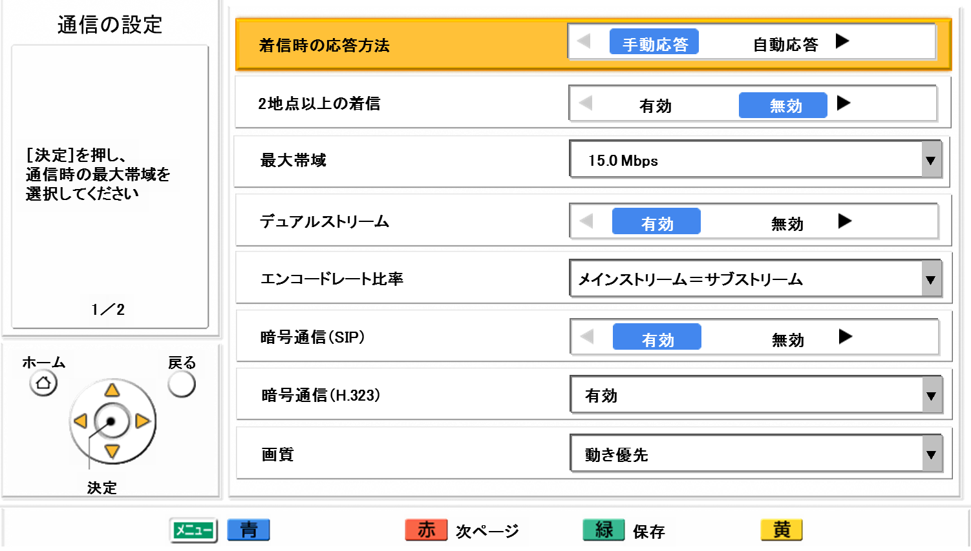

Max. Bandwidth Setting
< Max. Bandwidth Setting (IP bit rate) >
This is setting of Maximum value of IP packet (Video, Audio and QoS) that the HDVC send / receive against to all destination.
HDVC will control based on this setting value to obtain high video and audio quality among available bandwidth of the network.
< Max. Bandwidth of Base site = A + B + C >
< Max. Bandwidth Setting >
Available setting: 256kbps ～ 18Mbps
(Default: 9Mbps)
A
B
C
Stream of HDVC
IP bit rate
*Try to reach up to Max. setting value.
IP bit rate of line
Other Stream
(ftp, etc.)
=> Enough bandwidth is required against Max. setting value.
Page 7

Slide 9

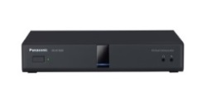




Max. Bandwidth Setting per site
This is new!
In addition to band setting for HDVC, band setting per site for each LAN interface(LAN1/LAN2) can be done, with this new function, communication band for connecting terminals can be controlled by base unit which has MCU.
＜So far＞
＜Ver4.2＞
# Below configuration is one example.
# Below configuration is one example.
Band per site is determined as follows.
Max. band assigned to HDVC ÷ number connected to built-in MCU
Band per site is determined with max. band per site set to HDVC, regardless of the terminal number connected to built-in MCU.
VC1600
Inside
VC1600
Outside
Inside
Max. band
9Mbps
Outside
Max. band
9Mbps
LAN2
LAN1
LAN2
LAN1
HDVC connection
service
HDVC connection
service
Intranet
VPN
Intranet
VPN
Internet
Internet
Communication
carrier
Communication
carier
Basic band：1.5Mbps/site
（ 9Mbps÷（Inside:3 units＋Outside:3 units））
LAN2
Max.1Mbps per site
LAN1
Max.512kbps per site
# When the band of connecting terminals(including band at contact list/direct dial) is smaller than basic band, each terminals connect with its band.
# When the band of connecting terminals(including band at contact list/direct dial) is smaller than band per site, each terminals connect with its band.
Page 8

Slide 10
Bandwidth Control
< Available Bandwidth per site >
In case of multiple connection, available bandwidth per site will be as follows.
  Value of Max. Bandwidth setting / # of connection site = Available Bandwidth / site
  Example: Max. Bandwidth setting: 10M / 5 sites = 2Mbps / site
Stream of HDVC
Stream of HDVC
Max. Bandwidth/site =
Max. Bandwidth / # of site
Max. Bandwidth
Stream of HDVC
Base site
Max. Bandwidth Setting
12M
Base site
Max. Bandwidth Setting
12M : 12M / 2 sites = 6M/site
Base site
Max. Bandwidth Setting
12M : 12M / 3 sites = 4M/site
Negotiated Bandwidth
8M
Re-Negotiated Bandwidth
6M
Re-Negotiated Bandwidth
5M
Re-Negotiated Bandwidth
4M
Re-Negotiated Bandwidth
4M
Re-Negotiated Bandwidth
3M
Add site
Add site
①
①
②
①
②
③
Remote site
Max. Bandwidth Setting
8M
Remote site
Max. Bandwidth Setting
8M
Remote site
Max. Bandwidth Setting
5M
Remote site
Max. Bandwidth Setting
8M
Remote site
Max. Bandwidth Setting
5M
Remote site
Max. Bandwidth Setting
3M
Page 9

Slide 11
Relation between Bandwidth and Resolution
H.264 HighProfile / BaselineProfile (Non-interleave mode)
◎ … Usual Resolution
○ … Available Resolution (QoS=ON)
< Video Quality: Motion Mode> (Default mode)
 | Resolution | Frame rate | Bandwidth [bps]
 |  |  | 18M | ～ | 2M | 1.5M | 1.2M | 1M | 768k | 512k | 384k | 256k
Motion mode | 1080p | 60p～10p | ◎ | ◎ | ◎
 | 720p | 60p～10p |  |  | ○ | ◎ | ◎ | ◎ | ◎
 | w432p | 30p～3.75p |  |  |  |  |  |  | ○ | ◎ | ◎ | ◎
 | w288p | 30p～3.75p |  |  |  |  |  |  |  |  | ○ | ○
< Video Quality: Sharpness Mode >
Support high resolution with low bandwidth, but weak for motion due to low frame rate.
 | Resolution | Frame rate | Bandwidth [bps]
 |  |  | 18M | ～ | 2M | 1.5M | 1.2M | 1M | 768k | 512k | 384k | 256k
Sharpness mode | 1080p | 60p～10p | ◎ | ◎ | ◎ | ◎ | ◎ | ◎
 | 720p | 60p～10p |  |  |  |  |  | ○ | ◎ | ◎ | ◎
 | w432p | 30p～3.75p |  |  |  |  |  |  |  |  | ○ | ◎
 | w288p | 30p～3.75p
< Video Quality: Resolution (Full HD) >
Fix the resolution as 1080p. It weak for motion due to low frame rate.
 | Resolution | Frame rate | Bandwidth [bps]
 |  |  | 18M | ～ | 2M | 1.5M | 1.2M | 1M | 768k | 512k | 384k | 256k
Full HD fixed | 1080p | 60p～3.75p | ◎ | ◎ | ◎ | ◎ | ◎ | ◎ | ◎ | ◎ | ◎ | ◎
< Video Quality: Resolution (HD) >
Fix the resolution as 720p. It weak for motion due to low frame rate.
 | Resolution | Frame rate | Bandwidth [bps]
 |  |  | 18M | ～ | 2M | 1.5M | 1.2M | 1M | 768k | 512k | 384k | 256k
HD fixed | 720p | 60p～3.75p | ◎ | ◎ | ◎ | ◎ | ◎ | ◎ | ◎ | ◎ | ◎ | ◎
Note: Available frame rate will be different depends on receiving capability of connection site.
Page 10

Slide 12
Relation between Bandwidth and Resolution
H.264 BaselineProfile (SingleNAL mode)
[ Receiving capability of connection site ]
more than 720p
more than w432p and below 720p
more than w288p and below w432p
more than SIF and below w288p
< Video Quality: Motion Mode > (Default)
 | Resolution | Frame reate | Bandwidth [bps]
 |  |  | 18M | ～ | 3M | 2.5M | 2M | 1.5M | 1.2M | 1M | 768k | 512k | 384k | 256k
Motion mode | 720p | 30/15p | → | → | → | 30p | 30p | 30p | 30p | 30p
 | w432p | 30/15p | → | → | → | → | 30p | 30p | 30p | 30p | 30p | 30p | 15p
 | w288p | 30/15/10p | → | → | → | → | → | 30p | 30p | 30p | 30p | 30p | 15p | 15/10p
 | SIF(4:3) | 30/15p | → | → | → | → | → | → | 30p | 30p | 30p | 30p | 15p | 15p
< Video Quality: Sharpness Mode >
Support high resolution with low bandwidth, but weak for motion due to low frame rate.
 | Resolution | Frame rate | Bandwidth [bps]
 |  |  | 18M | ～ | 3M | 2.5M | 2M | 1.5M | 1.2M | 1M | 768k | 512k | 384k | 256k
Sharpness mode | 720p | 30/15/10/7.5p | → | → | → | 30p | 15p | 15p | 10p | 10p | 10p | 7.5p
 | w432p | 30/15/10p | → | → | → | → | 30p | 30p | 30p | 30p | 30p | 15p | 15/10p | 10p
 | w288p | 30/15/10p | → | → | → | → | → | 30p | 30p | 30p | 30p | 30p | 15p | 15/10p
 | SIF(4:3) | 30/15p | → | → | → | → | → | → | 30p | 30p | 30p | 30p | 15p | 15p
< Video Quality: Resolution (Full HD / HD) >
Resolution will be fixed as 1080p or 720p. It weak for motion due to low frame rate.
 | Resolution | Frame rate | Bandwidth [bps]
 |  |  | 18M | ～ | 3M | 2.5M | 2M | 1.5M | 1.2M | 1M | 768k | 512k | 384k | 256k
Full HD fixed / HD fixed | 720p | 30～3.75p | → | → | → | 30p | 15p | 15p | 10p | 10p | 10p | 7.5p | 5p | 3.75ｐ
 | w432p | 30/15/10p | → | → | → | → | 30p | 30p | 30p | 30p | 30p | 15p | 15/10p | 10p
 | w288p | 30/15/10p | → | → | → | → | → | 30p | 30p | 30p | 30p | 30p | 15p | 15/10p
 | SIF(4:3) | 30/15p | → | → | → | → | → | → | 30p | 30p | 30p | 30p | 15p | 15p
Note: Available frame rate will be different depends on receiving capability of connection site.
Page 11

Slide 13
Relation between Bandwidth and Resolution
Video Quality: Motion Mode
8M
10M
12M
14M
16M
18M
Bandwidth
Video Quality | ２sites ３sites ４sites 5 sites 6 sites 7 sites 8 sites 9 sites 10 sites
768K
1M
2M
4M
6M
SD Quality
HD Quality
Full-HD Quality
In case of Single Stream
Transmission Capability |  | # of site | 1 | 2 | ３ | ４ | ５ | ６ | ７ | ８ | 9
 |  | IP rate | 18.0 | 9.0 | 6.0 | 4.5 | 3.6 | 3.0 | 2.6 | 2.3 | 2.0
Single Stream |  | Resolution | 1080p | 1080p | 1080p | 1080p | 1080p | 1080p | 1080p | 720p | 720p
 |  | Max. fps | 60p | 30p | 30p | 30p | 30p | 30p | 30p | 30p | 30p
Dual Stream | Camera | Resolution | 1080p | 1080p | 1080p | 1080p | 720p | 720p | 720p | 720p | 720p
 |  | Max. fps | 30p | 30p | 30p | 30p | 30p | 30p | 30p | 30p | 30p
 | PC | Resolution | 1080p | 1080p | 1080p | 1080p | 1080p | 1080p | 1080p | 1080p | 1080p
 |  | Max. fps | 30p | 30p | 30p | 30p | 30p | 30p | 30p | 30p | 30p
* Available Video Quality will be different depends on line condition and settings of HDVC so on.
Page 12

Slide 14
Relation between Bandwidth and Resolution
Video Quality: Sharpness Mode
8M
10M
12M
14M
16M
18M
Bandwidth
Video Quality | ２ sites ３ sites ４ sites 5 sites 6 sites 7 sites 8 sites 9 sites 10 sites
512K
1M
2M
4M
6M
SD Quality
HD Quality
Full-HD Quality
In case of Single Stream
Transmission Capability |  | # of site | 1 | 2 | ３ | ４ | ５ | ６ | ７ | ８ | 9
Single Stream |  | Resolution | 1080p | 1080p | 1080p | 1080p | 1080p | 1080p | 1080p | 1080p | 1080p
 |  | Max. fps | 60p | 30p | 30p | 30p | 30p | 30p | 30p | 30p | 30p
Dual Stream | Camera | Resolution | 1080p | 1080p | 1080p | 1080p | 1080p | 1080p | 1080p | 1080p | 720p
 |  | Max. fps | 30p | 30p | 30p | 30p | 30p | 30p | 30p | 30p | 30p
 | PC | Resolution | 1080p | 1080p | 1080p | 1080p | 1080p | 1080p | 1080p | 1080p | 1080p
 |  | Max. fps | 30p | 30p | 30p | 30p | 30p | 30p | 30p | 30p | 30p
* Available Video Quality will be different depends on line condition and settings of HDVC so on.
Page 13

Slide 15
Network I/F Specification
Items | Model | # of port | Remarks
LAN | VC1600 | 2 Port | RJ45 100BASE-TX (Full Duplex) Default: Auto Negotiation (Setting change can be done by CLI as 100M Full-Duplex) Non-support for Auto MDI/MDI-X | 1000Bas-T support by Auto Negotiation: TBD
 | VC1300 | 1 Port
VLAN (IEEE802.1Q) |  |  | Non-support
Items | Mode | Remarks
IP Address | IP mode | Static IP Address / DHCP (VC1600 LAN2: Static IP Address) | IPv6: Non-support
 | NAT Traversal Service mode | Static IP Address / DHCP
DNS | IP mode | Use in case of firmware version update via Internet Use in case of communication start and registration of SIP Server / GateKeeper
 | NAT Traversal Service mode | Use in case of firmware version update via Internet It is mandatory for NAT Traversal Service
Tos (Type of Service) /DiffServe |  | Support (Setting change can be done by CLI)
Communication Protocol | IP mode | SIP / H.323
 | NAT Traversal Service mode | SIP only
Page 14

Slide 16
Use Port Information
IP Mode (Static NAT setting: OFF)
Intended Purpose |  | Protocol | Use Port Number | Remarks
SIP | SIP | TCP/UDP | 5060
 | BFCP | UDP | 5800~5899 (VC1600 (9 ports) / VC1300 (3 ports)) | Max. 1 port is required for 1 session
H.323 | H.225 (Q.931) | TCP | 1720
 | H.225 (RAS) | UDP | 1719
 | H.245 | TCP | 5500~5599 (VC1600 (20 ports) / VC1300 (10 ports)) | Max. 2 ports + backup are required for 1 session
Audio | RTP/RTCP | UDP | 5100~5199 (VC1600 (36 ports) / VC1300 (12 ports)) | RTCP Port: RTP port + 1 4 ports per 1 stream is required (RTP + RTCP + Alternatives of Session change (RTP + RTCP))
Video | RTP/RTCP | UDP | 5200~5299 (VC1600 (36 ports) / VC1300 (12 ports))
Video (Sub) | RTP/RTCP | UDP | 5400~5499 (VC1600 (36 ports) / VC1300 (12 ports))
Camera | RTP/RTCP | UDP | 5300~5399 (VC1600 (36 ports) / VC1300 (12 ports))
IP Mode (Static NAT setting: ON)
Intended Purpose |  | Protocol | Use Port Number | Remarks
SIP | SIP | TCP/UDP | 5060 Setting range: 5000～5099
 | BFCP | UDP | 5800-5808 (VC1600 (9 ports) / VC1300 (3 ports)) Setting range: 5800~5890 | Max. 1 port is required for 1 session
H.323 | H.225 (Q.931) | TCP | 1720
 | H.225 (RAS) | UDP | 1719
 | H.245 | TCP | 5500~5519 (VC1600 (20 ports) / VC1300 (10 ports)) Setting range: 5500~5580 | Max. 2 ports + backup are required for 1 session
Audio | RTP/RTCP | UDP | 5100~5135 (VC1600 (36 ports) / VC1300 (12 ports)) Setting range: 5100~5164 | RTCP Port: RTP port + 1 4 ports per 1 stream is required (RTP + RTCP + Alternatives of Session change (RTP + RTCP))
Video | RTP/RTCP | UDP | 5200~5235 (VC1600 (36 ports) / VC1300 (12 ports)) Setting range: 5200~5264
Video (Sub) | RTP/RTCP | UDP | 5400~5435 (VC1600 (36 ports) / VC1300 (12 ports)) Setting range: 5400~5464
Camera | RTP | UDP | 5300~5335 (VC1600 (36 ports) / VC1300 (12 ports)) Setting range: 5300~5364
Page 15

Slide 17
Use Port Information
NAT Traversal Service Mode
Intended Purpose |  | Protocol | Use Port Number | Remarks
SIP | SIP | TCP | 50000~50999 | Destination Port: 5060
 | BFCP | TCP | 5800~5808 (VC1600 (9 ports) / VC1300 (3 ports)) Setting range: 5800~5890 | Max. 1 port is required for 1 session
Audio | RTP/RTCP | UDP | 5100~5135 (VC1600 (36 ports) / VC1300 (12 ports)) Setting range: 5100~5164 | RTCP Port: RTP port + 1 4 ports per 1 stream is required (RTP + RTCP + Alternatives of Session change (RTP + RTCP))
Video | RTP/RTCP | UDP | 5200~5235 (VC1600 (36 ports) / VC1300 (12 ports)) Setting range: 5200~5264
Video (Sub) | RTP/RTCP | UDP | 5400~5435 (VC1600 (36 ports) / VC1300 (12 ports)) Setting range: 5400~5464
Camera | RTP | UDP | 5300~5335 (VC1600 (36 ports) / VC1300 (12 ports)) Setting range: 5300~5364
NAT Traversal Service | NAT Traversal Service (DNS) | UDP | Any (32768~61000) (Access to DNS Server) | It is needed for server address settlement of NAT Traversal server (Admin. Server)
 | NAT Traversal Service (Download of Configuration Information) | TCP + SSL | Any (32768~61000) (Access to NAT Traversal Service Server) | It is needed for downloading of configuration information from NAT Traversal server (Admin. Server)
Other Use Ports
Intended Purpose |  | Protocol | Use Port Number | Remarks
External Control (Maintenance) | Web Server (HTTP) | TCP | 80 | Setting change and system control from external.
 | Telnet | TCP | 23 (Port number is changeable)
Maintenance | Automatic Firmware Update (DNS) | UDP | Any (32768~61000) (Access to DNS Server) | It is needed in case of firmware download from remote site.
 | Firmware Update (Version Check, Download) | TCP + SSL | Any (32768~61000) (Access to DL Server)
Network Diagnosis | Network Diagnosis | ICMP | Network Diagnosis
Page 16

Slide 18




Multi Protocol /Dual Network Support
Support both INTRANET and Internet (NAT Traversal Service) Network environmental
  Simultaneous operation of IP mode and NAT Traversal Service mode is possible
  Two different network environmental can be made with two LAN interface (KX-VC1600 only)
Utilize Terminal ID (7 digits number)
Utilize IP Address
Router
Router
VC1600
Site A
NAT Traversal Service
(Easy Connection)
Branch Office B
Head Office
Router
Internet
INTRANET
Site B
(Windows PC)
Sales Company
(Windows PC)
Router
ISP
LTE/Wi-Fi/
WiMAX
Wi-Fi
External
Company
Branch Office A
Windows PC
iOS
Android
Sales Company D
(Tablet)
Page 17

Slide 19
Dual Network Support
Two LAN Interface support (KX-VC1600 only)
  Two different network environmental can be made with two LAN interface
NAT Traversal Service
(Easy Connection)
(Default GW)
Router
VC1600
INTRANET
Internet
LAN1
LAN2
Interface | NAT Traversal Service mode | IP mode | Remarks
LAN1 | YES | YES | NAT Traversal Service mode can be used in only LAN1. IP mode with Static NAT setting can be used in only LAN1. Default Gateway can be set only LAN1. DHCP can be supported in only LAN1.
LAN2 | NO | YES | Routing setting is required in LAN2 interface (INTRANET) (Routing setting can be made up to 50 sites.)
< Restriction >
In case of H.323 protocol, there are following restrictions to compatible between connection via a Gatekeeper and direct connection.
When Gatekeeper registration is succeeded among same network interface, all communication will be taken via Gatekeeper.
Link between contact list and call history cannot be made.
Page 18

Slide 20
Network / Protocol Support (Supported Protocol by I/F)
2 LAN Interface (KX-VC1600 only, LAN1: enable, LAN2: enable)
LAN | Connection Mode and Protocol
 | IP Mode |  |  |  |  |  | NAT Traversal Service
 | SIP | SIP (SIP Server) | SIP (Static NAT) | H.323 | H.323 (Gatekeeper) | H.323 (Static NAT)
LAN1 | YES | YES *1 | YES *2 | YES | YES *1 | YES | YES *1
LAN2 | YES | YES *1 | NO *4 | YES | YES *1 | NO *4 | NO *1, *3
*1: Plural Server Connection (NAT traversal mode, SIP server or H.323 Gate Keeper) cannot be used simultaneously..
*2: When static NAT function is used in IP mode, Local IP Address judgment function will be available
*3: NAT Traversal Service mode can be used in only LAN1.
*4: IP mode with Static NAT setting can be used in only LAN1.
1 LAN Interface (KX-VC1300, KX-VC-1600 with LAN1: enable, LAN2: disenable)
LAN | Connection Mode and Protocol
 | IP Mode |  |  |  |  |  | NAT Traversal Service
 | SIP | SIP (SIP Server) | SIP (Static NAT) | H.323 | H.323 (Gatekeeper) | H.323 (Static NAT)
LAN 1 | YES | YES *1 | YES *2 | YES | YES *1 | YES *2 | YES *1
*1: Plural Server Connection (NAT traversal mode, SIP server or H.323 Gate Keeper) cannot be used simultaneously.
*2: When static NAT function is used in IP mode, Local IP Address judgment function will be available.
(The system is judged to be an NAT unnecessary IP address, then operate without NAT)
Automatic setting exclusion range: 192.168.0.0/16 (192.168.0.0-192.168.255.255)
172.16.0.0/12 (172.16.0.0-172.31.255.255)
10.0.0.0/8 (10.0.0.0-10.255.255.255)
Page 19

Slide 21
Multi Protocols Support
Various endpoints can be connected simultaneously by operating the Multi protocols such as SIP, H.323.
Operating outline
Multi protocols can be on the same network simultaneously.
Communication using NAT traversal mode and IP mode simultaneously
Communication using two IP mode (2 NIC).
Dual networks can be simultaneously accessed by using 2 NIC in case of VC1600.
One of NAT traversal mode, SIP server or H.323 Gate Keeper can be used. Plural Server Connection cannot be used simultaneously.
Protocol combination that can be used simultaneous is shown below in detail.
 |  | Protocol 1
 |  | SIP | SIP server | H.323 | H.323 Gatekeeper | NAT traversal mode
Protocol 2 | SIP | YES
 | SIP server | YES | NO *1
 | H.323 | YES | YES | YES
 | H.323 Gatekeeper | YES | NO *1 | YES | NO *1
 | NAT traversal mode | YES | NO *1 | YES | NO *1 | NO *1
*1 : Plural servers such as NAT traversal mode, SIP server, Gate Keeper cannot be used simultaneously.
Page 20

Slide 22


Multi Protocol / Dual Network Support (Configuration)
1 LAN Interface (KX-VC1300, KX-VC-1600 with LAN1: enable, LAN2: disenable)
Case 1 (INTRANET)
Case 2 (INTRANET)
INTRANET
INTRANET
HDVC Mobile
(SIP)
Other VC
(H.323)
HDVC Mobile
(SIP)
Other VC
(H.323)
HDVC
(SIP)
HDVC
(H.323)
HDVC
(SIP)
HDVC
(H.323)
Gatekeeper
IP mode
SIP connection
IP mode
H.323 connection
IP mode
SIP connection
IP mode
H.323 connection
LAN1
LAN1
Plural Server Connection (NAT traversal mode, SIP server or H.323 Gate Keeper) cannot be used simultaneously.
Page 21

Slide 23
Multi Protocol / Dual Network Support (Configuration)
1 LAN Interface (KX-VC1300, KX-VC-1600 with LAN1: enable, LAN2: disenable)
Case 3 (Internet + INTRANET)
Internet
INTRANET
HDVC Mobile
(NAT Traversal Service)
HDVC Mobile
(SIP)
Other VC
(H.323)
HDVC
(NAT Traversal Service)
HDVC
(SIP)
HDVC
(H.323)
NAT Traversal Service mode
IP mode
SIP connection
IP mode
H.323 connection
(Default Gateway)
LAN1
Set up Default Gateway settings of HDVC towards Internet side (NAT Traversal Service).
Set up Routing configuration required for communication with the network in INTRANET by the router side.
Use Panasonic recommended router for NAT Traversal Service.
Plural Server Connection (NAT traversal mode, SIP server or H.323 Gate Keeper) can not be used simultaneously.
Page 22

Slide 24
Multi Protocol / Dual Network Support (Configuration)
1 LAN Interface (KX-VC1300, KX-VC-1600 with LAN1: enable, LAN2: disenable)
Case 4 (Internet + INTRANET)
Internet
INTRANET
HDVC Mobile
(SIP)
Other VC
(H.323)
HDVC Mobile
(SIP)
Other VC
(H.323)
HDVC
(SIP)
HDVC
(H.323)
HDVC
(SIP)
HDVC
(H.323)
IP mode
SIP connection
(Static NAT)
IP mode
H.323 connection
(Static MAT)
IP mode
SIP connection
IP mode
H.323 connection
(Default Gateway)
LAN1
Set up Default Gateway settings of HDVC towards Internet side (NAT Traversal Service).
Set up Routing configuration required for communication with the network in INTRANET by the router side.
Set up Local Address judgment function of the HDVC, because NAT is not required communication with the network in INTRANET.
When static NAT function is used, install one HDVC system to one router as basic.
  (From technical point of view, plural installation can be made. But there is possibility that other VC systems may not be communicated because port setting change is required.
Page 23

Slide 25
Multi Protocol / Dual Network Support (Configuration)
2 LAN Interfaces (KX-VC-1600 with LAN1: enable, LAN2: enable)
Case 1 (INTRANET + INTRANET)
INTRANET 1
INTRANET 2
HDVC Mobile
(SIP)
Other VC (H.323)
HDVC Mobile (SIP)
Other VC (H.323)
HDVC
(SIP)
HDVC (H.323)
HDVC (H.323)
HDVC (SIP)
IP mode
SIP connection
IP mode
H.323 connection
IP mode
SIP connection
IP mode
H.323 connection
LAN1
LAN２
Set up Default Gateway settings of HDVC towards LAN 1 side.
Set up Routing configuration required for communication with the network in LAN 2 side.
Page 24

Slide 26
Multi Protocol / Dual Network Support (Configuration)
2 LAN Interfaces (KX-VC-1600 with LAN1: enable, LAN2: enable)
Case 2 (INTRANET + INTRANET)
INTRANET 1
INTRANET 2
HDVC Mobile
(SIP)
Other VC (H.323)
HDVC Mobile (SIP)
Other VC (H.323)
HDVC
(SIP)
HDVC (H.323)
HDVC (H.323)
HDVC (SIP)
Gatekeeper
IP mode
SIP connection
IP mode
H.323 connection
IP mode
SIP connection
IP mode
H.323 connection
LAN1
LAN２
Set up Default Gateway settings of HDVC towards LAN 1 side.
Set up Routing configuration required for communication with the network in LAN 2 side.
Plural Server Connection (NAT traversal mode, SIP server or H.323 Gate Keeper) can not be used simultaneously.
Page 25

Slide 27
Multi Protocol / Dual Network Support (Configuration)
2 LAN Interfaces (KX-VC-1600 with LAN1: enable, LAN2: enable)
Case 3 (Internet + INTRANET)
Internet
INTRANET
HDVC Mobile
(NAT Traversal Service)
HDVC Mobile
(SIP)
Other VC
(H.323)
HDVC
(NAT Traversal Service)
HDVC
(SIP)
HDVC
(H.323)
NAT Traversal Service mode
IP mode
SIP connection
IP mode
H.323 connection
(Default Gateway)
LAN1
LAN2
Set up Default Gateway settings of HDVC towards Internet side (NAT Traversal Service).
Set up Routing configuration required for communication with the network in LAN 2 side.
Set up router configuration as necessary.
Use Panasonic recommended router for NAT Traversal Service.
Plural Server Connection (NAT traversal mode, SIP server or H.323 Gate Keeper) can not be used simultaneously.
Page 26

Slide 28
Multi Protocol / Dual Network Support (Configuration)
2 LAN Interfaces (KX-VC-1600 with LAN1: enable, LAN2: enable)
Case 4 (Internet + INTRANET)
Internet
INTRANET
HDVC Mobile
(SIP)
Other VC
(H.323)
HDVC Mobile
(SIP)
Other VC
(H.323)
HDVC
(SIP)
HDVC
(H.323)
HDVC
(SIP)
HDVC
(H.323)
IP mode
SIP connection
(Static NAT)
IP mode
H.323 connection
(Static NAT)
IP mode
SIP connection
IP mode
H.323 connection
(Default Gateway)
LAN1
LAN2
Set up Default Gateway settings of HDVC towards Internet side (NAT Traversal Service).
Set up Routing configuration required for communication with the network in LAN 2 side.
Set up router configuration as necessary.
Since the Interface is separated, Local Address judgment function of the HDVC is not required.
When static NAT function is used, install one HDVC system to one router as basic.
  (From technical point of view, plural installation can be made. But there is possibility that other VC systems may not be communicated because port setting change is required.
Page 27

Slide 29
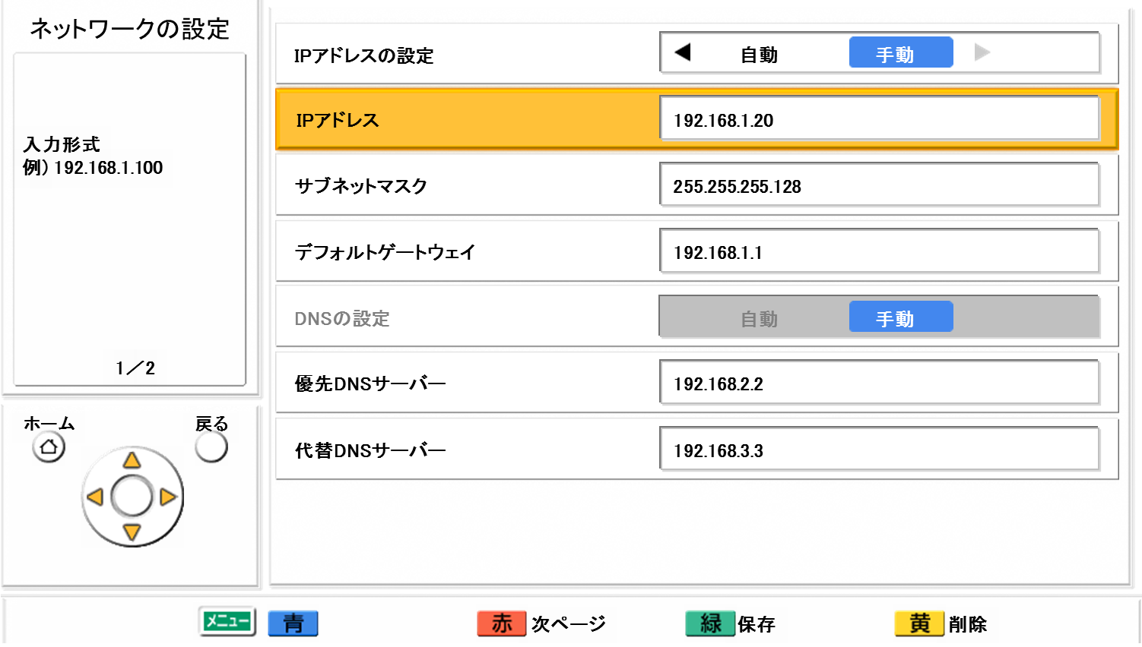
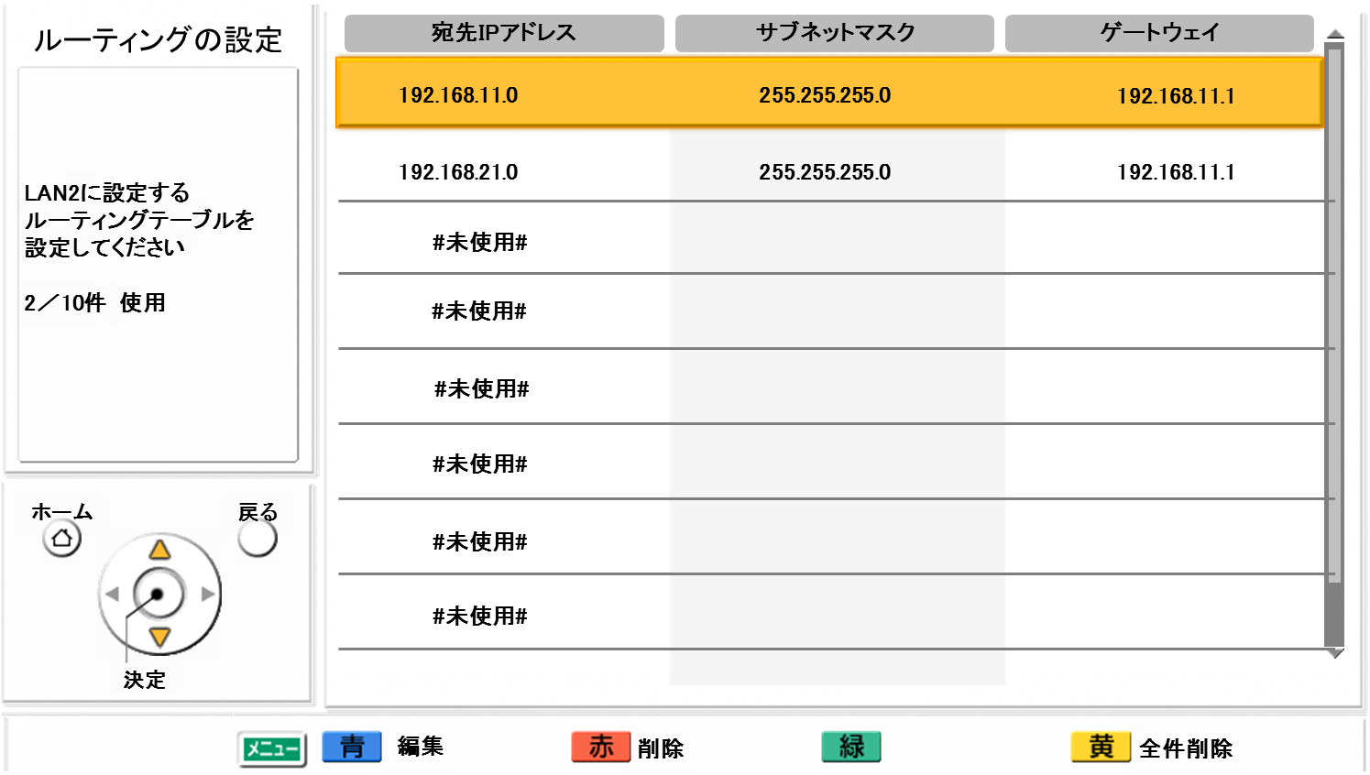
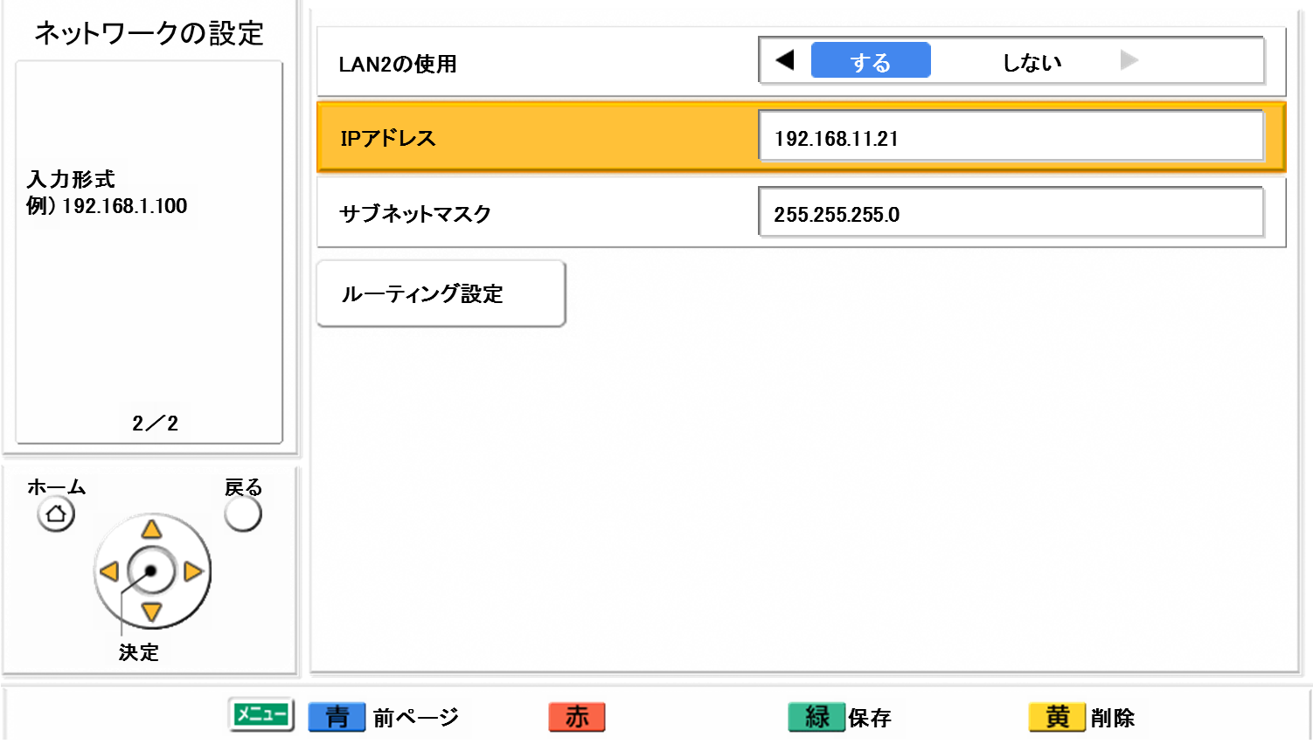
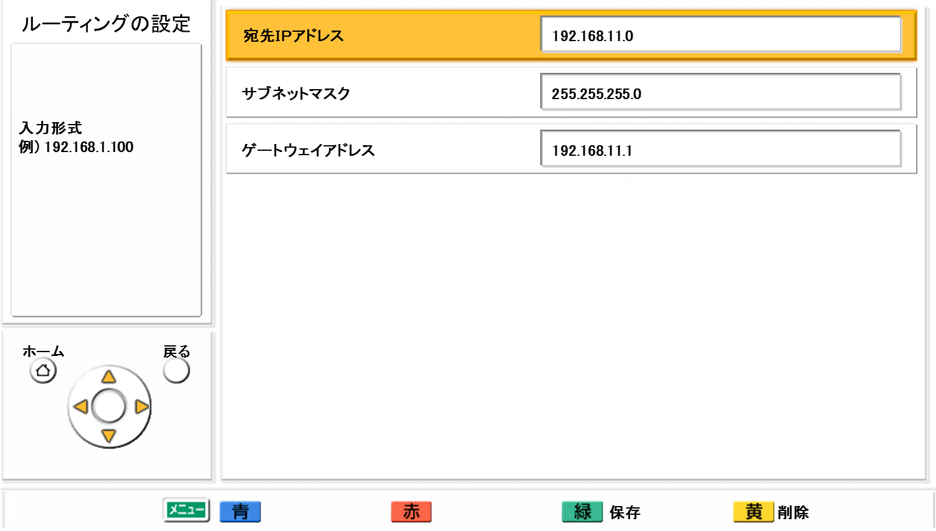
Network Settings
Network Settings (LAN1)
Routing List (Max. up to 50 sites can be registered)
IP Address
IP Address
Subnet mask
Default Gateway
DNS Server
Primary DNS Server
Secondary DNS Server
Network Settings (LAN2) (KX-VC1600 only)
Routing Settings
LAN 2
Destination
IP Address
Subnet mask
Subnet mask
Gateway
Router Settings
It will be appeared after inputting IP Address and Subnet mask of LAN 2, then press Green button.
Page 28

Slide 30








Static NAT Settings (Port Forward)
NAT: Network Address Translation
NAT has function that changes Private (Local) IP address and port number inside LAN, and Public (Global) address and port number on internet.
What is NAT/FW Traversal?
Simple NAT/FW Traversal
Forward data from outside “WAN” to inside “LAN” by using a “port forwarding” supported router.
Outside: WAN
NAT/FW
Fixed IP Address
Inside: LAN
Port forwarding supported Router
NAT: Cannot connect from outside (WAN) to inside (LAN).
FW : For security, control ports to open.
Passing data by router setting
Basic Network Configuration
Static NAT (Port Forwarding) Setting
Internet
Static NAT (Port Forwarding) Setting
Public IP Address (X)
Public IP Address (Y)
Private IP Address (X)
Router
Router
Private IP Address (Y)
Site A
Site B
Page 29

Slide 31






Static NAT Settings (Port Forward)
Outline of NAT (How does it work)
Local IP Address
（Fixed IP）
3. Packet from Site B to A converted by NAT
IP Header
To IP 122.1.63.91
From IP 114.10.229.161 (NAT convert it)
SIP Information
To IP 122.1.63.91
From IP 114.10.229.161
Site A (Receiver)
Public IP Address
2. Router will change From IP Address to its own Public IP (114.10.229.161) Address since Private IP Address (192.168.0.2) is useless once packet go into the Internet world.
This is called “NAT”.
Internet
IP 122.1.63.91
1. Send SIP from site B to Site A
IP Header
To IP 122.1.63.91
From IP 192.168.0.2
SIP Information
To IP 122.1.63.91
From IP 114.10.229.61
(Simple Static NAT overwrites From IP in SIP)
Router
4. Send SIP from Site A to B
IP Header
To IP 114.10.229.161
From IP 122.1.63.91
SIP Information
To IP 114.10.229.161
From IP 122.1.63.91
IP 192.168.0.1
IP 114.10.229.161
Static Port Forward Setting
5. Packet from Site A to B converted by NAT
IP Header (IP Information)
To IP 192.168.0.2 (NAT convert it)
From IP 122.1.63.91
SIP Information
To IP 114.10.229.161
From IP 122.1.63.91
IP 192.168.0.2
Site B (Initiator)
Simple Static NAT Setting
Page 30

Slide 32
Static NAT Settings (Port Forward)
NAT Traversal Function (Static NAT) can be used in IP Mode.
NAT Traversal Function makes possible communication in NAT Environmental together with Static NAT Function of Router.
Comparison (Relationship with Devices)
Applicable Devices | Availability of NAT Traversal Function | Type of Public IP Address
 |  | Static | Dynamic
HDVC | YES | YES | YES
Multi-Point Connection Software（MPCS） | NO | NO | NO
HDVC Mobile for Android / iOS | YES | YES | YES
HDVC Mobile Windows | YES | YES | YES
Internet
Router for Static NAT
(Port Forwarding)
Forward
LAN to WAN
Forward
WAN to LAN
Note:
Up to 2 HDVCs (include HDVC Mobile) can be installed under the same router. But it not allowed simultaneous connection at same time.
Static IP Address is surely required to assign HDVC. (DHCP does not support)
Dynamic IP address support with following firmware version.
  HDVC: From Ver.3.10 onward,
  HDVC Mobile for Android: From Ver.2.00 onward
  HDVC Mobile for Windows: From Ver.2.00 onward
Automatic Local IP Address judgment function: When HDVC is judged as a local IP address, it is regarded as the system in INTRANET, and NAT operation is not performed.
HDVC： In IP Mode (Static NAT Settings)
・・・Public IP
・・・Private IP (Static)
Page 31

Slide 33
Static NAT Settings (Port Forward)
Restriction (Non-supported Network Environmental for NAT)
Internet
Internet
X
X
Static Port Forward Setting
Static Port Forward Setting
Dynamic Port Forward Setting only
X
？？？
IP mode
(Static NAT Setting: ON)
IP mode
(Static NAT Setting: OFF)
NAT Traversal Service
IP mode
(Static NAT Setting: ON)
IP mode
(Static NAT Setting: OFF)
It cannot be connected with Non-static NAT setting systems.
It cannot be connected with NAT Traversal Service mode systems.
It cannot be connected with Dynamic Port Forwarding systems.
It cannot be connected between the systems installed under the same router. But it can be made if the router support NAT loopback (hairpin NAT).
Up to 2 HDVCs (include HDVC Mobile) can be installed under the same router. But it not allowed simultaneous connection at same time.
Page 32

Slide 34
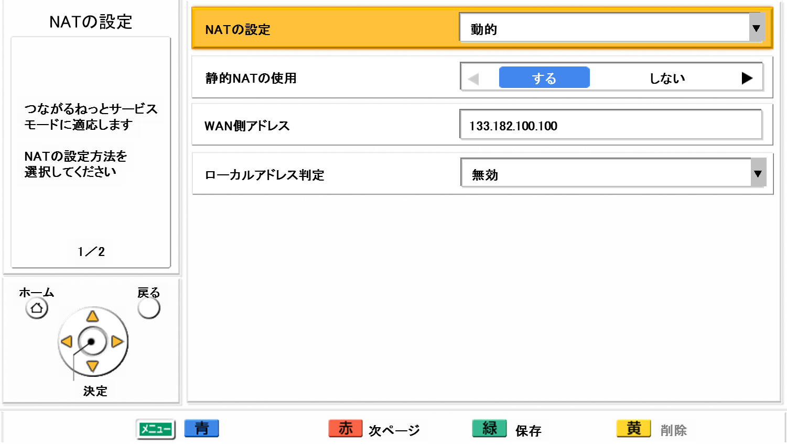
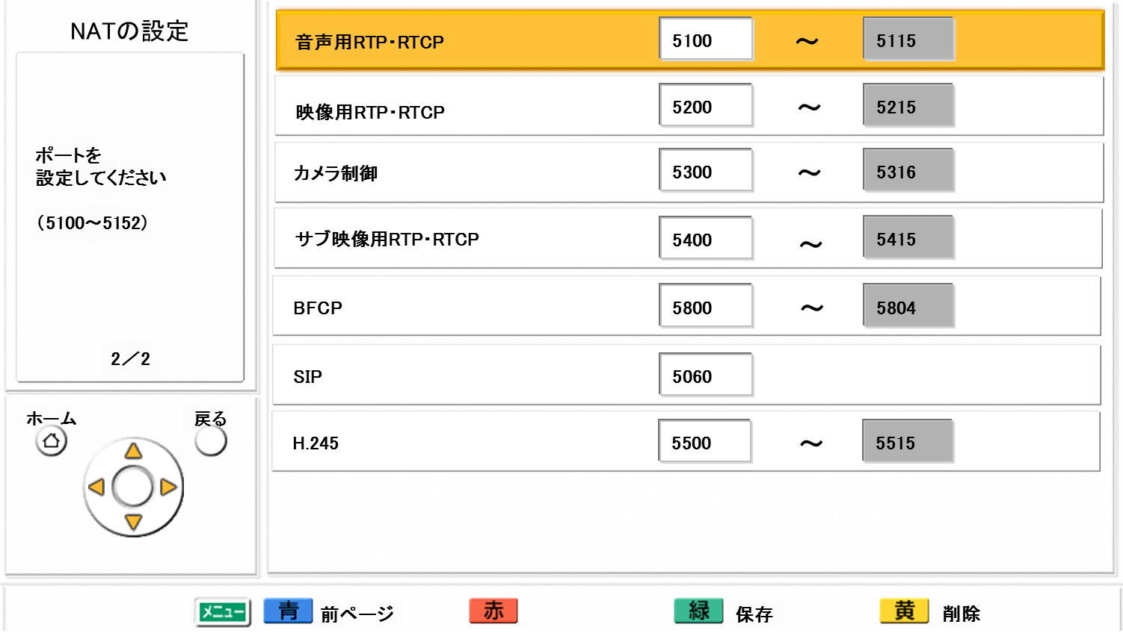
Static NAT Settings
Go to “Menu” => “Settings” => “Admin Login” => NAT Settings”
NAT Settings Menu (Page 1)
Setting Item | Setting Value
Static NAT | ON / OFF
WAN IP Address
Local Address Judgment | OFF / Auto
Static NAT
WAN IP Address
Local Address Judgment
Local Address Judgment | Setting Value
Disable | Conduct NAT operation against all IP address
Auto | When the system is judged as private IP address (10.0.0.0/8, 172.16.0.0/12, 192.168.0.0/16), NAT operation won’t be conducted because the system recognize as a endpoint that installed in INTRANET environmental.
Manual | For the manual inputted endpoint, the system recognize as a endpoint that installed in INTRANET environmental, then NAT operation won’t be conducted. (Manual setting can be done by CLI only)
NAT Settings Menu (Page 2)
RTP and RTCP for Audio
Setting Item | Setting Value
RTP and RTCP for Audio | 5100-5135 (VC1600: 16 ports / VC1300: 12 ports)
RTP and RTCP for Video | 5200-5235 (VC1600: 16 ports / VC1300: 12 ports)
Camera Control | 5300-5335 (VC1600: 16 ports / VC1300: 12 ports)
RTP and RTCP for Video (Sub) | 5400-5435 (VC1600: 16 ports / VC1300: 12 ports)
BFCP | 5800-5808 (VC1600: 9 ports / VC1300: 3 ports)
SIP | 5060
H.245 | 5500-5519 (VC1600: 20 ports / VC1300: 10 ports)
RTP and RTCP for Video
Camera Control
RTP and RTCP for Video
BFCP
SIP
H.245
Page 33

Slide 35
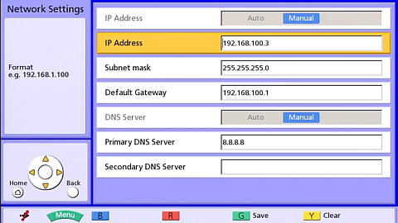
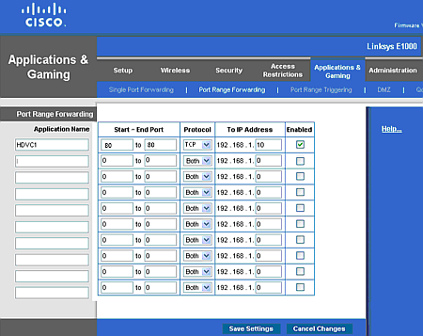
Static NAT Settings Procedure
Step 1: Input IP address
Step 3: Router configuration
Menu -> Settings -> Network Settings
Then input Local IP Address, Subnet Mask and Default Gateway.
Input specific Port Number based on port information that is assigned to the HDVC system at step 2. And select Protocol and IP Address where to forward.
192.168.1.10
255.255.255.0
192.168.1.1
5100
5115
192.168.1.10
5200
5215
192.168.1.10
5300
5316
192.168.1.10
Step 2: Static NAT Settings
5400
5415
192.168.1.10
5800
5804
192.168.1.10
Menu -> Settings -> Admin -> Static NAT Settings
Then input WAN IP Address. Change Port Information as necessary.
5600
5600
192.168.1.10
5500
5515
TCP
192.168.1.10
1720
1720
192.168.1.10
RTP and RTCP for Audio
RTP and RTCP for Video
Camera Control
RTP and RTCP for Video
Note 1: Setting menu will be different depends on router.
Note 2: If the router has “SIP ALG” function, set “SIP ALG” setting as “Disable” in the router as necessary.
BFCP
SIP
H.245
These are default port numbers that HDVC system uses.
Basically, it is not necessary to change these port numbers.
Page 34

Slide 36
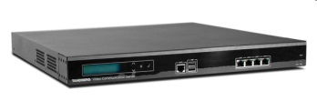

Gatekeeper Function
Outline of Gatekeeper Function
The device which manages and control the endpoints on H.323 networks.
Connection control, authentication, address translation, bandwidth control and fee collection management are performed.
Unified management of the video conferencing system is possible by connecting Gatekeeper installed in the INTRANET side.
Connection is possible at the connection method with which the IP Address, H.323 Extension (E.164) and H.323 ID were intermingled.
(Depends on Gatekeeper settings)
When registration fails in a Gatekeeper, the independent calling by an IP address is possible for HDVC.
Setting of the concurrent use of SIP server and Gatekeeper cannot be performed.
Gatekeeper
Register to Gatekeeper
INTRANET
HDVC
HDVC
Other VC
(H.323)
< Panasonic investigated Model >
TANDBERG：Video Communication Server（VCS） Ver7.2
VCS-Control / VCS-Expressway
(VCS-Expressway does not support Firewall Traversal connection.)
H.323 Name: hdcom01
H.323 Extension:1111
H.323 Name: hdcom02
H.323 Extension: 2222
H.323 Name: VC03
H.323 Extension: 3333
Page 35

Slide 37
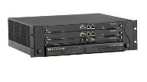



H.460 Client Function
Outline of H.460 Client Function
Standard protocol for NAT / Firewall Traversal on H.323 networks.
Communication with the video conferencing system of the INTRANET side is possible beyond the Firewall by connecting H.460 Server installed in the Internet (Global Network) side.
Other VC
(H.323)
MCU
(H.323)
Support NAT / Firewall Traversal by implementing the H.460 client function.
Connection with existing video conferencing systems via H.460 server.
Coordinate with multiple connection cloud service connected via H.460 server.
H.460 Server/
Gate Keeper
< Panasonic investigated Model >
TANDBERG：Video Communication Server（VCS） Ver7.2
VCS-Control / VCS-Expressway
(VCS-Expressway does not support Firewall Traversal connection.)
Internet
FW
FW
FW
HDVC
HDVC
Other VC
(H.323)
H.460 Client
H.460 Client
H.460 Client
Page 36

Slide 38
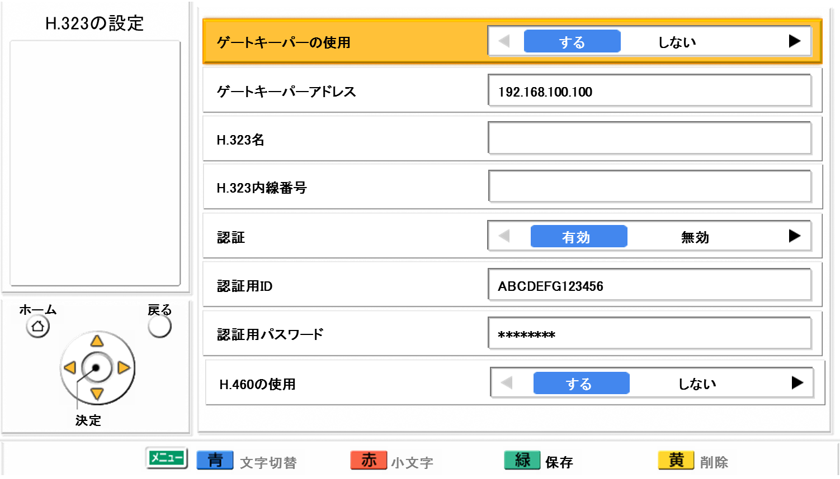
H.323 Settings (Gatekeeper / H.460)
H.323 Settings Menu (System settings (Admin. Menu))
Gatekeeper
Setting Item | Setting Value
Gatekeeper | ON / OFF
Gatekeeper Address | (Essential in case of use Gatekeeper)
H.323 Name
H.323 Extension
Authentication | ON / OFF
Authentication ID
Authentication Password
H.460 | ON / OFF （(Using Gatekeeper is mandatory)
Gatekeeper Address
H.323 Name
H.323 Extension
Authentication
Authentication ID
Authentication Password
H.460
Set up Gatekeeper based on setting information of TANDBERG Video Communication Server (VCS).
Settings are required when communicating via a Gatekeeper.
  Gatekeeper Address (Essential)
  H.323 Name (H.323 ID)
  H.323 Extension (E.164)
  Authentication (ID and Password)
Use of H.460:
*Using Gatekeeper is mandatory
Page 37

Slide 39
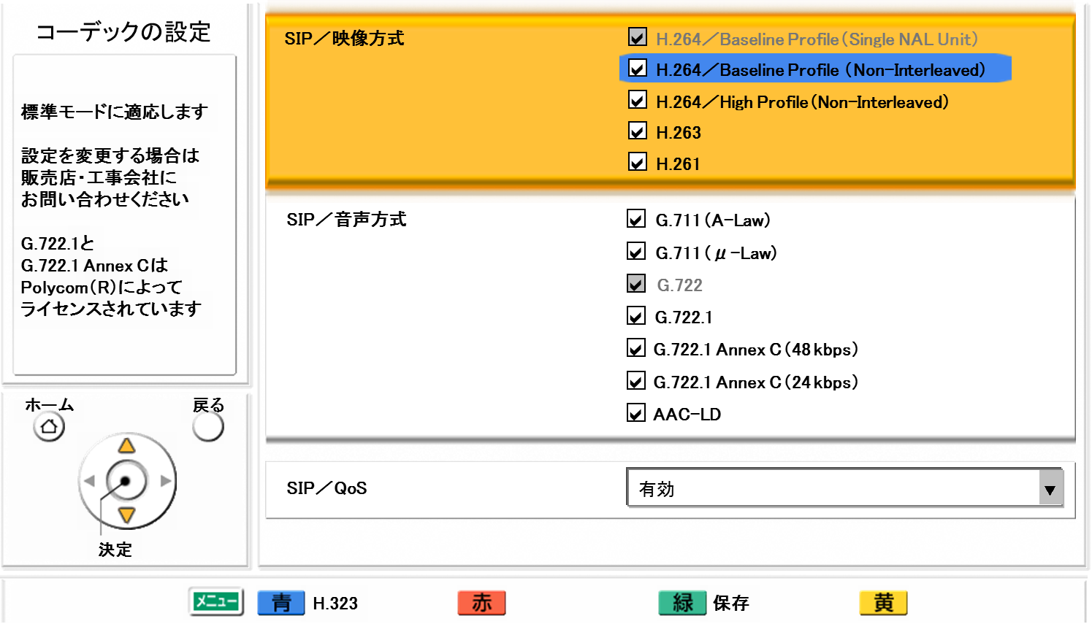

Codec Settings
Codec Settings Menu (System settings (Admin. Menu))
Setting Item | Setting Value
SIP / Video System | H.264 / Baseline Profile (Single NAL Unit) H.264 / Baseline Profile (Non-Interleaved) H.264 / High Profile (Non-Interleaved) H.263 H.261
SIP／音声方式 | G.711 (A-Law) G.711 (μ-Law) G.722 G.722.1 G.722.1 Annex C (48 kbps) G.722.1 Annex C (24 kbps) AAC-LD
SIPのQoS | ON / OFF
Setting Item | Setting Value
H.323 / Video System | H.264 / Baseline Profile (Single NAL Unit) H.264 / Baseline Profile (Non-Interleaved) H.264 / High Profile (Non-Interleaved) H.263 H.261
H.323 / Audio System | G.711 (A-Law) G.711 (μ-Law) G.722 G.722.1 G.722.1 Annex C (48 kbps) G.722.1 Annex C (24 kbps) AAC-LD
H.323 / QoS | ON / OFF
Page 38

Slide 40
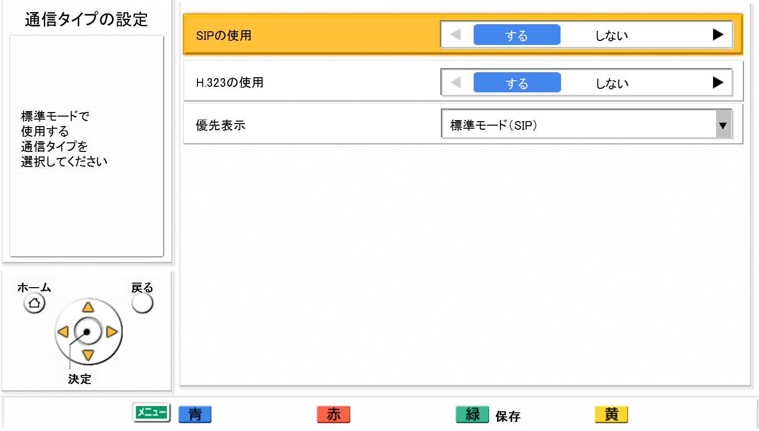
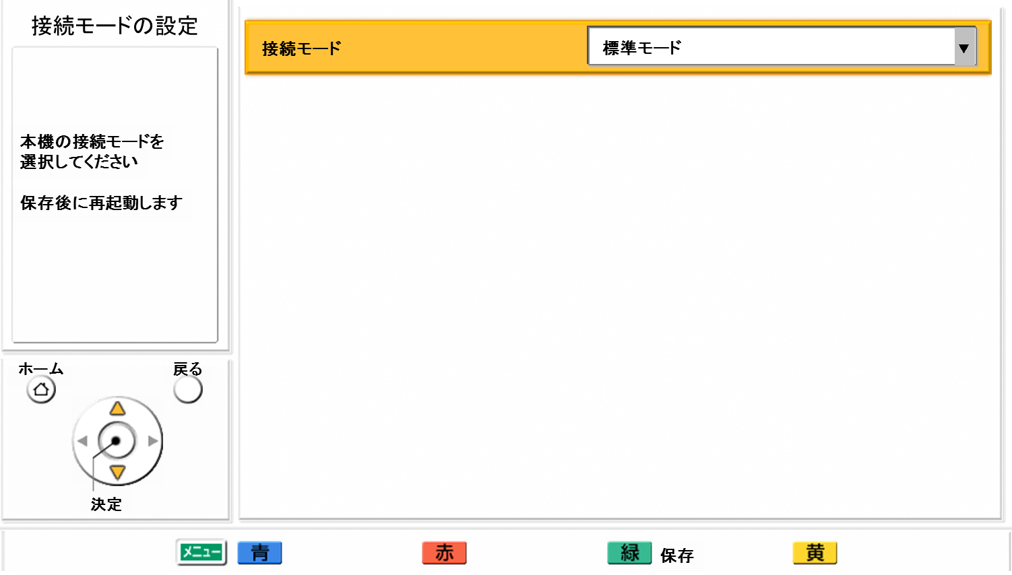
Call Type / Connection Mode Settings
Call Type Settings Menu (System settings (Admin. Menu))
SIP
Setting Item | Setting Value
SIP | ON / OFF
H.323 | ON / OFF
Priority for connection mode | NAT Traversal Service Mode IP Mode (SIP) IP Mode (H.323)
H.323
Priority for connection mode
Connection mode Settings Menu (System settings (Admin. Menu))
Connection mode
Setting Item | Setting Value
Connection Mode | IP Mode NAT Traversal Mode IP / NAT Traversal Mode
Page 39

Slide 41
Multi Protocol / Dual Network Settings Example 1
Case 1: 1 LAN Interface (NAT Traversal Service mode and IP mode)
Head Office
192.168.1.0/24
Branch Office B
192.168.12.0/24
Conduct routing settings for INTRANET at router side.
Router
Router
LAN1
192.168.1.201
Site A
NAT Traversal Service
(Easy Connection)
192.168.12.201
192.168.1.254
192.168.1.253
192.168.12.254
Router
Sales Office C
192.168.13.0/24
Internet
Set up Default Gateway toward Internet
Site B
(Windows PC)
INTRANET
192.168.13.254
ISP
LTE/Wi-Fi/
WiMAX
192.168.11.254
192.168.14.254
192.168.13.210
Branch Office A
192.168.11.0/24
Sales Office D
192.168.14.0/24
Windows PC
iOS
Android
Wi-Fi
192.168.11.201
192.168.14.210
Page 40

Slide 42
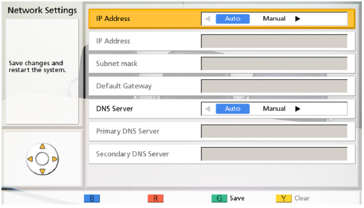
Multi Protocol / Dual Network Settings Example 1
Network Configuration at each site
 | Site | Network |  | Connection mode | Network Address | IP Address (HDVC) | Subnet Mask | Gateway Address | Remarks
１ | Head Office | Internet | WAN | NAT Traversal / IP mode | DHCP |  |  |  | Use recommended router
 |  | INTRANET | LAN |  | 192.168.1.0 | 192.168.1.201 | 255.255.255.0 | 192.168.1.254 | Manual set up for HDVC
２ | Branch Office A | INTRANET |  | IP mode | 192.168.11.0 | 192.168.11.201 | 255.255.255.0 | 192.168.1.254
３ | Branch Office B | INTRANET |  | IP mode | 192.168.12.0 | 192.168.12.201 | 255.255.255.0 | 192.168.1.254
４ | Sales Office C | INTRANAT |  | IP mode | 192.168.13.0 | 192.168.13.210 | 255.255.255.0 | 192.168.1.254
５ | Sales Office D | INTRANET |  | IP mode | 192.168.14.0 | 192.168.14.210 | 255.255.255.0 | 192.168.1.254
Network Settings at Head Office (VC 1300)
LAN | Connection mode | Network Settings |  |  | Remarks
LAN１ | NAT Traversal / IP mode | Manual | IP Address | 192.168.1.201 | Manual set up for HDVC
 |  |  | Subnet Mask | 255.255.255.0
 |  |  | Default Gateway | 192.168.1.254
 |  | Manual | Primary DNS server | 8.8.8.8 (Reference) | Manual set up for HDVC
 |  |  | Secondary DNS server | 8.8.4.4 (Reference)
*The following routing settings are needed at Router side
Item | IP address | Subnet Mask | Gateway Address
Set Point | 192.168.11.0 | 255.255.255.0 | 192.168.1.253
 | 192.168.12.0 | 255.255.255.0 | 192.168.1.253
 | 192.168.13.0 | 255.255.255.0 | 192.168.1.253
 | 192.168.14.0 | 255.255.255.0 | 192.168.1.253
Page 41

Slide 43
Multi Protocol / Dual Network Settings Example 2
Case 2: 2 LAN Interface (NAT Traversal Service mode and IP mode)
Head Office
172.16.1.0/24
192.168.1.0/24
Branch Office B
192.168.12.0/24
172.16.1.xxx
(DHCP)
192.168.1.201
Router
Router
LAN1
LAN2
Site A
NAT Traversal Service
(Easy Connection)
192.168.12.201
172.16.1.254
192.168.1.254
192.168.12.254
Router
Sales Office C
192.168.13.0/24
Internet
Set up Default Gateway for LAN 1 only. Set up Default Gateway toward Internet.
Site B
（Windows PC）
INTRANET
192.168.13.254
ISP
LTE/Wi-Fi/
WiMAX
192.168.11.254
192.168.13.210
192.168.14.254
Branch Office A
192.168.11.0/24
Sales Office D
192.168.14.0/24
Windows PC
iOS
Android
Wi-Fi
192.168.11.201
Conduct routing settings for INTRANET by “Routing settings” of HDVC.
192.168.14.210
Page 42

Slide 44
Multi Protocol / Dual Network Settings Example 2
Network Configuration at each site
 | Site | Network |  | Connection mode | Network Address | IP Address (HDVC) | Subnet Mask | Gateway Address | Remarks
１ | Head Office (LAN 1) | Internet | WAN | NAT Traversal / IP mode | DHCP |  |  |  | Use recommended router
 |  | INTRANET | LAN |  | 192.168.1.0 | 192.168.1.201 | 255.255.255.0 | 192.168.1.254
2 | Branch Office A | INTRANET |  | IP mode | 192.168.11.0 | 192.168.11.201 | 255.255.255.0 | 192.168.1.254
3 | Branch Office B | INTRANET |  | IP mode | 192.168.12.0 | 192.168.12.201 | 255.255.255.0 | 192.168.1.254
4 | Sales Office C | INTRANAT |  | IP mode | 192.168.13.0 | 192.168.13.210 | 255.255.255.0 | 192.168.1.254
5 | Sales Office D | INTRANET |  | IP mode | 192.168.14.0 | 192.168.14.210 | 255.255.255.0 | 192.168.1.254
ネットワーク構成
Network Settings at Head Office (VC 1600)
LAN | Connection mode | Network Settings |  |  | Remarks
LAN１ | NAT Traversal / IP mode | Auto (DHCP) | IP Address |  | Assigned by DHCP server
 |  |  | Subnet Mask
 |  |  | Default Gateway
 |  | Auto (DHCP) | Primary DNS server
 |  |  | Secondary DNS server
LAN2 |  | Manual | IP Address | 192.168.1.201
 |  |  | Subnet Mask | 255.255.255.0
Routing | IP address | Subnet Mask | Gateway Address | Remarks
1 | 192.168.11.0 | 255.255.255.0 | 192.168.1.253 | Router setting is required for INTRANET site
2 | 192.168.12.0 | 255.255.255.0 | 192.168.1.253
3 | 192.168.13.0 | 255.255.255.0 | 192.168.1.253
4 | 192.168.14.0 | 255.255.255.0 | 192.168.1.253
Page 43

Slide 45
Multi Protocol / Dual Network Settings Example 2
Choose Select Connection mode as “IP mode / NAT Traversal mode”.
Go to “Network settings”, then input necessary IP address for LAN 1. Choose “Auto” “Auto” as basic setting.
“Routing settings” (Max. 50 sites can be registered)
192.168.11.0 255.255.255.0 192.168.1.254
192.168.12.0 255.255.255.0 192.168.1.254
192.168.13.0 255.255.255.0 192.168.1.254
192.168.14.0 255.255.255.0 192.168.1.254
Press “Red button” (Next), then input necessary IP address for LAN 2. (KX-VC1600 only)
“Routing settings” menu
LAN 2
Destination
IP Address
192.168.1.201
Subnet mask
Subnet mask
255.255.255.0
Gateway
Router Settings
Set up remote site network segment among INTRANET.
Page 44

Slide 46

Multi Protocol / Dual Network Settings Example 3
Case 3: 2 LAN Interface (NAT Traversal Service mode and IP mode with Static NAT setting)
Head Office
172.16.1.0/24
192.168.1.0/24
Branch Office B
192.168.12.0/24
152.142.132.122
(Static Public IP Address)
172.16.1.201
192.168.1.201
Router
Router
LAN1
LAN2
Site A
NAT Traversal Service
(Easy Connection)
192.168.12.201
172.16.1.254
192.168.1.254
192.168.12.254
Router
Sales Office C
192.168.13.0/24
Internet
Set up Default Gateway for LAN 1 only. Set up Default Gateway toward Internet.
Site B
(Windows PC)
INTRANET
192.168.13.254
ISP
Router
LTE/Wi-Fi/
WiMAX
192.168.11.254
192.168.14.254
192.168.13.210
Branch Office A
192.168.11.0/24
Other VC
(H.323)
Sales Office D
192.168.14.0/24
Windows PC
Wi-Fi
iOS
Android
192.168.11.201
Conduct routing settings for INTRANET by “Routing settings” of HDVC.
192.168.14.210
Page 45

Slide 47
Multi Protocol / Dual Network Settings Example 3
Network Configuration at each site
 | Site | Network |  | Connection mode | Network Address | IP Address (HDVC) | Subnet Mask | Gateway Address | Remarks
１ | Head Office | Internet | WAN | NAT Traversal / IP mode with Static NAT | 152.142.132.122 |  |  | 0.0.0.0 | Static Public IP is required. Use recommended router
 |  | INTRANET | LAN |  | 192.168.1.0 | 192.168.1.201 | 255.255.255.0 | 192.168.1.254
2 | Branch Office A | INTRANET |  | IP mode | 192.168.11.0 | 192.168.11.201 | 255.255.255.0 | 192.168.1.254
3 | Branch Office B | INTRANET |  | IP mode | 192.168.12.0 | 192.168.12.201 | 255.255.255.0 | 192.168.1.254
4 | Sales Office C | INTRANAT |  | IP mode | 192.168.13.0 | 192.168.13.210 | 255.255.255.0 | 192.168.1.254
5 | Sales Office D | INTRANET |  | IP mode | 192.168.14.0 | 192.168.14.210 | 255.255.255.0 | 192.168.1.254
ネットワーク構成
Setting of Router 1
Remarks
The followings are use port information of HDVC and Port forward settings are required accordingly. UDP/5100～5135 Audio RTP・RTCP UDP/5200～5235 Video RTP・RTCP UDP/5300～5335 Camera Control UDP/5400～5435 Sub Camera RTP・RTCP TCP/5800～5808 BFCP TCP・UDP/5060 SIP TCP/1720 H.225 TCP/5500～5519 H.245
Page 46

Slide 48
Multi Protocol / Dual Network Settings Example 3
Network Settings at Head Office (VC 1600)
LAN | Connection mode | Network Settings |  |  | Remarks
LAN１ | NAT Traversal / IP mode | Auto (DHCP) | IP Address | 172.16.1.201 | Manual setting is required when Static NAT function is selected.
 |  |  | Subnet Mask | 255.255.255.0
 |  |  | Default Gateway | 172.16.1.254
 |  | Auto (DHCP) | Primary DNS server | 8.8.8.8 (Reference)
 |  |  | Secondary DNS server | 8.8.4.4 (Reference)
LAN2 |  | Manual | IP Address | 192.168.1.201
 |  |  | Subnet M | 255.255.255.0
Routing | IP address | Subnet Mask | Gateway Address | Remarks
1 | 192.168.11.0 | 255.255.255.0 | 192.168.1.253 | Router setting is required for INTRANET site
2 | 192.168.12.0 | 255.255.255.0 | 192.168.1.253
3 | 192.168.13.0 | 255.255.255.0 | 192.168.1.253
4 | 192.168.14.0 | 255.255.255.0 | 192.168.1.253
NAT Settings | Use of Static NAT | WAN IP Address | Local IP Address Judgment | Remarks
Static | YES | 152.142.132.122 | Auto | Local IP Address Judgment: Auto *When HDVC is judged as Private IP Address such as 10.0.0.0/8, 172.16.0.0/12 and 192.168.0.0/16, it is regarded as the endpoint in intranet. In fact, NAT operation is not performed.
Audio RTP/RTPC | Video RTP/RTPC | Camera Control | Sub Camera RTP/RTPC | Remarks
5100~5135 | 5200~5235 | 5300~5335 | 5400~5435 | Basically it will not be changed
BFCP | SIP | H.245
5800~5808 | 5060 | 5500~5519
Page 47

Slide 49
Multi Protocol / Dual Network Settings Example 3
Choose Select Connection mode as “IP mode / NAT Traversal mode”.
Go to “Network settings”, then input necessary IP address for LAN 1.
“Routing settings” (Max. 50 sites can be registered)
IP Address
192.168.11.0 255.255.255.0 192.168.1.254
IP Address
172.16.1.201
192.168.12.0 255.255.255.0 192.168.1.254
Subnet mask
255.255.255.0
192.168.13.0 255.255.255.0 192.168.1.254
Default Gateway
172.16.1.254
192.168.14.0 255.255.255.0 192.168.1.254
DNS Server
Primary DNS Server
8.8.8.8
Secondary DNS Server
8.8.4.4
Press “Red button” (Next), then input necessary IP address for LAN 2. (KX-VC1600 only)
“Routing settings” menu
LAN 2
Destination
IP Address
192.168.1.201
Subnet mask
Subnet mask
255.255.255.0
Gateway
Router Settings
Set up remote site network segment among INTRANET.
Page 48

Slide 50
Multi Protocol / Dual Network Settings Example 3
NAT Settings (System settings (Admin. Menu))
NAT Settings (Page 1)
Static NAT
Static
WAN IP Address
152.142.132.122
Local Address Judgment
Auto
NAT Settings (Page 2)
Gatekeeper
Gatekeeper Address
H.323 Name
These are default port numbers that HDVC system uses.
Basically, it is not necessary to change these port numbers.
And conduct Port Forward settings based on these information at router side.
H.323 Extension
Authentication
Authentication ID
Authentication Password
H.460
Page 49

Slide 51
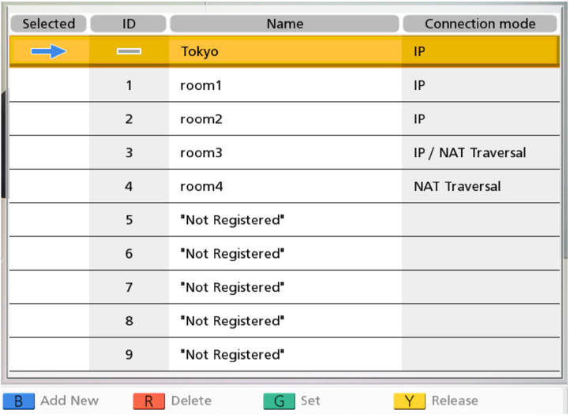
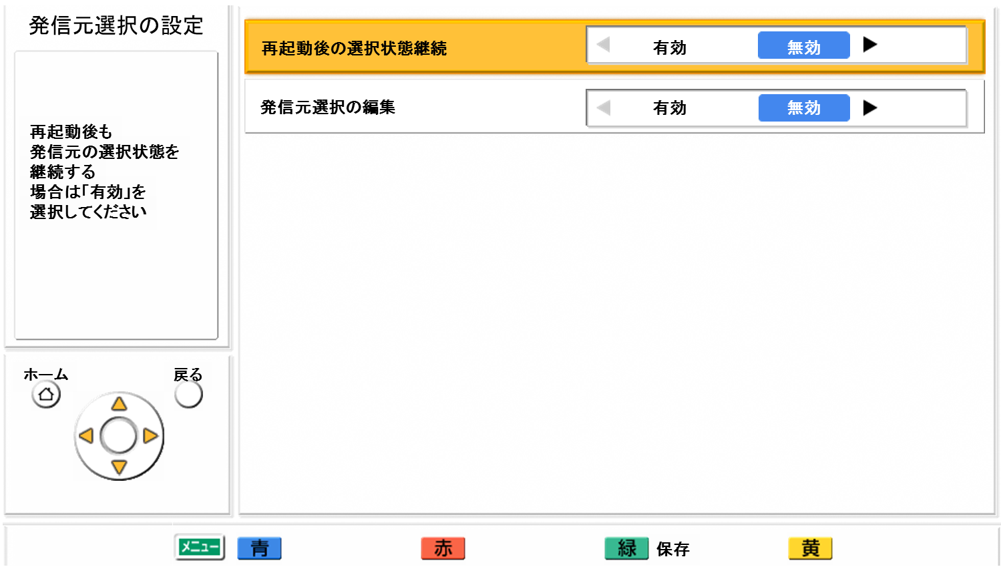
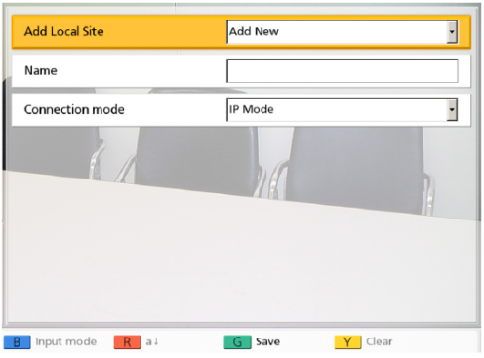
Select Local Site Function
Outline of Local Site Settings
The same unit can be used in multiple meeting rooms without the need to change the network or connection mode settings.
Up to 10 local sites can be registered.
The system will restart automatically when changing connection mode.
The system operation after restarting will be different depends on setting of “Same setting after restart”.
  ON: Setting contents will be remain right before restarting.
  OFF: Setting contents back to default.
Setting menu of Select Local site (Admin. Menu))
Setting menu of Select Local site (to Add)
Note:
It can be used the administrator menu to hide the select local site screen.
It can be used the administrator menu to disable the addition, editing, and deletion of local sites on the select local site screen.
Page 50

Slide 52
Select Local Site Function
Case Study of Select Local Site Function
Case 1: Use one HDVC in different meeting room
Easy to change network settings depends on meeting room.
Case 2: Change Encryption Key depends on Remote site
Easy to make secure communication depends on remote site.
Meeting Room A
192.168.1.1/24
In IP mode
In NAT Traversal mode
Enc. Key: 1111
HDVC (Local Site)
HDVC (Remote site A)
Select Local Site
Select Local Site
HDVC (Remote site)
HDVC (Local Site)
Meeting Room B
192.168.11.1/24
Enc. Key: 2222
HDVC (Local Site)
HDVC (Remote site B)
Case 3: Use IP mode and NAT Traversal mode depends on Remote site and use devices of Remote site.
Case 4: Change Network setting depends on connection pattern and use protocol of Remote site.
In IP mode
IP mode,
INTRANET
HDVC (Remote site A)
HDVC (Remote site)
Select Local Site
Select Local Site
HDVC (Local Site)
In NAT Traversal mode
HDVC (Local Site)
IP mode, H.323
Internet and with Static NAT setting
Mobile for Windows (Remote site B)
Other VC system
(H.323)
Page 51

Slide 53
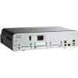
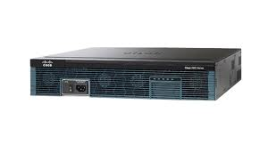

Panasonic Recommended Routers
The following routers are Panasonic recommended routers especially for center site of Multiple connection, MPCS server site and for VPN connection.
As of Nov. 2014
Maker / Model | DRAM / flash | IOS | Feature Set/License
CISCO 1812 | 256MB/64MB | 12.4(24)T2 | ADVANCED IP SECURITY
CISCO 892-K9 | 256MB/64MB | 15.0(1)M3 | ADVANCED SECURITY
CISCO ISR 1841-SEC/K9 | 256MB/64MB | 12.4(24)T2 | ADVANCED SECURITY
CISCO ISR 2801-SEC/K9 | 256MB/64MB | 12.4(24)T2 | ADVANCED SECURITY
CISCO 1921-SEC/K9 | 256MB/64MB | 15.0(1)M3 | IP Base License + Security License
CISCO 1941-SEC/K9 | 256MB/64MB | 15.0(1)M3 | IP Base License + Security License
CISCO 892
CISCO 1941
CISCO 2951
Note:
In case of CISCO routers, port 5100 cloud be used. If communication cannot be made, try to use alternative port instead of port 5100.
Page 52

Slide 54
Router Selection (Reference)
The following is reference to select suitable router depends on use case.
In case of VPN connection in IP mode
Max. Bandwidth Settings | VC1300 (4 sites) | VC1600 (6 sites) | VC1600 (10 sites)
4M | CISCO892 | CISCO892 | CISCO1941
9M | CISCO892 | CISCO892 | CISCO1941
18M | CISCO1941 | CISCO1941 | CISCO1941
In case of NAT Traversal Service mode
Max. Bandwidth Settings |  | VC1300 (4 sites) | VC1600 (6 sites) | VC1600 (10 sites)
4M | NAT Traversal mode / IP mode | CISCO892 | CISCO892 | CISCO1941
 | NAT Traversal mode only | CISCO892 | CISCO892 | CISCO1941
9M | NAT Traversal mode / IP mode | CISCO892 | CISCO892 | CISCO1941
 | NAT Traversal mode only | CISCO892 | CISCO892 | CISCO1941
18M | NAT Traversal mode / IP mode | CISCO1941 | CISCO1941 | CISCO1941
 | NAT Traversal mode only | CISCO1941 | CISCO1941 | CISCO1941
Page 53

Slide 55
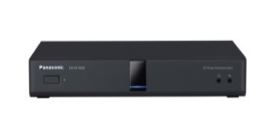
IPv6 Support
This is new!
Network specification required for tenders：IPv6
（IPv6 shall become necessary for VC system for tenders）
IPv6 supporting situation
 | Panasonic | SONY | Polycom | CISCO | Lifesize
CODEC | VC1600 VC1300 | XG100 XG77 XC1 | Group700 Group500 Group300 | SX80 SX20 C40 | Room220 Team220 Express220
IPv6 | ○ | ○ | ○ | ○ | ○
All VCS supplier support IPv6 with their main model.
VC1600/VC1300
IPv4
IPv6
What is IPv6？
Internet Protocol Version 6
Technical solution for IP address depletion
Ver4.2
HDVC support dual stack of IPv4 and IPv6.
・Following service does not support IPv6.
NAT Traversal Service mode, ALM, Version up via network (firmware download)
# These service work with IPv4, even if IPv6 is set.
Page 54

Slide 56
Encryption Improvement in SIP
This is new!
While applying two mode, IP mode/inside and NAT Traversal mode/outside, by using dual network function, following encryption setting can be done.
IP mode(SIP)/inside : no encryption, NAT Traversal mode(SIP)/outside : encryption
# Static NAT(SIP) is treated same as IP mode.
＜So far＞
＜Ver4.2＞
It is essential to set encryption ON at all inside site, if encryption is set to ON due to NAT Traversal Service use.
It is possible to set encryption ON for NAT Traversal mode and to set OFF for inside site.
Inside
VC1600
Outside
Inside
VC1600
Outside
Encryption : ON
Encryption：ON
Encryption : OFF
Encryption : ON
LAN2
LAN1
LAN2
LAN1
HDVC connection
Service
HDVC connection
Service
Intranet
VPN
Intranet
VPN
Internet
Internet
Communication
carrier
Communication
carrier
# Same as dual network with 1NIC
# Same as dual network with 1NIC
[Encryption for IP/NAT Traversal mode]
・Encryption（SIP)：On/Off
・Encryption key（SIP）:max.256 character
[Encryption for IP/NAT Traversal mode]
・Encryption（SIP)：On/Off
・Encryption(NAT Traversal mode) : On/Off
・Encryption key(SIP/NAT Traversal) : max.256 character
# It is impossible to set separately for IP mode and
NAT Traversal mode.
# It is possible to set separately for IP mode and NAT Traversal mode.
Page 55

Slide 57

Thank You !
Panasonic System Networks Co., Ltd.
Security System Business Division

